Slide 1

Recent results and upcoming experiments in Hall A/C 3D/GPD/TMD program
Recent results in Hall A/C 3D/GPD program
J. Roche (Ohio University)
The GPD program in Hall A/C aims at testing the limit of validity of the factorization scheme that is integral to the GPD formalism.
We are writing the first article on E12-06-114 on DVCS analysis
Hall A/C summer meeting 2019

Slide 2
The DVCS program worldwide
Experimental timeline
Pioneering results from non-dedicated experiments (Hall B and Hermes): ~2001
First round of dedicated experiments (Hall A/B, Hermes, H1&ZEUS): ~ 2005
Second round of dedicated experiments (Halls A/B): ~2010
Compelling DVCS program at JLab-12 GeV and Compass: 2015 and later
EIC program…
In the valence region (JLab 6 and JLab 12)
Partially complimentary, overlapping
Hall A/C:
  high accuracy (~5%)
  limited kinematic
  Test the validity of the formalism
Hall B:
  limited accuracy (15+%)
  wide kinematic range
  Map the GPDS

Slide 3
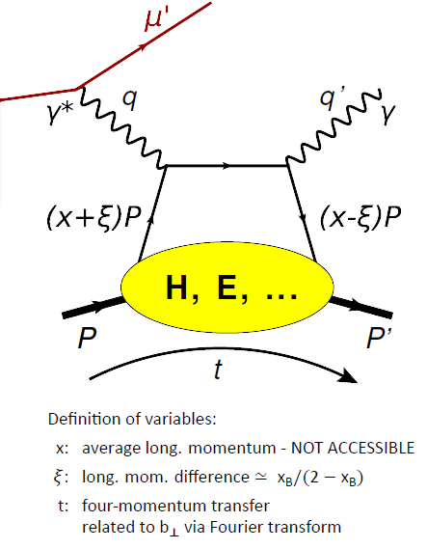
GPDs and factorization
D. Mueller et al, Fortsch. Phys. 42 (1994)
X.D. Ji, PRL 78 (1997), PRD 55 (1997)
A. V. Radyushkin, PLB 385 (1996), PRD 56 (1997)
In the Bjorken limit:
ℓ’
ℓ
Q²,x_{B}
Hard process
LO: QED
NLO: QCD perturbative
γ*
GPDs
Soft process
Non perturbative QCD
described by GPDs
The minimal Q² at which the factorization holds must be tested and established by experiments

Slide 4
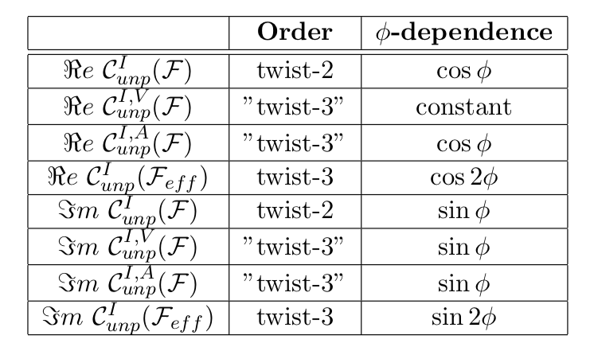
DVCS: some details beyond leading order
φ
The Q²−dependence of cross sections is the only unambiguous way to separate higher twist contributions to Deeply Virtual Compton Scattering (DVCS) and other exclusive channels.

Slide 5
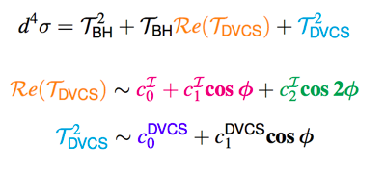
Hall A E07-007: a glimpse of gluons through DVCS
Goal:
To separate the BH.DVCS interference contribution from the DVCS² contribution.
OR
LT/LO
NLO
HT
Q²=1.75 GeV², t=-0.30 GeV²
d⁴σ
Δ⁴σ
Fit HT or NLO
E_{beam}=4.455 GeV
E_{beam}=5.55 GeV

Slide 6
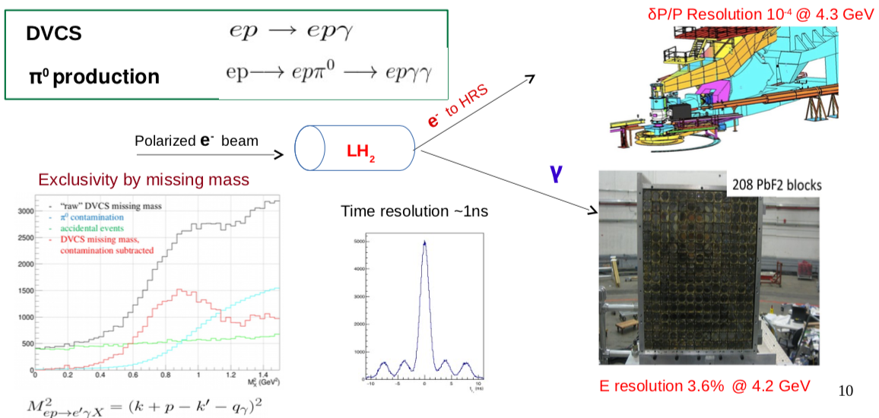
Hall A E12-06-114
DVCS paper in preparation
π⁰ analysis in progress

Slide 7
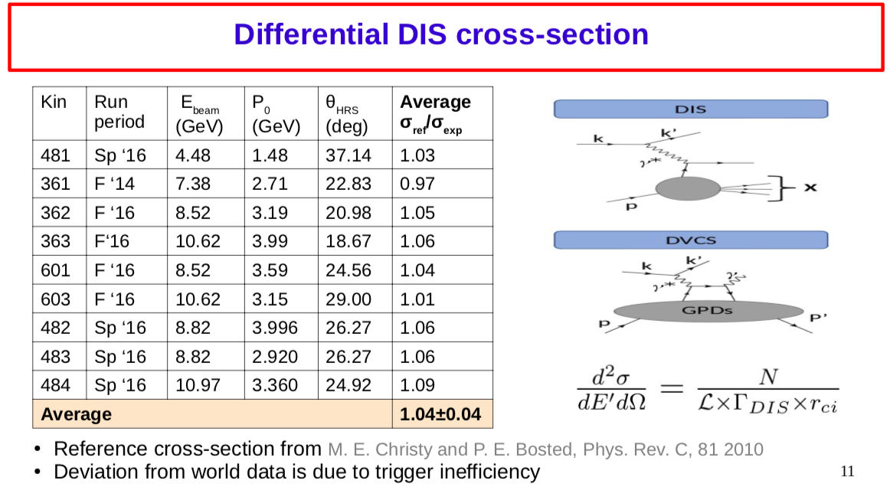

Slide 8
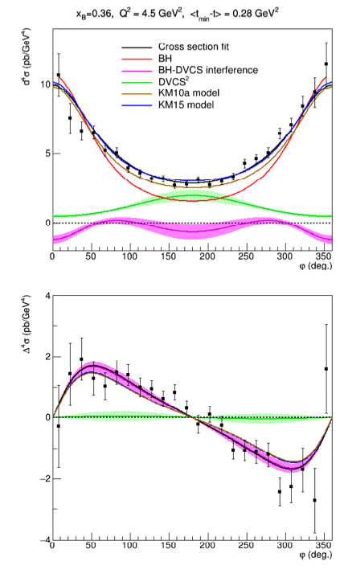
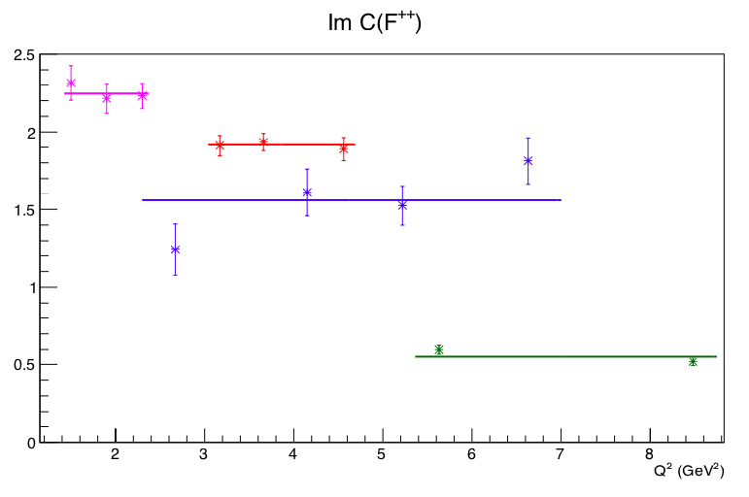
E12-06-114 DVCS results
(F. Georges’s thesis)
LT/LO
HT result in the ‘same’total fit
NLO
HT parametrization

Slide 9
DVCS/DVMP : same GPDs??
Chiral even GPDs
+
Chiral-odd GPDs:
(helicity of the parton can flip)
Chiral even GPDs:
(helicity of the parton is conserved)

Slide 10
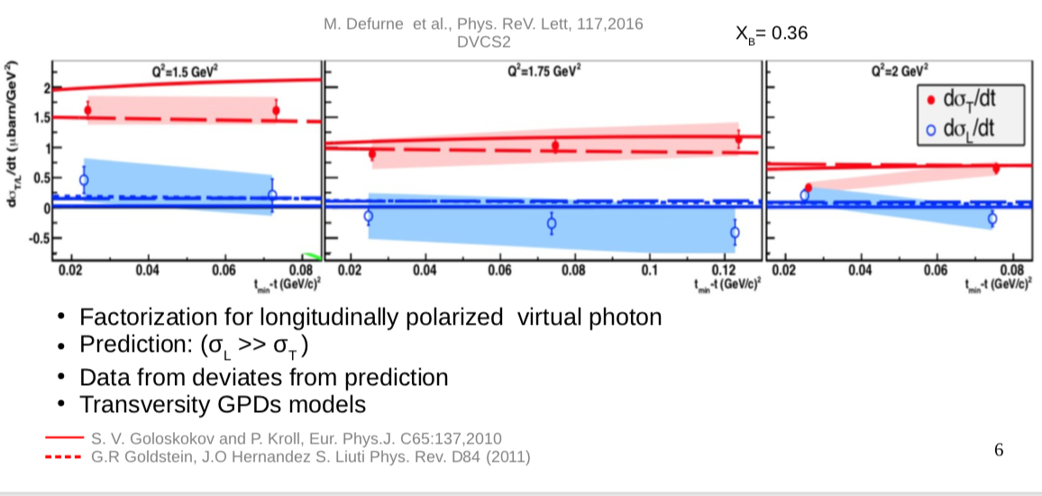
Hall A E07-007: LT separation for pi0 production

Slide 11
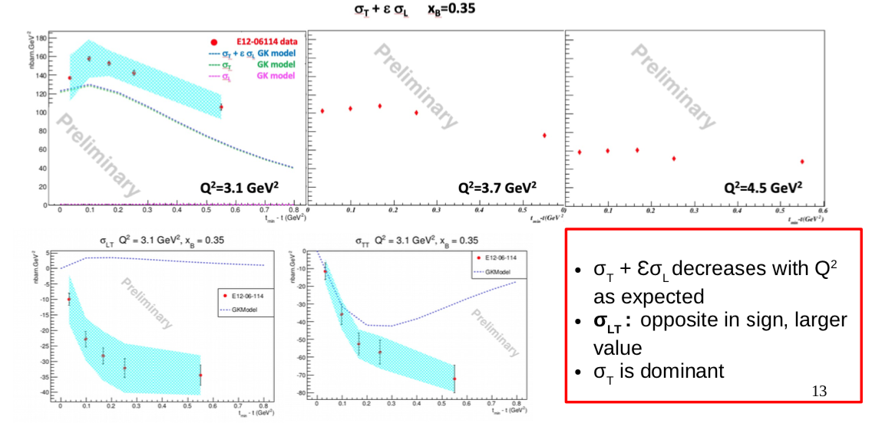
E12-06-114 π⁰ results
(M. Dlamini’s thesis)

Slide 12
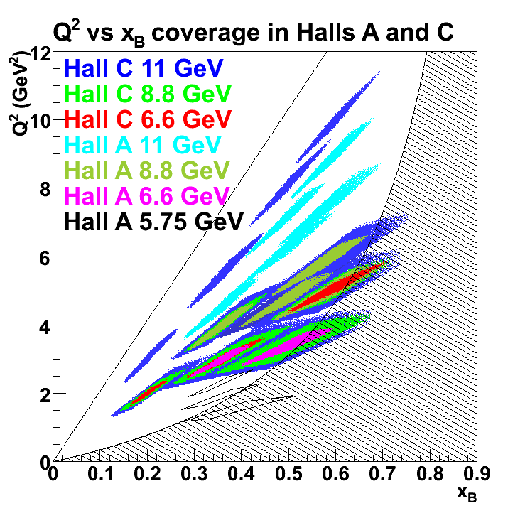
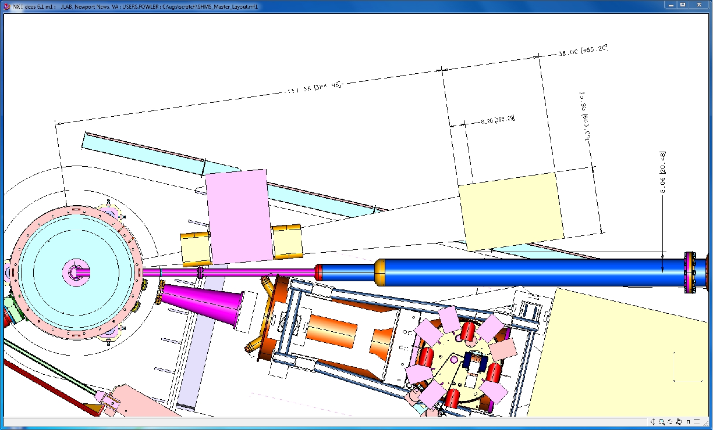
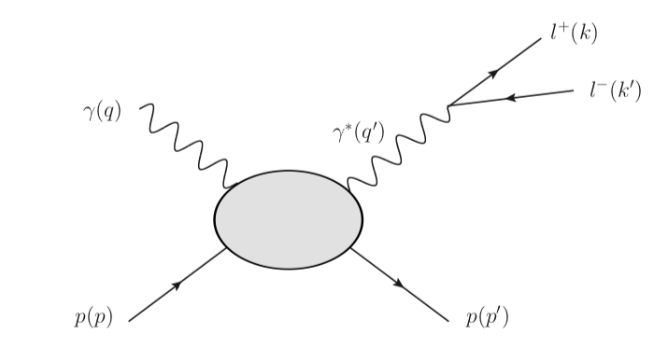
E12-13-010: DVCS at 11 GeV in Hall C
Energy separation of the DVCS cross section
Higher Q²: measurement of higher twist contributions
Low x_{B} extension (thanks to sweeping magnet)
Sweeping
magnet
1116-block PbWO₄ calorimeter
Also Timelike Compton Scattering
M. Boer’s talk Friday morning
Hall C
HMS
GPDs universality test

Slide 13
The DVCS program worldwide
Experimental timeline
Pioneering results from non-dedicated experiments (Hall B and Hermes): ~2001
First round of dedicated experiments (Hall A/B, Hermes, H1&ZEUS): ~ 2005
Second round of dedicated experiments (Halls A/B): ~2010
Compelling DVCS program at JLab-12 GeV and Compass: 2015 and later
EIC program…
In the valence region (JLab 6 and JLab 12)
Partially complimentary, overlapping
Hall A/C:
  high accuracy (~5%)
  limited kinematic
  Test the validity of the formalism
Hall B:
  limited accuracy (15+%)
  wide kinematic range
  Map the GPDS

Slide 17
DVCS sensitivities to GPDs at leading twist

Slide 18
Measuring DVCS to access GPDs information
GPDs
D
When only considering the handbag diagram (at leading twist)
Known to 1%
Bilinear combinations
of GPDS
Linear combinations
of GPDs

Slide 19
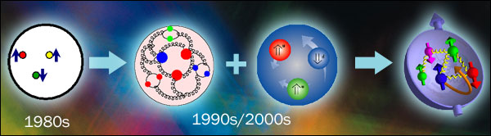
Nucleons are perfect laboratories for studying QCD .
Lepton beams are well understood probes of their internal structure.

Slide 20
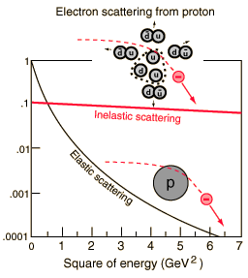
How is the structure of the nucleon studied?
Cross section/Mott cross section
At Q² fixed
υ= E-E’
Q² (GeV²)
Point like fermion
Elastic:
Form factors:
Transverse spatial structure
Deep Inelastic:
Parton distribution functions:
Longitudinal momentum structure

Slide 21
3D picture of the nucleon
Generalized Parton Distribution Function :
3-D imaging of the nucleon with access to correlations between
transverse spatial distribution and longitudinal momentum distributions.
Slide from S. Stepanyan, GHP April ‘15

Slide 22
A glimpse of gluon through
Deeply Virtual Compton Scattering on the proton
J. Roche (Ohio University)
Hard exclusive reactions allow the study of the 3D structure of nucleon through the measure of Generalized Parton Distributions that goes beyond what can be achieved with Elastic and Deep Inelastic Scattering.
Dedicated experiments are conducted world-wide. In the valence region, the growing set of existing results is helping refine our approach to extracting the GPDs from the data.
DVCS experiments are an essential part of the comprehensive GPD program with the 12 GeV CEBAF beam and the EIC.
Notes:
I would like to start my presentation by thanking the organizers for the opportunity to talk about my work in this session in honor of Bunny Clark and Virginia Brown. Their good scientific work has opened the door to the newt generations of female and for this I am personally grateful.
Today I will talk about spatial nucleon imaging. The takeaway messages of my talk are listed here

Slide 23
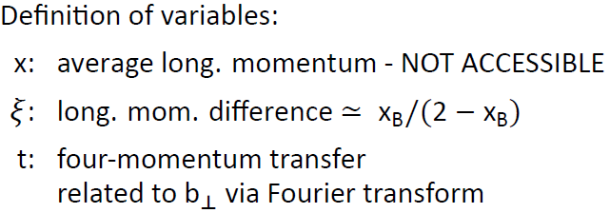
Exclusive reactions: handbag diagram
ℓ’
ℓ
γ or π, ρ , φ, J/ψ,…
Q²,x_{B}
γ*
DVCS: ℓp→ ℓ’ p’ γ (golden channel)
HEMP: ℓp→ ℓ’ p’ π or ρ or φ or J/ψ,…
GPDs
Slide from N d’Hose, Tranversity 2014

Slide 24
Exclusive reactions
Deeply Virtual Compton Scattering (DVCS):
γ*
γ*
Q²
γ
Q²
γ
hard
x + ξ
x - ξ
x + ξ
x - ξ
soft
GPDs
GPDs
p
p’
p
p’
p’
t
t
Hard Exclusive Meson Production (HEMP):
Q²
meson
Q²
meson
γ_{L}* factorization
γ*
γ*
hard
x + ξ
x - ξ
x + ξ
x - ξ
soft
GPDs
GPDs
Meson w.f.
Very slow scaling
p
p’
p
p’
t
t
Quark contribution
Gluon contribution
Slide from N d’Hose, Tranversity 2014

Slide 25
Generalized Parton Distributions
DIS
Elastic
~
No relation for the GPD E and E
RPP 76(2013) 066202
Notes:
What is the meaning of the comma in the PDF definition?

Slide 26
The “Holy grail” of GPDs physics
Ji’s sum rule
H
E
+
+
+
-
GPD H connects to the PDFs
(symmetric initial-final states)
Known from polarized DIS data
GPD E is the unknown
Experimentally, producing enough data to support
the integration over the whole x range is a challenge.
RHIC spin physics results (LRP 2015)

Slide 27
A glimpse of gluon through
Deeply Virtual Compton Scattering on the proton
J. Roche (Ohio University)
Hard exclusive reactions allow the study of the 3D structure of nucleon through the measure of Generalized Parton Distributions that goes beyond what can be achieved with Elastic and Deep Inelastic Scattering.
Dedicated experiments are conducted world-wide. In the valence region, the growing set of existing results is helping refine our approach to extracting the GPDs from the data.
DVCS experiments are an essential part of the comprehensive GPD program with the 12 GeV CEBAF beam and the EIC.
Notes:
I would like to start my presentation by thanking the organizers for the opportunity to talk about my work in this session in honor of Bunny Clark and Virginia Brown. Their good scientific work has opened the door to the newt generations of female and for this I am personally grateful.
Today I will talk about spatial nucleon imaging. The takeaway messages of my talk are listed here

Slide 28
The ideal experiment
High beam energy
ensure hard regime and large kinematic domain
polarized beam
availability of positive and negative leptons
variable energy for:
L/T separation for pseudo scalar production
ε separation for DVCS² and Interference (DVCS+BH)
H₂, D₂, Longitudinaly and Transversely Polarized Target
High luminosity
small cross section
fully differential analysis (x_{B}, Q², t, φ)
Hermetic detectors
ensure exclusivity
but does not exist (yet)
Slide from N d’Hose, Tranversity 2014

Slide 29
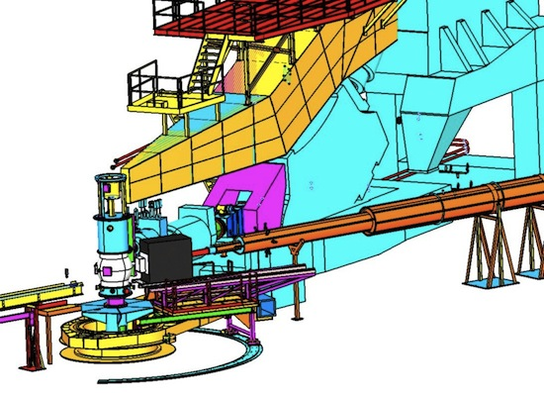
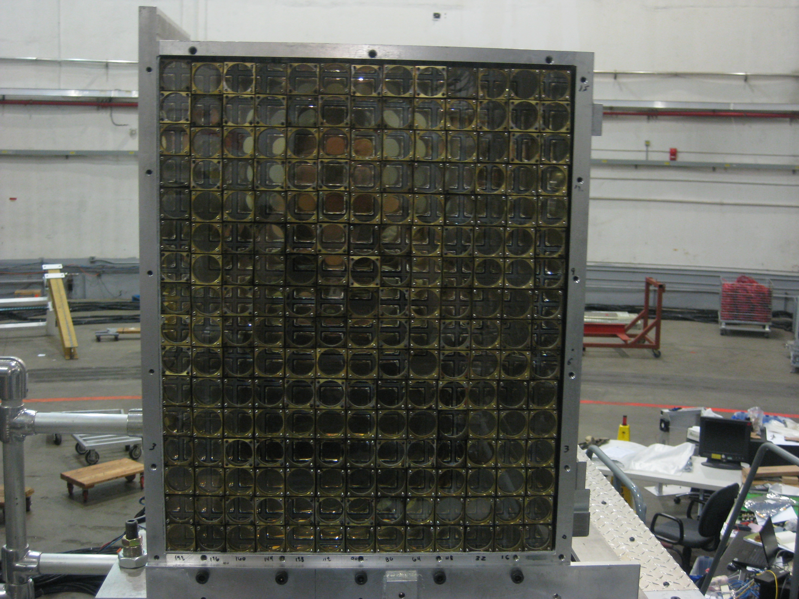
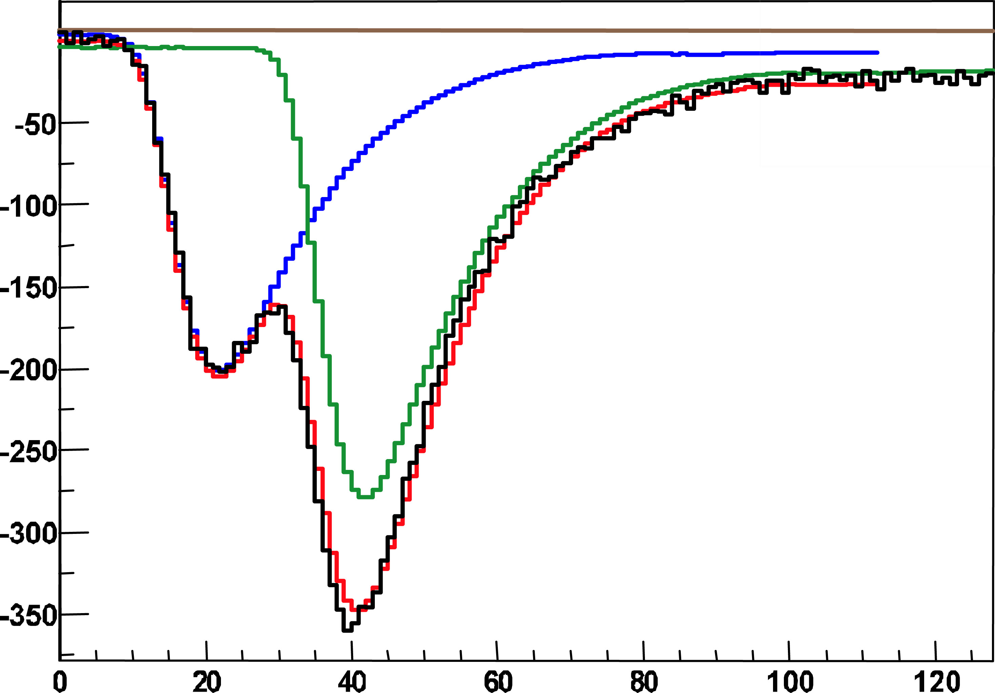
Dedicated apparatus eg the Hall A scheme
208 PbF2 blocks
Luminosity of ~5. 10³⁷ Hz/cm²
1 GHz digitizer
t (ns)

Slide 30
Exclusivity eg Hall A 2004 data
H(e,e’γ)X
X can be
p : ep -> epγ
γp : ep -> epπ⁰, π⁰->γγ
Νπ: ep -> eNγπ
…

Slide 31
Hall A E00-110: cross section Q² dependence
PRC C92, Nov ‘15
No Q² dependence within this limited range => leading twist dominance
Need to be checked over a larger Q² bite

Slide 32
Hall A E07-007: a glimpse of gluons through DVCS
Goal:
To separate the BH.DVCS interference contribution from the DVCS² contribution.

Slide 33
Hall A E07-007: a glimpse of gluons through DVCS
Goal:
To separate the BH.DVCS interference contribution from the DVCS² contribution.
 | Kin 1 |  | Kin 2 |  | Kin3
Q² (GeV²) | 1.5 |  | 1.75 |  | 2.0
X _{B} | 0.36 |  | 0.36 |  | 0.36
E_{beam} (GeV) | 3.36 | 5.55 | 4.45 | 5.55 | 4.45 | 5.55
OR
LT/LO
NLO
HT
Q²=1.75 GeV², t=-0.30 GeV²
d⁴σ
Δ⁴σ
Fit HT or NLO
E_{beam}=4.455 GeV
E_{beam}=5.55 GeV

Slide 34
Towards the 3D Structure of the Proton (past 10 years)
the CFF H in Im DVCS
  To “extract the GPDs”, one can:
  Compare data to models of the GPDs
  Extract GPDs from data:
    world-wide data fitted at once (8 quantities varying with x_{B} and t),
    fit data points versus φ at one kinematic point choosing a limited set of GPDs.
An encouraging proof of concept: one is looking forward to much refined data and analysis.
Notes:
JR: I took this slide from the recent talk by N. d’Hose at Panic2014.
https://indico.desy.de/getFile.py/access?contribId=294&sessionId=30&resId=0&materialId=slides&confId=8648
These data are not all the data produced in the 6GeV era but only the one relevant to the extraction of the Imaginary part of the amplitude. In fact some of the 6 GeV era data are still being analyzed (both hall A and hall B).

Slide 35
L/T pion production separation: E07-007
M. Defurne et al. PRL 117, 26 (2015)
4 chiral-even GPDs
4 chiral-odd GPDS (not seen in DVCS)
Leading twist , leading order factorization is
only proven for dσ_{L}/dt
Q²=1.5 GeV²
1.75 GeV²
Dominance of dσ_{T}/dt observed like at
  Hermes & Hall C π⁺
  Hall B, Hall A π⁰
2 GeV²

Slide 36
E07-007: π⁰ fully separated contributions
Models with dσ_{T} factorization scheme
Small dσ_{L}, large dσ_{T}: models ok on these
Wrong sign and t dependence on dσ_{TL} and dσ_{TT}
dσ_{TL} sizeable => dσ_{L} is small but not null
G-H-L ( JPG:NPP39 ‘12)
G-K (EPJA47 ‘11)

Slide 37
A glimpse of gluon through
Deeply Virtual Compton Scattering on the proton
J. Roche (Ohio University)
Hard exclusive reactions allow the study of the 3D structure of nucleon through the measure of Generalized Parton Distributions that goes beyond what can be achieved with Elastic and Deep Inelastic Scattering.
Dedicated experiments are conducted world-wide. In the valence region, the growing set of existing results is helping refine our approach to extracting the GPDs from the data.
DVCS experiments are an essential part of the comprehensive GPD program with the 12 GeV CEBAF beam and the EIC.
Notes:
I would like to start my presentation by thanking the organizers for the opportunity to talk about my work in this session in honor of Bunny Clark and Virginia Brown. Their good scientific work has opened the door to the newt generations of female and for this I am personally grateful.
Today I will talk about spatial nucleon imaging. The takeaway messages of my talk are listed here

Slide 38
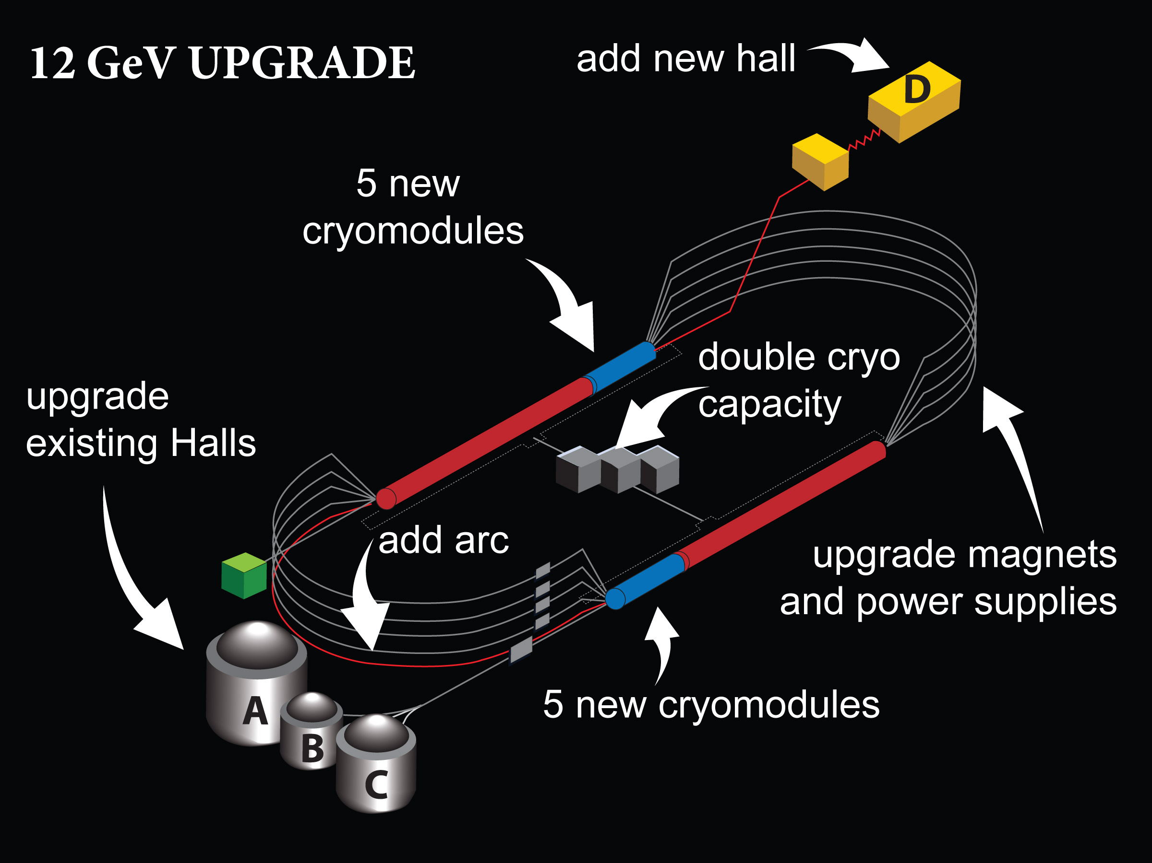
JLab
80 μA highly polarized beam
Physics topics:
Search for exotic mesons
Search for Physics beyond the Standard Model
Study of the spin and flavor dependence of valence PDFs
Study of modification of the quark structure in dense nuclear medium
Study of the 3-D structure of the nucleon (GPDs-TMDs)

Slide 39
Overall JLab 12 GeV DVCS proposals
Q² scans at various x_{B}
(data taking “completed” at the end of 2016)

Slide 40
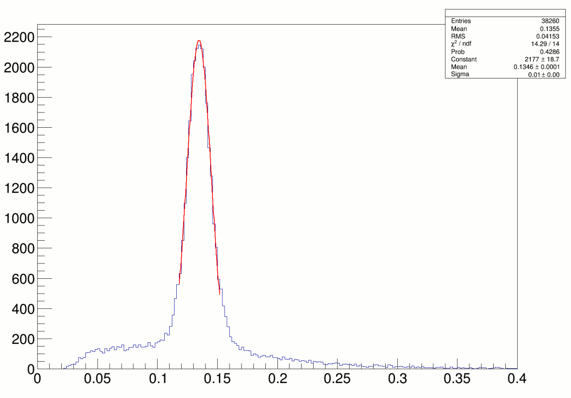
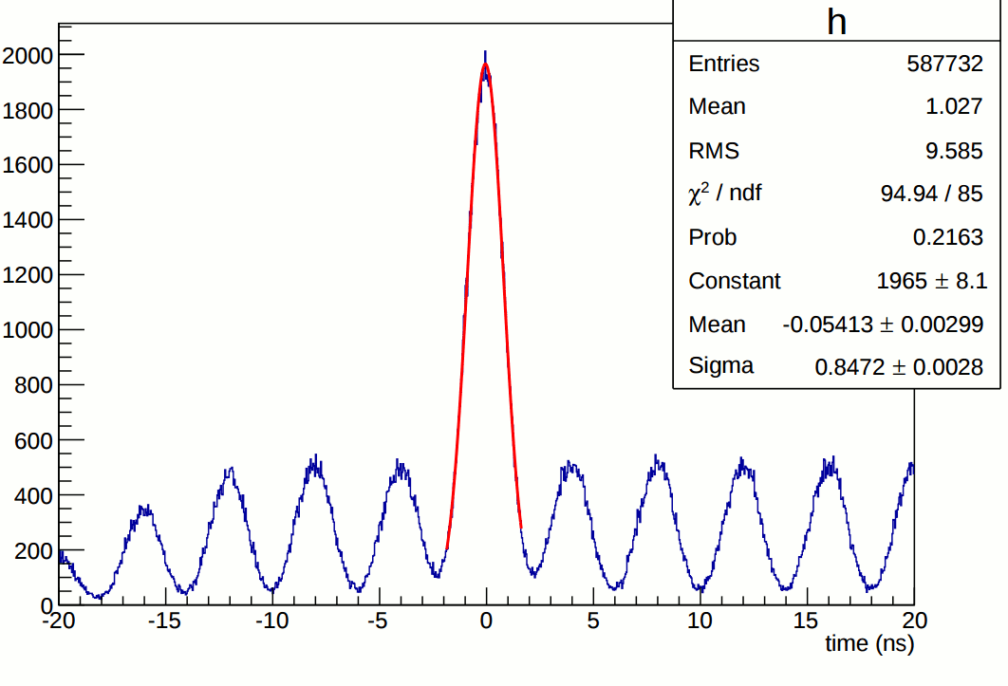
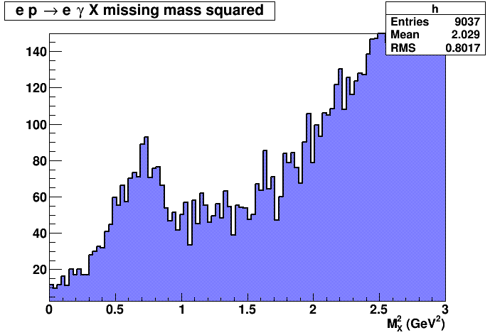
E12-06-114 DVCS/Hall A experiment at 11 GeV
Excellent coincident time resolution:
250 MHz beam structure
π⁰ ’s reconstructed in DVCS calorimeter
DVCS events
(1.5 h of beamtime)
Some preliminary results on π⁰
JLab @ 6 GeV

Slide 41
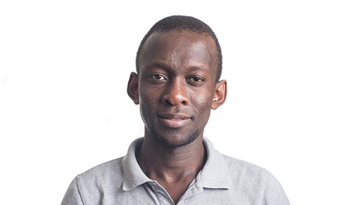
E12-06-114: π⁰ VERY preliminary results
Mongi Dlamini (Ohio U)

Slide 42
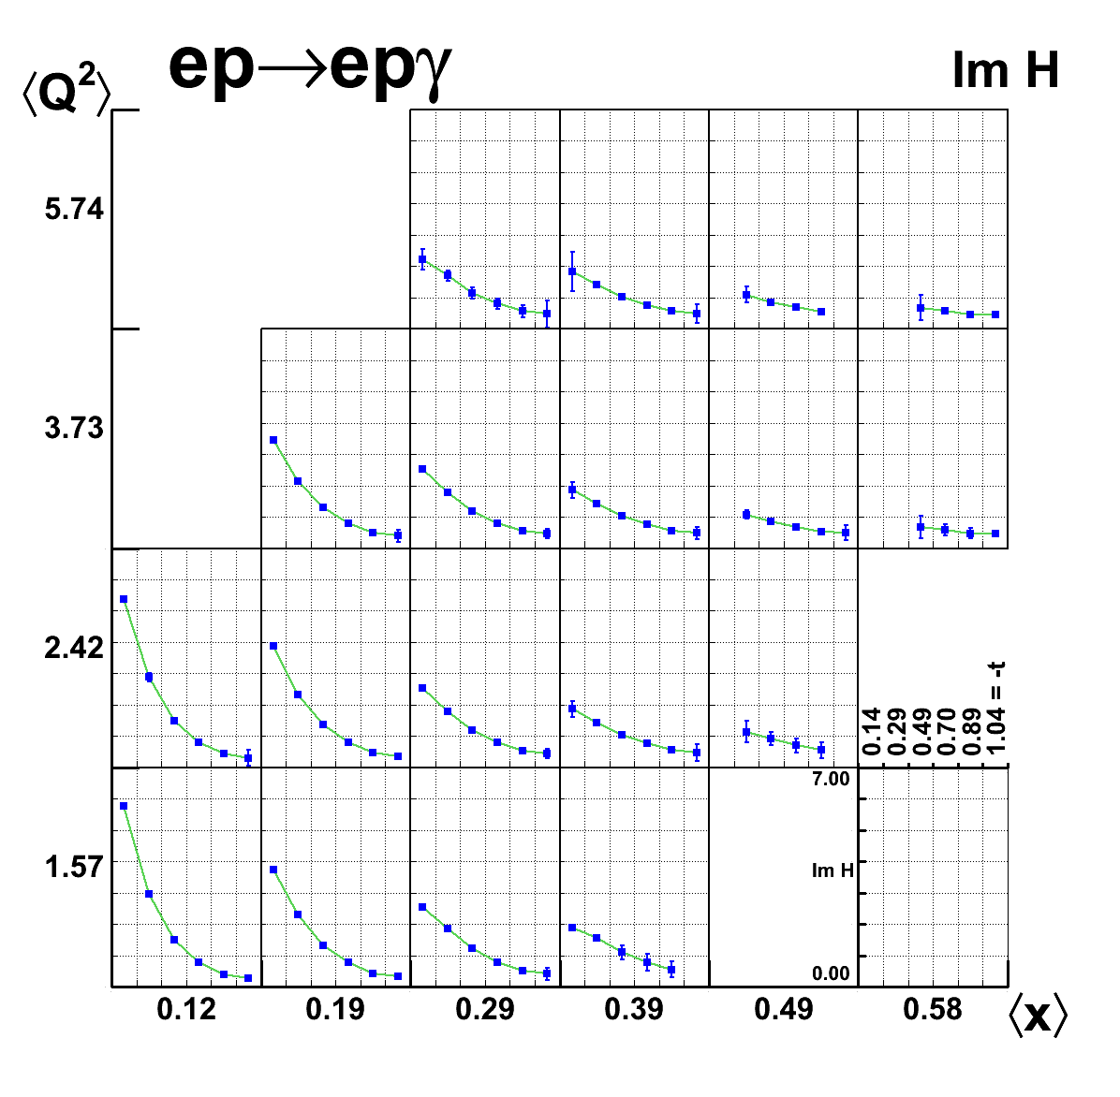
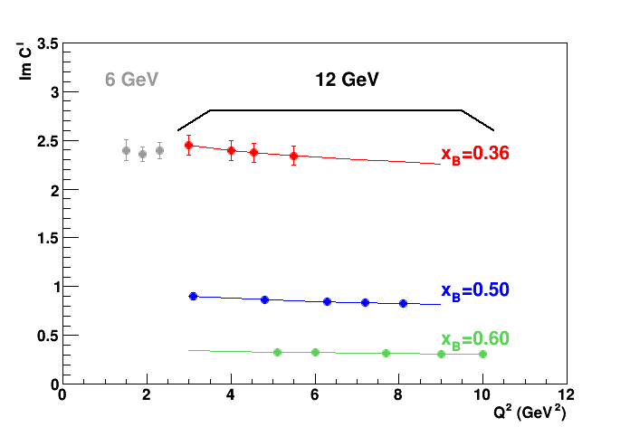
Towards the 3D Structure of the Proton (next 7 years?)
6 GeV data:
Hall B beam-spin asymmetries and cross sections
data show potential for imaging studies from analysis in x, Q² and t.
6 GeV data:
Hall A data over limited Q² range
agree with hard-scattering
12 GeV projections for Hall B:
(beam-spin and target-spin asymmetries)
transverse spatial maps
12 GeV projections for Hall A/C: confirm formalism
Im H
Notes:
JR: This slide was given by Rolf Ent. It is extracted from his 12 GeV physics generic talk, titled QCD_Frontier_12GeV_nucleon.pptx
I did modify
-the section directly underneath the “Simplest process box. On Rolf’s slide it had a statement of which GPDs are accessible with which measurement. Instead I put the comment about the “well defined formalism to analyze the cross section…”
-the projection for DVCS Hall A&C: to reflect the newly accepted Hall C experiment
-the projections for imaging in Hall B

Slide 43
A glimpse of gluon through
Deeply Virtual Compton Scattering on the proton
Hard exclusive reactions allow the study of the 3D structure of nucleon through the measure of Generalized Parton Distributions that goes beyond what can be achieved with Elastic and Deep Inelastic Scattering.
Dedicated experiments are conducted world-wide. In the valence region, the growing set of existing results is helping refine our approach to extracting the GPDs from the data.
DVCS experiments are an essential part of the comprehensive GPD program with the 12 GeV CEBAF beam and the EIC.
Thank you for your attention
Notes:
I would like to start my presentation by thanking the organizers for the opportunity to talk about my work in this session in honor of Bunny Clark and Virginia Brown. Their good scientific work has opened the door to the newt generations of female and for this I am personally grateful.
Today I will talk about spatial nucleon imaging. The takeaway messages of my talk are listed here

Slide 45
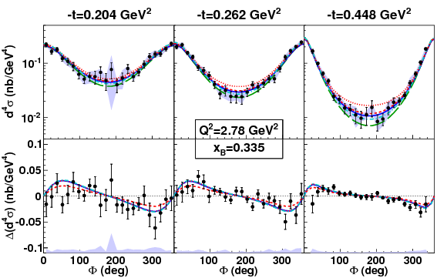
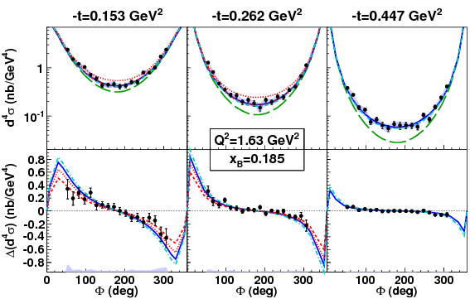
Hall B E01-113 cross sections
110 bins in (x_{B}, Q² and t)
Compatible with Hall A results
in overlapping regions
Leading twist models describe
the data within uncertainties (more than 15%)

Slide 46
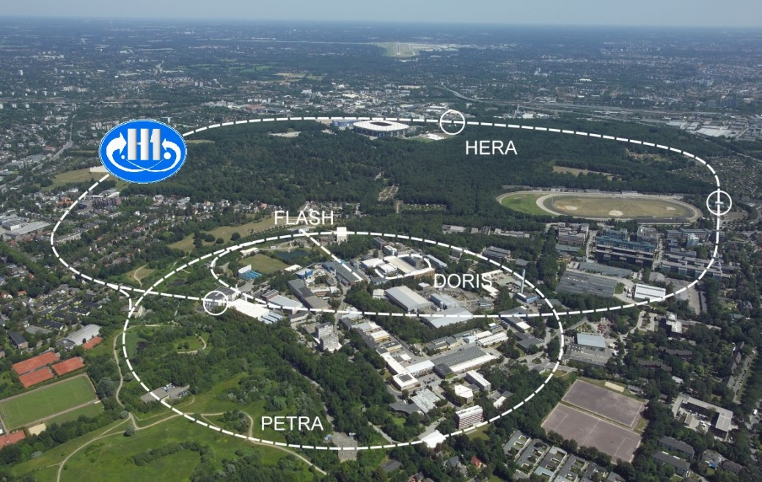



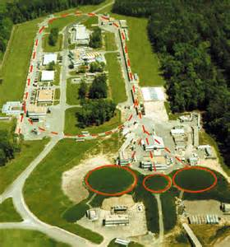

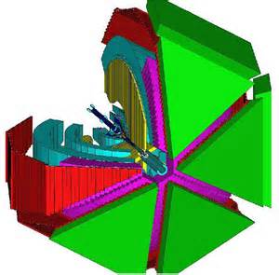

The past and future experiments
Collider mode e-p forward fast proton
HERA till 2007
Polarised 27 GeV e-/e+
Unpolarised 920 GeV p
∼ Full event reconstruction
CEBAF
at JLab
Fixed target mode slow recoil proton
Polarised 27 GeV e-/e+
Long, Trans polarised p, d target
Missing mass technique
2006-07 with recoil detector
HallA
High lumi, highly polar. 6 & 12 GeV e-
Long, (Trans) polarised p, d target
Missing mass technique
CLAS
LHC
COMPASS
Highly polarised 160 GeV μ+/μ-
p target, (Trans) polarised target
with recoil detection
SPS
Slide from N d’Hose, Tranversity 2014

Slide 47
Hall A E00-110 cross sections: higher twist corrections
PRC C92, Nov ‘15
Higher twist corrections might be necessary to fully explain experimental data
Confirmation of the significant deviation from BH => Need to measure T²_{DVCS}

Slide 48
Measuring DVCS to access GPDs information
GPDs
D
φ
P_{l} : polarization target or beam
e_{l} : charge of the lepton beam

Slide 49
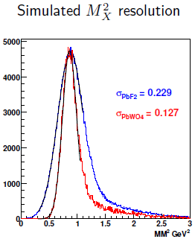
Moving from Hall A to Hall C: E12-13-007
Sweeping
magnet
SHMS
HMS
calorimeter
New Calorimeter
25 ms at 4m (two times larger than DVCS Hall A)
PW0₄ (larger light yield-better energy resolution) or
PbF₂ (Cerenkov light- no need to temperature control)
Radiation hardness is a must (expect dose in excess of 2 Mrad)

Slide 50
Hall A/JLab
208 PbF2 blocks
PbF2
3X3X18 cm block
~1000 pe
for 1 GeV outgoing
photon

Slide 51
Preliminary: re-analysis of 2006 data
(by grad student M. Defurne – CEA Saclay)
Better correction for events
lost in reconstruction
algorithm for VCD
Fiducial cuts on calorimeter
to take into account
π⁰ subtraction efficiency
Better description of the
energy resolution of the calorimeter.
Cross-sections have changed some, but the conclusions from the first article hold:
Large contribution from the DVCS²
No contribution from the twist 3 part of the interference.

Slide 52
Extracting Compton form factor from the data
Status:
Independent cross-check completed
Rosenbluth-type fits in progress
  (add a C^{DVCS} term)
Black dot: data / Red histogram: MC fit
Slide from C. Desnault

Slide 54
Ji’s sum rule on the fraction of the proton spin carried by quarks:
Hall A DVCS on neutron PRL 99: 242501 (2007)
!! Model dependent result !!
Q²=1.9 GeV², x=0.36
VGG model with various parameters defining
the GPD E (-> different values of J_{u} and J_{d})
Hermes:
Unpolarized beam, transversely polarized proton target
Ji, PRL 78:610 (97) VGG, Phys Rev D 60: 094017 (99) Lattice, PRL 92:042002 (04) Hermes, Eur Phys J C46:729 (06)

Slide 55
Multipole expansion of the amplitude
The full DVCS amplitude (ep->epγ) is
The hadronic tensor is
CFFs
In practice, one exploits the azimuthal modulation of the DVCS(and its interference)
φ_{γγ=}=φ
Harmonic coefficients
CFFs

Slide 56
DVCS2 results neutron data
M. Mazouz PRL 118 (2017) 22, 222002
At Q²=1.75 GeV² and x_{B}=0.36 , half of the data taken on a LD2 target.
Below the two pions threshold:
From LH2,
add Fermi smearing
LD2
LH2
LD2-LH2
d(e,e’π⁰)d
n(e,e’π⁰)n
separated by
Computed for
n(e,e’π⁰)X

Slide 57
Events with missing mass squared below 0.95 GeV^{2:}
  are divided in 12 x 2 x 5 x 30 bins in φ, E, t and M_{x}²
  φ, E allow for L, T, LT and TT separation
  M_{x}² allows for the n/d separation
  fitted with eight cross-section function structure
Q²=1.75 GeV² and x_{B}=0.36
E=4.45 GeV
<t’>= 0.025 GeV²
E=5.55 GeV
<t’>=0.021 GeV²
d(e,e’π⁰)d
n(e,e’π⁰)n

Slide 58
DVCS2n results: fully separated contributions
Q²=1.75 GeV² and x_{B}=0.36
Goloskokov and Kroll
Eur Phys J A47 (2012)

Slide 59
DVCS2n results: flavor separation
Q²=1.75 GeV² , x_{B}=0.36
account for the unknown phase variation between u and the d amplitude γ*q -> q’π⁰ convoluted with (H,E)_{T}
Goloskokov and Kroll
Eur Phys J A47 (2012)
u quark
d quark

