Slide 1
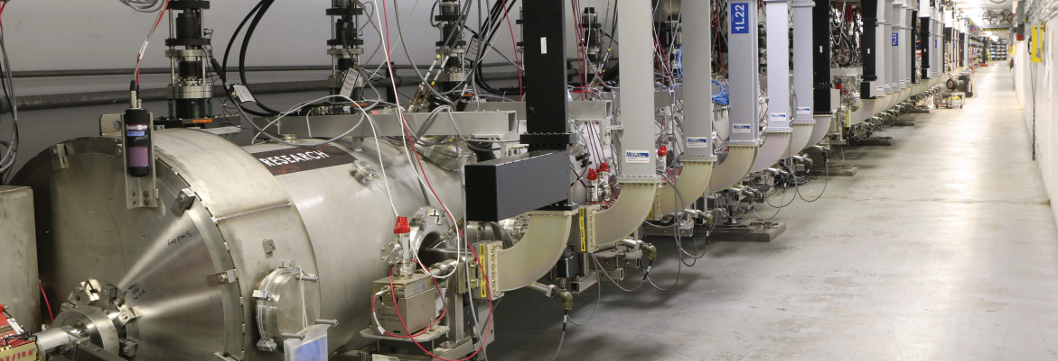
Accelerator Status and Gradient Improvement Plan
Andrei Seryi, Associate Director, Accelerator Operations and R&D
with many thanks to Matt Bickley, Interim Director of Operations Department, and to the entire team
Hall A/C Collaboration Meeting
June 27, 2019

Slide 2
Plan
Recent run status
Lab Agenda
CEBAF Energy and Reliability in the focus of efforts
  Near and long term plans
  C100 refurbishment
  Winter 2019 status and energy margin
  Summer 2019 plan
  P1 refurbishment
  C75 program
  CEBAF Schedule for Jan-May 2020
  Plasma processing
Other accelerators (UITF, LERF, GTS)

Slide 3
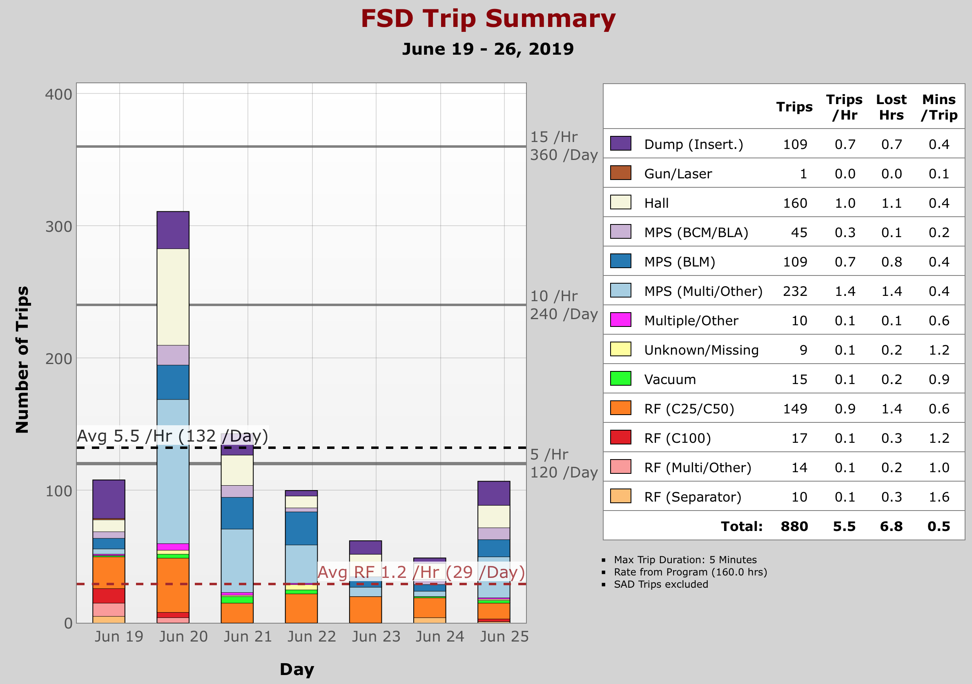
Summer ‘19 Run
Accelerator restored to 900 MeV/pass
  Low trip rate

Slide 4
Summer ‘19 Run
Accelerator restored to 900 MeV/pass
  Low trip rate
Beam to Hall B June 16

Slide 5
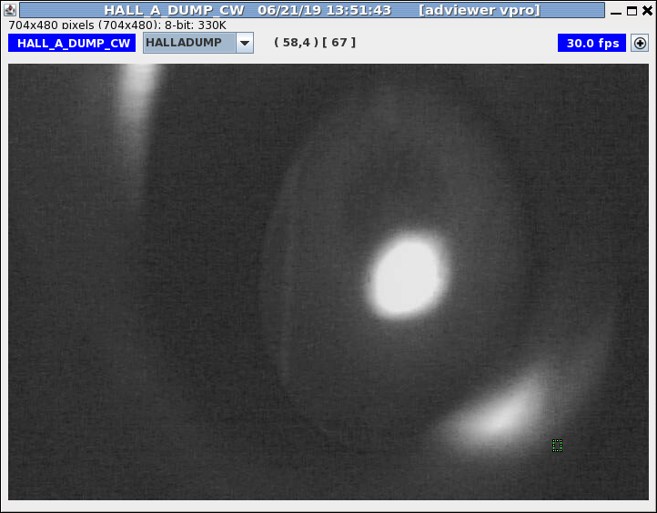
Summer ‘19 Run
Accelerator restored to 900 MeV/pass
  Low trip rate
Beam to Hall B June 16
70 uA beam to Hall A

Slide 6
Summer ‘19 Run
Accelerator restored to 900 MeV/pass
  Low trip rate
Beam to Hall B June 16
70 uA beam to Hall A
Simultaneous delivery to 3 endstations
Thu Fri Sat Sun Mon Tue Wed

Slide 7
Summer ‘19 Run
Accelerator restored to 900 MeV/pass
  Low trip rate
Beam to Hall B June 16
70 uA beam to Hall A
Simultaneous delivery to 3 endstations
ESR 15K bayonet
VFV1L27
Thu Fri Sat Sun Mon Tue Wed

Slide 8
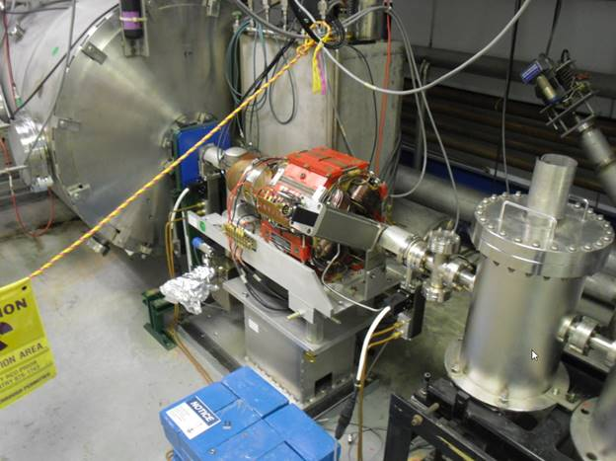
VFV1L27 valve
1L26 SRF
cryomodule
VFV1L27 fast valve
  Limit switch indicating insertion failed “on”
  Gave faulty impression that valve closed and locked in beamline
Fast valves also can disrupt vacuum when closing
  mimicking real vacuum event
Risk of aggressive or rash actions high
  Cannot risk (further) contamination of cryomodule
Slow valve
VFV1L27
Fast valve
Slow valve
Differential pumping station

Slide 10
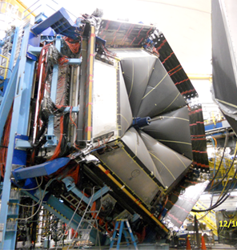
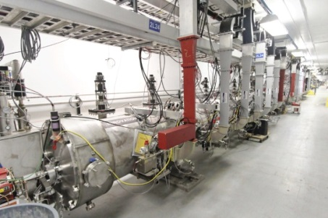
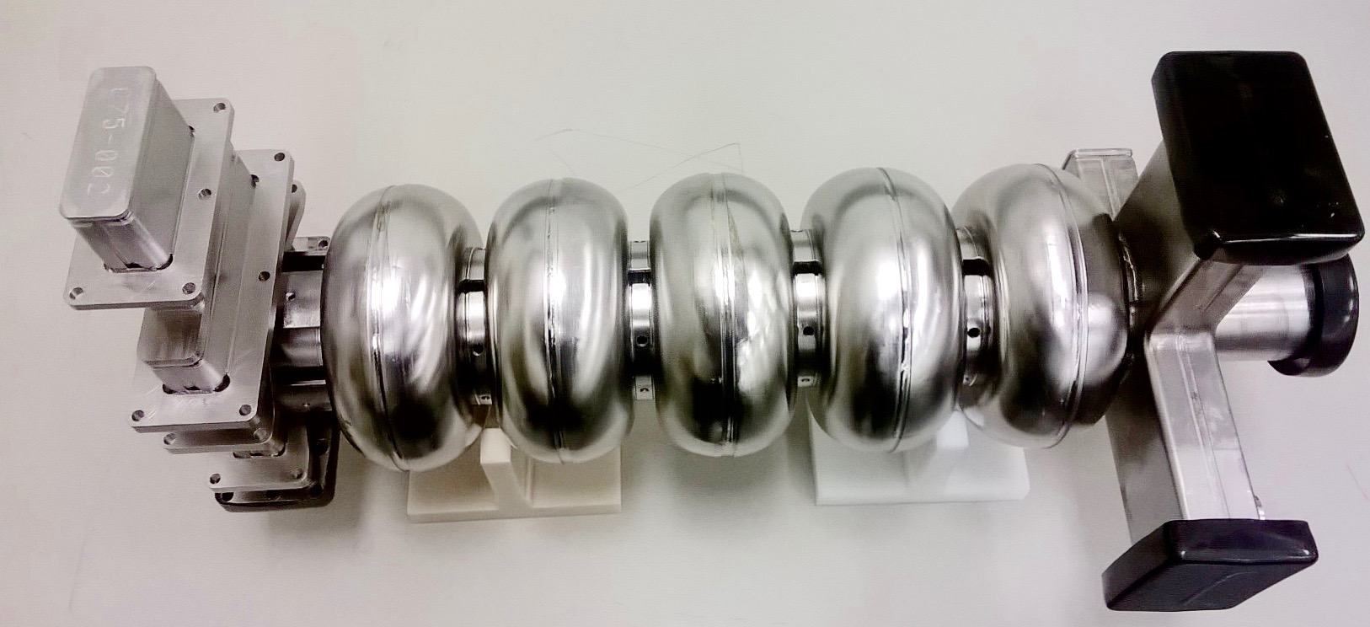
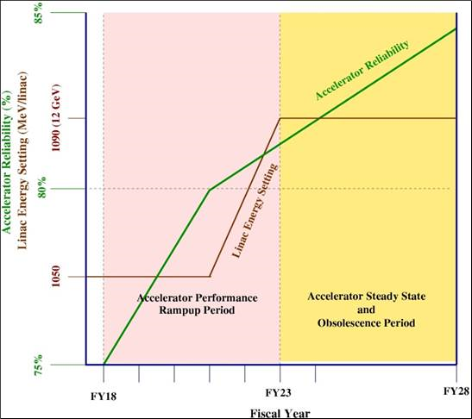
C75 cavity

Slide 11
C75 cavity

Slide 12
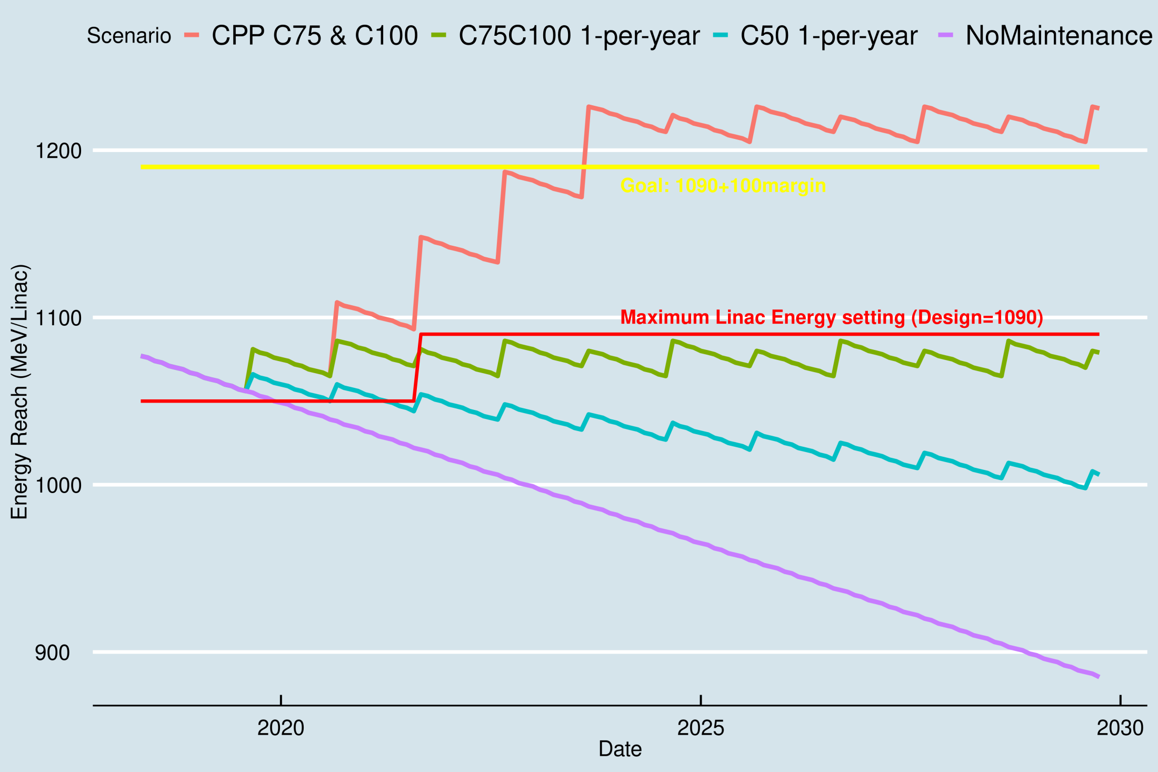
Details of the evolving Energy plan
Options as discussed with JLAAC in October 2018
Primary focus:
C100 refurbishment
New C75 CMs
Plasma processing to maintain energy reach
(Plan is subject to fund availability & continuous optimization)
Average smooth gradient degradation affected by one-off events, requiring adjustments of plan

Slide 13
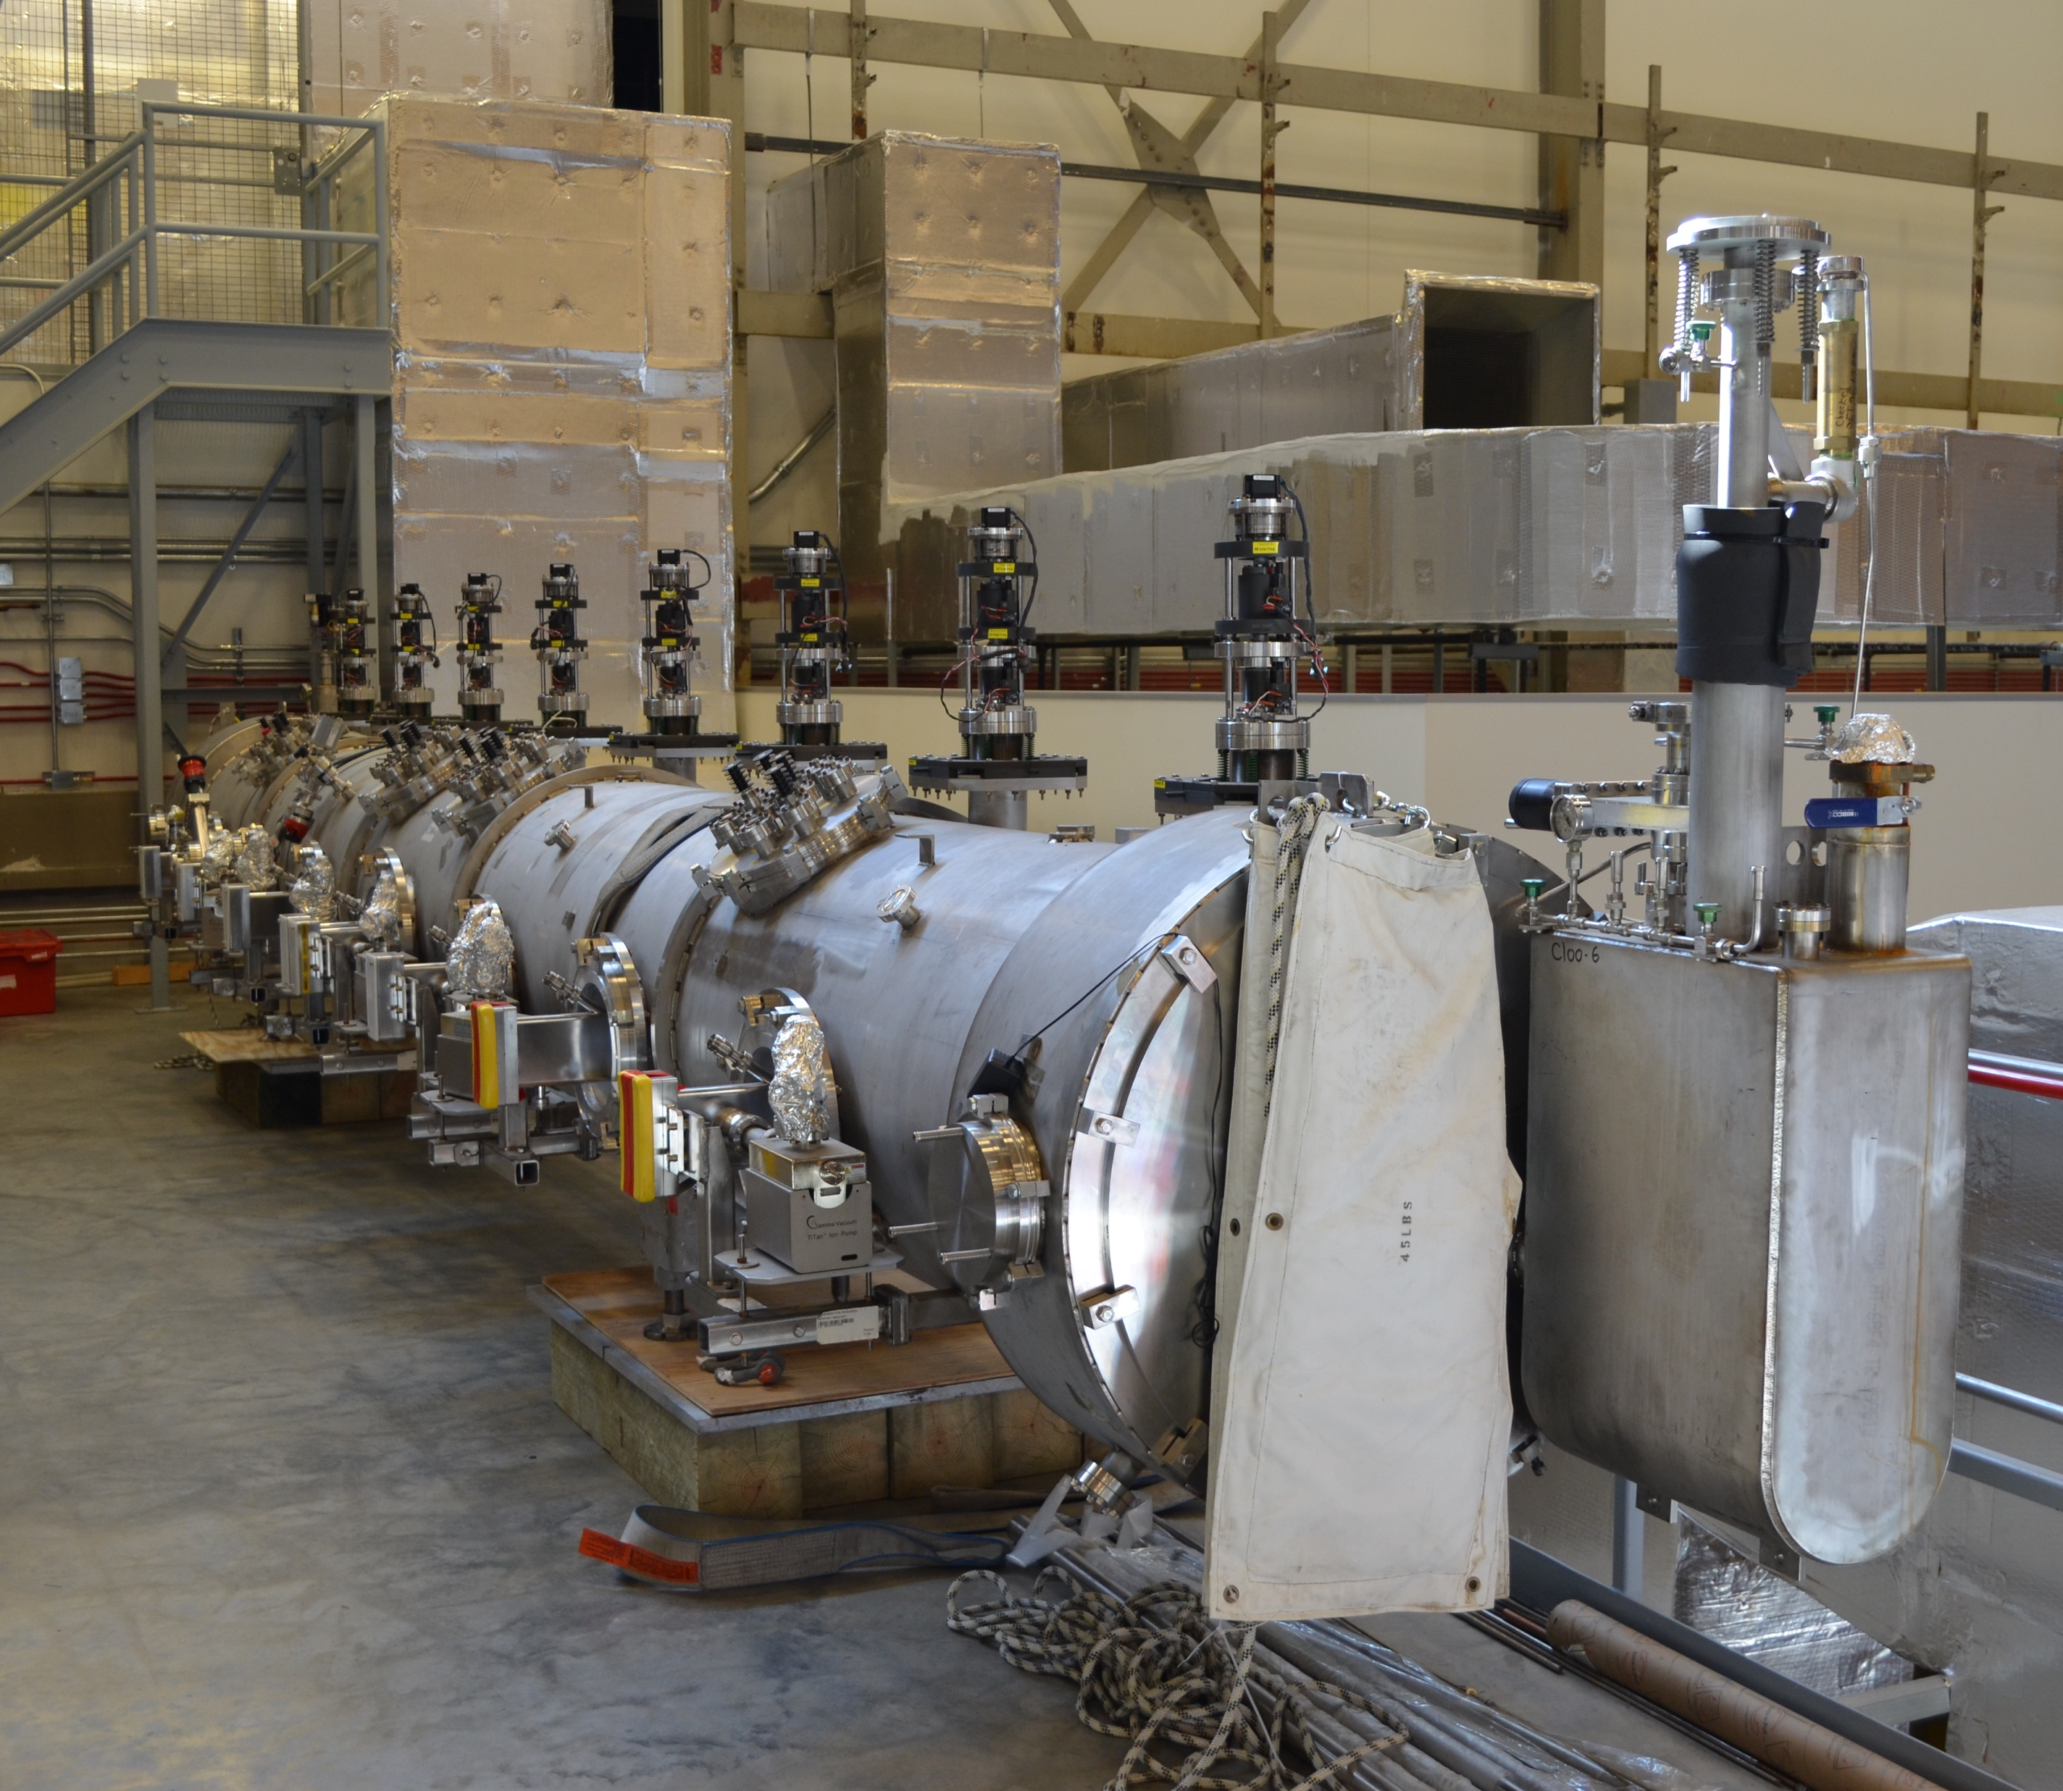
First C100 refurbishment
First C100 removed from the tunnel for refurbishment
Goals as stated initially:
Eliminate field emission to enable designed operating gradient to be achieved (~ 100 MV)
Evaluate and address any material degradation resulting from radiation exposure
C100s operate above field emission
Elevated radiation background
The first good news, when refurbishment started – haven’t detected any noticeable signs of radiation damage in internal parts of CM, e.g. in MLI (multi-leaves insulation), etc.
C100-06
4OCT2018

Slide 14
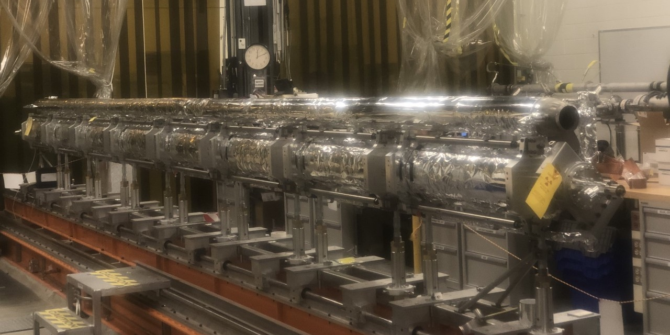
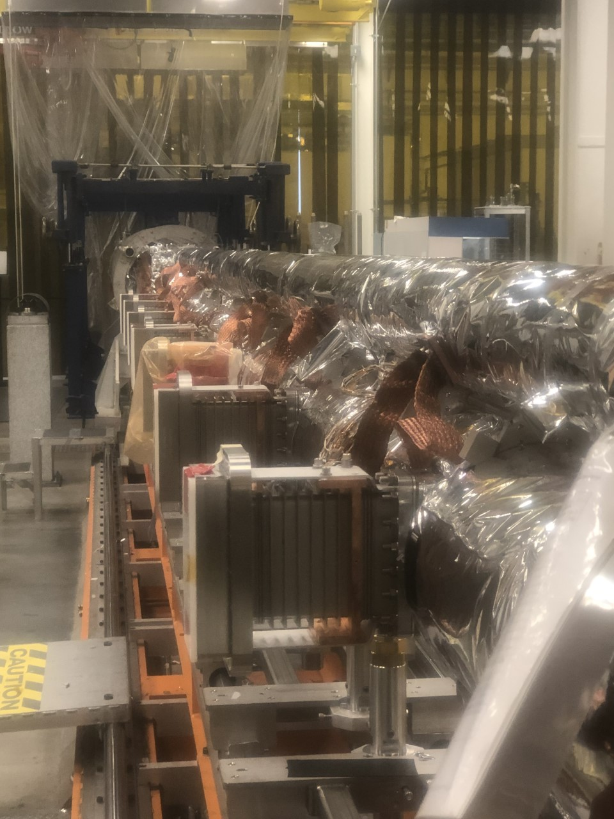
First C100 refurbishment – present status
Disassembled, then
Cavities cleaned with High Pressure Rinsing
(no chemical treatment was required)
According to individual tests of cavities in VTA the cryo-
module should produce ~98 MeV total
Assembly in advanced stage – cavity string installed into
space frame and aligned
On track to complete assembly by early August
C100-6 full module tests before operation in CEBAF:
-Only cold test (no RF) in CMTF (LCLS-II CM17/18 overlap)
-Full RF test in tunnel prior to fall ‘19 run

Slide 15
CEBAF energy margin in Winter 2018/19 run
Feb 2019 – lost gradient in North Linac 1L25 and 1L26 CMs due to vacuum related event. Cavity gradients were reduced below field emission onset.
North Linac energy margin became insufficient
Energy of NL/SL had to be reduced from 1040/1060 to 1000/1020 MeV
This affected near term and long term plans for restoring
the energy margin to allow 1050/1050 program and for
reaching 1090/linac with sufficient margin
  This plan had to be adjusted
Multiple options for Summer 2019 were considered and optimized:
  Installation location of refurbished C100-6
  Moves of other CMs and what CM to be refurbished next
Preferred plan (E’) suggested and being followed

Slide 16
CEBAF summer plan development: disposition
98MeV*
C100-6
13MeV
OFF
72MeV
59MeV
82MeV
1L07**
(P1)
1L20
(C20)
1L23
(P2)
1L25
(C100)
1L26
(C100)
**) 1L07 zone is digital-LLRF capable.
It can support C100-style cryomodules.
Klystron power is lower, C100 in this zone
will be limited to ~45 MeV.
*) Expected based on cavities tests results
Six versions of CM moves and placements were considered. Converged on the plan shown in the next slide.

Slide 17
CEBAF summer plan: Option E’
April/May: In-tunnel repair of 1L25&26
Assuming modules do not recover (they haven’t) =>
98MeV*
C100-6
Out for future rebuild
13MeV
OFF
72MeV
59MeV
82MeV
1L07
(P1)
1L20
(C20)
1L23
(P2)
1L25
(C100)
1L26
(C100)
*) Expected based on cavities tests results
Plan features:
Sufficient E-gain, can support <E>=1050
P1 is taken out, can help to develop plasma processing and after re-build will become additional C100 spare

Slide 18
Update to Winter 2020 plans
Modified schedule
  Deferring PSS certification adds two weeks of beam physics to schedule in January 2020
Additional gradient possible from cryomodule “Lucky”
  CM in 1L07 removed from accelerator in June 2018
  Stored in stub to cool down
  Testing under way to verify current gradient
  May be installed in September to NL zone 20 if required to maintain gradient for program
NL26 operationally available gradient is still unclear
  Recent testing of 1L26 was at higher than operational LHe pressure with two CHLs
  Cryocycle to 30K may improve its performance
  Further testing in October will be required to verify delivered gradient meets experimental needs

Slide 19
E’
When P1 is re-built and installed, the curve will go up faster
(green curve shown is tentative)
The long term plan will be re-optimized
Results of plasma processing will be folded in

Slide 20
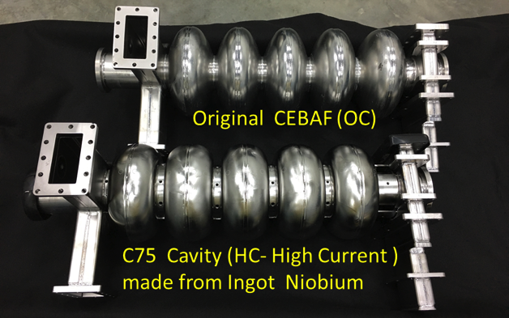
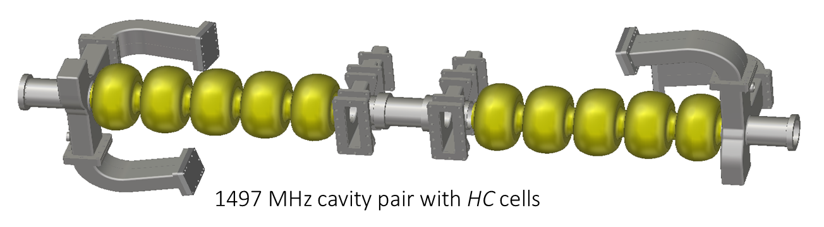
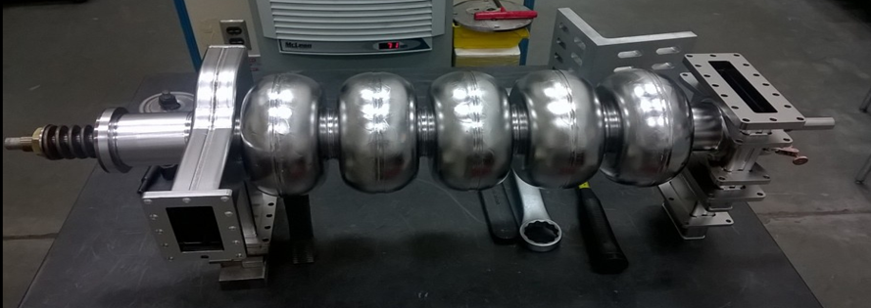
What’s New C20 to C50 to C75 Cavity
C20 to C50 to C75
Dogleg on wave guides and dogleg windows
Cavity pair gate valves
Light electropolish, clean assembly in upgraded facilities
Cell shape (OC to HC) and material (fine to large grain Nb)
New 5-cell cavity structure with added stiffening rings
  End groups are reused
  Cavities provided from industry
  Bulk chemistry and dehydrogenation
  Clean assembly practices leveraged from LCLS II
HC 5-cell1.5 GHz C75 Cavity (CEBAF)

Slide 21
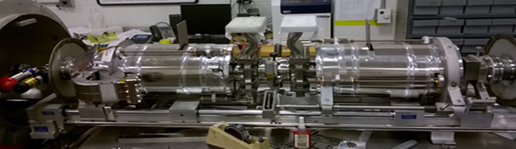
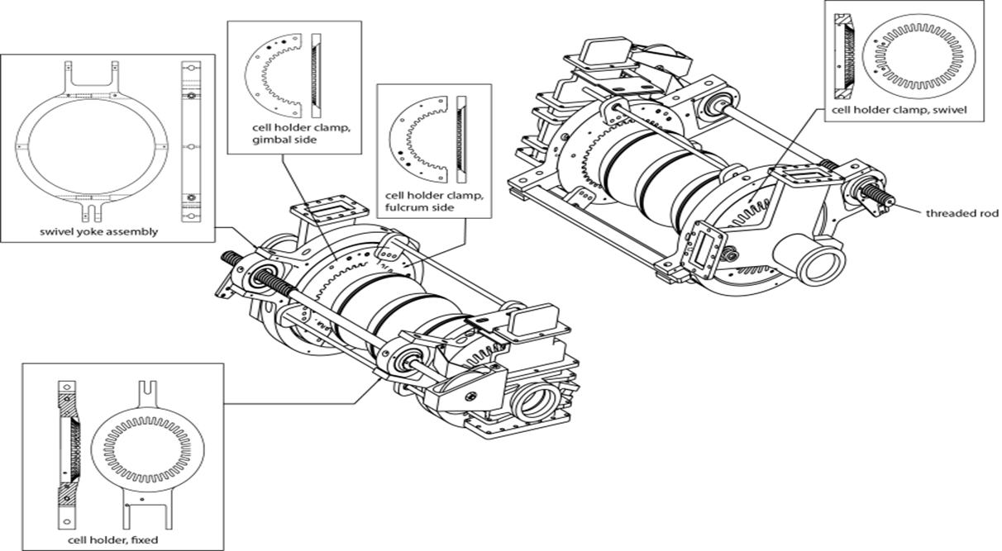
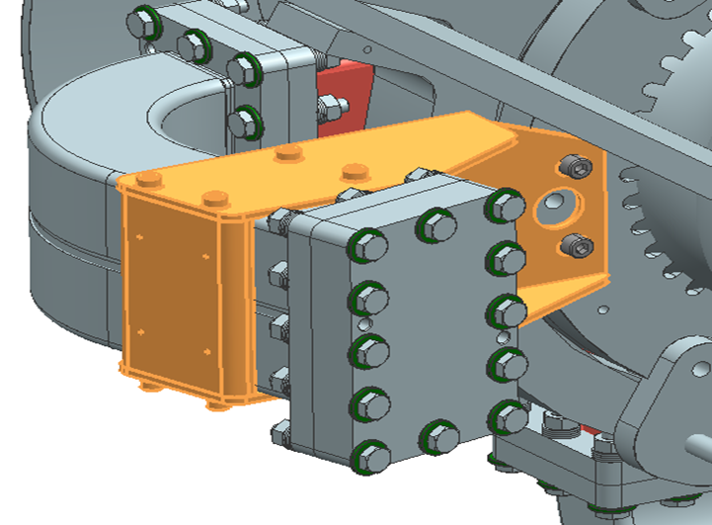
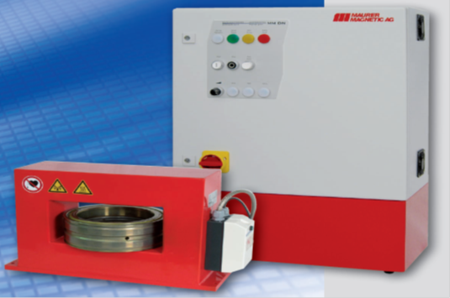
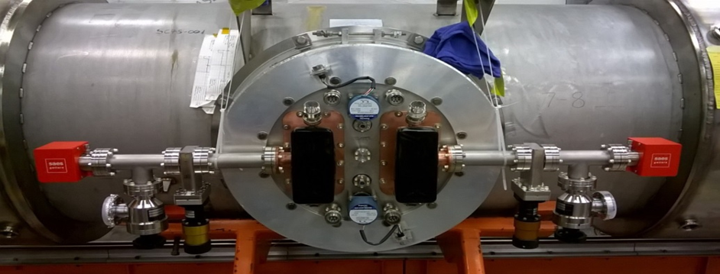
What’s New C20 to C50 to C75 Cryomodule
C20 to C50 to C75
Valves on ends of Cryo-units changed to new design
Minimized the amount of instrumentation (meaning fewer 2k feedthrus)
Rework of rotary feedthrus and tuner subassemblies
Replace HDPE warm windows with ceramic windows
Magnetic hygiene program leveraged from LCLS II
HOM elbow brackets
Tuner end plates are reworked to adapt to cell shape
Inner magnetic shields on cavity pairs
Non-evaporative getter (NEG) pumps replace ion pumps on cryomodule and warm girder
Wave guide vacuum manifolds are separated and NEG pumps replace ion pumps

Slide 22
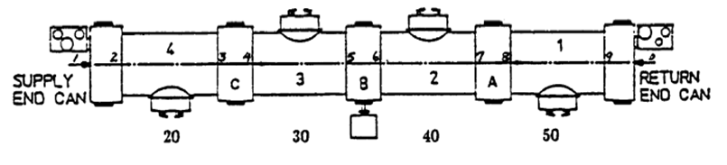
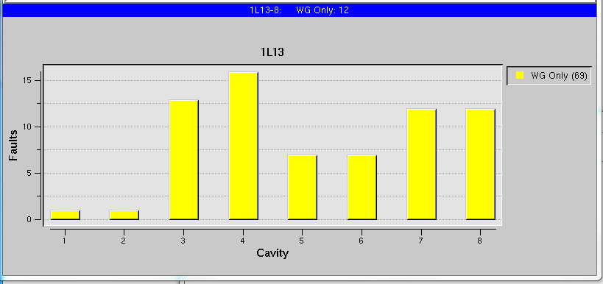
First “C75” prototype pair performance in CEBAF
Installed in slot “1L13” in CEBAF commissioned in Oct.-Nov. 2017
5C75-001 (cav 1)
5C75-003 (cav 2)
The remaining 6 cavities in the cryomodule are standard C50 cavities
NEG
Cav 1 quenched at 19.1 MV/m after RF processing. Operation limited by analog LLRF
Courtesy of M. Drury
Use NEG-SIP combination pumps one for each FPC waveguide, to improve hydrogen pumping speed and reduce trip rate

Slide 23
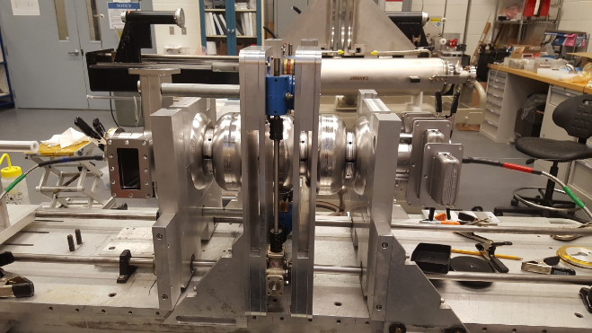
Latest status of C75-1 and C75-2
C75-1
  Received 8 cavities from vendor
  Qualified 6 cavities, returned 2 for re-work
  Assembled with 2 in-house and 6 vendor cavities
  Lessons learned implemented in vendor process
  Processed all in-house cavities
  Processing vendor cavities
  Completed vertical RF test of one cavity – good Qo, quenched slightly below 20 MeV/m (acceptable)
C75-2
  Preparing to order cavities from vendor, applying all lessons learned from the first batch
Plan
  Install C75-1 CM in mid 2020
  Install C75-2 CM at the end of 2020

Slide 24
Mitigation of gradient degradation
Actions toward development of methods for in-situ processing of cryomodules to mitigate gradient degradation
Plasma processing, early work
  Early work at Oakridge & JLAB (2012 J Mammosser et al)
  Used FPC (fundamental power couplers) – difficult to ignite plasma
Plasma processing, latest work
  Developed methods to use HOM (High Order Modes)
  couplers to ignite plasma
  Successfully applied at SNS since ~2016
  Also being now implemented at Fermilab
Re-started efforts on plasma processing in JLab
  Collaborating with SNS, FNAL and SLAC
  Goal: in situ processing of cryomodules
(Not a panacea. Studies are needed. Reported to work best for hydrocarbon contamination. May be less efficient for metal particulates)

Slide 25
SRF & Energy plan - SNS plasma processing
SNS plasma processing card
SNS cryomodule in situ plasma processing, example
Images: Marc Doleans, SNS

Slide 26
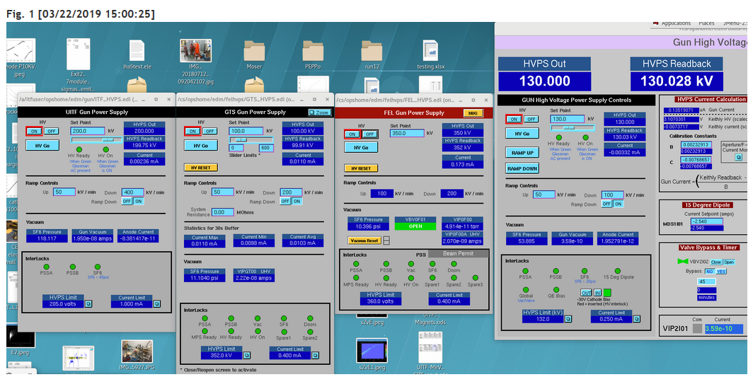
Other accelerators
March 22 – Four Accelerators Operating Simultaneously at JLab!
CEBAF
UITF
GTS
LERF

Slide 27
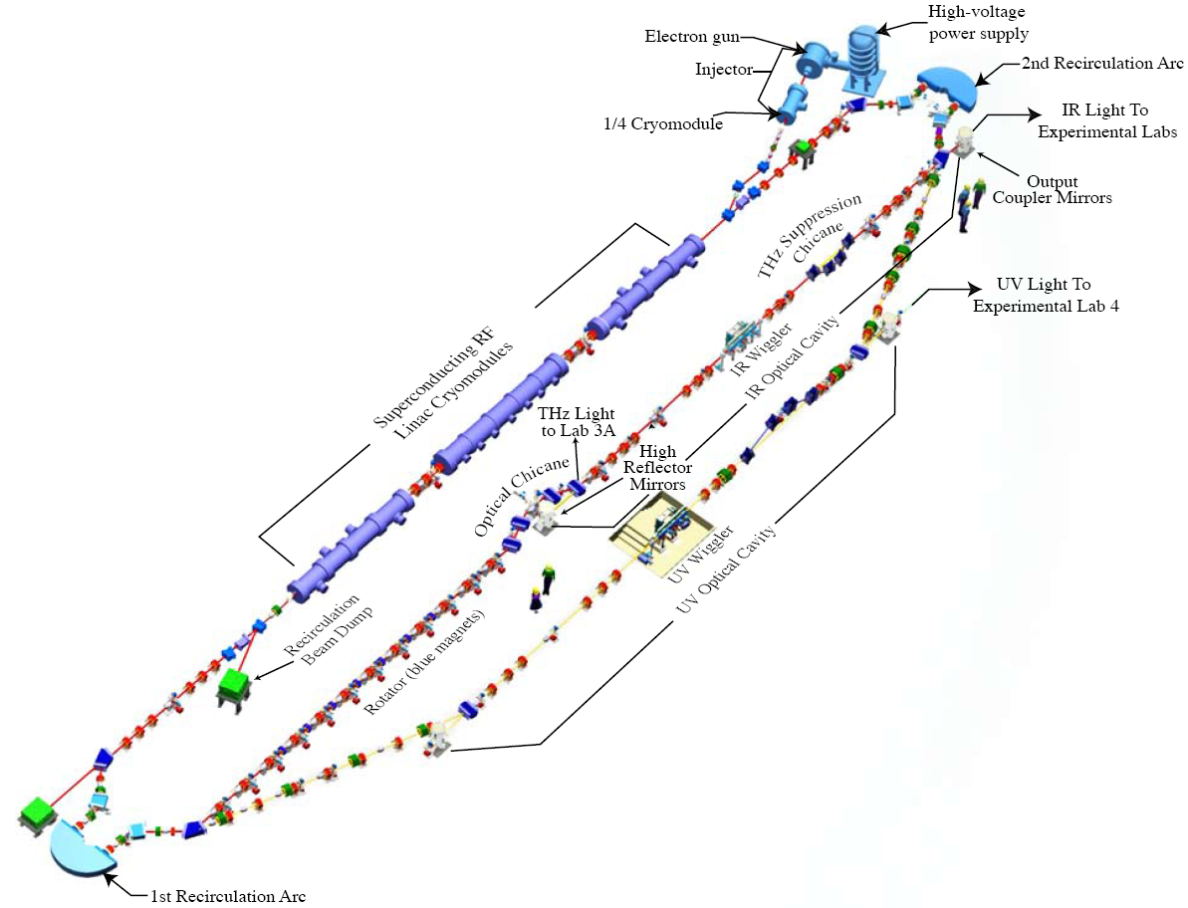
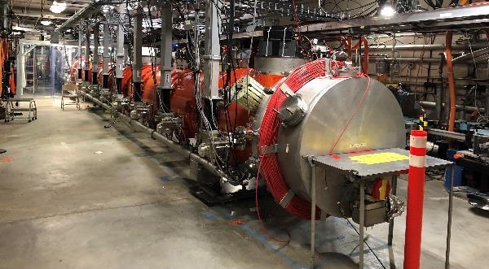
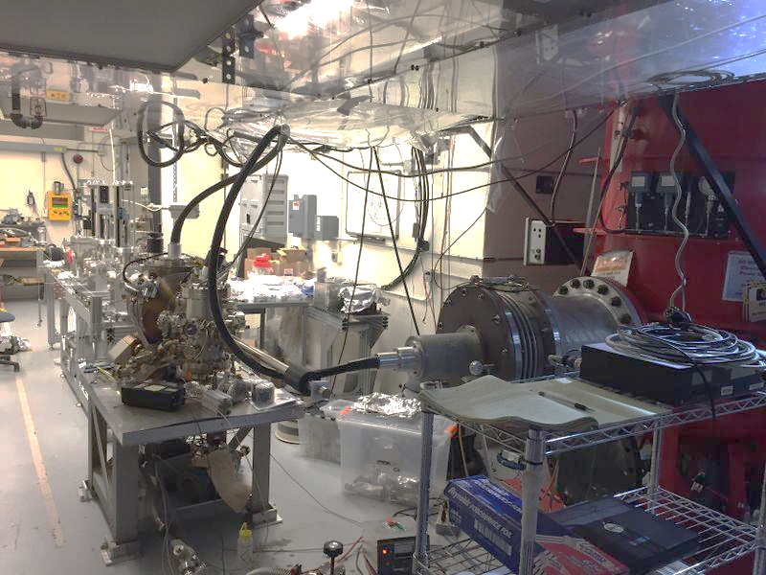
Low Energy Recirculation Facility (LERF) and Gun Test Stand (GTS)
Recent highlights:
High QE photocathodes and magnetized beam at GTS
Test of LCLS-II CMs at LERF
Beam to 0G dump in preparation for isotopes program at LERF
Gun Test Stand
Magnetized Gun
Magnetized Beam

Slide 28
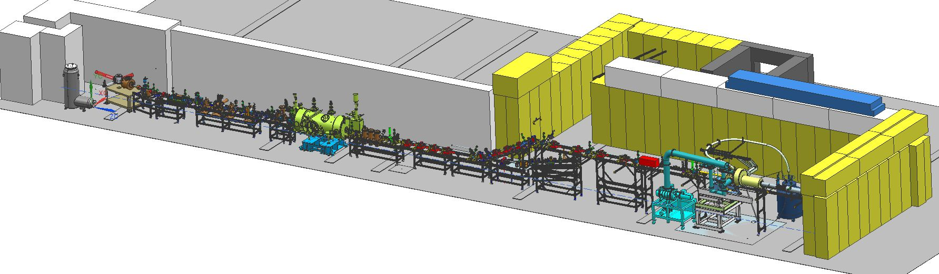
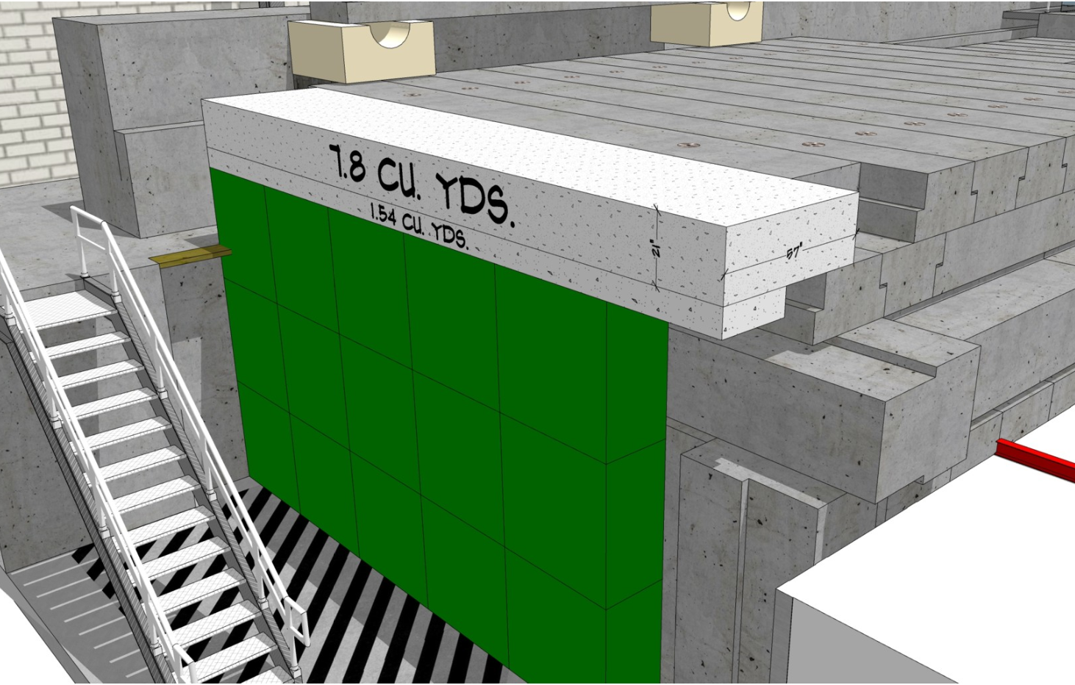
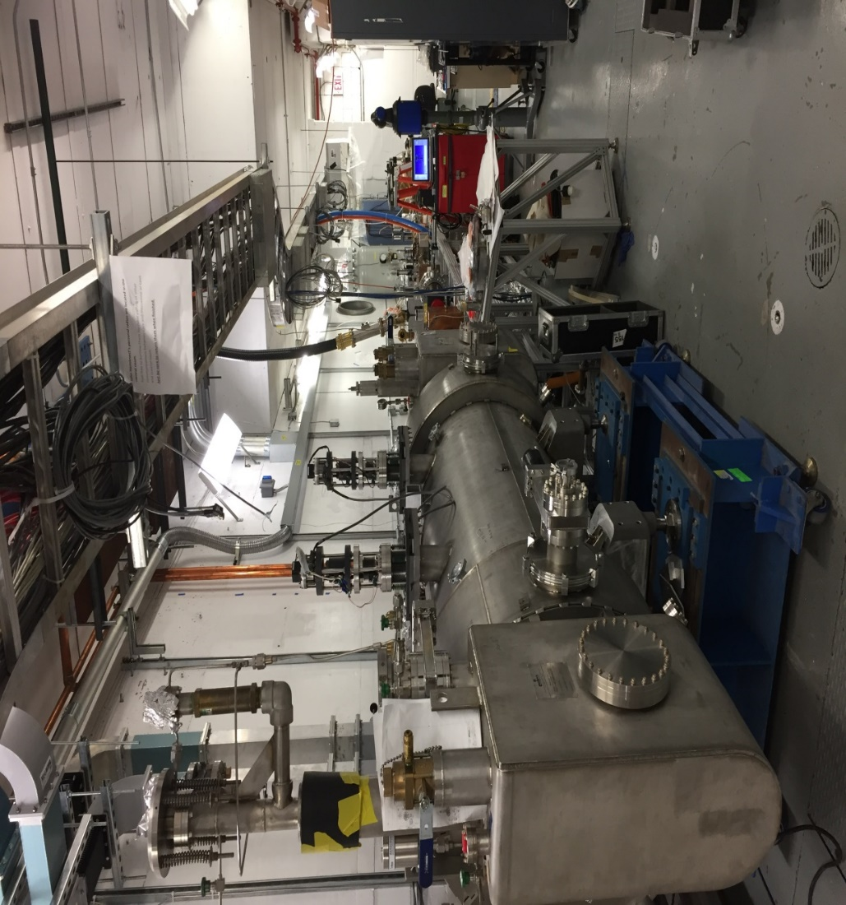
Upgraded Injector Test Facility (UITF)
Recent highlights:
  New Quarter Cryomodule commissioned
  Waist height beamline complete, under vacuum
  North wall shielding enhancements completed

Slide 29
Perspective
Focus on reaching 12 GeV with sufficient energy margin to ensure reliable operation for maximizing physics outcomes
Thank you for your attention!
Questions?
Thanks to Matt Bickley, Tony Reilly, Todd Satogata for materials for the talk and thanks to the entire team for efforts towards the energy plan and for safe and reliable operation of CEBAF

