Slide 1
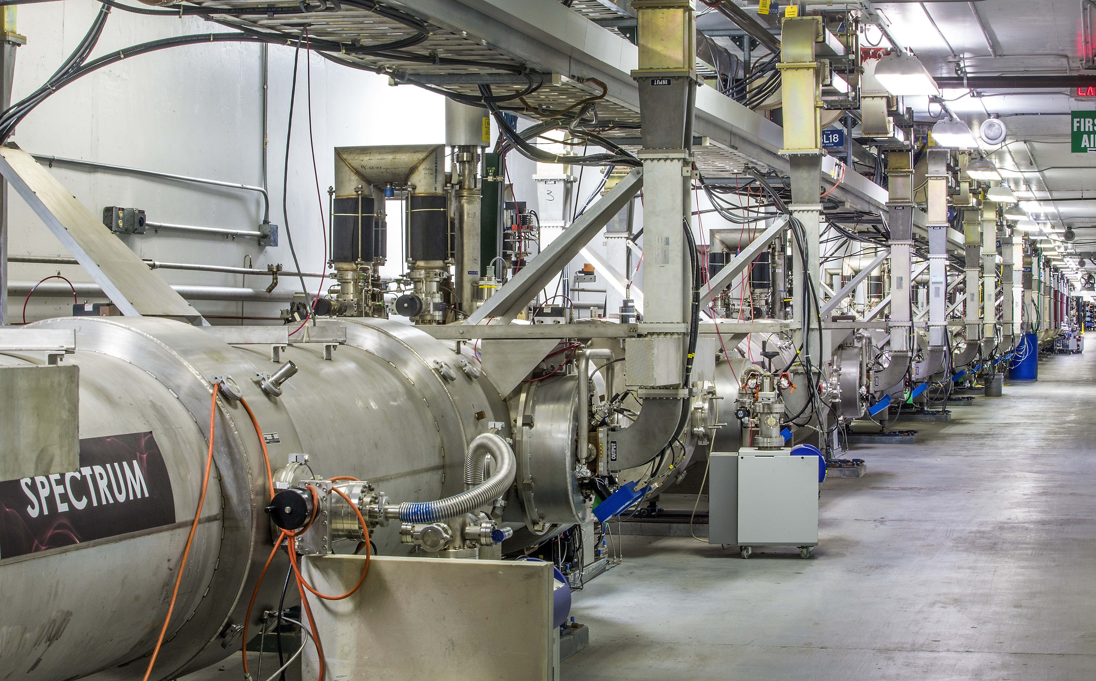
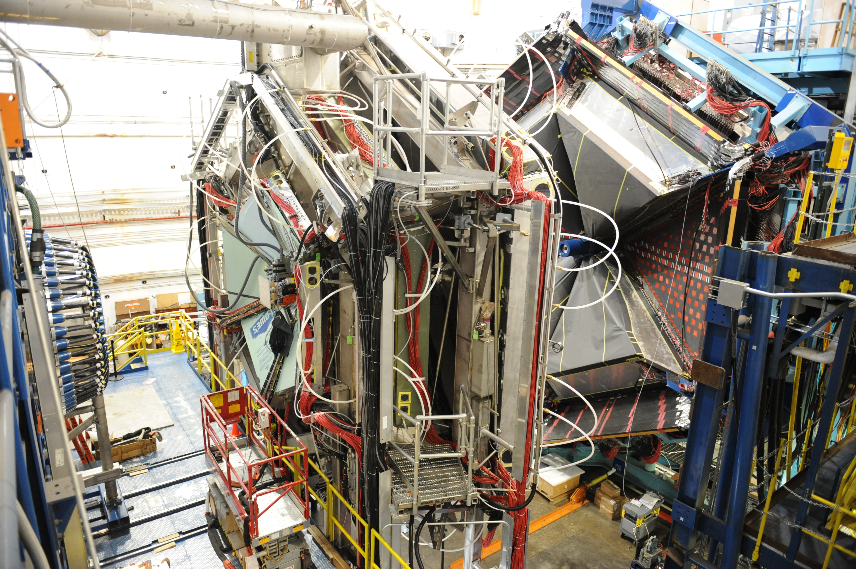
Jefferson Lab Status
Stuart Henderson
Laboratory Director
June 27, 2019

Slide 2
Jefferson Lab News and Highlights
12 GeV Scientific era is in full-swing!
  Completed several high impact, high profile experimental programs including tritium program and Glue-X phase 1
  Anticipating publications from first set of 12 GeV experiments
Mid-way through second full year of CEBAF 12 GeV Operations
  Will deliver more than 30 weeks operations in FY19; reliability YTD ~85%.
EIC Planning is moving forward: FY20 administration budget request documented intention to issue CD-0 in FY19
MOLLER Project is moving forward
DOE Support for important Jefferson Lab initiatives:
  CD-0 Approval for CEBAF Center Renovation and Expansion Project
  FY20 administration budget request included
    MOLLER Project start
    End Station Refrigerator funding

Slide 3
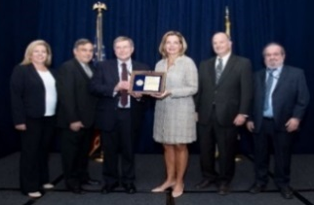
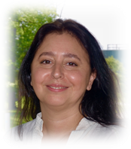
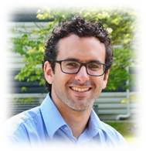
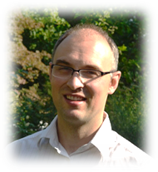

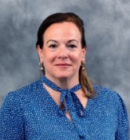
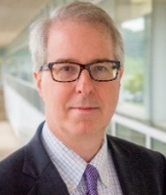
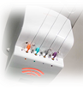
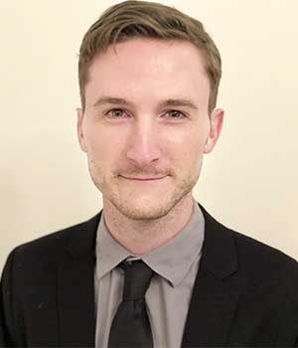
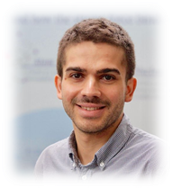
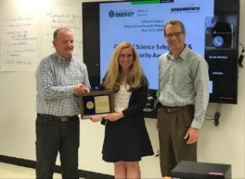
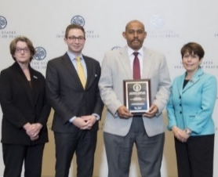
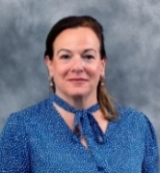
Jefferson Lab Staff and Users Continue to be Recognized for their Accomplishments
DOE Project Management Achievement Award
DOE Early Career Award
DOE Early Career Award
DOE Early Career Award
“The UIM Project provided several critical systems upgrades and allowed for increased capacity to support research in the areas of nuclear physics, accelerator science and advanced instrumentation, without interfering with usual JLab operations.”
~DOE Office of Project Management
… for hunting for the formula to produce better accelerators for research, industry and medicine …
…for engaging the incredible computational power of supercomputers to unravel the secrets of subatomic particles and how they interact…
…for developing experimental and analysis techniques that make full use of the new generation of high-precision experiments…
Anne-Marie Valente-Feliciano
(Jefferson Lab)
Raul Briceno
(Jefferson Lab/Old Dominion
University)
Anselm Vossen
(Jefferson Lab/Duke)
APS Distinguished Lectureship
on the Applications of Physics
Governors Distinguished CEBAF Professor at ODU
2018 R&D 100 Award
APS/GHP Dissertation Award
"The Commonwealth is proud to have you at the helm and appreciative of ODU for helping secure your Governor’s Distinguished Continuous Professor appointment."
~Gov. Ralph Northam
“"The OARtrac® system, built with detector technologies used in nuclear physics, has been cited as a 2018 R&D 100 Award Winner by R&D Magazine."
~The R&D 100 Awards Committee
“…achievements in developing a new approach to global analyses of parton distribution functions with modern statistical methods."
“…for pioneering work in Proton Therapy…”
~APS Physics
Cynthia Keppel
(Jefferson Lab/Hampton Univ.)
Stuart Henderson
(Jefferson Lab Director)
Jacob Ethier
(W&M)
Marie Sklodowska-Curie
Fellowship
2018 Outstanding Security
Manager
2018 Federal Energy and
Water Management Award
2018 APS Fellowship
2018 APS Fellowship (Users)
Moscov Amarian (ODU)
David Armstrong (W&M)
Oscar Rondon-Aramayo (UVA)
“…leadership on novel experimental techniques to study strong interactions ,…contributions to CTEQ… instrumental role in founding the H.U. Proton Therapy Center and other work applying Nuclear Physics to Medicine…”
~APS Physics
…for his research project “SQuHadron - Strategies to Tackle the Quest for Hadronization”.
1 of 1,348 selected out of 9,089 proposals submitted
…for improving lab security and furthering best practice safeguard initiatives…
…for data center consolidation…
Andrea Signori
(ANL)
Shauna Cannella
(Jefferson Lab)
Cynthia Keppel
(Jefferson Lab

Slide 4
Our Highest Priority is Getting Work Done Safely
We want you to be able to come to Jefferson Lab and safely carry out your research
Recent concerning events (electrical shock, laser near-miss) highlight ongoing safety culture concerns
My message to you:
Have a questioning attitude
Ask yourself, what can go wrong?
Pay attention to your surroundings – situational awareness
If you have any concerns, by all means let them be known
Ensure that our students in particular are properly trained and supervised

Slide 5
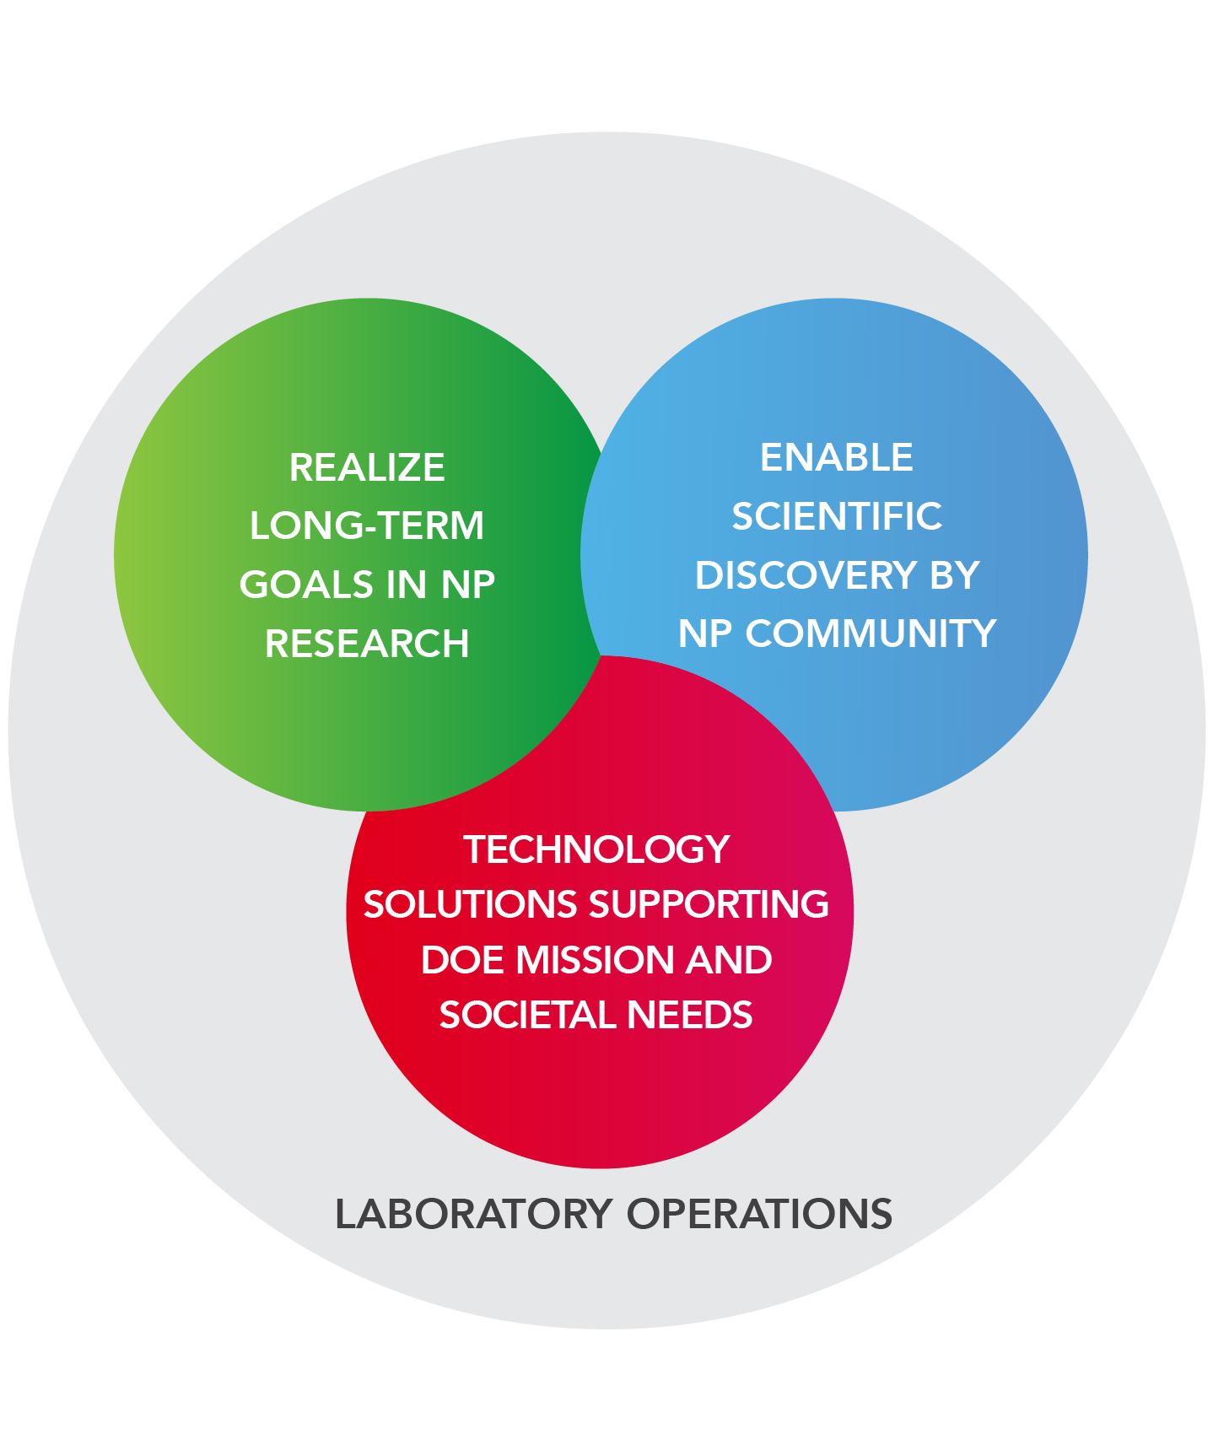
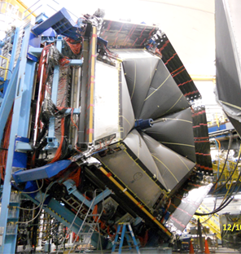
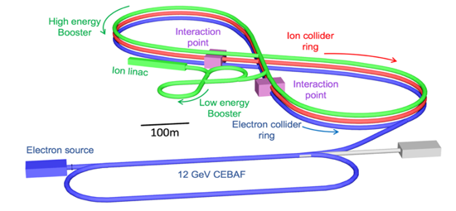
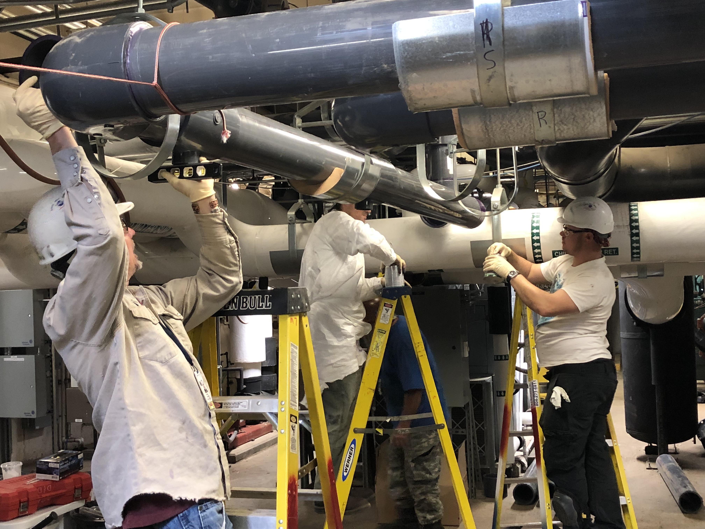
Long-Term Vision for Jefferson Lab
Jefferson Lab supports the DOE Office of Science and serves the Nuclear Physics user community as a world-leading center for fundamental nuclear science and associated technologies
1. Deliver on 12 GeV Scientific Program
2. Provide a long-term path for the field
3. Provide technology solutions supporting DOE mission
4. Enable world-class science through excellence in Laboratory Operations

Slide 6
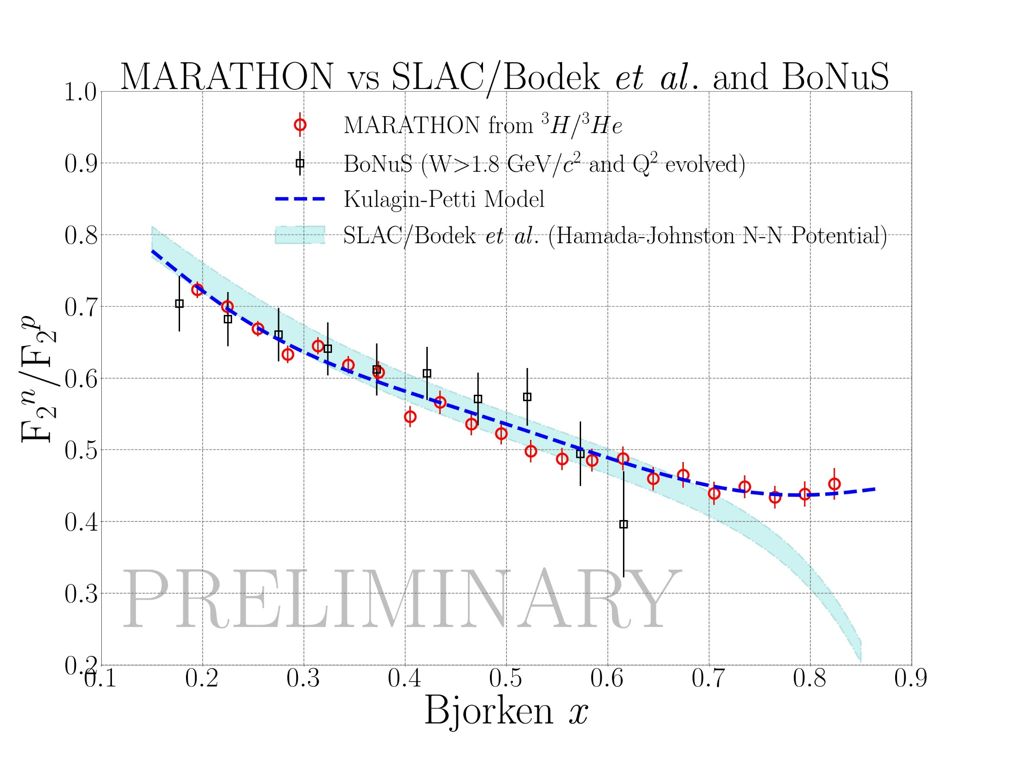
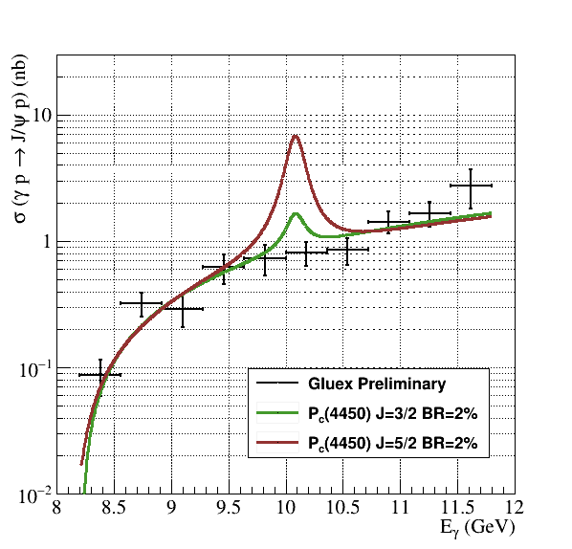
CEBAF 12 GeV Scientific Era is in Full Swing!
Mid-way through second full year of operation
Completed several high-impact experiments; analysis in progress
Delivered thesis data to nearly 50 graduate students
7-10 year experimental program “on the books”
Search for a pentaquark containing charm-type quarks
Measurement of proton radius

Slide 7
Jefferson Lab’s user community continues to grow Demand is very high

Slide 8
Highest Priority Has Been Increasing Weeks of CEBAF Operation
Optimal weeks
12 GeV Construction
On-track for > 30 weeks of operation in FY19
FY20 operations planning incorporates installation of replacement 2K Cold Box
Working towards optimal 34 weeks of reliable operations

Slide 9
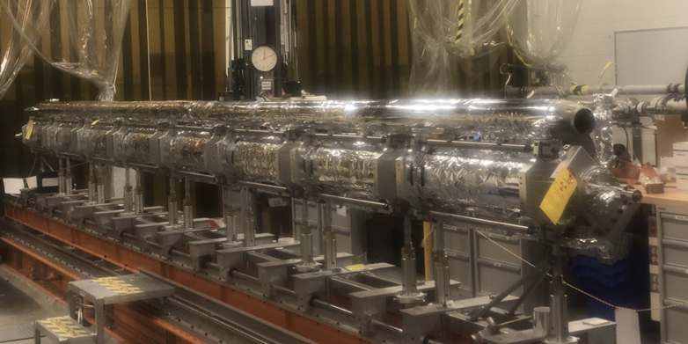
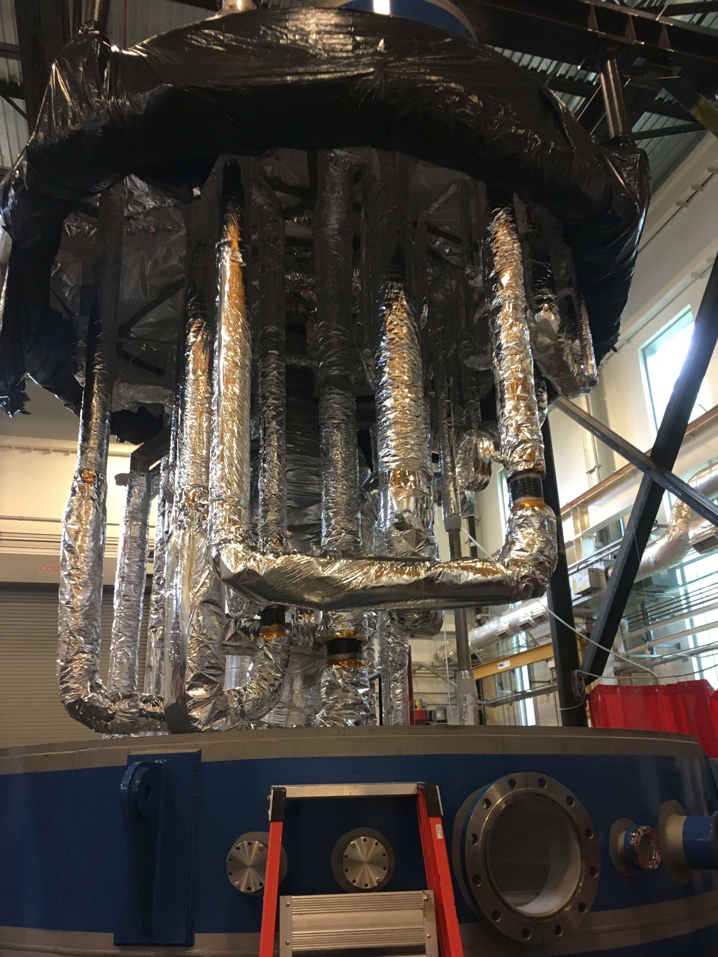
CEBAF Operations for 12 GeV Scientific Program
Successful Office of Nuclear Physics Operations Review in July 2018
  “The laboratory has made a successful transition to operations following the conclusion of the 12 GeV CEBAF Upgrade project.”
We are executing our CEBAF Reliability Plan to improve reliability of the facility and energy performance of the accelerator with significant investments
First C100 Cryomodule refurbishment
        Refurbishment of first C100 cryomodule removed from CEBAF; reinstalled in Fall 2019.
        Investigation of long-term energy degradation
        Significant progress on critical spares, klystrons, obsolescence, and cryogenic infrastructure (2K Cold Box and End Station Refrigerator Upgrade)
        FY19 YTD: 19 weeks of operation with 85% reliability. FY19: 19 weeks of operation with 77% reliability
2K Cold Box Assembly

Slide 10
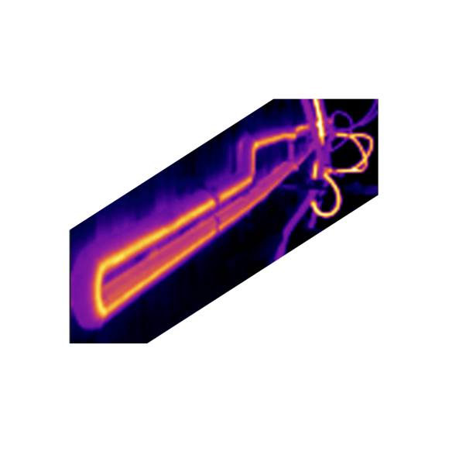
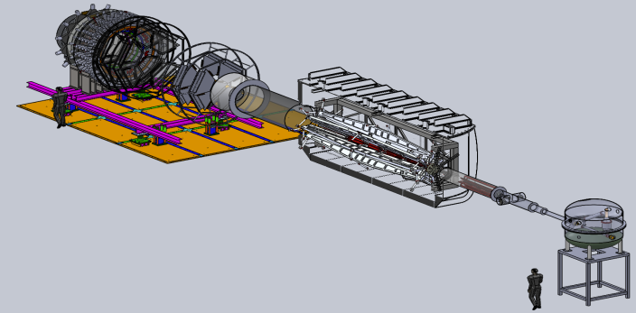
MOLLER Project
Fundamental Symmetries MIE
Special opportunity with 12 GeV Upgrade to Search for New Flavor Diagonal Neutral Currents
Unique discovery space for new physics up to 38 TeV mass scale, with a purely leptonic probe
Most impact if run timely or in phase with initial HL-LHC runs that will add the complementary hadronic probe (FY25-28)
CD-0 approved January 2017, project paused
Ongoing research within MOLLER collaboration
Project underway
Established project team
Director’s Review held April 2019
Funding
FY20 start in President’s Budget Request
House appropriations includes $2.5M
MOLLER main ingredients/activities:
High-power target:
High-Precision Polarimetry
Moller-quality parity beam
Spectrometer
Prototype magnet coil test

Slide 11
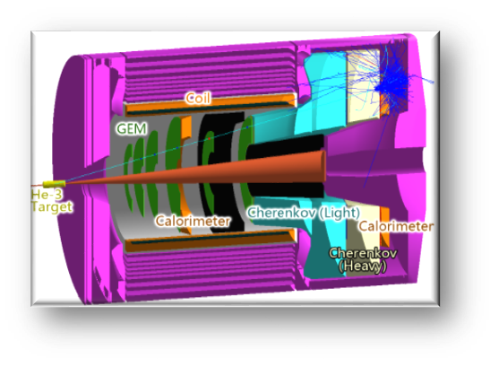
SoLID Activities
    Status meeting at DOE Headquarters with Office of Nuclear Physics July 13, 2018
    Revised pCDR (with updated cost estimate) submitted to JLab Director’s Office
      Base equipment configuration - US request
        Can do all approved SoLID science
    Director’s Review planning for CY 2019
        Verify No Showstoppers
        Verify Cost Estimate Robust
    Anticipating Science Review to follow
    Collaboration working on pre-R&D
    JLab CLEO-II magnet CE funding:
      Outer steel from Cornell ~June 2019
      Prep for Magnet Static Tests
      Magnet controls work ongoing
      Prep for Cryo Reservoir work
    Working towards CD-0
Light Gas Cerenkov PMT prototyping

Slide 12


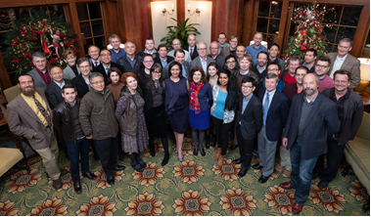
Virginia Center for Nuclear Femtography
Funded by Commonwealth to “…..to facilitate the application of modern developments in data science to the problem of imaging and visualization of sub-femtometer scale structure of protons, neutrons, and atomic nuclei”
  Seven (of fourteen) joint lab/university initiatives funded by the Commonwealth of Virginia
Multi-disciplinary, bringing together nuclear theorists and experimentalists, mathematicians, computer scientists,… … and architects and artists!
Workshop at University of Virginia
FEMTOGRAPHY 2018

Slide 13
Approved experiments
Topic | Hall A | Hall B | Hall C | Hall D | Other | Total
The Hadron spectra as probes of QCD | 0 | 2 | 1 | 3 | 0 | 6
The transverse structure of the hadrons | 6 | 3 | 3 | 1 | 0 | 13
The longitudinal structure of the hadrons | 2 | 3 | 7 | 0 | 0 | 12
The 3D structure of the hadrons | 5 | 9 | 6 | 0 | 0 | 20
Hadrons and cold nuclear matter | 8 | 5 | 7 | 0 | 1 | 21
Low-energy tests of the Standard Model and Fundamental Symmetries | 3 | 1 | 0 | 1 | 2 | 7
Total | 24 | 23 | 24 | 5 | 3 | 79
Total Experiments Completed | 7.0 | 8.0 | 4.9 | 1.2 | 0 | 21.1
Total Experiments Remaining | 17.0 | 15.0 | 19.1 | 3.8 | 3.0 | 57.9

Slide 14

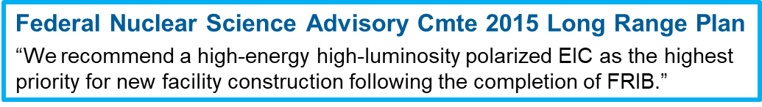

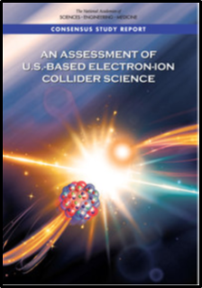
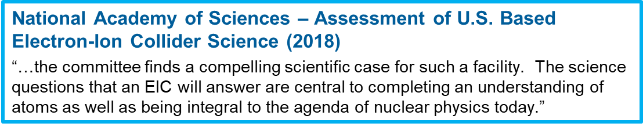
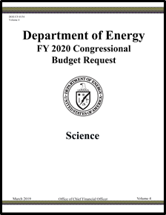
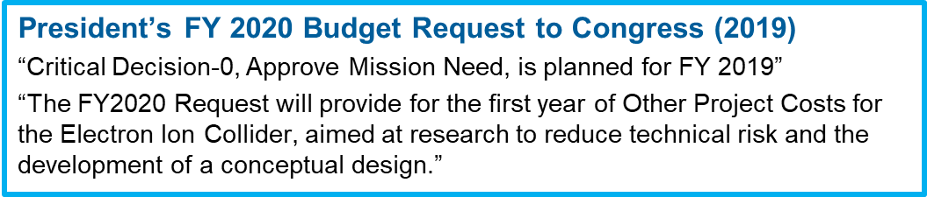
Electron-Ion Collider Planning

Slide 15

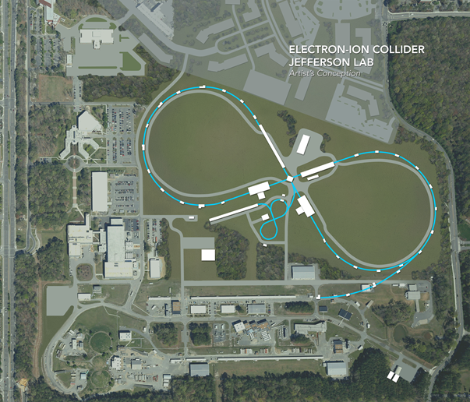
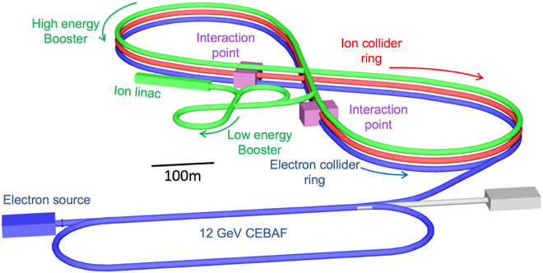
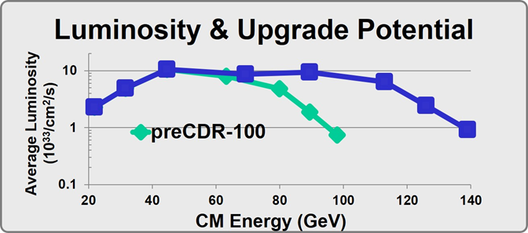
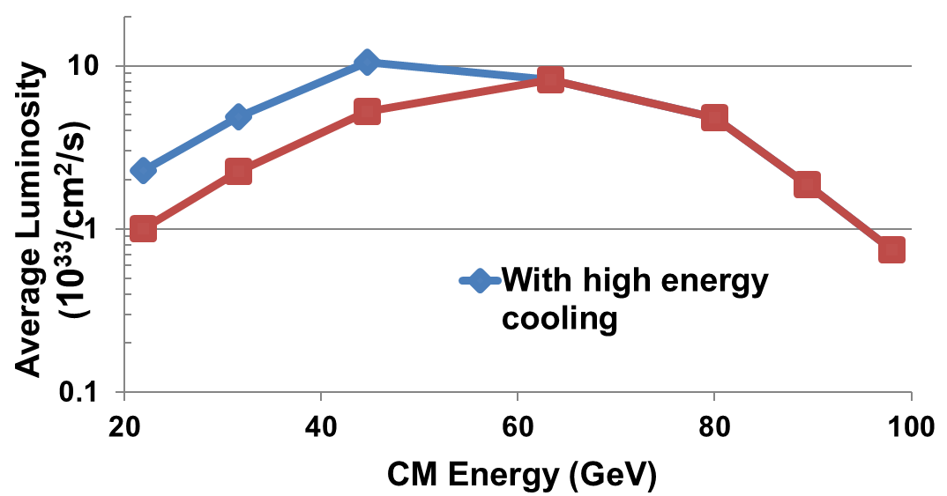
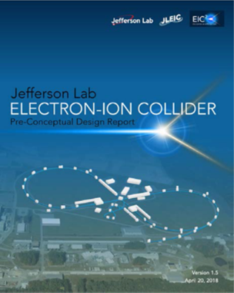
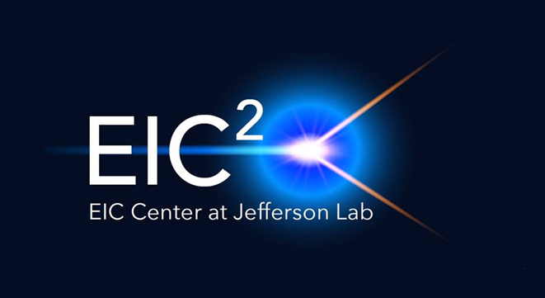
Jefferson Lab Electron Ion Collider
JLab EIC Figure 8 Concept
    High Luminosity of 10³⁴ /cm²/sec well-matched to requirements
    High Polarization (including deuterons)
    Energy Range: √s : 20 to 100-140 GeV (magnet technology choice)
    Appropriately balances performance and risk
    Flexible timeframe for construction
    consistent w/running 12 GeV CEBAF
    Cost effective operations
    Fulfills White Paper, NAS Requirements
100 fb⁻¹/yr
PreCDR complete
E_{CM} 65100GeV
Independent Cost Review June 2019

Slide 16
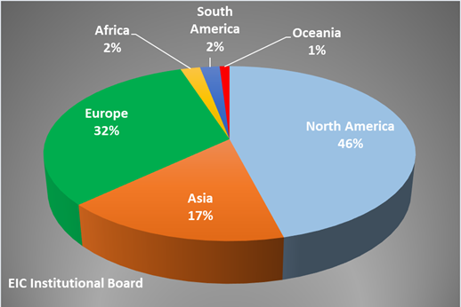
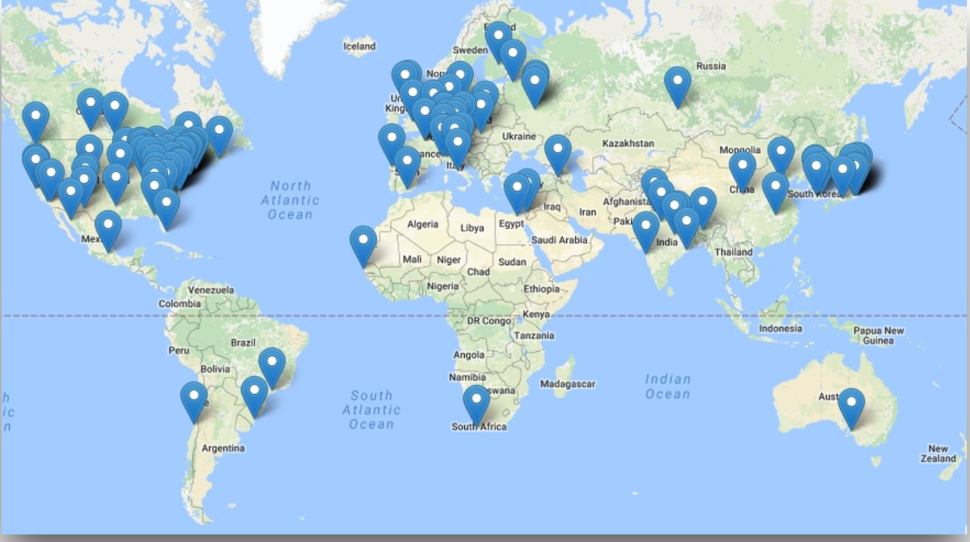
EIC Users Group and International Interest
Formed in 2016; currently:
  864 members
  184 institutions
  30 countries

Slide 17
Budget Status
FY19
President’s Budget Request called for $600M for Office of Nuclear Physics, $109M for Jefferson Lab
Congress appropriated $690M for Office of Nuclear Physics and $129M for JLab
FY16 | FY17 | FY18 | FY19
107.6 | 111.2 | 122.9 | 128.9
Jefferson Lab Nuclear Physics funding ($M)
FY20
President’s Budget Request to Congress:
  $5,546M for DOE Office of Science (16% reduction)
  $625M for Office of Nuclear Physics (9.4% reduction)
  $125M for Jefferson Lab
Many of our priorities, however, are reflected in the budget language: MOLLER, ESR, CRE, EIC
House appropriations indicates Congress’ support for DOE Office of Science
Congress needs to hear from all of us about the importance of robust funding for the sciences

Slide 18
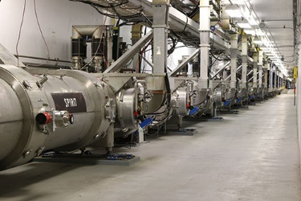
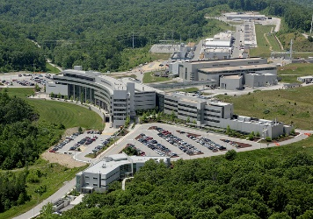
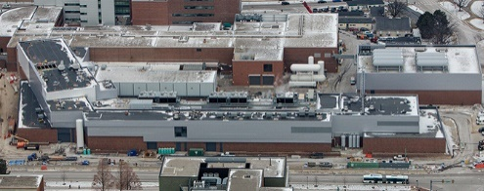
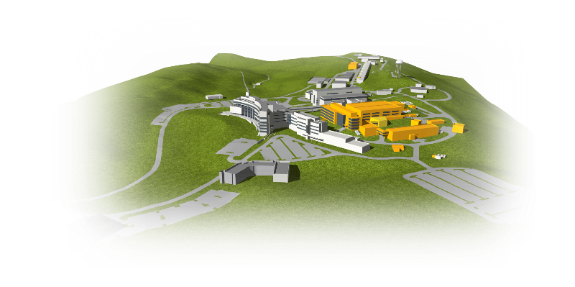

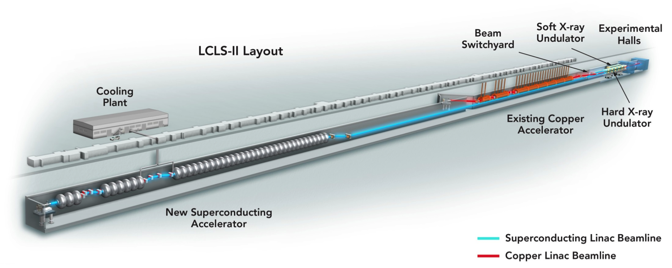
Jefferson Lab Plays a Vital Stewardship Role for “Big Science” Projects Within the Department Of Energy
Jefferson Lab is a world-leader in Superconducting Radiofrequency particle accelerators and cryogenic technologies
CEBAF - 1994
12 GeV Upgrade - 2017
Facility for Rare Isotope Beams (MSU) - 2021
Spallation Neutron Source (ORNL) - 2006
Linac Coherent Light Source II (SLAC) 2021
SNS Proton Power Upgrade
LCLS-II High Energy Upgrade
Jefferson Lab is partnering on two new DOE Projects

Slide 19
Challenges
Safety: positively influencing safety culture at Jefferson Lab
CEBAF Operations
  Reliability
  Energy
  Rhythm of 30+ weeks of operations per year
Electron-Ion Collider planning – next steps
Achieving/maintaining good Project performance
Café: Evaluation underway now to assess options for our Café
Site Access: new requirements for Foreign National visits and assignments, coupled with protection of certain technologies – priority for DOE
  Non-U.S. citizens must attach a CV to their visit request.
  All visit requests must be submitted not less than seven calendar days prior to the visit start date.

Slide 20
Perspective
The Lab is in good shape and in a strong position moving forward
Our priorities are
  Ensuring that the 12 GeV program is successful
  Maintaining reliable operation at high weeks-of-operation per year
  Preparing for next steps with the Electron-Ion Collider
What I would ask is that you keep in mind the competitive environment in which we are operating:
  Keep up the good work and proceed with an appropriate sense of urgency
  Let your voice be heard. Decision-makers need to hear from you about the importance of your work, training the next generation and the importance of Jefferson Lab in achieving your goals
Thank you for your continued enthusiasm and support for Jefferson Lab and its future

Slide 21
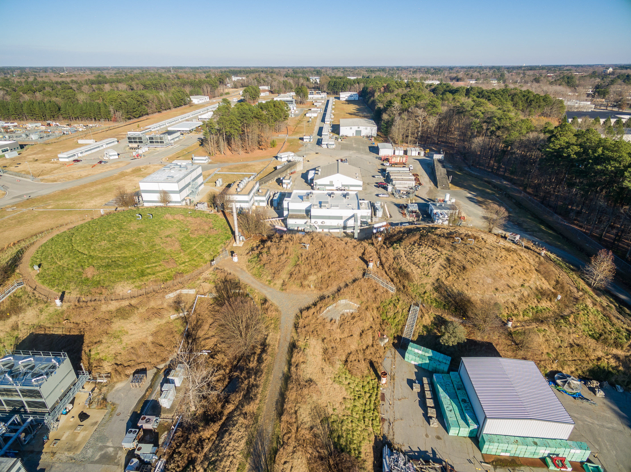
Thank you for your support!

Slide 22
Jefferson Lab Organization
Jefferson Science Associates LLC
Jerry Draayer, SURA
Timothy Sands, Virginia Tech
Chico Moline, PAE
Internal Audit
Gail Lucento
Laboratory Director
Stuart Henderson
Director’s Office
LCLS-II
Project Office
Joe Preble
CPO
CRO
COO
Communications
Lauren Hansen
CCO
Planning
Allison Lung
S&T Programs
Bob McKeown
Operations
Mike Maier
Tech Transfer and Commercialization
Drew Weisenberger
CTO
Experimental Physics
Rolf Ent
Accelerator
Andrei Seryi
Theoretical and Comp Physics
Jianwei Qiu
Engineering
Will Oren
Legal Counsel
Rhonda Scales
CIO
CHRO
CFO
ESH&Q
Mary Logue
Information Technology
Amber Boehnlein
Human Resources
Rhonda Barbosa
Business and Finance
Jennifer Logan
Facilities Mgt.
and Logistics
Rusty Sprouse

Slide 23
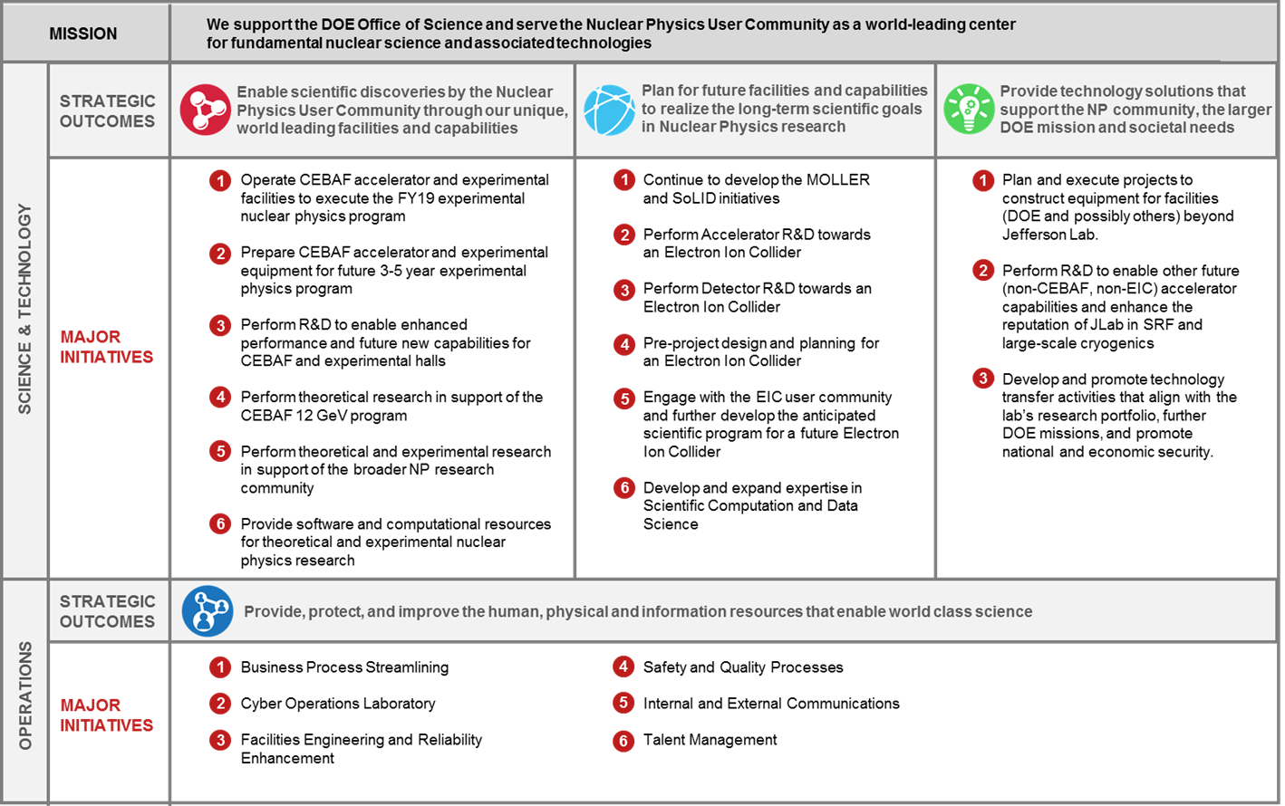
Jefferson Lab Agenda Supports Long Term Vision
FY2019 LABORATORY AGENDA

