Slide 1
Correction of Magnet Errors and Dynamic Aperture of JLEIC Electron Collider Ring
Yuri Nosochkov
Yunhai Cai, Fanglei Lin, Vasiliy Morozov
JLEIC Collaboration Meeting, April 1–3, 2019

Slide 2
Topics
Magnet errors
Misalignment, strength errors, non-linear field errors
Optics sensitivity to the errors
Correction of errors
Design of orbit correction scheme
Simulations with misalignment, linear and non-linear field errors, and corresponding corrections
Dynamic aperture
Without errors
With errors and corrections
Sensitivity to the errors
Conclusion

Slide 3
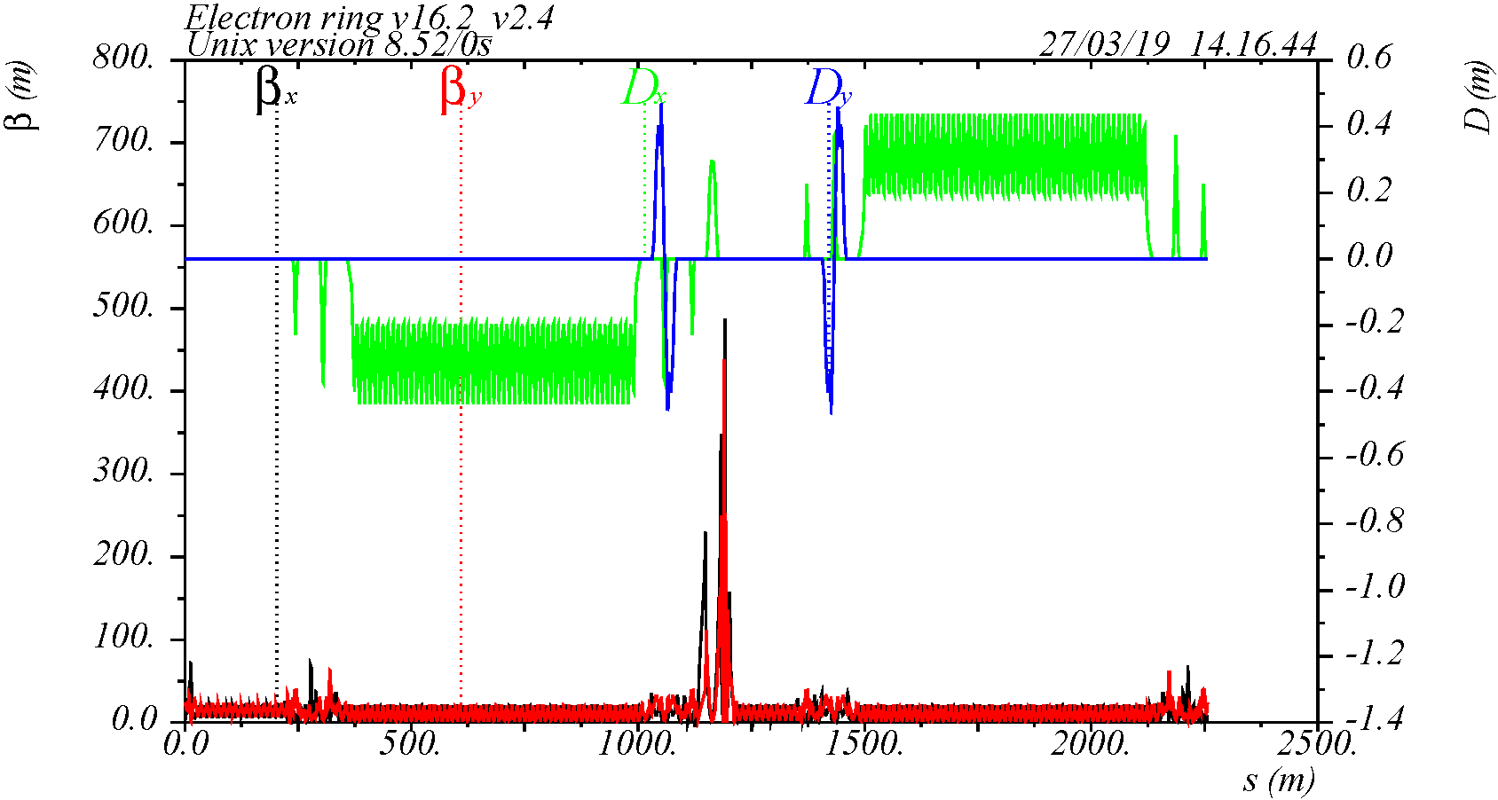
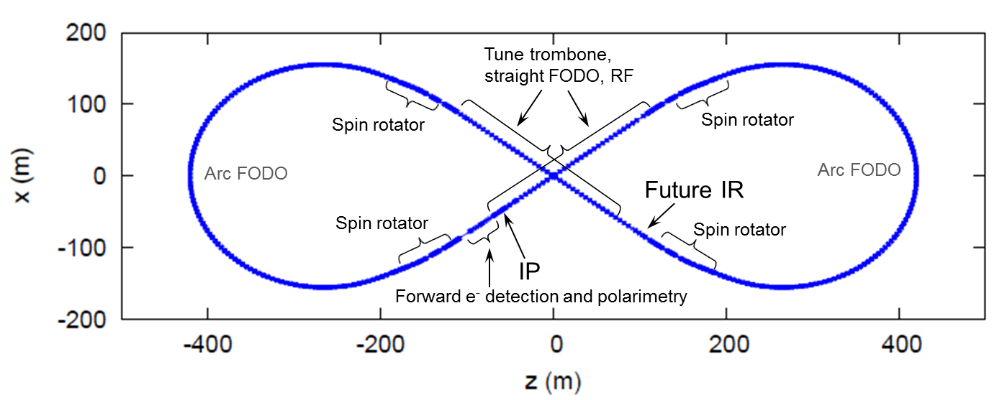
Electron collider ring optics
Lattice version V16.2_V2.4, includes spin rotators and vertical dogleg, detector solenoid is not included
C = 2256.6145 m, Q_{xy} = 57.22 / 50.16, β* = 10 / 2 cm, β_{max} = 487 / 438 m, ε_{x} = 4.6 nm-rad @ 5 GeV
Global chromatic compensation scheme, no local system for FFQ non-linear chromaticity correction
IP

Slide 4
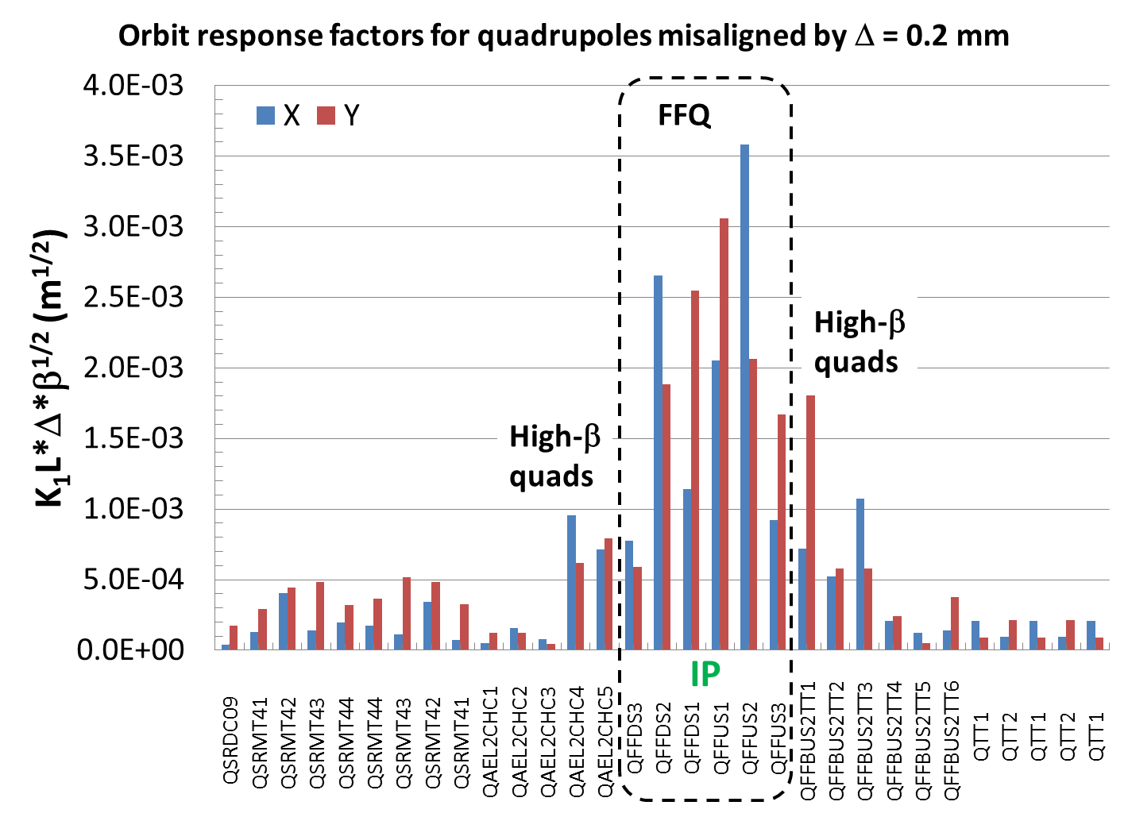
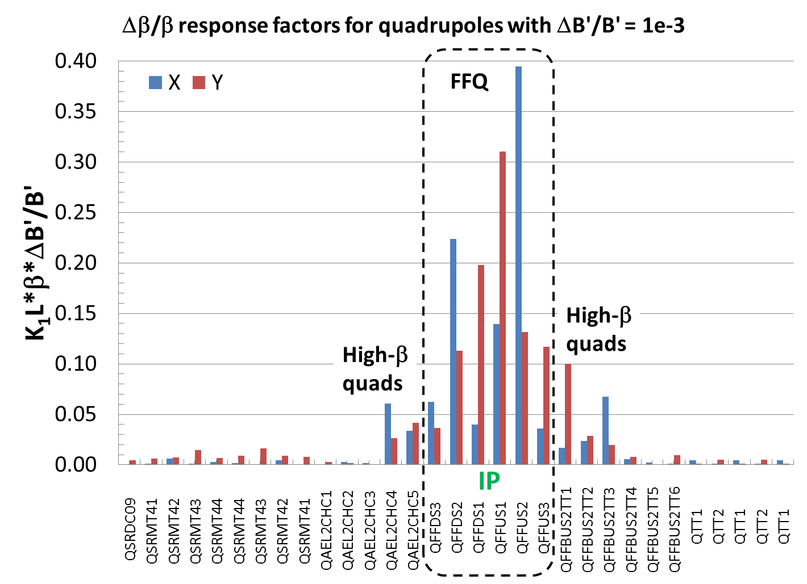
Magnet errors and sensitivity
Magnet X, Y offsets and roll angle → orbit, dispersion (rolled bends, offset quads); coupling (rolled quads, offset sextupoles); focusing (offset sextupoles)
Magnet strength errors → orbit, dispersion (bends); focusing (quads); chromaticity (quads, sextupoles)
Non-linear field errors → non-linear resonance effects, dynamic aperture
Highest optics sensitivity to errors in the strong FFQ magnets where beta functions are very high
Orbit response due to quad offsets near IP
Δβ/β response due to quad strength error near IP

Slide 5
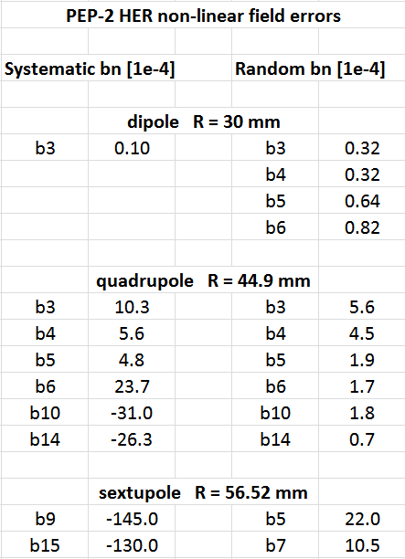
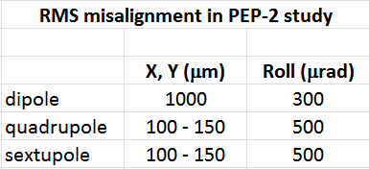
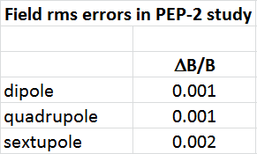
Reference errors
Errors in the study are based on the PEP-2 HER study and measured non-linear field errors of main PEP-2 magnets
Alignment errors are varied to find conservatively acceptable values
Magnet strength errors are identical to the ones used in PEP-2 design study, except the Final Focus Quads (FFQ)
Non-linear field errors are the same as the PEP-2 measured field errors (or scaled)
Non-linear field skew components are not included (no PEP-2 data)

Slide 6
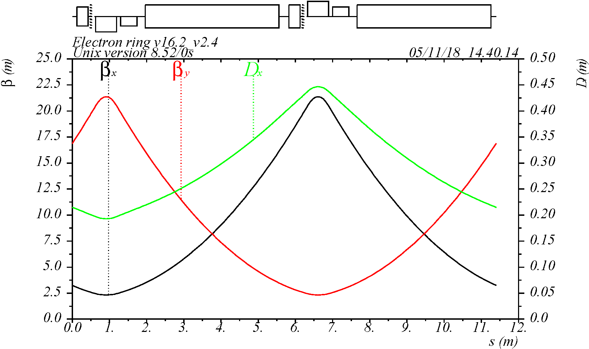
Design of orbit correction scheme
Horizontal and vertical orbit correctors and double-view BPMs placed next to most of the quadrupoles
Each corrector is 30 cm long and BPM is 5 cm long
Corrector system is optimized to have sufficient phase advance between consecutive correctors
Present scheme: total 213 horizontal correctors, 191 vertical correctors and 474 double-view BPMs
M
M
Y
QD
SD
B
X
QF
SF
B
One arc cell
QF, QD – quads
SF, SD – sext’s
B - dipole
M – monitor
X – corrector
Y – corrector

Slide 7
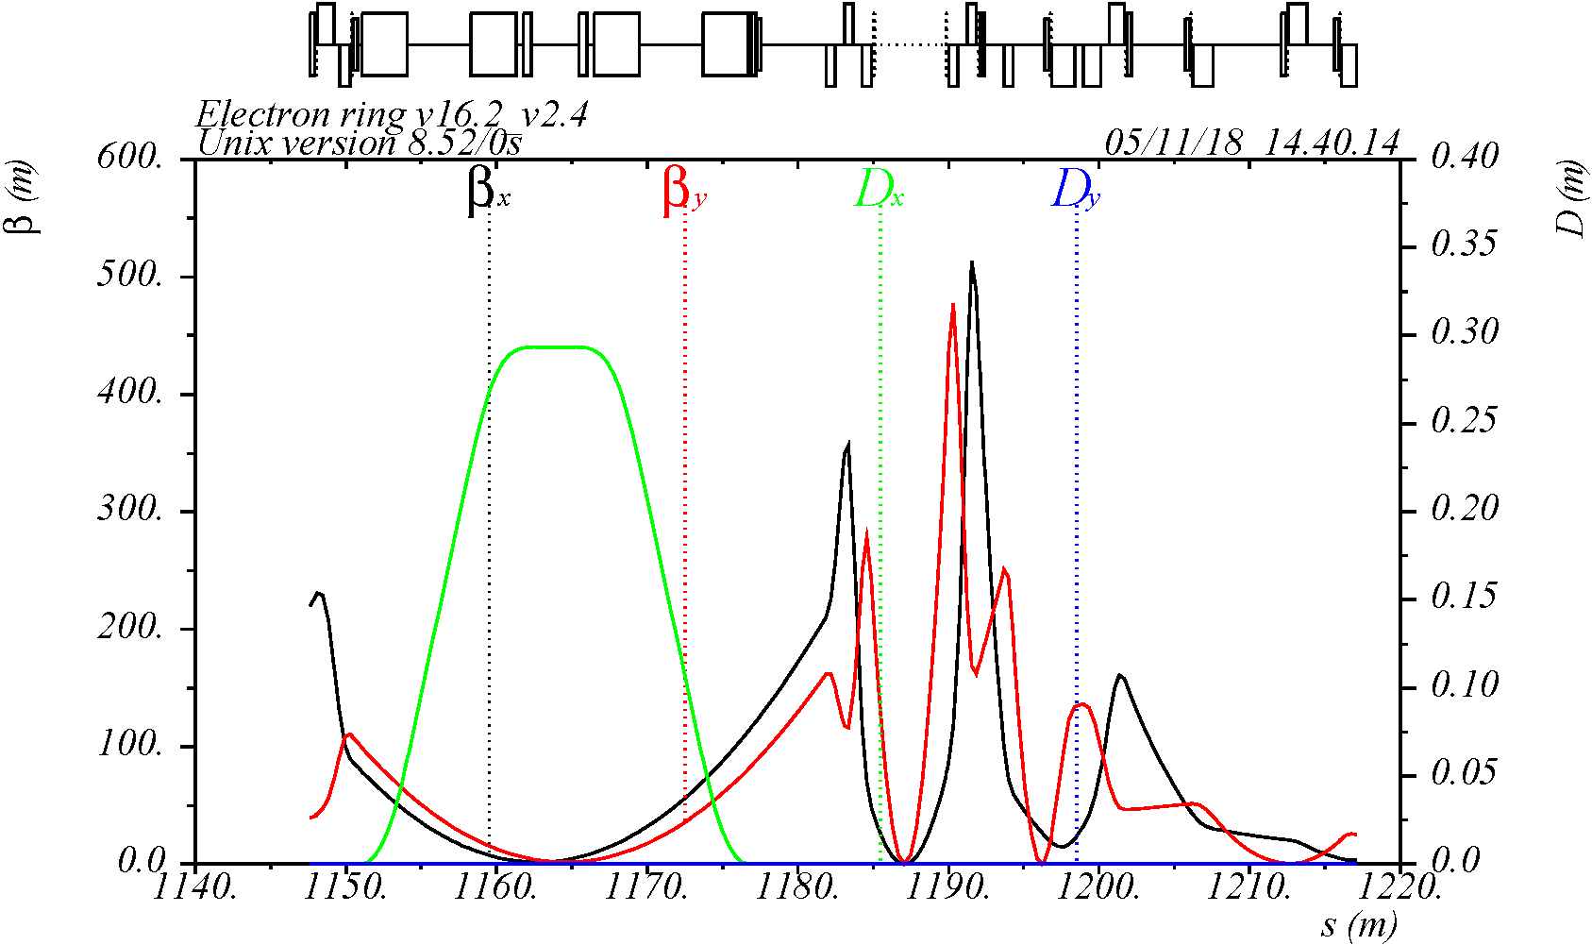
Orbit correctors and BPMs in the IR
X
Y
X,Y
X,Y
X
Y
Y
X
Y
X
Y
X
Y
M
M
M
M
M
M
M
M
M
M
M
M
M
M
M
IP
Provide enough correctors & BPMs in the FFQ area
The present spacing between the FFQ magnets may need to be increased for practical implementation of the correctors

Slide 8
Tracking simulations with LEGO
Simulations include generation of random errors (±3σ), corrections, dynamic aperture (DA) calculation
Synchrotron oscillations and higher order fringe field effects are included
Corrections in the simulations
Betatron tune (using 2-family arc quads)
Linear chromaticity (2-family arc sextupoles)
Global orbit (BPMs and X-Y dipole correctors)
Vertical dispersion (Y dipole correctors)
Beta functions (quads)
Global coupling (sextupole vertical offsets)
SVD method is used for orbit, dispersion, coupling and beta function corrections to find most efficient correctors (this may differ from what will be eventually used in the machine)
The applied errors in the simulations are increased gradually, in small steps, while doing correction at each step to avoid optical instability if errors are too large
Dynamic aperture at 5 GeV for 2000 to 10000 turns and 10 seeds of random errors
Chromaticity = +1
Emittance = 4.6 nm (X), 0.92 nm (Y) at 5 GeV (assuming 5:1 coupling ratio)

Slide 9
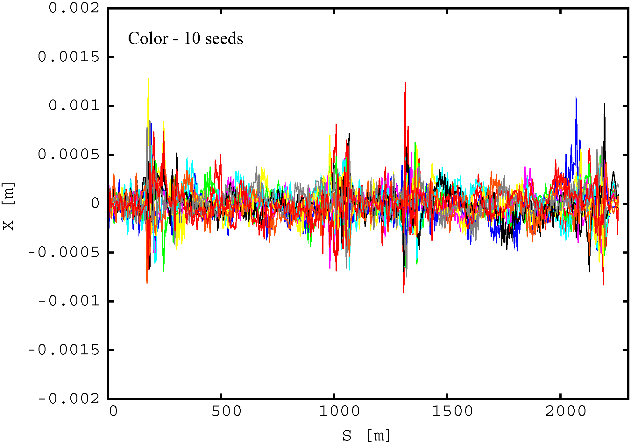
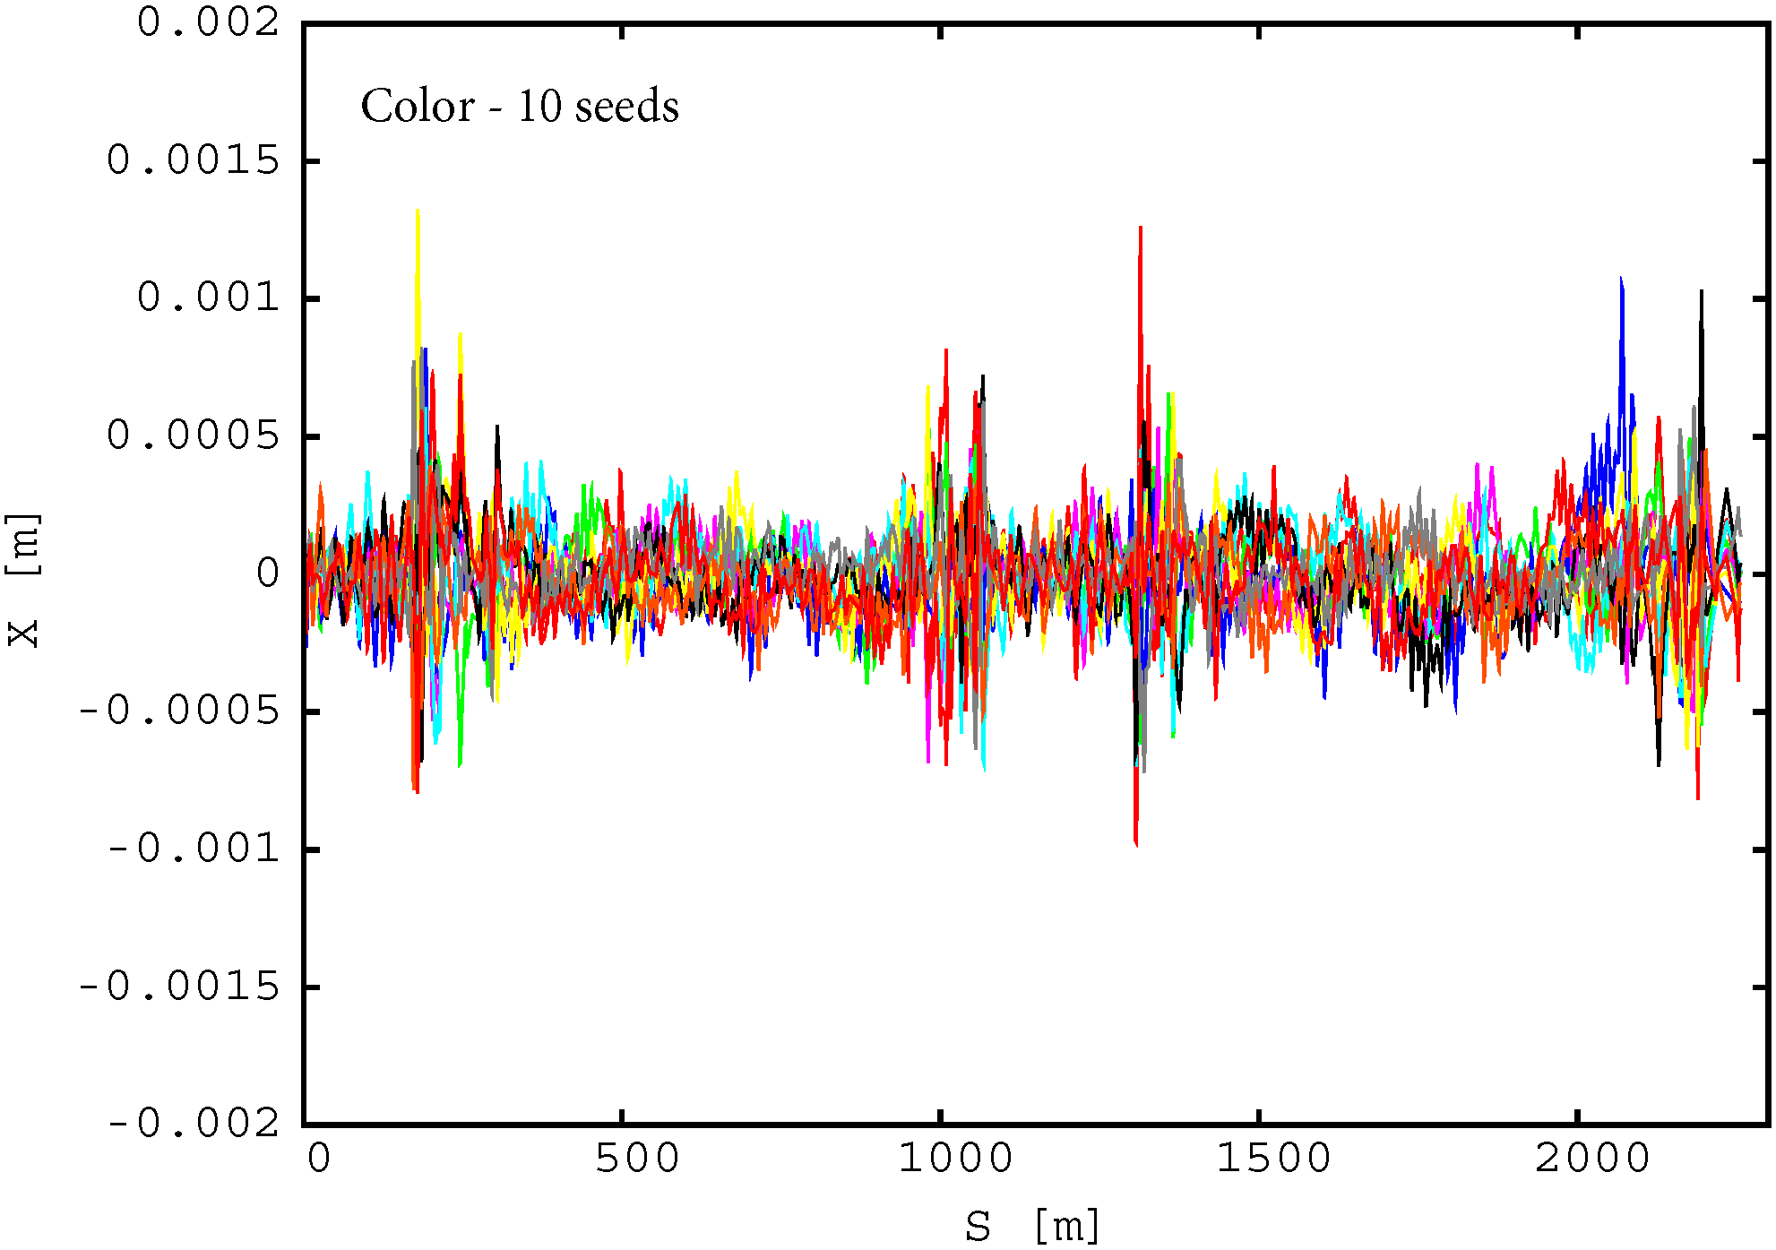
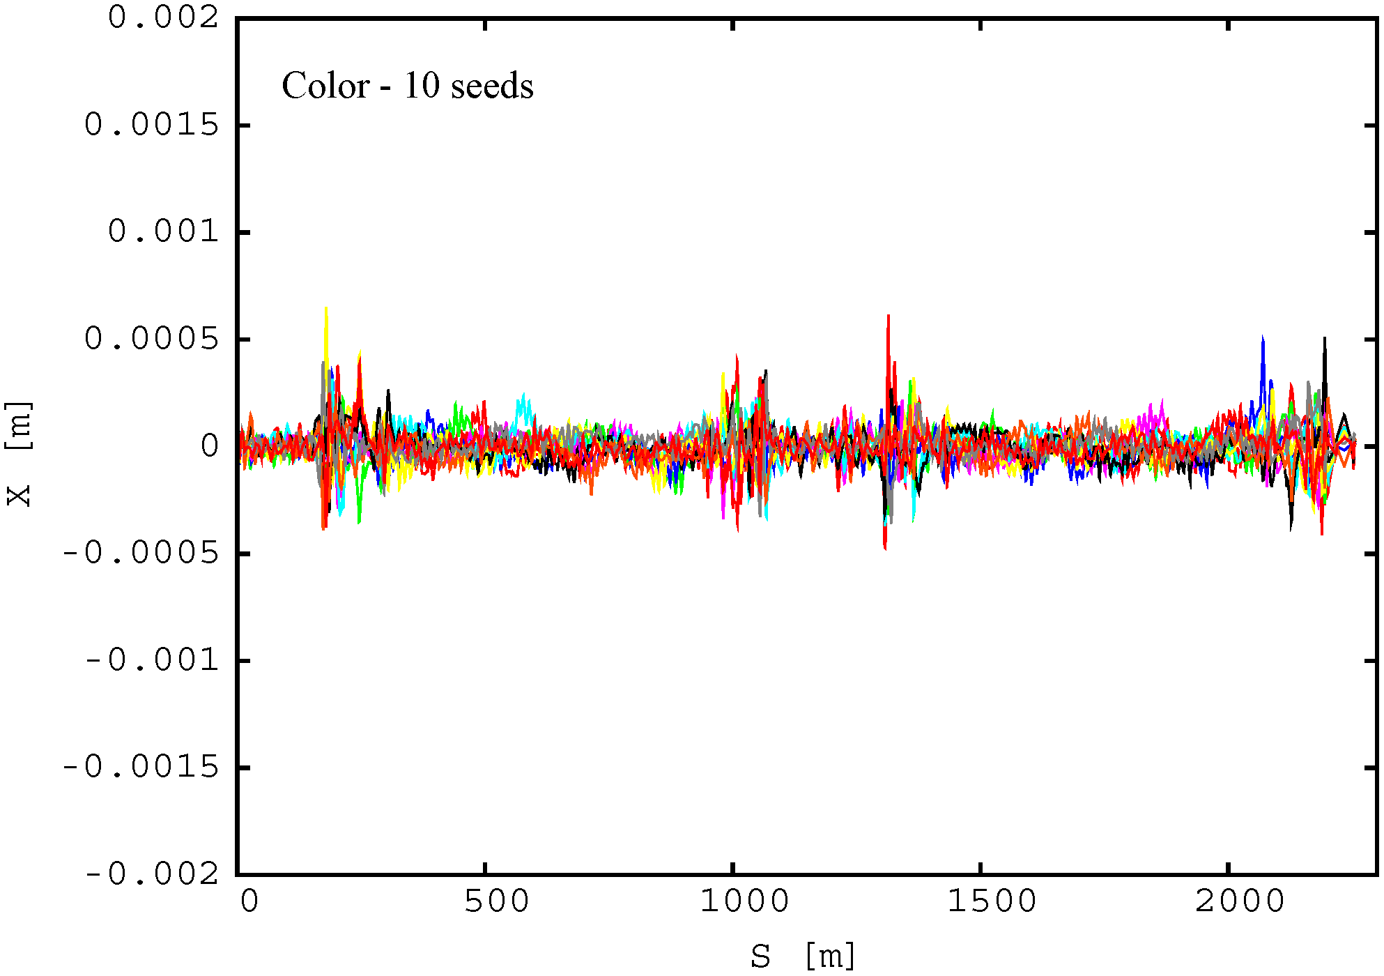
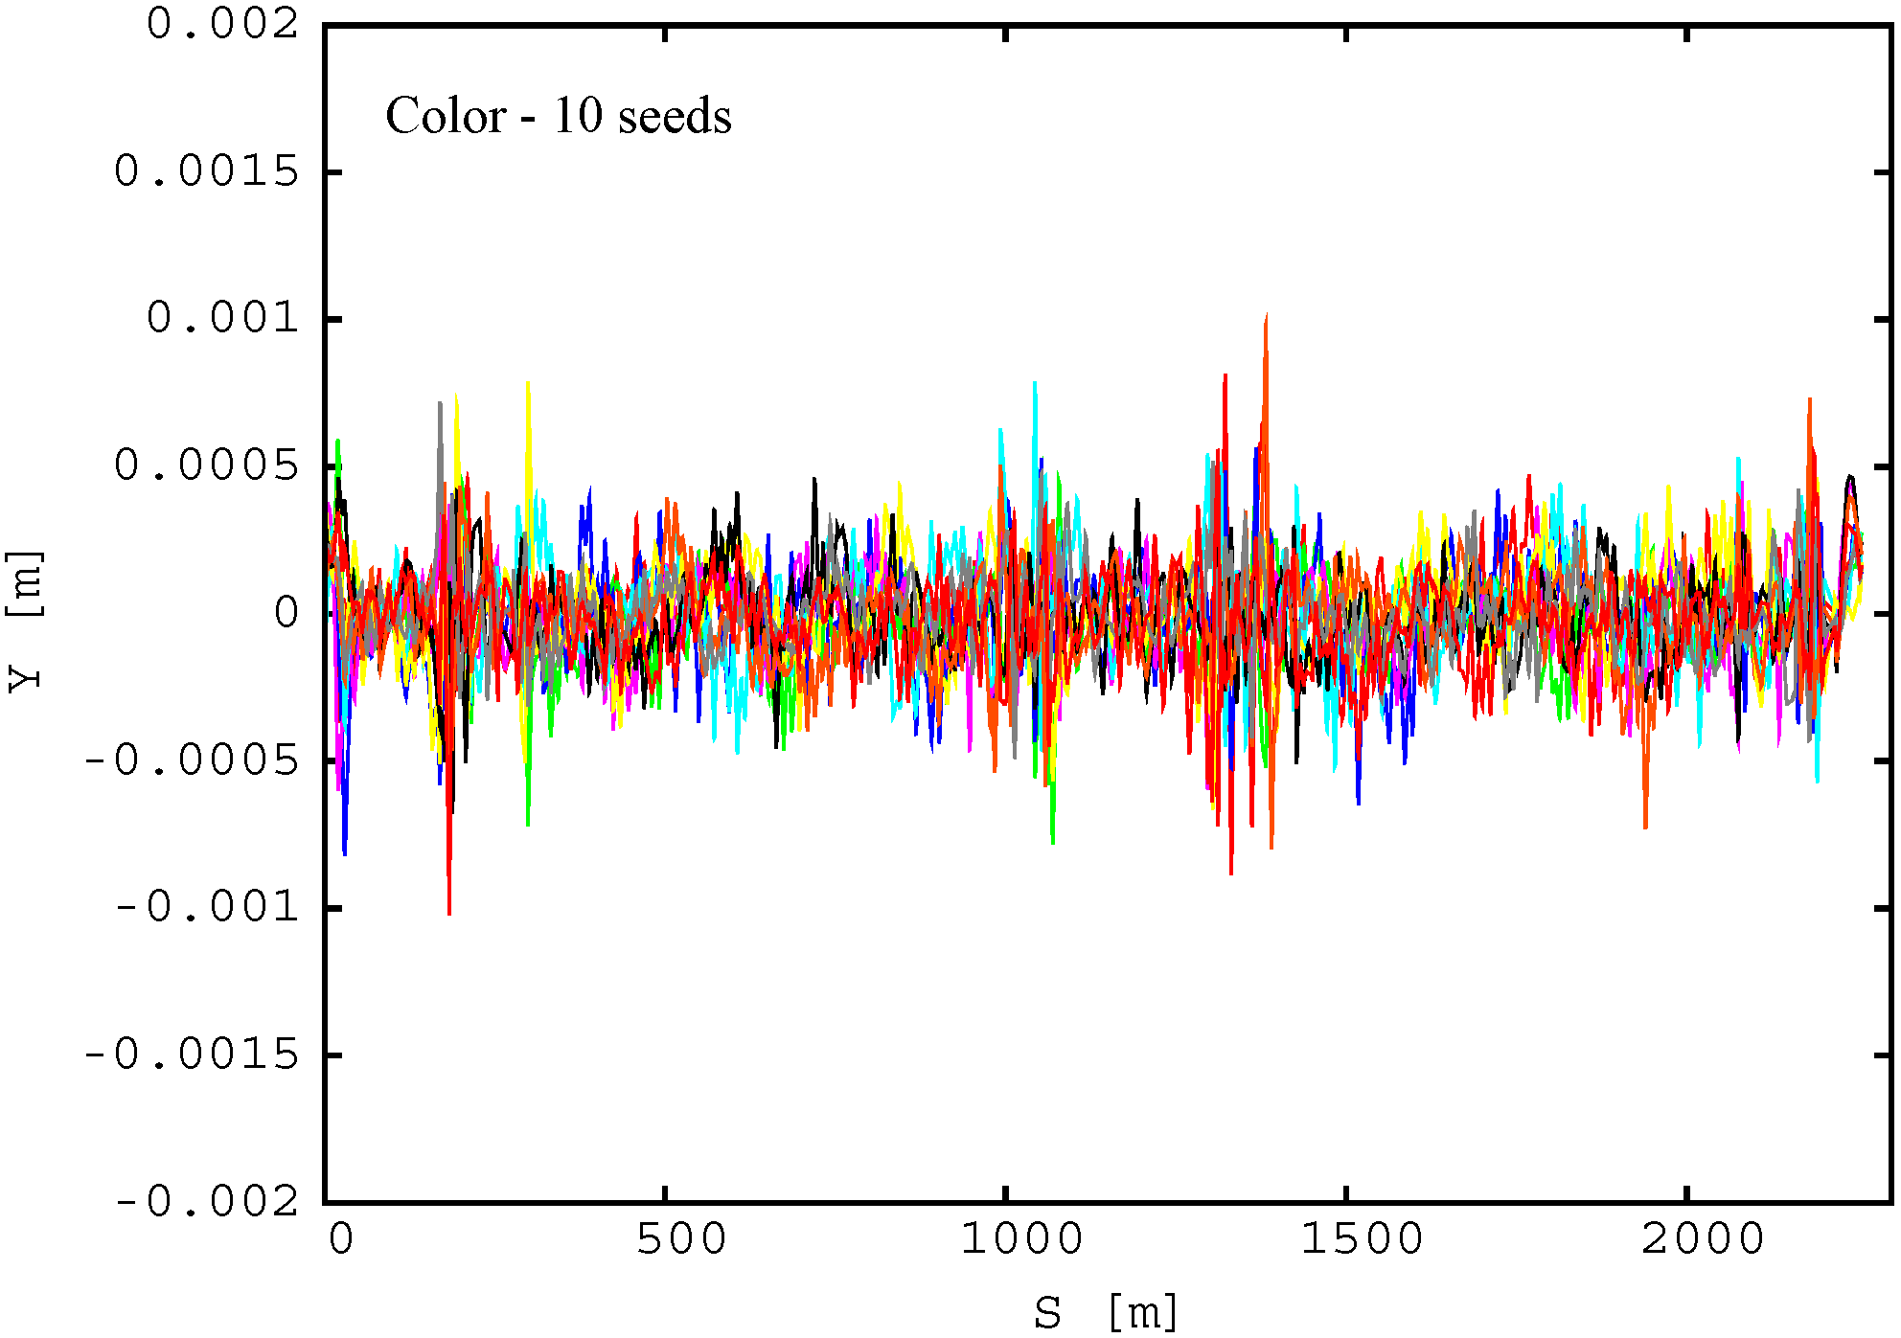
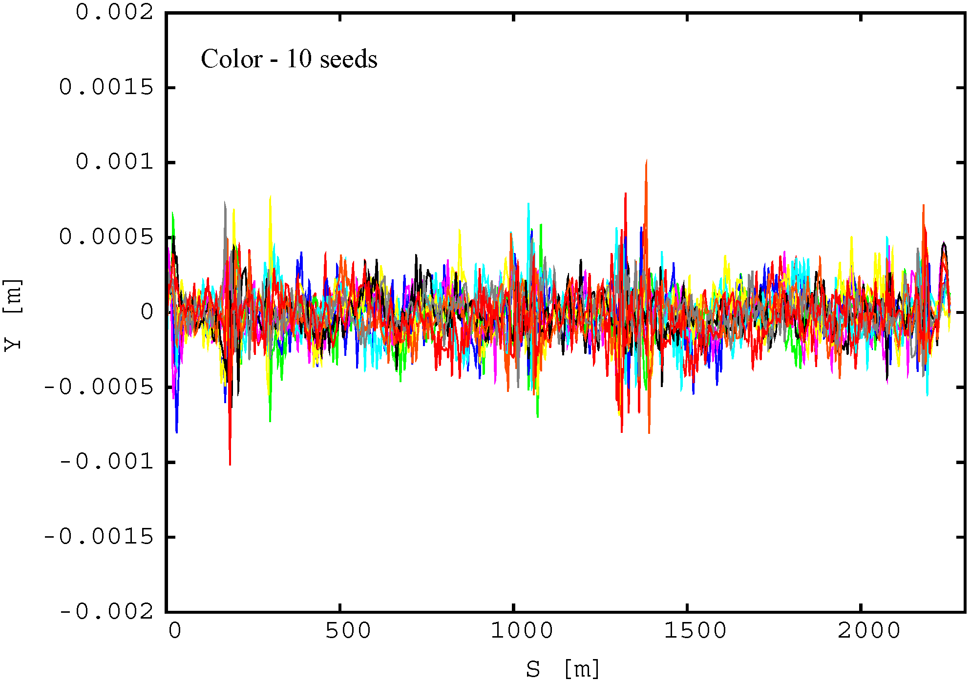
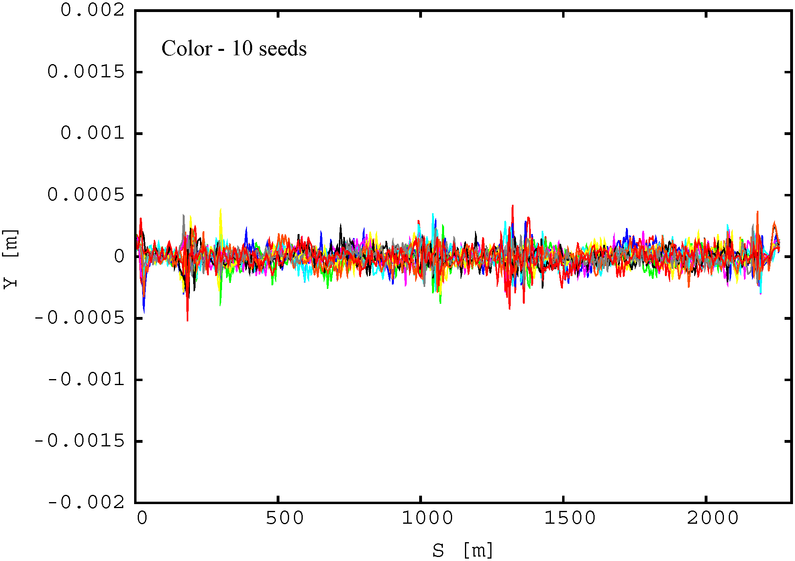
Example of orbit after correction vs misalignment
rms error X,Y (μm) / roll (μr) 200 / 500 200 / 500, FFQ 100 / 300 100 / 300
average rms orbit (μm) 168 167 81
X
IP @ S=0
Y

Slide 10
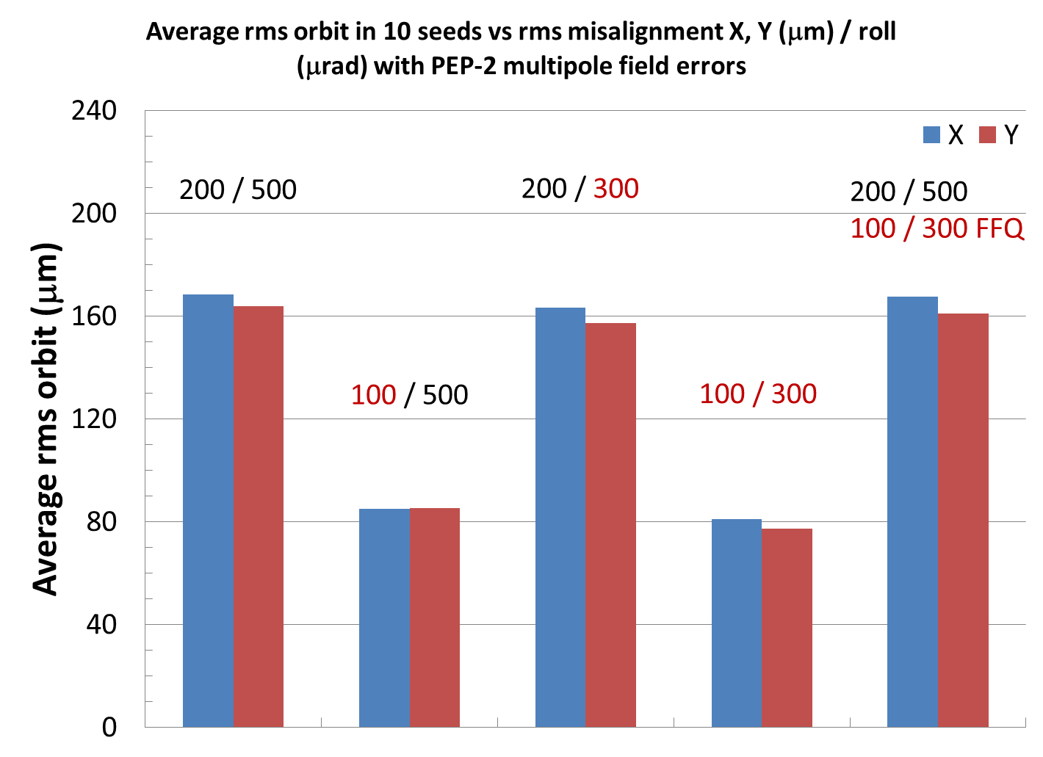
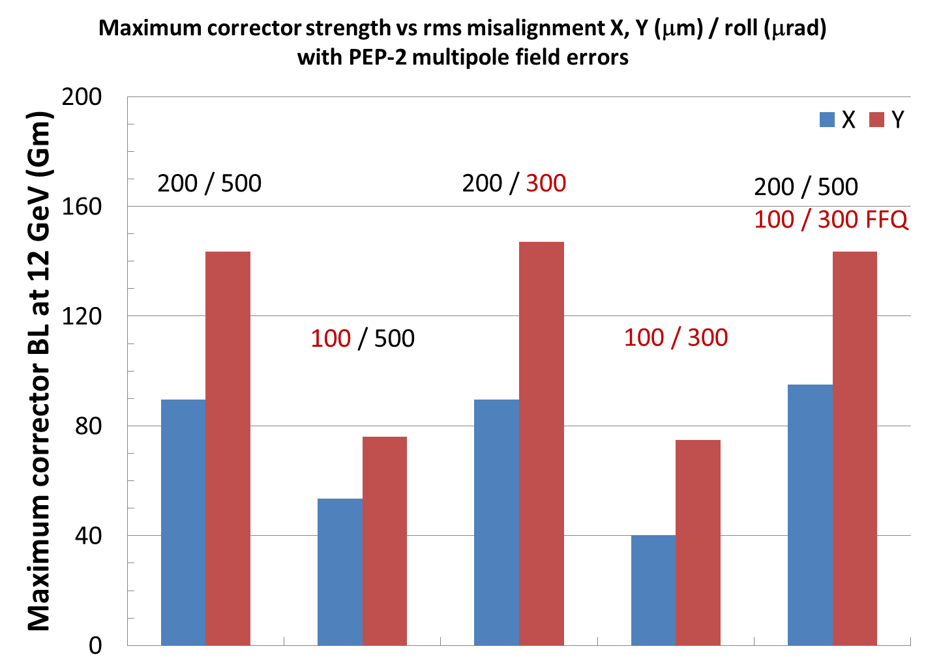
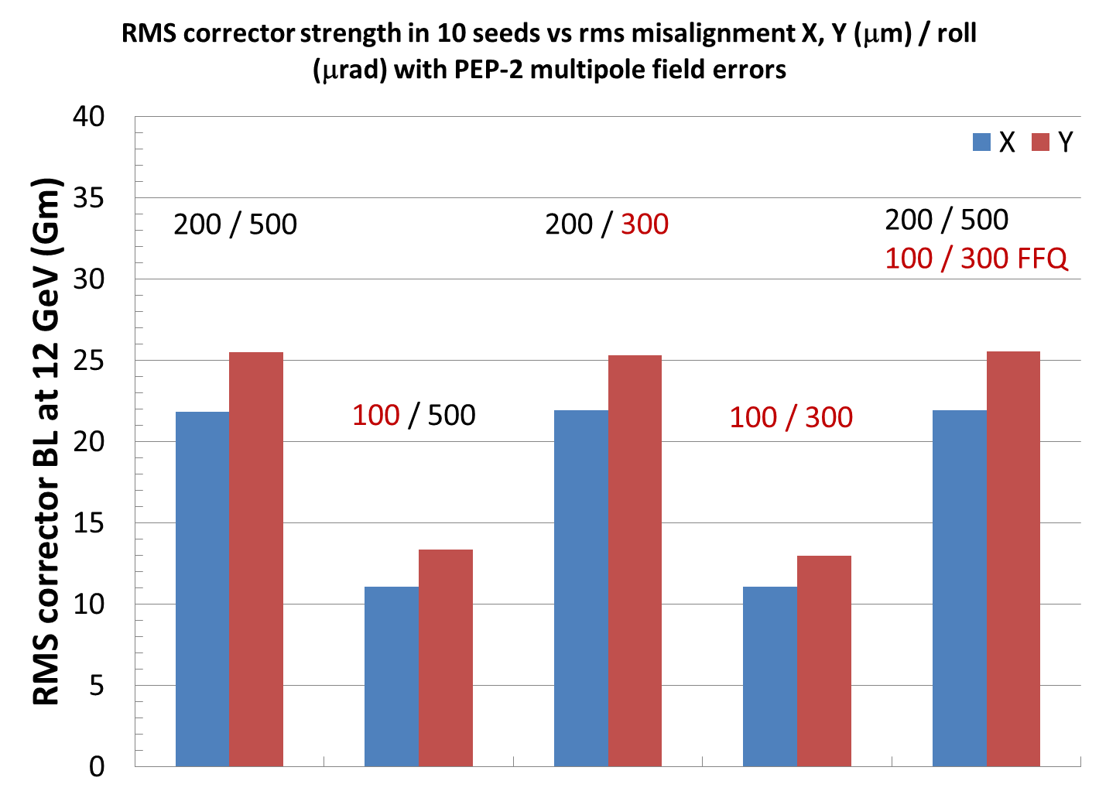
Orbit and corrector strength vs misalignment
We start with errors comparable or slightly larger than in PEP-2 study and compare to smaller errors
Orbit and corrector strengths are linearly reduced with smaller magnet X, Y offset errors
No significant improvement from smaller roll angle errors
Minor impact of a factor of 2 reduction of FFQ misalignment on global orbit and corrector strengths
Only minor improvement of DA with a smaller misalignment
Therefore, we proceed with a conservative misalignment of: rms X, Y = 0.2 mm, roll = 0.5 mrad
Average rms orbit
Maximum corrector BL @ 12 GeV
RMS corrector BL @ 12 GeV

Slide 11
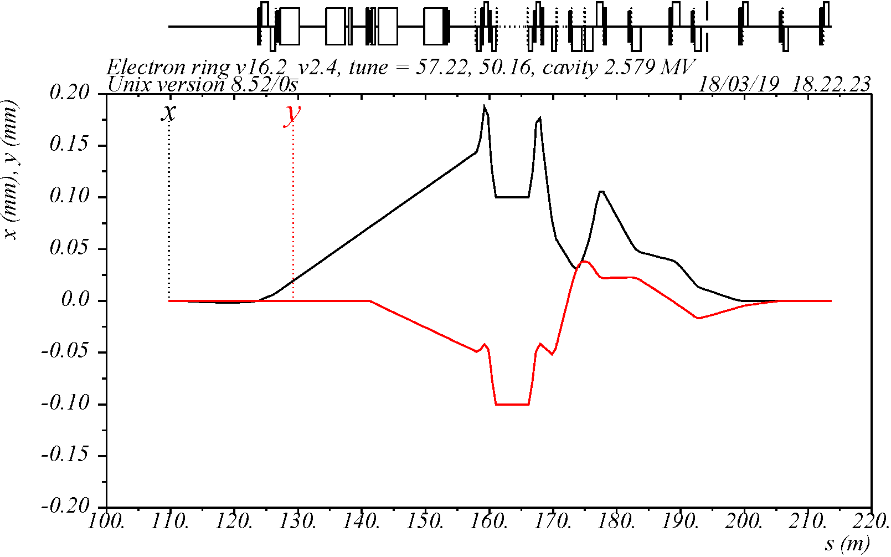
Correction of orbit at IP
IP orbit is not specifically corrected by the global orbit correction because there is no IP BPM
The residual IP orbit is in the range from 0 to 250 μm for different seeds
To correct the IP X, X′, Y, Y′, a local IP orbit correction would be more efficient than the global correction
A complete local system requires two X and two Y correctors on each side of IP (at ~90° and ~180°)
X
Y
X,Y
Y,X
X
Y
Example of local correctors creating ±100 μm X, Y offsets at IP using a closed orbit bump
The local corrector strengths are in the same range with the global corrector strengths
The local system is not used in these simulations
IP

Slide 12
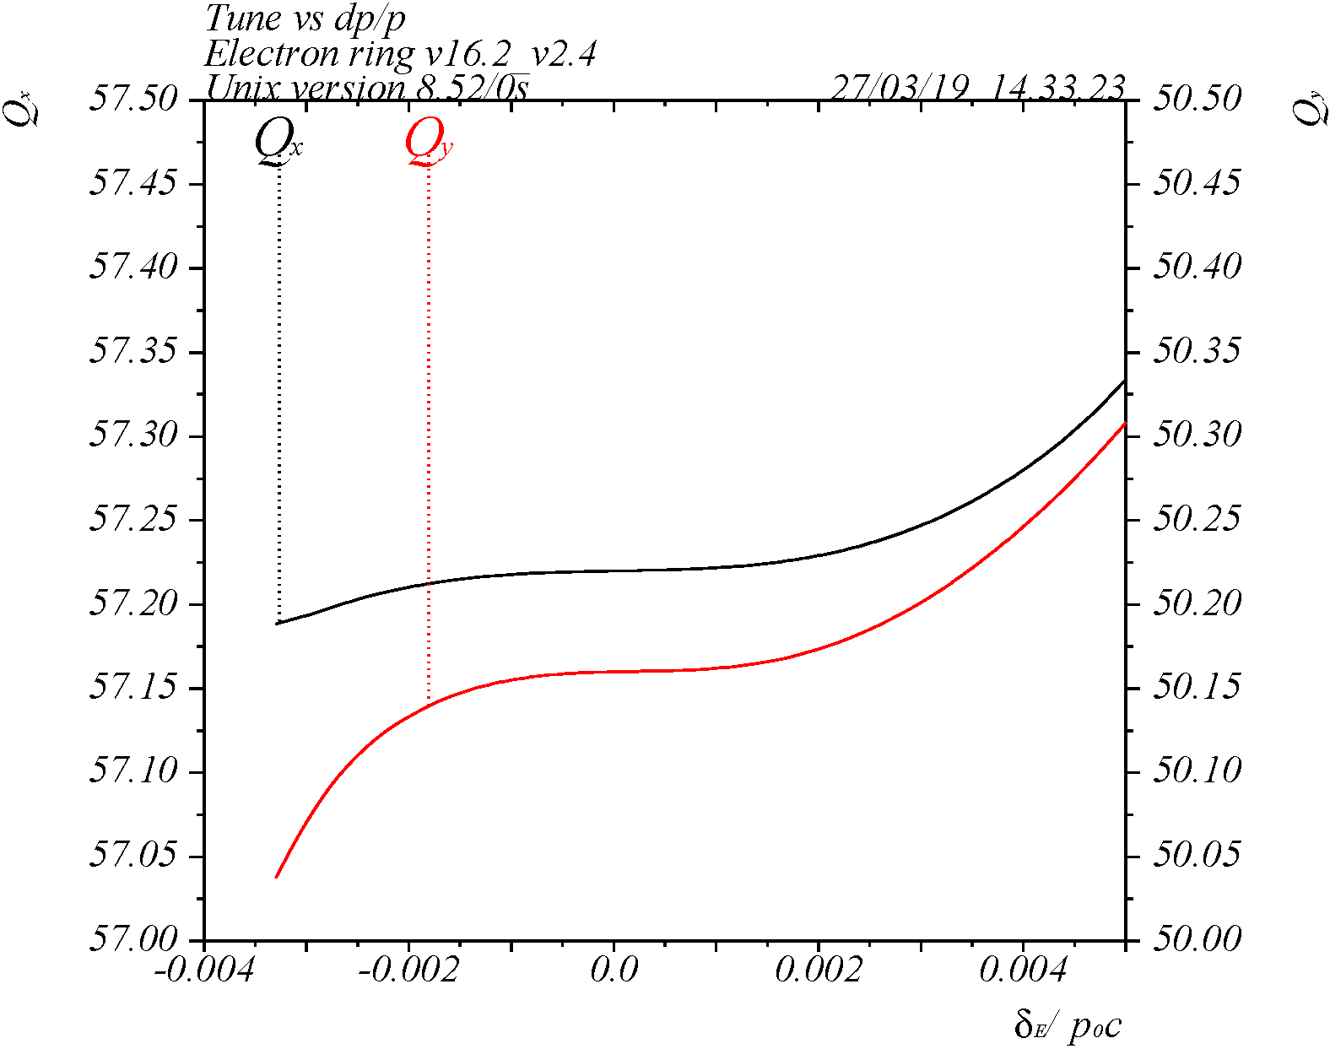
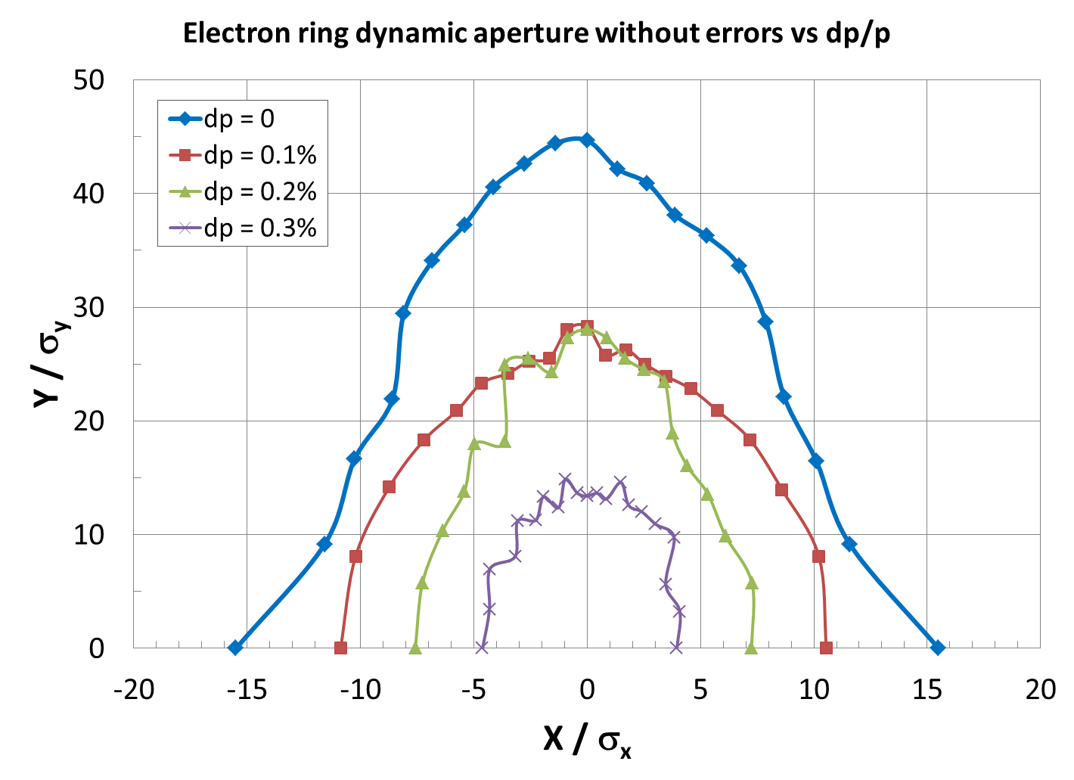
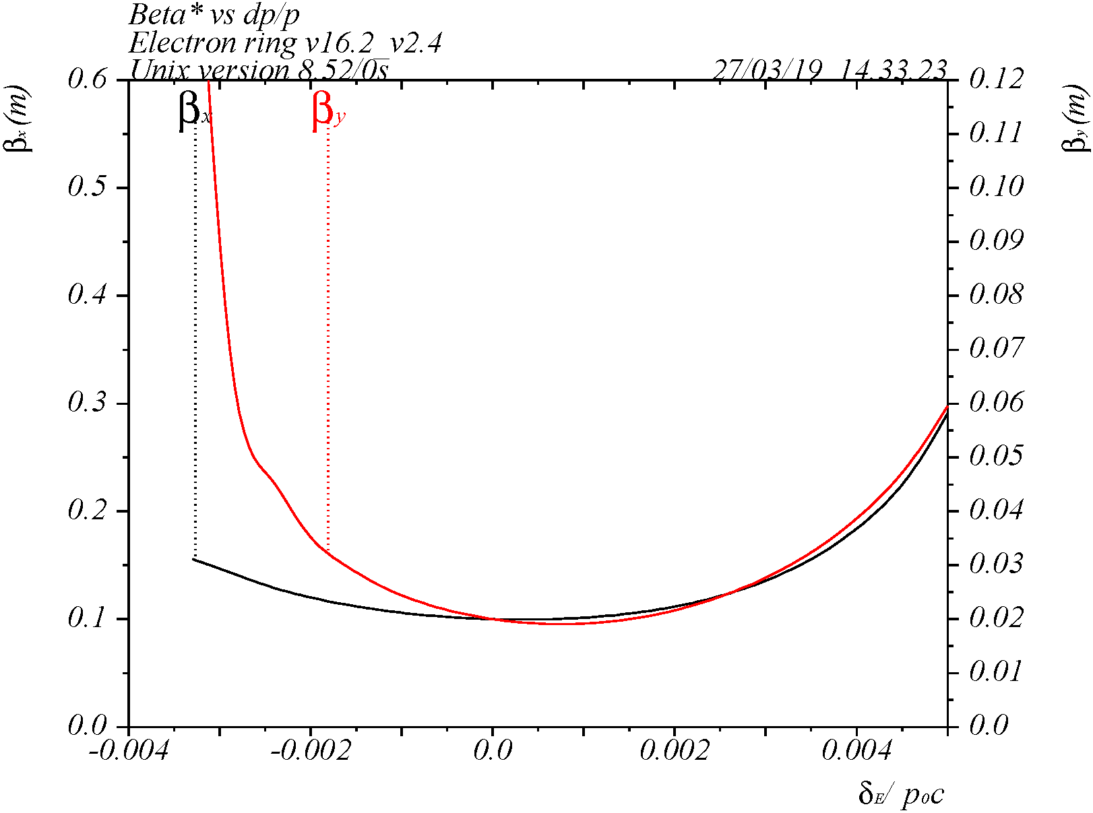
DA at 5 GeV without magnet errors
Sufficiently large on-momentum DA of 15σ_{x} x 45σ_{y} (sigma determined by emittance = 4.6 x 0.92 nm-rad)
Off-momentum range is about 8σ_{p} (σ_{p} = 4.6e-4), which may be sufficient; it is limited since only linear chromaticity correction is included (no space for FFQ non-linear correction)
Q_{x,y} vs δ
β*_{x,y} vs δ

Slide 13
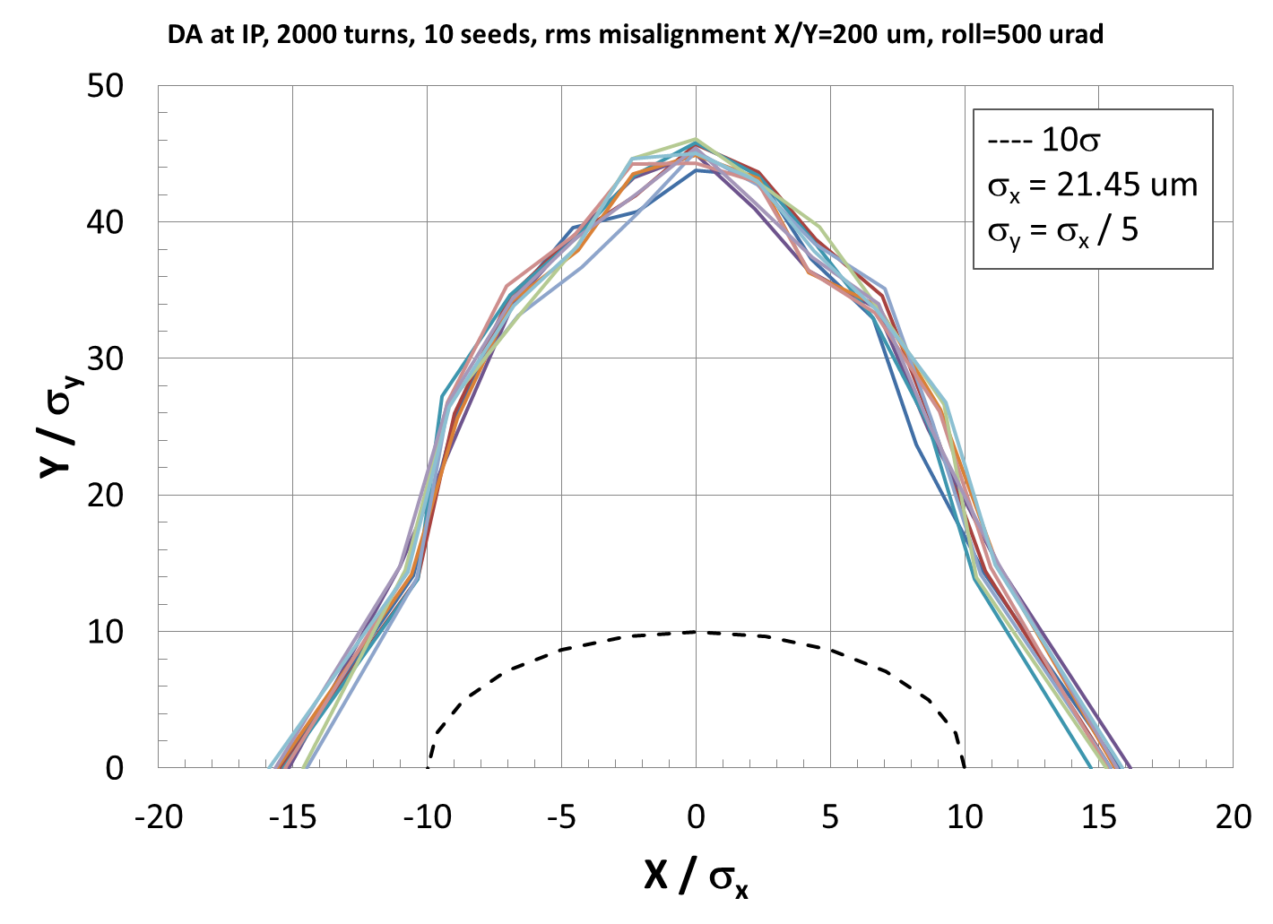
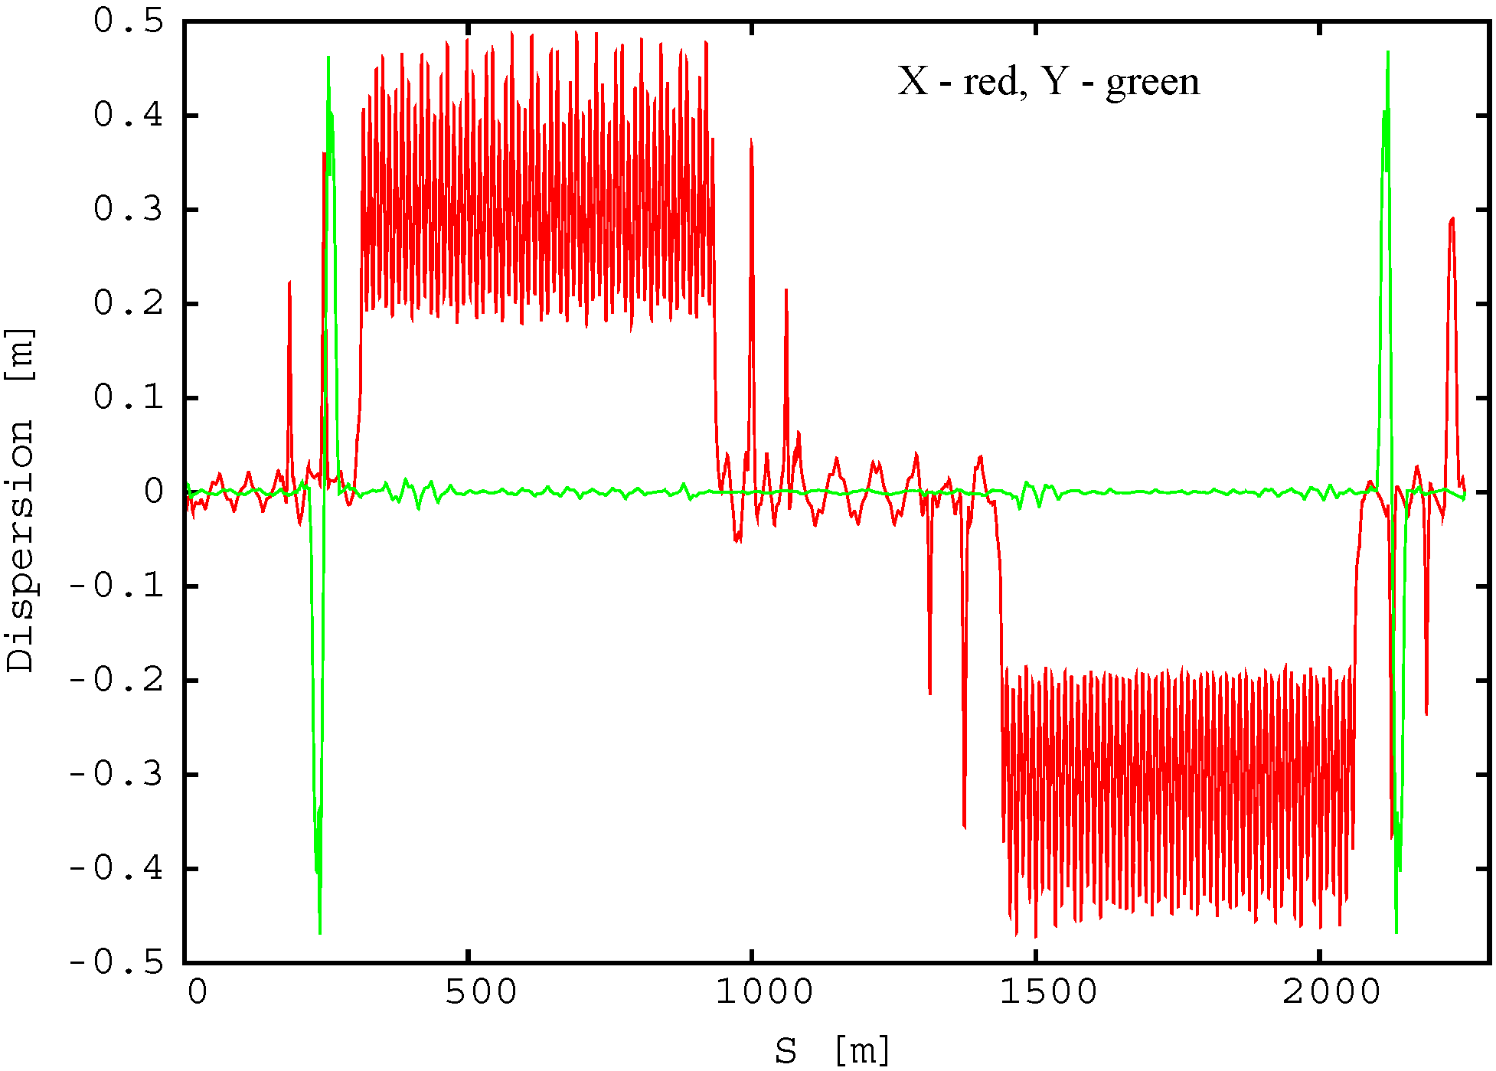
DA with misalignment and corrections
Conservative rms misalignment: X, Y = 0.2 mm, roll = 0.5 mrad in all magnets, generated within ±3σ
DA with misalignment and corrections is 14.5σ_{x} x 44σ_{y} – nearly the same as without errors
Dispersion, coupling and beta beat corrections are also included
In 10 seeds: rms orbit < 200 μm, rms Δβ < 3 m, Δβ*/β* < 3%, rms ΔD_{x} < 3 cm, rms ΔD_{y} < 5 mm
Example of dispersion after corrections
Well corrected vertical dispersion
Horizontal dispersion is not specifically corrected
IP

Slide 14
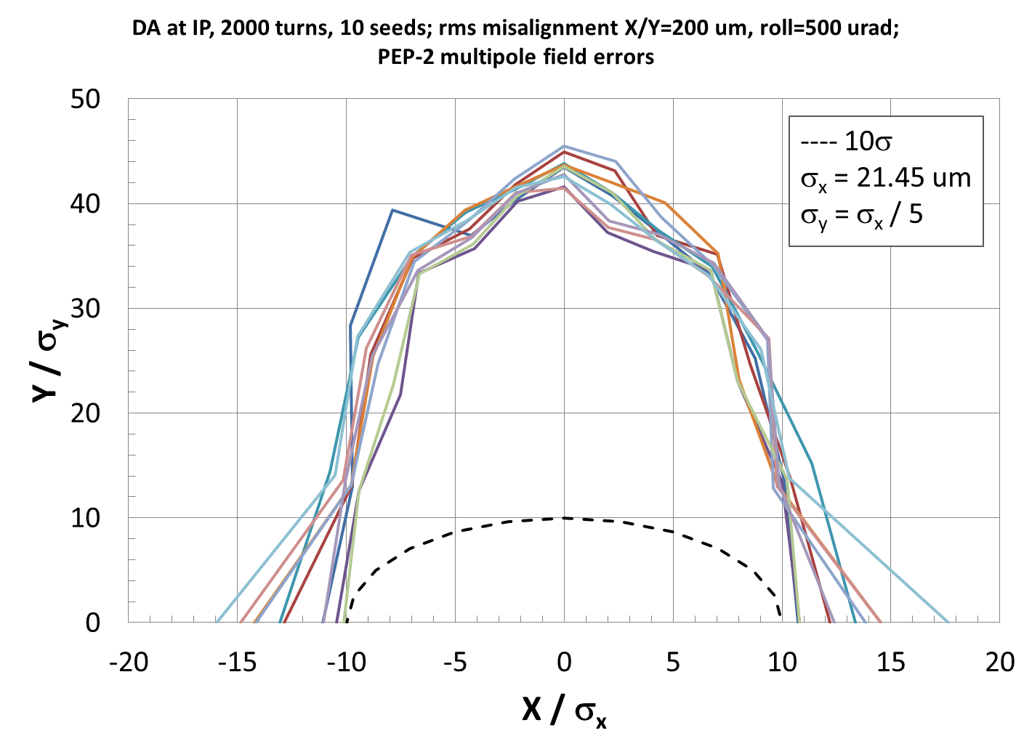
DA with misalignment and multipole field errors
RMS misalignment: X, Y = 0.2 mm, roll = 0.5 mrad in all magnets
PEP-2 measured normal multipole field errors are assigned to all magnets including FFQ
DA after corrections is 10.1σ_{x} x 41.5σ_{y} – about 4σ_{x} reduction relative to DA w/o multipoles
Still above 10σ

Slide 15
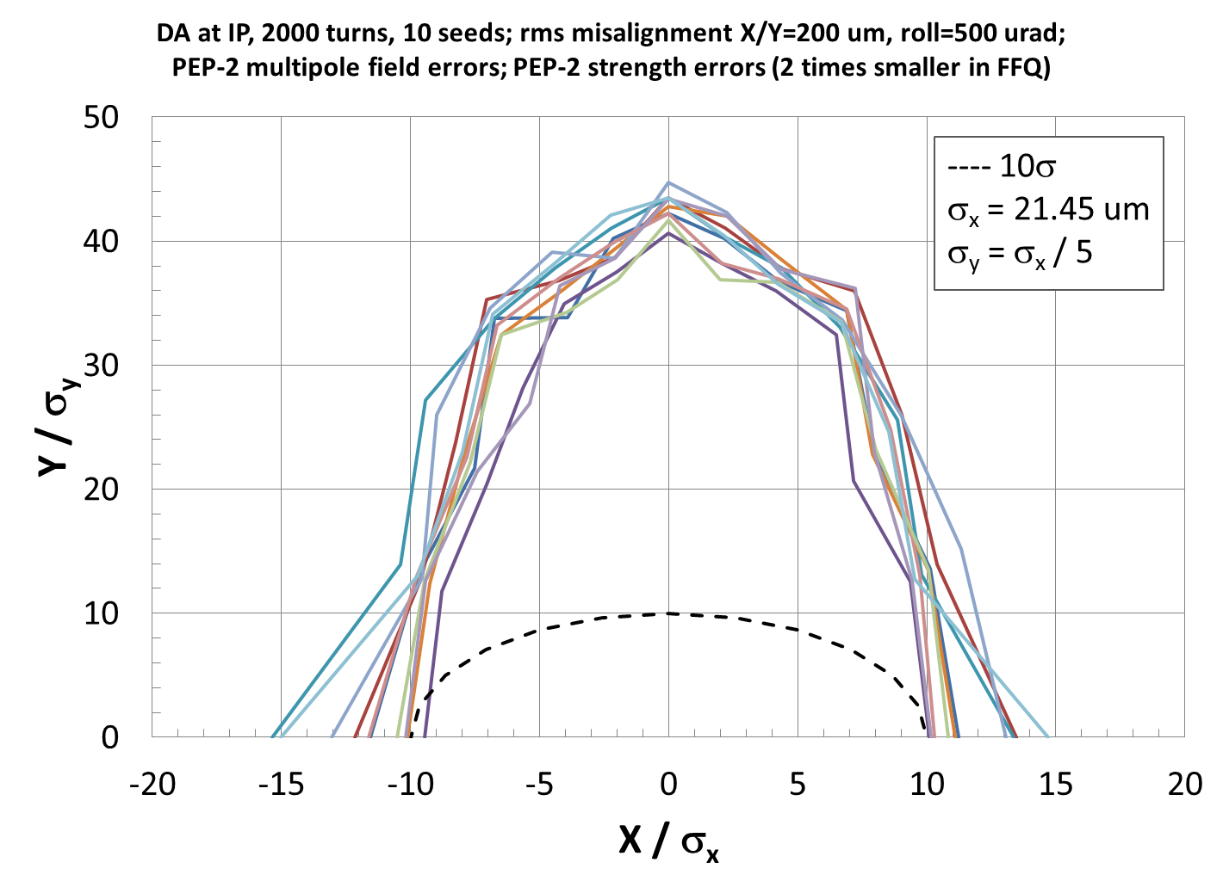
DA with misalignment, multipole and field strength errors
RMS misalignment: X, Y = 0.2 mm, roll = 0.5 mrad in all magnets
PEP-2 measured multipole field errors in all magnets
Magnet strength errors are based on PEP-2 design study: rms ΔB/B = 0.1% in dipoles & quadrupoles, 0.2% in sextupoles; except we use 0.05% in FFQ
DA after corrections is 9.4σ_{x} x 40.6σ_{y} – about 0.7σ_{x} reduction relative to DA w/o the strength errors
FFQ strength errors were studied in the range from 0.1% to 0.01%
At 0.1% FFQ rms errors, some seeds developed instability during the correction process
At 0.05% and lower errors, no instability
Since there is only minor DA improvement at less than 0.05% of FFQ error, we use the more conservative 0.05% value in this calculation

Slide 16
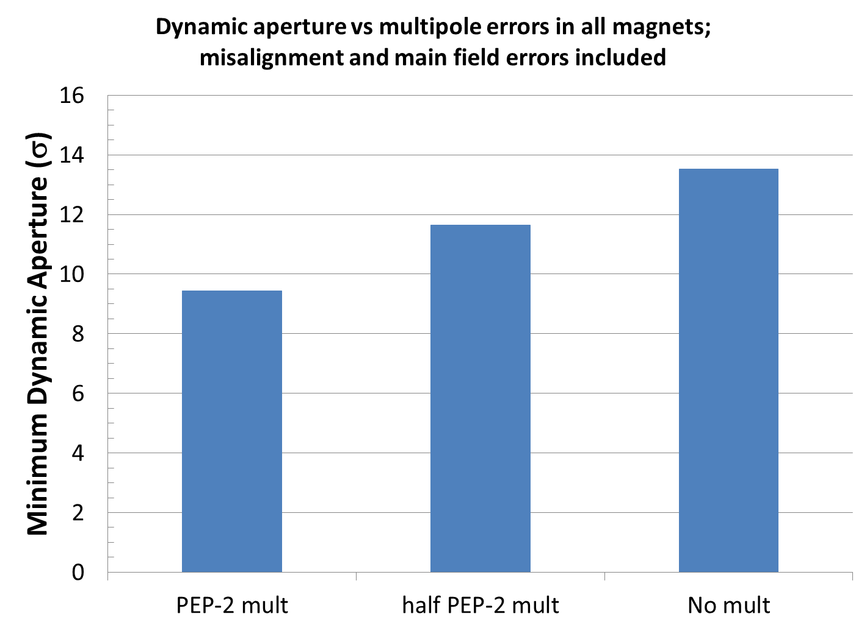
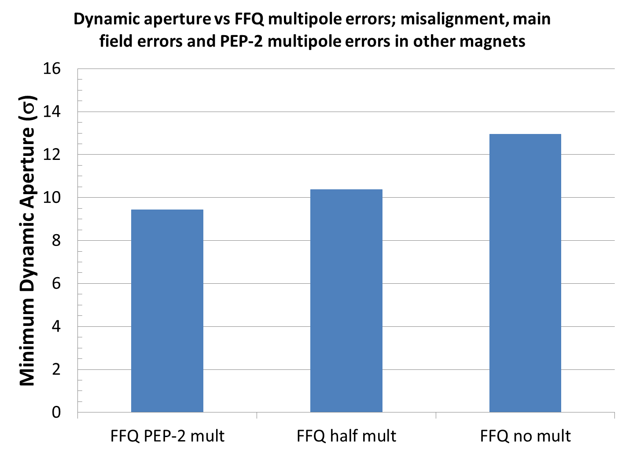
Possible DA improvement with a better multipole field quality
A factor of 2 reduction of PEP-2 multipole field in all magnets increases the DA by 2.2σ_{x} (11.6σ_{x} vs 9.4σ_{x})
A factor of 2 reduction of PEP-2 multipole field in FFQ (only) increases the DA by ~1σ_{x} (10.4σ_{x} vs 9.4σ_{x})
Better DA improvement if FFQ multipoles are reduced more
Further optimization of the FFQ field quality should be performed for maximum DA
All magnets: 1) PEP-2 mult, 2) half PEP-2 mult, 3) no mult
FFQ only: 1) PEP-2 mult, 2) half PEP-2 mult, 3) no mult

Slide 17
Conclusion
Orbit correction system is designed for the electron collider ring
Tracking simulations using LEGO are performed including alignment errors, magnet strength errors, non-linear field errors, and the corresponding corrections
Conservative alignment and field strength errors are used
If smaller errors are achievable, this would reduce the corrector strength budget and improve the DA
PEP-2 HER measured multipole field errors are used, which is especially relevant if the PEP-2 magnets will be re-used in the electron ring
Minimum DA in 10 seeds with the errors and corrections at 5 GeV is ~9.4σ, which may be acceptable
The DA may be improved with optimization of the FFQ field quality and the betatron tune
This project study will continue; the future work will include:
Similar study for the ion ring, as well as update for the new version of electron ring
More detailed study of FFQ multipole field tolerances
FFQ multipole field correction and simulations
Study of FFQ end fields

Slide 18
Thank you for your attention!

