Slide 1

EIC Perspectives from the User Community
Charles Hyde*
Old Dominion University
Norfolk VA
*Vice-Chair of the Electron Ion Collider Users Group Steering Committee www.eicug.org

Slide 2
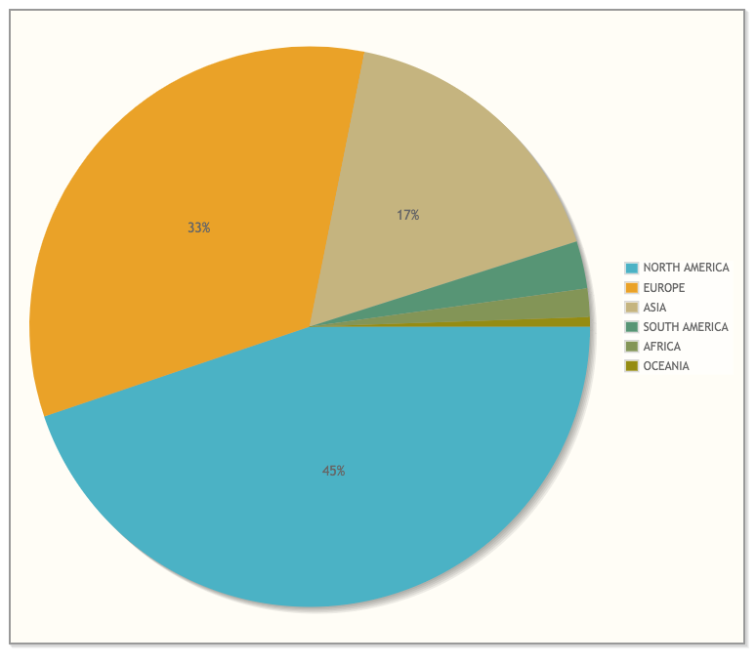
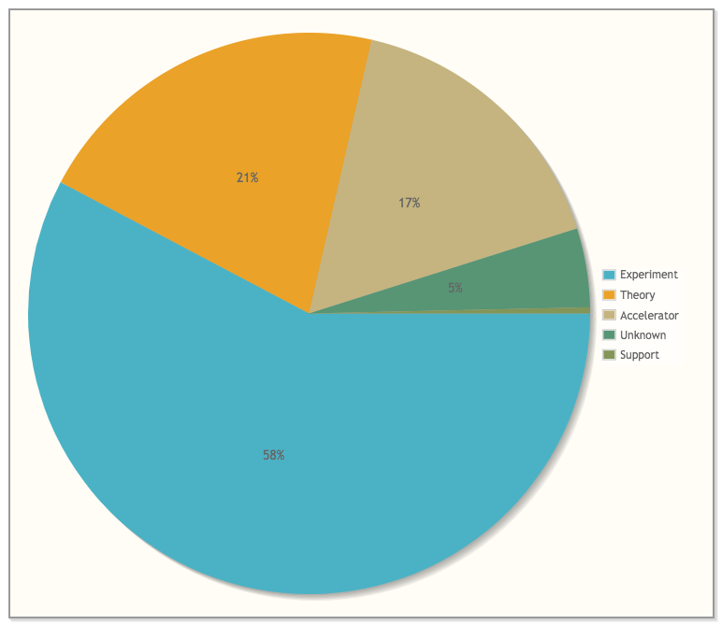
EIC Users Group
Institutions
Asia
860 Members
180 Institutions
30 Countries
Europe
Specialty
North America
Theory
Accelerator
• New Members welcome, especially in Accelerator!
Experiment

Slide 3
EICUG Annual Meetings
2019: Paris, France
2018: Washington D.C. (CUA)
2017: Trieste, Italy
2016: Berkeley CA & Argonne National Lab
…Earlier pre EICUG meetings Stony Brook, Hampton, MIT, …

Slide 4
EICUG Quarterly Remote Meetings
Videoconferences
  2018 Oct 4
  2019 Jan 10
    evernote-EICUG-Remote-10Jan2019
  2019 April 4, 10:00 am – 12:00 pm EDT
  https://bluejeans.com/805461005?src=join_info
  Meeting ID: 805 461 005

Slide 5
EICUG Steering Committee
Weekly Meetings: Thursdays 10:00 am Eastern Time https://bluejeans.com/459466561
Officers
  Bernd Surrow (Chair)
  Charles Hyde (Vice Chair)
At-Large
  Marco Radici
  John Arrington
European Regional representative
  Daniel Boer
International representative
  Yuji Gota
Ex-Officio
  Christine Aidala (IB Chair)
Laboratory Representatitves
  Thomas Ullrich (BNL)
  Rikotura Yoshida (JLab)

Slide 6
EICUG Institutional Board
One member per institution
  Chair: Christine Aidala (Univ. Michigan)
  Vice-Chair: Andrea Bressan (INFN Trieste)
Quarterly Meetings
  14 March 2019
    https://agenda.infn.it/event/18674/
    Call for proposals to host 2020 (U.S.) and 2021 (Global) Annual Meetings
  Next meeting at EICUG Annual Meeting in Paris

Slide 7
EICUG Working Groups: I
Software WG
  Markus Diefenthaler (JLab), David Blyth (ANL) conveners.
    D. Blyth resigned from ANL and from EIC work, searching for new converer
  Monthly Video Conference meetings
  02/14/2019 Status of documentation and tutorials, website
  03/07/2019 Summary of MCEG workshop, status of MCEG containerization
    https://docs.google.com/presentation/d/1HWf26-xwdnGAfek1Se1yc9QWMwkmqUwiU_Cs4QSORaQ/edit#slide=id.g4c47d0781b_0_1
  04/11/2019 Update on community reference reconstruction
  05/20/2019 In-person meeting in Trieste Italy
  Mailing list eicug-software@eicug.org (Google Group)
  Website https://eic.gitlab.io

Slide 8
EICUG Working Groups: II
Polarimetry WG
  David Gaskell (JLab), Elke Aschenauer (BNL), convenors.
  29 March 2019: https://indico.bnl.gov/event/5902/
Interaction Region WG
  Charles Hyde (ODU), Alex Kiselev (BNL), Christophe Montag (BNL), Vasiliy Morozov (JLab), convenors.
  Videoconference on Precision Luminosity Measurement Challenges
  15 Feb 2019: https://indico.bnl.gov/event/5743/
    Ion species p to U
    Polarization dependent signals (p, d, 3He….)
    Collision repetition period (JLEIC 2ns, eRHIC 8ns)

Slide 9
Talks Committee
Ralf Seidl (RIKEN Japan, Chair)
Carlos Munoz Camacho (IPN-Orsay, France),
Barbara Pasquini (Univ. Pavia, Italy),
Yulia Furletova (JLab), Lijuan Ruan (BNL),
Charge:
  Solicit invitations for EIC-themed talks from conference organizers
  Recruit volunteers to give talks about EIC
  Catalog talks (including slides)

Slide 10
Outlook
EICUG is active.
  Leadership working to expand member engagement
EICUG is neutral with respect to siting decision
  Primary interest is that the full physics program can be achieved in a timely manner.
Tell us how we can help!

