Slide 1
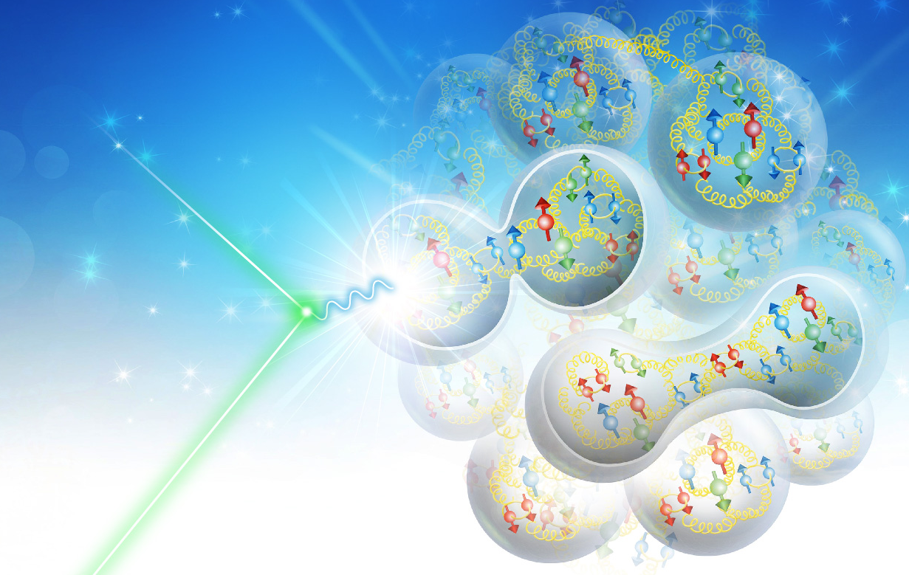
JLEIC at 100 GeV CM Energy
Vasiliy Morozov
on behalf of JLEIC design team
JLEIC Collaboration Meeting April 1-3, 2019

Slide 2
Outline
Overall layout of JLEIC
Electron complex
  CEBAF as a full-energy injector
  Electron collider ring
  Electron polarization
Ion complex
  Ion injector complex: ion sources, linac, and booster
  Ion collider ring
  Ion polarization
  Crab crossing
  Electron cooling
Summary

Slide 3
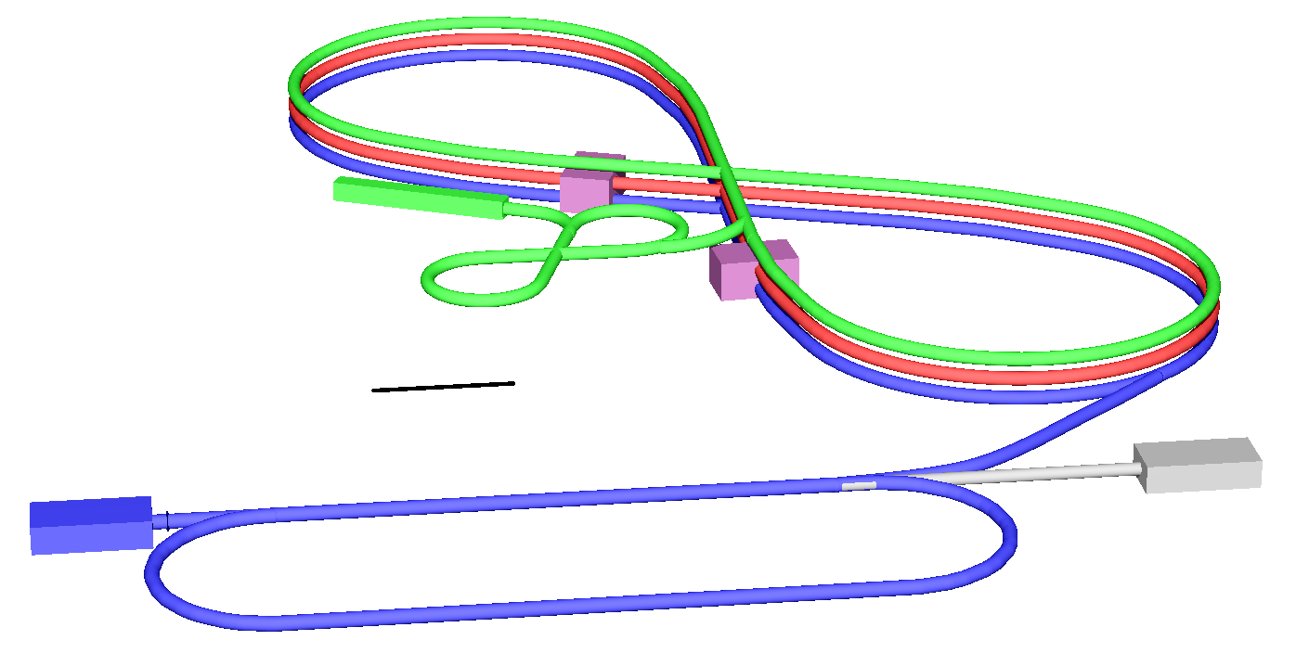
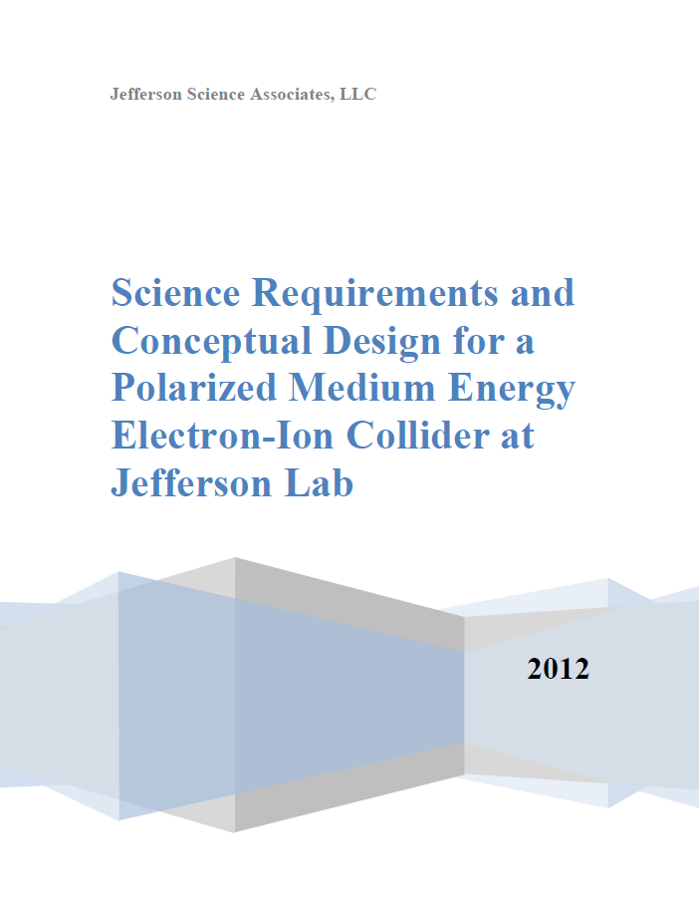
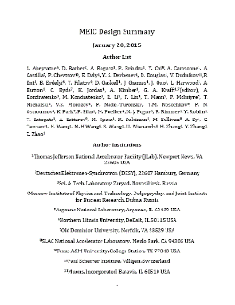
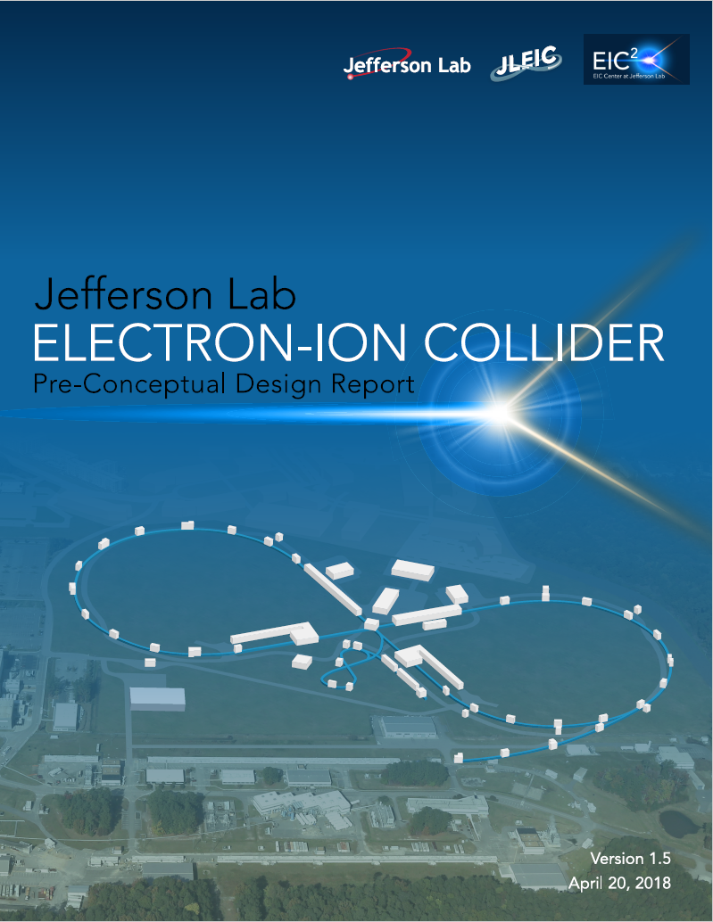
JLEIC Layout
Electron complex
  CEBAF
  Electron collider ring: 3-12 GeV/c
Ion complex
  Ion source
  SRF linac: 150 MeV for protons
  Low Energy Booster: 8.9 GeV/c
  High Energy Booster: 13 GeV/c
  Ion collider ring: 200 GeV/c
Up to two detectors at
minimum background
locations
13 GeV/c
High energy
Booster
Interaction
point
200 GeV/c
Ion collider ring
150 MeV Ion linac
Interaction
point
Low energy
8.9 GeV/c Booster
100m
3-12 GeV/c
Electron collider ring
Electron source
12 GeV CEBAF
2012
2015
arXiv:1209.0757
arXiv:1504.07961
pCDR-65
October 2019
pCDR-100
April 2019

Slide 4
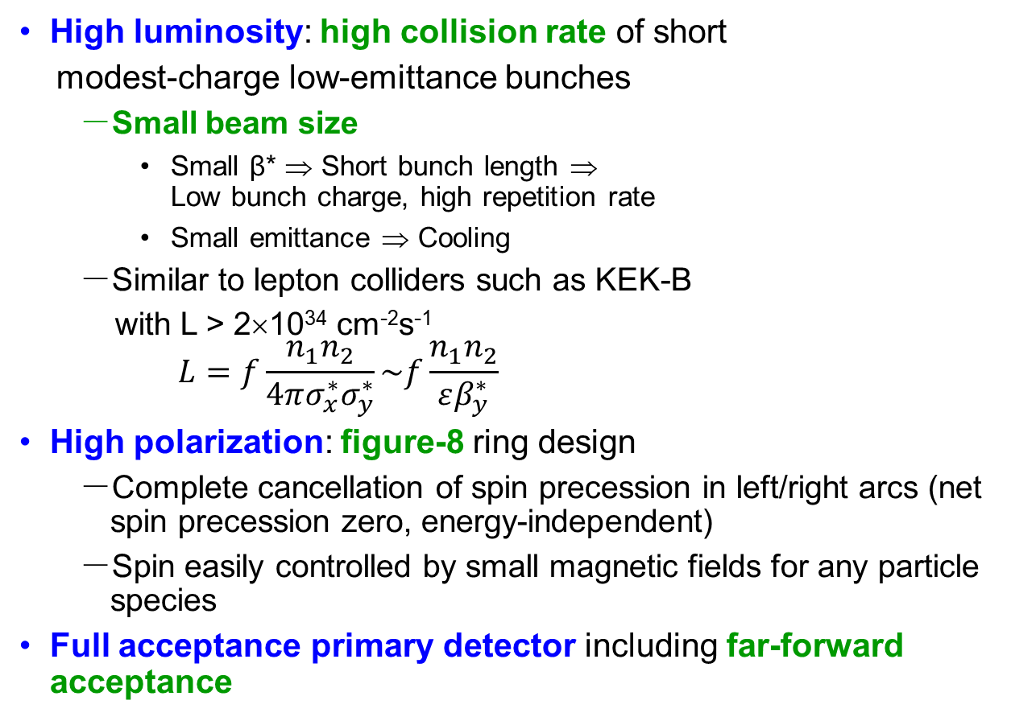
JLEIC: Key Design Concepts
High luminosity: high collision rate of short
modest-charge low-emittance bunches
  Small beam size
    Small β* ⇒ Short bunch length ⇒
    Low bunch charge, high repetition rate
    Small emittance ⇒ Cooling
  Similar to lepton colliders such as KEK-B
  with L > 2×10³⁴ cm⁻²s⁻¹
$$L=f\frac{n_{1}n_{2}}{4πσ_{x}^{∗}σ_{y}^{∗}}\sim f\frac{n_{1}n_{2}}{εβ_{y}^{∗}}$$
High polarization: figure-8 ring design
  Complete cancellation of spin precession in left/right arcs (net spin precession zero, energy-independent)
  Spin easily controlled by small magnetic fields for any particle
  species
Full acceptance primary detector including far-forward acceptance
Beam Design
High repetition rate
Low bunch charge
Short bunch length
Small emittance
IR Design
Small β*
Large beam-beam
Crab crossing
Damping Design
Synch. radiation
Beam cooling

Slide 5
JLEIC Parameters and Luminosity Performance
CM energy | GeV | 21.9 |  | 44.7 |  | 63.3 |  | 89.4 |  | 98
 |  | p | e | p | e | p | e | p | e | p | E
Beam energy | GeV | 40 | 3 | 100 | 5 | 200 | 5 | 200 | 10 | 200 | 12
Collision frequency | MHz | 476 |  | 476 |  | 476/2=238 |  | 476/4=119 |  | 476/4=119
Particles per bunch | 10¹⁰ | 0.59 | 3.9 | 0.98 | 4.7 | 1.97 | 6.8 | 3.93 | 4.2 | 3.93 | 2.05
Beam current | A | 0.45 | 3 | 0.75 | 3.5 | 0.75 | 2.58 | 0.75 | 0.8 | 0.75 | 0.39
Polarization |  | 85% | >85% | 85% | >80% | 85% | >80% | 85% | ~80% | 85% | ~80%
RMS bunch length | cm | 2.5 | 1 | 2.5 | 1 | 2.1 | 1 | 4 | 1 | 4 | 1
Norm. emitt, hori. | mm mrad | 0.5 | 18 | 0.65 | 83 | 0.96 | 83 | 3.1 | 664 | 3.1 | 1145
Norm. emitt, vert. | mm mrad | 0.2 | 3.6 | 0.13 | 16.6 | 0.25 | 16.6 | 1.5 | 133 | 1.5 | 229
Horizontal β* | cm | 8 | 30 | 8 | 5.72 | 21 | 11.2 | 21 | 9.1 | 21 | 6.6
Vertical β* | cm | 1.3 | 9.8 | 1.3 | 0.93 | 1.6 | 1.1 | 1.6 | 1.65 | 1.6 | 1.15
Beam-beam, hori. |  | 0.015 | 0.12 | 0.015 | 0.045 | 0.015 | 0.09 | 0.003 | 0.02 | 0.0013 | 0.014
Beam-beam, vert. |  | 0.01 | 0.15 | 0.013 | 0.041 | 0.008 | 0.065 | 0.001 | 0.02 | 0.0005 | 0.012
Laslett tune-shift |  | 0.055 | small | 0.018 | small | 0.008 | Small | 0.0014 | Small | 0.0014 | Small
Hour-glass (HG) |  | 0.85 |  | 0.73 |  | 0.82 |  | 0.73 |  | 0.67
Peak lumi., w/ HG | 10³³/cm²s | 3.2 |  | 14.7 |  | 15.5 |  | 1.9 |  | 0.86
Average lumi.* | 10³³/cm²s | 2.3 |  | 10.6 |  | 9.3 |  | 1.6 |  | 0.71
* Average luminosity was calculated assuming a one or two hour proton beam store without or with high energy bunched beam electron cooling plus 5 min beam formation time (mainly due to detector overhead), and a 75% duty factor of machine operation.

Slide 6
JLEIC Luminosity Performance
CM Energy (in each scenario) | Main luminosity limitation
low | space charge
medium | beam-beam
high | synchrotron radiation

Slide 7
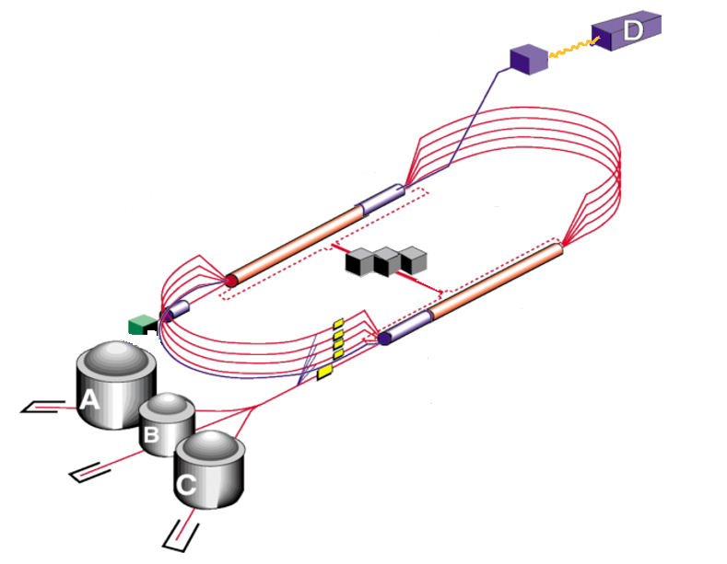
12 GeV CEBAF as Injector
Up to 12 GeV
to JLEIC
Extensive fixed-target science program
  Fixed-target program compatible
  with concurrent JLEIC operations
JLEIC injector
  Fast fill of collider ring
  Full energy
  ~85% polarization
  Enables top-off
New operation mode
but no hardware
modifications

Slide 8
Electron Collider Ring Layout
Cost reduction by reusing PEP-II magnets, RF and vacuum pipe in the electron ring
Tune trombone, straight FODO, RF
Spin rotator
Spin rotator
Arc
Arc
70.94º
Future IP
Spin rotator
Spin rotator
IP
Spin rotator
Forward e⁻ detection, polarimetry

Slide 9
Electron Collider Ring Optics: Complete Ring
Global chromaticity compensation scheme

Slide 10
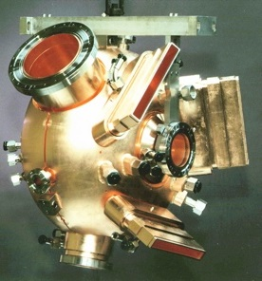
Electron Injection
Electron injection from CEBAF
  Existing CEBAF electron gun
  Two polarization state injection
  f_{ring} / f_{CEBAF} = 476.3 MHz / 1497 MHz = 7 / 22
Test of CEBAF in JLEIC injector mode completed
476.3 MHz e-ring
(NCRF PEP-II)
Mid-cycle 1, inject the 1st of every 7 buckets in the ring
injector pulse train up polarization from gun
injector pulse train down polarization from gun
68.05MHz bunch train, 3.6µs 247 bunches (I_{pulse} up to 1 mA @ 5GeV)
14.69 ns, 68.05 MHz (22 CEBAF buckets, 7 ring buckets)
2.1ns, 476.3 MHz (1 ring bucket)
1ps, 14.7 pC bunch
……
……
Waiting for damping or kicker recovery 10-400ms
Waiting for damping or kicker recovery 10-400ms
I_{ave} = 44 nA

Slide 11
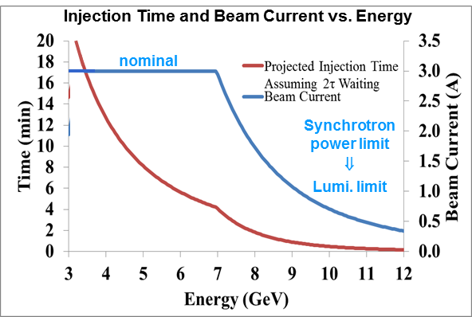
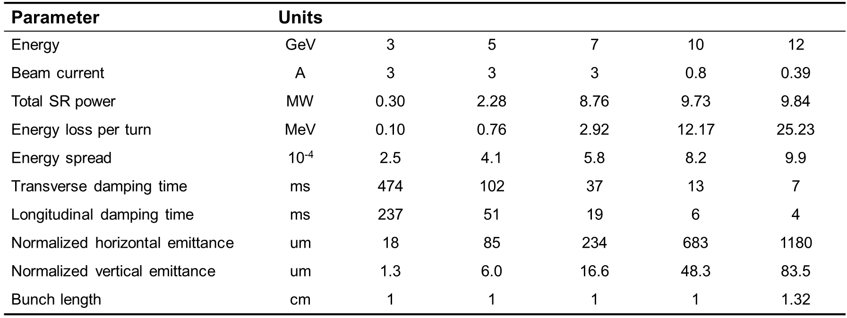
Electron Beam
Electron beam
  3 A at up to 7 GeV
  Normalized emittance
  58 µm @ 5 GeV
  Synchrotron power
  density < 10 kW/m
  Total power
  up to 10 MW

Slide 12
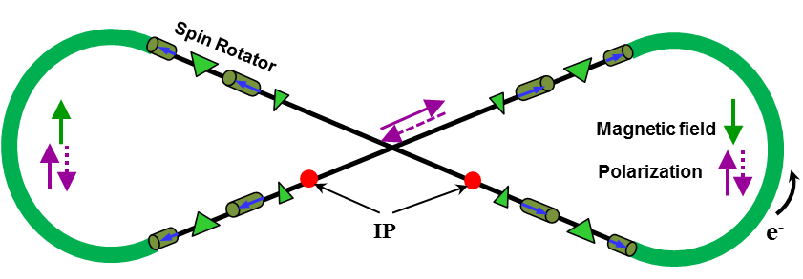
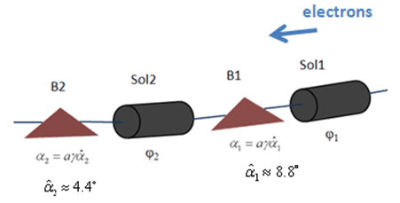


Electron Polarization
Two highly polarized bunch trains maintained by top-off
Universal spin rotator
  Minimizes spin diffusion
  by switching polarization
  between vertical in arcs
  and longitudinal in straights
  Sequence of solenoid and
  dipole sections
  Geometry independent of energy
  Two polarization states with equal
  lifetimes
  Basic spin match
Advantage of figure-8 geometry:
minimum depolarization demonstrated by spin tracking
Energy (GeV) | 3 | 5 | 7 | 9 | 10
Lifetime (hours) | 66 | 8 | 2.2 | 0.9 | 0.3
E | Solenoid 1 |  | Dipole set 1 | Solenoid 2 |  | Dipole set 2
 | Spin Rotation | BDL | Spin Rotation | Spin Rotation | BDL | Spin Rotation
GeV | rad | T·m | rad | rad | T·m | rad
3 | π/2 | 15.7 | π/3 | 0 | 0 | π/6
4.5 | π/4 | 11.8 | π/2 | π/2 | 23.6 | π/4
6 | 0.62 | 12.3 | 2π/3 | 1.91 | 38.2 | π/3
9 | π/6 | 15.7 | π | 2π/3 | 62.8 | π/2
12 | 0.62 | 24.6 | 4π/3 | 1.91 | 76.4 | 2π/3
Arc
IP
$$\vec{s}$$
$$\vec{s}$$

Slide 13
JLEIC ion injector chain for 200 GeV
~8GeV H⁺
2GeV Pb⁶⁷⁺
~12.1GeV H⁺
~4.28GeV Pb⁸²⁺
~200GeV H⁺
~78GeV Pb⁸²⁺
150MeV H⁻
40MeV Pb⁶⁷⁺
H⁻ Strip
Pb Strip
Pb Strip
Multi-turn injection
Bucket-to-bucket transfer
Bucket-to-bucket transfer
Collider ring with BB cooler
ion sources
SRF Linac
Low Energy Booster with DC cooler
Full-size high energy booster/ stacker with DC cooler
ion injector chain for 200 GeV ion ring
~150 MeV linac energy
Warm low energy booster (LEB)
  54-56 LEB cycles
Full-size high energy booster (HEB), also functioning as a stacker
  Most of the bunch formation process can be done in the HEB, increasing the collider duty factor and time averaged luminosity

Slide 14
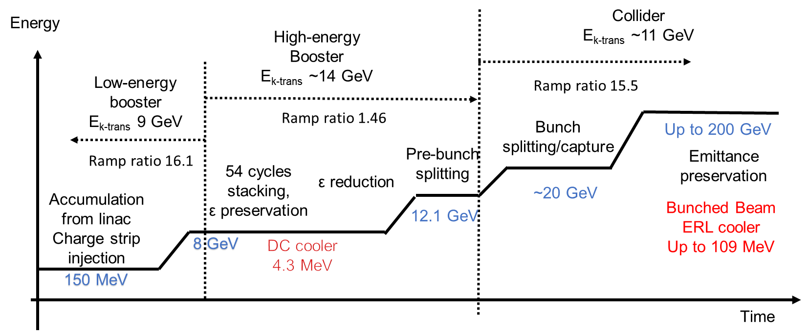
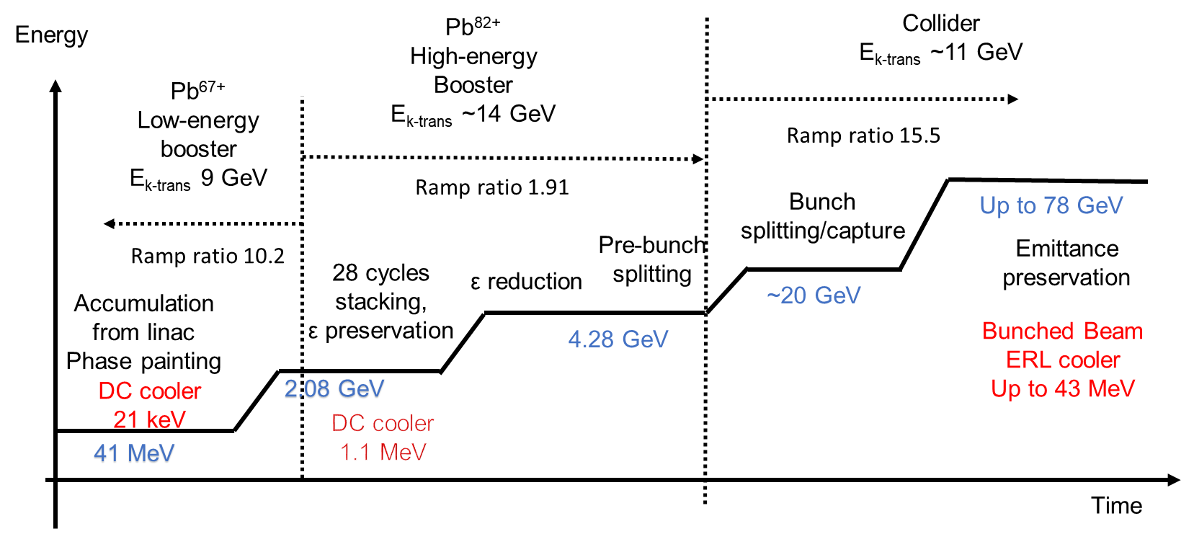
Ion Beam Formation
Protons
Lead

Slide 15
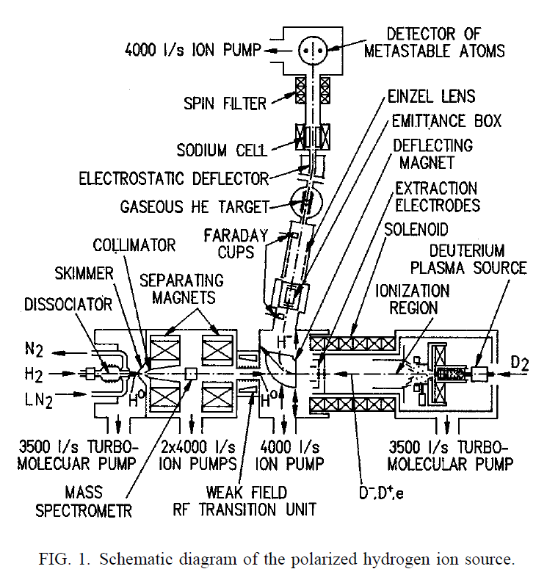
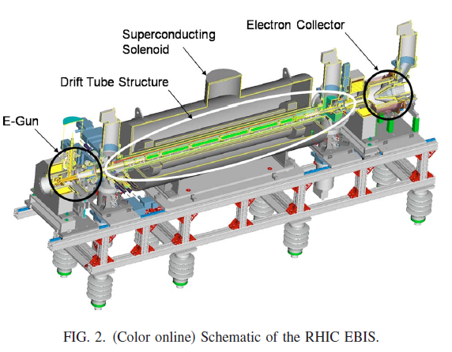
Ion Sources
Polarized ion source
Unpolarized heavy ion source
 | (units) | Desired value | ABPIS⁺ | OPPIS*
Charge status |  | H- | H- | H-
Pulse current | mA | 2 | 3.8 | 4 (0.7)
Pulse length | ms | 0.5 | 0.17 | (0.3)
Charge per pulse | μC | 1 | 0.65
Protons per pulse | 10¹² | 6.24 | 4.03
Polarization | % | 100 | 91 | 85
⁺[Belov et al., Rev. Sci. Instrum. 77, 03A522 2006]
*[Zelenski et al., Rev. Sci. Instrum. 87, 02B705 (2016)]
-Linac parameters in parentheses; 85% polarization at 200 MeV
[Belov et al., Rev. Sci. Instrum. 67 (3) (1996)]
[Belov et al., Rev. Sci. Instrum. 77, 03A522 (2006)]
 | (units) | Desired value | EBIS⁺ | ECR*
Charge status |  | Pb³⁰⁺ | Au³²⁺ | Pb²⁷⁺
Pulse current | mA | 1.3 | 1.7 | ~0.5
Pulse length | ms | 0.01 | 0.02 | ~0.2
Charge per pulse | μC | 0.075 | 0.1
Ions per pulse | 10¹⁰ | 1 | ~0.23
⁺[Beebe et al., AIP Conf. Proc. 1640, 5 (2015)]
*[Sortais et al., Rev. Sci. Instrum. 75, 1610 (2004)]

Slide 16
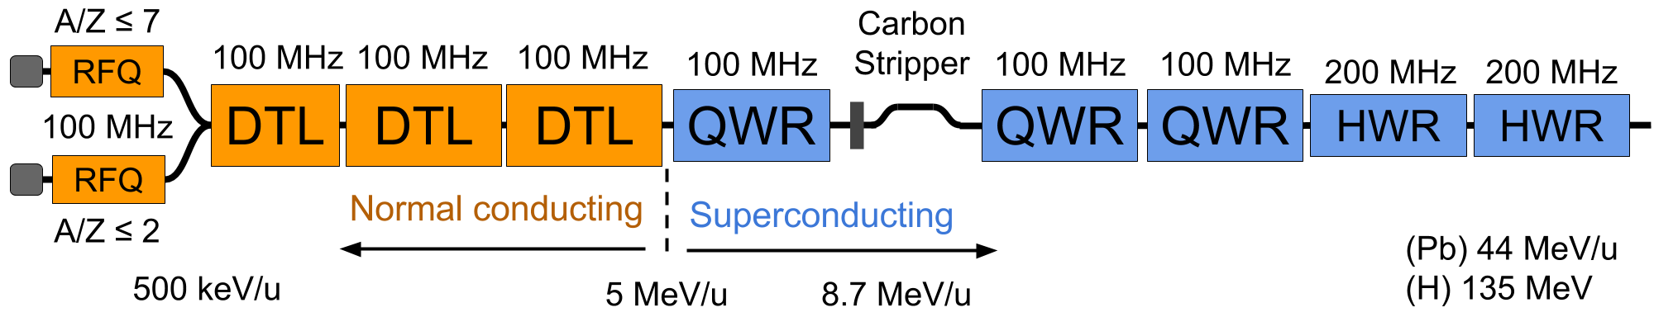
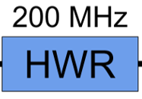
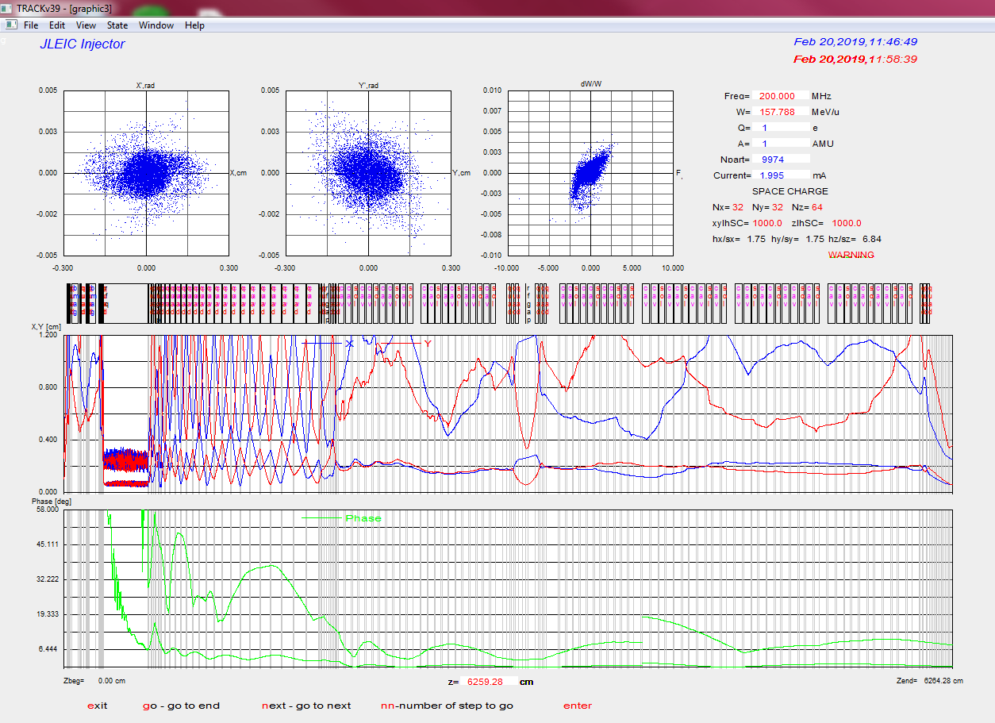
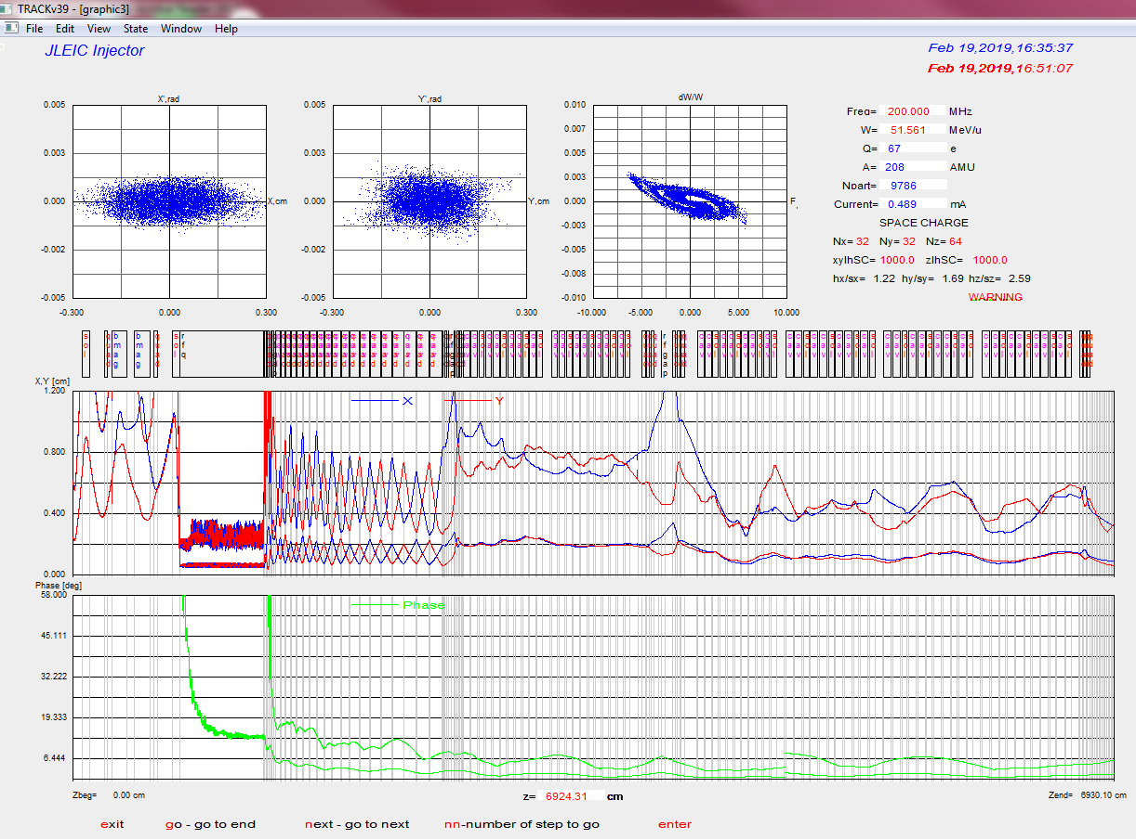
Ion RFQs and Linac
150 MeV design (50 MeV/u lead ion energy)
End-to-end simulations for protons and lead ions
(H) 150 MeV

Slide 17
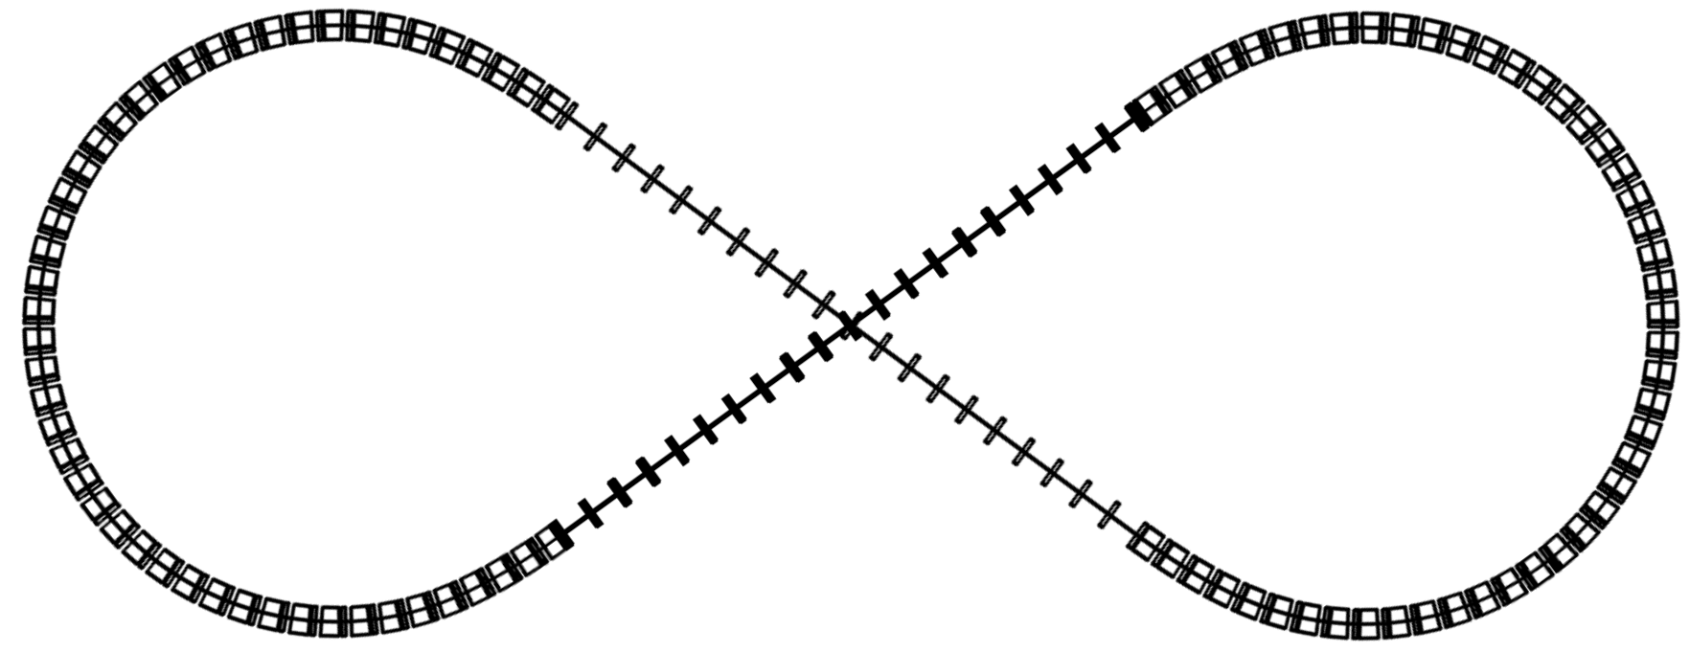

Low Energy Booster (LEB)
Takes protons from an injection E_{k} of 150 MeV to an extraction E_{k} of 8 GeV.
Overall length of 604.13m,
using warm magnets.
$γ_{t}=10.6$ to avoid transition crossing
Uses FODO lattice for simplicity

Slide 18

High Energy Booster (HEB)
Placed in the tunnel along with the two collider rings.
Accelerates protons (and ion equivalents) from 8 GeV E_{k} to 12.1 GeV E_{k} (13 GeV/c momentum)
Uses a FODO lattice with a $γ_{t}$ of 15.6

Slide 19
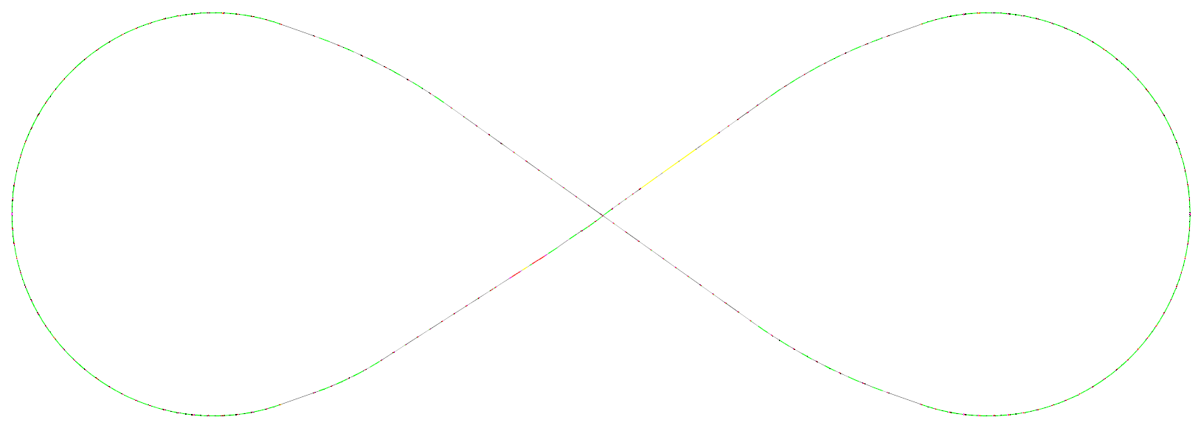

Ion Collider Ring
Circumference of 2335.975 m optimized for synchronization
200 GeV/c protons
6 T $\cos{θ}$ dipoles and $\cos{2θ}$ quadrupoles
~25 m for Crab Cavities
Electron
cooling
Disp. supp.
CCB
RF
Polarimeter
71°
IR
Future IR
Disp. supp.
Geom. match
CCB
ions
Disp. supp.
IP
3D spin
rotator
~25 m for Crab Cavities

Slide 20
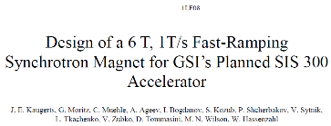
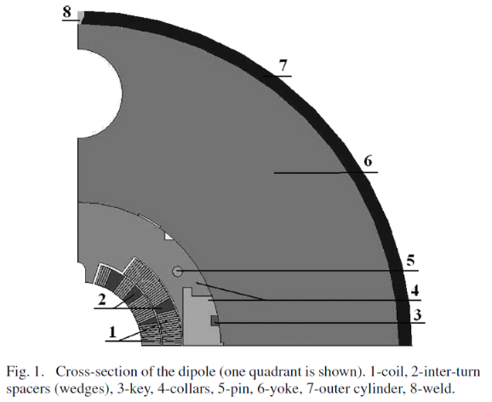
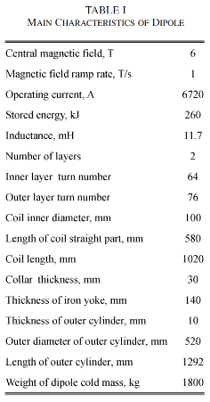
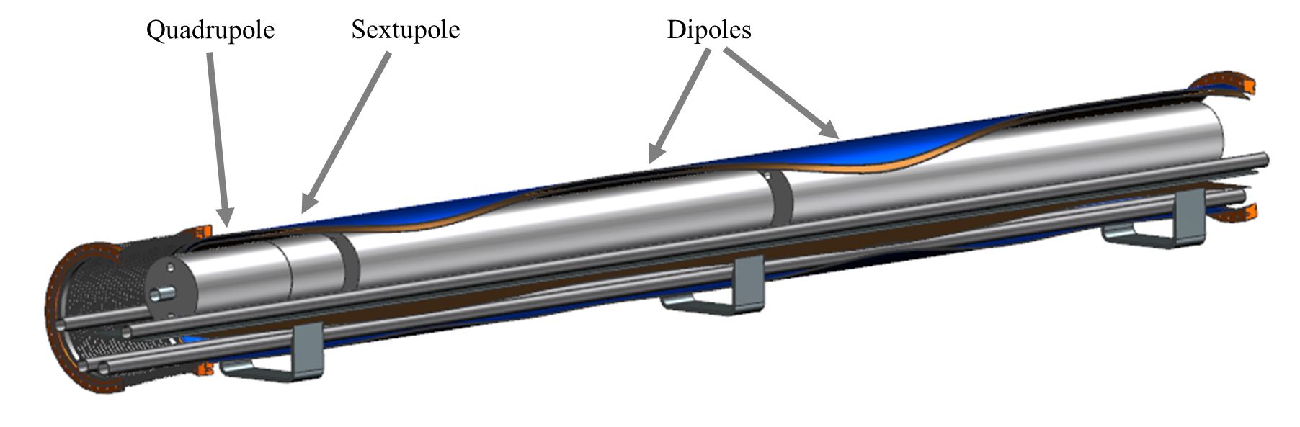
JLEIC 6T Dipole
Based on the SIS 300 prototype
dipole design:
  6 T central field
  100 mm coil aperture
  2.6 m long
  Two layer cos-theta magnet design
  Uses cored Rutherford cable
Cold Mass OD: ~0.52 m
Cryostat OD: 1.0 m

Slide 21
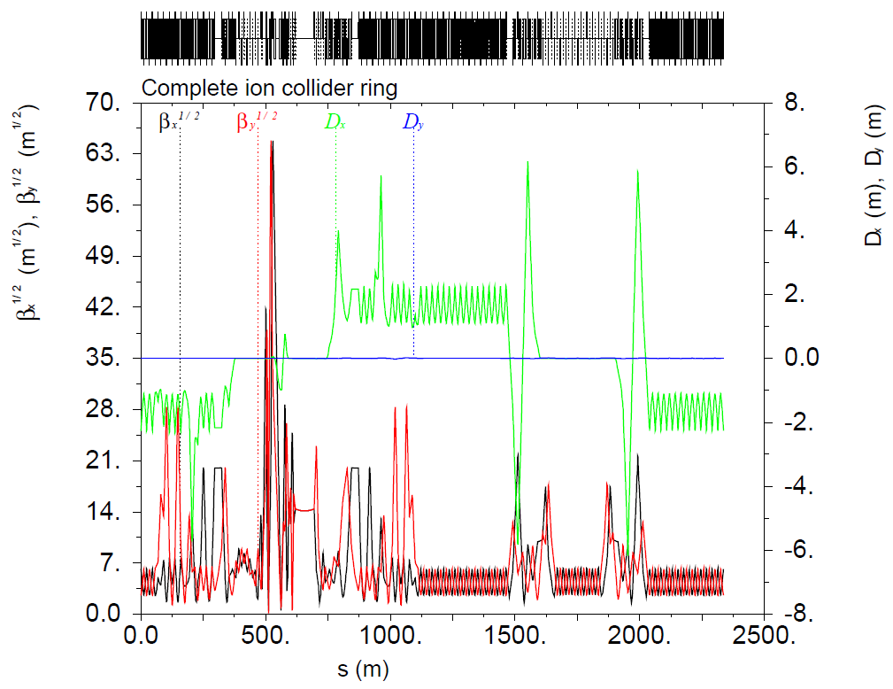
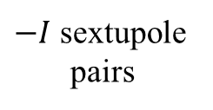
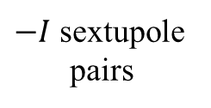
Ion Collider Ring Optics
Local chromaticity compensation scheme
Crab cavities
IP
$−I$ sextupole
pairs
$−I$ sextupole
pairs

Slide 22
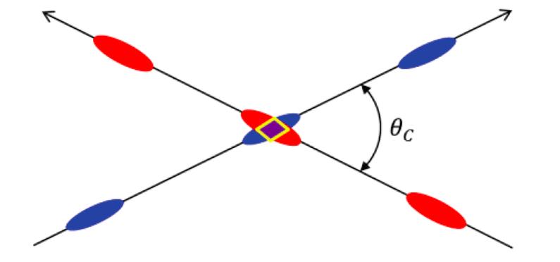
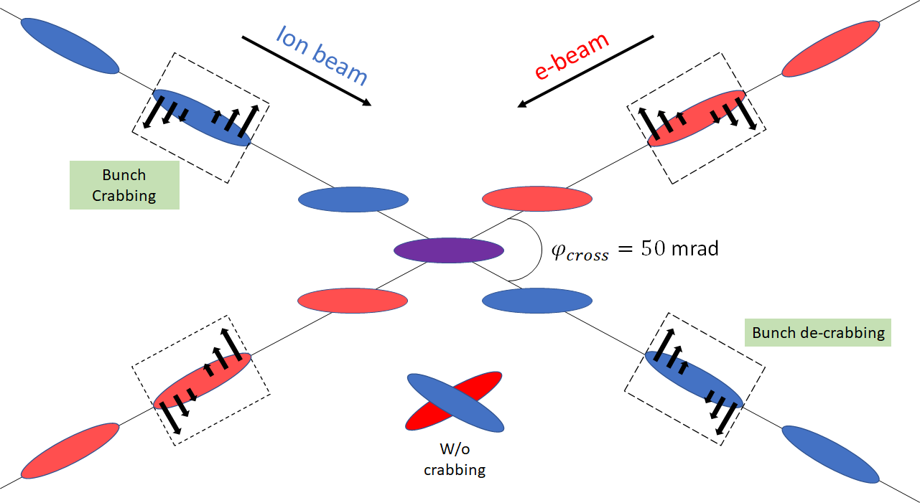
Beam Crabbing
Beam crossing angle is necessary to avoid parasitic collisions due to short bunch spacing, make space for machine elements, improve detection and reduce detector background
Without crabbing
Low luminosity
Beam dynamics issues
With crabbing
Effective head-on collision
restored
Factor of 12 luminosity increase
compared to uncorrected case

Slide 23

Crab Crossing Scheme of JLEIC
Local compensation scheme:
set of crab cavities upstream and
downstream of IP
Locations of horizontal chromatic
sextupoles are also adequate for
crab cavities:
  Right phase advance
  High $β_{x}$ values
Found that sextupoles between
crab cavities may lead to emittance
increase, avoid them
Dispersion at the crab cavities
satisfies the beam stability
criterion
Parameter | Electron | Proton | Proton | Units
Beam energy | 10 | 100 | 200 | GeV
Bunch frequency | 952.6 |  |  | MHz
Crab crossing angle | 50 |  |  | mrad
Betatron function at IP (β_{x}*) | 10 |  | 33 | cm
Betatron function at crab cavity (β_{x}^{crab}) | 200 | 450 | 450 | m
Total transverse voltage (V_{total}) per beam per side | 2.8 | 18.7 | 20.6 | MV
No. of cavities | 2 | 10 | 11
Transverse voltage per cavity (V_{cavity}) | 1.4 | 1.9 | 1.9 | MV
Peak electric field (E_{p}) | 28 | 35 | 35 | MV/m
Peak magnetic field (B_{p}) | 55.8 | 70.7 | 70.7 | mT

Slide 24
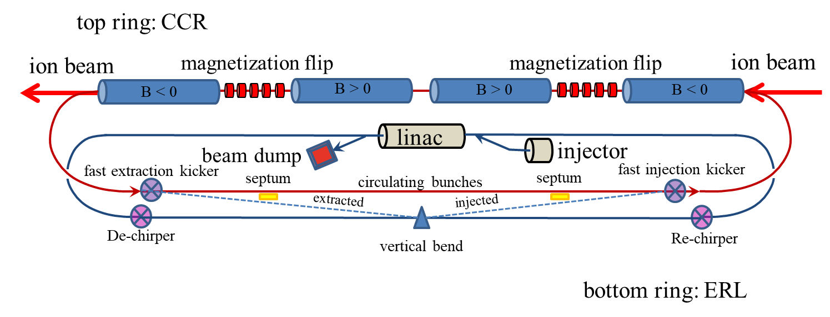
Cooling Ring Fed by ERL
Same-cell energy recovery in 476.3 MHz SRF cavities with Harmonic linearizer
Uses harmonic kicker to inject and extract from CCR (divide by 11)
Assumes high charge, low rep-rate injector (w/ harmonic linearizer acceleration)
Use magnetization flips to compensate ion spin effects

Slide 25
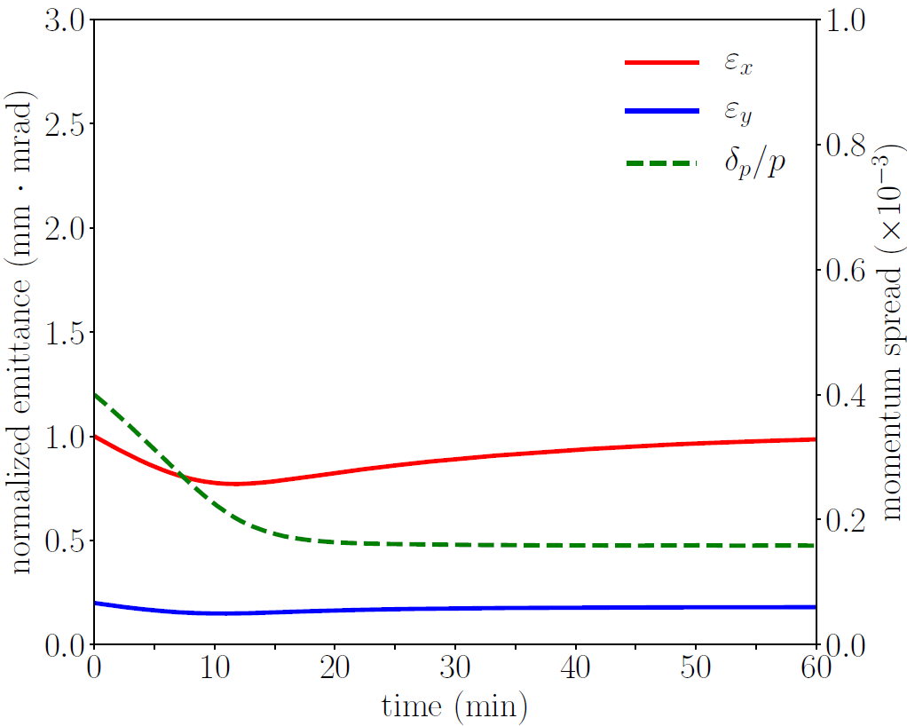
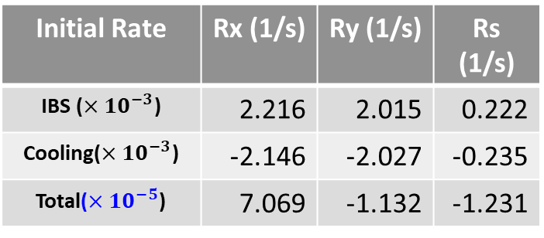
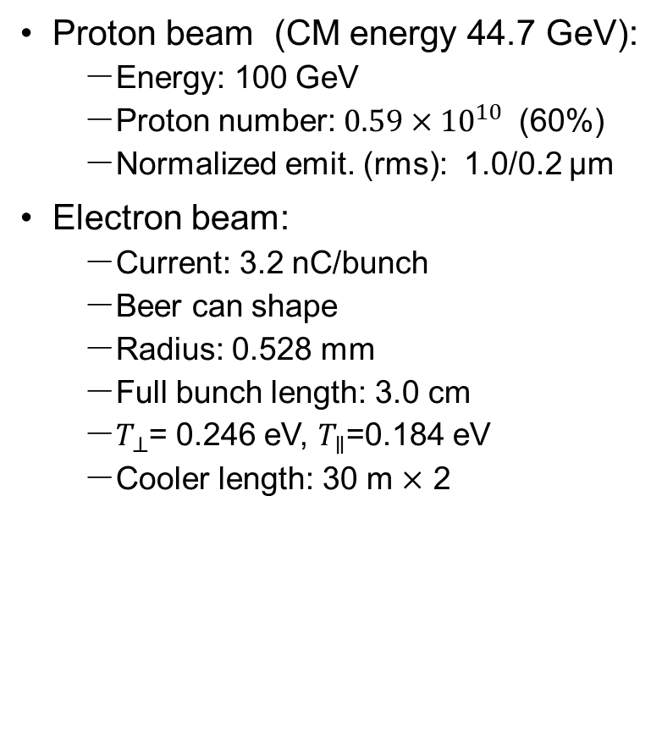

Maintaining Ion Beam Emittance
Proton beam (CM energy 44.7 GeV):
  Energy: 100 GeV
  Proton number:$0.59×{10}^{10}$ (60%)
  Normalized emit. (rms): 1.0/0.2 μm
Electron beam:
  Current: 3.2 nC/bunch
  Beer can shape
  Radius: 0.528 mm
  Full bunch length: 3.0 cm
  $T_{⊥}$= 0.246 eV, $T_{∥}$=0.184 eV
  Cooler length: 30 m $×$ 2
Momentum spread: $8×{10}^{−4}$
Bunch length (rms): 4 cm
Dispersion at cooler: 2.0/0.8 m
Transverse coupling: 50%
Initial Rate | Rx (1/s) | Ry (1/s) | Rs (1/s)
IBS ($×{10}^{−3}$) | 2.216 | 2.015 | 0.222
Cooling($×{10}^{−3}$) | -2.146 | -2.027 | -0.235
Total($×{10}^{−5}$) | 7.069 | -1.132 | -1.231

Slide 26
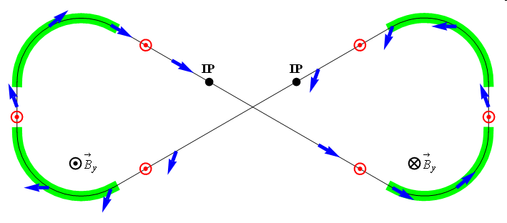
Ion Polarization
Figure-8 concept: Spin precession in one arc is exactly cancelled in the other
Spin stabilization by small fields: ~3 Tm vs. < 400 Tm for deuterons at 100 GeV
  Criterion: induced spin rotation >> spin rotation due to orbit errors
3D spin rotator: combination of small rotations about different axes provides
any polarization orientation at any point in the collider ring
No effect on the orbit
Polarized deuterons
Frequent adiabatic spin flips
ν = 0

Slide 27
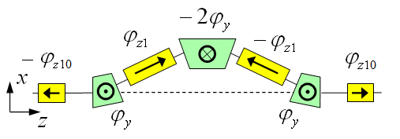
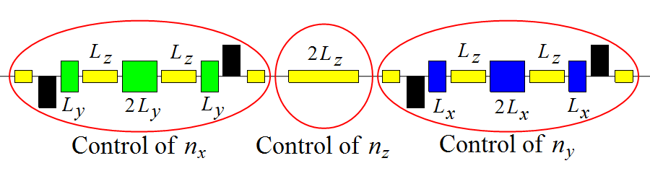
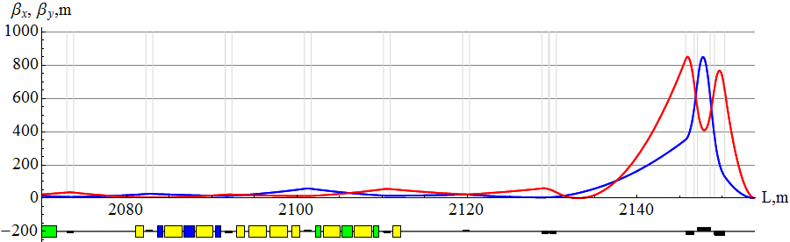
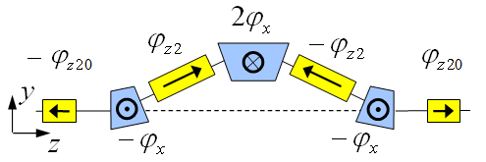

Ion 3D Spin Rotator below 100 GeV/c
Provides control of the radial, vertical, and longitudinal spin components
Module for control of the radial component (fixed radial orbit bump)
Module for control of the vertical
component (fixed vertical orbit bump)
Module for control of the longitudinal
component
3D spin rotator
$$L_{tot}=7 m, Δx=16 mm, B_{dip}^{max}=3 T, B_{sol}^{max}=2 T$$
IP
ions
$$L_{x}=L_{y}=0.6 m, L_{zi}=2 m, L_{zi0}=1 m, α_{orb}={0.31}^{∘}$$

Slide 28
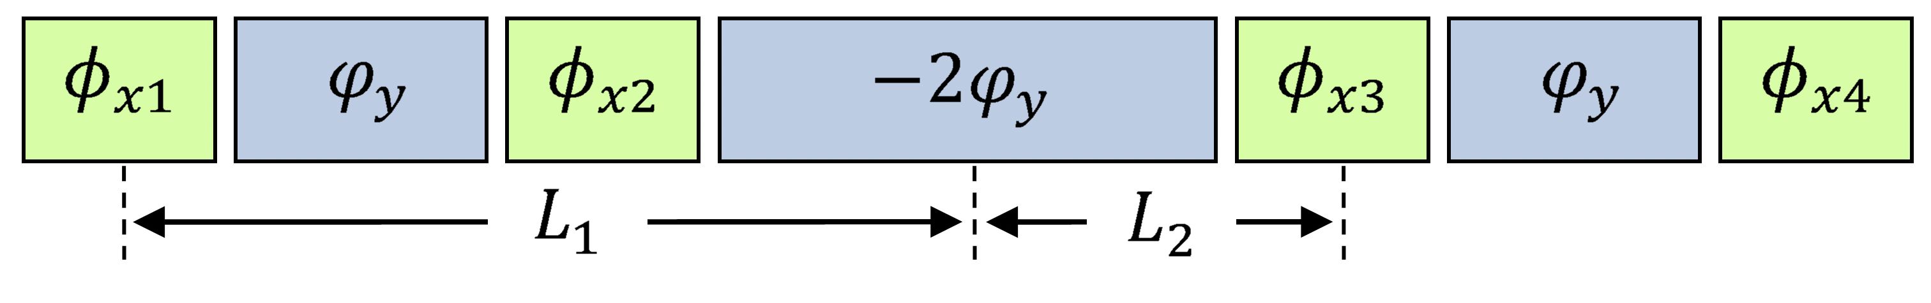
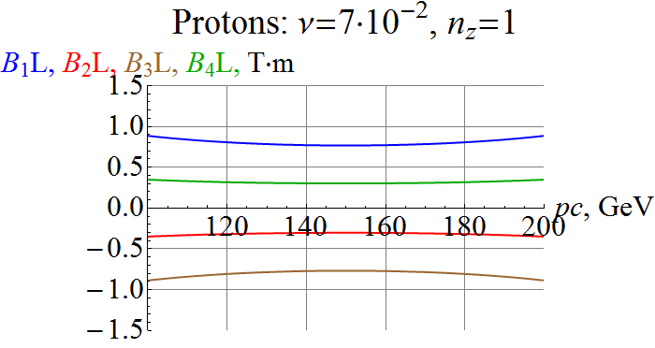
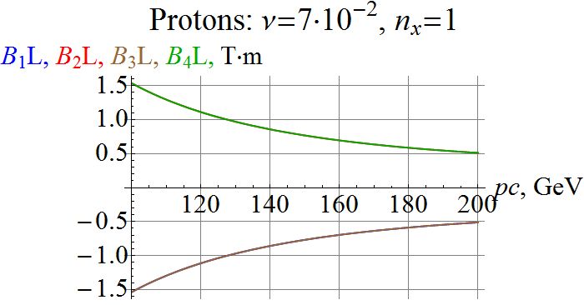
Proton Spin Rotator above 100 GeV/c
Longitudinal Polarization at IP
Radial Polarization at IP

Slide 29
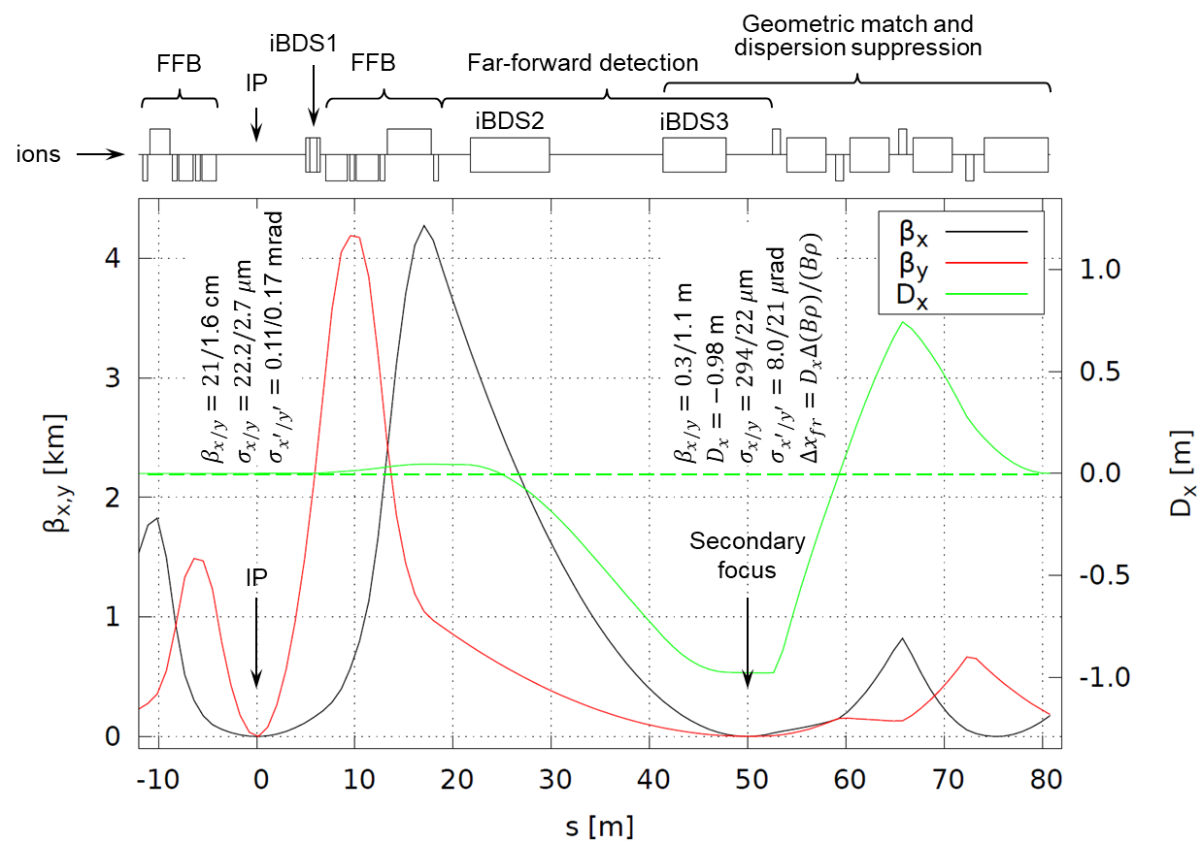
Ion Interaction Region
High luminosity and acceptance performance in the whole energy range
Conventional NbTi technology
Secondary focus with high dispersion

Slide 30
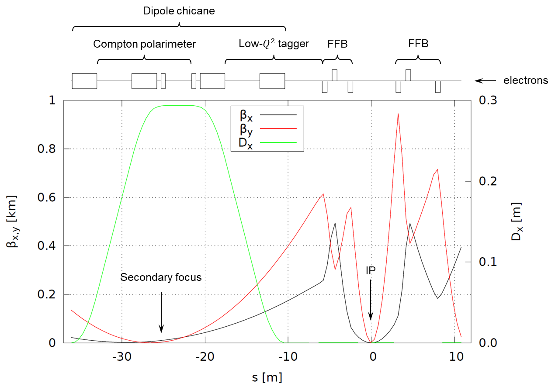

Electron Interaction Region
Downstream chicane for low-$Q^{2}$ tagging and polarimetry

Slide 31
Multi-lab Joint EIC R&D – Examples
High-Priority EIC R&D topics defined by the Jones review panel
A number of joint R&D funded by NP – FY17, significant progress achieved in:
  Crab system design and experimental test
  Electron cooler design
  IR magnet design
  Simulation software development
Example of awarded FY18-19 proposals:
  Crab cavity operation in a hadron ring (Lead: ODU, collaborators: JLab, BNL)
  Strong hadron cooling
    Development of innovative high-energy magnetized electron cooling for an EIC (Lead: JLab, collab.: BNL, FNAL, ODU)
    Strong hadron cooling with micro-bunched electron beams (Lead: BNL, collaborators: JLab, SLAC, ANL)
  Magnet design
    High Gradient Actively Shielded Quadrupole (Lead: BNL, collaborators: JLab, LBNL)
    Validation of EIC IR magnet parameters and requirements using existing magnet results (Lead: JLAB, collab.: SLAC, LBNL)
  Benchmarking of EIC simulations
    Development & test of simulation tools for EIC beam-beam interaction (Lead: BNL, collaborators: JLab, MSU, LBNL)
    Experimental verification of spin transparency mode in an EIC (Lead: JLab, collaborator: BNL)
  Electron complex
    High Bandwidth Beam Feedback Systems for a High Luminosity EIC (Lead: ANL, collaborator: JLab)

Slide 32
Summary
100 GeV CM JLEIC conceptual design is complete
pCDR-100 is nearly complete
Key features:
  High luminosity
  High polarization
  Full-acceptance detection
  Low risk using only NbTi magnets
Current work
  Key R&D
  Performance and cost optimization
  Evaluation of engineering challenges

