Slide 1


First Proton Beam Dynamics Results with Crab Cavities
Lee Carver
A. Alekou, F. Antoniou, R. Appleby, H. Bartosik, P. Baudrenghein, T. Bohl, G. Burt, R. Calaga, M. Carla’, A. Castilla, S. Cettour Cave, A. Dexter, T. Jones, E. Jordan, V. Kain, T. Levens, B. Lindstrom, T. Mastoridis, J. Mitchell, G. Papotti, S. Pattalwar, N. Shipman, N. Templeton, N. Triantafyllou, S. Verdu Andres, C. Welsch, D. Wollmann, E. Yamakawa
Material for this presentation summarized from more detailed BE seminar: https://indico.cern.ch/event/800428/
1 April 2019 - CERN

Slide 2
Outline
Introduction
Operational Setup
MD Overview
Diagnostic Comparison
Cavity Transparency
Emittance Growth in Coast
Conclusions

Slide 3
Outline
Introduction
Operational Setup
MD Overview
Diagnostic Comparison
Cavity Transparency
Emittance Growth in Coast
Conclusions

Slide 4
Introduction
High-Luminosity LHC is the planned upgrade of the LHC to provide a large boost to the luminosity output of the machine.
Bunches do not currently collide head-on due to the crossing angle which reduces the number of collisions per crossing.
Providing a rotational kick either side of IP1 and IP5 (ATLAS & CMS) can create a bunch rotation that will restore head-on collisions and therefore improve the luminosity.
This rotational kick can be provided by any device that provides a positive kick for the head of the bunch and negative for the tail (or vice versa) -> Crab Cavities.
2 superconducting crab cavities at 400 MHz have been fabricated and installed into the SPS and were tested in 2018.

Slide 5
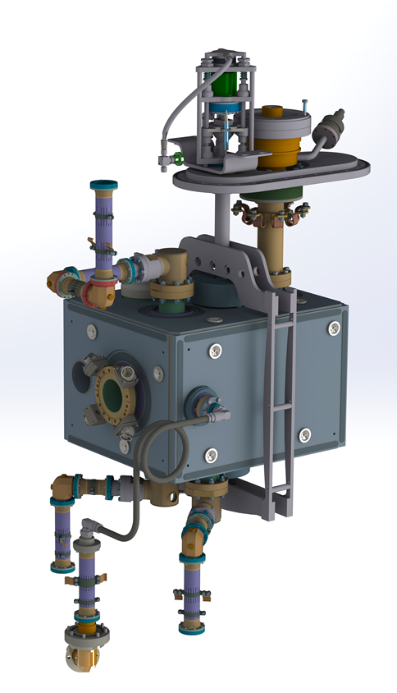
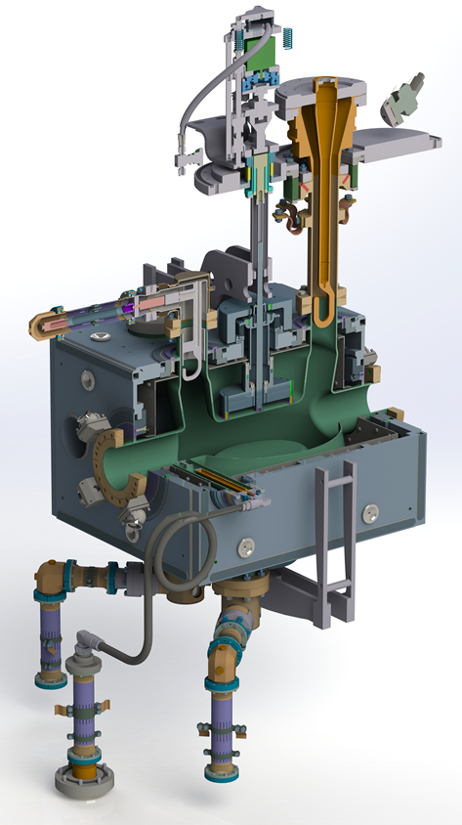
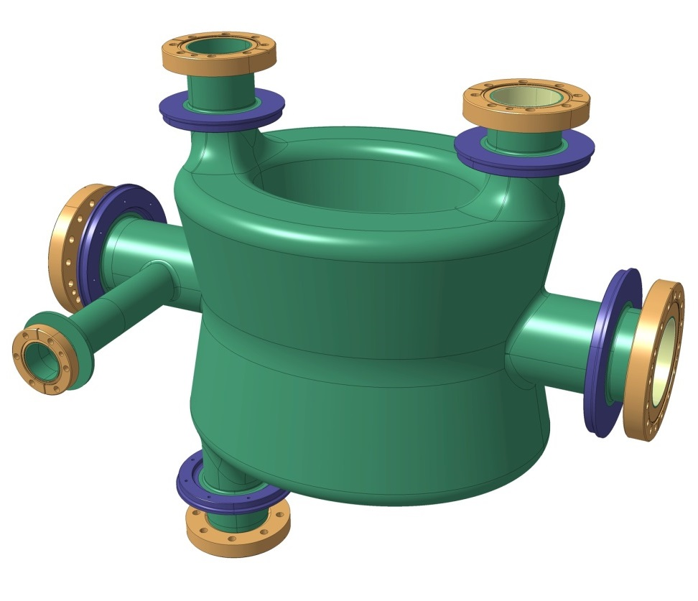
DQW Cavity
Bare DQW cavity (400MHz)
Dressed DQW cavity
Courtesy: EN-MME

Slide 6
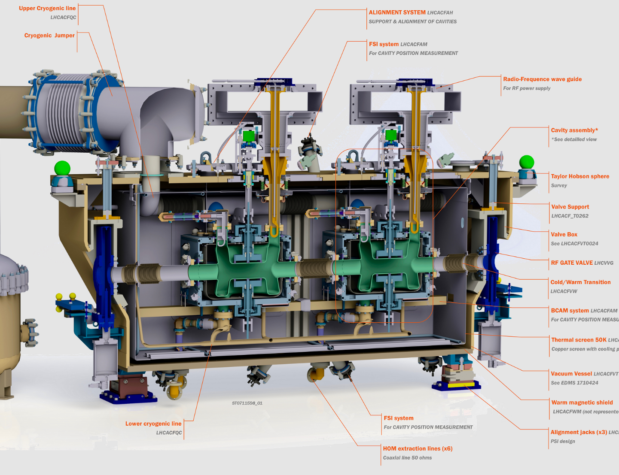
DQW cavity manufacturing sequence
Courtesy: EN-MME

Slide 7
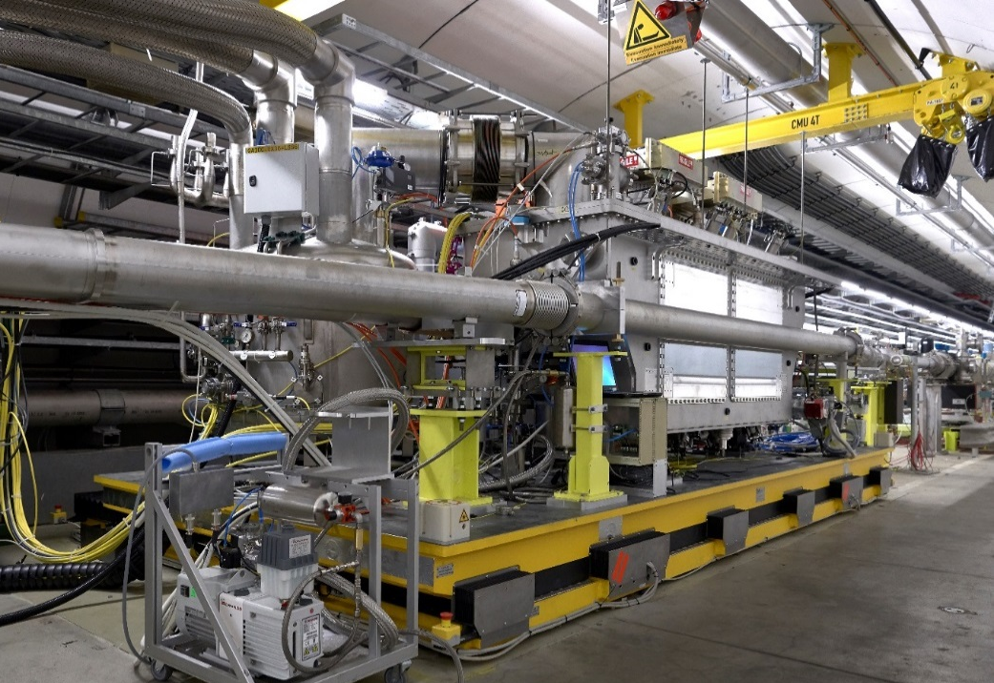
SPS Installation

Slide 8
Outline
Introduction
Operational Setup
MD Overview
Diagnostic Comparison
Cavity Transparency
Emittance Growth in Coast
Conclusions

Slide 9
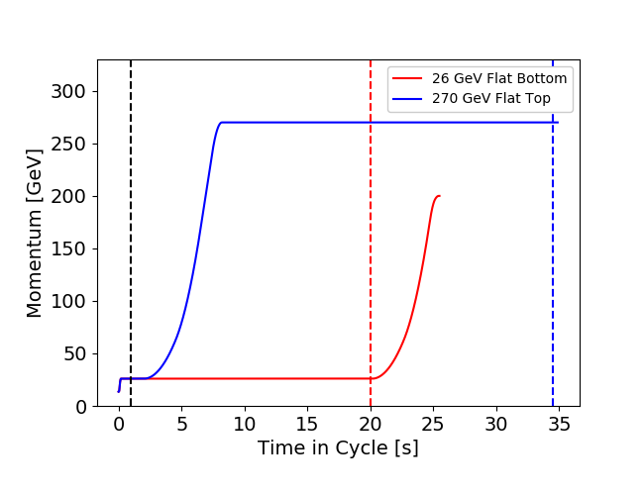
SPS Cycles
SPS is a medium-speed cycling machine, typical cycles ranging from 4s-50s.
Two cycles were setup specifically for the crab cavity MDs.
MD_CRAB_26_L26400_Q26_2018_V1 - 26 GeV with 19.12s FB.
MD_CRAB_26_270_L30000_Q26_2018_V1 - 270 GeV with 26.6s FT

Slide 10
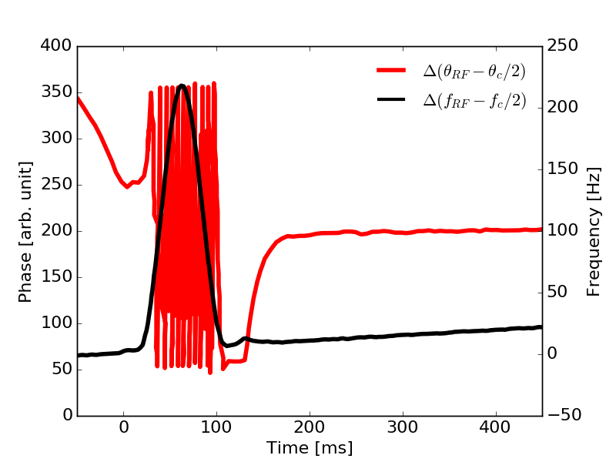
Crab-RF Sychronisation
Crab cavity RF set point from BA6 to BA3 (several km away)
CC ~400 MHz - narrow, SPS RF ~200 MHz - broad
Re-phasing of SPS RF to become synchronous with CC RF.
Occurs at the beginning of every 26 GeV cycle (normally ~1s after injection).
Occurs at the end of the ramp for every 270 GeV cycle (normally ~1s after reaching flat top).

Slide 11
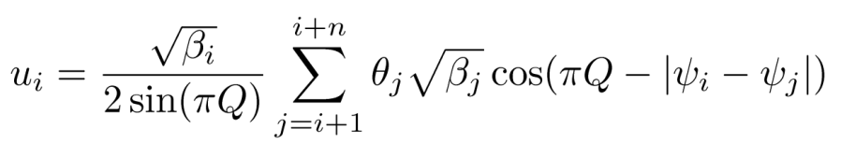
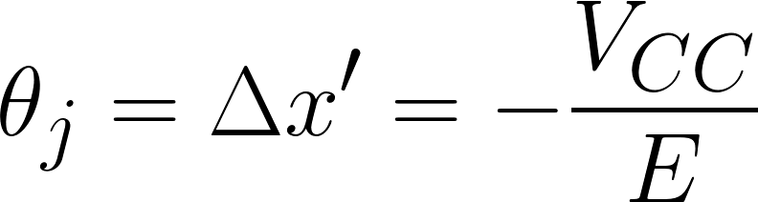
Calculation of Orbit from Crab Kick
Closed orbit at location i caused by a kick at location j. β is the beta function at the specific location, ψ is the phase (in tune units), θ is the kick, Q is the tune.
For only one kick at the location of the crab cavity, where V₁ and V₂ are the cavity voltages, φ₁ and φ₂ are the cavity phases and E is the beam energy.
For optics information at crab cavities and diagnostic devices, see backup.

Slide 12
Head-Tail Monitor
The Head-Tail monitor gives two data sets
  A sigma (or sum) signal, which is the longitudinal line density for a given window (often ~10,000 turns with 100ps sampling)
  A delta (or difference) signal, which is a measure of the transverse offset within the bunch.
When synchronised with the main rf, the crab signal vanishes into the baseline signal.
  Need to remove the baseline without removing the crab signal.
Step 1: Calculate baseline from delta signal acquired before synchronisation.
Step 2: Take delta signal acquisitions of interest and subtract baseline. Divide by the sum signal and apply normalisation factor to acquire intra-bunch offset in mm.

Slide 13
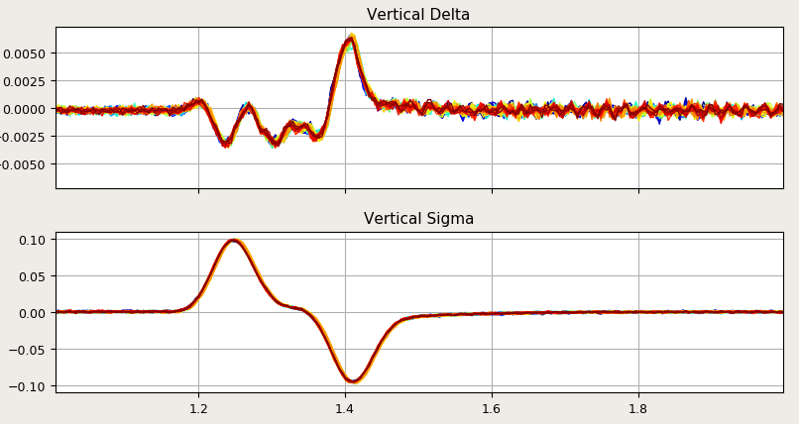
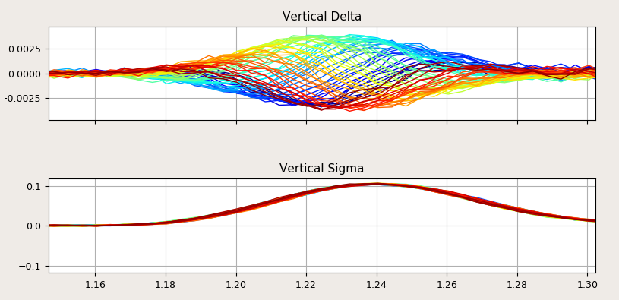
Head-Tail Monitor
Example of delta signal without baseline removal. Crabbing is in here somewhere…
Example of delta signal when cavity is not synchronous with beam. The baseline can be removed without affecting the crab signal because we only remove the average signal.

Slide 14
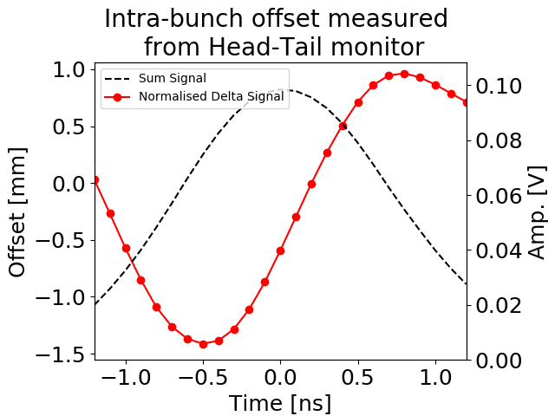
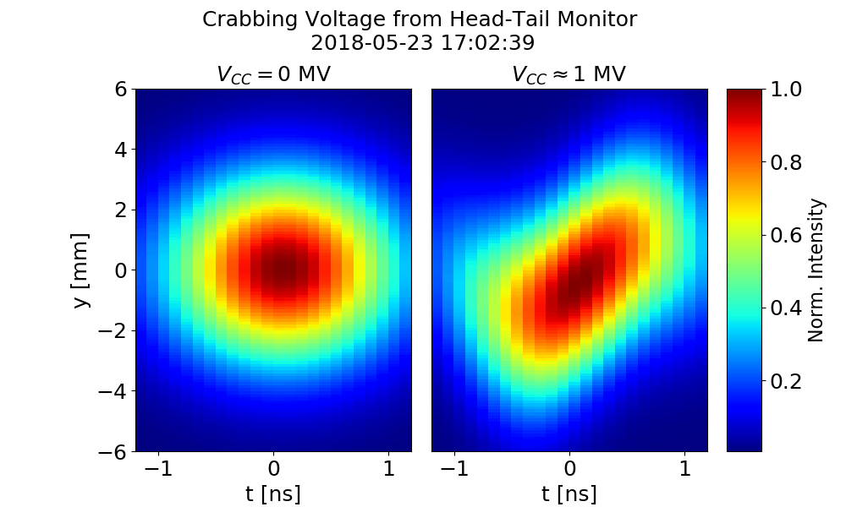
Head-Tail Monitor
Dividing delta signal (with subtracted baseline) with sum signal gives intra-bunch offset.
Take the measured profile in z. Assume a Gaussian profile in y with sigma taken from wirescan.
Modulate in z with intra-bunch offset.
Make plot of reconstruction of crabbing!

Slide 15
Outline
Introduction
Operational Setup
MD Overview
Diagnostic Comparison
Cavity Transparency
Emittance Growth in Coast
Conclusions

Slide 16
MD Overview
* Operating temp is 2K, V=3.4 MV
MD# |  | Cav1 [MV[ | Cav2 [MV] | Temp [K] | Energy [GeV]
1 | First crabbing, phase and voltage scan | 0.5 | 0 | 4.5 | 26
2 | 270 GeV ramp with single bunch | 1-2 | 0 | 4.5 | 26, 270
3 | Intensity ramp up | 1 | ~0.3 | 4.5 | 26
4 | 270 GeV coast setup | 1.0 | 0.5 | 2.0 | 270
5 | Emittance growth at 270 GeV with induced noise | 0 | 1.0 | 2.0 | 270
6 | Intensity ramp up to 4-batches | - | 1.0-1.5 | 2.0 | 26
7 | Intensity/Energy ramp up | 1.0 | 1.0 | 2.0 | 26, 270
10 MDs: 2 for cycle and table setup, 1 lost due to cavity issues
Notes:
DQW cryomodule was installed in the SPS without any high power test on the surface -> first MDs were much perturbed by hardware commissioning: cryo problem ( 4.5 K vs. 2 K), time needed to condition the cavity, TX problems (non linearity at low power), LLRF problems (understanding and curing ponderomotive oscillations, direct coupling of beam to antenna).

Slide 17
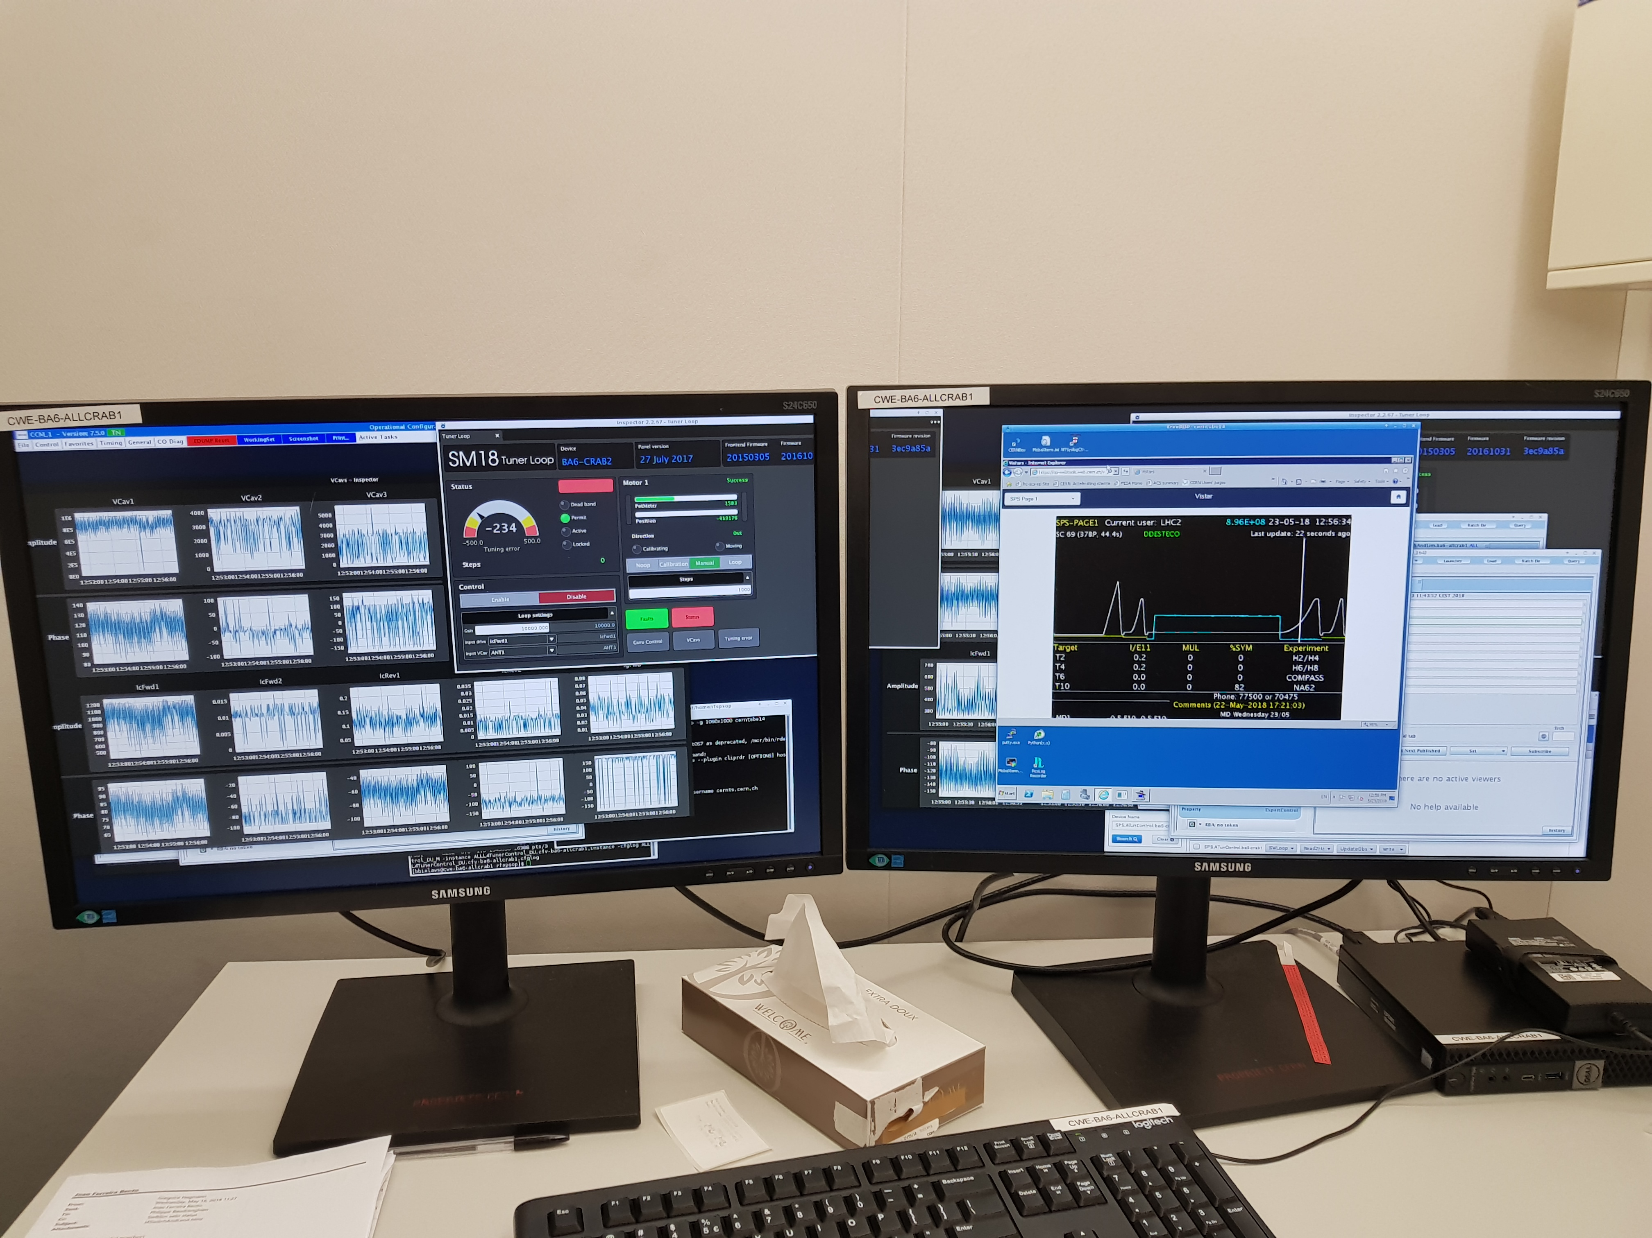

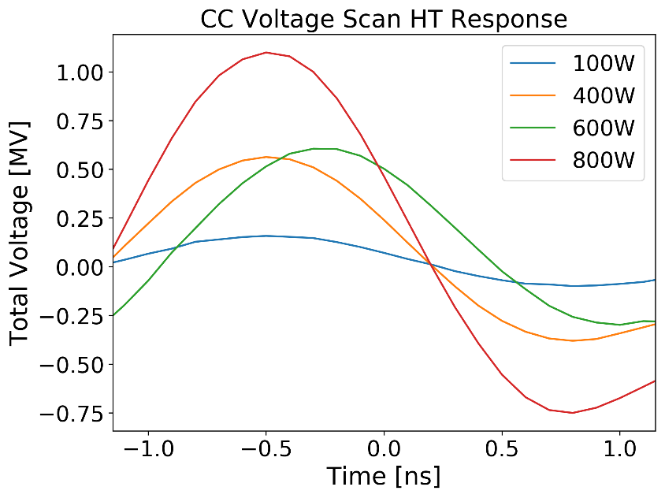
Protons meet Crabs
First injection – 12:55, May 23
Cavity 1 only.
Worked w/o RF feedback
$0.2−0.8×{10}^{11}$p/b
Crabbing reconstruction from Head-Tail monitor

Slide 18
Outline
Introduction
Operational Setup
MD Overview
Diagnostic Comparison
Cavity Transparency
Emittance Growth in Coast
Conclusions

Slide 19
Diagnostic Comparison
Crab orbit measurements made during MD7 (17-10-2018 12:20-12:40)
  1MV in Cavity 1 with fixed phase,
  1MV in Cavity 2 with phase varied in steps of 45 degrees. ~2 cycles per step.
For each cycle we have:
  DOROS BPMs (4 special LHC-type BPMs that accurately measure the orbit every 1s)
  Headtail monitor
  MOPOS BPMs (SPS standard BPMs, ~100 per plane, one measurement per cycle).
  Power sensors for Cavity 1 and Cavity 2
Will compare the results from each of these devices (specific results in backup).

Slide 20
Interim Summary of Measurements
Device | Measured Voltage [MV] | Note
Power Sensors | 0.98 | Dependence on Qe
Headtail Monitor | 1.23 | For z=0, No CTF
MOPOS BPMs | 0.72 | No Bunch Length
DOROS @Crabs | 0.62 | No Bunch Length
DOROS @518,520 | 0.60, 0.66 | No Bunch Length

Slide 21
Bunch Length
A reduction is expected that comes from the long bunch which probes the non-linear crab cavity rf fields.
Studies have been performed into the effect of the BPM filters on the readout in the presence of intra-bunch motion.
The MOPOS BPMs have a 200MHz narrow band (resonant) filter.
  Only the 200 MHz component of the beam is taken.
The DOROS BPMs have a low pass filter with cutoff at 200MHz (and a high pass filter at 60 MHz).
  All frequencies of the beam between 60MHz and 200MHz are taken.

Slide 22
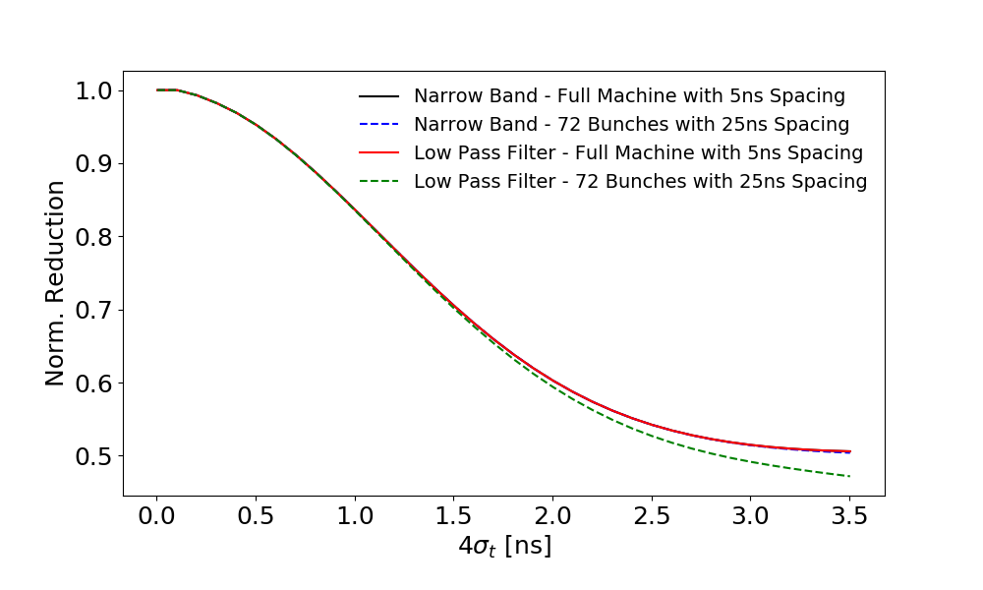





Bunch Length
Taking the idealized signal from the BPM buttons and computing a sum and delta signal and filtering on the sum and delta signals gives:
Where X(t) is the intrabunch motion, I(t) is the charge distribution and F is an operator that performs the necessary filtering.
$$A=C_{1}I\left(t\right)(C_{2}+X\left(t\right))$$
$$Δ=A−B$$
$$\frac{Δ}{Σ}=\frac{F\left(I\left(t\right)X\left(t\right)\right)}{F\left(I\left(t\right)\right)}$$
$$B=C_{1}I\left(t\right)(C_{2}−X\left(t\right))$$
$$Σ=A+B$$
For 4σ_{t}=2.9ns:
Low Pass = 0.4972
Narrow Band = 0.5183
Notes:
Full machine with 5ns spacing means I take one single 200 MHz bucket and put a Gaussian in it. So minimum possible frequency is 200MHz.
72 bunches with 25ns spacing means I take the empty buckets of the full machine (h=4620) and I overlay 72 bunches with 25ns spacing, keeping the rest of the empty machine.

Slide 23
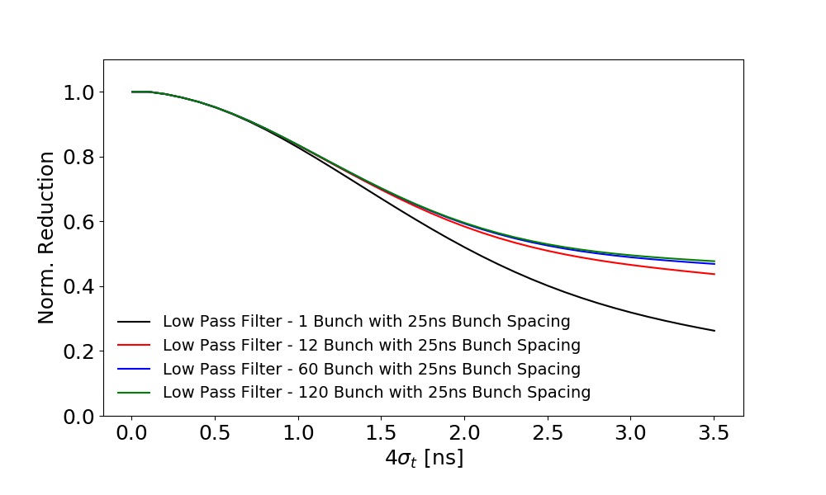
Bunch Length
Taking the idealized signal from the BPM buttons and computing a sum and delta signal and filtering on the sum and delta signals gives:
Where X(t) is the intrabunch motion, I(t) is the charge distribution and F is an operator that performs the necessary filtering.
$$A=C_{1}I\left(t\right)(C_{2}+X\left(t\right))$$
$$Δ=A−B$$
$$\frac{Δ}{Σ}=\frac{F\left(I\left(t\right)X\left(t\right)\right)}{F\left(I\left(t\right)\right)}$$
$$B=C_{1}I\left(t\right)(C_{2}−X\left(t\right))$$
$$Σ=A+B$$
Notes:
Full machine with 5ns spacing means I take one single 200 MHz bucket and put a Gaussian in it. So minimum possible frequency is 200MHz.
72 bunches with 25ns spacing means I take the empty buckets of the full machine (h=4620) and I overlay 72 bunches with 25ns spacing, keeping the rest of the empty machine.

Slide 24
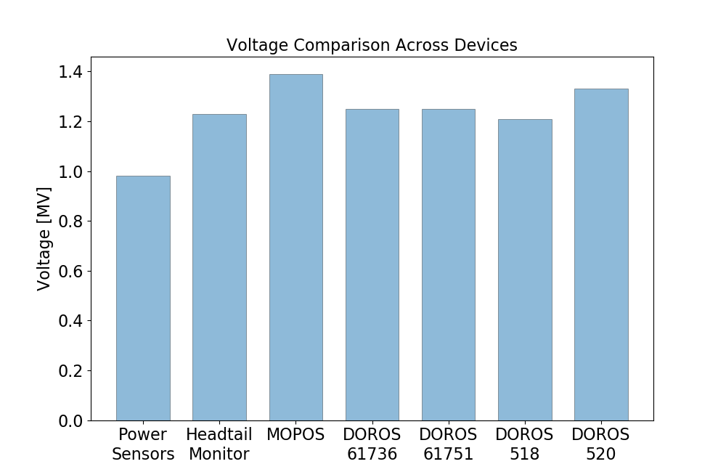
Summary of Measurements
Device | Measured Voltage [MV] | Note
Power Sensors | 0.98 | Dependence on Qe
Headtail Monitor | 1.23 | For z=0
MOPOS BPMs | 1.39 | BL Corrected
DOROS @61736 & 61751 | 1.25 | BL Corrected
DOROS @518, 520 | 1.21,1.33 | BL Corrected

Slide 25
Outline
Introduction
Operational Setup
MD Overview
Diagnostic Comparison
Cavity Transparency
Emittance Growth in Coast
Conclusions

Slide 26
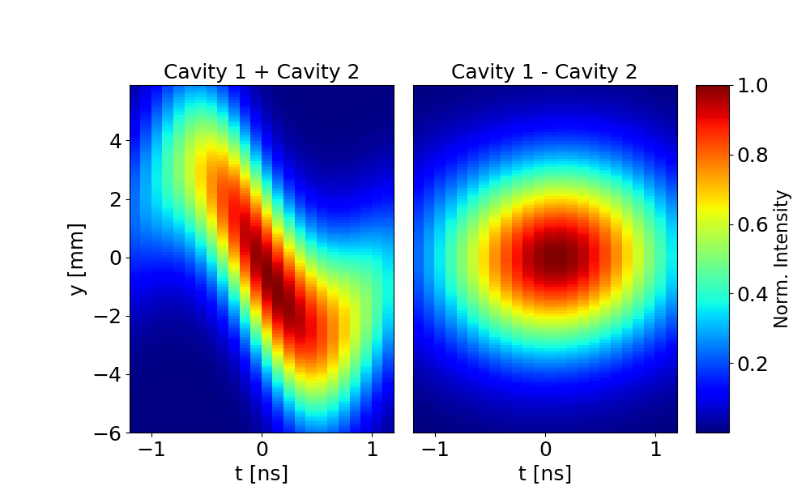
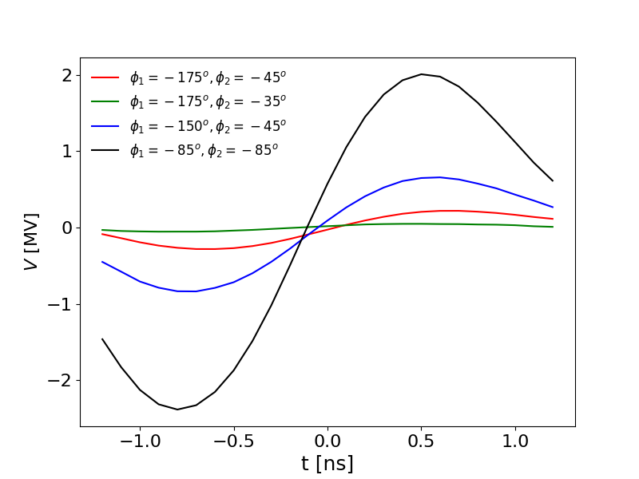
Transparency
For a period during MD7 (17/10/2018 ~10:30 – 11:30) we had both cavities with feedback and tuning loops operational at 2K pulsing with 1MV per cavity.
Set both cavities individually to approximate crabbing phase.
Set them in anti-phase and try to fine tune the phases (minimum step size 5 deg) to minimize the observed crabbing.
Lowest measured crabbing amplitude was ~60kV (with 1MV per cavity).

Slide 27
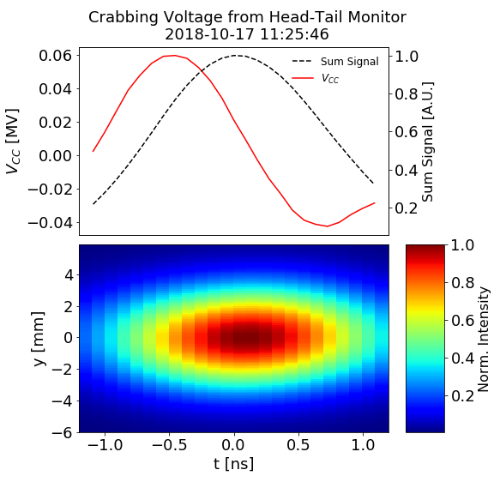
Transparency
For a period during MD7 (17/10/2018 ~10:30 – 11:30) we had both cavities with feedback and tuning loops operational at 2K pulsing with 1MV per cavity.
Set both cavities individually to approximate crabbing phase.
Set them in anti-phase and try to fine tune the phases (minimum step size 5 deg) to minimize the observed crabbing.
Lowest measured crabbing amplitude was ~60kV (with 1MV per cavity).

Slide 28
Outline
Introduction
Operational Setup
MD Overview
Diagnostic Comparison
Cavity Transparency
Emittance Growth in Coast
Conclusions

Slide 29
Emittance Growth in Coast
Crab cavity is a transverse kicker with a feedback system.
The feedback spectrum spreads over a wide range of frequencies which includes the first betatron sideband.
Crab cavity feedback means the bunch is being kicked at the tune, which causes emittance growth. Needs to be quantified!
Measurements were made of the emittance growth in coast as a function of the strength of the feedback spectrum at the tune.

Slide 30
Emittance Growth in Coast
CC1 idling (no RF), CC2 field at ~1 MV
4 coasts with some varying settings during each coast.
Transverse profile is measured with Wire Scanners
  Emittance is calculated by fitting the measured profile and bringing in the relevant optics parameters.
  Average emittance over 4 bunches is used
Coast MDs in 2017 defined the optimum settings for these kinds of measurements.
ADT off, 800 MHz off, longitudinal feedback and damper off, Qh=0.13, Qv=0.18, Q’h = 2, Q’v = 2.

Slide 31
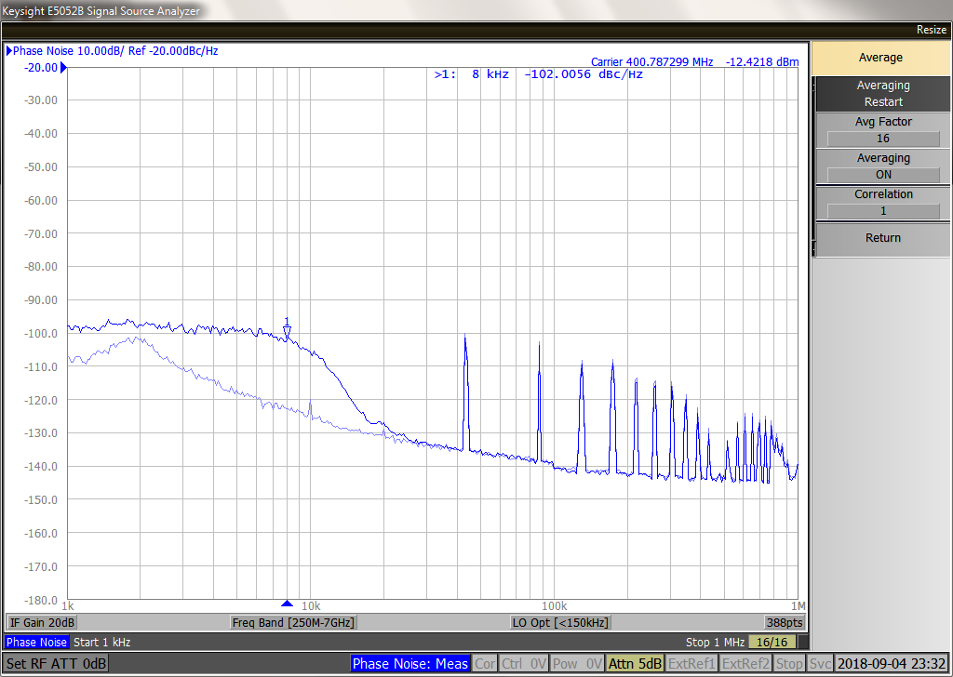
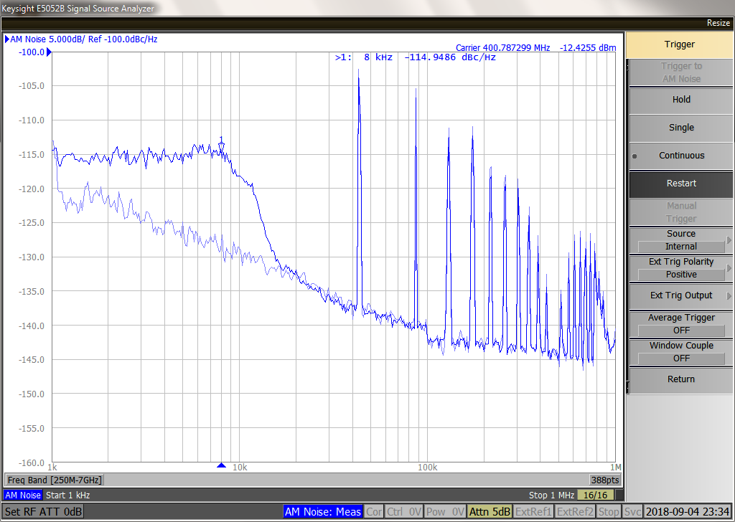
Injected Noise
RF noise added vectorially -> always a mixture of phase and amplitude noise. Phase noise was always dominant but some amplitude noise present.
RF noise (PM and AM) covered a band from DC to 10 kHz only -> excites the first betatron band only (around 8 kHz)
CC2 phase and amplitude noise Power Spectral Density measured with Signal analyser.
Below is the power spectral density measured in the cavity antenna.
Phase
Amplitude
Added noise @8kHz
Added noise @8kHz
Baseline
Baseline

Slide 32
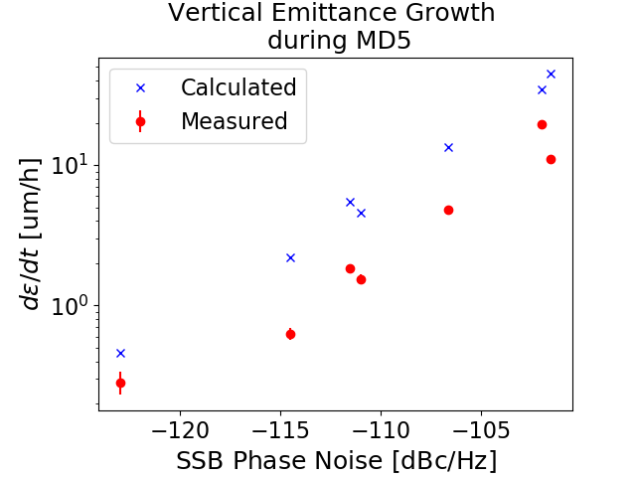
Results
The x-axis is the Phase Noise PSD. Although always smaller, the Amplitude Noise PSD varied during the successive coasts. This explains the different calculated values for very similar Phase Noise PSD, and may partly explain the different measured emittance growth.
The calculations over-estimate the growth by factor 2-4
Measured (Wire Scan) and calculated during the coasts with different noise levels.

Slide 33
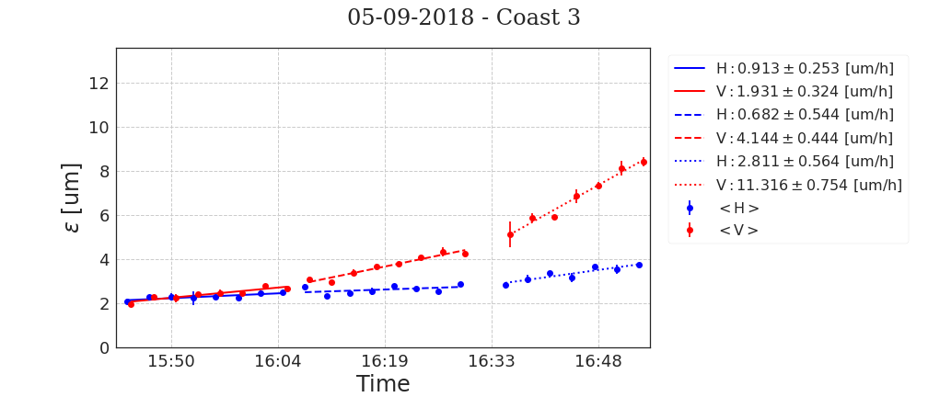
Possible reasons for the difference
Differences between definition of emittance between the measured and the calculated.
The measured emittance does not include beam losses: The bunch population from the fit decreases by 8-11% during the excitation. Could be real loss or moving particles from the core to the tails where the wirescan cannot detect it.
An additional source of error is the apparent coupling between the horizontal and vertical planes, which is not included in the calculations
The horizontal emittance growth rate is clearly increasing as we inject noise on the vertical plane.

Slide 34
Emittance Growth Summary
The first measurements of emittance growth show a factor of 2-4 lower growth than predicted.
Several factors suggest that the measured data are under-estimated, work is progress to understand exactly what the sources of discrepancy are.
The factor 2-4 is not very important though as the noise level must be reduced by factor 100-1000 (in power) for the HL-LHC target if calculations are trusted
This confirms that a very significant effort in RF noise reduction must be achieved for HL-LHC.

Slide 35
Outline
Introduction
Operational Setup
MD Overview
Diagnostic Comparison
Cavity Transparency
Emittance Growth in Coast
Conclusions

Slide 36
Conclusions
Successful MD program entirely down to the huge amount of work put in by all people involved.
Demonstrated the worlds first crabbing of a proton beam.
Able to provide answers to some of the beam dynamics questions surrounding the use of crab cavities in the LHC.
Provided some vital experience for future testing of crab cavities, relevant for both future SPS tests and for installation into the LHC.

Slide 37
Thanks for listening!

Slide 38
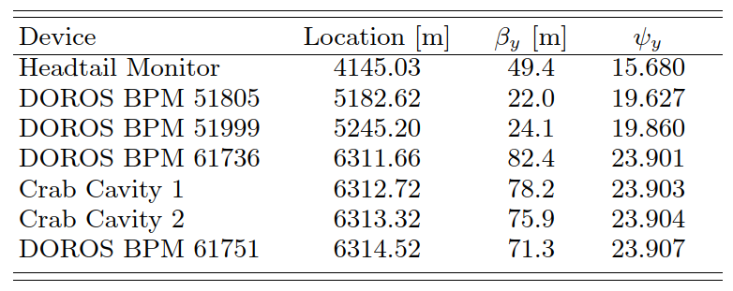
Diagnostic Information
https://docs.google.com/document/d/1kpqnNSXJv7Ro7iQ6OtxvnT4EUOSfYEWxjqUxqEZVIG0/edit

Slide 39
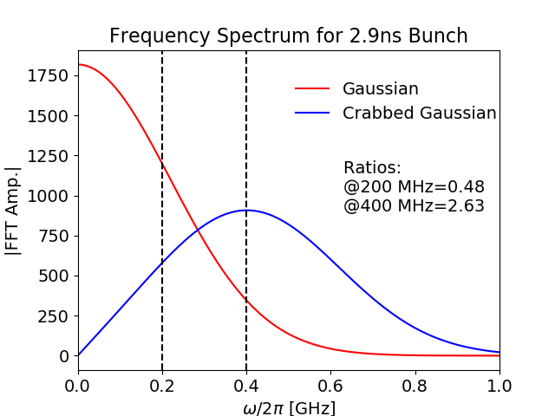
Backup

Slide 40
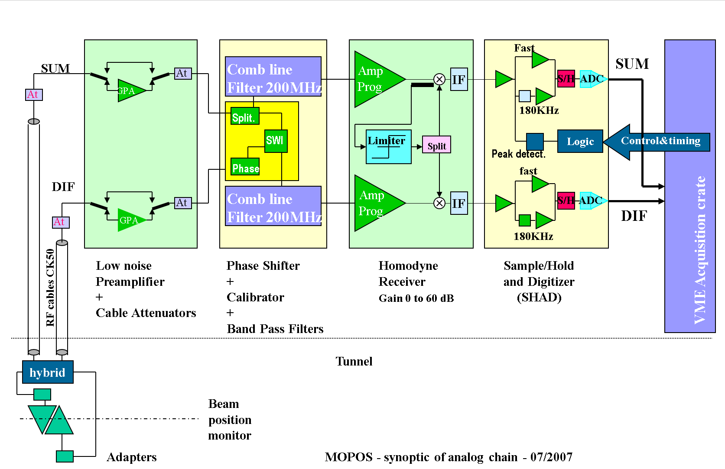
Bunch Length
200 MHz resonant filter. How does this behave when crabbing is present?

Slide 41
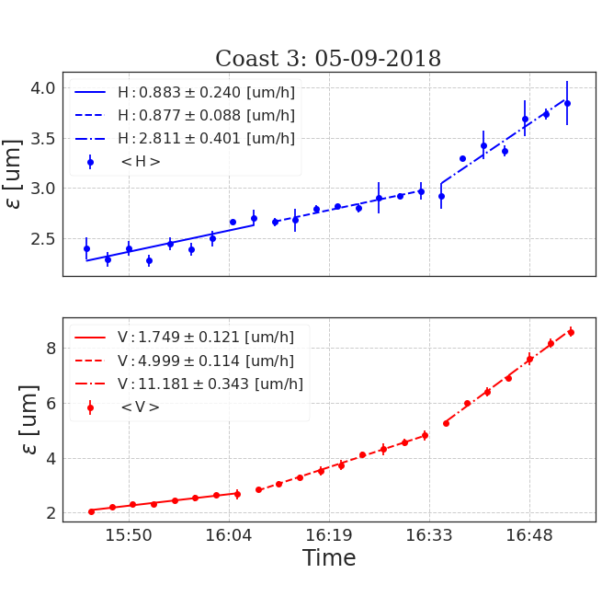
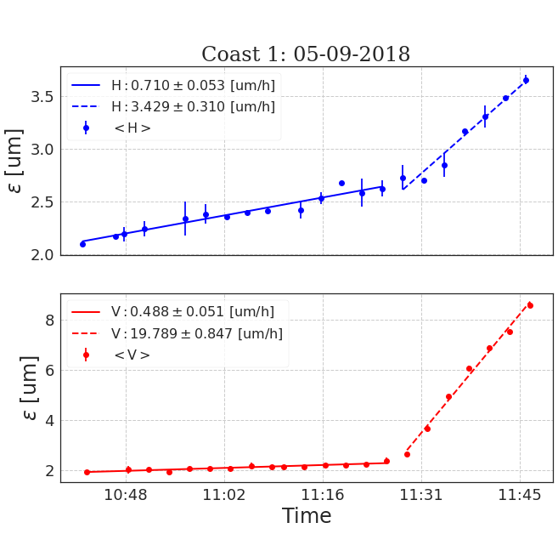
MD5: Summary of Coasts
0 [A.U.]
0 [A.U.]
-5 [A.U.]
Baseline
-10 [A.U.]

Slide 42
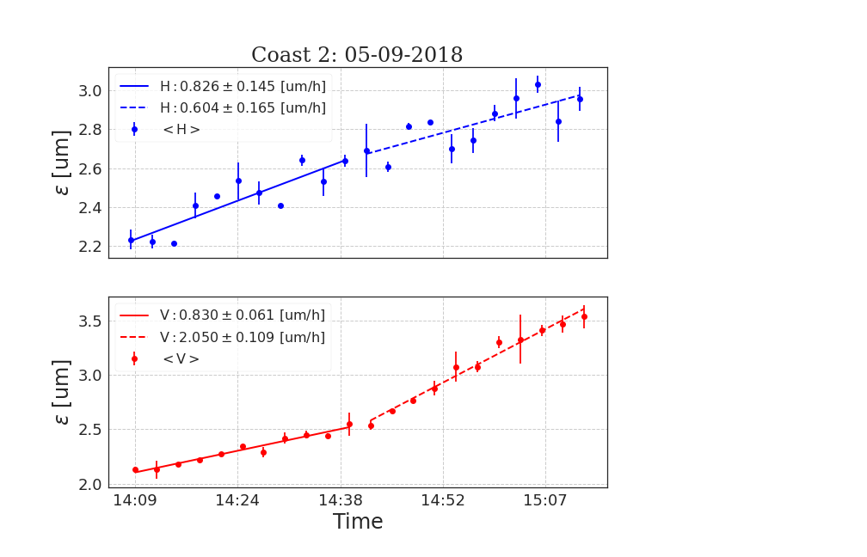
MD5: Summary of Coasts
-5 [A.U.]
-10 [A.U.]

Slide 43
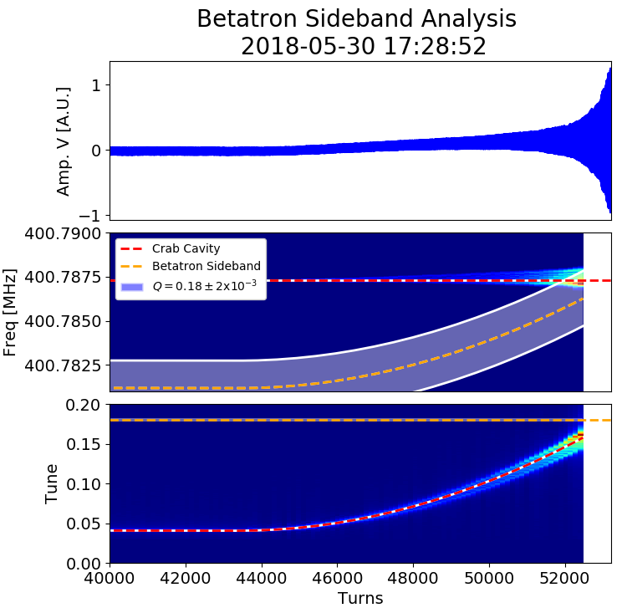
Ramp to 270 GeV
Vertical tune: $Q_{y}=0.18$
RF Freq:
Cavity 1: 400.787 MHz (~1 MV)
Cavity 2: 400.528 MHz (almost zero)
Resonant excitation observed as we cross the vertical tune (black dotted lines).
Kicking the beam at 270 GeV equivalent frequency , while sweeping the beam frequency from 26-270 GeV
After setting the correct cycle start voltage to 270 GeV equivalent, beam circulated w/o any issue

Slide 44
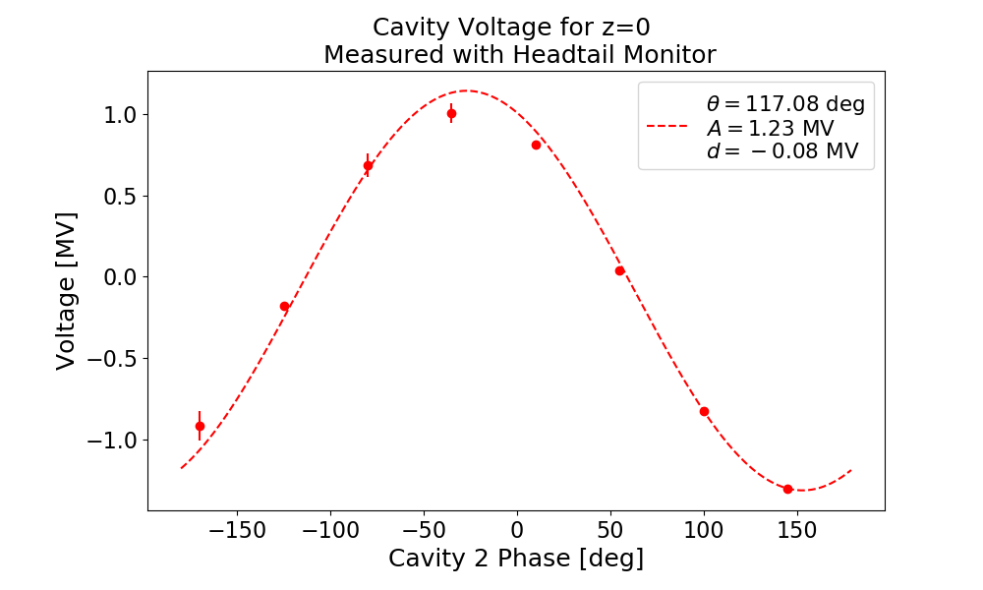
Diagnostic Comparison: Headtail Monitor
Headtail monitor measures intra-bunch offset.
  Calibrated with MOPOS BPMs without crabbing at end of 2017 and start of 2018.
One measurement per cycle
Below is a plot of the cavity voltage for the peak of the charge distribution, i.e. for a particle at z=t=0.
Measurement below shows sinusoidal fit and shows 1.23MV amplitude in cavity 2, more than the 0.98MV from the power sensors.
A=Amplitude
d=Offset
θ=Phase Offset
for ω=2π400MHz.

Slide 45
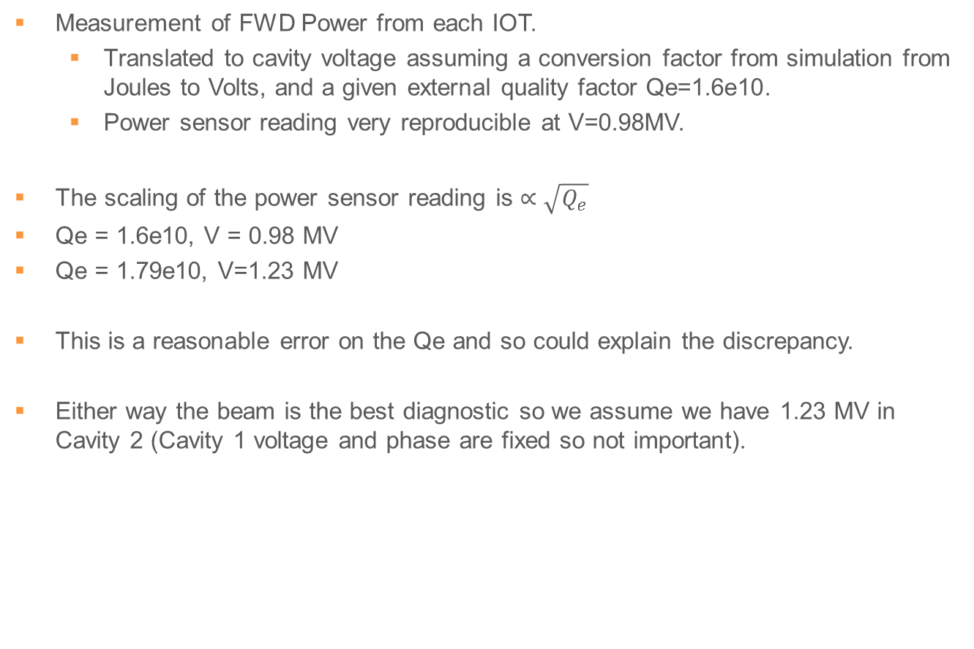
Diagnostic Comparison: Power Sensors
Measurement of FWD Power from each IOT.
  Translated to cavity voltage assuming a conversion factor from simulation from Joules to Volts, and a given external quality factor Qe=1.6e10.
  Power sensor reading very reproducible at V=0.98MV.
The scaling of the power sensor reading is $∝\sqrt{Q_{e}}$
Qe = 1.6e10, V = 0.98 MV
Qe = 1.79e10, V=1.23 MV
This is a reasonable error on the Qe and so could explain the discrepancy.
Either way the beam is the best diagnostic so we assume we have 1.23 MV in Cavity 2 (Cavity 1 voltage and phase are fixed so not important).

Slide 46
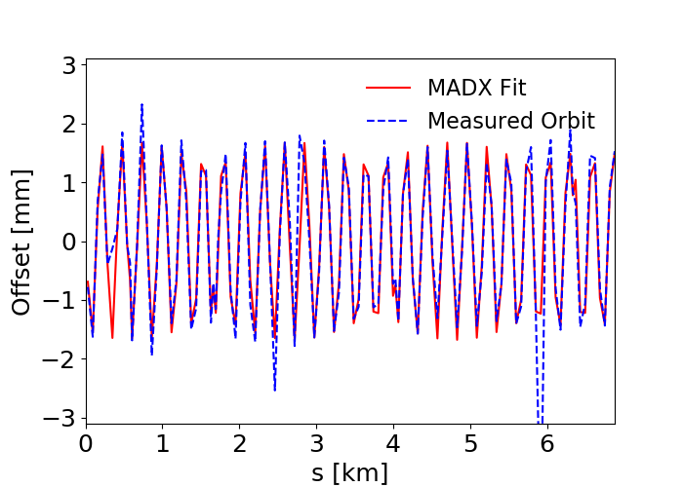
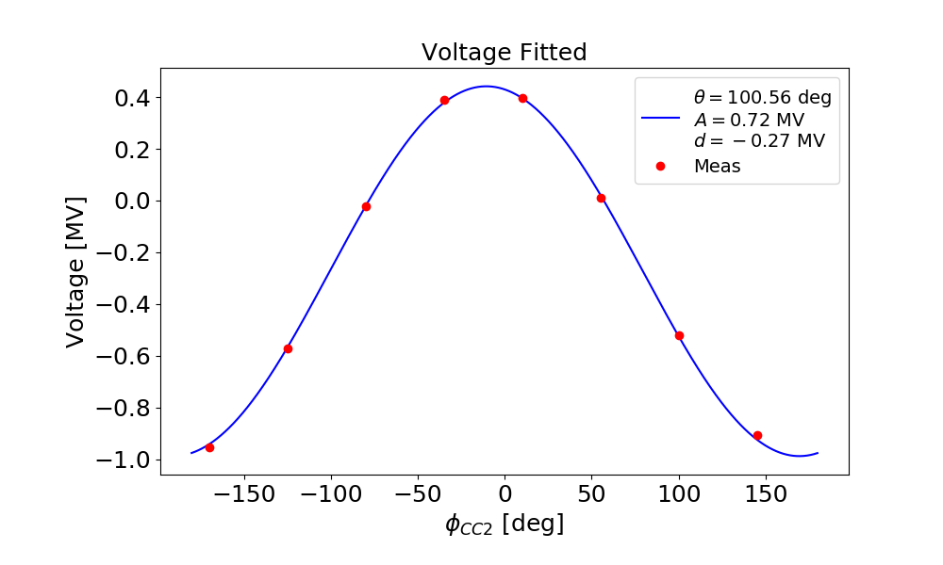
Diagnostic Comparison: MOPOS
For each cycle we acquire the orbit from MOPOS BPMs.
Take one orbit step as a reference and subtract it from all points to remove closed orbit without crab cavities.
Can then fit a kick using MADX twiss parameters and find the equivalent voltage to recreate the closed orbit from the crab cavities for each step.
The fitted MADX model does NOT include any effect of the bunch length.

Slide 47
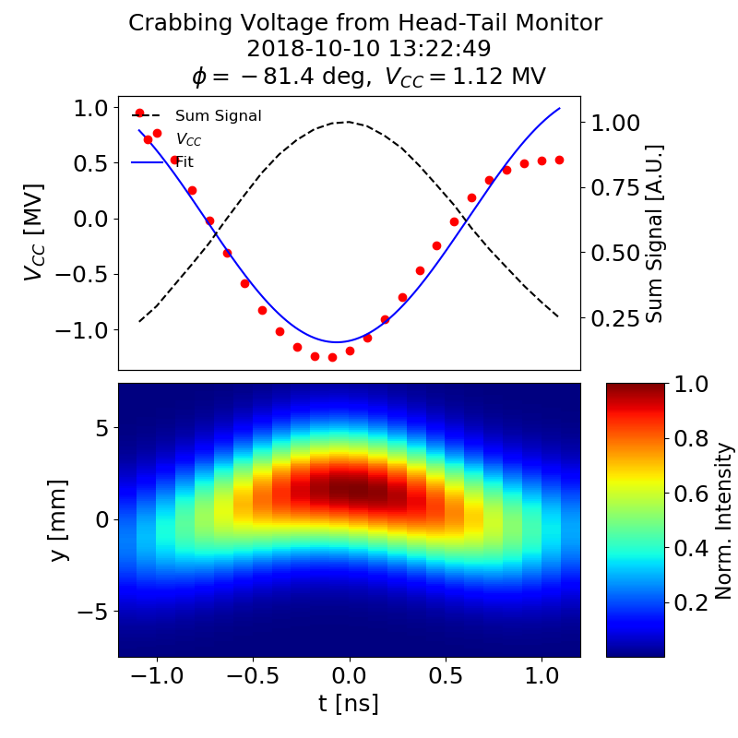
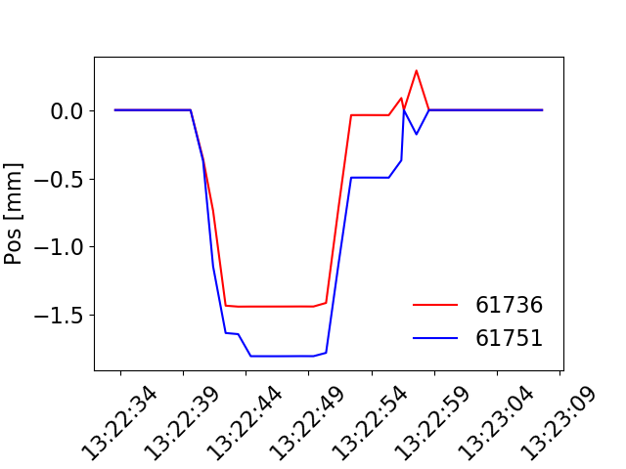
Diagnostic Comparison: DOROS
4 DOROS BPMs in total. 2 ~1m either side of crab cavity cryomodule and 2 in ring.
Acquires every 1s but averages over previous 2 seconds (polarity switching frequency of 1Hz).
CC RF is off for first half of 26GeV cycle, then switched on after all bunches are injected.
Orbit shift at crab cavity is observed. Required kick for this shift can be calculated.
Example
CC RF off
CC RF on

Slide 48
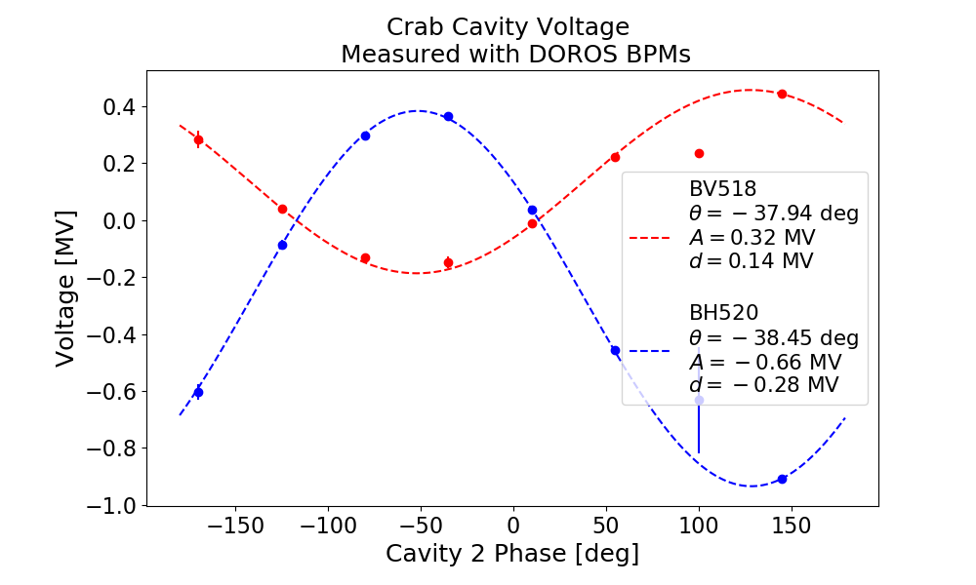
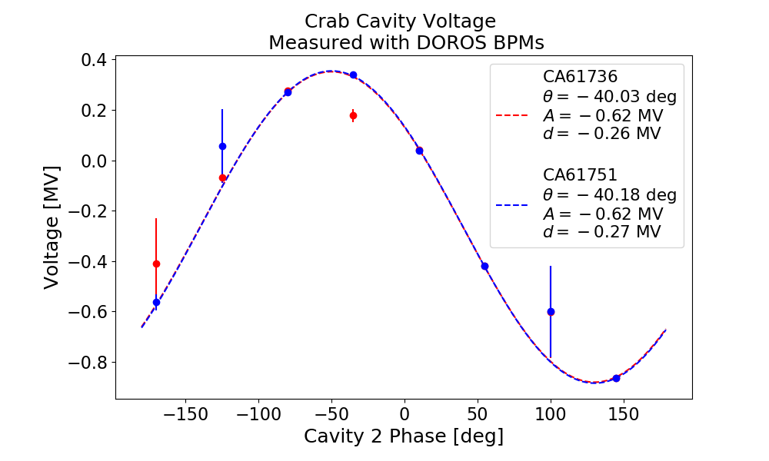
Diagnostic Comparison: DOROS
Yet again, a smaller kick than expected. Bunch length effect NOT included.
BV518 is ~ factor 2 lower than for all other BPMs. This is a software issue where FESA does not consider the correct aperture (H instead of V). Can be rescaled with 156mm/83mm.

Slide 49
Emittance Growth Calculations: Unnormalized Emittance
Phase noise
Beam parameters
Geometric factor (bunch length)
Depends on the overlap between phase noise spectrum and betatron tune distribution
Noise spectrum is aliased at f_{rev}
The “phase-noise geometric factor” decreases with bunch length
Depends on the overlap between phase noise spectrum and synchro-betatron tune distribution
The “amplitude-noise geometric factor” increases with bunch length.
Amplitude noise
  See P. Baudrenghien and T. Mastoridis, “Transverse emittance growth due to rf noise in the high-luminosity lhc crab cavities,” Phys. Rev. Accel. Beams 18, 101001 (2015).https://journals.aps.org/prab/abstract/10.1103/PhysRevSTAB.18.101001

