Slide 1
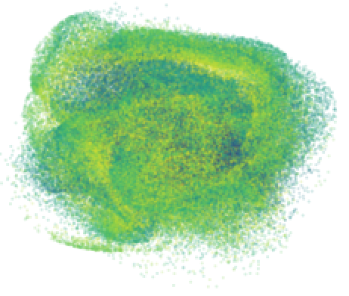


Northern Illinois Center for Accelerator
and Detector Development
High-Charged Magnetized
Beams at FAST-IOTA
Northern Illinois University: A. Fetterman*, C. Marshall*, P. Piot$
Fermilab: J. Ruan,
Collaborators at JLab: S. Benson, J. Gubeli,
F. Hannon, S. Wang
* Graduate students
$ also FermiLab

Slide 2
Introduction/Motivation
High-charge magnetized beam:
  Production of high-charge (3.2 nC) magnetized beam
  characterization of magnetization
  Transport + manipulation over long beamline including use of locally non-symmetric optics
High-current magnetized beams → understanding halo
  Explore halo formation in magnetized beam using a long-dynamical range diagnostics (LDRD)
New merger concept:
  Tests of merger concept combining RF deflector and magnetic coil proposed by A. Hutton -- augmenting recent test at Cornell.

Slide 3
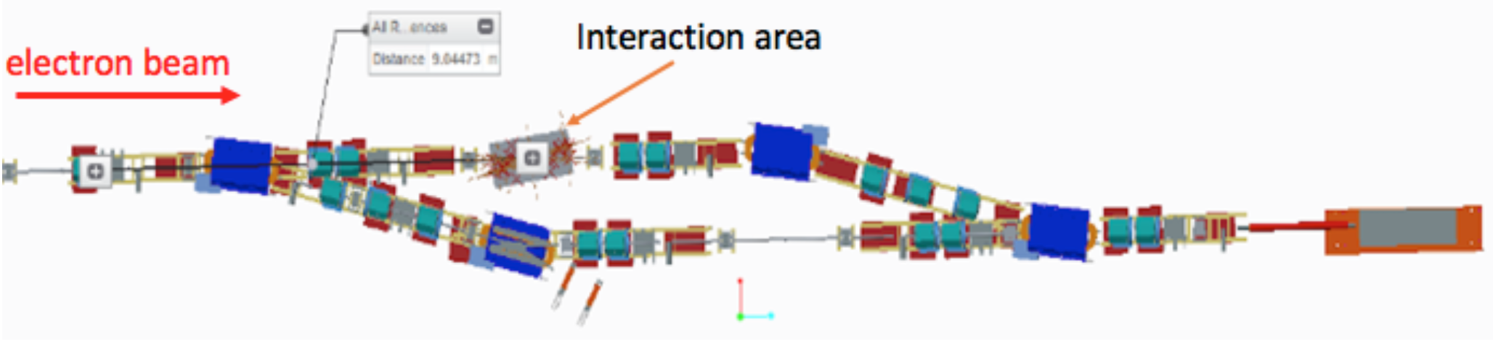
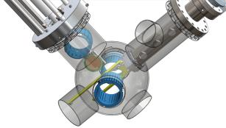
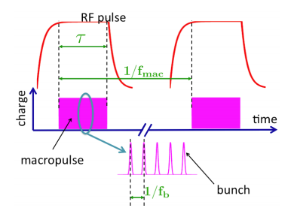
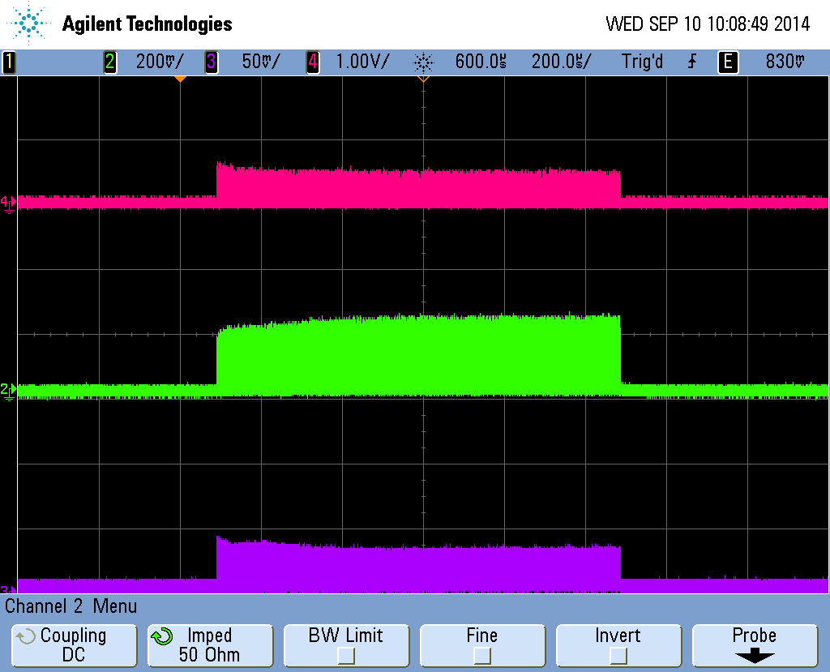
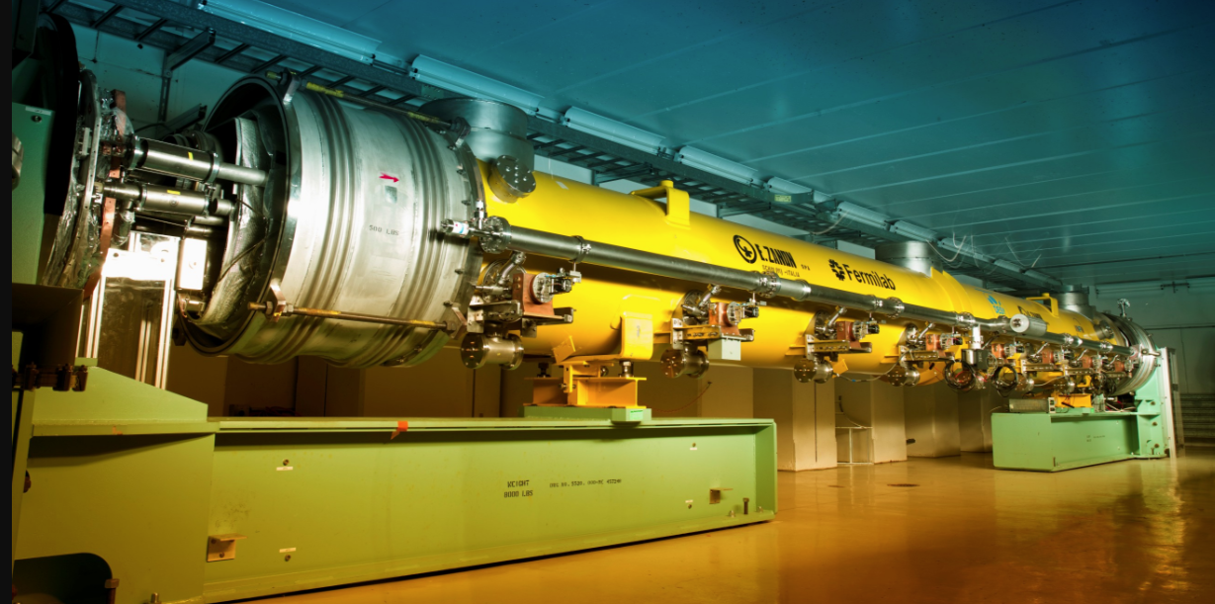
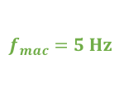
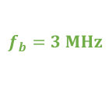
The FAST facility infrastructure
110 meters
RF gun
50-MeV injector
section
300-MeV
area
superconducting linac
LDRD
e- dump
BC1
superconducting
accelerating cavities
FAST facility accelerator vault
Integrable-optics
Test accelerator (IOTA)
`
SHG2
IR pulse train before SHG1
$$f_{b}=3 MHz$$
$$f_{mac}=5 Hz$$
Green pulse train before SHG2
SHG1
UV pulse train (electron beam)
1.2 ms
FAST photocathode
laser system

Slide 4
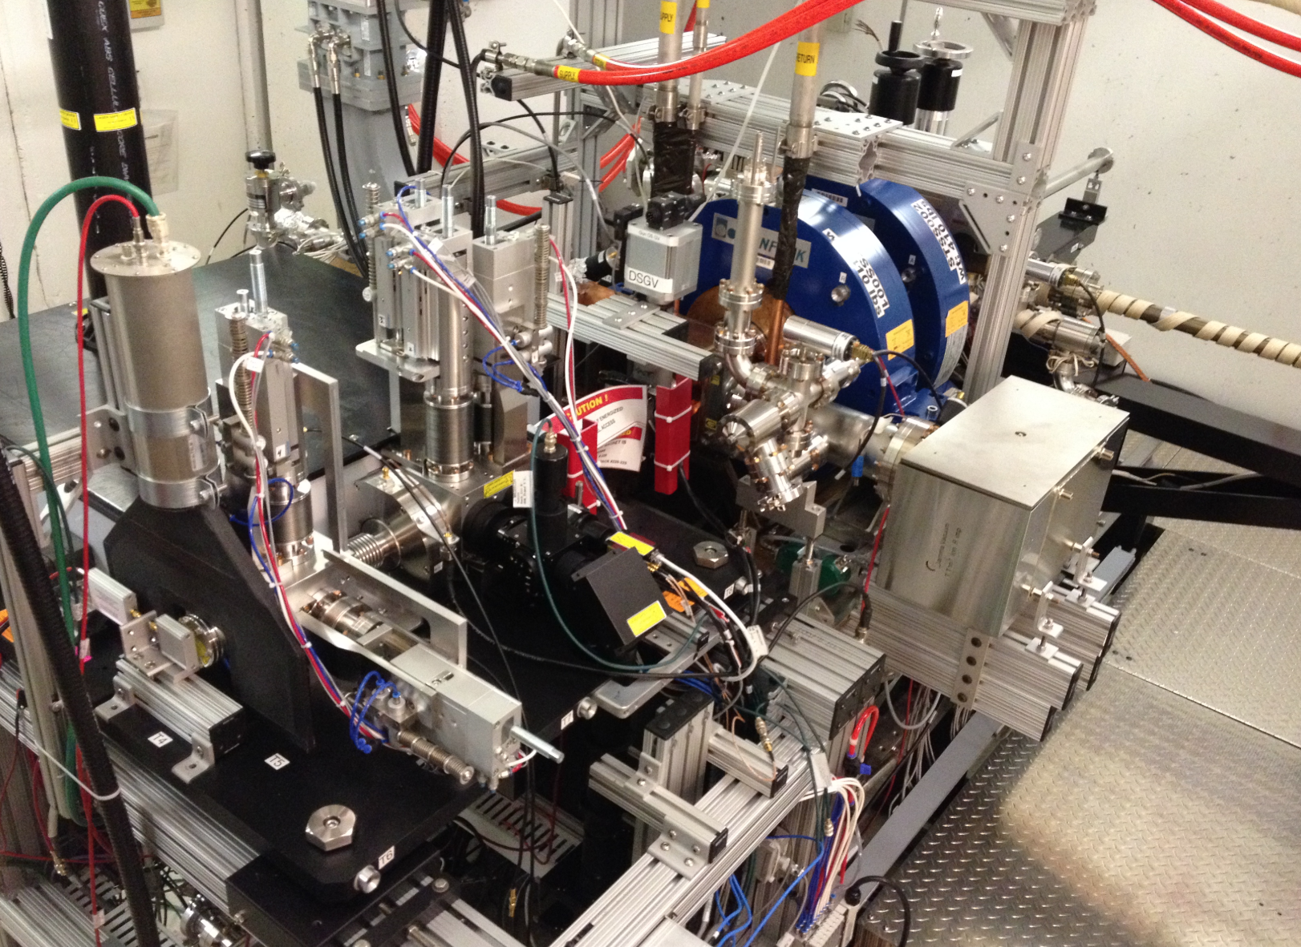
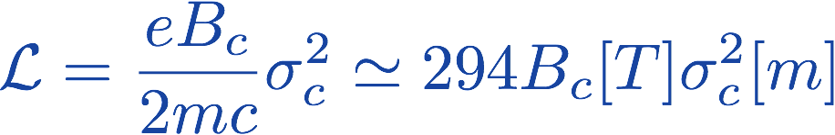
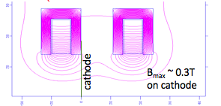
Magnetized beams in the FAST injector
The FAST injector includes
  1+1/2 RF gun
  High quantum efficiency Cs₂Te photocathode
  A symmetrical solenoid configuration can provides substantial field on cathode up to 0.15 T
Magnetized beam is characterized by the magnetization parameter
Laser-spot
size on cathode
L1 L2
B field on
cathode

Slide 5
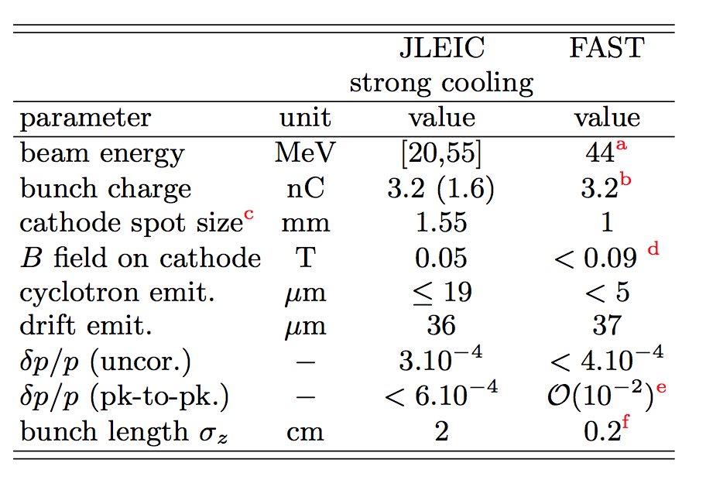
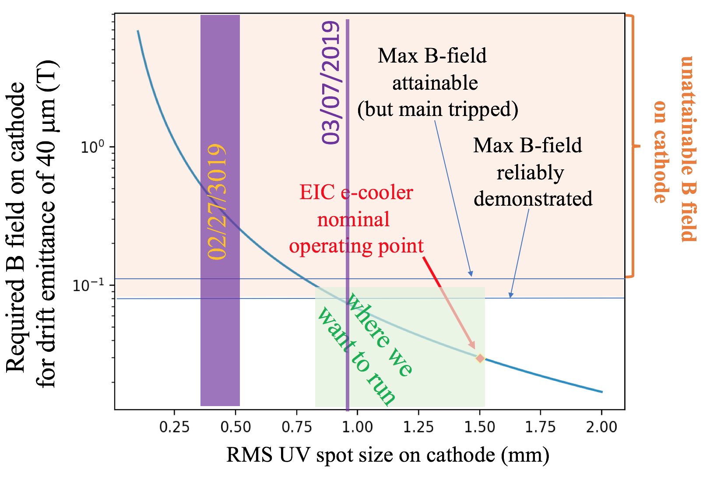
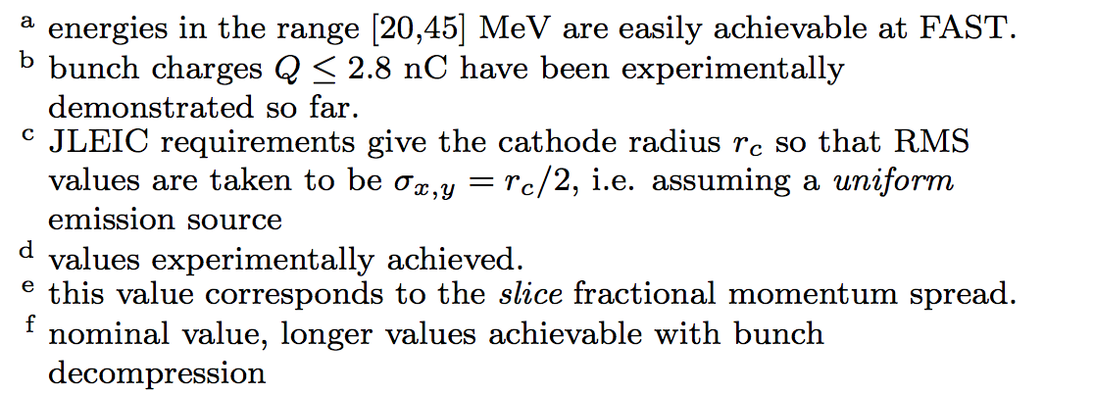
Relevance of FAST injector to EIC e- cooling
Similar beam parameters except
for a higher peak current

Slide 6

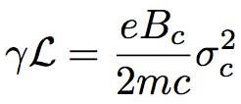


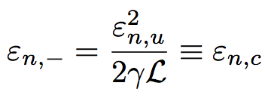

Note on emittances
Effective emittance of a magnetized beam
with magnetization given by
Eigen emittances
4-D emittance
“drift” emittance
“cyclotron” emittance

Slide 7
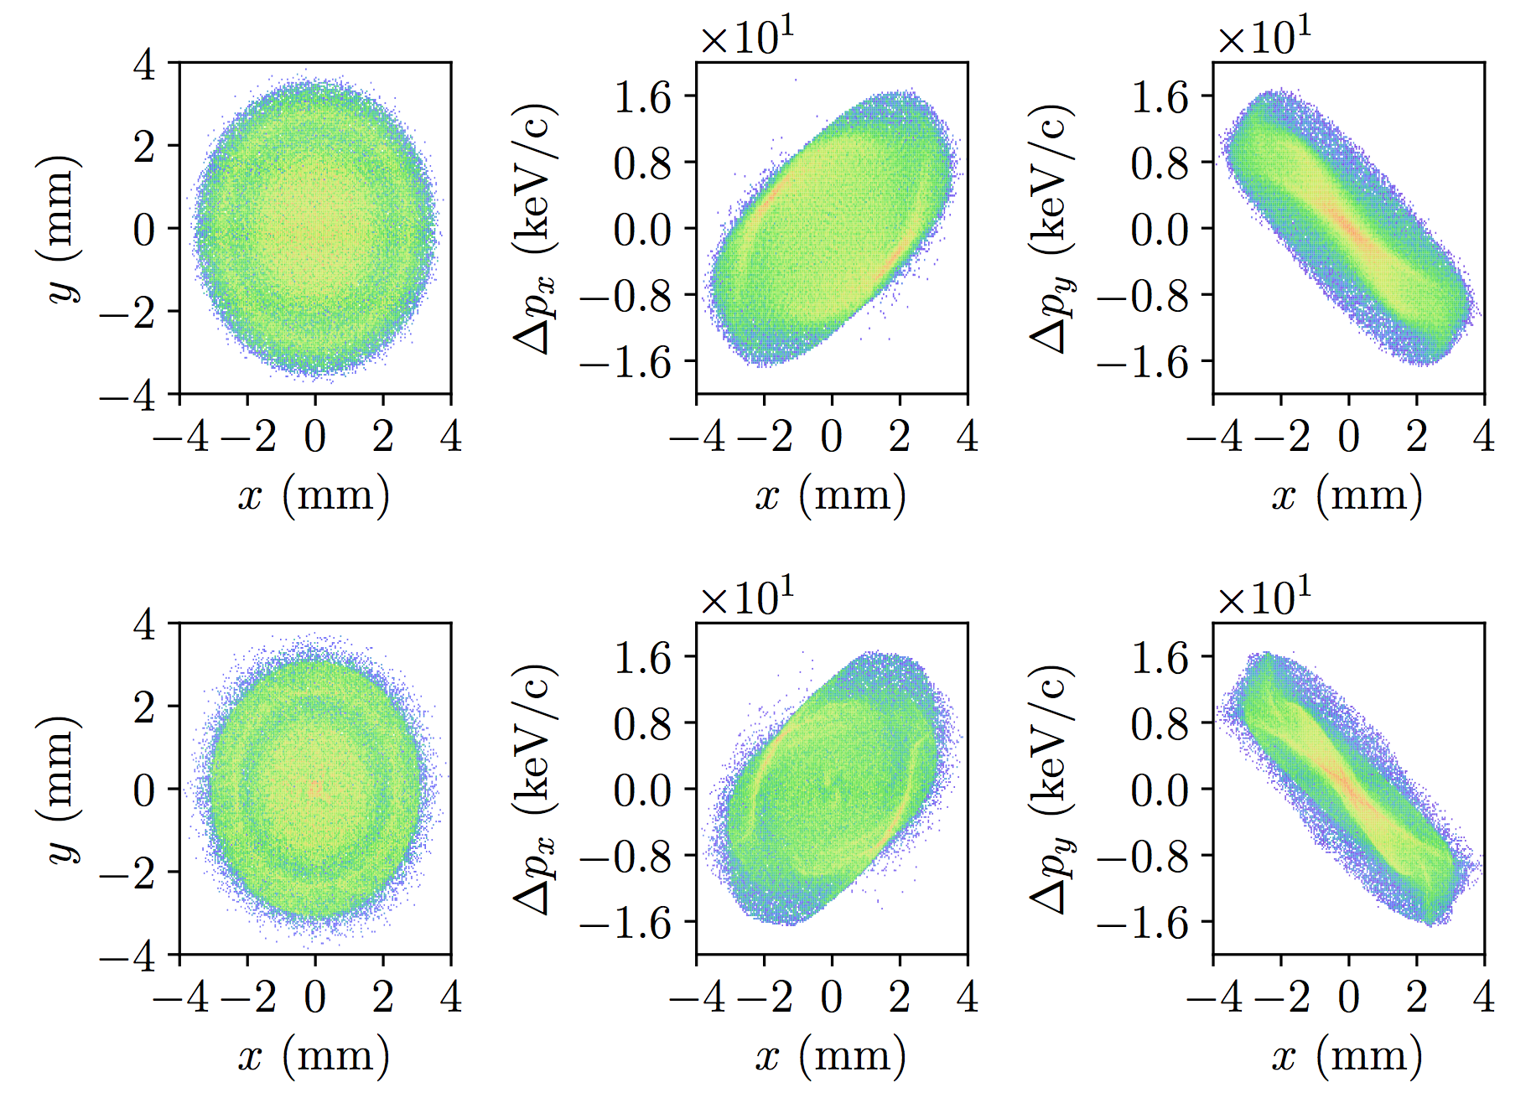
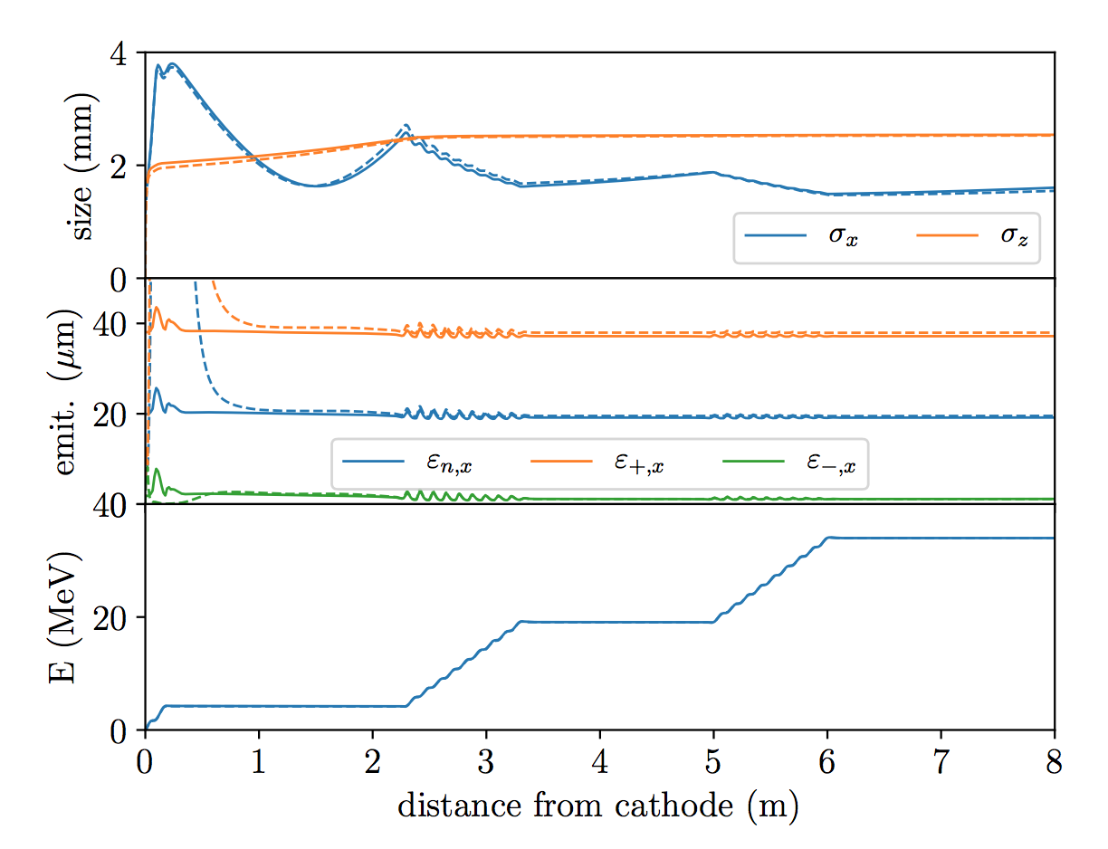
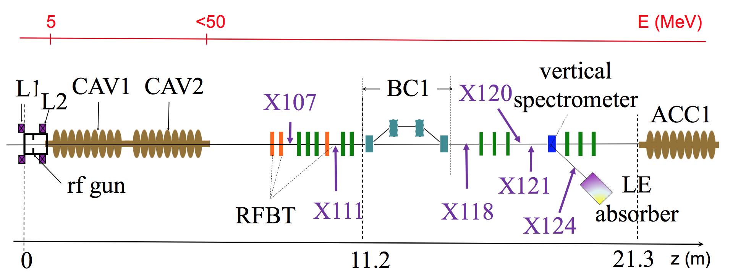
Example of optimization for 3.2 nC (simulations)
Distributions at z=8 m from photocathode
Excellent agreement between
ASTRA and IMPACT-T codes
ASTRA
IMPACT-T
CAV1
CAV2

Slide 8
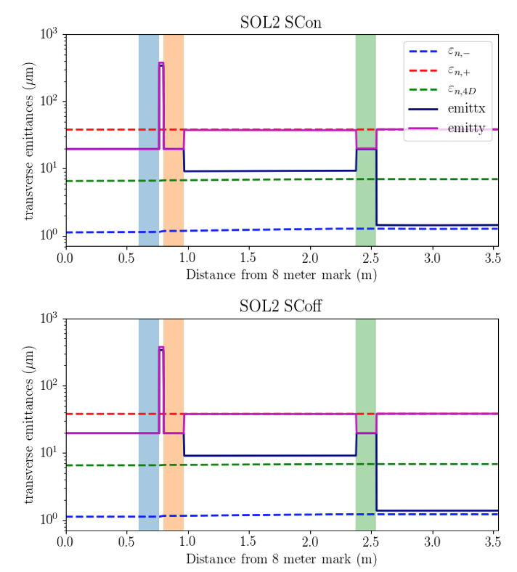
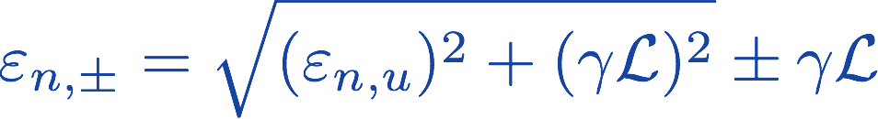

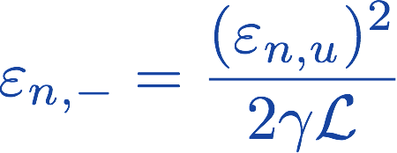
How can we measure the eigen emittances?
map the eigen emittances into conv-entional emittance using a round-to-flat-beam converter:
mapping is excellent (<5%) even in presence of space charge (Q=3.2 nC
and K~40 MeV)
(when beam is
CAM-dominated)

Slide 9
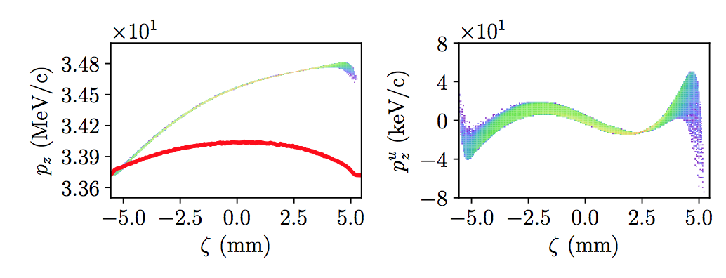
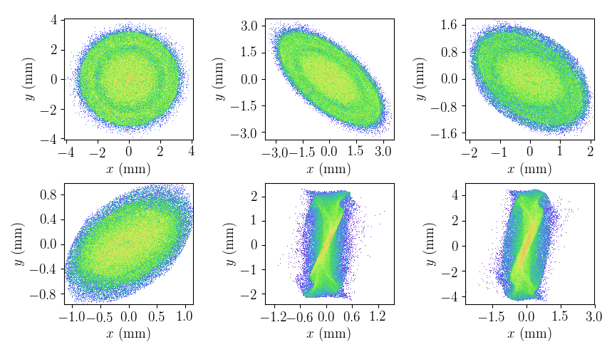
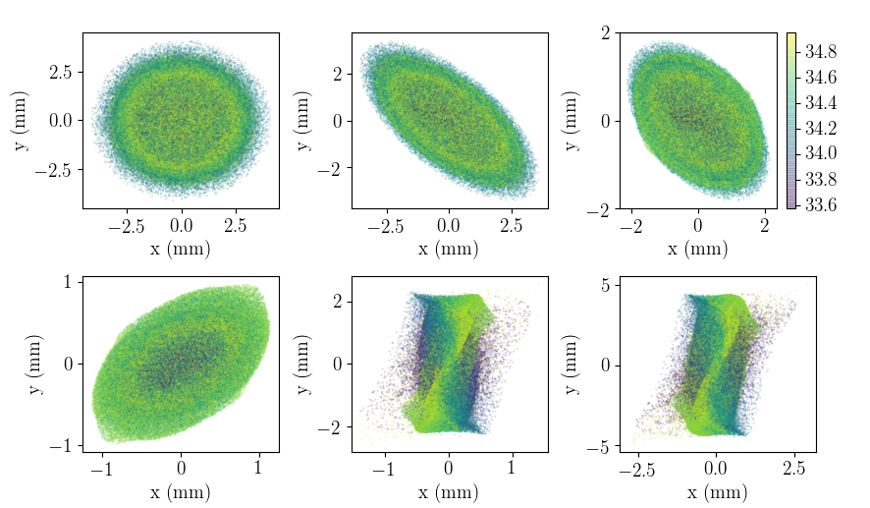
Mapping of eigen emittance to conventional emittances
Longitudinal phase space (left: 5th-order correlation removed)
Large total energy spread results in
chromatic aberrations [uncorrelated
energy spread O(1 keV)]
RMS matching to tune the RFTB is
probably not the best approach
2 keV
E (MeV)
Development of round-to-flat beam transformation
same but with macroparticle color-coded with energy

Slide 10
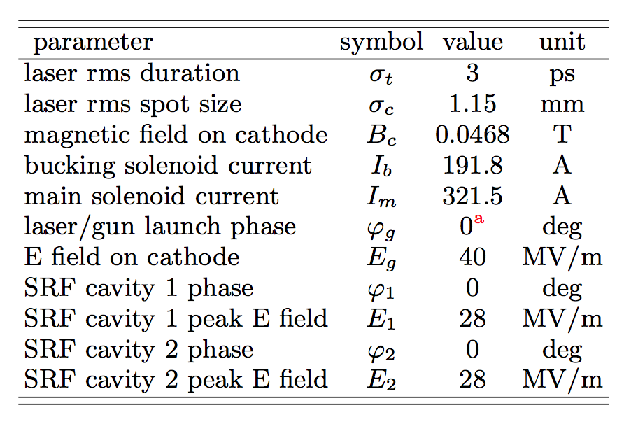
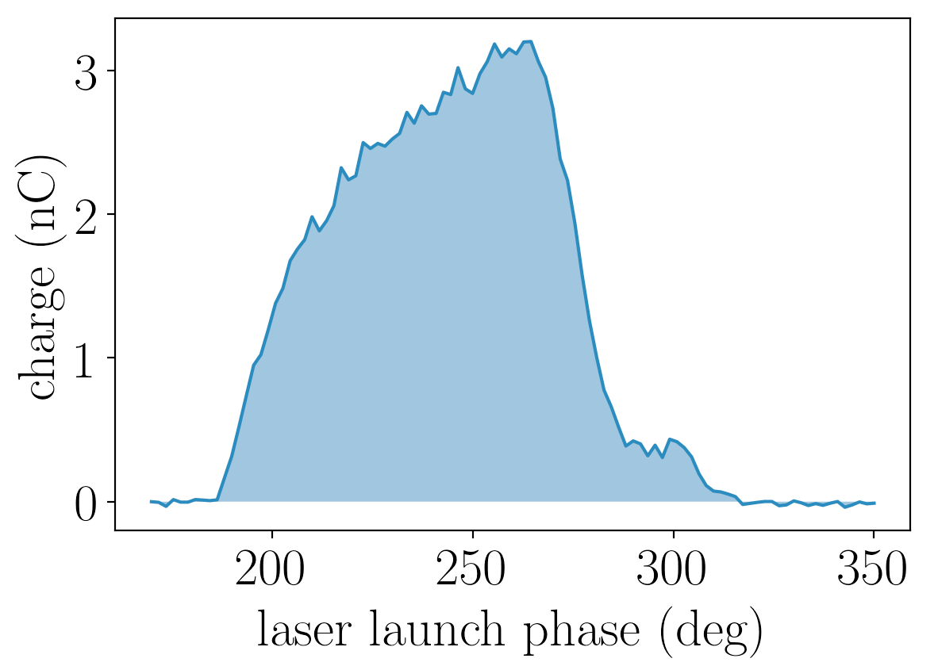
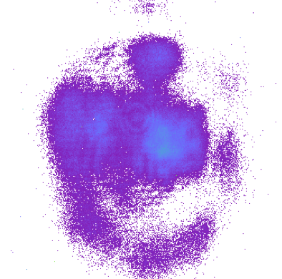
Experiment at FAST (March 2019)
6 shifts in march 2019:
  Optimized parameters were not all
  simultaneously attainable (CAV1 field had to be lowered)
  Laser distribution uniformity was
  an issue
  Solenoid fields were varied while
  locking the B-field on cathode
26
6 mm

Slide 11
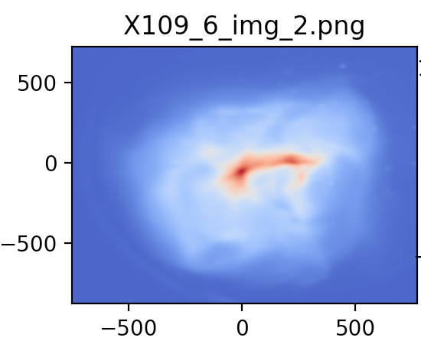
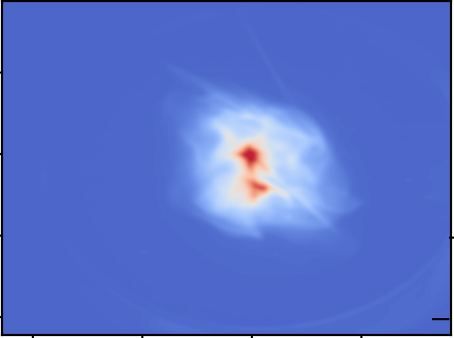
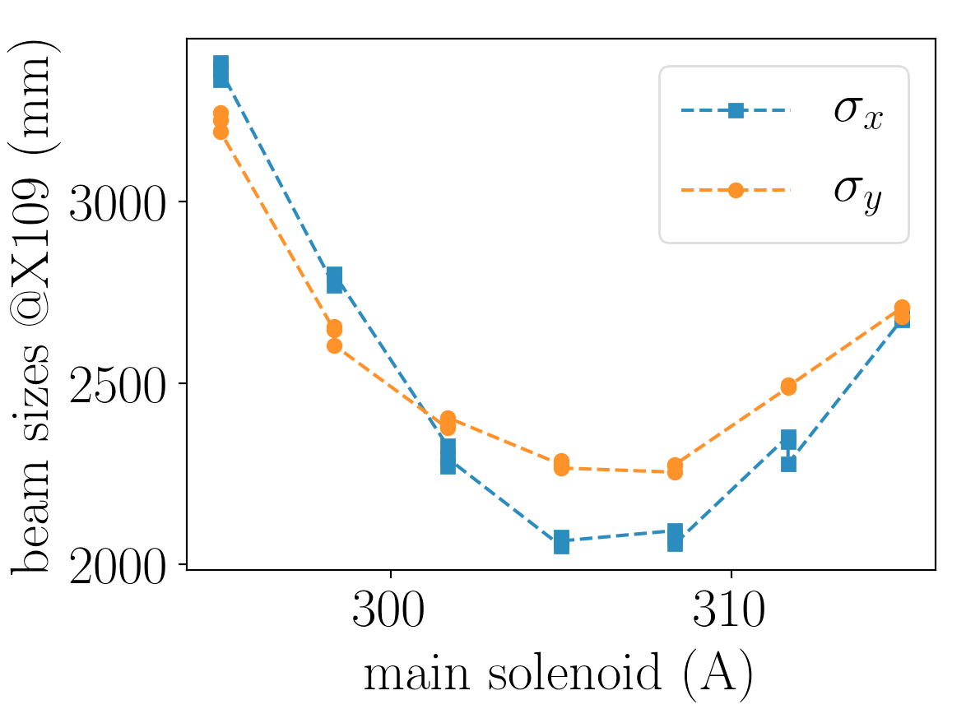
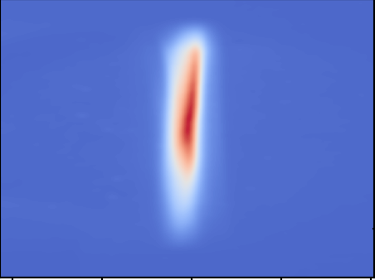
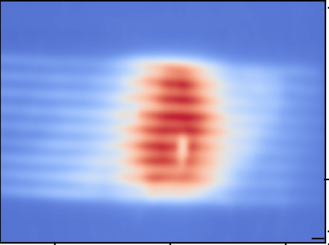

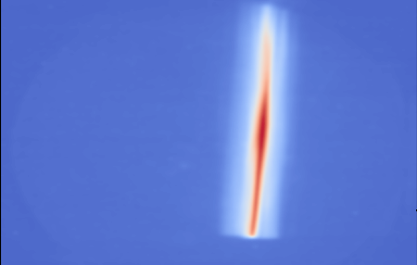
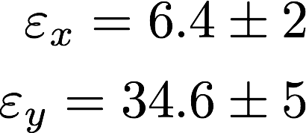
Preliminary Analysis of one case (3/14 data)
X106
X111
Q=3.29+/-0.1 nC
B_{c}=678 G
Solenoid scan with fixed
B field on cathode
X118
X120 +X118H
Measured
normalized
emittance in μm
X120 +X118V
PRELIMINARY
we expect
46 um from B_{c}
FlatBeam2019/MagBeam_EIC/MAR-14-2019/SolScan_fixedBcath_20190315_003959

Slide 12

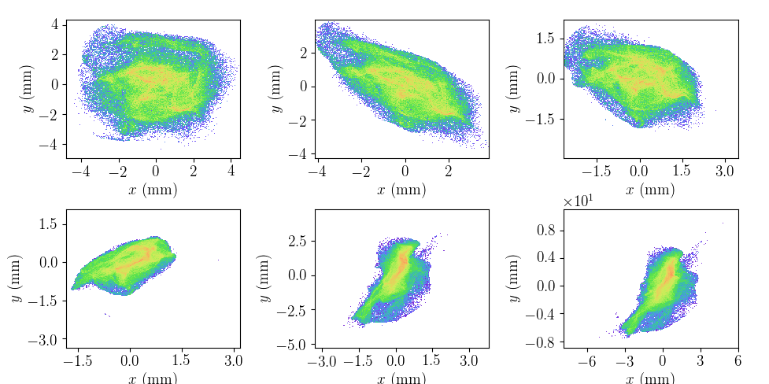
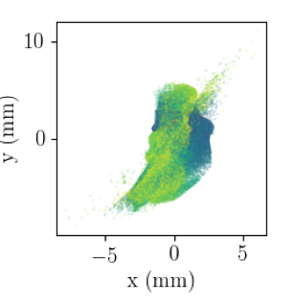
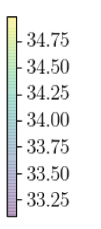
Simulation using realistic experimental conditions
Optimization done for idealized laser distribution
Impact of non-ideal distribution is explored via simulation
9 mm
E (MeV)
9 mm

Slide 13
Conclusions on measurements
Measurement technique tested based on mapping of eigen emittance to conventional emittance tested
Data will be analyzed over the next few weeks
  Better analysis based on RMS calculation
  Compared measured eigen emittance with what expected from B field on cathode and understand discrepancies
  Use simulation to guide/understand data analysis
FAST-IOTA is currently in a “spring” shutdown to install H- source for IOTA. We will use this down time to:
  Improve the laser transport + uniformity (considering using a UV DMD).
  Check diagnostics
  Install hardware related to future magnetized-beam work

Slide 14
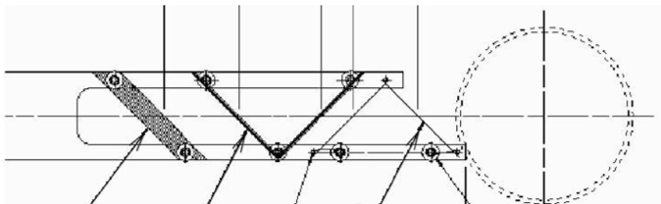
Halo formation in magnetized beams
Halo could cause beam loss which
would ultimately limit the average
current of the ERL cooler
Various source of halo (some could be mimicked with laser shaping)
Large-dynamical-range diagnostics developed at Jlab (P. Evtushenko
and J. Gubeli):
  Wire scanner with high-dynamical range electronic or PMT (measured projections only)
  YaG:Ce screen with dual-sensor detection system.
YAG
screen
wire scanner
assembly

Slide 15
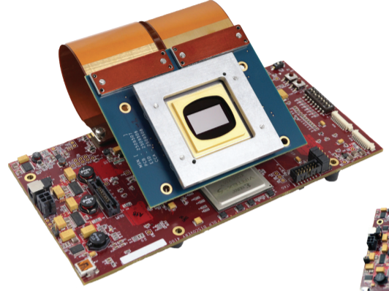
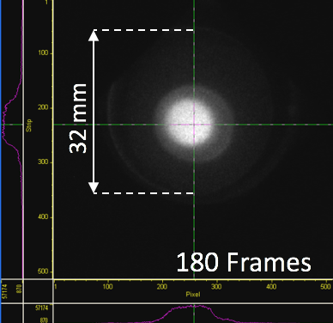
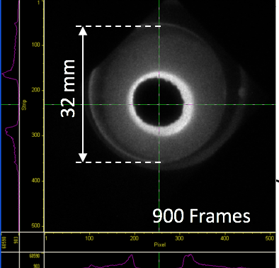
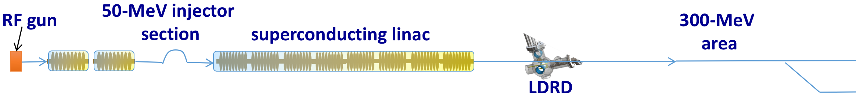
Measurement of halo at $∼10^{−6}$ fraction
Digital-micro-mirror (DMD)
development. kit
LDRD optics will be tested soon (w. DMD)
Optics simulation (SRW)
Magnetized beam will be transported for 50-70 m and halo diagnosed -- already done (and injected in IOTA) operators error.
CONCEPTUAL
SCHEMATICS
CCD #1
L3
e- beam
CCD #2
L3
L2
L1
BS
mask
CCD #1
CCD #2
(adapted from R. Fiorito UMD)

Slide 16
Summary
High-charge magnetized beam:
  Simulation of 3.2 nC magnetized beam with parameters consistent with JLEIC mostly done; need to understand limiting effects associated with mapping into conventional emittances (flat-beam transform).
  Simulations of transport of magnetized beams started.
  Beam experiment on magnetized-beam; analysis + comparison with simulation just started.
High-current magnetized beams
  Possible locations for the LDRD identified,
  LDRD optics designed and to be tested soon
Next running period (August) will focus on parametric studies on magnetized beam and halo formation (we expect more shifts given that all the operation subtilties associated with switching IOTA to FAST linac are now worked out)

