Slide 1

Injector for the Electron Cooler
An overview of photoinjector options
Fay Hannon
Accelerator Scientist
SRFR&D
JLEIC Collaboration Meeting April 1-3, 2019

Slide 2
Requirements
From the injector
  3.2nC
  ~5-8MeV
  43.3MHz bunch frequency
  Magnetized with drift emittance 36um
    From cathode inside a solenoid
  Intrinsic emittance <19um
Assumptions
  Gun voltage 400kV (DC)
Magnetized beam
Goal to preserve magnetization
  Want linear r, ρΦ
Want to minimize the emittance in the cooling solenoid
  Thermal contributions
  Non linear dynamics
Simulations are good for small, on axis beams
Would like to optimize the design with GPT

Slide 3
How to define the objective/ what is ‘good’
Can think of the emittance as two contributions:
  Correlated r, ρΦ, from the magnetization
  Uncorrelated from thermal, space charge, RF
  In practice, correlated and uncorrelated emittance get messy
Want correlated emittance to always be the correct value
Want uncorrelated emittance to be small
Small longitudinal emittance
  Small intrinsic energy spread
  Linear
  Uniform distribution in z

Slide 4
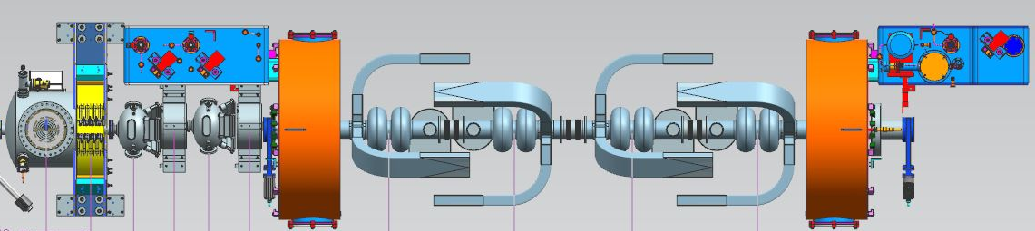
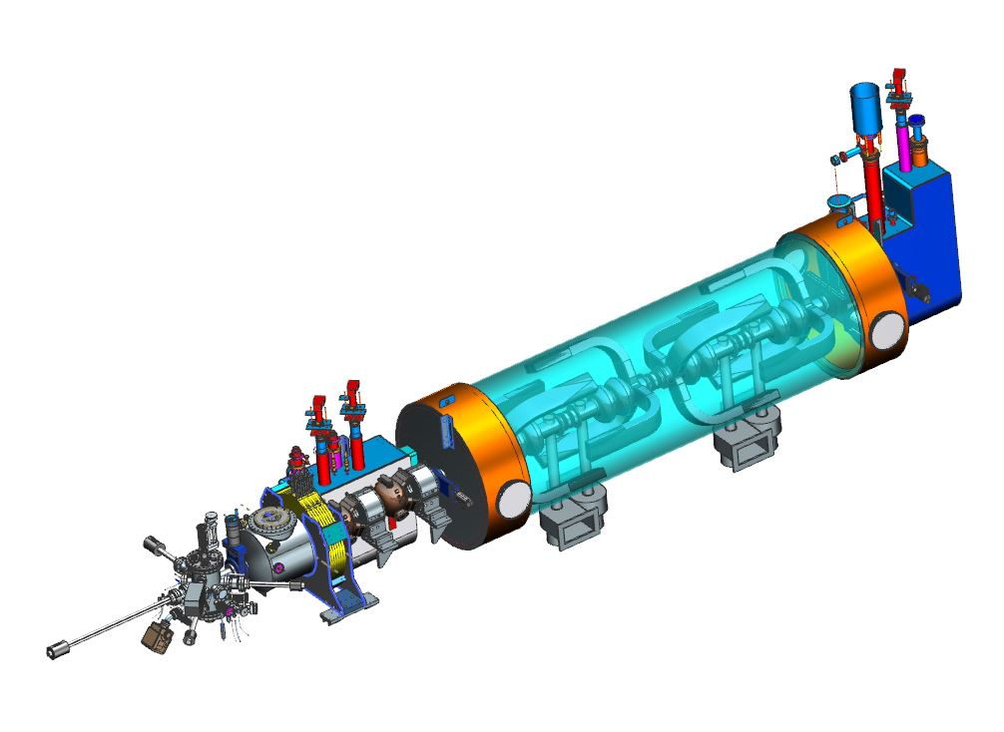
High Frequency Layout @ 952MHz
Gun
Single cell buncher / capture cavities
4 x two-cell booster
3rd harmonic (not shown)

Slide 5
High Frequency Optimization Results
objectives

Slide 6
High Frequency Simulation Results
19-03-13-002 _13668std

Slide 7
High Frequency Simulation Results
Transverse Emittance
Fit a slope to x, py data to get a correlated px and uncorrelated px

Slide 8
High Frequency Simulation Results
Transverse phase space

Slide 9
Optimize with uniform distribution as an objective
Trade off with magnetization (average is correct)

Slide 10
Low frequency solution – same layout @ 433MHz

Slide 11
Low Frequency Simulation Results

Slide 12
Low Frequency Simulation Results

Slide 13
High Frequency Simulation Results
19-03-12-002 _std54
Transverse emittance

Slide 14
Comparison
 | High Frequency | Low Frequency
KE [MeV] | 6.8 | 8.5
z rms [mm] | 4.03 | 3.36
Uncorrelated Emit [um] | 6.4 | 11.5
Ez [keV mm] | 24.4 | 28.6

Slide 15
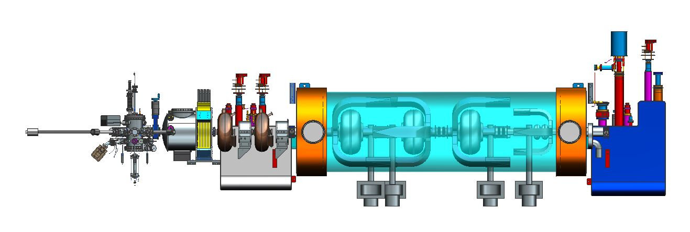
Improve the Low Frequency Design
Significant inverse correlation between Tcut and stduniform
Significant correlation between XYrms and cnemixrms

Slide 16
Preliminary results
Long bunch

Slide 17
Preliminary results

Slide 18
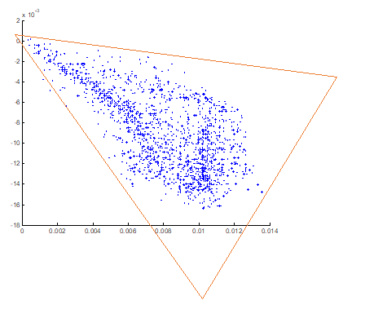
Outlook
Improve the optimization
  More generations (this is ongoing)
  Quantify quality of magnetization
  Alternate layouts
  Laser shaping

