Slide 1



Design Options for the JLEIC
Large Aperture IR Quadrupoles
JLEIC Spring Collaboration Meeting 2019
April 1-3, 2019
GianLuca Sabbi
Lawrence Berkeley National Laboratory

Slide 2
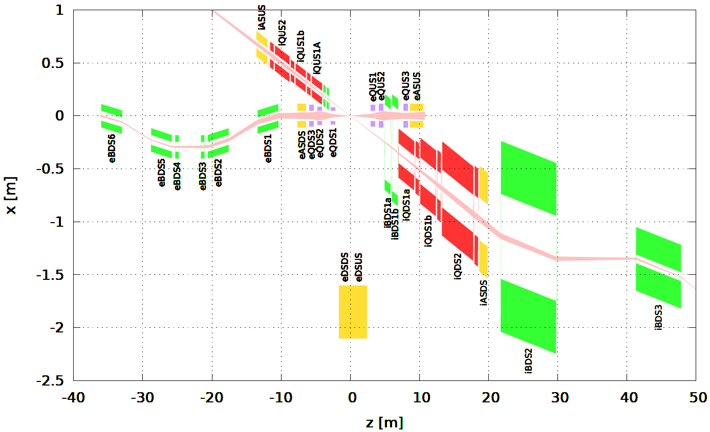
Layout and Parameters (V. Morozov)
10 GeV/c electrons
200 GeV/c protons
Quadrupole Element | Magnetic length [m] | Inner radius [cm] | Outer Radius [cm] | Good Field Radius [cm] | Field Gradient Normal / Skew [T/m] | G x R_{inner} [T]
iQDS1a | 2.25 | 9.2 | 23.1 | 4 | -37.2 / -1.23 | 3.4
iQDS1b | 2.25 | 12.3 | 31.0 | 4 | -37.2 / 0.0 | 4.6
iQDS2 | 4.5 | 17.7 | 44.4 | 4 | 26.0 / 0.0 | 4.6

Slide 3
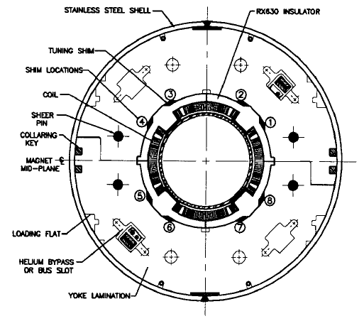
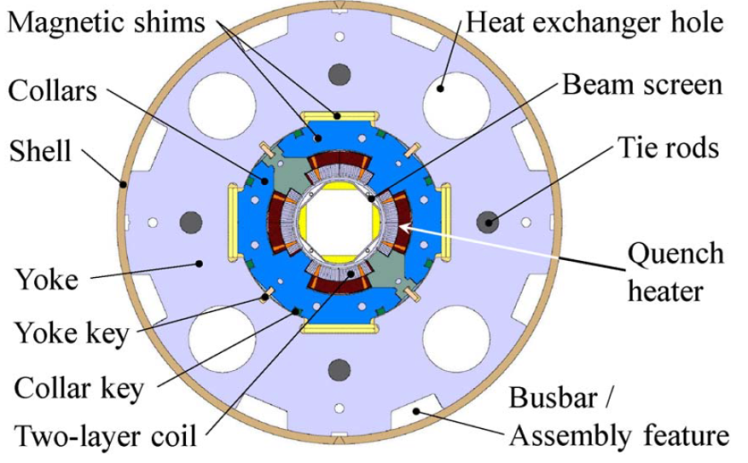
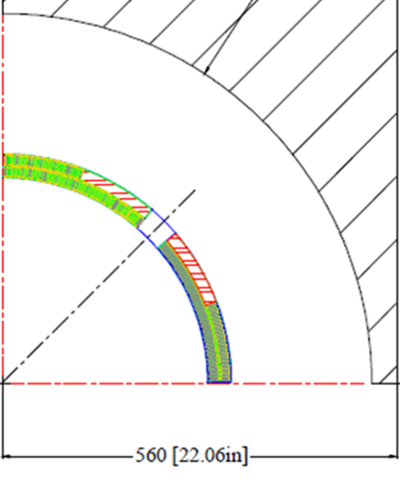
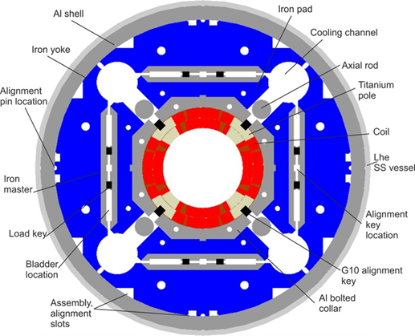
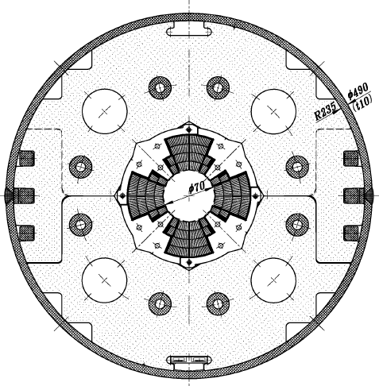
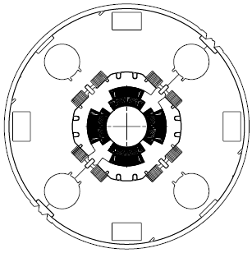
IR Quadrupole Design References
RHIC (130 mm, 48 T/m, 4.5K)
LHC MQXC (120 mm, 118 T/m, 1.9K)
AHF-2 (634 mm, 10.1 T/m, 1.9K)
Note: diameters refer to the coil winding
Nb₃Sn
HL-LHC MQXF (150 mm, 143 T/m, 1.9K)
LHC MQXA (70 mm, 205 T/m, 1.9K)
LHC MQXB (70 mm, 205 T/m, 1.9K)

Slide 4
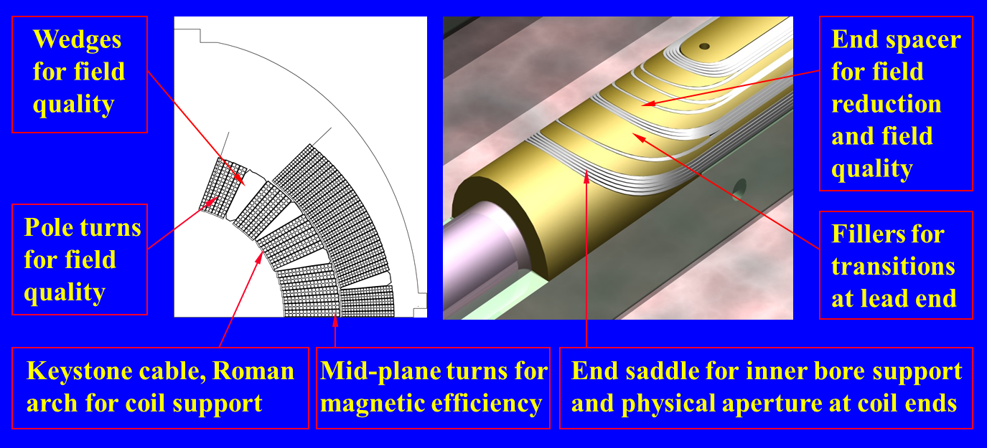
Cos(nθ) Coil Layout
The cos(nθ) coil layout with keystone Rutherford cable has dominated the accelerator applications to date
The extension to iQDS1a appears to be relatively straightforward (although aperture is significantly larger than in design references)
Combination of very large aperture, gradient, and limited radial/axial space budget in iQDS1b/2 may require a modified approach

Slide 5
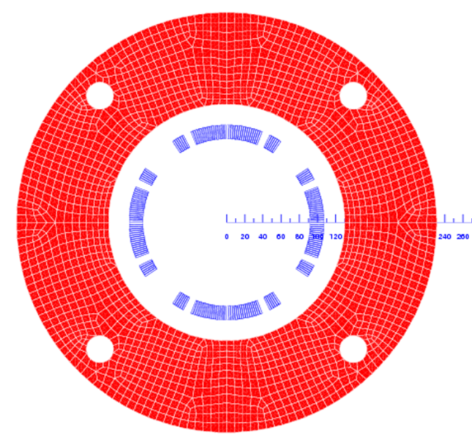
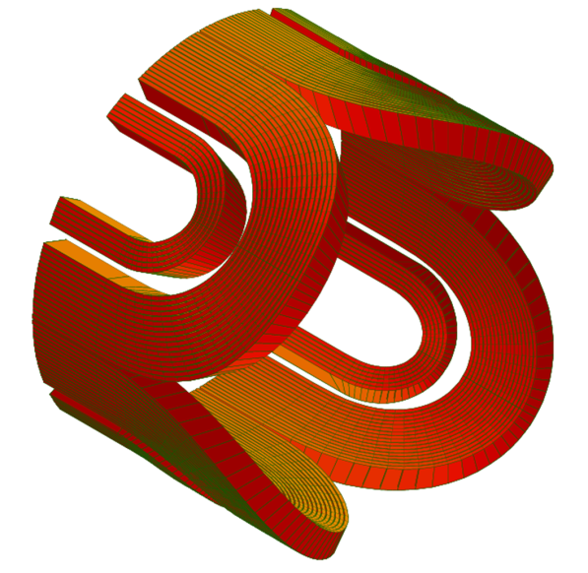
A Preliminary Design for iQDS1a
Goals:
Perform a first-pass magnetic analysis and optimization
Obtain a preliminary design and performance parameters: cable and coil geometry, operating current, margin to quench, fringe field, magnetic length and field quality
Iterate as needed, get feedback to/from AP
Coil and yoke geometry:
Single layer coil with 15 mm width
Two coil blocks (one wedge) for control of geometric harmonics
Inner coil radius at 9.19 cm (increase ~8 mm for inner vessel)
Radial space reserved for collars: 23 mm
Outer yoke radius 23.1 cm (decrease ~6 mm for outer vessel)
Superconductor and cable:
NbTi superconductor at 4.5K
MQXC inner cable (same as LHC dipole inner cable)
Alternative options: MQXC outer cable (same as LHC dipole outer cable, LHC arc quadrupole); MQXB inner cable

Slide 6
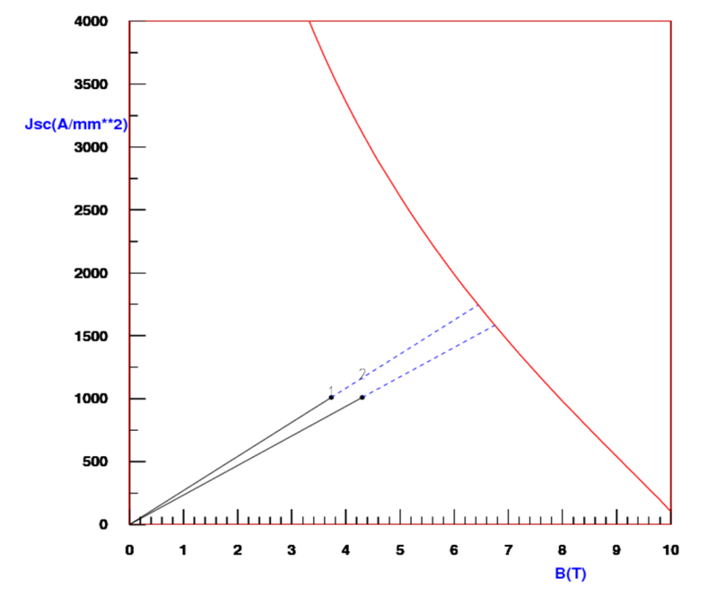
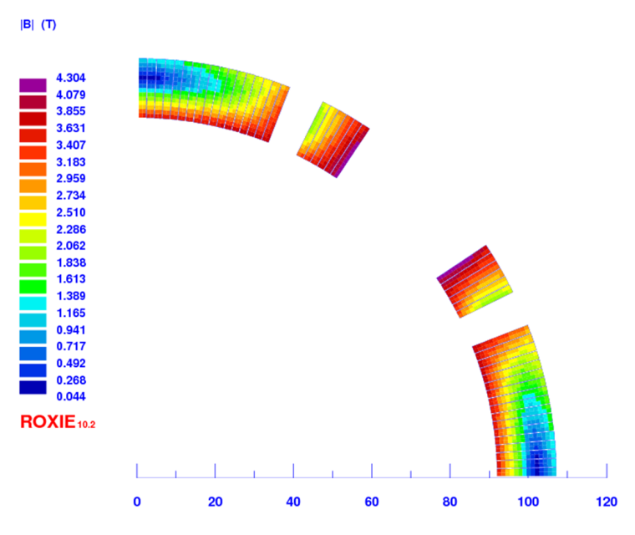
Design and Performance Parameters
Superconducting strand | Unit | Value
Strand diameter | mm | 1.065
Critical current density (*) | kA/mm² | 2.85
Copper/non-copper ratio |  | 1.65
(*) 5T, 4.2K
Cable and coil geometry | Unit | Value
Number of strands |  | 28
Cable width | mm | 15.1
Cable thickness (min) | mm | 1.736
Cable thickness (max) | mm | 2.064
Number of turns (B1+B2) |  | 17+6
Operating Parameters (2D) | Unit | Value
Current | kA | 9.5
Field Gradient | T/m | 38.0
Peak field in the coil (*) | T | 4.3
Lorentz force (azimuthal) | MN | 0.38
Coil stress (azimuthal) | MPa | 25
(*) Includes strand self-field

Slide 7
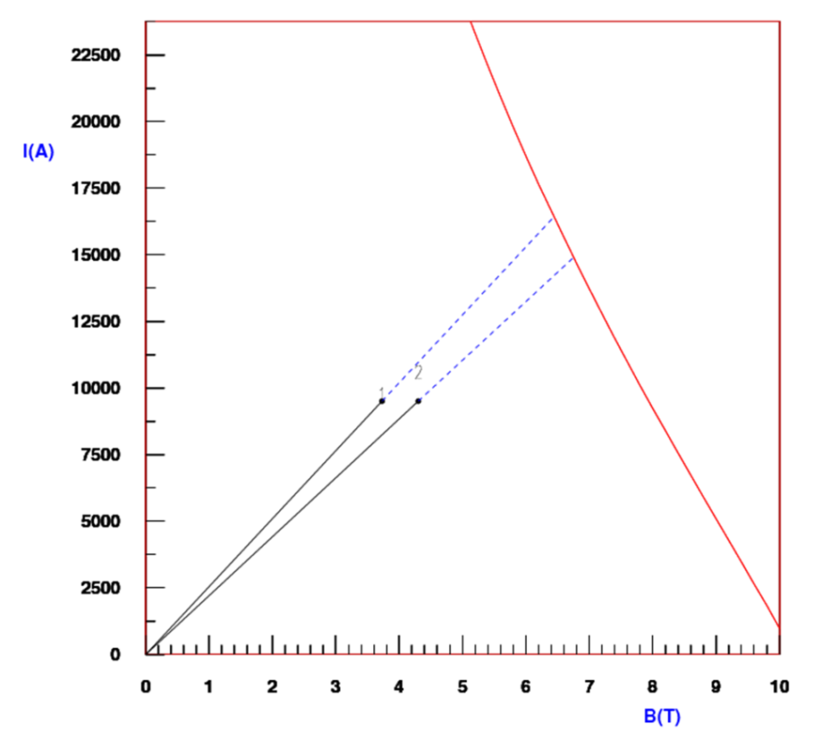
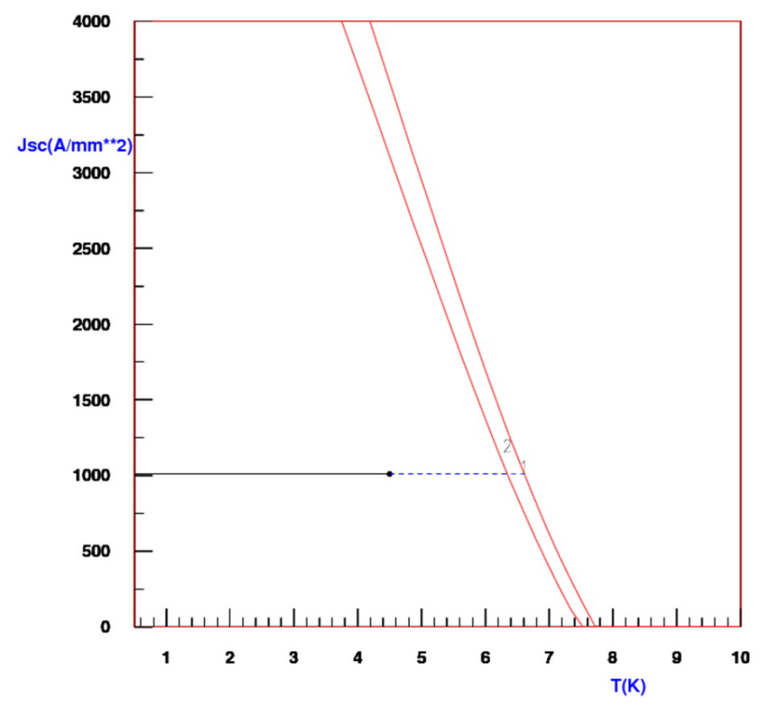
Short Sample and Margin to Quench
Short sample parameters (*) | Unit | Value
Current | kA | 14.9
Peak field | T | 6.75
Gradient | T/m | 59.6
Margins to quench (*) | Unit | Value
Operating point on the load line | % | 63.7
Fraction of critical current at I_{op} | % | 32.4
Temperature margin at I_{op} | K | 1.85
(*) based on a linear extrapolation of the peak field load line

Slide 8
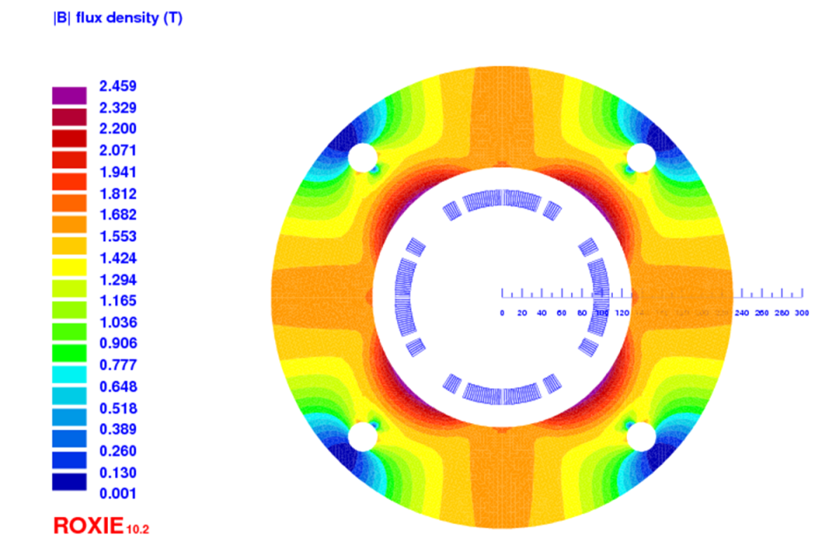
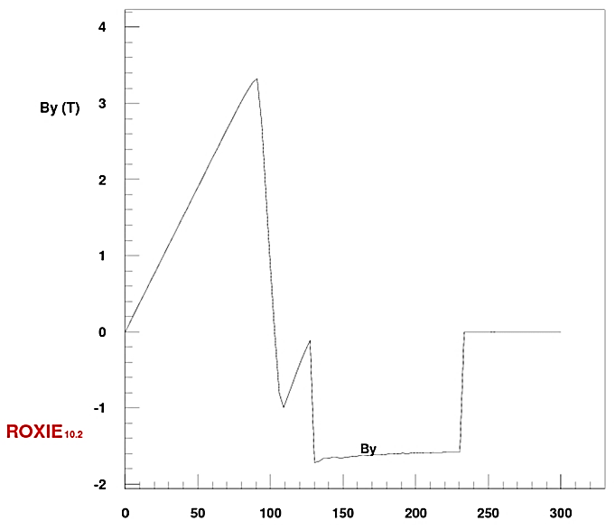
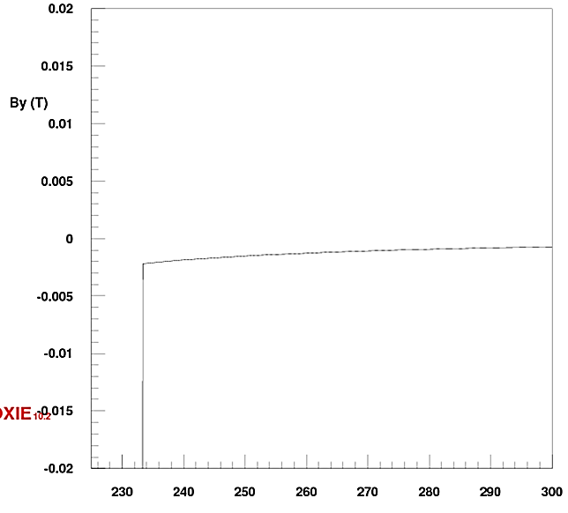
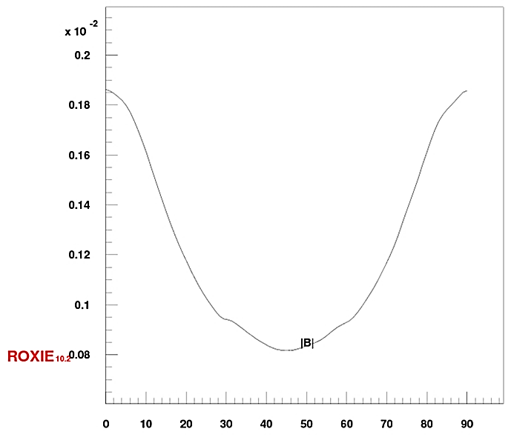
Fringe Field at the electron beamline
At the operating gradient, the iron yoke thickness at the magnetic mid-plane is sufficient to return all the magnetic flux
Fringe field field outside yoke is below 0.002 T at the magnetic mid-plane, and further decreasing to < 0.001 T at the pole
Note however that this case does not include radial space for He vessel/beam pipe and yoke geometry optimization to control saturation
mm
Magnetic field (By) along the x-axis
By (y=0) detail outside the iron yoke
B along a 90 degree arc at R=240 mm
< 0.002 T
mm
mm
deg

Slide 9
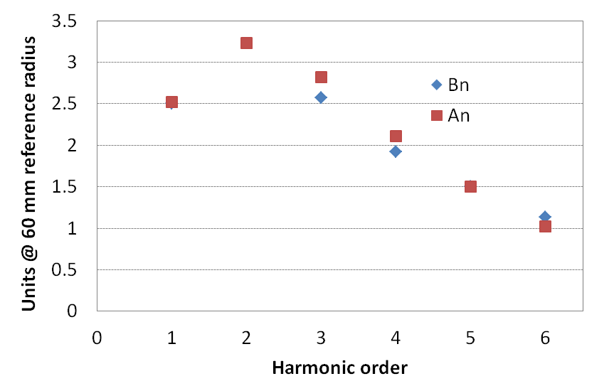
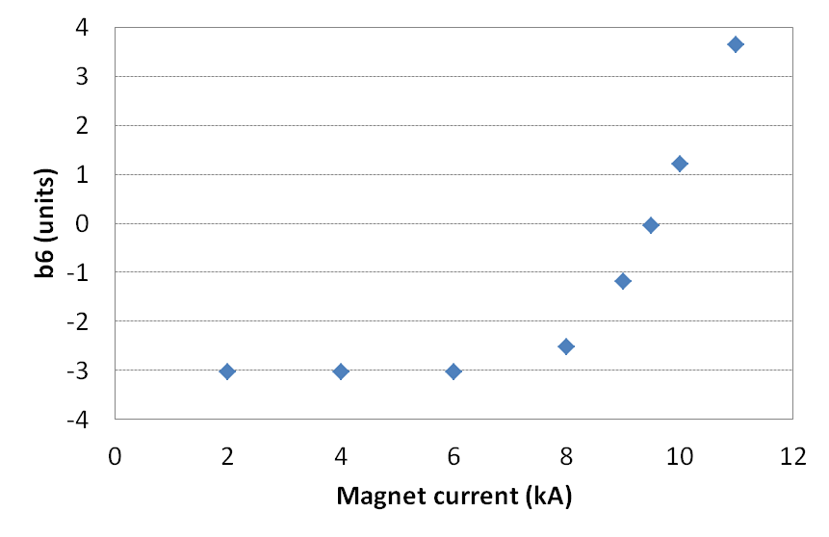

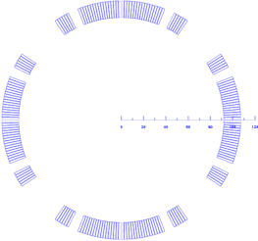
Field Quality (2D)
Field quality optimization carried out and reported at 60 mm radius (~2/3 of aperture)
Good field radius required by beam is 40 mm: significant benefit for higher orders
Harmonics at nominal current can be optimized to << 1 “unit” (10⁻⁴ of quadrupole)
However, b₆ saturation is several units (R=60 mm) in the absence of yoke optimization
Yoke optimization for saturation control will increase the fringe field: is it needed?
Random errors calculated for radial/azimuthal block displacements with ±100 μm range
Persistent current and ramp rate effects not yet analyzed – generally dominated by dipoles
Random errors (1 sigma) for 100 μm block displacements
Saturation effect on b₆ (R=60 mm)
Saturated region
Non-saturated region
9.5 kA
2x16 independent variables

Slide 10
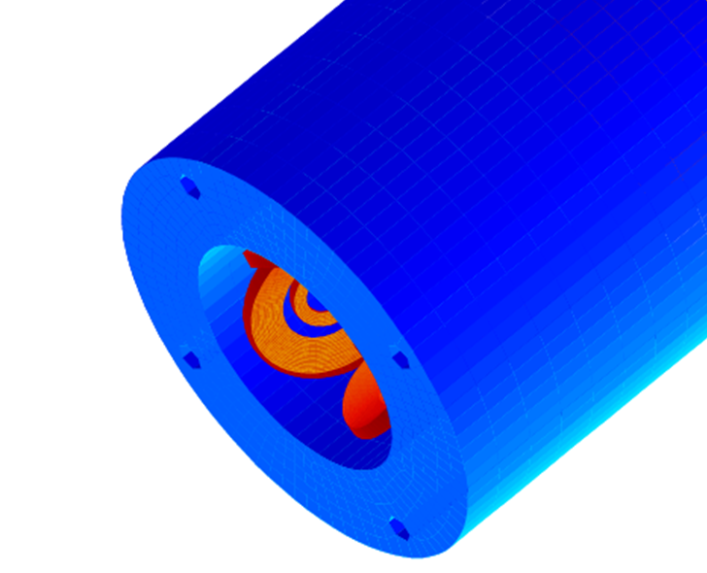
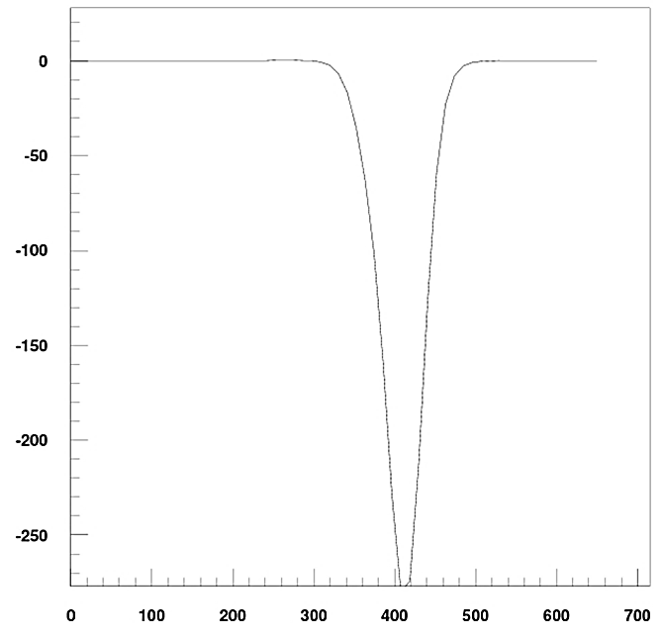
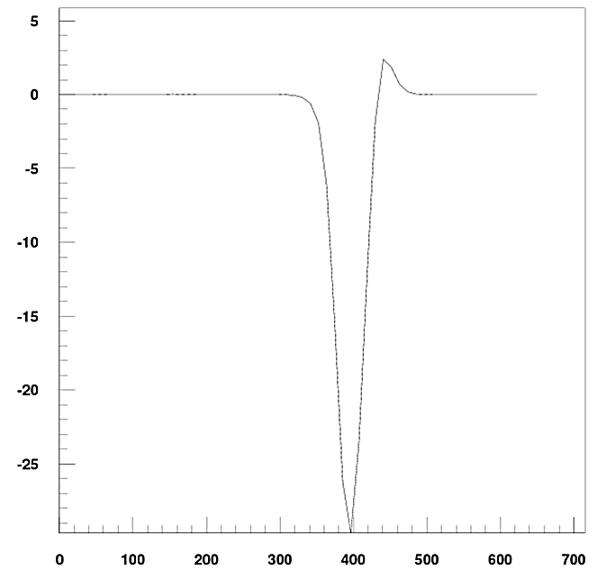

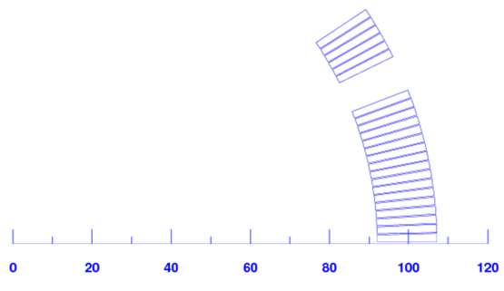
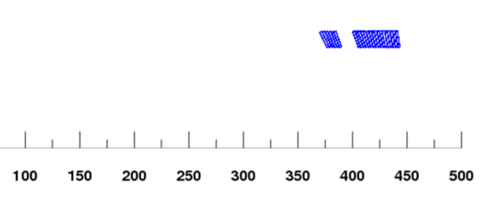
Field Quality (3D)
Large negative contribution to b₆, b₁₀ in the ends
  Due to conductor blocks lifting away from the mid-plane as they turn around the pole
b₆: -280 units peak, or -43.3 units integrated over a magnetic length (straight section equivalent) of 406.3 mm
b₁₀: -30 units peak, or -3.1 units integrated over 406.3 mm
Integral can be corrected by body-end compensation or by end optimization – with different advantages and disadvantages
Need AP evaluation and feedback for different options
+b₆, +b₁₀

Slide 11
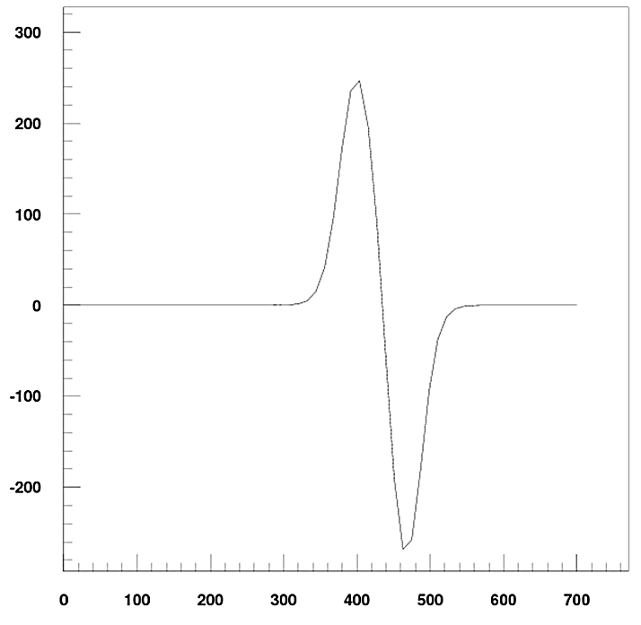
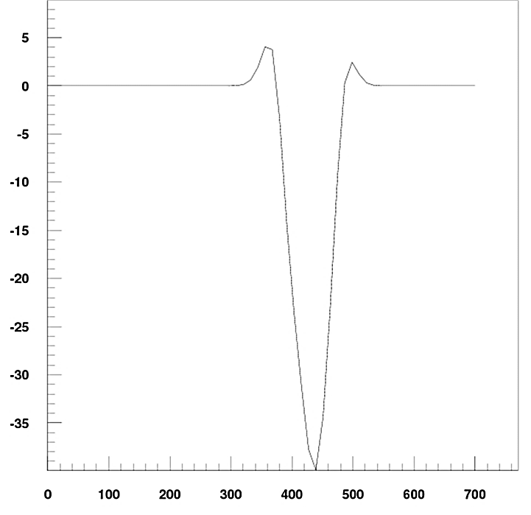
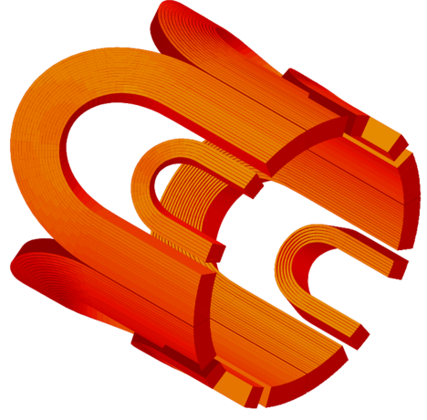
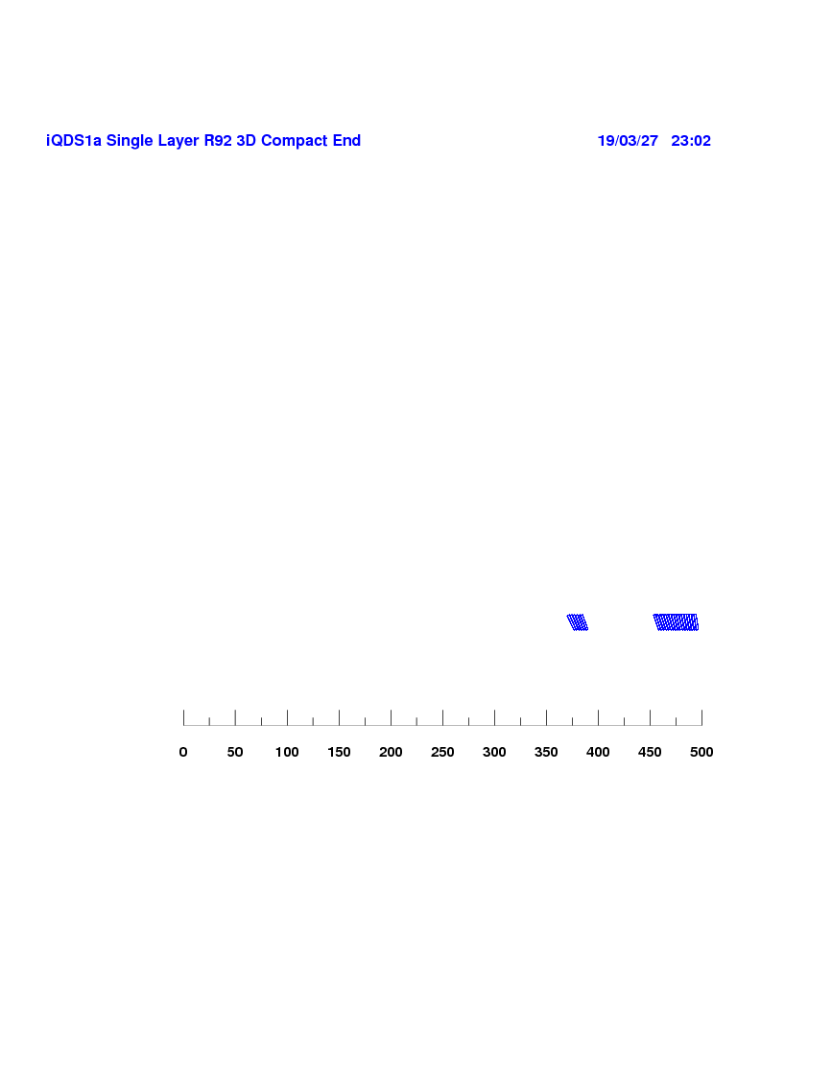
Coil End Optimization
Negative b₆, b₁₀ due to turns lifting away from the mid-plane can be compensated by increasing the length of straight section for these turns. Here we increase the straight section length of the entire lower block to avoid introducing additional spacers
b₆: Δz (B1)= 53 mm results in two peaks of ± 250 units which integrate to essentially zero
Additional spacers would be required to compensate b₁₀, or to further lower the b₆/b₁₀ peaks
Spacers are also effective to control the peak field in the ends (iron needs to cover entire length to avoid a large fringe field) but will increase the magnet length requirements
+53 mm
+53 mm

Slide 12
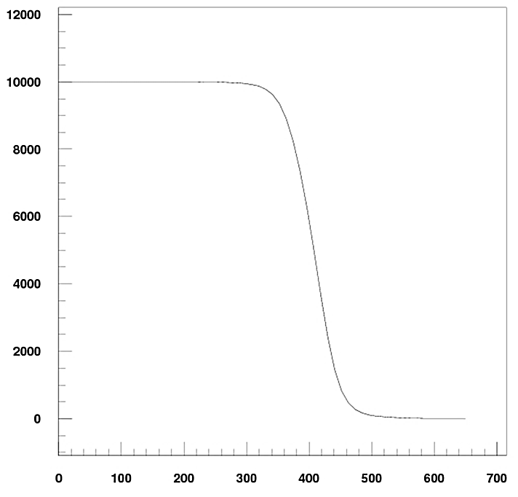
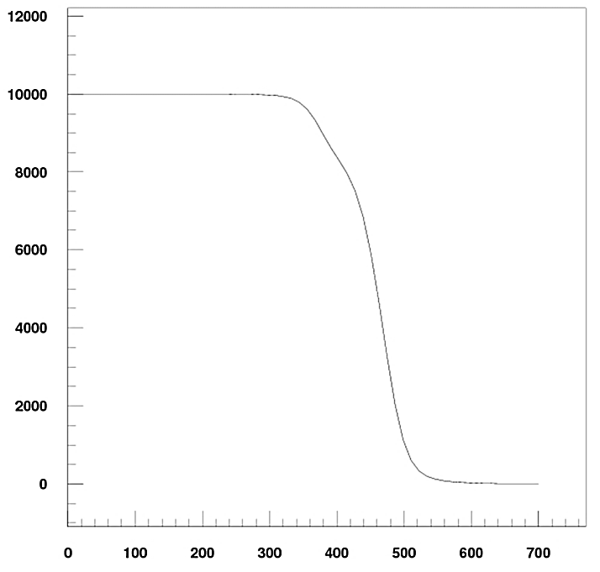
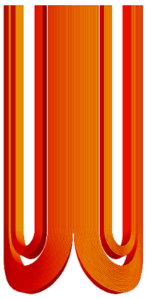
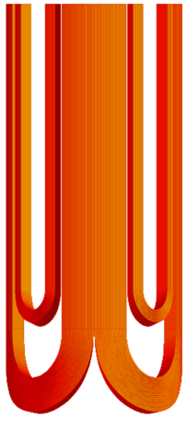
Magnet Length Requirements
Longitudinal space budget is one of the main challenges for the JLEIC IRs
Requires a global optimization to meet both AP requirements and technology constraints:
  Selection of operating parameters, coil design, acceptable fringe field, field quality (with implications on corrector needs), end mechanical support, leads and splices, integration of cold mass in cryostat and integration of different magnets/beamlines
A first-pass evaluation of the preliminary design will be useful to determine next steps
  Main question: do we need to increase the central gradient (with potential implications for coil design, operating temperature/margins, fringe field, forces etc.) to decrease length
Longitudinal efficiency:
Baseline (compact) end:
Coil half-length in the model: 450 mm
Magnetic length: 406.3 mm
With additional spacer:
Physical length +53 mm
Magnetic length + 44.6 mm
Requires a 17 mm increase of total coil length (both ends) to achieve the same magnetic length

Slide 13
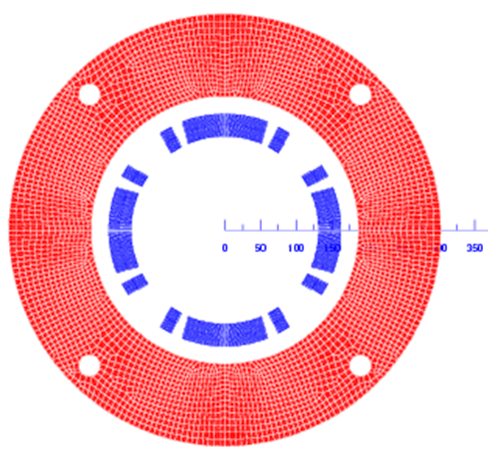
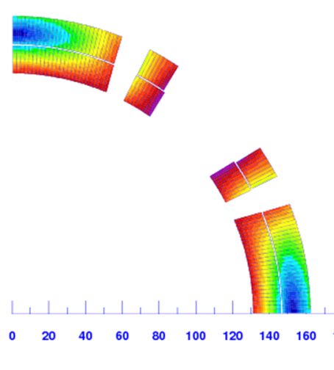
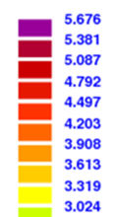
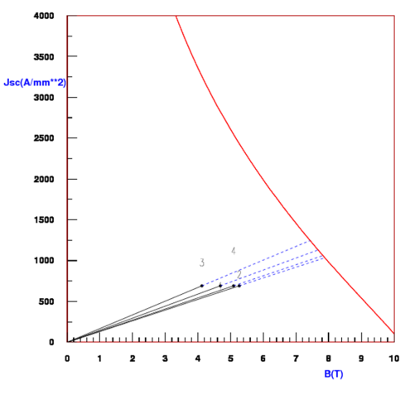
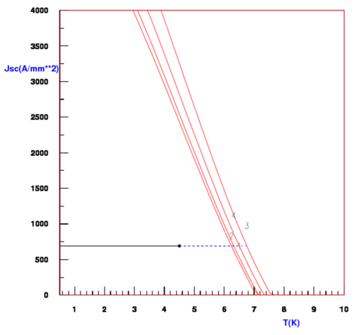
iQDS1b preliminary analysis
Main features:
Same gradient with increase aperture
Double-layer coil with 30 mm total width
MQXC cable with lower (1/2) keystone angle
One wedge in each layer (probably not required)
Radial space for “collars”: 25 mm
Radial space for He vessel: 8mm + 8 mm
B [T]
Coil and iron yoke geometry | Unit | Value
Inner coil radius | cm | 13.1
Outer yoke radius | cm | 30.2
Number of turns (L1, L2) |  | 33, 35
Operating Parameters (2D) | Unit | Value
Current | kA | 7.1
Copper current density | kA/mm² | 0.46
Field Gradient | T/m | 36.7
Field at coil radius (GxR_{in}) | T | 4.9
Peak field in the coil (2D) (*) | T | 5.67
Lorentz force (F_{θ} 1 octant) | MN/m | 1.12
Margins to quench (*) | Unit | Value
Operating point on the load line | % | 72.2
Temperature margin at I_{op} | K | 1.48
(*) Includes strand self-field
(*) based on 2D peak field

Slide 14
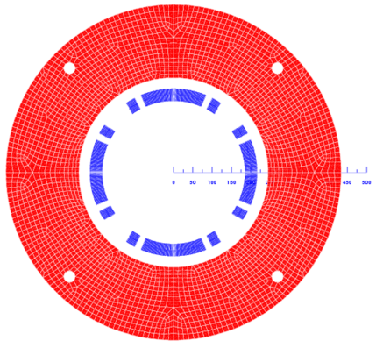
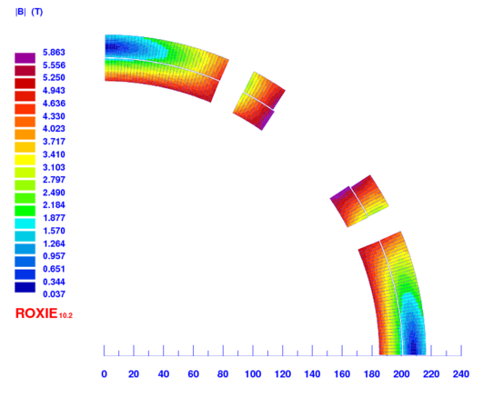
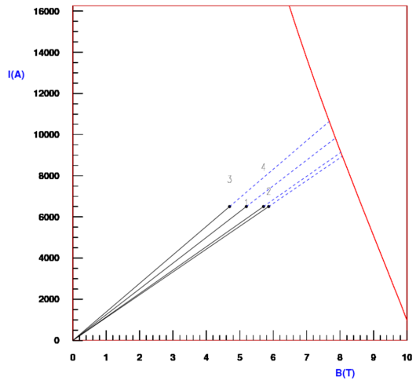
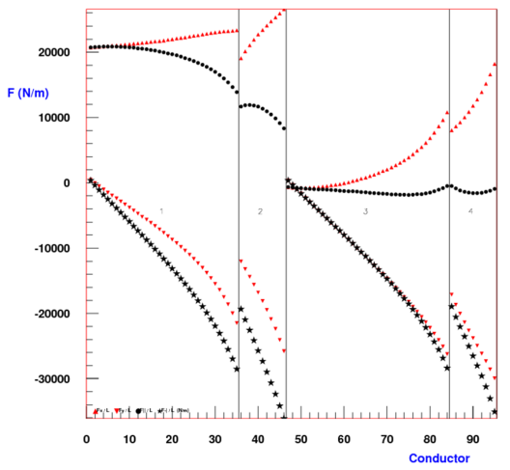
iQDS2 preliminary analysis
Main features:
Double-layer coil with 30 mm total width
MQXC cable with lower (1/2) keystone angle
One wedge in each layer (probably not required)
Radial space for “collars”: 30 mm
Radial space for He vessel: 8mm + 10 mm
Coil and iron yoke geometry | Unit | Value
Inner coil radius | cm | 18.5
Inner yoke radius | cm | 24.5
Outer yoke radius | cm | 43.4
Number of turns (L1, L2) |  | 46, 49
Operating Parameters (2D) | Unit | Value
Current | kA | 6.5
Copper current density | kA/mm² | 0.42
Field Gradient | T/m | 26.2
Field at coil radius (GxR_{in}) | T | 4.85
Peak (2D) coil field (*) | T | 5.86
Lorentz force (F_{θ} 1 octant) | MN/m | 1.49
Margins to quench (*) | Unit | Value
Operating point on the load line | % | 72.7
Temperature margin at I_{op} | K | 1.46
(*) Includes strand self-field
(*) based on 2D peak field

Slide 15
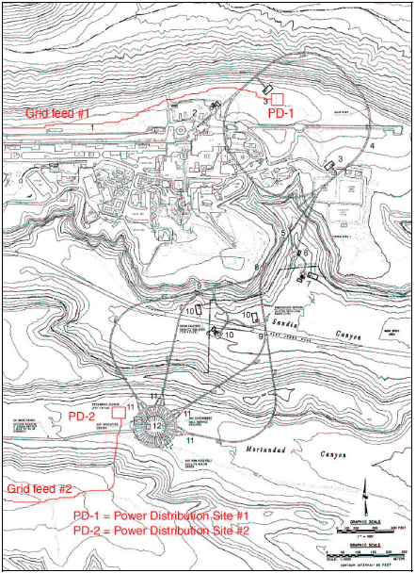
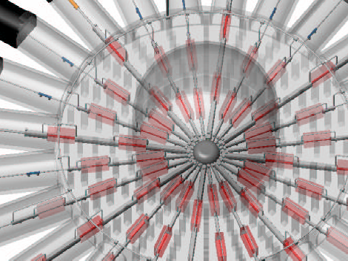
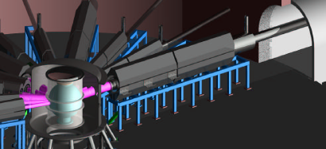
Advanced Hydrotest Facility at LANL
50 GeV synchrotron
Firing site 2

Slide 16
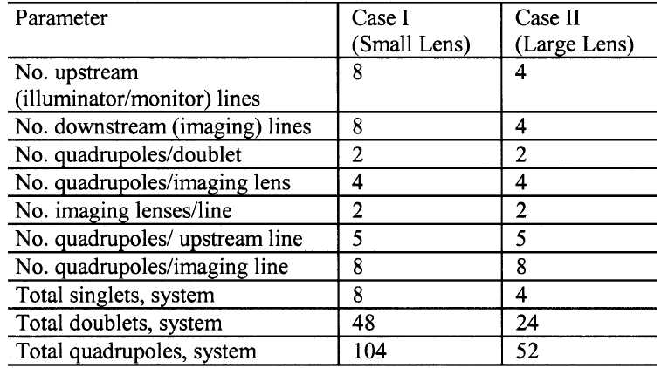
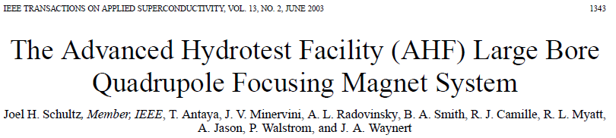
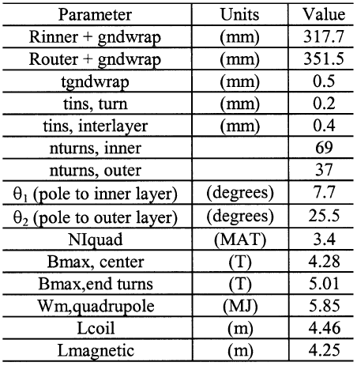
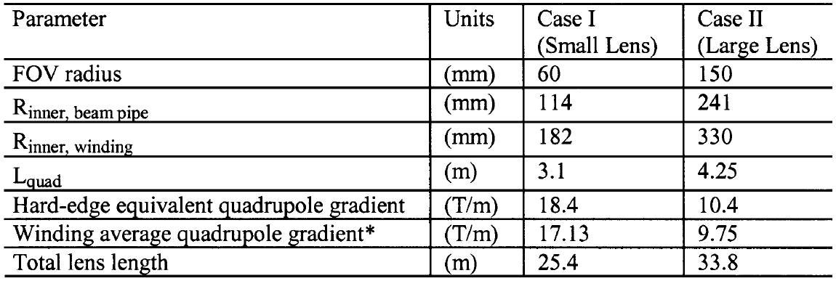
AHF Final Focus System Parameters
AHF Large Bore Quadrupole Focusing System Parameters
Reference: J. Schultz et al., IEEE TASC Vol. 13,
No. 2, June 2013, pp.1343
Case 2 coil geometry and operating field
Case 1 and Case 2 Quadrupole Requirements
G x R_{pipe}= 2.5 T ; G x R_{coil} = 3.3 T

Slide 17







AHF-2 Cable and Coil Design at MIT
2-layer cos(2θ) layout
Rutherford cable in Cu channel
Raised saddle end
3 spacers in each layer
Dummy turns in outer layer
SSC strand and cable

Slide 18

AHF-2 Mechanical Design at MIT
Design approach and main components:
The mechanical design is based on a 30 mm thick welded stainless steel shell directly surrounding the coil which provides preload and support against the Lorentz forces
The (warm) iron yoke is not part of the mechanical support structure
The pre-load level is selected to prevent separation at the coil-pole interface up to full field
A Titanium pole is required to increase pre-load at cool-down and decrease the warm pre-load
Cable is encased in a copper channel is to cope with the high pre-load and Lorentz forces/stresses
Results of mechanical analysis:
Stresses for Ti pole are within material limits
Warm pre-loaded stage is the most critical
Compute stress in cable conduit after pre-load (with Ti pole)
Comments/next steps:
New approach to address the specific design challenges, but outside established experience
Many questions: need to study in more detail, and discuss with MIT colleagues who may provide additional insights or experimental information
Range:
140-260 MPa

Slide 19

Shell-based structure option
The LBNL shell-based structure has replaced the traditional collars in high field/force/stress magnets
Based on an aluminum shell over iron yoke
Assembly preload provided by water-pressurized bladders and interference keys
Significant pre-load increase at cool-down due to differential thermal contraction
Main elements of the mechanical structure:
Shell-Yoke sub-assembly
  Aluminum shell
  Iron yoke
Coil-pack subassembly
  Nb₃Sn Coils
  Aluminum Collars
  Load pads
Master Key assembly
  Slots for pressurized bladders
  Load keys, alignment keys
Axial rods for longitudinal pre-load
HL-LHC (MQXF) IR Quadrupole
Note however that radial space requirements for shell and bladder assembly features will further constrain the yoke optimization relative to a traditional collar-based structure

Slide 20



Shell structure test results
Demonstrated performance in the range of interest: force and stress levels, fine control of pre-load, low pre-load at warm, large diameter (fabrication and test)
TQS quadrupole (LBNL/LARP)
FRESCA2 dipole (CERN)

Slide 21



AHF-2 Design Study at Fermilab
Design drivers and approach:
Traditional shell type coil will suffer from stress accumulation at the mid-plane and conductor displacements during excitation
Split in mechanically decoupled blocks, for stress management and individual positioning and support
NbTi and Nb₃Sn options considered
Active shielding of fringe field
Reference: V. Kashikhin et al., PAC 2003

Slide 22




iQDS1b fringe field
Fringe field is ~0.25 T
Evaluate correction options
Integrate the design of electron and ion quadrupoles and beamlines
Magnetic field (By) [T] along the x-axis
By (y=0) detail outside the iron yoke
B along a 90 degree arc at R=310 mm

Slide 23




iQDS2 Fringe Field
Fringe field is 0.1-0.15 T
Evaluate correction options
Integrate the design of electron and ion quadrupoles and beamlines
Magnetic field (By) along the x-axis
By (y=0) detail outside the iron yoke
B along a 90 degree arc at R=240 mm

Slide 24
Summary
A preliminary analysis of the JELIC large aperture IR quadrupoles was performed
Parameters of first quadrupole (iQDS1a) are within established technology envelopes
  Design can be based on traditional cos2θ approach: superconducting wire and cable, NbTi coil fabrication and collar-based mechanical support
  Initial parameters were provided and can be used as a starting point for further optimization (e.g. cable dimensions, operating current, collar thickness etc.)
  Field quality estimates were provided including 2D random errors, saturation effects, 3D end harmonics, and correction options
  Main issue is longitudinal space budget and optimization
  iQDS1a would be a good candidate for preliminary AP feedback on field quality and a detailed engineering exercise to establish longitudinal requirements for coil ends/transitions, current leads and splices, axial mechanical support, cooling, He contsinment and cryostat design. Results will be also useful for other magnets
The second and third quadrupoles (iQDS1b and iQDS2) require a significant extrapolation from past experience due to a combination of aperture, field gradient, radial and longitudinal space constraints
  Initial work should focus on conceptual design studies and selection of promising approach for conductor, cable, coil fabrication and mechanical structure
  Prototype fabrication and test will be required to validate the proposed design
Current radial allowances do not include any radiation shielding in the bore

Slide 25
Additional slides

Slide 26


iQDS1a with reduced radial envelope
In order to provide radial space for the inner and outer LHe containment and beam pipe, the inner coil radius is increased by 8 mm and the outer yoke radius is decreased by 6 mm
No change in cable parameters (15.1 mm width)
Added two turns in B1 and adjusted angles
Radial space for collars: 20 mm (-3 mm)
Margin on the load line decreases by 4.2%
Lorentz force and stress increases by ~24%
B [T]
Coil and iron yoke geometry | Unit | Value
Inner coil radius | cm | 10.0
Outer yoke radius | cm | 22.5
Number of turns (B1+B2) |  | 19+6
Operating Parameters (2D) | Unit | Value
Current | kA | 9.9
Field Gradient | T/m | 37.6
Peak field in the coil (*) | T | 4.63
Lorentz force (azimuthal) | MN | 0.47
Coil stress (azimuthal) | MPa | 31.1
Margins to quench (*) | Unit | Value
Operating point on the load line | % | 67.9
Fraction of critical current at I_{op} | % | 36.7
Temperature margin at I_{op} | K | 1.65
(*) Includes strand self-field
(*) based on a linear extrapolation of the peak field load line

Slide 27




Fringe field at the electron beamline
Fringe field is 0.02-0.04 T
Expect further increase if yoke is optimized for low saturation
Evaluate correction needs and options:
Passive correction e.g. with iron surrounding the electron beamline
Active correction by tuning the design of the electron quadrupoles, or with a small dipole coil
Magnetic field (By) along the x-axis
By (y=0) detail outside the iron yoke
B along a 90 degree arc at R=240 mm

