Slide 1
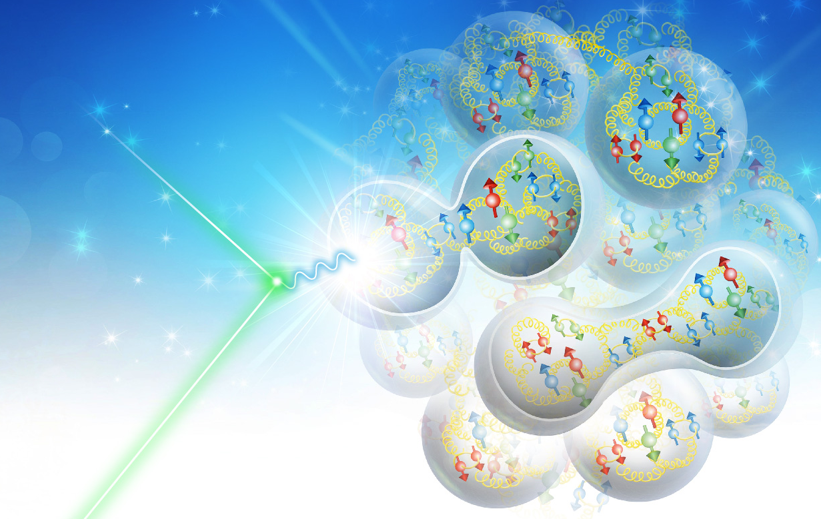
Summary of Working Group 4: IR/Detector/IR Magnets
Vasiliy Morozov
Rikutaro Yoshida
JLEIC Collaboration Meeting April 1-3, 2019

Slide 2
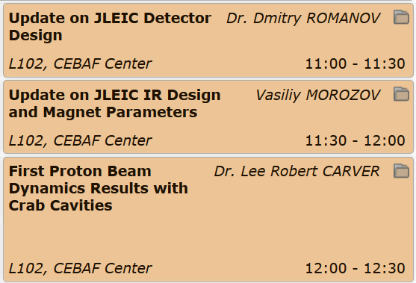
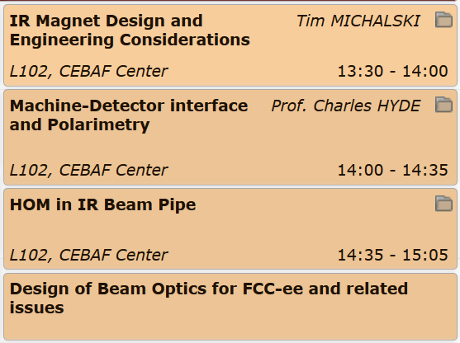
Working Group 4: IR/Detector/IR Magnets

Slide 3
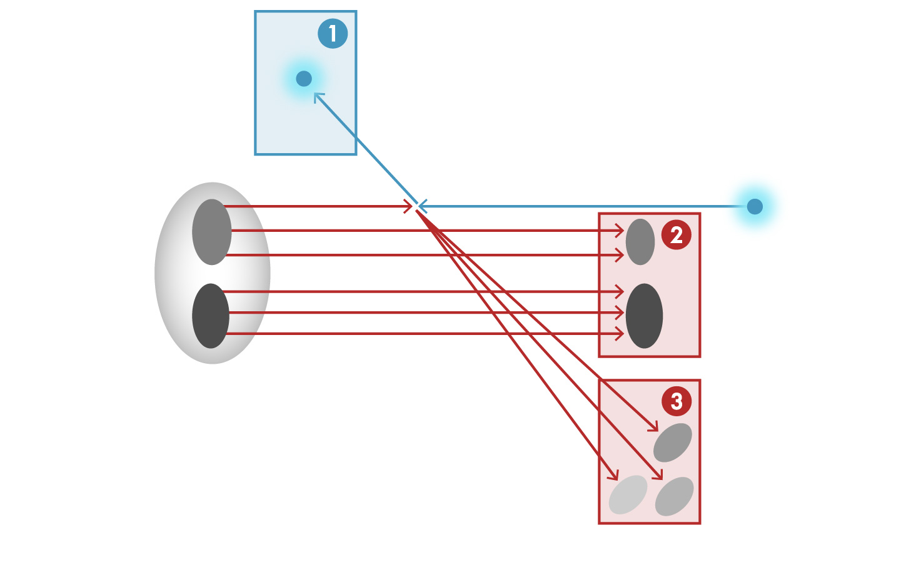
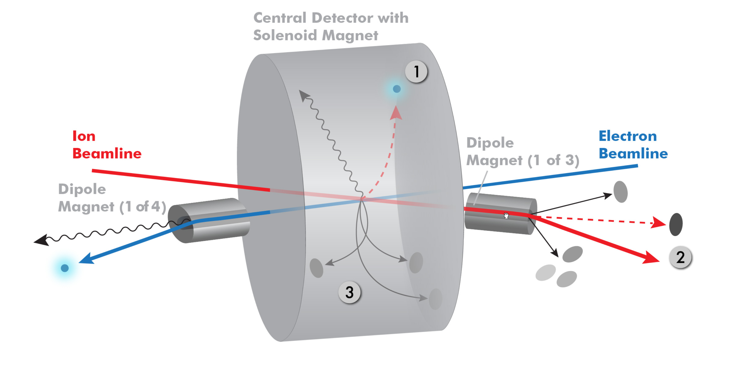
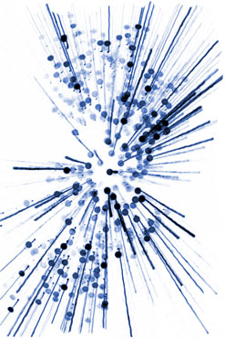
DIS experimental physics motivation for the detector design
Dmitry Romanov
Classification of the final-state particles of a DIS process at the EIC
e’
e
p/A
Scattered electron
Particle associated with initial Ion
Particle associated with struck quark
4π total acceptance detector
with efficient PID, tracking, calorimetry.
For typical collider experiments, measurements are performed mainly in central region.

Slide 4
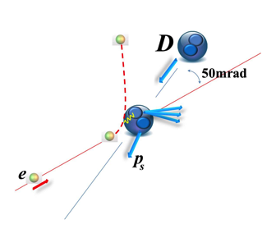
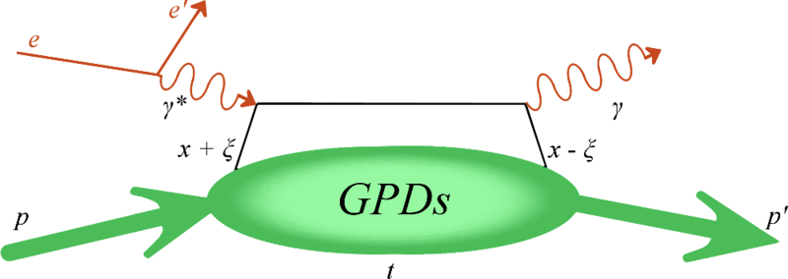
Far forward region importance
Dmitry Romanov
DVCS / Diffraction
e’
Ion remnant
1
e
p/A
e-/$ν$/e+
e-/e+
$γ,$Z⁰,W$±$
X
Provide transport of the forward going particles along the beam line
Design should be done close together with detector & accelerator
$π0, π$⁺,
K⁰,K⁺,B⁰
p
p’,n’,$Λ^{′},Σ$⁺,$Σ$⁺_{b}
Pion/Kaon structure

Slide 5
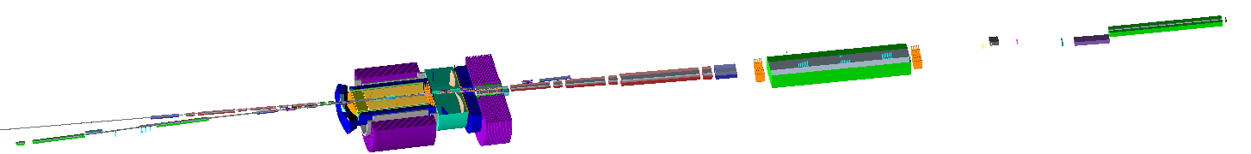
Detector details
Dmitry Romanov
√s 65 – 100 GeV design changes:
No major changes for the central detector region
Beam line elements and transport updates
("Update on JLEIC IR Design and Magnet" talk by Vasiliy Morozov)
e
Electron far forward
Central part
IP
p/A
p/A
e
e-endcap
h-endcap
barrel
Hadron far forward
(after D1)
Hadron far forward
(after D2)

Slide 6
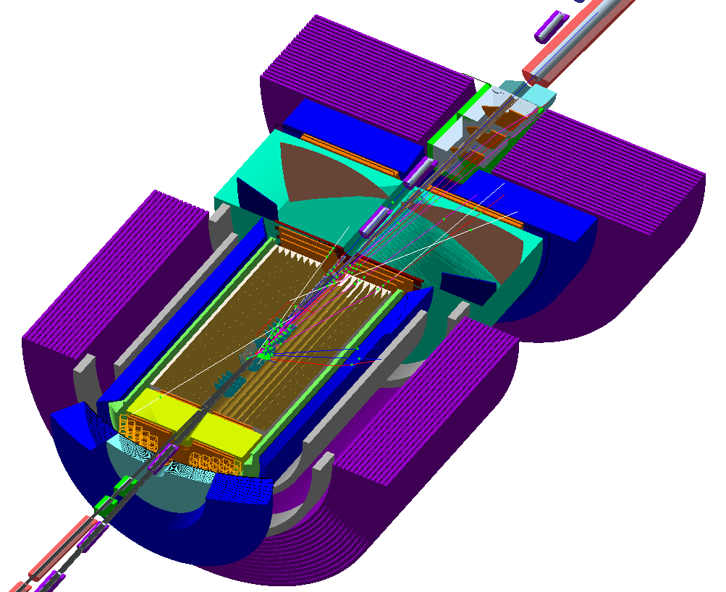
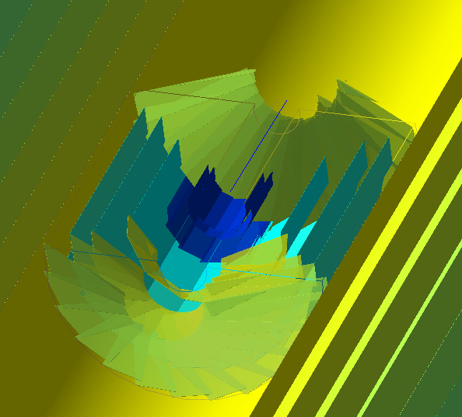
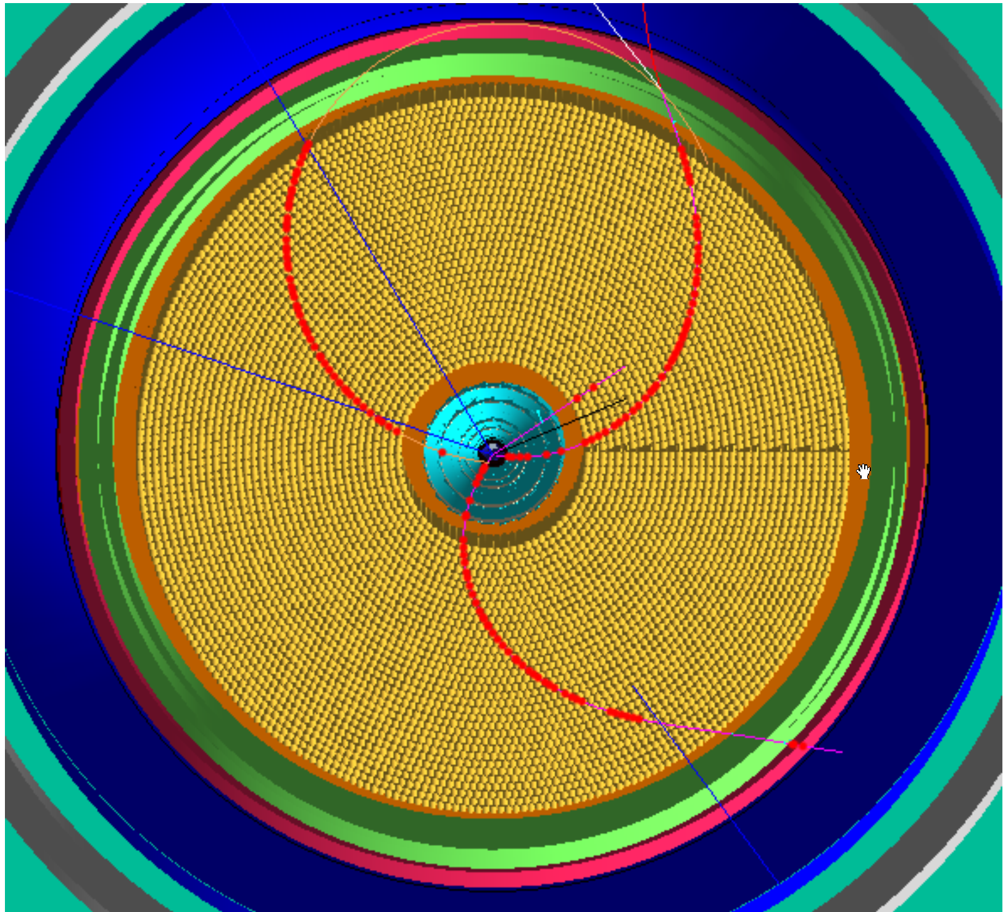
Central region Tracking detectors
Dmitry Romanov
e
Dipole
GEM
Vertex
GEM
Vertex zoomed
IP
CTD
e’
e
Straw CTD option
GEM
p/A
p/A

Slide 7
Software strategy
Dmitry Romanov
We cannot write everything and do all physics anaysis by just our team
Thus we will provide tools, documentation and support to users,
to help users to grow and direct the software.
Thus ease of user experience is one of our priorities

Slide 8
Goals of the detector simulation software
Dmitry Romanov
Docker containers
Your own system install
Event generator
Geant4 simulation
e^{JANA} Reconstruction
EJPM
  EIC
  Jana
  Packet
  Manager - helper
Installs Geant, g4e, Jana2, Rave…
Procs:
  One line to start
  Easy to automate
Cons:
  Graphics issues
  Still not your system
  Not all your tools are there…
Procs:
  Works natively!
  Use your usual tools
Cons:
  More than one command
  Not all systems are supported

Slide 9
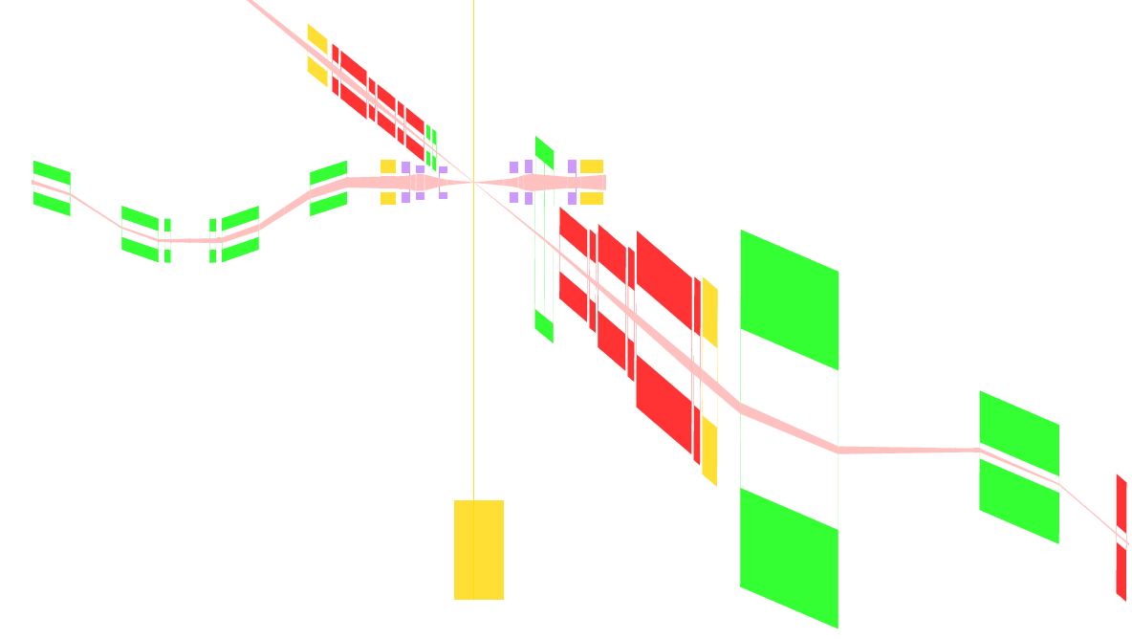



Schematic of Full-Acceptance Detector
Vasiliy Morozov
50 mrad crossing angle
Forward hadron detection in three stages
  Endcap
  Small dipole covering angles up
  to ~3°
  Far forward, ~10 mrad,
  for particles passing through
  accelerator quads
Low-Q2 tagger
  Small-angle electron detection
End caps
Roman pots
$±50$ mrad
Secondary
focus
Low $Q^{2}$ tagger
Central detector
$±10$ mrad

Slide 10
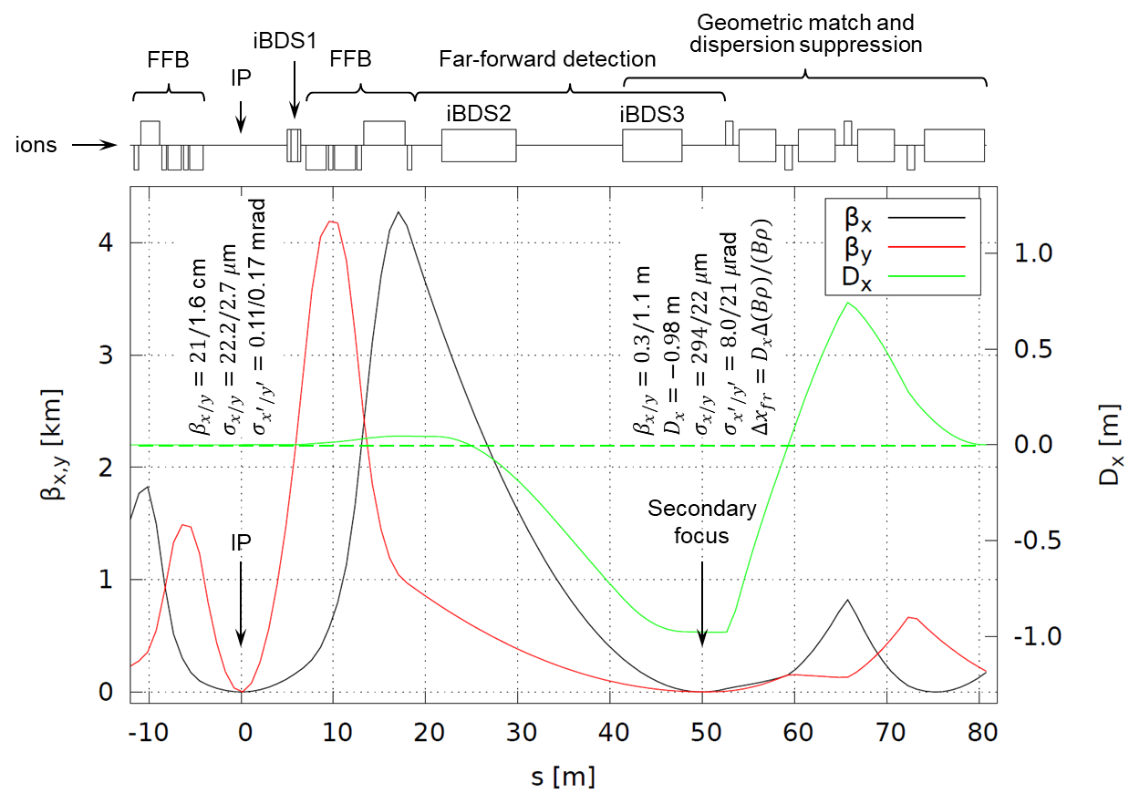
Ion Interaction Region
Vasiliy Morozov
High luminosity and acceptance performance in the whole energy range
Conventional NbTi technology
Secondary focus with high dispersion

Slide 11
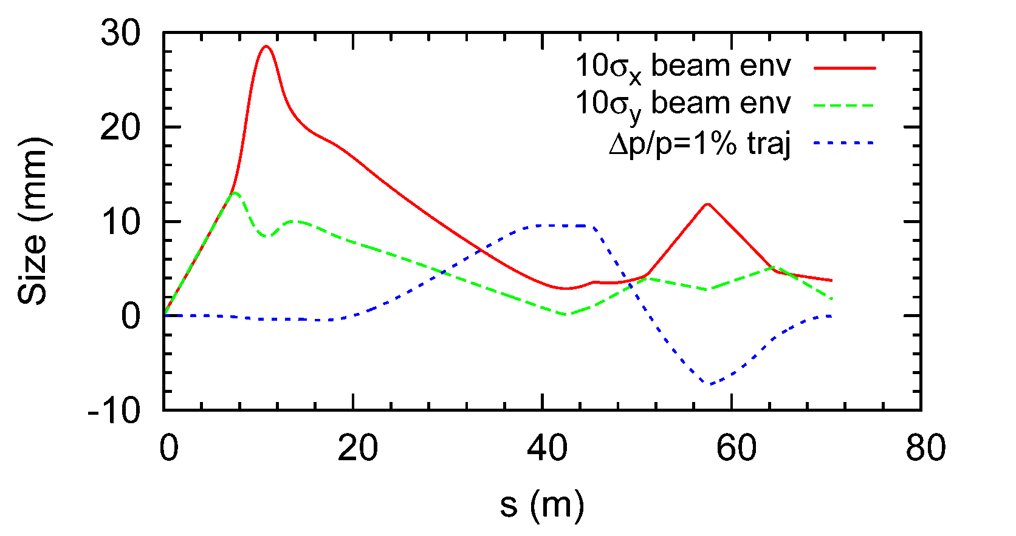

Ion Beam Envelope & 99%p Trajectory
Vasiliy Morozov
Assuming beam momentum of 100 GeV/c, ultimate normalized x/y emittances $xN/yN$ of 0.35/0.07 μm, and ultimate momentum spread $p/p$ of 3×10⁻⁴
The horizontal size includes both betatron and dispersive components
Ignoring effect of the crab tilt

Slide 12
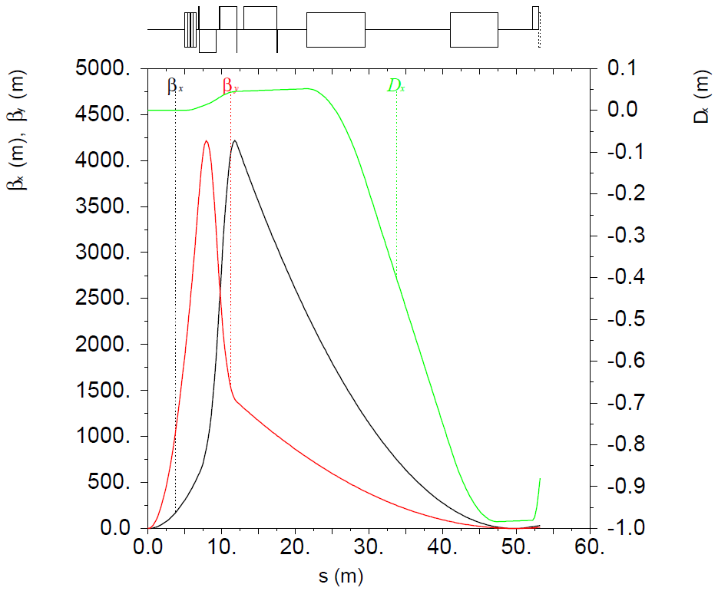
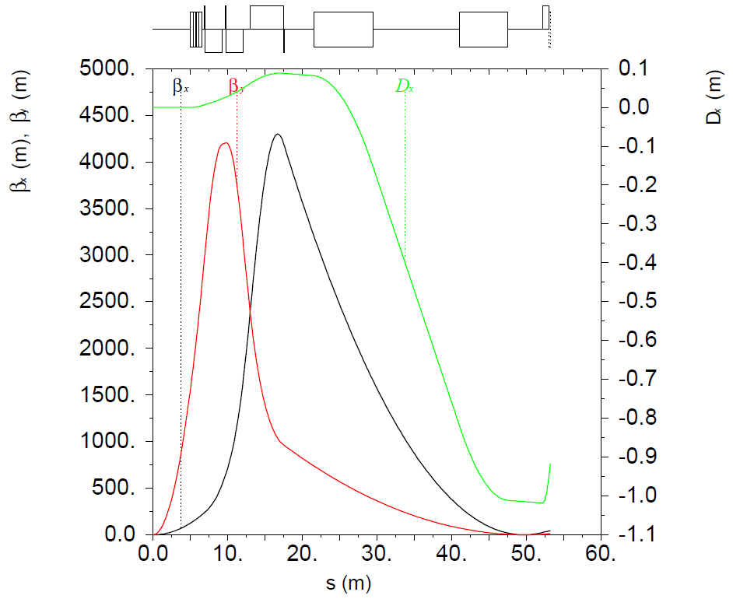


JLEIC Ion IR 100 GeV COM Design
Vasiliy Morozov
±10 mrad angular aperture acceptance in the whole energy range up to 100 GeV COM with a secondary focus in combination with high dispersion point downstream of spectrometer dipole
Conventional Nb-Ti technology Final-Focusing Quadrupole technology
Same high luminosity and detection performance as the 65 GeV COM design
Shorter- and longer-focus configurations at lower and higher energies, respectively
65 GeV COM
100 GeV COM
$β_{x,y}^{∗}=21/1.$6 cm
$β_{x,y}^{∗}=8/1.3$ cm

Slide 13
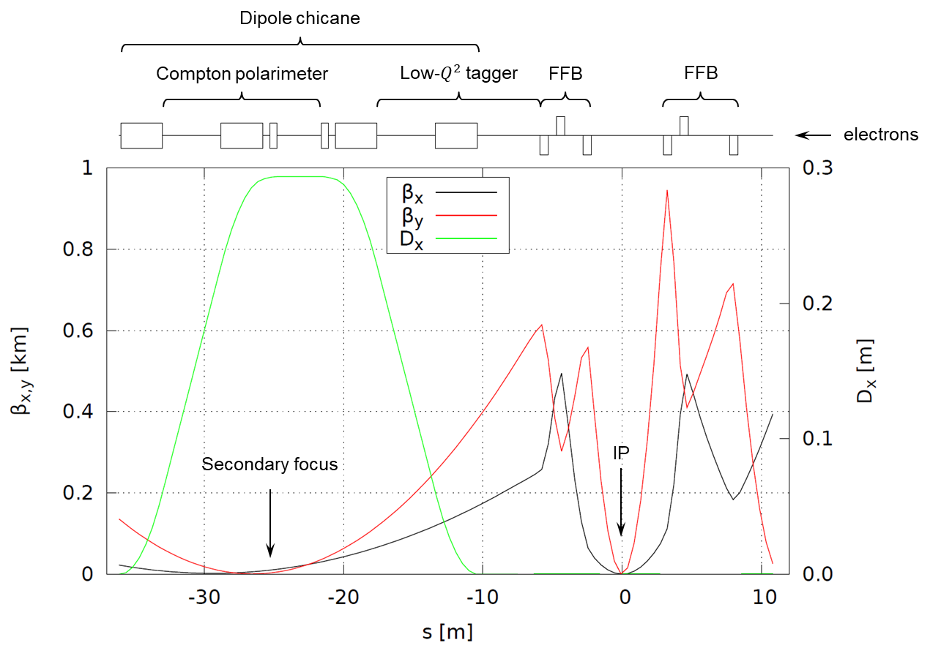

Electron Interaction Region
Vasiliy Morozov
Downstream chicane for low-$Q^{2}$ tagging and polarimetry

Slide 14
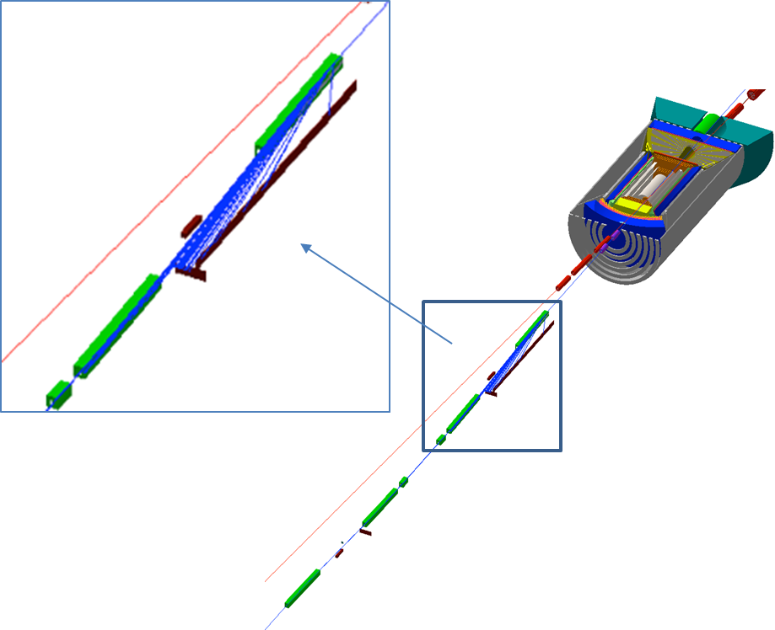
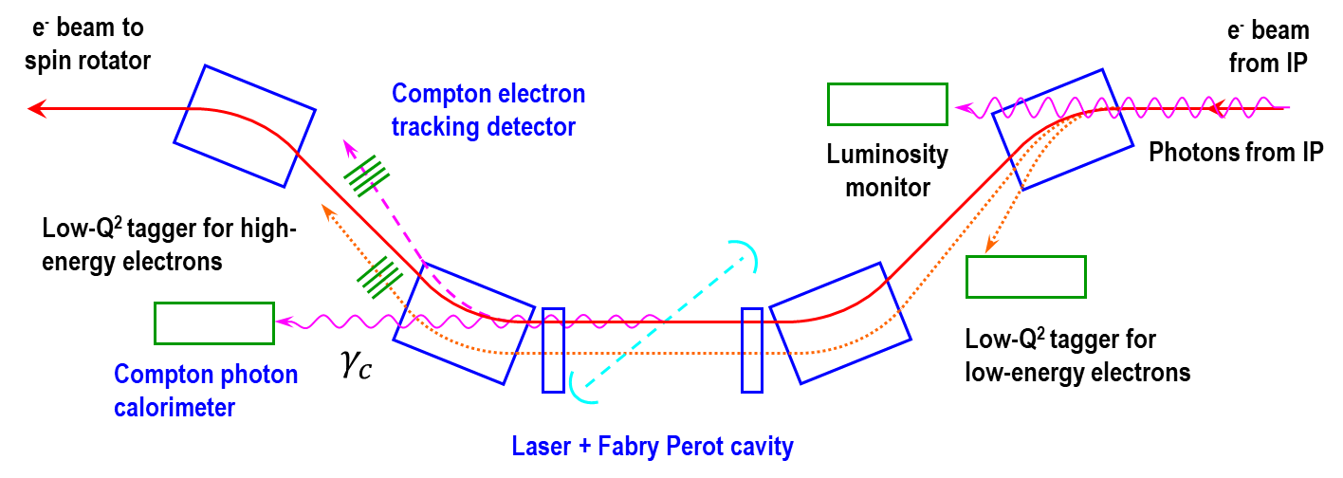
Low $Q^{2}$ Tagger in JLEIC
Vasiliy Morozov
Dipole chicane for high-resolution detection of
low-Q² electrons
Compton polarimetry has been integrated to
the interaction region design
  same polarization at laser as at IP due to zero net bend
  non-invasive monitoring of electron polarization

Slide 15
Introduction
High-Luminosity LHC is the planned upgrade of the LHC to provide a large boost to the luminosity output of the machine.
Bunches do not currently collide head-on due to the crossing angle which reduces the number of collisions per crossing.
Providing a rotational kick either side of IP1 and IP5 (ATLAS & CMS) can create a bunch rotation that will restore head-on collisions and therefore improve the luminosity.
This rotational kick can be provided by any device that provides a positive kick for the head of the bunch and negative for the tail (or vice versa) -> Crab Cavities.
2 superconducting crab cavities at 400 MHz have been fabricated and installed into the SPS and were tested in 2018.

Slide 16
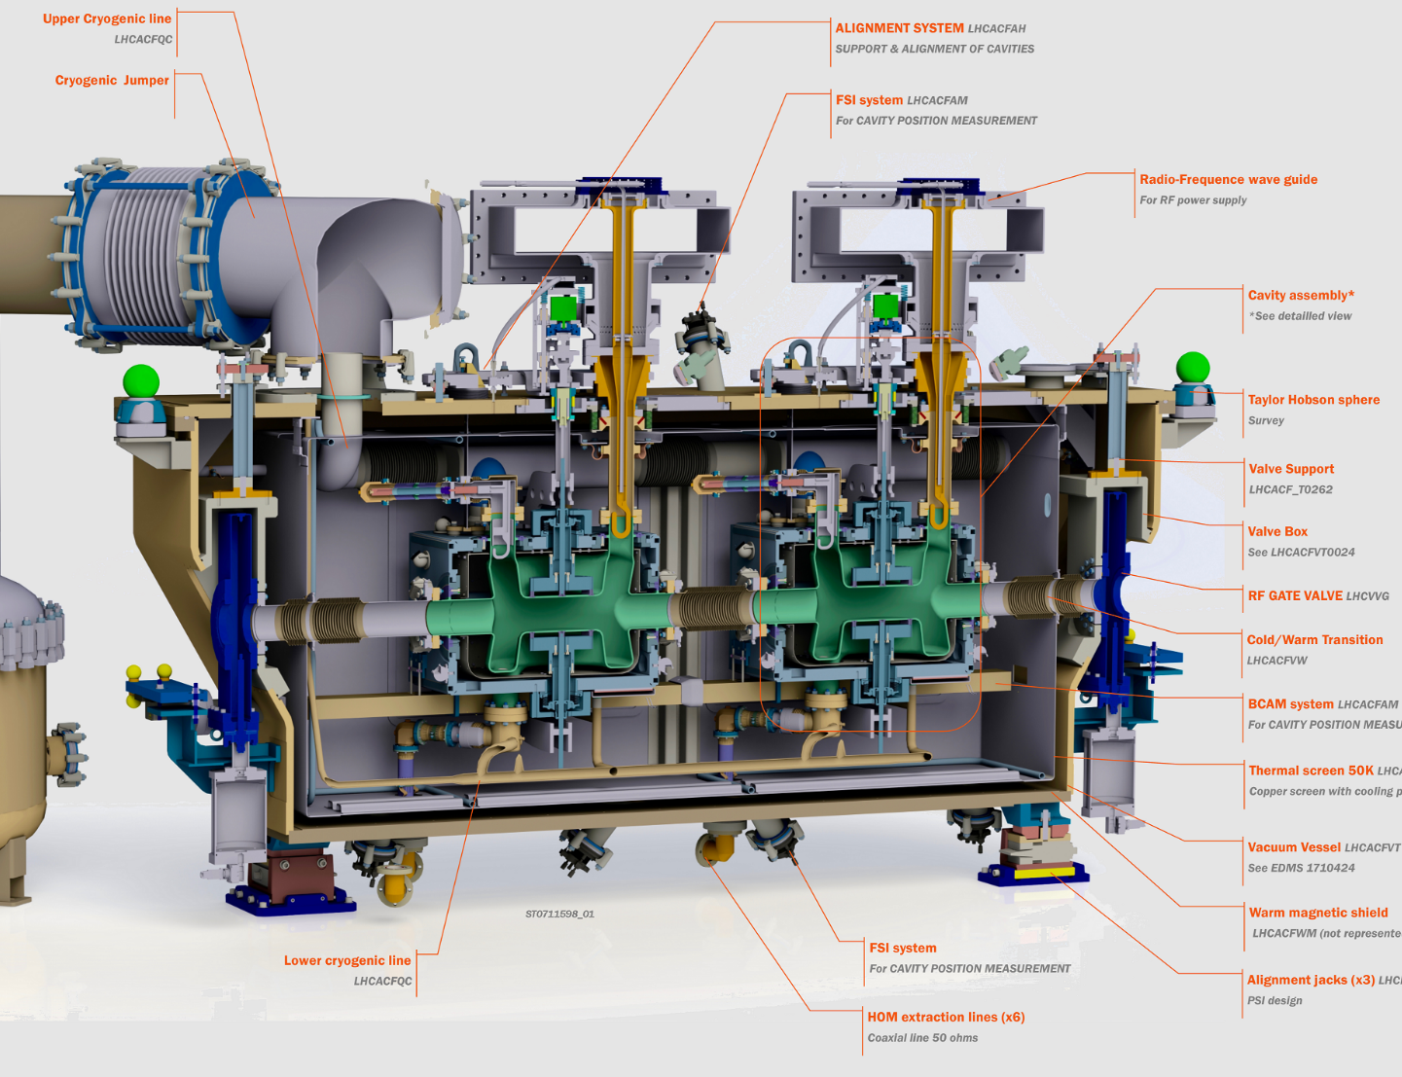
DQW cavity manufacturing sequence
Courtesy: EN-MME

Slide 17
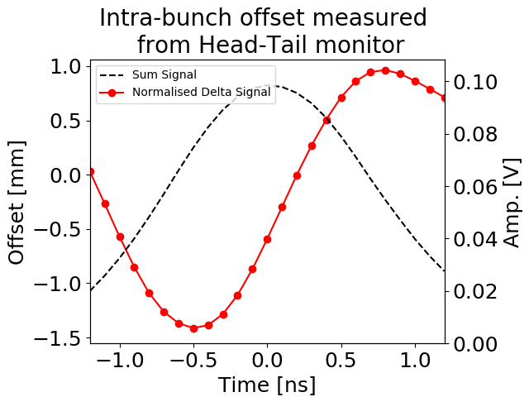
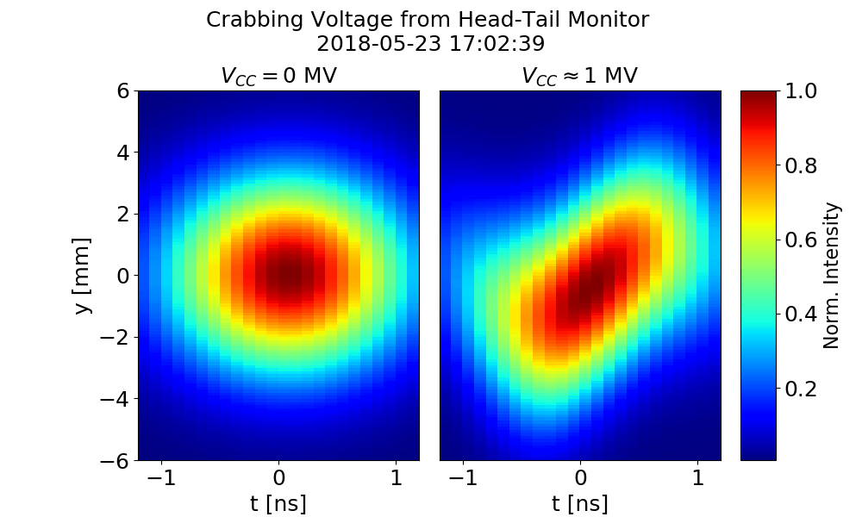
Head-Tail Monitor
Dividing delta signal (with subtracted baseline) with sum signal gives intra-bunch offset.
Take the measured profile in z. Assume a Gaussian profile in y with sigma taken from wirescan.
Modulate in z with intra-bunch offset.
Make plot of reconstruction of crabbing!

Slide 18
MD Overview
* Operating temp is 2K, V=3.4 MV
MD# |  | Cav1 [MV[ | Cav2 [MV] | Temp [K] | Energy [GeV]
1 | First crabbing, phase and voltage scan | 0.5 | 0 | 4.5 | 26
2 | 270 GeV ramp with single bunch | 1-2 | 0 | 4.5 | 26, 270
3 | Intensity ramp up | 1 | ~0.3 | 4.5 | 26
4 | 270 GeV coast setup | 1.0 | 0.5 | 2.0 | 270
5 | Emittance growth at 270 GeV with induced noise | 0 | 1.0 | 2.0 | 270
6 | Intensity ramp up to 4-batches | - | 1.0-1.5 | 2.0 | 26
7 | Intensity/Energy ramp up | 1.0 | 1.0 | 2.0 | 26, 270
10 MDs: 2 for cycle and table setup, 1 lost due to cavity issues
Notes:
DQW cryomodule was installed in the SPS without any high power test on the surface -> first MDs were much perturbed by hardware commissioning: cryo problem ( 4.5 K vs. 2 K), time needed to condition the cavity, TX problems (non linearity at low power), LLRF problems (understanding and curing ponderomotive oscillations, direct coupling of beam to antenna).

Slide 19
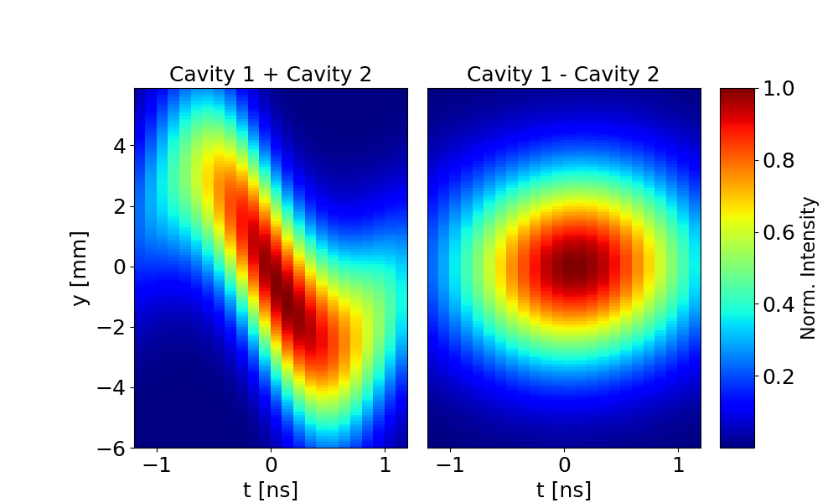
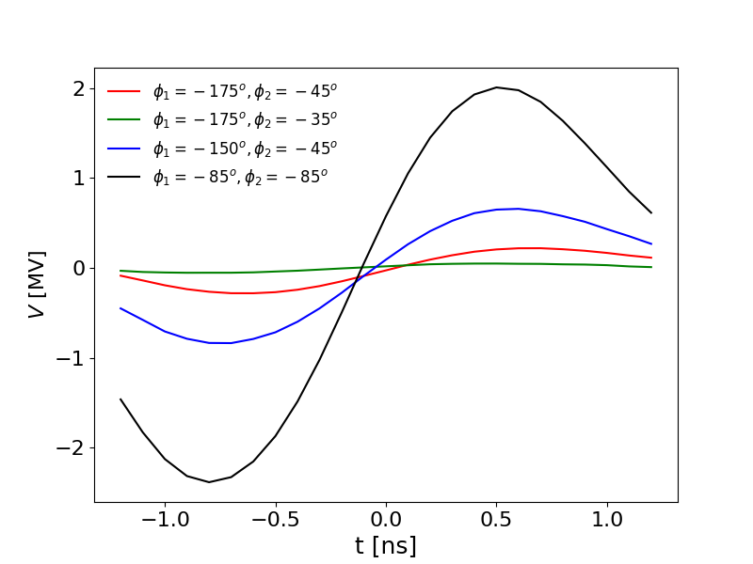
Transparency
For a period during MD7 (17/10/2018 ~10:30 – 11:30) we had both cavities with feedback and tuning loops operational at 2K pulsing with 1MV per cavity.
Set both cavities individually to approximate crabbing phase.
Set them in anti-phase and try to fine tune the phases (minimum step size 5 deg) to minimize the observed crabbing.
Lowest measured crabbing amplitude was ~60kV (with 1MV per cavity).

Slide 20
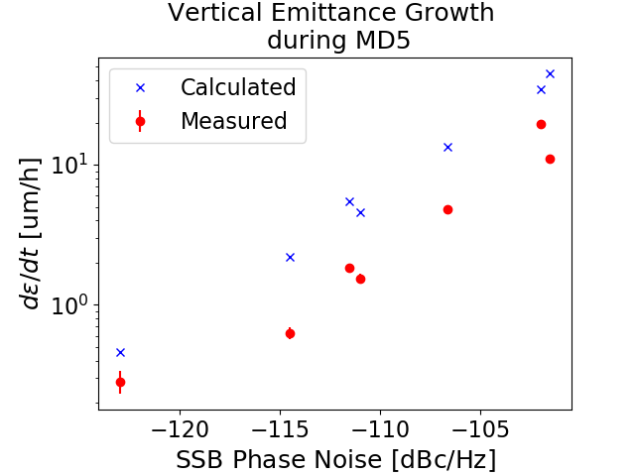
Results
The x-axis is the Phase Noise PSD. Although always smaller, the Amplitude Noise PSD varied during the successive coasts. This explains the different calculated values for very similar Phase Noise PSD, and may partly explain the different measured emittance growth.
The calculations over-estimate the growth by factor 2-4
Measured (Wire Scan) and calculated during the coasts with different noise levels.

Slide 21
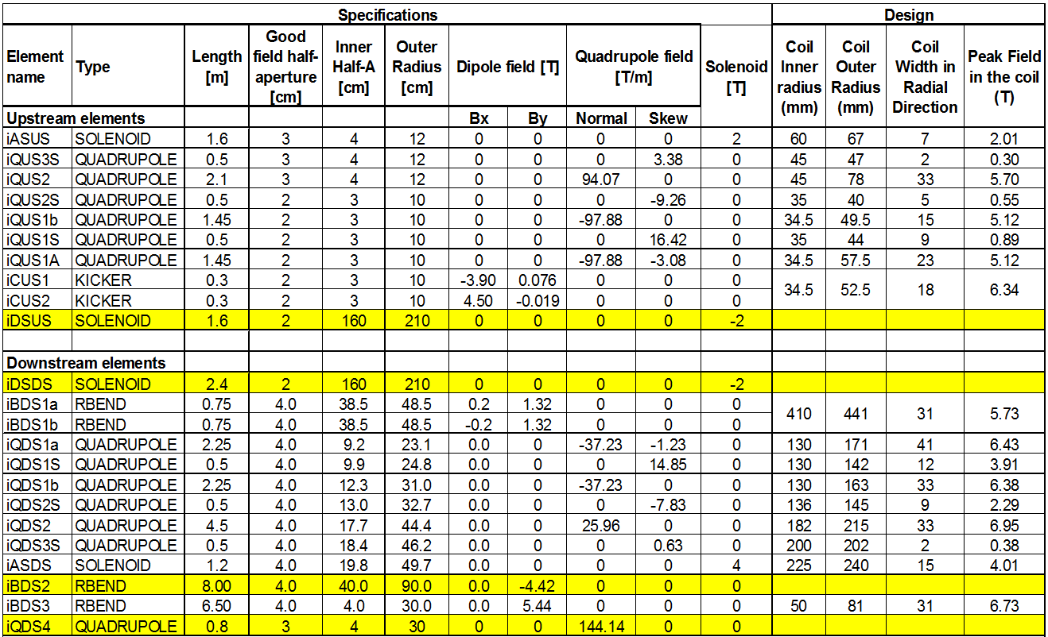
Magnet Design – Ion Magnet Parameters
Mark Wiseman
Tim Michalski
All FFQ magnets are NbTi
Ion FFQ lengths have been increased for 200 GeV
3 downstream magnets are most challenging due to aperture size
Four skew quadrupoles in the upstream and downstream lines, two are nested with the FFQ quadrupoles.

Slide 22
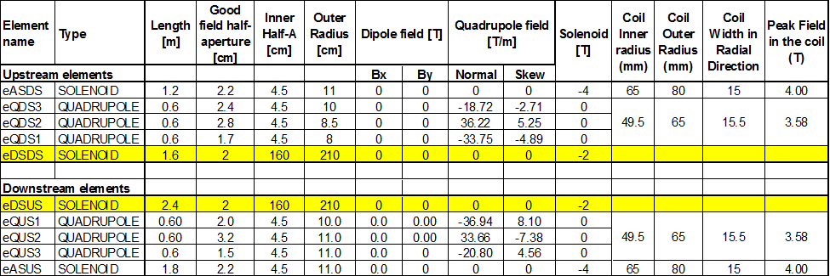
Magnet Design – Electron Magnet Parameters
Mark Wiseman
Tim Michalski
Electron FFQ designs have not changed.
All the quads and skew-quads are designed the same for 45 T/m main quad strength and 9.5 T/m for skew-quad strength. These quads can be optimized further to reduce space or reduce peak field in the coils.

Slide 23
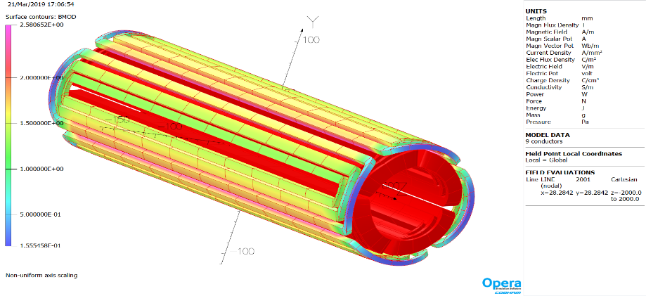
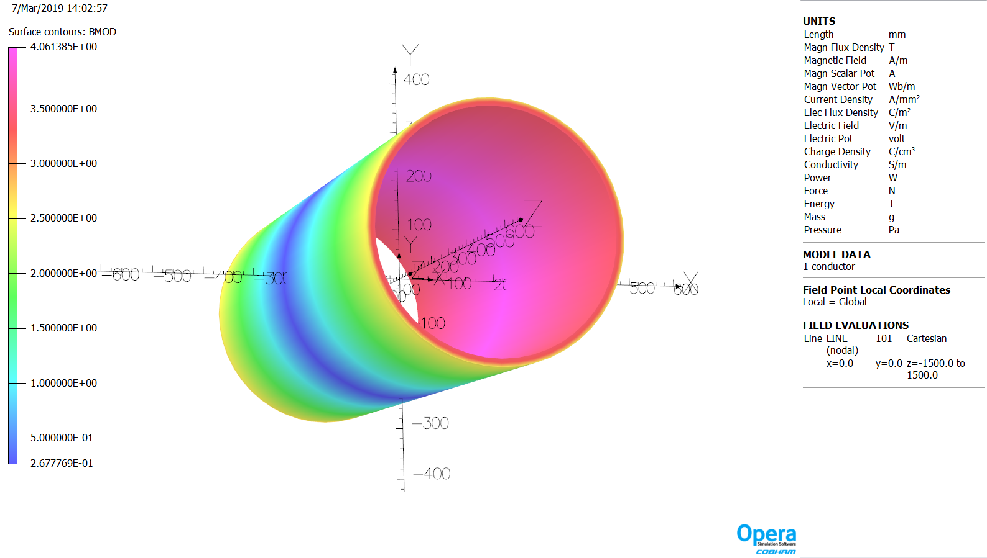
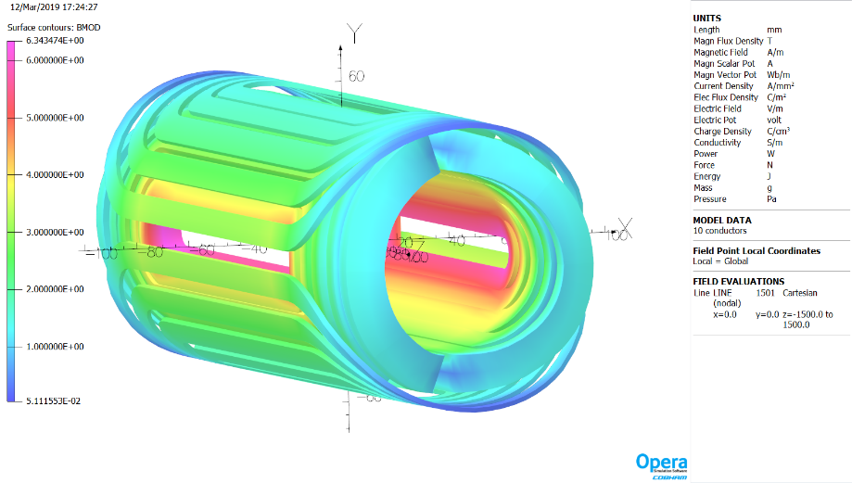
Ion Magnet Designs – Skew Quad, Solenoid, Corrector (Kicker)
Mark Wiseman
Tim Michalski
iQUS1a
iASDS
iCUS2
Peak field in the iQUS1a Skew quad is 2.6 T
Peak field in the iASDS Solenoid is 4 T
Peak field in the iCUS2 Corrector is 6.3 T

Slide 24
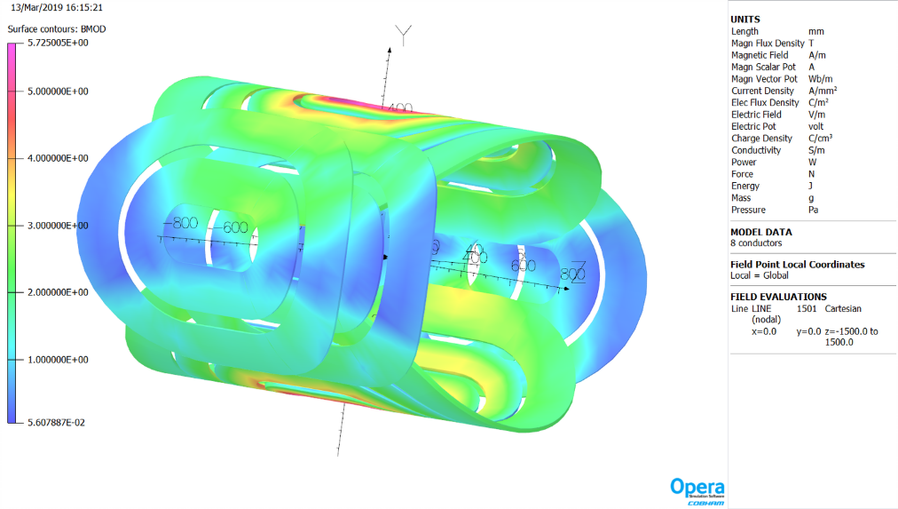
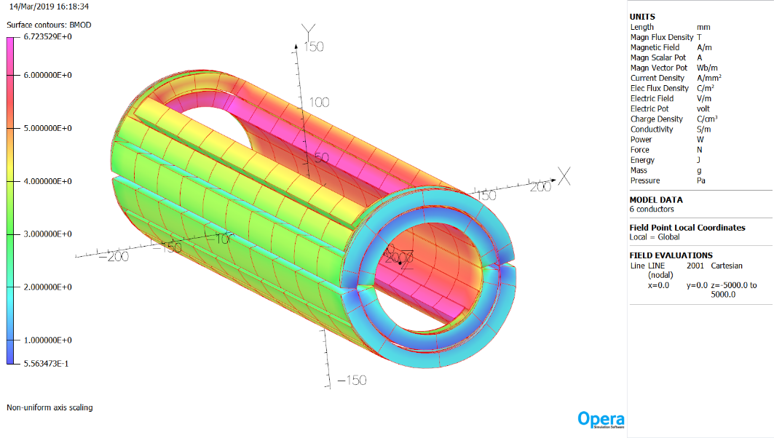
iBDS1 & iBDS3 Designs
Mark Wiseman
Tim Michalski
iBDS1
Peak field in the iBDS1 coil is 5.73 T
  Single horizontal bend plus two vertical bend coils
Peak field in the iBDS3 dipole coil is 6.73 T
  Start of ion beam transport after the detector
iBDS3

Slide 25
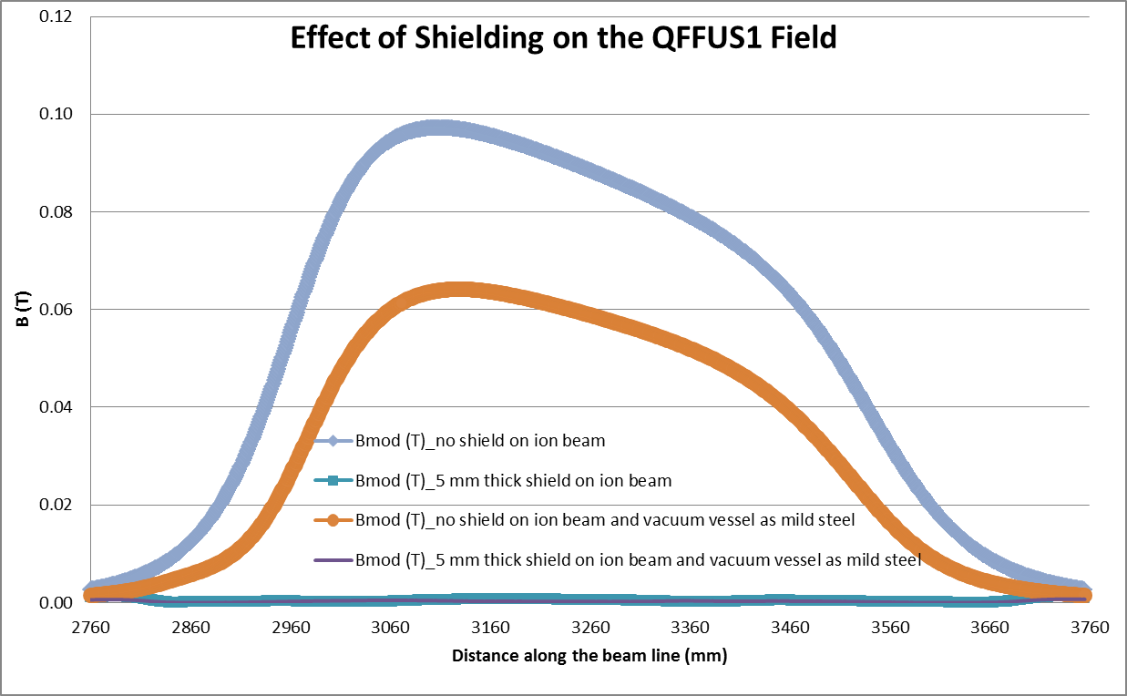
Magnet-Magnet Interaction – (previous design, will be updated for 200 GeV ions)
Mark Wiseman, Tim Michalski
In order to study the magnet-magnet interactions, the following combinations were selected for the initial study:
  eQUS1 with ion beam line (shown)
  eQUS1 with ion beam line (pending)
  iQDS1a, eQUS3 and eASUS (pending)
  eQUS2 and iQUS1a (pending)
eQUS1
eQUS1- (i) ion beam tube wrapped with 5 mm mild steel passive shield (ii) the vacuum vessel for the eQUS1 is assumed to be made of mild steel, and (iii) a combination of the above two options
Effect of eQUS1 shielding on Ion beam field

Slide 26
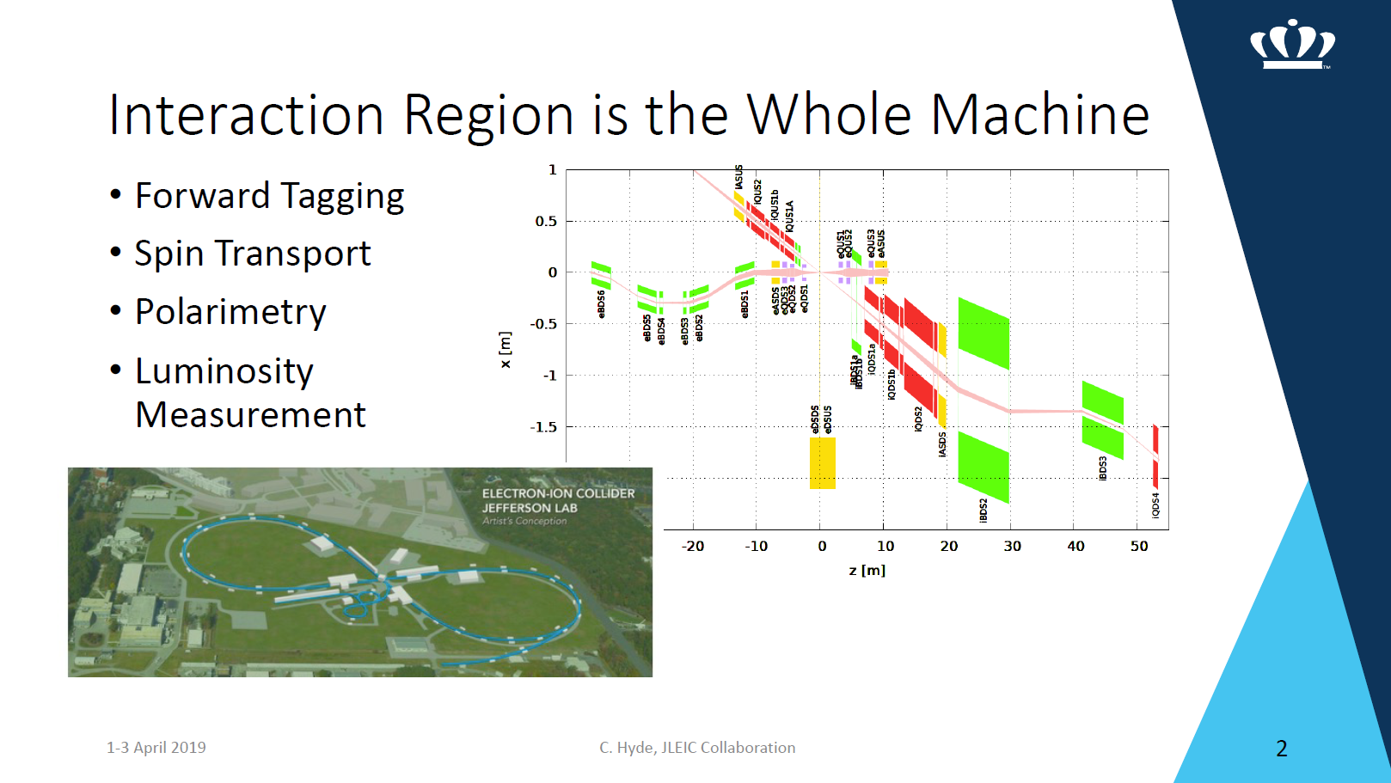

Slide 27
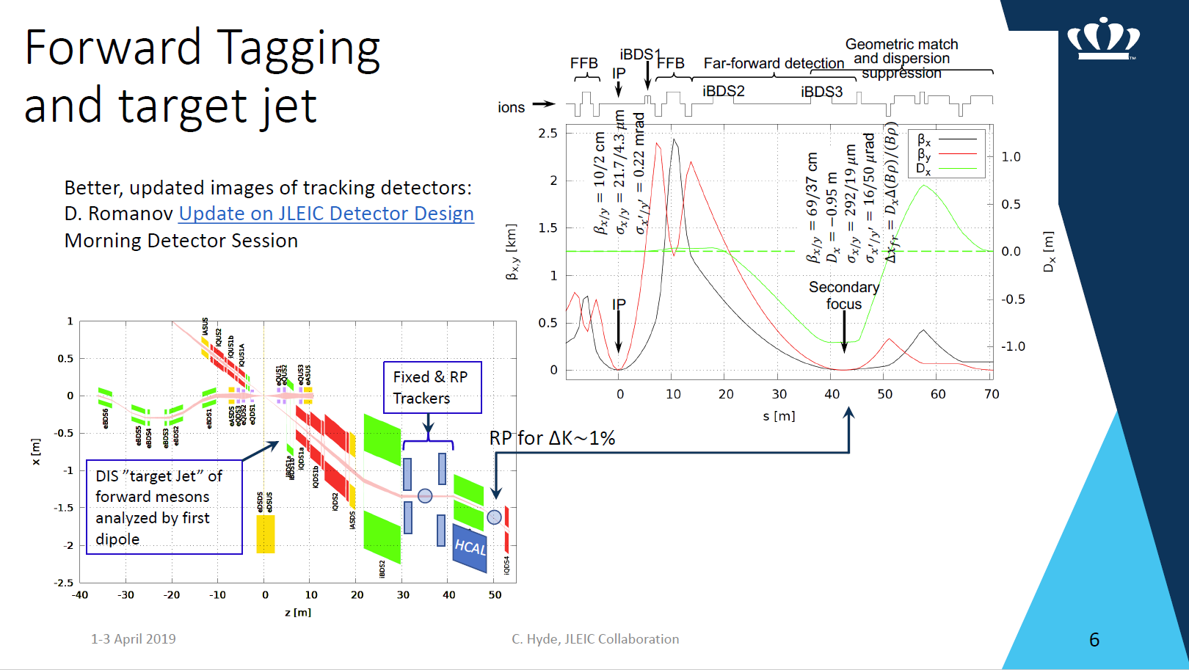

Slide 28
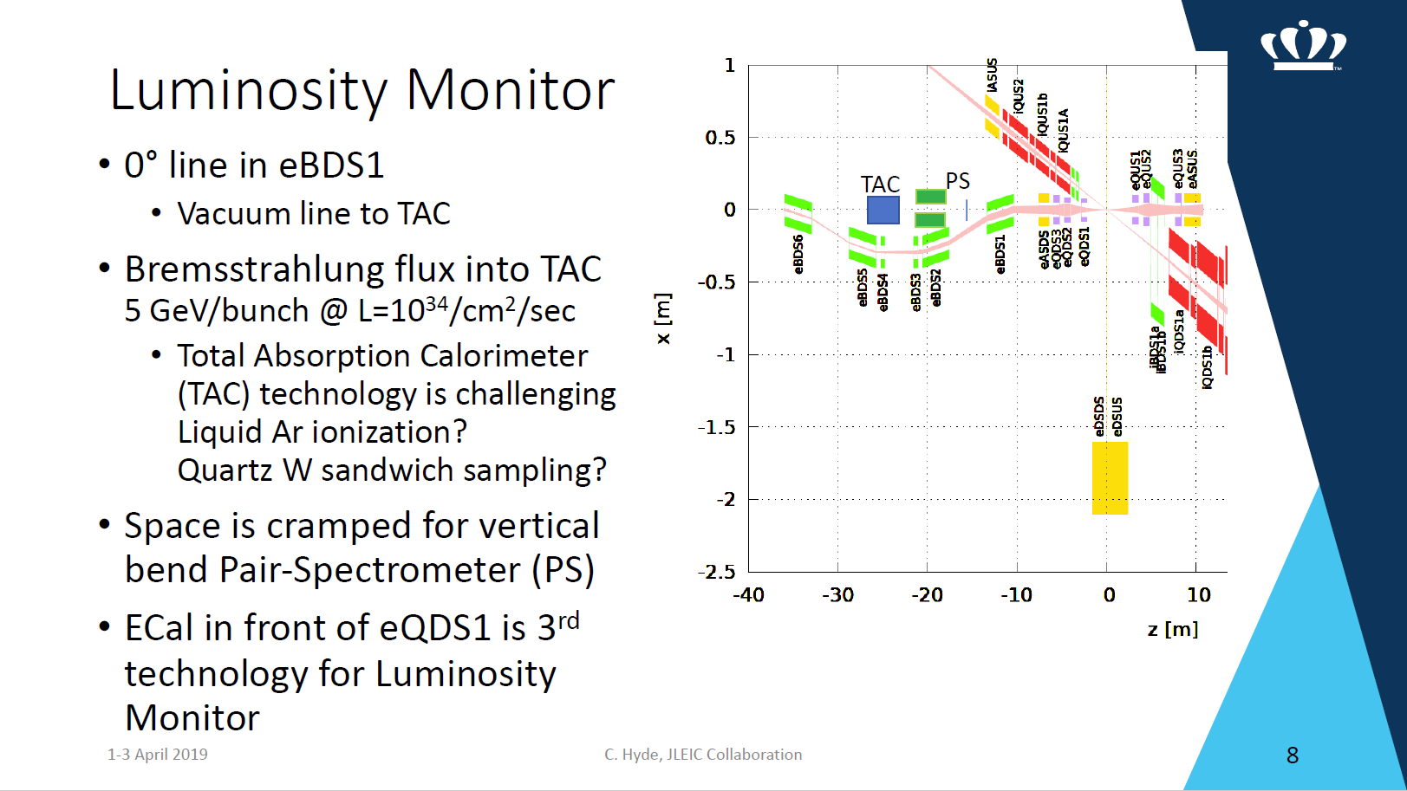

Slide 29
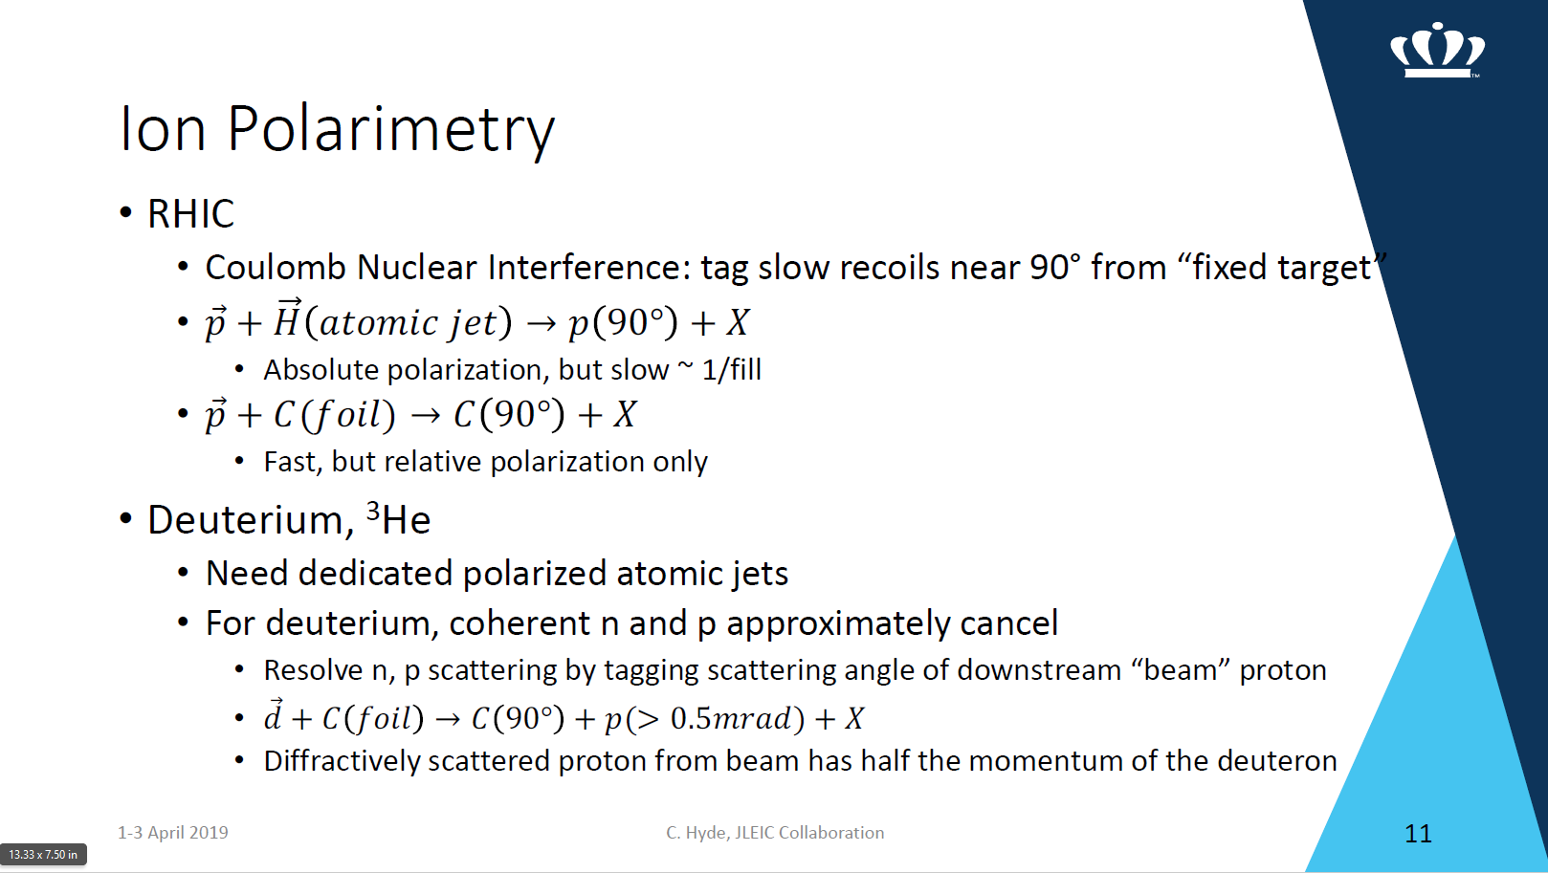

Slide 30
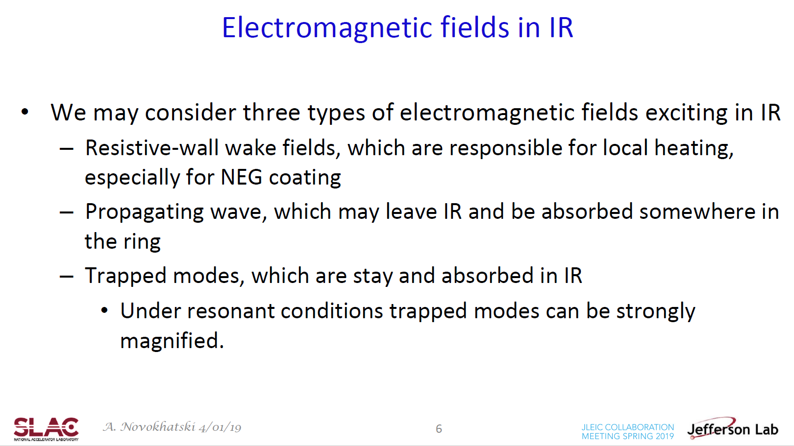

Slide 31
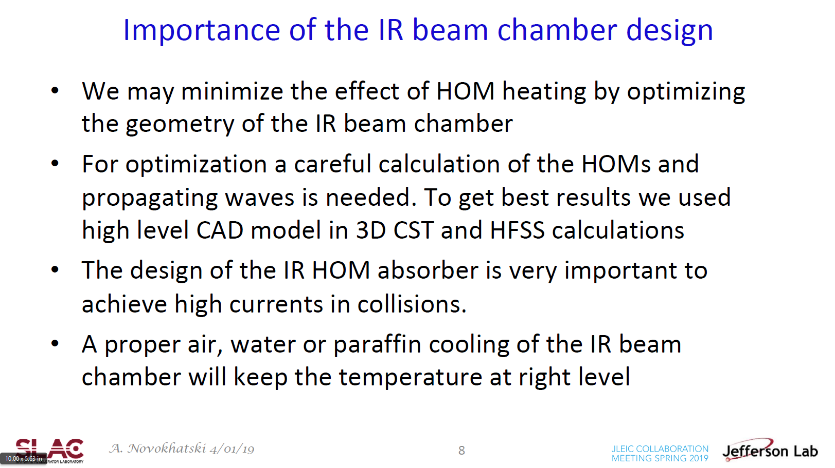

Slide 32
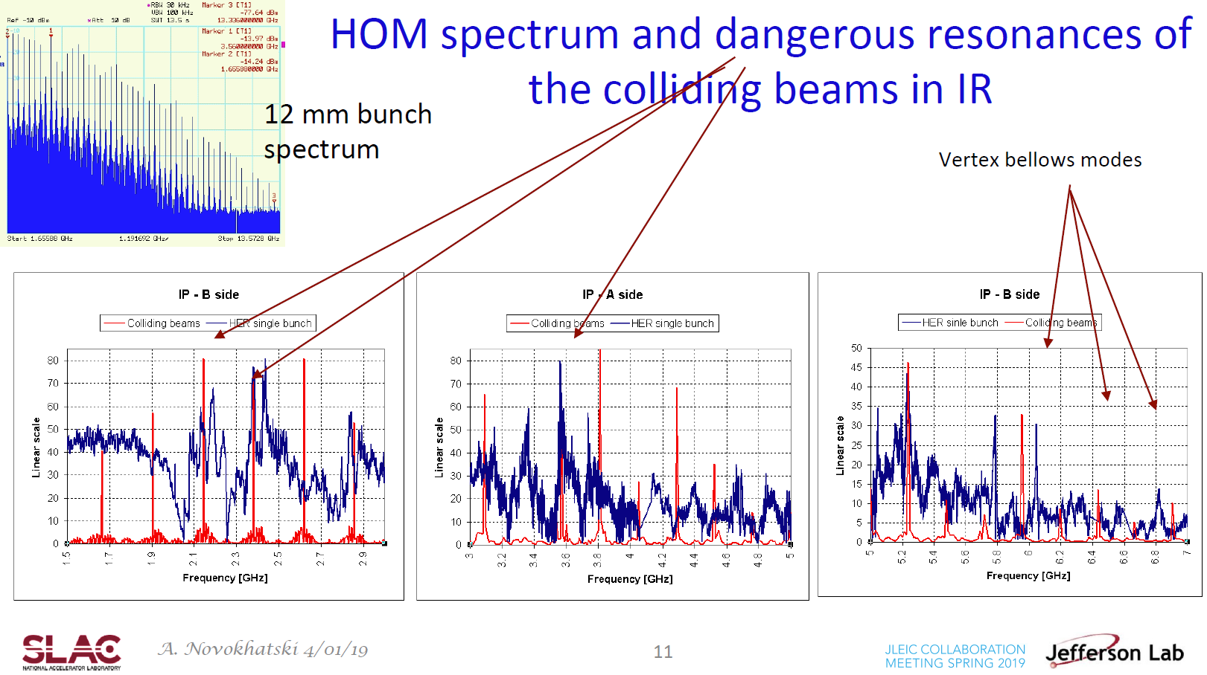

Slide 33
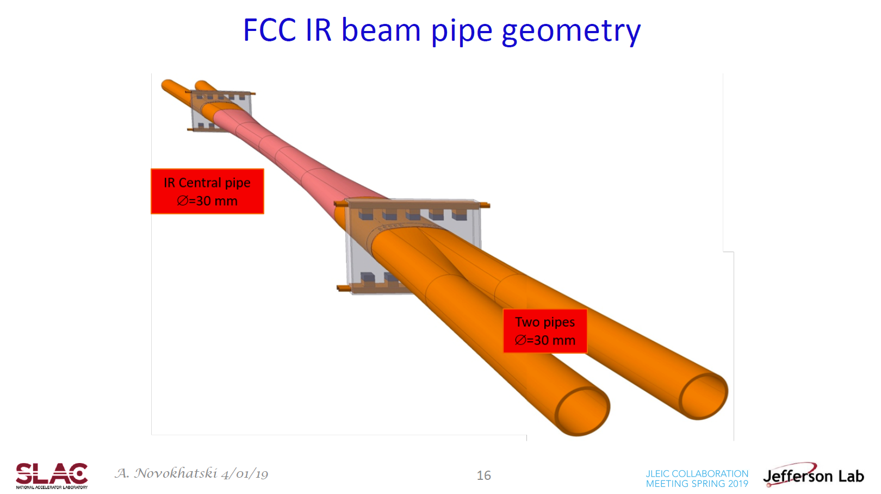

Slide 34
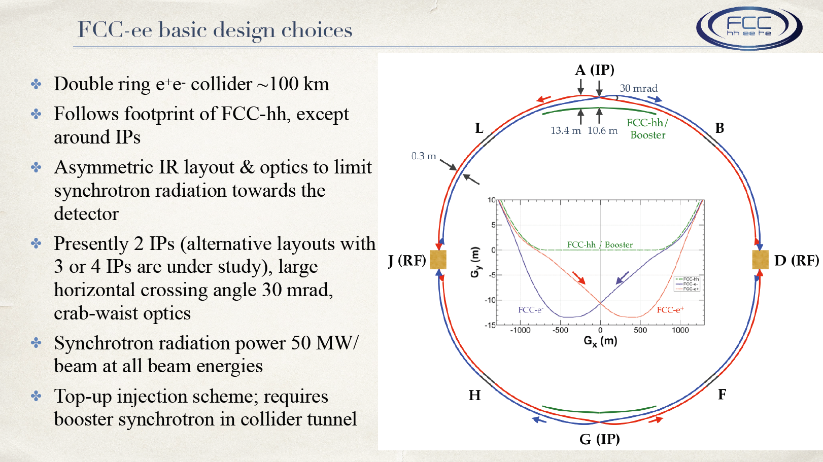
K. Oide

Slide 35
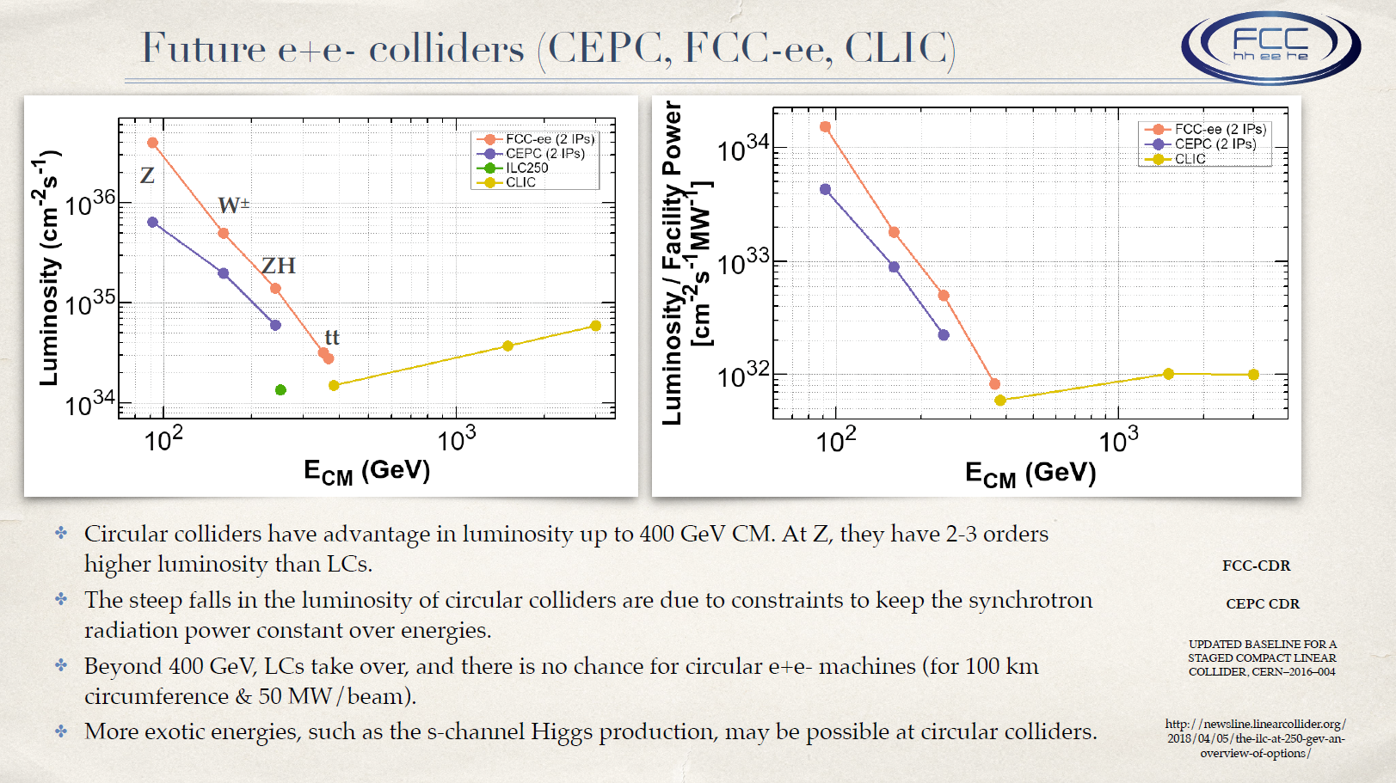
K. Oide

Slide 36
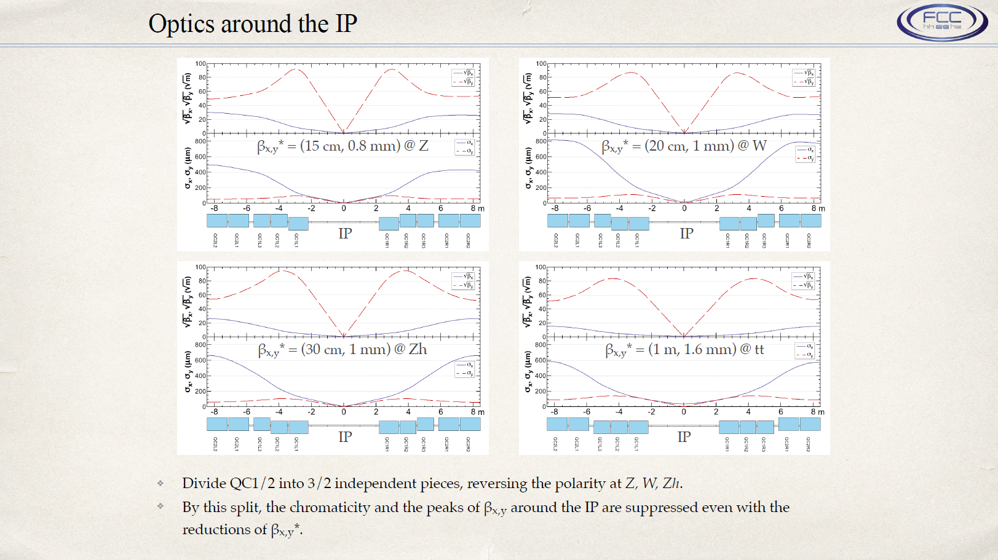
K. Oide

Slide 37
Discussion
Balance of detector performance and engineering complexity
Need to better quantify the detector requirements
Come up with a list of benchmark processes for quantifying the detector requirements
Use the benchmark processes to quantify the detector performance

