Slide 1
In-Medium Nucleon Structure and Fragmentation
Zhihong Ye
Medium Energy Group, Physics Division
Argonne National Lab
03/16/2019, FF2019-Workshop

Slide 2
Outline
Medium Effect In Inclusive DIS
Medium Effect In SIDIS
pA Drell-Yan Process
Summary

Slide 3
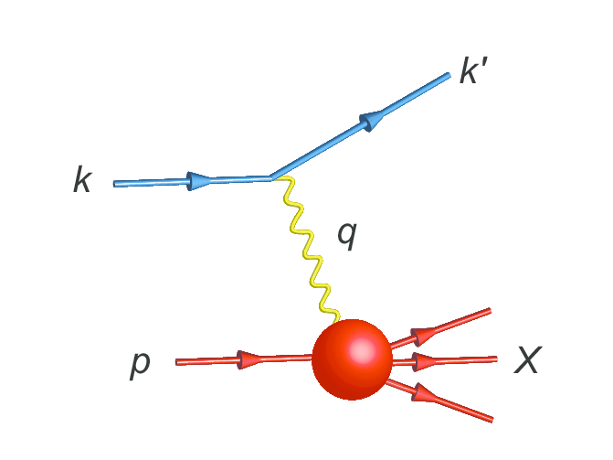
Medium Effect In Inclusive DIS

Slide 4
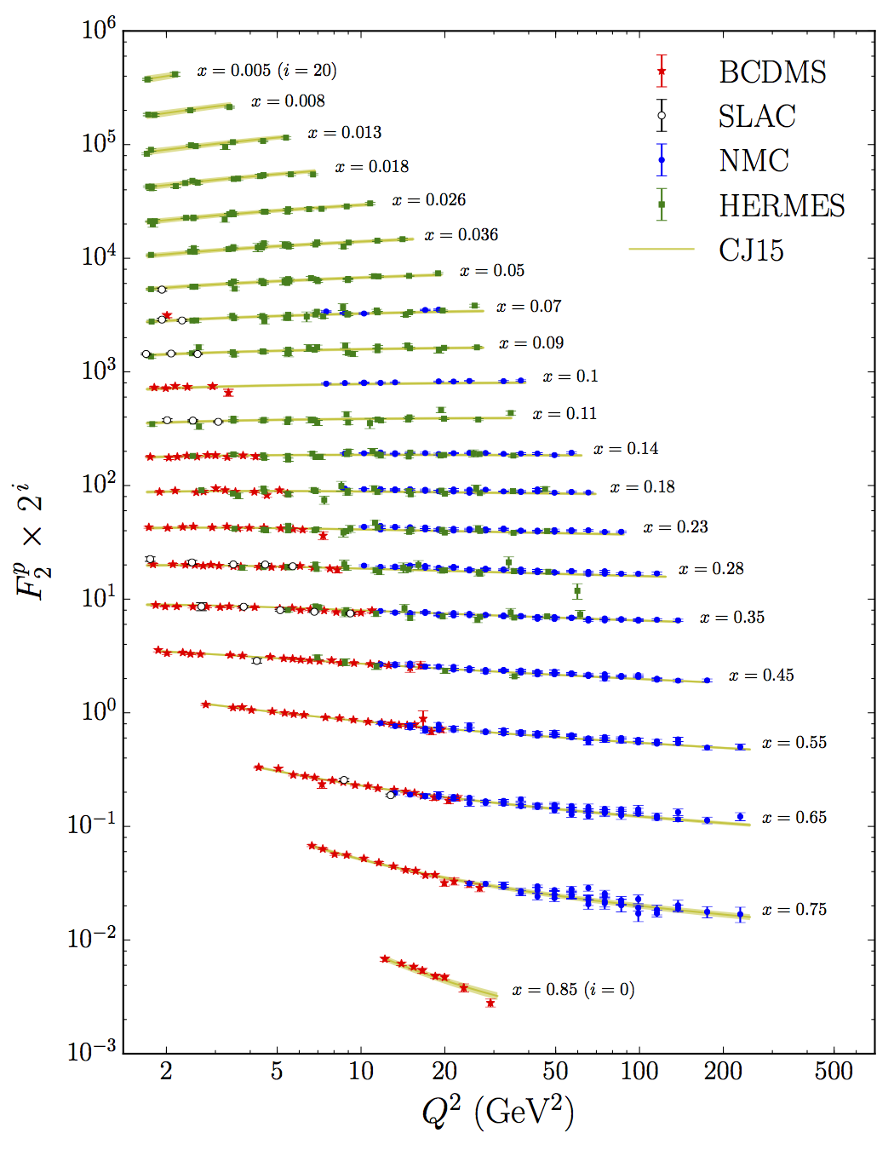
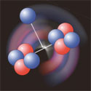
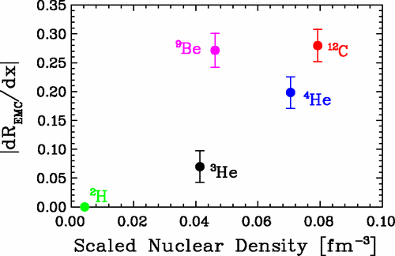
PDF in Inclusive DIS
Nucleons vs in Nuclei:
Inclusive DIS accesses PDFs:
Many decades of measurement w/ eDIS, pp
Nuclear effects corrected for effective-”free” neutrons (BoNUS/BoNUS12, MARATHON, PVDIS, …)
$$F_{2}^{N}(x)=x\sum_{q}{e_{q}^{2}q_{ }(x)}$$
Interesting features when using nuclei
Modified parton structure?
$$R(x)={\frac{σ_{DIS}^{A}}{σ_{DIS}^{D}}∝\frac{F_{2}^{A}}{F_{2}^{D}}=\frac{\sum_{q}{e_{q}^{2}q^{A} (x/y)}⨂{f_{q}^{A}(y)}}{\sum_{q}{e_{q}^{2}q^{D} (x/y)⨂{f_{q}^{D}(y)}}}}_{ }^{ }$$
Anti-Shadowing
Fermi-Moton
Nuclear medium correction?
Local-effect?
EMC
Shadowing

Slide 5
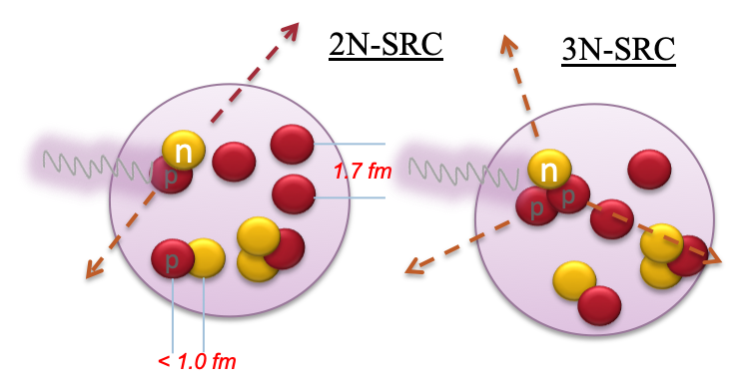
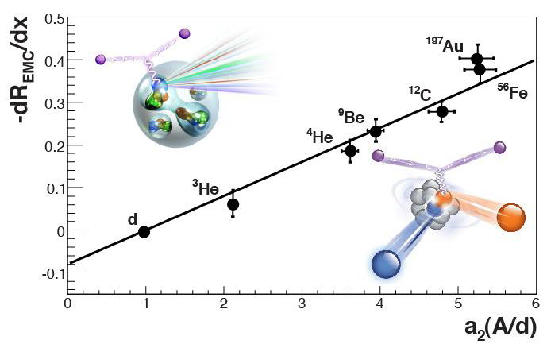
PDF in Inclusive DIS
EMC Effect vs. SRC Effect:
Short-Range Correlations (SRC): Nucleons largely overlapped (high-density); each carry large momenta (high-virtuality) ; small total momentum
2N-SRC and 3N-SRC in nuclei are similar to ²D and ³He (³H)
Inclusive QE XS ratios reveal a scaling behavior x in (1.3<x<2.0)
Surprising similar A-dependence with EMC
EMC vs SRC provide a way to understand the partonic picture in NN-interaction
Many new JLab@12GeV experiments
High virtuality?
EMC effect driven by virtuality of nucleon
Local Density?
EMC effect driven by local density
EMC vs. SRC
L. Weinstein et al, PRL 106, 052301 (2011)
J. Arrington et al., PRC 86, 065204 (2012)
O. Hen et al, PRC 85, 047301 (2012)

Slide 6
Medium Effect in Inclusive DIS
What more we can learn?:
The flavor-dependent medium effect:
Stronger medium effect on u- then d-quark?
Medium effect in sea-quarks?
Medium effect in Helicity-PDF g₁(x)
CLAS12 new experiment with polarized Li⁷
I. Cloet, PRL 95, 052302, 2005); PLB 642, 210(2006)
Medium effect in Transversity-PDF h₁(x)?
g₁(x) has stronger medium effect than f₁(x), how about h₁(x)?
I. Cloet, et. al.
Medium effect on the transverse direction?
Maybe the reason that we still don’t understand the
EMC effect is because we only look at 1D-PDF?
3D structure of nucleons in nuclei (Nuclear TMD/GPD, Nuclear Fragmentation-Function)?
Would be very difficult, especially w/ polarized nuclear targets
Higher-Twist effects in nuclear
Possible in new measurements on SIDIS/Drell-Yan w/ nuclei

Slide 7
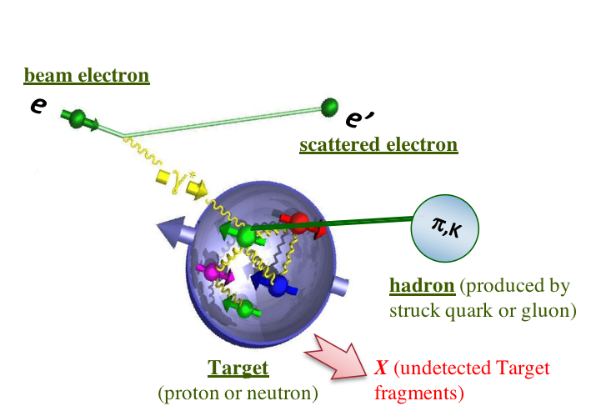
Medium Effect In SIDIS
$${=p}_{h⊥}$$
Quark’s final transverse momentum (before hadronized)
Quark’s intrinsic transverse momentum
$${\vec{p}}_{⊥}={\vec{P}}_{T}−{z_{h}\vec{k}}_{⊥}$$
Out-going Hadron’s transverse momentum

Slide 8
SIDIS with Nucleons
Some unpolarized LO formulism:
Unpolarized fragmentation functions (FF)
Unpolarized SIDIS cross section at LO:
Ignore heavy quarks and make few assumptions:
Useful observables for pion production :
Yield, XS
Sensitive to
”pure” PDF
Ignore strangeness
Partially sensitive to PDF
(experimental advantage, less NLO effect)
Sensitive to ”pure” FF
In kaon production:
Note: Simplified for proof of principle;
Global analysis needed!

Slide 9
Check NLO in Monte-Carlo
SIDIS with Nucleons
Some unpolarized LO formulism:
Supported by Hall-C data
JLab Hall C E00-108, x=0.32, Q2=2.3 GeV²
Good enough to motivate the initial study of SIDIS w/ nuclei
Courtesy to X-D. Jiang

Slide 10
SIDIS with Light Nuclei
Tritium and He3:
Stable free proton
Hydrogen
Free-proton available, but need Deuteron as effective neutron
p
$$F_{D}=F_{\tilde{p}}⊗f_{p}^{D}+F_{\tilde{n}}⊗f_{n}^{D}$$
Spectral functions (calculable)
Unstable free neutron
Neutron
“dressed” nucleons (but close to free)
n
Medium-Effect: Fermi-motion, binding, off-shell, medium-modification, …
Loose-bound (2MeV)
Deuterium
³H & ³He:
p
n
$$F_{H3}=F_{\tilde{p}}⊗f_{p}^{H3}+{2F}_{\tilde{n}}⊗f_{n}^{H3}$$
$$F_{He3}={2F}_{\tilde{p}}⊗f_{p}^{He3}+F_{\tilde{n}}⊗f_{n}^{He3}$$
Unstable, Tighter-bound (~5MeV)
Tritium
Spectral functions in A=3 nuclei are precisely calculable
Correction becomes small (sometimes ignored) in ratios
Medium-modification effect is similar and small at high-x
p
n
n
Stable,
Tight-bound (~8MeV)
Helium-3
n
³H & ³He can be used as effective “free-nucleons” or as well-controlled nuclear medium
Better to study medium effect in these lightly bound nuclei before getting into REAL nuclei (He4 and above) → A bridge to the free-world!
p
p
Very
Tight-bound (~28MeV)
Helium-4
n
n
p
p

Slide 11
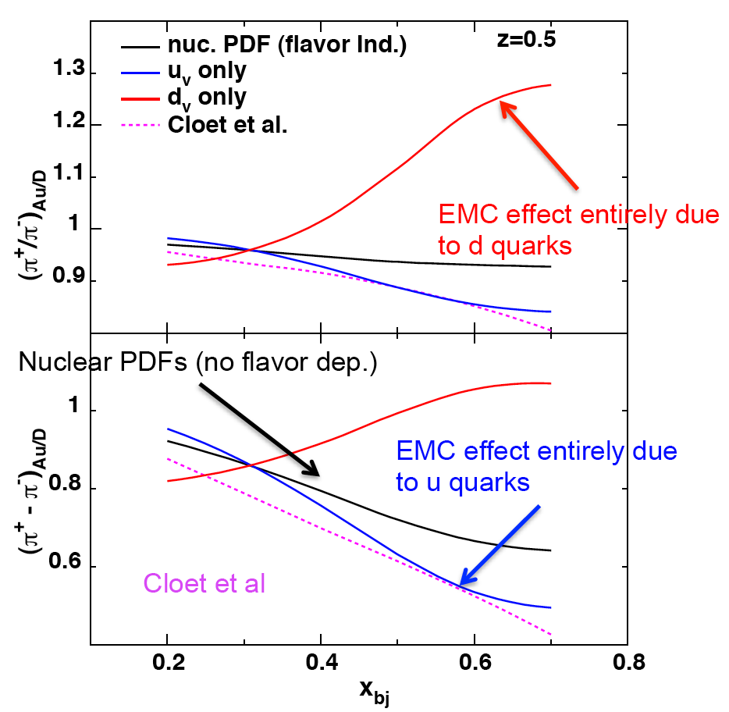
SIDIS with Light Nuclei
Tritium and He3 as well-controlled nuclear medium:
Study flavor-dependent EMC effect
In $Z≠N,$ different medium effect on u- and u- quark ?
I. Cloet, et al, PRL 109, 182301 (2012); PRL 102, 252301 (2009)]
A power probe with ³H (Z/N=1/2) and ³He (Z/N=2):
If N>Z, u-quark is more “bound” → ³H
If N<Z, d-quark is more “bound” → ³He
Systematic measurement w/ ¹H, ²D and ³He&³He
If not cancelled, we can exam their z-dependence!
Would also measure the p_{T} -dependence
Important input for SIDIS w/ polarized D2 and He3 as effect neutrons!

Slide 12
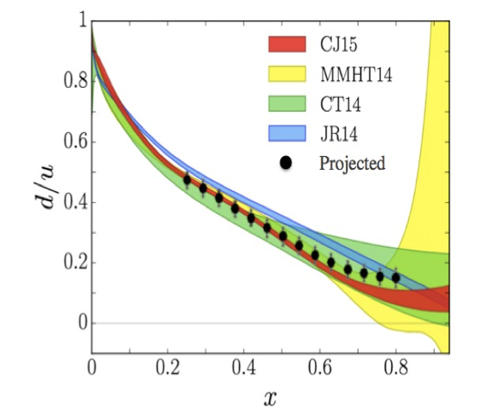
SIDIS with Light Nuclei
Tritium and He3 as “free”-nucleons:
MARATHON experiment
Super-Ratio in EMC (DIS)
R($3_{He}$)$=\frac{F_{3_{He}}}{{2F}_{p}^{ }{+F}_{n}^{ }}$, R($3_{H}$)$=\frac{F_{3_{H}}}{F_{p}^{ }{+2F}_{n}^{ }}$,
$$ℛ=\frac{R(3_{He})}{R(3_{H})}$$
SIDIS w/ ³H & ³He → direct flavor tagging of “free” nucleon PDF
Fragmentation function cancelled if A-dependence!
Equal if strangeness symmetry!
A way to test $s=\overline{s}$ assumption?
But probably not at large x
Flavor dependence of Fragmentation function:
If extending into dependence in (Q², x, z, p_{T}), test the factorization in SIDIS

Slide 13
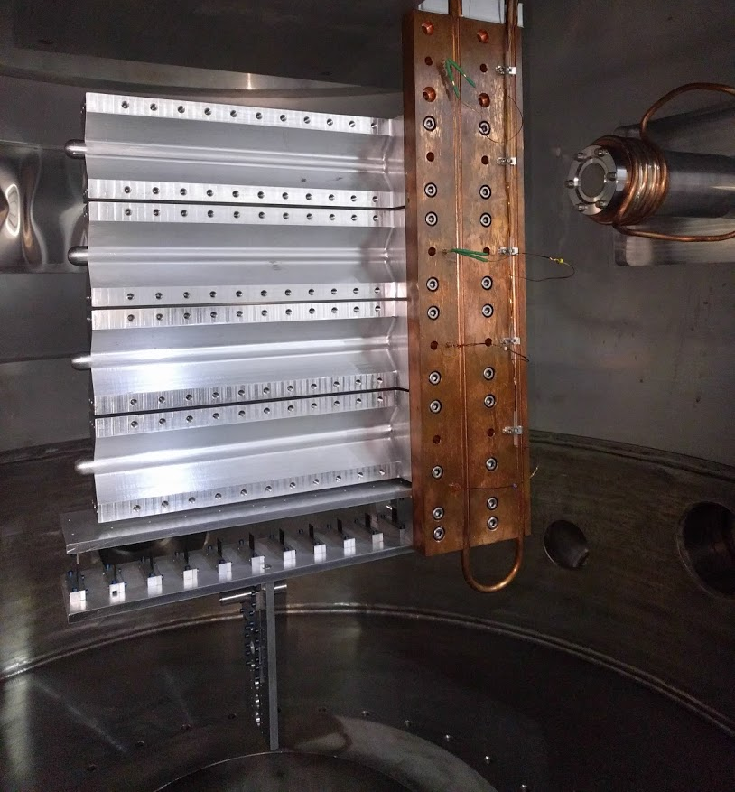
SIDIS with Light Nuclei
New Tritium Experiments:
Tritium
Tritium was successfully used in the Hall-A Tritium Run-Group (2018)
MARATHON, (e,e’)-SRC, (e,e’p)-SRC, (e,e’K) Λnn-Hypernucleus)
Deuterium
Hydrogen
Helium-3
A second Tritium experimental Run-Group is under discussion
11 Carbon-Foils
The Tritium Run-Group experiments were very successfully
Tritium Target System worked as expected
Still plenty of physics can do with Tritium
Foil Targets
Few ideas are under development:
Semi-Inclusive Deep Inelastic Scattering (SIDIS)
Coherence/Incoherence DVCS→ Nuclear-GPD, Neutron-GPD
(e, e’D) → Few body force, Deuteron Form Factors
(e, e’ pN) Triple-Coincident SRC
Tritium/He-3 Radii
More?
Currently consider using CLAS12 but can be in Hall-C or SoLID (prefer)
New Tritium target system design is ongoing

Slide 14
SIDIS with Heavy Nuclei
Nuclear 3D Tomography:
There are plenty rooms to improve the nPDF precision
Eur. Phys. J. C (2017) 77:163
Much less knowledge about fragmentation function in medium
(arxiv:1706.02859, also see Elke’s talk)
New data from eA and pA channels w/ wide range of nuclei are crucial
SIDIS provides additional info on the transverse direction

Slide 15
SIDIS with Heavy Nuclei
Nuclear 3D Tomography:
Learn the medium effect of PDF (aka, TMD) and FF in 3D using Hadronization data?
with Gaussian Ansatz:
Again, define useful observables but in 3D:
Convolution instead of production!
“Pure” TMD term
“Pure” FF term
To decouple “pure” TMD and FF terms, high luminosity and wide acceptance systems are needed! e.g., SoLID, CLAS12, EIC (similar experiment done in Hall-C, E12-09-004, w/o p_{T} dependence)

Slide 16
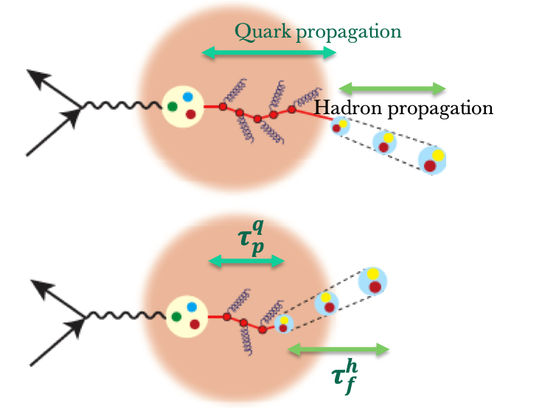
SIDIS with Heavy Nuclei
Hadronization Physics:
Historically, we used the SIDIS w/ heavy nuclei to lean the Hadronization process in medium
Study in Hadronization Physics
Color confinement
Parton energy loss in the medium
Modification of the fragmentation functions in the medium
Hadron/pre-hadron formation in the medium
CLAS6
HERMES
CLAS6
P_{T} broadening:
HERMES

Slide 17
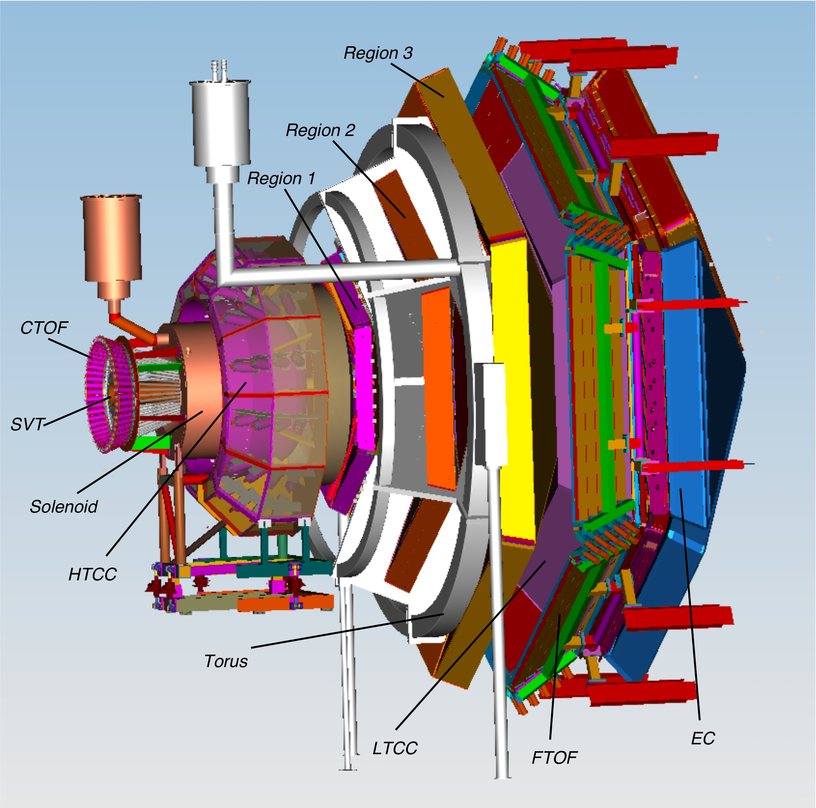
SIDIS with Heavy Nuclei
Future Hadronization Experiments in Hall-B:
A list of approved CLAS12 experiments (Run-Group B, D and E) to study Hadronization
Beam energy, E0 = 8.8 and 11 GeV
Targets: H1, D2, C12, N14, Ar40, Fe56, Kr85, Sn119, Au197
(~80 days for gas targets, 10 days for solid targets)
Hadrons: detecting all pions and kaons
Acceptance (Gaps between six sectors) :
electrons: 6.5 < theta < 40 degrees, 0< phi < 360 *80%
hadrons: 5.0 < theta < 40 degrees, 0< phi < 360 *80%
10³⁵ luminosity → Rates are good enough for 4D binning
Rate (KHz) | pi+ | pi- | K+ | K-
C12 | 1.16 | 0.43 | 0.34 | 0.16
Perform a parallel analysis to extract 3D info of nuclei?
(a developing effort by H. Avakian, D. Dutta, D. Gaskell, K. Hafidi, Z. Meziani, Z. Ye)

Slide 18
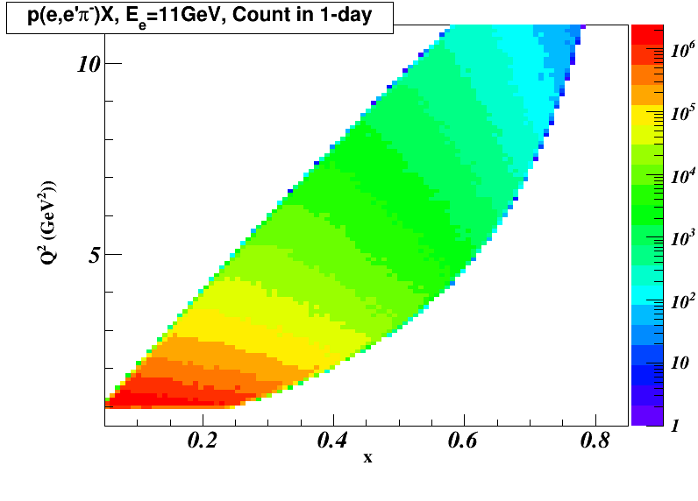
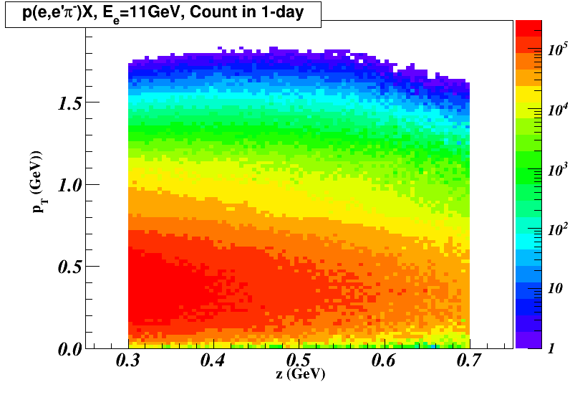
SIDIS with Heavy Nuclei
Nuclear 3D Tomography:
CLAS12 Kinematic Coverage:

Slide 19
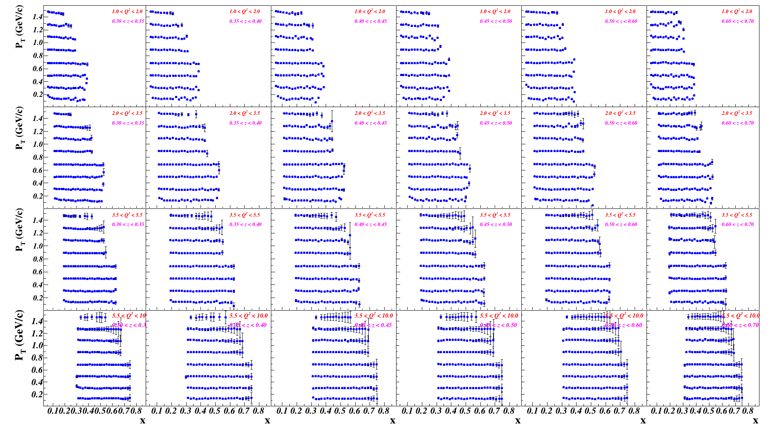
SIDIS with Heavy Nuclei
Nuclear 3D Tomography:
CLAS12 Projected Data Coverage and Statistical Accuracy:
$${}_{ }^{12}{C\left(e,e^{′}π^{+}\right)X}$$

Slide 20
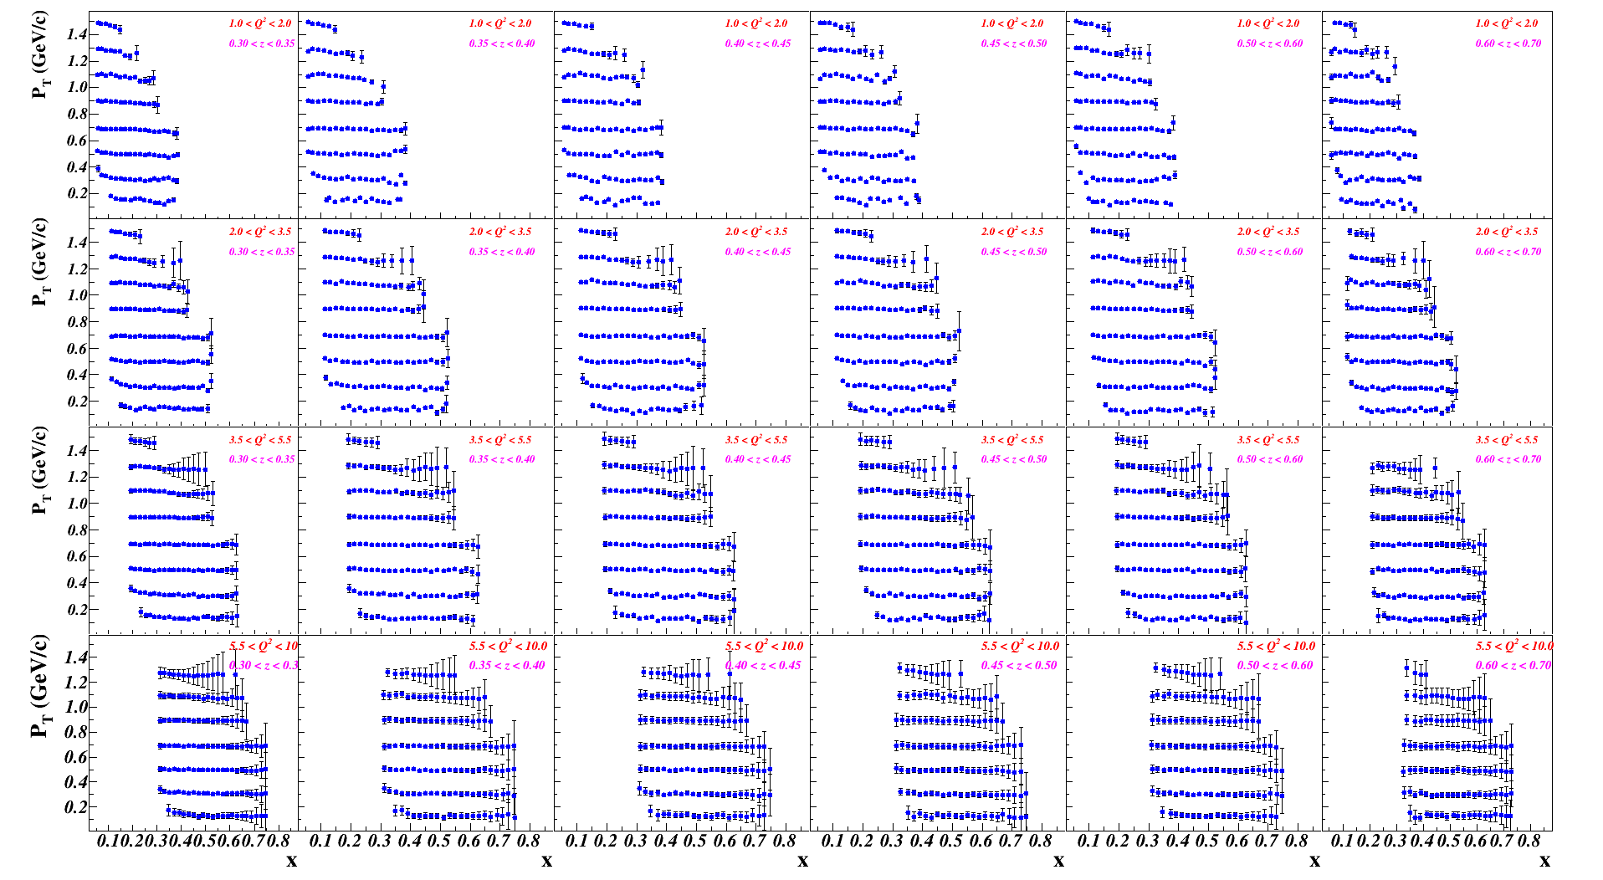
SIDIS with Heavy Nuclei
Nuclear 3D Tomography:
CLAS12 Projected Data Coverage and Statistical Accuracy:
$${}_{ }^{12}{C\left(e,e^{′}K^{−}\right)X}$$

Slide 21
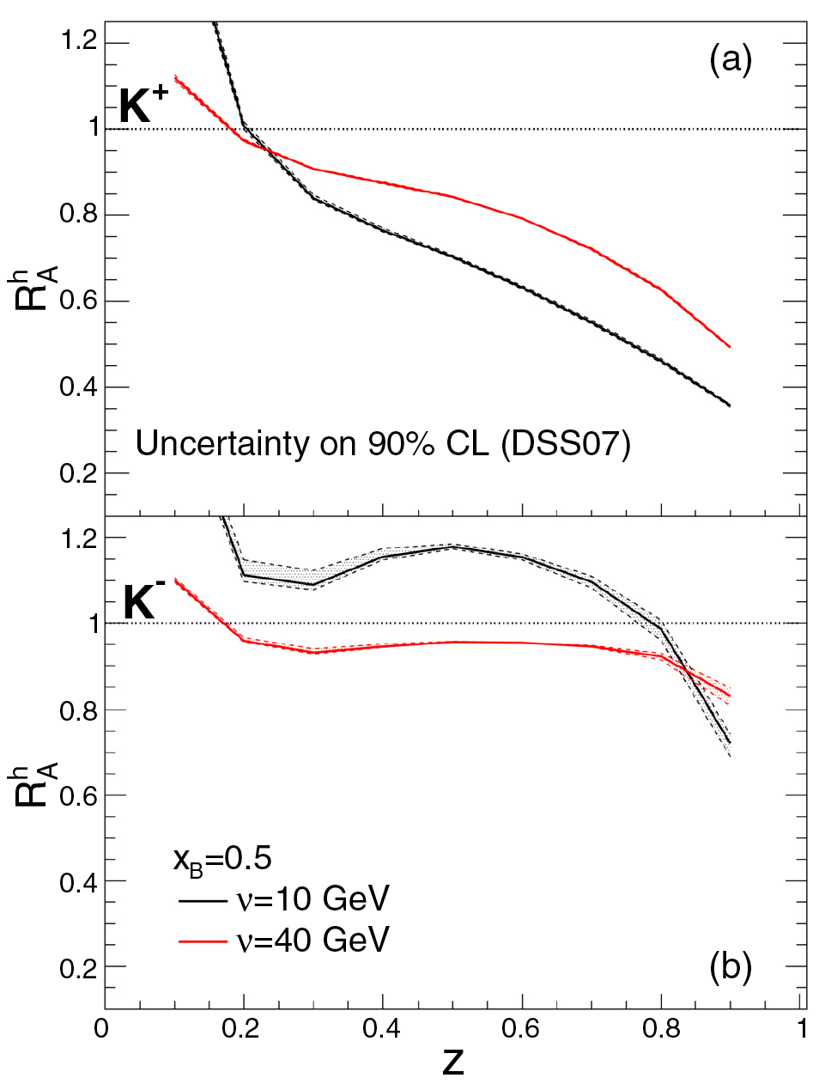
SIDIS with Heavy Nuclei
Nuclear 3D Tomography:
4D-binning (Q², x, z, P_{T}) in SIDIS for light and heavy nuclei
Study the A-dependence of PDF and PDF in medium
Study Medium effect of FF
N Chang, et. al. PRC92, 055207 (2015)
W. Deng and X.-N Wang PRC 81, 024902 (2010)

Slide 22
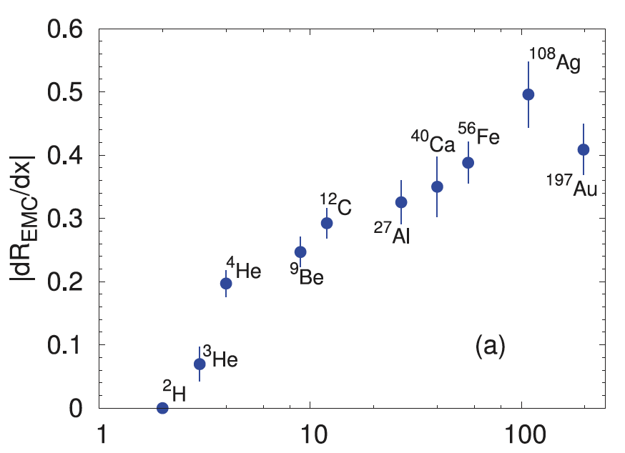
SIDIS with Heavy Nuclei
Nuclear 3D Tomography:
4D-binning (Q², x, z, P_{T}) in SIDIS for light and heavy nuclei
Study the A-dependence of PDF and PDF in medium
Look at the p_{T} dependence (not just broadening)
A comprehensive way to study nuclear-effect in QCD
EMC slope
$$A_{1}$$
p_{T} broadening
DEMO-ONLY
$$A^{h+}(x, p_{T})$$
$$A_{2}$$
HERMES
$$A_{3}$$
$$x_{B}$$
$$P_{T}$$
EMC ratio in 2D?

Slide 23
SIDIS with Heavy Nuclei
Nuclear 3D Tomography:
Possible to extraction of k⏊ and p⏊ distributions
${\vec{P}}_{T}={\vec{p}}_{⊥}+{z_{h}\vec{k}}_{⊥}+O(\frac{k_{⊥}^{2}}{Q^{2}})$,
not 100% correct in full QCD but roughly hold (see Andrea’s talk)
$${\vec{P}}_{T}$$
DEMO-ONLY
$${\vec{k}}_{⊥}$$
$${\vec{p}}_{⊥}$$
Extrapolation to $z_{h}$→0 to extract the distributions of ${\vec{p}}_{⊥}$
The slope gives the (“relative”) distributions of ${\vec{k}}_{⊥}$
$$z_{h}$$
By comparing the distributions of extracted ${\vec{p}}_{⊥}$and ${\vec{k}}_{⊥}$in different nuclei:
From ${\vec{k}}_{⊥} ,$does the quark shrink or enlarge when A is larger?
From ${\vec{p}}_{⊥}$, does the quark shrink or enlarge after it is struck out?
Is the Gaussian Ansatz hold for ${\vec{p}}_{⊥}$and ${\vec{k}}_{⊥}$ in all nuclei?
DEMO-ONLY
${\vec{k}}_{⊥}$or
$${\vec{p}}_{⊥}$$
Extract relative change of 3D TMD/FF in nuclei from this technique?

Slide 24
SIDIS with Heavy Nuclei
Nuclear TMDs?:
The unpolarized SIDIS cross section w/ additional azimuthal dependence:
Cahn
Boer-Mulder
If we consider the Boer-Mulder Term (very small):
The $\cos\left(φ_{h}\right)$ azimuthal dependence term:
Twsist-3
p_{T} width
broadening
Gao, Liang, Wang RPC 81, 065211 (2010)

Slide 25
SIDIS with Heavy Nuclei
Nuclear TMDs?:
The unpolarized SIDIS cross section w/ additional azimuthal dependence:
Cahn
Boer-Mulder
If we consider the Boer-Mulder Term (very small):
The $\cos\left(2φ_{h}\right)$dependence module gives the BM convoluted by Collins Fragmentations:
$$F_{UU,A}^{\cos\left(2φ_{h}\right)}(x,z,p_{T},Q^{2})∝{\left\langle \cos\left(2φ_{h}\right)\right\rangle }_{UU,A}∝ h_{1,A}^{⊥}(x,k_{⊥},Q^{2})⊗H_{1,A}^{⊥}(z{,p}_{⊥},Q^{2})$$
In principle, we can study the medium effects of BM-TMD and Collins-FF at the same time!
Very difficult! → Boer-Mulder is tiny; Cahn effect couples; radiative corrections …
Polarized nuclear targets (up to Li7) could be used to study other nuclear TMD → Dilution is a pain!
Directly probe the orbital angular momentum due to TMDs mixing in nuclei?
(Y.V. Kovchegov, M.D. Sievert, Nuclear Physics B 903 (2016) 164–203)

Slide 26
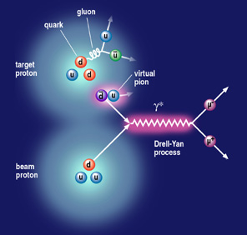
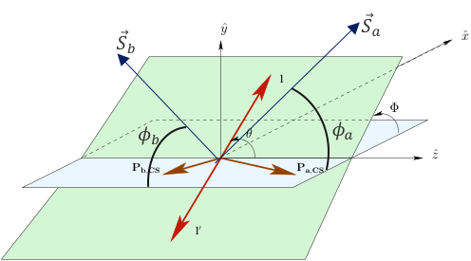
pA Drell-Yan Process

Slide 27
pA Drell-Yan Process
Study Medium Effect of Sea-Quark PDF:
DY get access to the initial-state information of the annihilated quark and anti-quark pair.
Unpolarized DY cross section is sensitive to sea-quark contents:
Small at selected region
SeaQuest experiment at Fermi-Lab aims to study (${\overline{d}}/{\overline{u}}$) at moderate high-x:
w/ heavy nuclei, can also study sea-quark EMC effect which has not been carefully studied experimentally

Slide 28
pA Drell-Yan Process
Nuclear TMD In Drell-Yan:
Sensitivity w/ different polarization in pp Drell-Yan:
$$ν=\frac{{2F}_{UU}^{cos2φ_{ }}}{{F_{UU}^{1}+F}_{UU}^{2}}∝\frac{h_{1}^{⊥q}(x_{b})∙h_{1}^{⊥\overline{,q}}(x_{t})}{f_{1}^{q}(x_{b})∙f_{1}^{\overline{q}}(x_{t})}$$
Boer-Mulders TMD from DY with unpolarized target$:$
$$A_{UT}^{sinφ_{S}}=\frac{F_{UT}^{sin{φ_{S}}_{ }}}{{F_{UU}^{1}+F}_{UU}^{2}}∝\frac{f_{1}^{q}(x_{b})∙f_{1T}^{⊥\overline{,q}}(x_{t})}{f_{1}^{q}(x_{b})∙f_{1}^{\overline{q}}(x_{t})}$$
Sivers TMD from DY with transversely polarized targets:
$$A_{TU}^{sinφ_{S}}∝\frac{f_{1}^{\overline{q}}(x_{b})∙f_{1T}^{⊥q}(x_{t})}{f_{1}^{q}(x_{b})∙f_{1}^{\overline{q}}(x_{t})}$$
Sivers TMD from DY with transversely polarized beam:
Sensitivity w/ different polarization in pA Drell-Yan:
$$A_{UU}(p^{ }+A→l^{+}+{\overline{l}}^{−}+X)$$
$$ν(A)=\frac{{2F}_{UU}^{cos2φ_{ }}}{{F_{UU}^{1}+F}_{UU}^{2}}∝\frac{h_{1}^{⊥q}(x_{b})∙h_{1}^{⊥\overline{,q}}(x_{t},A)}{f_{1}^{q}(x_{b})∙f_{1}^{\overline{q}}(x_{t},A)}$$
Sensitive to sea-quarks Boer-Mulders TMDs in nuclei
$$A_{TU}(p^{↑↓}+A→l^{+}+{\overline{l}}^{−}+X)$$
$$A_{TU}^{sinφ_{S}}∝\frac{f_{1}^{\overline{q}}(x_{b})∙f_{1T}^{⊥q}(x_{t}, A)}{f_{1}^{q}(x_{b})∙f_{1}^{\overline{q}}(x_{t},A)}$$
Sensitive to valance-quarks sivers TMDs in heavy nuclei
Polarized DY with polarized anti-proton beam would be ideal to study nuclear TMD since a quark-TMD is convoluted with an anti-quark TMD (no nuclear-FF involved!)
Drawback: Low rates, limited acceptance, low-luminosity w/ polarized anti-proton

Slide 29
Medium Modification in SIDIS
Nuclear TMD In Drell-Yan:
Nuclear Boer-Mulder TMD in unpolarized Drell-Yan:
L. Chen, J. Gao, and Z. Liang,
PHYSICAL REVIEW C 81, 065211 (2010)
Notes:
PHYSICAL REVIEW C 81, 065211 (2010)

Slide 30
Summary
How partonic structure differ in nucleons and in nuclei needs more studies
Detailed study w/ inclusive DIS → EMC effect and correlation with SRC
Origin of EMC effect is not understood;
Flavor-dependence EMC effect? Medium effect in sea-quarks?
SIDIS w/ light and heavy nuclei provides more info about the medium modification in nuclear structure → medium modified PDF/TMD and FF
Drell-Yan w/ heavy nuclei measures pure medium effect of PDF/TMD
Near future JLab 12GeV eA experiments will provide high precision SIDIS data w/ 4D binning
EIC eA program can push the study of medium effect into the sea-quark and gluon regions.

Slide 31
Backup Slides

Slide 32
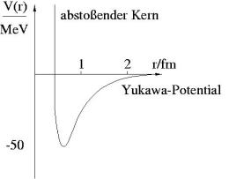
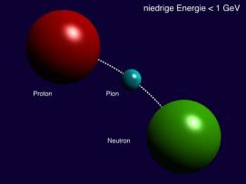
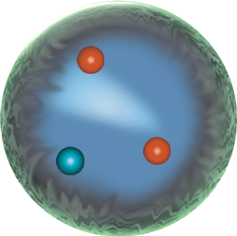
Nucleons in a Nucleus
Interesting Facts:
Quarks & Gluons → Nucleons → Nuclei
Quarks & Gluons move extremely fast inside Nucleon, but don’t escape!
NN-Interaction is strong-interaction, but much weaker
NN-interactions don’t need partons (pion-exchange)!
or
or
Not Modified?
Modified in Mean-Field?
Modified in Cluster?
50+ years old questions but yet to be answered:
How are protons and neutrons bounded together into nuclei?
Bounded protons and neutrons are really different from free ones?
Original from the same mechanism?
May require another 50+ years of works both theoretically and experimentally!

Slide 33
Tritium and Helium-3 Medium Effect are similar at moderate x
SIDIS with Light Nuclei
Tritium and He3 as well-controlled nuclear medium:
R($3_{He}$)$=\frac{F_{3_{He}}}{{2F}_{p}^{ }{+F}_{n}^{ }}$, R($3_{H}$)$=\frac{F_{3_{H}}}{F_{p}^{ }{+2F}_{n}^{ }}$,
Tropiano, Ethier, Melnitchouk, Sato, arXiv:1811.07668

Slide 34
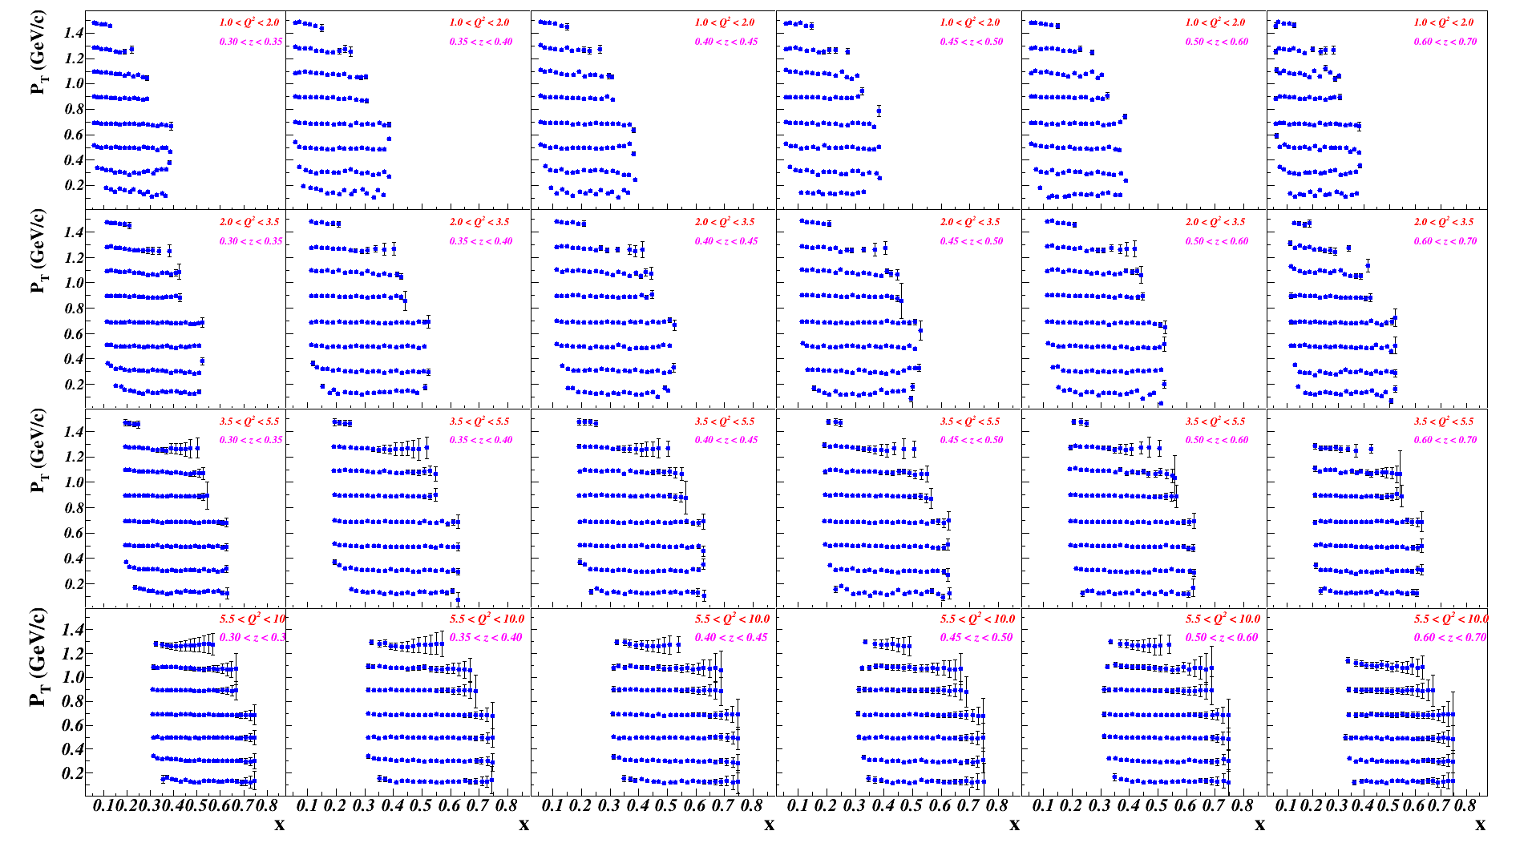
SIDIS with Heavy Nuclei
Nuclear 3D Tomography:
CLAS12 Projected Data Coverage and Statistical Accuracy:
$${}_{ }^{12}{C\left(e,e^{′}π^{−}\right)X}$$

Slide 35
SIDIS with Heavy Nuclei
Nuclear 3D Tomography:
CLAS12 Projected Data Coverage and Statistical Accuracy:
$${}_{ }^{12}{C\left(e,e^{′}K^{+}\right)X}$$

Slide 36
New Study with CLAS12
Simulation Study:
Beam energy, E0 = 8.8 and 11 GeV
Targets:
a) D2 (totally 90 PAC days, plus approved E12-11-003 and other CLAS12 Run-Group B experiments)
b) H1, D2, C12, Fe56, Sn119 (totally 60 PAC days, with 40+ days of production data taken, together with approved E12-06-106)
c) N14, Ar40, Kr85, Au197 (totally 60 PAC days, assuming 10 days for each target, together with approved E12-06-117)
Hadrons: detecting all pions and kaons
Acceptance:
electrons: 6.5 < theta < 40 degrees, 0< phi < 360 *80% (Gaps between six sectors)
hadrons: 5.0 < theta < 40 degrees, 0< phi < 360 *80% (Gaps between six sectors)
Using unpolarized SIDIS generator developed for SoLID to generate MC events
Using CLAS12-FastMC to build in the CLAS12 acceptance; Assuming 85% totally detector efficiency
Using the maximum CLAS12 luminosity (1e35/A cm-2 s-1, note: scaled by the nuclear number A)
Rate (KHz) | pi+ | pi- | K+ | K-
C12 | 1.16 | 0.43 | 0.34 | 0.16

Slide 37
New Study with CLAS12
Binning of MC Data (Binning method as demo):
Bin the Q2 and z first, by defining the following boundaries:
$Q^{2}\left[5\right]=\left[1.0, 2.0, 3.5, 5.5, 10.0\right] {GeV}^{2}$, $z\left[7\right]=\left[0.3, 0.35, 0.4, 0.45, 0.5, 0.6, 0.7\right]$
Further bin the data on pT and x:
$p_{T}\left[≤9\right]=\left[0.0, 0.2, 0.4, 0.6, 0.8, 1.0, 1.2, 1.4, 1.6\right]GeV/c$
Note: merge a bin to its larger bins until the total events >= 1e5 (before binning on x)
$x_{B}\left[N\right]=\text{[}\text{from}\text{ 0.0 }\text{to}\text{ 1.0, }\text{step}\text{=0.02}$], increase the step size if the total events in the bin is <1e4
Projected results (see plots on next few slides):
a) Choose C12 target as examples (other targets should have similar statistical budges)
b) Each projected data file has the detected hadron (pi+,pi-, K+, K-), and in which (Q2, z) bin
c) Statistical error delta_stat = 1./sqrt(N_exp_count)
d) No central values of any observables. Need theoretical inputs

