Slide 1
ML Applications for Accelerator Physics
Chris Tennant, Joe Grames, Yves Roblin
Computing Round Table, Jefferson Laboratory

Slide 2
Accelerator Priorities
areas where ML could be applied with quantifiable benefit to the lab
improve and/or maintain beam quality to users
increase beam availability to users
speed up standard – but time consuming – beam optics tuning tasks
provide better understanding of the beam and/or accelerator

Slide 3
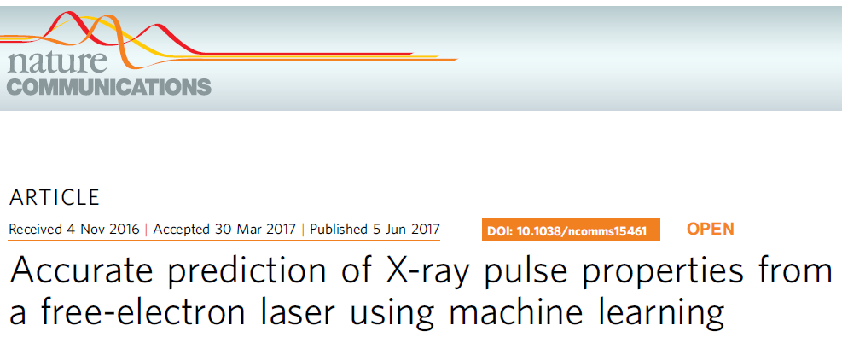
Surveying the Literature
surveyed several dozen publications of machine learning in accelerator physics (conference proceedings, workshop talks, peer-reviewed articles)
many are exploratory projects
most of cutting edge work is being done at light sources (e.g. LCLS)
why hasn’t there been a “killer app” identified yet?
ML has only started gaining momentum
superficial understanding of machine learning
(D. Ratner, ICAP18)

Slide 4
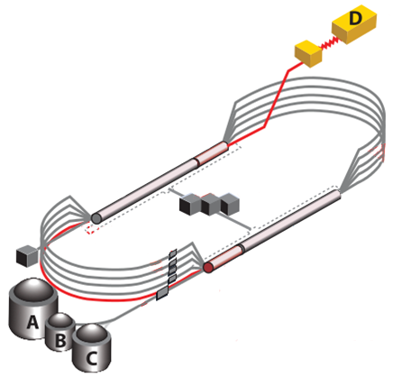
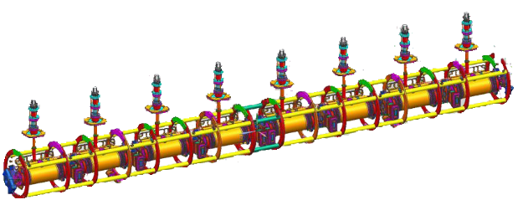
C100 SRF Cavity Faults
cavity faults occur multiple (7-12) times per hour
each trip represents a minimum of 90 seconds of lost data for users
cavities are strongly coupled so one trip often causes another
accurate information on which cavity in the string is responsible allows operators to retain gradient in other cavities
the recorded time-series data allows subject matter experts to analyze and classify the type of cavity fault

Slide 5
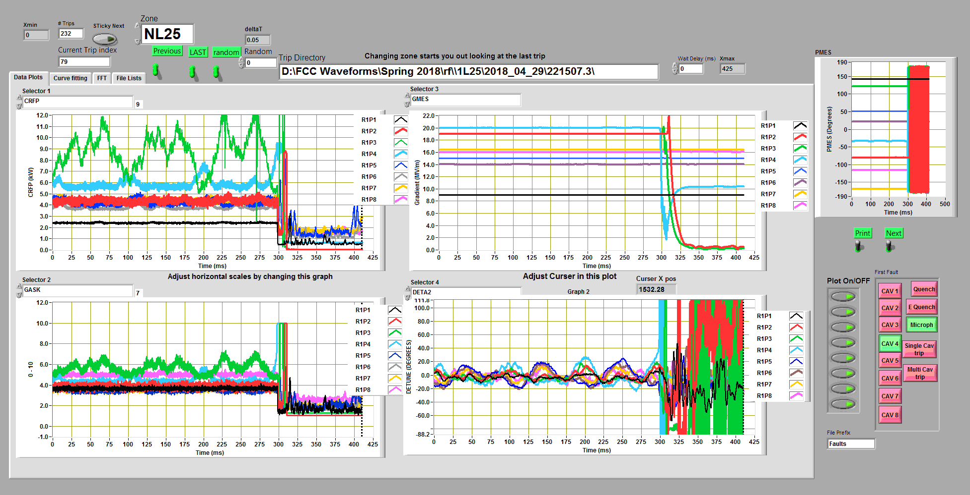
Time-Series Data from SRF Cavities
(courtesy T. Powers)
17 signals/cavity × 8 cavities = 136 traces

Slide 6
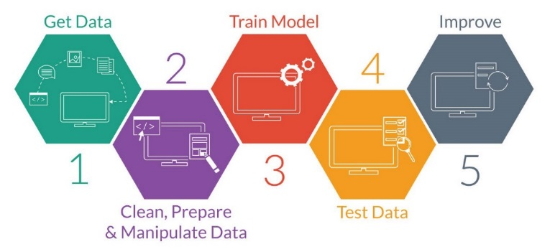
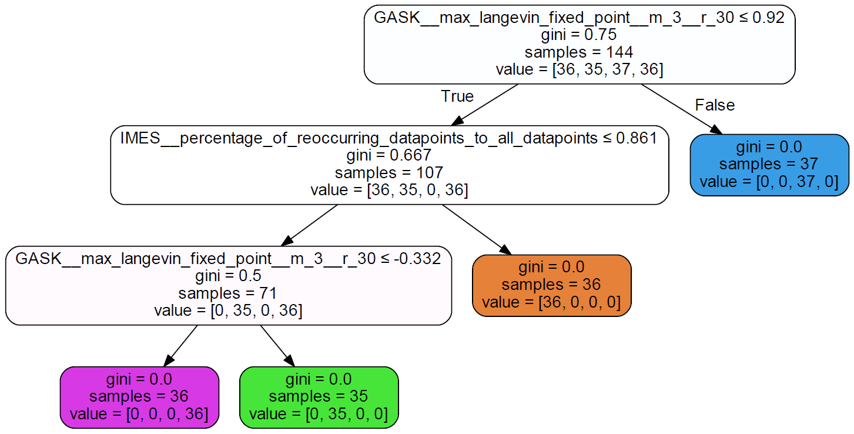
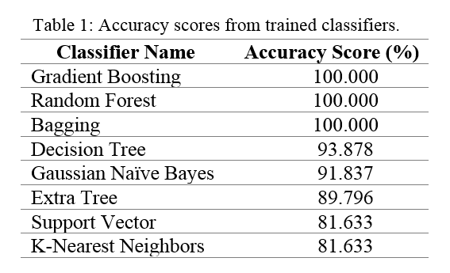
Typical ML Workflow
Get Data: automated system records data
Clean, Prepare & Manipulate Data: subject matter expert labels the data, compute many statistical properties (features) of each signal
6
Deploy
3. Train Model: train a variety of models from scikit-learn
4. Test Data: quantitatively check performance
5. Improve: appropriate feature selection and choice of algorithm
6. Predict: test on unseen, unlabeled data

Slide 7
Next Steps
can we anticipate trips before they occur?
(courtesy T. Powers)

Slide 8
Possible Topics for Applying ML
setup and control of longitudinal dynamics in the injector
control and suppression of helicity correlated beam asymmetries
SRF fault analysis
machine matching/tuning
machine modeling
data mining

Slide 9
Example: Tuning Arc Optics
(Michael Tiefenback)
Problem: Tuning Arc Optics in CEBAF
Why ML? legitimate question
Data Required? SLM images, beam positions, magnet settings
Time Scale? Summer 2019 (install hardware)
Development: 6 months
Deployment: 1 month
Resources Needed: GPU access, disk space (1 TB)
Synergies: leverage ODU collaboration?
Impact and Benefit: 4 hours/arc with traditional techniques (invasive), potential for real-time adjustment on the order of minutes

Slide 10
Summary
in principle, there should be lots of opportunities for applying ML to accelerator physics problems
important to clearly define the problem
there may be some problems where traditional methods are just as well suited as ML approaches
need to build solid ML knowledge base
ODU collaboration is a good start
get more involved in wider community
February 26 – March 1, 2019

