Slide 1
Online Computing at PANDA
15.2.2018 Tobias Stockmanns

Slide 2
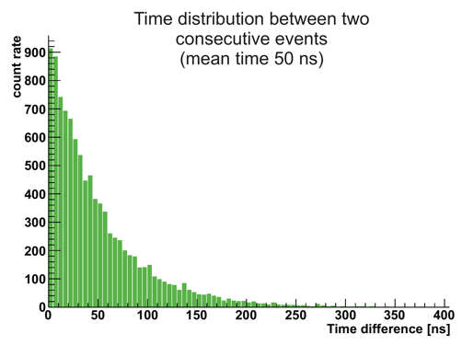
Boundary Conditions
Two magnets
4 tracking systems
7 PID detectors
4 calorimeters
Time difference
between two events
No time structure in beam
Up to 20 MHz interaction rate
Up to 200 GByte/s raw data
Online tracking and event selection
< 10 tracks / event
Mainly p, π, K, e, µ
𝛾, N

Slide 3
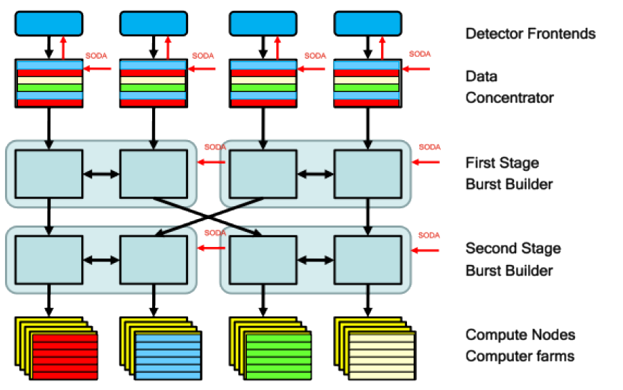
Online Data Taking
DETECTORS
Max Interaction rate
20MHz
80GB/s ‐ 200GB/s
1/1000 reduction factor
80MB/s ‐ 200MB/s
MASS STORAGE

Slide 4
Online Data Taking
DETECTORS
ASIC/FPGA
Fully digitized data
Time-stamp for event building
FPGA
Sub-detector specific
Local processing
FPGA
Compute Nodes
Burst of 1.6 µs with all detector
Data sorted by time-stamp
FPGA
CPU
GPU
Event building
Tracking + PID
Selection
MASS STORAGE

Slide 5
Online Data Taking
EMC Readout Scheme
Intelligent Front-End
Time distribution system
Data concetrators
Burst-building network
Online Computing

Slide 6
Online Data Taking
Compute Node v4
ATCA
Xilinx Ultrascale 60
16 GByte DDR4
4 xTCA mezzanine cards
1 RTM

Slide 7
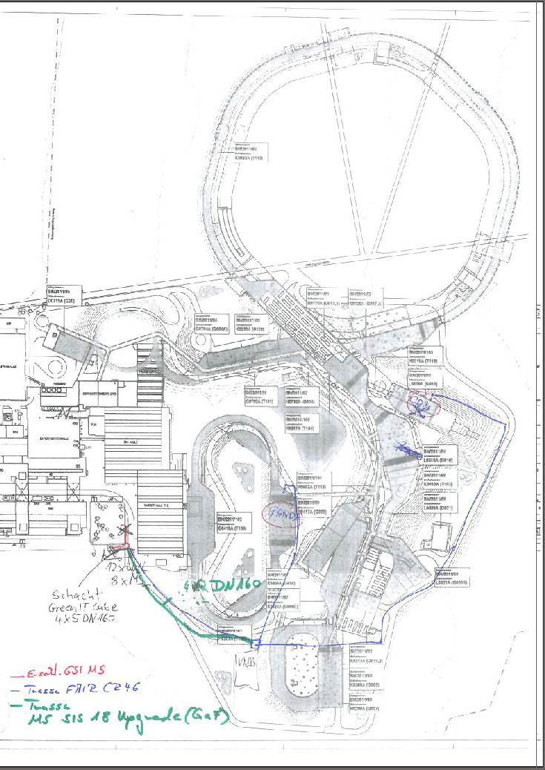
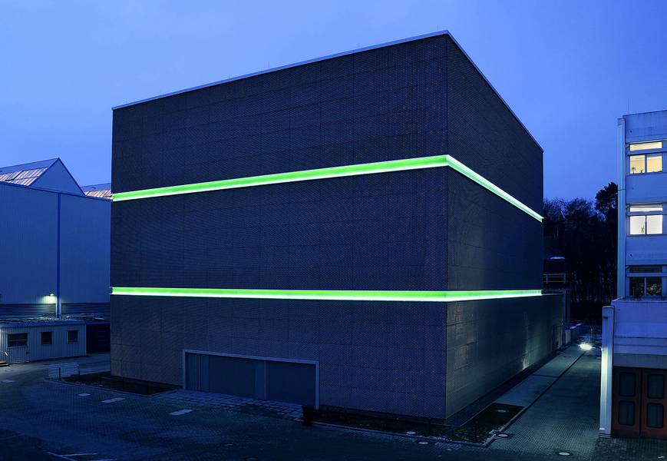
Connection to Green Cube
3500 optical fibers for CBM
500 optical fibers for PANDA
4 empty tubes
(10Gb/s fiber)
PANDA→ 2 X 310 GB/s
GreenCube
Panda
Maximum data rate from Panda data concentrators:
200 GB/s

Slide 8
Online Tracking

Slide 9
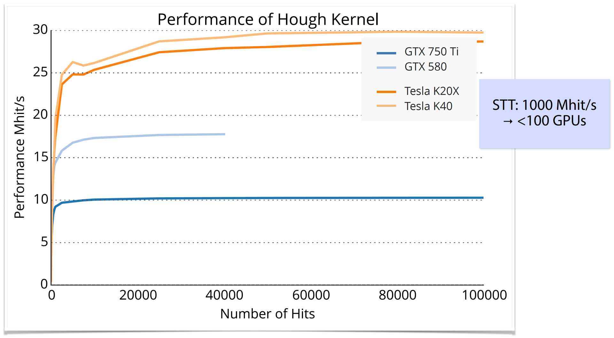
Online Tracking
Find and fit tracks with the production speed at Panda up to 20 MHz
Alternative hardware:
  FPGA:
    Helix tracking algorithm
  GPGPU:
    Cellular automaton
    Hough transformation
    Triplet finder
    Riemann transformation
    Direct switch in PandaRoot between CPU and GPU
Work in progress

Slide 10
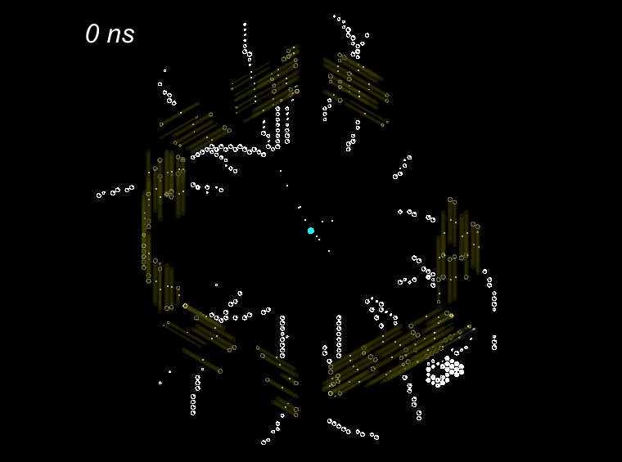
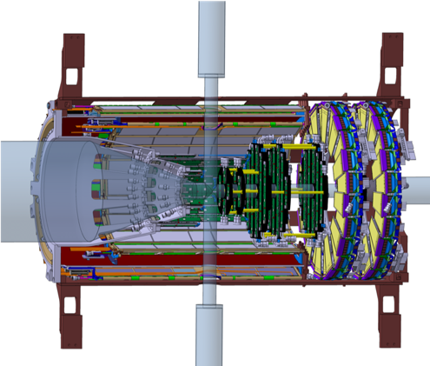
Simulated Events
STT
~ 4000 straws
Dense packaging
< 150 µm resolution
Isochrones
250 ns drift time
2D space point
No start time
MVD
4 barrel layers
6 disks
Mixed pixels / strips
3D space points
< 30 µm point resolution
< 10 ns time resolution
r_{isochr}
Straw Tube
MVD
STT
Time series of MVD and STT detector signals in PANDA (view along beam axis)

Slide 11
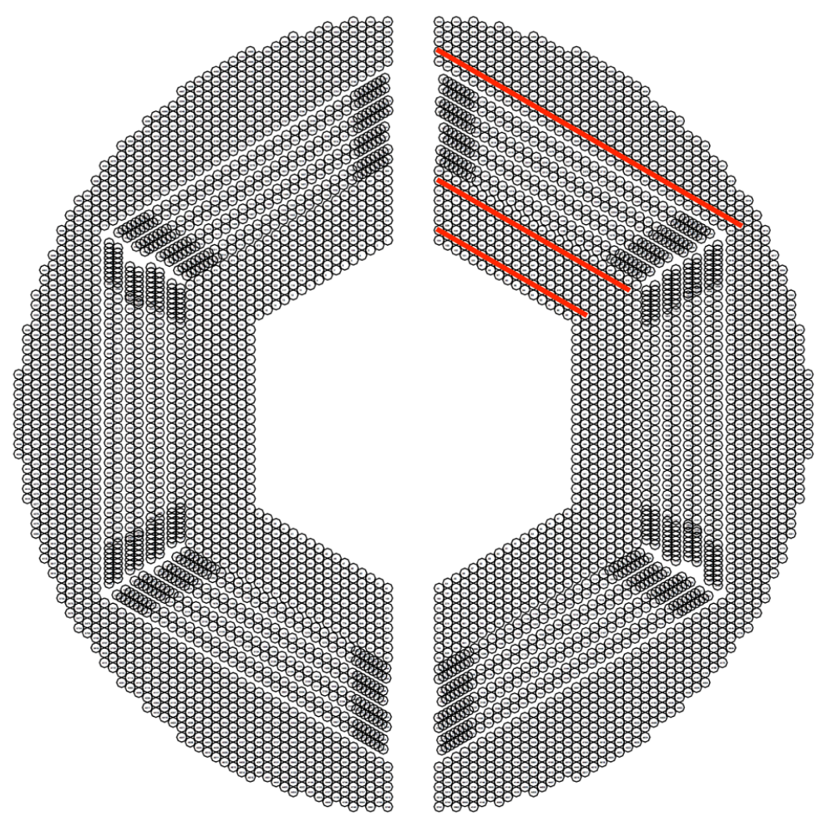
Triplet Finder
Find 2 out of 3 combinations of hits in pivot layers and primary vertex
Calculate circle
Add hits in other layers by distance to circle
Straight line fit for
z-component
Select track candidates by number of hits
+ Simple algorithm
+ No fitting needed
- No isochrone information
- Limited on primary tracks
Optimized for GPUs together with Nvidia Application Lab
x
Marius Mertens(FZJ), Andrew Adinetz(FZJ),
Andreas Herten(FZJ)

Slide 12
Triplet Finder
Non-bunched: packages of single events send
Bunched: Fixed time bunch with many events

Slide 13
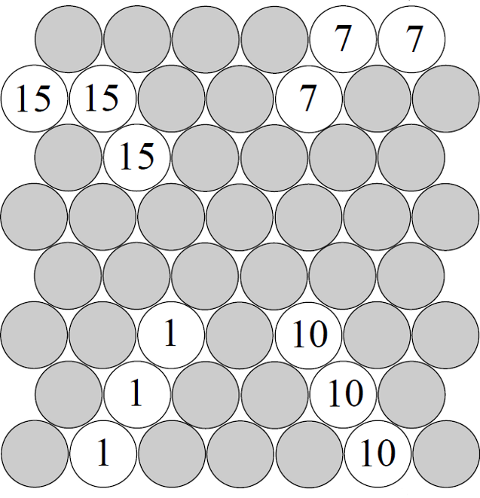
Cell Track Finder
Find (unambiguous) neighbours with hits → generates tracklets
Find connections between tracklets
Fit connected tracklets and take best matching one (Circle fit via Riemann Surface)
Add the ambiguous hits
Correct for isochrones
Straight line fit for
z-component
+ All hits processed at once
+ Primary and secondary tracks
+ Generall clustering algorithm
o Isochrone information in an additional stage
- Only suitable for STT
Optimized for GPU
1/10
7/15
1/10
7/15
1/10
7/15
1/10
7/15
1/10
7/15
Jette Schumann (FZJ), Walter Anderson (Uppsala), Jenny Regina (Uppsala)

Slide 14
Cell Track Finder
Processing time per event
incl. data transfer
Process neighbourhood relations
(EvaluateState & EvaluateMultiStates)
Version | Runtime per event | Ratio of CPU Time
CPU | 4.56 ms | 100 %
GPU (algorithm) | 0.575 ms | 12.08 %
GPU (+ event) | 0.045 ms | 0.94 %
t [ms]

Slide 15
Circle Hough
Calculate for all hits all circles through origin which are tangent to isochrone
Fill x, y coordinate of circle center into histogram
Find peaks
Straight line fit for
z-component
+ All hits in parallel
+ Isochrone information naturally in
+ Works for STT and MVD
- Limited on primary tracks
Andreas Herten (FZJ),
Ludovico Bianchi (FZJ)

Slide 16
Pair Circle Hough

Slide 17
Circle Hough

Slide 18
Pair Circle Hough

Slide 19
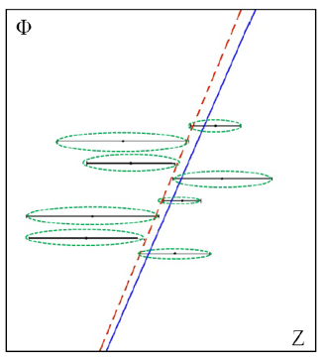
Track Finding on FPGA
Road Finding
Circle Fitting
Straight Line Fitting
+ Hits processed sequentially
+ Isochrone information used
+ T0 extraction possible
- Only suitable for STT
Optimized for FPGA
Layer_ID
Tube_ID
y
E² = ∑(x_{i}² + y_{i}² + a x_{i}+ b y_{i} + c)² (1/d_{i})²
x_{c}, y_{c}, R
x
E² = ∑(Φ_{i} + kz_{i} + Φ₀)² (1/d_{i})²
Yutie Liang (JLU Giessen)

Slide 20
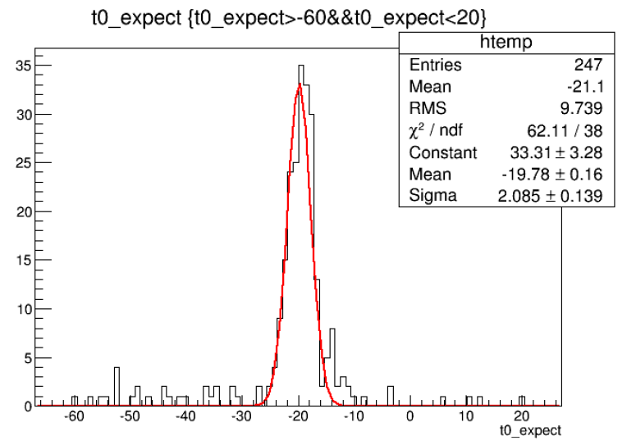
Track Finding on FPGA
T0 determination
T0 shift = Ʃdi /N / const (N: number of hits
di: signed distance of circle to track)
T0 shifted by:
-50 ns:
-20 ns:
10 ns:
20 ns:
Extracted T0:
-47.0±4.0 ns
-19.8±2.1 ns
9.4±2.5 ns
19.0±2.3 ns

Slide 21
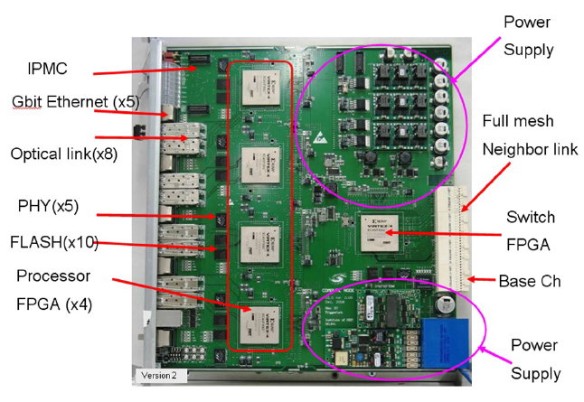
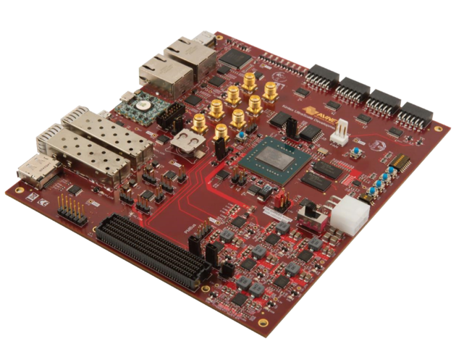
Performance
new
Efficiency > 90 %
σ_{pt} : ~ 3.2% σ_{pz} : ~ 4.2% .
7 μs/event (6 tracks)
Tracking strategy in case of missing t₀

Slide 22
FairMQ
Multi processing

Slide 23
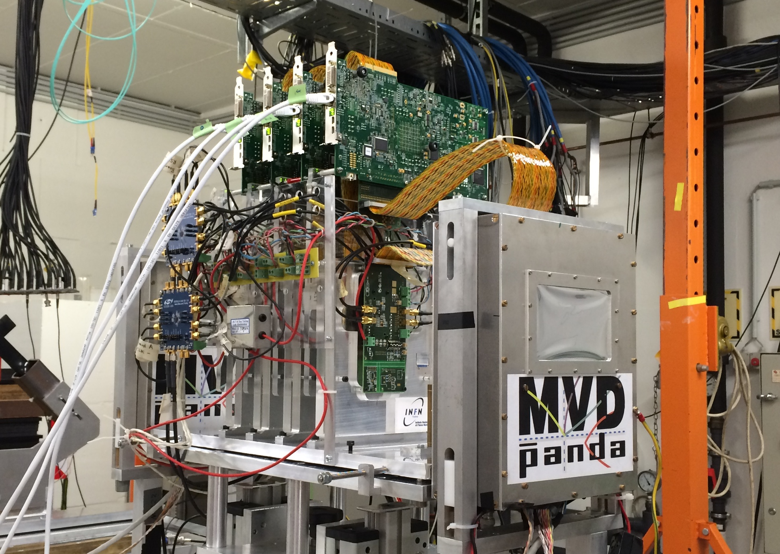
Test of FairMQ with Real Data
Parallel readout of 4 pixel detectors
Readout done by 4 FPGA boards sending their data to two PCs
On the PC bitstream converted into raw data
Raw data send via FairMQ to a FileSink
| Tobias Stockmanns

Slide 24
Idea
Use MQ to completely process TB data online
Processing steps:
  Convert raw data into Digis
  Sort by time stamp
  Build “event”
  Find cluster
  Convert Digis into Hits
  Combine data stream of all four ASICs
  Build global event
  Find Tracks
  Fit Tracks
4 x Single FE

Slide 25
Single Front-End
Online
Sorter
Online
Raw Data Sampler
Raw to Digi
Dupli-cator
Distri-butor
Sorter
Merger
Digi to Hit
TB Data
File Sink
Sorter
File handling
Data processing
Data handling
Online monitoring

Slide 26
Distributor

Slide 27
Data after sorting

Slide 28
Multiple Front-Ends
Online
Sorter
Raw Data Sampler
Raw to Digi
Dupli-cator
Distri-butor
Sorter
Merger
Digi to Hit
TB Data
File Sink
Sorter
Online
Online
Online
Sorter
Raw Data Sampler
Raw to Digi
Dupli-cator
Distri-butor
Sorter
Merger
Digi to Hit
TB Data
File Sink
Sorter
Event Builder
Track Finder/Fitter
File
Sink
Online
Sorter
Raw Data Sampler
Raw to Digi
Dupli-cator
Distri-butor
Sorter
Merger
Digi to Hit
TB Data
File Sink
Sorter
Online
Sorter
Raw Data Sampler
Raw to Digi
Dupli-cator
Distri-butor
Sorter
Merger
Digi to Hit
TB Data
File Sink
Sorter

Slide 29
Event Builder
Time Stamps
FE 1
FE 2
FE 3
FE 4
Data of each FE sorted in time

Slide 30
Event Builder
FE 1
FE 2
FE 3
FE 4
Take first in stack

Slide 31
Event Builder
FE 1
x
FE 2
FE 3
FE 4
Take first in stack
Take earliest

Slide 32
Event Builder
FE 1
x
FE 2
FE 3
x
FE 4
Take first in stack
Take earliest
Search for matching hits

Slide 33
Event Builder
FE 1
x
FE 2
FE 3
x
FE 4
Take first in stack
Take earliest
Search for matching hits
Write out those in one event

Slide 34
Event Builder
FE 1
FE 2
FE 3
FE 4
Fill empty positions with next hits

Slide 35
Event Builder
FE 1
FE 2
FE 3
FE 4
Fill empty positions with next hits
Repeat selection

Slide 36
Event Builder
FE 1
FE 2
FE 3
FE 4
Fill empty positions with next hits
Repeat selection

Slide 37
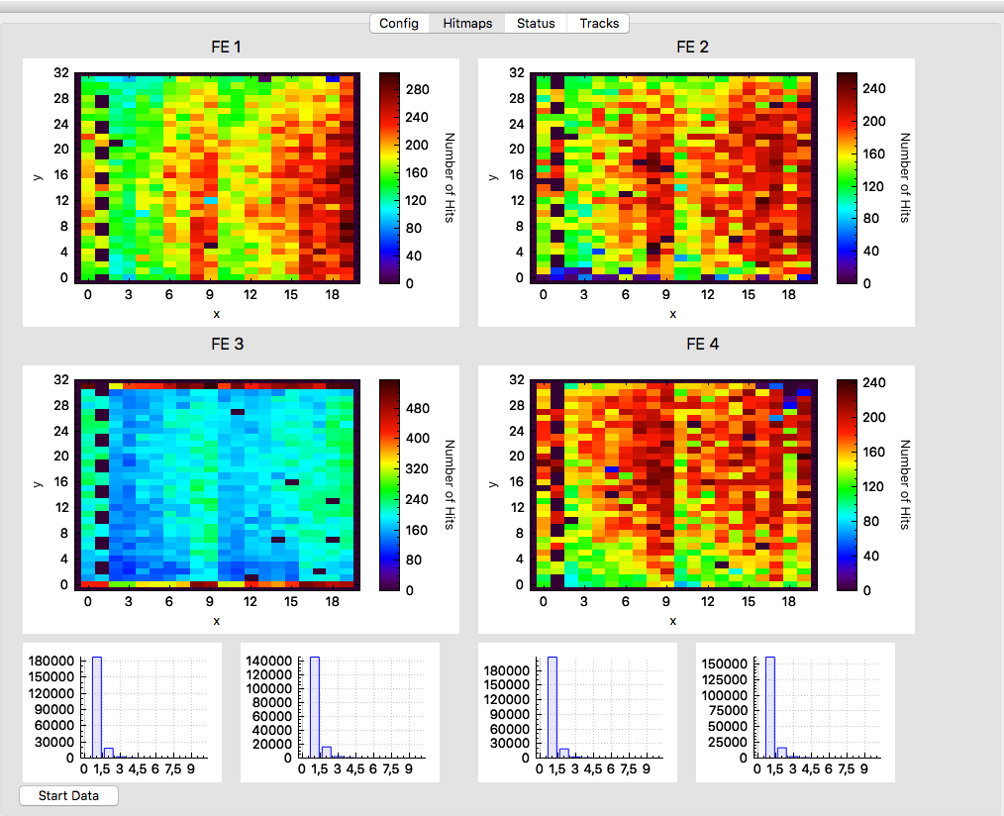
Online Monitoring
running on 6 PC
  4 for each FE
  1 for tracking
  1 for control

Slide 38
Online Monitoring
Hitmap
Running on 6 PC
  4 for each FE
  1 for tracking
  1 for control
Cluster
finder

Slide 39
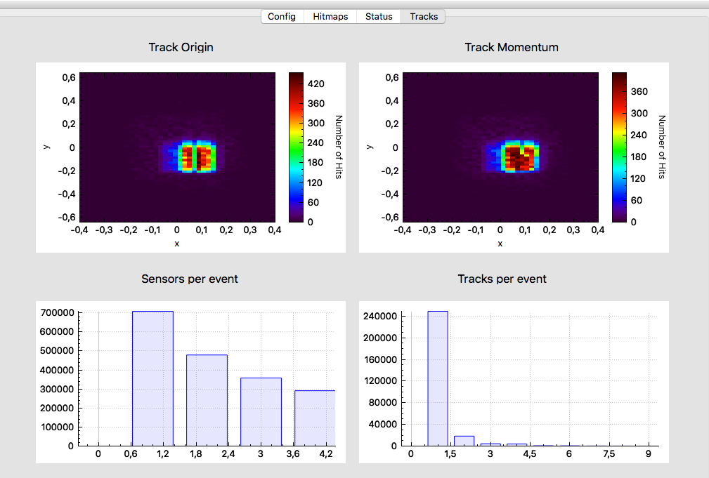
Online Monitoring
Track
fitter
Event
builder
Track
finder

Slide 40
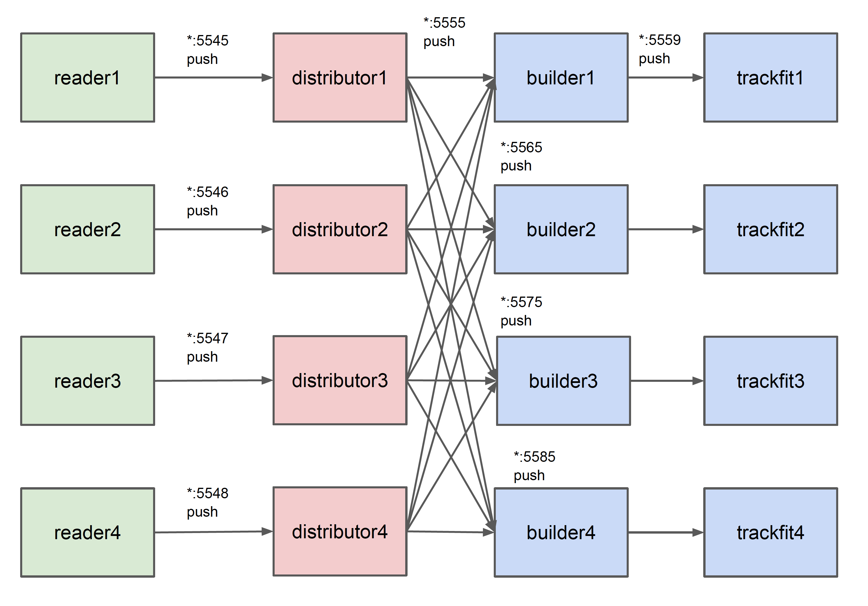
Parallelization of Event Builder

Slide 41
Time-Based Simulation

Slide 42
Event Structure and Detector Response
ev 1
ev 2
ev 3
time
Wanted data structure
Slow detector
Data structure in Root
Event 1
Event 2
Event 3
.
.
.
= detector hits from different events

Slide 43
Idea
3 Stage approach:
  Each event gets an event time generated after the simulation stage
  In the digitization stage a buffer is introduced which keeps the data beyond an event boundary
  In the reconstruction stage data is not retrieved event-by-event but based on time information

Slide 44
Event Mixing and Time Association
MC Files:
Back-ground
Event 0: time 50.3 ns
Event 1: time 72.4 ns
…
MC file does not know anything about time structure
Time structure is calculated at the beginning of digitization
Many different signal files can be added to one background file
Digiti zation
Signal 1
Event 102:
time 10230.1 ns
…
Signal n

Slide 45
FairWriteoutBuffer
Special buffer to store detector digis between events
Stores data as long as it can influence later events (Active Time)
Modifies the data if a detector element is hit a second time (pile-up)
If time of new event is after Active Time the data is written to file
Result is a randomized data stream for further processing
Mimics realistic detector response
Preamplifier with threshold
U
Time Stamp
Active Time
U_{thr}
t

Slide 46
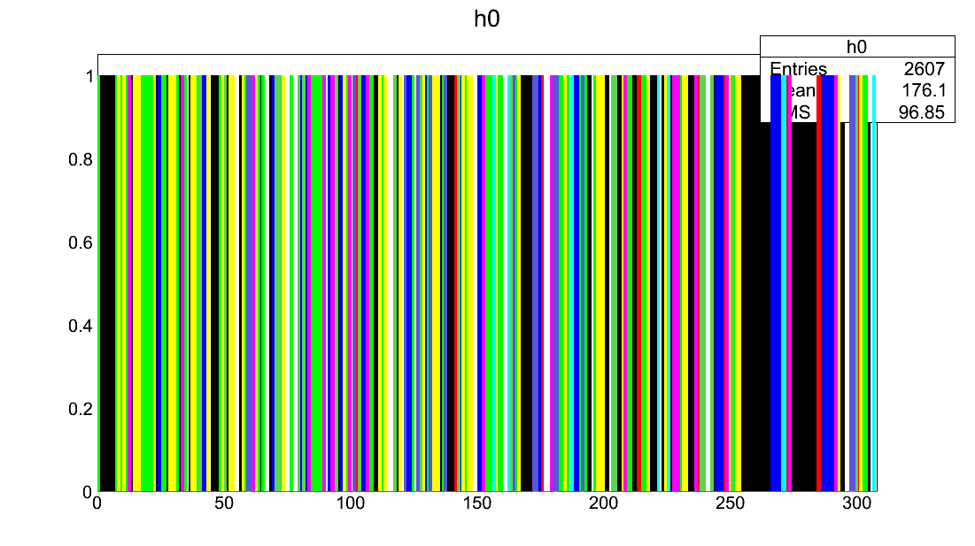
Digi Data Randomized
Digi Data Stream
Same color = same event
Digi Index

Slide 47
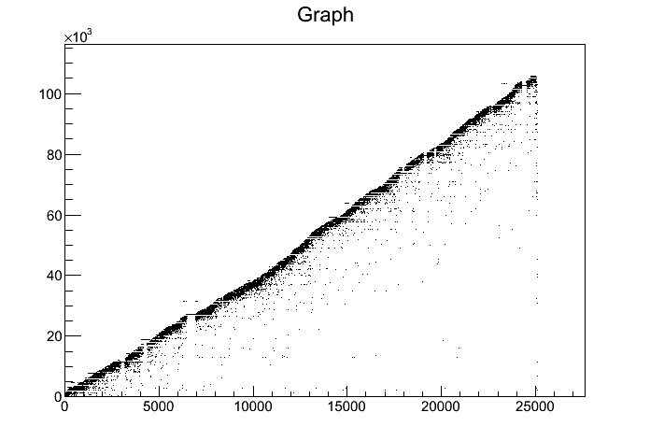
Digi Data Randomized
TimeStamp of Digi vs Index
Time Stamp [ns]
Digi Index

Slide 48
Sorting Data - FairRingSorter
Number of storage cells given by the spread of the time stamps within the data stream
Width of one storage cell given by time resolution of detector
Storage Pointer
position calculated numerically from time stamp
0-Element Pointer
If a storage position is calculated which would override old data, the old data is saved to disk and the storage cell is freed

Slide 49
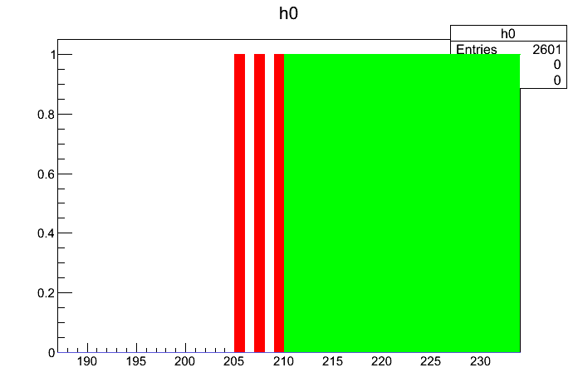
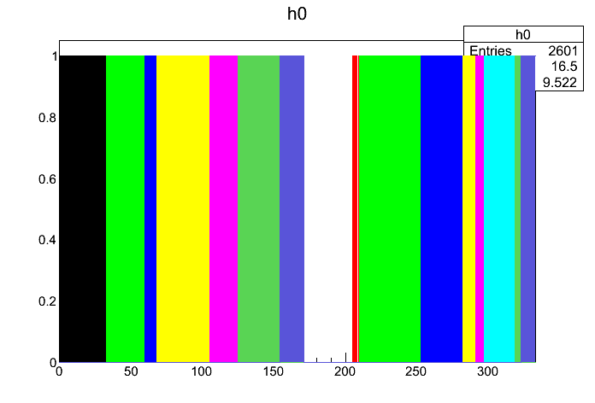
Digi Data Sorted
Digi Data Stream
Same color = same event
Digi Index

Slide 50
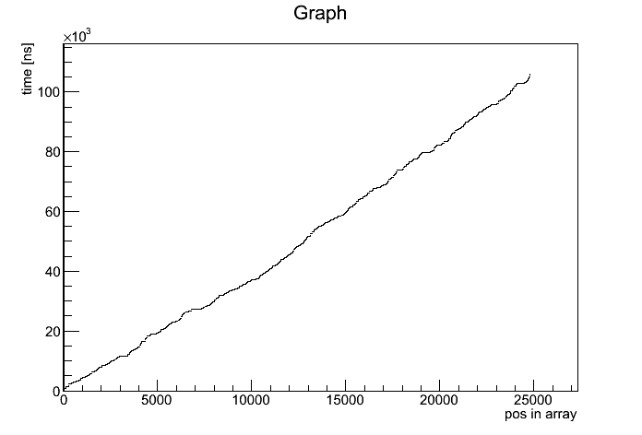
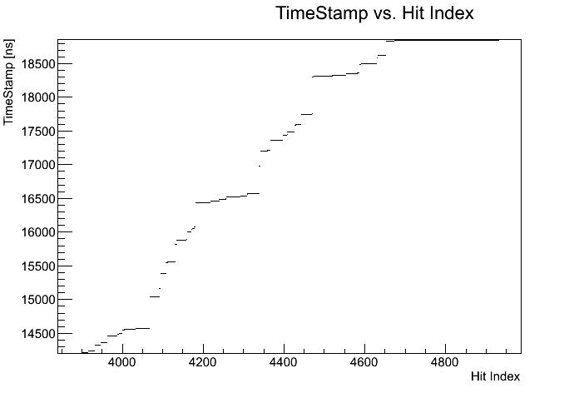
Digi Data Sorted
TimeStamp of Digi vs Index after sorting
Time Stamp [ns]
Digi Index

Slide 51
Reading Back Data
Two different methods exists
FairRootManager::GetData(BranchName, Functor, Parameter);
FairRootManager::GetData(BranchName, StartFunctor, StartParam,
StopFunctor, StopParam);
GetData with one functor/parameter runs always forward in time
  Data is only read once
GetData with two sets of functor/parameter is able to get data within a time window
  Data can be extracted many times

Slide 52
Reading Back Data
Different algorithms available to extract data:
  All data up to a given time
  All data in a time window
  All data between timegaps of a certain size
Other algorithms can be (easily) implemented

Slide 53
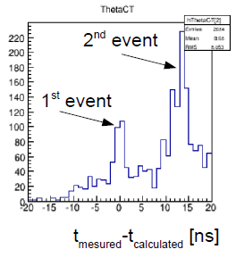
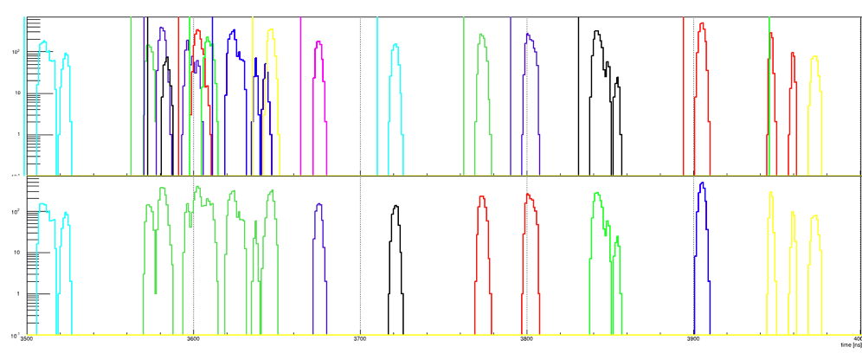
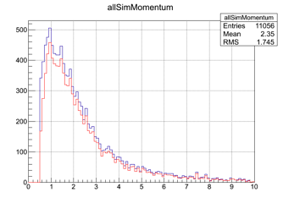
Examples
DIRC Pile-Up
GEM Digis – Event separation by time gap
MC Truth
Packages
R. Dzygadlo
R. Karabowicz
time [ns]
GEM track reconstruction
Event based
GEM tracking eff. for
p > 1 GeV/c:
Event based: ~ 95%
Time based: ~ 87%
Time based
p [GeV/c]
R. Karabowicz

Slide 54
Summary
Online reconstruction of PANDA data is THE challenge in PANDA computing
Some work has been done especially in tracking but no complete picture exists
Try to stay open to new developments and new types of hardware
FairMQ looks as a very useful tool for parallelizing the processing
More tests and more work is needed.

Slide 55
Backup

Slide 56
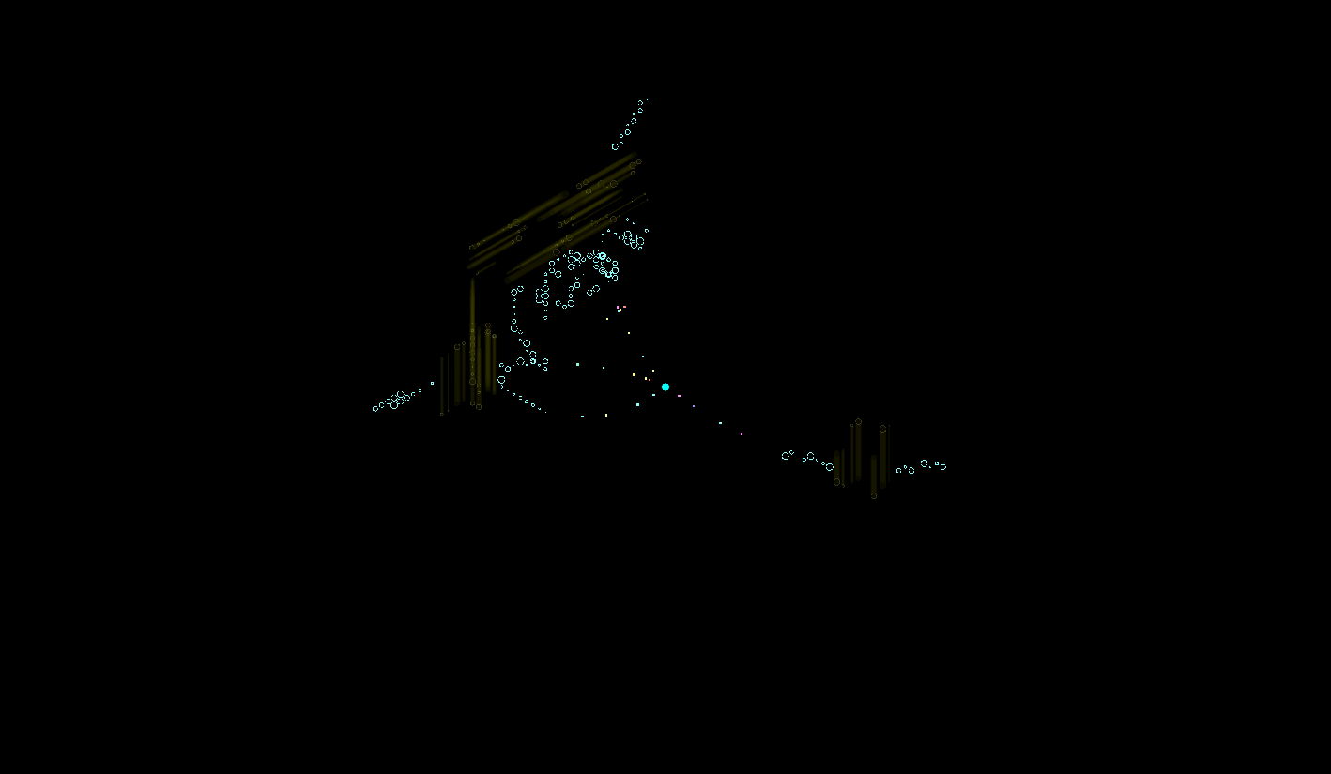
Time-Based Simulation
Single Event

Slide 57
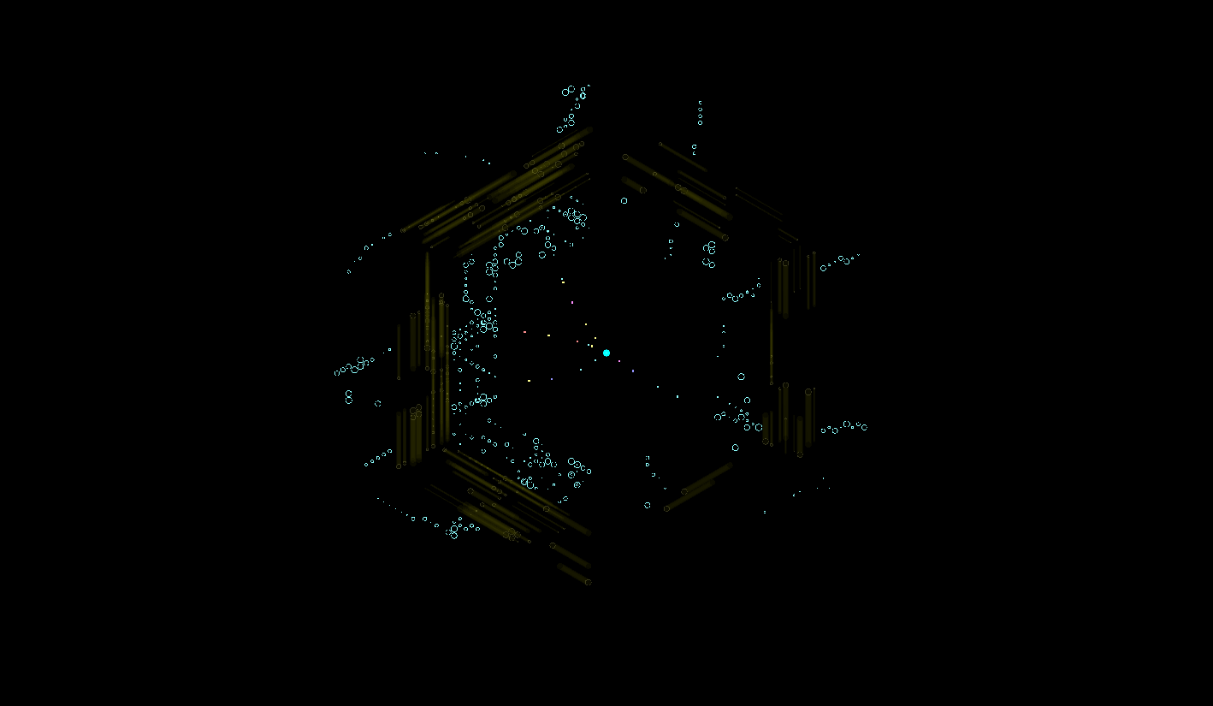
Time-Based Simulation
20 MHz overlap

Slide 58
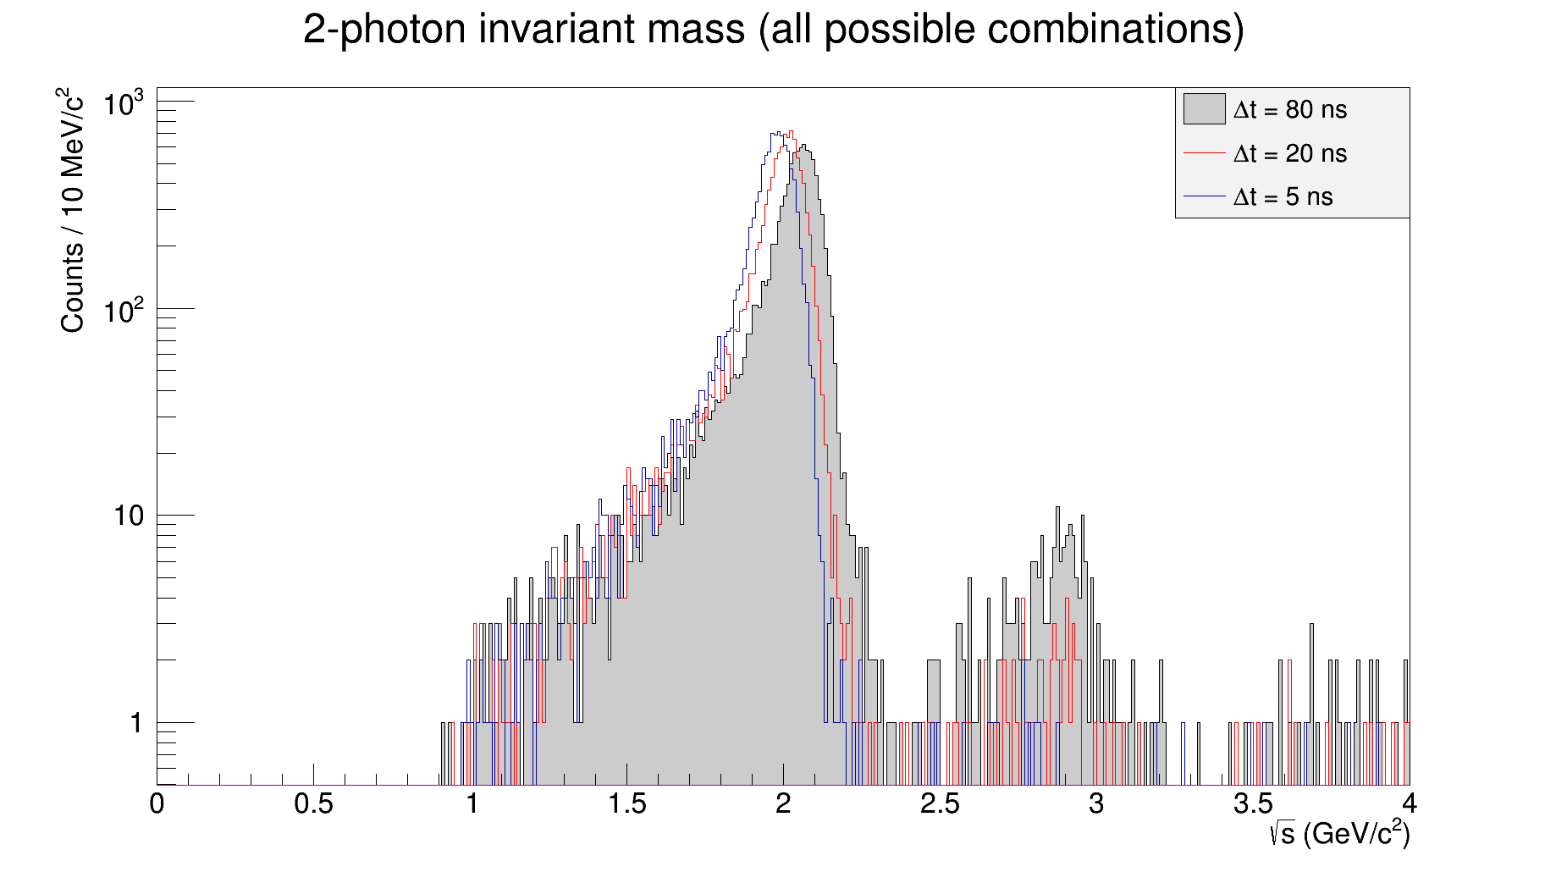
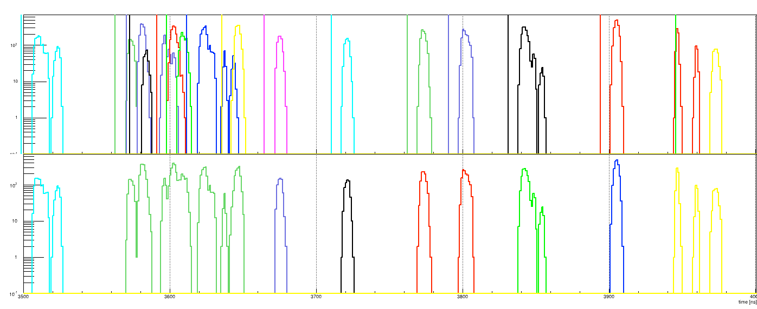
Time-Based Reconstruction
MVD
Work in progress
STT
Event 1
Event 2
Event 3
Activities on the central tracker MVD + STT + GEM + SciTil + EMC
EMC

Slide 59
Summary
Tracking in PANDA challenging
Several different algorithms exists in different states of maturity
No best candidate obvious
Common test environment finished
Next steps:
  Finalize the algorithms
  Test all on common data sample
  Chain or combine algorithms
  Machine Learning as alternative?

Slide 60
Online Track Finding
Circle Hough

Slide 61
Online Track Finding
Circle Hough

Slide 62
Online Track Finding
Circle Hough

Slide 63
Online Track Finding
Circle Hough

Slide 64
Online Track Finding
Circle Hough

Slide 65
Online Track Finding
Circle Hough

Slide 66
Online Track Finding
Circle Hough

Slide 67
Online Track Finding
Circle Hough

Slide 68
Online Track Finding
Circle Hough

Slide 69
Online Track Finding
Circle Hough

Slide 70
Online Track Finding
Circle Hough

Slide 71
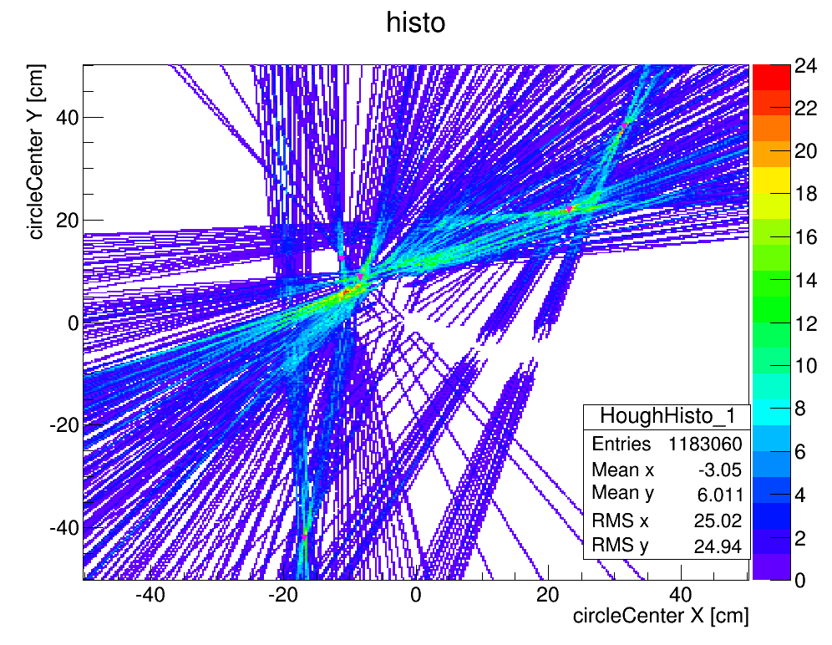
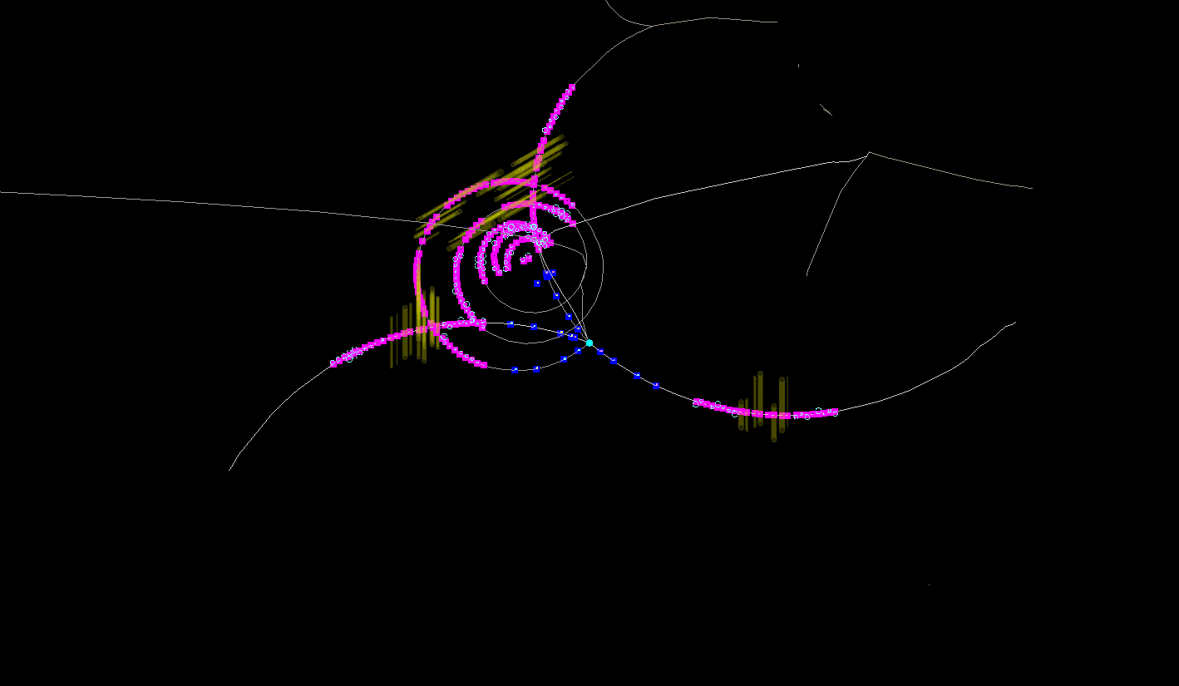
DPM Example 2

Slide 72
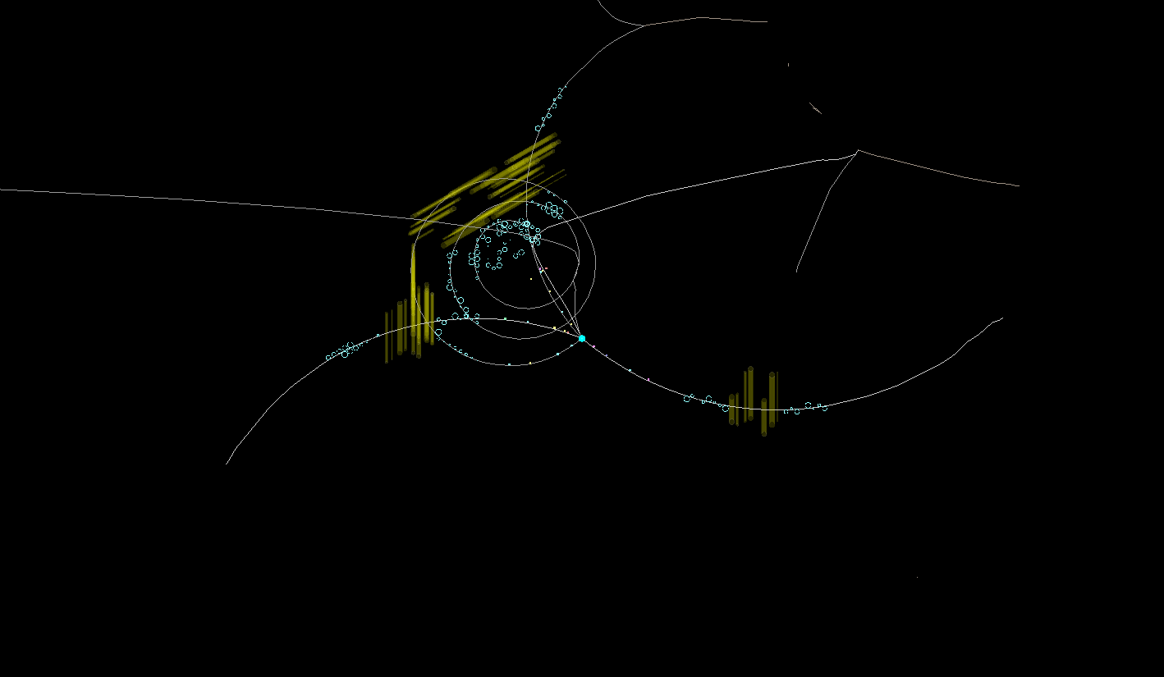
DPM Example 2

Slide 73
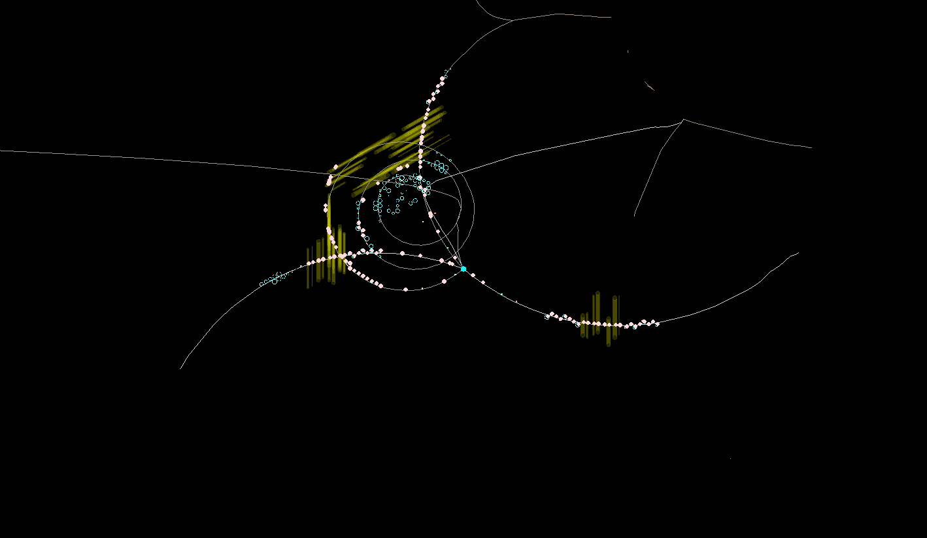
DPM Example 2

Slide 74
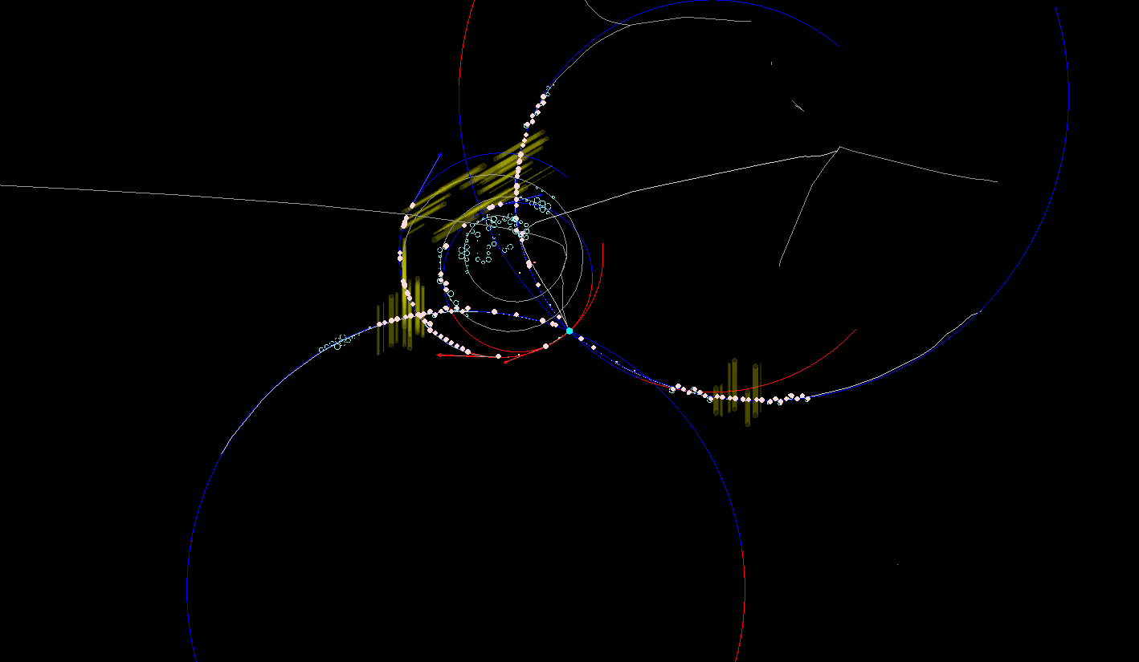
DPM Example 2

Slide 75
Tracking Algorithm -- Road Finding
Layer_ID
Hit
Hit
Hit
Hit
Hit
Hit
Hit
Hit
Hit
Hit
Hit
Tube_ID
Hit: Seg_ID (3 bits) + LayerID (5 bits) + Tube_ID (6 bits) + Arrival time
1: Start from inner layer
2: Attach neighbour hit to tracklet layer by layer
Boundary between two segments.
Number of neighbor:
4 in axial layer; 6 in stereo layer

Slide 76
Tracking Algorithm -- helix parameters calculation
Known : x_{i} , y_{i} , d_{i}
Question: To determine a circle,
x² + y² + ax + by + c = 0
Method: Minimize the equation
E² = ∑(x_{i}² + y_{i}² + a x_{i}+ b y_{i} + c)² (1/d_{i})²
y
x_{c}, y_{c}, R
x
S_{x} = ∑x_{i} …
S_{xx} = ∑x_{i}x_{i} …
S_{xxx} = ∑x_{i}x_{i}x_{i} …
1) Circle para.
2) Track quality.

Slide 77
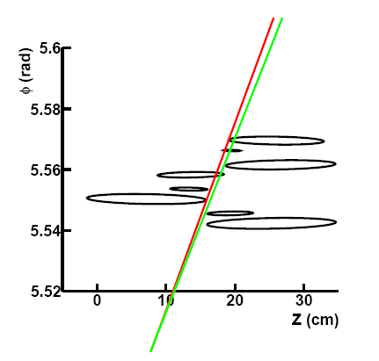
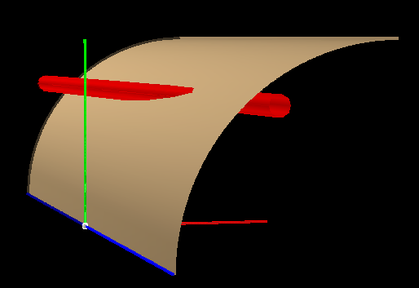
Pz reconstruction
1: The radius, the position of the helix center in the XY plane are determined.
2: Φ = kZ + Φ₀
One cylinder the helix lies in.
Based on Pt determined before
y
Crossing points
(ellipse)
One straw tube
x
z
Track need to be tangent to the crossing ellipse.
Gianluigi Boca and Panda Collaboration, Panda STT TDR, 2012

Slide 78
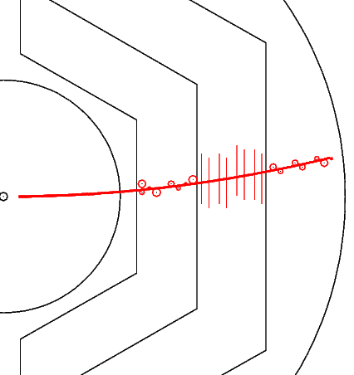
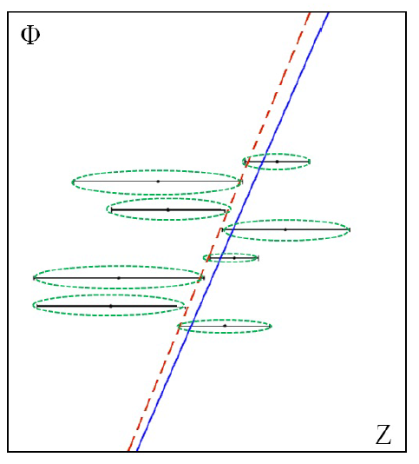
Pz reconstruction
Known : z_{i} , Φ _{i} , d_{i}
Question: To determine a line,
Φ + kz + Φ₀= 0
Method: Minimize E² = ∑(Φ_{i} + kz_{i} + Φ₀)² (1/d_{i})²

Slide 79
Extract T₀ from Tracking
T0 shift = Ʃdi /N / const (N: number of hits
di: signed distance of circle to track)
T0 shifted by:
-50 ns:
-20 ns:
10 ns:
20 ns:
Extracted T0:
-47.0±4.0 ns
-19.8±2.1 ns
9.4±2.5 ns
19.0±2.3 ns

Slide 80
Event Structure -- pile-up
20 MHz
1600 ns revolution time
400 ns gap
T_{Mean} between 2 events: 50 ns
Drift time: ~200 ns
Event pile-up

Slide 81
Tracking Strategy with experimental data -- 20 MHz
Hits are sorted according to their arrival time.
In case of T₀ provided:
Start from T₀ → Collect hits in 220 ns window →
Run tracking algorithm → Assign track to right event
In case of T₀ not provided:
Do tracking and T₀ extraction at the same time

Slide 82
Tracking Strategy with experimental data -- Phase I
Hits are sorted according to their arrival time.
In case of T₀ provided:
Start from T₀ → Collect hits in 220 ns window →
Run tracking algorithm → Assign track to right event
In case of T₀ not provided:
Take the earliest time of a segment of hit as T₀ . → do one more iteration to optimize.

Slide 83
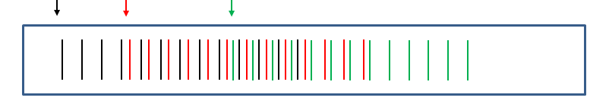
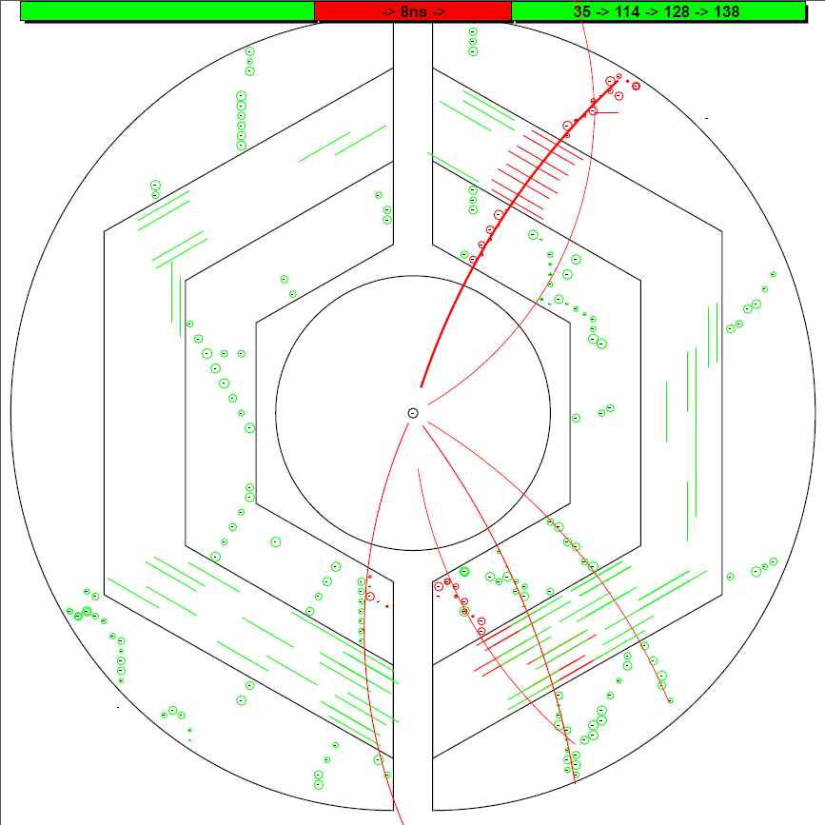
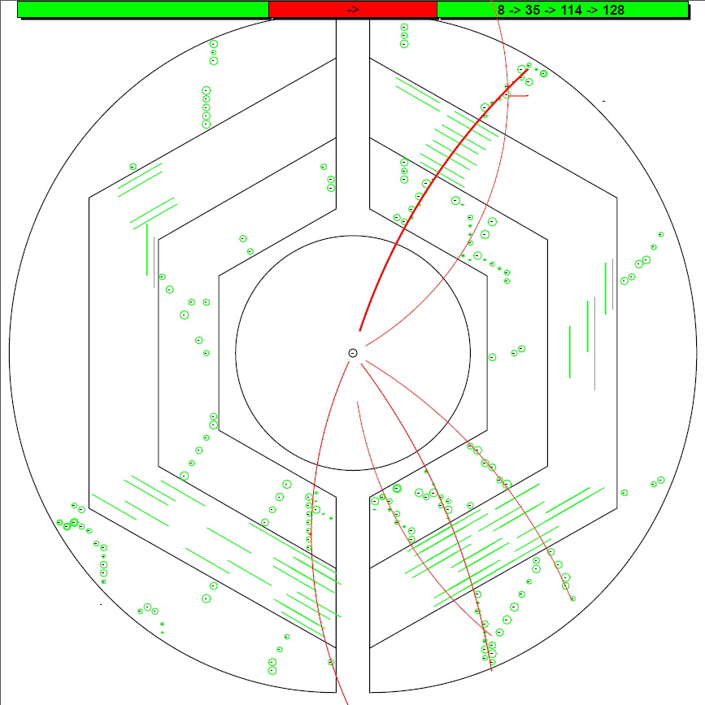
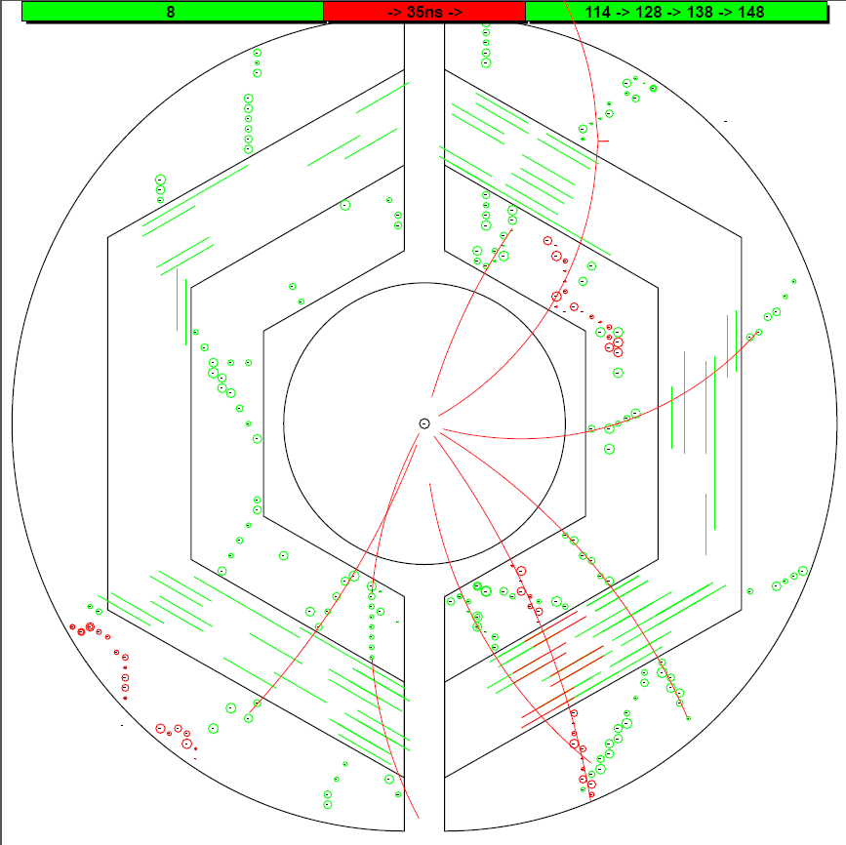
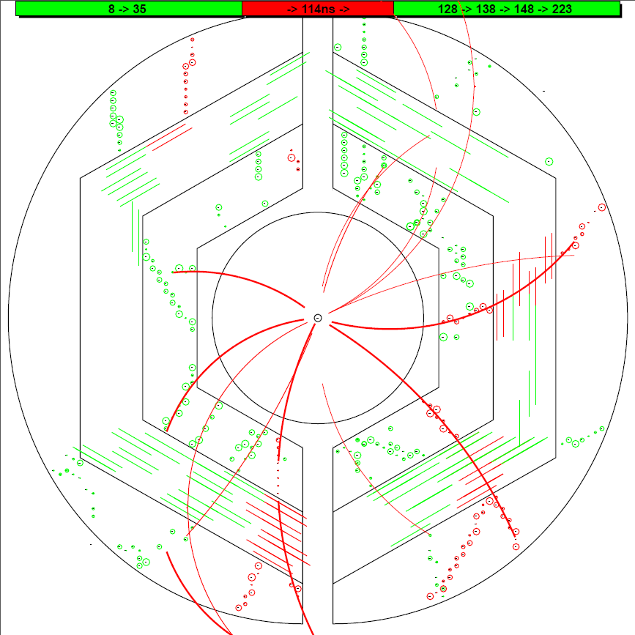
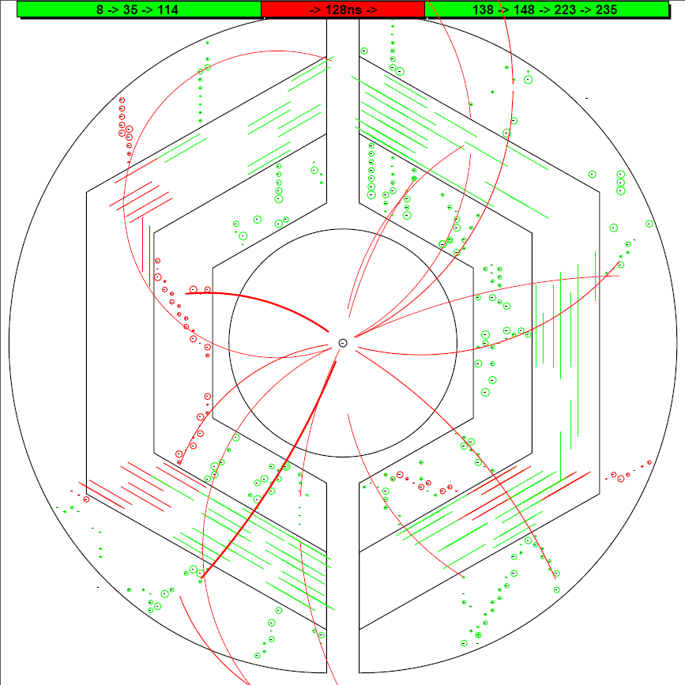
8.4
35.9
114.1
T0 (ns) : MC Input Iter_2
T0 (ns) : MC Input Iter_2
T0 (ns) : MC Input Iter_2
T0 (ns) : MC Input Iter_2
T0 (ns) : MC Input Iter_2
#1 T0 = 140.9 ns
0.0
0.0
0.0
0.0
0.0
8.4
8.4
8.4
8.4
8.4
9.0
9.0
9.0
9.0
9.0
9.4
9.4
9.4
9.4
#1 T0 = 9.4 ns
#0 T0 = 9.0 ns
37.2
37.2
37.2
37.2
38.2
38.2
35.9
38.2
35.9
35.9
35.9
35.9
#1 T0 = 115.3 ns
#1 T0 = 116.8 ns
114.1
114.1
114.1
114.1
114.1
114.5
114.5
114.5
116.6
115.3
#1 T0 = 98.3 ns
#1 T0 = 95.3 ns
#1 T0 = 114.5 ns
#1 T0 = 116.6 ns
128.2
128.2
128.2
128.2
128.2
140.9
139.0
140.9
141.1
139.0
139.0
139.0
139.0
148.3
150.9
148.3
148.3
148.3
148.3
#1 T0 = 128.0 ns
#1 T0 = 119.0 ns
#1 T0 = 35.7 ns
#0 T0 = 37.2 ns
#0 T0 = 38.2 ns
83

Slide 84
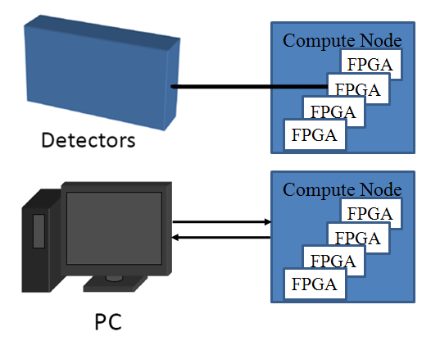
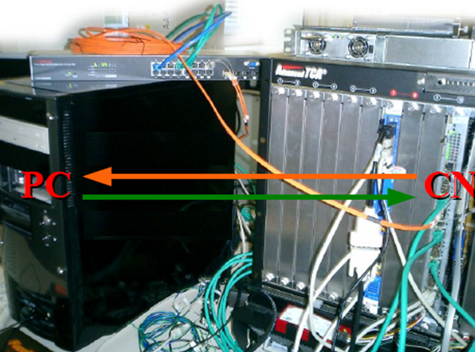
Setup and Test
PC as data source and receiver.
Ethernet.
Optical link
Ethernet via
Optical Link
FPGA
FIFO
Tracking algorithm
FIFO

Slide 85
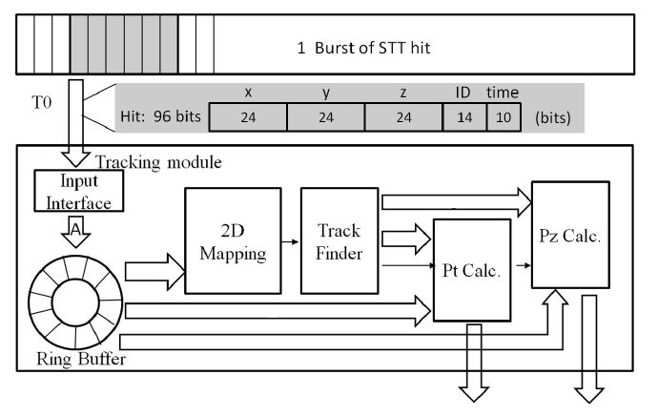
Block diagram of algorithm in VHDL

Slide 86
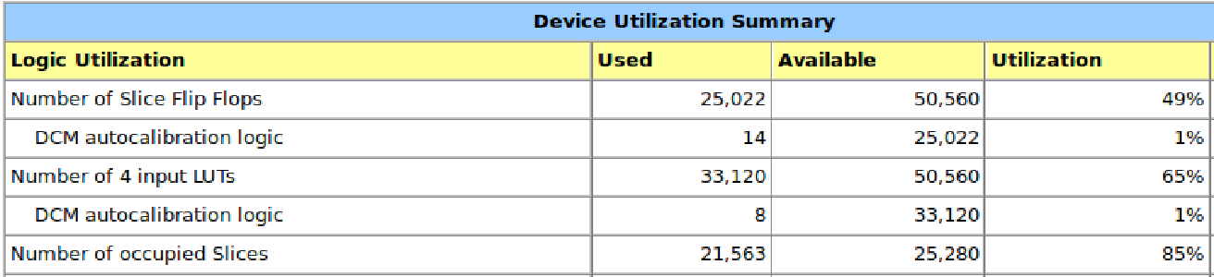
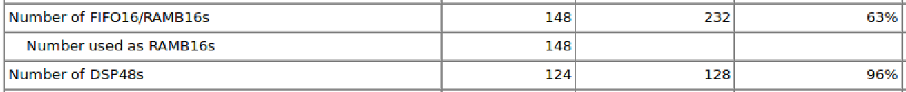
Performance at FPGA
For one event with 100 hits (6 tracks): 7 μs
Hit reading
Road finder
Pt extraction
Pz extraction
(100 cc)
(50 cc X 6)
(120 cc X 2 X 6)
(60 cc X 2 X 6)

Slide 87

Tracking at FPGA
Data flow: Hit information at PC → FPGA, extract helix para. → PC
PC is used to draw hits and helix in the plot. The helix parameters come from FPGA.

Slide 88

Performance test

Slide 89

The Latency

