Slide 1
Computing at PANDA
The PandaRoot Simulation and Analysis Framework
15.2.2018 Tobias Stockmanns

Slide 2
Computing at PANDA
Computing at PANDA coveres three areas:
Online Computing
Processing of the raw data of the experiment
Goal: Selection of data to keep for detailed analysis
Speed ←→ Precision
Offline Computing
Processing of stored experimental data
Goal: Physics result
Precision
Simulation
Simulation of experiment

Slide 3
Processing Stages
sim
Sim
Digi
Local Reco
Global Reco
Event Building
Analysis
Paper

Slide 4
Processing Stages
online
PANDA
FPGA
Event Selection
Storage
sim
Sim
Digi
Local Reco
Global Reco
Event Building
Analysis
Paper

Slide 5
Processing Stages
online
PANDA
FPGA
Event Selection
Storage
sim
Sim
Digi
Local Reco
Global Reco
Event Building
Analysis
Paper
Raw Data
Calibration Alignment
offline

Slide 6
Processing Stages
online
PANDA
FPGA
Event Selection
Storage
sim
Sim
Digi
Local Reco
Global Reco
Event Building
Analysis
Paper
Raw Data
Calibration Alignment
offline
PandaRoot

Slide 7
PandaRoot

Slide 8
FairRoot
Structure
AliceO2
http://alice-o2.web.cern.ch/
CbmRoot
https://fair-center.eu/for-users/experiments/cbm.html
PandaRoot
https://panda.gsi.de/
R3BRoot
https://www.gsi.de/r3b
FairShip
http://ship.web.cern.ch/ship/
SofiaRoot
AsyEosRoot
MPDRoot
http://mpd.jinr.ru
ExpertRoot
http://er.jinr.ru/
EnsarRoot
http://igfae.usc.es/satnurse/ensarroot.html
ATTPCRootv2
https://github.com/ATTPC/ATTPCROOTv2
BNMRoot
http://mpd.jinr.ru
ALFA
FairRoot
FairMQ
Geometry
Detector Response
Magnetic Field
Topology Editor
Event Generators
DDS
(Dynamic Deployment)
Parameter/ Condition Management
. . .
Testing
Software Stack
Network
(ZeroMQ, nanomsg, OFI libfabric)
Serialization
(Protocol Buffers, msgpack, FlatBuffers, ROOT)
Google Test
ROOT
. . .
Boost
Simulation Engines
VGM
CMake
see: R. Karabowicz Saturday 11:00

Slide 9
Event Generators
Event Generators
Signal
Background
PGun
EvtGen
EMFF
DPM
UrQMD
BoxGen
FlatGen
FTF
Pythia
GiBuu

Slide 10
Particle Propagator
Virtual MC
Geant3
Geant4
Usage of Virtual Monte Carlo allows seamless change of propagation engine
Same geometry description in propagation and reconstruction of events by using the same geometry engine from root

Slide 11
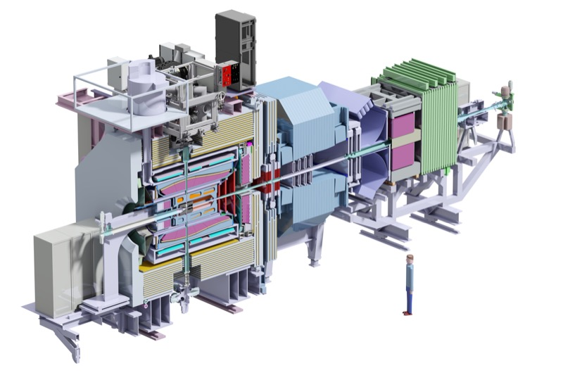
Geometry description

Slide 12
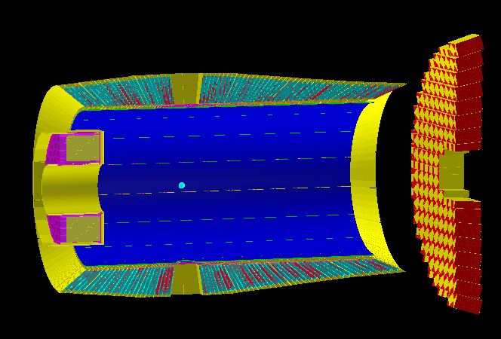
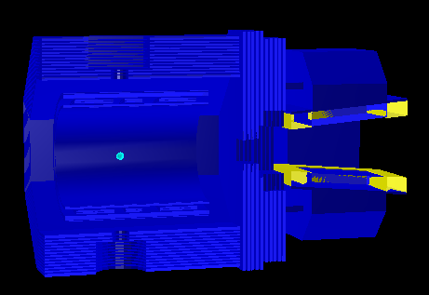
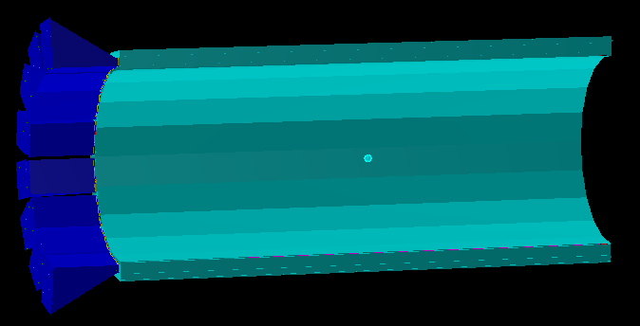
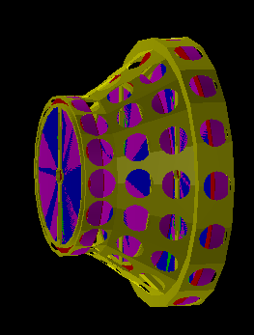
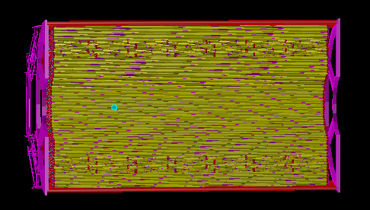
Geometry description
EMC
Magnets
DIRC + SciTil
STT
GEM
MVD

Slide 13
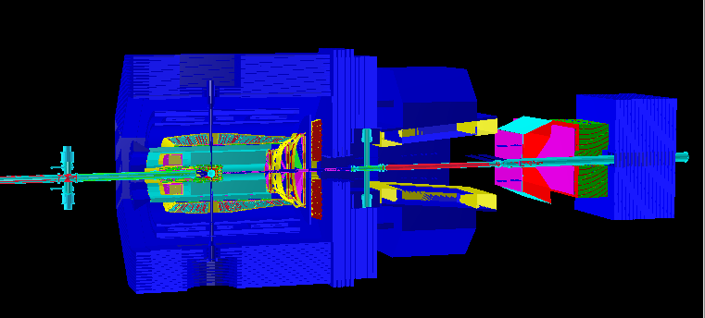
Geometry description
EMC
Magnets
DIRC + SciTil
STT
GEM
MVD

Slide 14
Magnetic Field

Slide 15
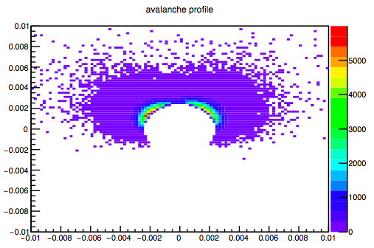
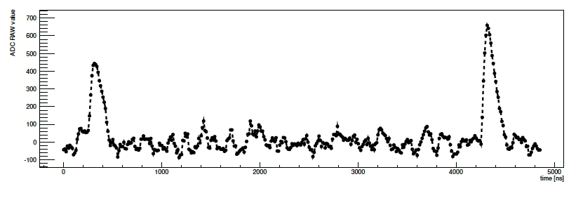
Digitization
Avalanche Simulation in MDT
Translates ideal detector data into realistic data stream
3D space points into channel number
Deposited energy into ADC values
Adding noise and inefficiencies
Charge sharing between neighboring detector elements
Dead times and electronics properties
Data should look like as coming from the final experiment
Simulated EMC waveform

Slide 16
Reconstruction - I
Local reconstruction for each sub-detector
Translation from detector data into physical parameters (from channel number to space point, ADC to energy)
Calibration
Cluster formation
Reconstruction algorithms
Various different algorithms implemented for each sub-detectors
Compared with test beam data
PandaRoot used to reconstruct test beam data

Slide 17
Detector Processing Example

Slide 18
Reconstruction - II
Global reconstruction
Combining different sub-detectors
Tracking
PID
Event building

Slide 19
Tracking

Slide 20
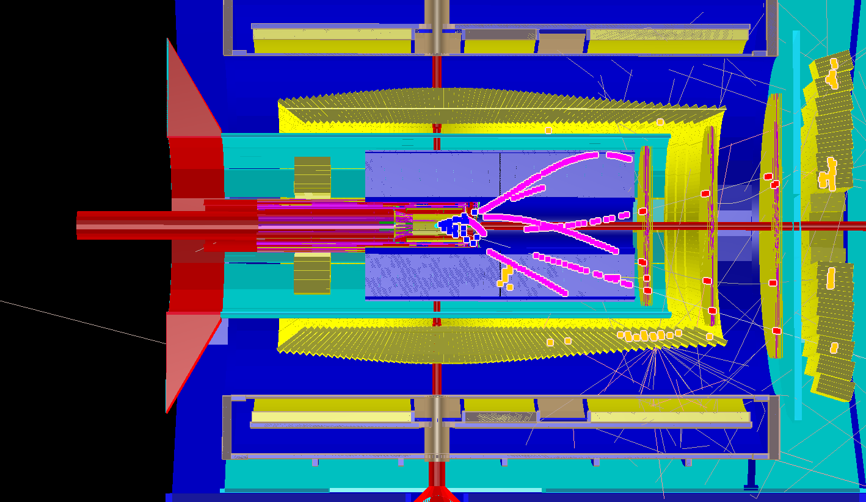
Tracking
Event Simulation

Slide 21
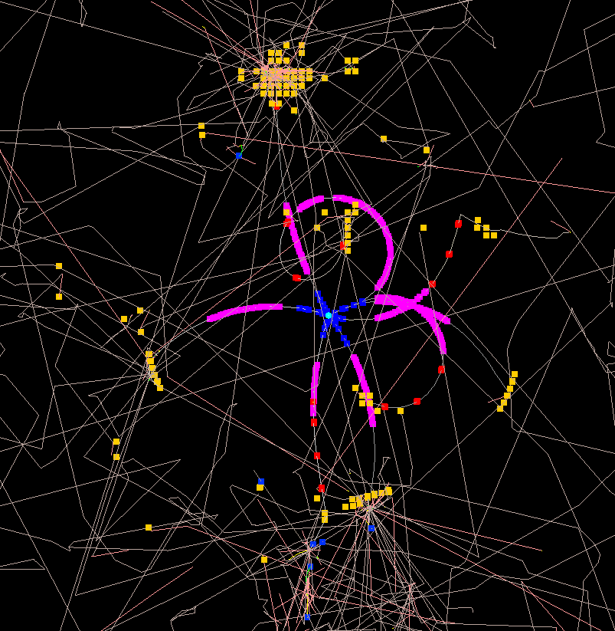
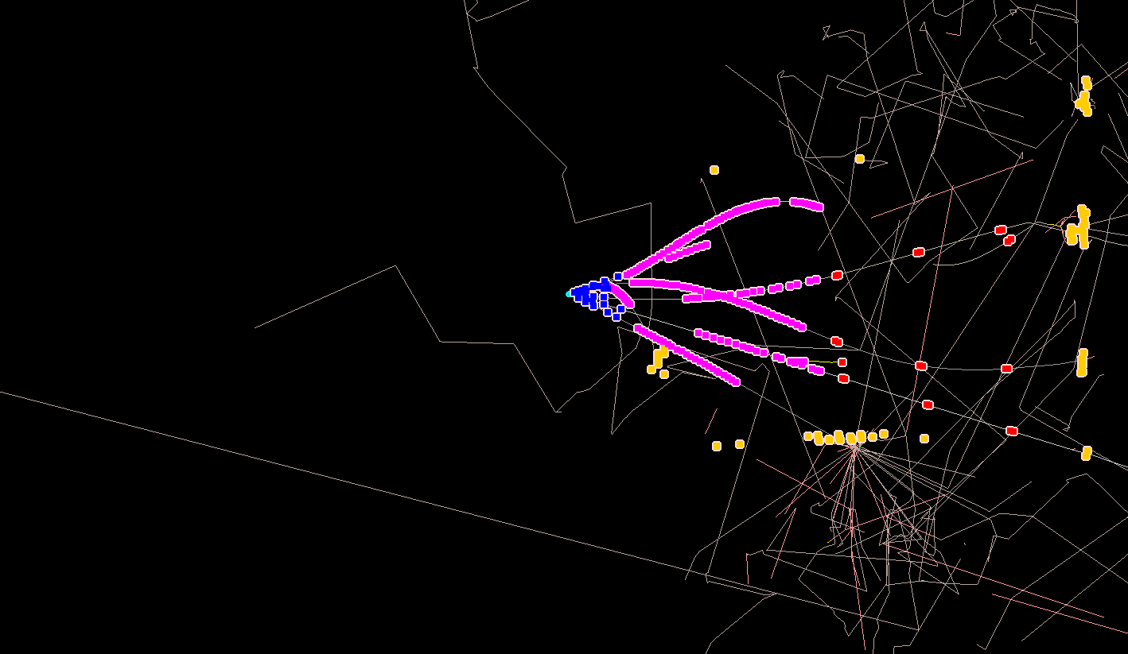
Tracking

Slide 22
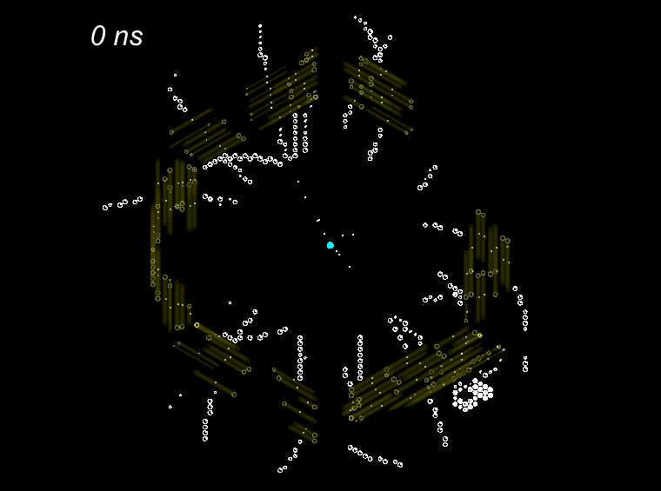
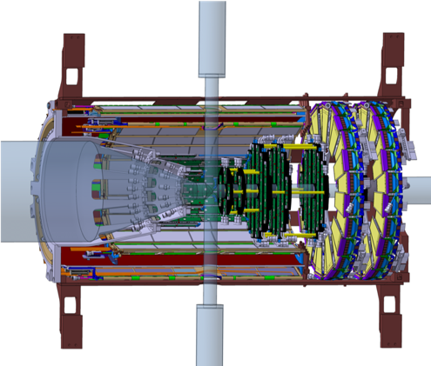
Simulated Events
STT
~ 4200 straws
Dense packaging
Isochrones (2D)
Up to 250 ns drift time
< 150 µm resolution
No start time
➔ 4D tracking needed
MVD
4 barrel layers
6 disks
3D space points
< 30 µm point resolution
< 10 ns time resolution
r_{isochr}
Straw Tube
MVD
STT
Time series of MVD and STT detector signals in PANDA (view along beam axis)

Slide 23
Tracking Procedure
Full track reconstruction happens in various steps:
Group the hits which belong to the same track
Fast evaluation of the track parameters
Precise fitting of the track parameters
Propagate track parameters to the point where they are needed
pattern recognition / track finding
pre-fit
Kalman fit
propagation / extrapolation

Slide 24
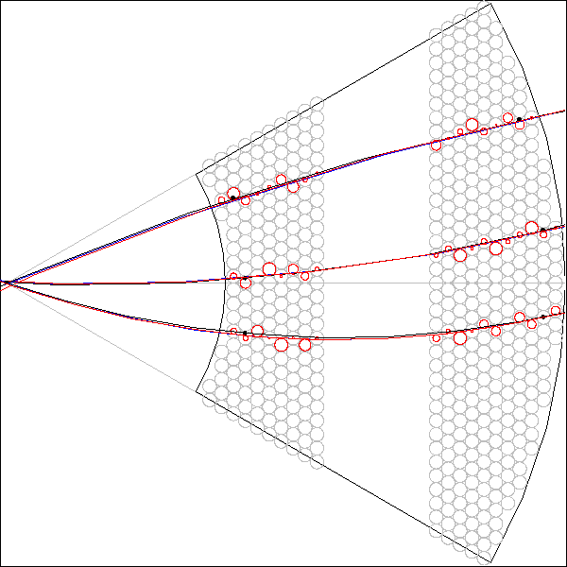
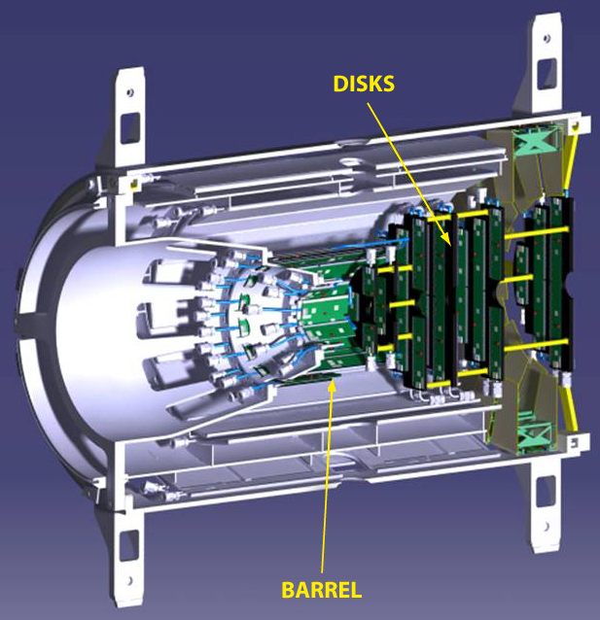
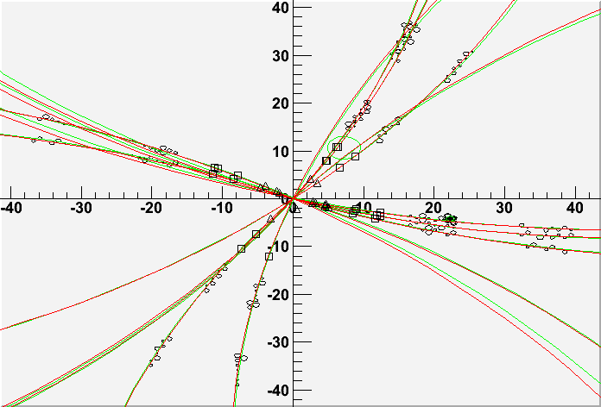
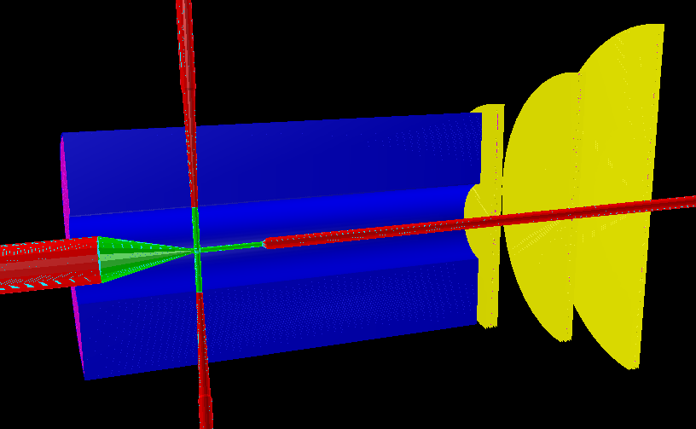
Offline Barrel Tracking
STT
MVD
Local pattern recognition in STT and MVD
Correlation of STT and MVD tracklets
Extrapolation to GEM
Kalman Filter

Slide 25
Forward Tracking
Cellular Automaton
Cellular Automaton
Build short track segments
Connect according to track model
Collect segments into track candidates
Select best track candidates
97 % track finding efficiency

Slide 26
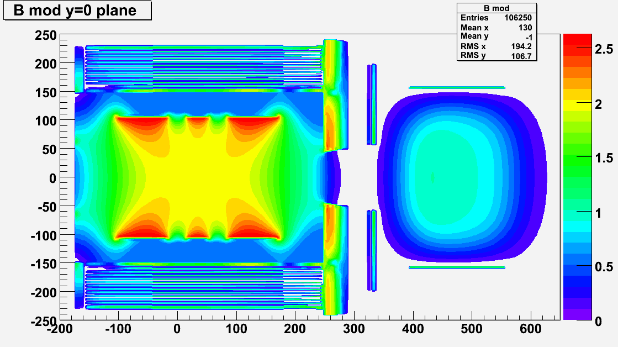
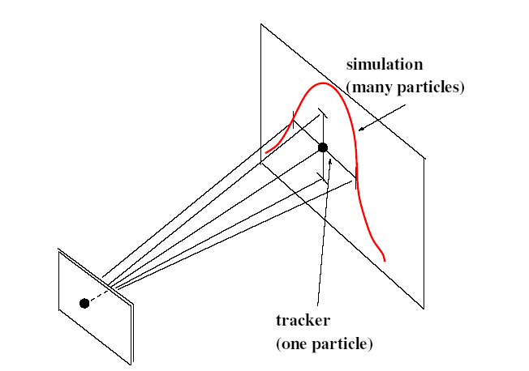
Tracking: Global Fit
Energy loss
Not homogeneous magnetic field
Different detector hits
planar hits – MVD/GEM
tube + drift time – STT/FTS
barrel
forward
Prefit Track
Kalman Filter
(GENFIT)
Detector Hits
Track Follower
(GEANE)
same geometry for simulation and track following

Slide 27
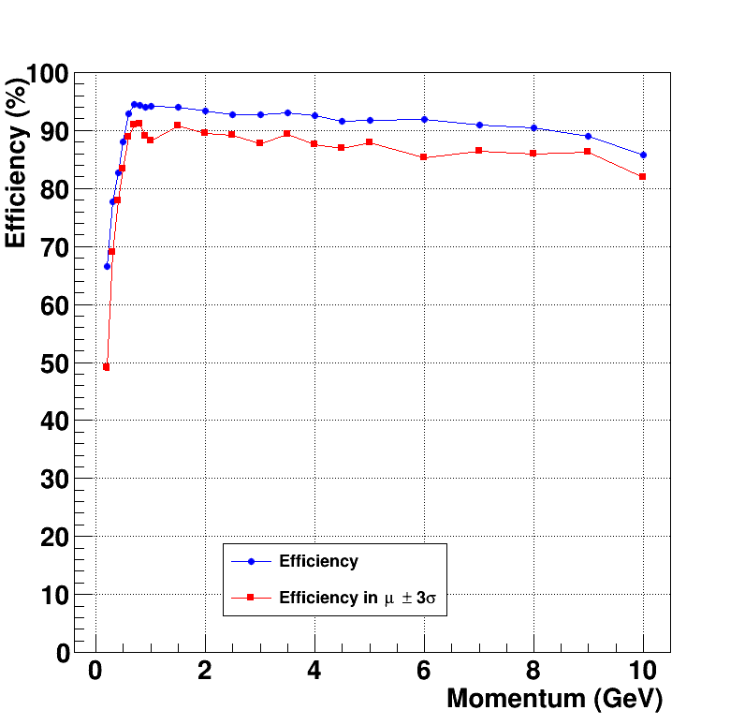
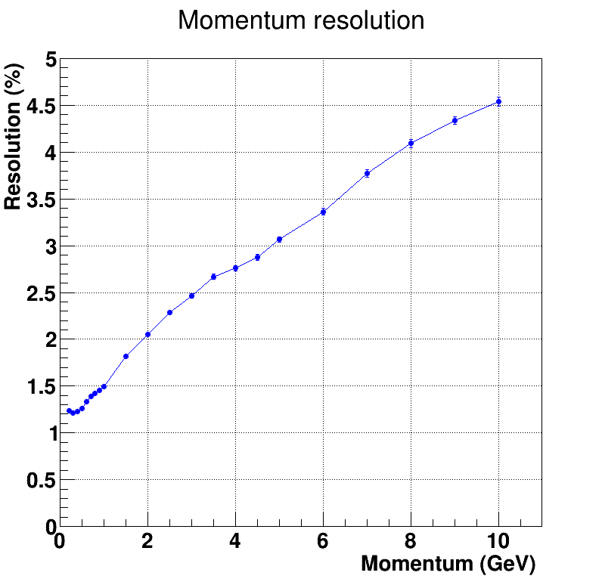
Tracking - offline
Track finding and fitting working in Central and Forward Spectrometer
Kalman filter used as second stage developed by TUM (GenFit 1 + 2)
Efficiency above 90 % (for beam above 3 GeV/c)
Momentum resolution between 1% and 5% depending on momentum
For p(pbar) < 3 GeV/c
B = 1T
p resolution doubles
low p efficiency increases
For online tracking
see: T. Stockmanns Saturday 11:30

Slide 28
Particle Identification

Slide 29
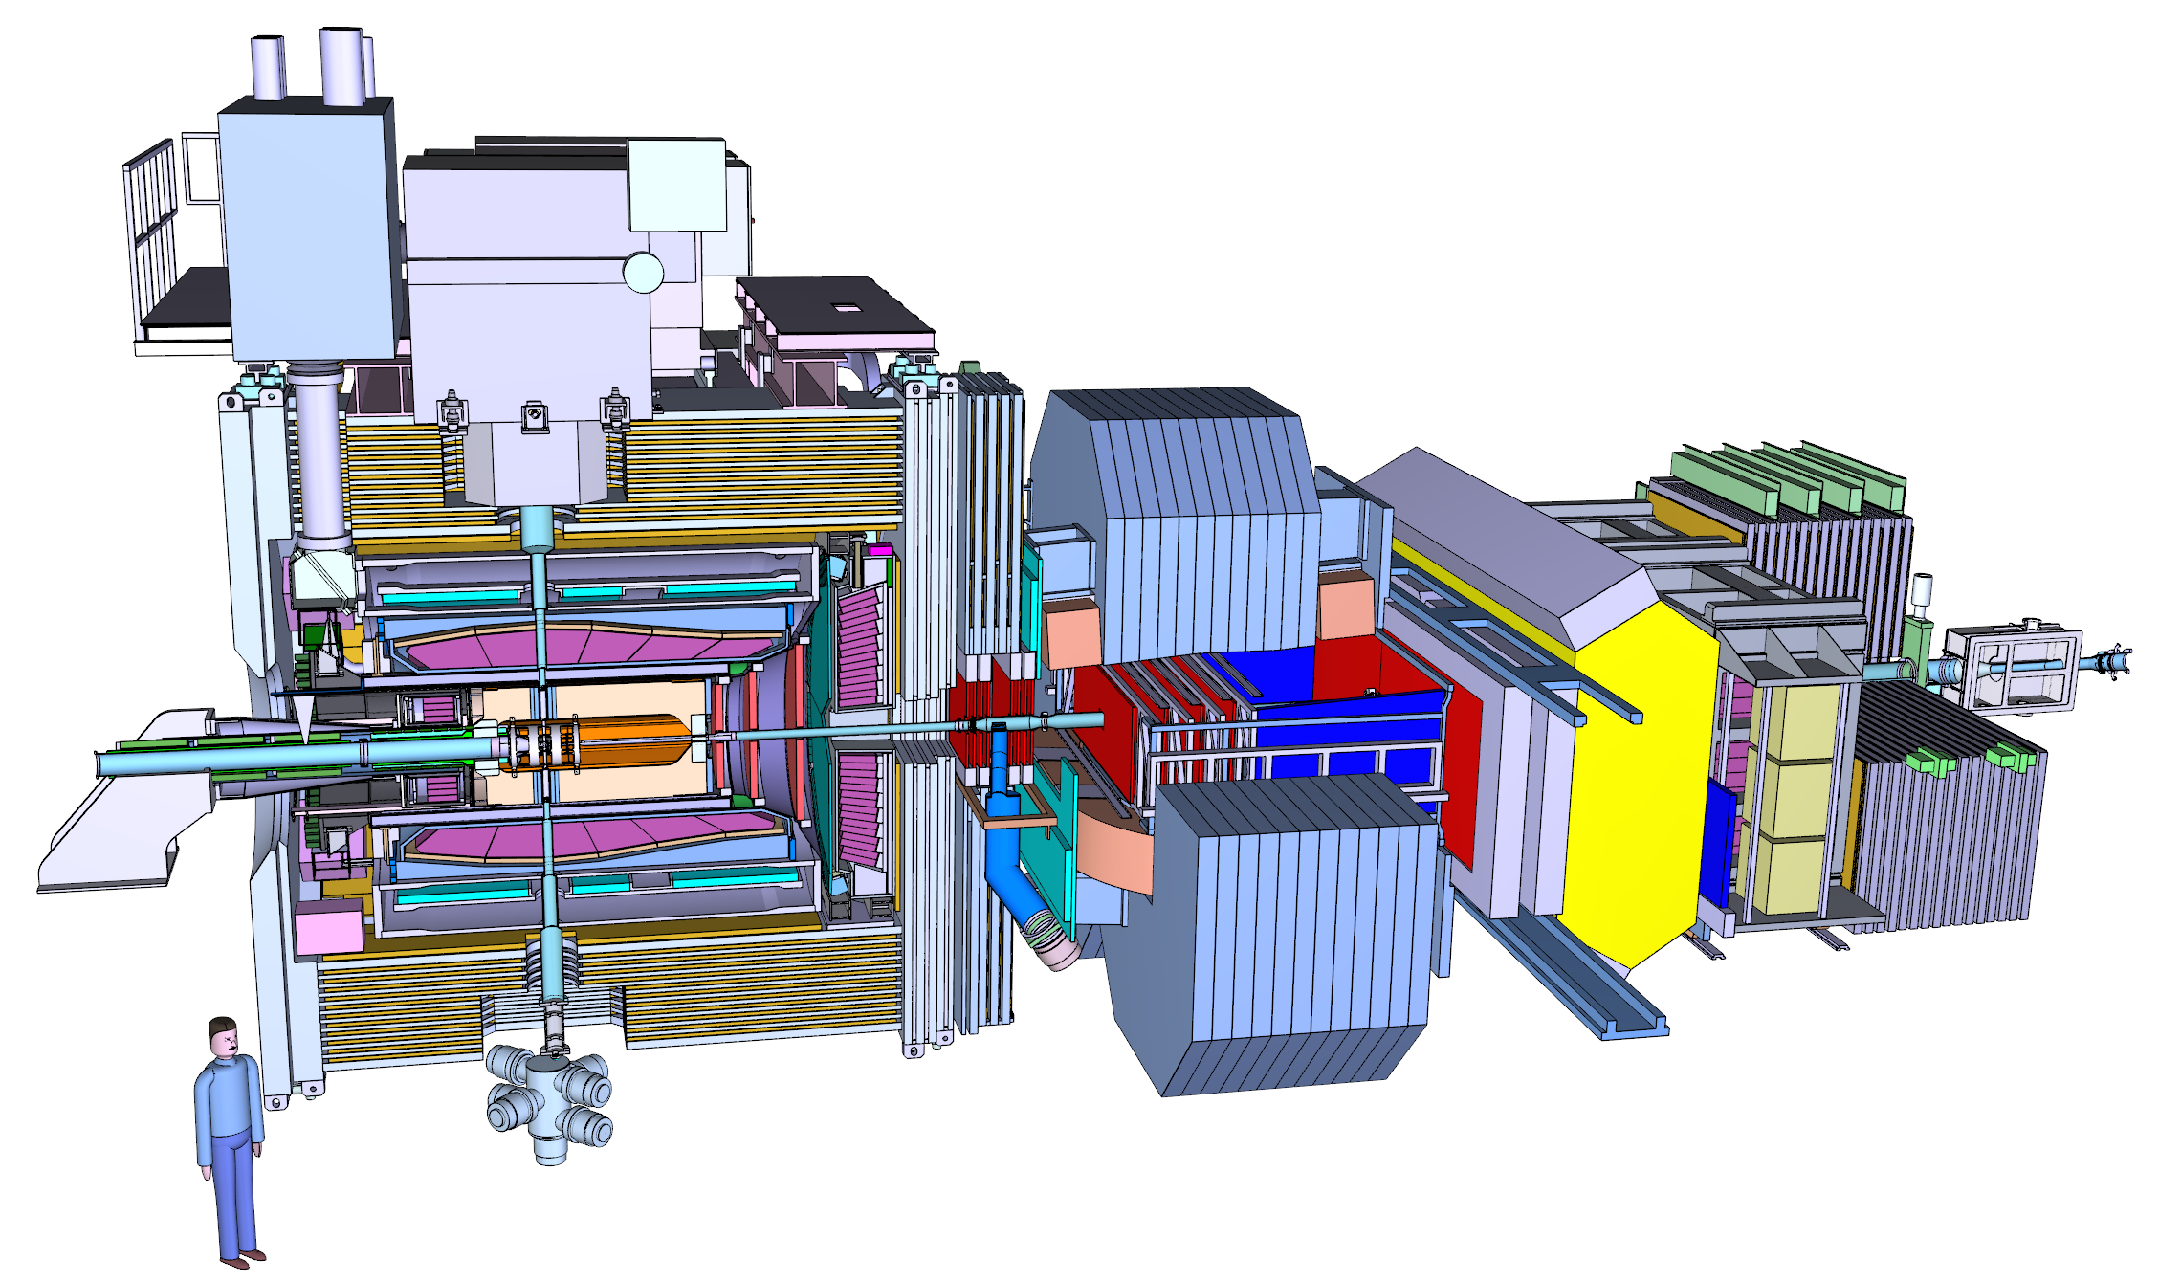
Geometry description
EMC ShowerShape
FTOF TOF
RICH Cherenkov
DIRC Cherenkov
SciTil TOF
STT dE/dx
MVD dE/dx
Muon #layers, #hits

Slide 30
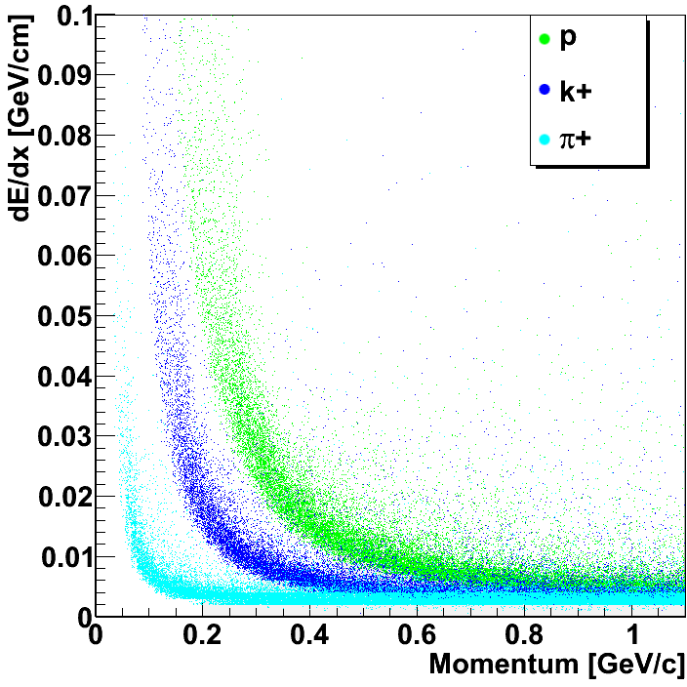
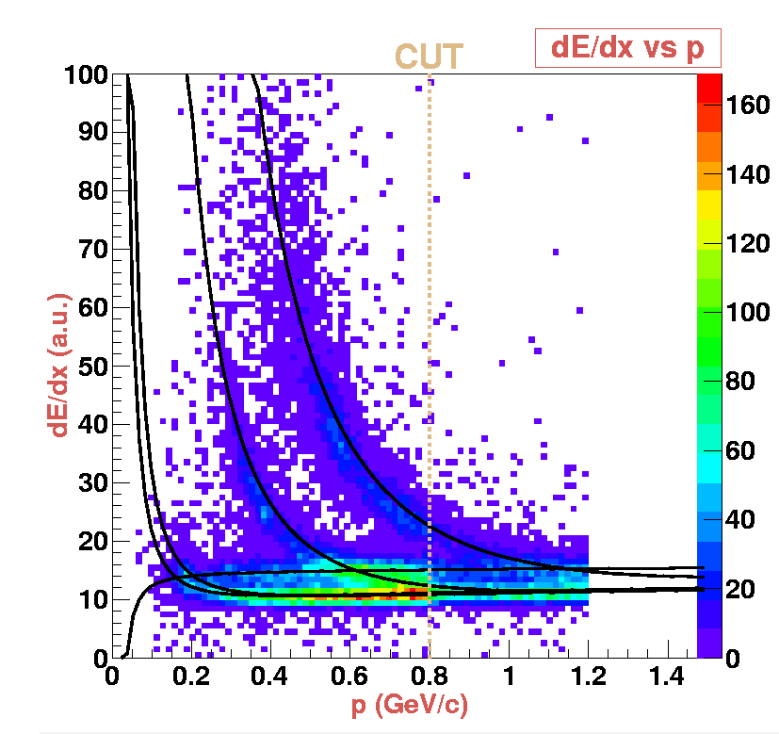
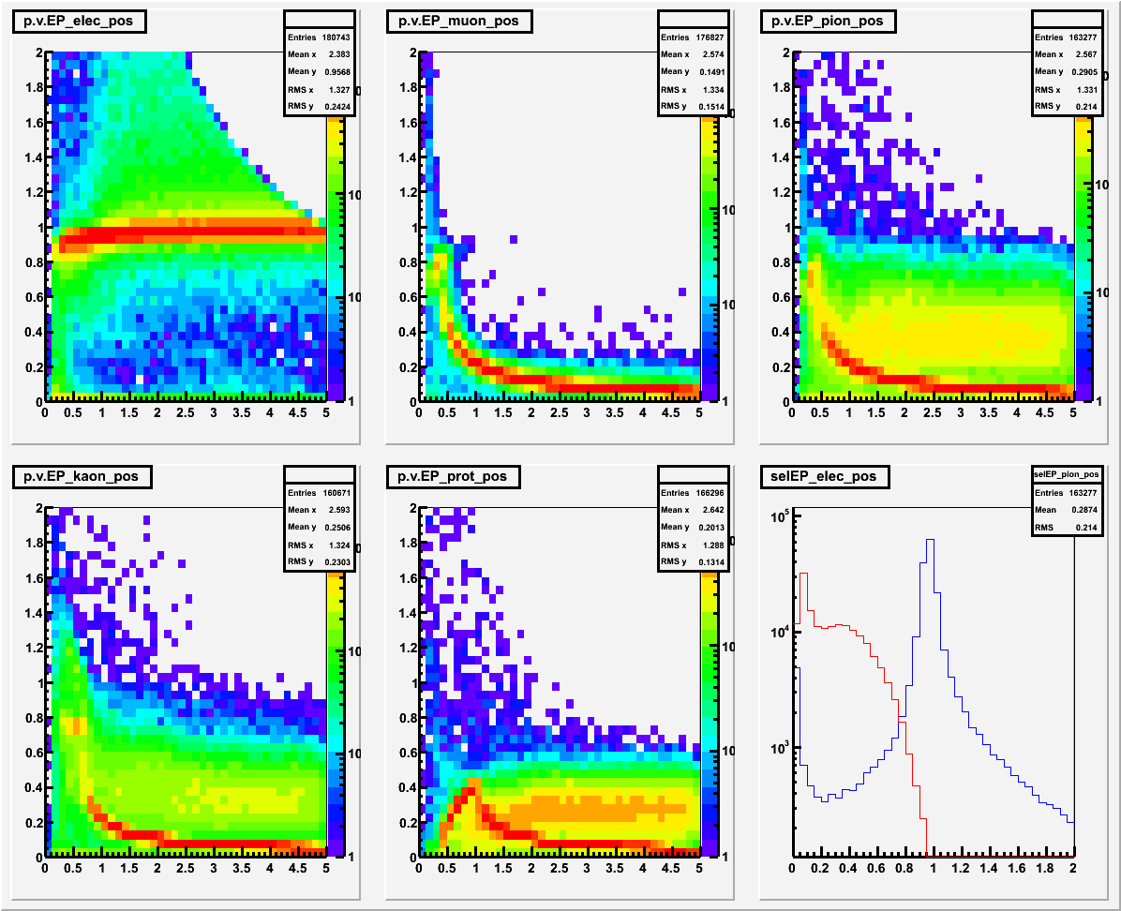
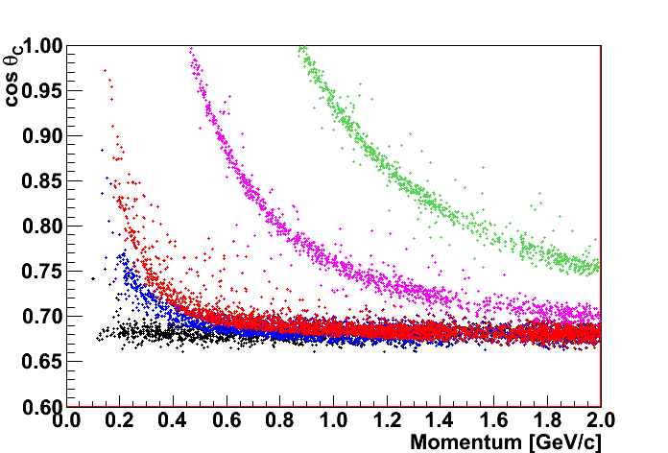
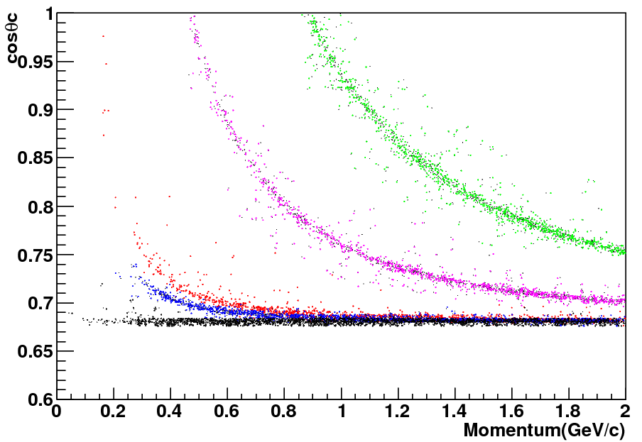
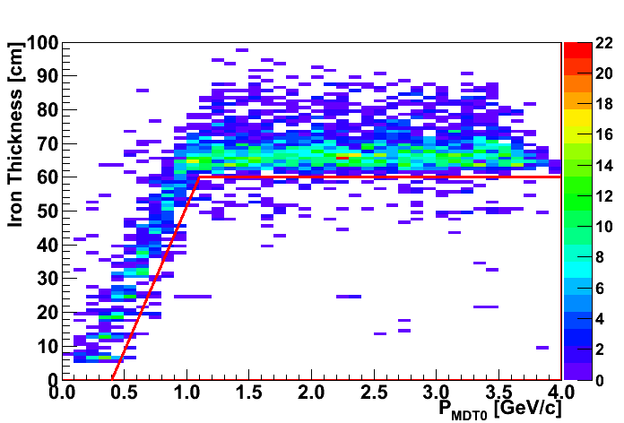
Particle Identification
Implemented PDFs for many detectors (Bayes)
EMC
STT
MVD
DIRC
DISC
MDT

Slide 31
PID
Bayes Theorem
If many detectors/alogirhtms contribute to PID
Probability that a given track with parameters x corresponds to particle type h
Global Likelihood
k = MVD dE/dx, DRC θ_{C}…

Slide 32
Machine Learning for PID
Work in progress
Artifitial Neural Network
Boosted Decision Tree
More about ML:
R. Kliemt Saturday 08:30

Slide 33
Time-Based Simulation

Slide 34
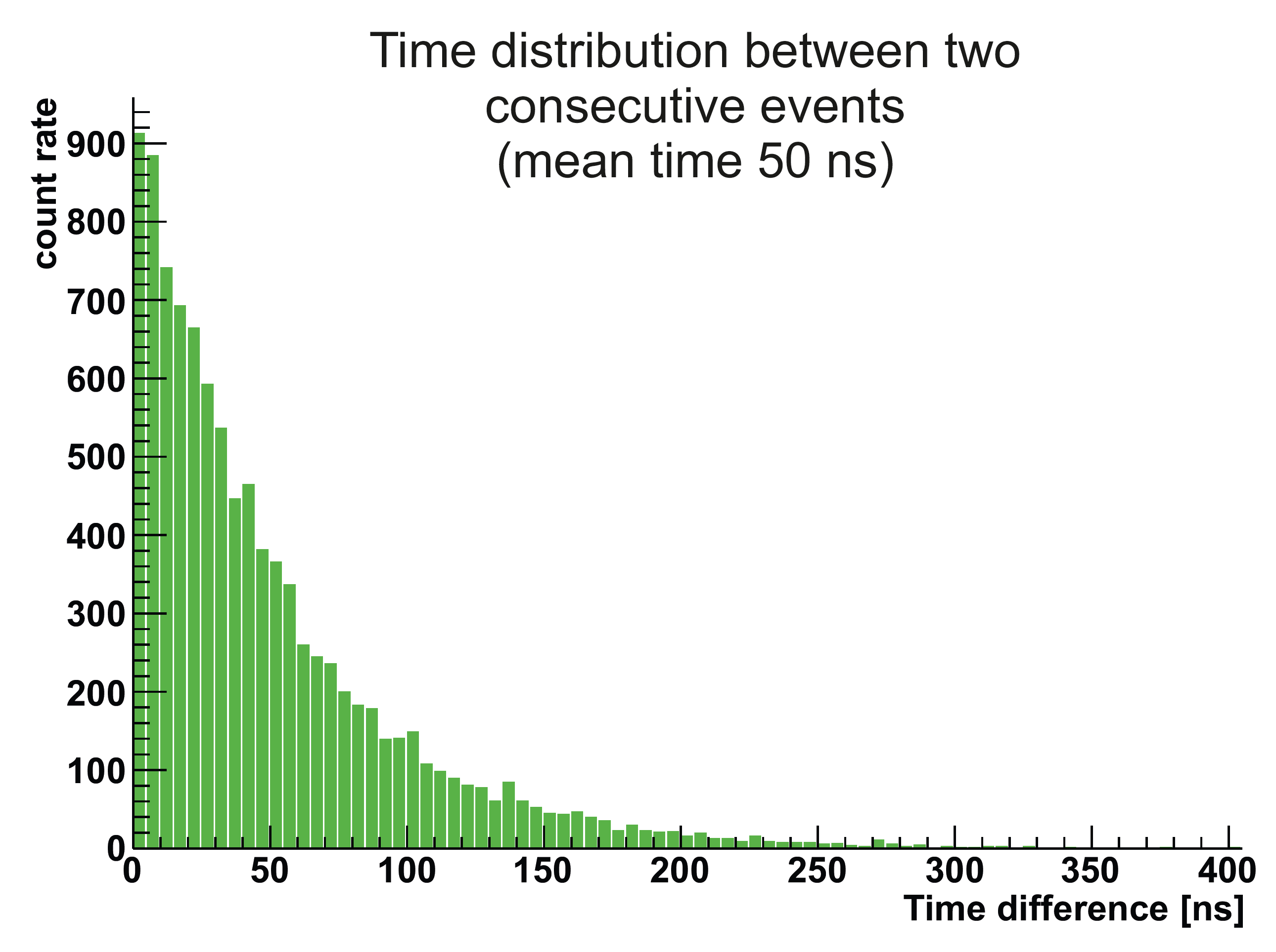
Time-Based Simulation
Signal and background-events very similar ➔ no hardware trigger possible
Quasi continuous beam with maximum interaction rate of 20 MHz ➔ Poisson distribution
Raw data rate of 200 GByte/s
Reduction of 1000 needed for permanent storage O(PByte/year) ➔ Online Event Filte

Slide 35
Time-Based Simulation
Single Event

Slide 36
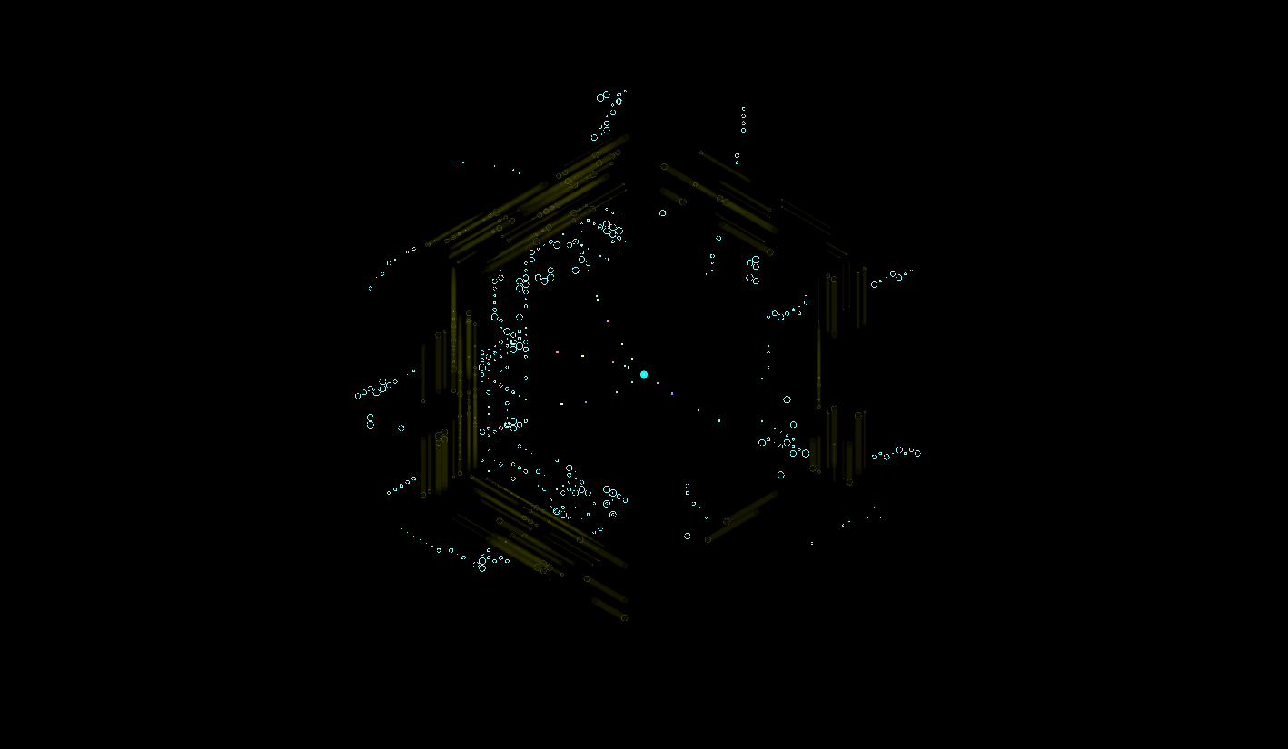
Time-Based Simulation
20 MHz overlap

Slide 37
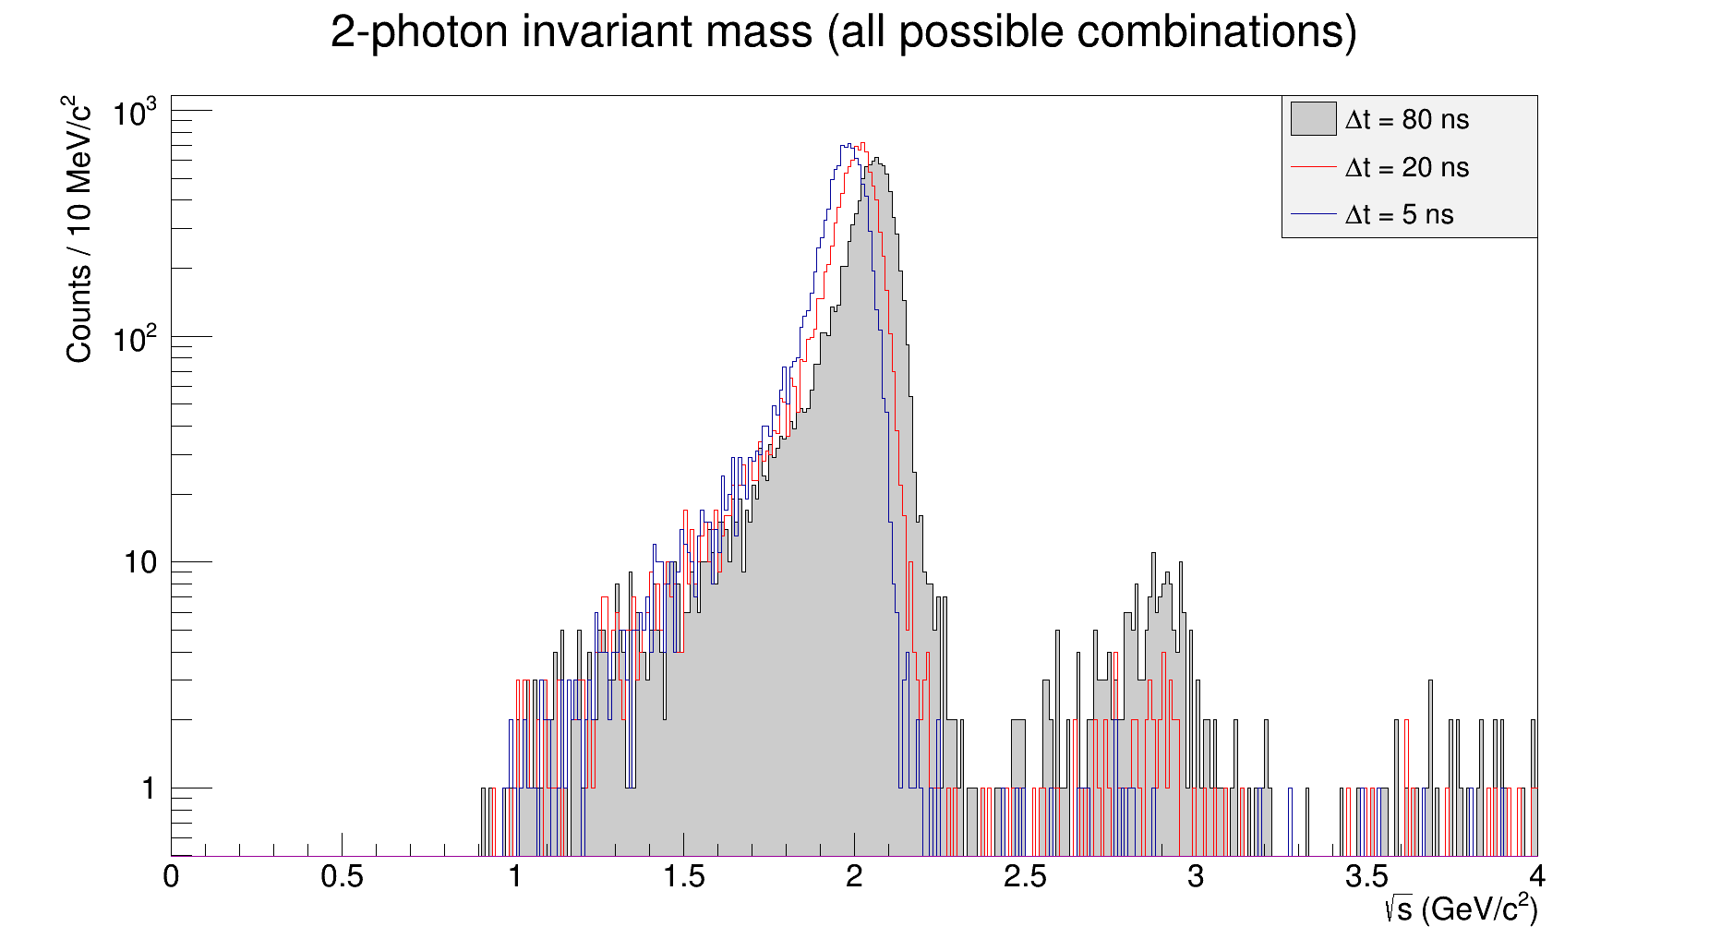
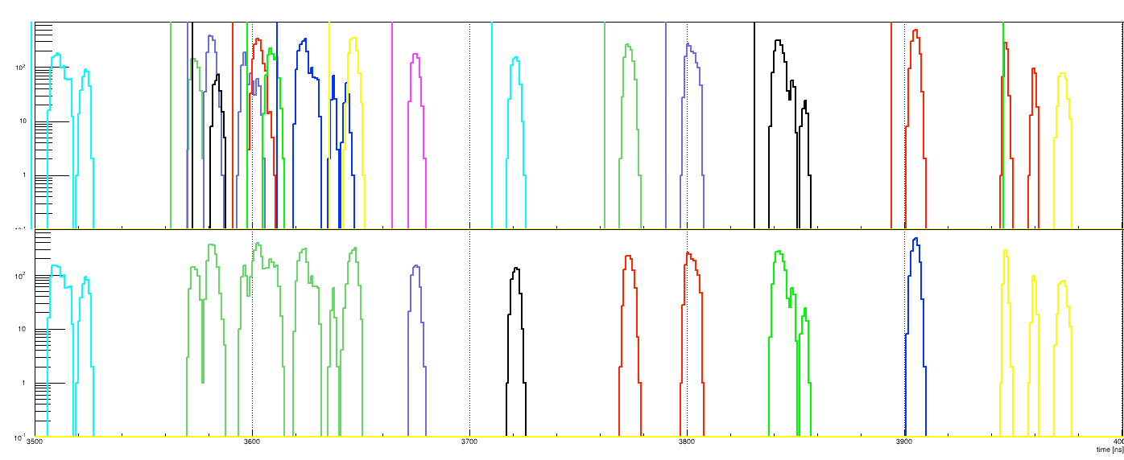
Time-Based Reconstruction
MVD
Work in progress
STT
Event 1
Event 2
Event 3
Activities on the central tracker MVD + STT + GEM + SciTil + EMC
EMC
see: T. Stockmanns Saturday 11:30

Slide 38
Panda Analysis

Slide 39
Analysis Tools
Reconstruction
PndAnalysis
Vertex Fit
DecayTree Fit
Kinematic Fit
QA Tools
PWA

Slide 40
Analysis Tools
Reconstruction
PndAnalysis
Rho
Vertex Fit
DecayTree Fit
Kinematic Fit
QA Tools
PWA

Slide 41
Analysis Framework
Rho and PndAnalysis
Rho
Small framework to handle particle candidates
Combinatorics, lists and selectors
Smart n-tuple: RhoTuple
PndAnalysis
Providing Rho with reconstructed data and basic particle lists
PID selections on PndPidProbability
Propagation interface to GEANE
MC-Truth access & decay chain MC-Matching

Slide 42
Analysis Tools
Particle Fitters
Vertexing
POCA finder
RhoKalmanVtxFitter: fast
RhoKinVtxFitter: precise
Kinematic Fits
Rho4CFits
RhoKinFitter: → Mass, 4C (P3, E)
Tree Fits
Iterative mechanism
DecayTreeFitter fits complete decay tree at once

Slide 43
Analysis Framework
Supporting Tools
QaTools
Employs smart n-tuples (RhoTuple) as root trees
Many automated functions to fill them (p4, daughters, mc, pid, ...)
Common nomenclature for fast command line analysis
QuickAnalysis
Automated scripts to get large n-tuples by a few settings for: combinatorics, fits and selections
Usually enough to make all desired plots!
FastSim implementation allows results from one macro
see: K. Götzen Saturday 9:00

Slide 44
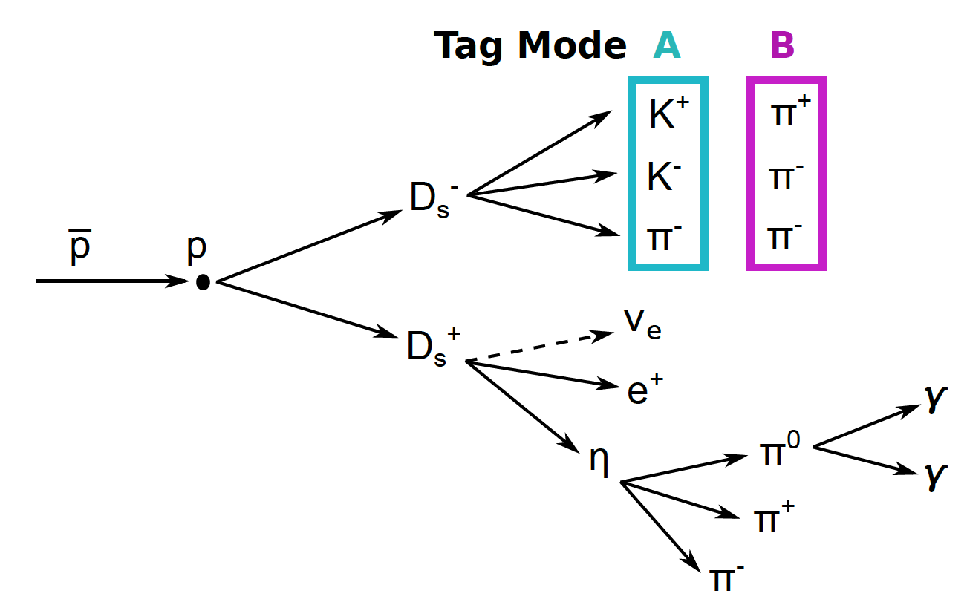
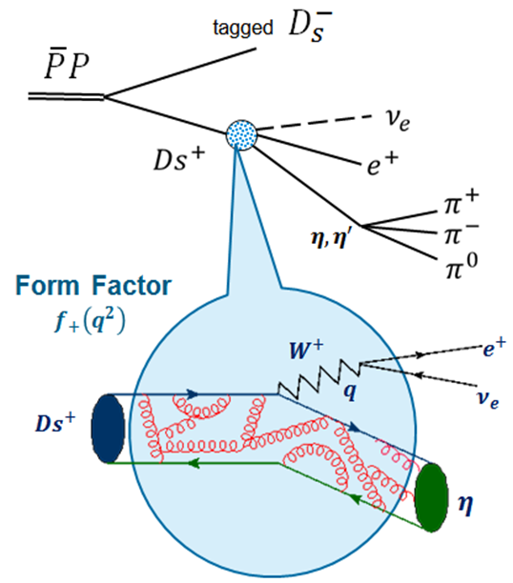
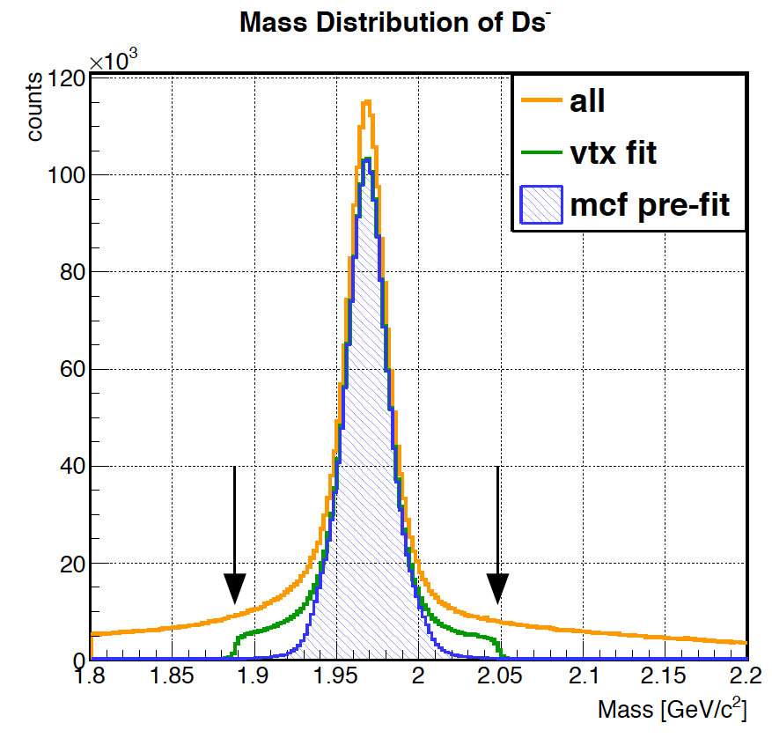
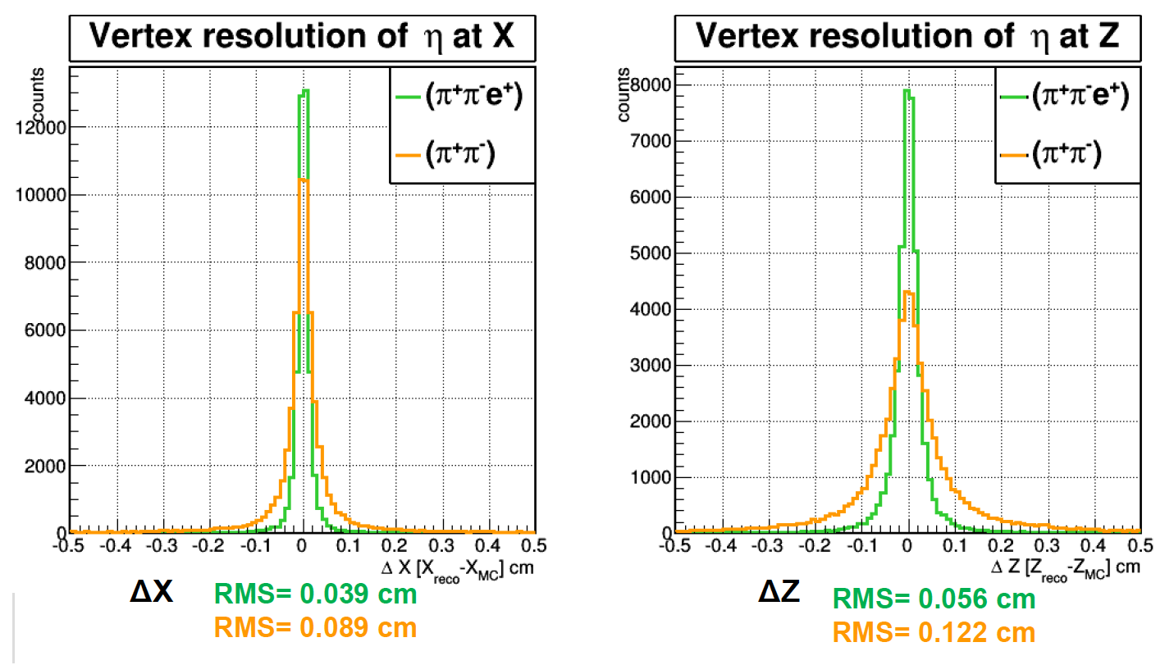
Analysis example
Rho package
Combine hits
Fit with constraints
Apply cuts

Slide 46
PandaRoot Example Macros

Slide 47
PandaRoot Infrastructure
Code Repository: pandaatfair.githost.io
Issue Tracker, Constant Integration for each commit
Nightly builds and tests
Dashboard: https://cdash.gsi.de/index.php?project=PandaRoot
Wiki page: panda-wiki.de/foswiki/bin/view/Computing/PandaRoot
Forums: forum.gsi.de & Slack: pandaroot.slack.com
Bi-weekly online metings: Thursdays 10-11

Slide 48
Computing Infrastructure

Slide 49
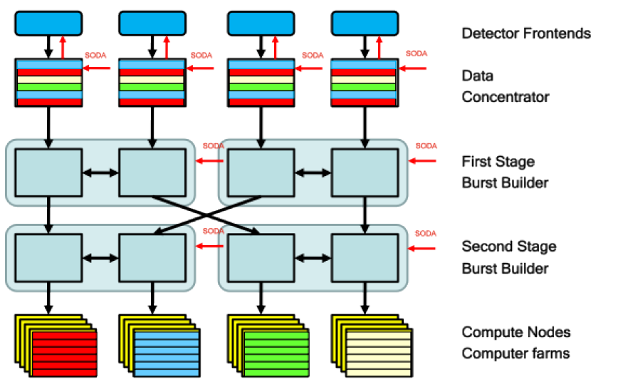
Online Data Taking
DETECTORS
Max Interaction rate
20MHz
ASIC
80GB/s ‐ 200GB/s
FPGA
1/1000 reduction factor
CPU GPU
80MB/s ‐ 200MB/s
MASS STORAGE

Slide 50
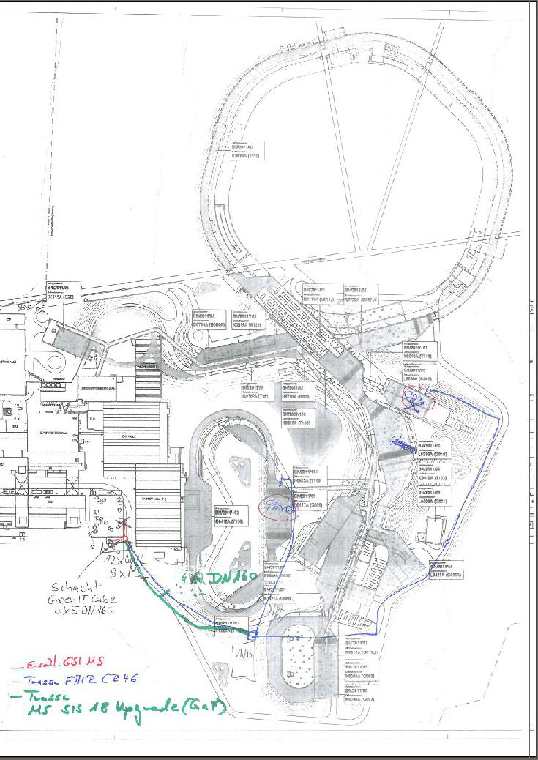
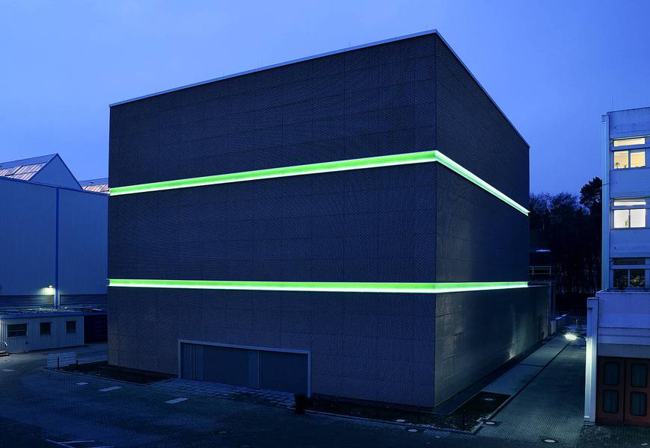
Connection to Green Cube
3500 optical fibers for CBM
500 optical fibers for PANDA
4 empty tubes
(10Gb/s fiber)
PANDA→ 2 X 310 GB/s
GreenCube
Panda
Maximum data rate from Panda data concentrators:
200 GB/s

Slide 51
Design of Distributed Computing
Tier 0
Prompt reconstruction
Permanent storage of ALL data
Calibration
Reprocessing
Simulation ?
50k cores (6 months)
Tier 1
Reprocessing
Calibration ?
Simulation
Permanent storage of part of the data
Analysis ?
70k cores (12 months)
Tier 2
Analysis
Taking data from close Tier 1
Small simulation jobs

Slide 52
Summary
Computing at PANDA is challenging
Overlapping events in time
Many different sub-detectors
Two different magnetic fields
Reconstruction of low momentum particles
Online reconstruction
PandaRoot / FairRoot software well developed (but still some holes open)
Online reconstruction still an open issue
Which algorithm to use at which hardware?
Change to FairMQ

