Slide 1

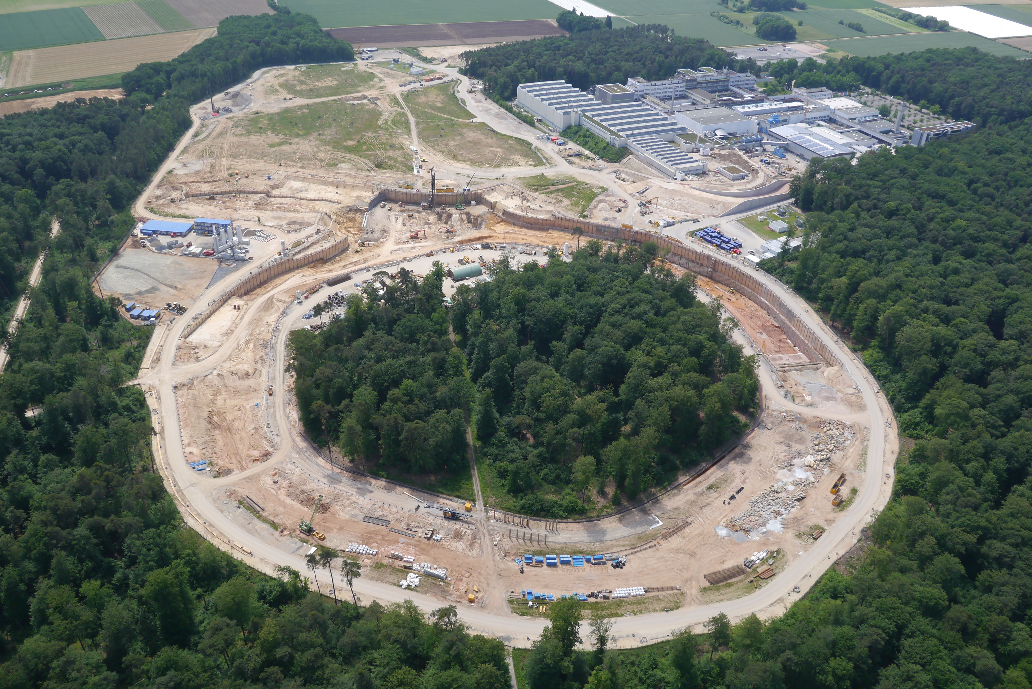

FAIR Facility for Antiproton and Ion Research
Status
GWU, May 3, 2019
Klaus Peters GSI/U Frankfurt

Slide 2
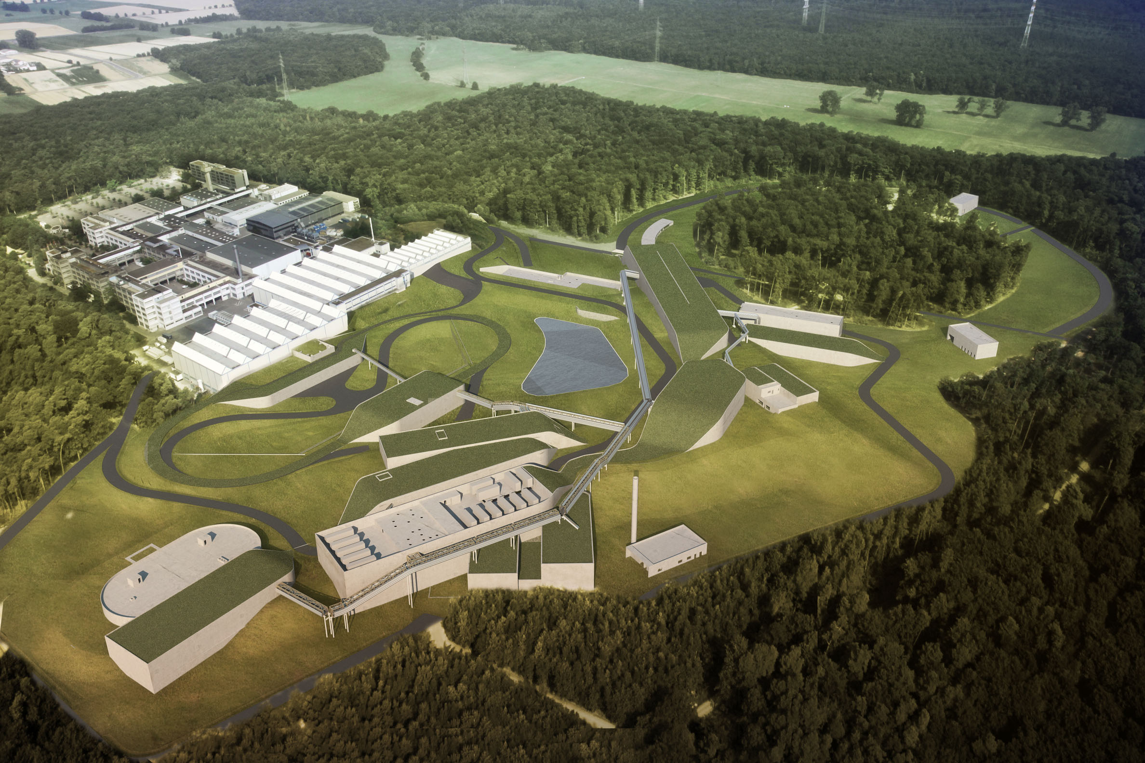









FAIR: Facility for Antiproton and Ion Research A World-Wide Unique Accelerator Facility
ESFRI Landmark
Top priority for European
Nuclear Physics Community
Driver for Innovation in Science and Technology
Finland
France
Germany
India
Poland
Romania
Russia
Slovenia
Sweden
UK
2

Slide 3
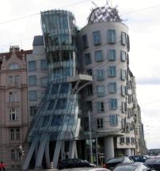
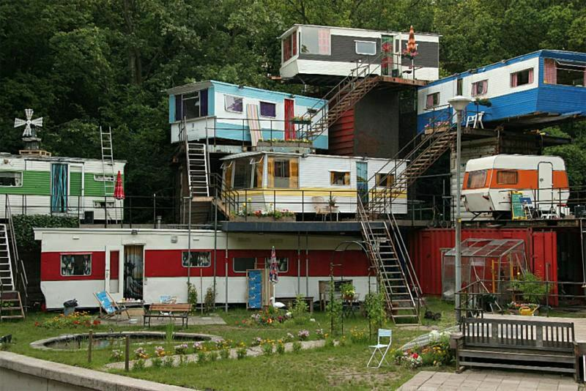
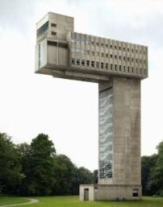
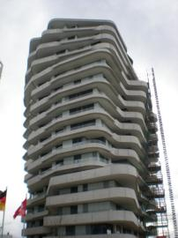
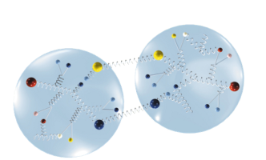
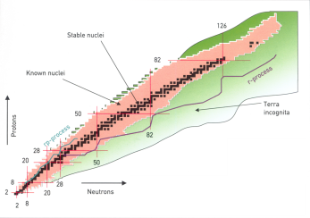
sub nuclear material research….
criteria of stability can be derived
from extreme (exotic) structures
→ properties of the binding
Notes:
biegen, zerren/strecken, aufheizen:
Was soll nun passieren, wir wollten ja die Struktur des Hauses untersuchen
wenn man Werkstoff untersucht...biegen, zerrren/strecken, aufheizen

Slide 4
Physics of Hadrons and Nuclei
Our Mission: Study strongly interacting matter on all scales
The strong force is responsible for forming
the pion, the proton, all nuclei,
thus it is the basis of our existence
The strong force is the least understood (not calculable),
when it comes down to
relations to the real life …
The combination of the large coupling and the non-abelian structure
of the interaction are the scientific reasons for the difficulties
It requires theoretical and experimental progress on
strongly interacting systems on all relevant scales
Notes:
Our ambition is the strong force
The strong force is responsible for forming subatomic particles
like the pion and the proton
and its residual effects account for the existence
and most of the properties of nuclei
...ergo its is the basis of our existence
Although known since a long time and basically described by a field theory
called Quantum Chromo Dynamics – real life observables,
like masses, production and decay properties, abundances
are not directly accessible by ab-initio caclulations due to the
complexity of the strong force
The large coupling combined with the non-abelian character
of the interaction are the reasons for the difficulties
It is therefore mandatory to progress experimentally and theoretically
in this field to connect our observed world with fundamental theories
and effective models

Slide 5
Common Features
High reaction rate → Frequent events
Speed is an issue (few 10⁷)
High incident flux → Luminosity and high doses
Radiation hardness is an issue (up to 100 krad)
Price scales with volume →
Compactness of the detector (up to 1000 t)
Compact volumes →
High fields are an issue (2 T) Heat is an issue
High Precision →
Systematics is an issue
Rare signals →
Dead-time is an issue
}
Full coverage is an issue

Slide 6
Additional Features (not common to all)
High dynamic range →
Hadron physics (e.g. calorimeters 10 MeV-10 GeV)
High occupancy →
Relativistic heavy ion coll. (e.g. tracking, >1000 tracks)
Complex topologies →
Challenging hardware & software (e.g. FPGA, GPU,..)
Factory mode →
Rare access → durability
Large assemblies →
Many electronics channels → high integration
Long delivery and assembly lines/times

Slide 7
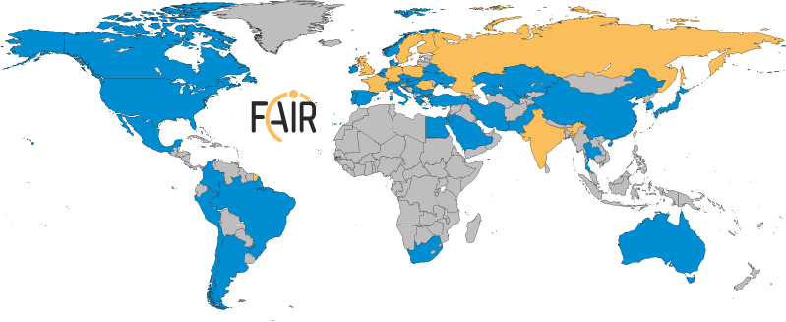
FAIR: International Cooperation
Finland
France
Germany
India
Poland
Romania
Russia
Slovenia
Sweden
UK
Realisation and operation of FAIR in international cooperation
9 international FAIR shareholders plus
1 Associate Partners and
Aspirants
Participation of
3.000 scientists from all continents (200 institutions from 53 countries
7

Slide 8
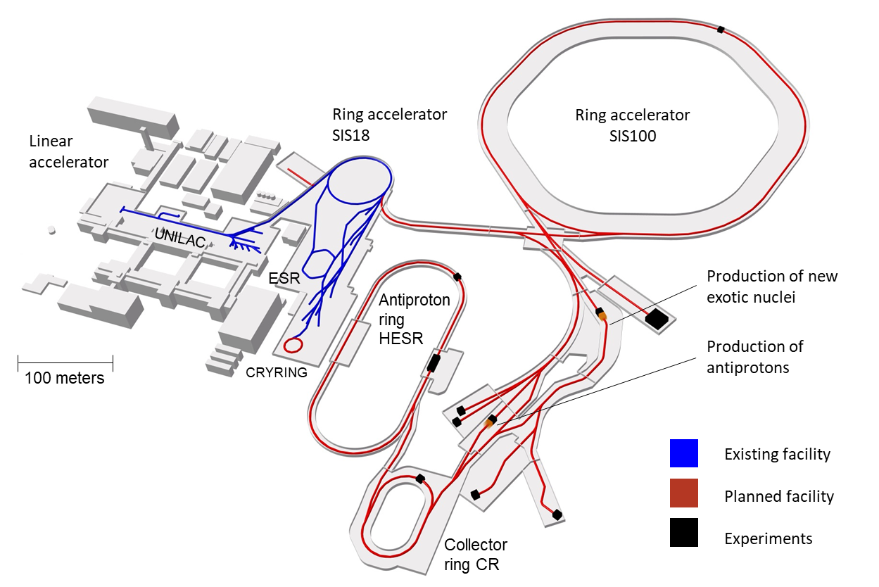
FAIR @ Darmstadt
Nuclear Structure & Astrophysics
(rare isotope beams)
Our Mission
Study strongly interacting matter
on (almost) all scales
Hadron Physics
(stored and cooled
15 GeV/c anti-protons)
QCD-Phase Diagram
(HI beams 2 to 45 GeV/u)
Fundamental Symmetries
& Ultra-High EM Fields
(anti-protons & highly stripped ions)
Dense Bulk Plasmas
(ion beam bunch compression
& petawatt-laser)
Materials Science & Radiation Biology
(ion & anti-proton beams)
Accelerator Physics

Slide 9
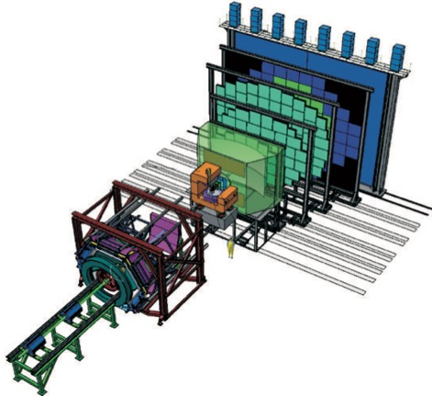
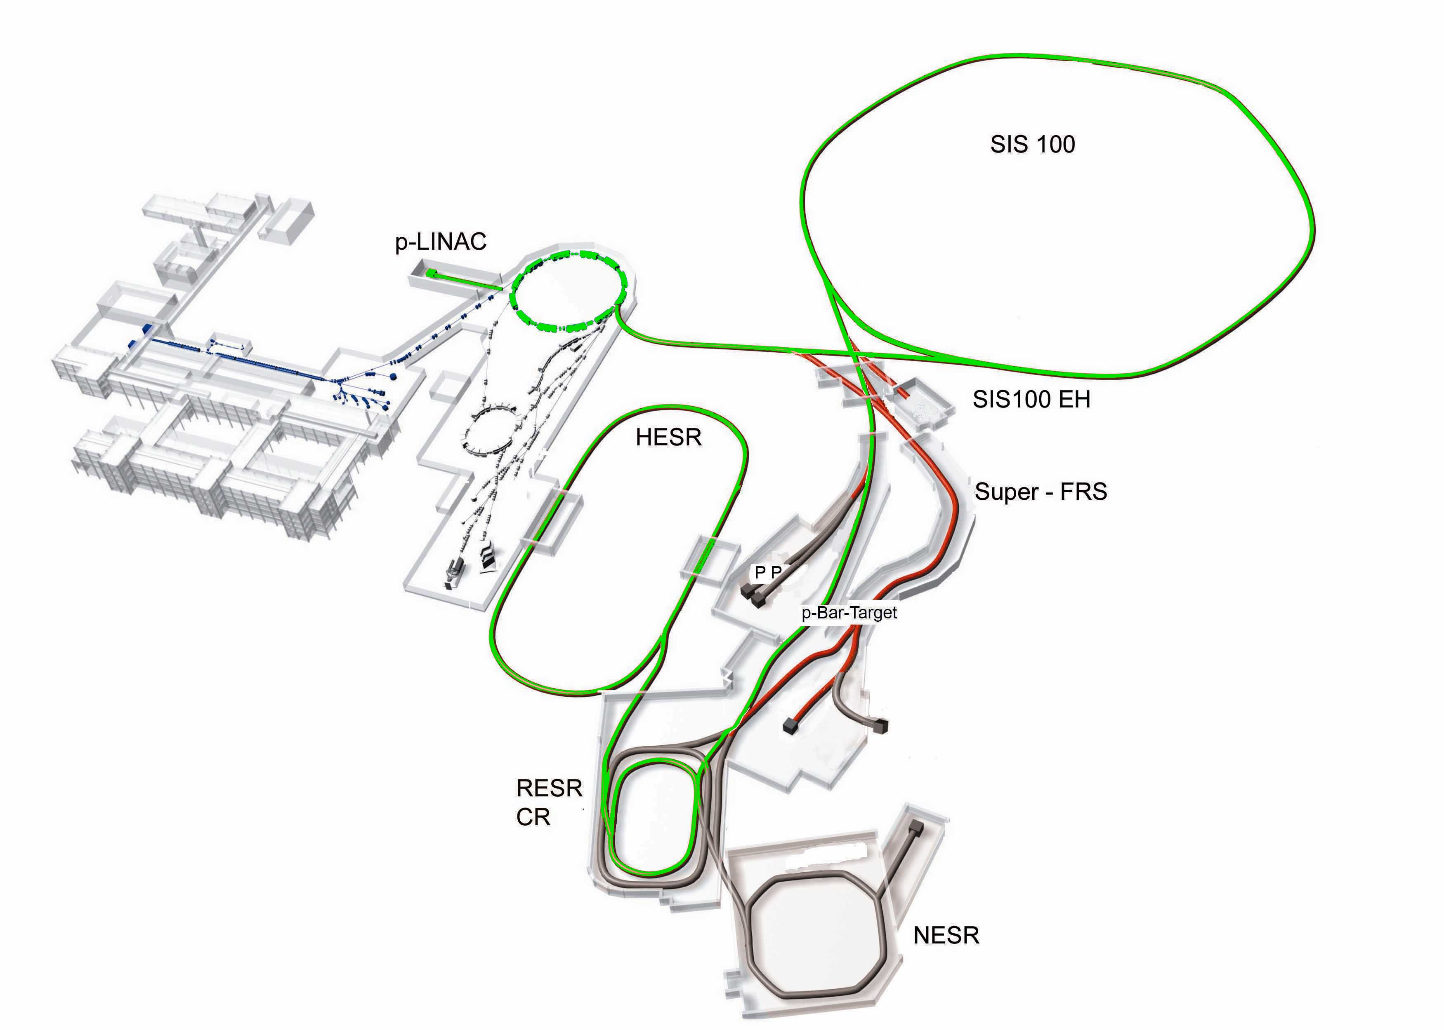
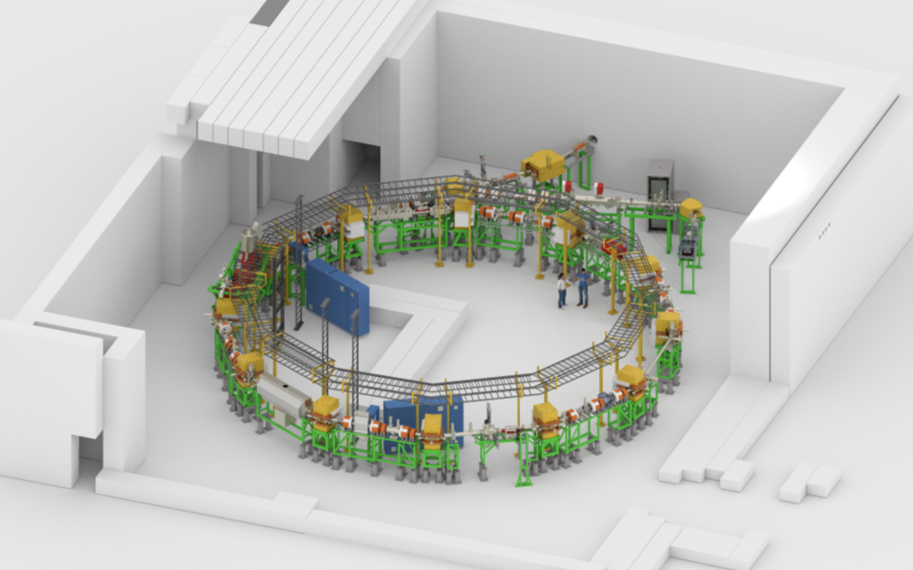
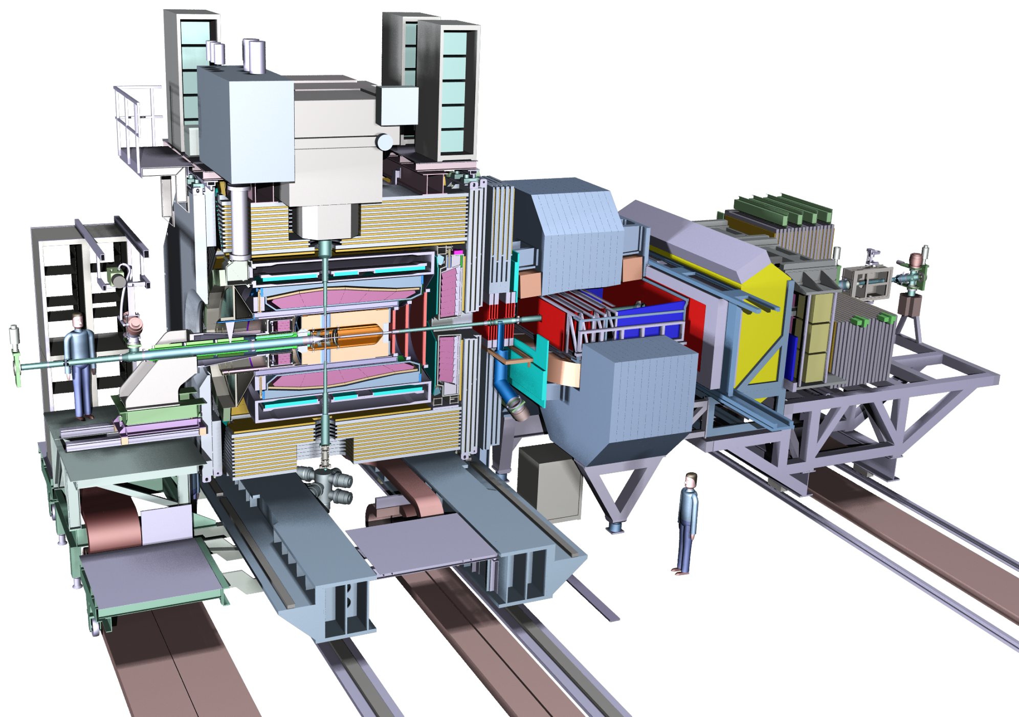
FAIR Experiments
CBM
APPA
Super-FRS
NuSTAR

Slide 10
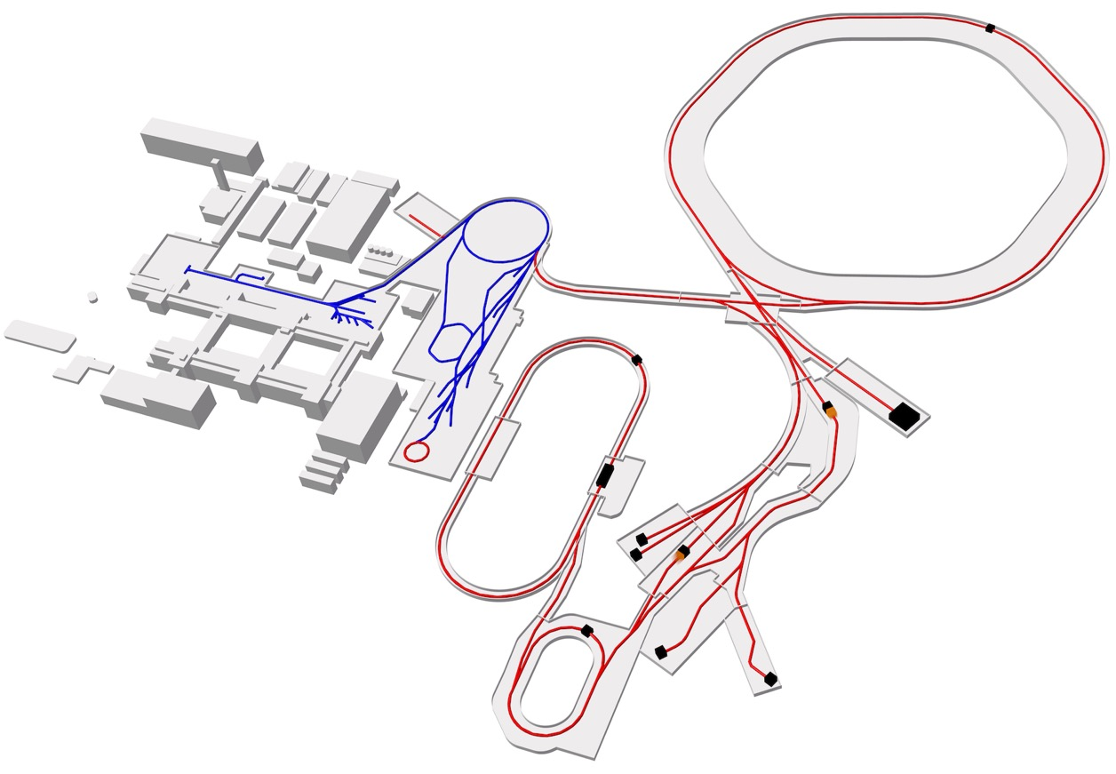
FAIR Experimental Stations
SIS100
SIS18
ESR
CBM/HADES
Super
FRS
Cryring
Pillars
APPA
CBM/HADES
NUSTAR
PANDA
APPA
PANDA
HESR
CR
NUSTAR

Slide 11
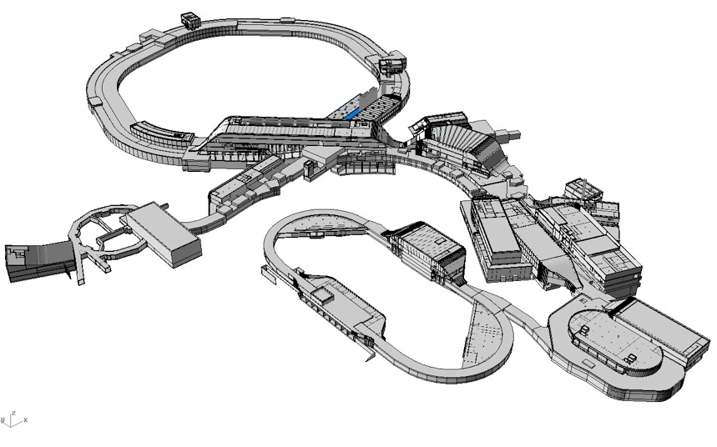
Civil Engineering
New
Beamline ∑ 3.2 km
thereof
Synchrotron 1.1 km
New
Existing only SIS 18
600.000 cbm > 1 Mio tons of concrete
35.000 tons of steel

Slide 12

Construction Site

Slide 13
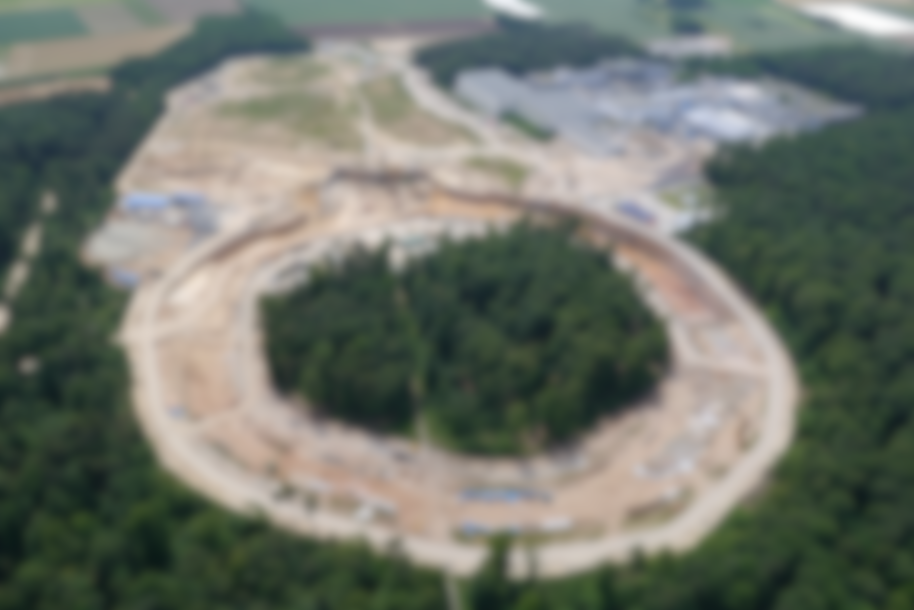
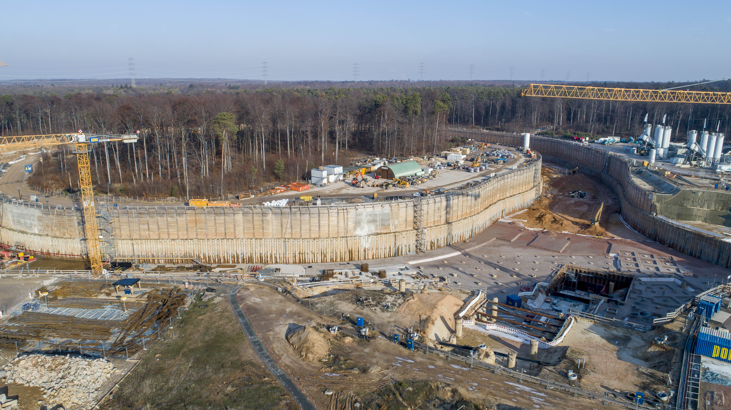
Construction Site

Slide 14
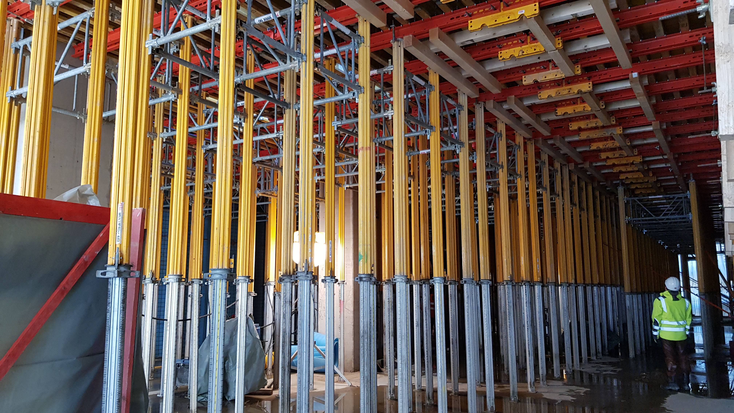
Construction Site

Slide 15
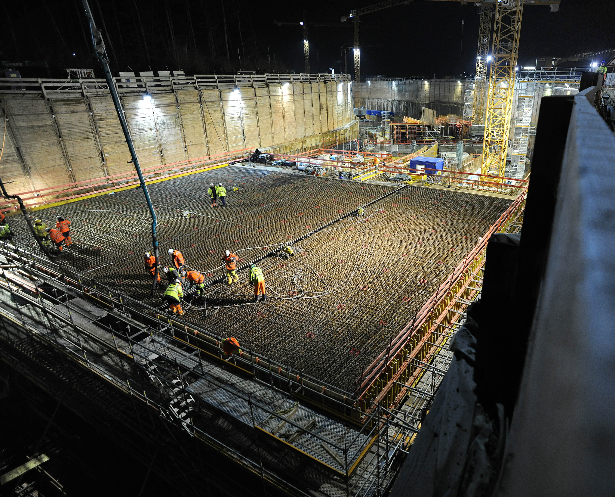
Construction Site

Slide 16
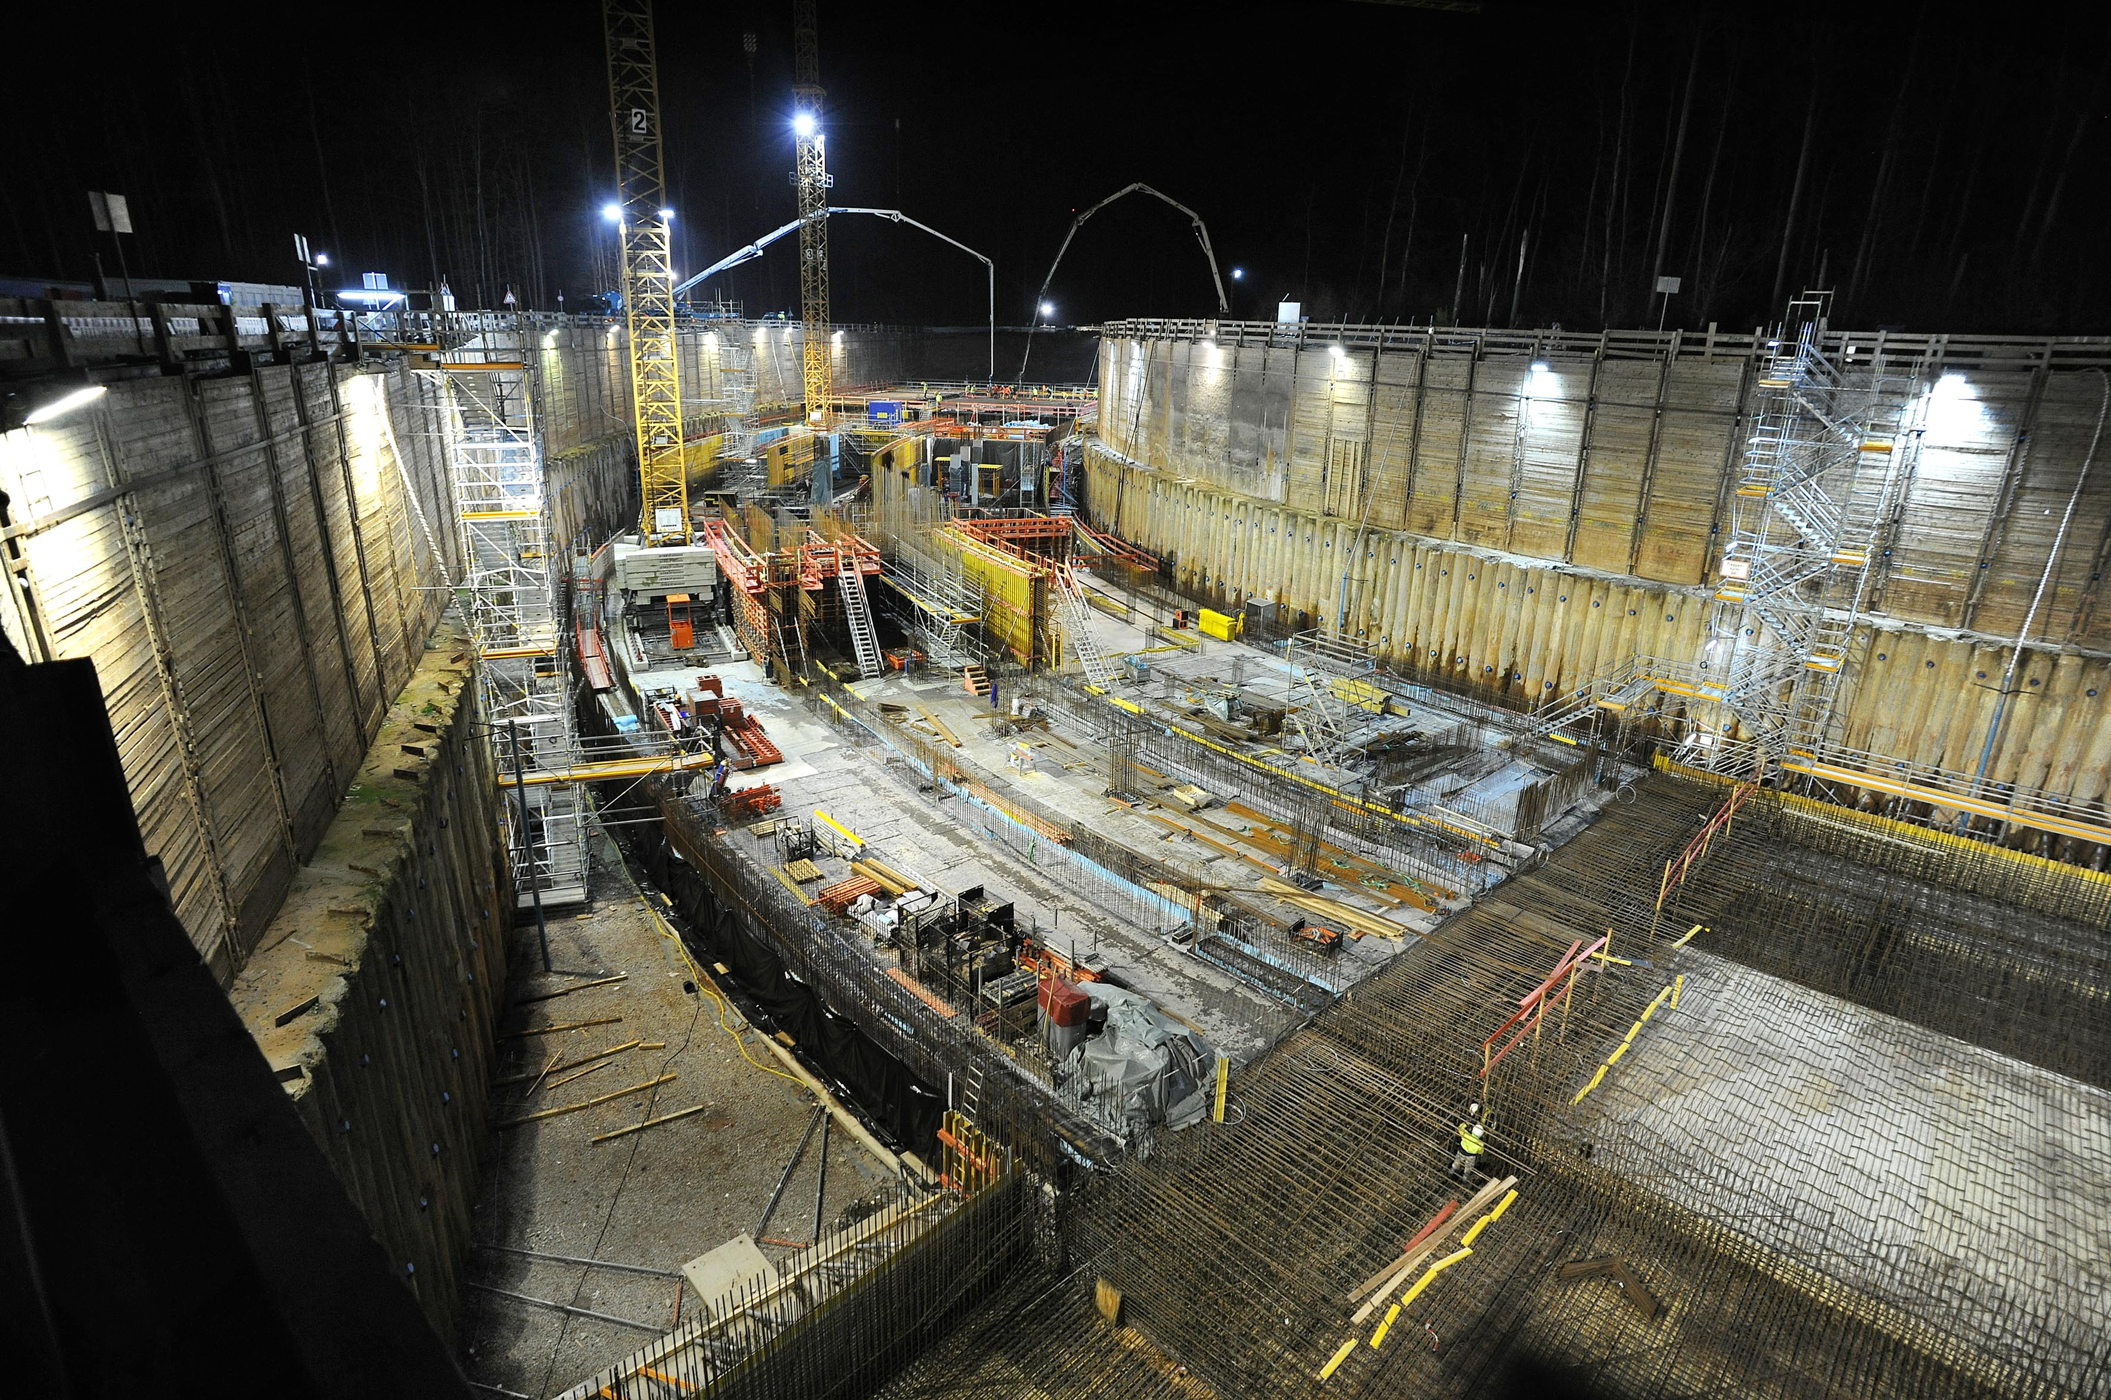
Construction Site

Slide 17
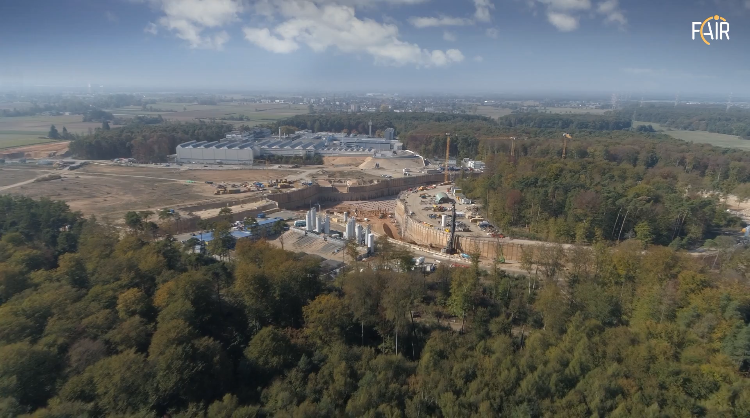
Construction Site

Slide 18
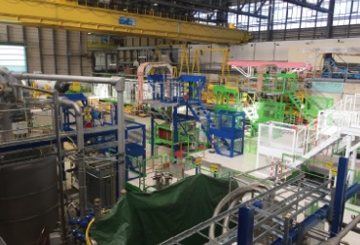
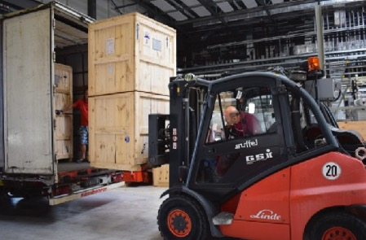
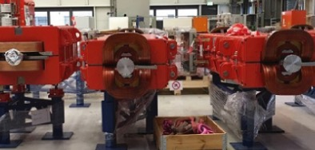
Overall Project – Recent Highlights
Testing facility for magnets of the FAIR SuperFRS is now ready for use at CERN
Six quadrupole power converters for HEBT were delivered from India in November 2018
Dipole magnets with integrated vacuum chambers for high energy beam transfer are prepared for storage

Slide 19
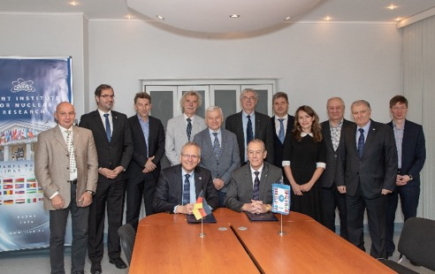
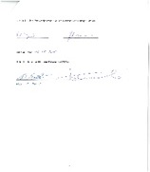
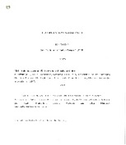
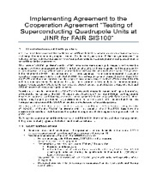
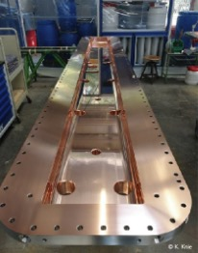
Overall Project – Recent Highlights
Contract for Testing of SIS100 Quadrupole Units signed with JINR on 26th October 2018
Copper plating and first tests of the RFQ accelerator
cavity for the p-Linac have been completed and match specification

Slide 20
FAIR Experiments
CBM
APPA
Super-FRS
NuSTAR

Slide 21
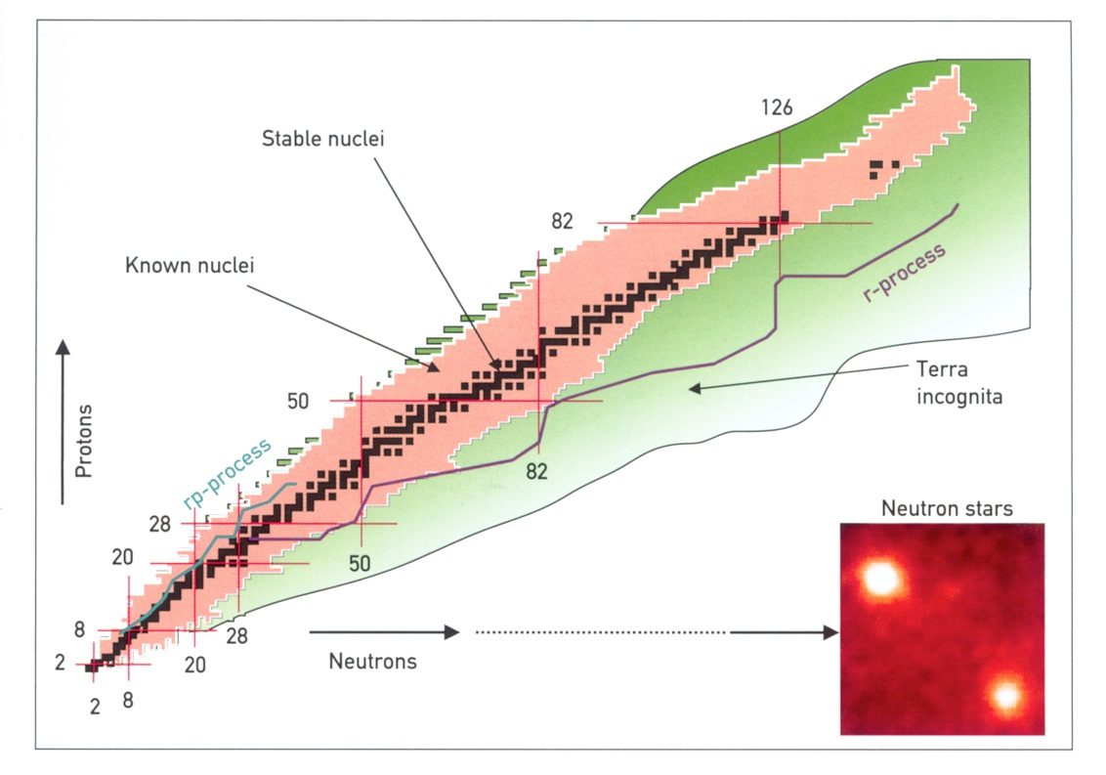
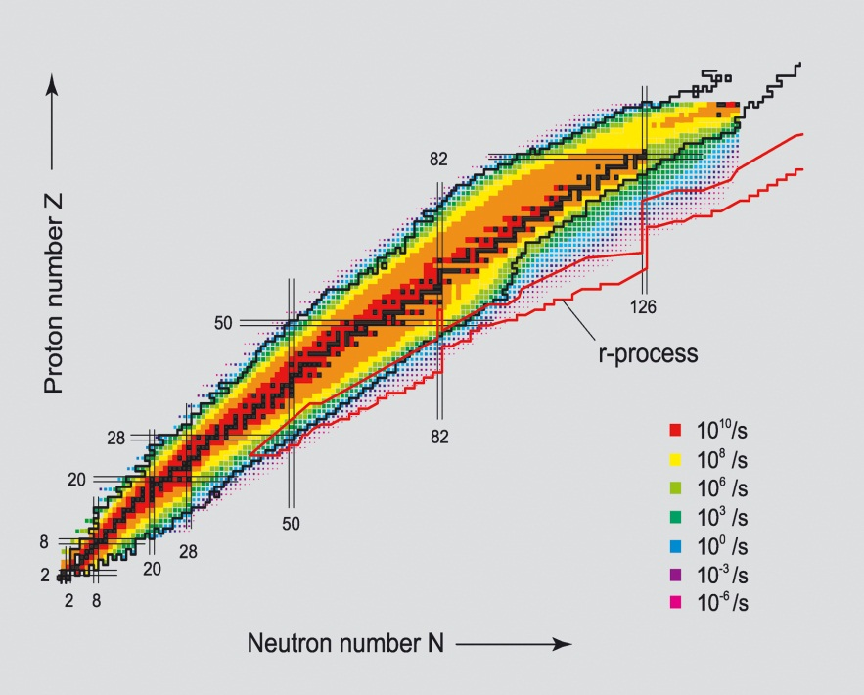
NUSTAR @ FAIR: physics of the nuclei
How Are Elements Made ?
Structure of exotic nuclei far off stability ?
Nuclear synthesis in stars
and star explosions
Fundamental interactions
and symmetries
Superheavy Nuclei
Neutron Drip Line

Slide 22
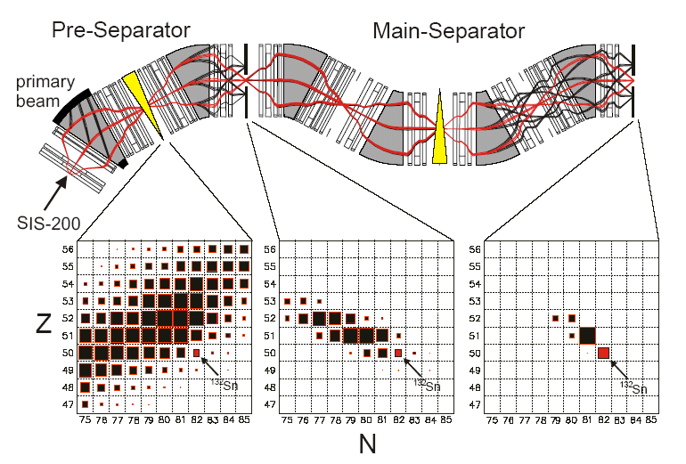
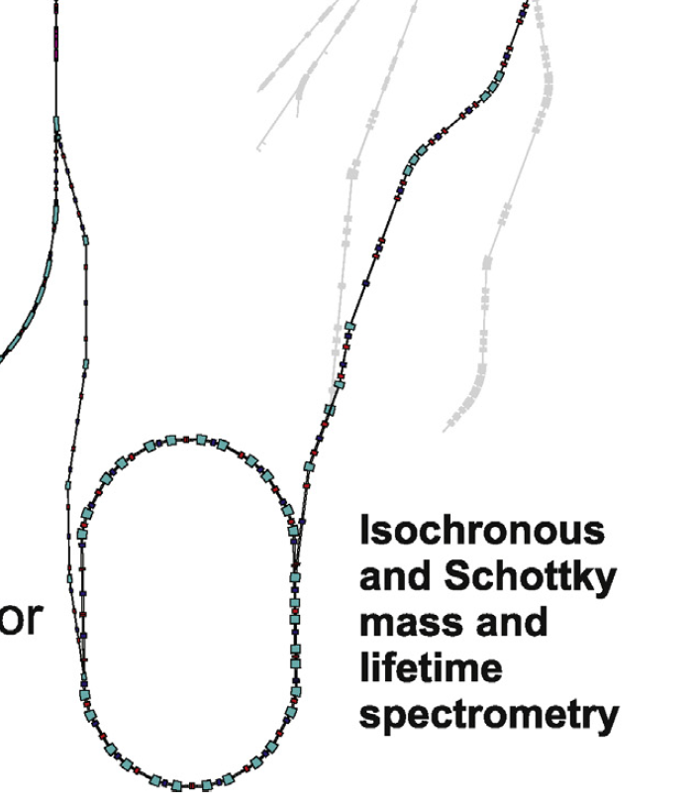
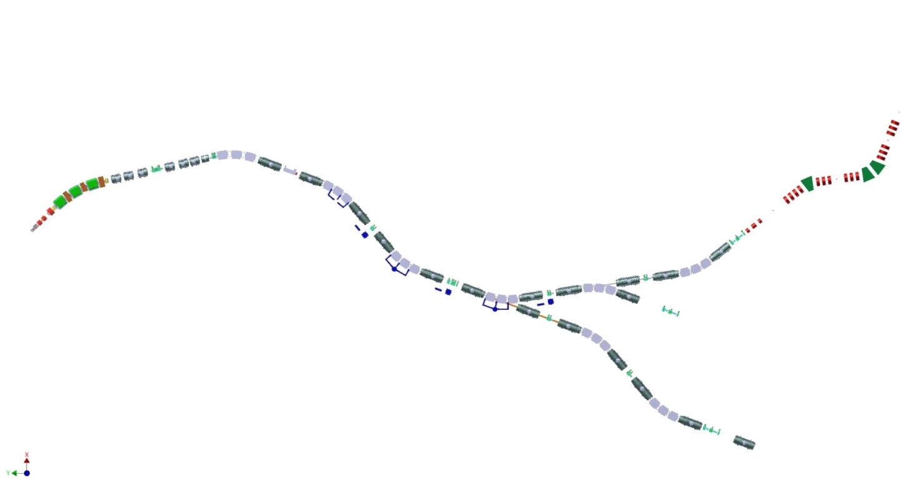
NUSTAR @ FAIR: Installations
Superconducting FRagment Separator
High-Energy Reaction Setup
Multi-Storage Rings (CR, NESR, eA)
Energy-Bunched Stopped Beams
MATS & LaSpec
HISPEC/DESPEC
R³B
Super-FRS
ILIMA
production
target
Key characteristics :
- all elements, H to U
- intensity > 10¹² ions/sec.
- high and low energies
- pulsed and CW beams

Slide 23
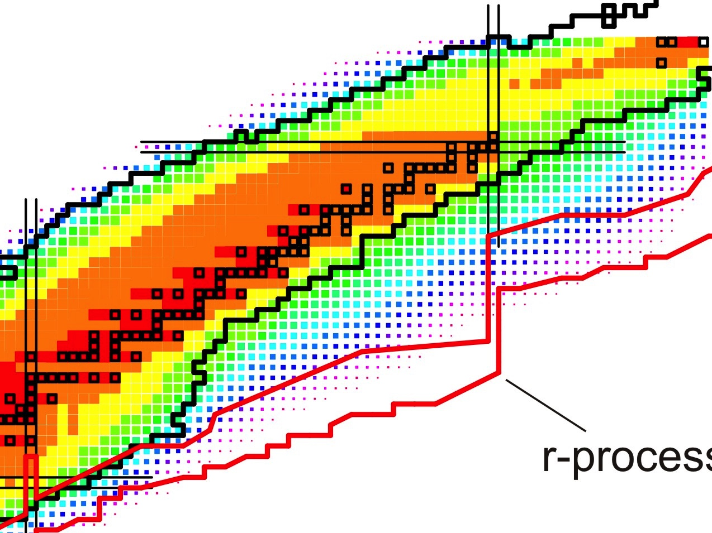
NUSTAR @ FAIR: Day-1
NUSTAR phases
Phase-0: R&D and experiments in existing facilities
Phase-1: First measurements with Super-FRS beams
Phase-2: Full “MSV” power
One example
GSI
Phase-0
Phase-1
Phase-2
3rd waiting point
r-process path
NUSTAR aims to measure:
-masses
-β-lifetimes
-neutron-branchings
-strength distributions
-level structure
Mass abundances depend on the detailed structure
of N=126 nuclei around the 3rd r-process waiting point

Slide 24
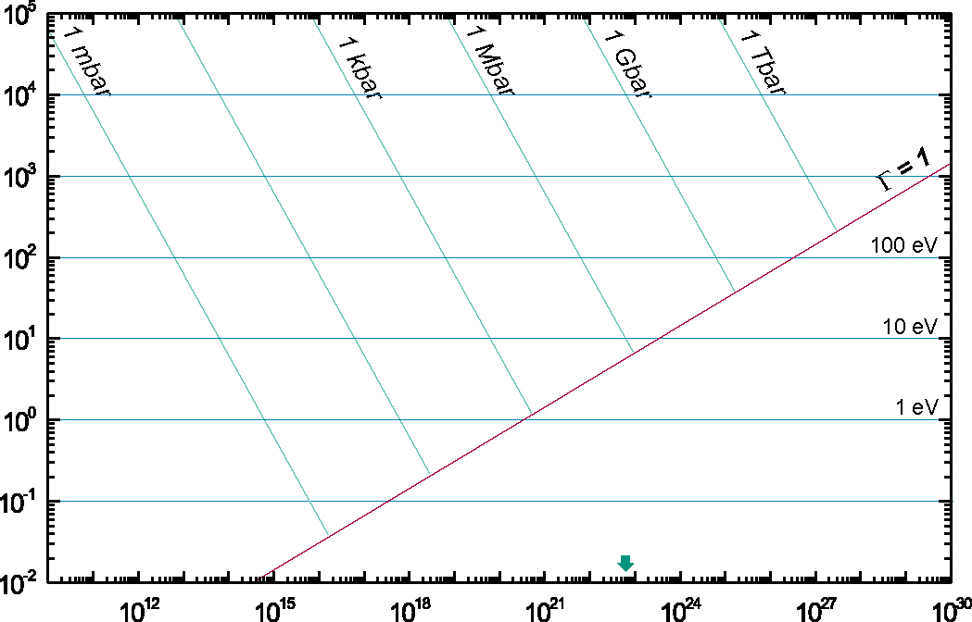
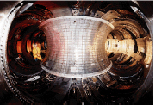
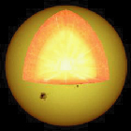
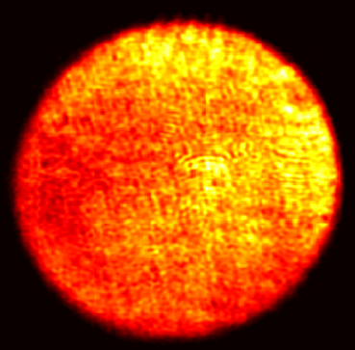
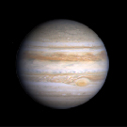
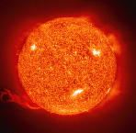
APPA - Plasmas
Magnetic Fusion
Inertial
Fusion
Energy
Temperature [eV]
XFEL
Sun Core
PHELIX
SIS
100
Laser
Heating
FLASH
Ideal plasmas
Ion Beam
Heating
Strongly coupled
plasmas
SIS 18
Jupiter
Sun Surface
solid state
density
Particles / cm⁻³
Notes:
24

Slide 25
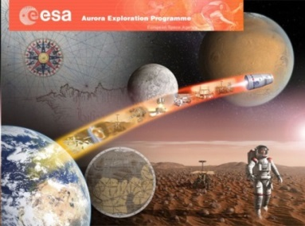
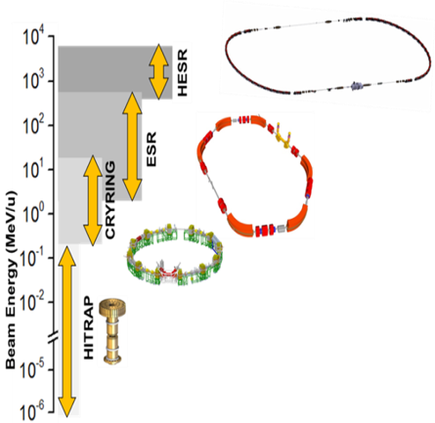
APPA– Day 1 (Examples)
BIOMAT (Biophysics and Materials Research)
Materials under extreme conditions (pressure, heat, irradiation)
Radiation shielding of cosmic radiation
Day-1 experiments @ APPA cave
  Sample irradiation using high pressure cells
  Irradiation of biological samples
HEDgeHOB/WDM (Plasma Physics)
Phase transitions shocked/compressed matter
Opacity measurements of Warm Dense Matter
Day-1 experiments @ APPA cave
  Proton microscopy of shocked/compressed materials
  Opacity changes from Cold- to Warm Dense-Matter
SPARC (Atomic Physics)
Precision test of QED in the strong field domain (αZ≈1)
Model independent determination of nuclear parameter
Day-1 experiments @ Storage Rings
  Ion channeling at APPA cave
  Laser spectroscopy at HESR (fine-structure)
  and at CRYRING (hyperfine)

Slide 26
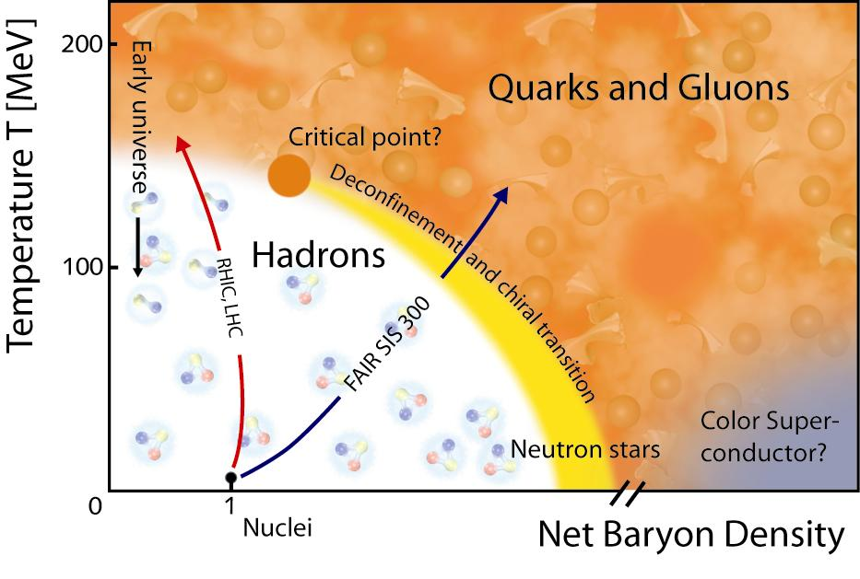
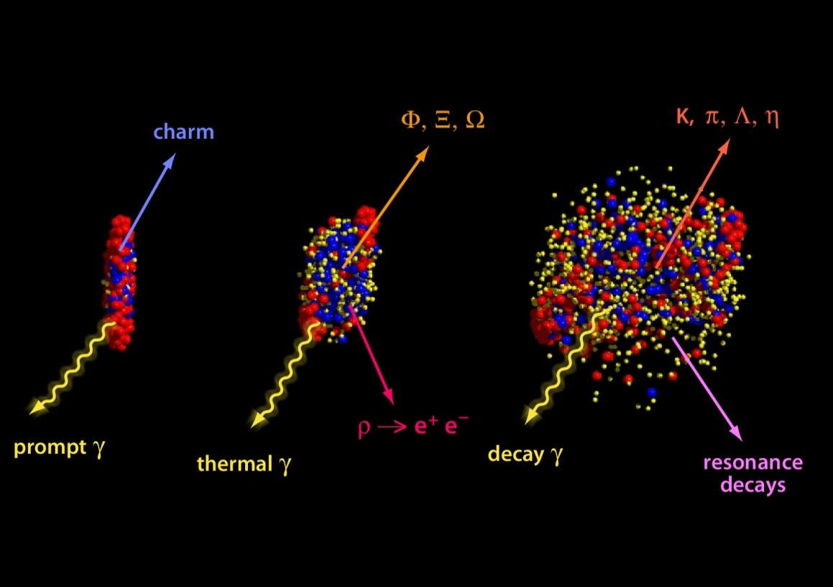
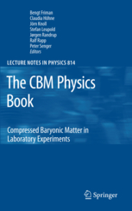
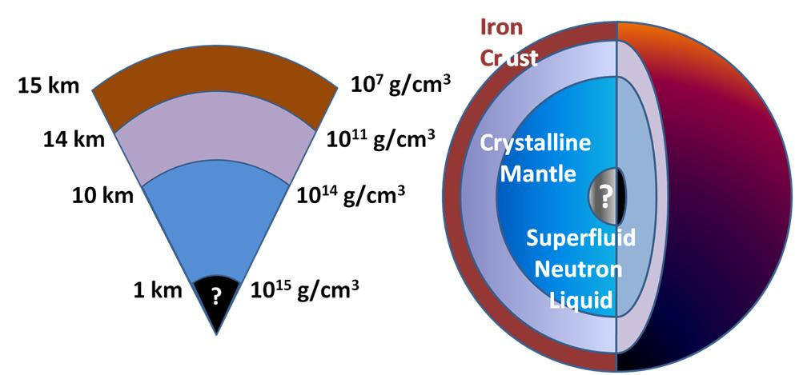
CBM: Exploring the phases of nuclear matter
Nuclear Equation-of-state at high density
Search for phase transitions
Search for the QCD critical endpoint
Study chiral symmetry restoration and
the origin of the hadron mass
Observables
neutron
star

Slide 27
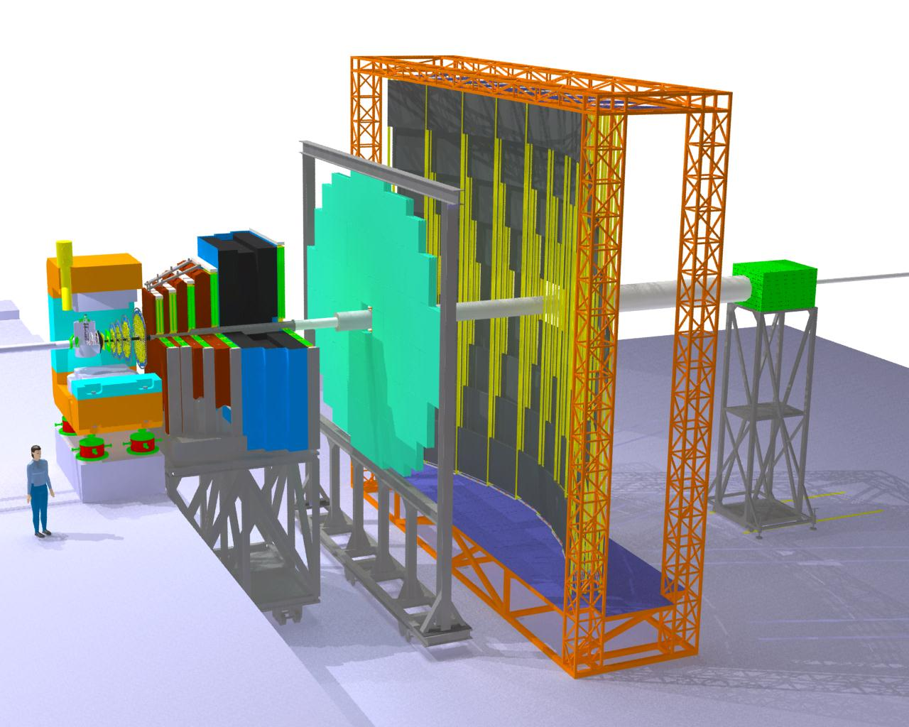
CBM at FAIR: Detector
Tracking
Detector
Projectile
Spectator
Detector
(Calorimeter)
Silicon
Tracking
System
Muon
detection
System
Micro
Vertex
Detector
Resistive
Plate
Chambers
(TOF)
Dipole
magnet

Slide 28
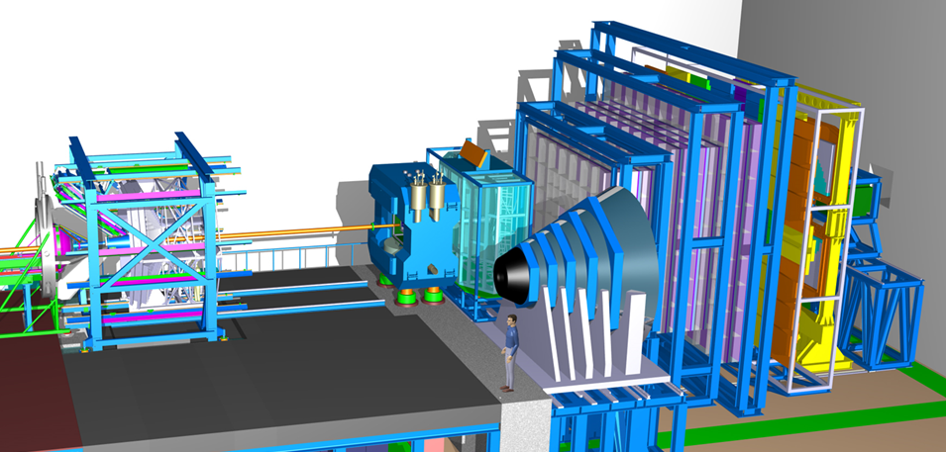
CBM at FAIR: Day-1 Equipment
HADES: p+p, p+A, A+A small collision systems
CBM: p+A, A+A all collision systems
Observables: Excitation function of yields and phase-space distributions of multi-strange hyperons and lepton pairs
→ Au+Au collisions from 2-11 A GeV (no data available in this energy range)

Slide 29


PANDA at FAIR: Detector
Particle ID
Forward
Tracking
Vertexing
Calorimetry
Barrel

Slide 30





PANDA at FAIR: Hadron Physics with Antiprotons
Hadrons in matter
Absorption
Modifications
QCD Bound States
Charmonium
Exotic States
arXiv:0903.3905v1
Non-pert. QCD Dynamics
Strangeness and
Charm Production
Hadron structure
DVCS
Formfaktors
Hypernuclei
Molecules
Exotic nuclei

Slide 31
Accessible Charmed Hadrons at PANDA
Other exotics with
identical decay channels → same regionc
p Momentum [GeV/c]
0
2
4
6
8
10
12
15
Two body
thresholds
ΛΛ
ΣΣ
ΞΞ
ΩΩ
DD
Λ_{c}Λ_{c}
Σ_{c}Σ_{c}
Ξ_{c}Ξ_{c}
Ω_{c}Ω_{c}
D_{s}D_{s}
Molecules
qqqq
ccqq
Gluonic
Excitations
Hybrids
nng,ssg
ccg
Hybrids+Recoil
nng,ssg
ccg
exotic
charmonium
Glueball
ggg,gg
Glueball+Recoil
ggg
qq Mesons
light qq
π,ρ,η,f₂,K,K*
cc
J/ψ, η_{c}, χ_{cJ}
conventional
charmonium
1
2
3
4
5
6
Mass [GeV/c²]

Slide 32

PANDA Detector ...
What we need

Slide 33




Status of FAIR: experiments detector R&D and construction well on track …
APPA
CBM
NUSTAR
PANDA
MUCH
TRD

Slide 34

FAIR Phase-0 – Beamtime 2018/19
up to 90 % speed of light
Accelerated ions: H⁺,..., U⁹²⁺
heavy-ion synchrotron
SIS 18
Experiment station
PHELIX
linear accelerator
UNILAC
M-branch
ion sources
Z6
Fragment Separator
HHT
storage ring ESR
8 % - 15 % speed of light
HITRAP
HADES, mCBM
External Cooperations Related to FAIR Phase-0
RIKEN, MSU, IMP/Lanzhou, BESIII/Beijing/IHEP, JLAB/Newport, RHIC/Brookhaven,Dubna
Cave A, M
Cave C (R3B)
CRYRING
GPAC: Beam time for FAIR Phase-0
149 experiments; more than 1000 scientists
Notes:
Message: whole OF India in constructing the FAIR Project

Slide 35












FAIR Phase-0 – Beamtime 2019
FRS
ESR
HITRAP
Cryring
SIS18
UNILAC
ESR
R3B
UNILAC / SIS18
CRYRING
PHELIX
TASCA
SHIP
HADES
Notes:
Message: whole OF India in constructing the FAIR Project

Slide 36
FAIR Project and Cost Review 2019
Evans-Report – Press Release April 30, 2019
The full 39-page report is publicly available via:
https://www.gsi.de/en/start/news/details/2019/04/30/expertengruppe_abschlussbericht_zum_fair_projekt0.htm
Here are some important statements from the executive summary related to the experiments:
“The FAIR Project is based on the scientific pillars APPA, CBM, NUSTAR and PANDA. Their programmes will enable unique and world leading discovery science. The breadth and reach of these programmes will remain unsurpassed at the planned start of FAIR operation in 2025 and for many decades beyond.”
“Delaying or reducing part of the MSV’s scope is not recommended, for scientific and also cost reasons. Interrupting and later resuming a part of civil construction would lead to very considerable additional cost and considerable obstruction of the use of the already working parts of the facility.”

Slide 37
Summary/Outlook
Despite of certain delays FAIR is progressing well.
Rich scientific program and discovery potential already with completion of Modularized Start Version.
FAIR will allow for unique measurements in many fields and remain competitive for decades.
Versatile detector configurations for optimal performance are under construction.
Day-one physics with start version for high interaction rates in preparation.
Strong and experienced international collaborations are active, more scientists expected to join in the coming years.

Slide 38
Thank you

