Slide 1

Correlated di-hadron production
Harut Avakian (JLab)
Jlab 7 March 2019
Introduction
Dihadron production on proton and deuteron
Simulations
Di-hadron multiplicities
Data MC comparison
The role of dihadrons in interpretation of single hadron observables
Correlated di-hadron production
Conclusions

Slide 2
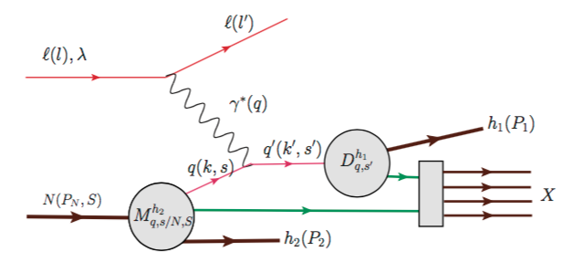
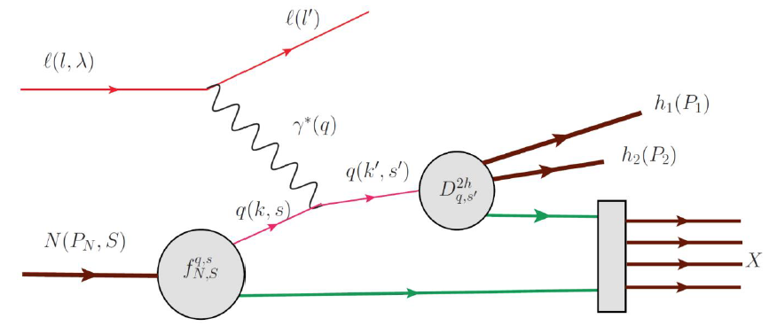

Di-hadron production in SIDIS
2h production in SIDIS provides access to correlations inaccessible in simple SIDIS (dihadron fragmentation, correlations of target and current regions, entanglement....)
Beam SSA provides access to quark helicity in SIDIS via dihadron correlations using the helicity-dependent dihadron fragmentation function (DiFF) .
Dedicated CLAS12 proposals: E12-06-112B/E12-09-008B

Slide 3
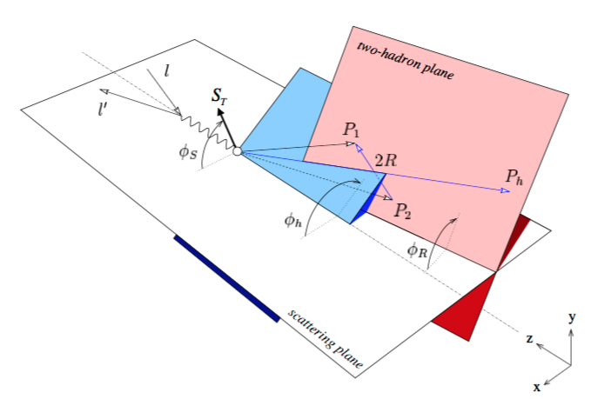
Correlated hadron production in hard scattering
2 hadrons in current fragmentation
hadrons in current & target fragmentation
With φ_{S}, φ₁, φ₂, φ_{R}, φ_{h} several observables have been identified to study correlations
φ_{R}−φ_{S}, φ_{R} -accessing transversity and quark-gluon correlations Radici & Bacchetta
φ_{R}−φ_{h} -accessing leading twist polarized fragmentation functions Matevosyan,Kotzinian,Thomas
φ₁−φ₂ -accessing correlations in current and target regions Anselmino, Barone, Kotzinian
Notes:
{\cal{F}}_{LU}^{\sin(\phi_1-\phi_2)}=\frac{\mid\vec{P}_{1\perp}\vec{P}_{2\perp}\mid}{m_Nm_2} {\cal{C}}[w_5M_L^{\perp,h}D_1]

Slide 4
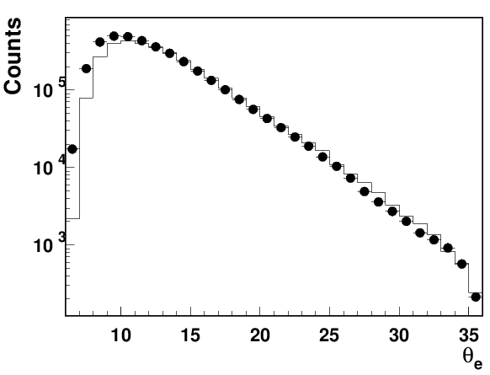
Generators for MC simulations
Full event generators (LUND-MC PEPSI, LEPTO)
Dedicated event generators for e’hhx (TMDGen T.Hayward)
Data(Run 6144,T-1,10.6GeV)

Slide 5
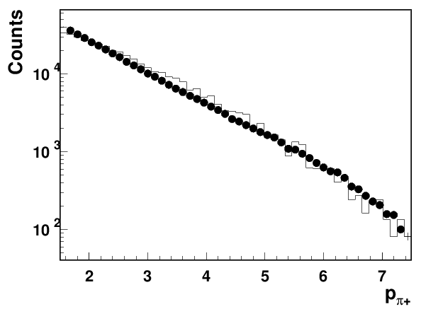
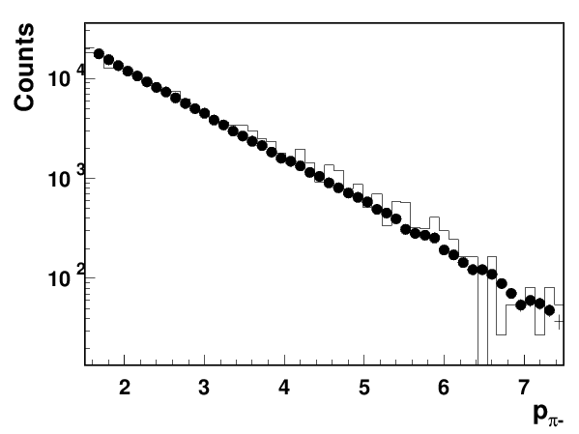
SIDIS ehX: Data(Run 6144,T-1,10.6GeV)
ep→e’hX (Data/MC normalized to number of electrons)
Pion counts for normalized e’X events consistent with clasdis

Slide 6
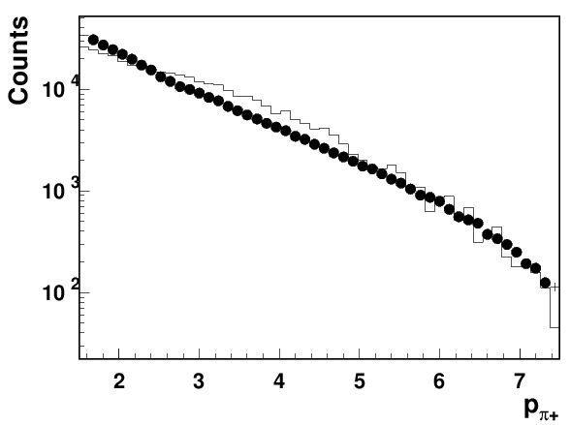
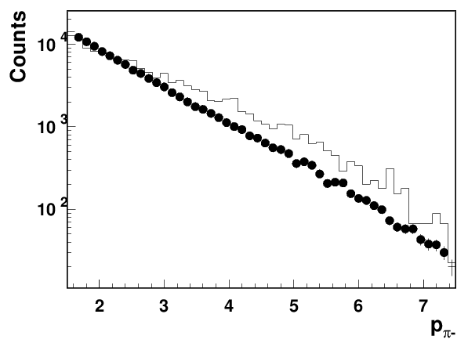
Correlated pairs: Data(Run 5038,T-1,10.6GeV)
ep→e’hX
Data/MC normalized by number of e’X events
Reasonable agreement for pi+ (apart from region 3<p<5)

Slide 7
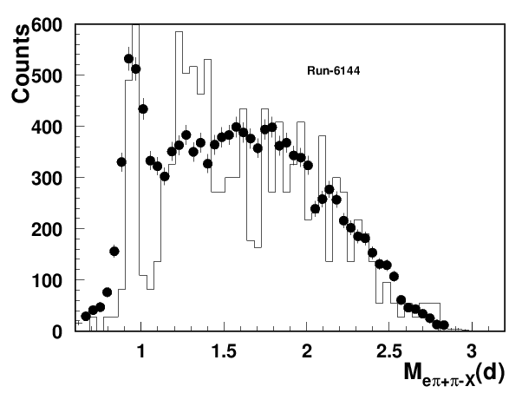
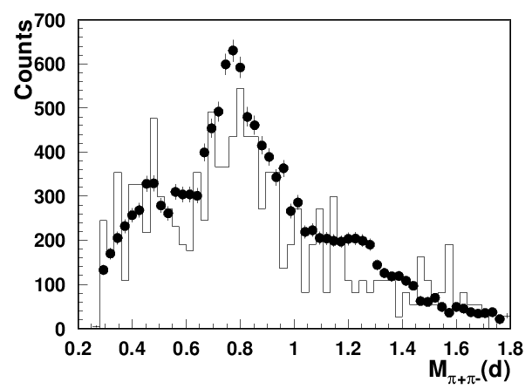
Correlated pairs: Data(Run 6144,T-1,10.6GeV)
ep→e’hX
Normalized to number of electrons pion pair multiplicities consistent with clasdis MC
Fraction of exclusive states may be significant

Slide 8
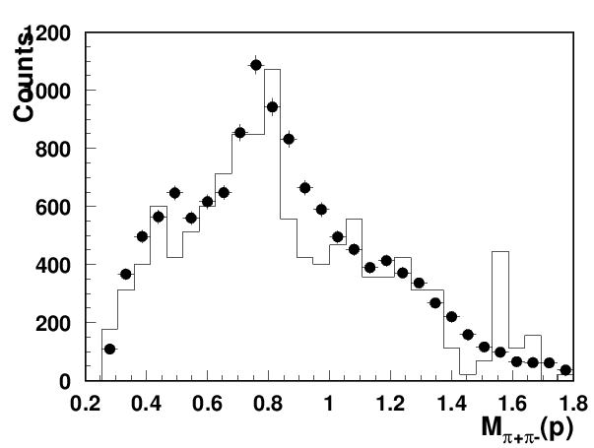
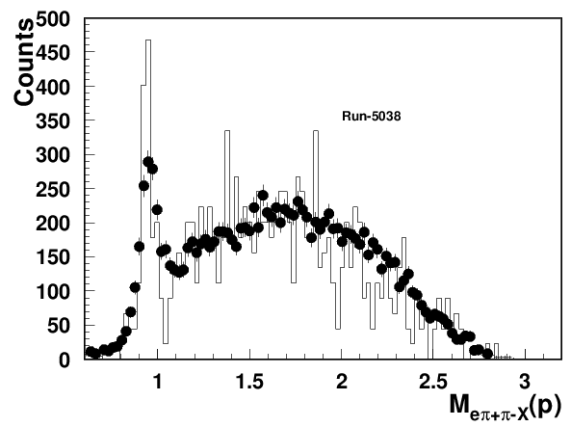
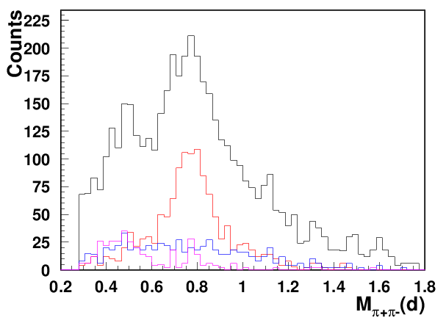
Correlated pairs: Data/MC(Run 5038,T-1,10.6GeV)
Data/MC normalization by number of reconstructed e’X events
ρ⁰
ρ⁺
5038
5038vsMC
ω
Fraction of exclusive pairs could be separated
Most of the pion pairs comes from SIDIS VM decays
  those are mostly SIDIS VM

Slide 9
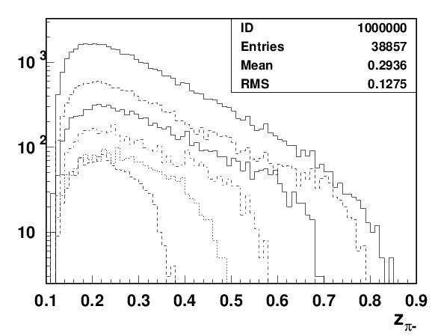
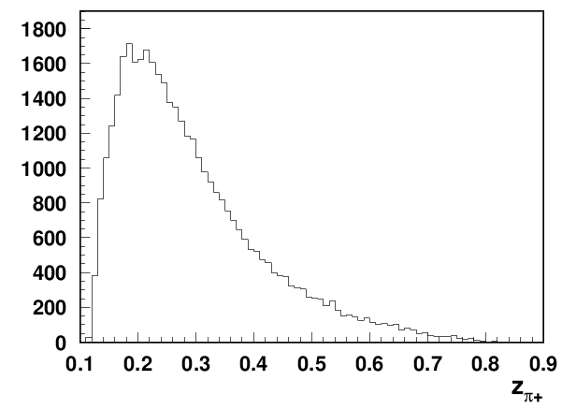
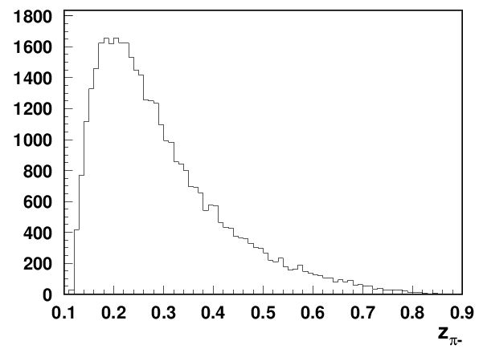
Correlated pairs: Data(Run 5038,T-1,10.6GeV)
ep→e’hhX
0.3<z<0.4
04<z<0.5
z>0.6
0.5<z<0.6
0.2<z<0.3
Similar z-distributions for dihadrons

Slide 10
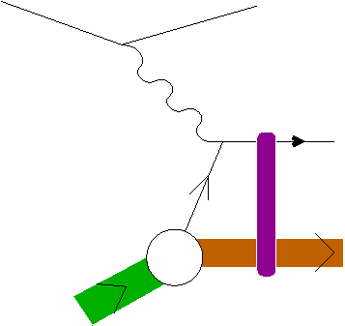
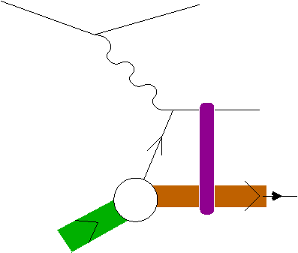
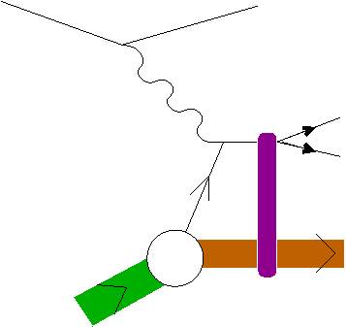
Sources of inclusive hadron electro-production
with additional radiation
single hadron in CFR
single hadron in CFR
radiation mixes contributions from different structure functions and complicates separation of exclusive from semi-inclusive
h₁
h₁
single hadron in TFR
single hadron in TFR
Does it matter what is the source of the single hadron, and if yes, where?
h₁
h₁
correlated hadrons(dihadron,rho,..) in CFR
correlated hadrons(dihadron,rho,..) in CFR
h₁
h₂
h₁
h₂

Slide 11
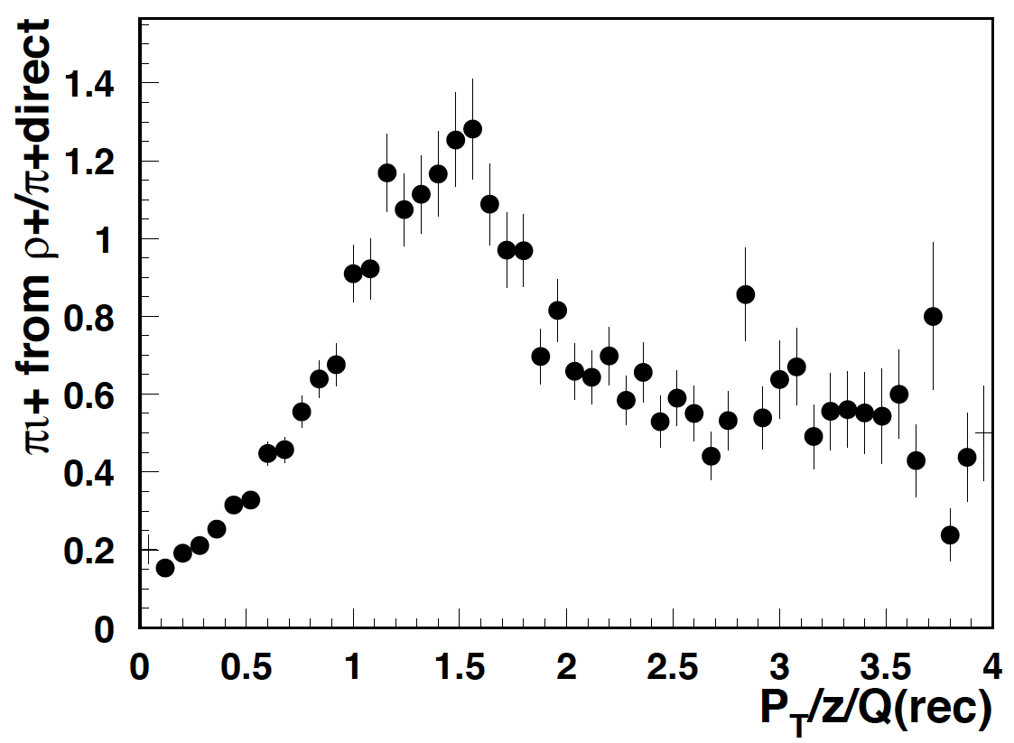
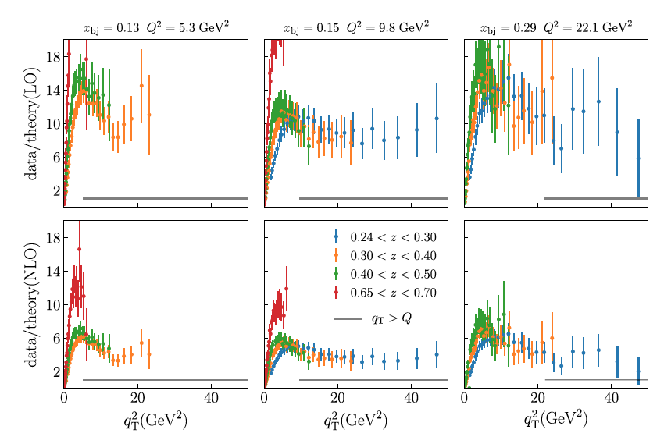

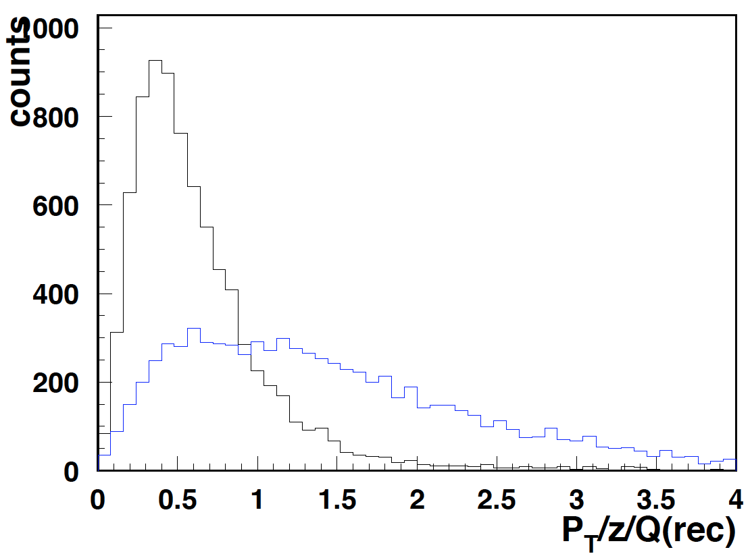
Does it matter if the pion comes from correlated pairs?
quark transverse momentum
q_{T} =P_{T}/ z_{ρ}
Q²>2
perturbative?
q_{T}=P_{T}/ z_{π}
The measurements disagree with leading order and next-to-leading order calculations most significantly at the more moderate values of x close to the valence region.
understanding the fraction of pions from “correlated dihadrons” will be important to make sense out of qT distributions
Gonzalez-Hernandez et al, PRD 98, 114005 (2018)

Slide 12



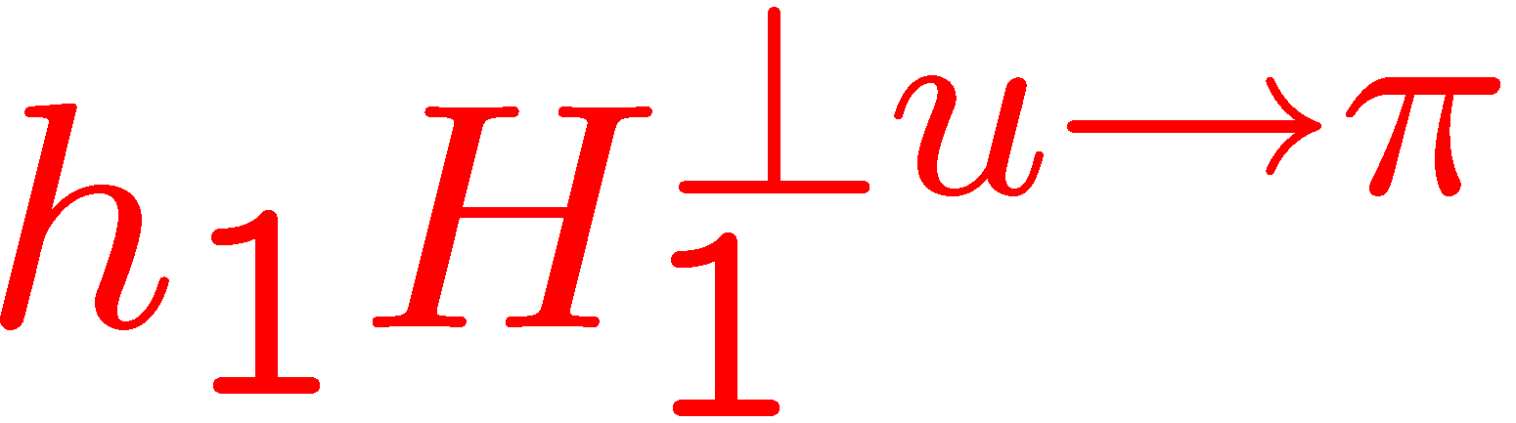
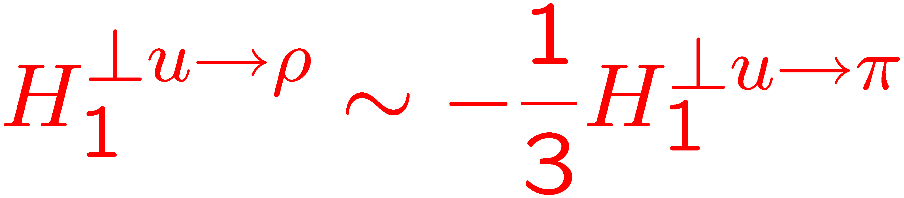
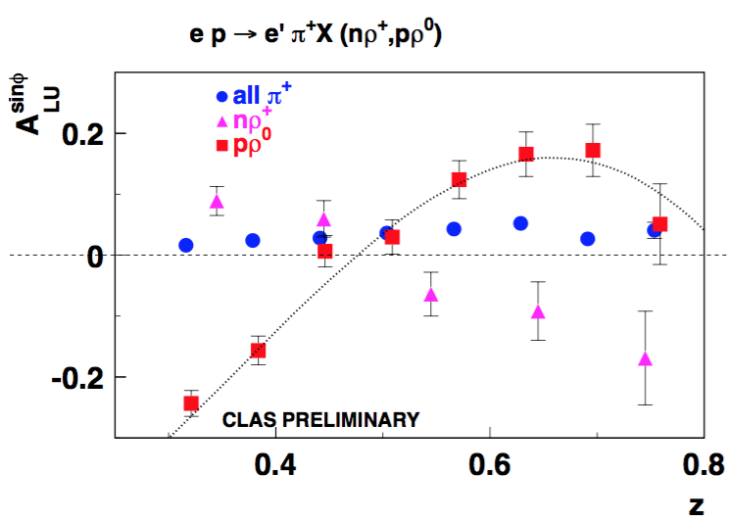
Collins effect
π⁺
leading pion out of page
Simple string fragmentation for pions (Artru model)
z
L
Leading ρ opposite to leading π(into page)
ρ production may produce an opposite sign A_{UT}
z
ρ
L
hep-ph/9606390
Fraction of ρ in eπX | % left from eπX asm
20% 40% | ~75% ~50%
π+π⁰
Pions from rho decays may require special treatment for understanding of certain observables
π+π−
12

Slide 13
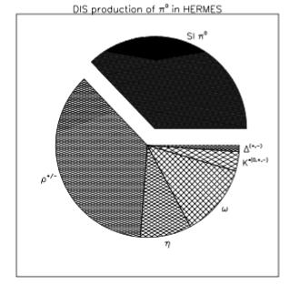
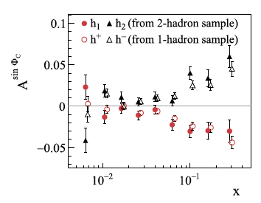
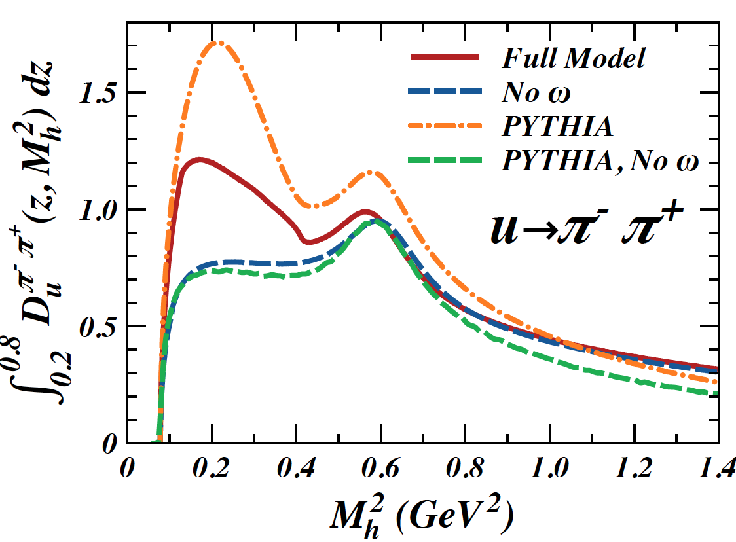
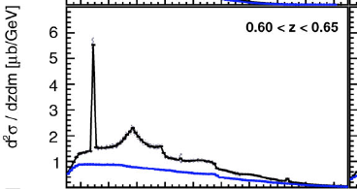

Dihadron production
What is the origin of dihadrons?
What is a single hadron?
COMPASS: arXiv:1507.07593
R. Seidl et al. arXiv: 1706.08348
Matevosyan et al, arXiv:1312.4556

Slide 14
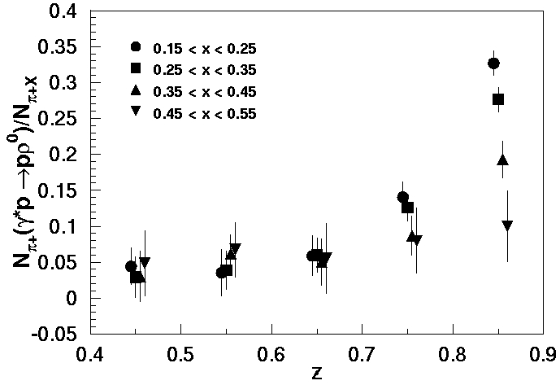
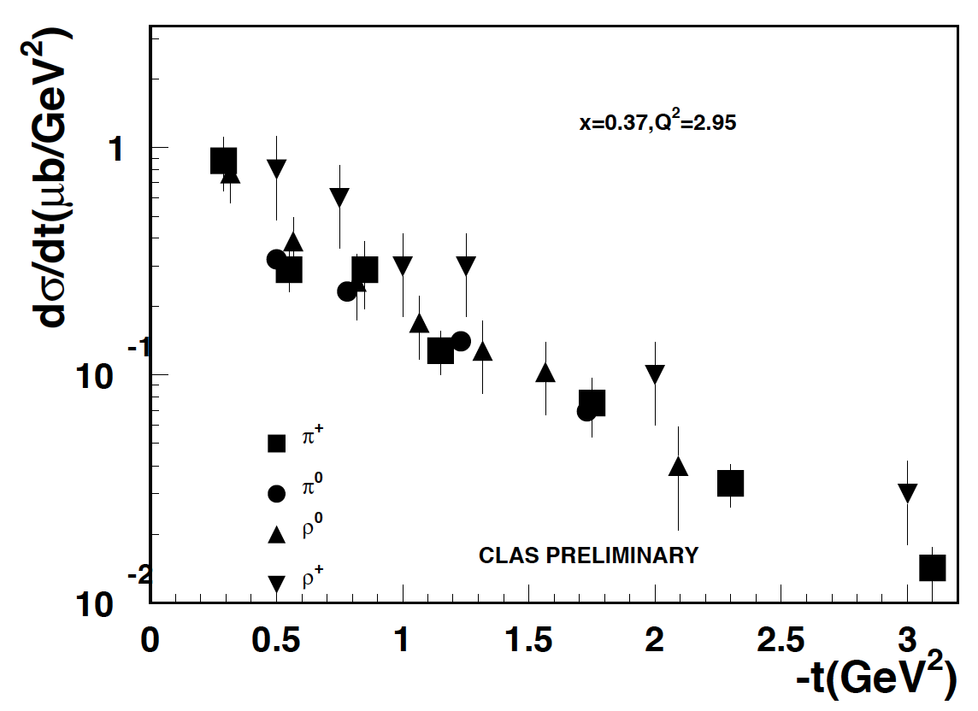
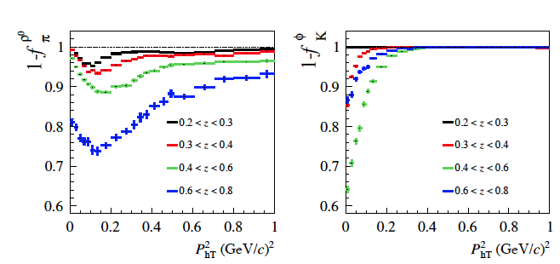
Dihadrons and Vector meson contributions
Should we worry about pions/kaons coming from vector meson decays?
What about ρ+ and ρ-
What do we know about relevant observables for pions specifically coming from vector meson decays
What about SIDIS rhos (can we measure?)
What is radiative correction due to rho?
Vector meson as resonance in dihadron production?
Hard exclusive meson production from clas6
COMPASS:1709.07374

Slide 15
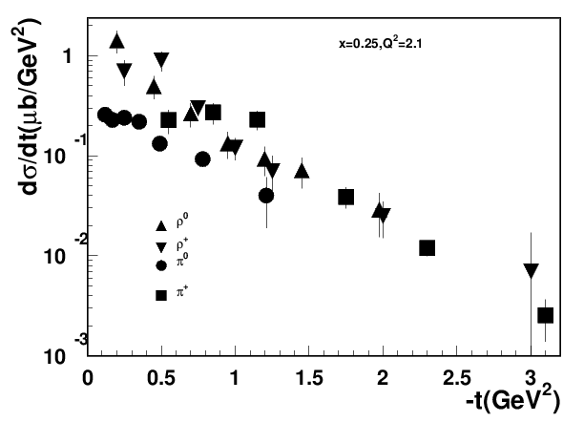
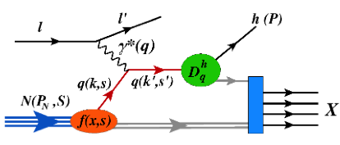
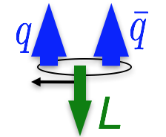
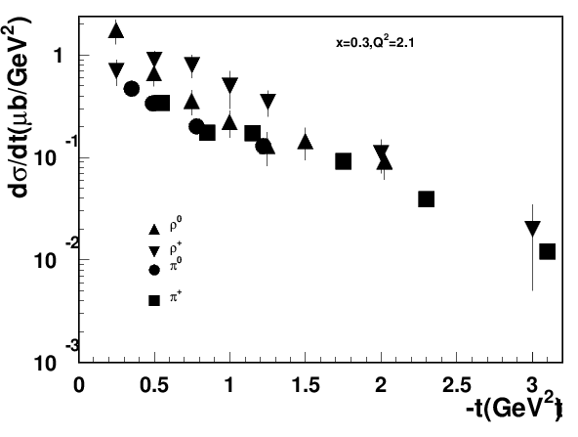
Exclusive π/ρ production at large t
p,n
CLAS PRELIMINARY
Implications
x-section of measured exclusive process at large t exhibit similar pattern
ρ+>ρ⁰ →Diffractive production suppressed
at large t production mechanism most likely is similar to SIDIS
Slightly higher rho x-sections indicate the fraction of SIDIS pions from VM > 60%
consistent with LUND-MC in fraction of pions from rho
…......
CLAS PRELIMINARY

Slide 16
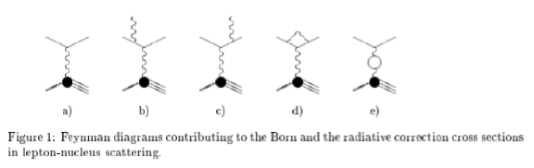
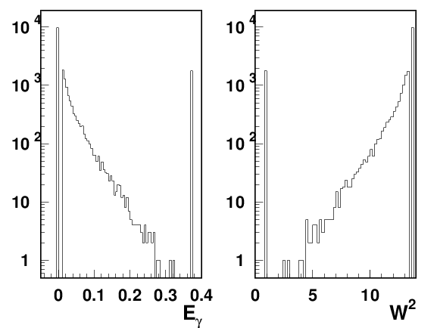
Radiative DIS
Akushevich et al. http://www.jlab.org/RC/radgen/
For SIDIS may need ρ x-sections in the full W range, including exclusive part
generate a single kinematical point at 10.6 GeV with e’=2.5 GeV, θ=0.3
→ x,y,Q²,W²(0.16,0.76,2.38,13.75)
Integrated over all Eγ σ_{Rad}/σ_{Born}=1.425
original W²

Slide 17
SUMMARY
CLAS12 (Fall) proton and deuteron (Spring) data compared with clasDIS MC based on the LUND string fragmentation
Exclusive di-hadrons can be separated and used for data analysis (also calibration)
Understanding exclusive production of hadrons, in particular, at large t, where they show similar behavior, will be important for SIDIS
The interpretation of di-hadron production in SIDIS, as well as interpretation of single-hadron production is intimately related to contributions to those samples from correlated semi-iclusive and exclusive di-hadrons in general, and vector mesons, in particular.
CAA: Propose multiplicity measurements of exclusive dihadrons π⁺π⁰,π⁺π⁻,π⁻π⁰ from RGA/RGB (JLab,Duke,LNF,Ferrara,Tunisia,…)

Slide 18
Support slides

Slide 19
Event generators for DIS/SIDIS/HEP studies
Main classes of event generators:
a)Full event generators where sets of outgoing particles are produced in the interactions between two incoming particles and a complete event is generated
Applications: attempt to reproduce the raw data
understand background conditions
estimating rates of certain types of events
planning and optimizing detector performances,…
b) Specific event generators (single hadron, di-hadron, DVCS…) , where only the final state particles of interest are generated
Applications: providing fast tests of analysis procedures with relatively simple integration of different input models.
developing analysis frameworks.
1) Providing events with cross section
2) Phase space with realistic x-sections provided as weight factors
+unfolding measured data for acceptance and detector resolution effects
3) Easier implementation of Radiative Effects

Slide 20
3D PDF Extraction and VAlidation (EVA) framework
SIDIS,DY,e+/e-)
experiments
Hard Scattering MC (GEANT, FASTMC,…)
EVA/TED meetings at JLab to finalize goals and coordinate efforts
event selection
e’hX, e’hhX,..
Grid operations
QCD fundamentals
Library for Structure Function (SF) calculations
3D PDF and FF (models,
parametrizations)
Radiative
x-section
x-section calculations
SF calculations
Data Counts
(x-sections, multiplicities,….)
Defined set of assumptions
Defined set of assumptions
Extract 3D PDFs
extract
x-section
Extract SFs
Validation of extracted SFs or 3D PDFs (for a given set of assumptions)
Development of a reliable techniques for the extraction of 3D PDFs and fragmentation functions from the multidimensional experimental observables with controlled systematics requires close collaboration of experiment, theory and computing

Slide 21
Event generators for DIS/SIDIS/HEP studies
https://github.com/JeffersonLab/clasdis-nocernlib
https://github.com/JeffersonLab/inclusive-dis-rad
https://github.com/JeffersonLab/dvcsgen
….....
More generators announced
Exclusive 2 pion
HEPGEN /group/gpd/sidis/hepgen/
Manual:
http://project-gpd-full-chain-mc.web.cern.ch/project-gpd-full-chain-mc/hepgen/
-- single photon production (DVCS + BH)
-- exclusive π⁰ production and decay π⁰ → γ + γ
-- exclusive ρ⁰ production and decay ρ⁰ → π⁺ + π⁻
-- exclusive φ production and decay φ → K⁺ + K⁻
-- exclusive ω production and decays ω → π⁺ + π⁻ + π⁰
⁻⁻⁻ exclusive ρ⁺ production and decay ρ⁺ → π⁺ + π⁰,
-- exclusive J/ψ production and decays J/ψ → e⁺ + e⁻ or J/ψ → μ⁺ + μ⁻
Radiative corrections for all relevant processes should be done with MC generating a radiative photon with account of proper SF set involved.

Slide 22
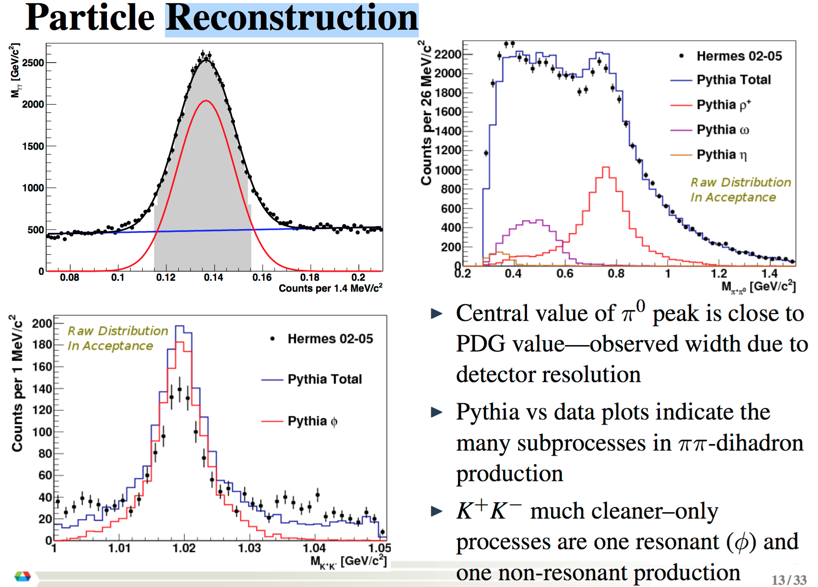
HERMES dihadrons

Slide 23
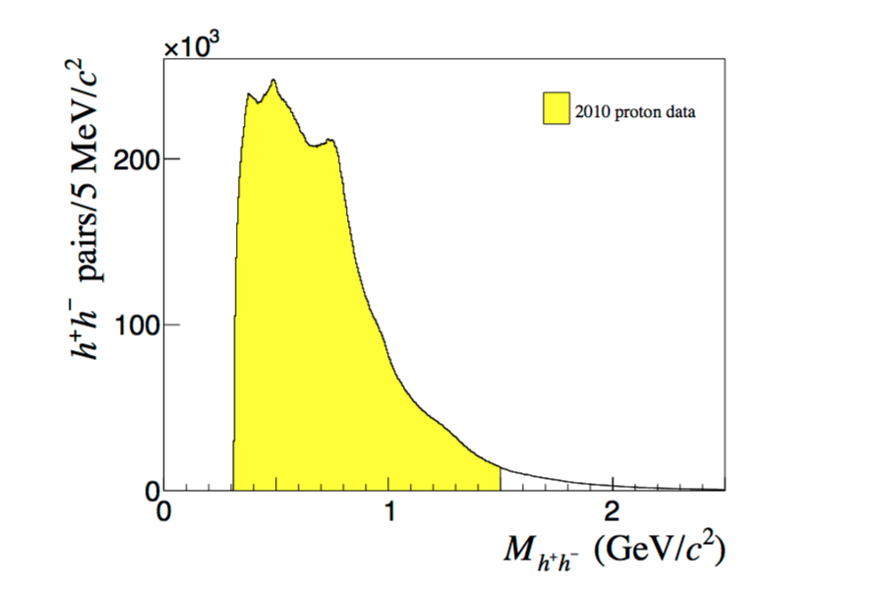
COMPASS dihadrons
Higher energy, higher the probability to pick up pions from different rhos

Slide 24
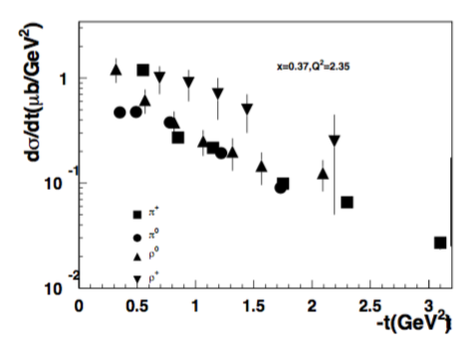
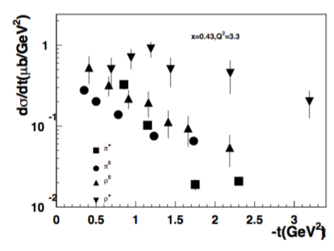
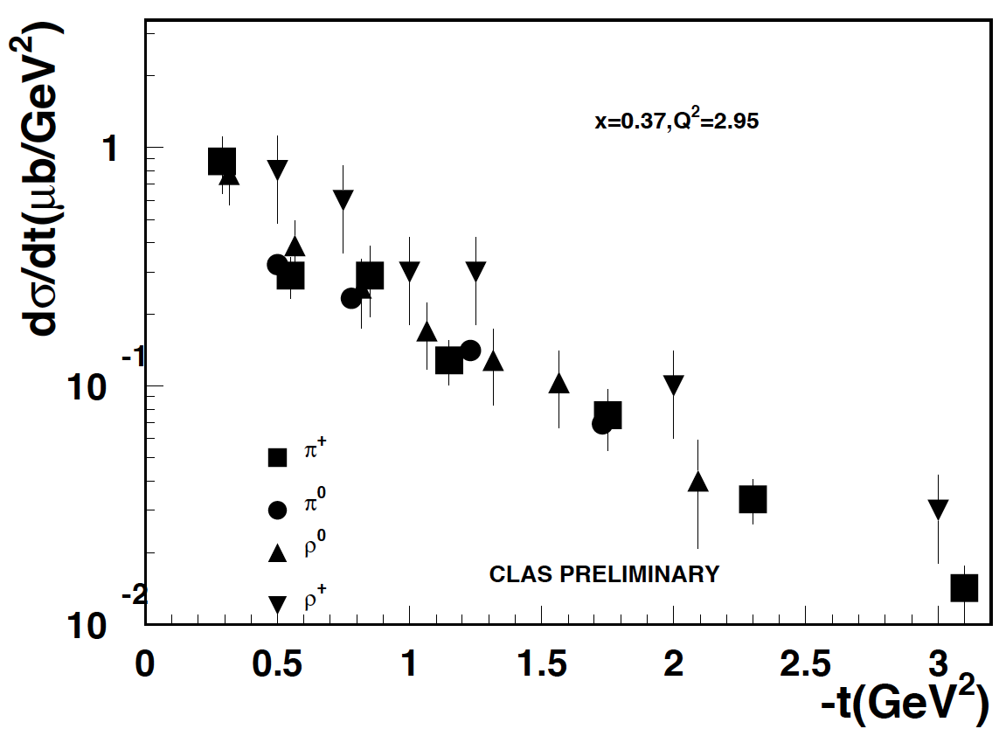
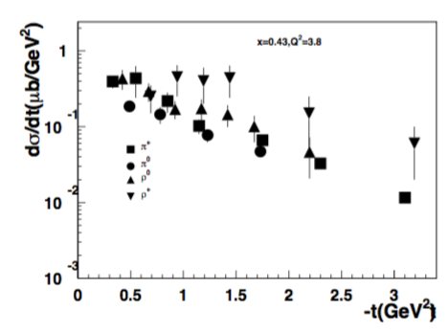

Slide 25
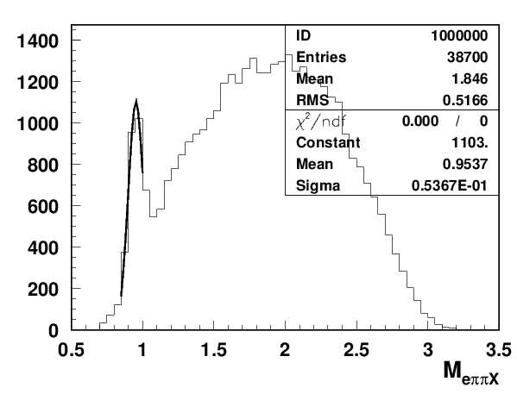
Correlated pairs: Data/MC(Run 5038,T-1,10.6GeV)
Data/MC normalization by number of reconstructed e’X events
ρ⁰
ρ⁺
5038
5038vsMC
ω
Fraction of exclusive pairs could be separated
Most of the pion pairs comes from SIDIS VM decays
  those are mostly SIDIS VM

Slide 26
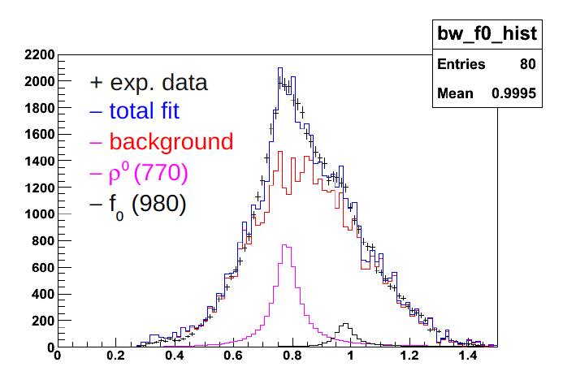
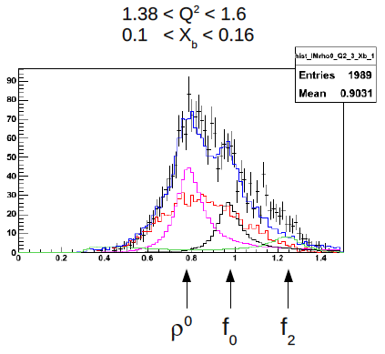
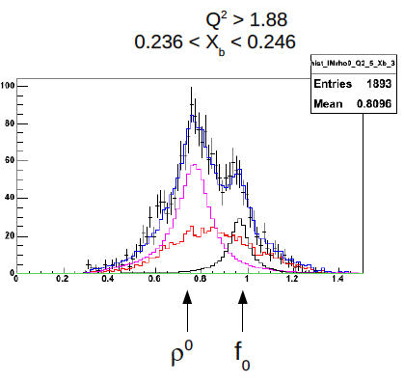
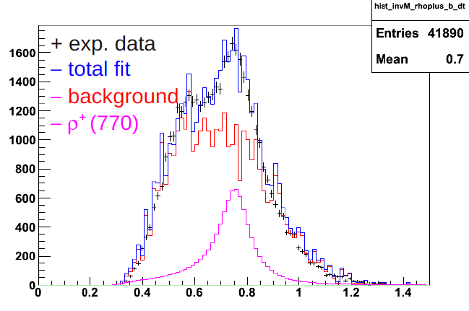
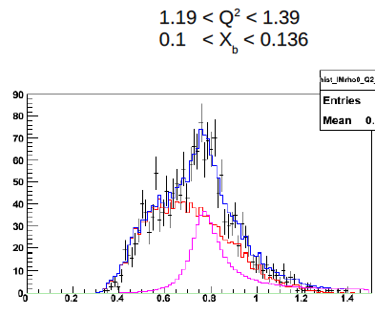

Dihadron simulations with LUND-MC @6 GeV

Slide 27

Beam SSA for single pions
diff of <sin>
<sin>⁺
-<sin>⁻
fit to φ-dep
sum of <sin>
Significant beam SSA generated for single pions by the dihadron SSA input

Slide 28


Resonant vs Non-resonant Contributions in π⁺π⁻p
Electroproduction off Protons
Q² =2.20 GeV²
Q² =3.20 GeV²
Q² =4.20 GeV²
Opening of ρp, π⁺N⁰(1680)5/2⁺, π⁺N⁰(1520)3/2⁻ meson-baryon channels results in sharp growth of the non-resonant contributions at 1.65 GeV<W<1.75 GeV into π⁺π⁻p electroproduction off proton cross sections
Opening of several meson-baryon channels at 1.65 GeV<W<1.75 GeV causes increase of the non-resonant contributions into inclusive structure functions in the aforementioned W-range seen from the data (slide # 24)

Slide 29

Extracting beam SSA: cross check
Input asymmetry
Generated curves in reasonable agreement with extraction
Small systematic difference (likely from acceptance) under investigation

Slide 30

MC Generator to simulate SIDIS output
SIDIS MC in 7D (10D)
p┴
Theory
Provide a set of SF_{l}
step-1
For a given model/theory based on underlying non-perturbative input and assumptions calculate SF_{l}
step-2 (for a given E_{beam},λ,Λ)
step-3 (detected for a given Detector configuration)
Need criteria to compare the input and output parameter spaces (validate)
Notes:
$\frac{d\sigma_{\lambda\Lambda}^{eN \rightarrow e^\prime h X}}{dxdQ^2 dz dP_{hT}^2 d\phi_h d\phi_l d\phi_s}$

Slide 31


Slide 32



Additional complications: Experiment covers ranges described by different SFs
Boglione et al, Phys.Lett. B766 (2017) 245-253
Kinematics covers regions with different fractions from target and current fragmentation
JLab12
Understanding of the scale of ignored contributions (M/Q²,P_{T}/Q², Target/Current correlations,…) will define the limits on precision for other involved contributions (ex. evolution).
more CFR more TFR
CM
Breit
Multidimensional bins (x,y,z,P_{T},φ) are crucial for separation of different contributions

Slide 33

pi0s
https://arxiv.org/pdf/1512.05379.pdf

Slide 34


B2B hadron production in SIDIS: First measurements
M. Anselmino, V. Barone and A. Kotzinian, Physics Letters B 713 (2012)
Asymmetry transverse momentum dependence (linear with P_{Tπ}P_{Tp} ) consistent with theory prediction
Notes:
{\cal{F}}_{LU}^{\sin(\phi_1-\phi_2)}=\frac{\mid\vec{P}_{1\perp}\vec{P}_{2\perp}\mid}{m_Nm_2} {\cal{C}}[w_5M_L^{\perp,h}D_1]

Slide 35


Production mechanism

Slide 36




Non-perturbative distributions
L
Non-perturbative sea in nucleon is a key to understand the nucleon structure
-- Large flavor asymmetry as evidence
provides a hint for region where non-perturbative effects will be significant
Predictions from dynamical model of chiral symmetry breaking [Schweitzer, Strikman, Weiss JHEP 1301 (2013) 163]
-- k_{T} (sea) >> k_{T} (valence)
-- short-range correlations between partons (small-size q-qbar pairs)
-- directly observable in P_{T}-dependence of hadrons in SIDIS
“Pion tornado”?
spin and momentum of struck quarks are correlated with remnant
correlations of spins of q-q-bar with valence quark spin and transverse momentum will lead to observable effects
Non-perturbative sea most relevant for x>0.01, more for 0.1<x<0.2

Slide 37




Back-to-back hadron (b2b) production in SIDIS
P₁
Leading Twist
M. Anselmino, V. Barone and A. Kotzinian, Physics Letters B 713 (2012)
P₂
The beam–spin asymmetry appears, at leading twist and low transverse momenta, in the deep inelastic inclusive lepto-production of two hadrons, one in the target fragmentation region and one in the current fragmentation region.
Back-to-back hadron production in SIDIS would allow:
study SSAs not accessible in SIDIS at leading twist
measure fracture functions
control the flavor content of the final state hadron in current fragmentation (detecting the target hadron)
study entanglement in correlations in target vs current
access quark short-range correlations and χSB (Schweitzer et al)
...
Notes:
{\cal{F}}_{LU}^{\sin(\phi_1-\phi_2)}=\frac{\mid\vec{P}_{1\perp}\vec{P}_{2\perp}\mid}{m_Nm_2} {\cal{C}}[w_5M_L^{\perp,h}D_1]

