Slide 1
High Crimes and Misdemeanors In Data Analysis
by
Douglas W. Higinbotham

Slide 2
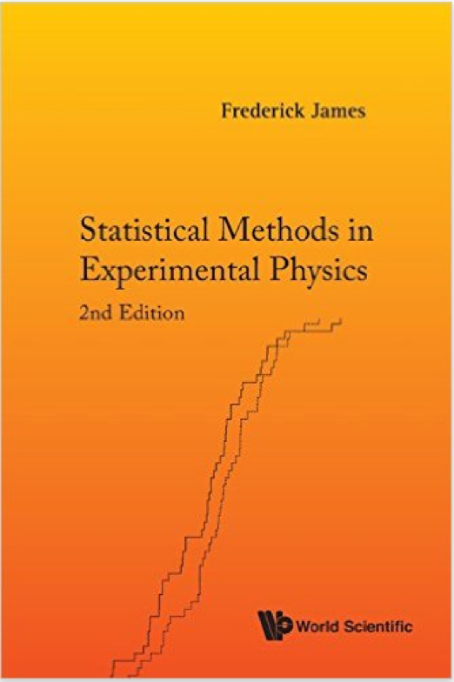
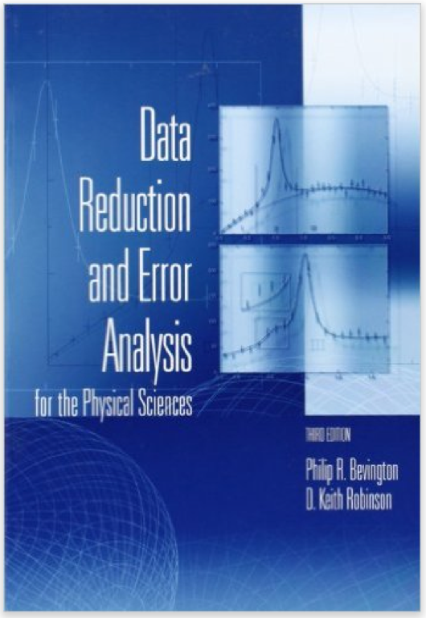
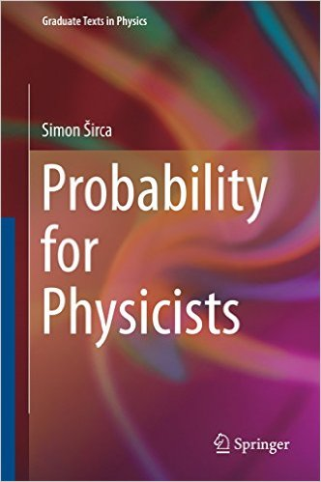
Did anyone here have a class with one of these textbooks?
( if not, did you have a class on these topics with another book?)

Slide 3
Hopefully A Fun Talk, But Hopefully One That Gets You To Think
How many of you have reported errors from MINIUT?
How many of you have read the note interpretation of errors from MINIUT?
16 page write-up ( three links since not archival ) [ I read this in 2014 … ]
  http://lmu.web.psi.ch/docu/manuals/software_manuals/minuit2/mnerror.pdf
  https://wiki.hepg.sdu.edu.cn/doc/cernlib/mnerror.pdf
  http://seal.cern.ch/documents/minuit/mnerror.pdf
I also remember doing my first fit as a student at NIKHHEF [ 1996 ] with MINIUT and being happy that I had gotten it to run.
I also remember seeing A LOT of numbers go by that I didn’t understand and being told not to worry about it since my 𝝌² was “good”.

Slide 4
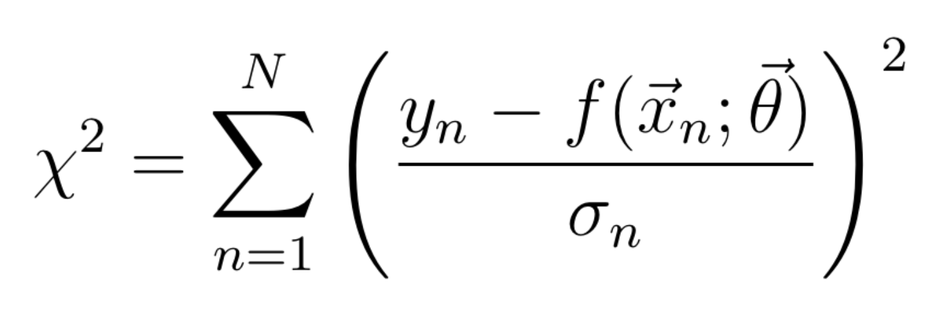
What’s a nuclear physicist need to know about fitting?!
Where you have data y with uncertainness 𝛔_{n} at different values of x_{n} fit to a function f with parameters 𝛳.
Just fit until you get total χ² divided by number of degrees of freedom < 1 and your good!
And knowledgeable physicists love to add terms to 𝛳 and make fun of those who have less terms then them)
What could possibly go wrong?!
What if the weights (sigma’s) are underestimated or overestimated?
What if I have the wrong mode?
What if the data aren’t normally distributed?
How do you get the number of degrees of freedom if you do a non-linear regression?
What if average reduced χ² is good, but one over-fits one area and under-fits another?
What are the number of degrees of freedom in a non-linear model? (see https://arxiv.org/abs/1012.3754 )
( It is not trivial and just getting a reduced χ² ~ 1 does not mean you have a good result! )

Slide 5
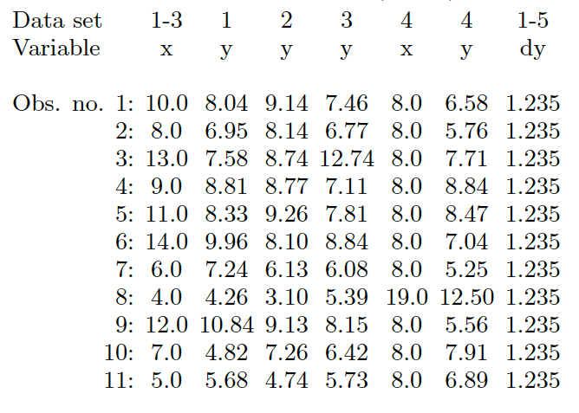
Anscombe's Quartet
F. J. Anscombe, The American Statistician 27 (1973) 17 with added dy terms.

Slide 6
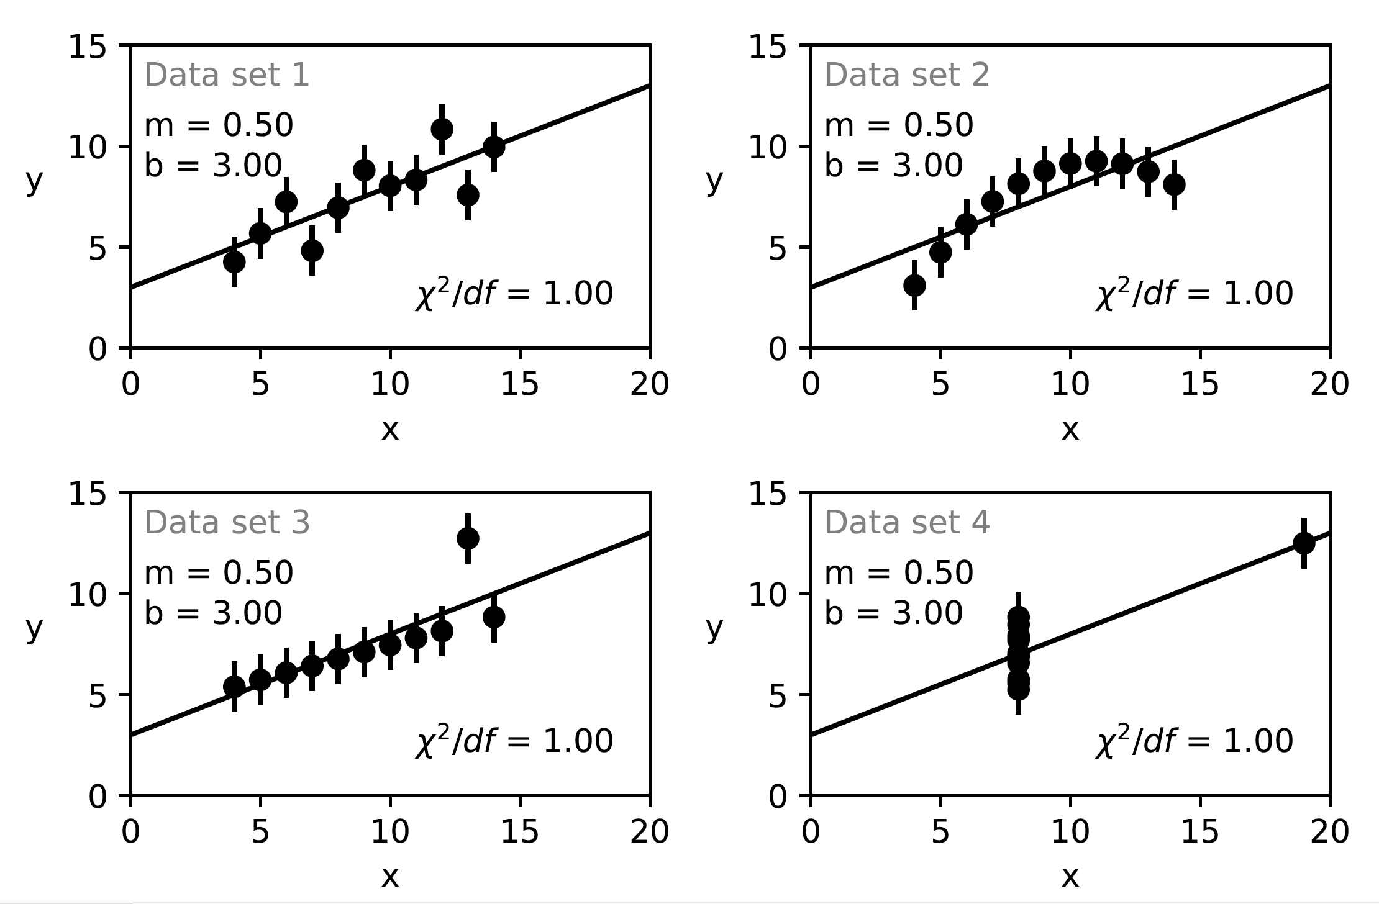
When fit with a linear function, Slope, Intercept, 𝝌², etc. are all the same.
NOTE: Standard error assumes that the data are normally disturbed about the fit function.
https://arxiv.org/abs/1812.05706
Details in appendix of https://arxiv.org/abs/1812.05706

Slide 7
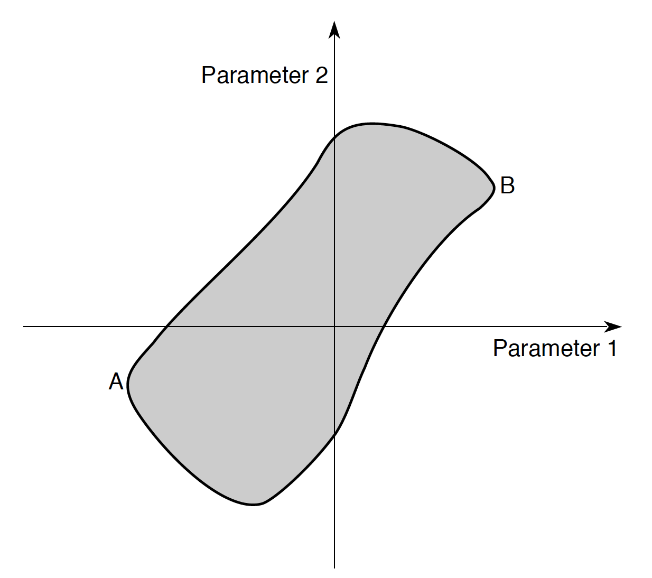
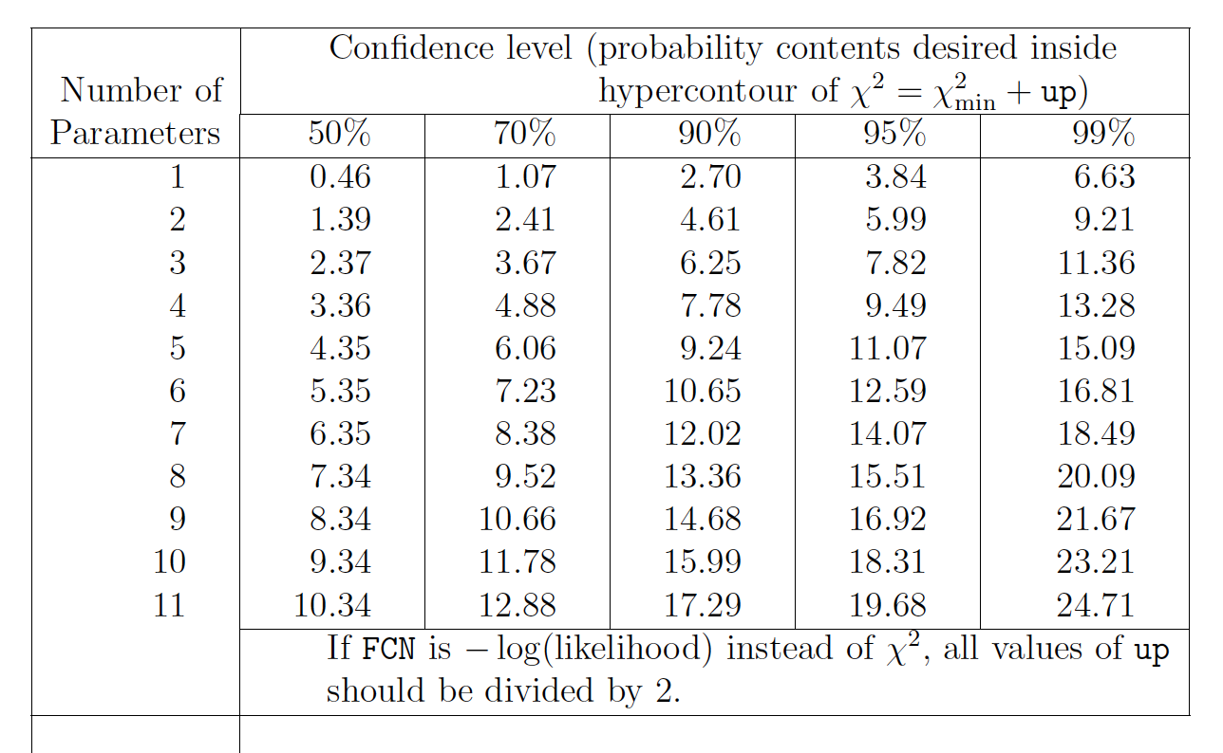
Multivariate Errors
As per the particle data handbook, one should
be using a co-variance matrix and calculating the
probably content of the hyper-contour of the
fit. Default setting of Minuit of “up”(often call Δχ2 )is one.
Also note standard Errors often underestimate true
uncertainties. (manual of gnuplot fitting has an
explicate warning about this)
The Interpretation of Errors in Minuit (2004 by James)
http://seal.cern.ch/documents/minuit/mnerror.pdf
In ROOT: SetDefaultErrorDef(real #)
Default is 1 and doesn’t change unless you change it!
SHOW COIN EXAMPLE

Slide 8
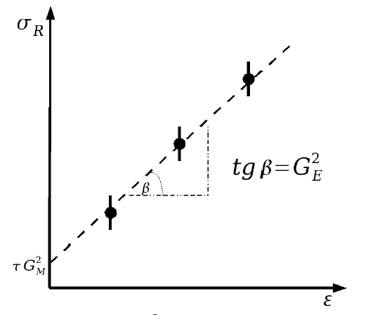
Rosenbluth Separation
unpolarized beam on unpolarized target, cross section measurement.
Method: Vary at fixed Q², fit linearly
Slope G²_{E}
Intercept G²_{M}
When you run your regression in MINUIT it uses “up” of 1 by default
In other words, each uncertainty is calculated without regards to other values.

Slide 9
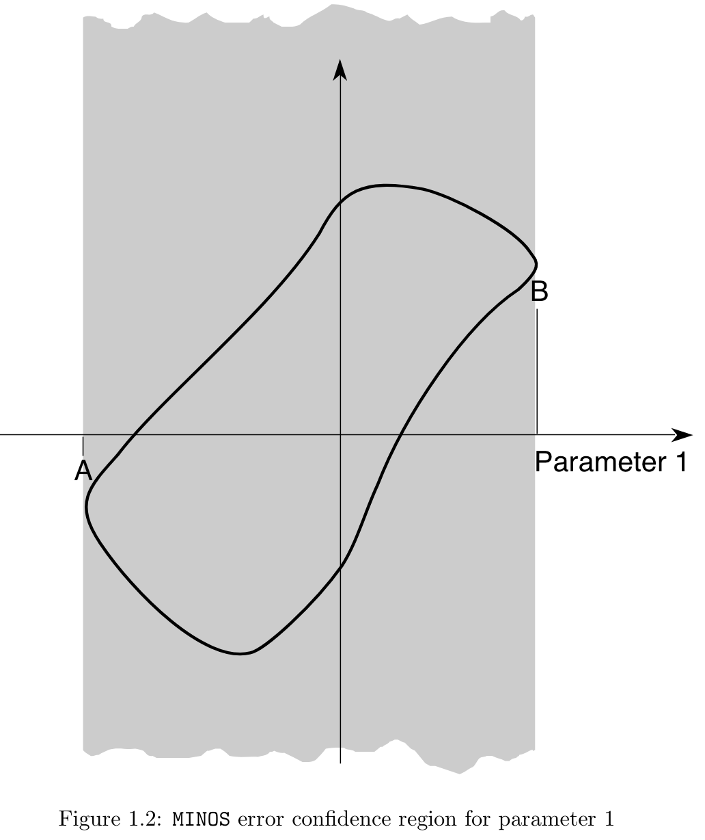
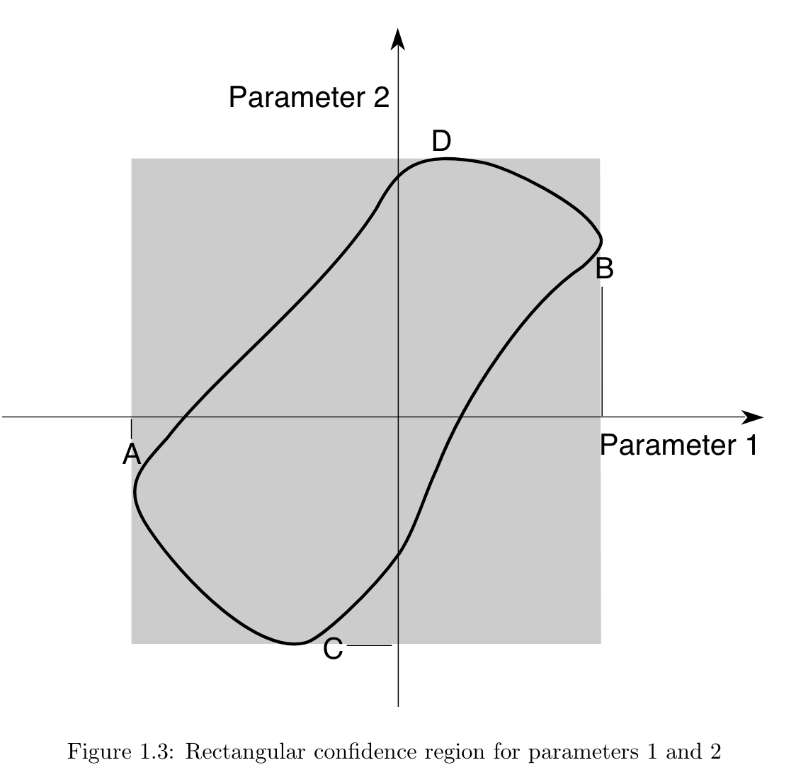
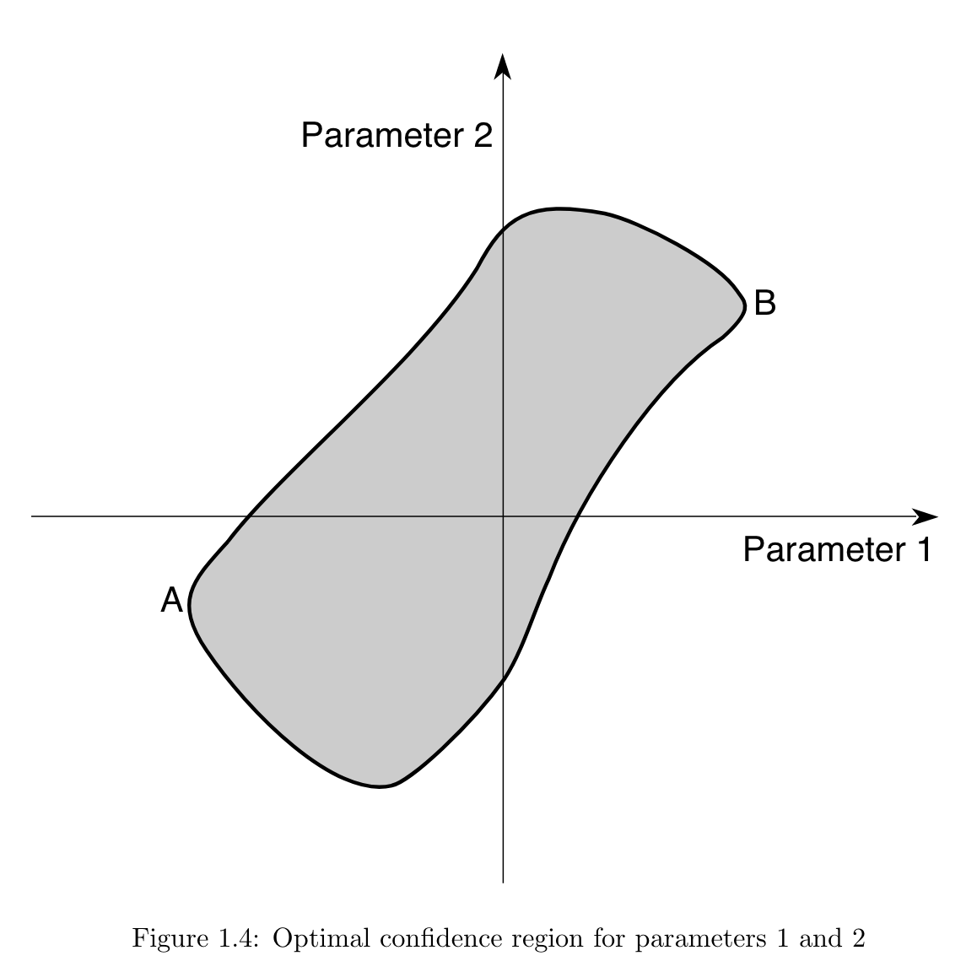
This discussion can also be found in PDG book
http://pdg.lbl.gov/2014/reviews/rpp2014-rev-statistics.pdf page 29
Rectangular confidence region for parameter 1 & 2
Optimal Confidence Region
( this is only a 39% CL )
Confidence region for parameter 1
( shown for 68% CL )
THNK CAREFULLY ABOUT WHAT YOUR FIT IS DOING AND DON’T JUST BLINDLY USE THE DEFAULTS

Slide 10
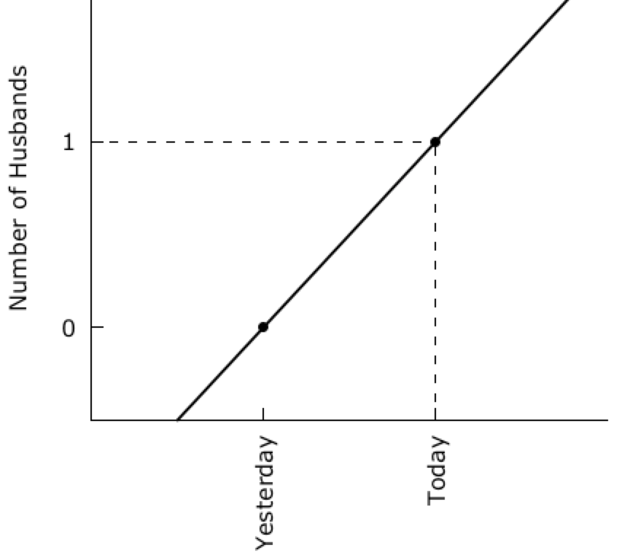
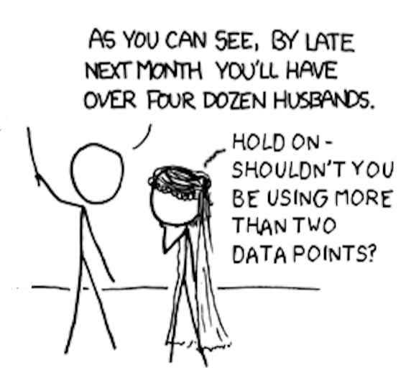
“My Hobby: Extrapolating” from XKCD

Slide 11
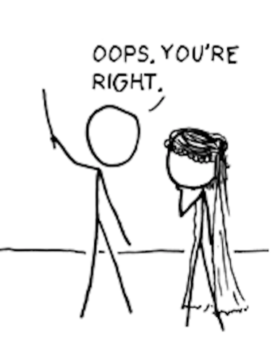
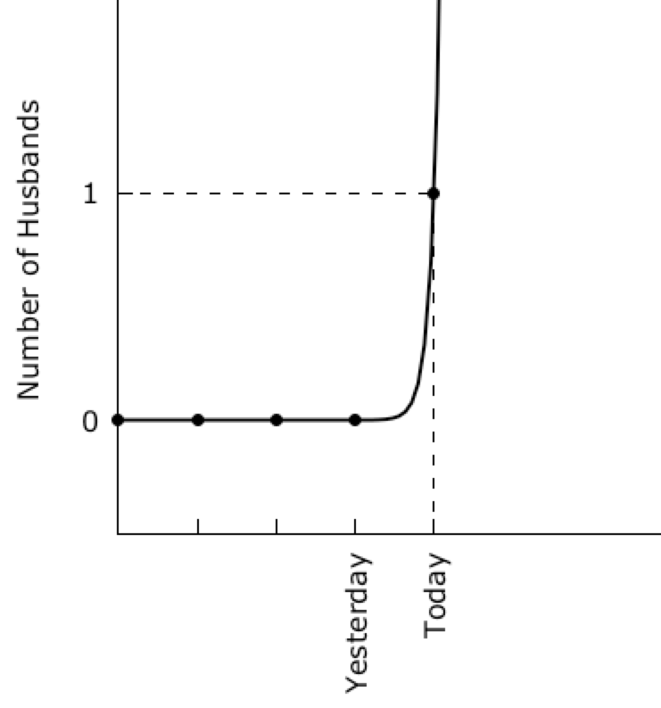
“My Hobby: Extrapolating” from XKCD
#
# gnuplot overfitting of xkcd Husband Data
# modified from https://xkcd.com/605/
# by
# Douglas W. Higinbotham
#
set terminal wxt enhanced font "verdana,12" size 900,450
set nokey
set xtic rotate 90
set ytic 0,1,1
set border 3
set xtics nomirror
set ytics nomirror
set multiplot layout 1,2
set ylabel "Number of Husbands"
f(x)=f0+f1*x
g(x)=g0*exp(g1*x)
fit f(x) '1.dat' using 1:3 via f0,f1
fit g(x) '2.dat' using 1:3 via g0,g1
set arrow from 0,1 to 2,1 nohead dashtype 7 lc 'black'
set arrow from 2,-0.5 to 2,1 nohead dashtype 7 lc 'black'
set xrange [0:3]
set yrange [-0.5:2]
plot '1.dat' using 1:3:xtic(2) lt 7 lc 'black' ,f(x) lw 2 lc 'black'
unset arrow
set xrange [-2:6]
set arrow from -2,1 to 2,1 nohead dashtype 7 lc 'black'
set arrow from 2,-0.5 to 2,1 nohead dashtype 7 lc 'black'
plot '2.dat' using 1:3:xtic(2) lt 7 lc 'black' ,g(x) lw 2 lc 'black'
unset multiplot
pause -1

Slide 12
Fermi’s Rejection of Dyson’s Work
https://www.webofstories.com/people/freeman.dyson/94?o=SH
Also written as a Nature article: https://www.nature.com/articles/427297a

Slide 13

The Five Parameter Elephant
“Drawing an elephant with four complex parameters”
by Jurgen Mayer, Khaled Khairy, and Jonathon Howard, Am. J. Phys. 78 (2010) 648.
https://www.johndcook.com/blog/2011/06/21/how-to-fit-an-elephant/

Slide 14
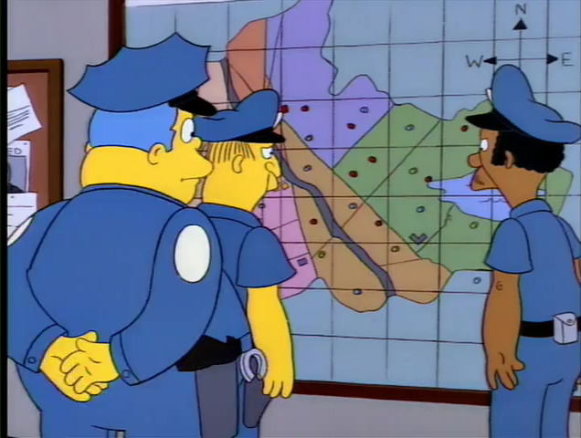
Too Many Free Parameters

Slide 15
Statistical notes on the problem of experimental observations near an unphysical region
What happens when everyone knows that the neutrino mass must be positive?!
https://doi.org/10.1103/PhysRevD.44.299
Image being the student who walks into the professor’s office with the negative results.
Now image the sum of the effect of everyone being pushed to report the “physical” result instead of quoting unbiased results.
The solution is of course to report both, but if you can only do one publish the biased results (i.e. what you actually measured)

Slide 16
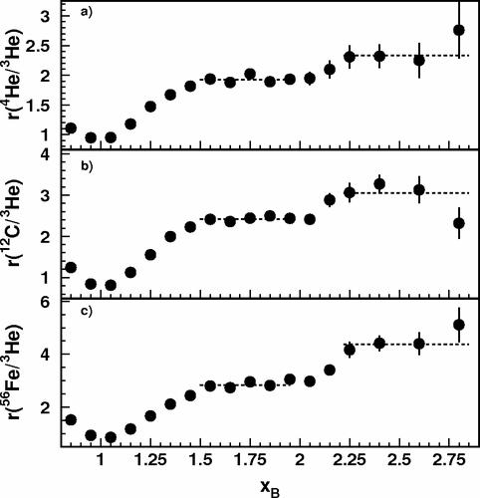
CLAS x_{B} > 2 Three Nucleon Plateau
I used to show this plot at conferences and tell a story about 2 and 3 nucleon correlations.
https://doi.org/10.1103/PhysRevLett.96.082501
Then when the Hall C preliminary results only agreed with the xB < 2 data, I thought hard about what was going on . .

Slide 17
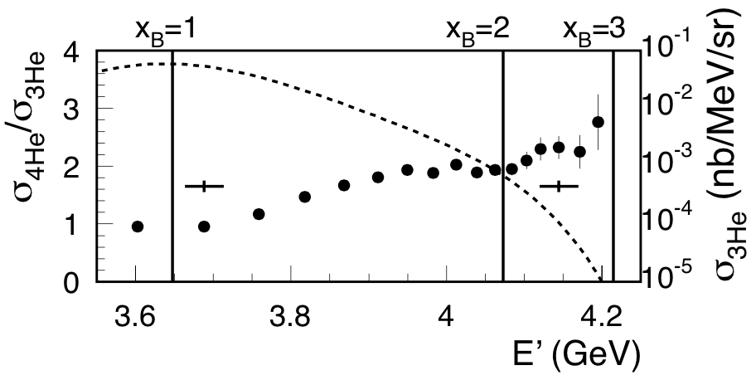
Plotting CLAS Results vs. E’ instead of x_{B}
D. H. and O. Hen, Phys. Rev. Lett. 114 (2015) 169201. (a PRL from checking a result on the back of an envelope )
https://doi.org/10.1103/PhysRevLett.114.169201

Slide 18
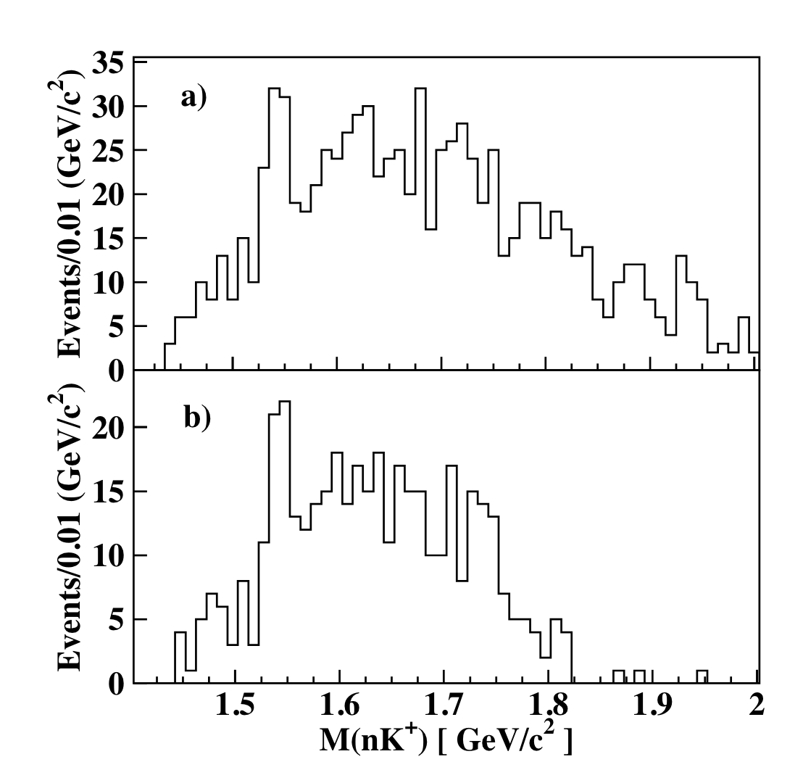
And with over 600 citations, the CLAS Pentaquark
Shown is the data with two different cuts (one a subset of the other).
Cuts were made until a peak they wanted to see was emphasized and the crime was then quoting an error as if it was a frequentist result.
https://doi.org/10.1103/PhysRevLett.91.252001
Notice how the HPS and similar experiments talk about the ”look elsewhere” effect to take this into account.
What was good science was repeating the experiment and using the same cuts and not seeing a peak.

Slide 19
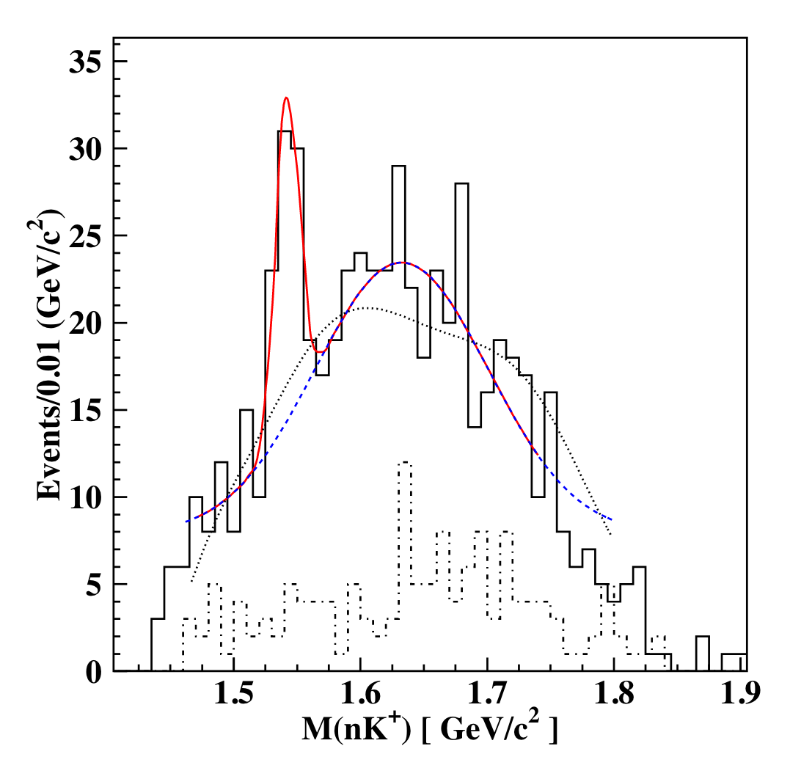
And with over 600 citations, the CLAS Pentaquark
Shown is the data with two different cuts (one a subset of the other).
Cuts were made until a peak they wanted to see was emphasized and the crime was then quoting an error as if it was a frequentist result.
https://doi.org/10.1103/PhysRevLett.91.252001
Notice how the HPS and similar experiments talk about the ”look elsewhere” effect to take this into account.
What was good science was repeating the experiment and using the same cuts and not seeing a peak.

Slide 20
And just for fitting fun!
https://twitter.com/dwhiginbotham/status/1043837703991832577
and the source code: http://doi.org/10.5281/zenodo.1436555
  Probability of Physics – Simon Širca

Slide 21
Finding Any Proton Radius With Polynomials
Code Outline
  generate ONE set of equal spaced random data with 1000 points from 0.01 to 10 fm⁻² using standard dipole and 0.003 random errors
  pick a proton radius from 0.70 to 0.92 fm (as example I picked 0.92 fm)
  loop over polynomial functions to see if code can find the chosen radius
  it fails, drop one low q2 data point and try again
  repeat until we find at polynomial that will give the answer we want
Bonus
  float the normalizing of the "rejected" low q2 data and then show all the data now agrees with the high order polynomial function
Code Posted On Github
  https://github.com/dhiginbotham/PolynomialMagic

Slide 22
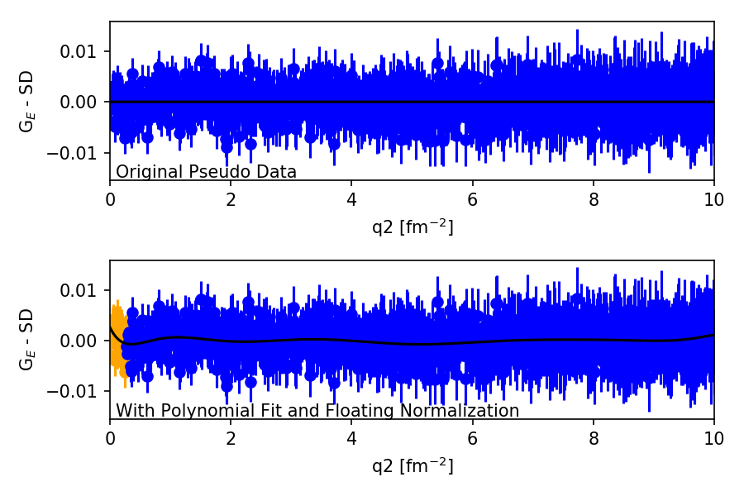
From 0.81 fm to 0.90 fm With A Polynomial
https://github.com/dhiginbotham/PolynomialMagic
LET’S TRY IT!

Slide 23
Full Mainz Data Set
1422 Data Points
31 Normalization Parameters
Fit with a high order polynomial
  Green 11 order G_{E} & G_{M}
    No bounds on the fit
  Yellow 11 order G_{E} & G_{M}
    Force Alternating signs
    As one would expect from a monotonically decreasing function
Green gives a radius of 0.880 fm
Yellow gives a radius 0f 0.845 fm
I don’t believe Fermi would be happy with any of this!
Fermi would want a physical model.
  From 2018: https://arxiv.org/abs/1809.06373 to
  1976 https://doi.org/10.1016/0550-3213(76)90449-1
  And many in-between that you can research.

Slide 24
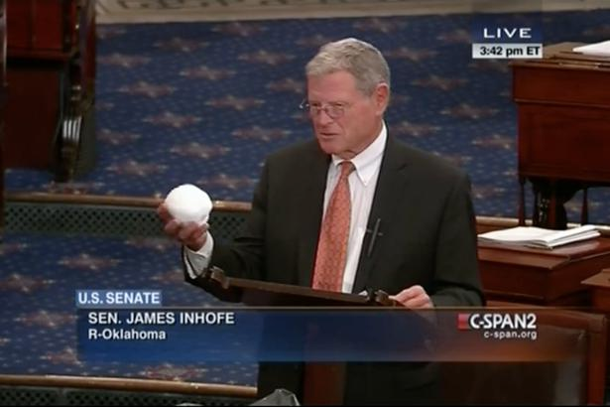
Warning: Danger of Confirmation Bias
In psychology and cognitive science, confirmation bias is a
tendency to search for or interpret information in a way that confirms one's preconceptions, leading to statistical errors.
https://www.youtube.com/watch?v=3E0a_60PMR8
And this week we have tweets: https://twitter.com/realDonaldTrump/status/1090074254010404864

Slide 25
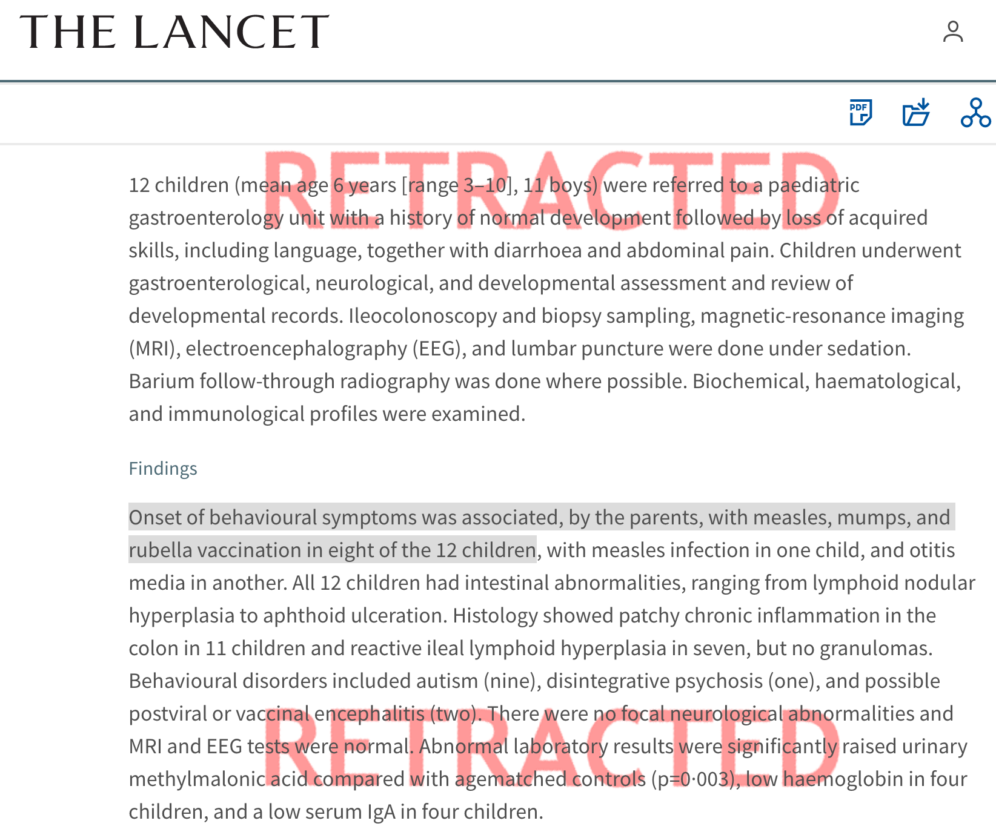
And the high crime…
The LANCET is a top tier medical journal and this is a highly cited article (>1.4k citations).
https://doi.org/10.1016/S0140-6736(97)11096-0
The red retracted was added by the journal, but the damage has been done.
MANY people know the news story of the original publication, but few know it has been retracted.
This author’s work led to a decline in vaccination rates in the United States, United Kingdom and Ireland and a corresponding rise in measles and mumps resulting in serious illness and deaths.
“A lie can travel half way around the world while the truth is putting on its shoes.” – attributed to Mark Twain but that too is a lie

Slide 26
Further Reading & Source For Python & R Software
To Explain or Predict? ( Descriptive, Predictive and Explanatory Modeling )
  https://projecteuclid.org/euclid.ss/1294167961
The Interpretation of Errors – Fredrick James (most of you use MINUIT, so please read!)
  http://seal.cern.ch/documents/minuit/mnerror.pdf
Data Analysis Textbooks
  Data Reduction and Error Analysis – Philip Bevington
  Statistical Methods in Experimental Physics – Fredrick James
  Computation Methods for the Physical Science – Simon Širca
  Probability of Physics – Simon Širca (https://www.springer.com/us/book/9783319316093)
Anaconda Open Source Software (https://www.anaconda.com/download)
And one of my favorites: https://en.wikipedia.org/wiki/How_to_Lie_with_Statistics
  This book shows you the lies
  Though it is old, you can see example after example that was discussed in this book on social media sites!

Slide 27
Hall A Collaboration Meeting 30 – 31 January 2019

