Slide 1
E02-013 (GEN) Data Analysis and Archival Publication Status
Andrew Puckett
University of Connecticut
Hall A Winter Collaboration Meeting, 2019

Slide 2
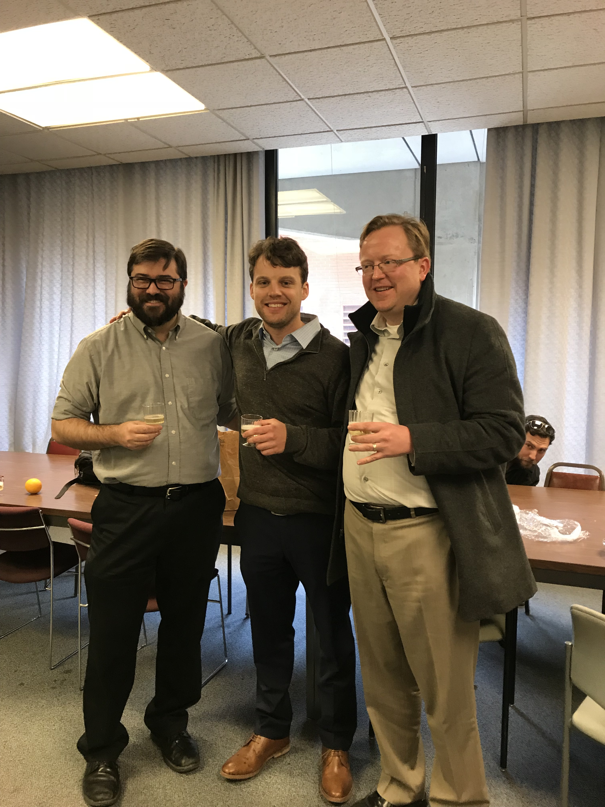
Acknowledgements
This talk is based on the doctoral dissertation research of Freddy Obrecht, who successfully defended his thesis on 1/4/2019
Special thanks to Seamus Riordan (ANL) and Bogdan Wojtsekhowski (JLab) for enormous contributions to the success of this project
Support from US Department Of Energy, Office of Science, Office of Nuclear Physics, Award ID DE-SC0014230 (Early Career research program)

Slide 3
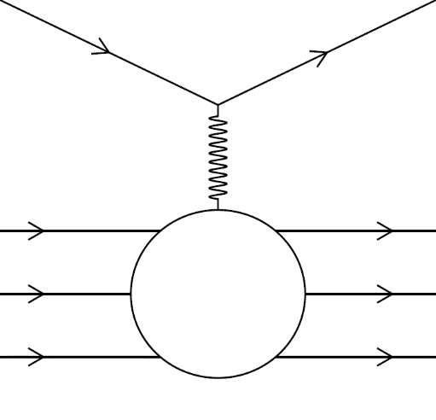





Elastic eN scattering and form factors: formalism
Invariant amplitude for elastic eN scattering in the one-photon-exchange approximation
The most general possible form of the virtual photon-nucleon vertex consistent with Lorentz invariance, parity conservation and gauge invariance is described by two form factors F₁ (Dirac) and F₂ (Pauli):
  F₁ describes the helicity-conserving amplitude (charge and Dirac magnetic moment)
  F₂ describes the helicity-flip amplitude (anomalous magnetic moment contribution)
Sachs Form Factors G_{E} (electric) and G_{M} (magnetic), are experimentally convenient linearly independent combinations of F₁, F₂
Differential cross section in the nucleon rest frame: Rosenbluth formula
Rosenbluth Separation Method: Measure cross section at fixed Q² as a function of ε to obtain G_{E}² (slope) and G_{M}² (intercept).

Slide 4
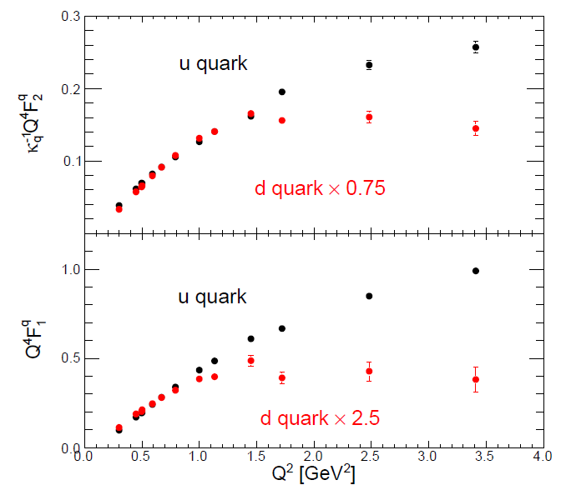

Nucleon FFs—Existing Data (ca. 2012)
Flavor decomposition of nucleon FFs: Cates et al., Phys. Rev. Lett., 106, 252003 (2011)
Different behavior of u and d quark contributions to FFs can be interpreted as a probe/signature of diquark correlations
World data for G_{Ep}, G_{Mp}, G_{En}, G_{Mn} compared to selected theoretical model predictions from Puckett et al., Phys. Rev. C, 85, 045203 (2012)

Slide 5
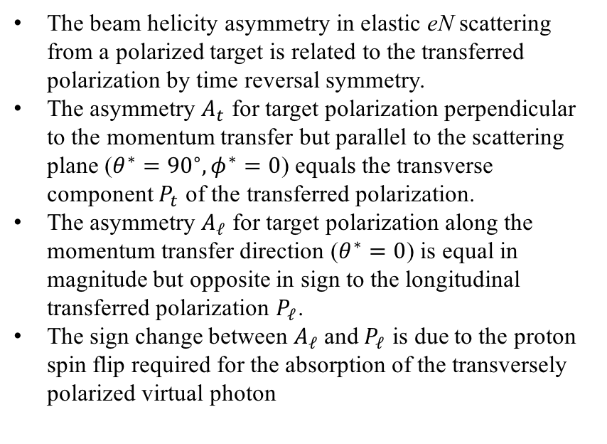
Polarized Beam-Polarized Target Asymmetry
The beam helicity asymmetry in elastic eN scattering from a polarized target is related to the transferred polarization by time reversal symmetry.
The asymmetry $A_{t}$ for target polarization perpendicular to the momentum transfer but parallel to the scattering plane ($θ^{∗}={90}^{∘}, φ^{∗}=0$) equals the transverse component $P_{t}$ of the transferred polarization.
The asymmetry $A_{ℓ}$ for target polarization along the momentum transfer direction ($θ^{∗}=0$) is equal in magnitude but opposite in sign to the longitudinal transferred polarization $P_{ℓ}$.
The sign change between $A_{ℓ}$ and $P_{ℓ}$ is due to the proton spin flip required for the absorption of the transversely polarized virtual photon

Slide 6
Neutron form factors—G_{Mn} existing data
Lachniet et al., CLAS Collaboration, Phys.Rev.Lett. 102 (2009) 192001
Three main methods have been used to measure G_{Mn}:
  “Ratio” method: measure cross section ratio of d(e,e’n)p/d(e,e’p)n in quasi-elastic kinematics
  Absolute d(e,e’n)p quasi-elastic cross section measurement
  Beam-target double-spin asymmetry* in inclusive quasi-elastic ³He(e,e’)
*Note: double-spin asymmetry method for G_{Mn} would not work for a free neutron target, as the free nucleon asymmetry depends only on the ratio G_{E}/G_{M}, and not G_{E} or G_{M} independently.
Widest combined Q² coverage and precision from recent CLAS 6 GeV data from 1 < Q² < 5 GeV²—consistent with “standard” dipole
Consistency issues in low-Q² data

Slide 7
Neutron form factors—G_{En} existing data
Riordan et al., Phys. Rev. Lett. 105, 262302 (2010)
Schlimme et al., Phys.Rev.Lett. 111 (2013), 132504
G_{En} is the least well-known and most difficult to measure of the nucleon EMFFs:
  Goes to zero at low Q² and cross-section contribution is small at large Q²
Existing knowledge (believed to be reliable) is mostly based on polarization observables:
  Beam-target double-spin asymmetry in semi-exclusive quasi-elastic ³He(e,e’n)pp
  Beam-target double-spin asymmetry in semi-exclusive quasi-elastic ²H(e,e’n)p
  Neutron recoil polarimetery: d(e,e’n)p

Slide 8
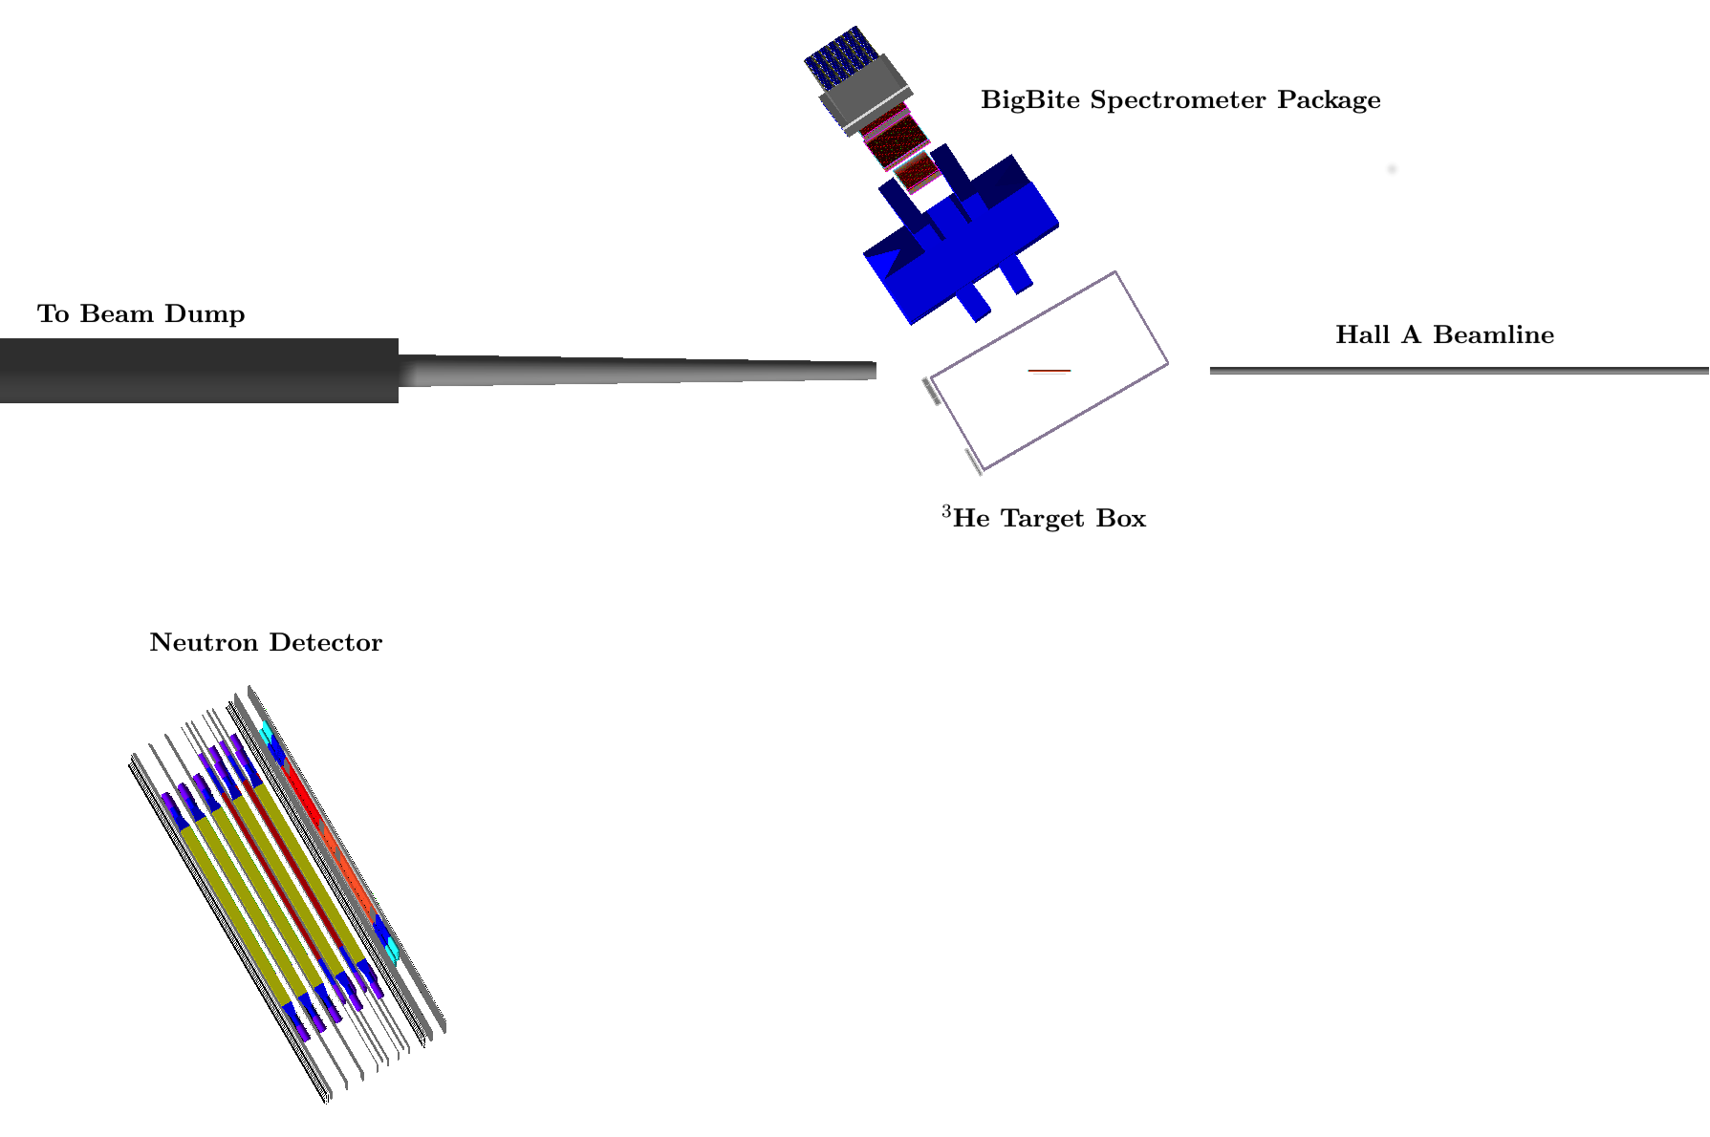
Experiment E02-013 Layout (in GEANT4)
E02-013 Kinematics: lowest Q² not included in PRL 2010 publication

Slide 9
E02-013 Analysis and Motivation
Lowest Q² data were collected at the beginning of the experiment—commissioning phase of entirely new detectors/target/etc.
Detector response/performance was initially poorly understood
Detector calibrations were not in good shape; BigBite calorimeter and BigHAND poorly gain-matched, trigger efficiency highly nonuniform, event reconstruction poor.
Freddy’s calibrations of detectors and recooking of the low-Q² data more than doubled the statistics of quasi-elastic neutral coincidence events passing the cuts relative to a preliminary analysis done “over a weekend” in 2011.
All four Q² points were reanalyzed with the new and improved machinery developed for the unpublished point-–no significant changes relative to original PRL publication in higher-Q² points

Slide 10
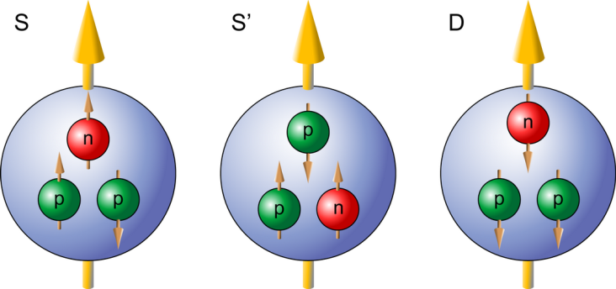
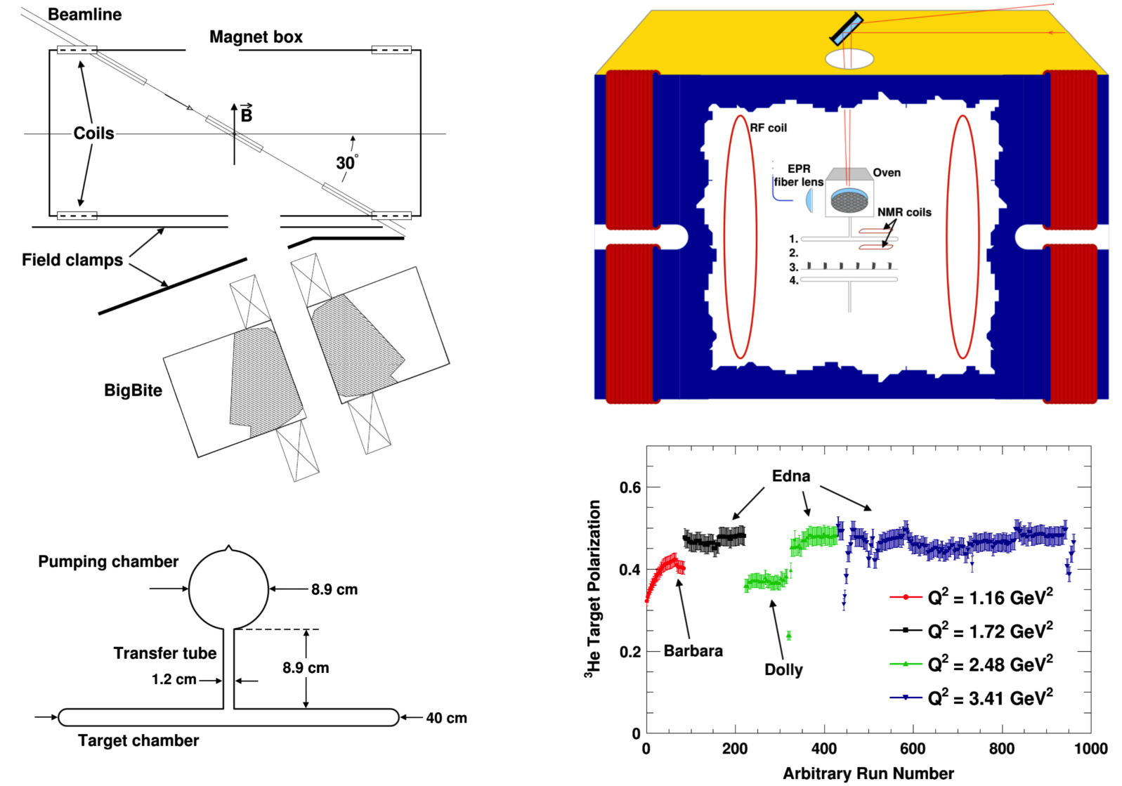
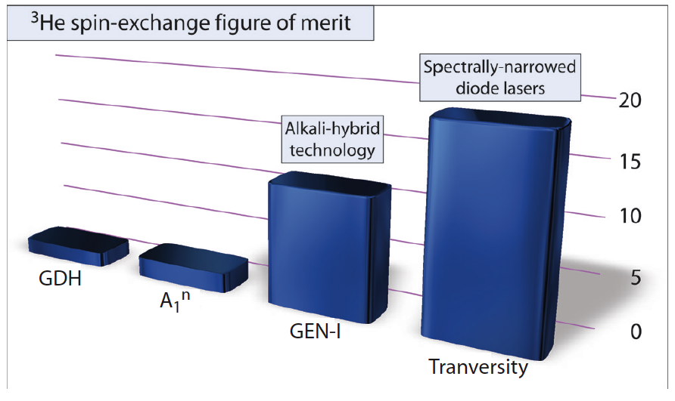
Polarized ³He Target
~87% ~8% ~1.5%
Reminder—Polarized ³He as effective polarized neutron target:
Ground state wavefunction dominated by S-state, with unpaired neutron carrying the nuclear spin
GEN (2006) was the first electron-polarized ³He scattering experiment to utilize the alkali-hybrid spin-exchange optical pumping technique to increase figure-of-merit.

Slide 11
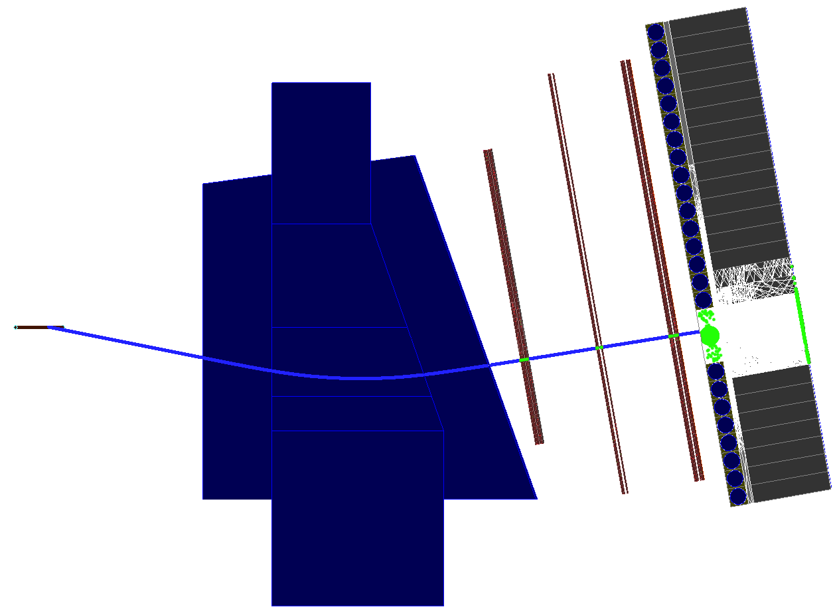
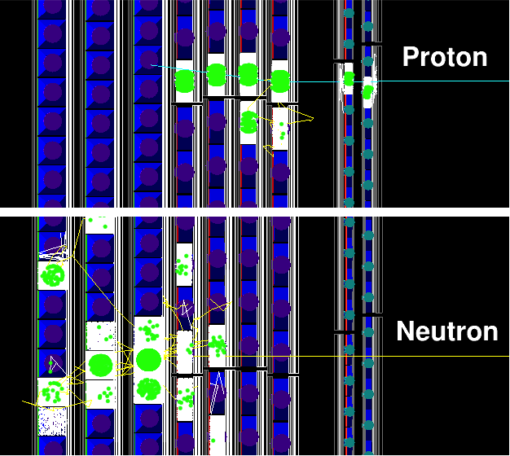
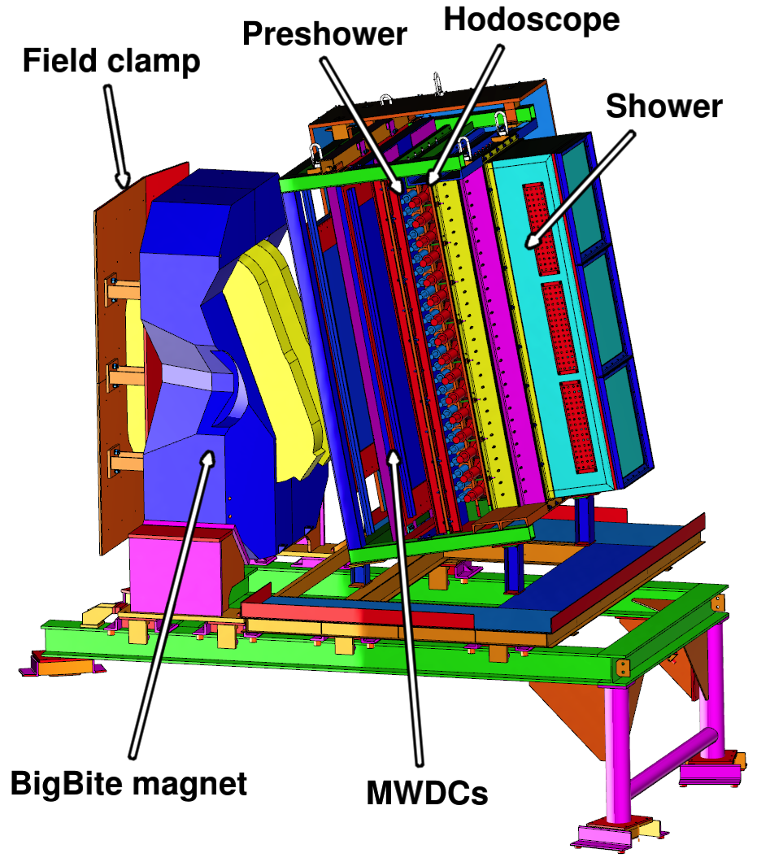
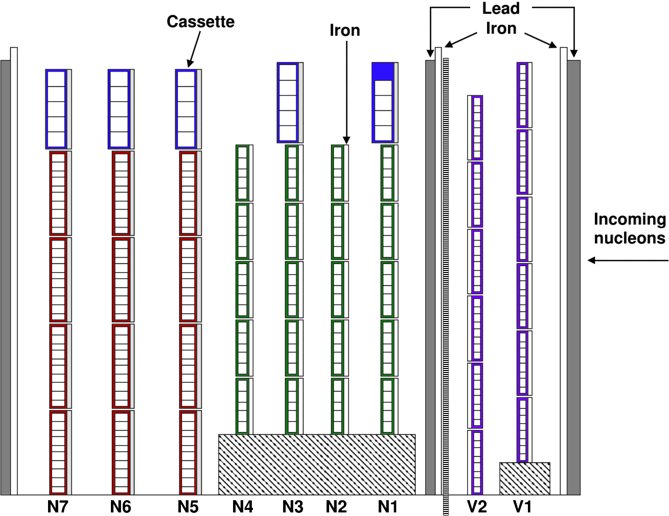
Electron and Nucleon Detection

Slide 12
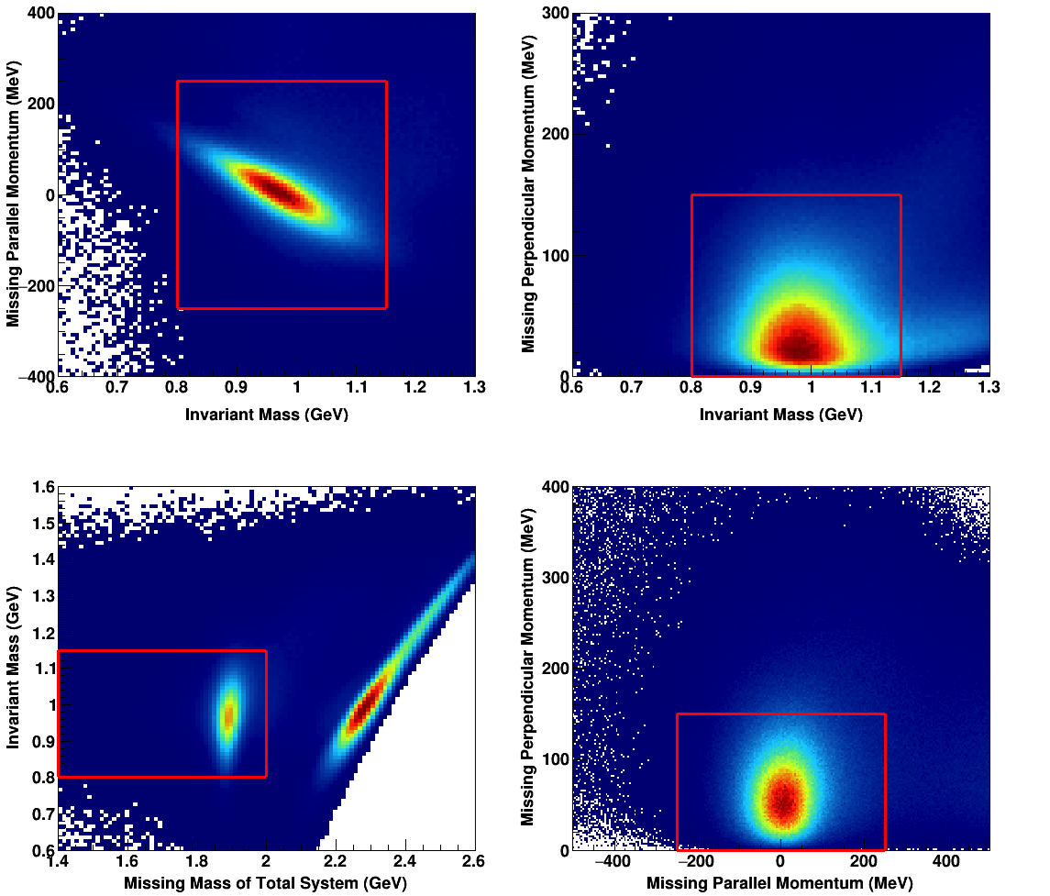
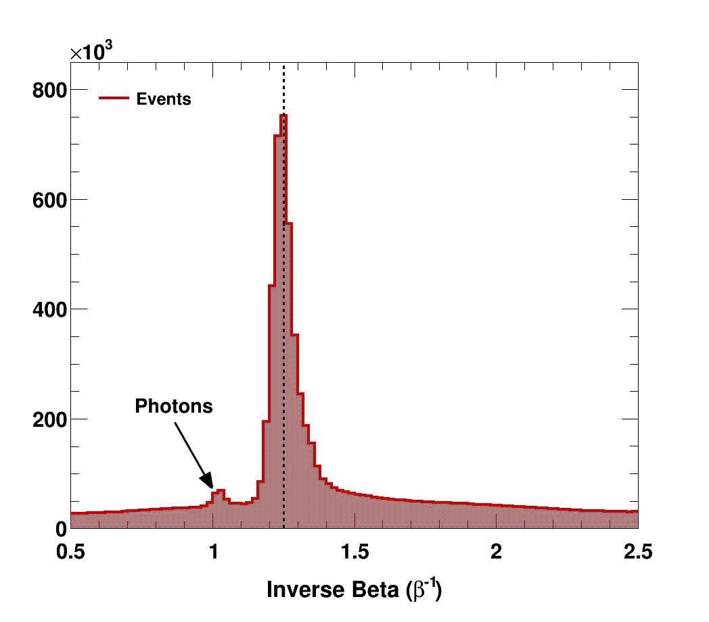
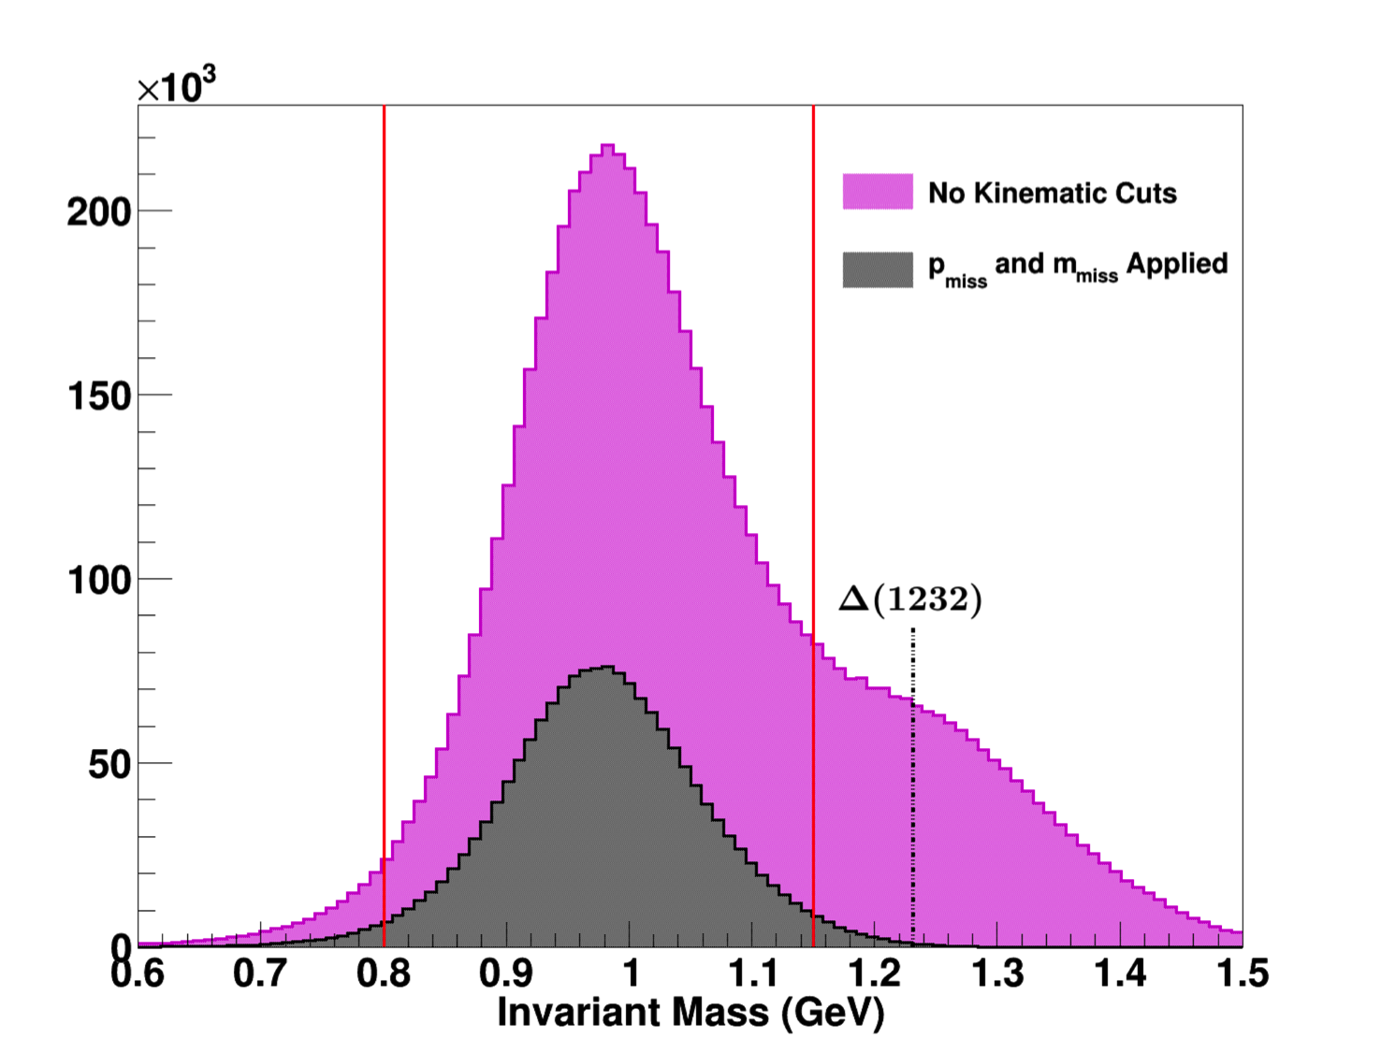
Quasi-elastic Event Selection: ³He data, Q² = 1.16 GeV²
Nucleon identification and momentum reconstruction via time-of-flight
Three main cuts to select the coincidence quasi-elastic channel: Invariant mass W, missing parallel and perpendicular momentum, and ”missing mass”
W distribution before and after cuts

Slide 13
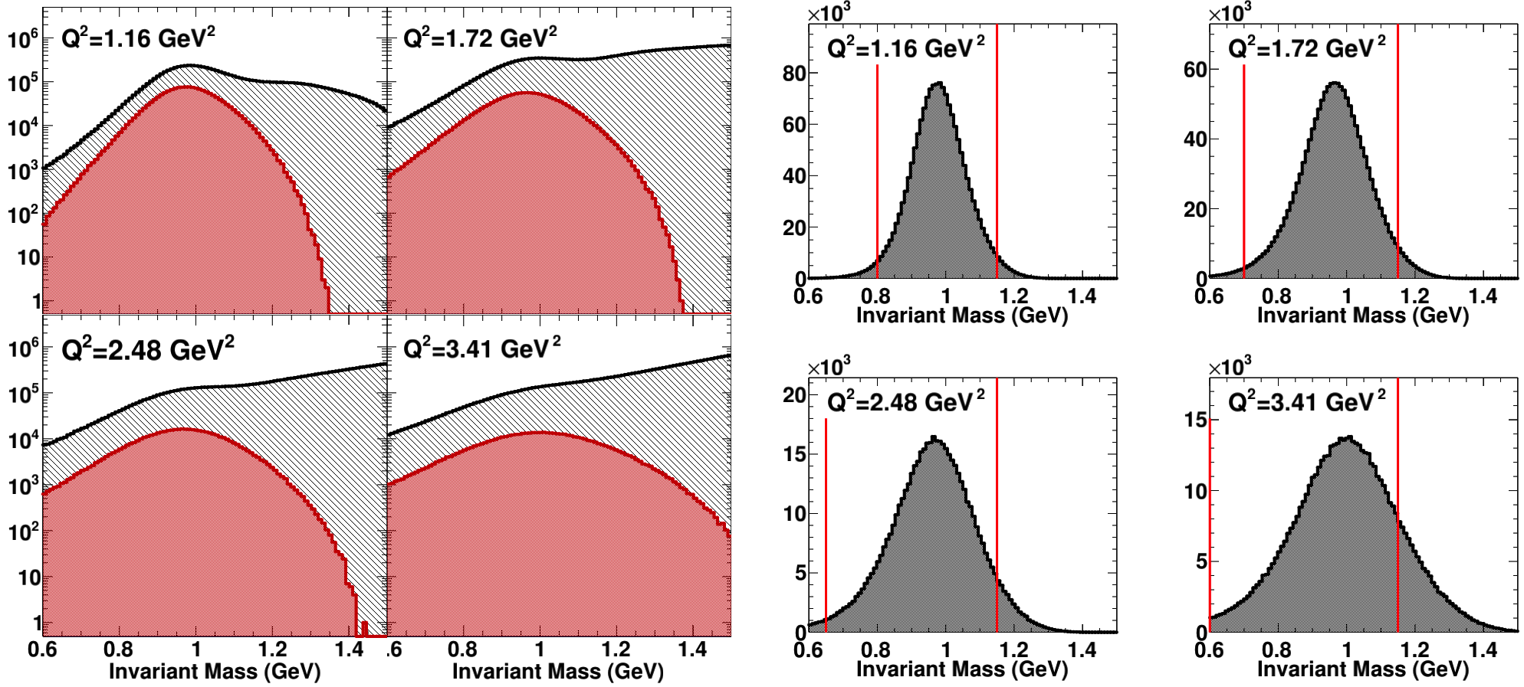
Quasi-elastic coincidence event selection: All kinematics
Width of quasi-elastic W distribution due to Fermi smearing increases with Q².
Inelastic scattering yield relative to quasi-elastic also increases with Q².
Nevertheless, two-arm coincidence and exclusivity cuts result in a very clean selection of QE events at all four Q²

Slide 14
Raw Asymmetries

Slide 15
Raw asymmetry to ”physics” asymmetry—Summary of Dilution Factors/Corrections
See backup slides for more plots/details
Most significant dilution factors:
  Accidental coincidence background
  Nitrogen dilution
  Proton misidentification
Others include FSI, inelastic contamination, and BigBite pions. The latter two are basically negligible.

Slide 16
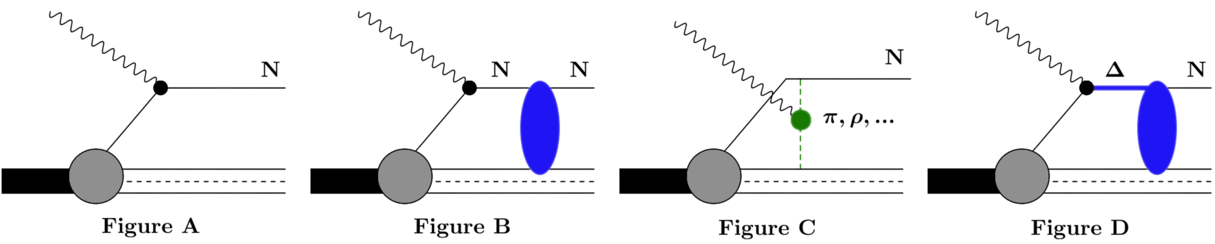
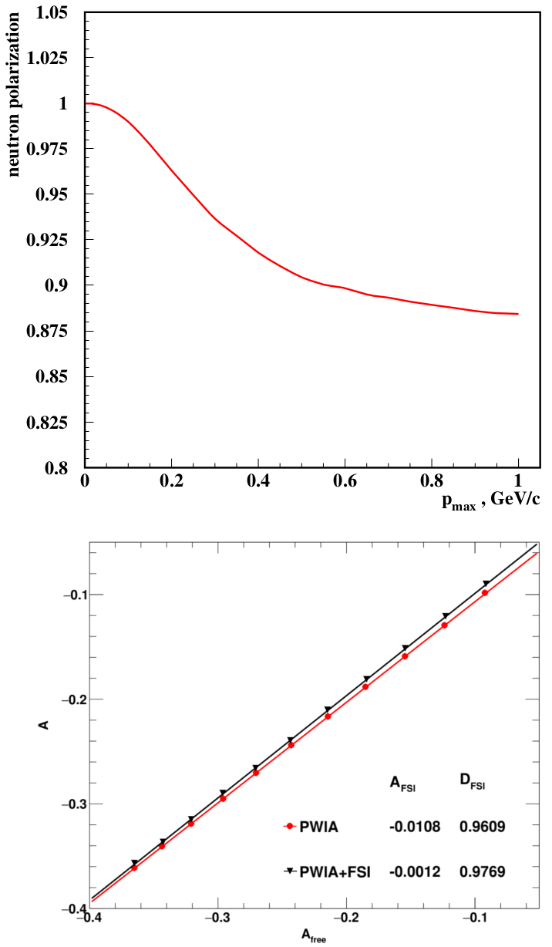
Nuclear corrections—Mainly FSI
Nuclear corrections calculated within Generalized Eikonal Approximation framework
  Cross section/asymmetry calculation code provided by Misak Sargsian (FIU)
  Event-by-event MC simulation folded with experimental acceptance—lots of numerical integration, computationally expensive! (Much easier to do with 2019 JLab scientific computing facilities than 2009)
A: PWIA
B: FSI/charge-exchange
C: Meson Exchange Currents
D: Isobar Configurations
Diagrams “A” and “B” dominant in E02-013 kinematics
Exclusivity selection increases effective neutron polarization from the canonical 86% (of P_{He}) in the inclusive case to 96% in the coincidence—quasi-elastic case.

Slide 17
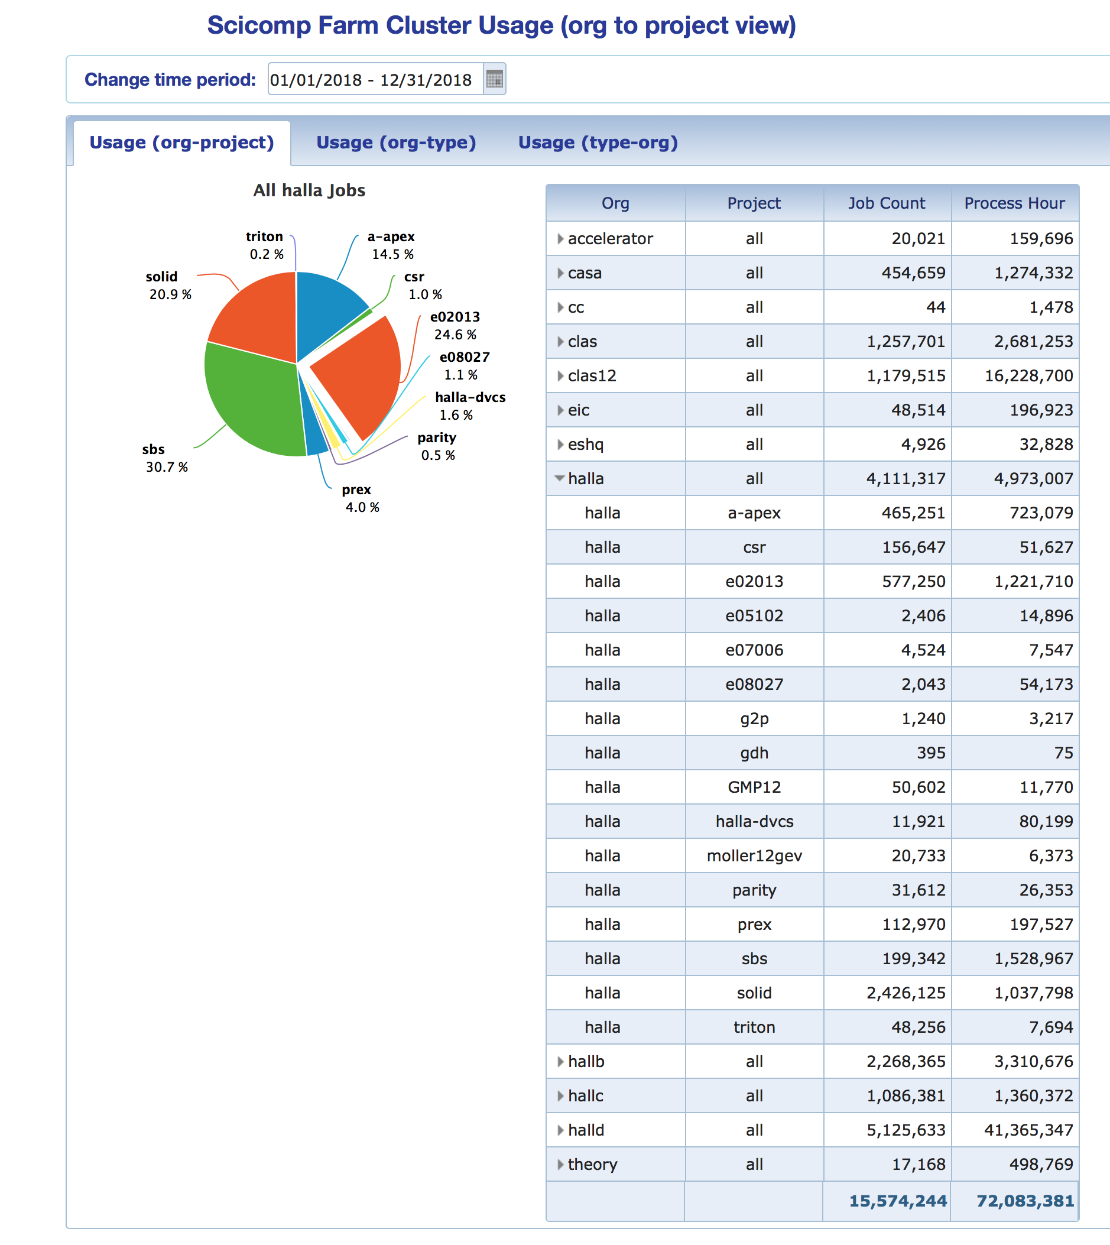
GEN Nuclear Effects Compute Farm Stats
In calendar 2018, the GEN nuclear corrections calculations accounted for approximately 25% of Hall A batch farm usage by process-hours.
Essentially ALL of this was the nuclear corrections; no reconstruction, no analysis
Nuclear corrections redone for all four Q² points with higher MC statistics, better precision/accuracy, exploiting a decade of improvements in batch farm capacity.
No major changes in nuclear corrections observed since 2009

Slide 18
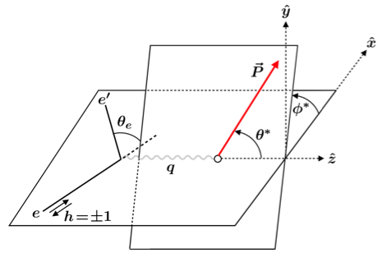
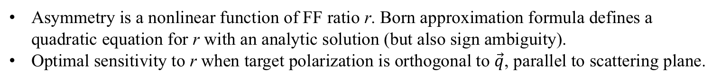
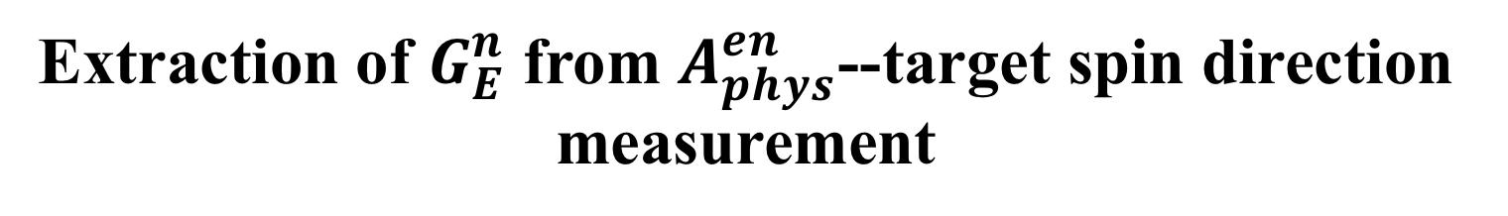
Extraction of $G_{E}^{n}$ from $A_{phys}^{en}$--target spin direction measurement
Asymmetry is a nonlinear function of FF ratio r. Born approximation formula defines a quadratic equation for r with an analytic solution (but also sign ambiguity).
Optimal sensitivity to r when target polarization is orthogonal to $\vec{q}$, parallel to scattering plane.

Slide 19
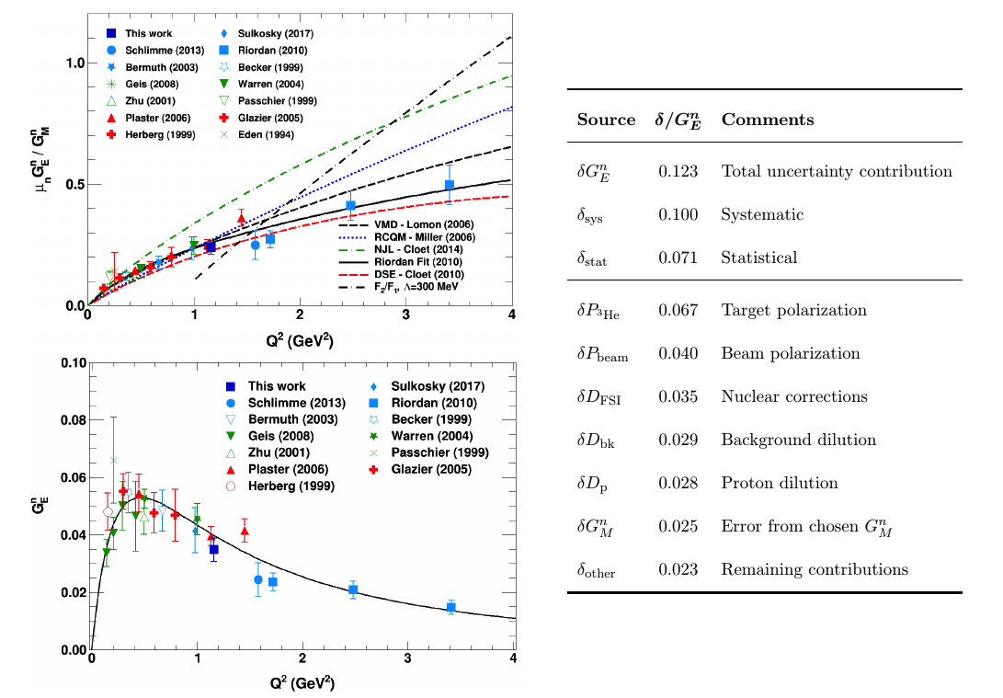
Results
Result at 1.16 GeV² consistent with other data in this region.
Total uncertainty ~12% relative. Systematics dominated by target polarization. Statistical error slightly smaller than total systematics.

Slide 20
Summary and Conclusions
Draft archival publication (Phys. Rev. C) in preparation, ~90% complete (very much in editing and proofreading stage)
Analysis is complete and final, up to finalizing the target polarization systematics for the lowest Q² point.
Completion of low-Q² analysis and archival publication of whole experiment brings closure to E02-013
Consistency of low-Q² data with existing overlapping data also increases confidence in validity of high-Q² data (not that they were in doubt…).
Expect archival paper submission to PRC in first half of 2019
Thank you for your attention!

Slide 21
Backup Slides

Slide 22
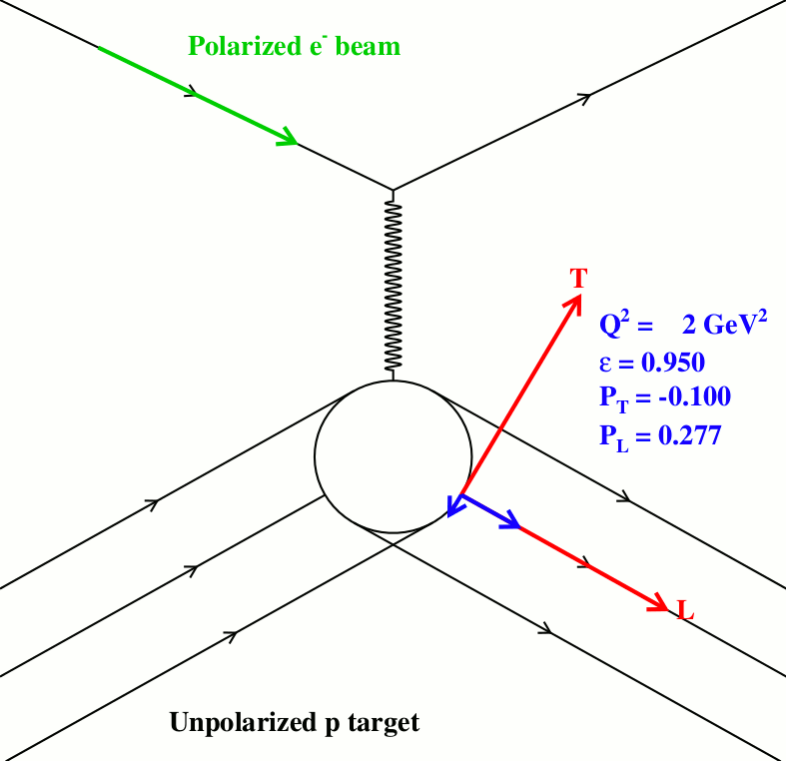
Polarization Transfer in Elastic eN scattering
Akhiezer and Rekalo (1968) + Arnold, Carlson, Gross (1981):
  Derived the relations between transferred polarization components in elastic eN scattering and the ratio of electromagnetic FFs R = μG_{E}/G_{M}
Perdrisat + Punjabi, 1993 proposal to CEBAF PAC: A simultaneous measurement of the two recoil polarization components in a polarimeter determines the FF ratio while canceling many systematic uncertainties (beam polarization, analyzing power, FPP instrumental asymmetry)
The ratio of transferred polarization components is directly proportional to G_{E}/G_{M}, and therefore much more sensitive to G_{E} at large Q² than the cross section

Slide 23
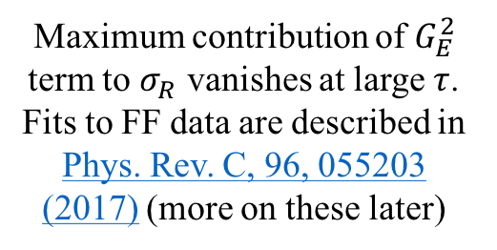

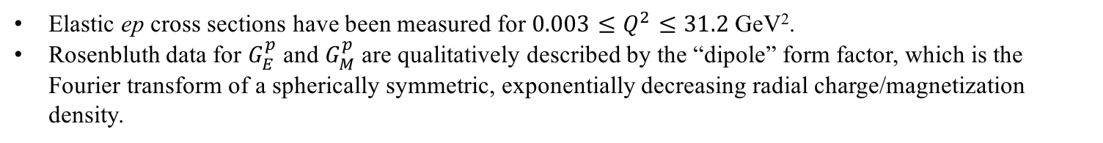
Proton FFs—Rosenbluth data
The problem—G_{E} sensitivity of σ_{R} vanishes at large Q²
Maximum contribution of $G_{E}^{2}$ term to $σ_{R}$ vanishes at large $τ$. Fits to FF data are described in Phys. Rev. C, 96, 055203 (2017) (more on these later)
$G_{E}^{p}$ and $G_{M}^{p}$ Rosenbluth Data: $G_{E}^{p}≈\frac{G_{M}^{p}}{μ_{p}}≈G_{D}$
Elastic ep cross sections have been measured for ${0.003≤Q}^{2}≤31.2$ GeV².
Rosenbluth data for $G_{E}^{p}$ and $G_{M}^{p}$ are qualitatively described by the “dipole” form factor, which is the Fourier transform of a spherically symmetric, exponentially decreasing radial charge/magnetization density.

Slide 24
Proton FFs—Polarization Data
GEp-III/GEp-2$γ$ final results (Puckett et al., Phys. Rev. C 95, 055203 (2017))

Slide 25
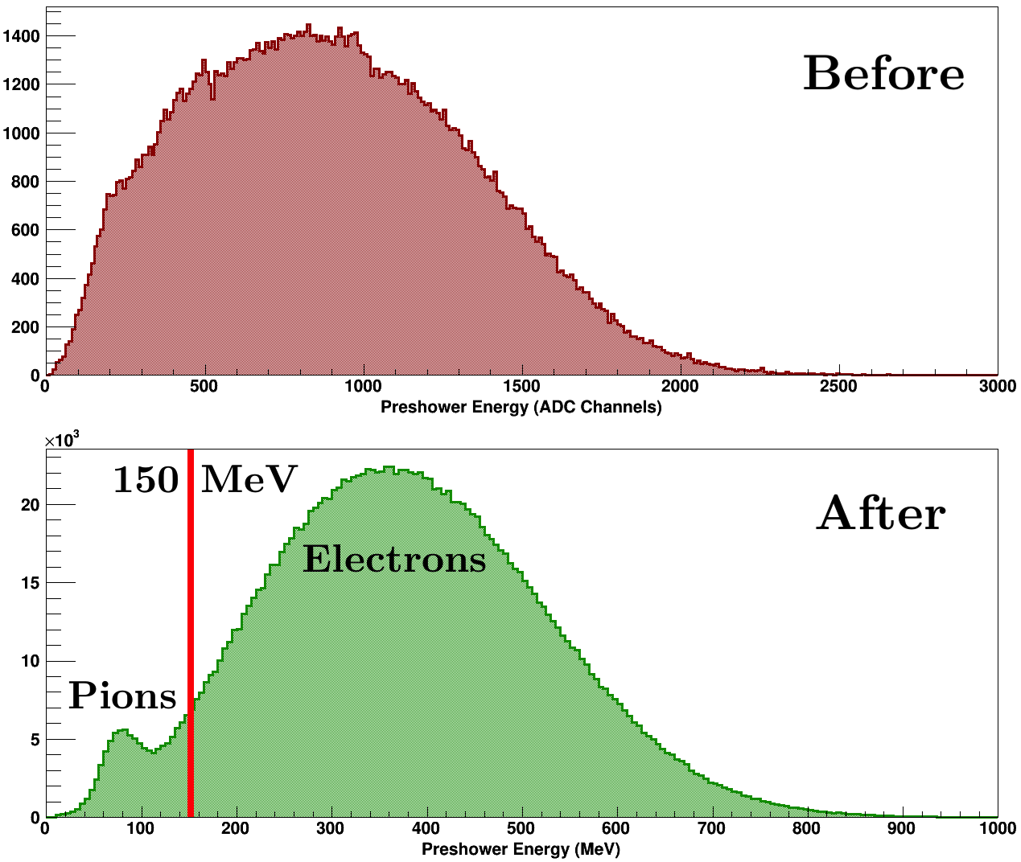
Kin. 1 Calibrations and reconstruction improvements—BigBite preshower and shower
Preshower Energy Calibration
BigBite Trigger Logic Sums—poor initial gain matching and calibration leads to non-uniform trigger efficiency/”gaps”
After calibration, this is reproducible in simulation—important for dilution analysis

Slide 26
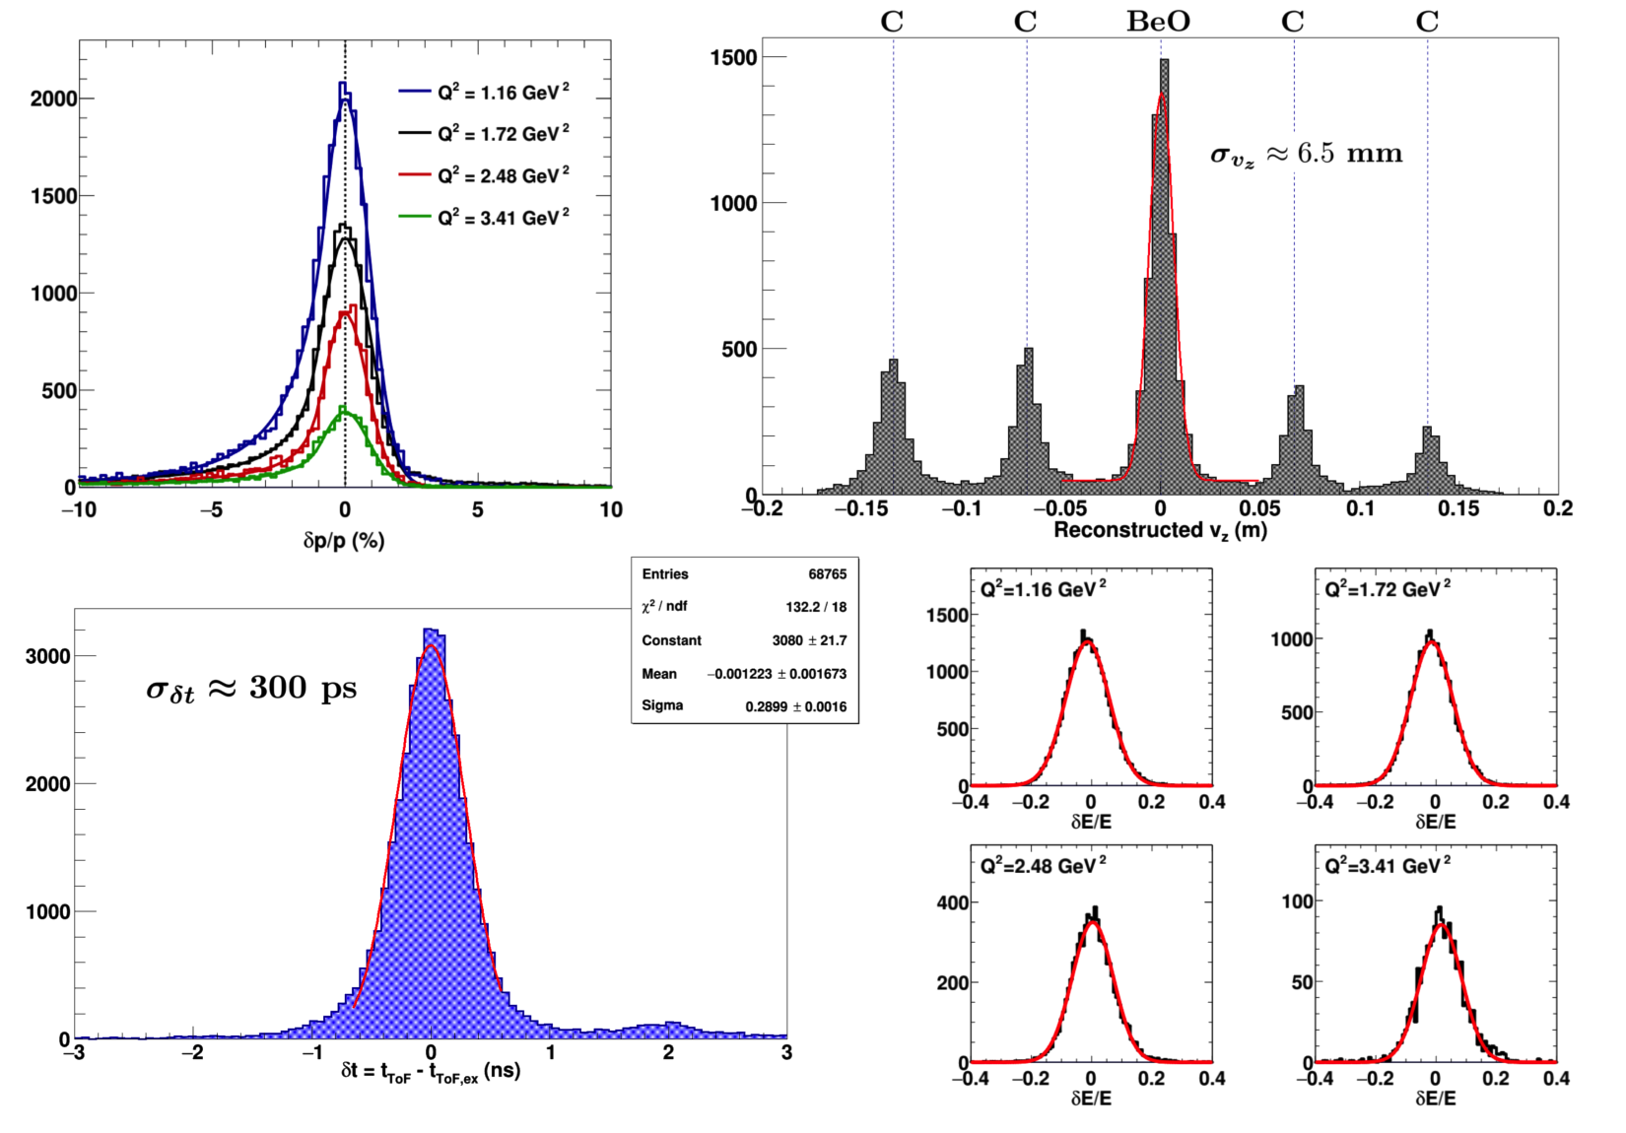
Kin. 1 Calibrations—Summary

Slide 27
Neutron arm Kin. 1 Gain Calibration
Neutron arm gain/trigger threshold calibration
Detailed simulation of trigger logic including realistic channel-to-channel gain variations required to reproduce Kin. 1 nucleon misidentification probabilities/dilution factors

Slide 28
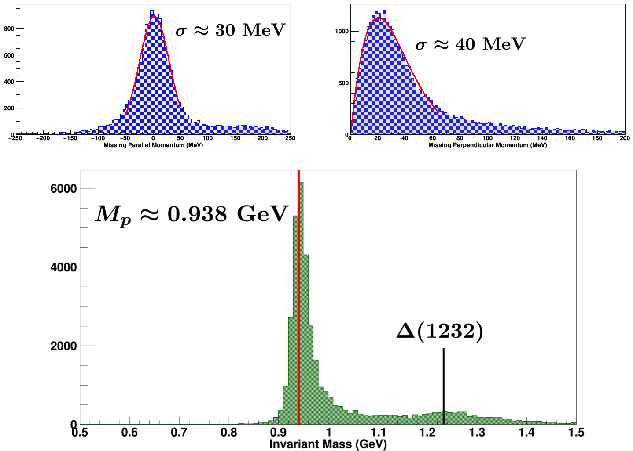
Quasi-elastic Event Selection: H₂ elastic data

Slide 29
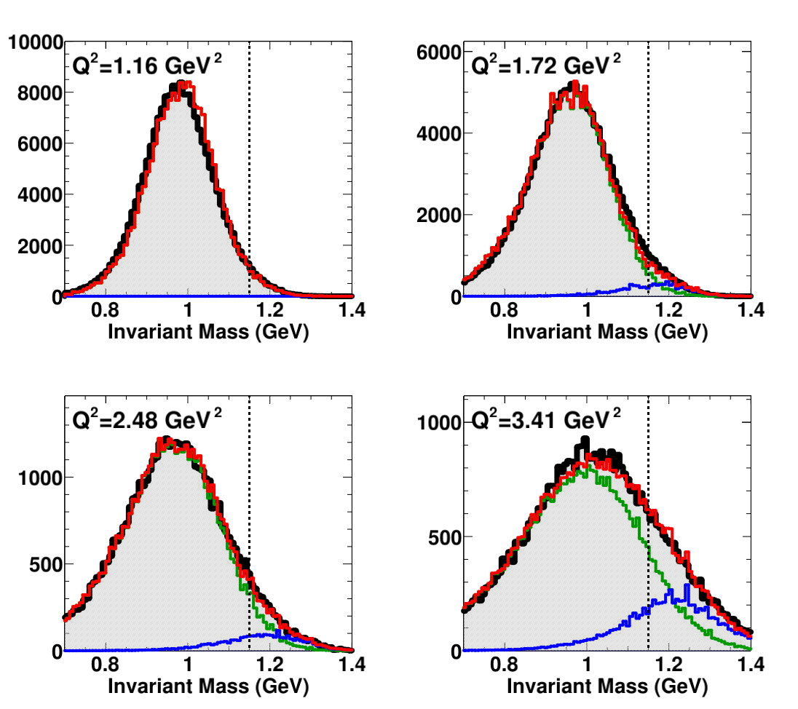
Inelastic Dilution: All kinematics

Slide 30
Random Background Dilution (Q²=1.16 GeV²)

Slide 31
Pion dilution-–All kinematics

Slide 32
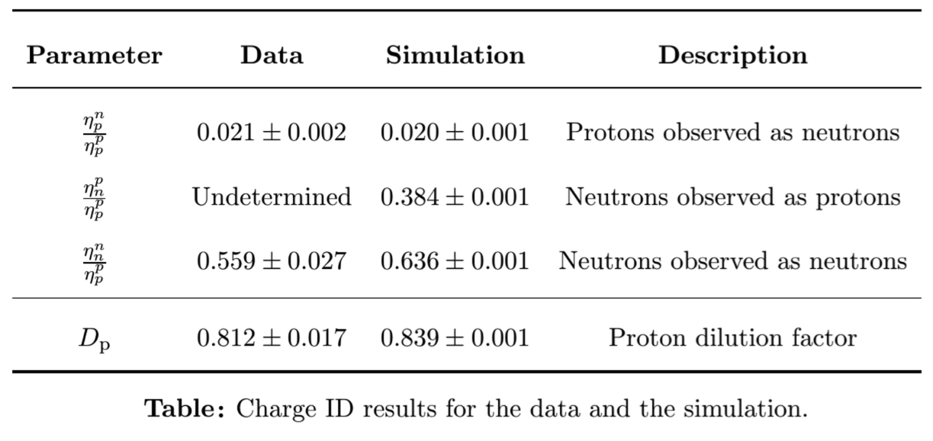
Proton Dilution (Q² = 1.16 GeV²)
The relevant nucleon misidentification probabilities are estimated from both the GEANT4 simulation and data using ”three-target” method and theoretical estimate of effective neutron/proton ratios passing quasi-two-body elastic kinematic cuts.

Slide 33
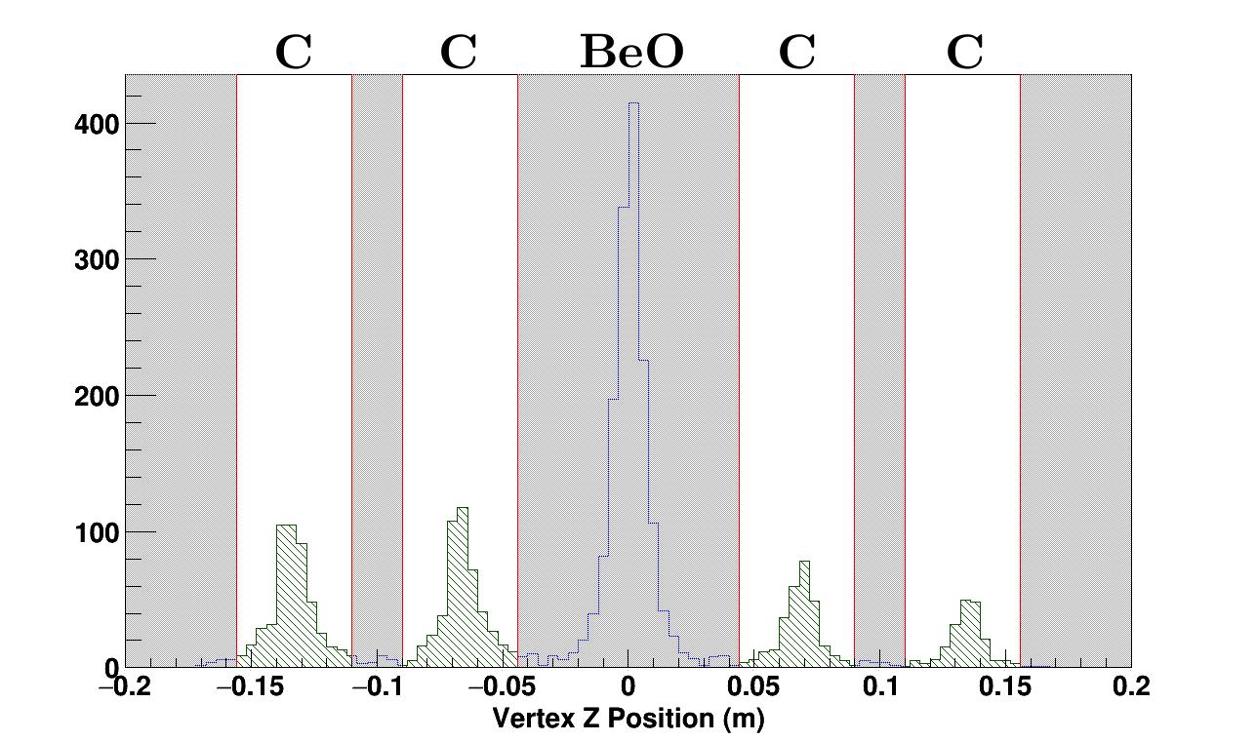
Nitrogen Dilution
Carbon foil data used in lieu of N₂ ref. cell data for lowest Q²

