Slide 1
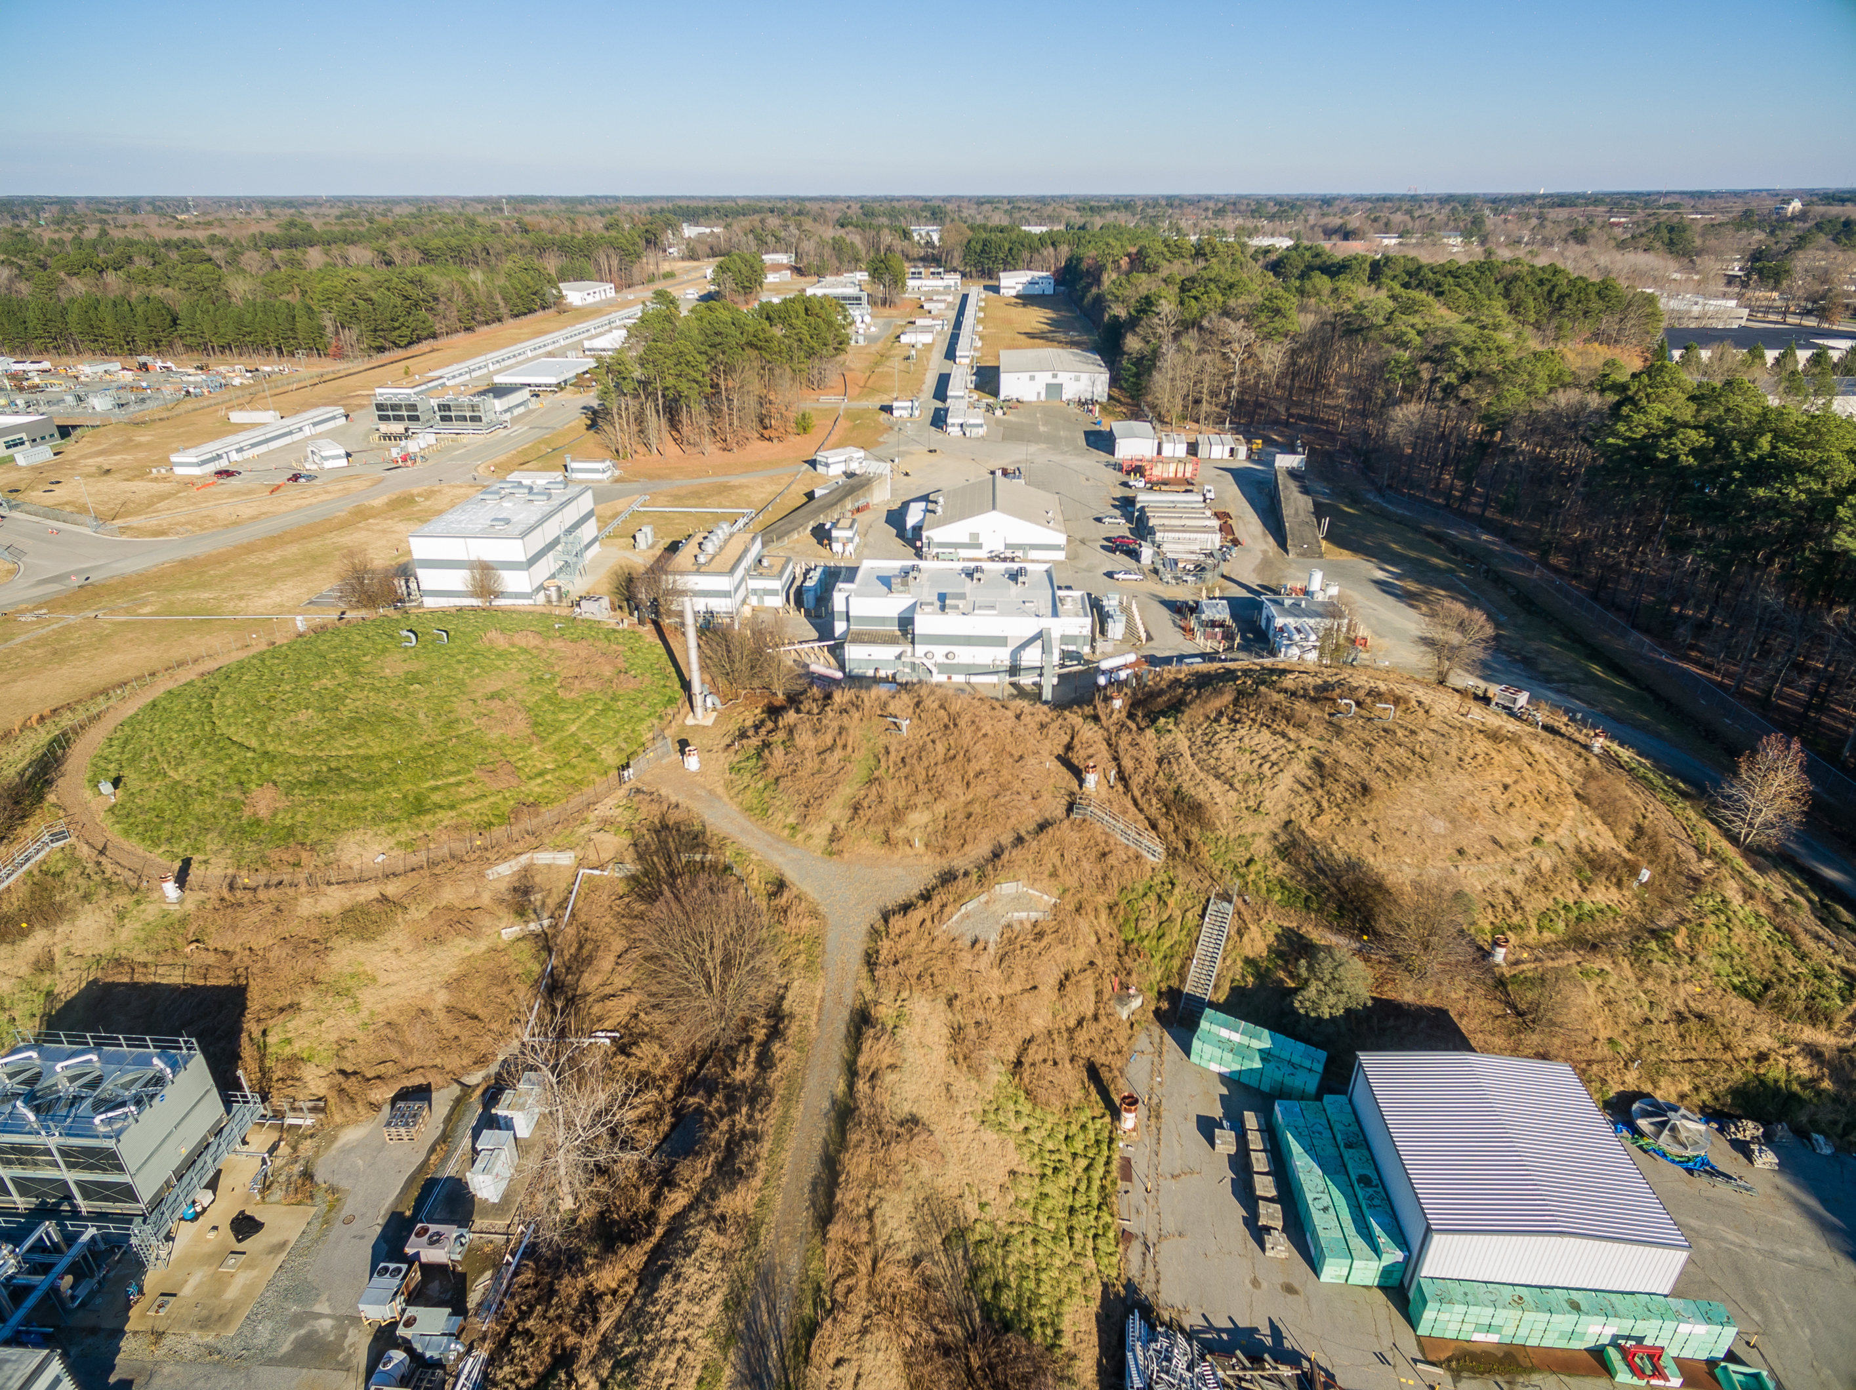
Jefferson Lab Status
Stuart Henderson
Laboratory Director
January 30, 2019

Slide 2
Jefferson Lab Organization
Jefferson Science Associates LLC
Jerry Draayer, SURA
Timothy Sands, Virginia Tech
Chico Moline, PAE
Internal Audit
Gail Lucento
Laboratory Director
Stuart Henderson
Director’s Office
LCLS-II
Project Office
Joe Preble
CPO
CRO
COO
Communications
Lauren Hansen
CCO
Planning
Allison Lung
S&T Programs
Bob McKeown
Operations
Mike Maier
Tech Transfer and Commercialization
Drew Weisenberger
CTO
Experimental Physics
Rolf Ent
Accelerator
Andrei Seryi
Theoretical and Comp Physics
Jianwei Qiu
Engineering
Will Oren
Legal Counsel
Rhonda Scales
CIO
CHRO
CFO
ESH&Q
Mary Logue
Information Technology
Amber Boehnlein
Human Resources
Rhonda Barbosa
Business and Finance
Jennifer Logan
Facilities Mgt.
and Logistics
Rusty Sprouse

Slide 3
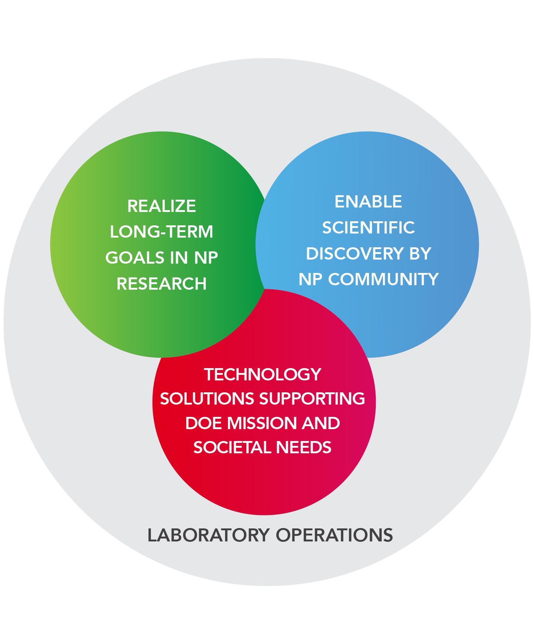
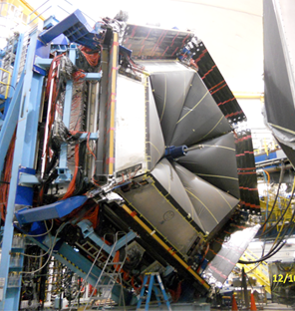
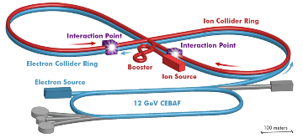
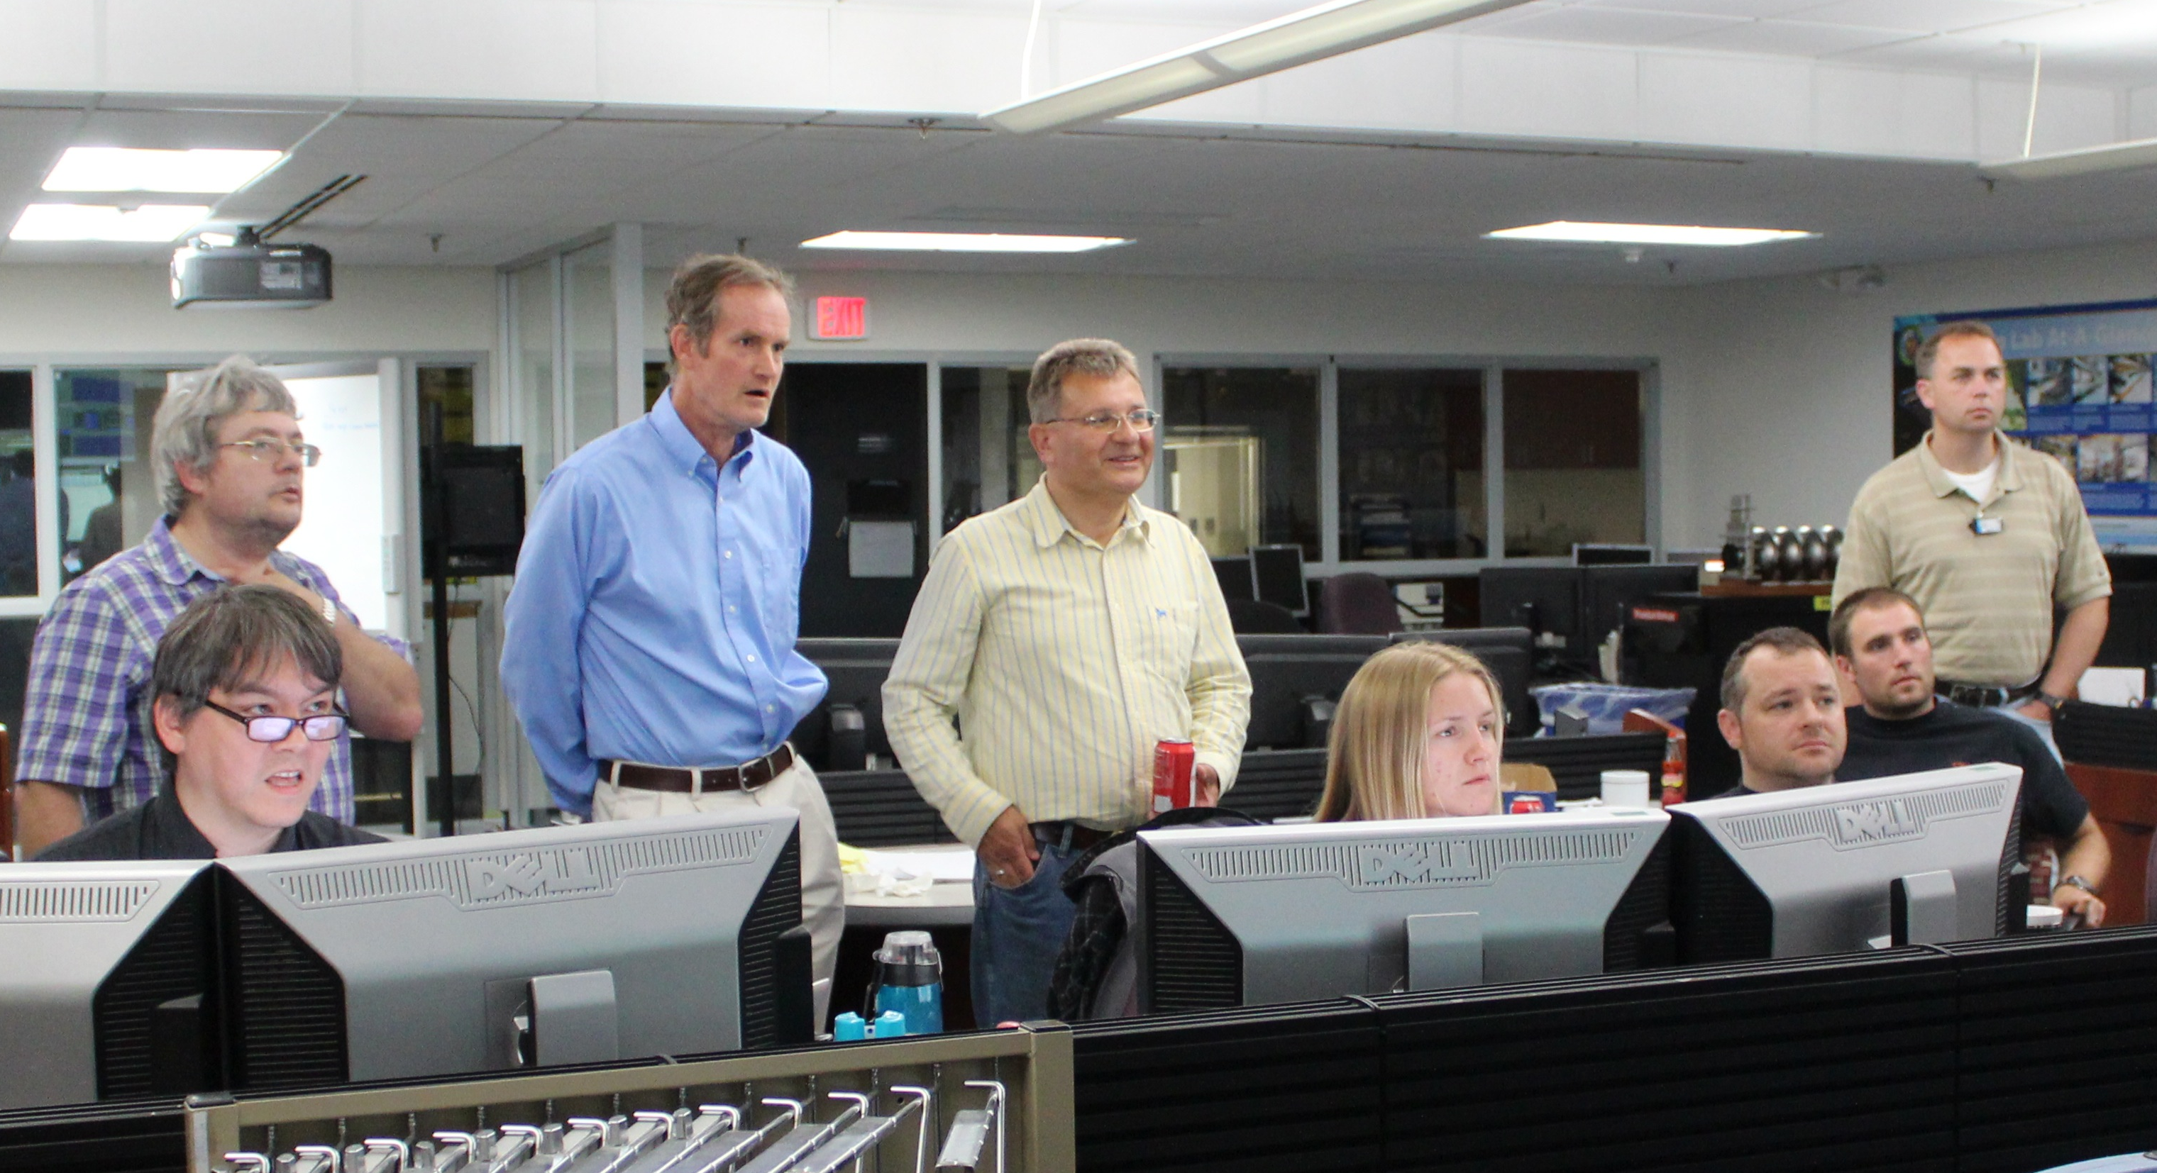
Vision for Jefferson Lab
Jefferson Lab supports the DOE Office of Science and serves the Nuclear Physics user community as a world-leading center for fundamental nuclear science and associated technologies
1. Deliver on 12 GeV Scientific Program
2. Provide a long-term path for the field
3. Provide technology solutions supporting DOE mission
4. Enable world-class science through excellence in Laboratory Operations

Slide 4
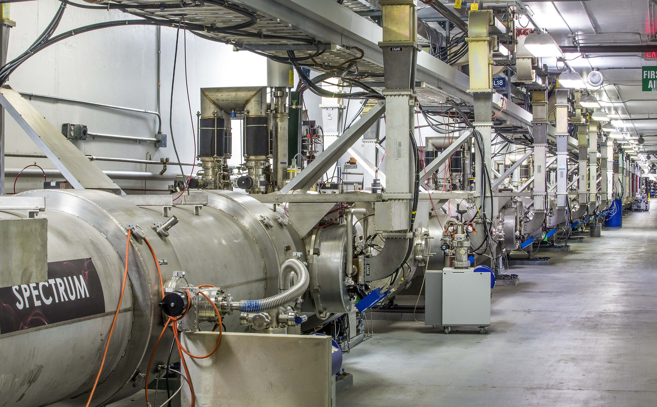
Considerable Progress in CEBAF Operations for 12 GeV Scientific Program
Completed first full year of 12 GeV Operations with many successes:
  4-Hall operation, achieving full power
  Complete tritium run and Glue-X Phase 1
We have developed a CEBAF Reliability Plan to improve reliability of the facility and energy performance of the accelerator
We made a significant investment in FY18 and that will continue
Cryogenic infrastructure investments are key
Reliability in FY18: 77.1%
Q1 Reliability in FY19: 85.3%
Successful DOE-NP Operations Review in July 2018
  Proposed baseline operations at 34 weeks/yr

Slide 5
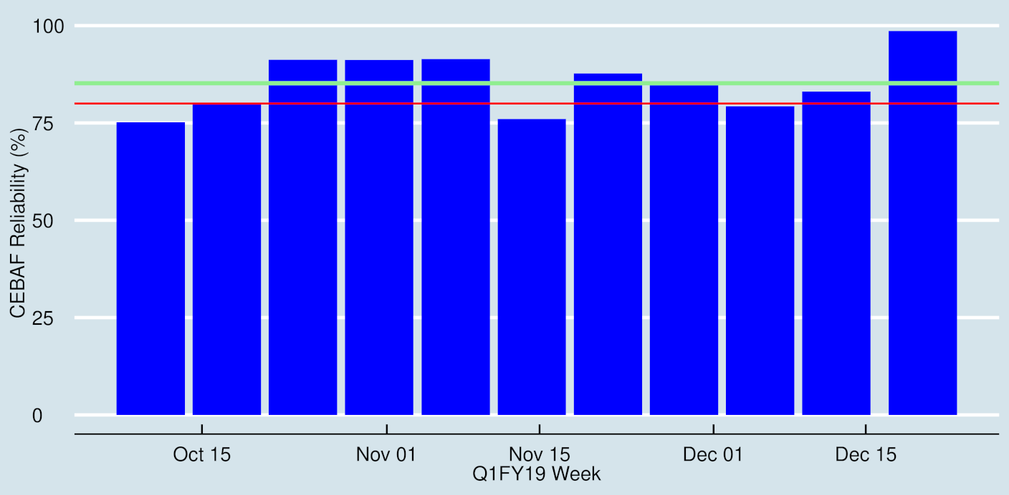
Q1FY19 DOE Performance Metric: Accelerator Reliability
First quarter in 12 GeV era with reliability > 80 %
805 MeV/linac, last eight days of the run, had reliability > 98%

Slide 6
Jefferson Lab’s Operating Budget Supports the 12 GeV Scientific Program
Recent challenge has been achieving adequate funding to fully operate our facility and address aging infrastructure
Operations funding was increased in FY18 and FY19 approps
Jefferson Lab Nuclear Physics funding ($M)
FY16 | FY17 | FY18 | FY19
107.6 | 111.2 | 122.9 | 128.9
Received DOE approval for CEBAF Center Renovation and Expansion project to renovate and expand our main building
Secured Jefferson Lab involvement in two additional accelerator construction projects, one at Oak Ridge NL, another at SLAC (Stanford U.)
We are working with DOE/NP to start MOLLER, and get SoLID moving forward
  Director’s Reviews in the planning stages

Slide 7
Our Goal is to Establish and Maintain CEBAF Operation of 34 Weeks Per Year
12 GeV Construction

Slide 8
12 GeV Approved Experiments by PHYSICS TOPICS
Topic | Hall A | Hall B | Hall C | Hall D | Other | Total
The Hadron spectra as probes of QCD | 0 | 2 | 1 | 3 | 0 | 6
The transverse structure of the hadrons | 6 | 3 | 3 | 1 | 0 | 13
The longitudinal structure of the hadrons | 2 | 3 | 7 | 0 | 0 | 12
The 3D structure of the hadrons | 5 | 9 | 6 | 0 | 0 | 20
Hadrons and cold nuclear matter | 8 | 5 | 7 | 0 | 1 | 21
Low-energy tests of the Standard Model and Fundamental Symmetries | 3 | 1 | 0 | 1 | 2 | 7
Total | 24 | 23 | 24 | 5 | 3 | 79
Total Experiments Completed | 6.7 | 4.1 | 3.7 | 1.0 | 0 | 15.5
Total Experiments Remaining | 17.3 | 18.9 | 20.3 | 4.0 | 3.0 | 63.5
Situation January 2018 Total = 76 (last year’s table showed 78 but there was a mistake in it)
Total Experiments Completed = 4.0
Total Experiments Remaining = 72.0
Approved in last year: Beam Dump eXperiment search (parasitic), polarized Wide-Angle Compton Scattering (release CA status), electrons for neutrinos

Slide 9
Jefferson Lab’s User Community Continues to Grow

Slide 10
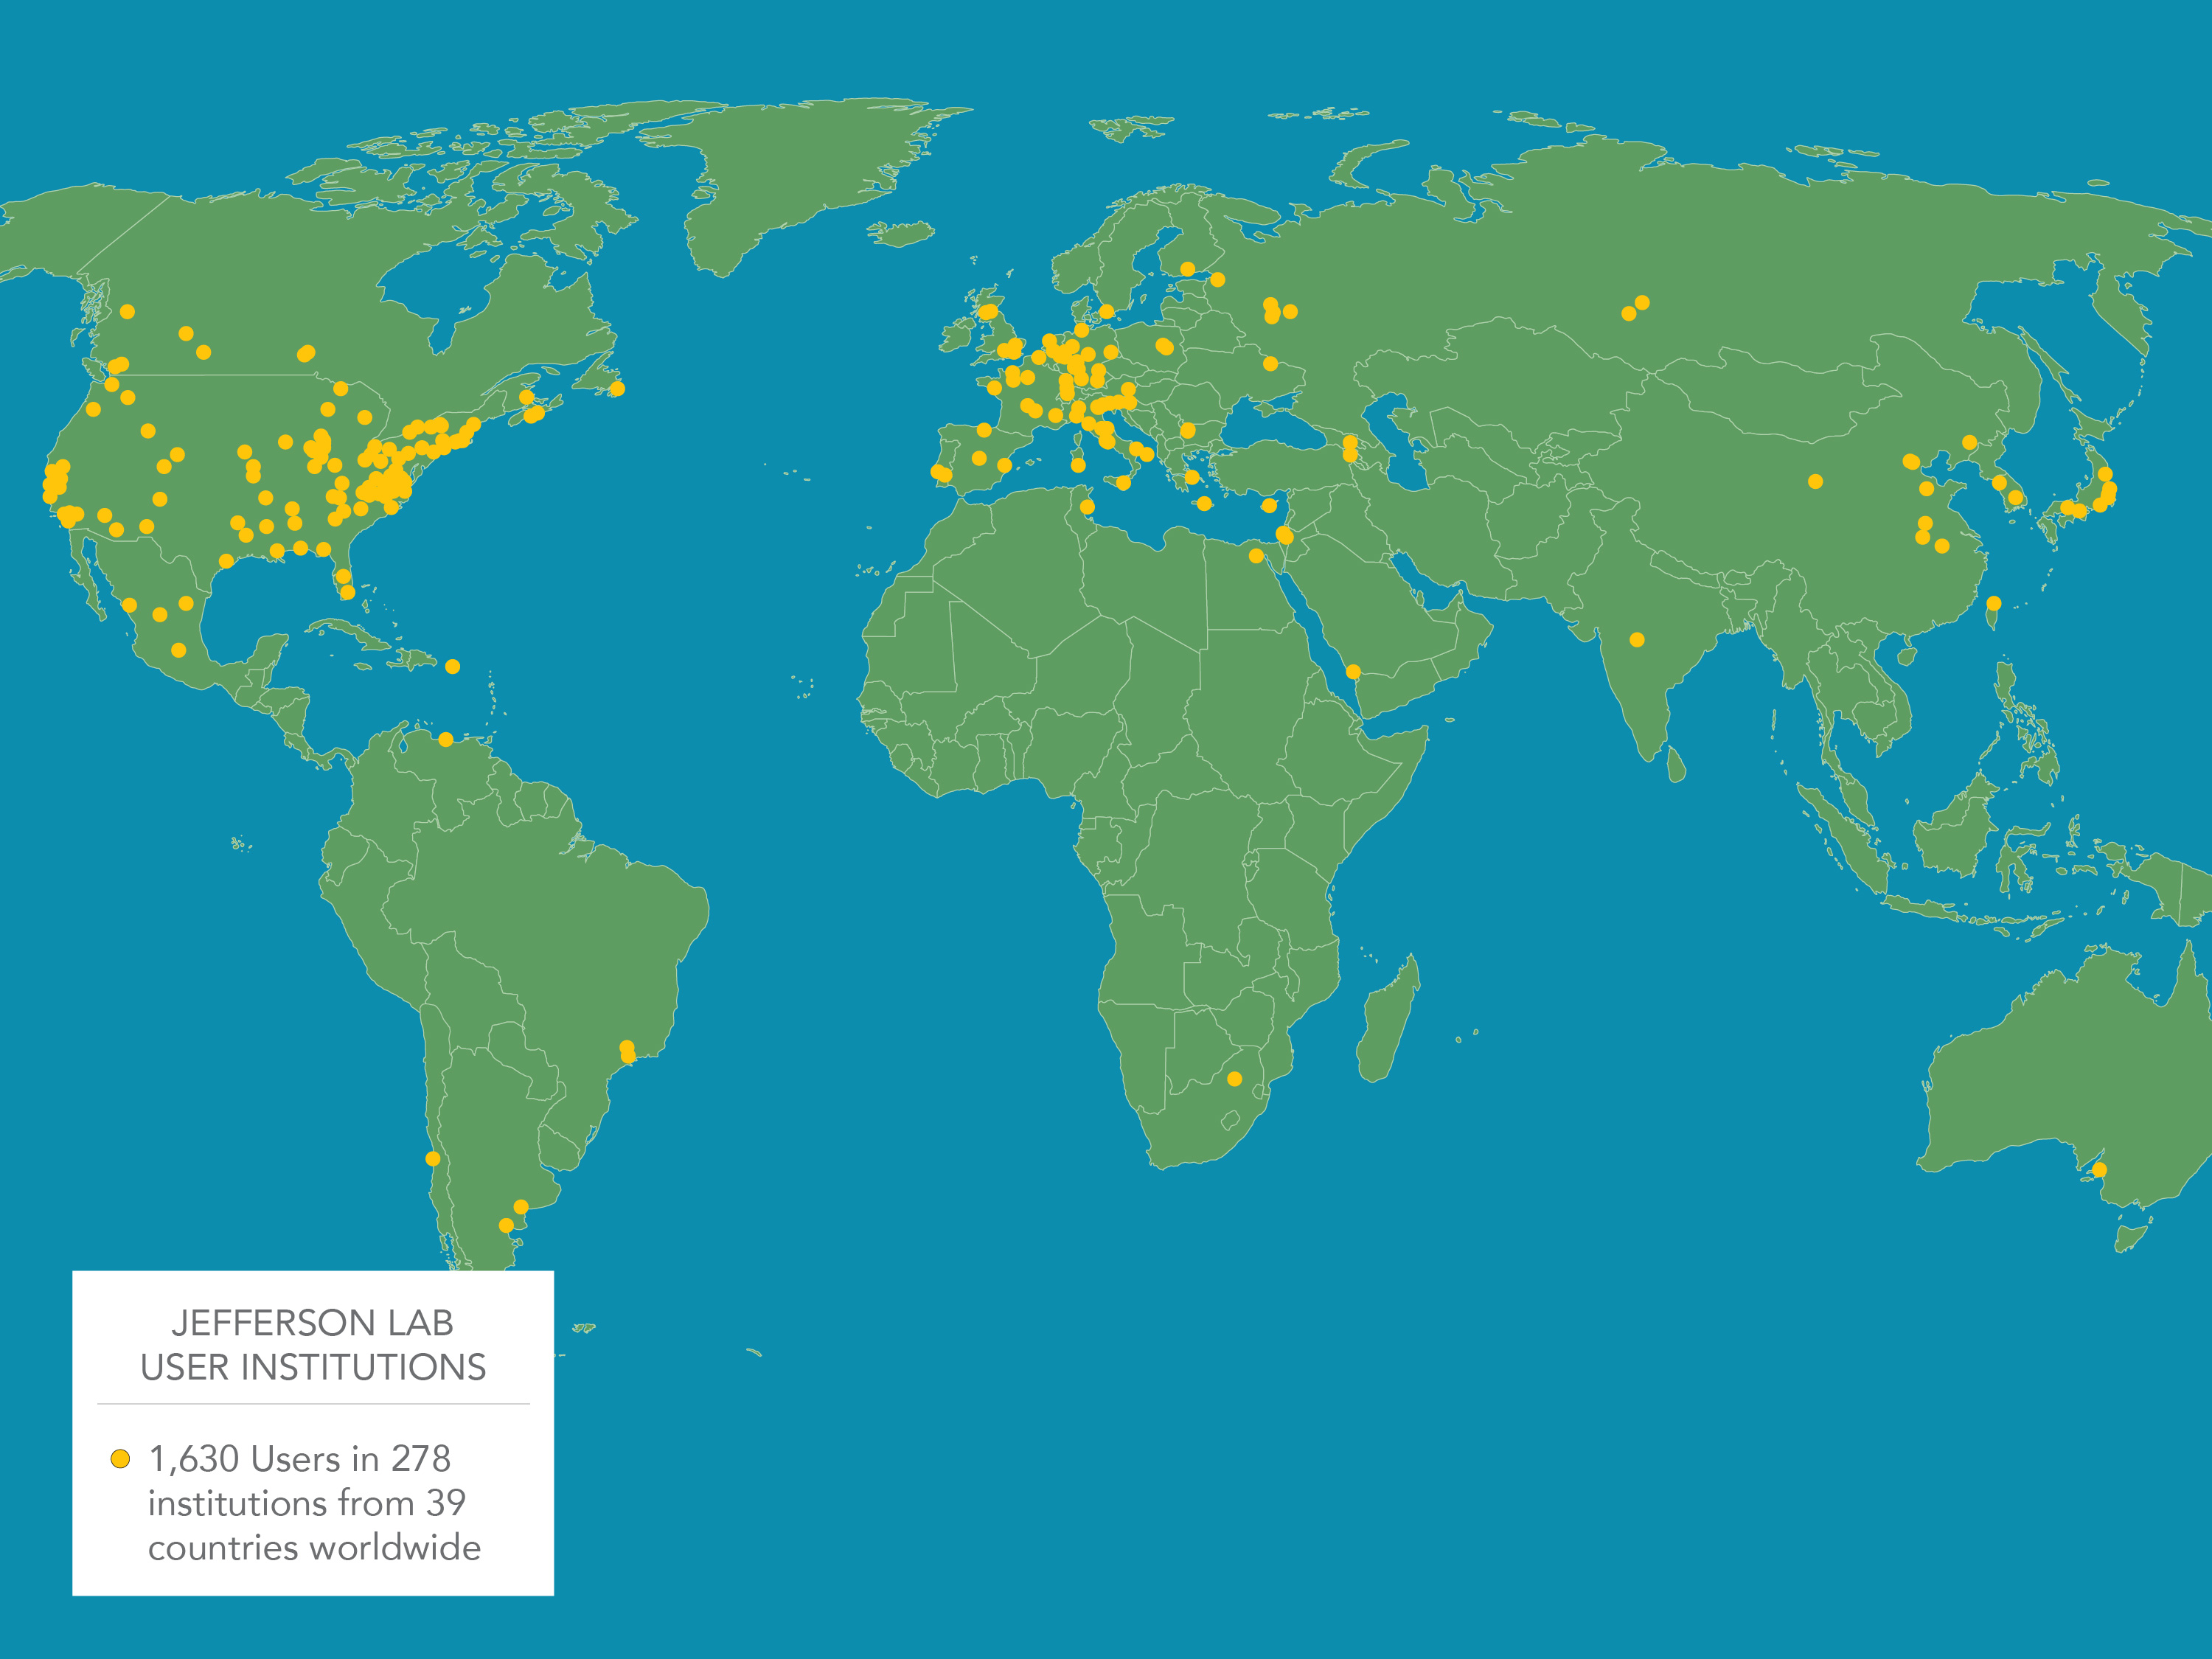
10
Jefferson Lab’s Scientific User Community

Slide 11
Electron-Ion Collider Planning
Federal Nuclear Science Advisory Cmte 2007 Long-Range Plan
“An Electron-Ion Collider (EIC) with polarized beams has been embraced by the U.S. nuclear science community as embodying the vision for reaching the next QCD frontier”
Federal Nuclear Science Advisory Cmte 2015 Long Range Plan
“We recommend a high-energy high-luminosity polarized EIC as the highest priority for new facility construction following the completion of FRIB.”
National Academy of Sciences – Assessment of U.S. Based Electron-Ion Collider Science (2018)
“…the committee finds a compelling scientific case for such a facility. The science questions that an EIC will answer are central to completing an understanding of atoms as well as being integral to the agenda of nuclear physics today.”

Slide 12

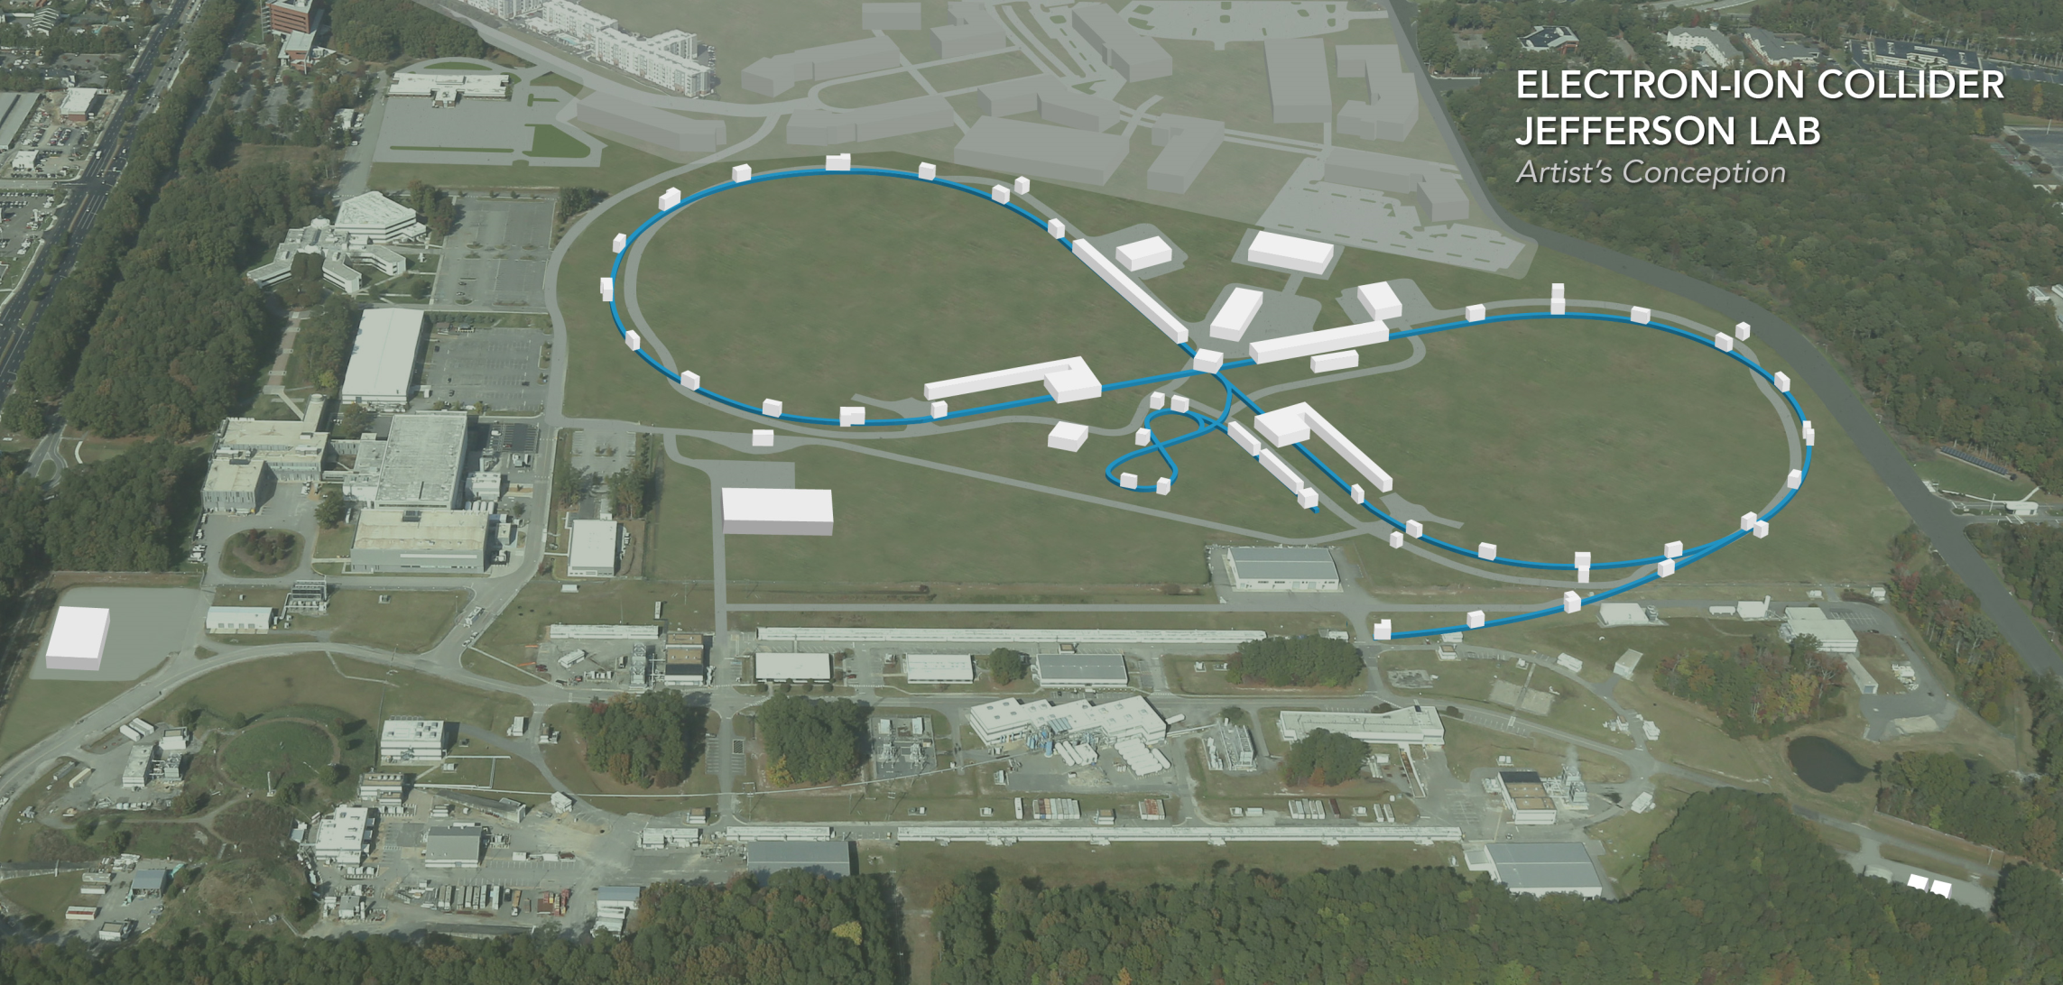
Jefferson Lab Electron Ion Collider
    Highly optimized greenfield design to deliver scientific goals – emphasis on:
      High Luminosity
      High Polarization and preservation
    Energy Range: 20 to 100 GeV
    Cost effective operations
Flexible timeframe for construction consistent w/running 12 GeV CEBAF
    Strong multi-institutional effort including: ANL, BNL, FNAL, LBNL, SLAC
    Carrying-out R&D on highest priority topics through DOE/NP EIC R&D Program
JLEIC Pre-CDR

Slide 13
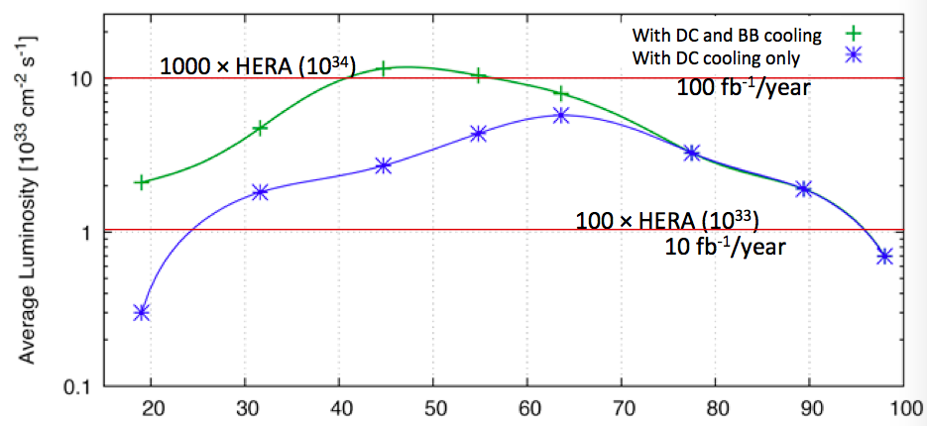
JLEIC: Update on design parameters
DocDB-doc-273-v3
Beam energy range
E_{e} 3 to 12 GeV (same as before)
E_{p} 30 to 200 GeV (enabled by 3T→6T dipoles) upgradable to 400 GeV (use HE-LHC/FCC development of 12T dipoles)

Slide 14
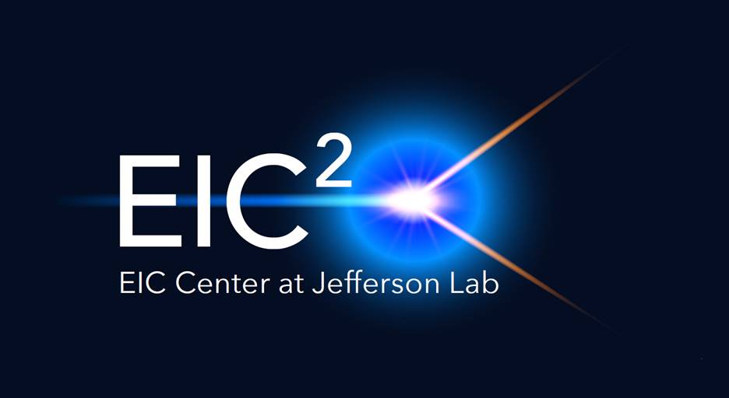
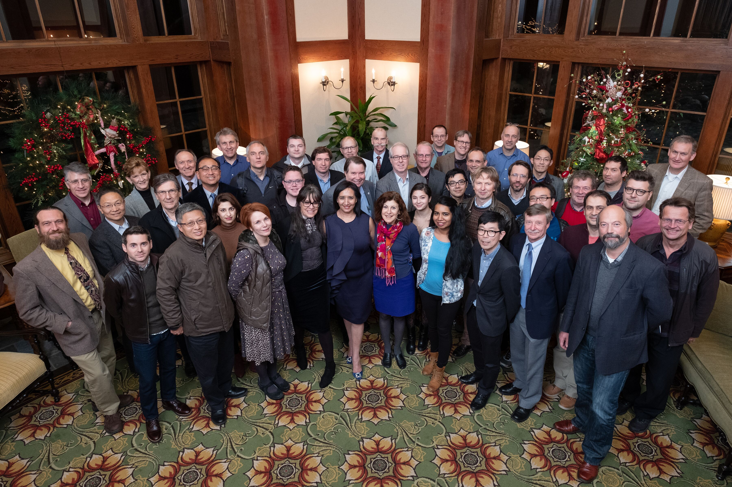
Two Centers Launched in 2018
eiccenter.org
Center for Nuclear Femtography:
Awarded $0.5M by Commonwealth of VA to bring VA university system around emerging field of science
Interdisciplinary challenge and opportunity: theoretical physics, experimental physics, computation, data science, statistics
Benefit to 12 GeV program and for strengthening position for EIC
The Electron-Ion Collider Center (EIC²@JLab) advances and promotes the science program at a future EIC facility, with emphasis on close connection of EIC science to JLab 12 GeV program
EIC themed seminars
Enhanced EIC content in HUGS summer school.
Graduate and Post-doc Fellowships
Visitor Program
Symposium on Imaging and Visualization in Science, Univ. Virginia, Dec. 10-11, 2018

Slide 15
Getting Work Done Safely is Our Highest Priority
Nothing is more important than accomplishing our work safely. Safety and Quality before Schedule! An emphasis on “Human Performance Improvement” Principle tenets: People are fallible; the goal is reducing severity and consequences of mistakes Have a questioning attitude: what could go wrong?

Slide 16
Perspective
The Lab is in good shape and in a strong position moving forward
We look forward to continuing to work with the user community to do all we can so that you can be successful
High priority for us is:
  Keeping up the strong support for CEBAF and Jefferson Lab to support CEBAF Operations at 34 weeks/year
  Successful execution of the Reliability Plan
  Preparing for next steps with the U.S. Electron-Ion Collider planning
  Delivering good project performance
For the User Community:
  I would ask that you be mindful of the competitive environment in which we operate
  Keep up the good work; proceed with appropriate sense of urgency
  Demonstrate the value of CEBAF and your physics research by delivering timely scientific results
  Articulate the excitement of the work that you are doing
  Thank you for your continued enthusiasm and support for Jefferson Lab and its future!

Slide 17
Thank you!

