Slide 1
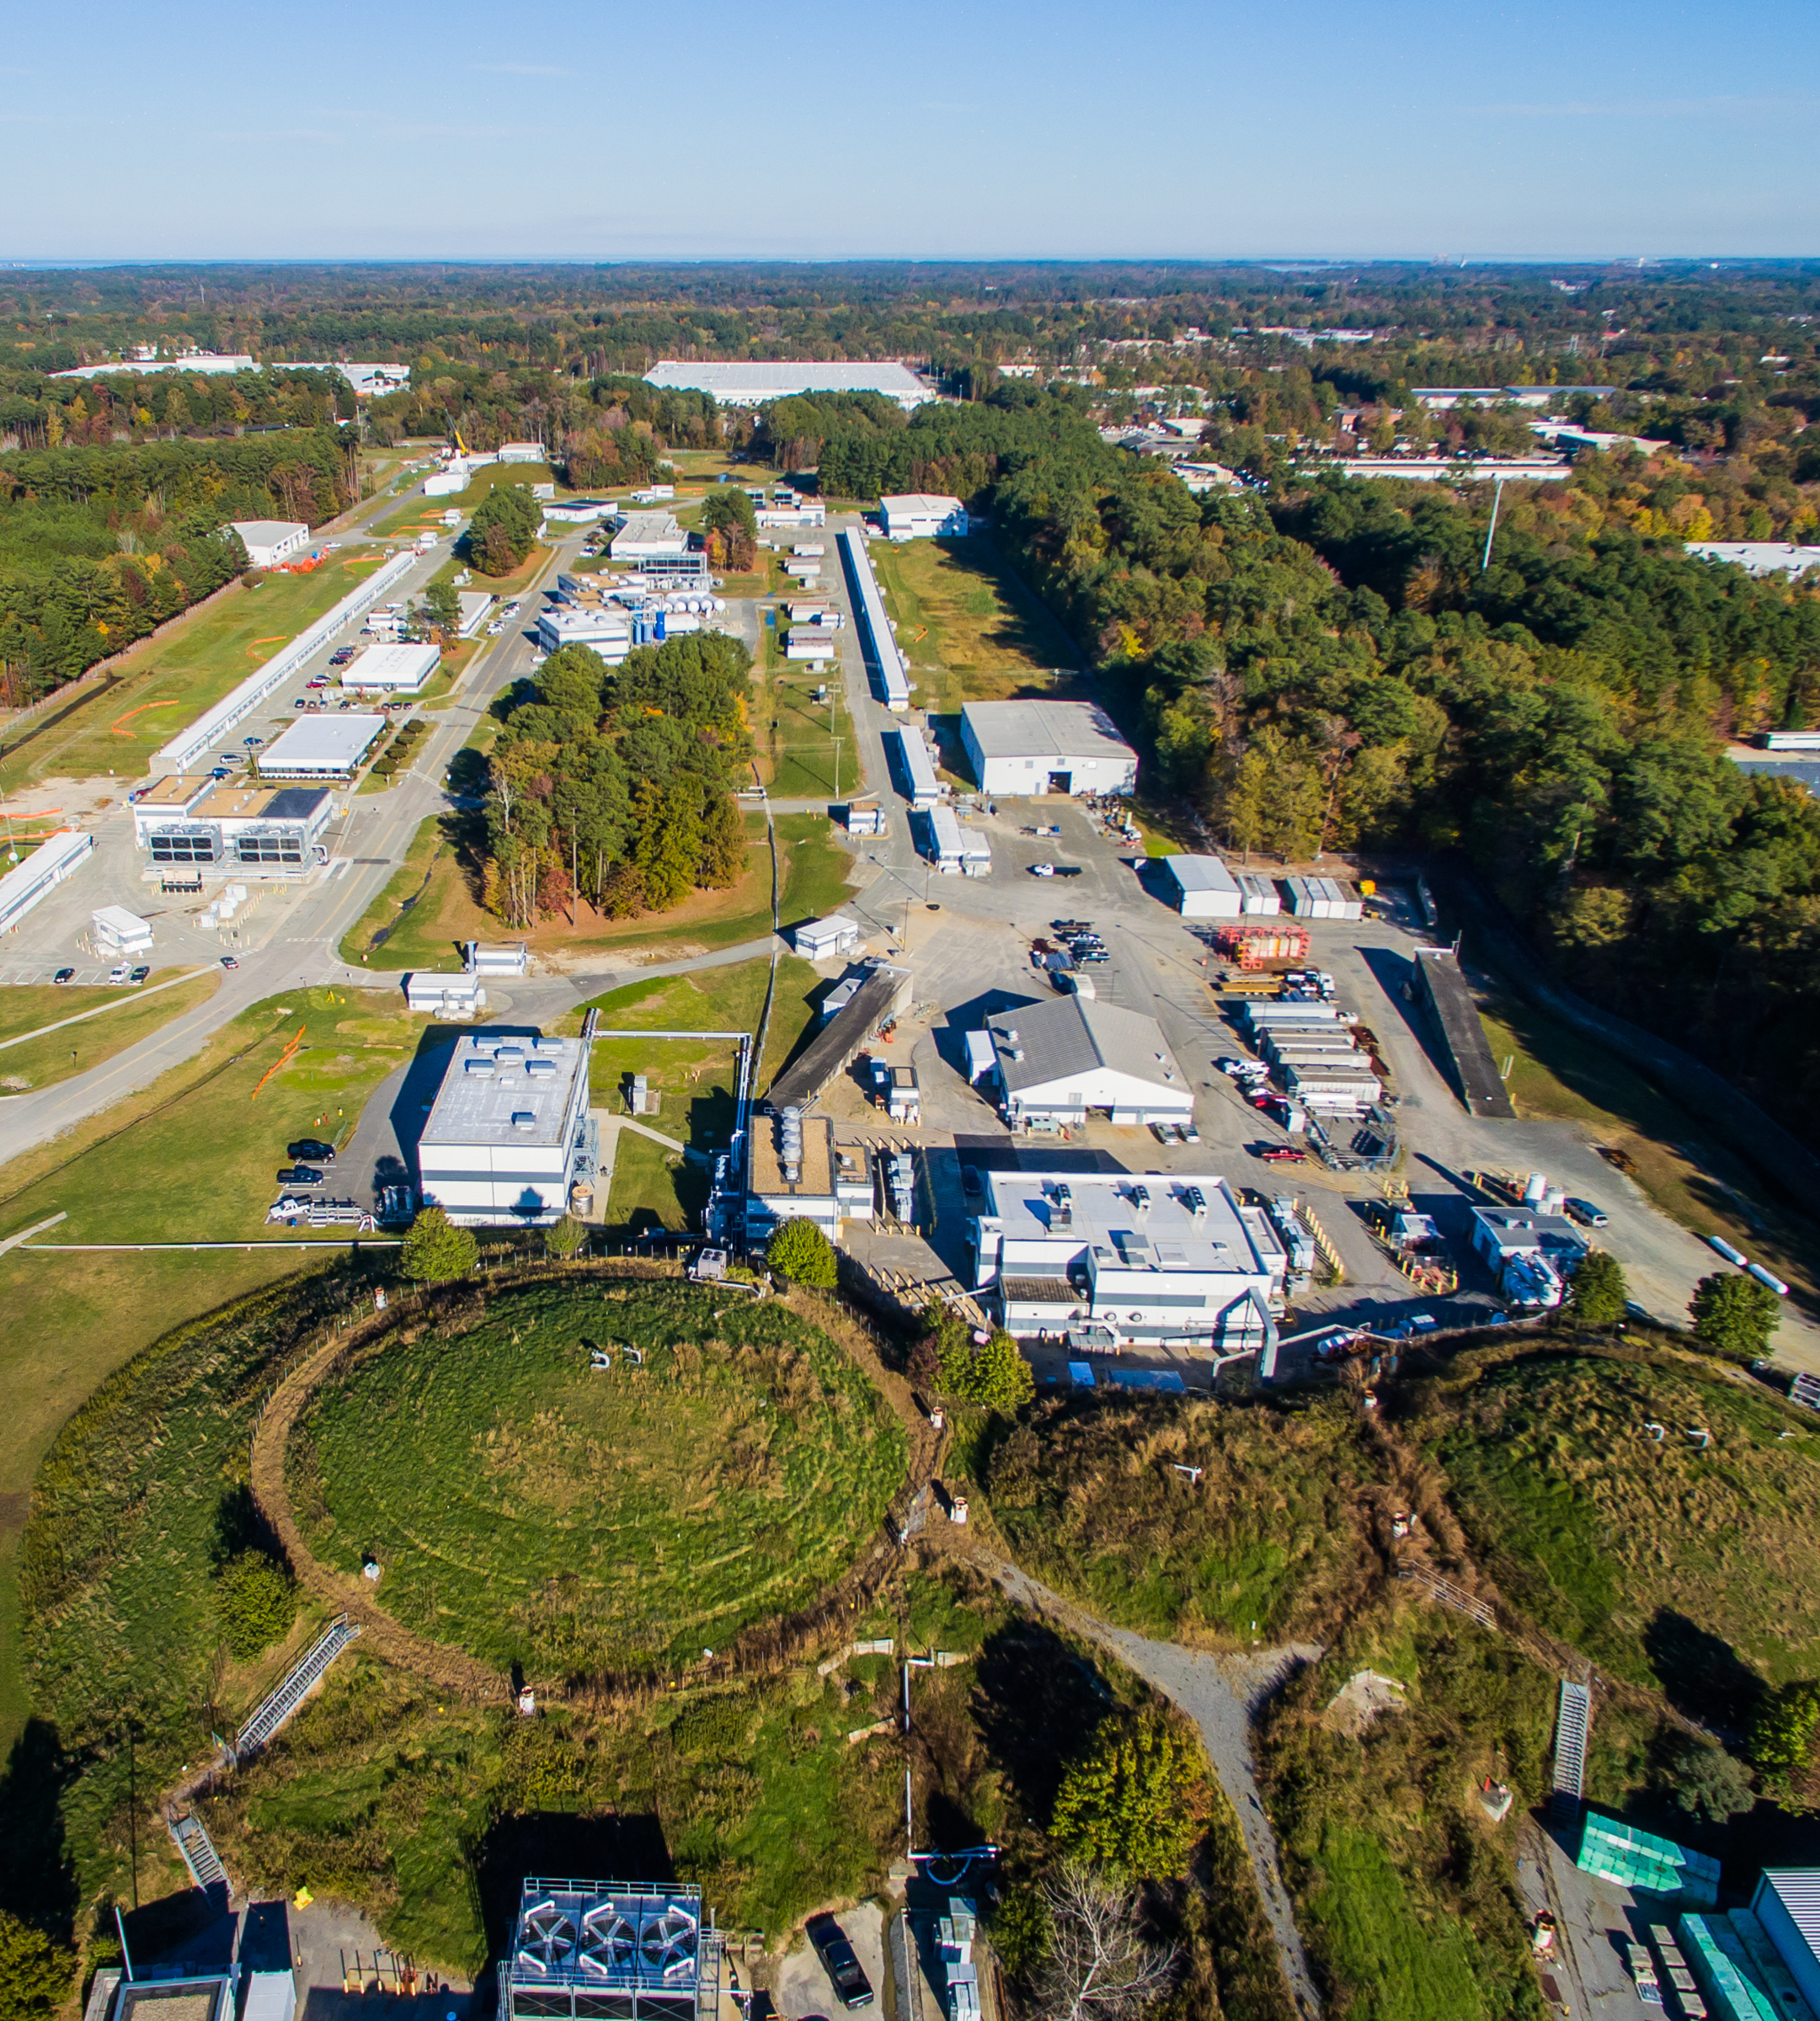
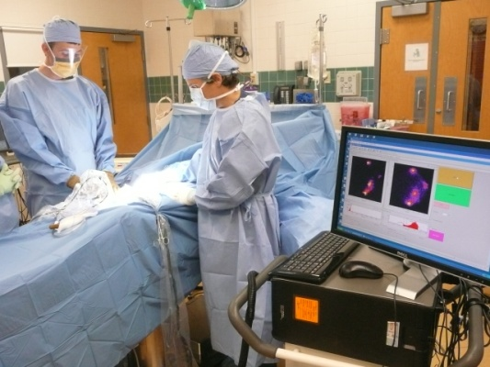
Medical Applications of Jefferson Lab Science
Cynthia Keppel
Medical Imaging

Slide 2
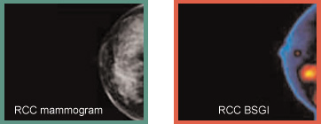
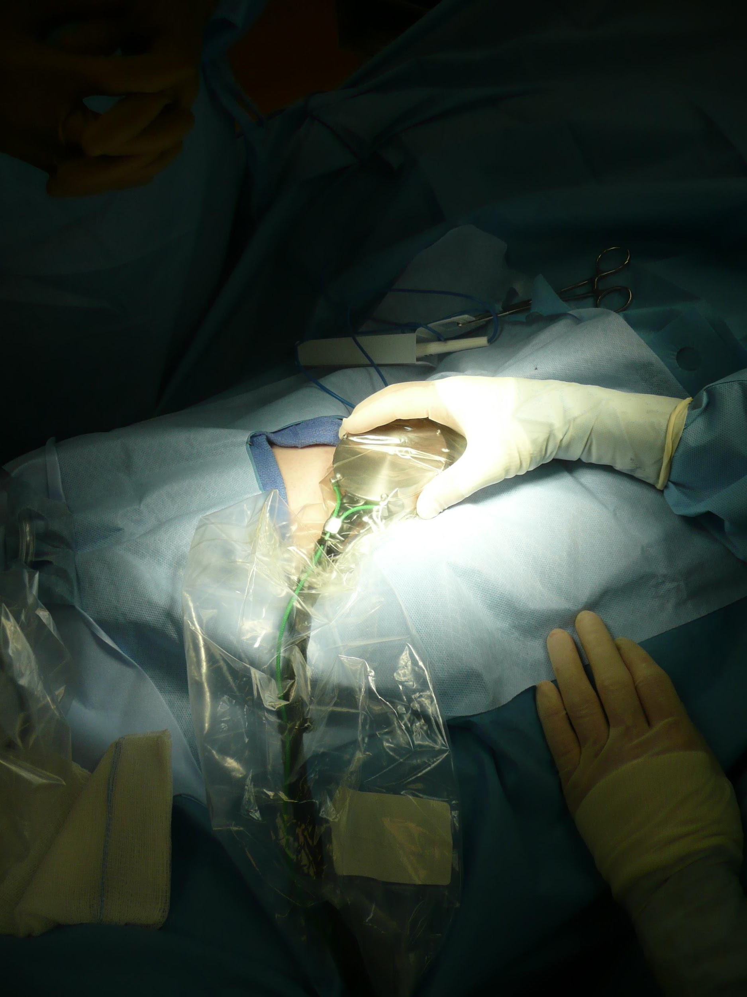
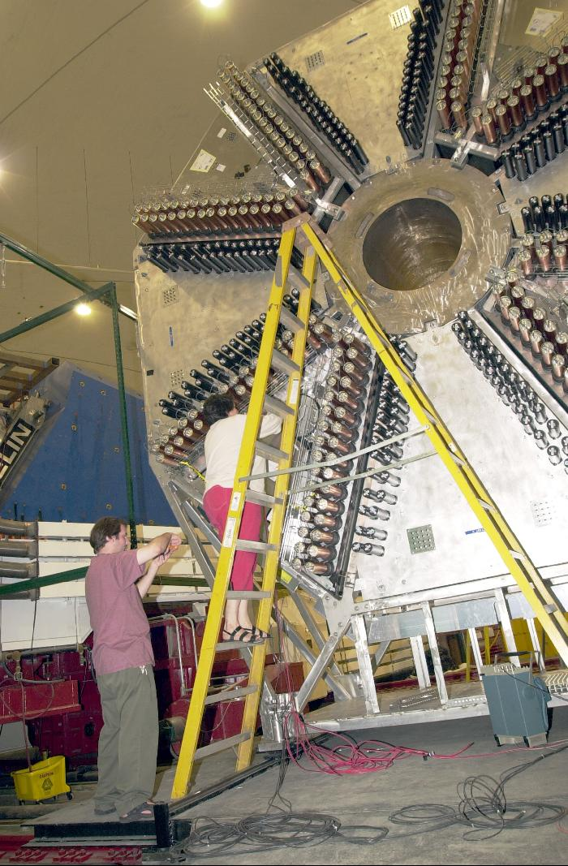
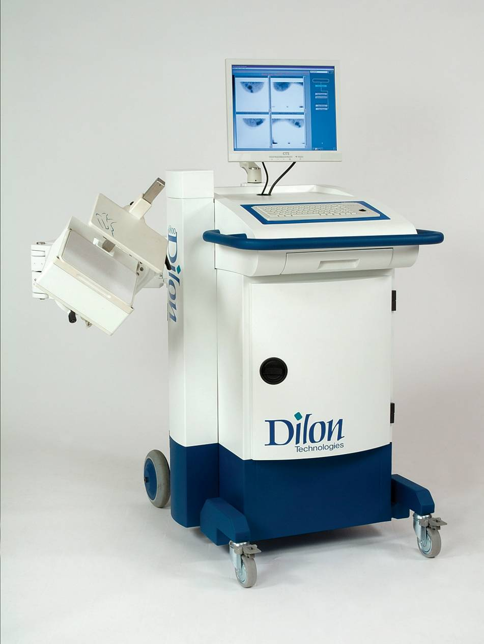
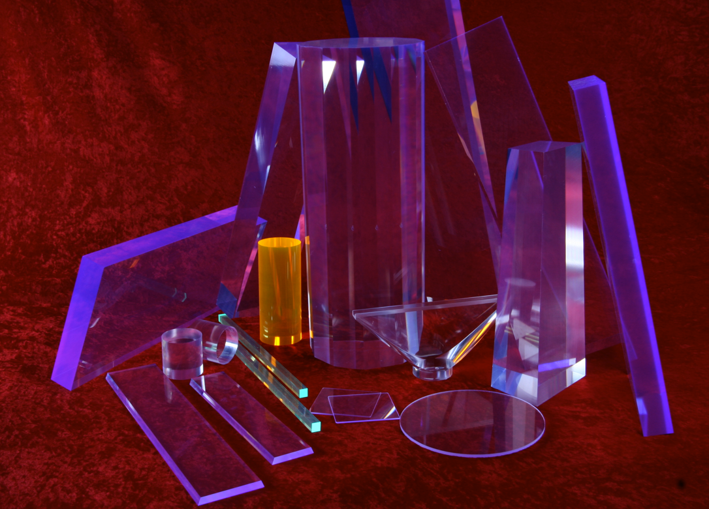
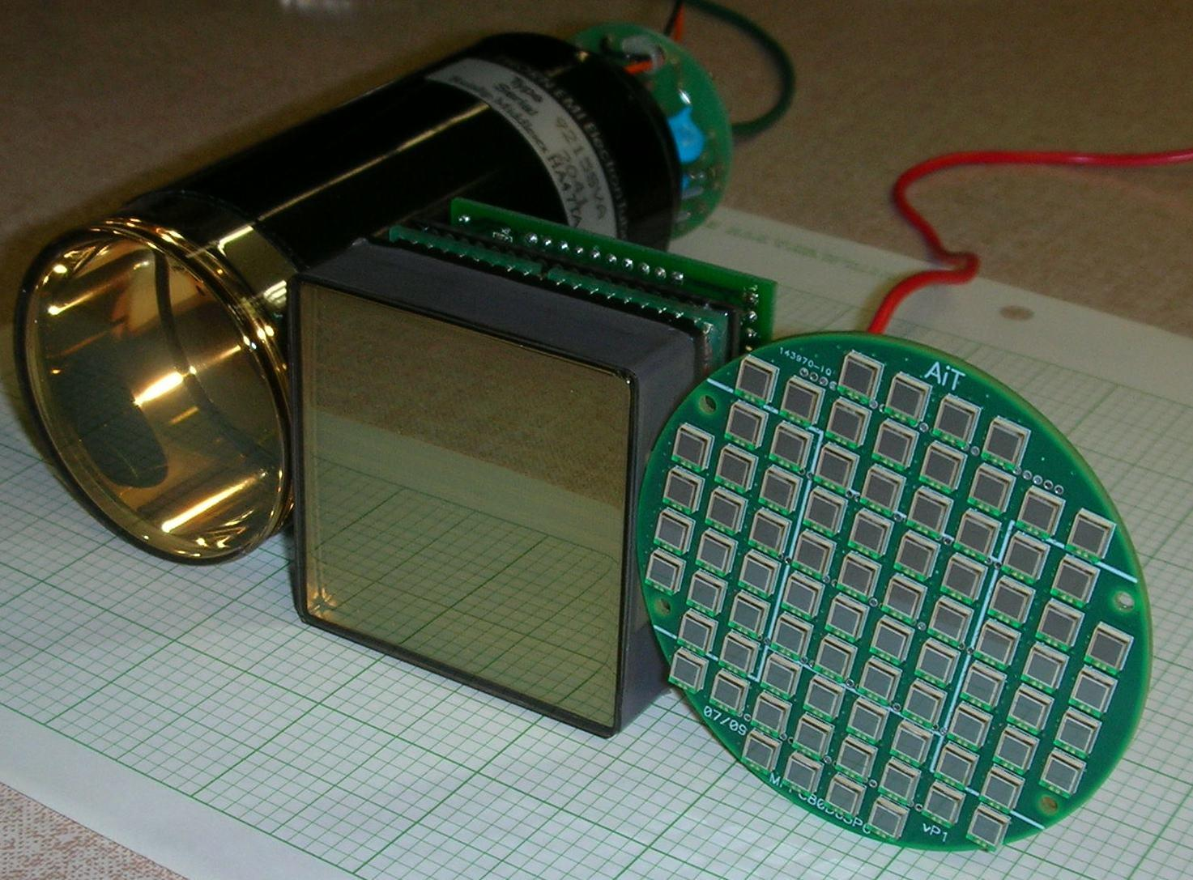
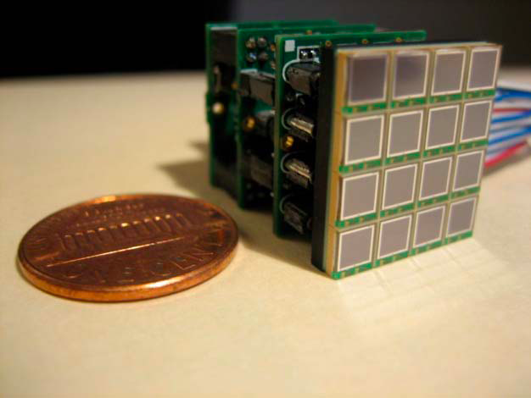
Detector Spin-Off Advances Patient Care
Nuclear physics detector technology developed to explore the structure of matter at Jefferson Lab leads to new and advanced tools for better patient care.
Tools for nuclear physics research photomultiplier tubes, silicon photo multipliers, scintillator and detector electronics.
Tools for better patient care
Hand held gamma camera to guide surgeons
Silicon photo multipliers provide precise imaging at low voltages
Now also wire-free and wireless, to give flexible motion without tethering
Compact gamma camera for breast cancer detection
Led to several Jefferson Lab patents and a start-up company
9
Notes:
2

Slide 3
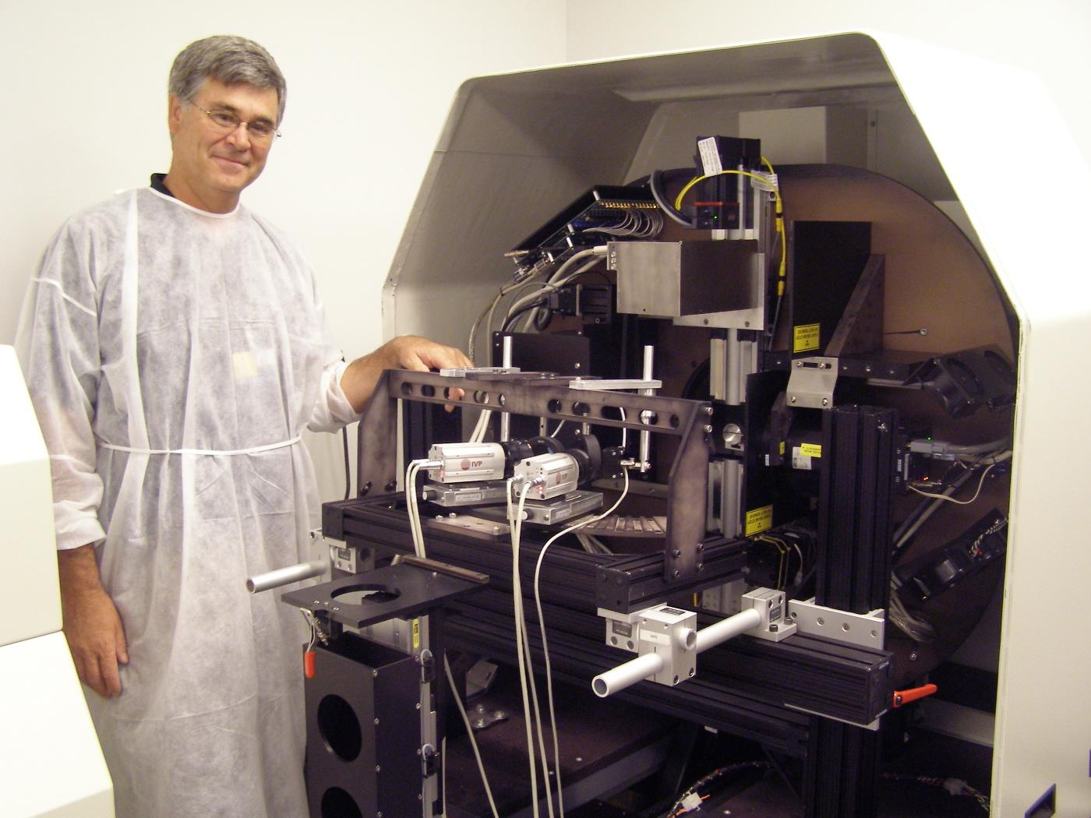
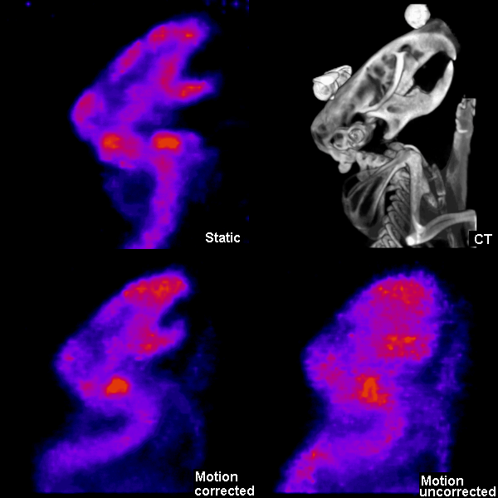
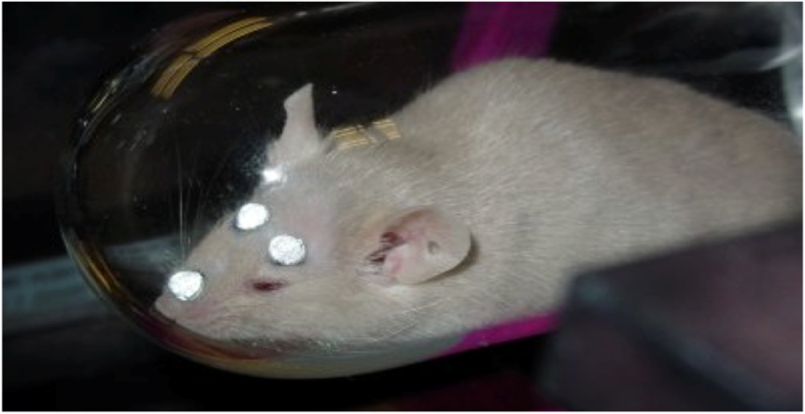
Advancing Brain Imaging Technologies
Methods based upon anesthesia inhibit/complicate brain based studies. Scientists work towards imaging methodology in awake humans to study neurological based diseases.
AwakeSPECT System is based on technology developed by Jefferson Lab, with contributions from ORNL, Johns Hopkins University and University of Maryland.
Utilizes custom-built gamma cameras, image processing system, infrared camera motion tracking system and commercial x-ray CT system.
Acquires functional brain images of conscious, unrestrained, and un-anesthetized mice.
Can aid research into Alzheimer’s, dementia, Parkinson’s, brain cancers, traumatic brain injury and drug addiction.
Gamma cameras based on nuclear physics detector technology.
Three IR markers attached to the head of a mouse enable the AwakeSPECT system to obtain detailed, functional images of the brain of a conscious mouse as it moves around inside a clear burrow.

Slide 4
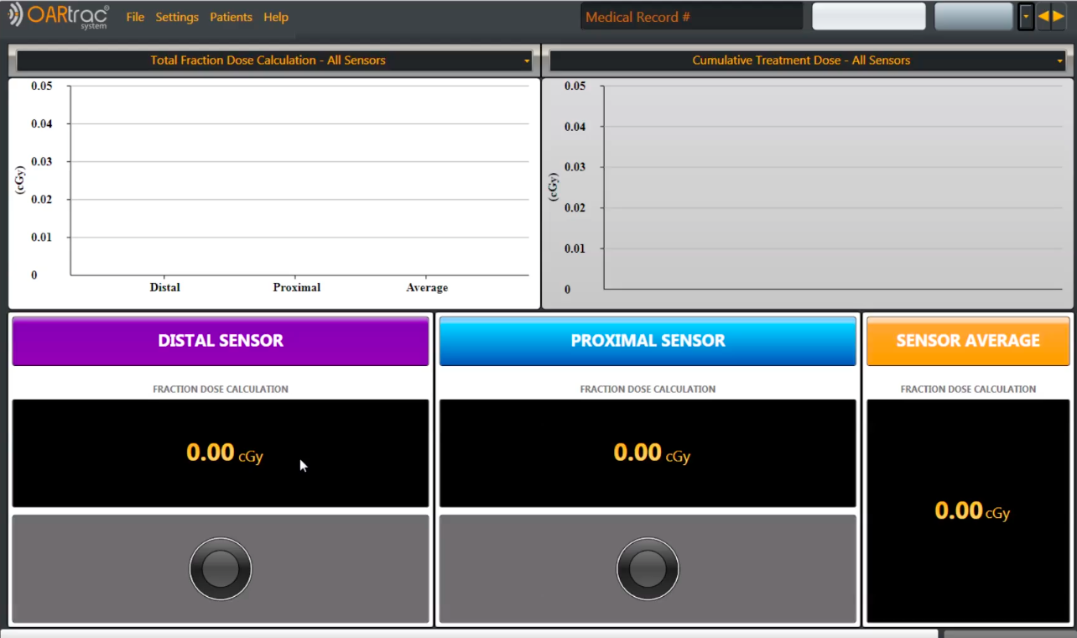
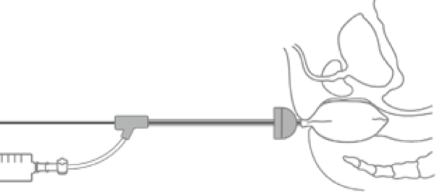
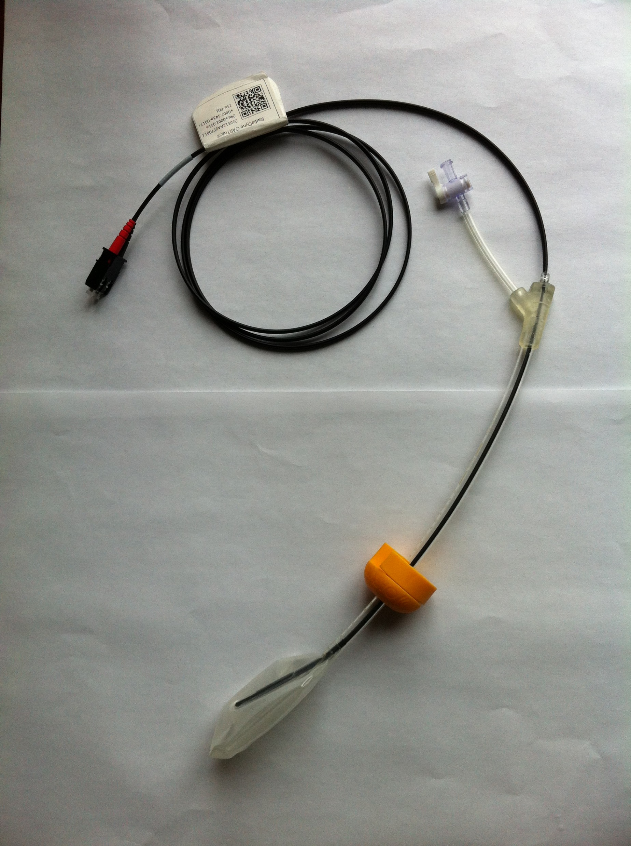
Enabling Real Time Radiation Treatment Dosimetry
Nuclear physics detector technology incorporates real time dosimetry monitoring into radiotherapy cancer treatment procedures.
Radiation treatment dose uncertainties can affect tumor control and may increase complications to surrounding normal tissues.
The current standard of practice does not provide information on actual delivered dose to the tumor.
Nuclear scientists at Jefferson Lab and Hampton University developed real-time, in vivo, dosimetry technology (3 patents)
Licensed to Radiadyne, created
Plastic scintillating detector (PSD) fiber technology with balloon-type patient organ immobilizers to measure real time dose delivery.
Scintillating Fiber
Fiber Core
Fiber Cladding
Fluorescent dopants
2018 Awards
11

Slide 5
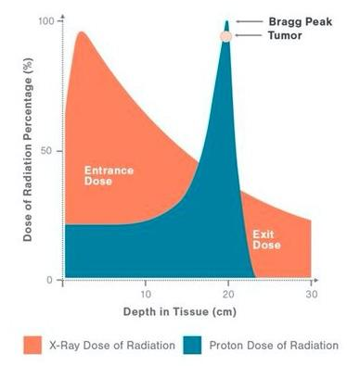
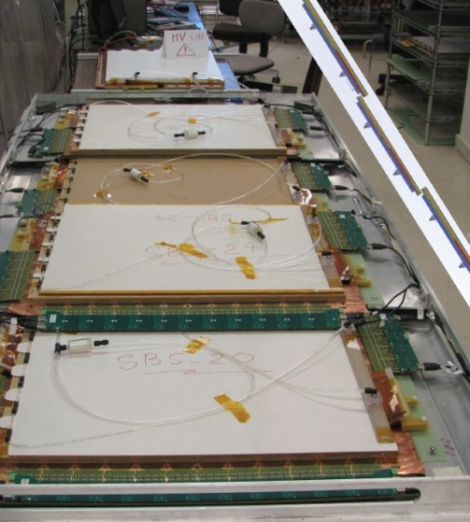
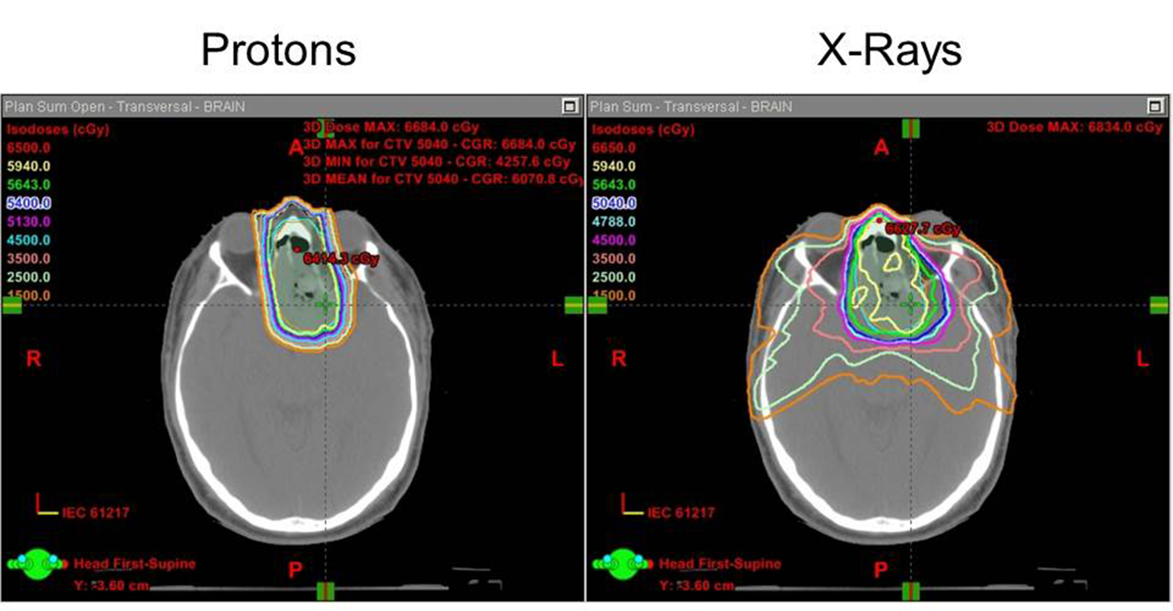
Proton Therapy for Cancer Treatment
Radiotherapy with a proton accelerator (up to 250 MeV) allows oncologists to design fine-tuned three-dimensional cancer treatment plans.
Fundamental nuclear physics: Bragg peak determines proton energy loss = dose to patient
Enables higher precision localized treatment
Has fewer side effects due to reduced stray radiation outside the tumor region
Nuclear physics technology to enable this includes simulation, beam transport, acceleration, dose monitoring, and more
Jefferson Lab scientists collaborate with the nearby Hampton University Proton Therapy Center, and other facilities.

Slide 6
Proton Therapy for Cancer Treatment
Radiotherapy with a proton accelerator (up to 250 MeV) allows oncologists to design fine-tuned three-dimensional cancer treatment plans.
Fundamental nuclear physics: Bragg peak determines proton energy loss = dose to patient
Enables higher precision localized treatment
Has fewer side effects due to reduced stray radiation outside the tumor region
Nuclear physics technology to enable this includes simulation, beam transport, acceleration, dose monitoring, and more
Jefferson Lab scientists collaborate with the nearby Hampton University Proton Therapy Center, and other facilities.

Slide 7
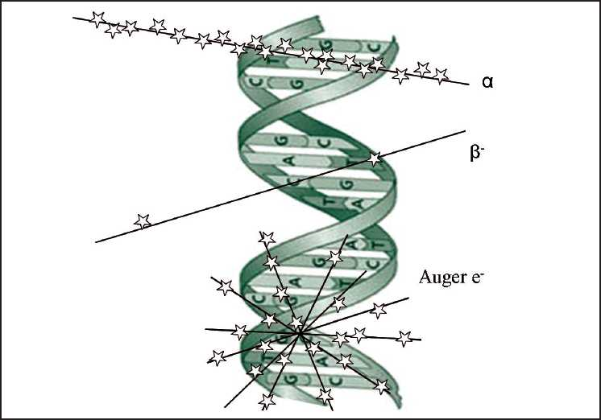
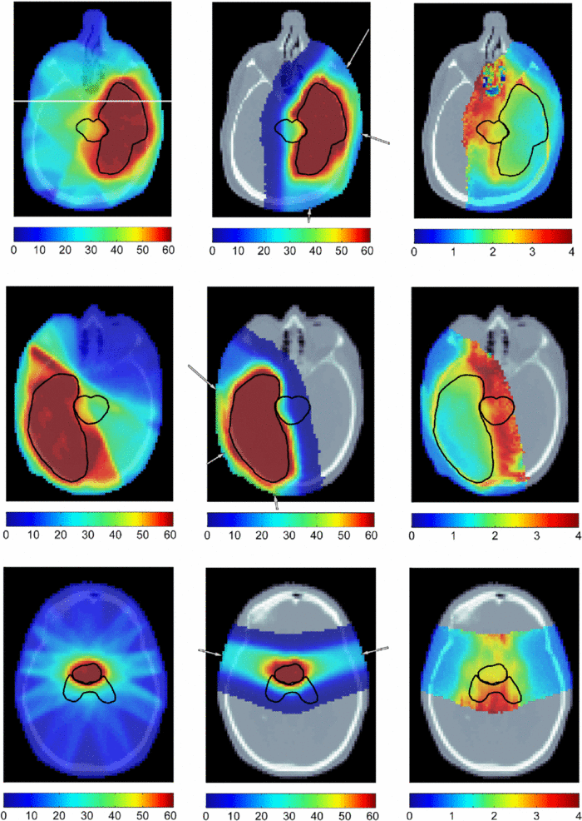
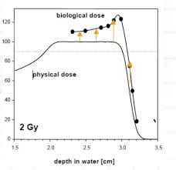
Proton Beam Simulation – “BioEclipse” Development
X-Ray proton RBE
Varian Medical Systems, VA CRCF, JLab, EVMS, HUPTI
“Relative Biological Effectiveness” (RBE) factor allows comparison between the killing power of radiation of type R to that of X-rays.
A single (RBE) value is currently applied to all proton patient treatment plans, RBE=1.1
We were able to show that RBE’s at the far side of the treatment volume can be significantly higher
Effect of RBE-weighted treatment planning on brain tumor dose distributions

Slide 8
On to the panel!
Jefferson Lab Hall C
Where are the roles for accelerator technology development in medicine?
Proton Therapy Gantry Under Construction

