Slide 1
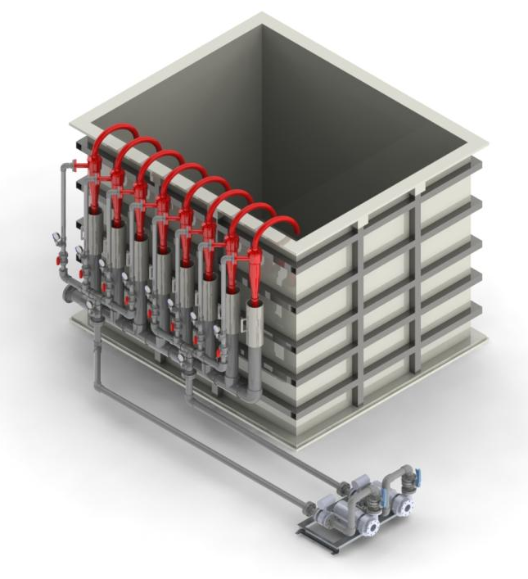
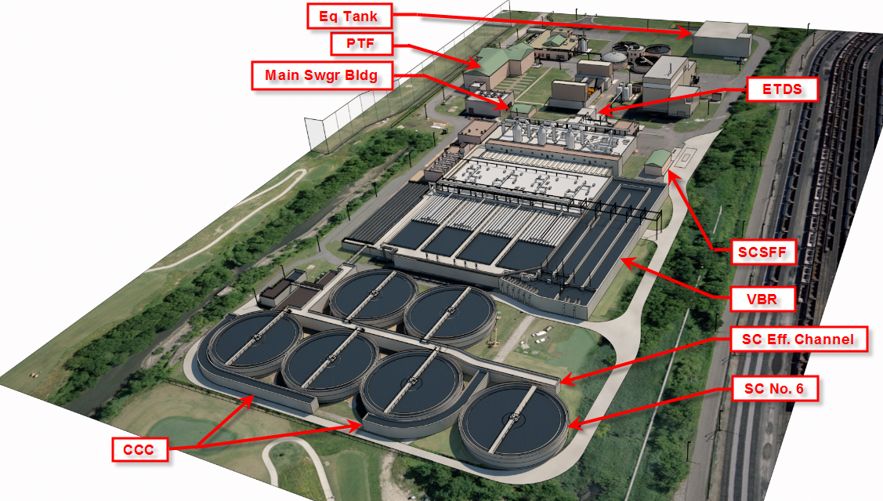

Intensifying Treatment and Resource Recovery SWIFTly and Pragmatically at HRSD
Charles B. Bott, PhD, PE, BCEE
Chief Technical Officer &
Director of Water Technology and Research
Hampton Roads Sanitation District

Slide 2
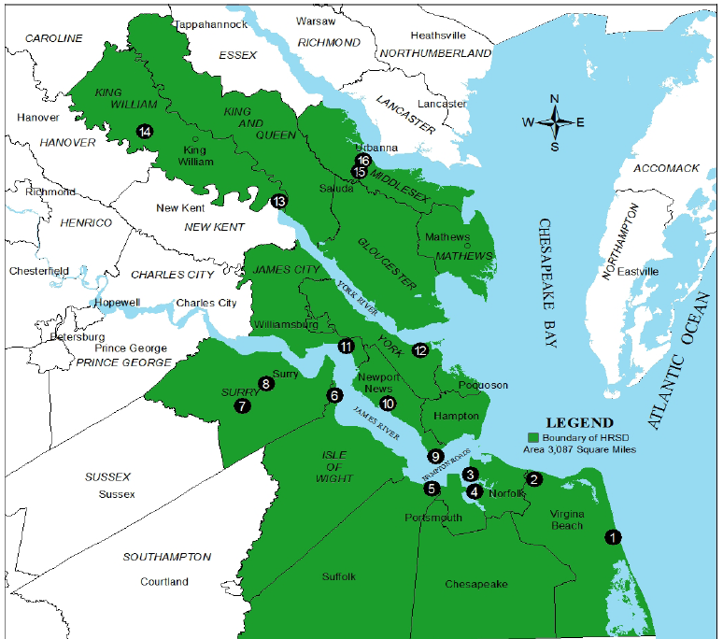
Who/What is HRSD?
Provide wastewater treatment for 18 localities (~250 MGD treatment capacity)
Serve 1.7 million people (20% of all Virginians)
Independent political subdivision with Governor appointed Commission
HRSD Treatment Facilities
Notes:
HRSD provides wastewater treatment for 18 localities, recently adding in Surry County services to the fold. We serve a population of about 1.7 million people which is about 1/5 of the population of Virginia. One unique aspect of our organization is that we are a true regional entity and are not controlled by any one jurisdiction. As an independent political subdivision oversight is provided by Governor appointed Commissioners. We own and operate 13 facilities with a combined capacity of roughly 250 MGD. The facility locations are denoted by the yellow diamonds. The SWIFT facilities are those located along the James and the lower York River – 7 facilities in all. One other note of importance to the discussion is that storm and sewer are separate systems and each of the Hampton Roads communities manages its own stormwater program.

Slide 3
Water Issues Challenging Virginia and Hampton Roads
Depletion of groundwater resources
  Including protection from saltwater contamination
Water quality concerns
  Chesapeake Bay restoration (N & P removal)
  Local water quality issues
Sea level rise
  Compounded by land subsidence
Wet weather sewer overflows (SSO)
  Compliance with Federal enforcement action
Notes:
Currently there are a number of water issues challenging the state and Hampton Roads. I’ll discuss each of these in further detail and I’ll introduce them briefly here to set the stage for why we were prompted to consider SWIFT.
Chief among them from a state perspective is a rapidly depleting groundwater resource which is not only a threat to the quantity of water supply but also to the quality.
Looking to surface water quality, Chesapeake Bay restoration efforts top the list of challenges. HRSD is on target to meet its nutrient reduction goals but the Hampton Roads region stormwater utilities are faced with costly and complex urban stormwater retrofits. Algal blooms continue to be a concern in the James River and in our local waters. Also, certainly not unique to Virginia, many of our local waters are failing to meet the bacterial water quality criteria for recreational or shellfish use.
Sea level rise is a significant challenge for the Hampton Roads region and this is further compounded by land subsidence.
Our region is also being challenged to reduce wet weather capacity related overflows as part of a federal consent decree.

Slide 4


Current state of wastewater in Hampton Roads
SURFACE WATER 80%
HRSD costs are rising to treat water to higher standards. Treated water currently discharged to area waterways – no beneficial use.
OCEAN
GROUND WATER 20%
AQUIFER

Slide 5

HRSD’s Vision for Managed Aquifer Recharge in Eastern Virginia
Notes:
The title Master is a blank slide with no graphics so you aren’t locked in to type boxes or a particular layout.
PLEASE NOTE: Slide numbers are on the Master pages, and can be turned on-off by selecting “Header and Footer” from the VIEW menu.
Slide numbering begins on the first content slide, and the title slide has no number.

Slide 6
SWIFT – Sustainable Water Initiative for Tomorrow
Treat water to meet drinking water standards and replenish the aquifer with clean water to:
  Provide regulatory stability for wastewater treatment
  Provide a sustainable supply of groundwater
  Reduce nutrient discharges to the Bay
  Reduce the rate of land subsidence
Advanced Water Treatment
SWIFT H2O
AQUIFER
Ocean
Notes:
Need to break the aquifer mining cycle by adding an advanced water treatment plant at our existing plants sites and injecting that clean water back into the aquifer

Slide 7
The Challenges/Opportunities for HRSD
~$750M in Nutrient Removal Upgrades by 2021.
  Sidestream treatment: anammox/deammonification & struvite recovery
  More sophisticated mainstream process controls
Biosolids – strong reliance on old Multiple Hearth Incinerators
  Thermal hydrolysis and centralized digestion
~$2.2B in Consent Decreed Mandated Upgrades to Reduce Sanitary Sewer Overflows over 20 years
  Integrated plan to do SWIFT first – Submitted to EPA in October 2017
SWIFT = very large managed aquifer recharge effort pending
  Advanced Water Treatment based on Ozone/Biofiltration/GAC/UV
  ~120 MGD; ~$1B

Slide 8
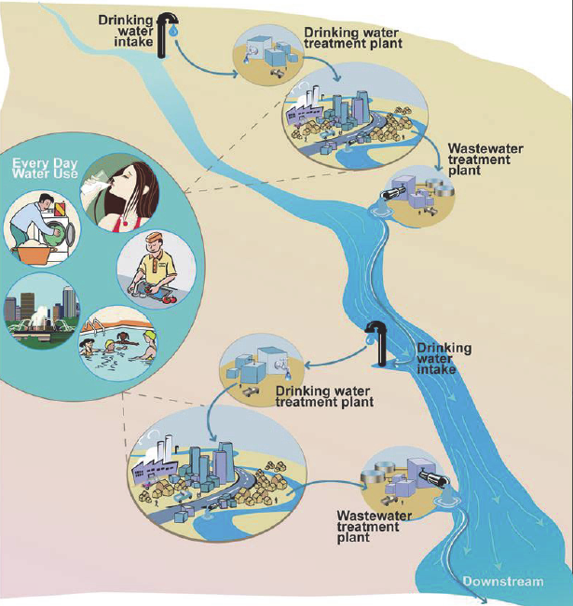
De Facto water recycling
Common throughout the world and in Virginia
  James River
  Shenandoah
  Potomac
  Roanoke River Basin (Lake Gaston)

Slide 9
Water recycling opportunities
Treatment Plant Effluent
Notes:
Non-potable – lost YR refinery, have tried to make several other projects work – business case associated with scalping plant for industrial reuse is tough

Slide 10
Operational Potable Reuse Cases
Project | Location | Type of Potable Reuse | Year | Capacity | Current Advanced Treatment Process
Montebello Forebay, CA | Coastal | GW recharge via spreading basins | 1962 | 44 mgd | GMF + Cl₂ + SAT (spreading basins)
Windhoek, Namibia | Inland | Direct potable reuse | 1968 | 5.5 mgd | O₃ + Coag + DAF + GMF + O₃/H₂O₂ + BAC + GAC + UF + Cl₂ (process as of 2002)
UOSA, VA | Inland | Surface water augmentation | 1978 | 54 mgd | Lime + GMF + GAC + Cl₂
Hueco Bolson, El Paso, TX | Inland | GW recharge via direct injection and spreading basins | 1985 | 10 mgd | Lime + GMF + Ozone + GAC + Cl₂
Clayton County, GA | Inland | Surface water augmentation | 1985 | 18 mgd | Cl₂ + UV disinfection + SAT (wetlands)
West Basin, El Segundo, CA | Coastal | GW recharge via direct injection | 1993 | 12.5 mgd | MF + RO + UVAOP
Scottsdale, AZ | Inland | GW recharge via direct injection | 1999 | 20 mgd | MF + RO + Cl₂
Gwinnett County, GA | Inland | Surface water augmentation | 2000 | 60 mgd | Coag/floc/sed + UF + Ozone + GAC + Ozone
NEWater, Singapore | Coastal | Surface water augmentation | 2000 | 146 mgd (5 plants) | MF + RO + UV disinfection
Los Alamitos, CA | Coastal | GW recharge via direct injection | 2006 | 3.0 mgd | MF + RO + UV disinfection
Chino GW Recharge, CA | Inland | GW recharge via spreading basins | 2007 | 18 mgd | GMF + Cl₂ + SAT (spreading basins)
GWRS, Orange County, CA | Coastal | GW recharge via direct injection and spreading basins | 2008 | 70 mgd | MF + RO + UVAOP + SAT (spreading basins for a portion of the flow)
Queensland, Australia | Coastal | Surface water augmentation | 2009 | 66 mgd via three plants | MF + RO + UVAOP
Arapahoe County, CO | Inland | GW recharge via spreading | 2009 | 9 mgd | SAT (via RBF) + RO + UVAOP
Loudoun County, VA | Inland | Surface water augmentation | 2009 | 11 mgd | MBR + GAC + UV
Big Spring (Wichita Falls), TX | Inland | Direct potable reuse through raw water blending | 2013 | 1.8 mgd | MF + RO + UVAOP
Notes:
Highlight direct potable – Namibia and Big Spring
Yellow is direct aquifer injection – not distribution of techs
Red is VA
Not a full list – other global examples

Slide 11
Water recycling - Surface water augmentation
Examples:
  Upper Occoquan Service Authority – Northern VA
  Gwinnett County (Georgia)
  Singapore NEWater

Slide 12
Water recycling - Groundwater recharge via direct injection
+WTP
Examples:
  Groundwater Replenishment System (Orange County, CA)
  West Basin (El Segundo, CA)
  Los Alamitos (Long Beach, CA)
  Scottsdale Water Campus (AZ)
  Hueco Bolson (El Paso, TX)
Notes:
Must move the important drinking WTP elements into the AWTP – reorder and make logical process sequence – providing same level of tmt

Slide 13
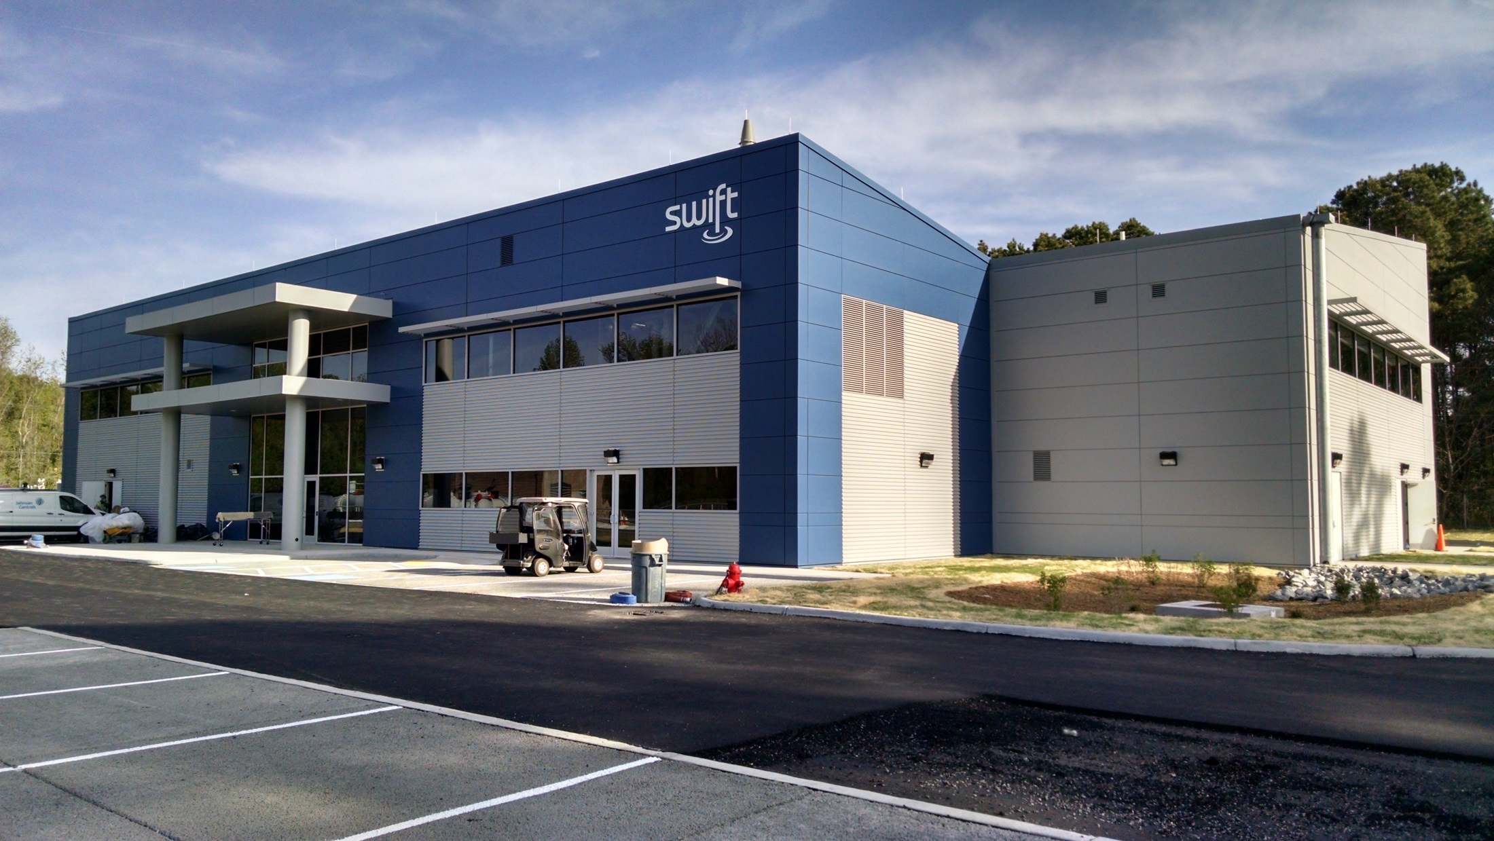
SWIFT Research Center
(3.8 MLD AWT + recharge well + monitoring wells +
public outreach and education center + research facilities)

Slide 14
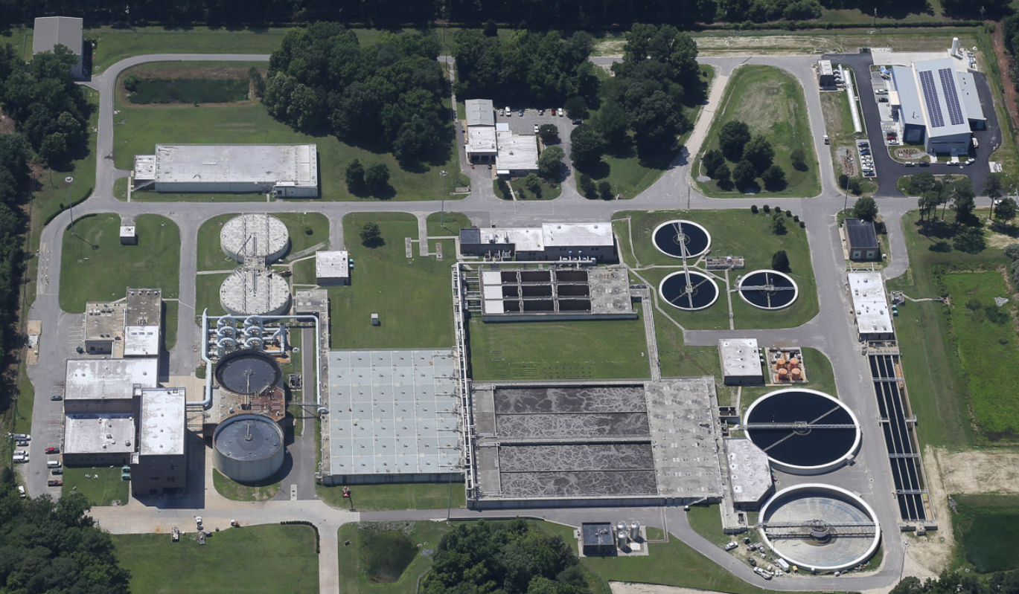
SWIFT Research Center at HRSD Nansemond Treatment Plant (30 MGD)

Slide 15
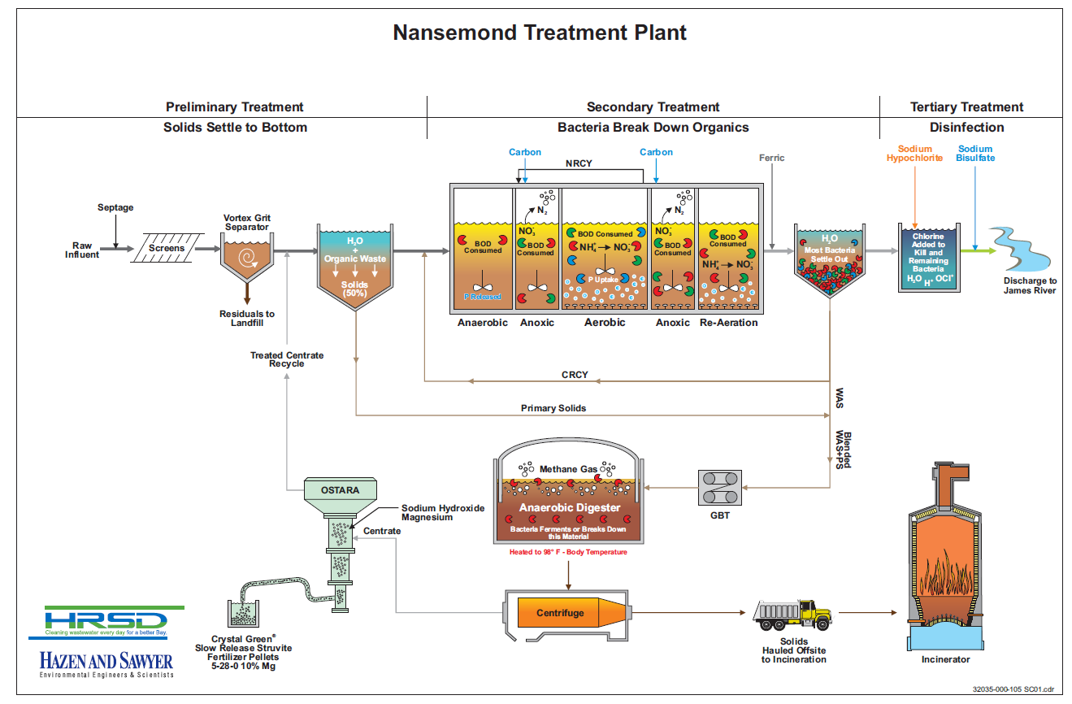
Nansemond Plant Schematic

Slide 16
Process Flow Diagram for SWIFT Research Center

Slide 17
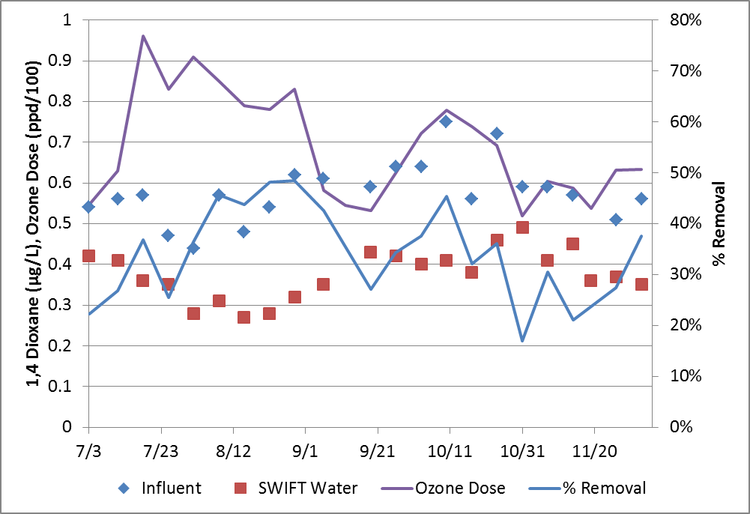
1,4-Dioxane
Trace organic included on the EPA Contaminant Candidate List 3
CA Drinking Water Notification Limit = 1 µg/L
  Partial removal by hydroxyl radical through ozonation
  Biodegraded in biologically active filters (some)
  Adsorption on virgin GAC

Slide 18
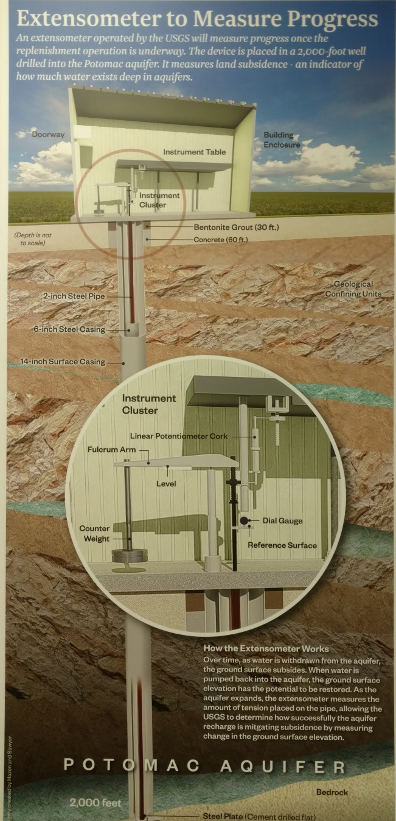
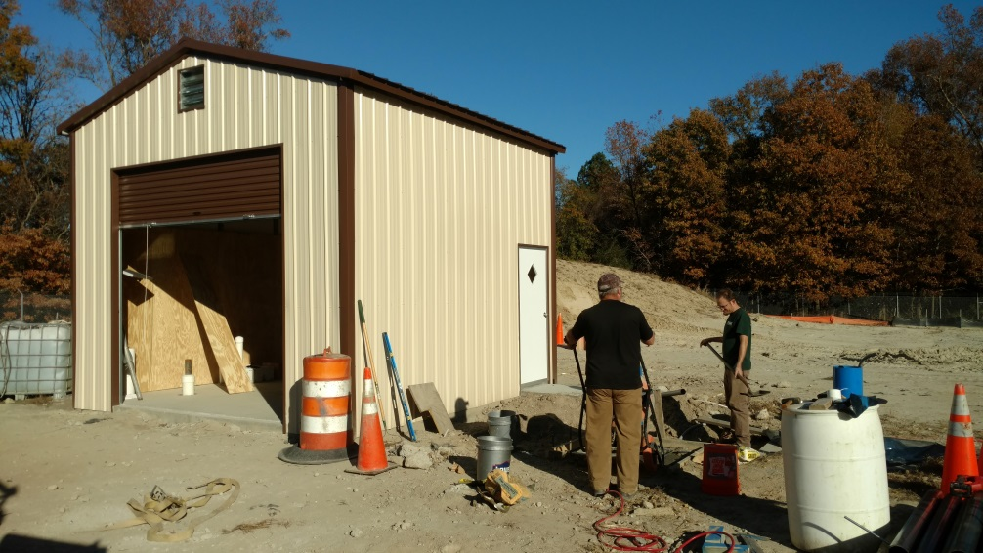
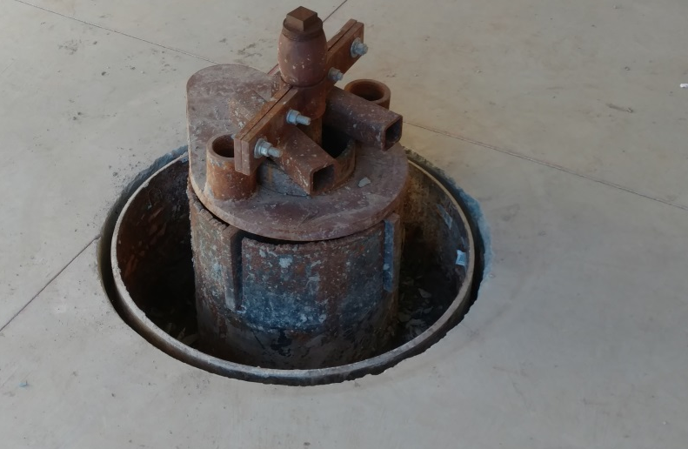
Installation of Extensometer to monitor impact on land subsidence
  Operational as of March 2018
  $1M in partnership with USGS and Virginia

Slide 19
Technology Implementation at HRSD is Driven by:
MINIMIZING Resource Utilization:
  Energy
  Chemicals
  Labor (operations, maintenance, instrumentation…)
  Concrete, footprint, land area
MAXIMIZING Resource Recovery (business case must be good)
  Water
  P
  N (can’t compete)
  CH₄ – biogas (electricity, CNG, etc)
  Heat
  Hydraulic energy
  Chemicals of interest (maybe)
  Biosolids (N, P, organics)
  Etc, etc, etc
Intensification

Slide 20
Mainstream Treatment
MBRs
High
Granular
BAFs
IFAS
Life Cycle Cost
$ / Kg N Removed
MLE +
Post Denit
Medium
Activated Sludge
Lagoons
Low
Compact
Footprint
Large

Slide 21
Mainstream Treatment - Intensified
MBRs
High
Granular
BAFs
IFAS
Life Cycle Cost
$ / Kg N Removed
MLE +
Post Denit
Medium
Activated Sludge
Lagoons
Low
Compact
Footprint
Large

Slide 22
Technology Implementation at HRSD is Driven by:
MINIMIZING Resource Utilization:
  Energy
  Chemicals
  Labor (operations, maintenance, instrumentation…)
  Concrete, footprint, land area
MAXIMIZING Resource Recovery (business case must be good)
  Water (SWIFT)
  P (struvite)
  N (hard to compete with Haber-Bosch right now…)
  CH₄ – biogas (electricity, CNG, etc)
  Heat
  Hydraulic energy
  Chemicals of interest (maybe)
  Biosolids (N, P, organics)
  Etc, etc, etc
Intensification

Slide 23
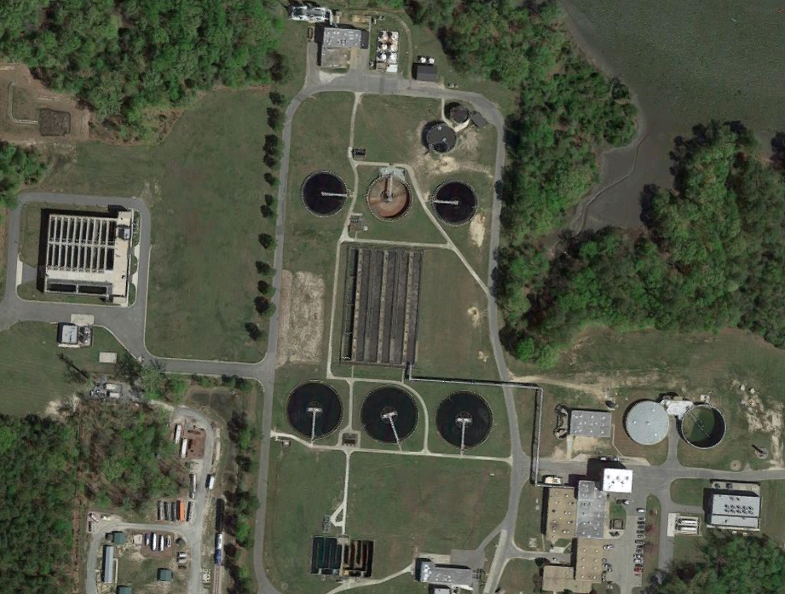
HRSD York River Plant (15 MGD)
First full-scale sidestream deammonification process in North America – partial nitritation + anammox
DEMON

Slide 24
Drivers for Mainstream Shortcut N Removal
Eliminate External Carbon
Energy
  decreases aeration demand for N removal
  decreases aerobic COD oxidation
  diverts wastewater carbon to anaerobic digestion
Intensification
  carbon diversion = much smaller aeration tank volume required

Slide 25
Challenges
Management of populations
NOB out-selection (maximize AOB rate)
Anammox retention

Slide 26
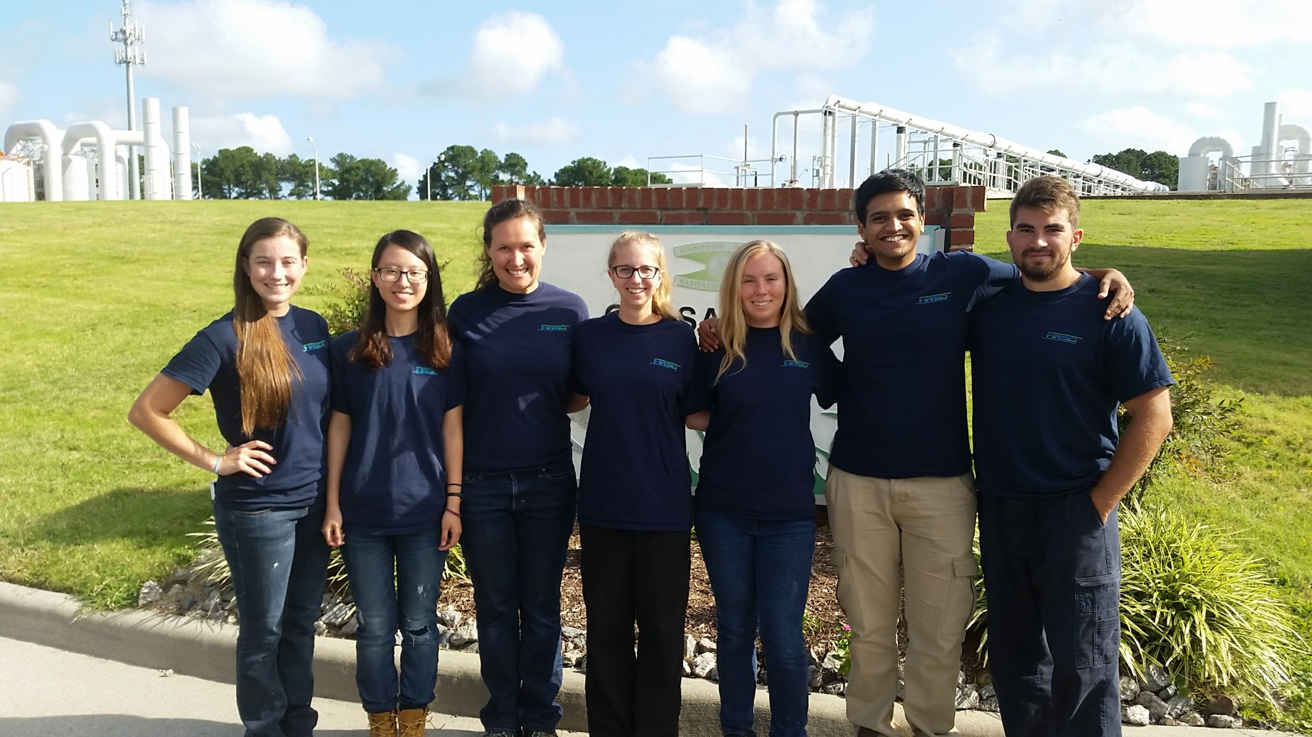
HRSD Chesapeake-Elizabeth BNR Pilot Facility

Slide 27
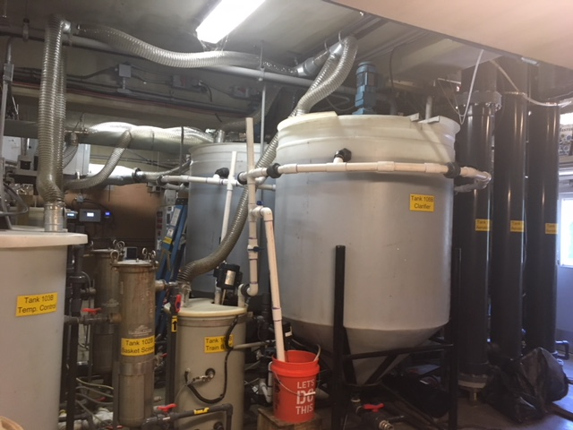
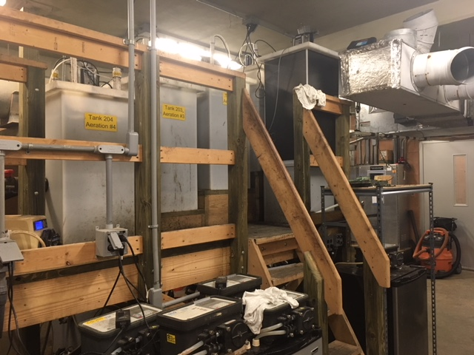
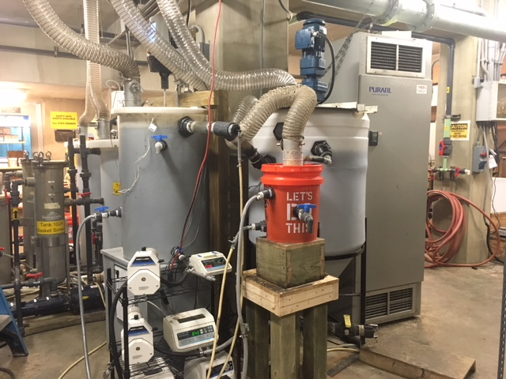
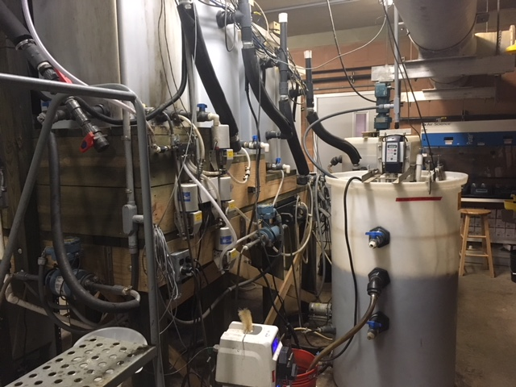

Slide 28

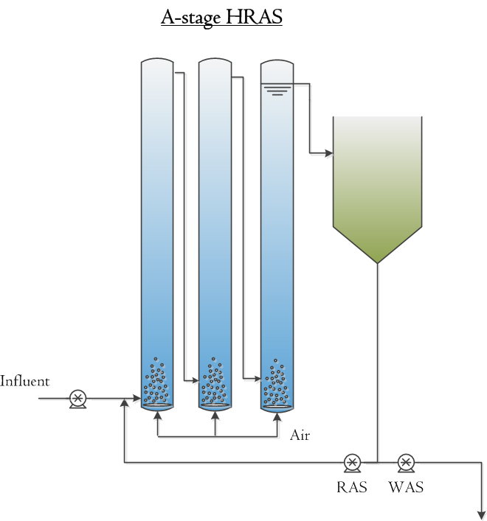

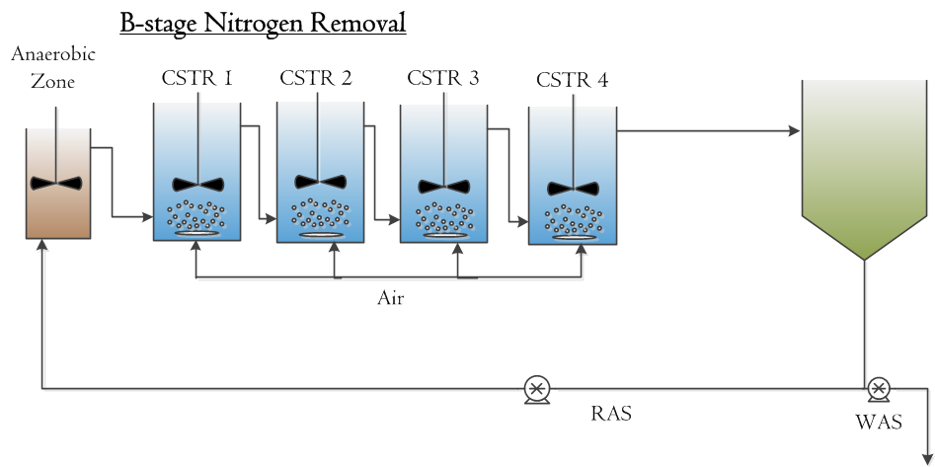
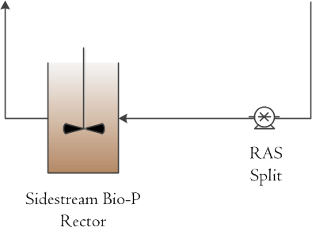
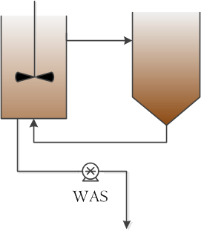
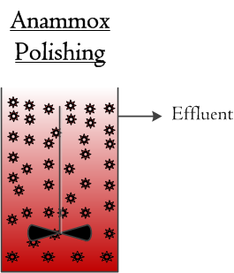
Bioaugmentation of sidestream anammox granules
Settling Column for Anammox Retention
Column RAS
A-stage WAS Fermentation
Partial Denitrification/
Anammox MBBR
Glycerol
Addition

Slide 29
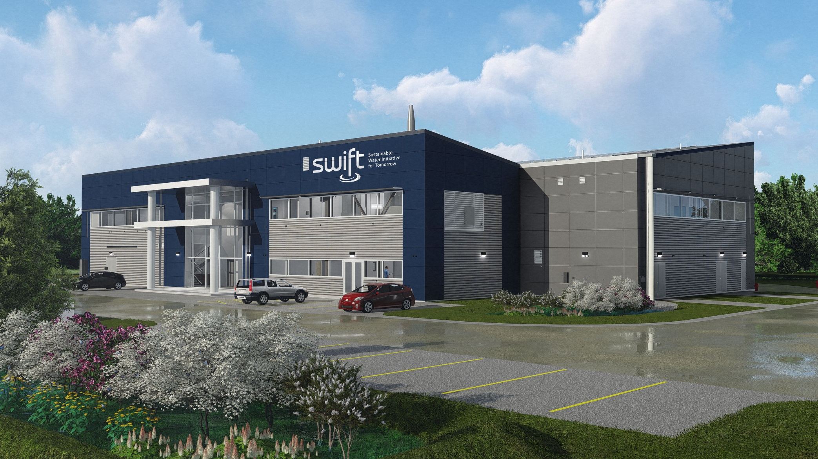
SWIFTVA.COM
cbott@hrsd.com
Notes:
This slide can be last so there is something on the screen while the speaker answers questions

Slide 32
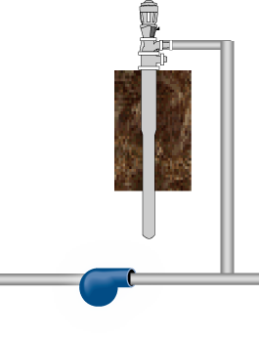

MAR Well TW-1
MW-LPA
MW-MPA
MW-UPA
MW-SAT
500’
450’
400’
50’
~3 days travel time
8+ months travel time

Slide 33
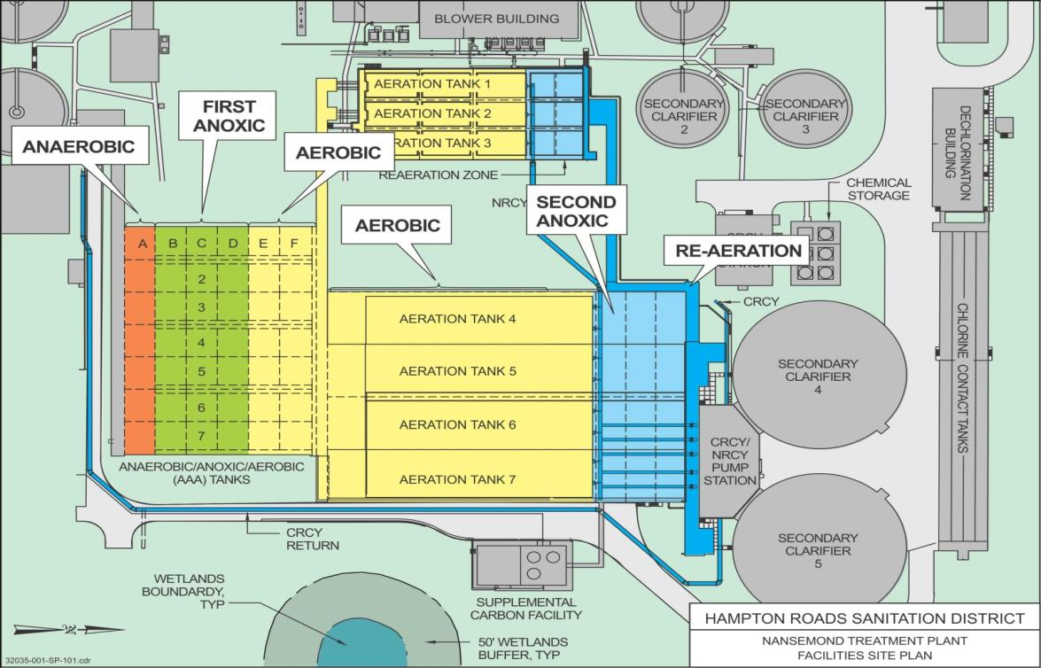
5-Stage Bardenpho Configuration
Notes:
Summer Operations
5-stage mode
3,000 mg/L MLSS in summer
Carbon addition: 1st stage and 2nd stage anoxic zones
Transition before wastewater temperature is below 17 ⁰C
Historically around December

Slide 34
Integrated Plan Prioritizes the Greatest Water Quality and Economic Benefits for the Region
Plan Approval
2019
2030
SWIFT
(~$1B)
High Priority RWWMP Projects
(~$200 M)
Final Measures Plan
($10M)
Pathogen Tracking Program

Slide 35
Impact on nutrient reductions
Nansemond Completed
James River Completed
Army Base Completed
6,000,000 lbs TN
2011 WLA
VIP Completed
4,553,500 lbs TN
2017 WLA
3,553,500 lbs TN
2022 WLA
Chesapeake-Elizabeth Offline
1,600,000 lbs TN
EPA Backstop
SWIFT Projected TN
James River Basin – TN Similar results with TP and TSS and in other river basins.
WLA – Nutrient Waste Load Allocation in lbs/yr

Slide 36
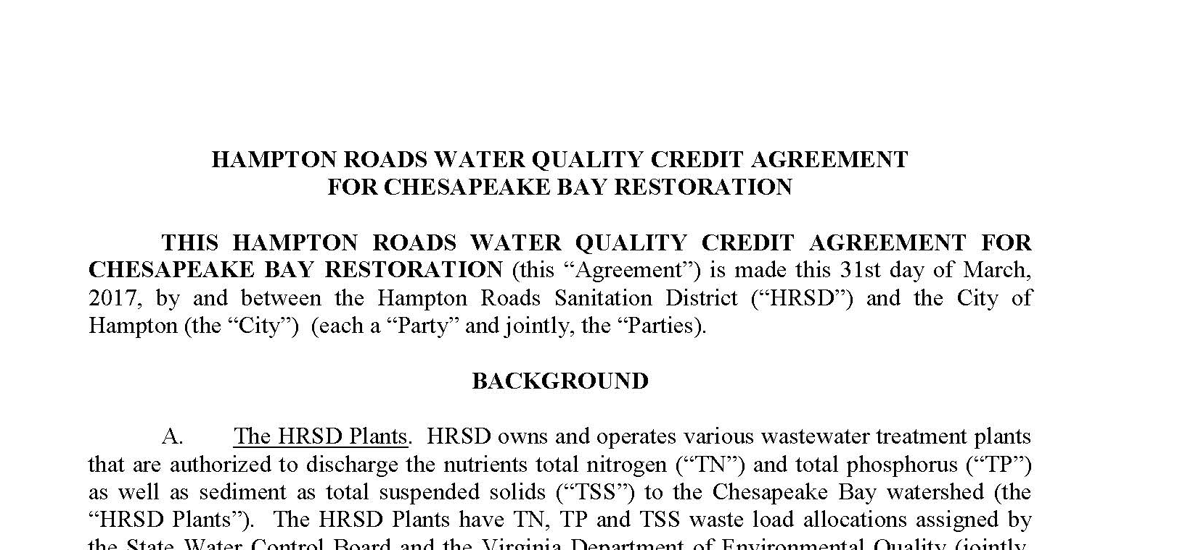

Benefit – Eliminated Costly Urban
Stormwater Nutrient BMPs
Executed nutrient trading agreements with 11 MS4 localities
Example – James River TN
3,000,000 lbs/yr TN credit available with SWIFT
64,000 lbs/yr TN removal needed for all stormwater MS4s in James River watershed

Slide 37
Ammonia-Based Aeration Control (ABAC)
Taking advantage of unused aeration tank capacity!

Slide 38
Benefits of ABAC
    Reduce energy consumption
      less NH4 converted, aerating at lower DO, less COD oxidized aerobically
    Improve usage of sbCOD, reduce need for supplemental carbon
    Decrease ALK demand
    Decrease chlorine demand – chloramination
    Control ammonia peaks
    Increase in nitrogen removal via simultaneous nitrification/denitrification (SND)

Slide 39
Upgrading to 5-stage BNR → VIP + 2

Slide 40
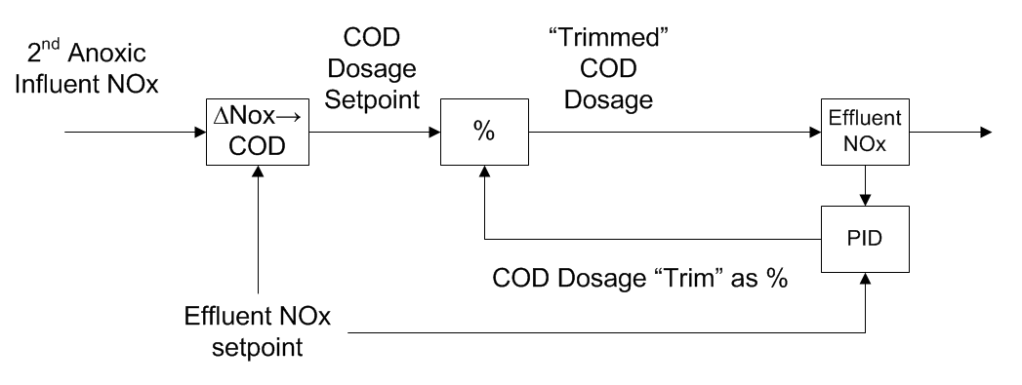
Advancing Process Control:
Beyond PIDs…
Supplemental Carbon Control – Feedforward w/ PID control
Notes:
Real-time control strategies in place respond to disturbances rather than preventing them. They do a pretty good job when trying to meet effluent nutrient goals. Successful implementation and operation of SWIFT will rely on preventing upsets in the upstream treatment plant and providing optimal stable effluent quality. Adapted PID control from power, chemical and energy industry, which often have much more control over dynamic conditions and economically the drive has pushed them farther forward.

Slide 41
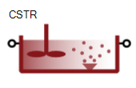
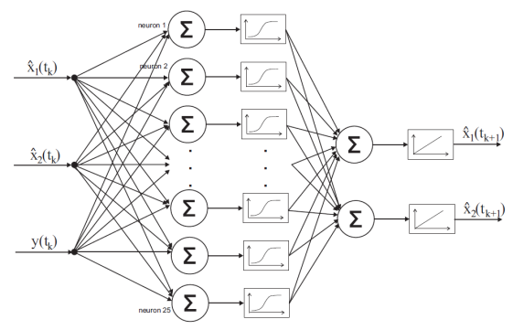
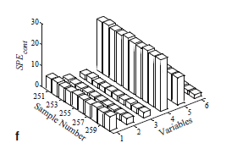
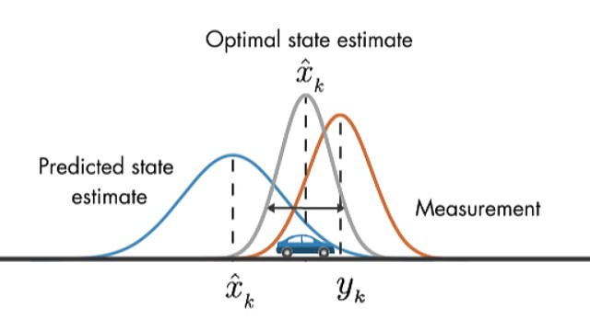
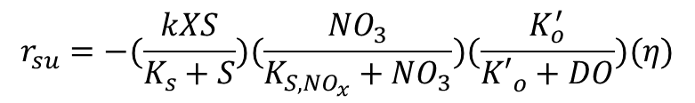
Advancing Process Control:
White Box - Mathematical Models (ASM equations)
Black Box - Statistical Models
$$r_{su}=−(\frac{kXS}{K_{s}+S})(\frac{{NO}_{3}}{K_{S,{NO}_{x}}+{NO}_{3}})(\frac{K_{o}^{′}}{{K′}_{o}^{}+DO})(η)$$
SUMO® 2018.
Artifical Neural Networks (Gomolka et al. 2017)
Kalman Filtering (Medium 2017)
Multivariate Control (Ge and Song 2013)
Notes:
Gray-box models combine simplified versions of established mathematical models and statistical methods using real time sensor data to provide more accurate control and prediction of dynamic system demands allowing prevention of upset and increased stability.

Slide 42
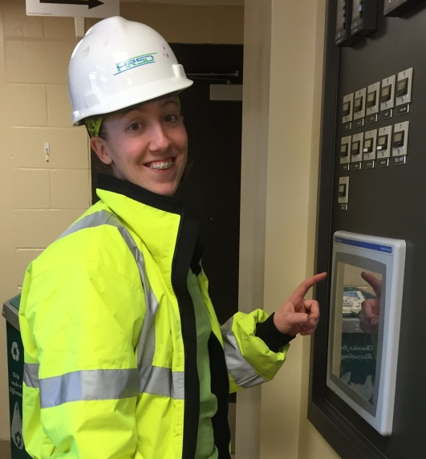
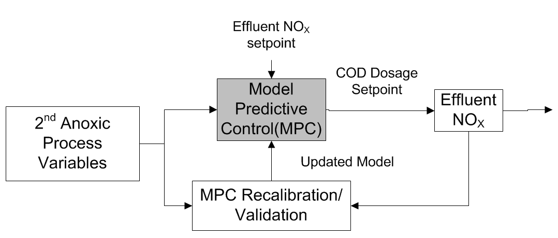
Advancing Process Control:
…to Gray-Box Models
White Box
+
Black Box
↓
Gray Box – Combining deterministic models with historical data for new control strategies.
Ali Gagnon,
VT PhD Student
Notes:
Gray-box models combine simplified versions of established mathematical models and statistical methods using real time sensor data to provide more accurate control and prediction of dynamic system demands allowing prevention of upset and increased stability.

Slide 43
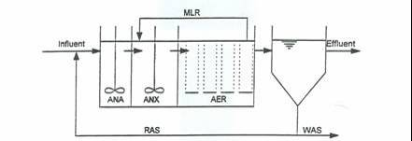
Conventional BioP + N Removal
A²/O or Phoredox Process
ANA = Anaerobic
ANX = Anoxic
AER = Aerobic

Slide 44
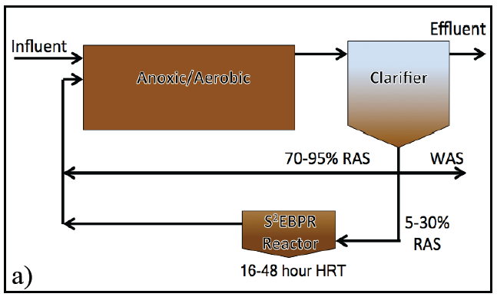
“Sidestream BioP” –
RAS/Mixed Liquor Fermentation
Increases reliability of Bio-P when influent VFA is low
Combines hydrolysis, fermentation, and enrichment of PAO
Selection of PAO over GAO
Possibly enrichment of Tetrasphaera over Accumulibacter
Tooker, N.B., Barnard, J.L., Bott, C.B., Carson, K., Dombrowski, P.D., Martin, K., McQuarrie, J., Menniti, A., Phillips, H., Schauer, P., Shaw, A., Stevens, G., Takács., I., Onnis-Hayden, A., Gu, A. (2016). Side-stream enhanced biological phosphorus removal as a sustainable and stable approach for removing phosphorus from wastewater. IWA – Nutrient Removal & Recovery, Denver, USA.

Slide 45
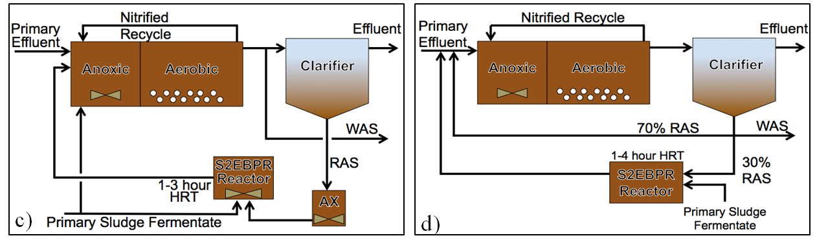
Sidestream Bio-P
Ferment for 24-48 hours without external carbon
More realistic sizing is 4-8 hr HRT with some external carbon addition

Slide 46
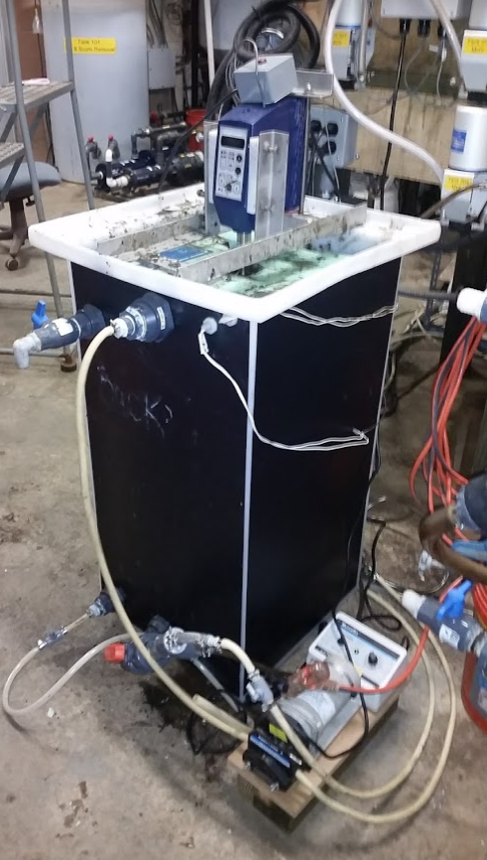
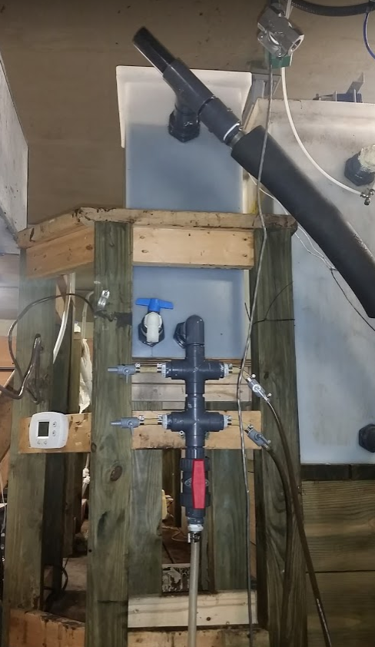

Slide 47
Atlantic Treatment Plant (200 MLD)

Slide 48
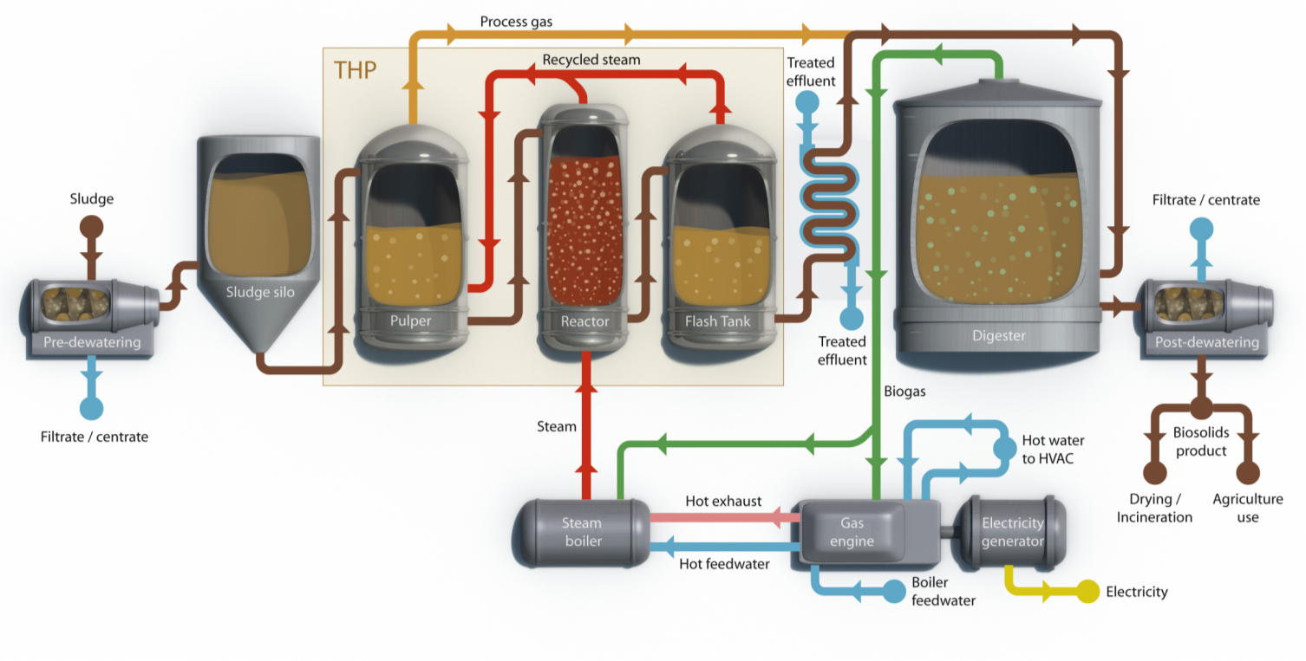
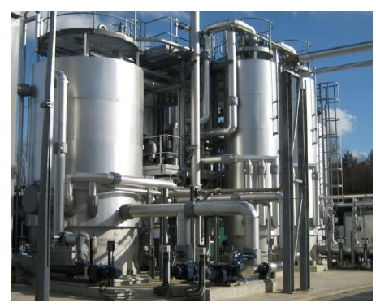
CAMBI Thermal Hydrolysis Process

Slide 49
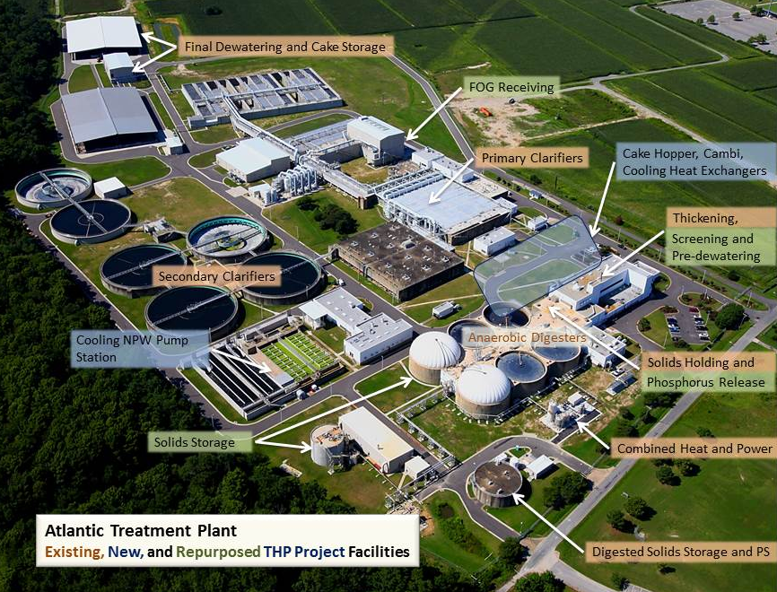
Motivation for THP at Atlantic Plant
Class A (with certainty)
  Land Application
  Marketable products
High quality, low odor
Improve dewaterability
  Storage at plant (or field)
  Stackability
Regionalize on anaerobic digestion (intensification)
FOG and high strength waste co-digestion ➔ Energy

