Slide 1
Accelerating Environmental Cleanup
Application of accelerators for wastewater and flue-gas treatment
Accelerator Stewardship Workshop, Jefferson Lab, Dec. 17, 2018
Gianluigi Ciovati

Slide 2
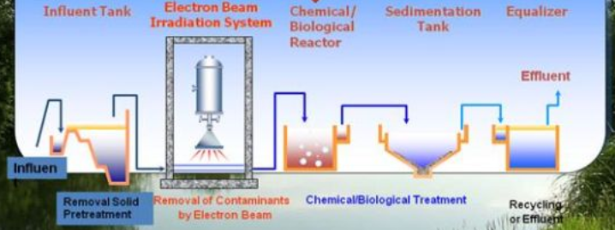

Wastewater treatment
EB-treatment uses the short-lived reactive species formed during the radiolysis of water
Degradation of pollutants occurs through different reactions (chain oxidation, formation of insoluble compounds, coagulation of colloids)
Reduction of certain chemicals can depend strongly on the dose. ~1 kGy to remove color, odor, disinfection and removal of some organic pollutants.
reducing
oxidizing

Slide 3
Flue gas treatment
Electrons interacting with the gas create ions and radicals (N₂⁺, N⁺, O2+, H₂O⁺, OH⁺, H⁺, CO₂⁺, CO⁺, N, O, H, OH, CO)
These excited species react in various ways such as ion-molecules reactions, neutralization reactions and dimerization
Nitric and sulphuric acids resulting from these reactions are converted into ammonium nitrate and sulfate (fertilizer) through the flow of ammonia
∼70% reduction of NO_{x}, ∼90% reduction of SO_{x}, and ∼99% reduction of Hg with 7-12 kGy dose

Slide 4
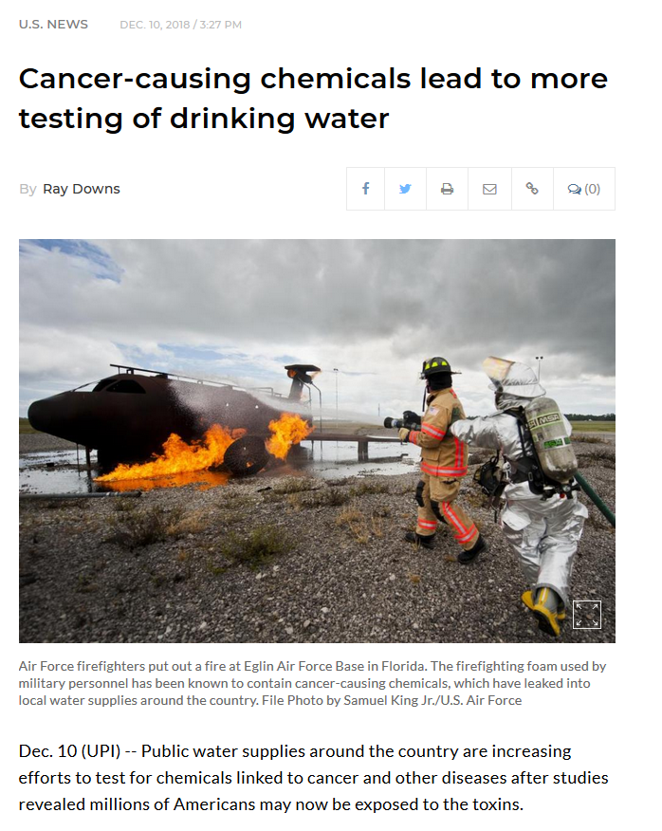
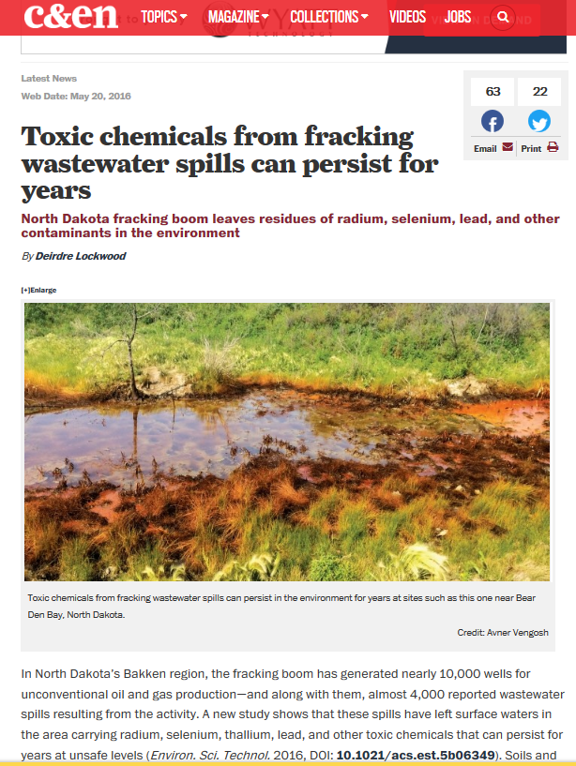
Examples of environmental applications
https://www.upi.com/Top_News/US/2018/12/10/Cancer-causing-chemicals-lead-to-more-testing-of-drinking-water/5611544460878/
https://cen.acs.org/articles/94/web/2016/05/Toxic-chemicals-fracking-wastewater-spills.html

Slide 5
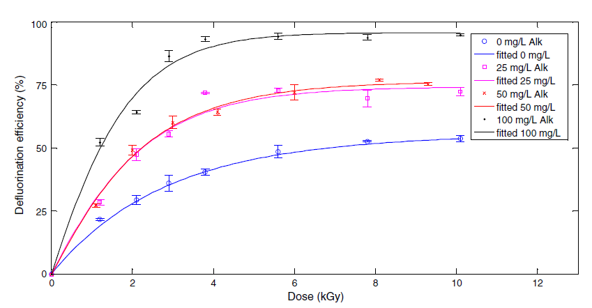
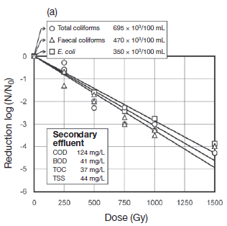
Wastewater irradiation
Beam power ∝ Water flow × Dose
At test facility at Miami-Dade County, Florida: 75 kW -> 6.5 kGy, 160 gal/min
Effect on degradation of contaminants:
L. Wang et al. / Chemical Engineering Journal 302 (2016) 58–68
IAEA, Radiation processing: environmental applications, 2007
Notes:
Defluorination efficiency of PFOA (perfluorooctanoic acid) with different alkalinity levels

Slide 6
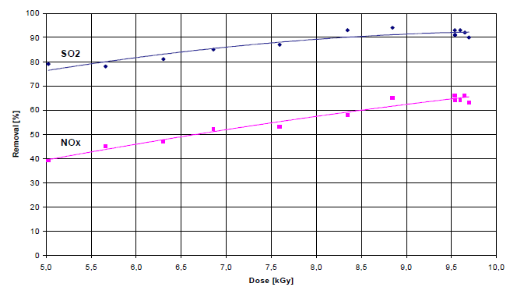
Flue gas irradiation
1 MW beam provides a dose of 7-10 kGy to treat flue-gases from a 100 MW(e) coal power plant
Multi-pollutant control:
IAEA, Radiation treatment of gaseous and liquid effluents for contaminant removal, 2005
Notes:
Gas irradiation vessel

Slide 7
Current technology
ELV-12 accelerator (DC, transformer-type), 0.6-1 MeV, 400 kW
Size: 6.5 m (L) x 2 m (W) x 6 m (H)
Developed at Budker Institute of Nuclear Physics (Russia)
Commercialized by EB Tech Co., Ltd., South Korea
Installed in 2005 in a dyeing wastewater plant in Daegu, South Korea

