Slide 1
Shepherdess Ecotech

Slide 2
Alberta Oil Sands Tailings

Slide 3
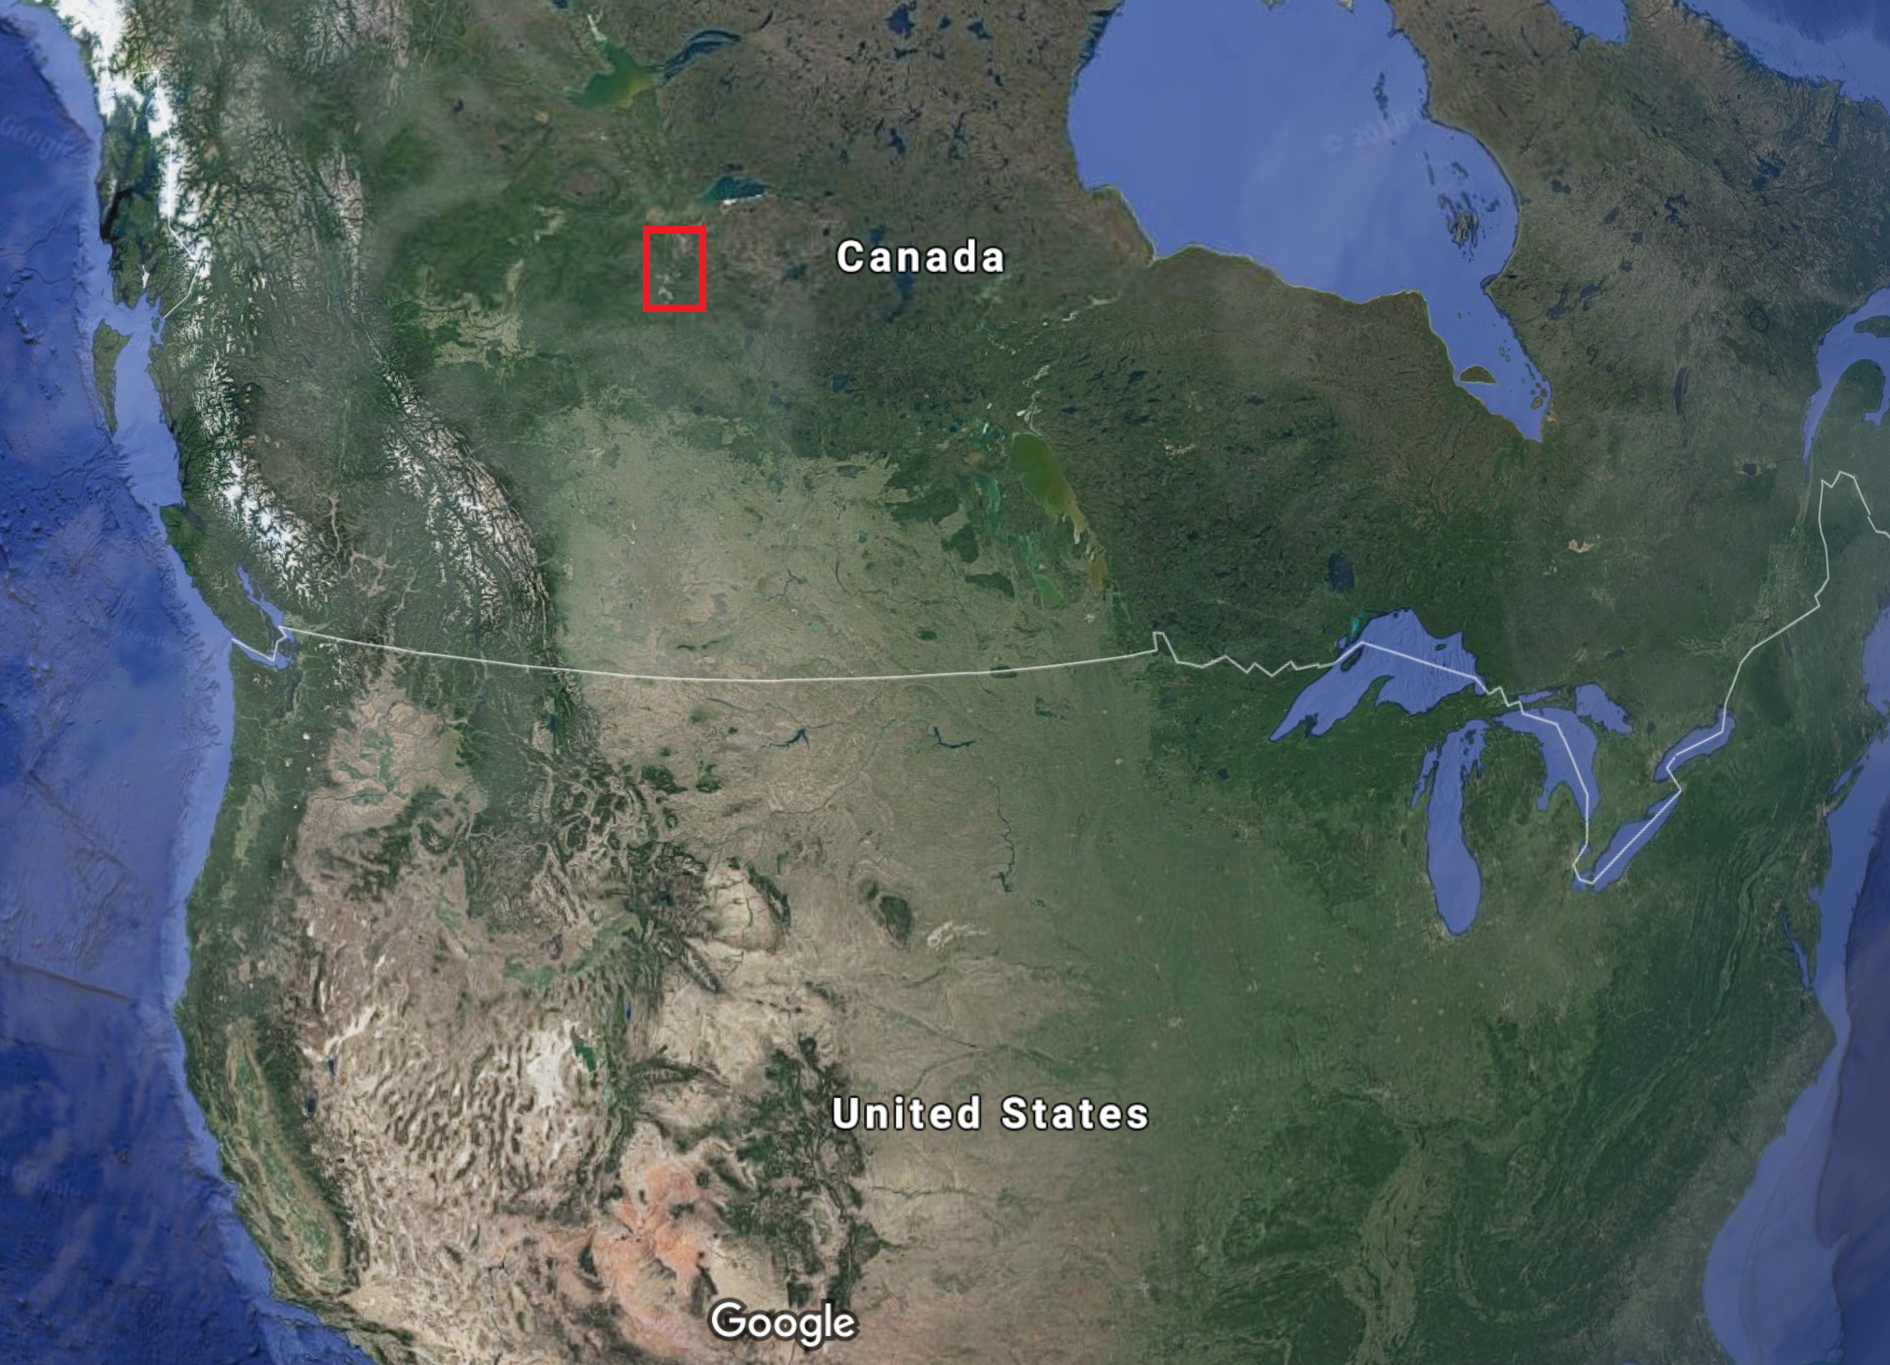

Slide 4
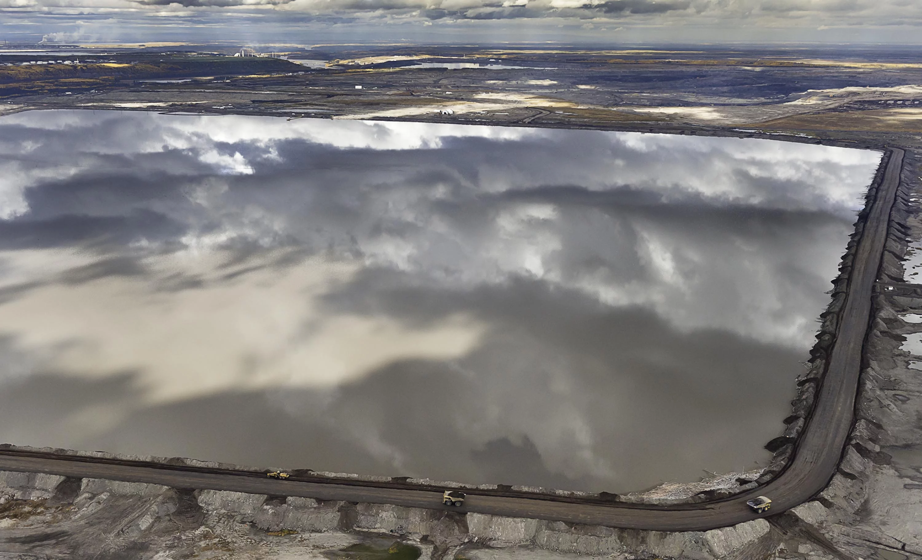

Slide 5
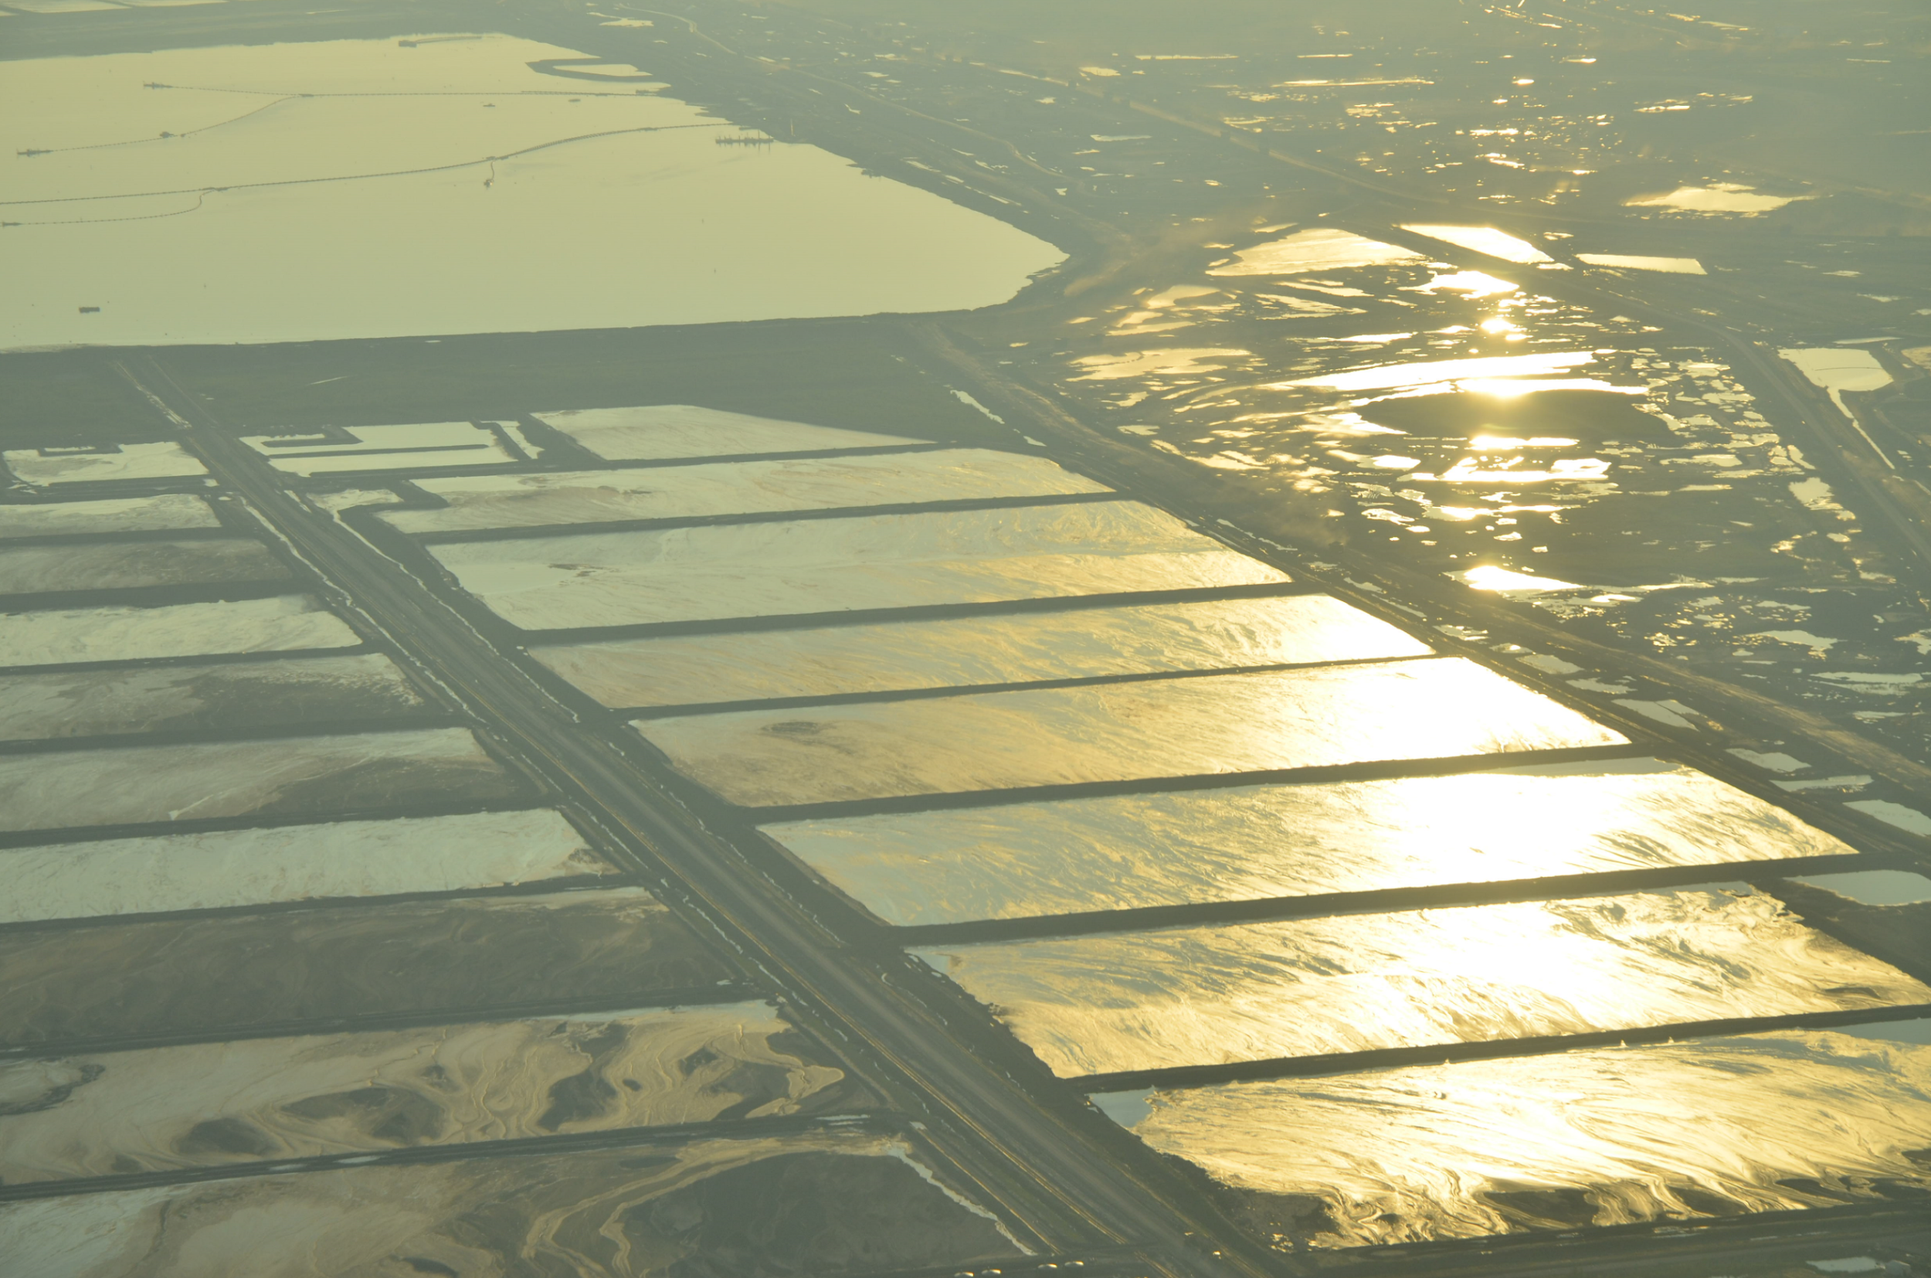

Slide 6
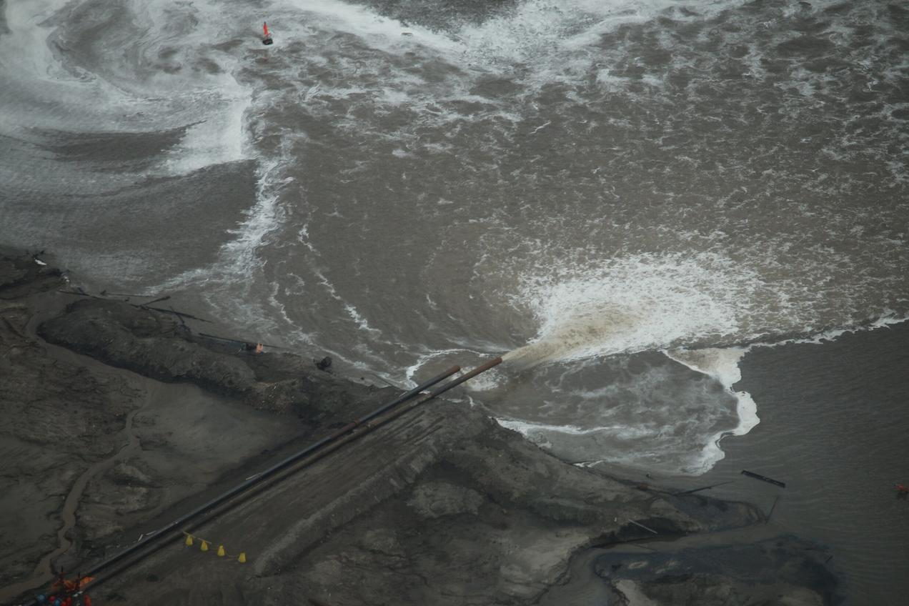

Slide 7
~1.3 billion tonnes of waste
Mostly water
Lots of sand, silt, clay, salt
Complex organic soup: hydrocarbons, napthenic acids, benzene, plenty others
Official cleanup estimates vary $50-$250 billion CAD

Slide 8
Solution = physical + biological

Slide 9
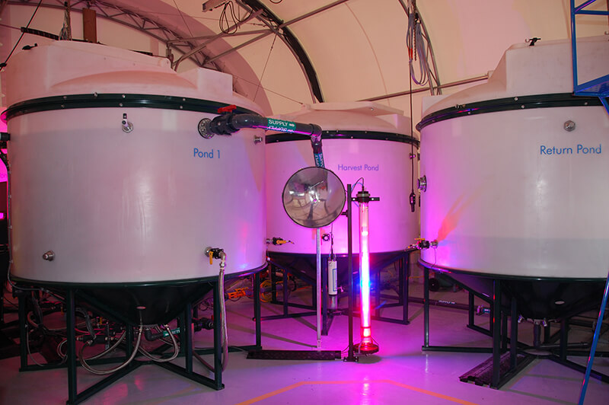

Slide 11
Alberta Cleanup Pilot Plant Specs
1,200 tonnes/day processed
2 reactors
2 accelerators
100% biomass powered/heated
Total cleanup by 2030 (with ~100x pilot capacity)
Procurement begins Q1 2019

Slide 12
Other wastewater applications
US fracking (280+ billion gal/year)
US mill tailings (450+ Mt/year)
US slimes/muds (95+ Mt/year)
Municipal water ( )
Worldwide total wastewater released to environment = 2.2 trillion tonnes/year

Slide 13
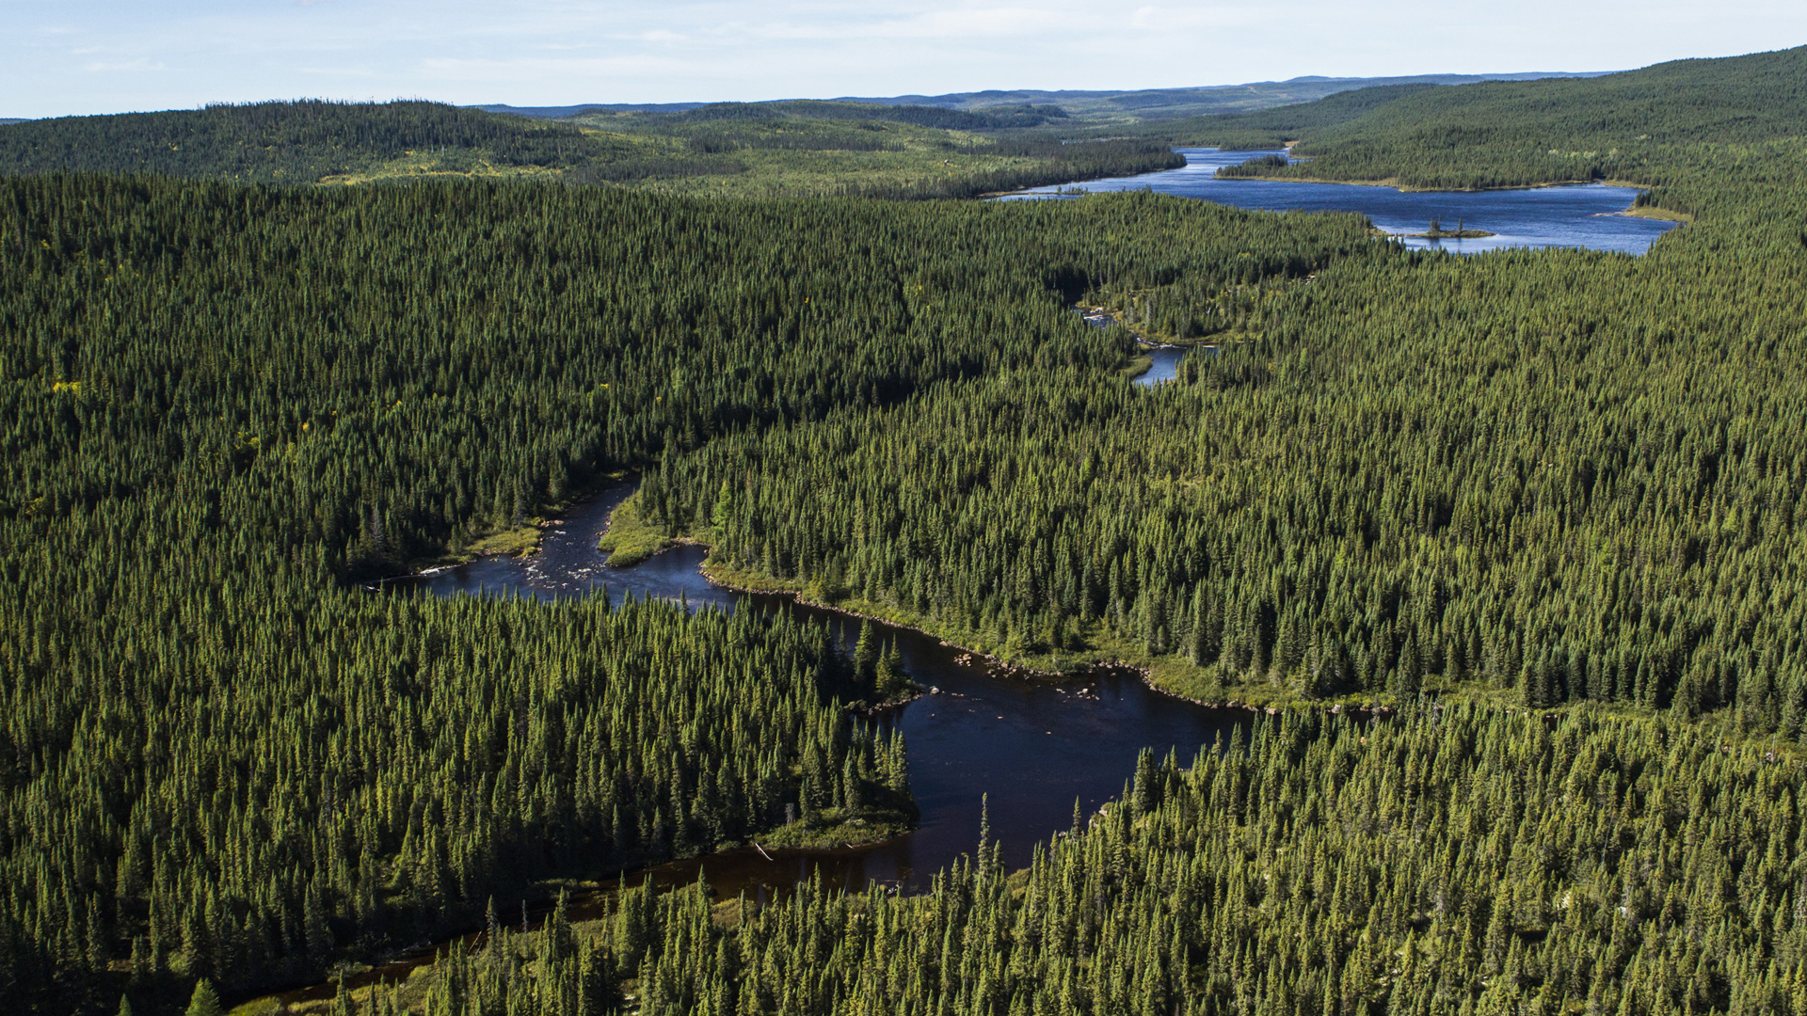
Thank you !

