Slide 1
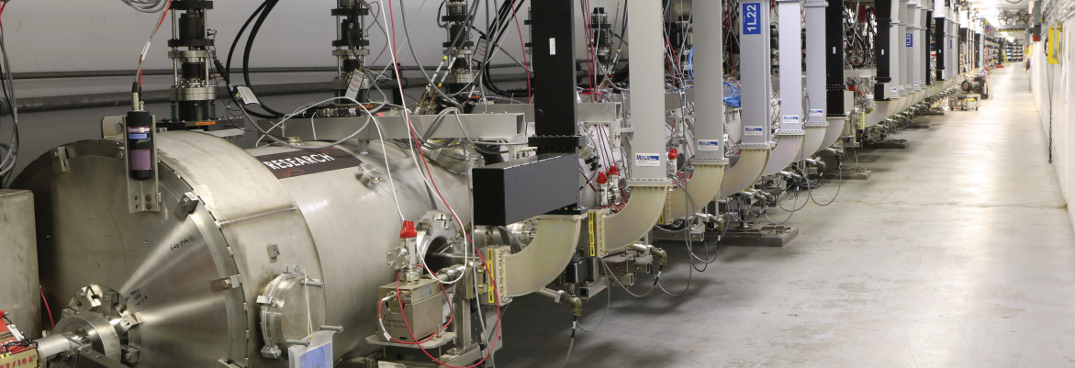
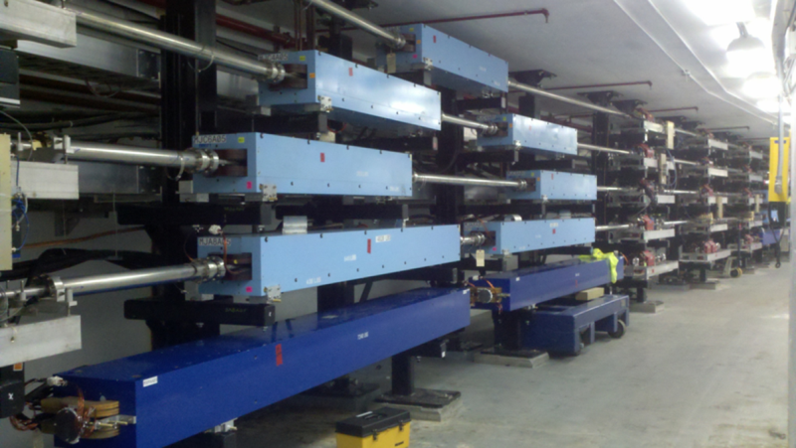
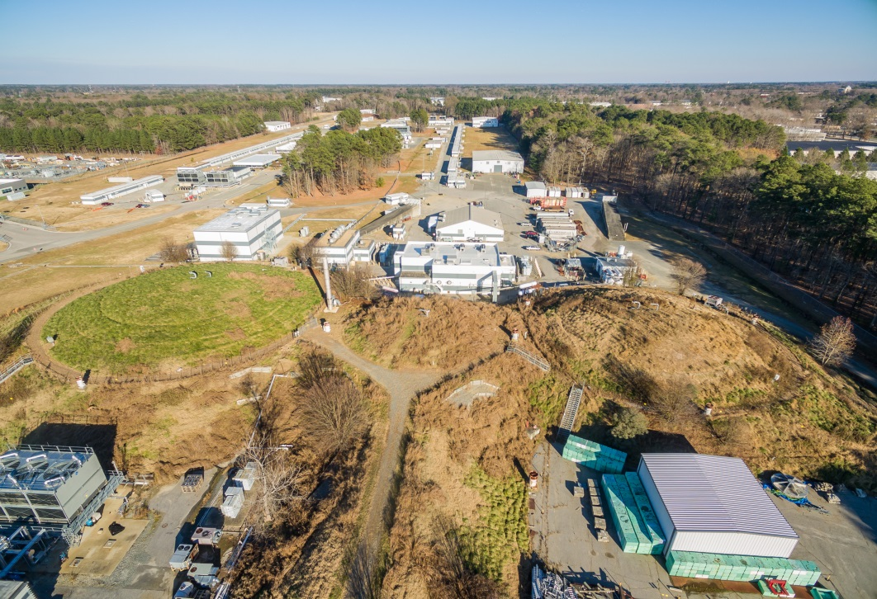
Accelerator Technology at Jefferson Lab:
Toward Applications
Andrei Seryi
Associate Director
Accelerator Operations and R&D

Slide 2
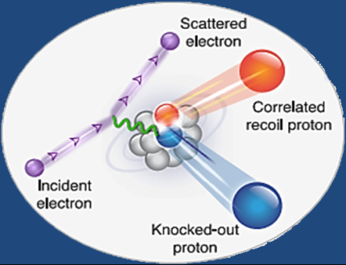
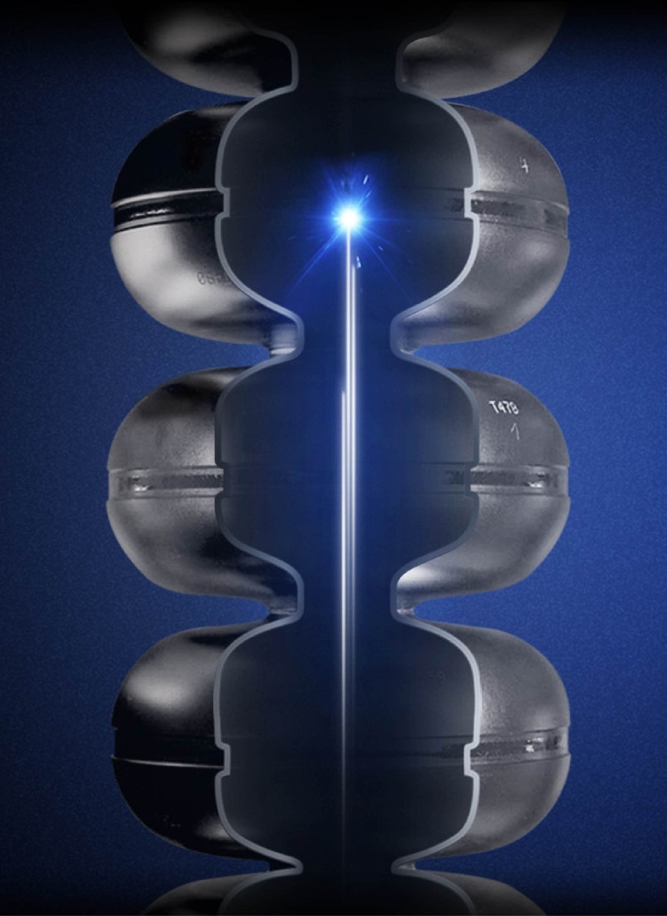
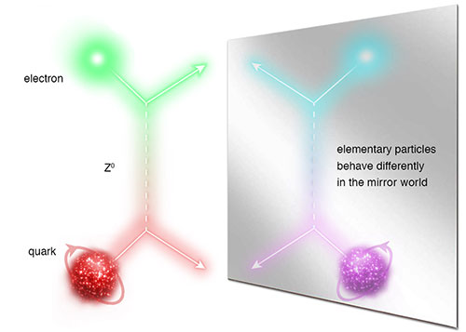
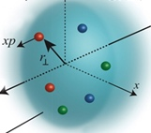
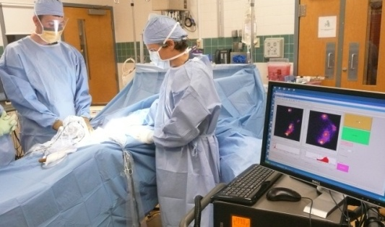
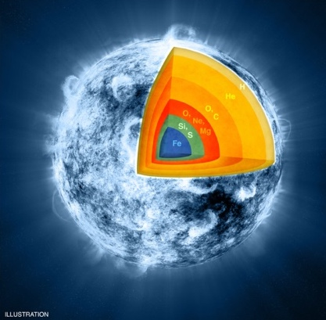
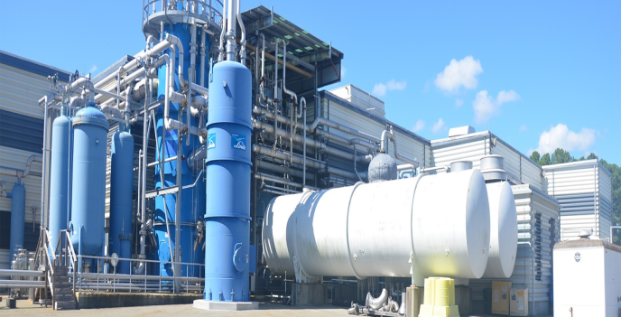
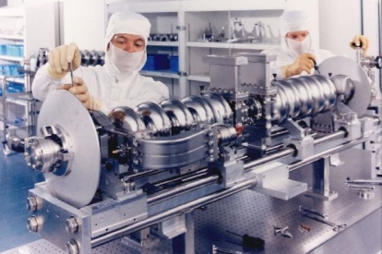

JLab: Nuclear Science, R&D => Innovation Driver
Z⁰
Nuclear Structure
Fundamental
Forces & Symmetries
Structure of Hadrons
Today’s R&D enable tomorrow’s industrial applications
Medical Imaging Technology
Nuclear Astrophysics
Cryogenics
Accelerator S&T
Theory & Computation

Slide 3
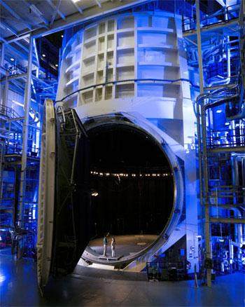
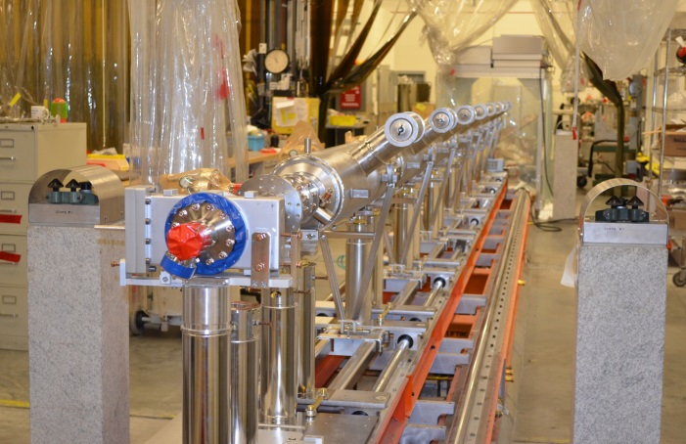
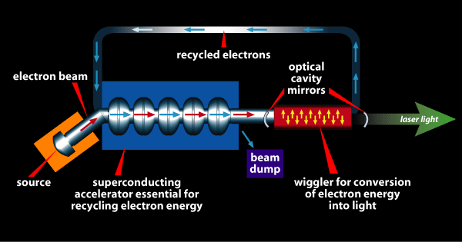
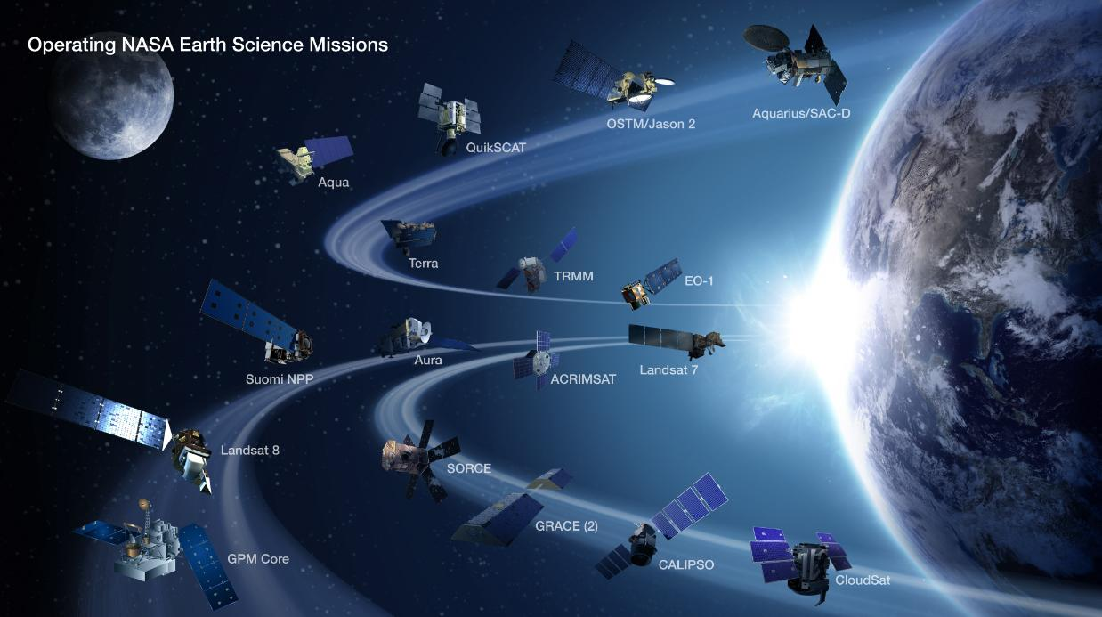
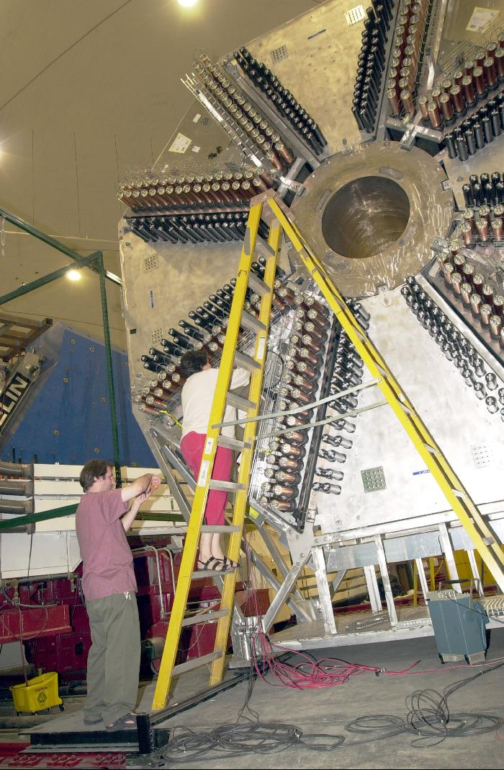
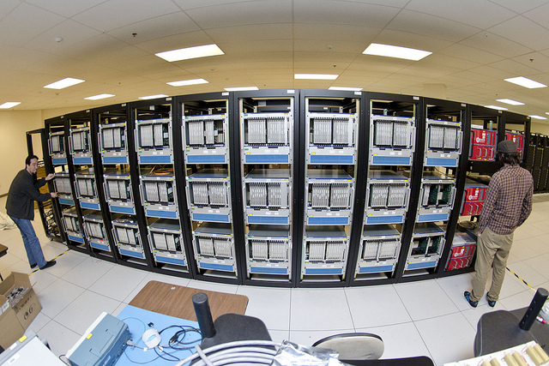
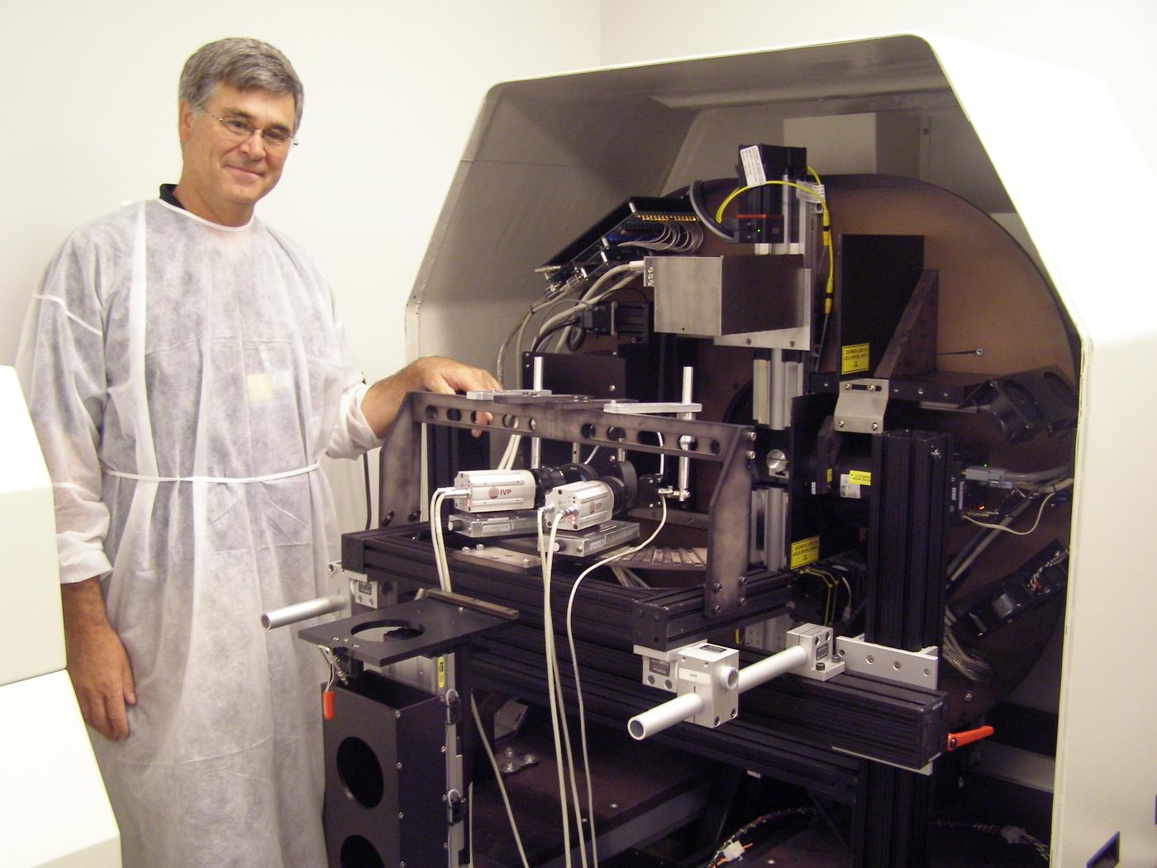
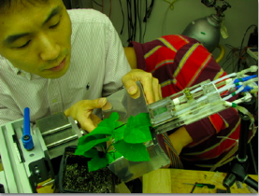
Jefferson Lab’s Technology Portfolio
High-power Free electron lasers (Ex: Record power achieved in Office of Naval Research program at JLAB)
Big Data challenges (Ex: NASA Langley adoption of JLAB software framework for multi-satellite data processing)
Superconducting particle accelerators (Ex: LCLS-II Project)
Large scale Cryogenics
(Ex: NASA James Webb Space Telescope)
Particle Detector Technologies
(Ex: Compact gamma camera for breast cancer detection; AwakeSPECT for functional brain images of conscious, unrestrained mice; molecular imaging for plant biology
High performance computation (Ex: GPU hardware in HPC)

Slide 4
Large Scale Cryogenics
Jefferson Lab's cryogenics group helped NASA scientists design and commission a cryogenics plant to cool the Webb telescope’s components to temperatures its instruments will experience in space, to within 30 degrees Fahrenheit of absolute zero.
tripled the capacity of the refrigeration system.
cut the liquid nitrogen consumption in half
helium refrigerator system now maintains peak efficiency
NASA Johnson Space Center's Space Environment Simulation Lab Chamber A. Photo: NASA.
Notes:
4

Slide 5
A New Approach for a NASA Challenge
Interagency agreement between NASA’s Langley Research Center and JLab for multi-satellite data processing.
Multiple geo-satellites.
Missions last longer and sensors become more complex.
Open Source Software Engineering is becoming a high priority (large data volume).
Multiple Nuclear Physics detectors.
CLARA is a Jefferson Lab software application built as a network of “black box” independent processes that exchange data.
This renders a software well-suited to multi-user, inter-disciplinary studies.
NASA
JLab
Notes:
5

Slide 6
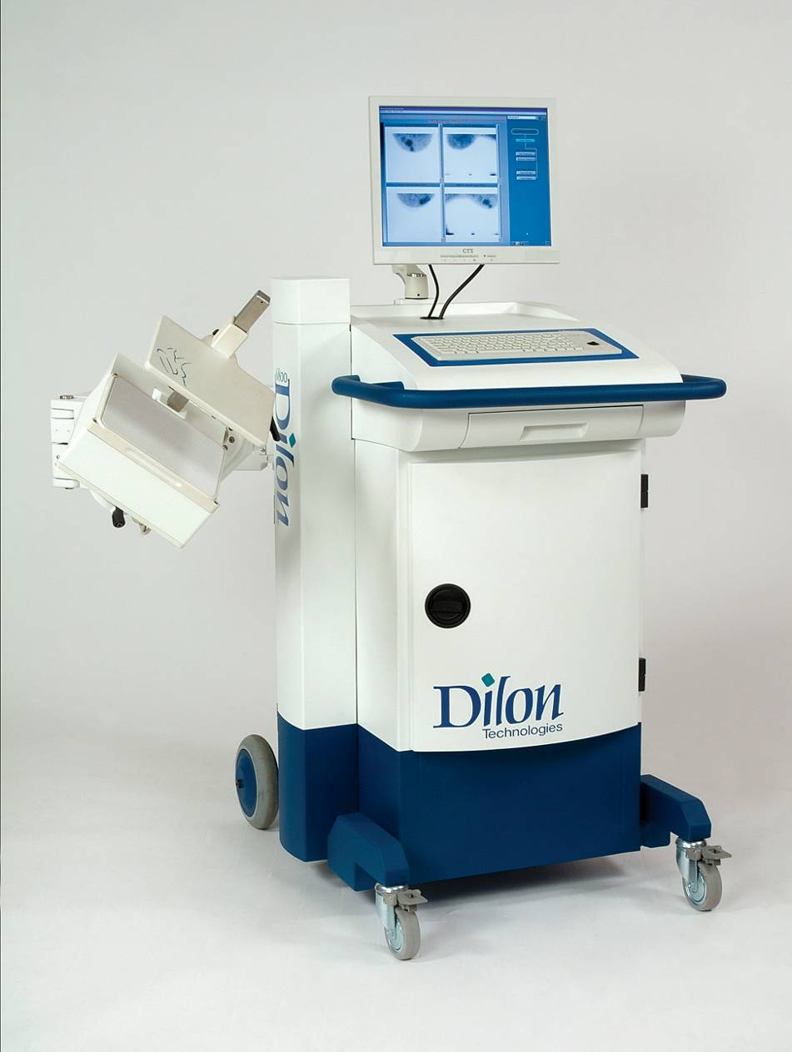
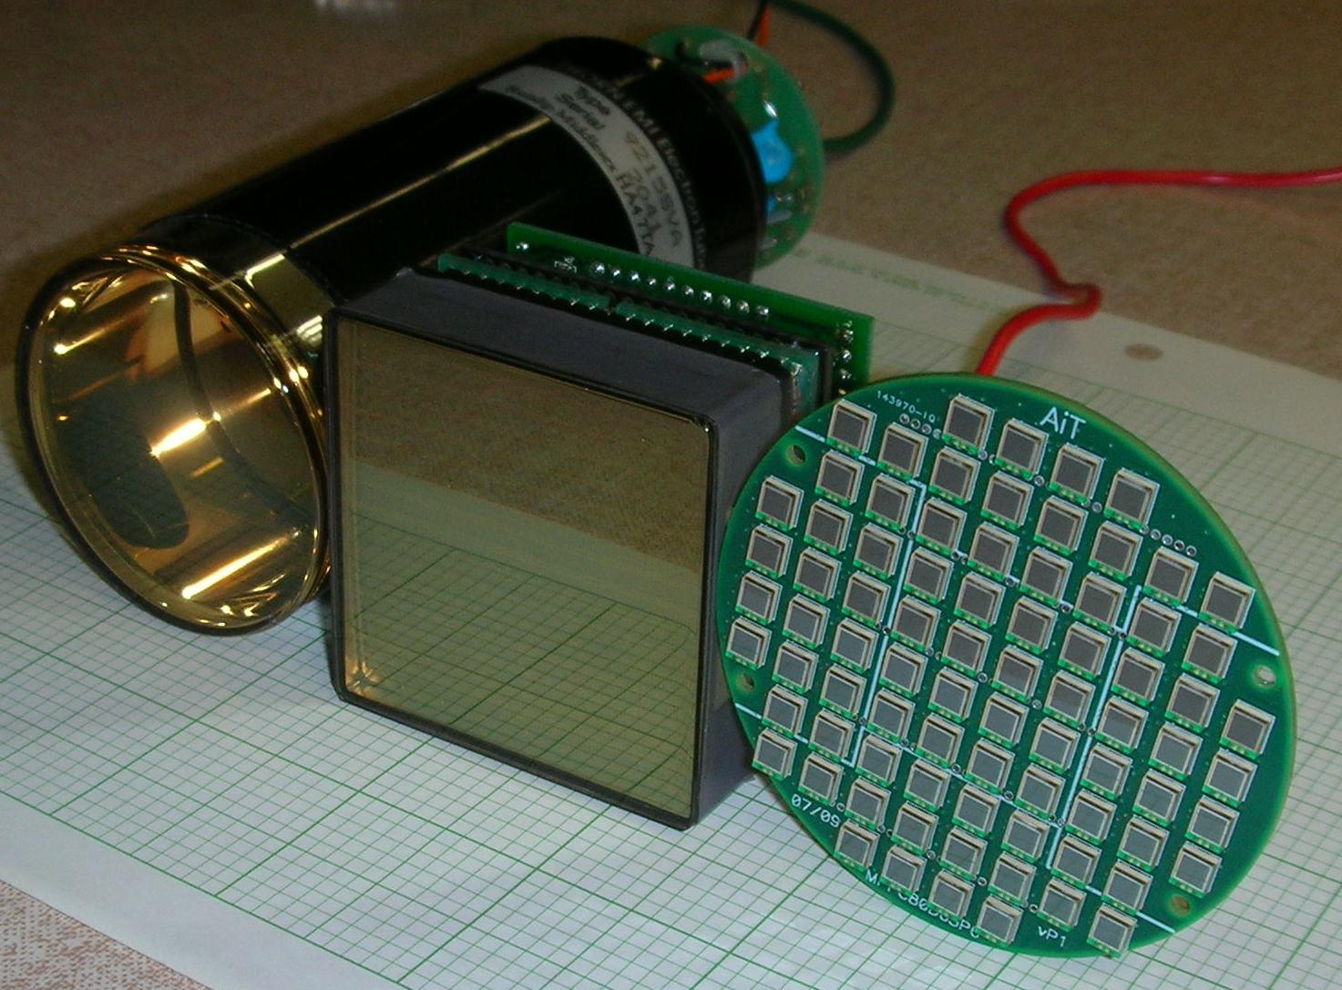
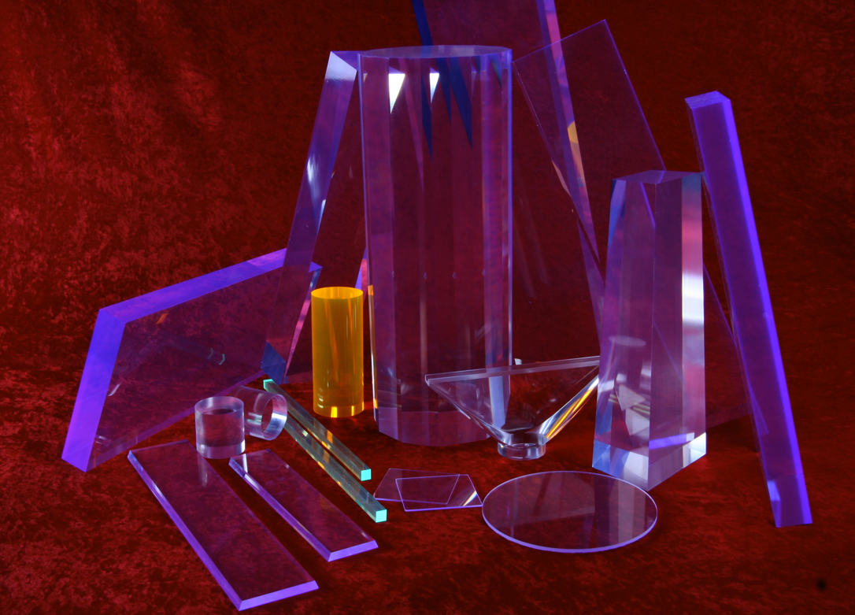
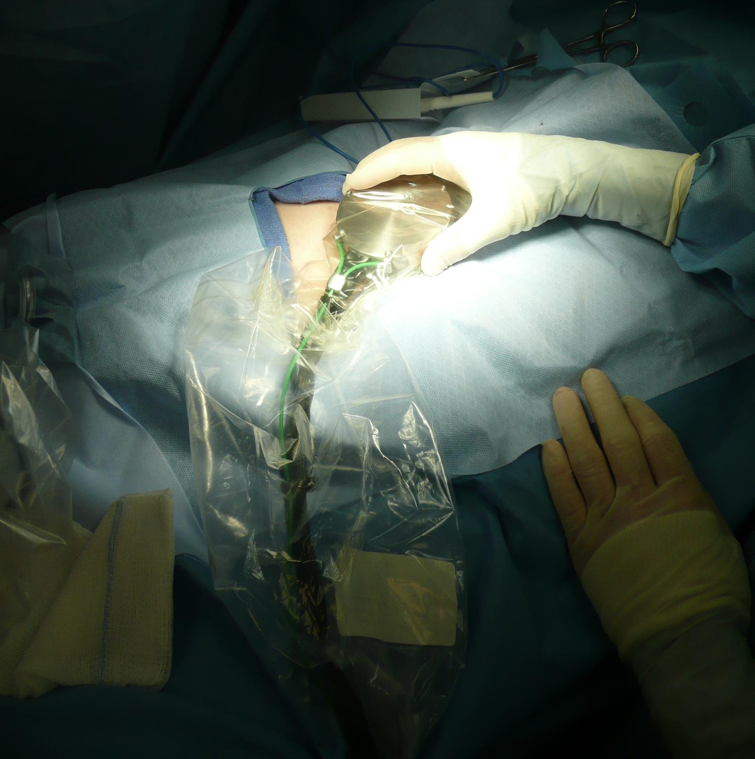
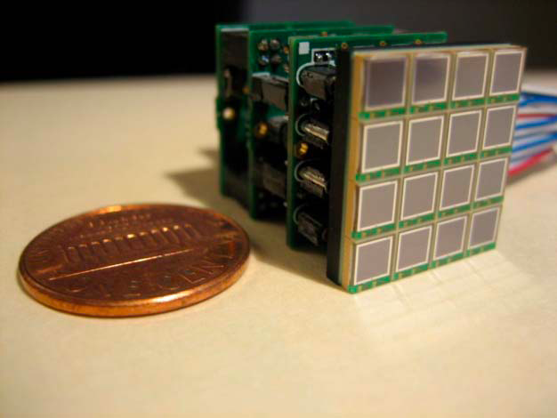
Detector Spin-Off Advances Patient Care
Nuclear physics detector technology developed to explore the structure of matter at Jefferson Lab leads to new and advanced tools for better patient care.
Tools for nuclear physics research: photomultiplier tubes, silicon photo multipliers, scintillator and detector electronics
Tools for better patient care:
Compact gamma camera for breast cancer detection (FLC Award)
Hand held gamma camera to guide surgeons
6
Notes:
6
Nuclear physics detector technology developed to explore the structure of matter at Jefferson Lab leads to new and advanced tools for better patient care. Tools for nuclear physics research include: photomultiplier tubes, silicon photo multipliers, scintillator and detector electronics. Tools for better patient care were developed including compact gamma camera for breast cancer detection, leading to several Jefferson Lab patents and a start-up company. Also, hand held gamma camera was developed to guide surgeons, allowing silicon photo multipliers to provide precise imaging at low voltages and are now also wire-free and wireless, to give flexible motion without tethering.

Slide 7
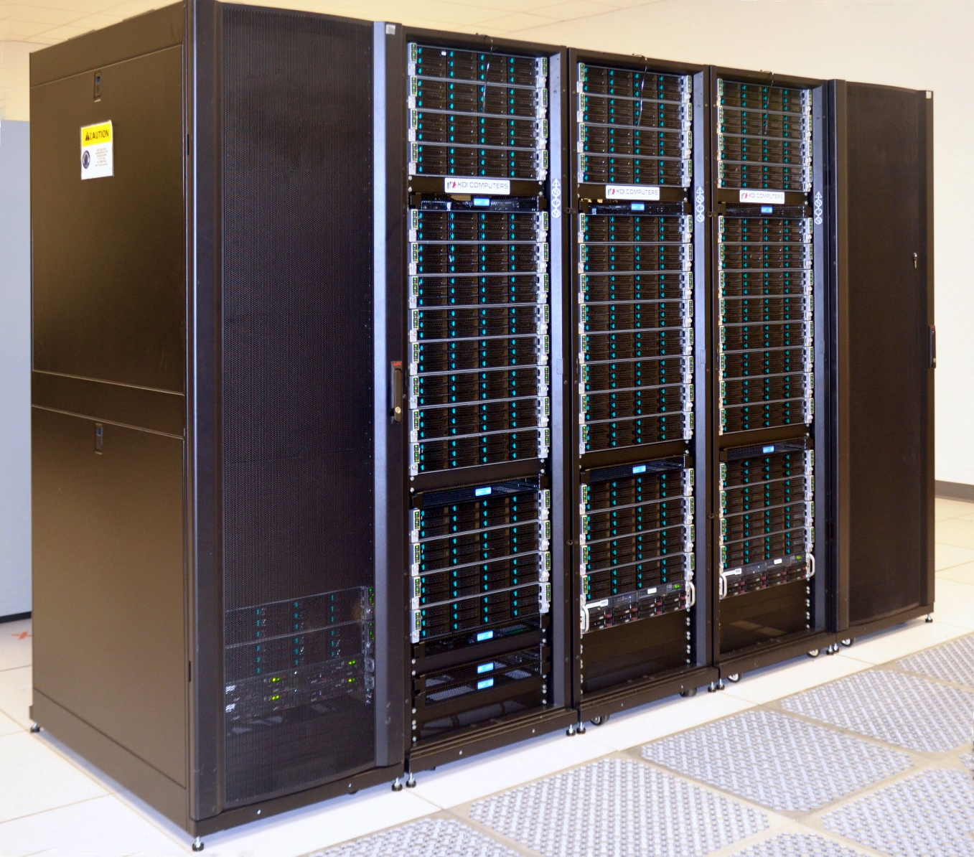
High Performance Computing
There is increasing demand for high-performance computing to solve our understanding of complex many-body systems and predict their behavior.
Use of graphics processing unit (GPU) for CPU-intensive, repetitive computations was first implemented in JLab Lattice QCD calculations, gaining computing speedup factors of two to ten.
These capabilities underpin many important scientific challenges, e.g. studying climate and heat transport over the Earth.
The effort to boost the computing capabilities will continue with the Exascale Computing Project and enable a new era of high-precision calculations, including Lattice QCD.
Big data and opportunities for development machine learning approaches
7
Notes:
7
There is increasing demand for high-performance computing to solve our understanding of complex many-body systems and predict their behavior.
Use of graphics processing unit (GPU) or graphics cards for the low-cost solution of extremely CPU-intensive, repetitive computations was first implemented in the Jefferson Lab Lattice QCD calculations, gaining computing speedup factors of two to ten. This is now applied on leadership GPU systems such as DOE Titan (ORNL) and NSF Blue Waters (NCSA - University of Illinois).
Lattice QCD in collaboration with industry have driven development of new computing paradigms that benefit large scale computation. These capabilities underpin many important scientific challenges, e.g. studying climate and heat transport over the Earth.
The hottest video games on the market often have the most realistic graphics, enabled by performing intense calculations on a device called a graphics processing unit (GPU) or graphics cards.

Slide 8
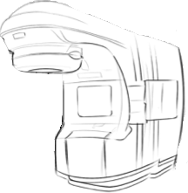

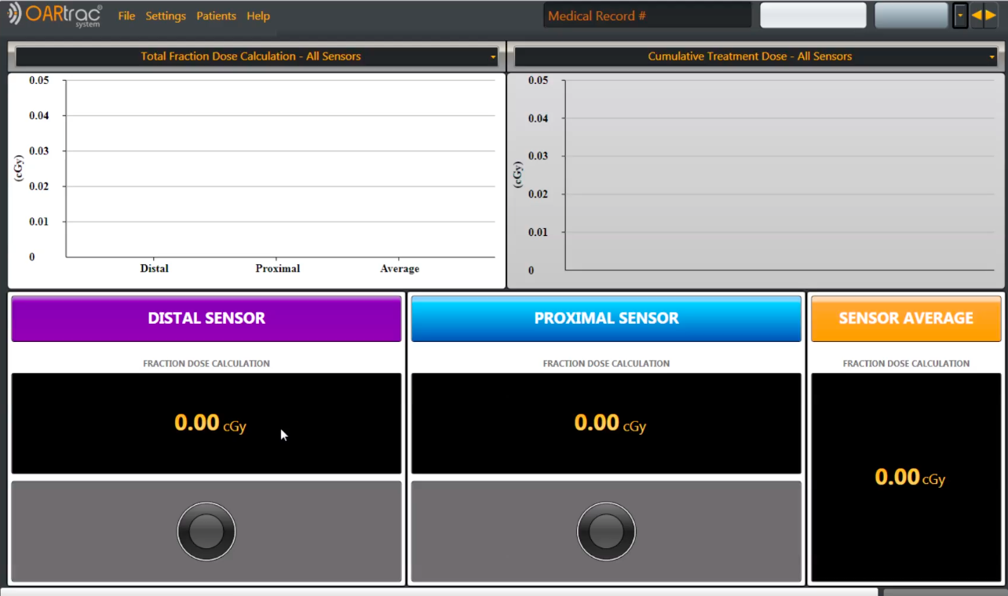
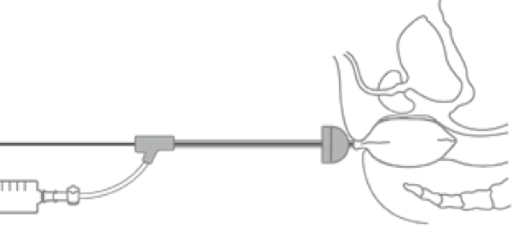
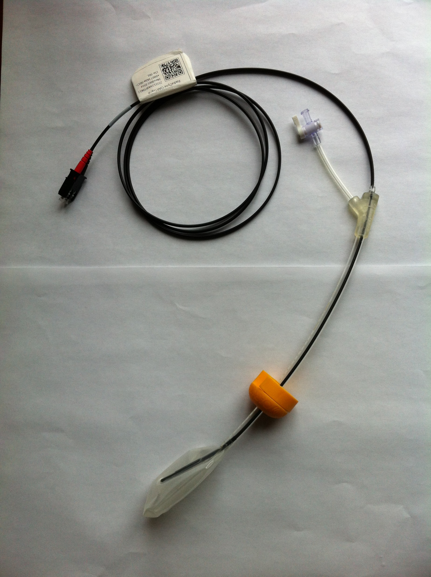
Enabling Real Time Radiation Treatment Dosimetry
Nuclear scientists at Hampton University and Jefferson Lab developed real-time, in vivo, dosimetry technology.
Incorporates real time dosimetry monitoring into radiotherapy cancer treatment procedures
Uses plastic scintillating detector (PSD) fiber technology with balloon-type patient organ immobilizers
Scintillating Fiber
Fiber Core
Fiber Cladding
Fluorescent dopants

Slide 9
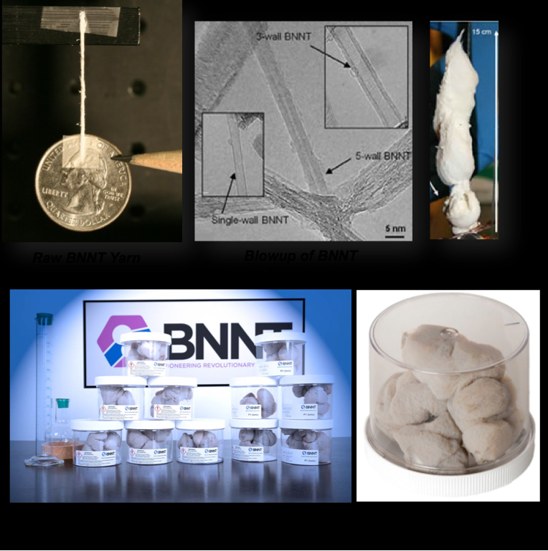
Boron Nitride Nanotubes (BNNT)
BNNT is lightweight, very strong, electrically insulating, thermally conductive, likely not cytotoxic
Maintains strength to > 900ºC vs. carbon at 400ºC
Possible applications: biomedical - scaffolding for living tissue; chemical -aircraft, aerospace, jet engine parts, fire retardant cabling, electrical insulation, athletic equipment and more.
BNNT IP developed from research conducted at JLab with NASA Langley Research Center and National Institute of Aerospace
BNNT LLC in Newport News, Virginia. www.bnnt.com

Slide 10
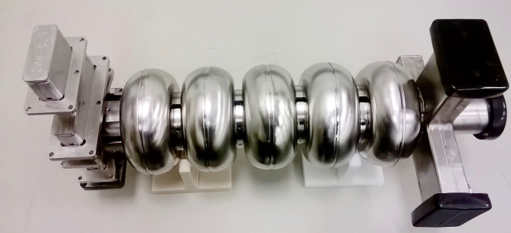
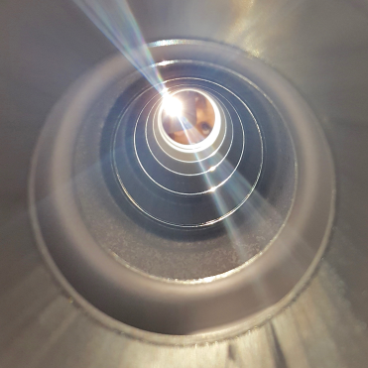
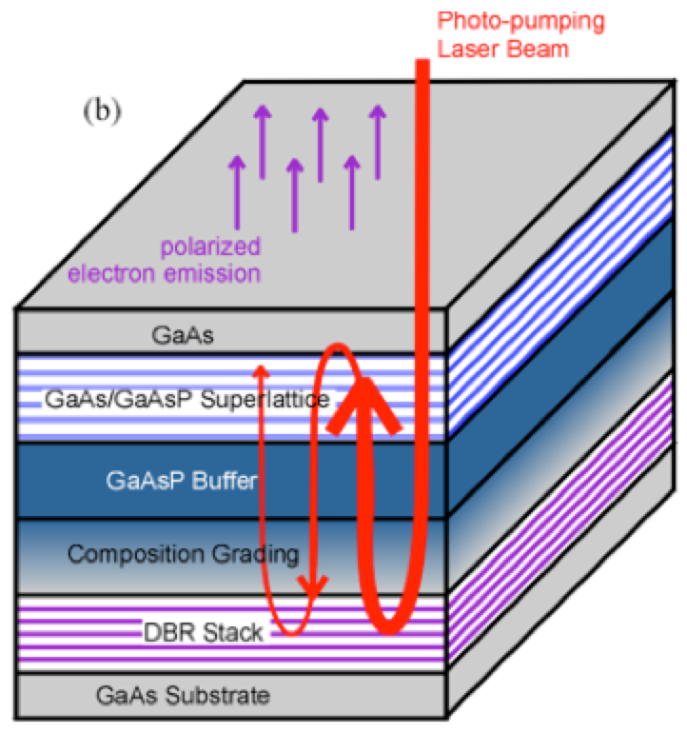
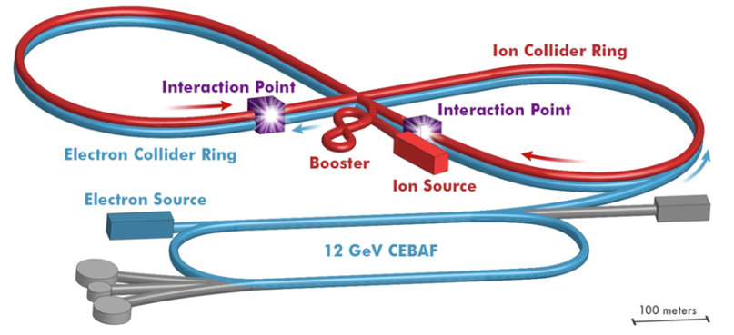
JLAB R&D Major Directions
Superconducting RF R&D
  Improving SRF performance of CEBAF
  Next-generation SRF for high quality factor, high-gradient, higher temperature
  New materials and processes for higher efficiency, lower cost, safer operations
Electron Source R&D
  Enhance quantum efficiency for high polarization photocathodes
  Magnetized electron beam
  Advanced cathode materials
JLEIC R&D activities
  Pre-conceptual R&D
  R&D on high-priority topics
C75 cavity
World Record High Polarization Photocathode
Nb₃Sn coated 5-cell cavity
Many thousands of industrial and medical accelerators worldwide – based on technology developed many decades ago.
Today’s R&D enable tomorrow’s industrial & medical applications.

Slide 11
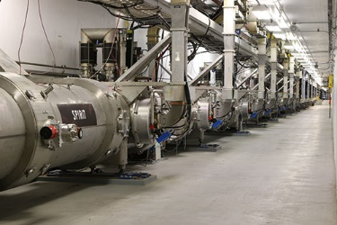
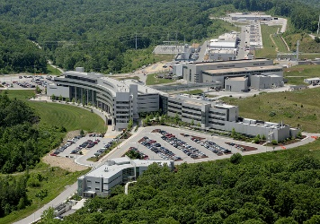
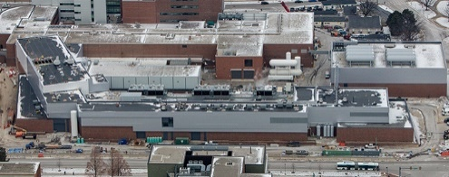
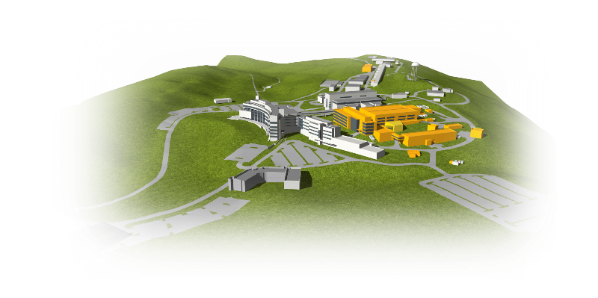
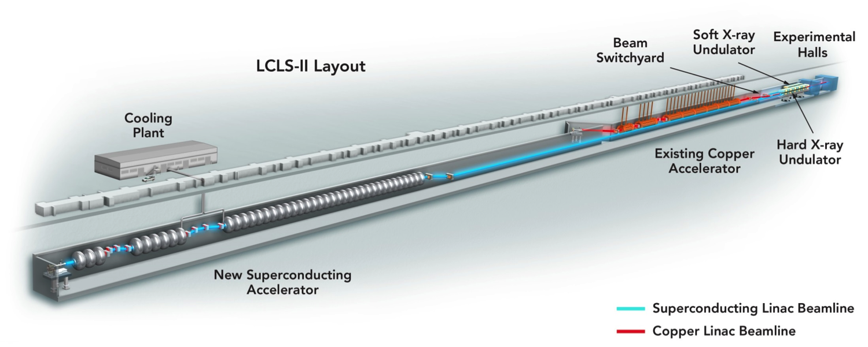
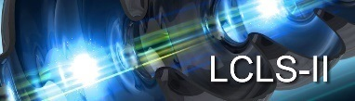
Jefferson Lab Plays a Vital SRF Stewardship Role
Jefferson Lab is a world-leader in Superconducting Radiofrequency particle accelerators and cryogenic technologies
CEBAF - 1994
12 GeV Upgrade - 2017
Spallation Neutron Source (ORNL) - 2006
Facility for Rare Isotope Beams (MSU) - 2021
Linac Coherent Light Source II (SLAC) 2021
SNS Proton Power Upgrade
LCLS-II High Energy Upgrade

Slide 12

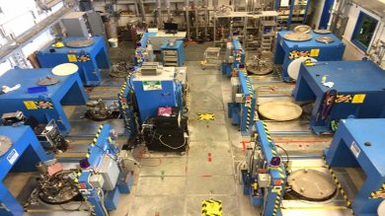
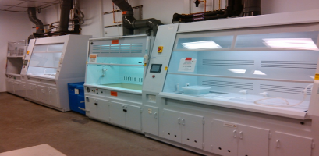
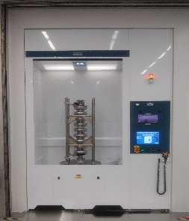
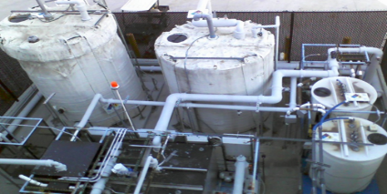
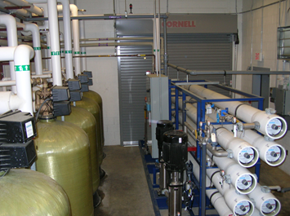
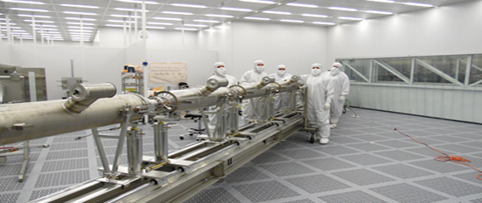
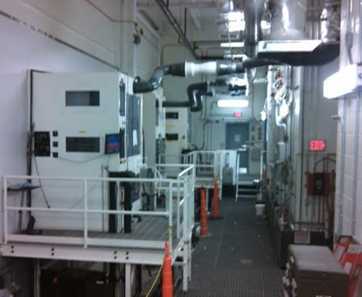
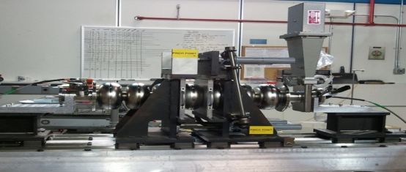
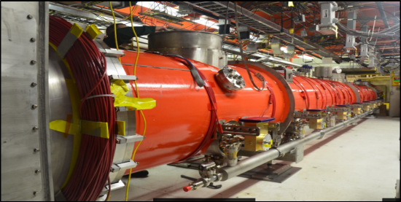
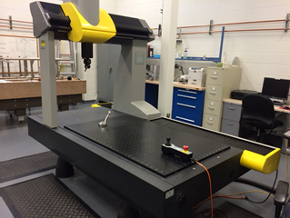




SRF Institute – unique capabilities – all in one place
Inventory and R&D
Parts Clean and Etch
R&D Chem Lab
Vertical Test Area & Electronics Shop
Process Support Area
Physics
Cryomodule Test
R&D Labs
Clean Room
Vertical Attachment
QA/CMM & Tuning
R&D Clean Lab
1st and 2nd Floor Offices
Cryomodule Assembly
Furnaces
Fabrication
Machine Shop
Electron beam Welding

Slide 13

















A sampling of JLab’s Cavity R&D
For CEBAF
For JLEIC
For SPPs and R&D
JLEIC 5-cell 952.6 MHz ERL cooler
5-cell 802 MHz ERL main linac cavity (PERLE/Orsay & LHeC/CERN)
HC 5-cell1.5 GHz C75 Cavity (CEBAF)
2-cell 952.6 MHz ion ring cavity
Beta-matched 2-cell for new injector CM
750 MHz compact SRF-based environmental accelerator
First 952.6 MHz cavity parts
CEBAF 750 MHz separator
Harmonic kicker magnetization cavity
1.5 GHz ERL twin-axis cavity

Slide 14



Upgraded Injector Test Facility (UITF)
Ongoing and planned R&D include:
  Full Injector Upgrade: 200 kV gun, Wien filters, new Quarter Cryomodule
  Polarize solid targets for CEBAF Physics Program
  Magnetized beam tests for JLEIC
  Polarized positron source development for CEBAF and EIC
  Possible area for R&D in support of Environmental Applications of Accelerators

Slide 15


Energy Recovery, FEL, Electron Source R&D
Parameter * | Value
Gun High Voltage | 350 kV
Bunch Charge | 150 pC
Bunch Frequency | 75 MHz
Current (Fixed Target) | 0.5 mA
Current (ERL) | 8 mA
Max. Energy | 170 MeV
Long Axis Length | 64 meters
FEL – world record (>10kW in IR, 1.6 um)
Energy Recovery enabled FEL
High polarization & High QE photocathodes R&D
Magnetized beam R&D at Gun Test Stand
*Capabilities at full config.
Gun Test Stand
Magnetized Gun
Magnetized Beam
Notes:
A bunchlength monitor and a fast kicker are a type of harmonically-resonant cavity (antenna)
All Jlab photocathodes from SBIR program
Booster=first SC cavity the beam sees
200kV gun is the actuall CEBAF injector
350 kV load-locked gun is the LERF injector, load-locked means many photocathode processing steps under vacuum.

Slide 16




SBIR R&D example: JLab R&D on magnetron RF source
Motivation:
Klystron: Space-charge effect in electron bunch forming process in linear motion dominates the efficiency. Spent energy deposits in the collector.
Magnetron
forms bunches in spoke-on-hub process in circular motion. Beam-to-RF cavity interaction in multiple passes. Much less wasted energy.
12.2
L3 20-80kW magnetron
Varian 5 kW klystron
L3 13 kW klystron
National 1.2kW oven magnetron

Slide 17

Compact high-power CW SRF accelerator for industrial application
1-year design collaboration among JLAB, AES, General Atomics
Funded by DOE-HEP (Accelerator Stewardship)
Use in wastewater and flue-gas treatment
1 MeV, 1 A electron beam
Nb₃Sn/Nb/Cu β=0.5 single-cell cavity, conduction cooled with four 1.5 W cryocoolers
~6 m
Patent on Cryomodule design filed on 01/29/18

Slide 18



Compact, scalable normal-conducting e-beam source
The source uses new technology developed at JLab as well as established components
Scalable in size (frequency) and power
Additional units could be stacked for higher energy
Gridded electron gun
Vacuum pumping
Focusing coils
Compact graded-β copper linac
Magnetron RF source
Deflecting system
Horn
Exit window
915 MHz 100 kW

Slide 19

JLEIC – JLab Electron Ion Collider
Electron Ion Collider – priority project in Long Range Plan for Nuclear Science, strongly endorsed by National Academies of Sciences
JLab is a possible host for EIC
JLab EIC innovative design:
  High polarization
  High luminosity
  Energy range: 20 to 140 GeV CM
  Low technical risk
  Cost effective operation
Location of JLEIC in
  Close proximity of VA industries
  Area with several nearby universities & Tech Center
  Area with high density of technically skilled workers
  Area with high demand for post-career technical on-the-job training
=> great impact on local and national industry & society

