Slide 1
Worldwide Utilization of Industrial Accelerators
Present Status & Market Opportunities
Dr. Robert W. Hamm, CEO
R&M Technical Enterprises, Inc.
Pleasanton, CA, USA
Presented to
DOE Accelerator Stewardship Event
Jefferson Lab, Newport News, VA
December 17, 2018

Slide 2
Introduction
This talk will cover only the industrial applications of accelerators, excluding medical therapy and Discovery Science systems.
(>60% of all accelerators now being sold annually.)
These systems include all commercial charged particle accelerators except those generating internal beams (i.e., CRTs, x-ray tubes, rf tubes and electron microscopes or lithography systems).
The present status of these applications will be discussed, along with future applications and technology.
Presentation caveats:
Sales estimates made by author from publications and vendor input.
Don’t have a crystal ball but do have 50 years of experience in developing accelerators, 37 of those at 4 commercial companies.

Slide 3
“Accelerators for America’s Future”(2010), Walter Henning and Charles Shank
“A beam of the right particles with the right energy at the right intensity can shrink a tumor, produce cleaner energy, spot suspicious cargo, make a better radial tire, clean up dirty drinking water, map a protein, study a nuclear explosion, design a new drug, make a heat-resistant automotive cable, diagnose a disease, reduce nuclear waste, detect an art forgery, implant ions in a semiconductor, prospect for oil, date an archaeological ﬁnd, package a Thanksgiving turkey or discover the secrets of the universe”.

Slide 4
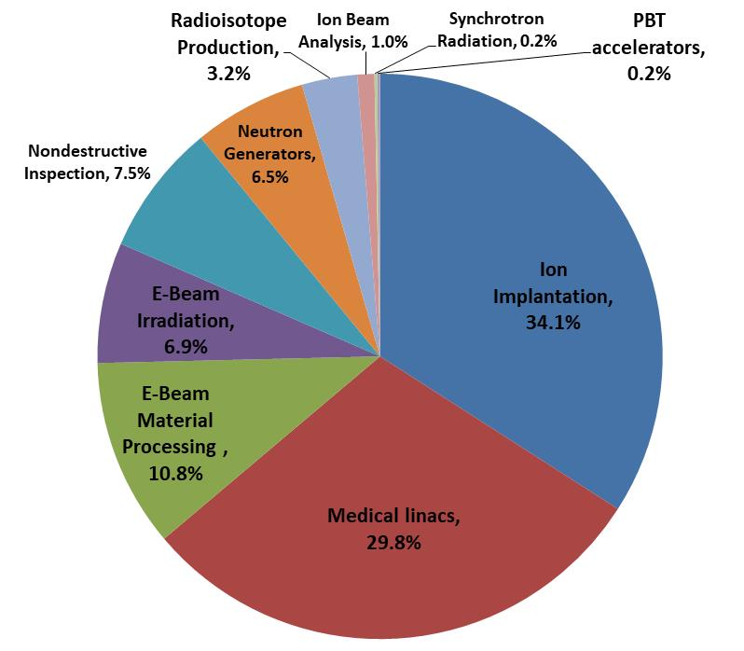
Commercial Accelerator Business
Updated totals indicate that ~47,000 systems have been sold to date with > 40,000 now in operation.
More than 100 vendors worldwide are in the accelerator business.
Vendors are primarily in US, Europe, and Japan, but numbers are growing in China, Russia, and India
The total sales of accelerators is ~US$5B annually.

Slide 5
Commercial Accelerator Vendors (2017)
Some vendors are in multiple applications.

Slide 6
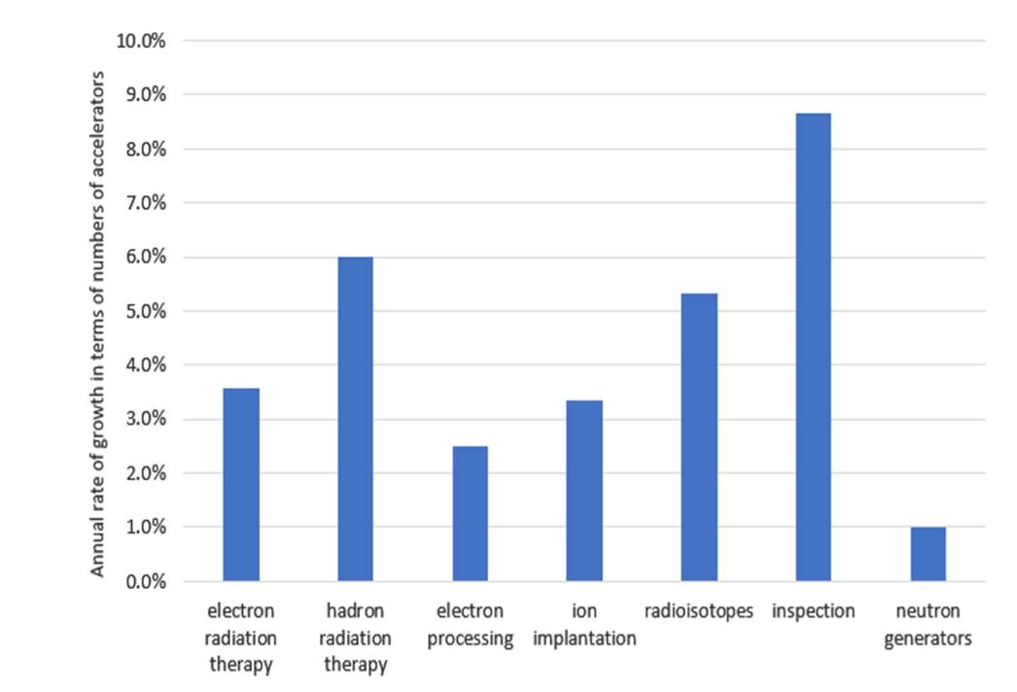
Annual increase in commercial accelerators used in each of the labeled applications between 2008 and 2018

Slide 8
Discovery Science Accelerator Business
Søren Pape Møller, IPAC17
Discovery Science (research) accelerators are large systems supported by governments and are very costly undertakings.
The construction and upgrades of these accelerators is still a very active business, with a large number of small, medium and very large projects spread all over the world.
These projects are large investments/procurements, but only a small part of the BEAM BUSINESS:
  13,764 M€/5 years ≈ 275 M€/year.
  Hamm: ~5,000 M€/year for commercial accelerators.

Slide 9
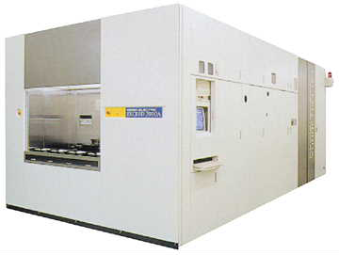
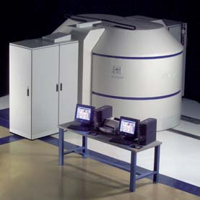
Industrial Accelerator Applications
Well established commercial applications
Ion Implantation - Semiconductors and materials
E-Beam Material Processing – Welding, cutting & melting
E-Beam Materials Irradiators – Irradiation & sterilization
Radioisotope Production – Medical & Industrial use
Developing commercial applications
NDT & Inspection Linacs – NDT & security
Neutron Generators – Mineral detection and NDT
Ion Beam Analysis – Element profiling & AMS
Synchrotron Radiation – Users at large research facilities
These eight categories were first defined by the speaker in a RAST-1 article and then used for the book “Industrial Accelerators and Their Applications” (Robert W. & Marianne E. Hamm, eds., World Scientific, 2012 ).
Latest review update is an article in RAST-10 to update RAST-4.

Slide 10
RI Prod

Slide 11
Current Commercial Accelerators
Electron accelerators
  Electrostatic (10 kev-10 MeV) — Van de Graaff, Insulated Core Transformers, Cockcroft-Walton, Pelletron, Dynamitron
  RF Linac (2 MeV-200 MeV) — mostly room temperature operating at 100 MHz to 9 GHz, but superconducting models now available
  Microtron (10-100 MeV) — multiple pass linac
  Betatron (1-20 MeV) — old technology, but compact
  Rhodotron (5-10 MeV) — new cross-field device with coaxial gap
  Synchrotron (1-3 GeV) — mostly room temperature
Ion accelerators
  Electrostatic (.05-10 MeV) — Van de Graaff and Cockcroft-Walton
  RF linacs (1-100 MeV) — RFQ-based (protons to heavy ions)
  Cyclotrons (5-230 MeV) — room temperature and superconducting

Slide 12
Applications of Accelerators for Energy
Accelerators have large potential markets in Energy, but these are large systems that need much more development. Scientists are actively developing accelerators for:
  Transmutation of nuclear waste
  Generation of electrical power with accelerator-driven subcritical reactor systems
  Generating extreme radiation environments required for reactor materials in next generation nuclear fission, or future nuclear fusion devices (materials studies)
  Generating electrical power from fusion by utilizing heavy-ions to affect inertial confinement
  Neutral beam heating of fusion plasmas
  Bio-fuel production
  Large research projects being conducted at national laboratories.

Slide 13
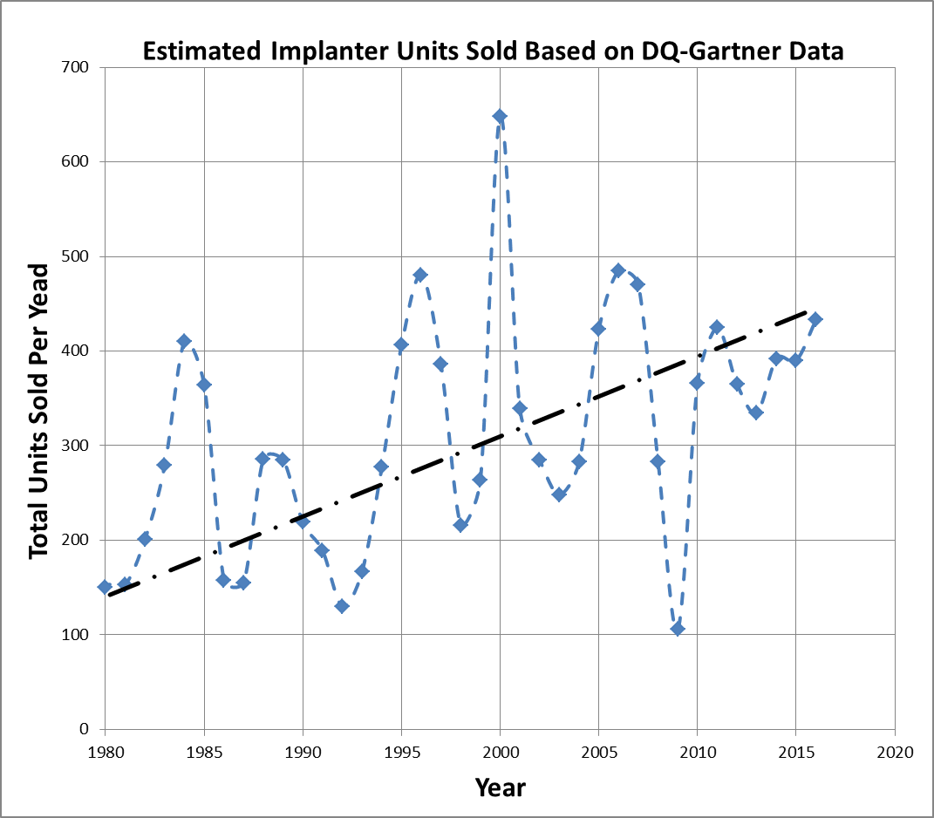
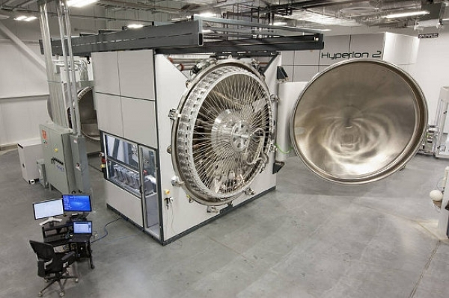
Ion Implantation Applications
Semiconductors
  CMOS transistor fab for essentially all IC devices
  CCD & CMOS imagers for cell phones & digital cameras
  Cleaving silicon for producing photovoltaic solar cells
Metals
  Harden cutting tools
  Reduce friction in metal parts
  Biomaterials for implants
Ceramics & Glasses
  Harden surfaces
  Modify optics

Slide 14
Ion Implantation Market
In the IC device area, doping applications for CMOS transistors have now been joined by an even larger number of non-dopant, “materials modiﬁcation” implant steps, accounting for a total of 50–80 passes through some form of implant tool for each completed advanced device.
  Market is mature, with few vendors
  Sales are cyclical and have been moving to Asian countries
  Semiconductor market still growing rapidly with growth in digital age
Accelerators are specialized and changing rapidly.

Slide 15
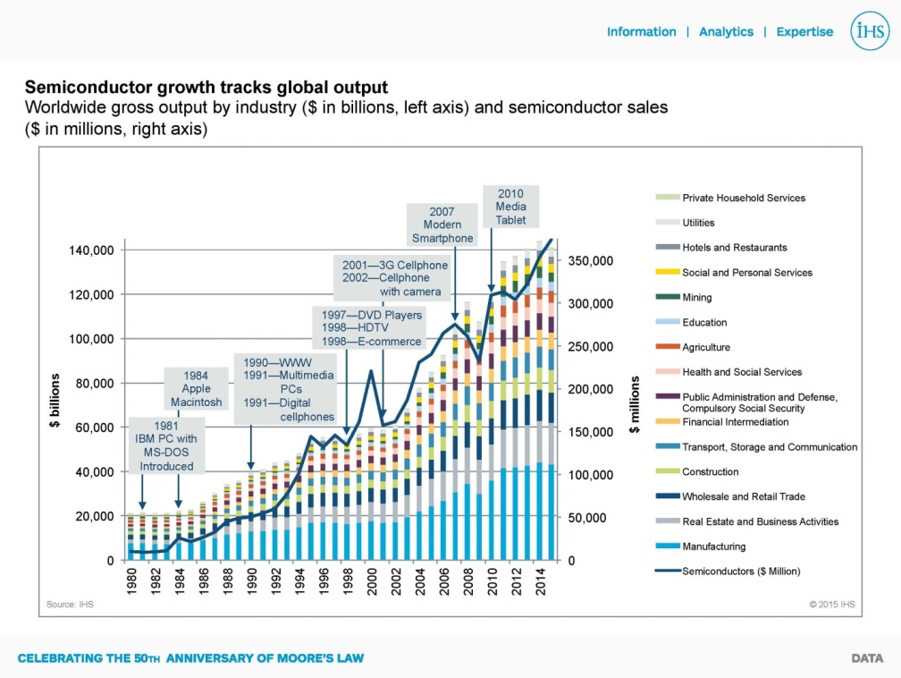
Growth of Implantation Market: Driven by Semiconductors

Slide 16
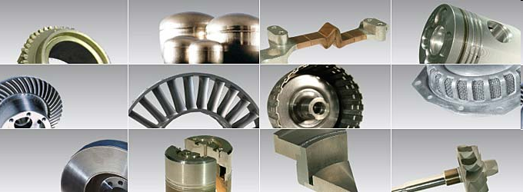
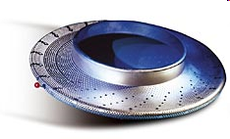
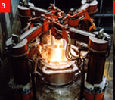
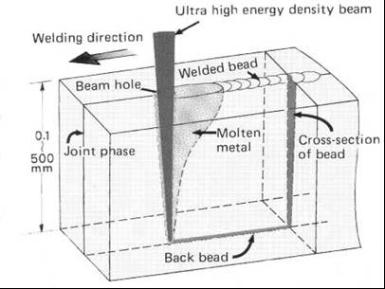
Electron Beam Material Processing Applications
Applications started in 1905.
Critical to automotive production
  Welding & hardening of parts
  Dissimilar metals – deep welds
  Speed gears
Precision cutting and drilling
  3000 holes/sec at 0.55 mm
Recovery of refractory metals
Typical industrial sectors
  Automotive
  Machine construction
  Medical technology
  Aerospace
Many factory systems are fully automated.
Beam energy from 30 to 200 keV
Beam power from 6 to 200 kW
Beam used in vacuum or air
>5000 systems w/w – mature business with growth in developing countries.

Slide 17
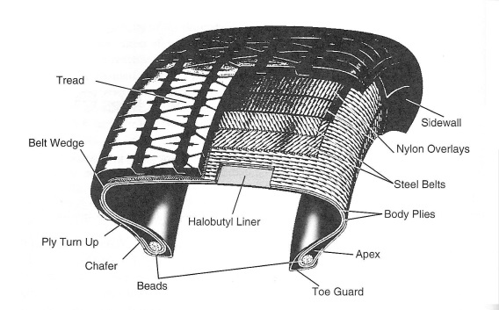
Electron Beam Irradiator Applications
Cross linking of materials (largest application)
  Wire & cable insulation – heat resistant
  Heat shrink tubing
  Heat shrinkable food packaging films
  Closed cell polyethylene foams – auto & medical parts
  Tire components
  Curing of inks, coatings & adhesives – paper, wood, metals & plastics
  Hydrogels for wound dressings
Sterilization of medical products (the fastest growing application)
Decontamination of food & medical device packaging
US$60B per year
Now >1500 dedicated e-beam irradiation facilities operating worldwide.

Slide 18
New Electron Beam Irradiator Markets
Some recent opportunities for radiation processing:
New polymeric materials developed with new properties by combining materials with different properties
Radiation curing for fiber-reinforced composite materials by the automobile and aircraft manufacturers
Increased use of plastic pipe for the distribution of hot water
Increased sale of irradiated foods to reduce the use of toxic chemicals for insect control, and to reduce the risk of disease
Cracking crude oil with radiation to increase the yield of lighter compounds which are the most valuable products
Food and waste irradiation are large potential applications.

Slide 19
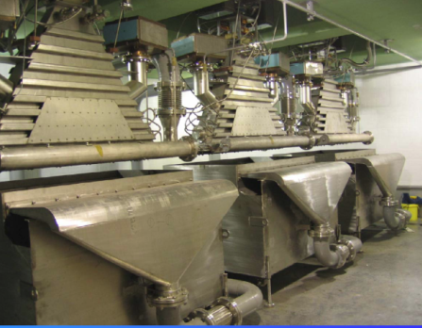
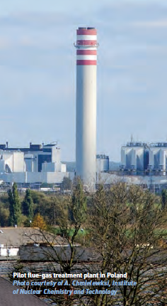
Environmental Applications of Irradiators
Accelerator scientists are developing technology for:
  Purifying drinking water – remove contaminants
  Treating waste water – Destruction of organics and pharmaceuticals before release in waterway
  Disinfecting municipal sewage sludge bio-solids
  Flue gas treatment for removal of NO_{X} and SO_{X}
  Radiation processing of flue gases and waste water is being studied in Austria, Brazil, Ecuador, Hungary, Jordan, Korea, Poland, Portugal, Turkey, and the US, and pilot plants have been built in Poland, Bulgaria, China and Korea.
Market acceptance hindered by cost & reliability.

Slide 20
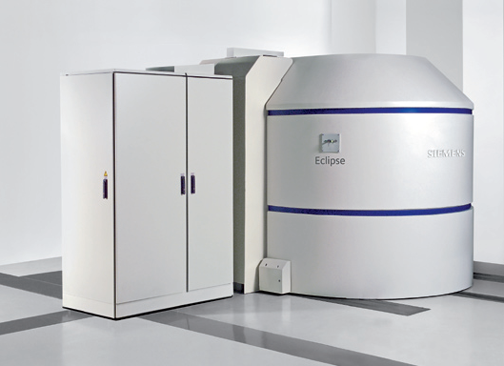
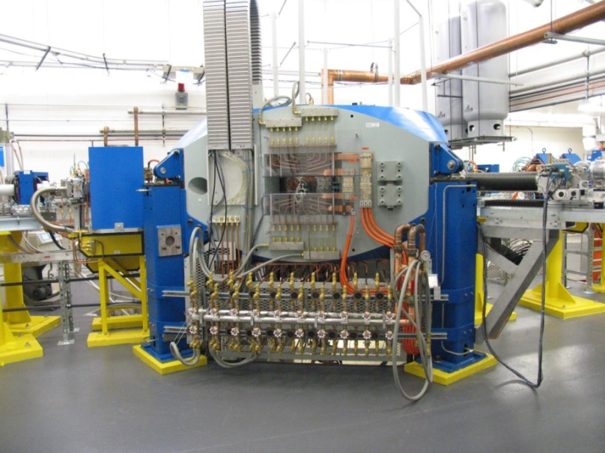
Radioisotope Production
Commercial cyclotron and linac systems produce isotopes for
  SPECT: 20-70 MeV with ~mA current; ¹¹¹In, ¹²³I
  PET: 7 to 18 MeV with ~0.1 mA current;¹⁸F, ¹¹C, ¹³N, ¹⁵O
~50 isotopes routinely produced for both diagnostics and therapy
Considerable US interest in using accelerators to produce ⁹⁹Mo due to past reactor production issues (15 million procedures annually)
PET systems currently dominate this market.

Slide 21
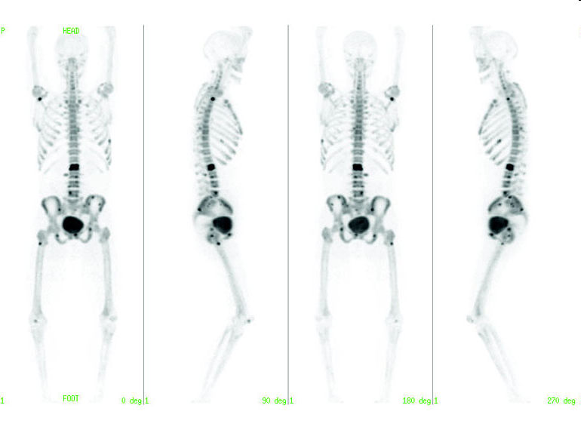
Radioisotope Applications
Industrial – Gauging & Calibration
  Thickness monitoring
  Moisture content determination
Medical – Diagnostics & Treatment
  Single Photon Emission CT: ¹²³I & ¹¹¹In (^{99m}Tc ??)
  PET (Positron Emission Tomography): ¹⁸F, ¹¹C, ¹⁵O, ¹³N, ⁶⁴Cu & ¹²⁴I
  Brachytherapy: ¹²⁵I & ¹⁰³Pd
>50 accelerator-produced radioisotopes in routine use.

Slide 22
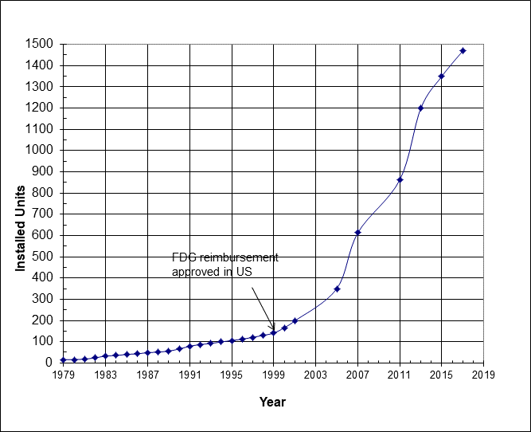
Radioisotope Production Market
Sales in 2015 - US$165M (~ 60 units sold per year).
Top 5 manufacturers sell more than 50 units per year.
PET sales dominate market (> 95% of all PET procedures use FDG.
Sales flat (saturated?) in North America and Europe due to FDG distribution model.
Sales increasing in Asia and rest of the world.

Slide 23
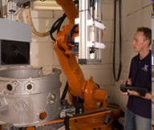
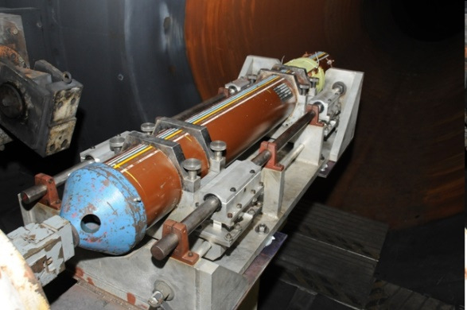

High Energy X-Ray Inspection Applications
Radiography of large castings – Original application that led to development of systems.
Examination of rocket motors and munitions – Includes CT examinations systems.
Port examination of containers & semi-trailers – Started as a security application and is now an import/export control tool.
Used by many countries for manifest verification.

Slide 24
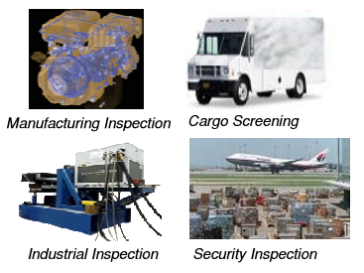
High Energy X-Ray Inspection Markets
Market Drivers:
New safety and quality standards
Inline manufacturing inspections
Disruptive technology (e.g., 3D printing)
Airport/ship cargo scanning
Vehicles scanning at borders
Packaged food safety scanning
Market dominated by 2 main vendors:
Varex & Nuctech.

Slide 25
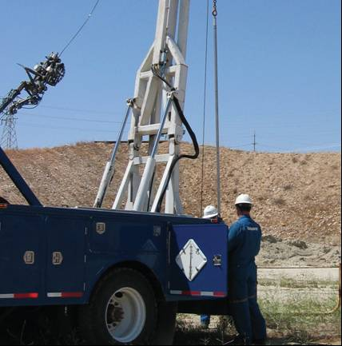
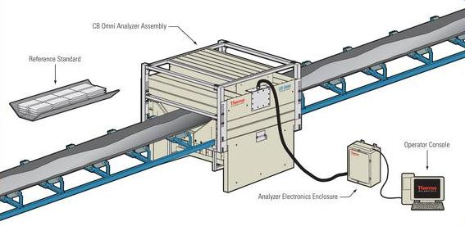
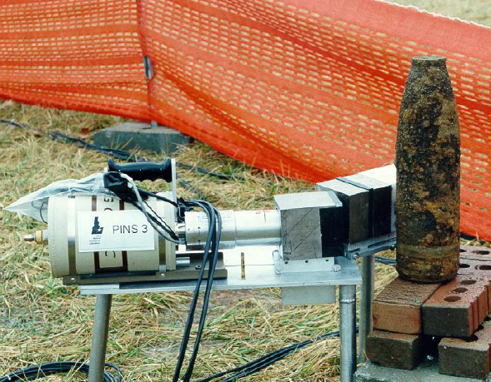
Neutron Generator Applications
Geophysical Exploration – Mineral detection and oil well borehole logging.
Bulk material analysis – Includes gold, coal, cement and scrap metal on-line monitoring.
Gauging & radiography – Materials inspection.
Neutron activation analysis – Trace elements in biological and environmental areas.
Security – Detection of contraband, high explosives, fissionable materials, and chemical weapons agents.
Medical – New systems for Mo-99 production and Boron Neutron Capture Therapy (BNCT).
Oil well logging is the largest application of these systems.

Slide 26
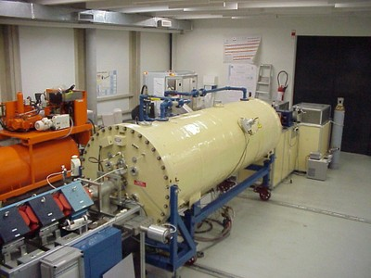
Ion Beam Analysis Applications
Application Techniques – All were adapted from nuclear physics measurements
  Rutherford Back Scattering (RBS)
  Elastic Recoil Detection Analysis (ERDA)
  Nuclear Reaction Analysis (NRA)
  Particle Induced X-ray Emission (PIXE)
  Particle Induced Gamma ray Emission (PIGE)
  Nuclear Resonance Reaction Analysis (NRRA)
  Resonant Scattering Analysis (RSA)
  Charged Particle Activation Analysis (CPAA)
  Accelerator Mass Spectrometry (AMS)
  Focused Ion Beams
Applications
Semiconductor quality
Environmental monitoring
Geological studies
Oceanography studies
Biomedical science
Renewable energy
Market dominated by 2 main vendors:
NEC & HVEE
These applications are still widely used at many research labs.

Slide 27
Synchrotron Radiation Sources: Impact on Industry
Construction and operation of new light sources – Many components are not commercially available, so collaboration with industry is required in the development and production of these systems.
The primary impact of light sources for industry is the provision of beam-time on a commercial basis to companies that benefit from the unique characteristics of synchrotron radiation but cannot justify the investment of building their own accelerator.
Laboratories that operate SRSs often seek industrial partners to commercialize their ideas and produce new products. An important development for industry would be the development of a compact SRS.

Slide 28
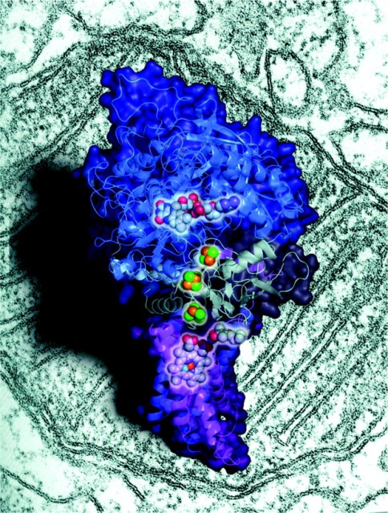
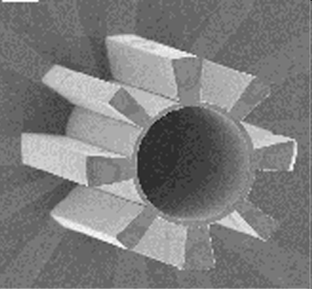
Synchrotron Radiation Applications
Application Techniques
  Fourier Transform infrared spectroscopy
  Infrared microspectroscopy
  Circular dichroism
  UV-VUV photoelectron spectroscopy (ESCA)
  VUV-microspectroscopy
  Powder & surface diffraction
  Small angle & wide angle X-ray scattering (SAXS-WAXS)
  Protein Crystallography
  Microtomography
  X-ray fluorescence (XRF) and X-ray microscopy
  X-ray absorption spectroscopy: EXAFS, XANES
  Fabrication techniques
    UV-VUV lithography (Microelectronics)
    X-ray lithography (LiGA) for MEMS (sensors, gears, etc.)
Application Areas
  Semiconductors – lithography, material interface studies, and production issues.
  Chemical industry – Determine properties such as stress or texture of various materials produced and the chemical reactions themselves.
  Biomedical – protein crystallography, molecular structures imaging, and molecular dynamics studies in tissue cells.

Slide 29
Evolutionary New Commercial Accelerators?
Superconducting Linacs & Cyclotrons
  Increase in efficiency and size reduction of systems for cancer therapy, and radioisotope and neutron production.
Fixed Field Alternating Gradient (FFAG) Cyclotron
  Being developed as a neutron source for BNCT and as a hadron source for therapy. Has potential in energy production as an “energy amplifier”.
Free Electron Lasers (FEL)
  Still needs broad application not possible using conventional lasers.
Industrial developments kept confidential for competitive reasons.

Slide 30
Recent SRF Technology Breakthroughs:
R. Kephart, IPAC17
Higher temperature superconductors: Nb₃Sn coated cavities dramatically lower cryogenic losses and allow higher operating temperatures ( e.g., 4 K vs 1.8 K)
Commercial Cryocoolers: new devices with higher capacity at 4 K enables turn-key cryogenic systems
Conduction Cooling: possible with low cavity losses➔ dramatically simplifies cryostats (no Liquid Helium !)
New RF Power technology: injection locked magnetrons allow phase/amplitude control at high efficiency and much lower cost per watt
Integrated electron guns: reduce accelerator complexity

Slide 31
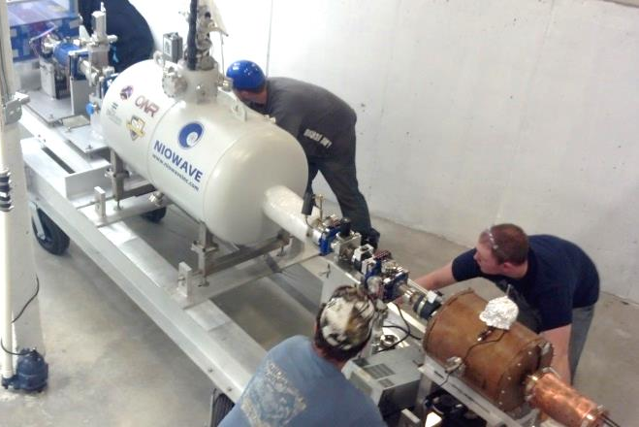
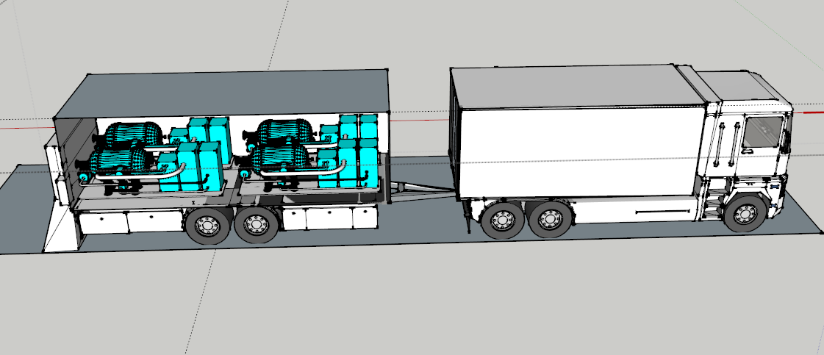
Superconducting Electron Linac Applications
  Medical radioisotope production
  High power X-ray sources
  Fast and thermal neutron sources
  Photon activation analysis
  Compton X-rays
  Free electron lasers
US Army Corps of Engineers partnership with Fermilab’s IARC
to create a tough, strong binder to extend pavement lifetime.

Slide 32
Revolutionary New Accelerators?
Terahertz accelerators
    Use terahertz radiation instead of radiofrequencies to make accelerator resonant structures smaller, i.e. centimeters.
Laser and plasma wakeﬁeld-driven accelerators
    In the laser-driven accelerator, extremely high values of electric ﬁeld (up to teravolts per meter) can be realized, much higher than any conventional accelerators. These systems could provide high energy electrons or ions and be quite small, reducing future costs.

Slide 33
Future Industrial Accelerator Applications
Materials Irradiation – Blood irradiation, beehive irradiation
Nanotechnology
  Medical probes in blood
Energy
  Accelerator Driven Reactor
  Nuclear Waste Transmutation
  Upgrade of heavy oil, flare gas
Environmental
  Treat Municipal Waste & Sludge
  In-situ environmental remediation

Slide 34
Conclusions
Industrial Accelerators have an impact on all of our lives by
  Enabling the manufacturing of products that we rely upon,
  Protecting our health and improving medical diagnostics and treatment,
  Improving our safety and security.
The annual market for industrial accelerators is estimated (2016) to exceed US$5 Billion/year and is growing at >4% per year.
There is the potential for increased impact in new areas, particularly in the fields of nanotechnology, environmental, and energy.
“Accelerator science is at a tremendously exciting period as we envision the next steps in energy, power, intensity and brightness, powered by new concepts and technologies. As history has shown, we can anticipate that those developments, motivated by Discovery Science, will have a substantial impact across Physics and Society.” Stuart Henderson, Fermilab, APS Mtg, May 3, 2011.

