Slide 1
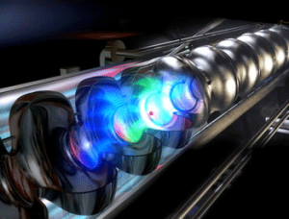
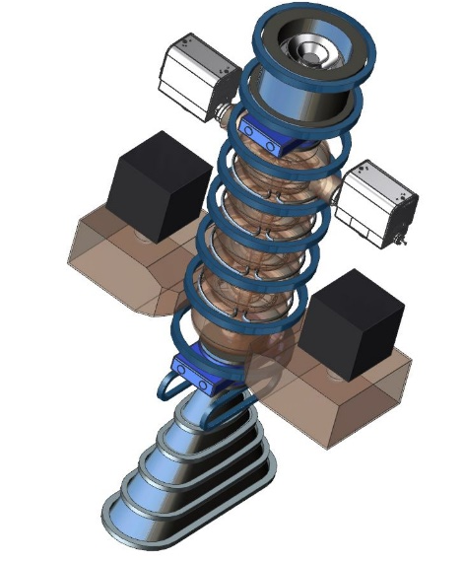
Welcome and Introduction
Accelerators: Driving Applications for Society
Stuart Henderson
Laboratory Director

Slide 2
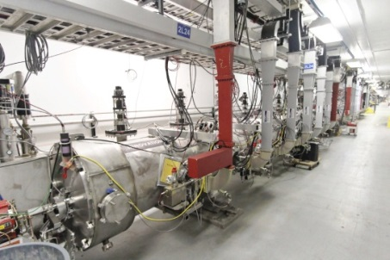
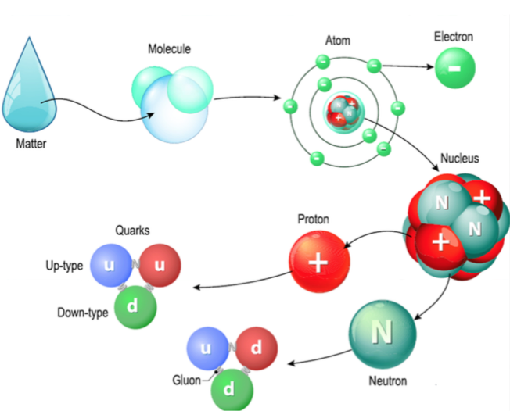
Jefferson Lab’s Scientific Mission
Our mission is to understand the subatomic constituents of protons and neutrons and the force that holds them together – the strongest force in the Universe
Our primary research tool is CEBAF - a superconducting high-energy electron particle accelerator

Slide 3

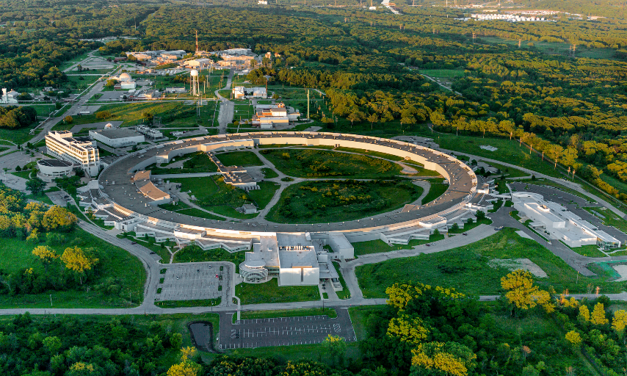
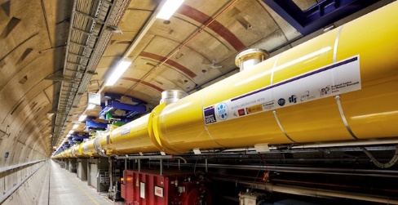
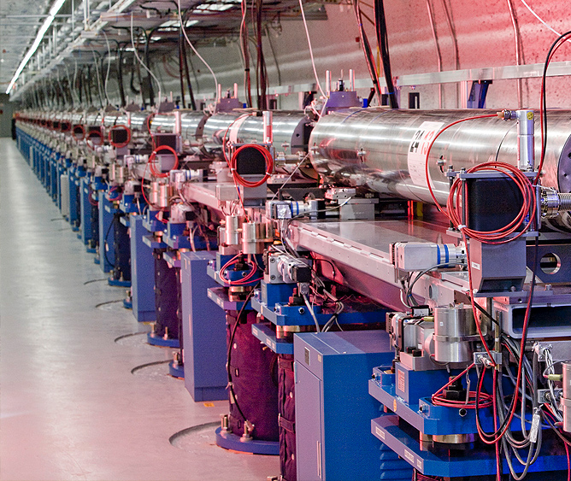
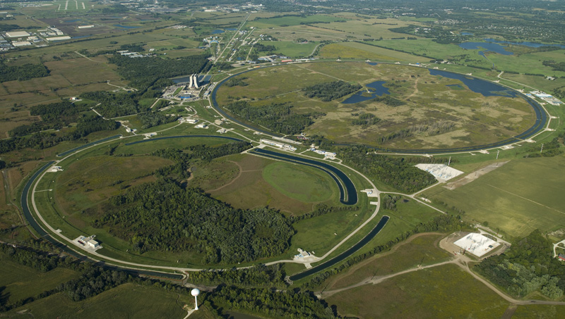

When you think of particle accelerators, you may think of these

Slide 4
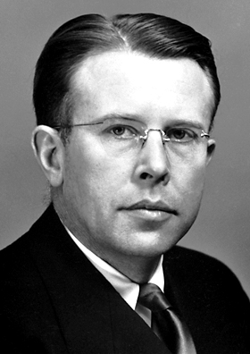
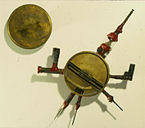
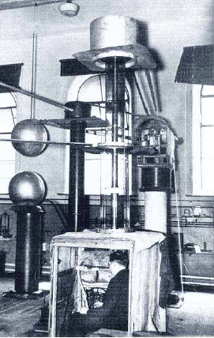
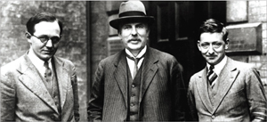
Particle Accelerators have an enormous impact on Discovery Science, Health, Industry and Security
Accelerators are “Engines of Discovery” for many scientific fields
  ~15,000 US researchers yearly make use of accelerator facilities
Accelerators have an enormous impact on people’s lives
  Healthcare
    10’s of millions of accelerator-based cancer treatments annually
  Industry
    Amazing array of products using ~30,000 industrial accelerators
    Annual value of all products that make use of accelerator technology: $500B
  Security and Defense
  Energy and Environment
Lawrence and the Cyclotron
Cockcroft, Rutherford and Walton, and the HV generator
What are the developments in accelerator technology that hold the potential to power applications that benefit society?

Slide 5
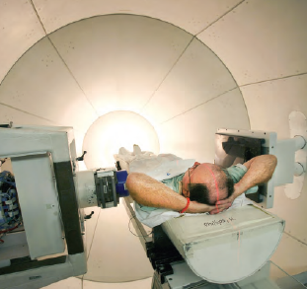
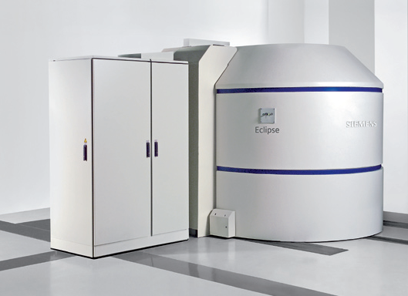
Accelerators in Medicine
  Tens of millions of patients receive accelerator-based diagnoses and treatments each year
  More than 10,000 radiation therapy accelerators installed
50 medical isotopes are routinely produced with accelerators
Dominated by PET isotope production
More than 1,000 accelerators installed

Slide 6
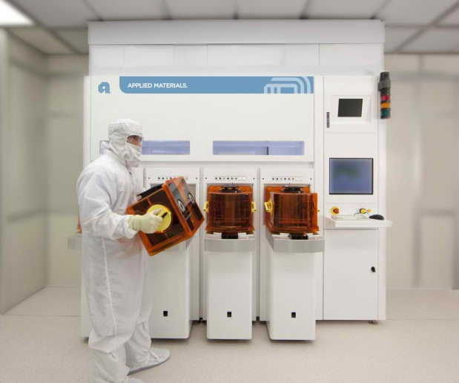
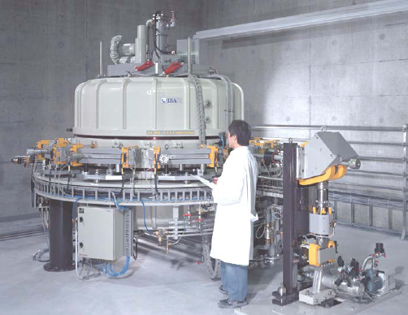
Accelerators in Industry
A wide-range of industrial applications make use of low-energy beams of electrons, protons and ions
  Semiconductor manufacturing
  Sterilization of medical products
  Food irradiation for disinfection, extension of shelf-life or sterilization
  Cross-linking and polymerization for tires, rubber, plastics
  Curing of composite materials
  Welding/hardening, cutting and drilling
  Neutron production: oil-well logging, trace element analysis, …
Ion Implantation - Applied Materials Inc.
Industrial Accelerator System - IBA

Slide 7
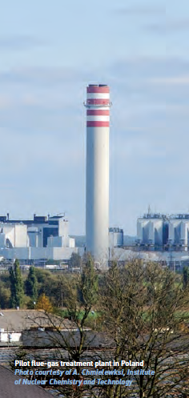
Accelerators for Environmental and Energy Applications
Accelerators have been used at pilot-scale to
treat industrial waste water,
disinfect sewage sludge,
remove NO_{X}, SO_{X} from coal-fired flue gases with high efficiency
Active R&D in
Water treatment: waste water, potable water, environmental remediation
Environmental remediation of hydrocarbon contaminated soil at oil drilling sites
Very large scale energy applications are under development world-wide:
Accelerator-driven nuclear reactors for spent fuel transmutation, power generation, process heat applications
Decontamination cross section for a 10 MeV beam in contaminated soil

Slide 8
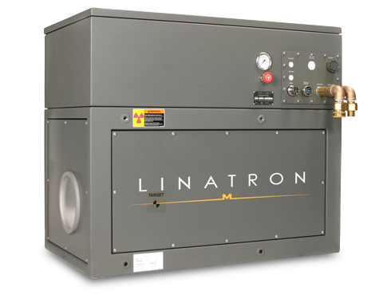
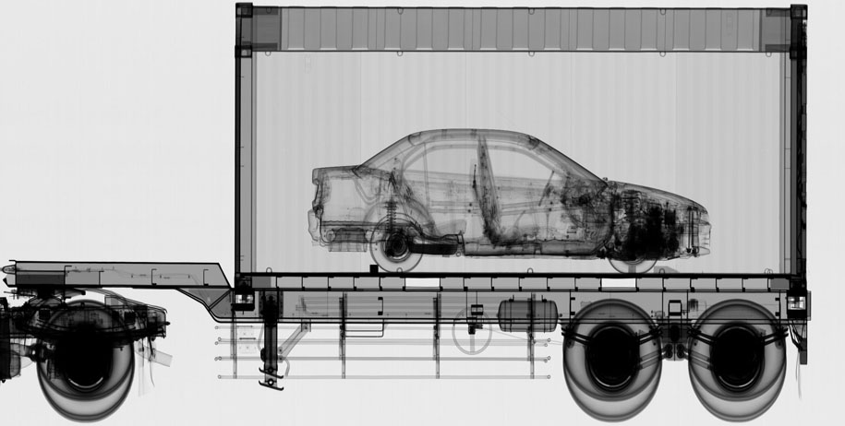
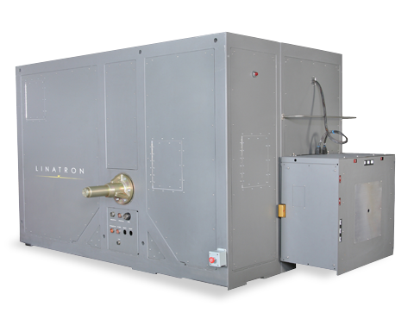
Security and Inspection Applications
Accelerators are used for cargo screening, security inspection
Inspection in manufacturing, industry
More than 3,000 installations
Varian Medical System Linatrons

Slide 9

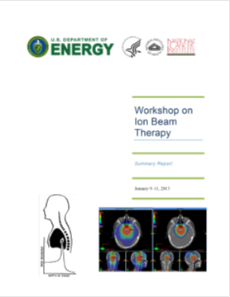
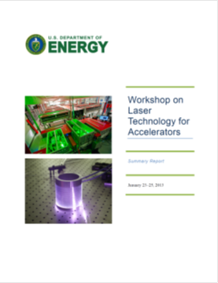

Applications of Accelerators within the DOE Accelerator Stewardship Program
Accelerators have an enormous impact today
What are tomorrow’s applications?
The High Energy Physics (HEP) Program within DOE is the steward for accelerator science and technology within the Office of Science
Medical Applications
Laser
Technology
Energy and Environment

Slide 10
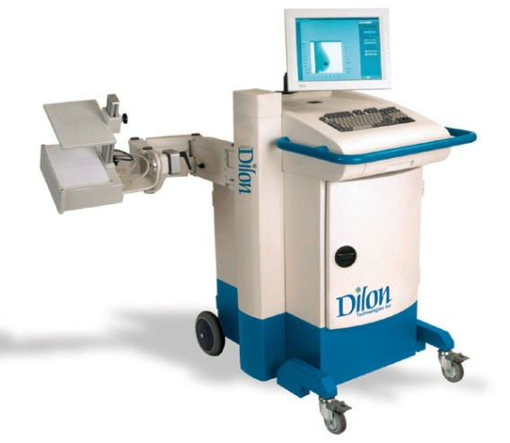
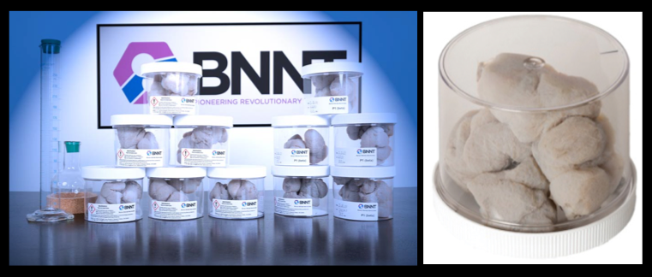

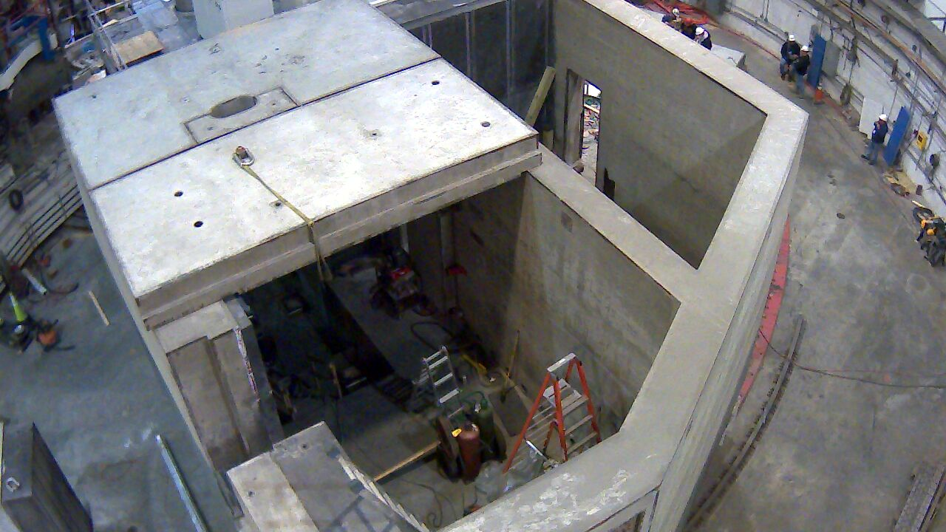
Jefferson Lab Tech Transfer and Commercialization Activities
Dilon Technologies, a local bio-tech company, produces molecular imaging breast cancer cameras using licensed IP from Jefferson Lab
BNNT LLC: Boron Nitride Nanotubes are lightweight, very strong, electrically insulating, thermally conductive
Boron based neutron shielding uses patents owned by JSA/JLab and manufactured at Bransome Concrete, Williamsburg, VA
Eager to grow further opportunities as Tech Center comes online
Jefferson Lab is committed to putting our technology to use in the marketplace

Slide 11
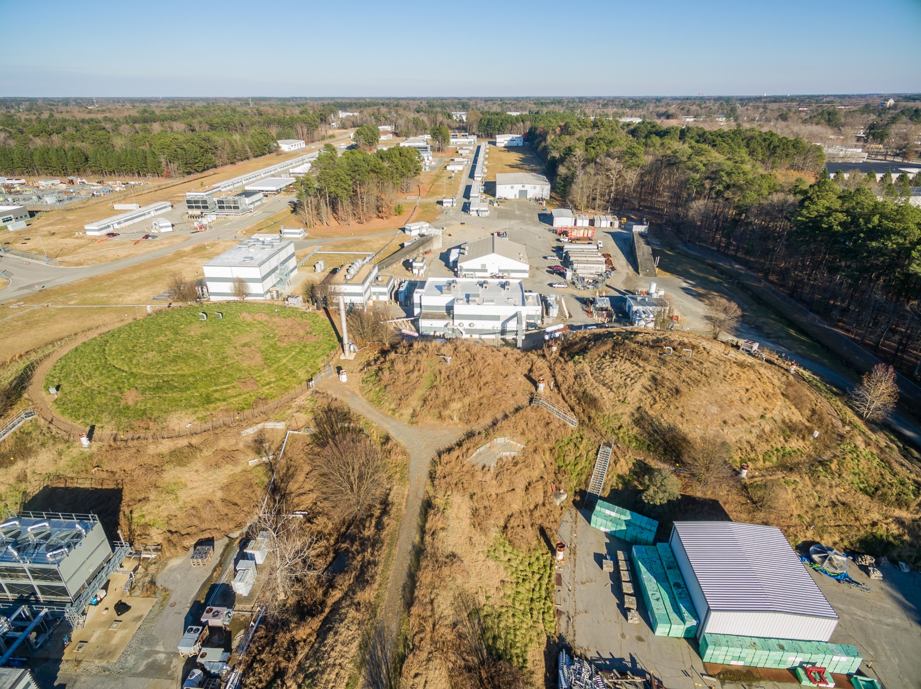
Welcome!

