Slide 1
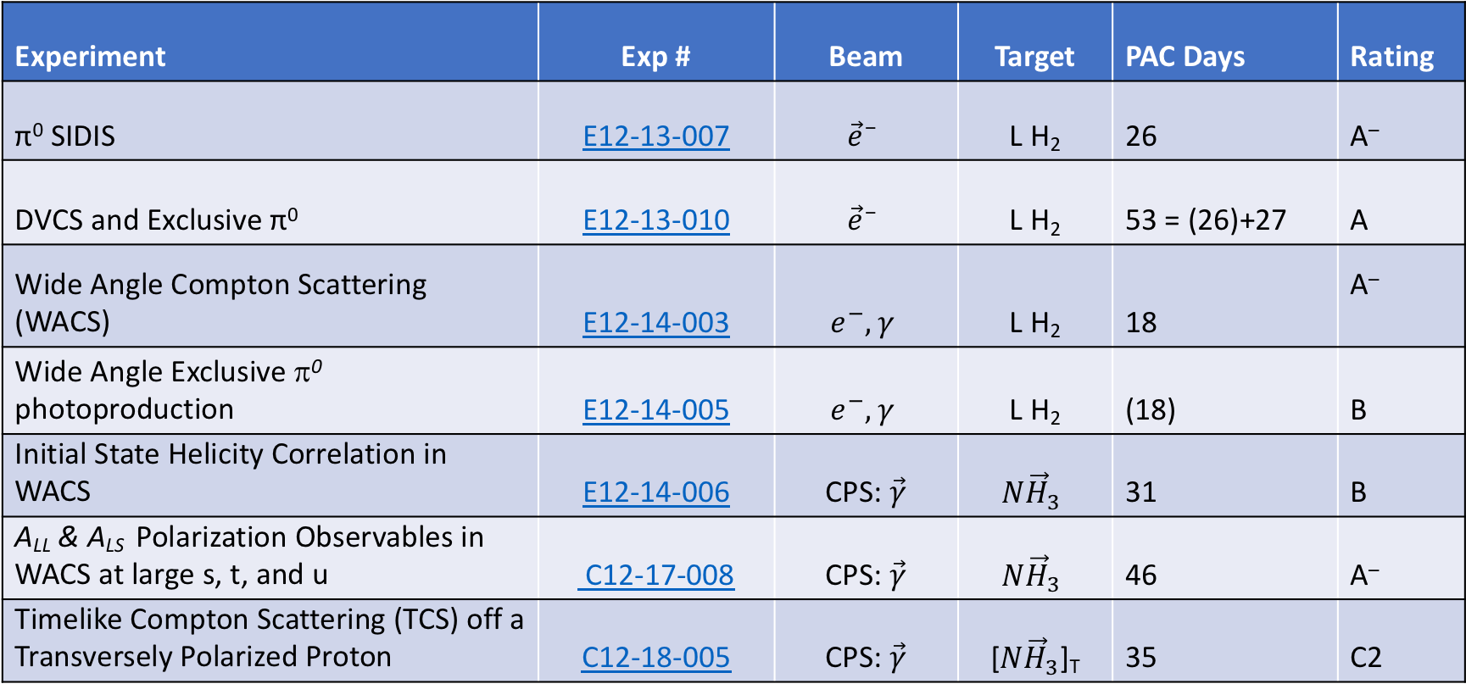
Neutral Particle Spectrometer (NPS) + Compact Photon Source with Longitudinal & Transverse Polarized NH₂
Experiment | Exp # | Beam | Target | PAC Days | Rating
π⁰ SIDIS | E12-13-007 | $${\vec{e}}^{–}$$ | L H₂ | 26 | A–
DVCS and Exclusive π⁰ | E12-13-010 | $${\vec{e}}^{–}$$ | L H₂ | 53 = (26)+27 | A
Wide Angle Compton Scattering (WACS) | E12-14-003 | $$e^{−}, γ$$ | L H₂ | 18 | A–
Wide Angle Exclusive π⁰ photoproduction | E12-14-005 | $$e^{−}, γ$$ | L H₂ | (18) | B
Initial State Helicity Correlation in WACS | E12-14-006 | CPS: $\vec{γ}$ | $$N{\vec{H}}_{3}$$ | 31 | B
A_{LL} & A_{LS} Polarization Observables in WACS at large s, t, and u | C12-17-008 | CPS: $\vec{γ}$ | $$N{\vec{H}}_{3}$$ | 46 | A–
Timelike Compton Scattering (TCS) off a Transversely Polarized Proton | C12-18-005 | CPS: $\vec{γ}$ | [$N{\vec{H}}_{3}$]_{T} | 35 | C2
Hall C Winter Meeting
Charles Hyde, Hall C Meeting, 28–29 Jan 2019

Slide 2
NPS Layout on SHMS Carriage
WACS H(γ, γ p), Wide angle H(γ, π⁰p)
DVCS H(e,e’ γ)p, Deep H(e,e’ π⁰)p
Proton to HMS
PbWO₄
γ-
e– to HMS

Slide 3
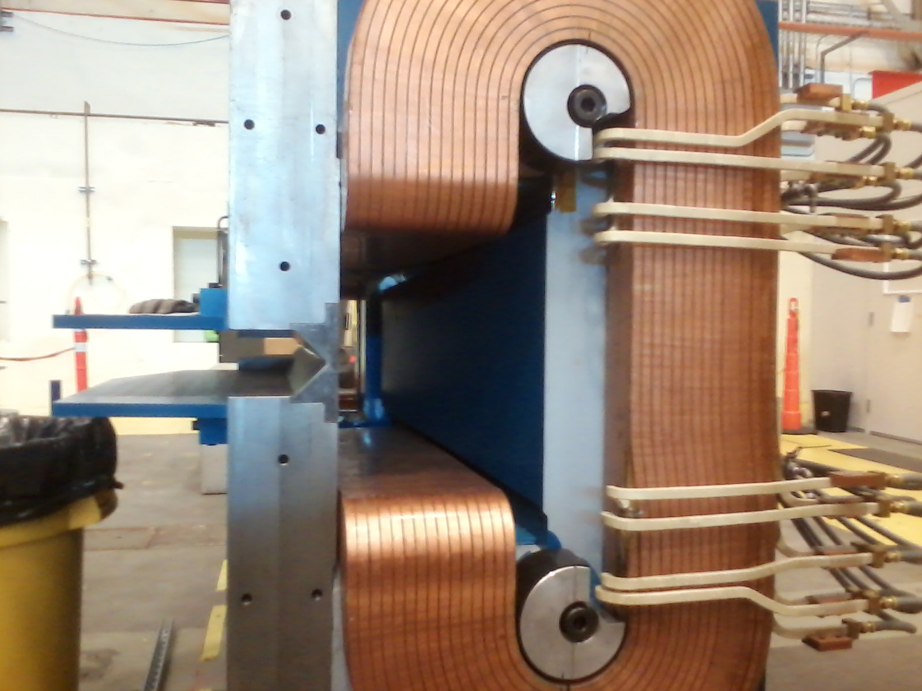
Sweep Magnet replaces SHMS Horizontal Bender
Looking upstream
  Vertical bend ~0.3 Tm
1cm steel septum between 0-field beam pipe and γ−aperture (at smallest angle setting)
Ready for power, cooling
Magnetic field mapper constructed at ODU

Slide 4
PbWO₄ Crystal Procurement 2x2x20 cm³
SICCAS (China): 460 received, 160 failed specs, returned for replacement. Additional 52 below spec to be used at edges.
SICCAS: Contract to be signed for 400 more
Crytur (Czech Republic): 100 received, OK
Crytur: 250 crystals on order delivery ≤ October 2019
  Supply limited by PANDA order
  Raw material reserve exhausted

Slide 5
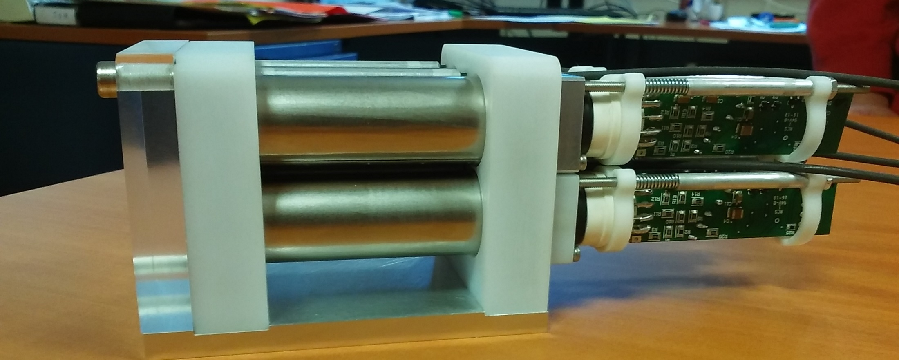
PMTs from HyCal, New Active bases
Gain stabilization at high rates by amplifier fed from last stage of HV divider.
PMT base assembly:
Ohio U.
Prototype assembly:
IPN-Orsay

Slide 6
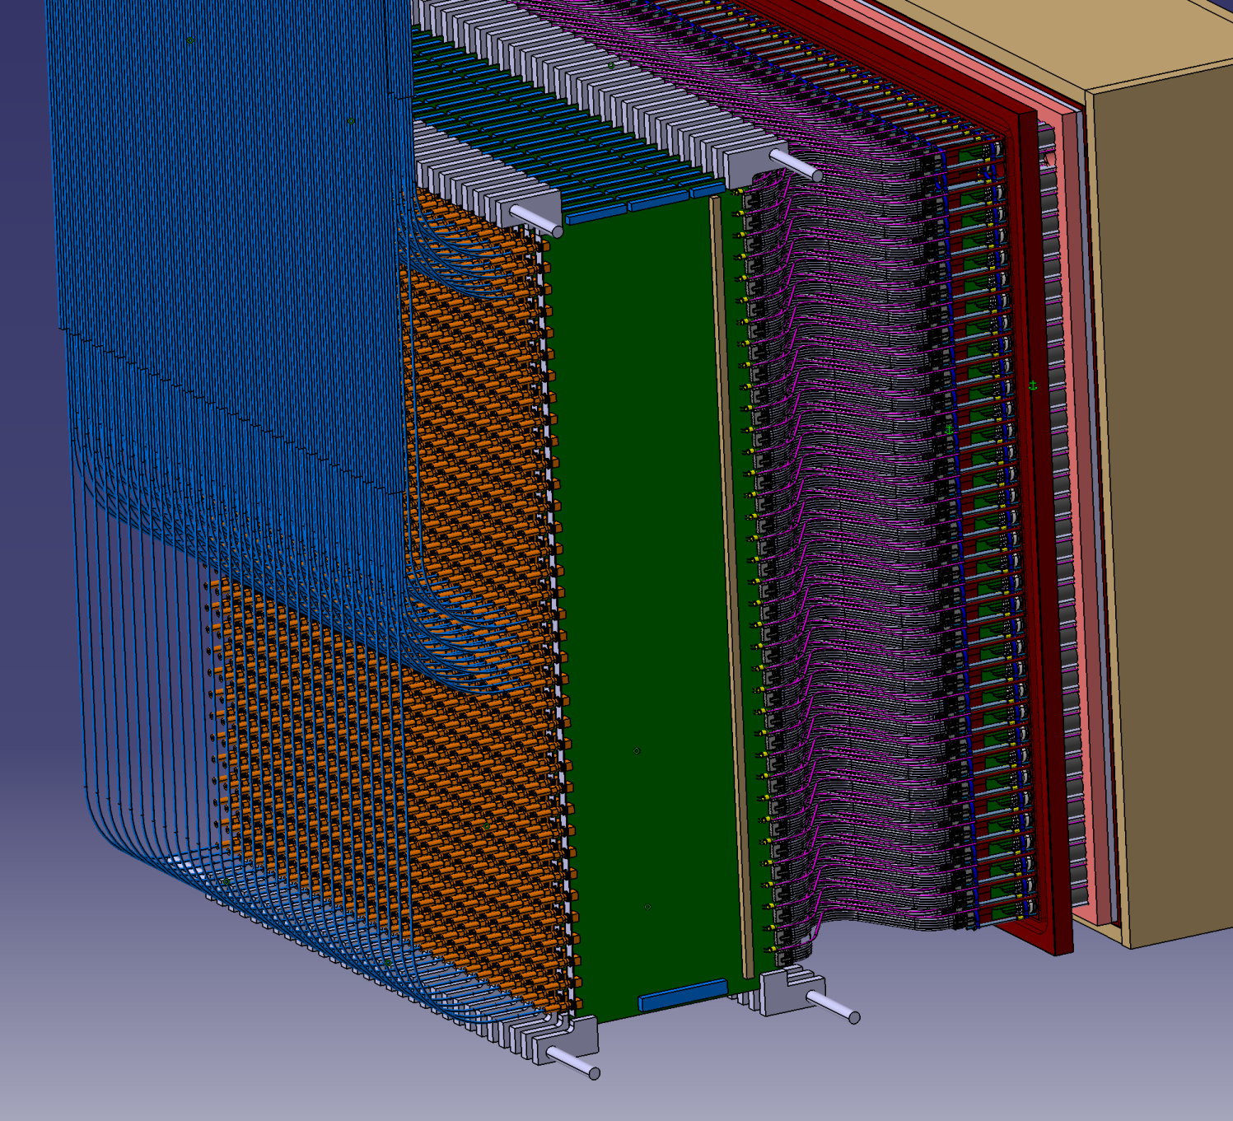
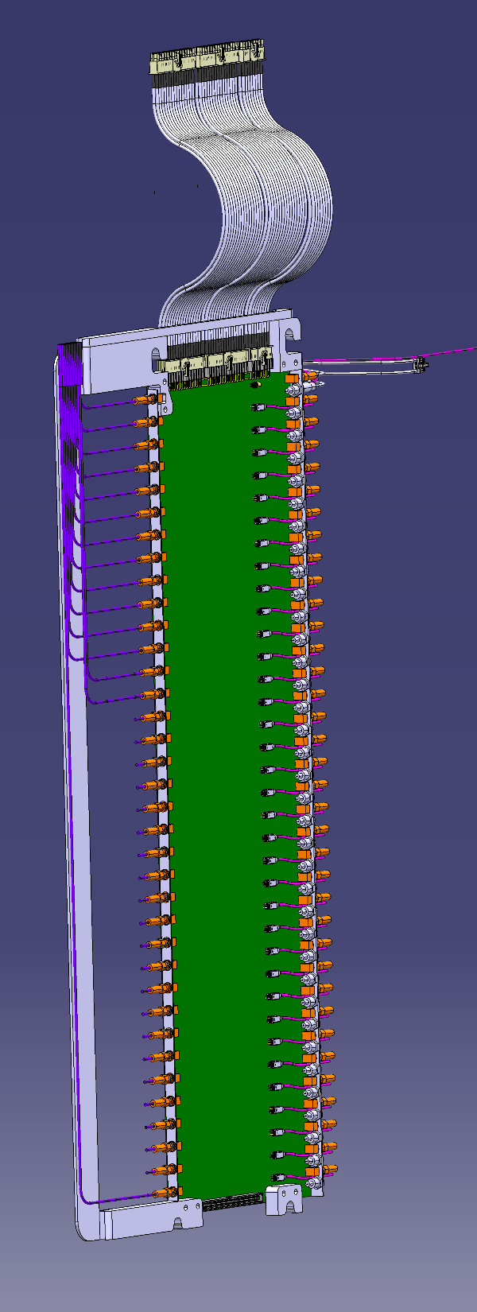
Calorimeter
Assembly
HV
Signal cables to 250 MHz FADC
Carbon fiber alveoli cantilever crystals in place
Temperature controlled box for crystals
Translation cards
Translation cards
LED Ribbon

Slide 7
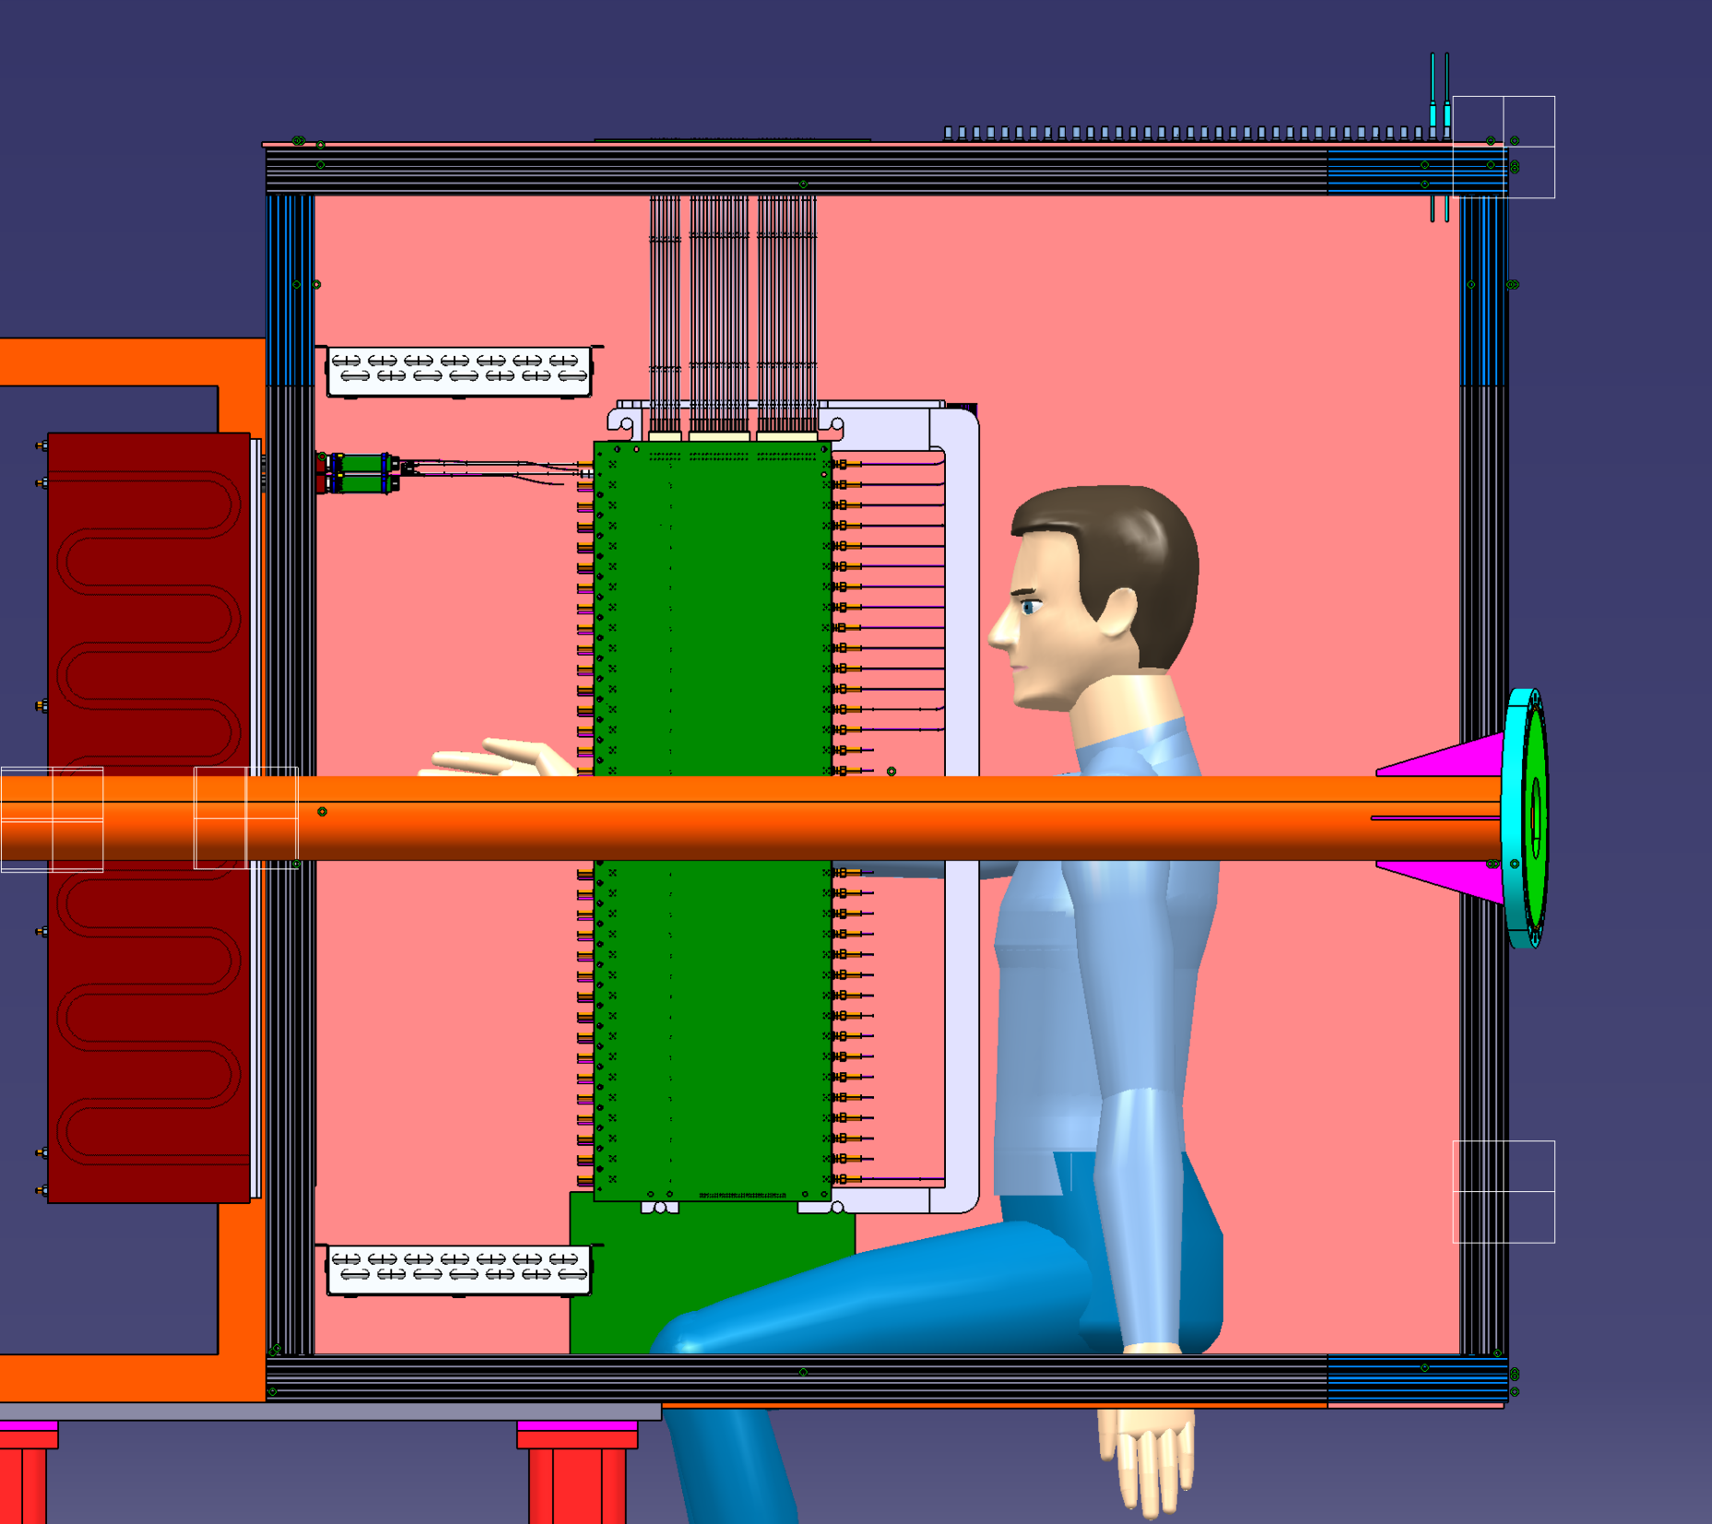
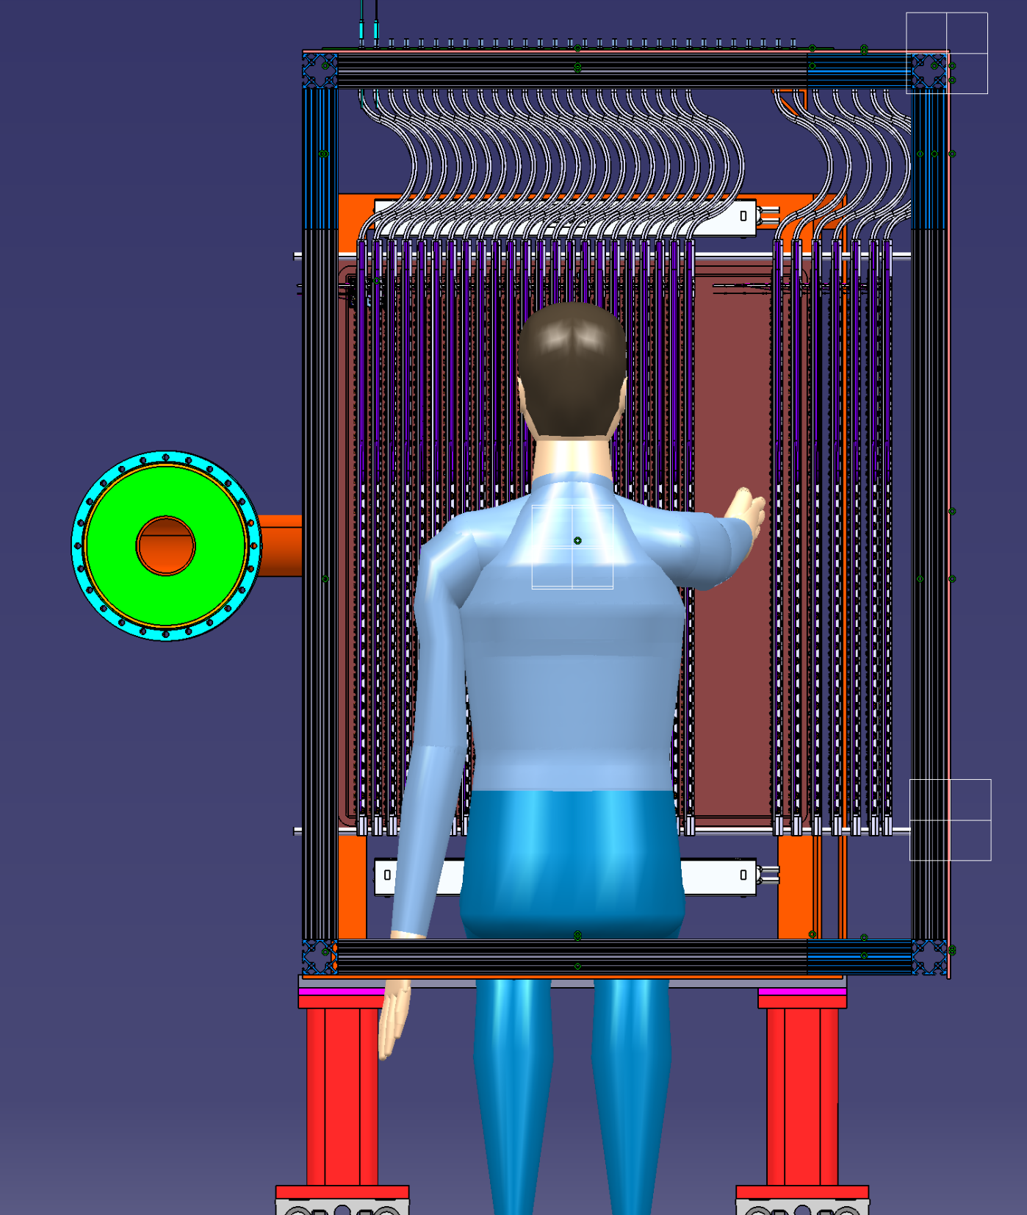
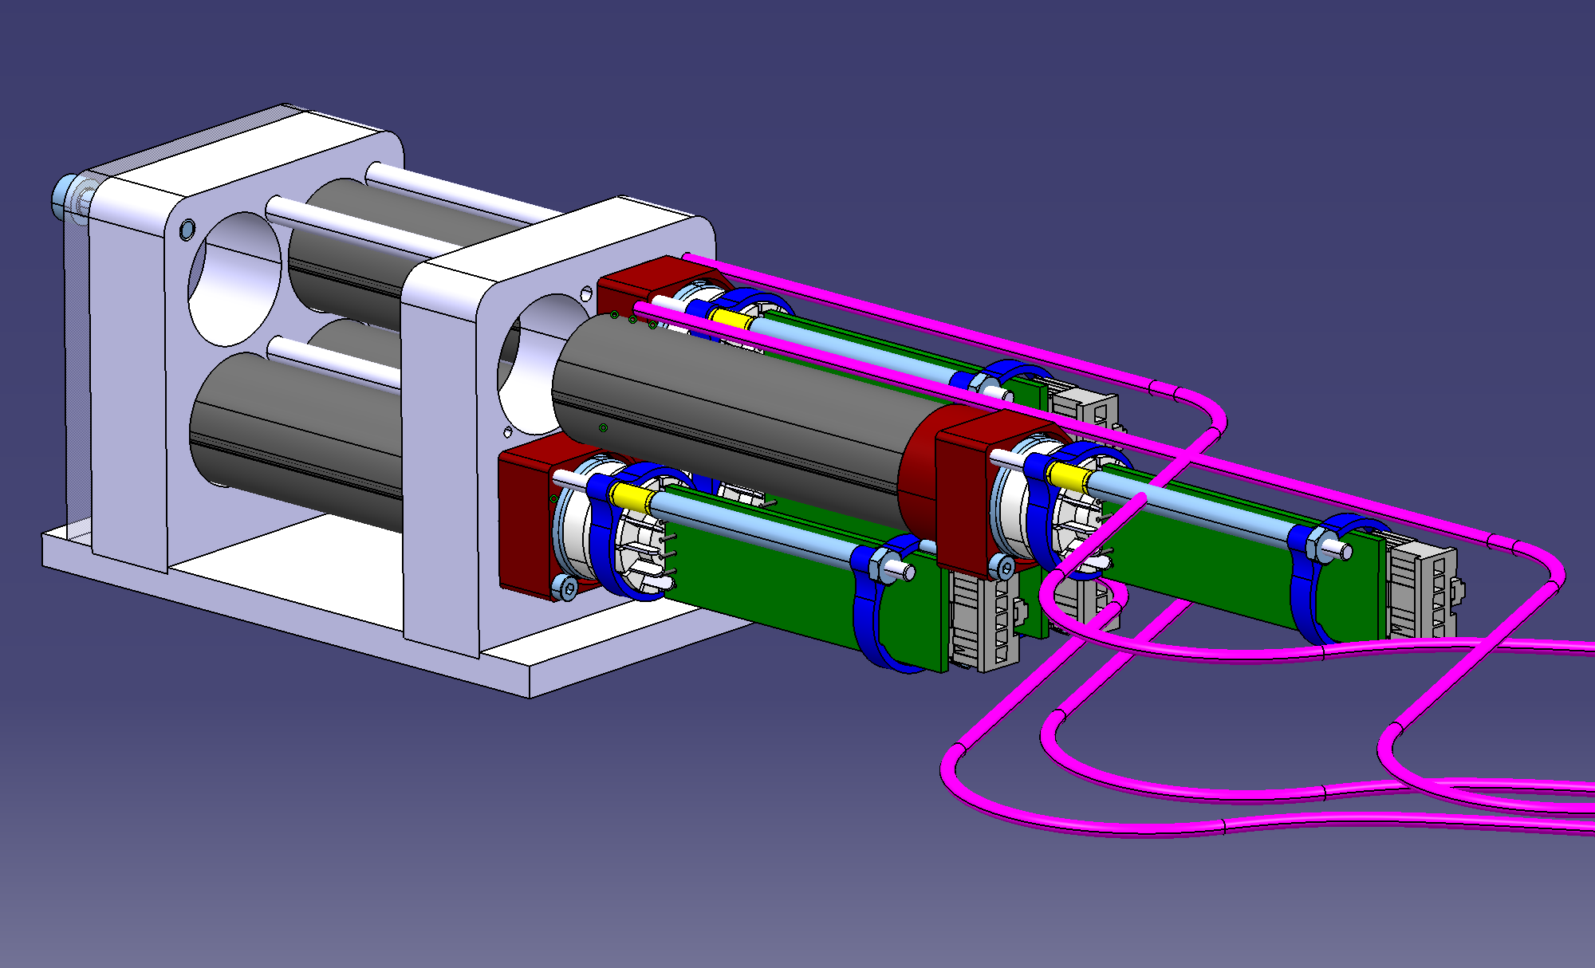
Calorimeter Servicing
Access to remove any individual PMT+Base module without disassembly
Module
disassembles
from calo with a
single screw
LED fiber
Signal + HV ribbon jumper

Slide 8
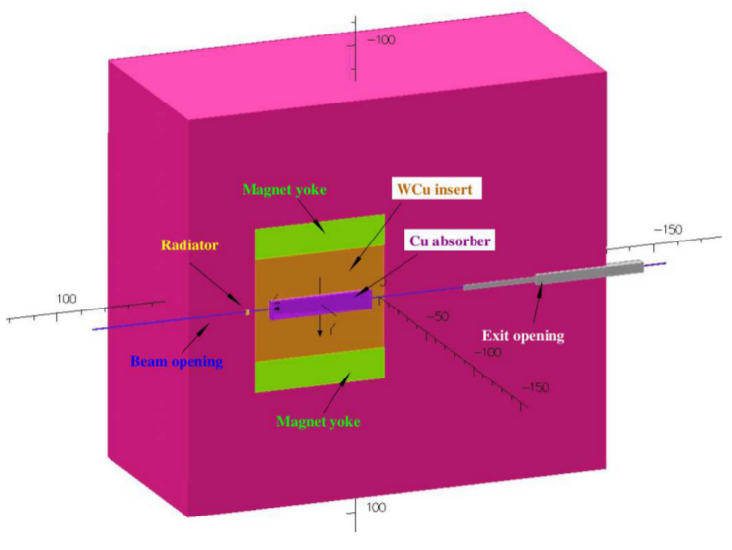
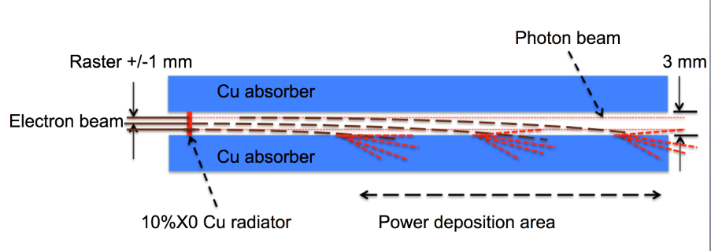
Compact Photon Source for Polarized Targets
Self-contained radiator, forward collimator, & electron dump
Pure photon beam on NH₃
  Longer polarization lifetime
  Higher γp luminosity
  Transverse polarization
Dipole magnet, central Cu absorber/dump, W powder and borated plastic radiation absorber.
CPS concept Jlab Internal Review Committee 2018. Feasible and ready for detailed design

Slide 9
WACS Polarization Observables
UVA n NH₃ target
  100° longitudinal aperture
  38° transverse aperture
A_{LL} = K_{LL}
  Except when it doesn’t.
  Free elementary quark (diluted by polarization)
Kroll, Miller = handbag models (different off-shell)
K-V = SCET

Slide 10
Timelike Compton Scattering
Access to E(ξ,t) Compton Formfactor with transversely polarized target.
Quark Orbital Angular Momentum
11 GeV Kinematic Coverage
DVCS
TCS
TCS
TCS
DVCS
BH

Slide 11
NPS
Equipment will be ready for beam before 2022
Rich physics program
Join us!
https://wiki.jlab.org/cuawiki/index.php/Main_Page
Tanja Horn, coordinator

Slide 13
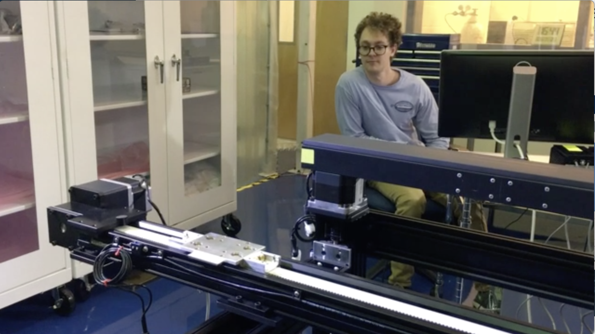
Magnet Mapper
ODU graduate student Mitch Kerver at the controls
Hall Probe recording now added

