Slide 1
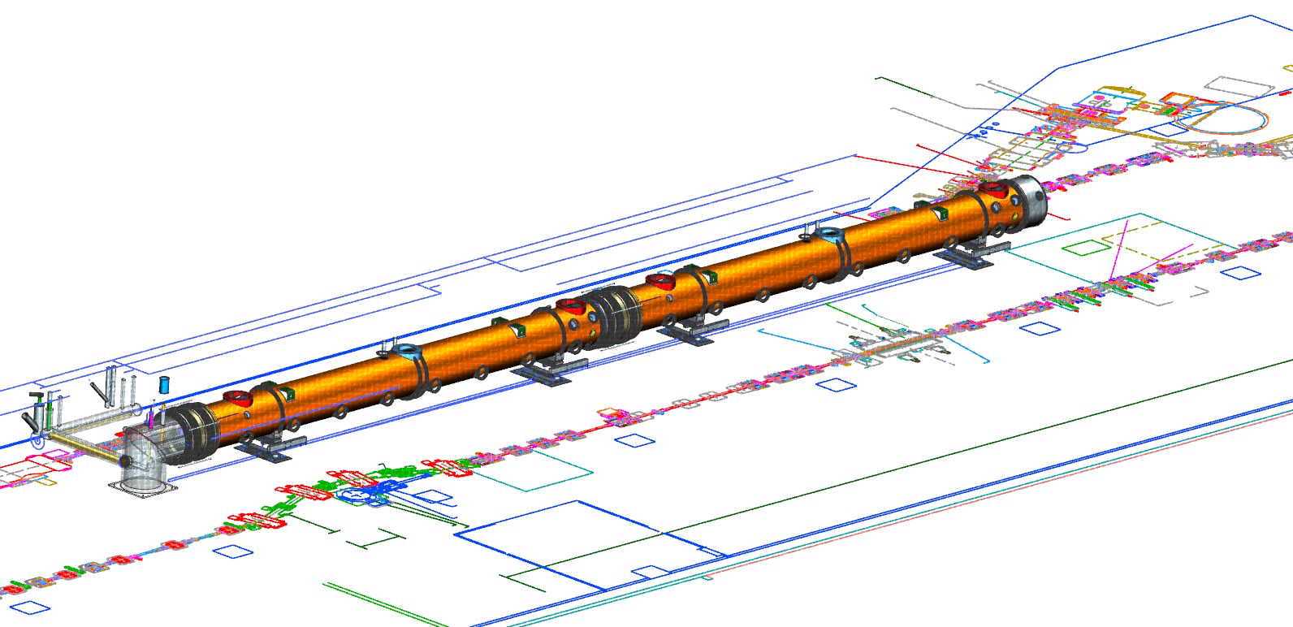
LCLS-II Remote Controls/Commissioning
LERF/LCLS-II Transition to Operations Review
Wesley Moore
wmoore@jlab.org
Revisions documented in comments.
(Review -> Show Comments)

Slide 2
Overview
Controls Objectives
Cyber Policies
Infrastructure
Remote Commissioning

Slide 3
Controls Objectives
SLAC objectives:
Head start on development, conquer learning-curve
Design/implement/test new software environment and workflow
Streamline, transparent development and portability back to SLAC
Assist JLAB staff and SLAC visitors with troubleshooting/fixing SW/HW
Prove SW/HW is ready for commissioning and operations at SLAC
JLAB risk management objectives:
Meet/exceed all cyber security requirements
Engineered controls and isolation from all JLAB systems
Zero impact to existing LERF control systems

Slide 4
Controls Saga
Series of SLAC proposals:
Provide SLAC VM image(s) to run at JLAB
Full admin on Linux hosts
No EPICS Channel Access Security (they use host-level access)
Install all software ever used at SLAC (no thought/refinement of actual specs)
All such proposals were denied.
We worked with them to:
Define/implement
Support infrastructure (servers, services, etc.)
Software environment
Security measures
Host management/monitoring
All with JLAB oversight (IT in concert with Accelerator Computing Group)

Slide 5
Cyber Policies
JLAB’s Cyber Security Program Plan (CSPP):
Addresses Federal Information Security Management Act (FISMA) Requirement that all federal agencies (and their contractors) develop and implement an agency wide information security program to safeguard the IT assets and data.
Submitted to DOE to satisfy the site’s Authority to Operate (ATO) certification.
Uses NIST guidance documents, including Special Publication 800-53
NIST SP 800-53 – baseline management, operational, and technical controls that must be incorporated into a system to minimally assure the security of low, moderate, and high risk systems.

Slide 6
Cyber Policies
Remote Access to each enclave is limited and controlled through centrally managed remote access services and gateways and in accordance with the site CSPP.
JLAB’s Remote Access Services*:
Secure Shell (SSH)
Virtual Desktop Infrastructure (VDI)
Provide access to internal resources via a virtualized desktop, hosted at JLAB
Virtual Private Network (VPN) – Not used, would put SLAC hosts on our network.
Multi-factor authentication (MFA) is required for remote access to certain enclaves or services. This includes, but is not limited to, networks associated with the accelerator, LERF, experimental halls, or business systems.
* See also: https://cc.jlab.org/remoteaccess

Slide 7
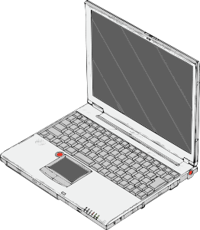
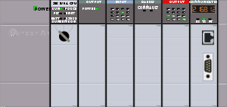
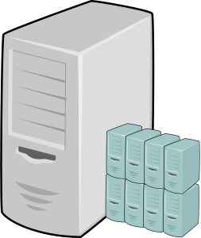
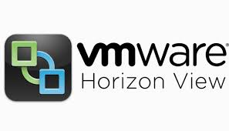
Infrastructure - Network Segmentation
NEW VLAN
LCLS-II VLAN
RHEL6 Fileserver
WWW
Outbound Proxy
RHEL6 IOC/Application Server
RHEL6 Development/Backup Server
RHEL6 Control Room Workstations (x3)
WIN7 - Rockwell SW (x2)
SLAC Host
(Patching)
CRYO PLCs (x2)
LLRF Chassis (x16)
NEW VLAN
LCLS-II ACCESS VLAN
Managed Switch (48 port)
Digi PortServer
SSH
EPICS CA
RDP
VDI VMs*
(RHEL6, 2-Factor)
CEBAF/OPS VLAN
MYA Archiver
MCC Operations Staff
LERF/OPS VLAN
LERF Control Room Workstations
LERF Operations Staff
* Virtual Desktop Infrastructure
used for 2-Factor remote access

Slide 8
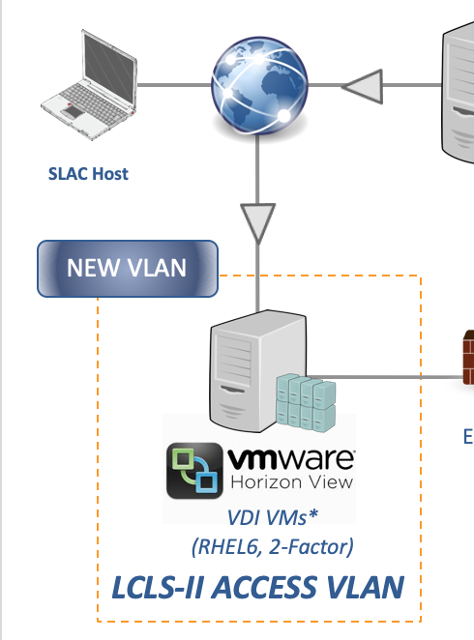
Infrastructure - Network Segmentation
NEW VLAN
LCLS-II VLAN
RHEL6 Fileserver
WWW
Outbound Proxy
RHEL6 IOC/Application Server
Disabling remote access…
Chokepoints allow for disabling remote access for
all users or individuals.
Several options:
Suspend 2-factor token(s)
Disable LCLS-II VDI pool
etc.
RHEL6 Development/Backup Server
RHEL6 Control Room Workstations (x3)
WIN7 - Rockwell SW (x2)
SLAC Host
(Patching)
CRYO PLCs (x2)
LLRF Chassis (x16)
NEW VLAN
LCLS-II ACCESS VLAN
Managed Switch (48 port)
Digi PortServer
ssh
EPICS CA
RDP
VDI VMs*
(RHEL6, 2-Factor)
CEBAF/OPS VLAN
MYA Archiver
MCC Operations Staff
LERF/OPS VLAN
LERF Operations Staff
LERF Control Room Workstations
* Virtual Desktop Infrastructure
used for 2-Factor remote access

Slide 9
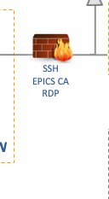
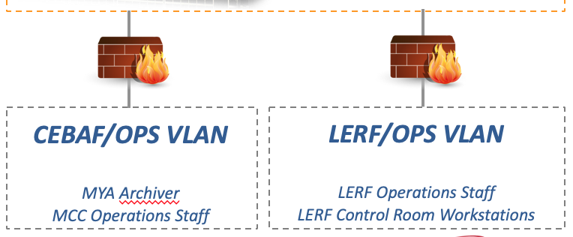
Infrastructure - Network Segmentation
Exceeds normal security controls
NEW VLAN
FWs controlled by Accelerator Computing Group
Special allowances:
Read-only EPICS channel access for archiving
SSH from MCC to LCLS-II workstations
Restrictions:
All traffic going into CEBAF/LERF VLANs blocked
NOTE:
By default, SLAC users only have CUE accounts.
ACE accounts not required or used.
LCLS-II VLAN
RHEL6 Fileserver
WWW
Outbound Proxy
RHEL6 IOC/Application Server
RHEL6 Development/Backup Server
This is actually a pair of Firewalls
(one IT, one Ops/Software Group)
RHEL6 Control Room Workstations (x3)
WIN7 - Rockwell SW (x2)
SLAC Host
(Patching)
CRYO PLCs (x2)
LLRF Chassis (x16)
NEW VLAN
LCLS-II ACCESS VLAN
Managed Switch (48 port)
Digi PortServer
ssh
EPICS CA
RDP
VDI VMs*
(RHEL6, 2-Factor)
CEBAF/OPS VLAN
MYA Archiver
MCC Operations Staff
LERF/OPS VLAN
LERF Operations Staff
LERF Control Room Workstations
* Virtual Desktop Infrastructure
used for 2-Factor remote access

Slide 10
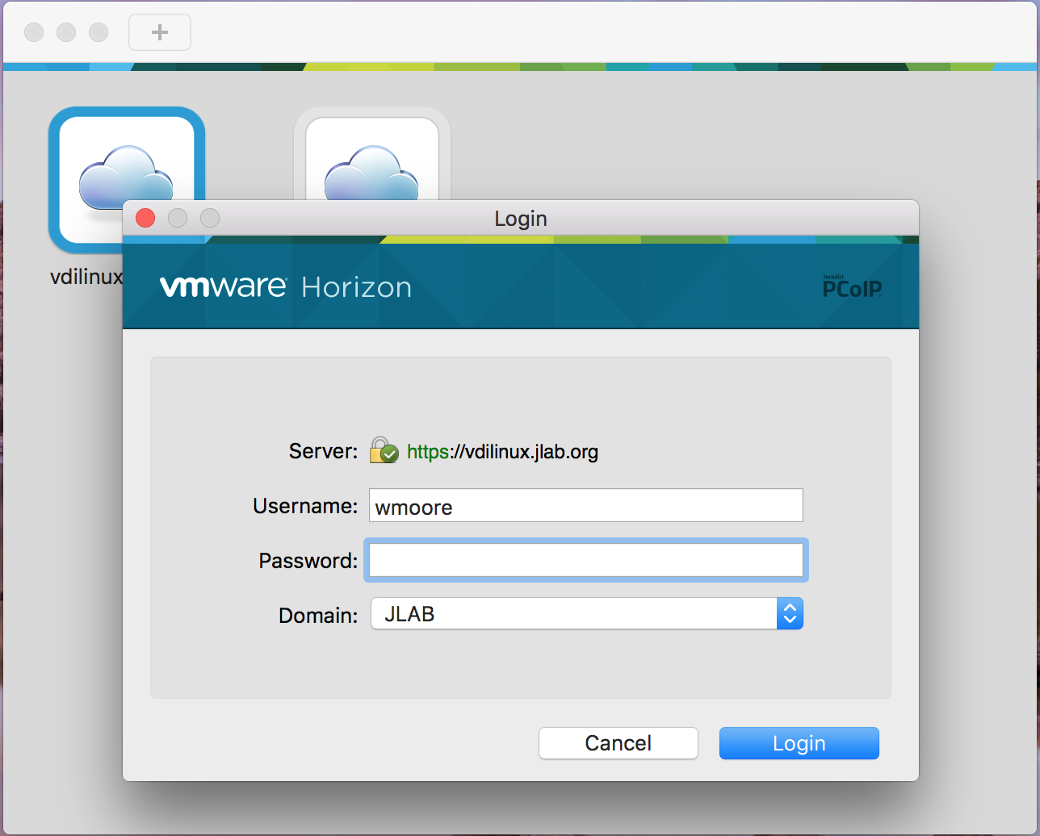
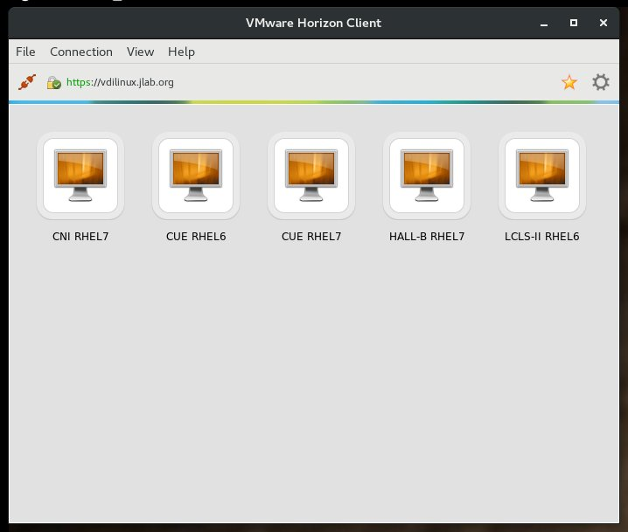
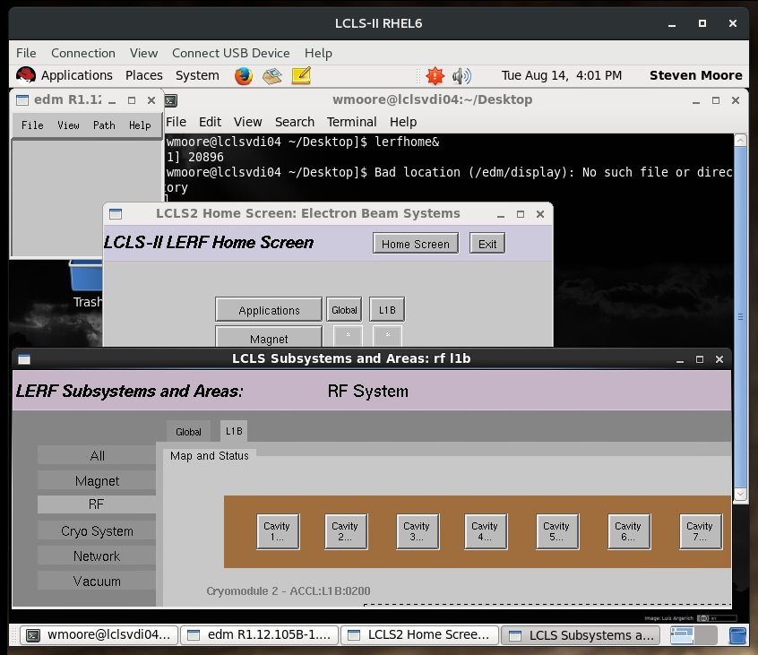
Infrastructure - VDI User Experience
Virtual Desktop Infrastructure
After installing client app:
Login to VDI connection server (password)
Select a VM-pool from list
Login to Linux VM
1
VM login is 2-Factored
2
RHEL6 VM
3
PROS
Speed (faster than X-forwarding and VNC)
Auto adjust resolution
Reconnect to existing sessions
Cross-platform

Slide 11
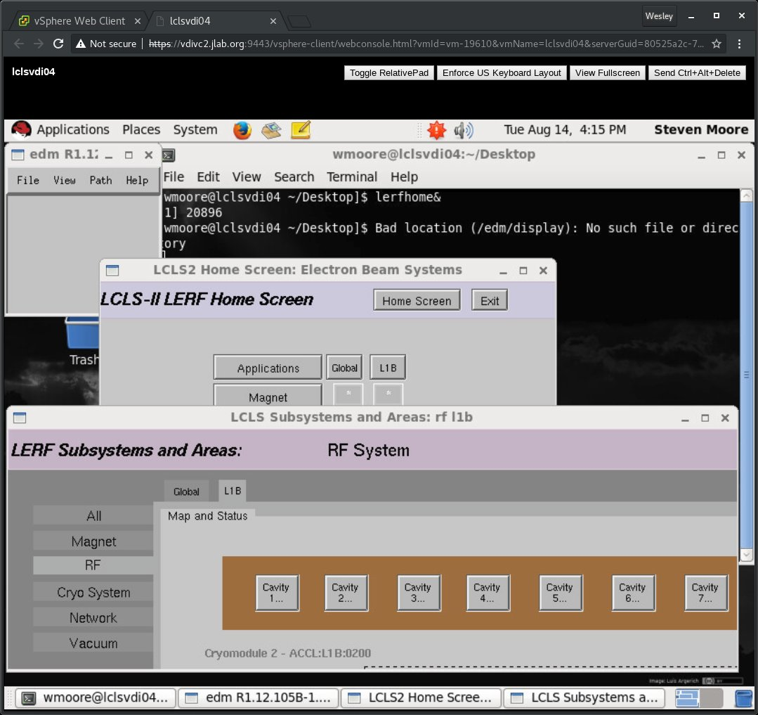
Infrastructure - VDI Admin Console
Provides better oversight
than ssh/X-forwarding

Slide 12
Infrastructure - Host Security
Red Hat EL6 x86_64:
Includes 3 servers, 3 workstations, 10 VDI VMs
At a minimum, fully patched monthly
Reboots coordinated
2-factor insurance (VDI hosts)
Monitored and text messages sent to IT On-Call 24x7
Services and configuration enforced by Puppet
Windows 10:
Includes 2 PCs that host programming software for SLAC PLCs
At a minimum, fully patched monthly and rebooted
Managed by Accelerator Computing Group (ACG)
Exceeds normal security controls
Meets normal security controls

Slide 13
Infrastructure - Channel Access Security (CAS)
Refresher…
EPICS access security protects IOC databases from unauthorized Channel Access Clients. Access is based on the following:
Who: userid of the channel access client.
Where: hostid where the user is logged on. This is the host on which the channel access client exists. Thus no attempt is made to see if a user is local or remotely logged on to the host.
What: Individual fields of records are protected. Each record has a field containing the Access Security Group (ASG) to which the record belongs…
How: User Access Groups (UAG) and Host Access Groups (HAG) combine to create read/write permissions.
We use userid in addition to network-level and host-level access controls.

Slide 14
Infrastructure - Access Security Groups (ASG)
Exceeds normal security controls
Roles* translated into engineered controls…
Cryomodule Controls (SLAC)
Default: read-only access
SLAC RF Guests: write-access granted for periods of time to RF controls
Responsibility of Test Coordinator (Mike Drury) to designate membership
JLAB RF Test Operators: read-write access 24x7
Responsibility of Test Coordinator (Mike Drury) to designate membership
RF Experts (ex. Curt Hovater)
Cryo Experts (ex. Jonathan Creel)
Cryo Can Controls (JLAB)
Default: read-only access
JLAB Cryo Test Operators: read-write access 24x7
Responsibility of Test Coordinator AND Cryo Group to designate membership
Write-access coordinated by Test Coordinator (or designee)
and controlled by MCC Crew Chief
Will be implemented by Cryo Group
* Further details in OSP

Slide 15
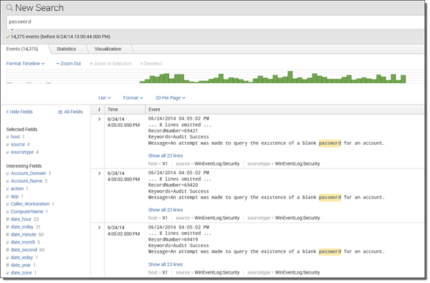
Infrastructure - EPICS Logging (example-only)
Exceeds normal security controls
Example:
clonioc1.jlab.org:44638 Tue Aug 14 17:04:01 2018 14-Aug-18 17:04:00
hb-crio-sf lvuser B_DET_HTCC_GAS_H2O.VAL new=116.016 old=116.021
Log contents:
IOC hostname:port
Timestamp
Client hostname
User name
Channel being modified
New value and old value
All info reported to Splunk server
for easy searching and dashboards

Slide 16
Infrastructure - Local/Remote User Recap
Requirements for read-only:
JLAB Common User Environment (CUE) account, requires a JLAB sponsor and training
Enrollment for 2-factor token*
Get added to special user group, requires approval by Wesley Moore
Required for LCLS-II VDI login
Required for LERF control room login
Additional requirements for write-access:
Read and be familiar with OSP and LOD. If visiting, lots of training (ODH, GERT, etc.)
Get vetted by Test Coordinator, maintain good standing
Get added to EPICS Access Security Group (ASG)
Only then, the Test Coordinator can grant write-access on a temporary basis based on:
Receiving request in advance
Description of work performed, systems affected.
May require ATLis, subsequent approval and scheduling.
* Not required if sitting in the control room, but all else applies

Slide 17
Infrastructure - Known “soft-spots”
Same type of administration is required
for CEBAF, LERF, Experimental Halls, etc.
Administrative controls for:
LCLS-II LLRF firmware
LCLS-II IOCs and their applications
LCLS-II PLCs
However…
Engineered responses available, including:
Disable local/remote access for individuals or all users.
Disable access to PCs used to program PLCs.

Slide 18
Remote Commissioning
Objectives: Assist in commissioning of cryomodule subsystems required for software/hardware development and testing for the LCLS-II accelerator.
Limited scope, and only WITH local oversight. Local oversight consists of RF/Cryo Operator in direct contact with remote individual(s) for:
Technical support
debugging and fixing sw/hw during commissioning
Testing new software (scheduled after ATLis approval)
Cryomodule temperature and pressure behavior require thorough understanding before any further remote assistance would be considered.
Same type of support that is required
for CEBAF, LERF, Experimental Halls, etc.

Slide 19
Q&A
LERF/LCLS-II Transition to Operations Review
Wesley Moore
wmoore@jlab.org

Slide 20
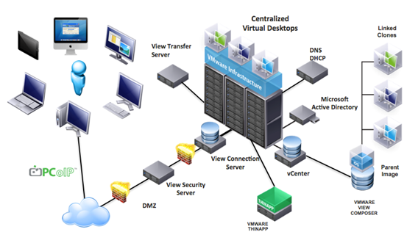
Infrastructure - A deeper look at VDI
Internet → VDI Connection Server → LCLS-II VM (MFA-req’d)

