Slide 1
LERF Readiness Review
Kevin Jordan
LERF Cryomodule Test Facility Overview
November 12 - 13, 2018

Slide 2
Outline
Scope of the LCLS-II conversion
Work planning
Top level schedule
Safety systems & radiation shielding
Software, controls & network infrastructure
Solid State Amps, LLRF & all that waveguide
Cryomodule & tunnel connections
Cryogenic connections
Summary

Slide 3
Scope of the LCLS-II Conversion Project
Modify LERF to enable LCLS-II CM testing
Take advantage of Safety System interlocks / shielded vault
Install computer services; firewalled network & servers
EPICS Software development & test bed for SLAC team
PCs with PLC licenses to remotely develop cryo & vacuum PLC controls
Install16 SSAs & reroute existing waveguide to LCLS-II modules
1400 feet of new waveguide
Install, test & commission LCLS-II production racks (SLAC staff)
LLRF, Cryo Controls, SC Magnets (w/Quench protection) & Vacuum
Enable testing and running of 2 CMs together, this simulates Linac 1
Operate 2 cryo modules with a similar cryo system rather than CTF
Gain invaluable experience cooling down 2 CMs at SLAC tunnel grade

Slide 4
Work Planning
Weekly schedule meetings are held in LERF breakroom
Work planning for the upcoming week discussed
Interferences discussed
Long range schedule is posted on white board
http://lerfboard.acc.jlab.org/board1.html
http://lerfboard.acc.jlab.org/board2.html
ATLis is used as work control document
https://wiki.jlab.org/lerf/index.php/ATLis
SAD is also used
Controlled by Steve Suhring
SOP for testing, travelers, & procedures
Controlled by Mike Drury

Slide 5
Top Level Schedule
The test schedule is drive by various scheduled shut downs of the physics program
Caveats
CHL requires 200 watts + 10%; Either the LERF ¼ CM & FL02 are cold & full and/or the 2 LCLS-II CMs are cold and full
The CHL 1 has to be at 4K for LCLS-II U-Tube operations
The CHL 1 will be taken to 4 K in Dec. to manage Helium inventory for the first cool down in January. By going to 4 K early there is less of a time constraint for U-Tube operations
First cool down is either complete or aborted by January 15 to enable hot check out of CEBAF prior to the February physics run
The test cycle is nominally 2 months
1St Break – January 2 to 15, that is followed by 2 weeks of hot check out & start of Physics Feb. 1
2nd Break – April 15 to May 10
3rd Break – August 15 to Sept. 15

Slide 6
Safety System & Shielding
Shielding assessment done for the vault with 2 LCLS-II modules, all 16 cavities at full gradient
All 26 blocks will be in place for any testing
Originally I hoped not to install & remove all 26 shield blocks each time but I gave up on that – it is not a cost driver with the crane already there
Rad Group Doc: RCD-DEP-18#002 dated Jan 2018
https://wiki.jlab.org/lerf/images/2/2b/LERF_TRUCK_ENTRANCE_SHIELDING.pdf
PSS interlocks are identical to the CMTF in the test lab
System duplicated from existing drawing to avoid new design effort
Waveguides are pressurized (few psi) for standard interlocks
PSS has already been certified, except for waveguide pressure

Slide 7
Software & Controls
Servers & network are up & on-line – Wesley Moore’s talk
Two PCs are online with Siemens PLC licences
Cryo-Con RTD controllers are up and running
These are for the Cryo-can & non LCLS-II instrumentation
New flow meters will be tied into cryo control system
JT electric valve controls are re-assigned channels & cables are relocated to new locations (RT03, SH04, JT03)
New high level aps for testing will be developed by JLab
This is an opportunity for SLAC software development
This will greatly speed the commissioning @SLAC
Initial cooldown will be manually – Matt Marchlik’s talk
Cavity Testing – Mike Drury’s talk

Slide 8
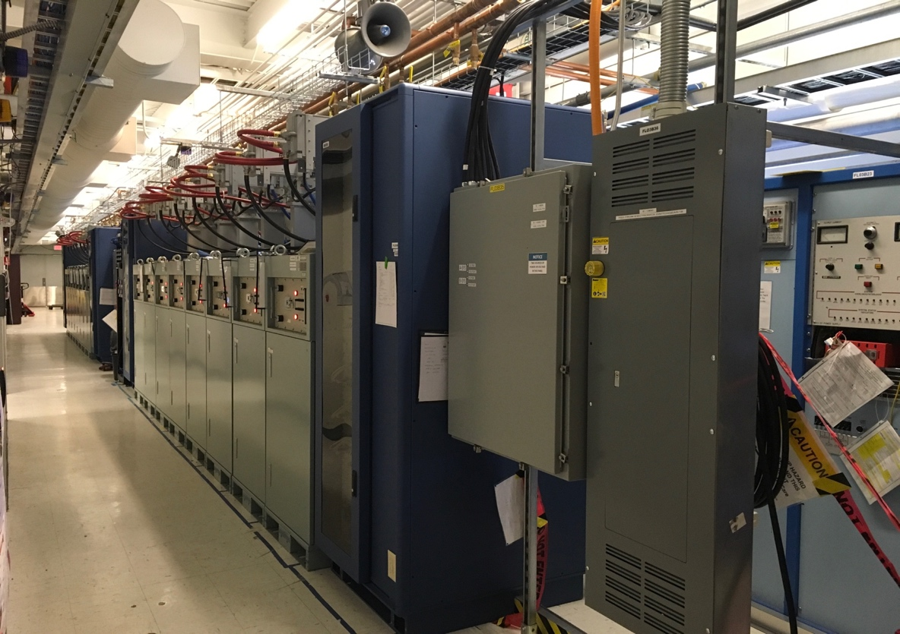
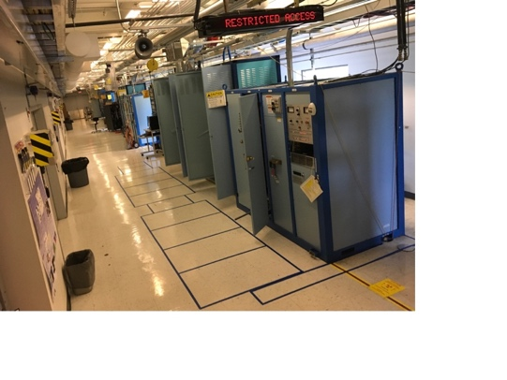
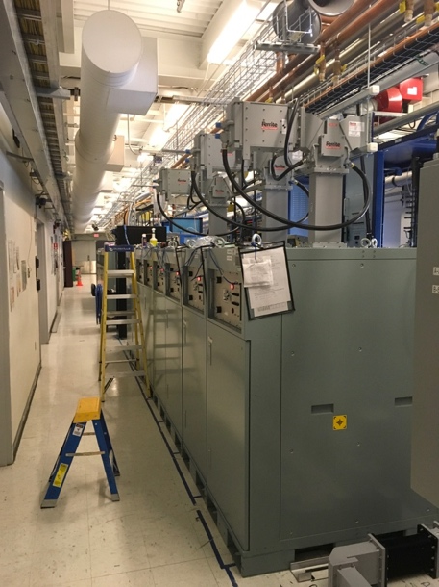
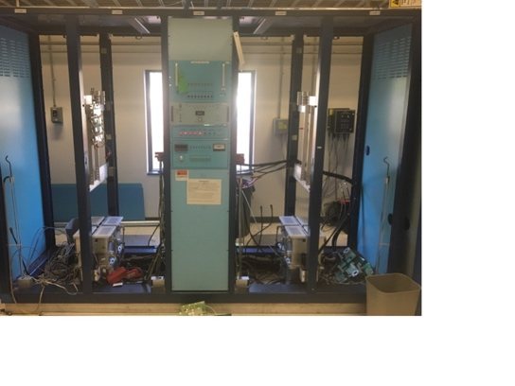
SSAs & Gallery Waveguide Layout
Entire system exists as a 3-D model in Solid Works
Total project requires new waveguide ~380 pieces, ~ 1,400 feet
+ LCW cooling of circulator loads & SSAs
Production LCLS-II SSAs, couplers, circulators, & loads are used
All waveguide pieces fit (first time!)

Slide 9
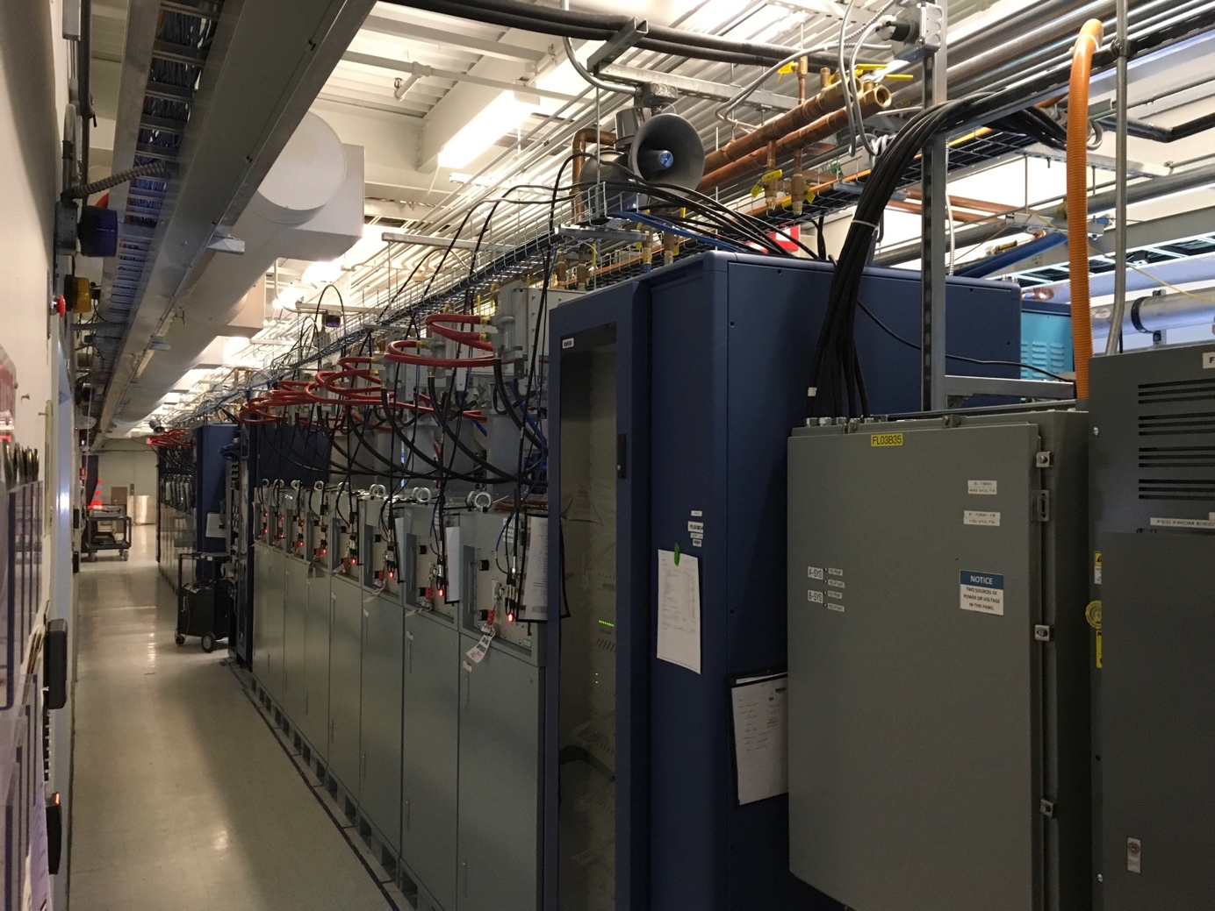
Solid State Amps
ALL 16 SSAs have been run to full power
All waveguide couplers have been calibrated
Personnel Safety System (PSS) connections are complete

Slide 10
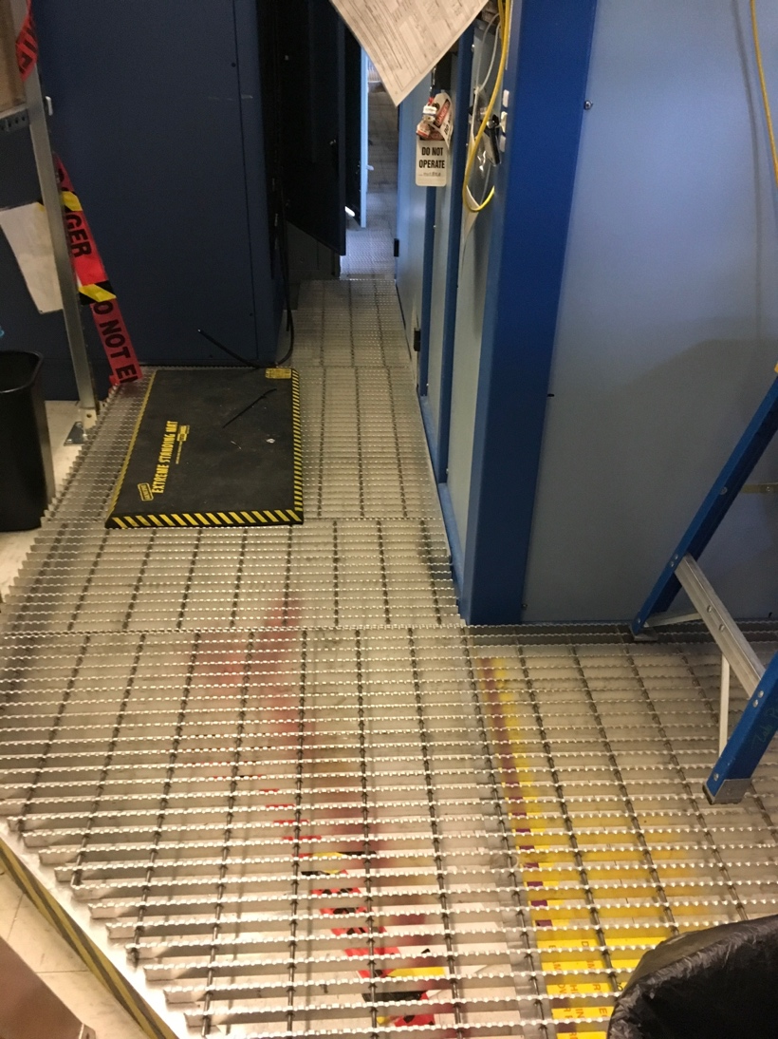
Raised Floor in Gallery & Cable Tray
The RF cable routing will be through the penetrations and along the gallery floor, protected by the raised floor
This image is before the heliax cables have been installed, some sections of floor grating needed to be removed
All cable & connectors are delivered
Cryo rack cable installation ~99% complete (88 cables), all of those have been terminated in racks
Tunnel terminations > 90 % complete

Slide 11
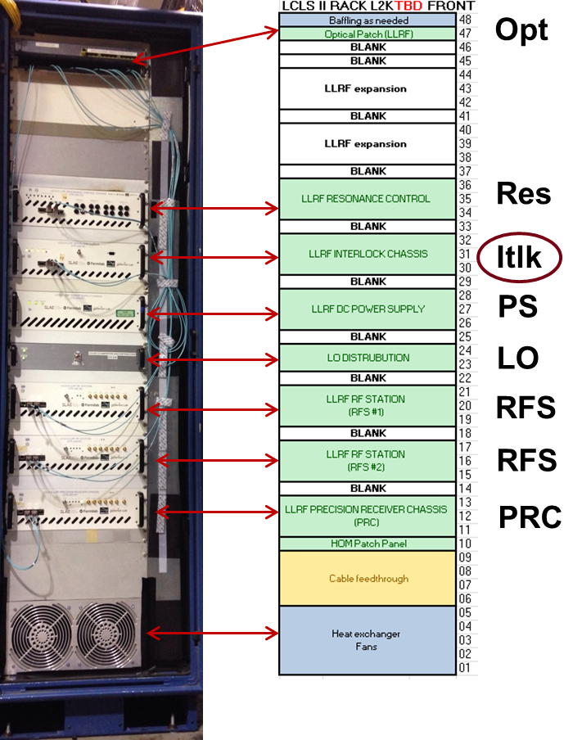
LLRF Controls
Fully functional LCLSII LLRF control racks (4) are powered up & remotely accessible from SLAC
Precision receiver chassis
RF Station
Resonance/Interlock chassis
LO Chassis
Power supply
EPICS Interface
LLRF Rack

Slide 12
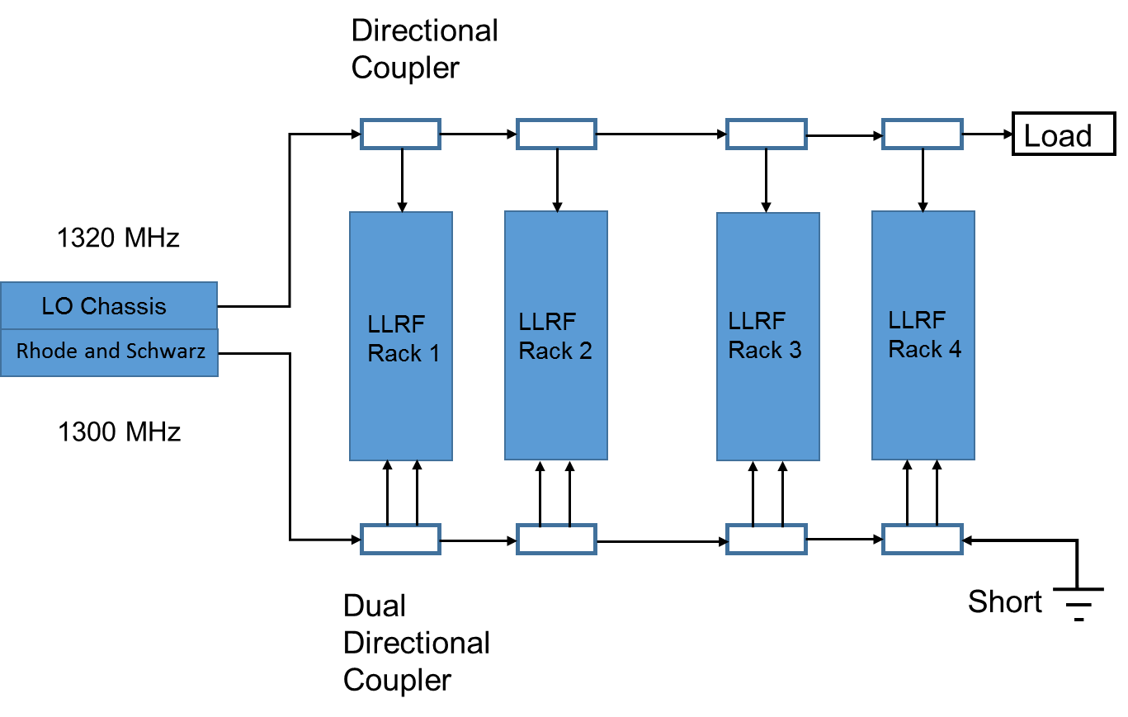
Master Reference & LO Distribution in Progress
1300 MHz Reference: Rohde & Schwarz Signal Generator
1320 MHz LO: Derived from 10 MHz and 1300 MHz

Slide 13
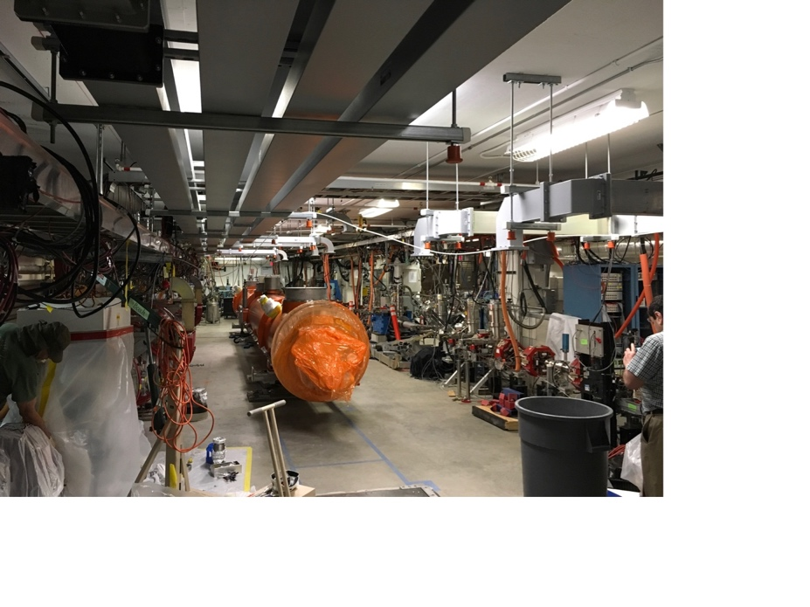
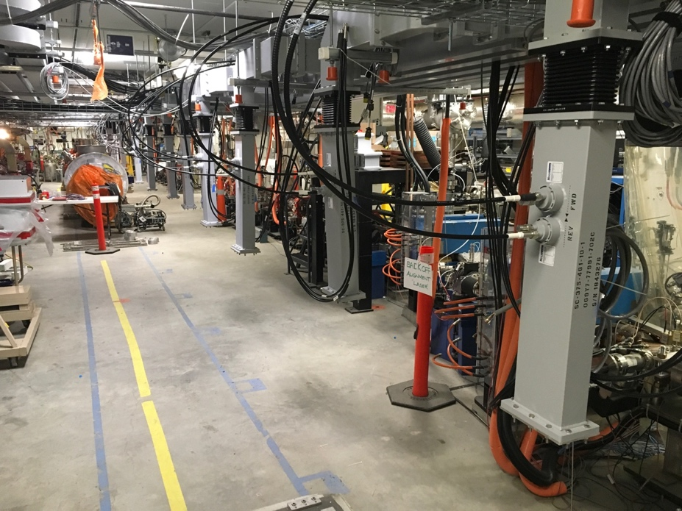
Tunnel Waveguide Layout
Installation is complete in the gallery & tunnel

Slide 14
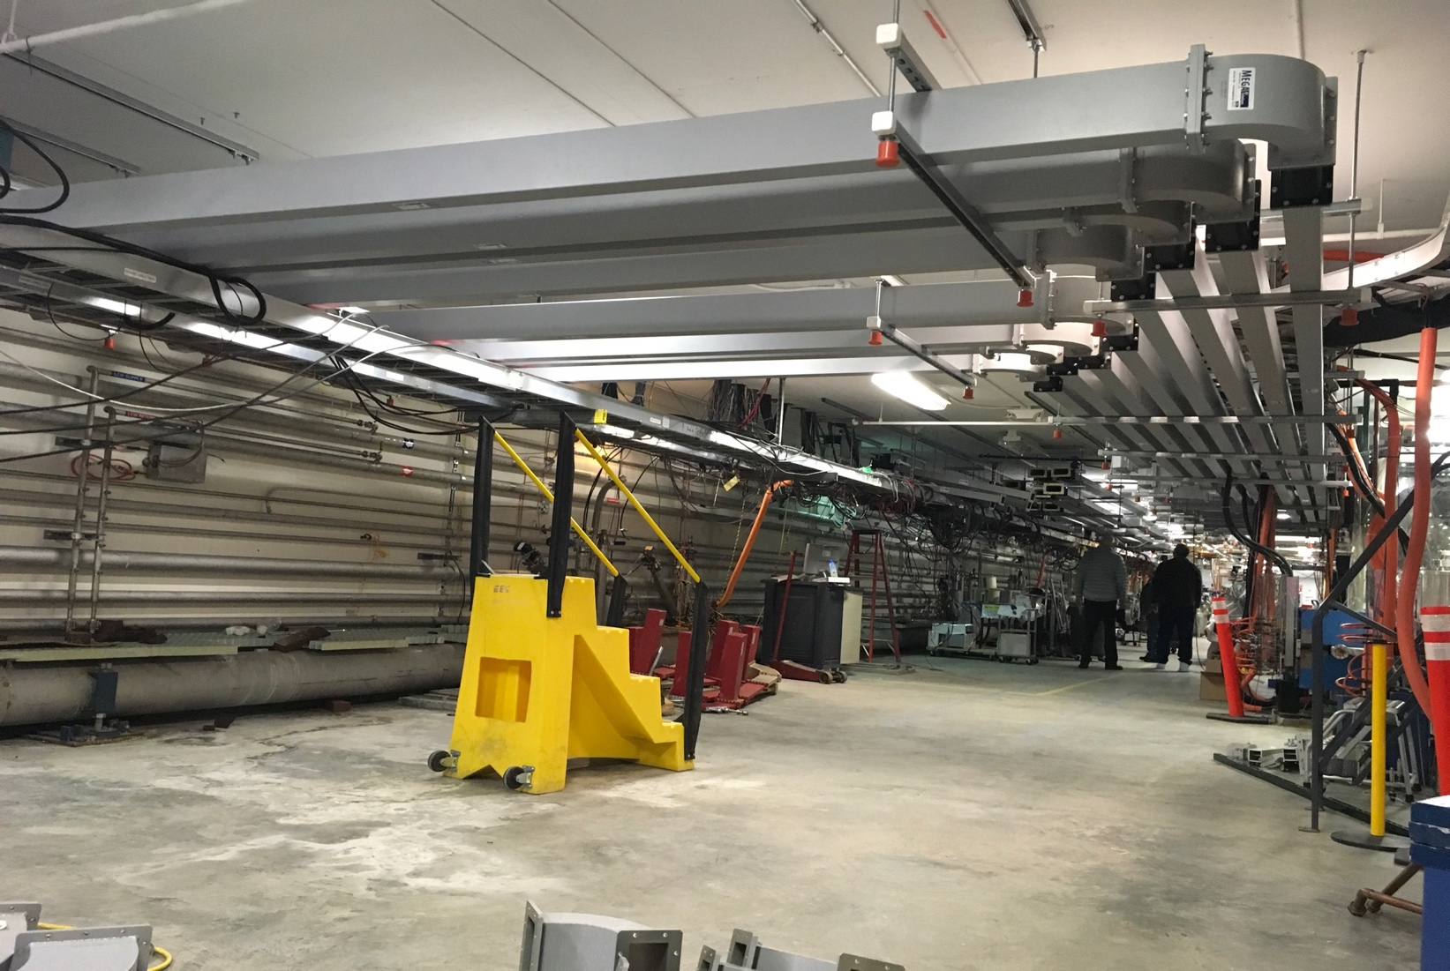
Tunnel Waveguide Layout
Installation complete

Slide 15
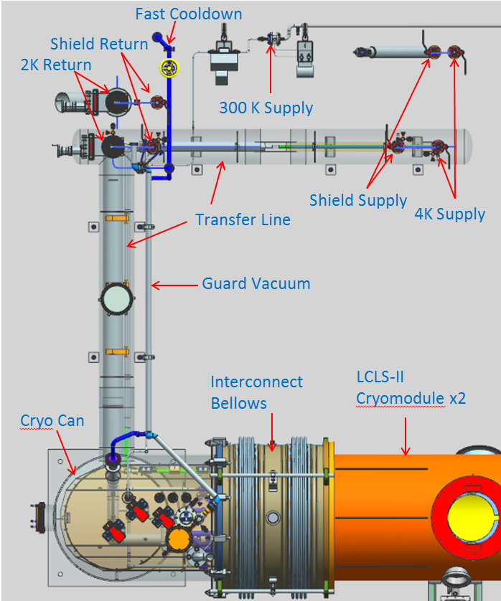
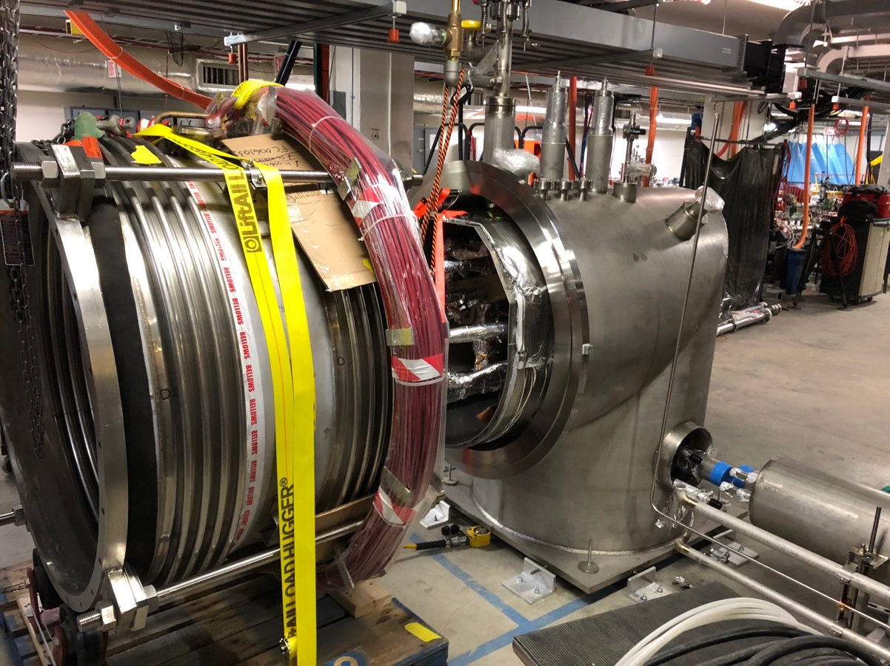
Cryogenic Connections to Transferline
Cryo can was late 3 months, it was delivered on Nov. 1, placed Nov. 5, and now in process of having field fit joints tied in & instrumentation checked out
See Matt’s talk

Slide 16
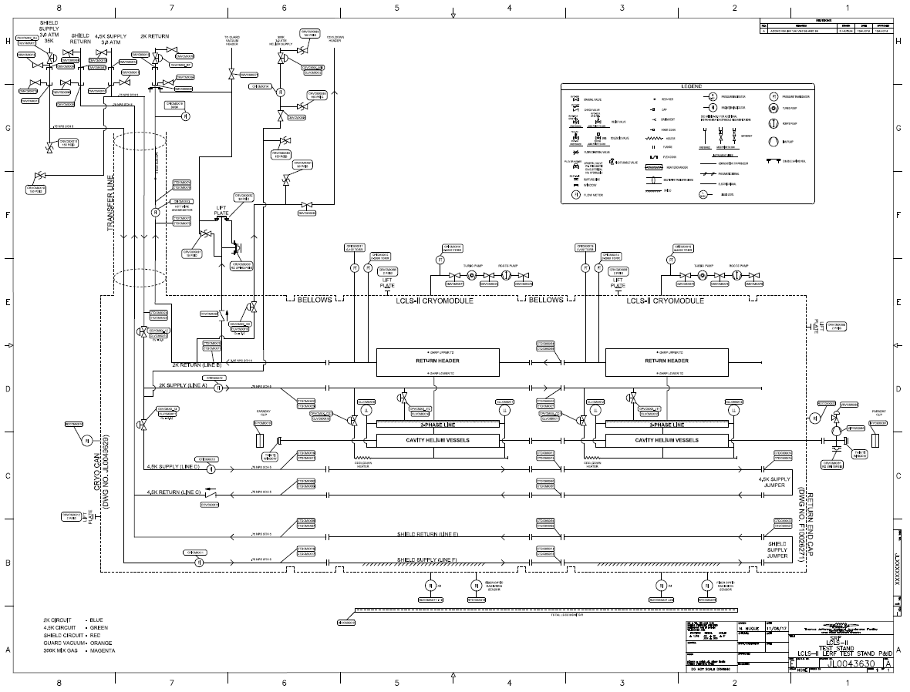
Process & Instrumentation Diagram
P&ID JL0043630
In approval process
CM 2
CM 1
Zone 03
Zone 00
Zone 02
Zone 01

Slide 17
LCLS-II Cryogenic Controls & Interfaces
JLab cryo staff controls cryo-can & JT valves for cooldown
SLAC has access to CM JT valves & heater controls
Two fully assembled sets of cryo-control racks are operational
Tunnel terminations done by Jlab staff
Rack ‘field’ terminations have been done by SLAC
PLCs for cryo control are on line and can be remotely programed from SLAC
Cryo racks will provide UPS power to the LLRF racks for backing out tuners during power failure
SLAC staff encouraged to be present for cooldown

Slide 18
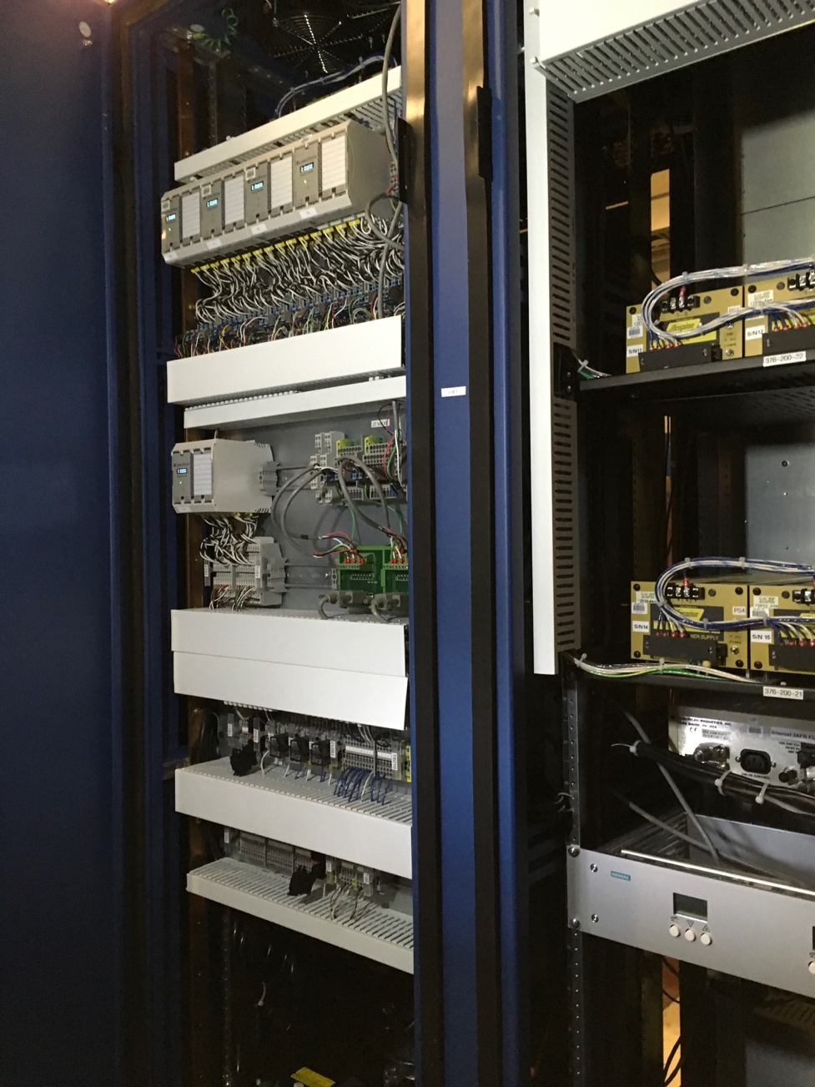
LCLS-II Cryogenic Controls Racks (1 of 2 sets)

Slide 19
Vacuum Controls & Interfaces
Controllers for ion pumps and gauging from SLAC are on-site
Gauges are part of CM assembly
A LCLS-II vacuum pump cart will be shipped soon as a test of microphonics
Roughing pump, turbo, pirani, cold cathode, & PLC controller
Jlab provided pump cart will be initially used if SLAC cart is late
EPICS control interface to pump cart, gauges & PLC
Interlocks to LLRF

Slide 20
Other Instrumentation
Faraday cup on both ends
Decarad monitors
Fermi supplied Total Loss Monitor (TLM)
Other radiation detectors
Fox - ?
Chipmunk - ?
Scarecrow - ?
TLDs - ?

Slide 21
ES&H issues
All radiation shielding blocks will be used for first test
Dosimetry will be used between first & second layer to get a total dose
Operational Safety Procedure is being finalized
Mini review held for running SSAs into shorts
ODH Assessment done, needs to be signed
Less LHe volume than used in the past
Pressure system design authority is Matt Marchlik
Egress has been reviewed by Facilities
https://wiki.jlab.org/lerf/index.php/Facilities_Documents

Slide 22
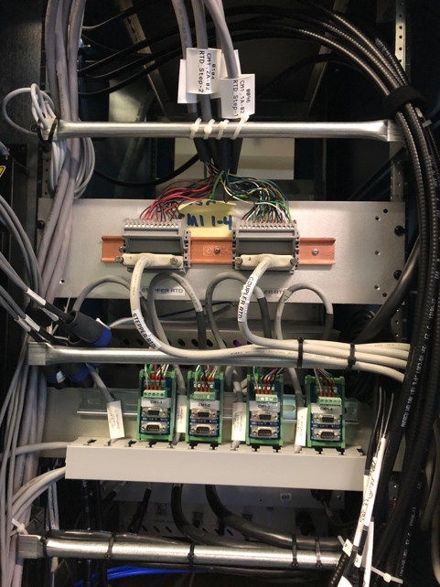
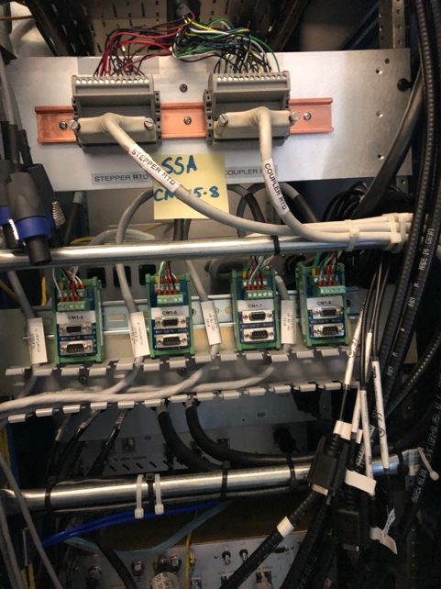
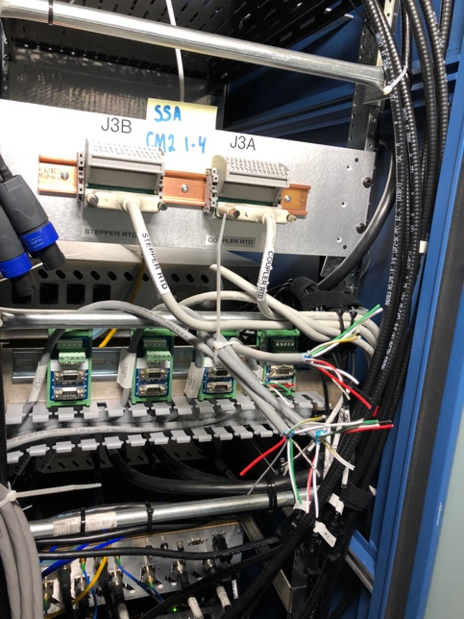
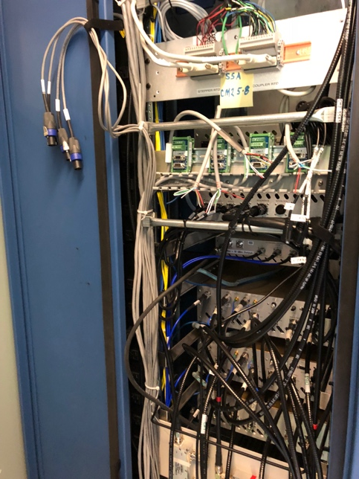
Remaining work LLRF
There are 4 LLRF racks, one for each 4 SSAs
Field wiring downstairs complete – need check out
Upstairs ~ 3 Person-Days to finish
SSA CM 1; 1 – 4
Complete
SSA CM 1; 5 - 8
Complete
SSA CM 2; 1 – 4
Need RTD & Stepper
SSA CM 2; 5 - 8
Need Stepper

Slide 23
Remaining work JLab Cryo
Field fit joints from cryo-can to transferline in progress
Complete leak check of system
Diode terminations; cables are in place (5 out of 6)
34 diodes need to be terminated – Terminal block + 6 pcs x 32 pins
All channels are in EPICS with proper nomenclature
There are 3 Coriolis flow meters
3 pcs x 9 wires need terminated in cryo-can + 3 cables to ethernet controllers mounted in the tunnel
Diode
Terminations
Resistors are
to simulate T

Slide 24
Remaining work JLab Cryo
3 EV; JT type – reusing existing channels rerouting existing cables
One each EV and other flowmeter need to be tied into EPICS
Need control screens for ease of operation
Installation of Hot Wire Anemometer
Complete leak check of system
Welding and leak checking – 2 person weeks
Hardware connections + software – 4 person weeks

Slide 25
Remaining work Mics.
Terminate SC magnet voltage taps in rack – 1 day
Connect and test Fluxgate Magnetometers – couple days
Compact Rio is setup, it with controllers will be on a cart & used only for degaussing
Check out the Deca Rad system – 2 days
Finish up vacuum control rack and HV cables – 1 week
Finish bridging section clean room

Slide 26
Summary
Work control documents are same as CEBAF
All waveguide delivered, installation complete
Cryo Can delivered and being connected
Last piece of the puzzle
File & application servers operational, build complete
All of the cable and connectors have been delivered & installed
Cryo cables terminated in racks
RF cables installed and calibrated
A few cables including cryo-can instrumentation remaining
LLRF & SSA commissioning is on-going
Positioned well for cooldown in January
Few man-weeks of work remaining for Jlab cryo-can controls
SRF support for CM connection to cryo-can and inter-module beam tube

