Slide 1


Possible high current tests at CBETA
Karl Smolenski
for the CBETA Team:
Nilanjan Banerjee, John Barley, Adam Bartnik, Ivan Bazarov, David Burke, Jim Crittenden, Luca Cultrera, Kirsten Deitrick, John Dobbins, Richard Gallagher, Colwyn Gulliford, Georg Hoffstaetter, Yulin Li, Wei Yuan (William) Lou, Tobey Moore, Peter Quigley, John Reilly, Vadim Veshcherevich, Dwight Widger
Cornell University
J. Scott Berg, Stephen Brooks, Joseph Tuozzolo, George Mahler, Dejan Trbojevic, Robert Michnoff, Nicholas Tsoupas, Steve Peggs
Brookhaven National Lab
Bruce Dunham, Chris Mayes
SLAC - Stanford University

Slide 2
Outline
CBETA Capabilities / EIC Cooler Requirements
Past high current efforts
Limitations
  Gun / Source
  RF System
  Transport Issues
    Beam Physics Issues

Slide 3
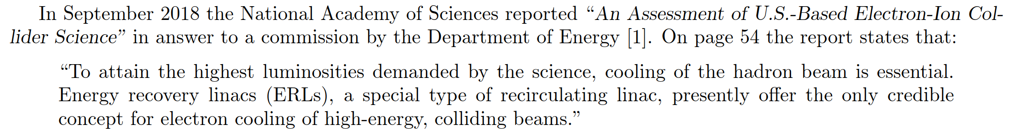
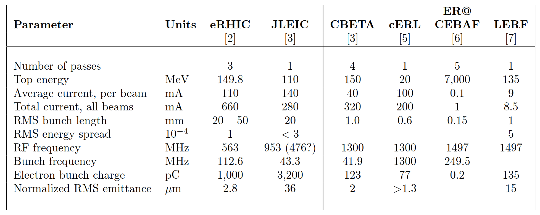
EIC Cooler Parameters

Slide 4
EIC Cooler Parameters
CBETA offers a reasonably realistic EIC Cooler testbed and opportunities for high current and high bunch charge studies

Slide 5
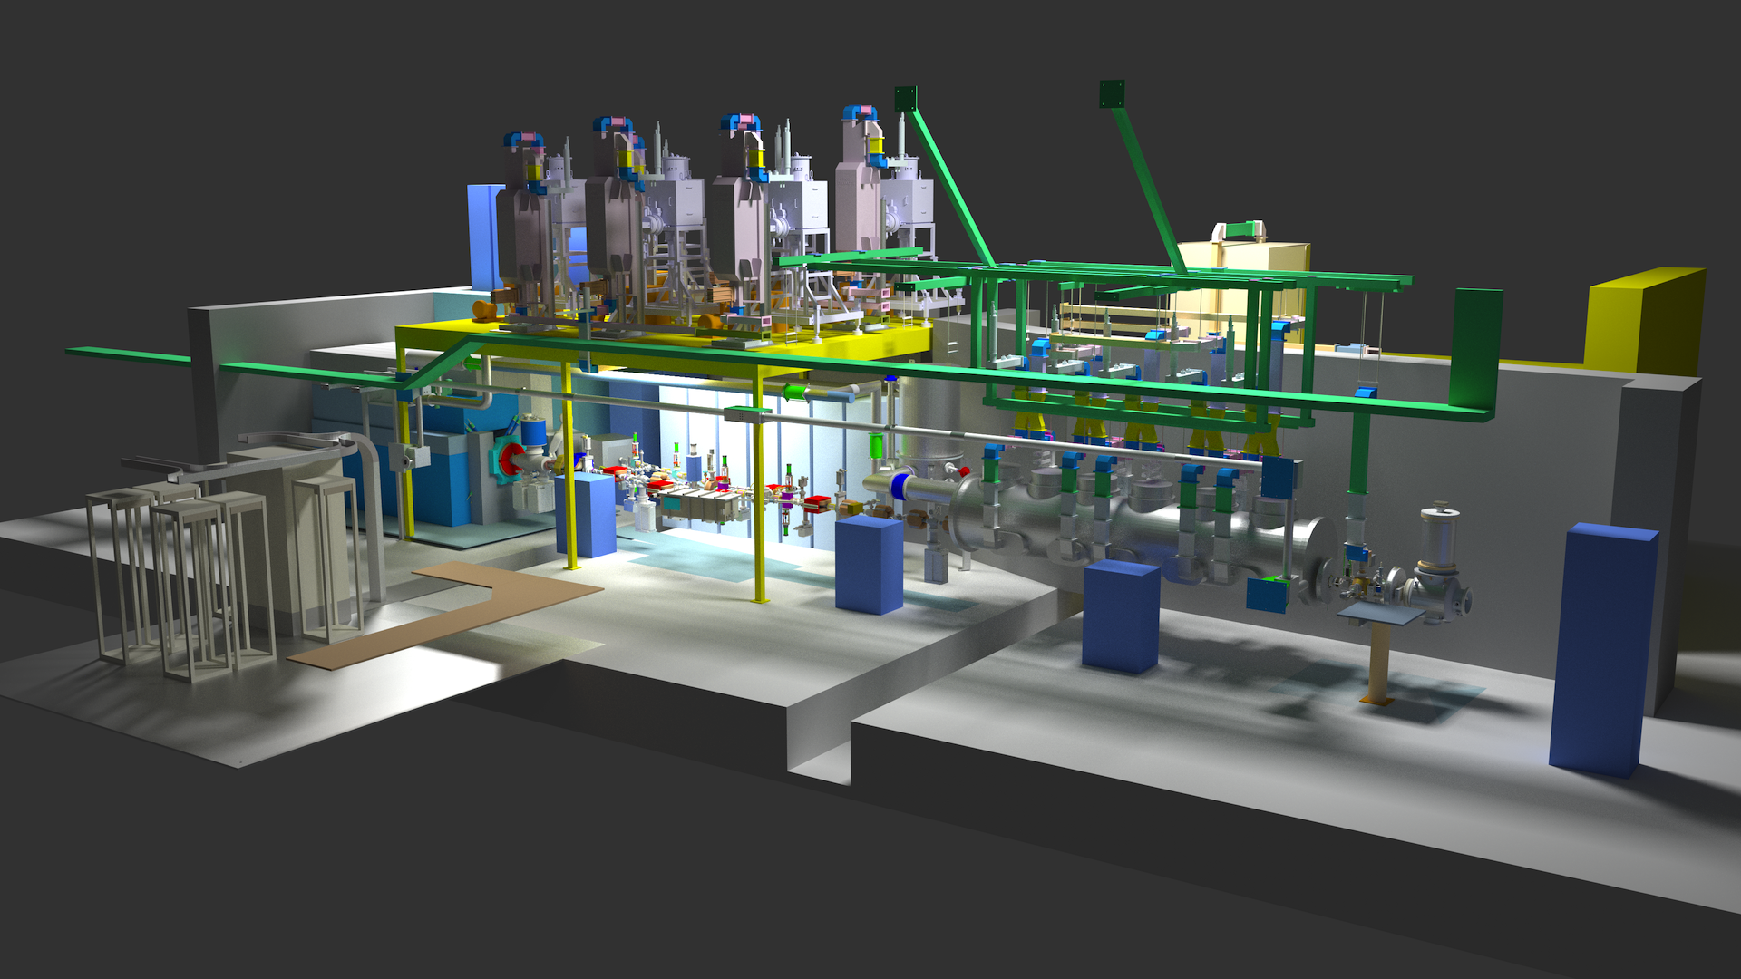
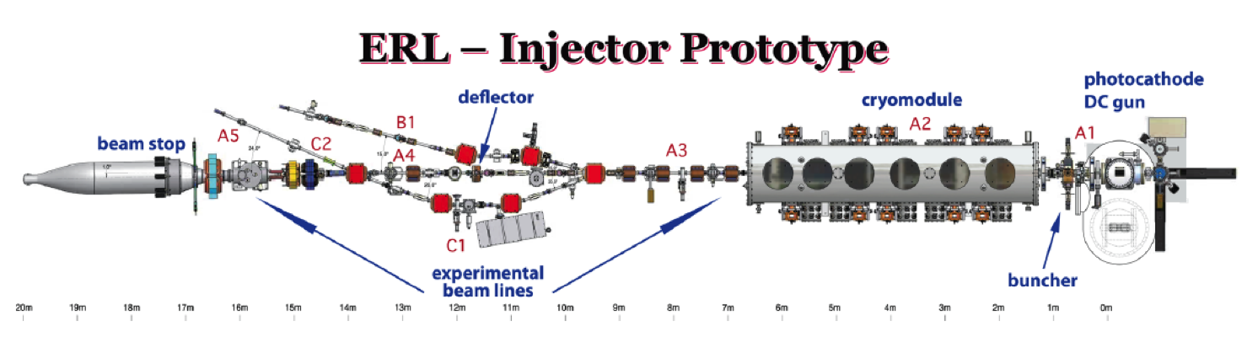
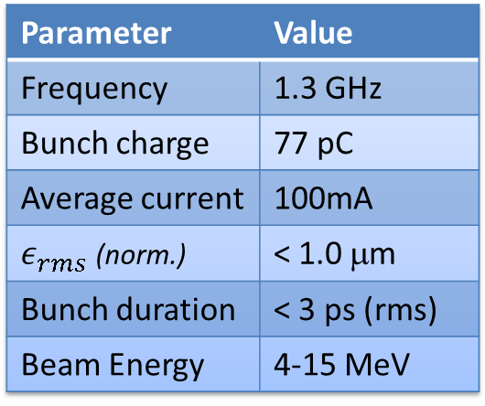
Original Design
Original design: ERL injector
Moderate charge
High current
Note: merger section (B1)
Injector Specification
Parameter | Value
Frequency | 1.3 GHz
Bunch charge | 77 pC
Average current | 100mA
 | < 1.0 μm
Bunch duration | < 3 ps (rms)
Beam Energy | 4-15 MeV

Slide 6
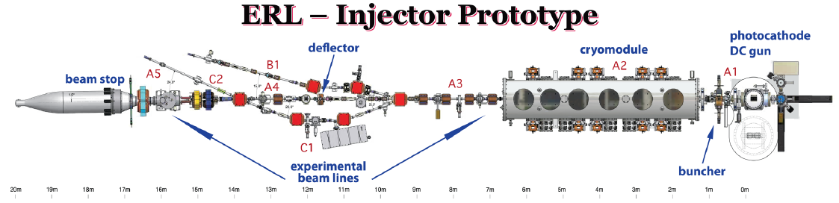
Push for 100 mA
Cornell has had three high current projects
Push for 100 mA at 1.3 GHz
  Injector for Cornell ERL
Push for 1 nC at 50 MHz
  Injector for EIC
Push for low trip rate
  Isolate the gun
  Importance of ion clearing
CU Injector as possible injector for an ERL light source
1.3 GHz bunch rate
Up to 77 pC
4 MeV beam energy
Question: is 100 mA from a photo-injector conceivable?

Slide 7
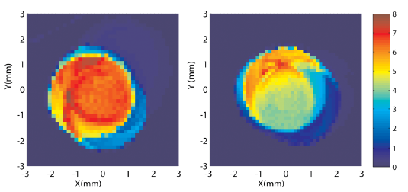
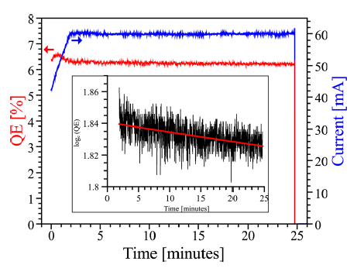
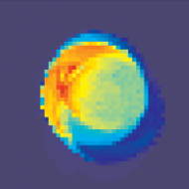
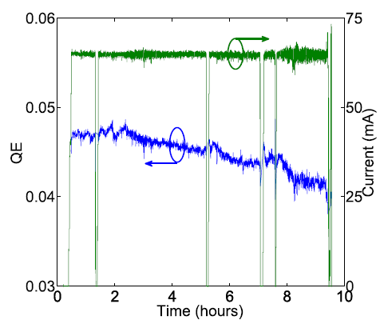
Record photoinjector current!
Push for 100 mA
Using multi-alkali off center, a robust bulk emitter:
CsK₂Sb
CsK₂Sb
CsK₂Sb
Before use
After use
60mA run with CsK₂Sb had ~30 h 1/e lifetime
  P_{gun}=1.13x10⁻¹¹ torr → 3.0x10⁻¹¹ torr
  Likely due to beam halo scraping
65mA run with NaKSb had ~66 h 1/e lifetime
NaKSb
Dunham et. al. APL 102, 034105 (2013)

Slide 8
Push for Bunch Charge
Cornell has had three high current projects
Push for 100 mA at 1.3 GHz
  Injector for Cornell ERL
Push for 1 nC at 50 MHz
  Injector for EIC
Push for low trip rate
  Isolate the gun
  Importance of ion clearing
CU Injector as possible injector for EIC
50 MHz bunch rate
Up to 1 nC
5.5 MeV beam energy
Question: what is the highest possible current at 50 MHz bunch rate?

Slide 9
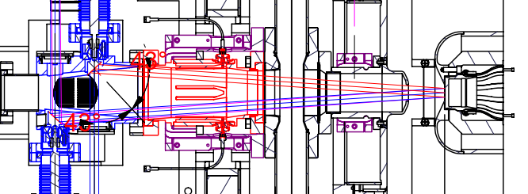
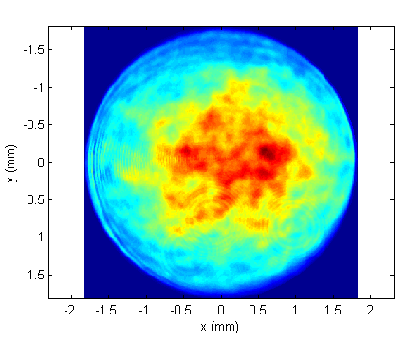
Push for Bunch Charge
High charge -> Large laser spot
Anode clips laser light more than 9 mm from cathode center
  To avoid central 6 mm, laser size must be <6 mm
  Sets a hard upper limit to charge
At the time of the experiment, we only had a 3 mm cathode
  Simulation -> Hard limit to charge with 3 mm ~ 450 pC
Laser profile during high current
3 mm

Slide 10
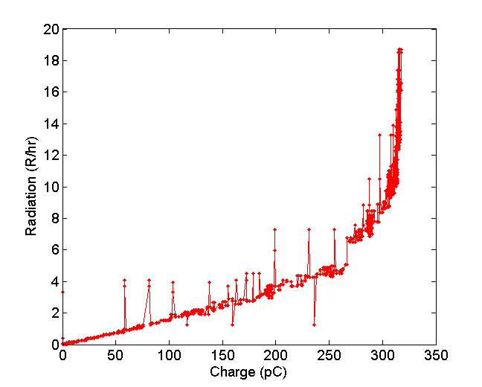
Push for Bunch Charge
High current machine settings (more conservative)
  350 kV gun
  5.5 MeV final energy
See dramatic increase in radiation around 320 pC
  Changing machine settings did not help
  Made laser size (slightly) bigger
    same problem at 375 pC (~ 20 mA)
Need larger cathode for higher charge
Radiation while increasing charge
Cathode space charge limit?
Adam Bartnik, Colwyn Gulliford, Ivan Bazarov, Luca Cultera, and Bruce Dunham, “Operational experience with nanocoulomb bunch charges in the Cornell photoinjector,“ Phys. Rev. ST Accel. Beams 18, 083401 (2015).

Slide 11
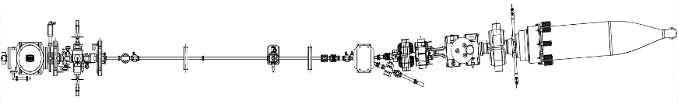
Push for low trip rate
Cornell has had three high current projects
Push for 100 mA at 1.3 GHz
  Injector for Cornell ERL
Push for 1 nC at 50 MHz
  Injector for EIC
Push for low trip rate
  Isolate the gun
  Importance of ion clearing
Unexplained Machine Trips
In high average current operation (>20 mA) the Cornell Photoinjector (Gun + ICM) would experience machine trips with a frequency on the order of ~1/hour.
Isolate the gun
During extended maintenance on the ICM, a beam line was designed to isolate and test only the DC gun under high current load. Without the added complexity of the SRF cavities, we hoped to be able to find the cause of the trips.
Experimental Goals
Construct a beamline isolating the DC gun
Measure the trip rate with 20 mA average current
Identify the trip mechanism, investigate solutions
Main goal: Run for ~24 hours without any trips at 20 mA
Transport
Gun Section
Dump Section

Slide 12
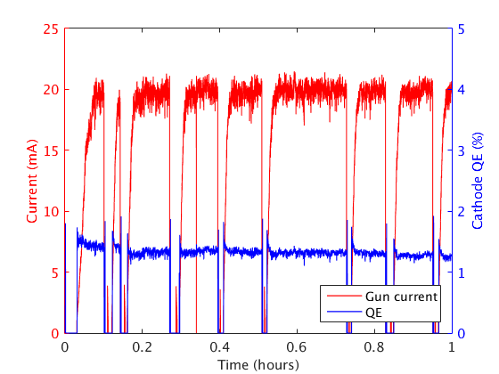
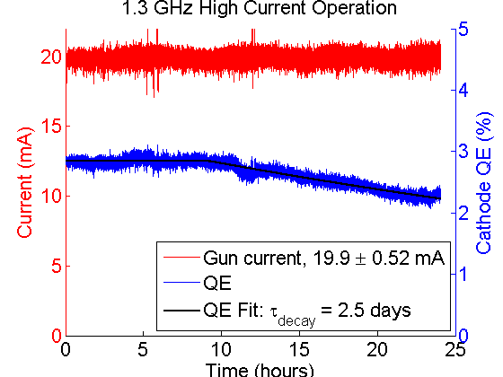
Push for low trip rate
Figure 1: One hour of trips during a 20 mA gun test
Time [Hr.]
Initially, trip rate is worse
Surprisingly, the trip rate was much higher in the gun test beamline, averaging close to ~10/hour.
Trip Mitigation with DC Ion Clearing
DC ion clearing electrode was added to the beamline at the beginning of the transport section.
Above ~10 V, dramatically reduced, decrease the trip rate by a factor of >50 with 100 V across the beam pipe.
Future High Current Operation
Clearing as close to the gun as possible seems best. In the future, we plan to bias the new gun’s floating anode
(~100-1000 V) as an ion barrier.

Slide 13
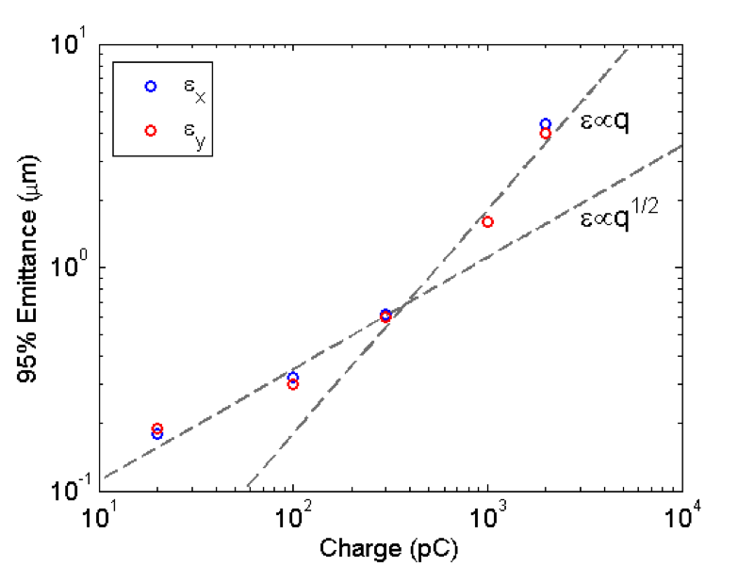
Emittance summary
Low Current / High Bunch Charge summary
Q (pC) | Peak current (A) | Emittance (95%, μm)
20 | 5 | H: 0.18 V: 0.19
100 | 11.5 | H: 0.32 V: 0.30
300 | 32 | H: 0.62 V: 0.60
1000 | 50 | H: 1.6 V: 1.6
2000 | 56 | H: 4.4 V: 4.0
Gulliford el al., Phys. Rev. ST Accel. Beams 16, 073401 (2013)

Slide 14
Challenges
Gun / Cathode limits
  Cooling of cathode (high QE = less problematic)
  Bunch charge / emittance / cathode lifetime tradeoffs
  Laser not a limit
RF
  Injector cavity coupler / klystrons
  Cavity phasing is tuned for emittance, not max power
  MLC limits / beam loading / microphonics / SSA power
Transport
  Radiation damage to magnets
  Radiation shielding (0.6m thickness)
  Dump not a limit (600kW, 100mA @ 6MeV)
Halo / Beam loss

Slide 15
Bright Beams Lab
New lab being constructed
Ivan Bazarov / Jared Maxson / Luca Cultrera groups
Two gun test stands:
Cold gun
Mk. I Cornell Gun
Polarized Beams
Ultra-Low Emittances
High Current Development

Slide 16
Ideas
Magnetized beam transport (JLab gun or magnetize Cornell gun)
High current run with ICM / Diagnostic Line only (100mA) - Gun Limit
Bunch Charge Studies

Slide 17

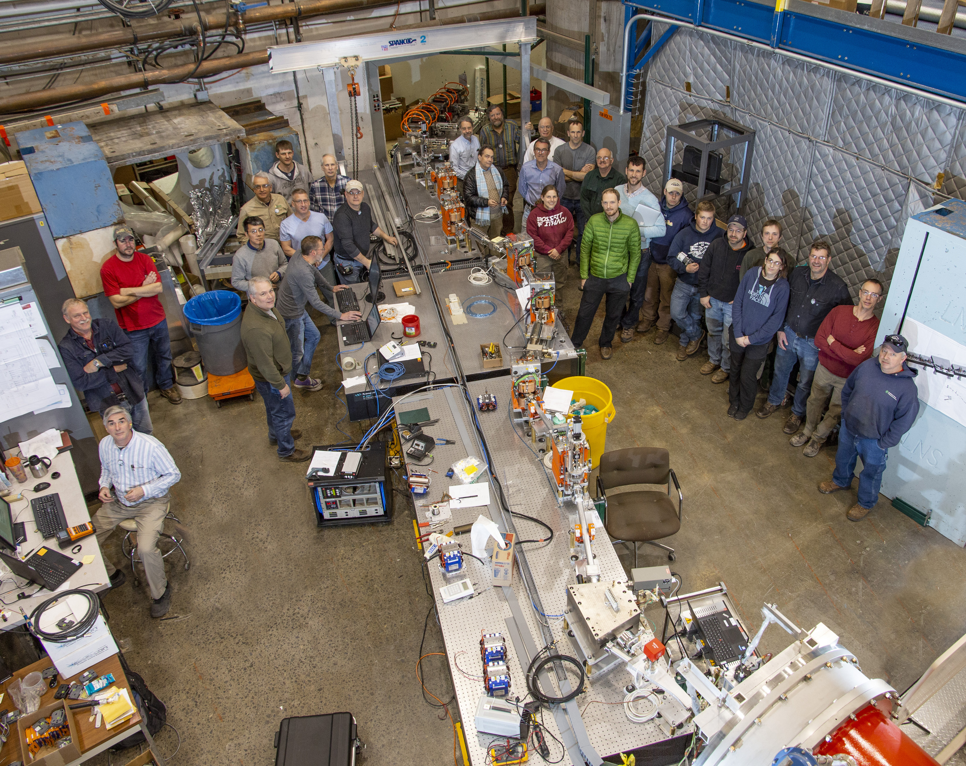
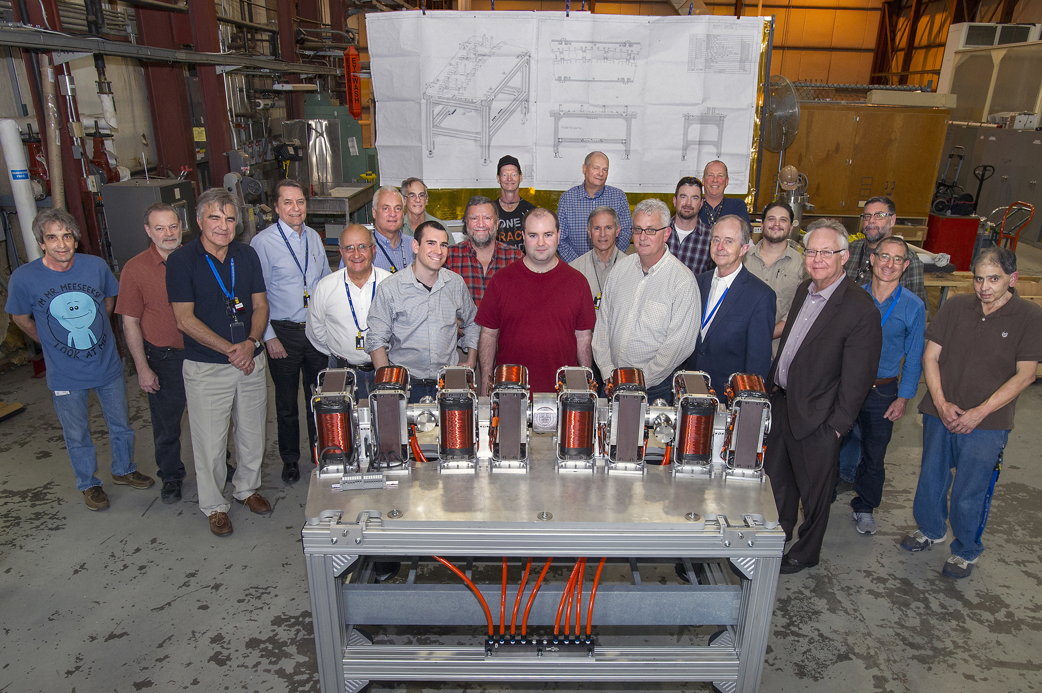
Acknowledgements
Thanks to the whole CBETA Team
Thank you for your attention!

Slide 18
Backup Slides

Slide 19
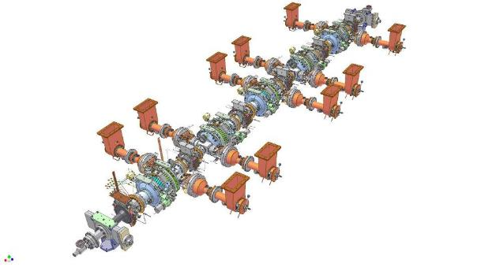
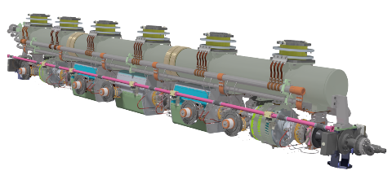
CBETA RF Systems:
Injector Cryomodule (ICM)
Twin Input Power Coupler
HGRP with three sections
Support Posts 300K to 2K Isolation
HOM load at 80K between cavities
µ-metal “Lunch Box” around cavities
WPM, (one on each cavity)
1.3 GHz 2-cell SRF cavity, blade tuner.
Wire Position Monitor (WPM) tube
Number of 2-cell cavities | 5 | Number of HOM loads | 6
Energy gain per cavity | 1 – 3 MeV | HOM Power per cavity | 40 W
Gradient | 4.3 – 13.0 MV/m | Couplers per cavity | 2
R/Q (Linac definition) | 222 Ω | RF power per cavity | 120 kW
Q_{ext} | 4.6 x 10⁴ – 4.1 x 10⁵ | Amplitude/phase stability | 10⁻⁴/0.1º (rms)
Total 2K / 5K/ 80K loads | 30 W / 60 W / 700 W | Module Length | 5 m
CBETA Operating Temperature | 2K | Current Temperature | 80K

Slide 20
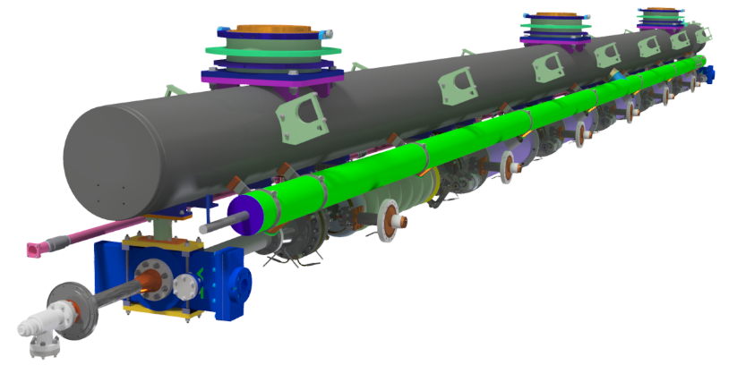
CBETA RF Systems:
Injector Cryomodule (ICM)
6 7-cell Cavities
ΔE = 6 MeV
σ_{A}/A ~ 10⁻⁴, σ_{φ} ~ 0.1°
Input Power Coupler (Max 10 kW)
Helium Gas Return Pipe (1 section)
Wire Position Monitor (WPM) tube
2K 2-Phase Helium Line
Based on TESLA cryomodule design with important differences:
Optimized for CW operation.
Designed for ERLs.
Cavities hang from the HGRP which is used to align them.
7 HOM Absorbers (Max 400 W)
All RF system components have been delivered, installed, tested, and operated to meet all FAT milestone requirements.
Notes:
Heavily change! Done.

Slide 21
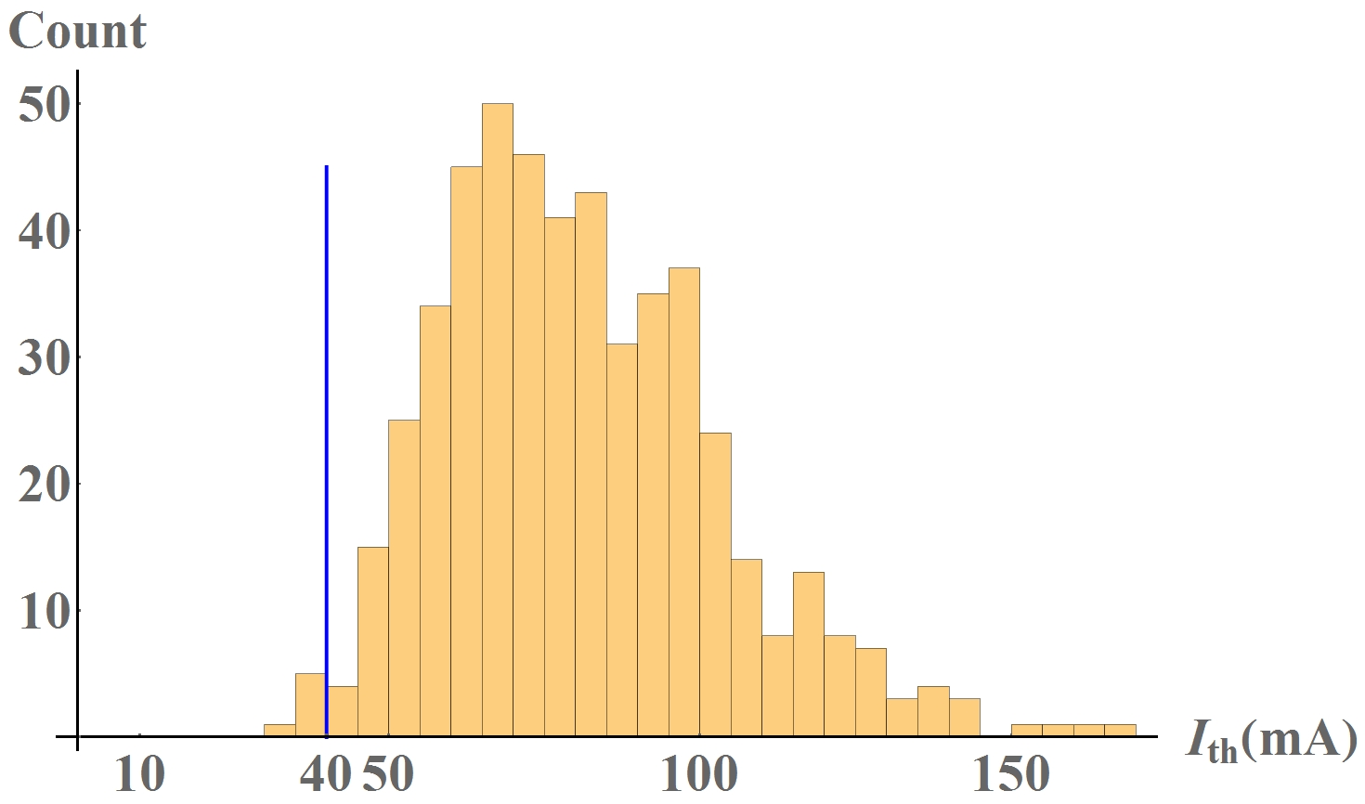
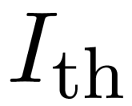
CBETA 4-pass
Cavity shape error: 125 μm
494 out of 500 results below 40mA
W. Lou, G. H. Hoffstaetter, “Beam-Breakup Studies for the 4-pass Cornell-Brookhaven Energy-Recovery Linac Test Accelerator”, (Proceedings, 9th International Particle Accelerator Conference (IPAC2018): Vancouver, Canada, 2018) THPAF022.
Notes:
Before: 70 out of 300

Slide 22
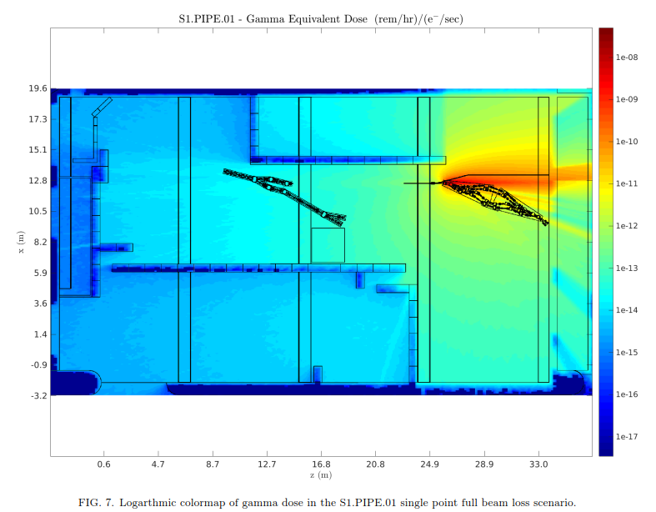
Shielding Limitation
N. MacFadden, C. Gulliford, “Development and Validation of a Geant4 Radiation Shielding Simulation Framework”, Internal CBETA Tech Note.

Slide 23
PM Radiation Damage

Slide 24
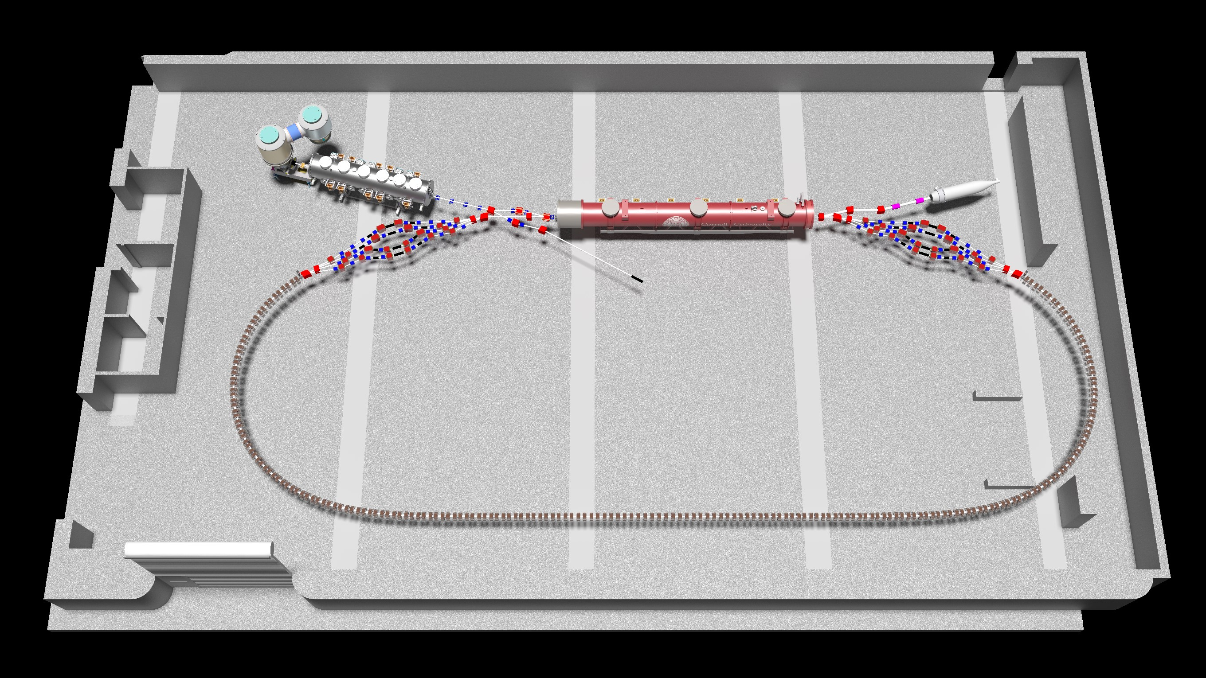
CBETA Final Layout
Complete and Beginning Operations
Late
2017
Late 2018

Slide 25
CBETA Requirements

Slide 26
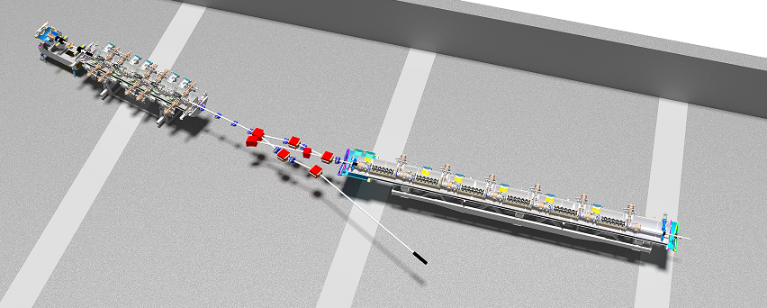
Present Injector Layout
Gun
(350 kV)
Injector Cryomodule
(+12 MeV)
Main Linac Cryomodule
(+50 MeV)
Switch Yard
Magnet
Buncher
Merger
Mirror Merger
Diagnostics Beamilne
Notes:
Diagram and component descriptions (turns into outline for talk)
Buncher – no mention

Slide 27
Cornell DC Guns
1st Generation Gun – emittance and high current studies
  Suffered (at least) 3 ceramic punch-through failures
  Operated ~2005-2015 (will continue in new gun dev. lab)
  Local cathode preparation
2nd Generation Gun (2012-Current)
  Segmented Insulators with integral shielding
  Modular SF6 tank design for flexibility and service access
  Scaled up diameter, but retains original electrode and cathode puck design
  No local cathode preparation – all delivered by vacuum suitcase
  Operational Margin (350kV operation)
Third Gun built (2016) – (next talk)
  Simplified duplicate for BNL LEReC program

Slide 28
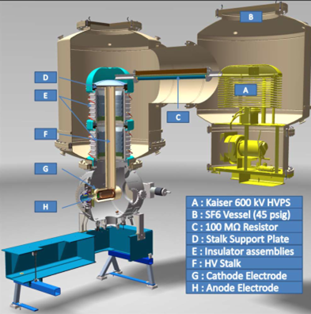
2nd Generation DC Gun
DC electron source
Based on scaled up DC-gun technology with:
Load-locked cathode transfer
Compact power supply
Shielded insulator
Shaped cathode and anode
Duplicate for BNL’s low energy electron cooler project.
Holds world record in current and normalized brightness.

Slide 29
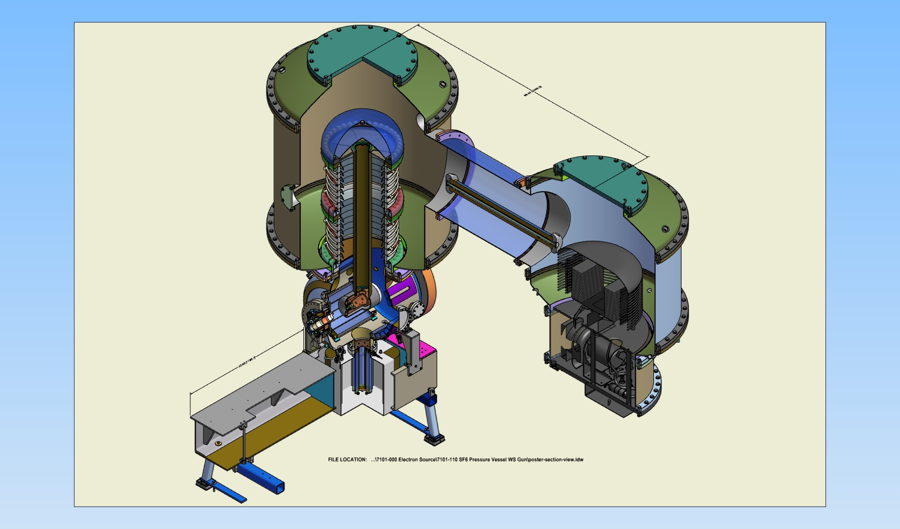
New gun overview
Segmented, shielded insulator
SF6 @ 4 atm
316LN stalk
Kaiser 600kV PS
5cm gap, 25deg focusing
100-300 MΩ
Ion pump behind 3500l/s Capacitorr NEG pump (x2)
Notes:
Gun was originally designed for 750—not at all necessary.

Slide 30
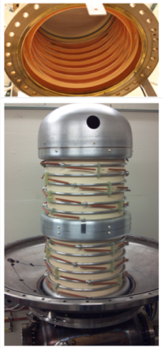
Segmented insulator
Mitigate punch-through: shield the ceramic
Brazed Alumina segments with kovar ring in each joint.
Inside: Cu protection rings entirely shield ceramic from field emitted electrons
Outside: Mount 500MΩ resistors between each segment (1GΩ / 2 in parallel)
  Allows differentiation between field emission going to ground or going to the rings!
  If anode floats, can distinguish between emission from stalk, cathode, and direct to ground.

Slide 31
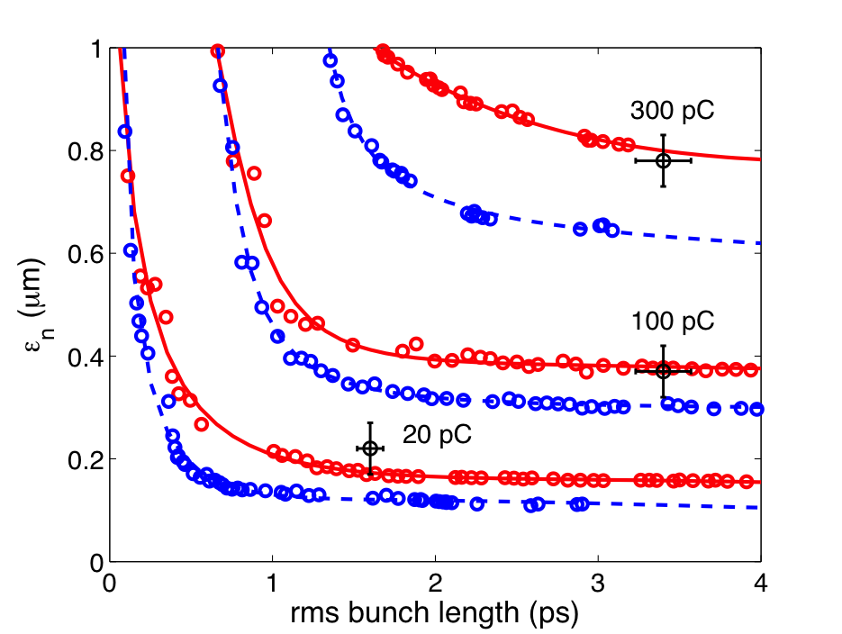
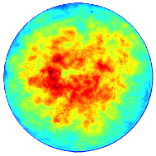
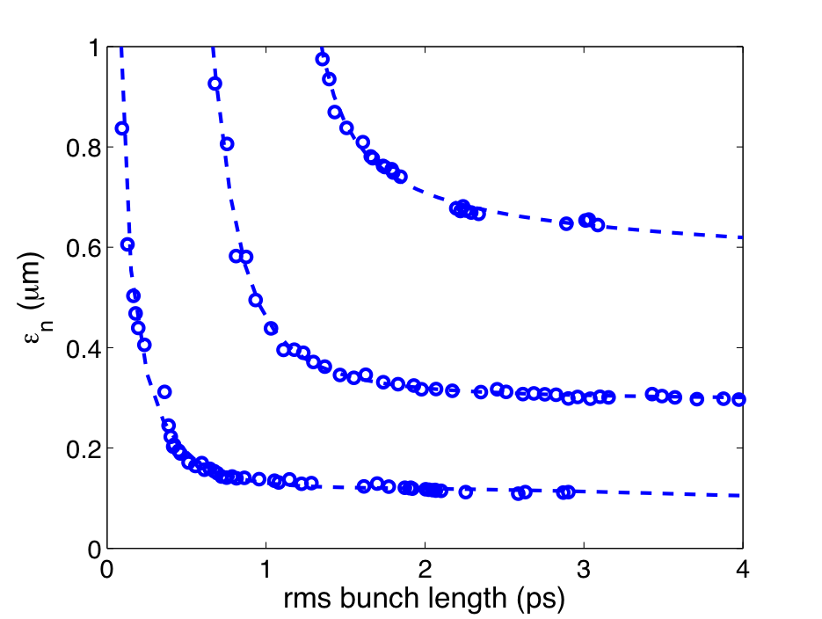
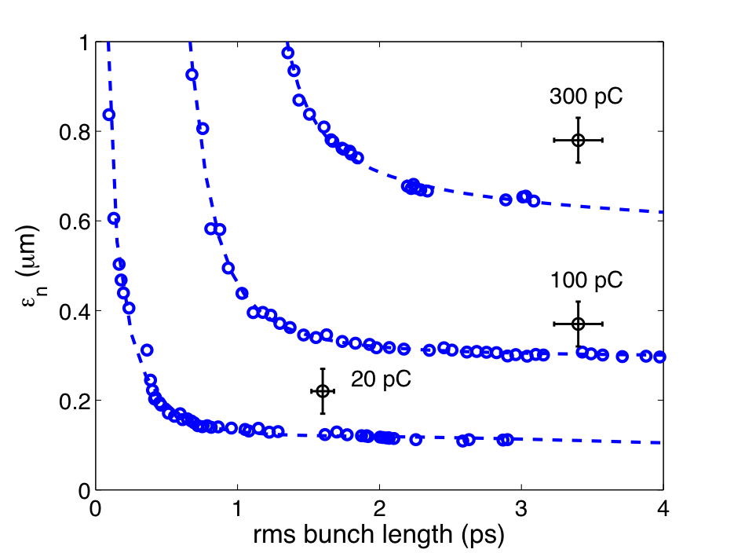
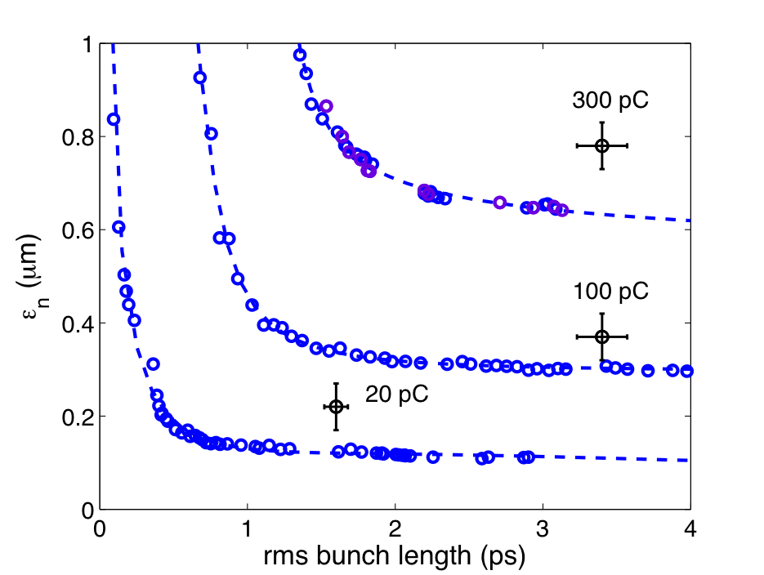
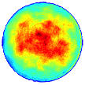

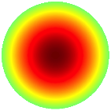
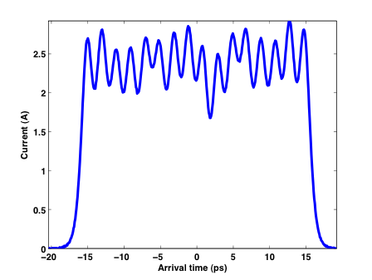
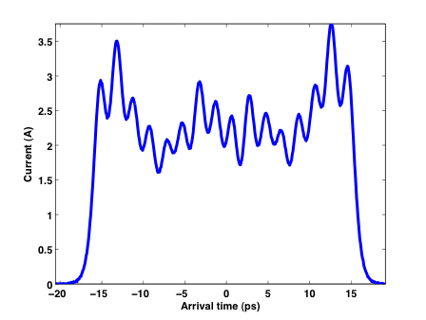
Effects of the Laser Shape
Ideal Shape
Measured Shape

Slide 32
Injector Cryomodule
Injector Cryomodule
Main Linac Cryomodule
1 2 3 4 5
6 5 4 3 2 1
1.300000 GHz
Tuner Range
(Arbitrary Units)
1.299925 GHz
Sufficient margin in Injector Cryomodule to run without Cavity #2 with minor emittance penalty

