Slide 1
Abstract: There are already multiple proposals in the world for use of ERL and RLA for example: LHeC, FCC eh at CERN, the ELIC at Jefferson Lab, previous eRHIC Linac ring design at BNL, and EIC@HIAF in China. There are multiple advantages of ERL’s - reusing the linacs as it is regularly done at Jefferson Lab where the two recirculating 1 GeV linacs make up to total energy of 12 GeV: reduction of the cost of the superconducting linac, savings in energy as the enormous power created with the 60 GeV electrons in LHeC, for example, could be reduced after collisions to the initial energy. The report from committee of Academy of Sciences in the Assessment of U.S. Based Electron Ion-Collider said it clearly: …“To reach the performance goals of the proposed EIC conceptual designs, a number of accelerator advances are required. Several of these advances are common to all EIC designs and include the following: advanced magnet designs, strong hadron beam cooling, high current multi turn ERL technology, crab cavity operation with hadron beams, the generation of polarized 3He beams, and development and benchmarking of simulation tools”… The following subsections review these enabling technologies, the present state of the art, and required research and development to meet EIC facility specifications and realize EIC science: Energy Recovery Linacs. ...The ERLs required for electron cooling are at scales much larger than supported by present-day experience, so a number of accelerator physics and technology challenges still need to be overcome with focused R&D and great attention to detailed simulations”…
Why is the CBETA Important for the Electron Ion Colliders?
Dejan Trbojevic

Slide 2
OUTLINES
ERL’s, RLA’s in LHeC, FCC eh (CERN), eRHIC(BNL), ELIC(CEBAF), EIC@HIAF(China)
The CBETA ERL could be used for the studies of the ELR cooling and possibly for the multi-turn magnetized electron beam transport necessary.
It also could be used to study the beam break up instabilities, HOMs, halo mitigations, etc.
Electron Cooling proposals with ERL’s : test with “FAST”, Coherent Electron Cooling with ERL, Development of the Electron cooler with ERL (Benson), Micro-bunched coherent electron beam cooling, …
Academy of Sciences Assessment of U.S. Based Electron Ion-Collider

Slide 3
Academy of Sciences Assessment of U.S. Based Electron Ion-Collider
To reach the performance goals of the proposed EIC conceptual designs, a number of accelerator advances are required. Several of these advances are common to all EIC designs and include the following: advanced magnet designs, strong hadron beam cooling, high current multi turn ERL technology, crab cavity operation with hadron beams, the generation of polarized He³ beams, and development and benchmarking of simulation tools.
The ERLs required for electron cooling are at scales much larger than supported by present-day experience, so a number of accelerator physics and technology challenges still need to be overcome with focused R&D and great attention to detailed simulations.

Slide 4
Academy of Sciences Assessment of U.S. Based Electron Ion-Collider
The challenges center around the following three major areas:
Achieving high electron source brightness;
Maintaining high beam brightness through the accelerator transport -beam dynamics of an unprecedented number of spatially superposed bunches in the SRF linacs; very precise phase and amplitude control;
Dealing with unprecedented beam currents in SRF linacs (halo mitigation, beam breakup instabilities, higher order mode dissipation).
Many of these R&D issues are being investigated vigorously in dedicated test facilities under construction and commissioning in laboratories around the world. Specially, the 4-pass Fixed Field Alternating Gradient R&D loop for eRHIC, see Box 4.2 CBETA and Fixed Field Alternating Gradient Optics for Electron Acceleration. It could illuminate key issues including multi-turn beam-breakup instability thresholds for proof of possible cavity designs, halo mitigation, beam - ion effects, and operational challenges such as instrumentation and stability of multi-turn beams..."

Slide 5
Academy of Sciences Assessment of U.S. Based Electron Ion-Collider
ERLs, a high-performance and high-efficiency type of recirculating linac, presently offer the only credible concept for electron cooling of high-energy colliding beams.
The Brookhaven National Laboratory (BNL) has launched a collaboration with Cornell University to build a high-intensity multi-pass 150 MeV test energy recovery linac (ERL) with non-scaling fixed-field alternating gradient (NS-fixed-field alternating gradient) return arcs, called CBETA (for Cornell-BNL ERL Test Accelerator).

Slide 6
EIC with ERLs
The large momentum acceptance of the NS-fixed-field alternating gradient optics could substantially reduce the number of return arcs and the cost of the 18 GeV injector of the eRHIC electron storage ring (or the 18 GeV ERL itself, in the case of the linac-ring design concept). Several beams of different energies could pass through the same arc structure on different orbits. Like eRHIC, the Jefferson Laboratory Electron Ion Collider (JLEIC) design of an EIC also employs an ERL as an electron cooler to achieve low-emittance ion beams. These, and other future ERLs or recirculating linac accelerators, could also benefit from the fixed-field alternating gradient focusing principle.

Slide 7
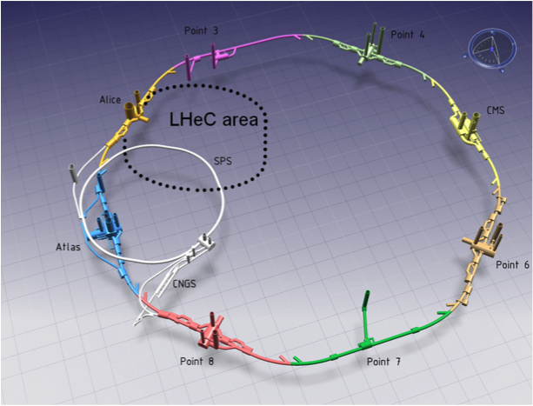
Linac-Ring Option − LHeC Recirculator

Slide 8
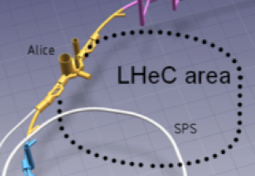
Fixed Field LHeC Recirculator with ER
Linac 2
5 GeV
Dump
60 GeV
IP
10 GeV
Linac 1
5 GeV
5 GeV
Recovery:
55 GeV
45
35
25
15
Injector
Acceleration:
15 GeV
25
35
45
55
LHC
8

Slide 9
NS-FF LHeC Recirculator with ER
IP
Linac 1
5 GeV
Linac 2
5 GeV
LHC
60 GeV
Injector 150 MeV
10 GeV
Dump
Local FFA 5 GeV loop
Recovery
55 GeV
45
35
25
15
Acceleration
15 GeV
25
35
45
55
3.7 x energy
9

Slide 10
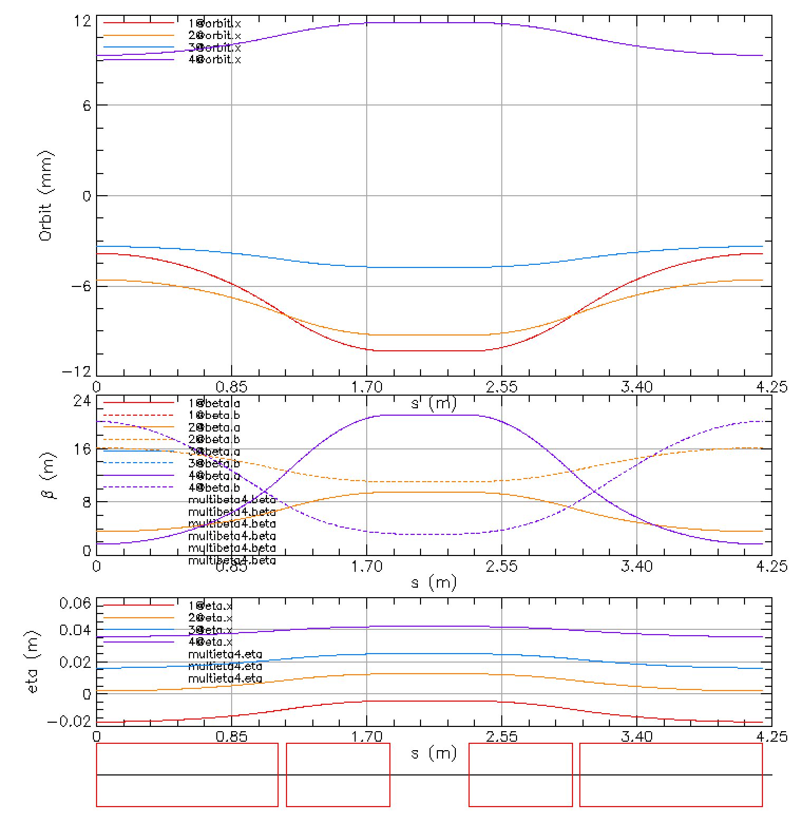
Lattice Function in the LHeC FFA arc
10

Slide 11
Fixed Field single arcs for PERLE – new proposal as previously described with the triplet magnets between the 5 RF cell units
44.6 m
16 m
12.6 m
16 m
Linac 150 MeV
NS-FF #2
305 MeV
605 MeV
905 MeV
NS-FF #1
155 MeV
455 MeV
755 MeV
16.00
5 MeV
Injector
Linac 150 MeV

Slide 12
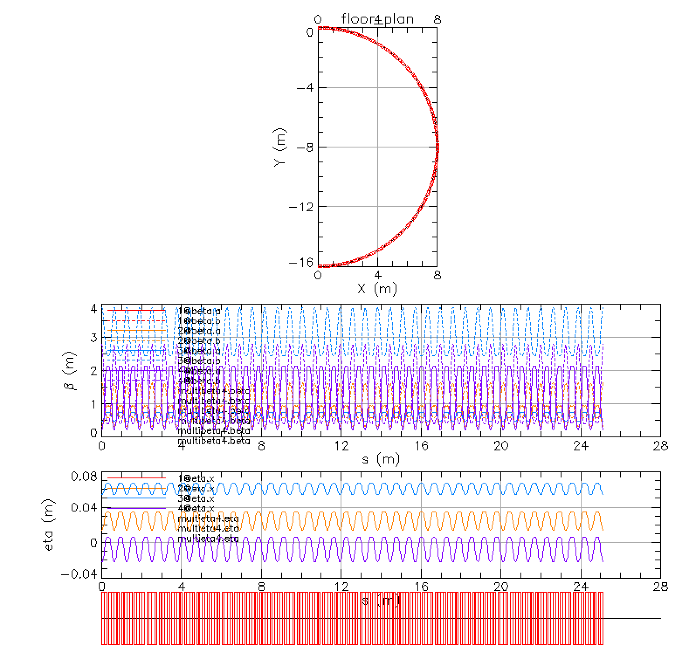
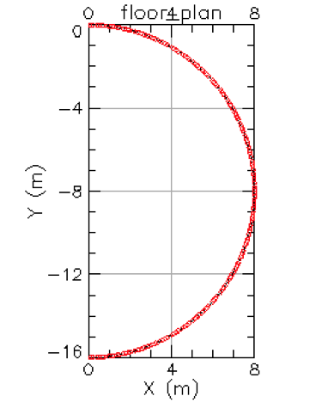
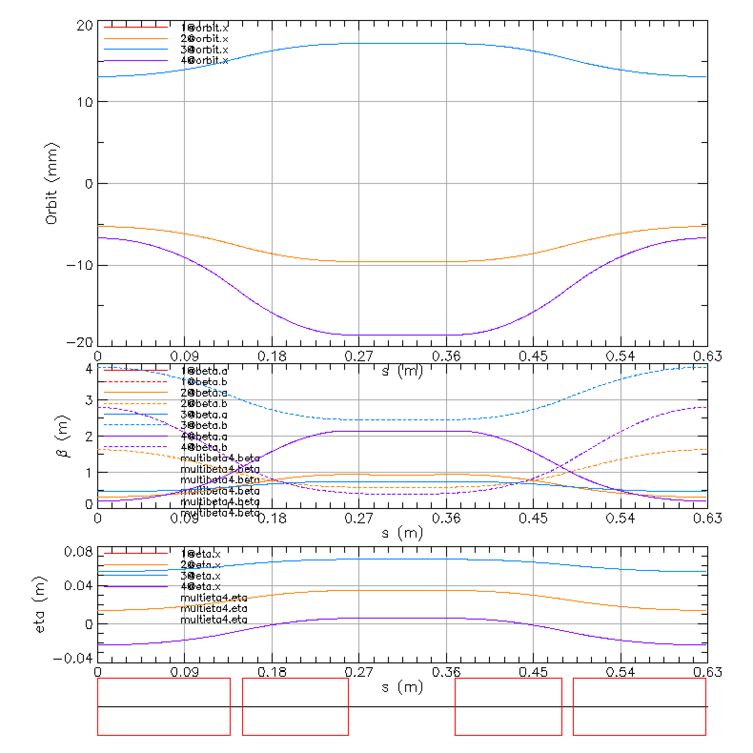
Fixed Field Arc for PERLE 305-905 MeV– similar to CBETA
905 MeV
4
Y(m)
8
12
605 MeV
16
x(m)
0
4
8
305 MeV

Slide 14
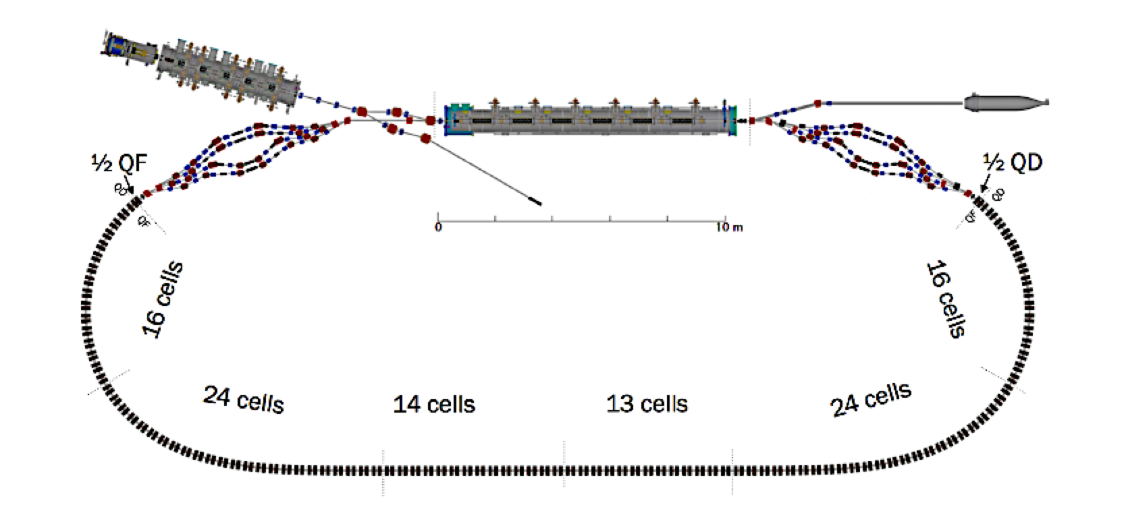
Properties of the linear fixed field large energy acceptance lattice for the CBETA project

Slide 15
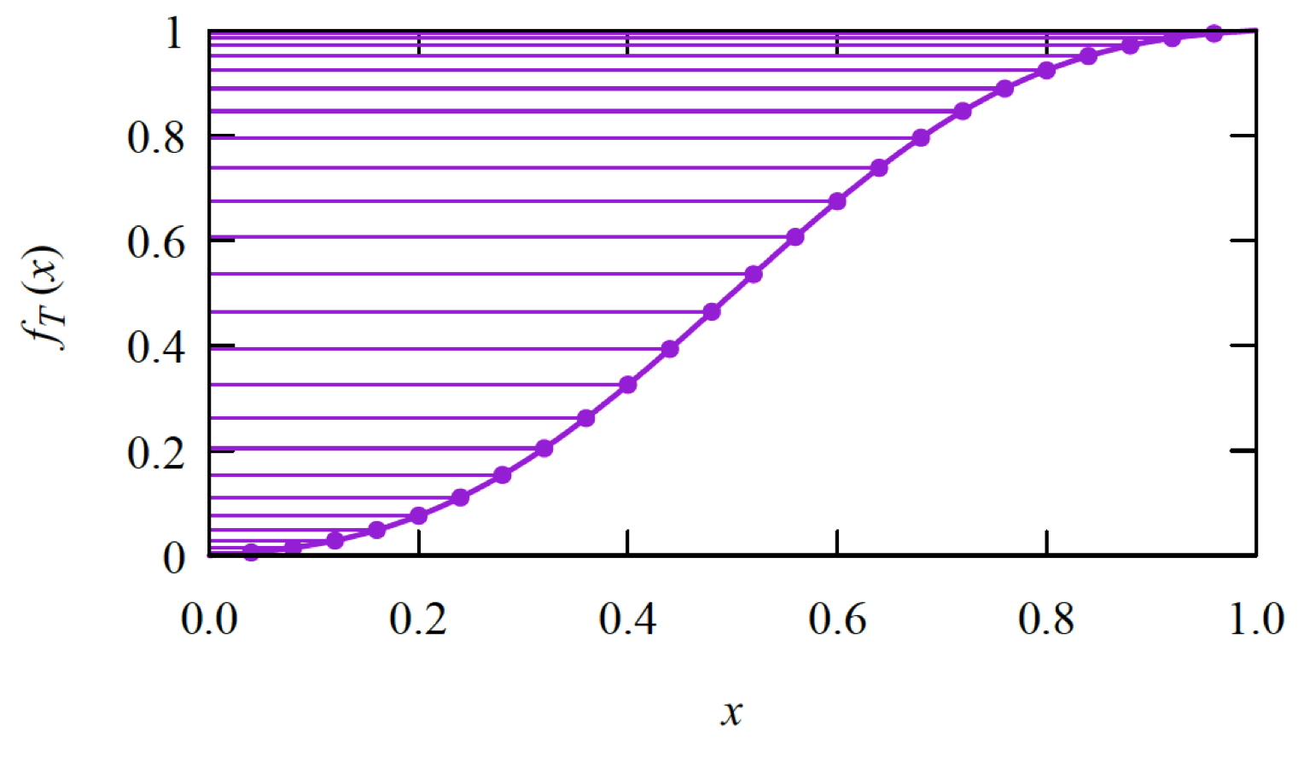
Adiabatic transition from the arc to the straight with expanding the transition cell lengths

Slide 16
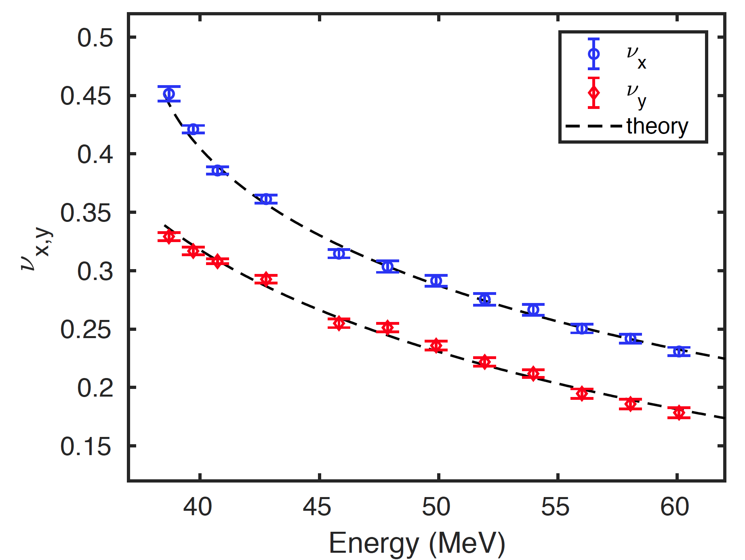
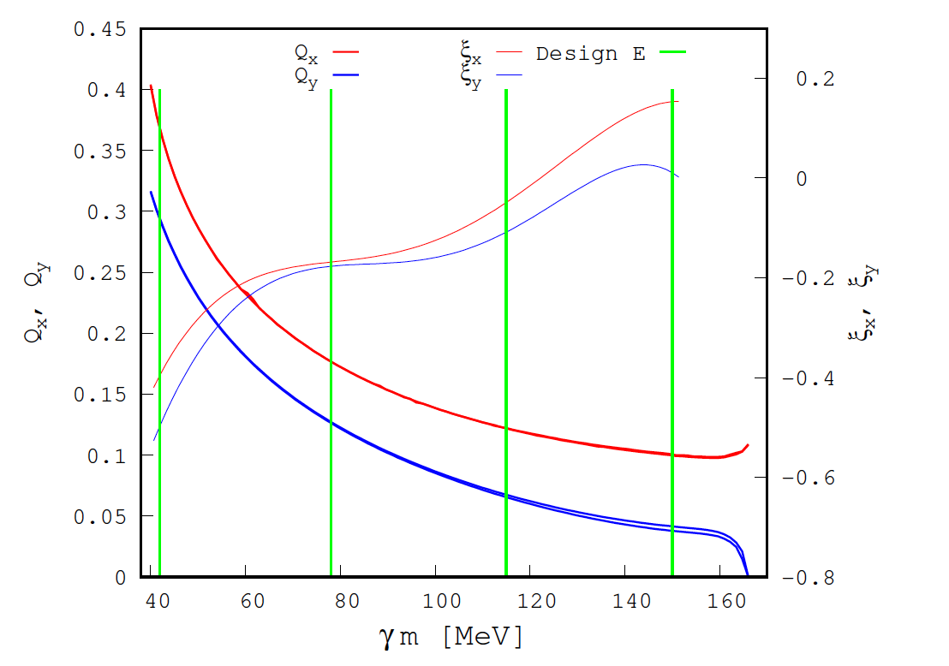
Predicted CBETA tunes and chromaticity dependence on energy
CBETA measured tunes dependence on energy in the partial arc test May 2018
Dejan Trbojevic, ICAP 18, October 23, 2018, Key West, Florida, USA
16

Slide 17
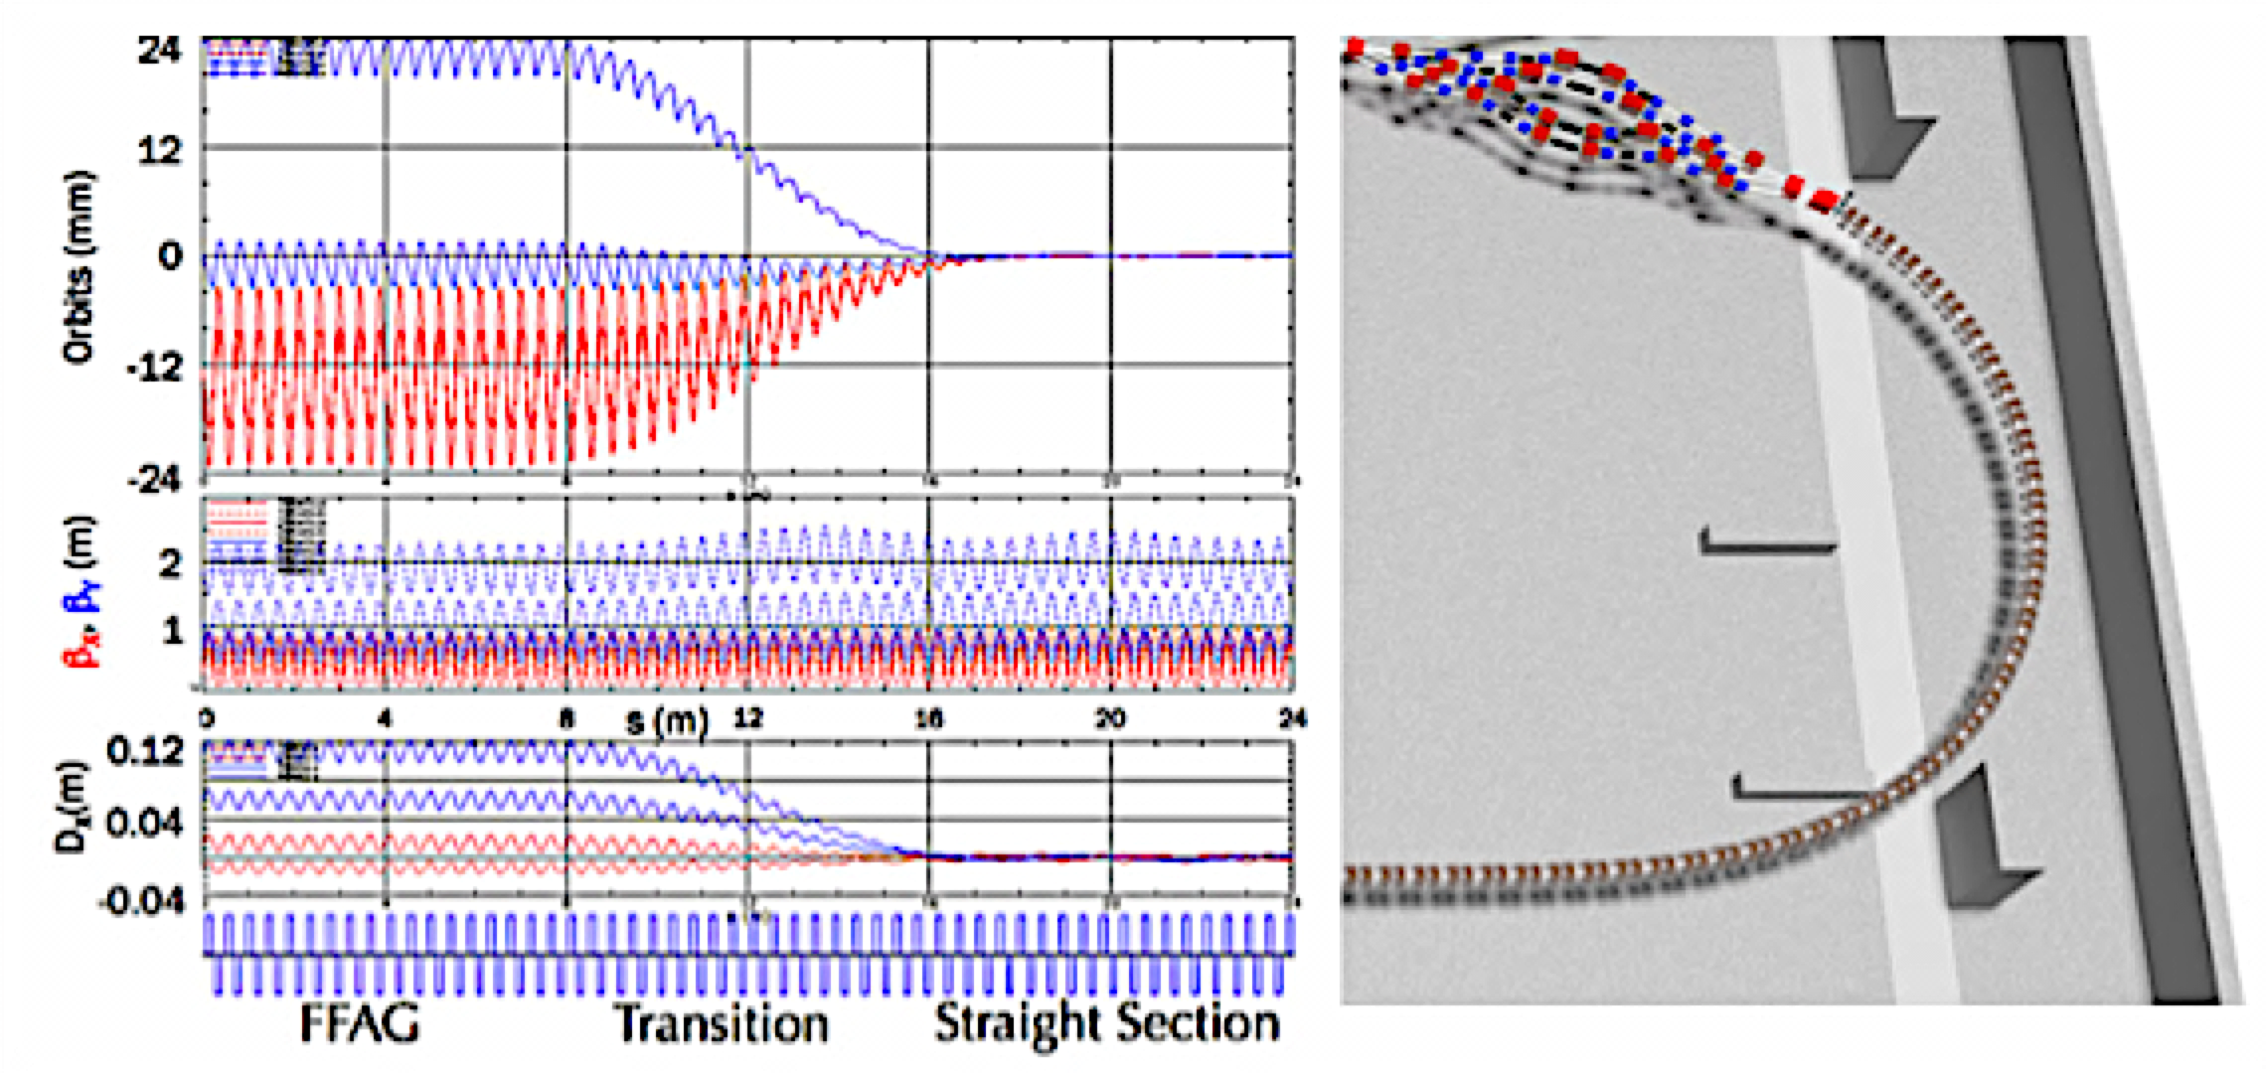
Merging of the orbits at the CBETA project
The Proton Gantry Design is based on few other examples

Slide 18
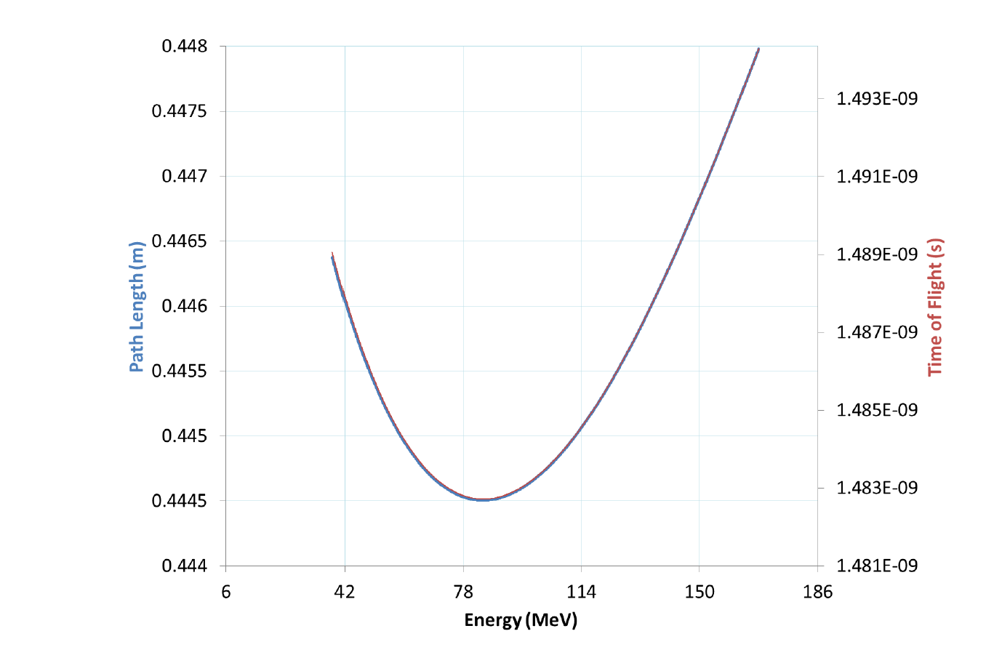
Path length and time of fight
in the CBETA arc cell as a function of energy.
Dejan Trbojevic, ICAP 18, October 23, 2018, Key West, Florida, USA
18

Slide 19
What needs to be done with CBETA
…”Specially, the 4-pass Fixed Field Alternating Gradient R&D loop for eRHIC, see Box 4.2 CBETA and Fixed Field Alternating Gradient Optics for Electron Acceleration. It could illuminate key issues including multi-turn beam-breakup instability thresholds for proof of possible cavity designs, halo mitigation, beam - ion effects, and operational challenges such as instrumentation and stability of multi-turn beams...”

Slide 20
eRHIC with a single large FFA arc
Linac 1.25 GeV
#1 5.00 GeV
#2 6.25 GeV
#3 7.50 GeV
#4 8.75 GeV
#5 10.0 GeV
#6 11.25 GeV
#7 12.50 GeV
#8 13.75 GeV
#9 15.00 GeV
#10 16.25 GeV
#11 17.50 GeV
#12 18.75 GeV
Linac 0.625 GeV
#1 4.375 GeV
#2 5.000 GeV
#3 5.625 GeV
#4 6.250 GeV
#5 6.875 GeV
#6 7.500 GeV
#7 8.125 GeV
#8 8.750 GeV
#9 9.375 GeV
#10 10.00 GeV
R=80m
#1 1.250 GeV
#3 2.500 GeV
#5 3.750 GeV
3.75/1.25=3x energy
#1 1.250 GeV
#2 1.875 GeV
#3 2.500 GeV
#4 3.215 GeV
#5 3.750 GeV
3.75/1.25=3x energy

Slide 21
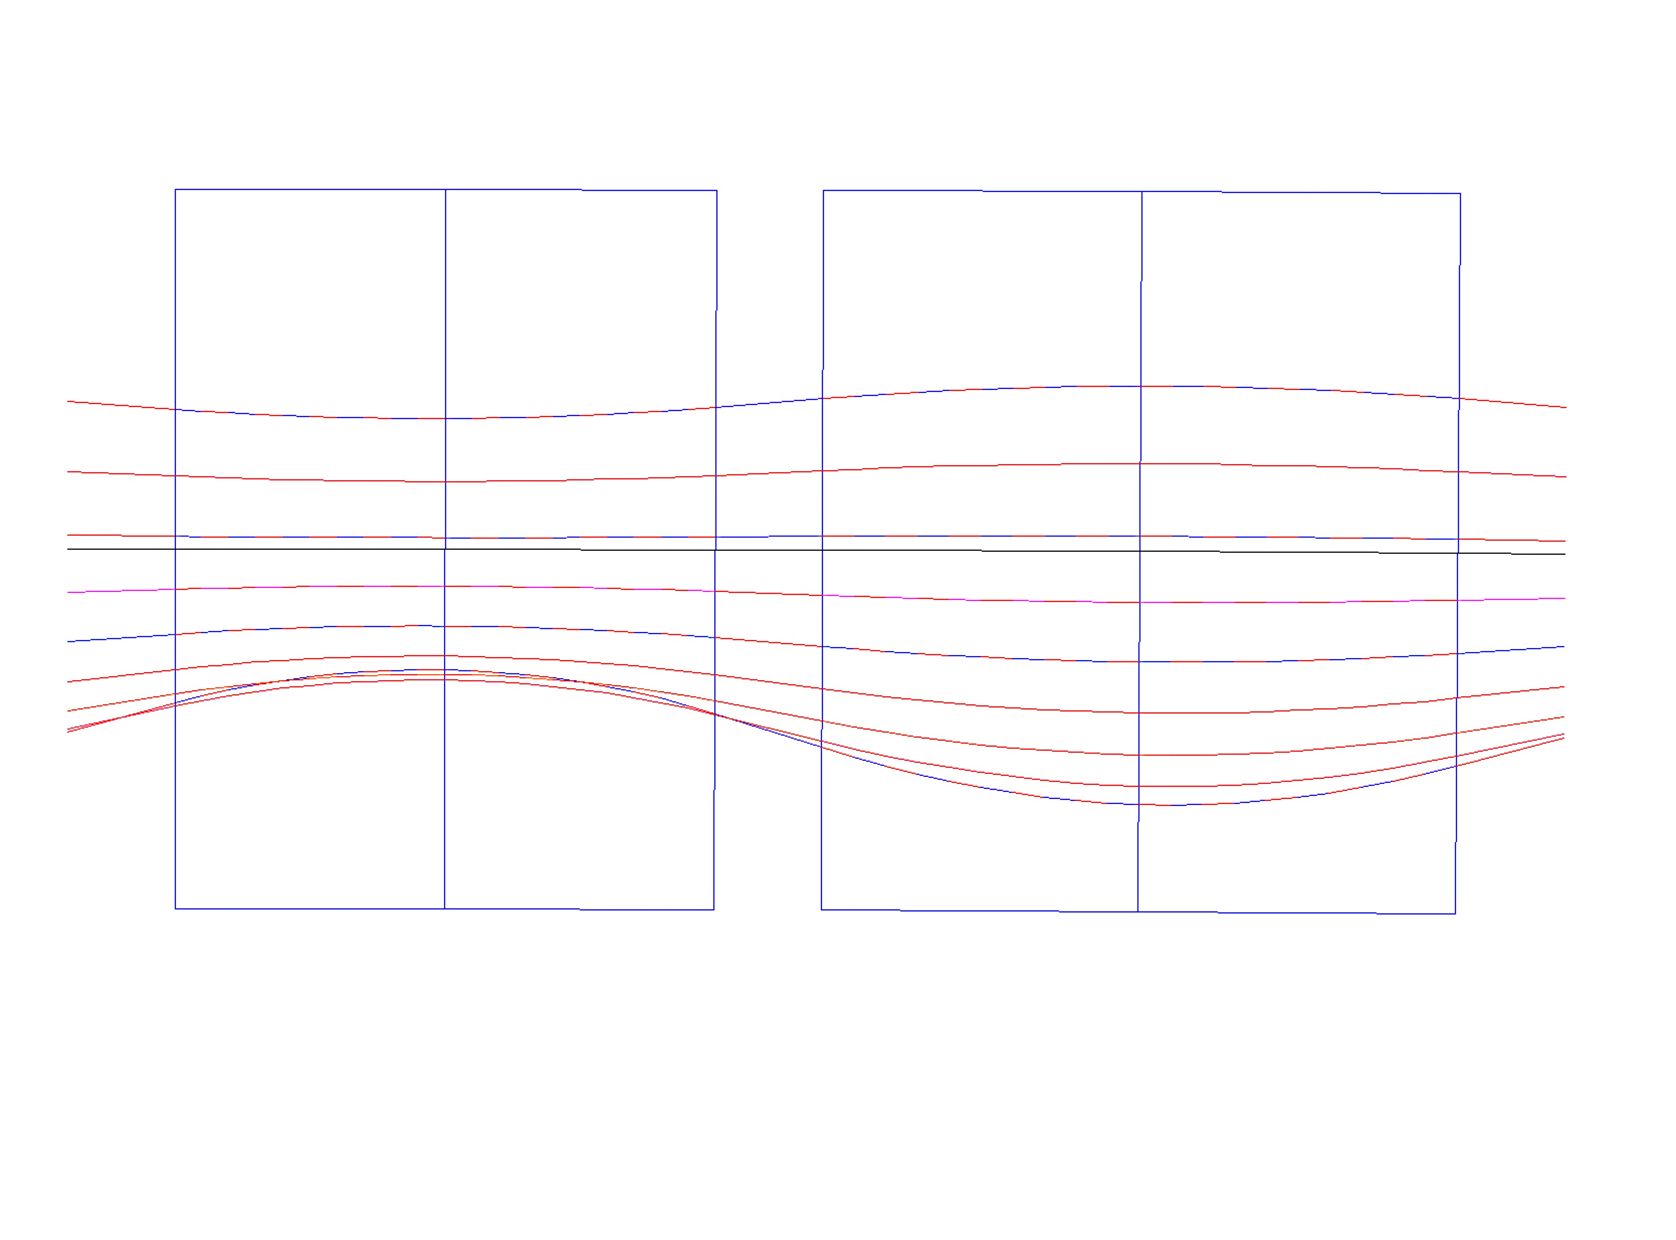
High Energy eRHIC NS-FF Cell
Synchrotron Radiation:
for 10 mA 20 GeV 3.32 MW
for 10 mA 15 GeV 1.62 MW
for 10 mA 16.67 GeV 1.95 MW
B_{Do} = 0.181 T,
G_{D} = -34.42 T/m
x_{Doffset}=+5.26 mm
B_{Fo}= 0.181 T,
G_{F}= 34.42T/m
x_{Foffset}= -5.26 mm
x(mm)
BD
B_{Fmax,min} =[0.446,-0.225] T
QF
x(mm)
10
B_{Dmax,min}=[0.443,0.046] T
20.00 GeV
1.3
D-Quad center
18.34 GeV
6.6
7.7
16.67 GeV
5.26
E_{CEN}=16.198 GeV
0
12.96
15.005 GeV
F-Quad center
-5.26
13.34 GeV
-7.6
11.68 GeV
10.01 GeV
-11.8
8.345 GeV
6.54
-10
6.68 GeV
B_{D}=B_{Do} + G_{D}•x
B_{F}=B_{Fo} + G_{F}•x
ρ_{D}=300.01 m
ρ_{F}= 302.3 m
20 cm
θ_{D}=3.366 mrad
20 cm
θ_{F}=3.927mrad
1.01 m
1.187m
20 cm
L = 2.797 m

Slide 22
ERL for proton/ion cooling

Slide 23
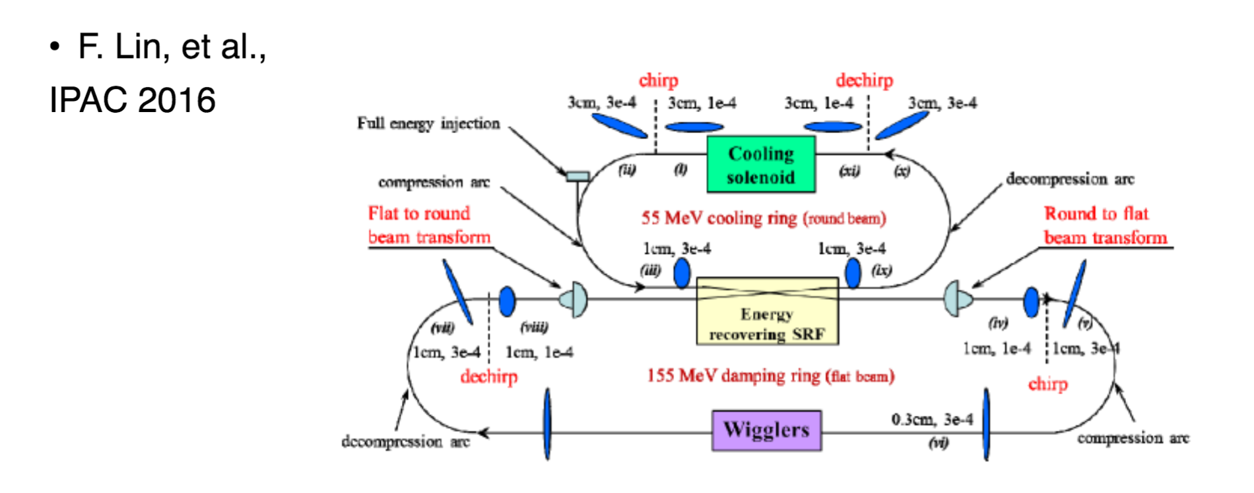

Slide 25
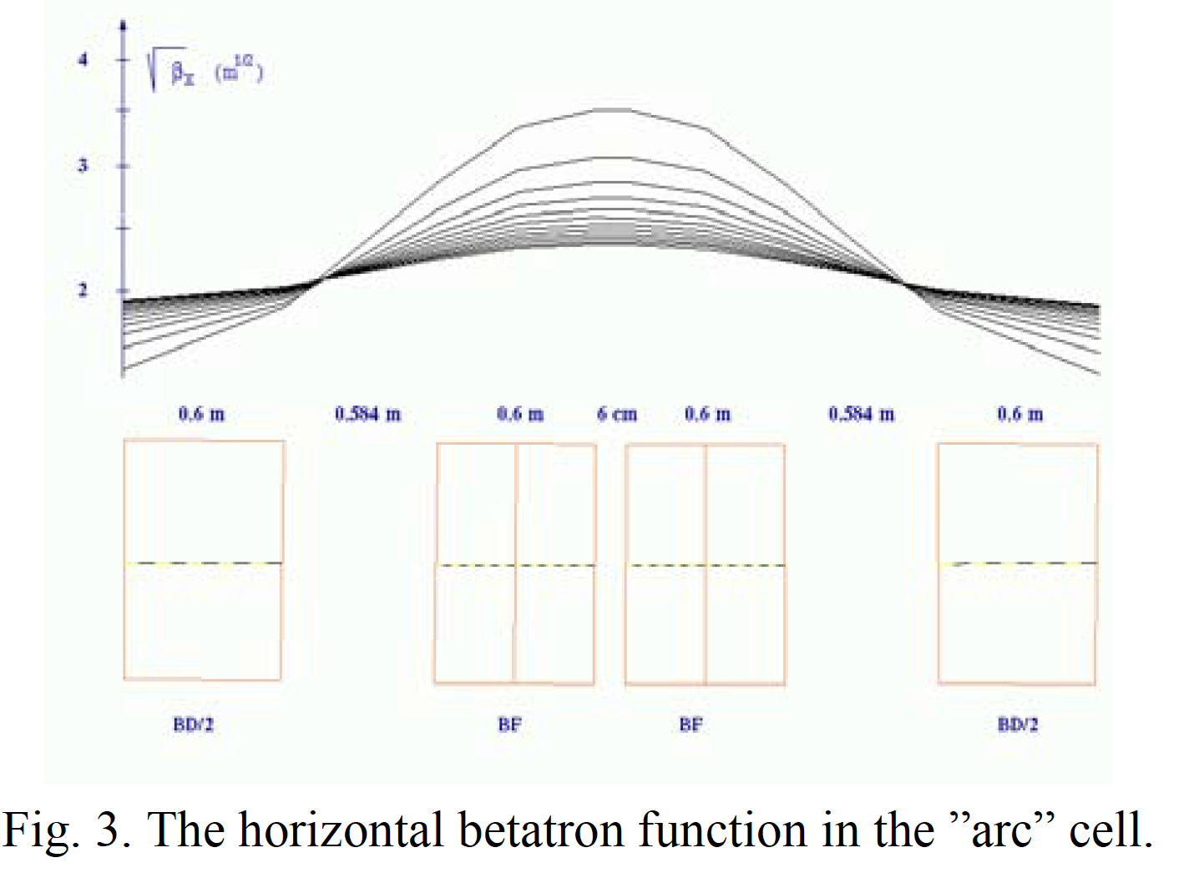
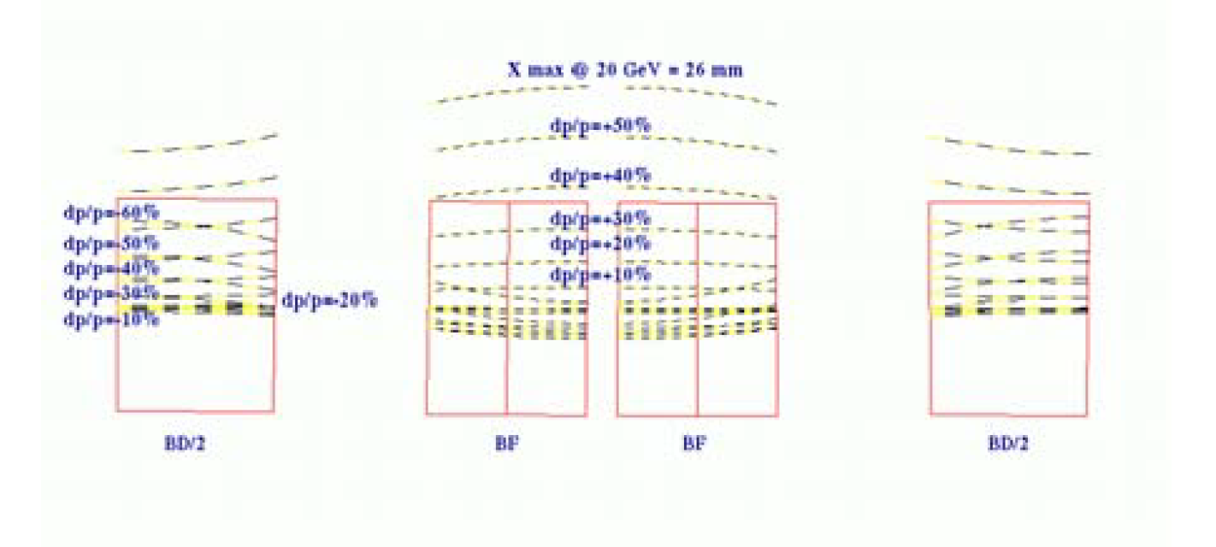
Proceedings of PAC07, Albuquerque, New Mexico, USA
“ACCELERATION OF ELECTRONS WITH THE RACETRACK NONSCALING FFAG FOR e-RHIC”
D. Trbojevic, S. J. Berg, I. Ben-Zvi, M. Blaskiewicz , V. Litvinenko, W. MacKay, V. Ptitsyn, T. Roser, and A. G. Ruggiero, Brookhaven National Laboratory, NY, Upton, 11973, USA

Slide 26
Advantages of the Fixed Field Large momentum lattice:
For multiturn ERL’s there is no other option but to use the fixed field magnets as with the present technologies it is impossible to change the magnetic field in a very short time (ns)
With the exception of CBETA all ERL’s use multiple beam lines with the fixed magnetic field to bring the beam back to linacs.
The fixed field large momentum acceptance beam lines show multiple advantages in the multiple pass ERL’s:
Multiple beam lines are replaced with a single one
Electron beam polarization is preserved
Operation is simplified

Slide 27
CONCLUSION
The CBETA project would be of interest for the electron cooling as well as the magnetized cooling applications in the Electron Ion Colliders and a list of studies could be listed as the NAS report emphasized:
“It could illuminate key issues including multi-turn beam-breakup instability thresholds for proof of possible cavity designs, halo mitigation, beam - ion effects, and operational challenges such as instrumentation and stability of multi-turn beams...”
And to add additional EIC aspect: multi-turn transfer of the MAGNETIZED BEAM.

