Slide 1
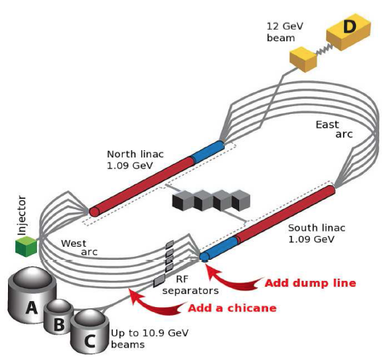
ER@CEBAF: High Energy Multipass Energy Recovery
Todd Satogata
Interim Director
Center for Advanced Studies of Accelerators
EIC ERL Satellite Meeting
November 2 2018

Slide 2
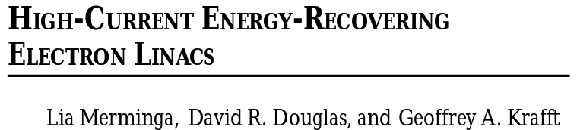

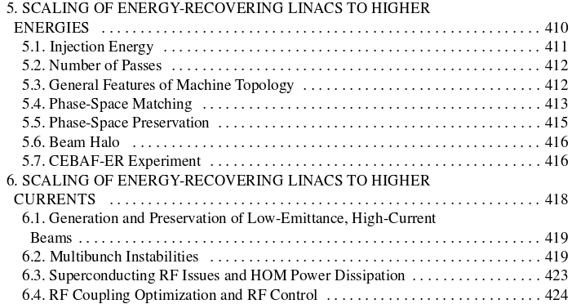
ERL Frontiers
“Energy Frontier”
“Power Frontier”
“Current Frontier”
http://uspas.fnal.gov/materials/05UCB/Merminga-Douglas-Krafft.pdf

Slide 3
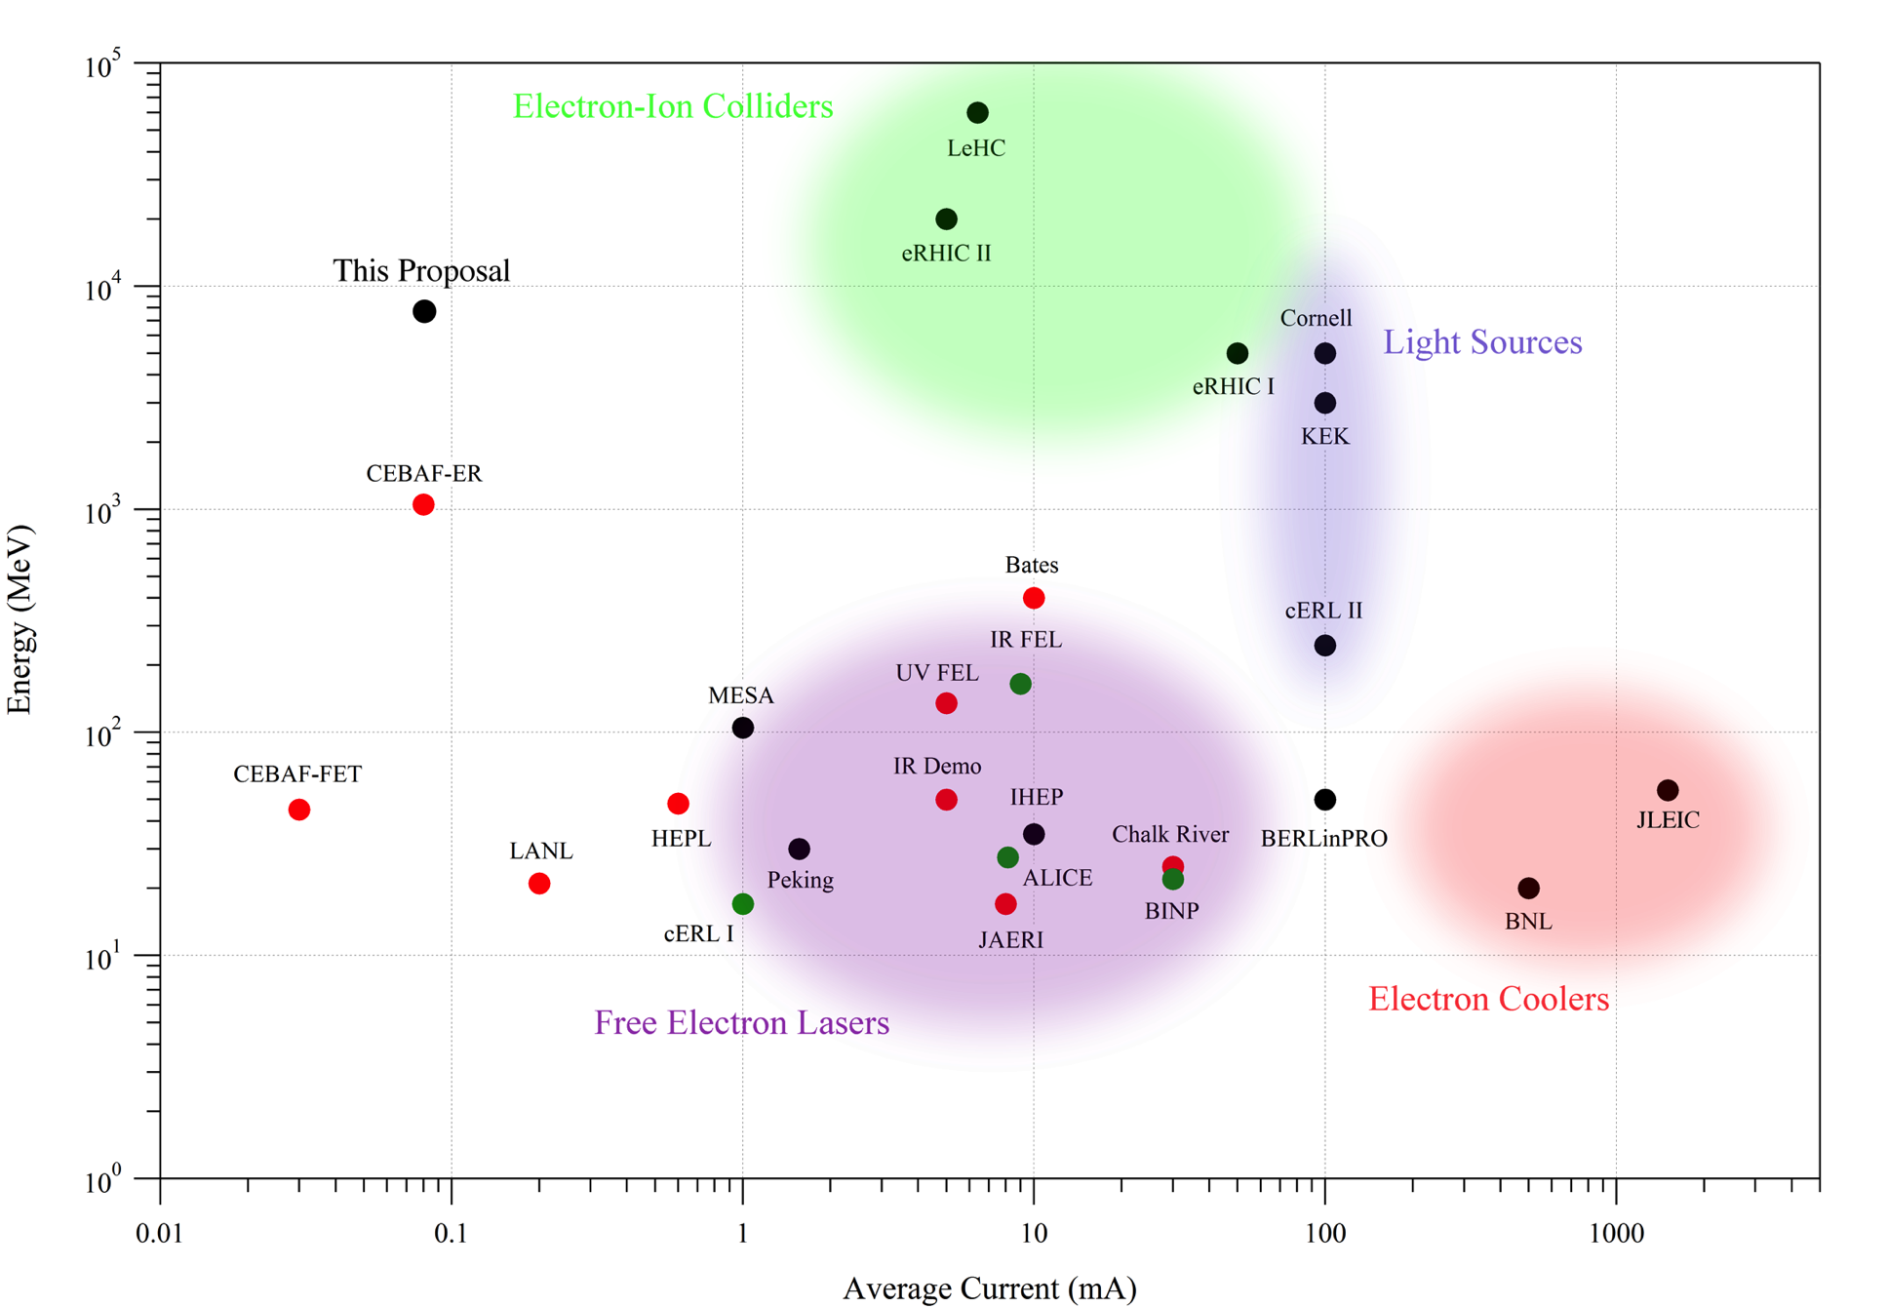
World ERL Landscape
10⁵
Existing
Commissioning
Proposed
LHeC
“Tigner-tron”
Beam Energy (MeV)
cBeta
10⁰
0.01
1000
C. Tennant
Average Current (mA)

Slide 4
World ERL Landscape: Power
10⁵
Existing
Commissioning
Proposed
LHeC
“Tigner-tron”
Beam Energy (MeV)
cBeta
100 MW
10 MW
Beam
Power
10 kW
100 kW
1 MW
10⁰
0.01
1000
Average Current (mA)

Slide 5

World ERL Landscape: Energy Frontier
10⁵
Existing
Commissioning
Proposed
LHeC
“Tigner-tron”
Beam Energy (MeV)
owns SRF ER energy frontier
cBeta
10⁰
0.01
1000
Average Current (mA)

Slide 6
ERLs at Jefferson Lab
Jefferson Lab has a history of world leadership in ERLs
  1993: CEBAF front end ERL test
  1998-2001: IR FEL demo
    First demonstration of ERL-based light source
  2002-3: CEBAF one-pass energy recovery expt
    Remains world leader in ERL beam energy
  2002-10: UV FEL
    Remains world leader in beam power (2 MW)
  Present: ERL collaborations
    BNL, cBETA, PERLE, LHeC
ER@CEBAF continues Jefferson Lab’s world leadership in high energy ERL beam and RF studies

Slide 7
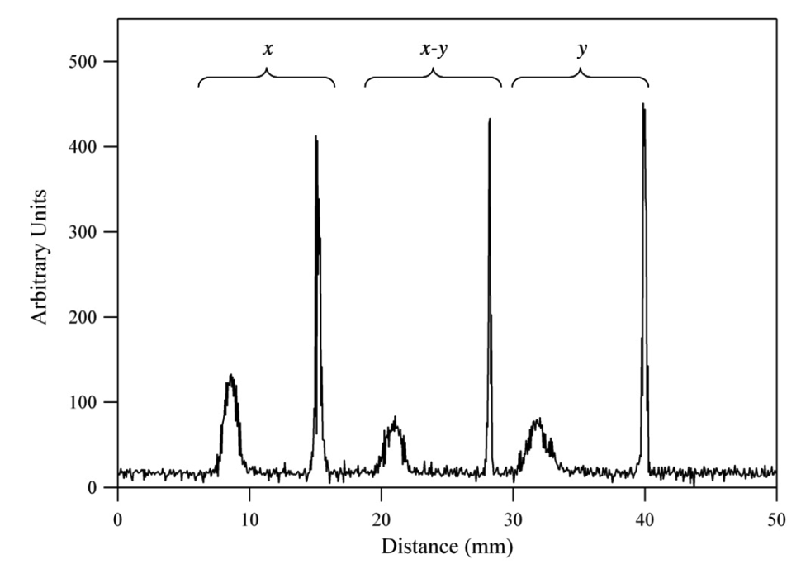
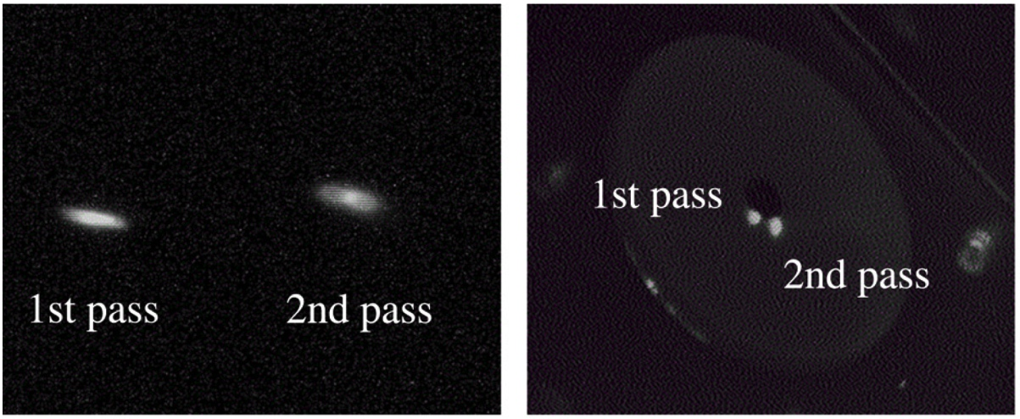
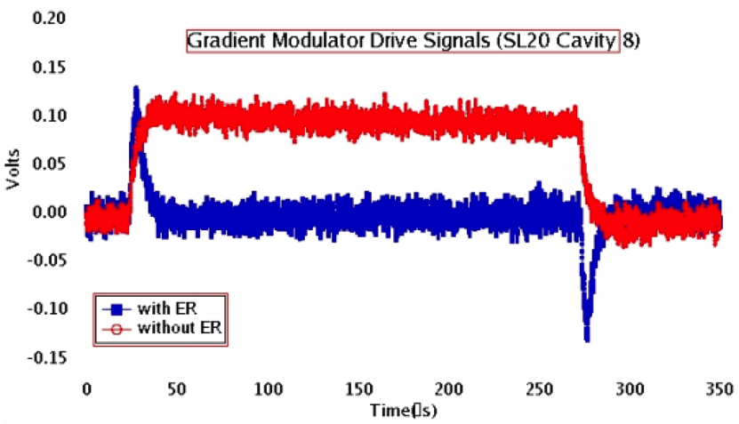
2003 CEBAF-ER Measurements
Arc 1
South linac
1056 MeV
56 MeV
2003 2-pass viewer images
2003 2-pass harp scan (2L24)
RF Drive Power: ER on and Off
Injector energies: E_{inj}=20 MeV and 56 MeV
Viewers and harps discriminated multiple pass beams
12 GeV improvements in CEBAF optics tuning
  Harp scans, emittance measurements
  Dispersion measurements and matching
  Full-machine transport (RayTrace)
Note RF transients even with ER on

Slide 8
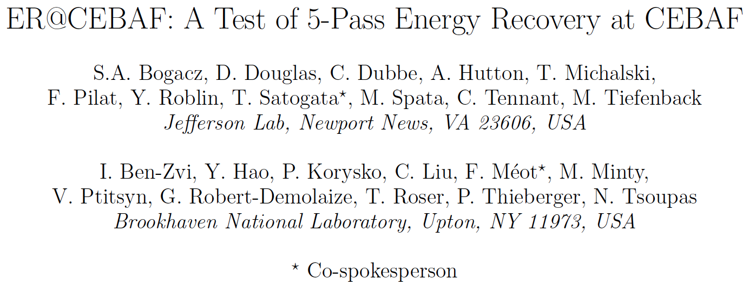
ER@CEBAF Collaboration
A collaboration between Jefferson Lab and BNL
Collaboration telecons since July 2015
Six conference publications (IPAC, ERL); two conference talks (ERL, APS Spring Meet)
(Also an amusing football game)

Slide 9
ER@CEBAF
Add pathlength chicane
Add low energy dump line
Do not interfere with existing
CEBAF 12 GeV capabilities
Failure of new magnets does
not affect 12 GeV capability
Δs = λ/2
A. Bogacz

Slide 10
ER@CEBAF: Accelerating
0.75 GeV/pass
0.75 GeV/pass
85 MeV
Energy gain per pass limited by
disruption of beam energy
spread σ_{E} due to synchrotron
radiation
Δs = λ/2
7.585 GeV
A. Bogacz

Slide 11
ER@CEBAF: Slip Half RF Wavelength
Δs = λ/2
A. Bogacz

Slide 12
ER@CEBAF: Decelerating
90:1
98.9% ERL
Challenge: decelerating
beam (and synchrotron
radiation-driven energy
spread) adiabatically
anti-damps
Small energy losses to
synchrotron radiation
Δs = λ/2
84 MeV
A. Bogacz

Slide 13
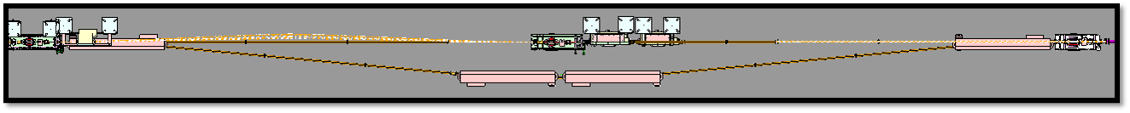
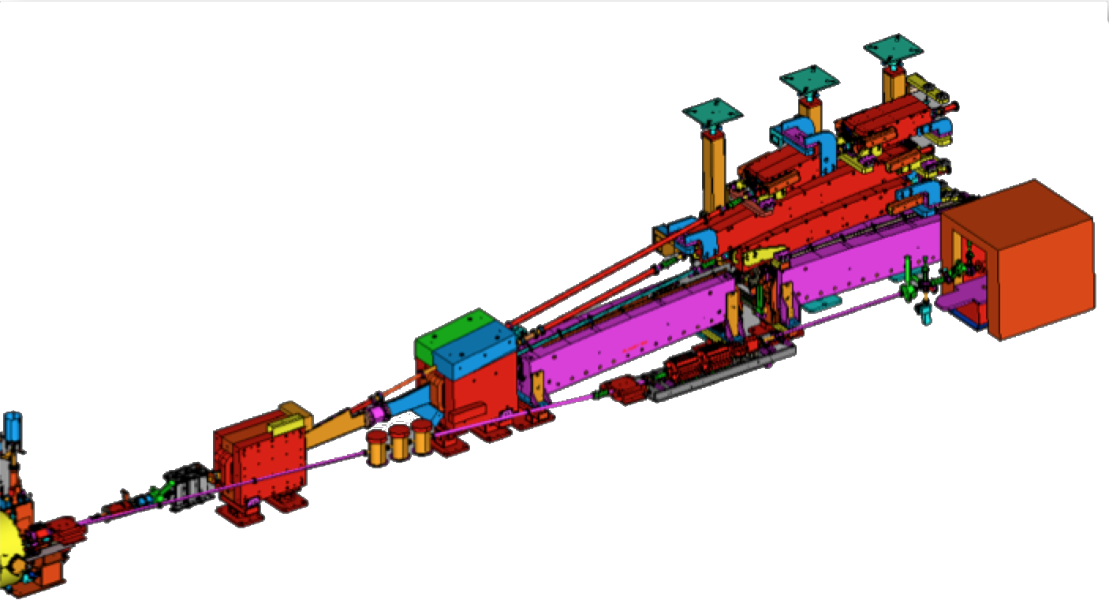
CEBAF Hardware Modifications
Extends 1m into aisle
λ/2 pathlength chicane: Add four 3m dipoles in AE region
  Optics solution designed, only magnet strength changes
Low energy dump: Add quadrupole girder, low energy dump
  Located at end of south linac next to SL spreader
  Maintains vacuum isolation
Use existing CEBAF designs, spares
  Small costing uncertainty
  Summer SAD installation
New Low
Energy Dump
New
Quadrupole
Girder
Extraction Area

Slide 14
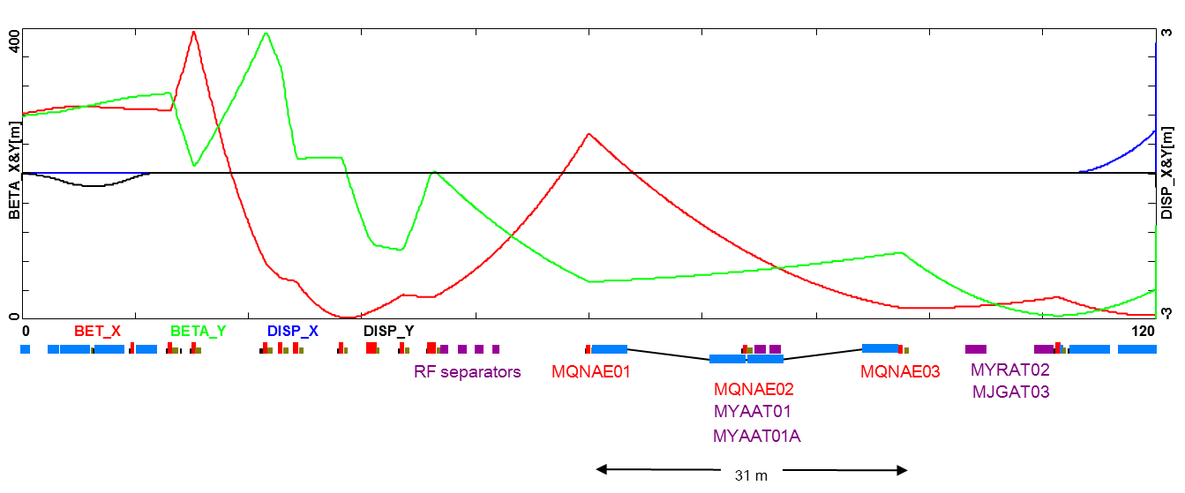
Pathlength Chicane
L_{b}
L_{b}
−θ
−θ
L_{b}
5°
5°
L_{b}
θ
θ
MQNAE01
MQNAE02
MQNAE03
31m
Match with bypassed
MQNAE02 quadrupole
A. Bogacz

Slide 15
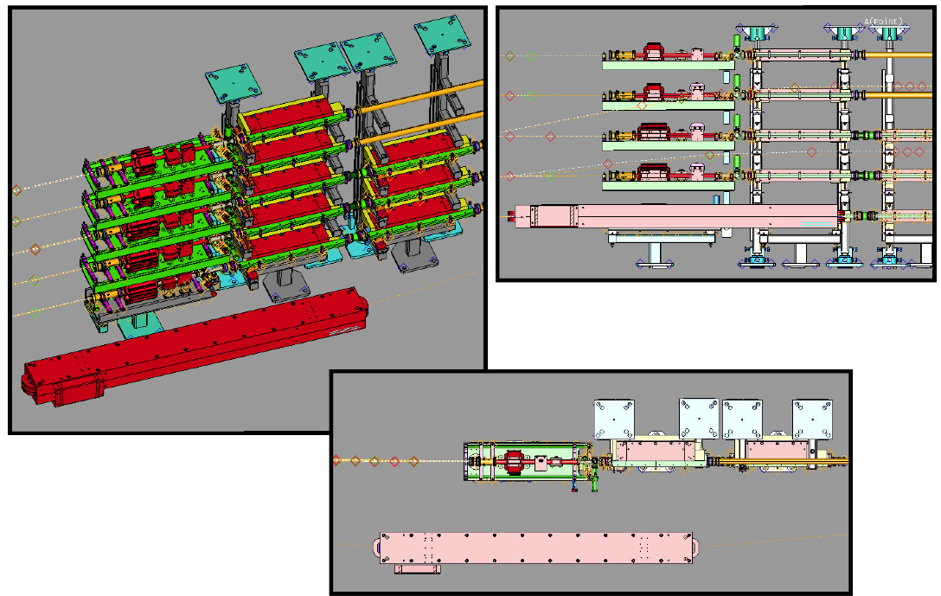
Pathlength Chicane: AE02 region
Use 3m magnets procured from Cornell/CESR upgrade Oct 2018
No cryomodule passthrough clearance necessary
C. Dubbe

Slide 16
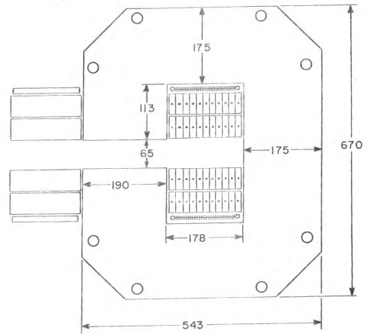
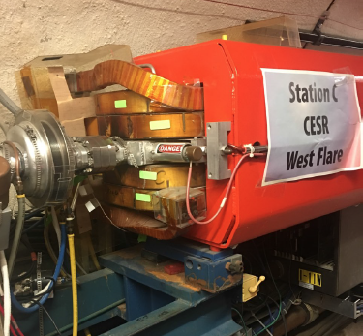
CESR Magnets
Possible magnets offered from Fermilab, CERN, Cornell
Four 3m CESR dipoles finally found to be best fit
  Excessed by Cornell summer 2018
    part of CESR/CHESS DBA upgrade
  procured by JLab for modest costs
    shipping and minor handling, few $k
  Documented for ER@CEBAF use in JLAB-TN-18-030
    June 2018
Suitable for pathlength chicane
  Excess aperture vs spec
  Correct lengths, transfer fns
  $200-250k project savings
September 2018 review suggestion:
  Investigate chicane on lower pass (less invasive?)
Dimensions
in [mm]

Slide 17
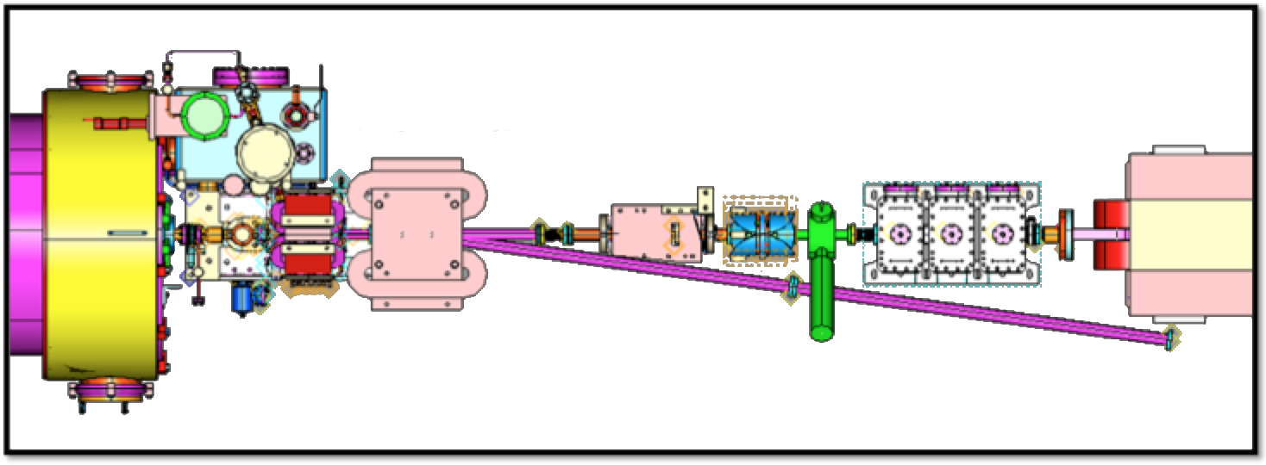
Dump Extraction Detail
BPM + H/V Correctors
BL magnet
CA magnet
DP station
8° bend
MQL quad
Pathlength cavity
Existing area has corrector / BPM / quad downstream of 2L27 C100 cryomodule
  No additional apertures or points of failure created
  Dump line diagnostics angled away from C100 cone
  BL magnet failure only affects ER@CEBAF capability
M. Spata

Slide 18
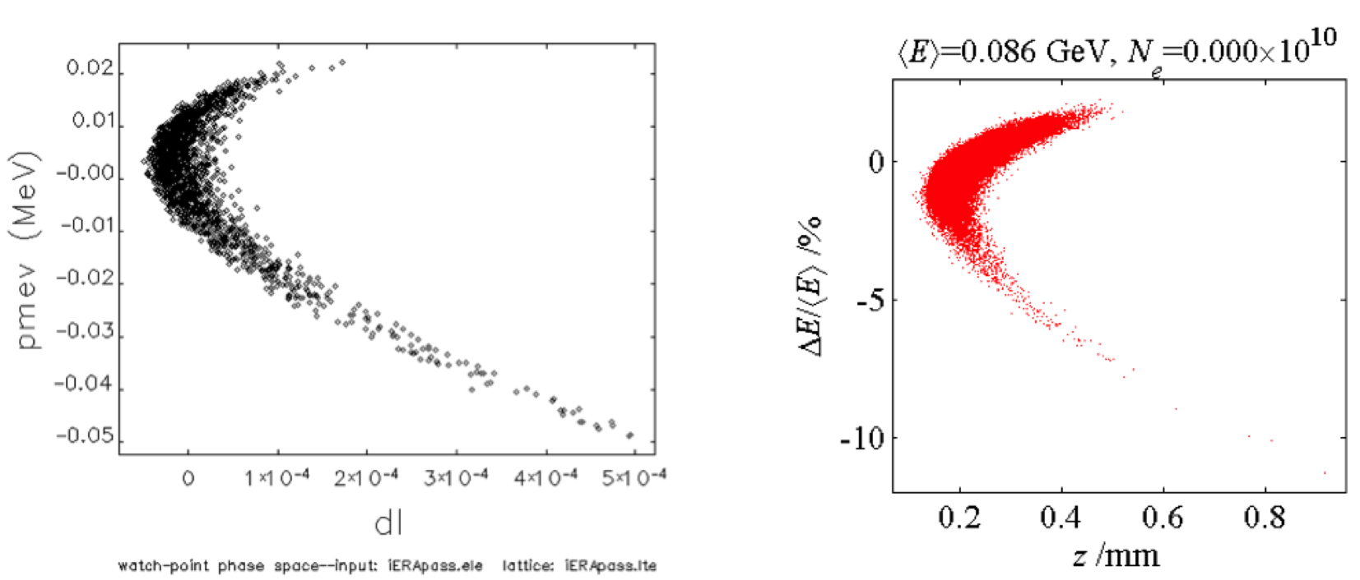
Longitudinal Simulations and Match
Collaboration with BNL using four accelerator simulation codes to verify optics design
  Manipulate bunch length and compression
  Associated benefits to CEBAF parity quality program, CEBAF energy spread control
elegant
LiTrack
Beam energy/longitudinal position distributions after energy recovery
Y. Roblin

Slide 19
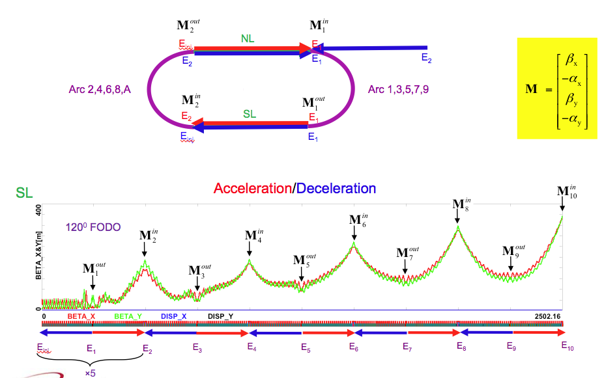
Optimized Recirculation Linac Optics
A. Bogacz: APS SLC 2016 Talk

Slide 20
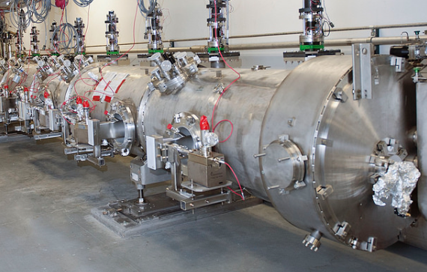
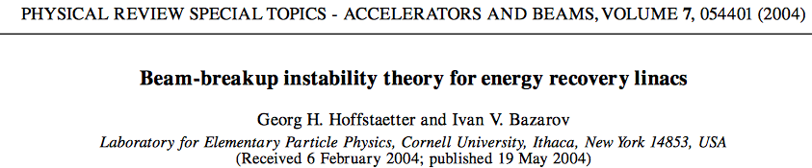
Recirculating Beam Breakup (BBU)
Recirculating beam breakup
  Positive feedback loop between beam power and higher order mode RF power
  Couples through beam transport
  Many RF higher order modes communicate with beam, each other in near-exponential complexity
  Limits total beam current
Open questions in literature
  Hoffstaetter/Bazarov PRST:AB: Scale as N_{pass} or N_{pass}² ?
  May only be answerable experimentally
  ER@CEBAF SRF scale is ideal test bed
    E.g. C100 warm HOM damper loads accessible
http://journals.aps.org/prab/abstract/10.1103/PhysRevSTAB.7.054401

Slide 21
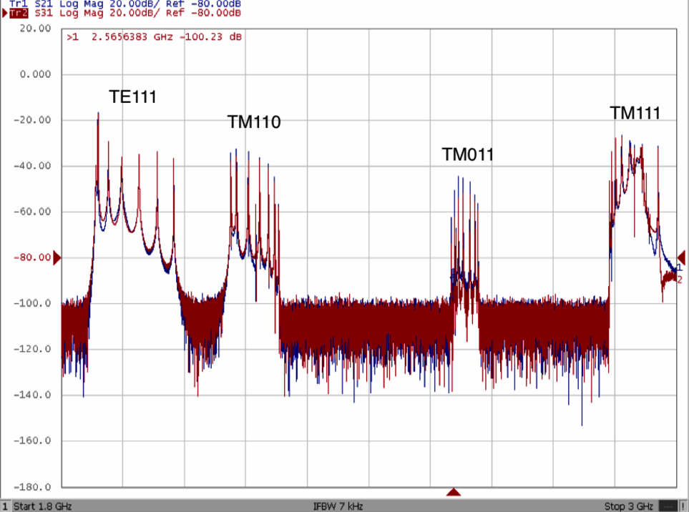
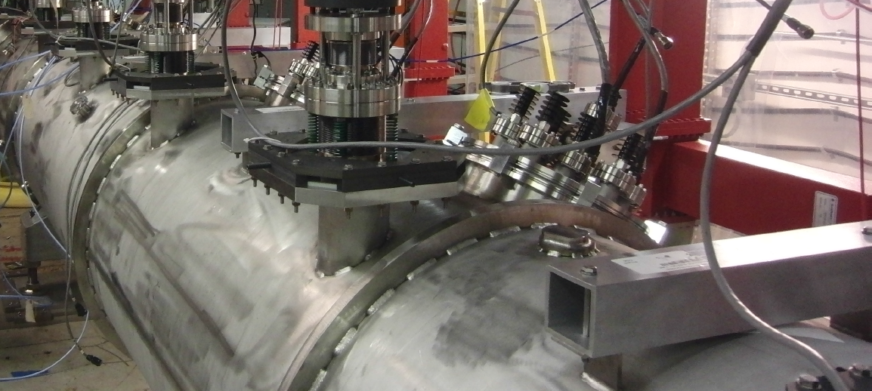
BBU Measurements: C100 Warm HOM Loads
1.5 GHz
3.0 GHz
C100 HOM, BBU experiment: Ilkyoung Shin’s PhD thesis (2013)
Surveyed HOMs using warm coupler ports in CMTF, tunnel
  With and without beam loading, varying recirculation optics
Based on techniques described in Chris Tennant’s thesis (2006)
HOM power and BBU measurements are accessible
Can we drive BBU instability in ER@CEBAF with existing beam?

Slide 22
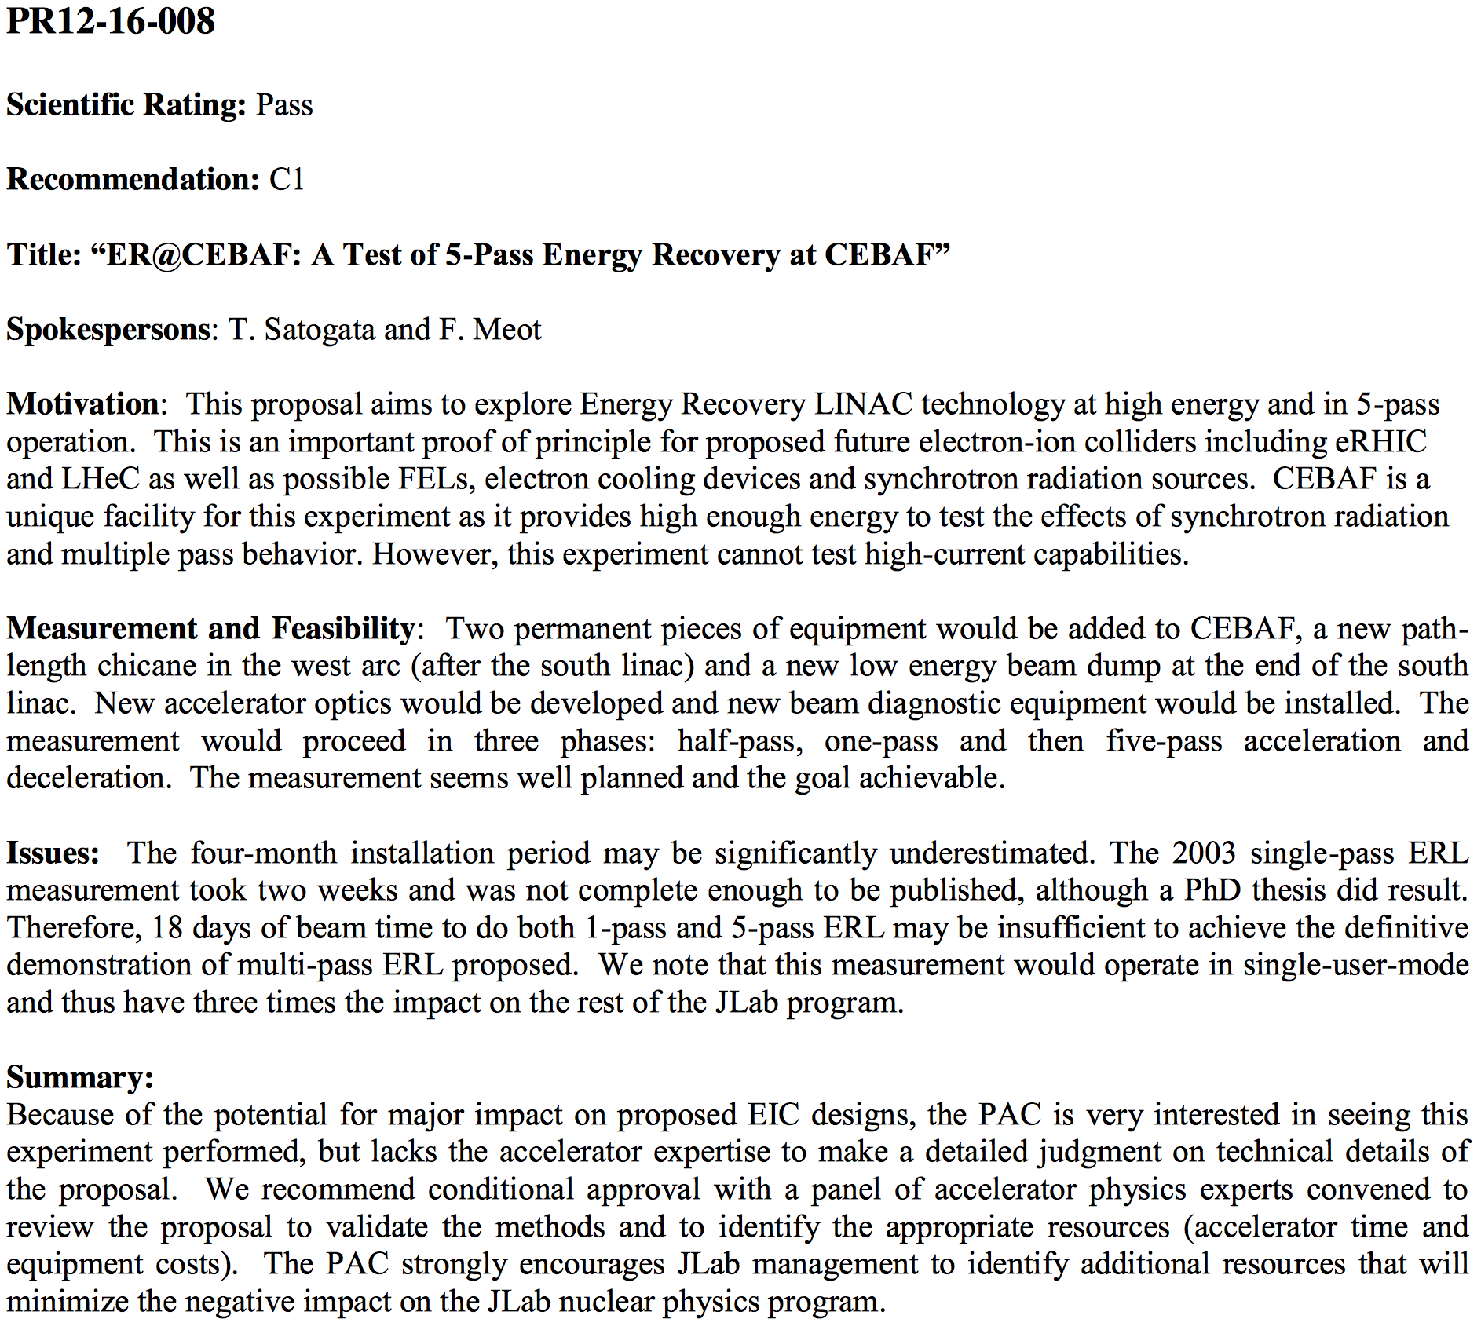
Jefferson Lab 2016 Program Advisory Committee Review
Jefferson Lab 2016 PAC proposal
  PR12-16-008
Scientific rating: Pass
Recommendation: C1 (conditional)
  “We recommend conditional approval with a panel of accelerator physics experts convened to review the proposal to validate the methods and to identify the appropriate resources (accelerator time and equipment costs). The PAC strongly encourages JLab management to identify additional resources that will minimize the negative impact on the JLab nuclear physics program.

Slide 23
Jefferson Lab 2018 Accelerator Advisory Committee Review
Director’s review of accelerator division, September 2018
Committee comprised of accelerator physicists
Supported in draft closeout comments
Awaiting final committee report
  “It is suggested to further optimize the design of the proposed experiment, e.g. the location of the chicane may be optimized to minimize interference with CEBAF nuclear physics running. The committee supports consideration of the experiment.”
  Oliver Brüning particularly interested in experimental opportunities in support of LHeC design

Slide 24
Summary
High energy ERLs are a required technology for affordable, high-quality, high power electron beams
  Required for future high-energy EIC designs
  Energy frontier exploration requires large facility
CEBAF is a unique facility to study energy recovery of high energy, disrupted beams in a large installation
  Synchrotron radiation: graceful energy scaling
  Design in hand to add capability to CEBAF 12 GeV facility without affecting base program
  Net project cost ~$500k after Cornell dipole donation in 2018
  Optics optimization, BBU studies accessible
A positive collaboration between Jefferson Lab and BNL for ERL studies at CEBAF
Supported by Jefferson Lab PAC (2016) and accelerator advisory committee (2018)
ER@CEBAF will continue Jefferson Lab’s world leadership in high energy ERL beam and RF studies

Slide 25
====== BACKUP SLIDES ======

Slide 26
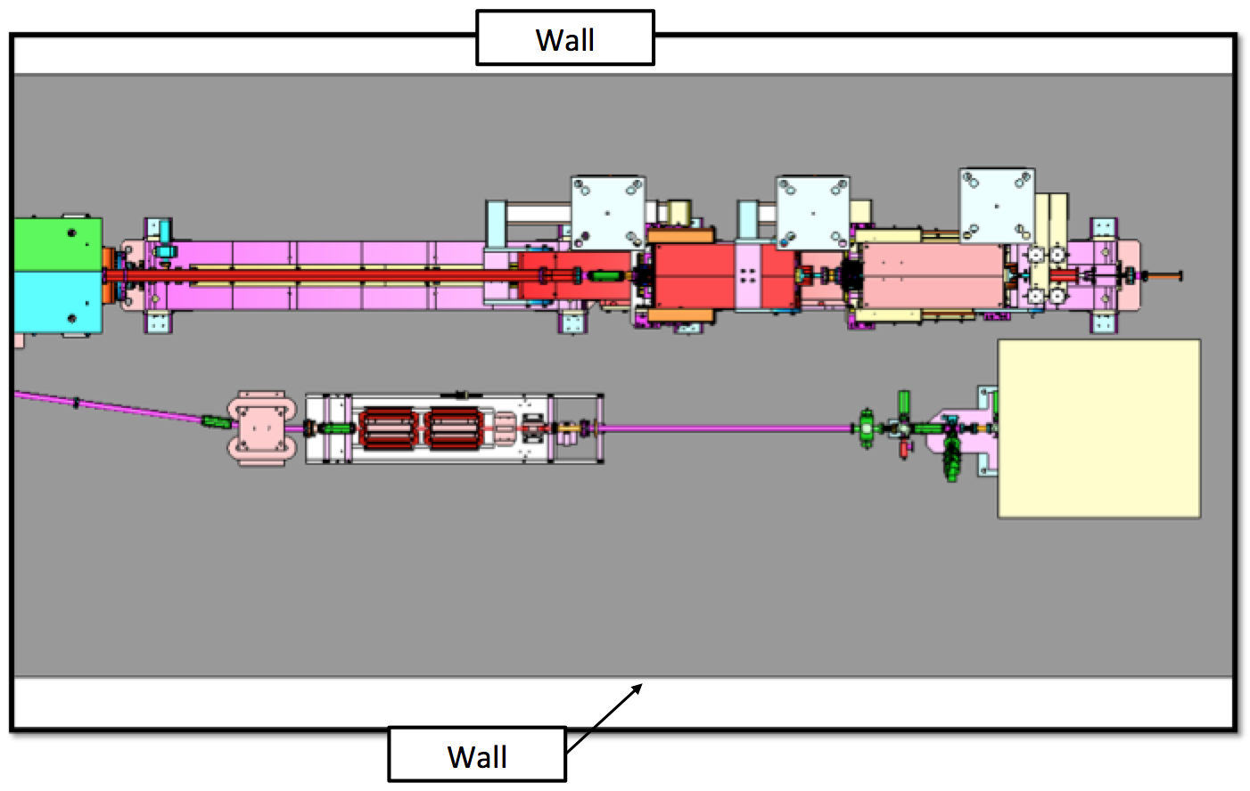
Dump Traffic Clearance
Dump line maintains clearance for magnet carriage clearance
  Cryomodule carriage clearance not required in this area
  ER@CEBAF would not interfere with expected tunnel traffic
41”

Slide 27
Optimized Linac Optics
Acceleration/Deceleration
‘Drift Linac’
E_{inj}
E₁
E₂
E₃
E₄
E₅
E₆
E₇
E₈
E₉
E₁₀
60⁰ FODO
A. Bogacz
E_{inj}
E₁
E₂
E₃
E₄
E₅
E₆
E₇
E₈
E₉
E₁₀

Slide 28
Diagnostics and Measurements: BPMs
Linac SEE BPM extension
  Current linac SEE BPMs temporally multiplex 5-6 passes of beam
  Feasible to extend to 10 passes with software and beam pulse structure modification
3 GHz BPMs
  Six modified SEE BPMs (3 each Arcs 1 and 9)
  Establishes accelerating/decelerating energy ratios
  Wire scanners resolve both accelerating and decelerating beams
  No other decelerating arc BPMs
    no steering degrees of freedom
  Have demonstrated bench prototype

Slide 29
Diagnostics and Measurements: Dump
Extraction beam measurements
  Leverage well-calibrated Hall A dipole system
  IHA1C12 and viewer provide energy spread
  Emittance measurements in zero-dispersion 2C line
  All measurements feasible each even pass up/down
Dump line includes full diagnostics suite
  Three BPMs for steering
  Two quadrupoles for focus/emittance measurements
  MPS BCM for total beam transmission
  Viewer for dump beam images

Slide 30
Phased Hardware Commissioning
½ pass: NL accelerating, SL decelerating
  Commission dump line extraction, diagnostics
  Compare injection / dump line beam characterization
  1-2 days
1 pass: reproduce 2003 ER experiment results
  Requires first pass beam passing through Arc A
  Commission pathlength chicane, Arc 1 3 GHz BPMs
  Demonstrate intermediary beam diagnostics
  Evaluate MOMOD pathlength control tolerances
  3-4 days (took 1.5 days in 2003 experiment)
  Preferably E_{inj} = 56 MeV (same as 2003), E_{linac}=500 MeV
  Does not require changes to arc optics

Slide 31
Phased Hardware Commissioning
5 pass (E_{linac} up to 750 MeV, E_{inj} up to 85 MeV)
  Commission new arc optics, longitudinal beam manipulations
  Commission Arc 9 3 GHz BPMs, 10-beam BPM software
  Further demonstrate intermediary beam diagnostics
    Use 500 MHz separators at start of west arcs
  Perform tuning tolerance studies
  Demonstrate full decelerating beam transport
  Perform RF tuning studies
  Demonstrate CW energy recovery
  ~14 days of tuning and characterization

