Slide 1

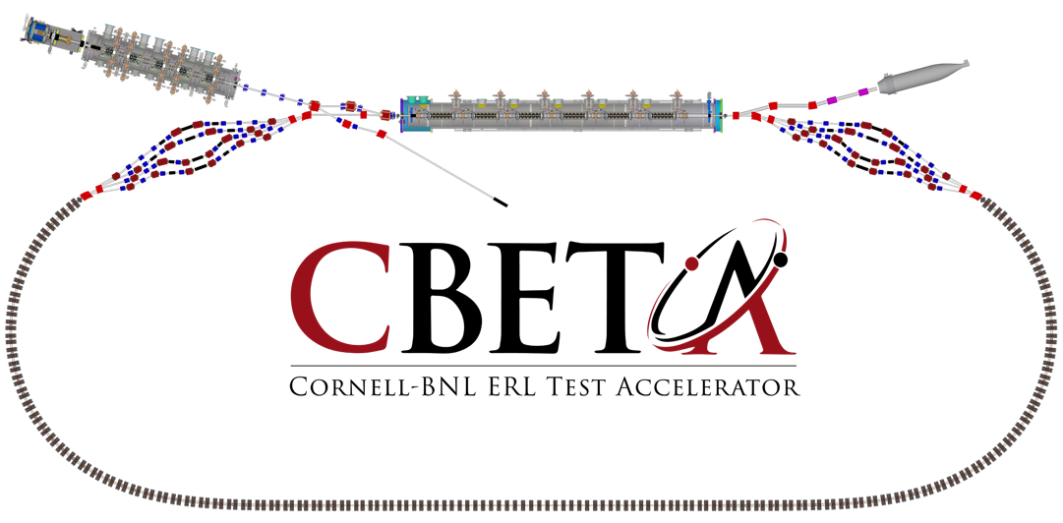



CBETA for EIC R&D
JLAB, 2 November 2018
Georg Hoffstaetter (Cornell)

Slide 2
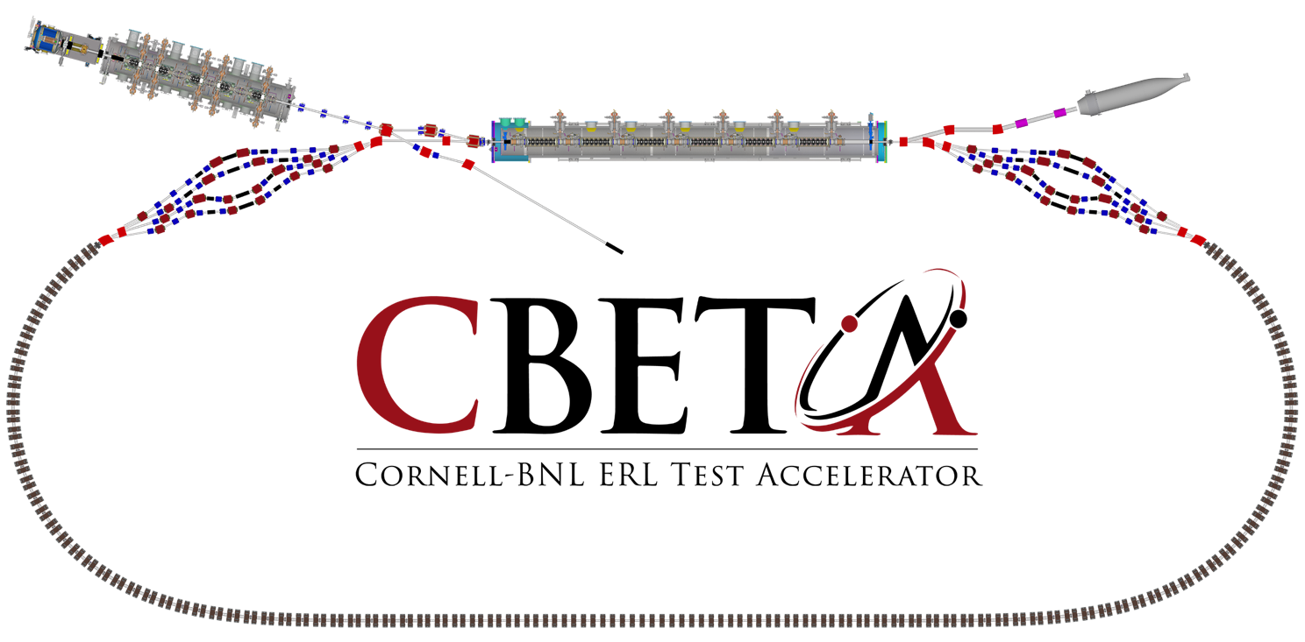
The test ERL in Cornell’s hall LOE
Cornell DC gun
100mA, 6MeV SRF injector (ICM)
600kW beam dump
100mA, 6-cavity SRF CW Linac (MLC)
Existing components at Cornell
6 MeV
6 MeV
+/- 36 MeV
Electron Current up to 320mA in the linac
Bunch charge Q of up to 2nC
Bunch repetition rate 1.3GHz/N
Beams of 100mA for 1 turn and 40mA for 4 turns
42, 78, 114, 150 MeV

Slide 3
CBETA capabilities
The accelerator I am presenting has beam parameters of an EIC electron cooler and provides a prototype for such an instrument.
It is unique in that it
  is the first 4-turn SRF ERL
  has the first NS FFA loop with large (x4) momentum aperture
  has the first long-distance beam through Halbach magnets
  has the largest electron beam power in an ERL
It is being constructed in a Cornell/BNL collaboration and its main components have been beam-tested.
It is commissioned in a world-wide collaboration, incl. JLAB, and an international ERL Technology Collaboration formed that supports such work.
It has applications beyond EIC research

Slide 4
Key Performance Parameters and
Ultimate Performance Parameters
Parameter | Unit | KPP | UPP (Stretch)
Electron beam energy | MeV |  | 150
Electron bunch charge | pC |  | 123
Gun current | mA | 1 | 40
Bunch repetition rate (gun) | MHz |  | 325
RF frequency | MHz | 1300 | 1300
Injector energy | MeV |  | 6
RF operation mode |  |  | CW
Number of ERL turns |  | 1 | 4
Energy aperture of arc |  | 2 | 4

Slide 5
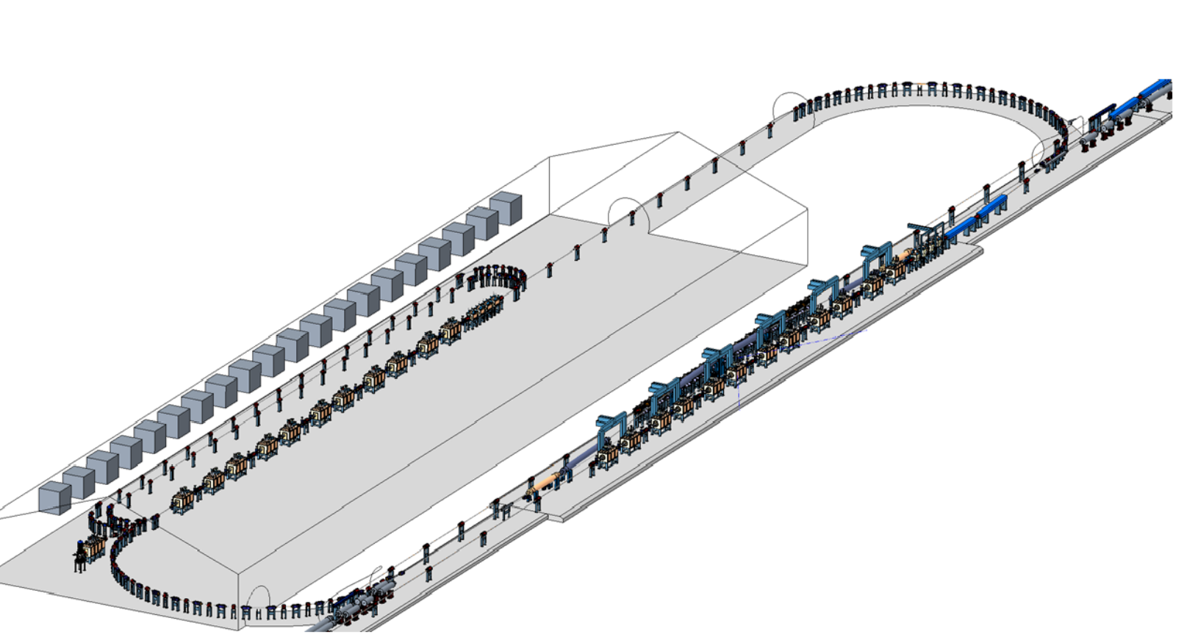
ERLs projects: Electron Ion Colliders
Strong Hadron Cooling for EICs
Both EIC projects, the one at BNL and the one at JLAB, plan to cool the hadron beam with electrons.
eRHIC cooler required beams:
Up to 100 mA CW electron beams at
up to 150 MeV
1-2.5nC, 1-10μm, <10-3
Note: 15MW !
JLEIC cooler: magnetized beam
3nC, 100mA, 100MeV, 10MW
Preserve low energy spread
Previous projects have concerned
High-power FELs
Coherent light sources
Lithography for chip production
Compton backscattering sources

Slide 6
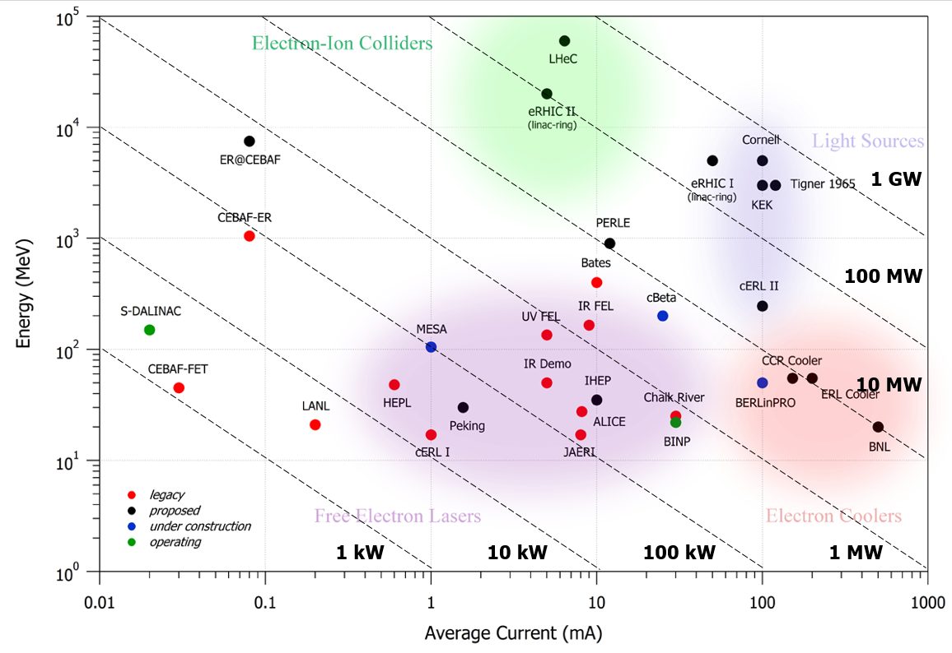
The beam power frontier
eRHIC cooler
CBETA has 150MeV and up to 40mA: 6MW beampower => Delete black
eRHIC cooler ERL has 150MeV and up to 100mA: up to 15mW

Slide 7
The beam power frontier
eRHIC cooler
Home projects of collaborators who joint in recent CBETA running

Slide 8
The path is free for CBETA
# | Milestone (at the end of months) | Baseline | Actual
 | Funding start date |  | Oct-16
1 | Engineering design documentation complete | Jan-17
2 | Prototype girder assembled | Apr-17
3 | Magnet production approved | Jun-17
4 | Beam through Main Linac Cryomodule | Aug-17
5 | First production hybrid magnet tested | Dec-17
6 | Fractional Arc Test: beam through MLC & girder | Apr-18
7 | Girder production run complete | Nov-18
8 | Final assembly & pre-beam commissioning complete | Feb-19
9 | Single pass beam with factor of 2 energy scan | Jun-19
10 | Single pass beam with energy recovery | Oct-19
11 | Four pass beam with energy recovery (low current) | Dec-19
12 | Project complete | Apr-20

Slide 9
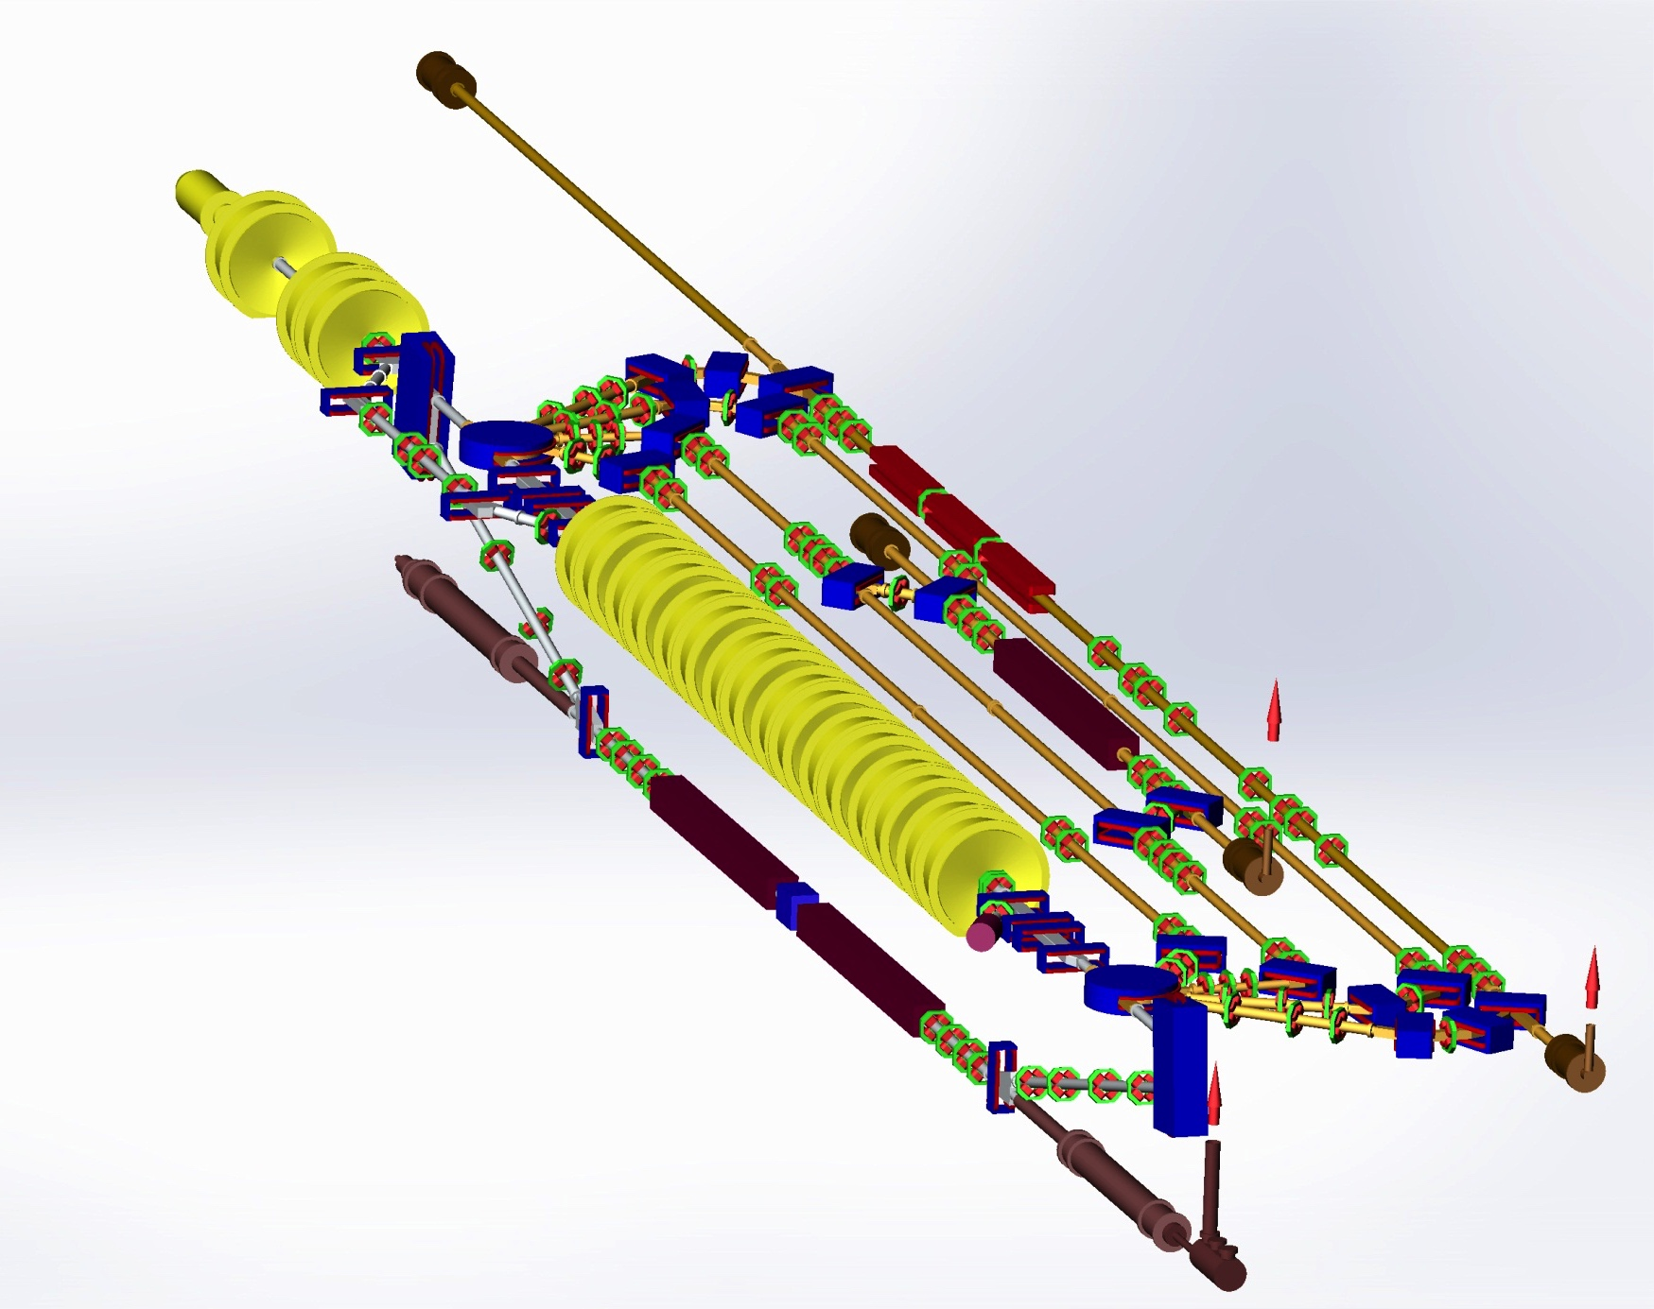
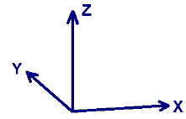
NovoFEL Accelerator Design
Gun
The third IR FEL
undulator sections
The second FEL
undulator
Injector
Main linac
The first THz FEL
undulator sections
Courtesy G. Kulipanov
Dump

Slide 10
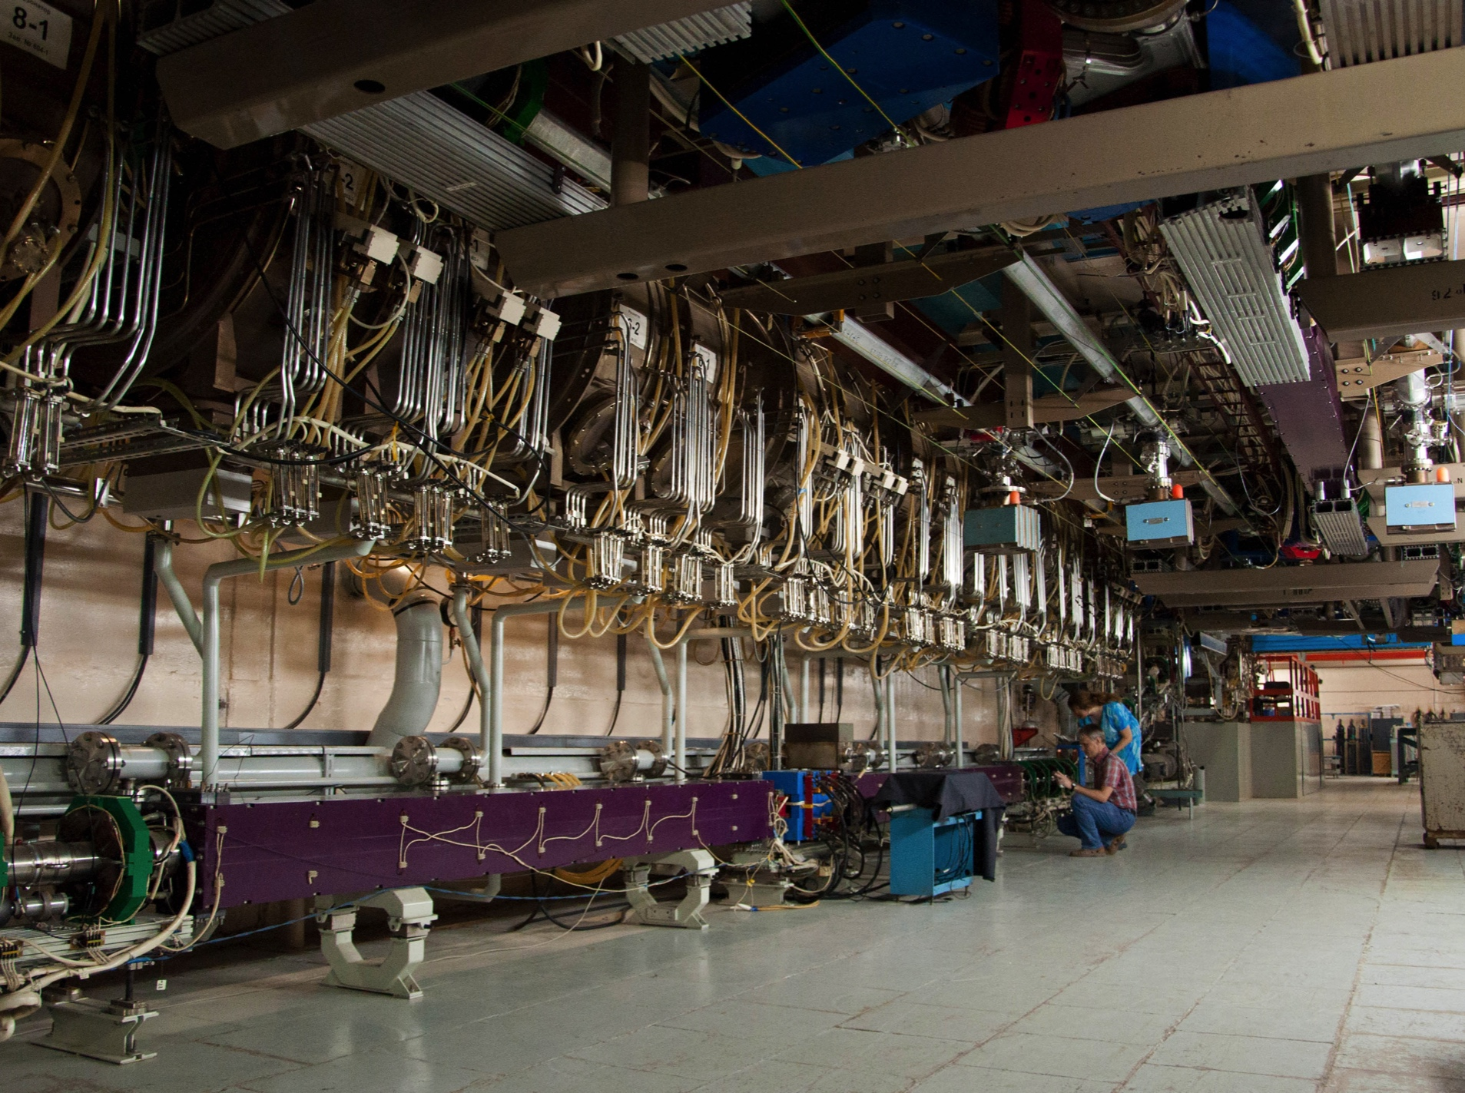
NovoFEL Accelerator Construction
Horizontal tracks
Courtesy G. Kulipanov
1st stage FEL
undulator
2nd stage FEL
undulator
Main linac

Slide 11
Toward high power at CBETA
It is after April 2020 that we can make a serious effort toward high current.
Challenging items (partly from past experiences with up to 75mA at the ERL injector)
  (1) Exceeded radiation limits outside the shielding wall.
  (2) Coupler field breakdowns in the ICM.
  (3) Vacuum breakdown in the gun.
  (4) Quantum efficiency of the cathode
Synchronization of all cavities
Microphonics control for SRF resonance frequencies
Precision alignments
Component limits, e.g. RF absorbers.

Slide 12
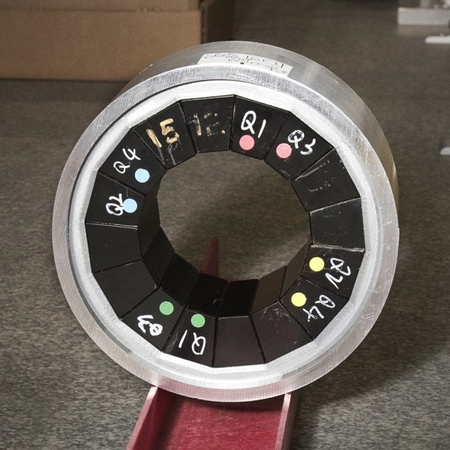
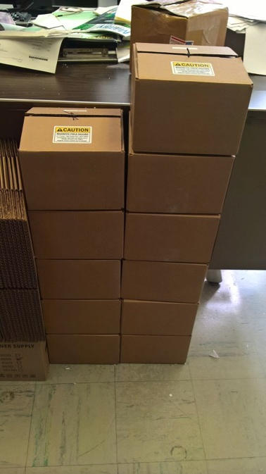
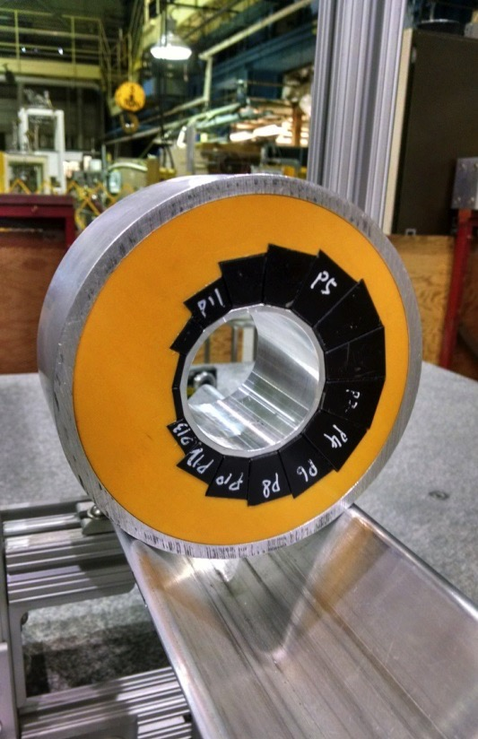
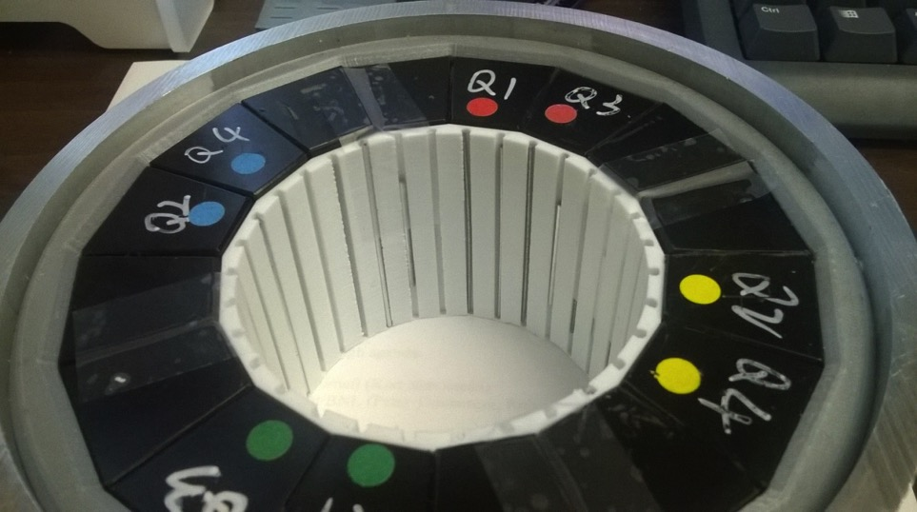
PoP QF
12 proof-of-principle magnets (6 QF, 6 BD) have been built as part of CBETA R&D.
Iron wire shimming has been done on 3 QFs and 6 BDs with good results.
PoP BD
PoP magnet series
Iron wire shims
January 30, 2017
Stephen Brooks, CBETA Technical Review
12

Slide 13
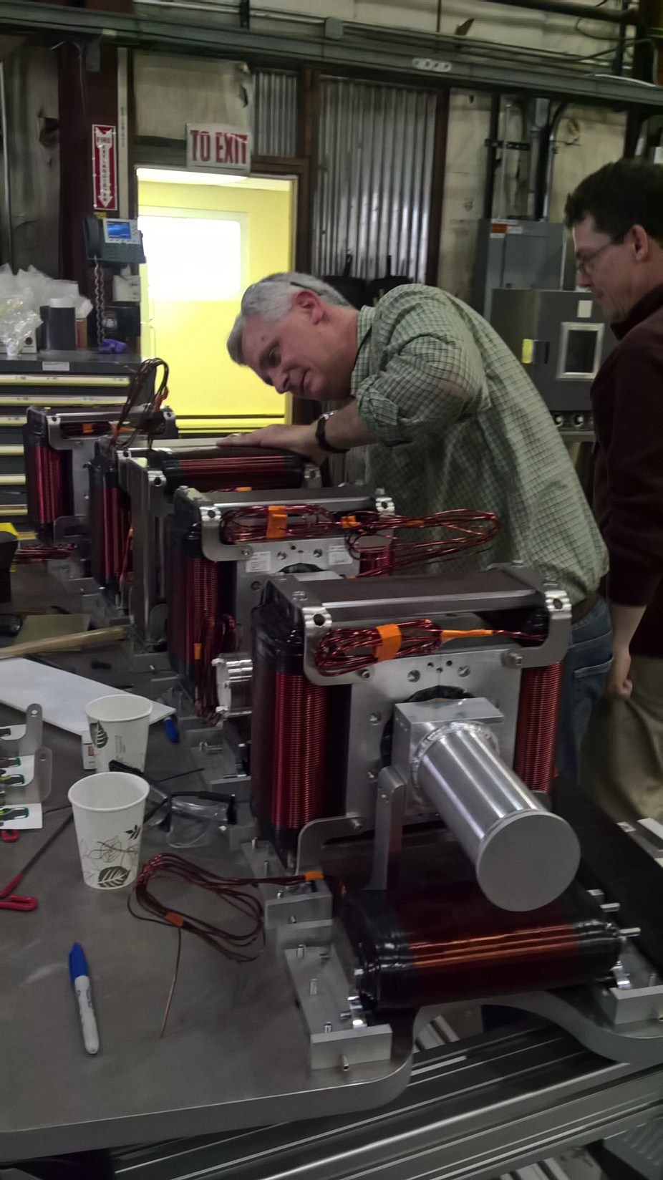
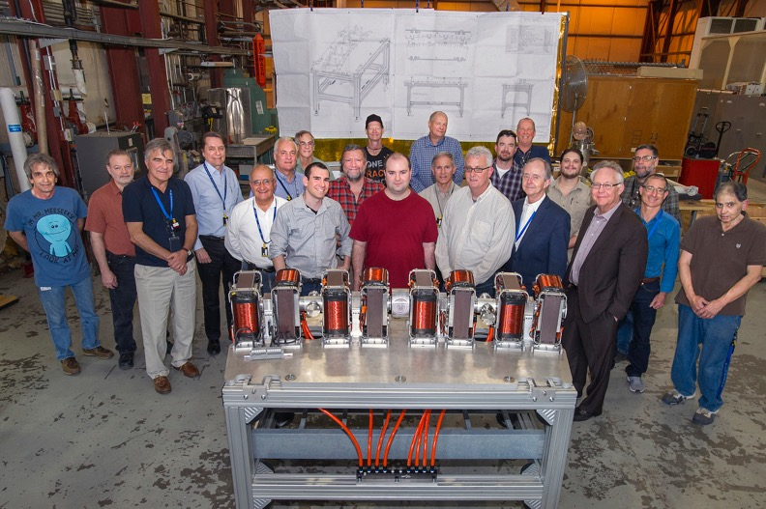
First Girder Construction

Slide 14
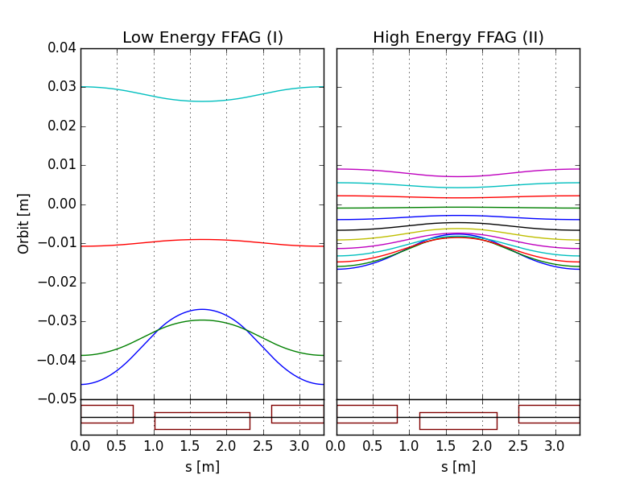
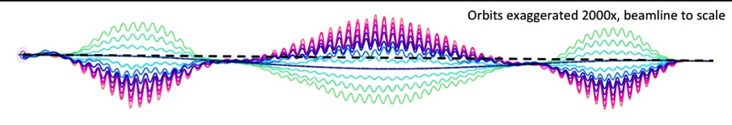
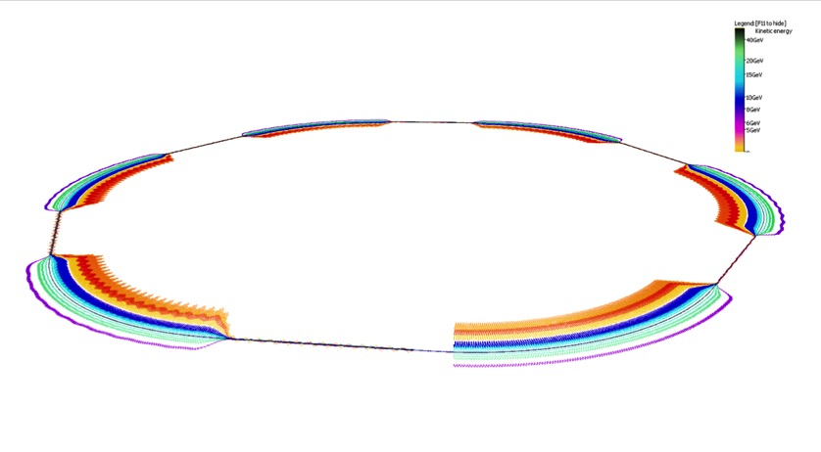
Multiple-beam orbits and optics
eRHIC uses two FFAG beamlines to do multiple recirculations.
(FFAG-I: 1.3-5.4 GeV, FFAG-II: 6.6-21.2 GeV)
All sections of a FFAG beamline is formed using a same FODO cell. Required bending in different sections is arranged by proper selection of the offsets between cell magnets (or, alternatively, with dipole field correctors).
Permanent magnets can be used for the FFAG beamline magnets (no need for power supplies/cables and cooling).
E=5.3 GeV
E=21.2 GeV
E=6.6 GeV
E=1.3 GeV
BD
QF
@S.Brooks, D.Trbojevic
Orbits in Detector bypass section
Quad offsets evolve adiabatically
Orbits in Transition section
Each of two eRHIC FFAGs contain 1066 FFAG cells

Slide 15
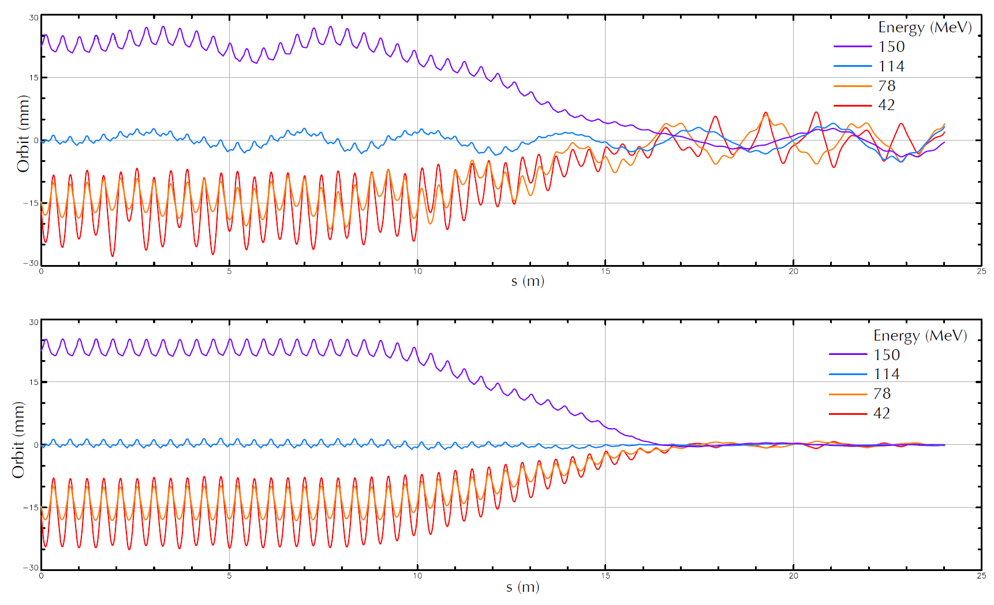
Orbit Correction of 4 Beams
Courtesy C. Mayes

Slide 16
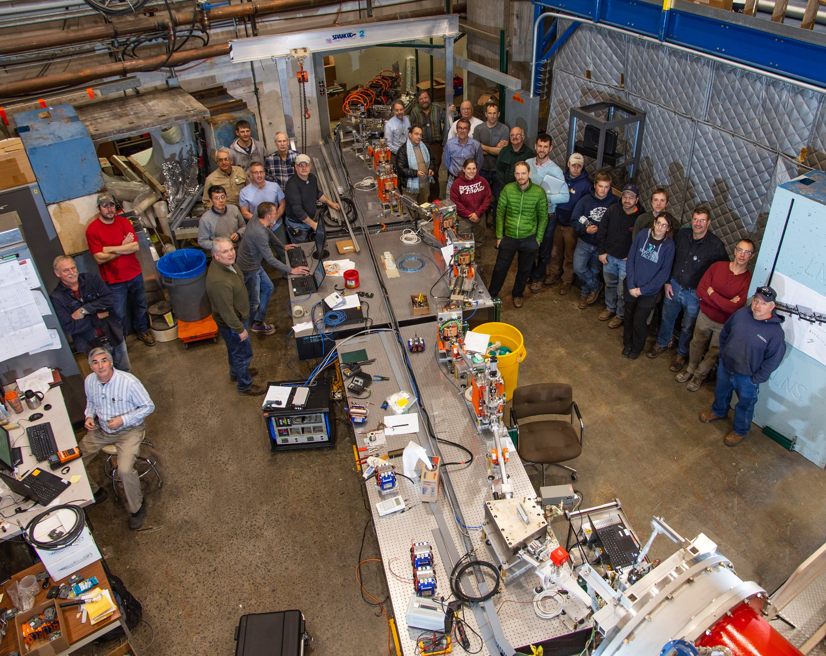
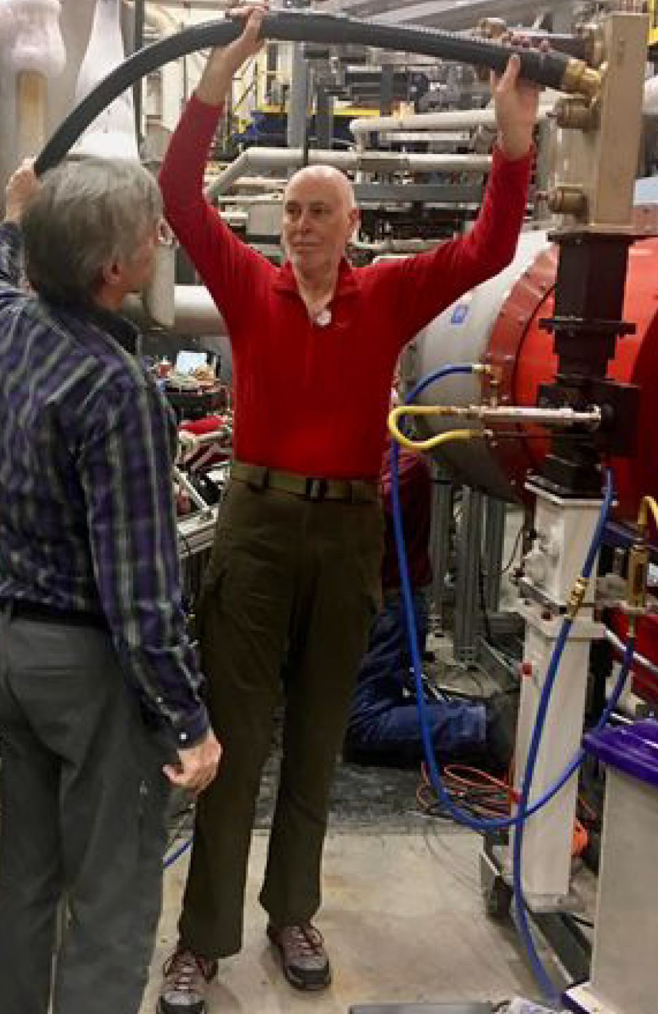
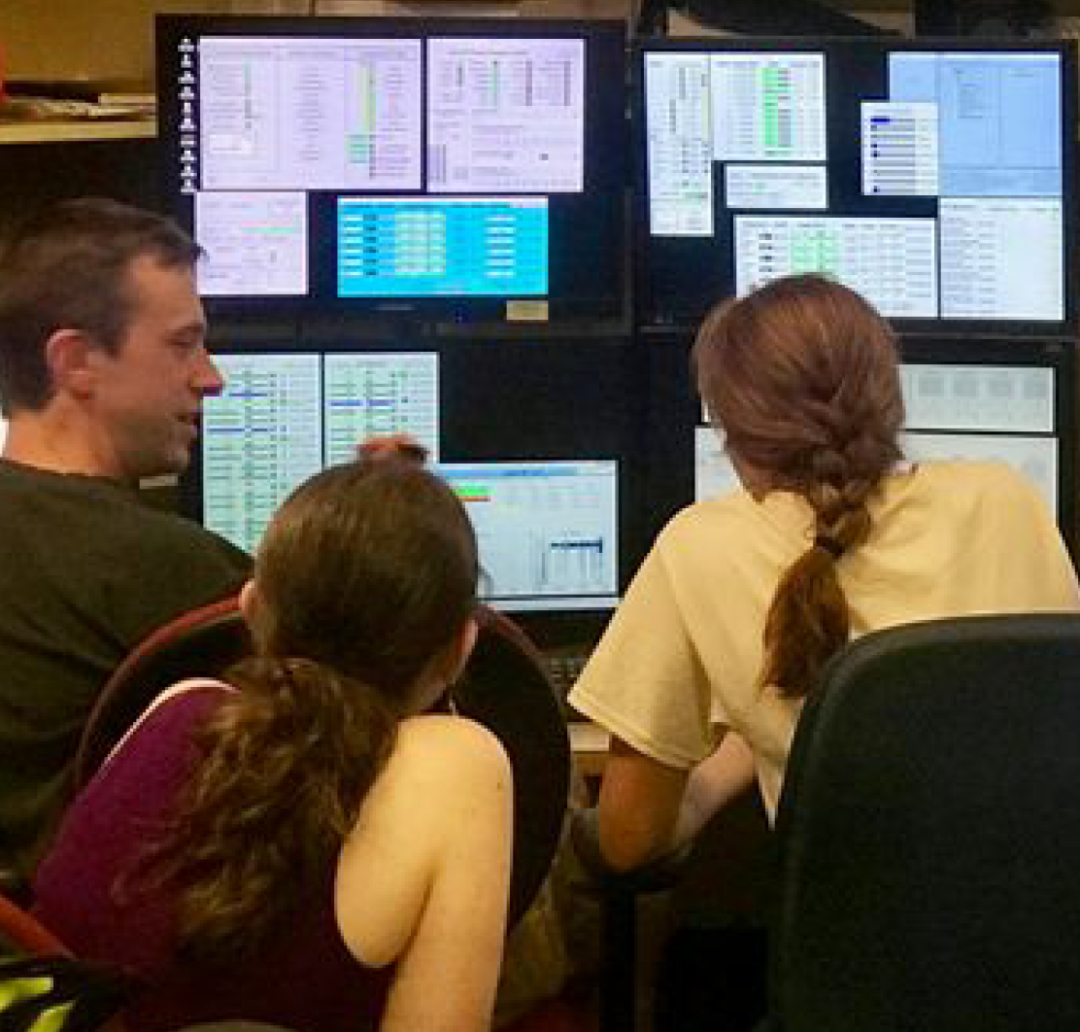
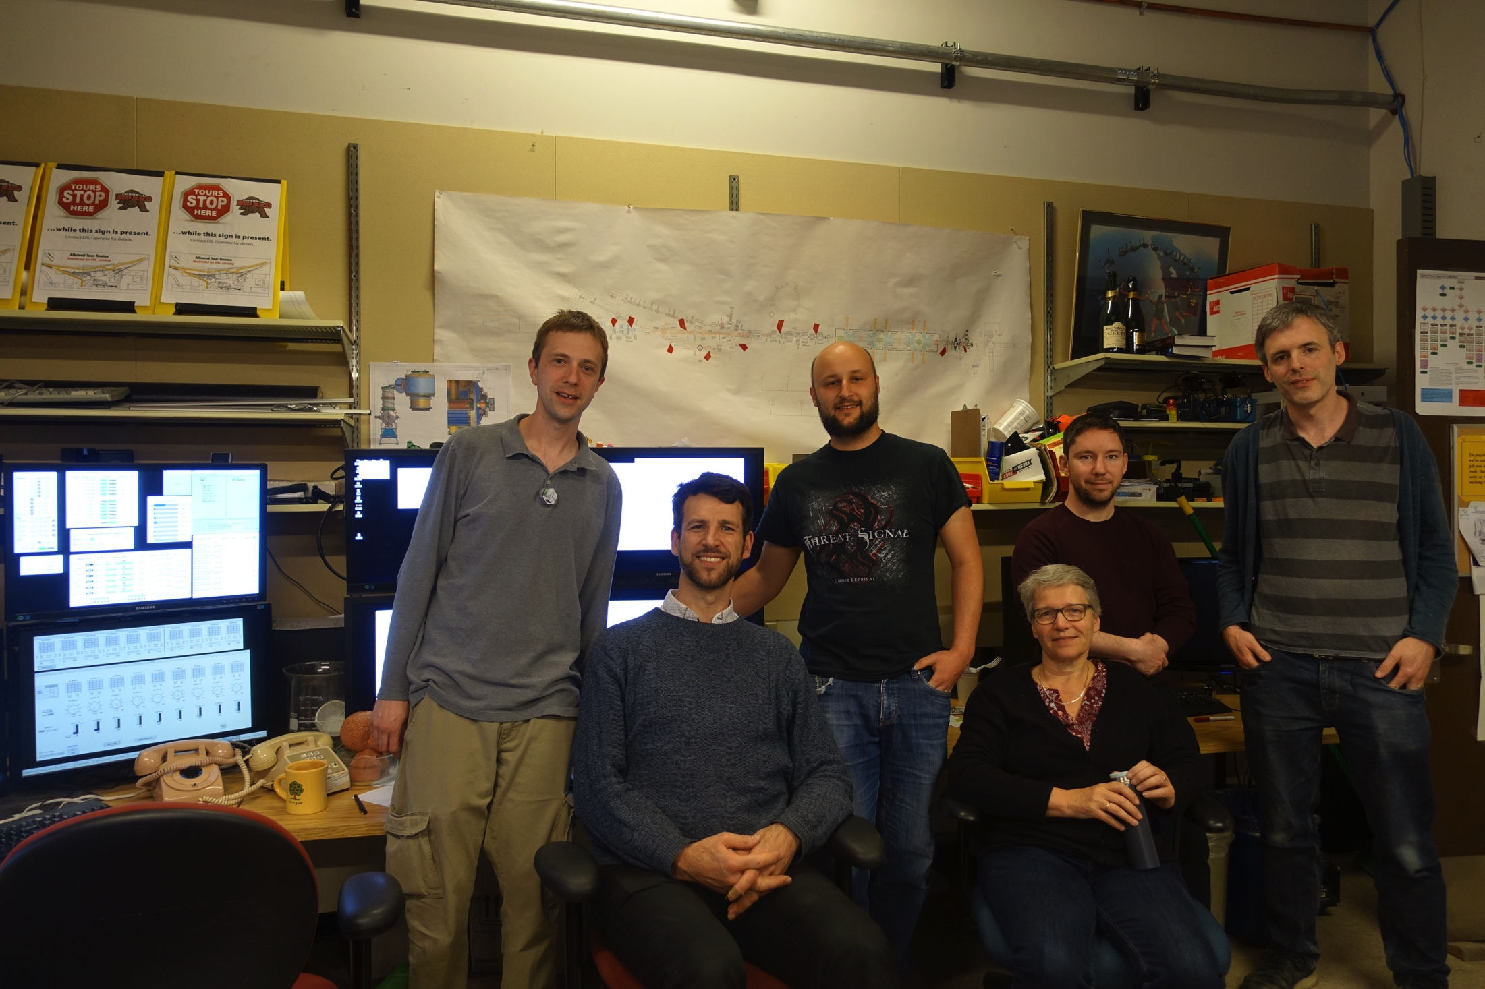

Main Linac Cryomodule
We encourage participation in the next commissioning period starting March 2019.
FFAG workshop 2017 visiting CBETA

Slide 17
Expected new challenges
Challenging new items toward KPPs (1mA)
  Beam loss, especially in the permanent magnet regions.
  Halo collimation
  BPM timing for multiple beams
  SRF stabilization
  SRF phasing with relativistically changing flight times.
  Orbit correction for multiple beams
  Operation without optics correction in the FFA section.
Challenging new items toward UPPs (40mA, 6MW!, 125pC {or 32pC})
  Beam loss on the 1/1000,000 level (40nA in order 500m)
  Note: Storage rings, e.g. CESR (1.5nA in order 500m)
  Demagnetization of permanent magnets
Challenges beyond UPPs (higher bunch charges)
  Microstructure in the bunch (microbunching, CSR, LSC, PCA)

Slide 18
CBETA is then ready for EIC R&D
Prototyping EIC cooling (unprecedented beam powers of 6MW)
1) ERL operation for high-power beams (note SNS @ 1.4MW, PIP-II@1-2MW)
Current limits (BBU instabilities and component heating, micro-bunching)
Startup scenarios
Simultaneous beam measurements
2) High-power beam propagation
- Beam micro structure that can prevent cooling (pointed out by CeC)
Loss monitoring, component protection, and shielding
Intra-beam and rest-gas scattering
Beam halo dynamics and halo detection
3) High-brightness beam production
CW electron sources and space-charge dynamics, including dark currents
High-current polarized beams (see presentation by Luca Cultrera)
4) Low-emittance-growth beam propagation
High precision magnets
High precision beam dynamics control
Control of energy spread and energy stability
Other EIC topics, e.g. for a linac-ring collider.

Slide 19
Ideas for next-phase CBETA proposal
Push CBETA current at 150MeV and 100MeV toward 40mA.
Develop halo diagnostics for high current and high bunch-charge running.
Develop CSR and micro-bunching diagnostics.
Develop time-resolved beam-loss diagnostics for post-mortem loss analysis.
Simulate bunch-charge limites for CBETA.
Simulation of a magnetized gun before the Injector
Operate CBETA with increased bunch charge, pushing toward 1nC.
Design and build of HOM couplers that allow for more beam in ERLs.
Use CBETA as a beam-test facility for EIC cryomodules
Design and build a beam-extraction line for the highest energy beam.
Experiments for beam extraction:
  (a) Drive the highest-energy beam to large orbit for only the highest-energy beam.
  (b) Measure demagnetization of a small permanent extraction magnet.
12) Test a fast kicker for the beam accumulation in the JLEIC cooler.
13) Install a magnetized gun from JLAB for beam tests.
14) Microbunching instability tests at CBETA.
15) Creation of a magnetized beam from a not-magnetized gunk by longitudinal to transverse emittance exchange.

Slide 20
Questions?

Slide 21
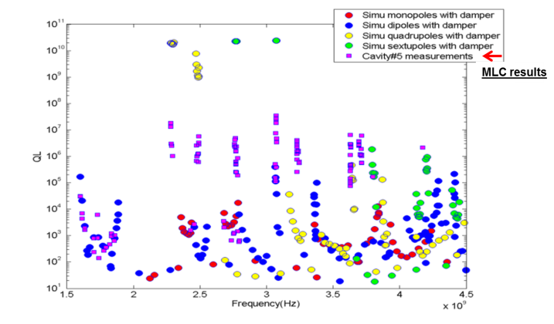
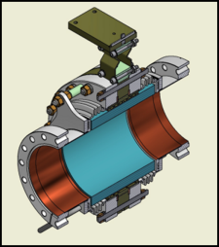
Current limits from HOMs
Dipole HOMs on MLC were strongly damped below Q~10⁴.
Consistent with HTC and simulation results.
HTC results were:
HOM heating: currents are limited to < 40mA in CBETA
BBU no HOM limits BBU to below 100mA in one turn

Slide 22

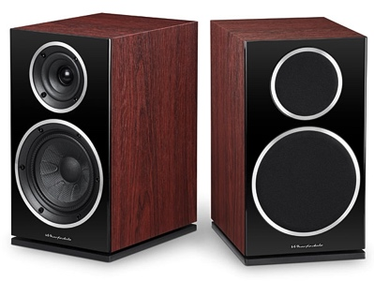
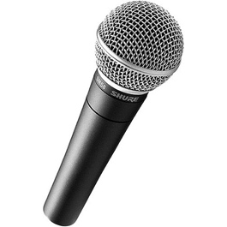
New current limit
Beam break up: a potential limit to ERL currents
Higher Order Modes
=

Slide 23
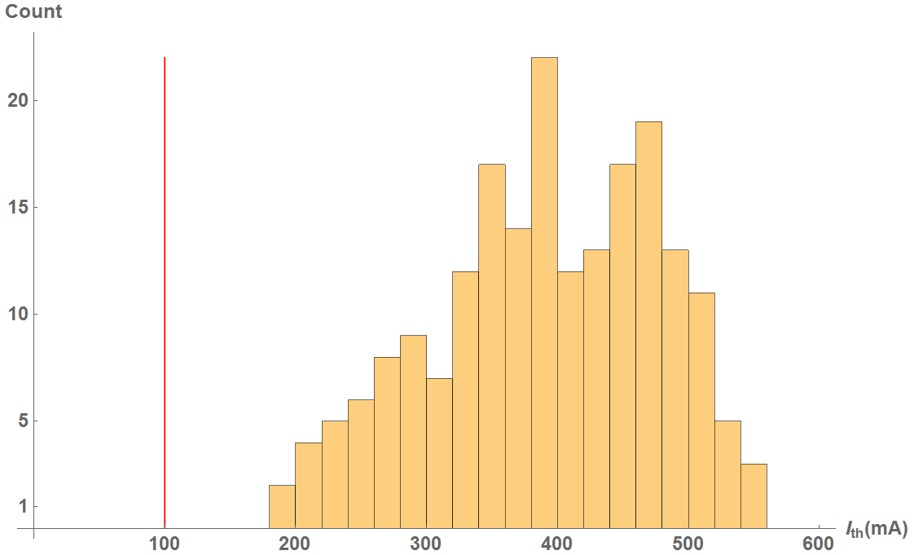

BBU for 1 pass in CBETA
CBETA 1-pass
Cavity shape error: 125 μm
100% of simulations have > 100mA

Slide 24
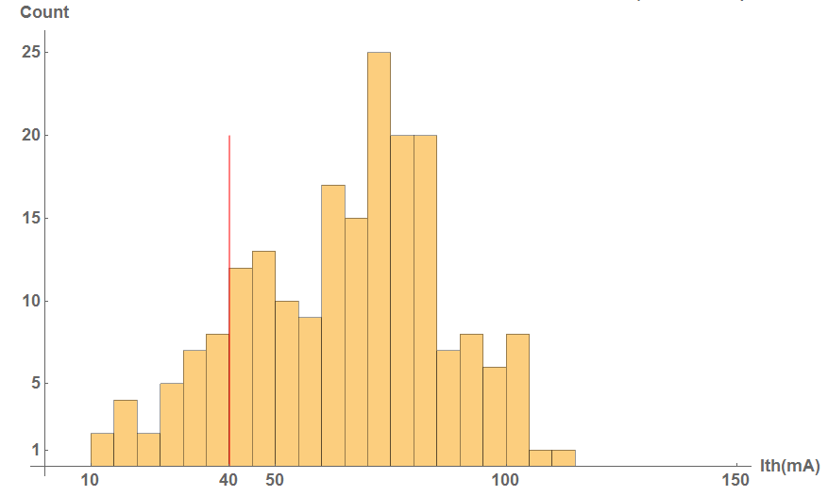
BBU for 4 passes in CBETA
CBETA 4-pass
Cavity shape error: 125 μm
x/y coupling is simulated to increase the threshold significantly
100% of simulations have > 100mA
86% of simulations have > 40mA

Slide 25
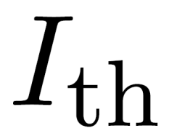
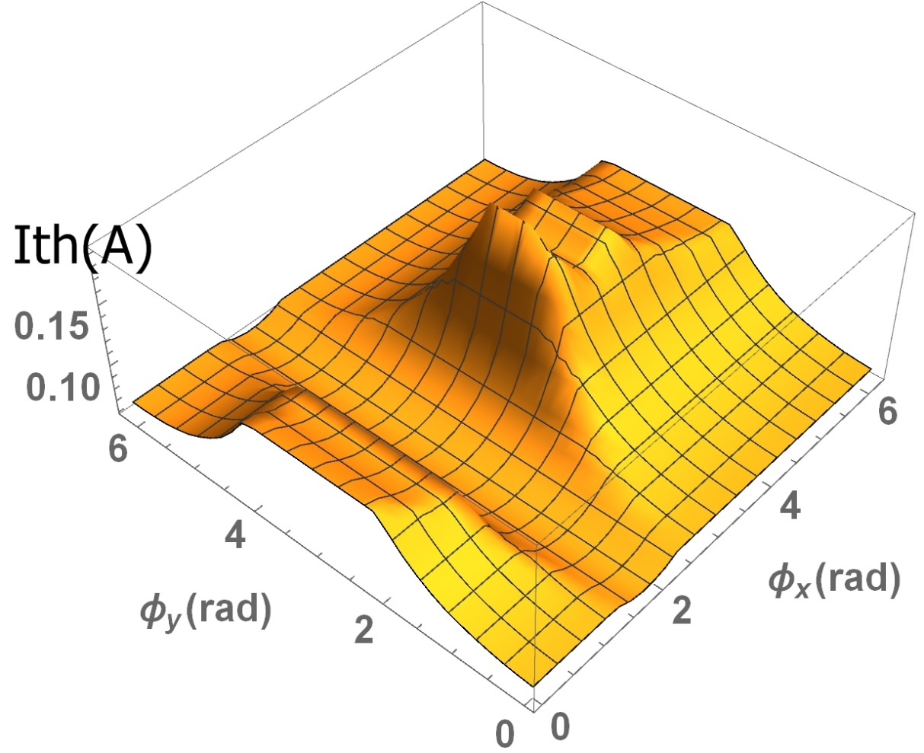

4-path ERL with variable phases
Min = 61 mA
Max = 193 mA
Nominal = 69 mA
results can improve

Slide 26
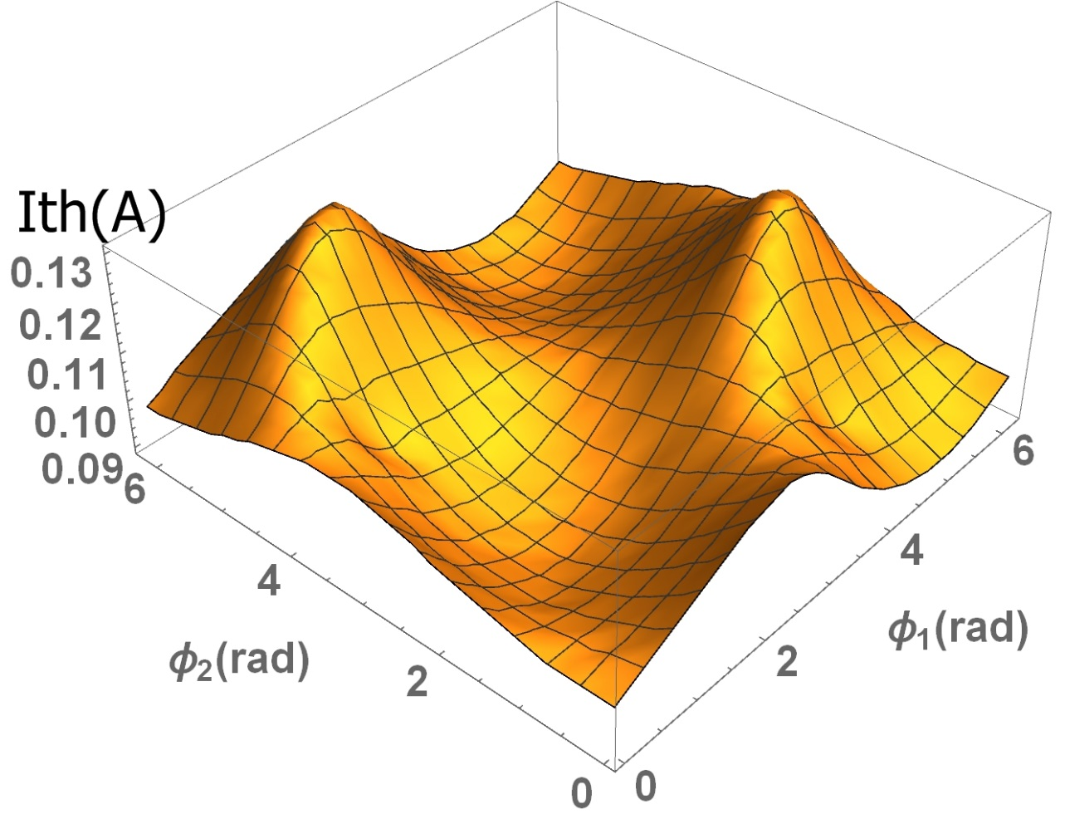
4-path ERL with x/y coupling
Min = 89 mA
Max = 131 mA
Nominal = 69 mA
results can improve
Conclusion: In 1-path ERLs the benefit from coupling and phase optimization can be significant. In multi-turn ERLs this benefit is much diminished.

Slide 27
Next-order BBU
Don’t forget that there is
Transverse Dipole BBU that is often considered and there are good codes
Longitudinal BBU
  contained in the BMAD simulation code
  It is important because they excite monopole (accelerating) modes with very large Q
  Is minimized by T56=0 for all cavity couplings
  Phase and time-of-flight tricks need to be checked against this instability.
Quadrupole BBU
  - Is important because the frequencies of the lowest order Quadrupole modes are below the first higher order dipole modes. Their Q can therefore be extremely large.
Higher-order multipole BBU: Check out the simple scaling formulas in [1]
  - Is usually benign if (C) is ok. But it can be important for similar reasons at (C).
[1] Recirculative BBU, G.H. Hoffstaetter in A. Chao, M. Tigner, Accelerator Handbook.

Slide 28
Beam dynamics specific to ERLs
ERLs provide: High currents for (a) either highly damaged beams or
(b) pristine beams (small emittance, small energy spread).
If the current is not high, use a linac!
If the beam is not pristine and not highly damaged, use a ring!

Slide 29
Beam dynamics specific to ERLs
ERLs provide: High currents for (a) either highly damaged beams or
(b) pristine beams (small emittance, small energy spread).
If the current is not high, use a linac!
If the beam is not pristine and not highly damaged, use a ring!
What are then the beam dynamics issues specific to ERLs?

Slide 30
Beam dynamics specific to ERLs
ERLs provide: High currents for (a) either highly damaged beams or
(b) pristine beams (small emittance, small energy spread).
If the current is not high, use a linac!
If the beam is not pristine and not highly damaged, use a ring!
What are then the beam dynamics issues specific to ERLs?
High current effects
  space charge
  halo dynamics
  HOM heating
  Intra-Beam Scattering
  Touschek scattering
  Rest Gas scattering
  Ion accumulation
    optics changes
    nonlinear dynamics
    scattering

Slide 31
Beam dynamics specific to ERLs
ERLs provide: High currents for (a) either highly damaged beams or
(b) pristine beams (small emittance, small energy spread).
If the current is not high, use a linac!
If the beam is not pristine and not highly damaged, use a ring!
What are then the beam dynamics issues specific to ERLs?
High current effects
  space charge
  halo dynamics
  HOM heating
  Intra-Beam Scattering
  Touschek scattering
  Rest Gas scattering
  Ion accumulation
    optics changes
    nonlinear dynamics
    scattering
Beam quality
  Emittance matching
  Time of flight control of energy spread
  Wakefield interactions
  Micro bunching instability
  Coherent Synchrotron Radiation
Transport of damaged beam
  Phase space rotation for energy spread
  Large 6-D phase-space aperture optics

Slide 32
Beam dynamics specific to ERLs
ERLs provide: High currents for (a) either highly damaged beams or
(b) pristine beams (small emittance, small energy spread).
If the current is not high, use a linac!
If the beam is not pristine and not highly damaged, use a ring!
What are then the beam dynamics issues specific to ERLs?
High current effects
  space charge
  halo dynamics
  HOM heating
  Intra-Beam Scattering
  Touschek scattering
  Rest Gas scattering
  Ion accumulation
    optics changes
    nonlinear dynamics
    scattering
Beam quality
  Emittance matching
  Time of flight control of energy spread
  Wakefield interactions
  Micro bunching instability
  Coherent Synchrotron Radiation
Recovery topics
  Energy spread growth during deceleration.
  Halo transverse growth during deceleration.
  Recirculative Beam Breakup instabilities.
    Transverse Dipole BBU
    Longitudinal BBU
    Quadrupole BBU
  Ion instabilities
  Simultaneous control of multiple beams
Transport of damaged beam
  Phase space rotation for energy spread
  Large 6-D phase-space aperture optics

Slide 33
Beam dynamics specific to ERLs
ERLs provide: High currents for (a) either highly damaged beams or
(b) pristine beams (small emittance, small energy spread).
If the current is not high, use a linac!
If the beam is not pristine and not highly damaged, use a ring!
What are then the beam dynamics issues specific to ERLs?
High current effects
  space charge
  halo dynamics
  HOM heating
  Intra-Beam Scattering
  Touschek scattering
  Rest Gas scattering
  Ion accumulation
    optics changes
    nonlinear dynamics
    scattering
Beam quality
  Emittance matching
  Time of flight control of energy spread
  Wakefield interactions
  Micro bunching instability
  Coherent Synchrotron Radiation
Recovery topics
  Energy spread growth during deceleration.
  Halo transverse growth during deceleration.
  Recirculative Beam Breakup instabilities.
    Transverse Dipole BBU
    Longitudinal BBU
    Quadrupole BBU
  Ion instabilities
  Simultaneous control of multiple beams
Transport of damaged beam
  Phase space rotation for energy spread
  Large 6-D phase-space aperture optics
What are the Beam Dynamic Issues for Multi-Turn ERLs?
➔ All of the above, only worse!

Slide 34
Multi-turn ERLs
ERLs provide: High currents for (a) either highly damaged beams or
(b) pristine beams (small emittance, small energy spread).
If the current is not high, use a linac!
If the beam is not pristine and not highly damaged, use a ring!
What are then the beam dynamics issues specific to ERLs?
High current effects
  space charge
  halo dynamics
  HOM heating
  Intra-Beam Scattering
  Touschek scattering
  Rest Gas scattering
  Ion accumulation
    optics changes
    nonlinear dynamics
    scattering
Beam quality
  Emittance matching
  Time of flight control of energy spread
  Wakefield interactions
  Micro bunching instability
  Coherent Synchrotron Radiation
Recovery topics
  Energy spread growth during deceleration.
  Halo transverse growth during deceleration.
  Recirculative Beam Breakup instabilities.
    Transverse Dipole BBU
    Longitudinal BBU
    Quadrupole BBU
  Ion instabilities
  Simultaneous control of multiple beams
Transport of damaged beam
  Phase space rotation for energy spread
  Large 6-D phase-space-aperture optics
What are the Beam Dynamic Issues for Multi-Turn ERLs?
➔ All of the above, only worse!

Slide 35
ERL - Internal target colliders
ERLs: Linear acceleration and deceleration to capture the energy of spent beam, like a linac but without the power limit on beam current, as spent beam provides the power. Loss rates have to be limited.
Dense internal targets, moderately high energies, high currents, small beam size.
ERLs provide a new niche of beam parameters: What physics can they be used for?
Lost beam power has to be available from power sources.
Target has length L, nuclei with charge Z.
Coulomb scattering and particle optics determine beam loss (at an aperture a with a maximal optical beta function)
ERL Target density limits:
Courtesy Chris Mayes

Slide 36
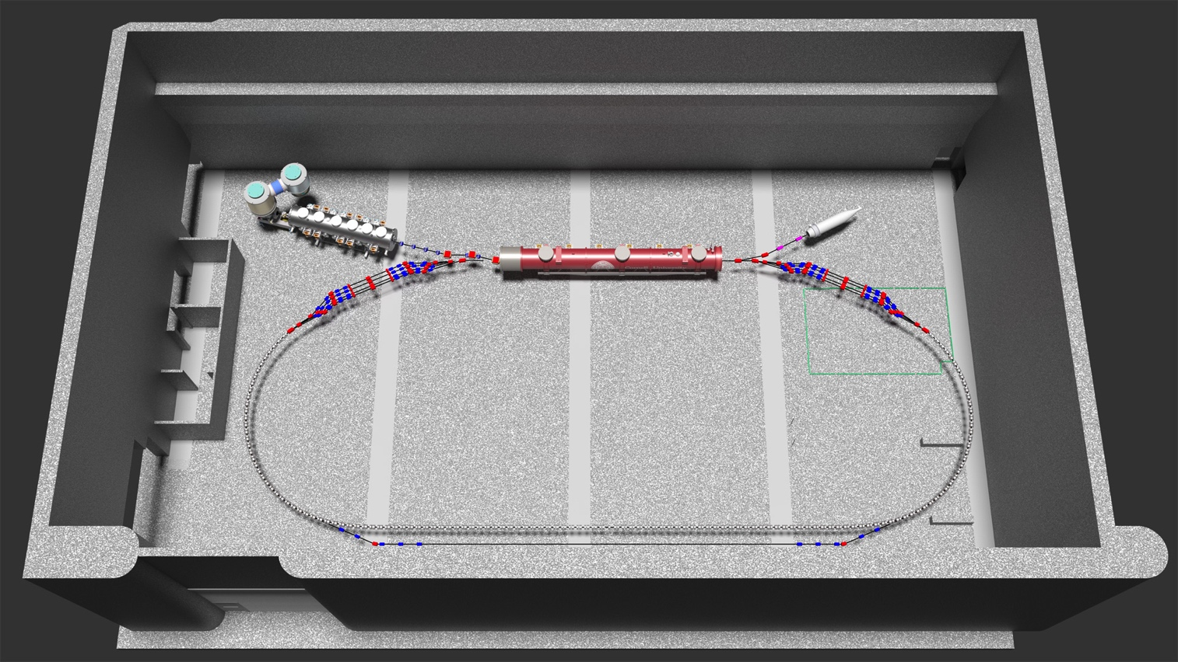
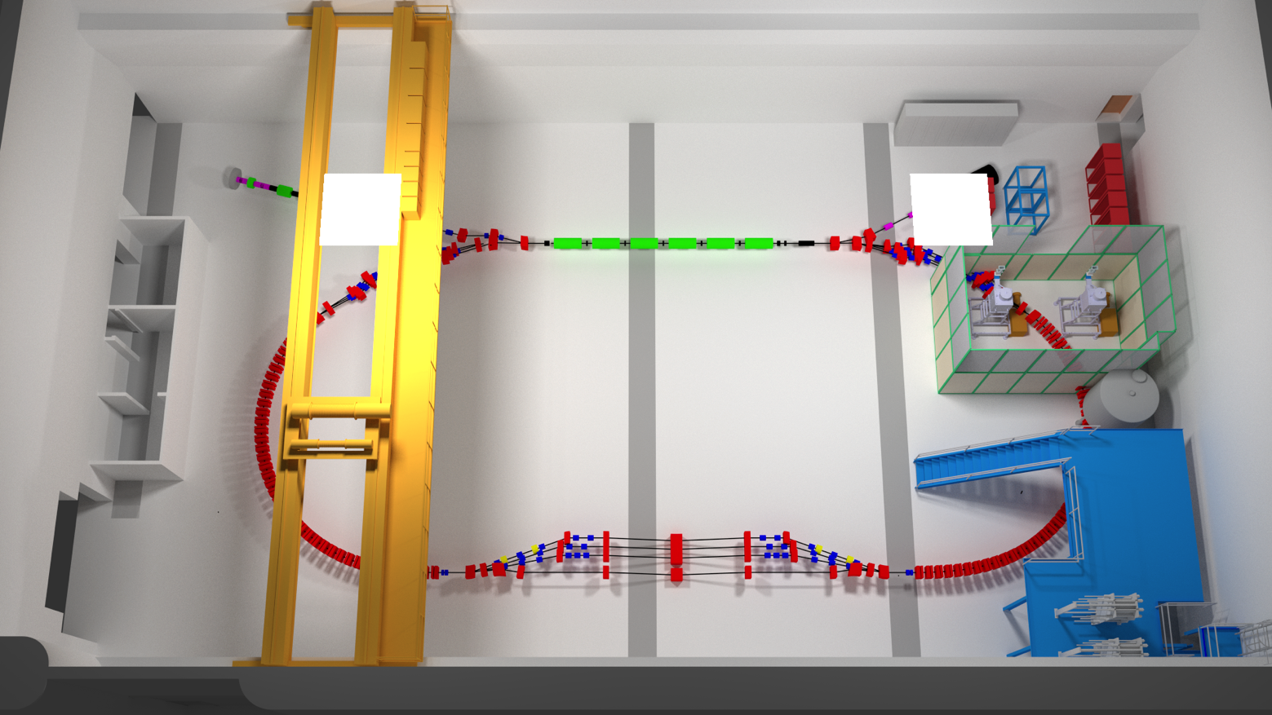
Resonantly extracted beam
Resonant extraction:
Use correctors that cancel for three energies but add for the highest energy.
Beam separation:
Use septa magnets to separate each energy.

Slide 37
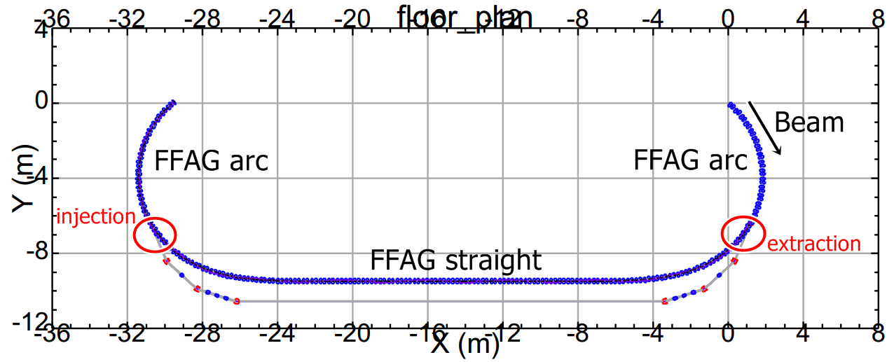
Layout of extraction beam line
Extraction line contains:
Extra dipoles to guide the beam
Extra quadrupoles to maintain beam optics

Slide 38
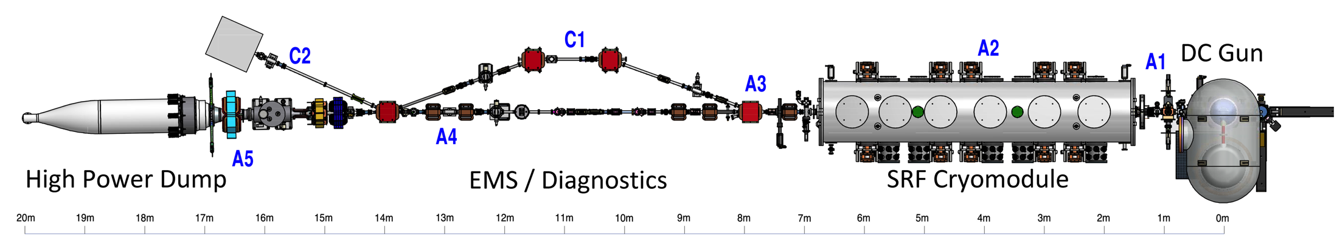
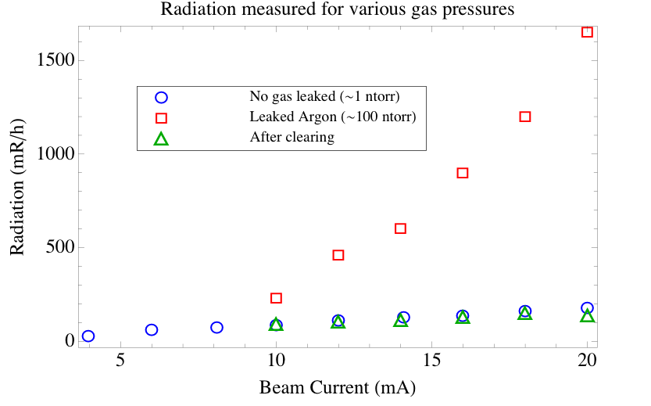
Evidence of Ion trapping in Lincas
Observed ion trapping multiple times
During 75 mA, 5 MeV runs, ion clearing electrode reduced background radiation by > 50%
During low energy 350 keV runs, intermittent trips vanished after using clearing electrode
Ion generated
Ions
cleared
Normal

Slide 39
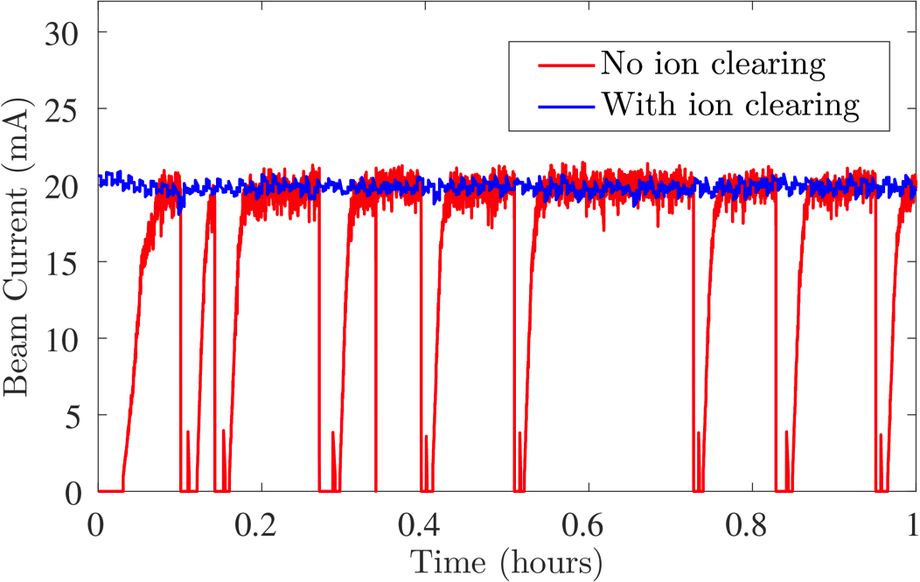
Evidence of Ion trapping in Lincas
Observed ion trapping multiple times
During 75 mA, 5 MeV runs, ion clearing electrode reduced background radiation by > 50%
During low energy 350 keV runs, intermittent trips vanished after using clearing electrode
Stable operation
With ion clearing
Ion generated
Ions
cleared
Normal
Gun HV power supply trips
with no ion clearing
More ion studies in high-current linacs in 2017 PhD thesis of Steven Full.

Slide 40
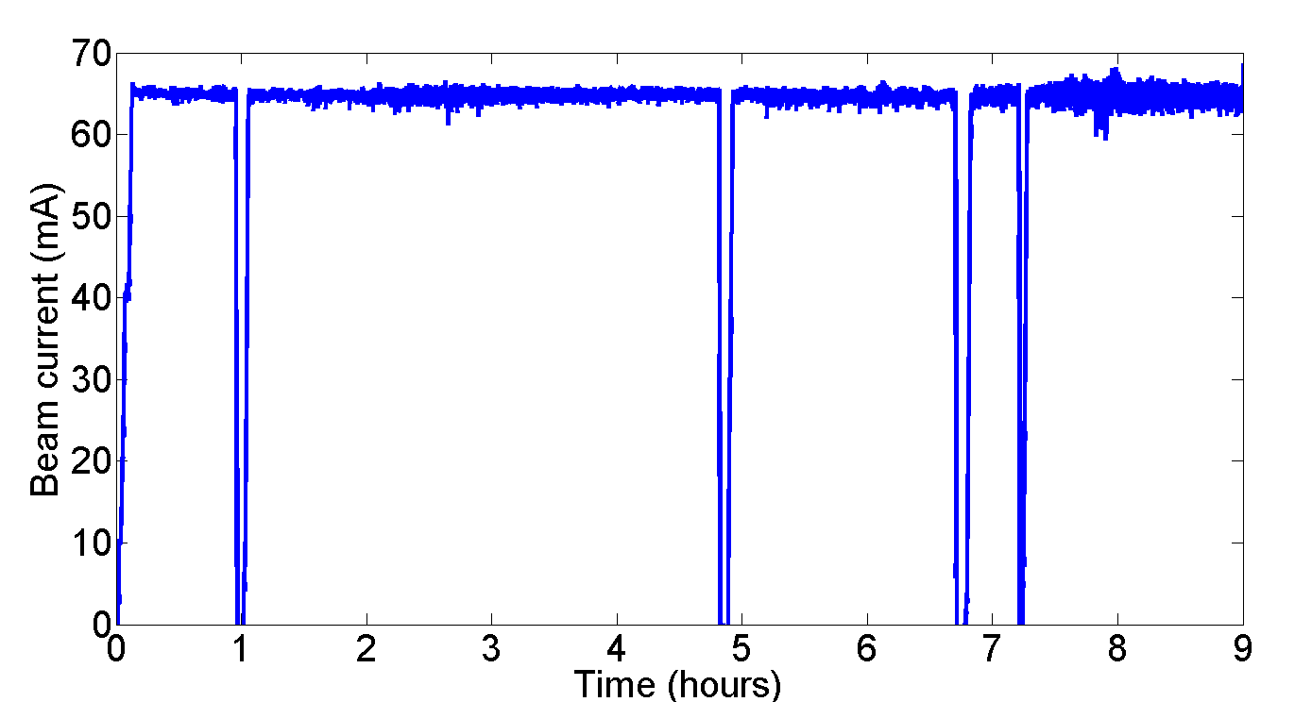
High Current Beams
Peak current of 75mA (world record)
NaKSb photocathode
High rep-rate laser
DC-Voltage source
Source achievements:
2.6 day 1/e lifetime at 65mA
8h at 65mA, at only 5W laser.
The gun group is now working on polarized guns of high current (See today at 11:30, High-Current Polarized e-Sources by Luca Cultrera)
This gun was copied at Cornell and commissioned at BNL for the RHIC Low Energy Run (another successful BNL / Cornell collaboration) as seen on Tuesday at 11:00, Status and Commissioning Results of LEReC by Alexei Fedotov)
DC-gun + SRF injector are now prototyped for industrial Mo99 production.

Slide 41
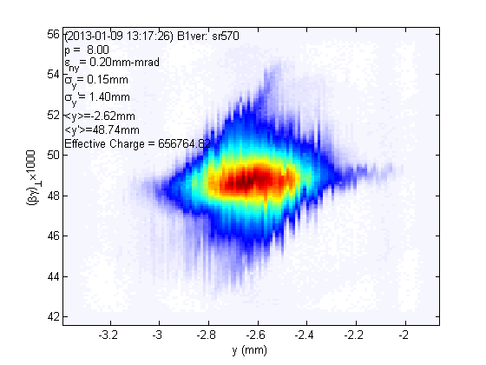
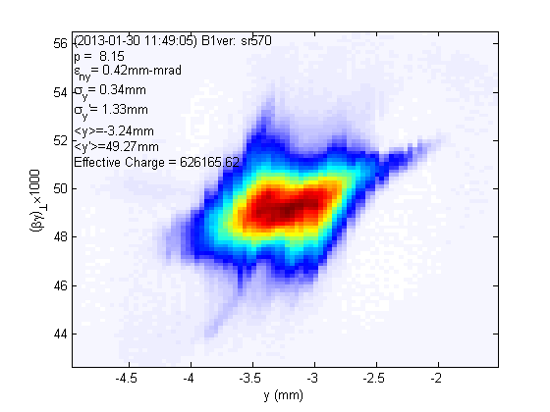
Beam Brightness
20 pC/bunch 80 pC/bunch
vertical phase space
vertical phase space
Normalized rms emittance (horizontal/vertical) 90% beam, E ~ 8 MeV, 2-3 ps
0.23/0.14 mm-mrad 0.51/0.29 mm-mrad
Normalized rms core* emittance (horizontal/vertical) @ core fraction (%)
0.14/0.09 mm-mrad @ 68% 0.24/0.18 mm-mrad @ 61%
*Phys. Rev. ST-AB 15 (2012) 050703
ArXiv: 1304.2708
At 5 GeV this gives 20x the world’s highest brightness (Petra-III)

Slide 42
Main linac cryomodule (MLC)
achieved accelerating gradients
Limit.
Admin.
Admin.
Admin.
Quench
Admin.
FE
*FE processed out.
5 of 6 cavities had achieved design gradient of 16.2MV/m at 1.8K in MLC.
Cavity#4 is limited by quench so far, no detectable radiation during test.
Enough Voltage for 76MeV per ERL turn (where 36MeV are needed)

Slide 43
Main linac cryomodule (MLC)
achieved surface losses (Q0)
*Q₀ at 14MV/m, FE started.
Target Qo 2.0e10 at 1.8K
*Q₀ after FE processed out.
*Q₀ at 16.2MV/m with severe FE.
*Q₀ after many quench.
1.8K
4 of 6 cavities had achieved design Q₀ of 2.0E+10 at 1.8K.
Q₀ of Cavity#6 had severe FE at 16MV/m.
Enough cooling for 73MV per ERL turn (where 36MeV are needed)

Slide 44
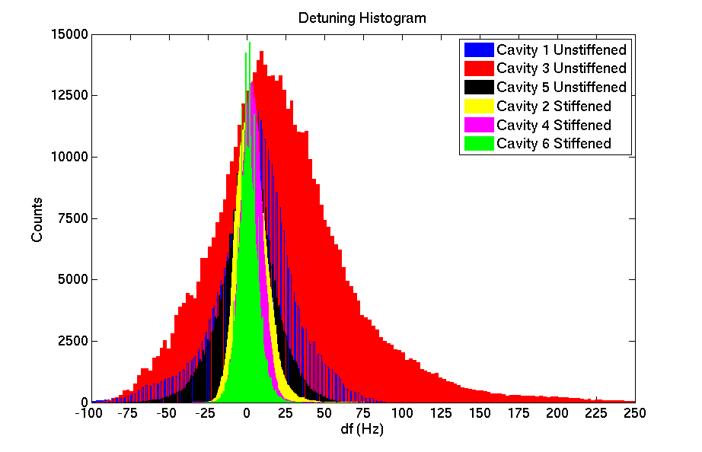
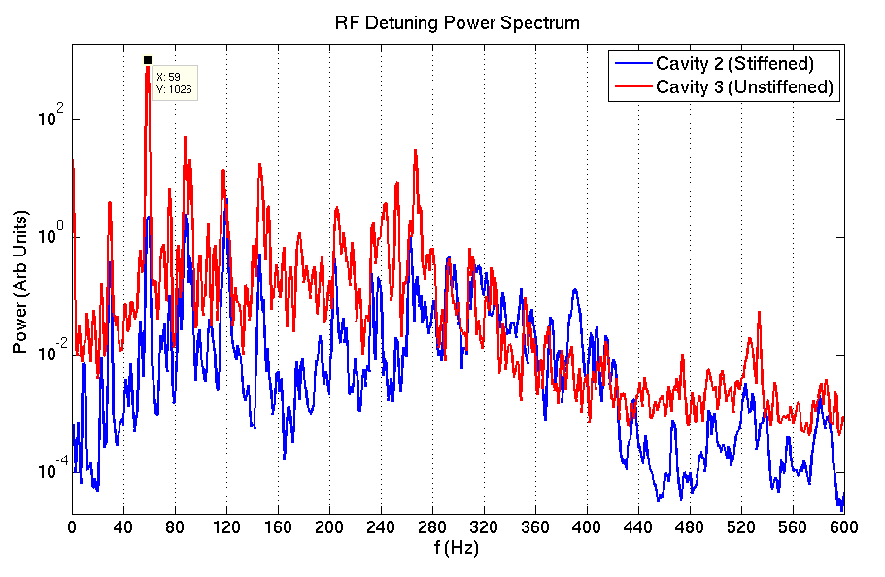
RF Detuning Measurements
Preliminary results:
Stiffened cavities have ~30Hz detuning, Un-stiffened cavities have ~150Hz detuning.
Design specs are ~20Hz.
Detuning spectrum showed large peaks at 60 Hz, 120 Hz.
Enough Voltage for about 50MeV per ERL turn, if microphonics is not reduced (where 36MeV are needed)

Slide 45
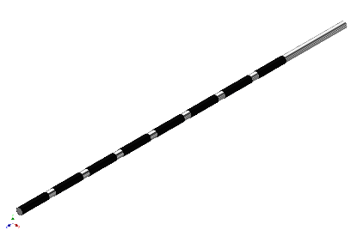
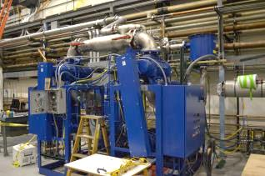
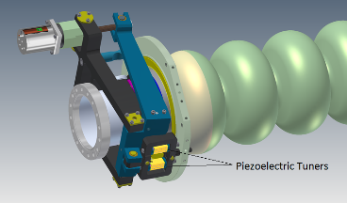
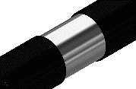
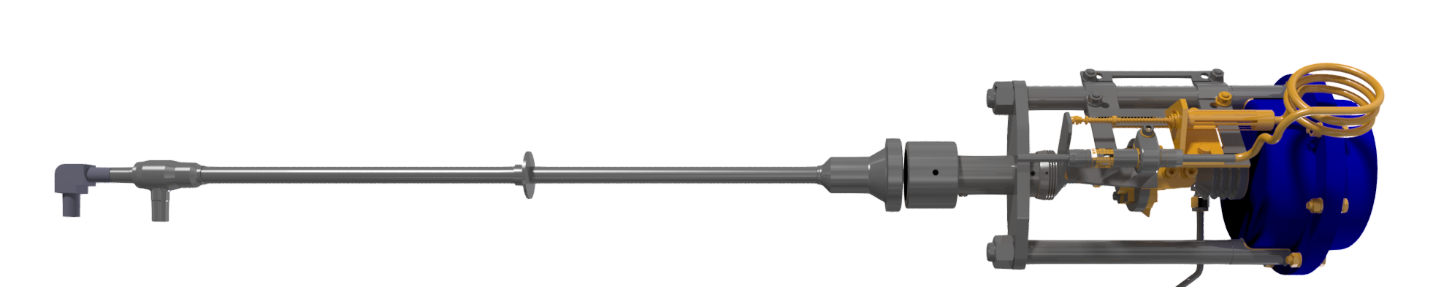
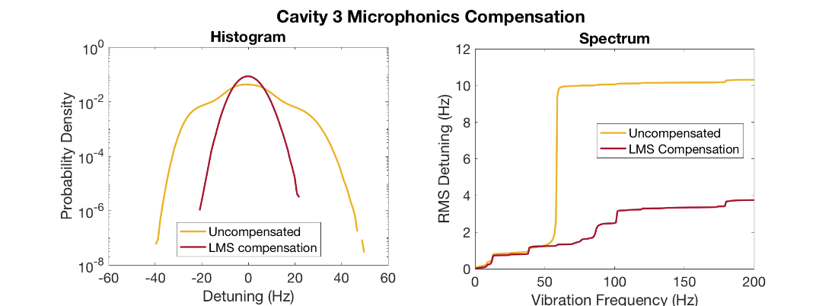
SRF microphonics stabilization
PhD work (Nilanjan Banerjee)
became essential for CBETA operation
1) Specified 70 potential microphonic sources
2) Identified thermo-achoustic sources
2) Deigned piezo control software
Valve Modification
Active Compensation
LCLS-II needs similar controls!
and we are in touch with LCLS-II teams at FNAL and JLAB.
Novel microphonics compensation reduces peak detuning by a factor of 2!
Notes:
The power requirements increase with detuning of the cavity, and due to the high Q of the cavities and the tight power budget, the detuning must be carefully controlled.
This poses a problem with vibrations in the cryomodule, generated by cryogenic pumps, valves and other machinery since they deform and lead to microphonics detuning.
To mitigate this problem, we have modified our cryogenic system and used piezo-electric actuators to actively compensate for the vibrations. We developed a novel algorithm which is capable of stably reducing microphonics by a factor of 2!

Slide 46
Questions?

