Slide 1
Overview of the LERF
S. Benson
Jefferson Lab, 12000 Jefferson Avenue, Newport News, Virginia, USA
Accelerator Physics of ERLs for the EIC
November 2, 2018
Jefferson Lab, Newport News VA

Slide 2
JLAB ERL: Low Energy Recirculation Facility (LERF)
Energy 135 MeV
Charge 135 pC
Current <8.5 mA
Max IR power 14.3 kW
Max UV power 100 W
Max circ. Power 1.3 MW
Avail. RF power 292 kW
Search for Dark Matter
Fixed Target Options
Accelerator Research
Powerful light source
IR and UV FEL
THz light
2

Slide 3
JLAB ERL: Low Energy Research Facility (LERF)
Energy 135 MeV
Charge 135 pC
Current <8.5 mA
Max IR power 14.3 kW
Max UV power 100 W
Max circ. Power 1.3 MW
Avail. RF power 292 kW
Search for Dark Matter
Fixed Target Options
Accelerator Research
Powerful light source
IR and UV FEL
THz light
3

Slide 4
Isotopes at LCLS II Test Facility
Reinstall 2 triplets on either side of new transfer line
New dipole & additional shielding
Existing recirculation dump shielding
Shielded isotope production target (50 kW)

Slide 5
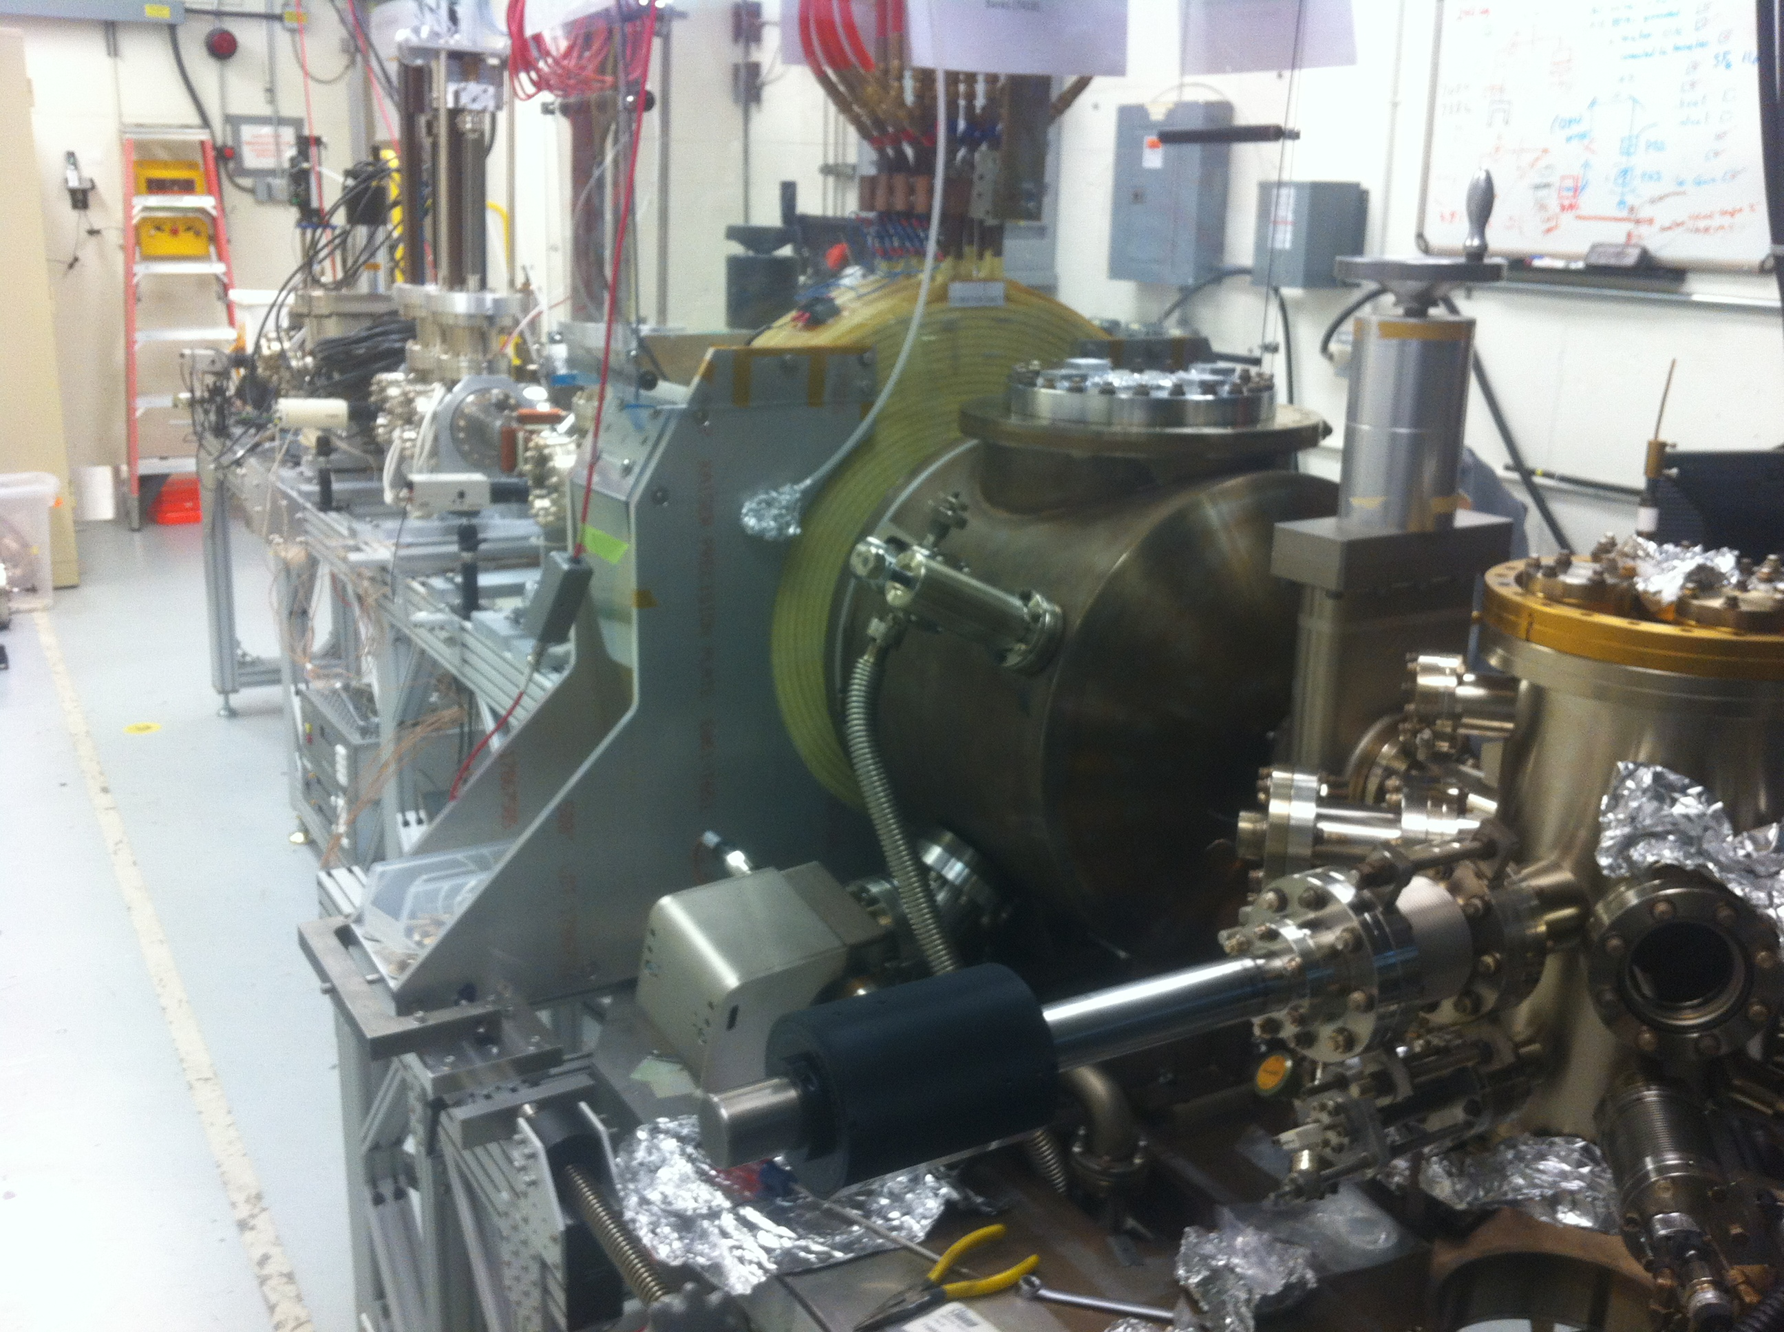
Magnetized Source in GTS
Magnetized Source for e-cooler at 28 mA: A high charge (420 pC) magnetized source is funded by the Jefferson Lab LDRD program and has operated up to 28 mA avg. current.
Magnetized beam parameters:
$a_{0}$ = 1 – 5 mm, B_{z} = 0 – 2 kG
Bunch charge: 1 – 500 pC
Frequency: 15 Hz – 476.3 MHz
Bunch length: 10 – 100 ps
Average beam currents up to 28 mA
Gun high voltage: 200 – 350 kV

Slide 6
LERF Availability
The LERF will be used to test LCLS II cryo-modules for the next ~12 months. During that time it will be limited to about 50 MeV. After that it will be restored to its previous state.
Currently setting up for isotope production work.
Can still be used for injector tests and magnetized beam transport. (Deitrick study)

Slide 7
LERF Advantages and Disadvantages
Advantages:
Very flexible architecture.
Access to CEBAF resources.
Easy to add magnetized beam.
Room for new arcs or exchange region
Disadvantages:
Different frequency from EICs (1497 MHz)
Needs new booster
UITF booster (symmetric)
AES booster (748.5 MHz with 3rd harm.)
Operating cost is high
Unavailable until LCLS II is done (except for single pass work).

