Slide 1
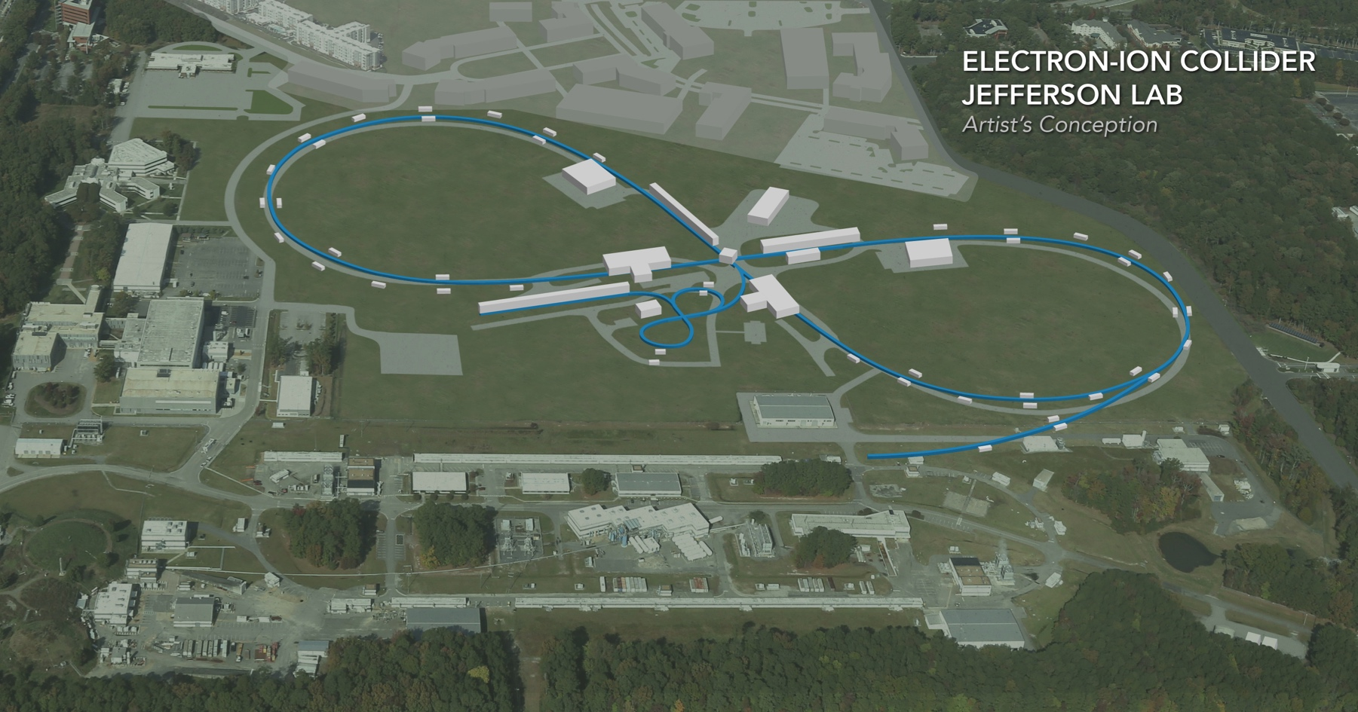
Requirements for Magnetized Bunched-Beam Cooling
Speaker: Chris Tennant, Jefferson Laboratory
ERL EIC Workshop | Jefferson Laboratory | November 2, 2018

Slide 2
Introduction
top level requirements are “standard” for an ERL
generate, accelerate, and deliver a properly configured beam to the user
recover (possibly degraded) beam after use
preserve beam quality, avoid instabilities and limit losses
unique features of JLEIC cooling system:
magnetized beam
axially symmetric transport
high charge
collective effects aggravated
long bunch
samples large(r) part of RF waveform
small momentum spread
susceptible to wake-induced distortion

Slide 3
Strong Cooling
ERL (bottom)
magnetized gun
linac
beam dump
chirper
booster
chirper
dipole
dipole
CCR (top)
ion beam
cooling solenoids
magnetization flip
magnetization flip
DC & RF kicker
septum
DC & RF kicker
DC & RF kicker
DC & RF kicker
CCR
chirper
injected bunch orbit
extracted bunch orbit
chirper
ERL
dipole
Beam Exchange (side)
dipole
harmonic kicker exchanges every 11th CCR bunch between ERL and CCR

Slide 4
Getting From Here to There
state-of-art performance for SRF-driven ERLs:
decoupled beam (but with fully coupled transport/phase space exchange)
Q_{bunch} ≈ 100 pC
I_{ave} ≈ 10 mA
P_{beam} ≈ 1 MW
JLEIC cooler requirements:
magnetized beam (coupled)
Q_{bunch} ≈ 3 nC
I_{ave} ≈ 100 mA (ERL) – 1 A (CCR)
P_{beam} ≈ 10 MW (ERL) – 100 MW (CCR)
(30x)
(10-100x)
(10-100x)
required performance orders of magnitude beyond state-of-art
(courtesy D. Douglas)

Slide 5
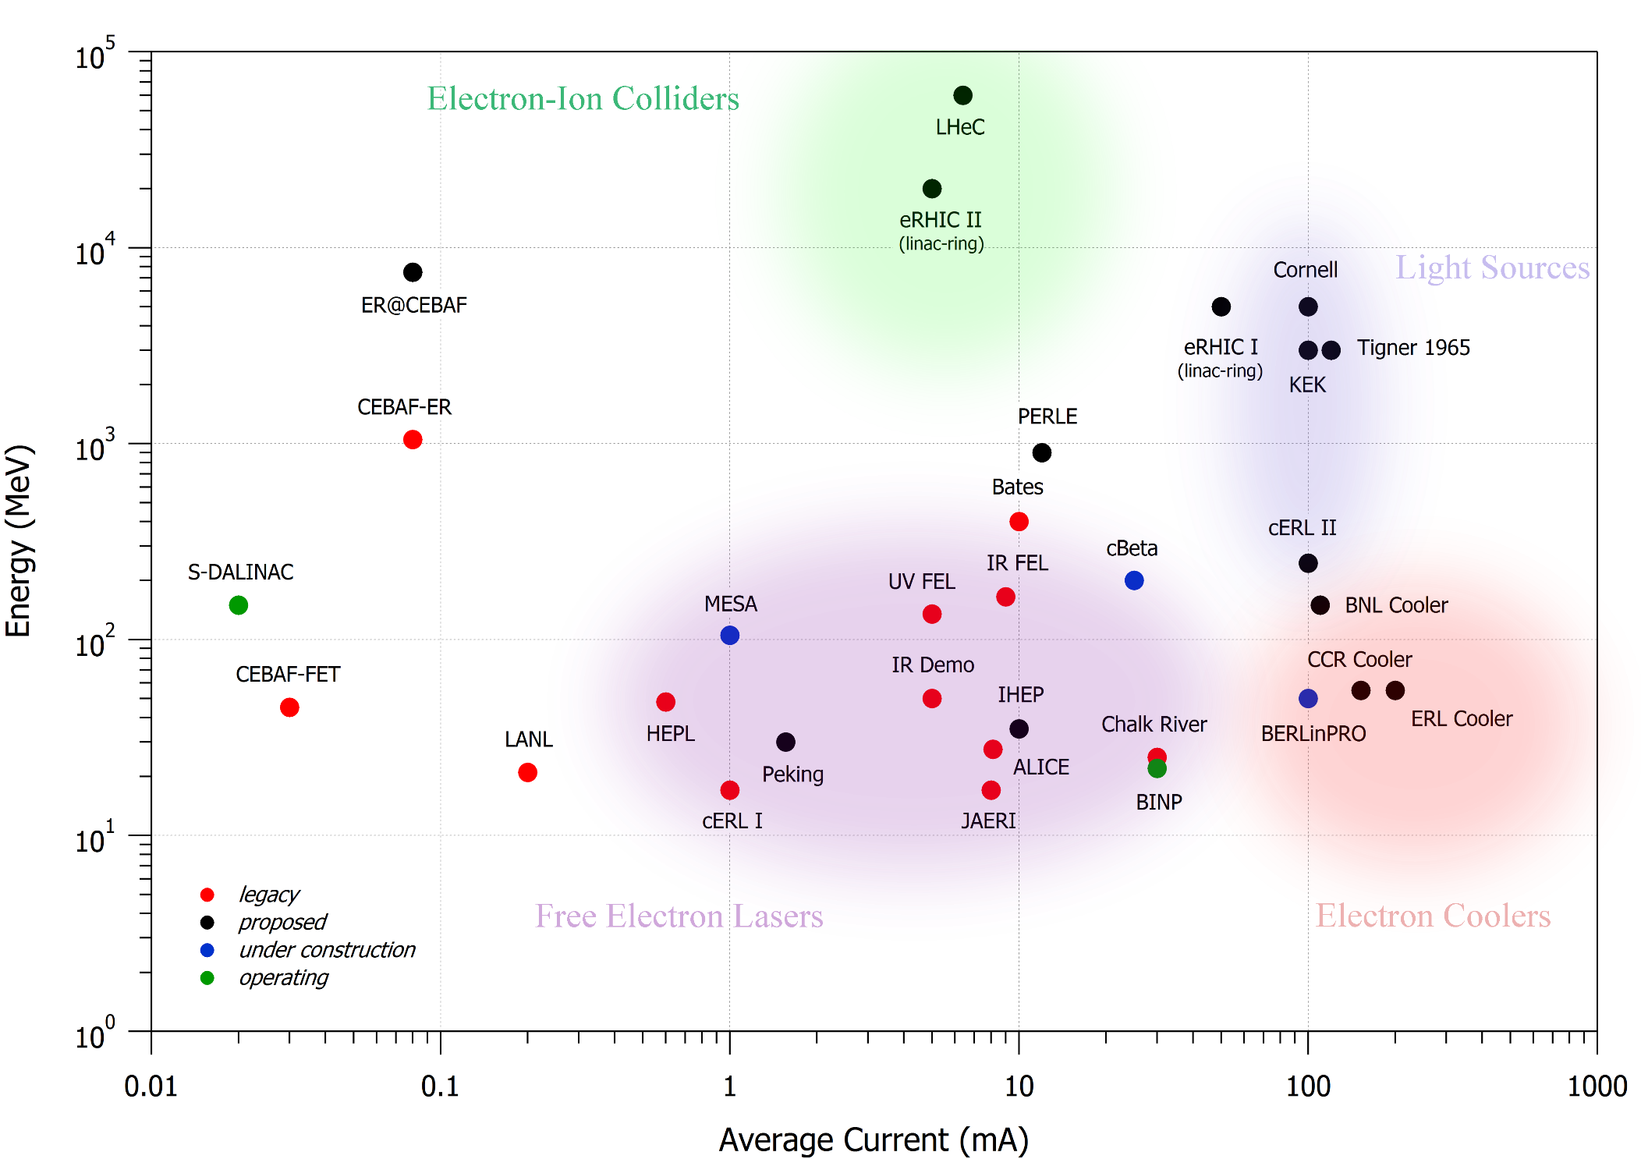
ERL Landscape
1 GW
100 MW
10 MW
1 kW
10 kW
100 kW
1 MW

Slide 6
Summary: Beam Dynamics Issues
BEFORE: a premium on short bunch length and transverse emittance (i.e. FELs)
NOW: bunch lengths are long and the metric of interest is the energy spread
high charge, high power transport that preserves
magnetization and small energy spread
power management: understand sources of, and manage, losses
CSR, space charge, mBI: machine lives in unique part of parameter space
beam breakup (BBU): well understood, need full system to assess impact
halo: serious operational problem, formation via many processes
(collimation: not demonstrated in high power, CW operation)
ion trapping: potential problem
these items represent only the things about which we know,
not the things we know we don’t know

Slide 7
Outlook & Points of Discussion
historically, SRF-driven ERLs have taken advantage of high repetition rates and modest bunch charges to achieve high power → moving into a regime of high repetition rate, high bunch charge
unlikely we will have a high power ERL testbed in the near future
how can we leverage currently available accelerators to help our understanding of high power machines?
(S. Nagaitsev)

Slide 8
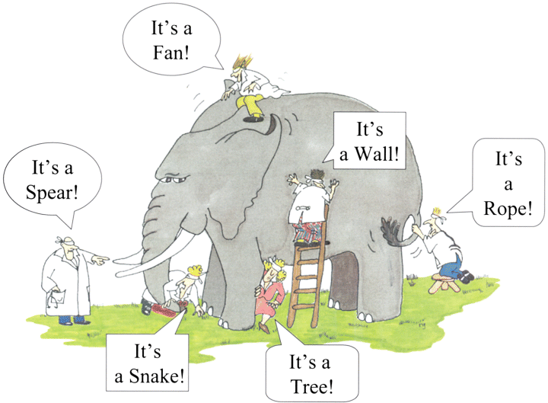
The Elephant in the Room

Slide 9
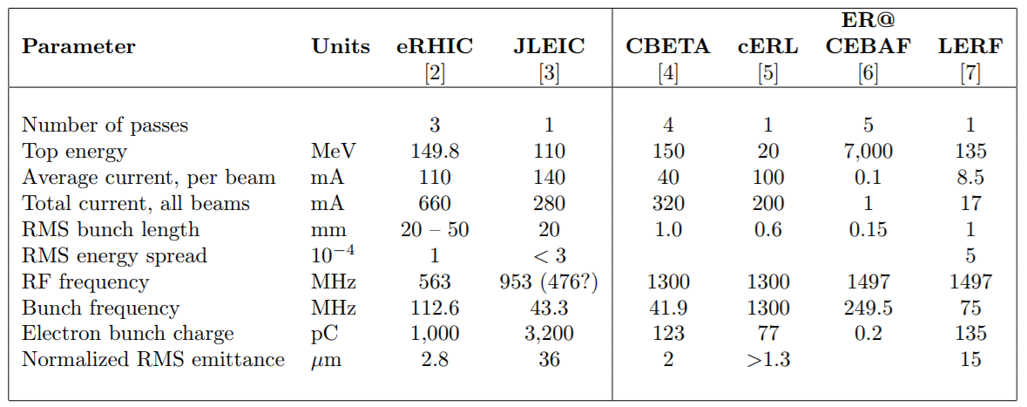
Table of Parameters
(courtesy S. Peggs)

Slide 11
What to Do, Where to Go?
multiple generations separate state of art system readiness from required performance
need development in many areas, including:
CW/high charge magnetized source
merger
management of CSR/space charge/microbunching
modeling with CSR and space charge
model validation (1D, 2D, 3D…)
validate treatment of ends of bunches
simulation dynamic range (part per million statistics => trillion particle simulation…)
CSR shielding
methods for mB gain control
LSC wake control/compensation
nonlinear longitudinal matching
magnetization-preserving beam transport
high-rep-rate beam transfer
halo (simulation statistics inadequate…)
formation mechanisms (scattering: IBS, Touschek, beam/gas,…; dynamical)
characterization (LDR diagnostics, tomography…)
control (suppression, collimation, matching (linear and nonlinear…)
power scaling
100x state of art
(courtesy D. Douglas)

Slide 12
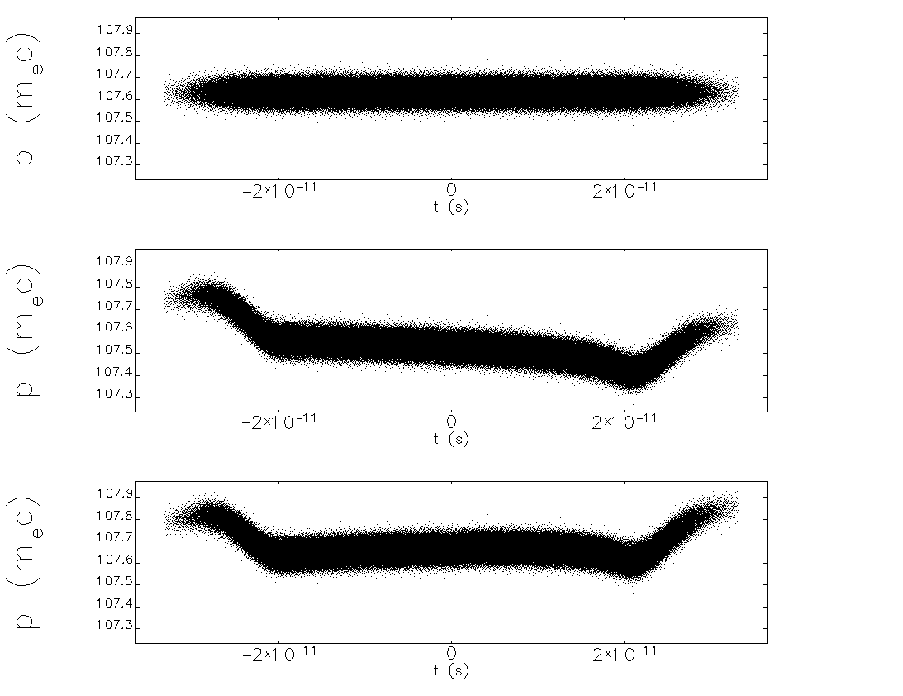
Effect of CSR on Longitudinal Phase Space
no CSR
CSR
CSR “corrected”

Slide 13
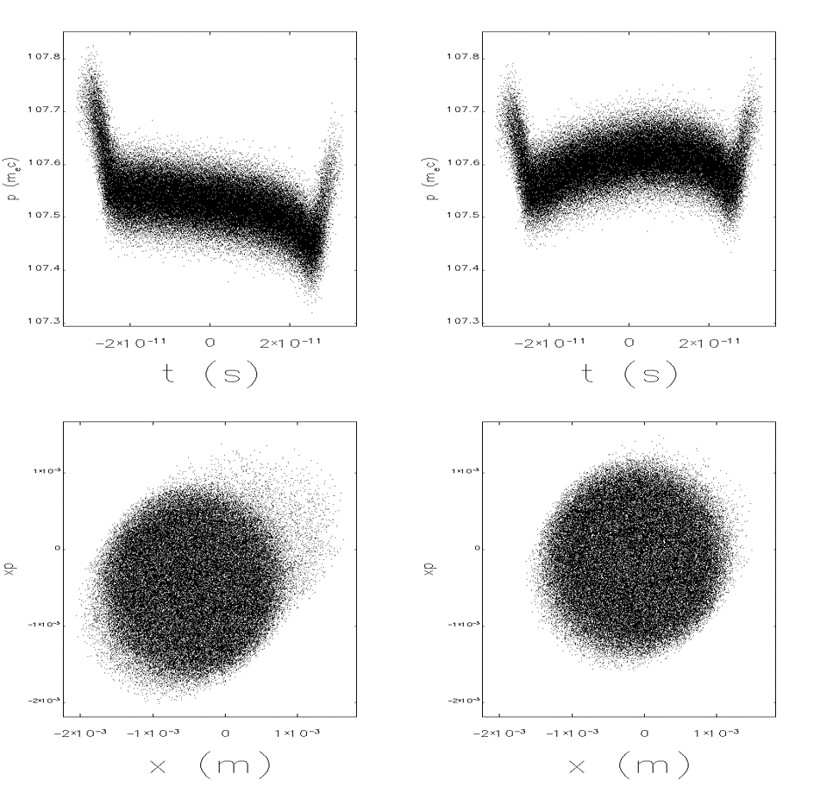
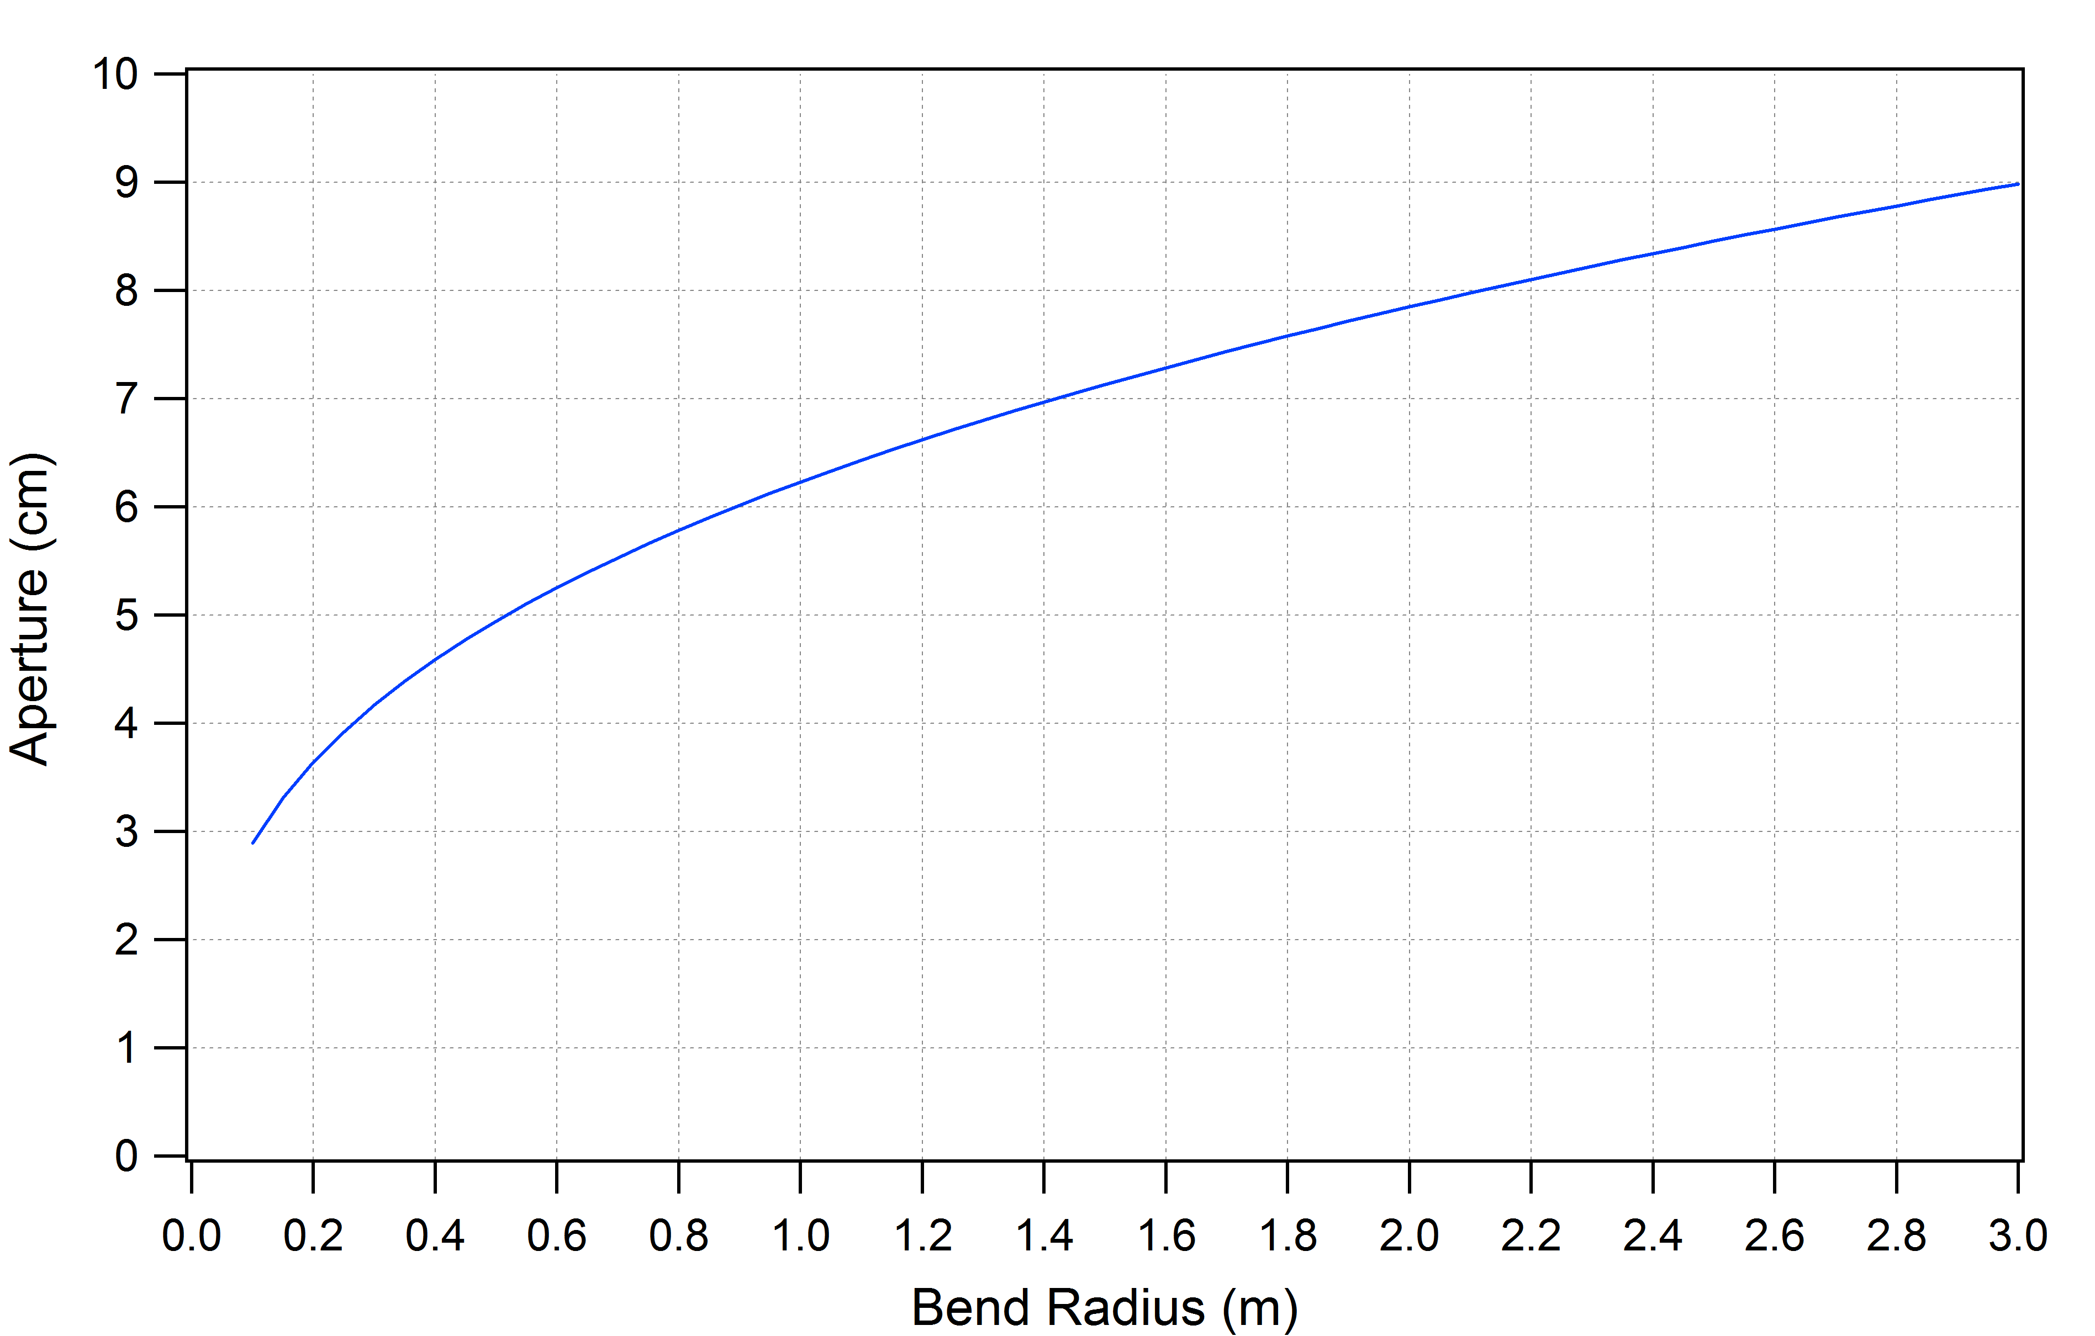
CSR Shielding
shielding of CSR is effective when the full aperture size is less than $R^{1/3}{\left(πσ_{z}\right)}^{2/3}$ where R is the bend radius and σ_{z} is the rms bunch length
for R = 0.53 m and σ_{z} = 4.95 mm, the (full) aperture needs to be less than ~2 inches (5.04 cm)
with CSR
with CSR + shielding
for σ_{z} = 4.95 mm

Slide 14
Why Magnetized Electron Cooler?
At cathode immersed in solenoid, a gun generates almost parallel (laminar) beam state of a large size (electron Larmor orbits are very small compared to beam size)
This beam state is then transplanted to the solenoid in cooling section
(while preserving the canonical emittances: the drift and the Larmor
emittances)
The solenoid field can be controlled to make e-beam size properly match the ion beam size
Magnetization results in the following critical advantages
(compared to a non-magnetized gun/cooling solenoid):
Tremendous reduction (by a factor 20 – 30) of the regional and global deleterious Space Charge transverse impact to dynamics in CCR (tune shift)
Strong mitigation (suppression) of the CSR microbunching/ energy spread growth
Suppression of deleterious impacts of high electron transverse velocity spread and short-wave misalignments to cooling rates (thanks to ion collisions with “frozen” electrons at large impact parameters)
Notes:
At cathode immersed in solenoid, one can generate almost parallel (laminar) beam state after the gun

Slide 15
Where to go: Existing Opportunities
ASTA/IOTA/FAST can support single bunch studies
3.2 nC magnetized bunch ⬄ can initiate evaluation of single-bunch dynamics & evolution
could IOTA offer a CW analog?
JLab UITF & LERF, ELBE at HZD can support low power/low charge CW tests for hardware and dynamics
JLab ERLs down for LCLS-II module tests through 2018
No “true” (P_{beam}>>P_{RF}) SRF ERLs in operation at this time
no immediate opportunity for high power testing in SRF enviroment
BINP capable of high charge/current/CW at low energy…
2019: three SRF ERL facilities available: Cb, bERLinPRO, Jlab
complementary capabilities/limitations
JLab is legacy generation (low charge, MW class) but fully commissioned and operationally flexible
Cb is “next generation”, but experimental design may be operationally challenging (FFAG)
bERLinPRO ⬄ high current/power; design charge low but SRF gun offers possibility for high charge, but no magnetization ☹
(courtesy D. Douglas)

