Slide 2
Why CeC is needed?
High luminosity of US future electron-ion collider(EIC) is critical for success of its physics program
  2018 NAS Assessment of U.S.-Based Electron-Ion Collider Science states: The accelerator challenges are two fold: a high degree of polarization for both beams, and high luminosity.
CeC is the most promising technique for boosting the EIC luminosity
  2018 eRHIC pCDR review states: The major risk factors are strong hadron cooling of the hadron beams to achieve high luminosity, and the preservation of electron polarization in the electron storage ring. The Strong Hadron cooling [Coherent Electron Cooling (CeC)] is needed to reach 10³⁴/(cm²s) luminosity. Although the CeC has been demonstrated in simulations, the approved “proof of principle experiment” should have a highest priority for RHIC

Slide 3
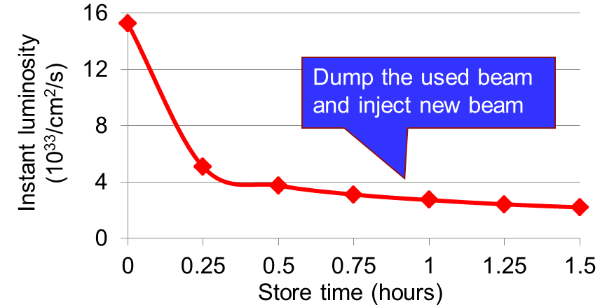
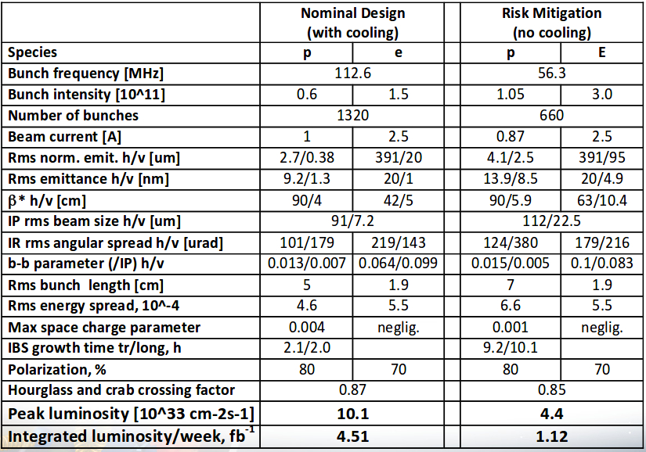
What CeC can do for EIC
Integrated Luminosity boost
eRHIC R-R - at least 4-fold;
eRHIC L-R – at least 10-fold
JLEIC R-R - ~ 5-10(?)
JLEIC at 100 GeV c.m.

Slide 4
What is common for all CeC schemes
Relativistic factor the e-beam should match that of the proton beam
    100 GeV p -> 54.46 MeV e⁻
    275 GeV p -> 149.8 MeV e⁻
  In practice – e-beam is needed at all energies from 20 MeV t0 150 MeV
All need fresh beam with tens or hundreds of mA and e-beam power 1 MW to 50 MW
Energy recovery linac are the MUST as the driver

Slide 5
What are CeC options all operating at ~ 300 to 1,000 THz
Bandwidth ~ 25 THz
Very low gain
Full Bandwidth
Full Bandwidth

Slide 6
CeC options vs EIC design
eRHIC R-R v
NONE
eRHIC R-R v
eRHIC R-R v
JLEIC v
eRHIC R-R v
eRHIC R-R v
JLEIC v

Slide 7
Relative cost of the CeC options
~80%
Not needed
FULL price
~50%

Slide 8
Other requirements
Charge per bunch - 1 nC to 2.5 nC
Rep-rate:
  eRHIC R-R – 112.6 MHz
  eRHIC L-R – 9 (28) MHz
  JLEIC R-R – 476 MHz
Normalized emittance – 1 to 10 μm
Relative energy spread – 10⁻⁴ to 10⁻³

Slide 9
Specific combinations*
EIC | eRHIC RR | eRHIC RR | eRHIC RR | eRHIC LR | JLEIC 200 GeV
CeC amplifier | FEL | MBEC | PCA | PCA | PCA
Charge/ bunch nC | 2.5 | 1 | 1 | 5 | 1
Peak current, A | 10 | 30 | 250 | 250 | 200
Normalized emittance, mm mrad | <10 | ~ 1 | 4 | 4 | 4
Relative energy spread, RMS | 3x10-4 | 10-4 | 3x10-4 | 3x10-4 | 3x10-4
Rep-rate, MHz | 113 | 113 | 113 | 9 | 475
Average current, mA | 280 | 113 | 113 | 45 | 476
Cooling time, min | <60 | <60 | <60 | < 1 | ~1
*Some numbers in this table are estimations

Slide 10
Conclusions
ERL are accelerator of choice for any IEC Coherent electron Cooling system
Beam energies from 20 MeV to 150 MeV are needed to cover all range of the proton energies in EIC
Charge per bunch depend on design and varies from 1 nC to 5 nC
Normalized emittance depends on the scheme and the most relaxed for FEL amplifier (10 μm) and most stringent (1 μm) for traditional micro-bunching amplifier
Energy spread requirements are typically 0.03% RMS, with exception of for traditional micro-bunching amplifier – it requires 0.01% RMS energy spread
Average beam current depends on EIC design and varies from 45 mA (eRHIC L-R) to 115-280 mA (eRHIC L-R) and nearly half of the amp for JLEIC

