Slide 1
Using EIC Multipass ERL Projects as a Testbed for XFEL and Compton Gamma Sources
Peter Williams
ASTeC, Daresbury Laboratory & Cockcroft Institute, UK
2nd November 2018

Slide 2
Outline
Why I am here! Ultimate goal: a CW-XFEL based on recirculated ERL
Proposal 1: Proving that a GeV-scale multipass ERL can drive an XFEL (ER@CEBAF)
The need for a test accelerator for a UK-XFEL? And how it could drive high power EUV source & narrowband MeV Compton source
Proposal 2: Can a multipass ERL with FFAG transport drive an EUV-FEL or Compton source (CBETA)
How does all this help EIC?

Slide 3
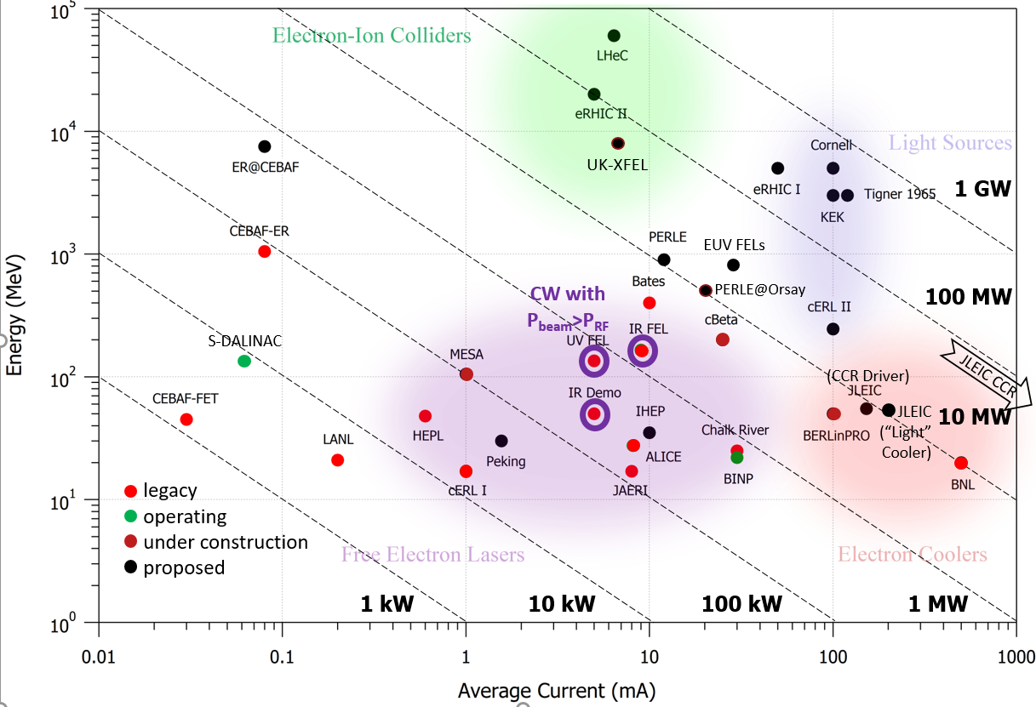
ERL Landscape: Current State of the Art
Gives summary of
Legacy systems (now decommissioned)
Operating facilities (there are now two presently operating SRF system, the Darmstadt S-DALINAC, we also now re-colour cERL ☺)
Systems under construction (CBETA, MESA, bERLinPRO, can now add ER@CEBAF?)
Proposed machines
Only three (legacy) SRF systems have operated CW with P_{beam}/P_{RF}>>1
JLab IR Demo, IR Upgrade, UV Demo; all single-pass up/down FEL drivers
Note that other legacy or operating systems did not achieve CW (Chalk River*, MIT*, LANL*, HEPL, JAERI, ALICE) and/or P_{beam}/P_{RF}>1 (CEBAF-FET, CEBAF-ER, BINP*, KEK cERL, BNL test ERL, S-DALINAC *NCRF linacs
All next generation applications have the *undemonstrated* commonalities:
Beam powers approaching / exceeding 10 MW
Consideration / use of multiple passes
The assumption that those passes are in common transport

Slide 4
Legacy ERL projects have not demonstrated enough
Taken from “Why PERLE” by Dave Douglas:
Reviewing the history of all 10 SRF ERLs operated to date offers insight…
2 limited to pulsed running by SRF spec / performance (ALICE, JAERI)
2 (probably) longitudinal-match limited (HEPL, CEBAF-FET)
3+ were source-limited to P_{beam}<P_{RF} (CEBAF-FET, CEBAF-ER, S-DALINAC)
1+ was probably magnet field-quality limited (CEBAF-ER)
1 was / is loss (halo)-limited (cERL), now making progress!, all 3 achieving break-even (Jlab ERLs) operationally challenged by halo
Longitudinal matching involves more than riding crest up, trough down
RF drive/controls more complex than naively expected; power requirements defined by transient management
Power flow management – things getting very warm – was an issue in CW systems with P_{beam}>P_{RF}
Lesson learned: charge- and beam-power-dependent phenomena pose critical challenges when power scaled up!
Before we bet the success of a “production scale” project like EIC on an ERL, every opportunity to test these limits should be taken

Slide 5
Motivation of Recirculation, Followed by Energy Recovery, as Cost Mitigation for a UK-XFEL
There is an ambition to build an XFEL in the UK in the coming decade
Some specified parameters are not compatible with normal conducting linac e.g. 1 MHz ~10 keV pulses, laser/XFEL synchronisation < 1fs. We therefore explore superconducting linac as a full capability option
Cost motivates use to consider TWO stages of accelerator development
N-Pass*
N-Pass with Energy Recovery
Additional capability of stage 2 ERL stems from the high average virtual beam power, we should expect future user demand (anticipate 30 year lifetime) for the following :
Enabling transform-limited pulses at ~10 keV through deployment of XFELO & RAFEL – Requires Multi-MHz
Industrial uses for longer wavelength high average power enabled by ease of access to lower energy recirculation passes: 100 eV – 1 keV e.g. semiconductor chip lithography
Harmonics of 10 keV MHz sources due to the high spectral brightness – 100 – 1000 keV, applications in materials science
Inverse Compton Scattering narrowband (10⁻⁴ – 10⁻⁵) gamma sources in two regimes – ~10 MeV & multi-GeV
Gas internal target beam experiments – e.g. precision standard model, dark matter, medical isotope production
= A broader potential user community than “just an XFEL”

Slide 6
Recirculating Linac → ERL as a Cost Optimisation
Max rep. rate of 1, 2, 3, 4 = 1 MHz
Max rep. rate of 1 (ER), 2(ER), 3 (ER), 4 (ER) ~ 100 MHz
Example cost scaling as a function of N: The “1” line is a straight linac, “1 (ER)” is long bypass
For all N > 1, we semi-arbitrarily chose E = 8 GeV with arc radii of 150 m, RF frequency 800 MHz, gradient 14 MV/m, switchyard fixed length 150 m, 50 m fixed for spreader / recombiners and compressors
Indicative cost contributions taken from previous project costings (JLAMP-X, NLS, LHeC)
We see a ~35% saving for a 3-pass configuration as opposed to a 1-pass configuration
It would then cost an additional ~10% to implement Energy Recovery “3 (ER)”, enabling additional capability as linac would now support 100 MHz repetition rate without beam loading
A 3-pass ER machine could thus be achieved with a cost saving over a 1-pass non-ER machine of ~25%

Slide 7
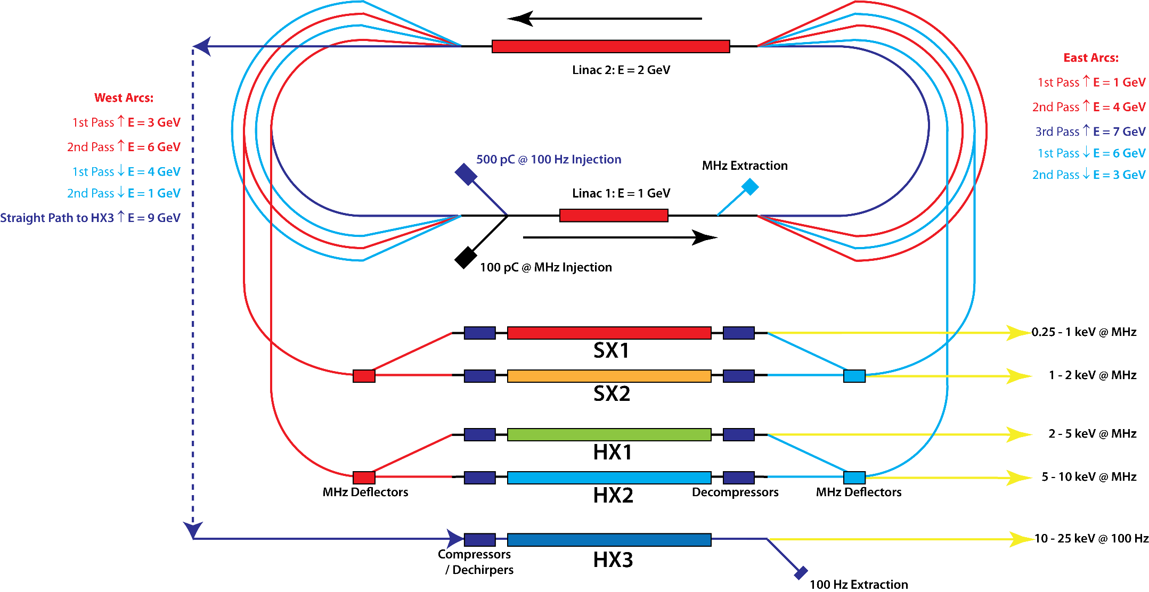
Strawman UK-XFEL Stage 2 (= 100 MHz rep rate) based on 2-Pass Separate Transport ERL + 3rd Pass HXFEL

Slide 8
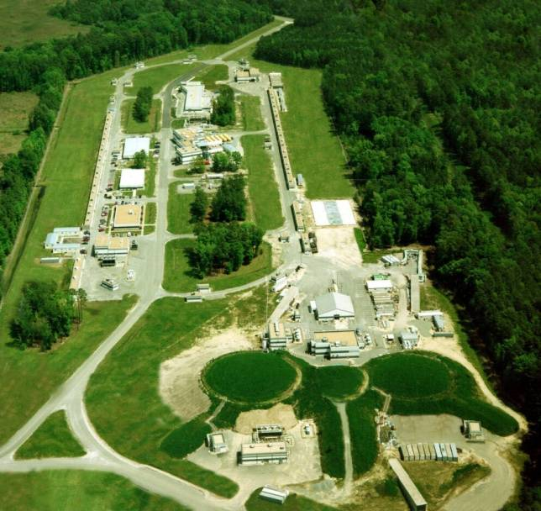
UK-XFEL-1: A Possible Topology
Options 1 & 2 not shown (or 5 or 6!)
Option 3: Symmetrically bisected: Split linac into two identical half-linacs on opposite sides of a racetrack
CEBAF-like, also used in design for PERLE / LHeC
When we implement energy recovery, we are faced with a choice…
1st pass: E= 2 units
linac 2: energy gain 1 unit
1st pass: E= 1 unit
output: E= 6 units
2nd pass: E= 3 units
2nd pass: E= 4 units
linac 1: energy gain 1 unit
3rd pass: E= 5 units
injection: E~0 units

Slide 9
UK-XFEL-2: A Common Transport ERL?
Option 3a: Symmetrically bisected with L1 reinjection:
This involves minimal number of beamlines
The recirculation transport necessarily carries both accelerated and recovered beams simultaneously as their energies are very similar (true even when interaction and SR losses included). Therefore there is no independent control of optics and longitudinal phase space on deceleration
User area constrained (although “paperclip” 540-degree turn would provide 2)
A lesser design complication is that the east and west splitter / recombiners are optically different (energy ratios 1:3:5 and 2:4:6 respectively)
The common transport of the recovered beam features here – and in most multipass ERL proposals I have seen
1st pass up & 2nd pass down: E=2
1st pass up & 3rd pass down: E=1
2nd pass up & 1st pass down: E=4
linac 2: energy gain 1 unit
2nd pass up & 2nd pass down: E=3
3rd pass output: E=6
dump: E~0 units
full energy
(E=6) user area
linac 1: energy gain 1 unit
3rd pass up & 1st pass down: E=5
reinject “6 unit” beam
injection: E~0 units

Slide 10
UK-XFEL-2: A Separate Transport ERL?
Option 3b: Symmetrically bisected with L2 reinjection:
Accelerated and recovered beams now carried separately. Enables individual pass-to-pass orbit, optics and longitudinal phase space control
Provides naturally spacious straight user area
East and west splitter / recombiners are identical
My instinct is that separating out the recovered beam transport is simpler – can we experimentally test this? At ER@CEBAF? I cannot see a way as the east / west splitter ratio difference won’t allow ☹ - even if one linac gradient reduced
3rd pass down: E=1
1st pass up: E=1
1st pass up: E=2
2nd pass down: E=2
2nd pass down: E=3
linac 2: energy gain 1
2nd pass up: E=4
2nd pass up: E=3
1st pass down: E=5
1st pass down: E=4
3rd pass up: E=5
3rd pass up: E= 6
linac 1: energy gain 1
injection: E~0
dump: E~0
full energy (E=6) transport and user area

Slide 11
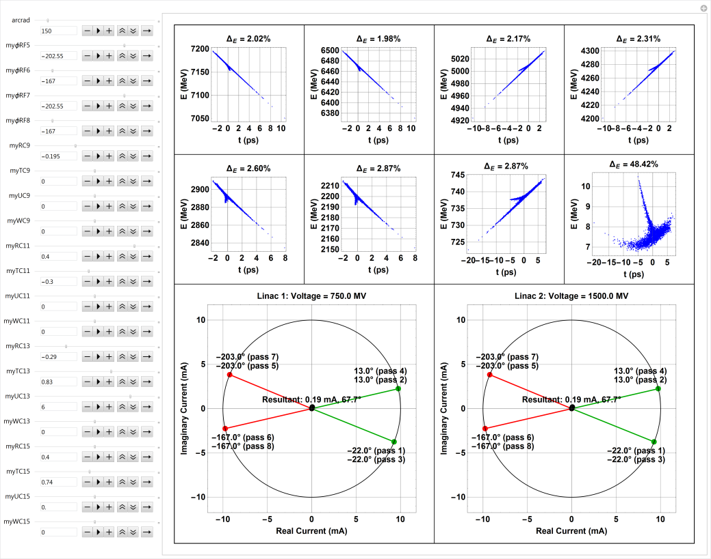
Constructing a Longitudinal Match in a Multipass ERL Driven XFEL is Like Looking for a Needle in a Haystack
LiTrack very quickly becomes cumbersome when asked to deal with a multipass ERL
Self developed LiTrack-like code that includes also FEL interaction, wakes, ISR. And crucially, allows RF load balancing in an ERL simultaneously with accelerating bunch compression and decelerating bunch decompression (and energy spread compression). Working on incorporating uBI gain (Bosch model) and Caustic analysis (Tessa Charles)
However solutions still found by ad-hoc twiddling – not satisfactory! How to differentiate between “good” and “bad” solutions?
Working on extending Zagorodnov / Dohlus semianalytic model of multistage compression to ERL systems to establish more robust method of finding and categorising solutions…
Proposal: Benchmark these solutions on ER@CEBAF and CBETA

Slide 12
Proposal 1: Produce an Off-Crest Longitudinal Match to Imitate a Multi-Pass XFEL on ER@CEBAF
Although compression to make a bunch suitable to drive an XFEL would need at least two tune-able R56 chicanes at the top energy, it is possible to “imitate” an XFEL by just producing the energy profiles required for a proper longitudinal match
Would prove the mitigation of adiabatic anti-damping of the relative energy spread through proper phase control on deceleration in a multipass ERL
Only involves optics retuning of the arcs to further increase momentum acceptance, can reduce peak dispersion from 2.66m to 1.18m increasing the momentum acceptance to 2.1%
ASTeC / Lancaster U. PhD student now looking at such longitudinal matches for ER@CEBAF

Slide 13
A Test Accelerator for UK-XFEL – and why this Test Accelerator Is As Compelling as the XFEL!
Returning to the ERL landscape we see that the beam power of such a UK-XFEL sits closer to the 100 MW line, whereas only ~1MW CW is demonstrated!
Following the philosophy of “one order of magnitude at a time”, it seems reasonable to propose a 10% scale model UK-XFEL test accelerator. This would be in the 0.8 – 1 GeV, 10 mA range
There are strong industrial applications (= money!) reasons to build such a machine:
To drive a >10 kW EUV-FEL for high power tests of optical transport systems for semiconductor lithography
To drive a high-flux, narrowband Inverse Compton Scattering MeV photon source for nuclear industry

Slide 14
An ICS Narrowband Gamma Source on the Test Accelerator for UK-XFEL?
Motivated by upcoming ELI-NP / MEGa-ray demonstrations of the utility of high flux (10¹³ /s) low (10⁻³) energy spread γ’s in the 1-30 MeV range
A CW ERL driven source could go well beyond, with 10,000 x average flux and 100 x narrower bandwidth (if laser chirping techniques adopted - “Combining harmonic generation and laser chirping to achieve high spectral density in Compton sources”, Terzić, Reeves & Krafft, Physical Review Accelerators and Beams 2016 vol: 19 (4) pp: 1-8 )
Precise photonuclear / photofission studies would become possible with industrial applications such as
nuclear resonance fluorescence
non-proliferation enforcement
radioactive waste stewardship (and even mitigation)
economic production of novel medical isotopes
moderator-free thermal neutron source
narrow bandwidth positron / muon source
…

Slide 15
An ICS Narrowband Gamma Source on the Test Accelerator for UK-XFEL?
E.g. “hidden” resonances in photofission cross sections as all gamma sources thus far are broadband – far reaching implications for nuclear waste management techniques
Experiment:
Photofission induced by broadband (~200 keV) Bremsstrahlung
Calculation:
Photofission intrinsically composed of individual sharp resonances
“Perspectives for photofission studies with highly brilliant, monochromatic γ-ray beams” P. G. Thirolf et. al., EPJ Web of Conferences 38, 08001 (2012)

Slide 16
An Example Photon Energy to Aim For on an ERL-Driven Narrowband MeV Photon Source
2.143 MeV

Slide 17
Proposal 2: Produce an Off-Crest Longitudinal Match to Imitate a Multi-Pass FEL & Compton IP on CBETA
As on ER@CEBAF, on CBETA as it currently stands we can’t directly make a compressive match, but we can imitate the energy manipulations that would be needed and try it out
This should be a piece of cake as FFAG transport is by definition large acceptance! But what about the spreaders???
ASTeC / Manchester U. PhD student now looking at FEL extraction beamline into CBETA backleg (possibly multi-colour – utilising each energy, possibly tapered to produce high power)
Also student will assess what would be needed to enable an Compton IP – the most exciting nuclear industry applications will NEED HIGH FLUX AND HIGH SPECTRAL BRIGHTNESS = high beam power + optimised for narrowband

Slide 18
Why Is This Useful for EIC?
Politics: ERLs are still “alternative” not “mainstream”
Physics specific to the proposals: “Stress testing” of the longitudinal dynamics of multipass ERLs – probes the effects of wakes, CSR – already shown as challenge for EIC cooling
Physics common to all applications: Using a non-equilibrium system (ERLs and CCRs are this) to provide high power beams is in itself the challenge – halo, RF transients, power management
In order to fulfil their potential, ERL community must use all the tools at its disposal to show these systems are mature enough to be deployed

Slide 19
Acknowledgements
Thanks to Dave Douglas (Jefferson Lab) who has helped develop these ideas
Cockcroft team contributing:
Alex Brynes, James Jones, Bruno Muratori, PW (STFC Daresbury Laboratory, UK)
Gustavo Perez-Segurana, Ian Bailey (Lancaster University, UK)
Joe Crone, Hywel Owen (U. Manchester, UK)

