Slide 1
Current status of cERL in KEK and potential research on ERLs for EIC
14:20-14:40, November 2, 2018
EIC ERL Accelerator Physics
Thomas Jefferson National Accelerator Facility
Newport News, VA
Tsukasa Miyajima
KEK, High Energy Accelerator Research Organization
On behalf of cERL team
Notes:
I’m tsukasa miyajima, in KEK, High energy accelerator research organization.
Today, I will be talking about Development of an Injector for the compact ERL.

Slide 2
Outline
Current status of compact ERL (cERL) in KEK
History and Change the target from academia to industry of cERL
CW 1 mA operation in June 2018
Potential research on ERLs for EIC
Upgrade and operation plan of cERL in 2019 and 2020
What can we contribute for ERLs for EIC?

Slide 3
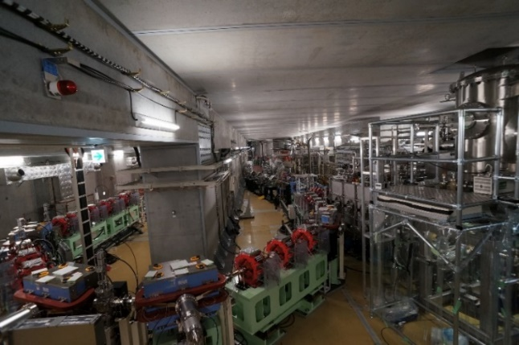
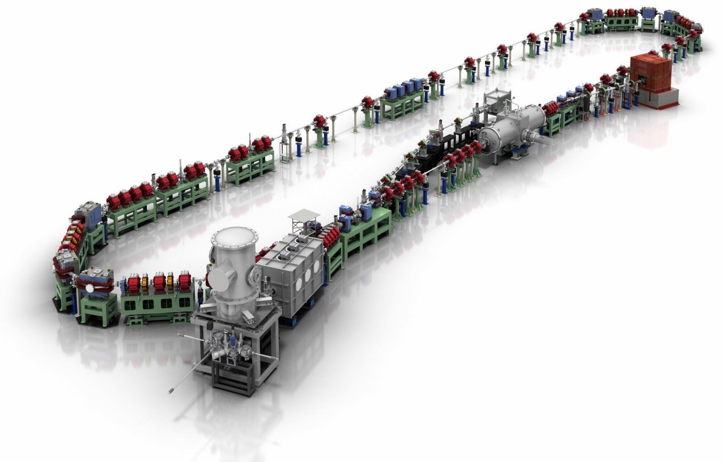
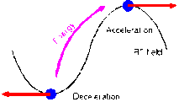
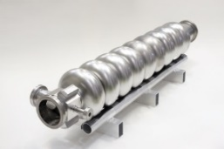
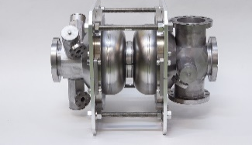
Compact ERL (cERL) in KEK
Compact ERL (cERL) has been constructed in 2013 at KEK to demonstrate energy recovery with low-emittance, high-current CW beams of more than 10 mA for future multi-GeV ERL.
Compact ERL (cERL)
Circumference: ~ 90 m
Beam Dump
Circumference ~ 90m
Main LINAC
Marger
9-cell SC cavity x 2
RF frequency= 1.3 GHz
17.7 MeV
Injector LINAC
Design parameters of the cERL
Nominal beam energy | 35 MeV → 20MeV
Nominal Injector energy | 5 MeV →2.9MeV
Beam current | 10 mA (initial goal) 100mA (final)
Normalized emittance | 0.1 ‒ 1 mm⋅mrad
Bunch length (bunch compressed) | 1-3ps (usual) 100fs (short bunch)
©Rey.Hori/KEK
2-cell SC cavity x 3
Photocathode DC gun
(Not SRF gun)
Buncher

Slide 4
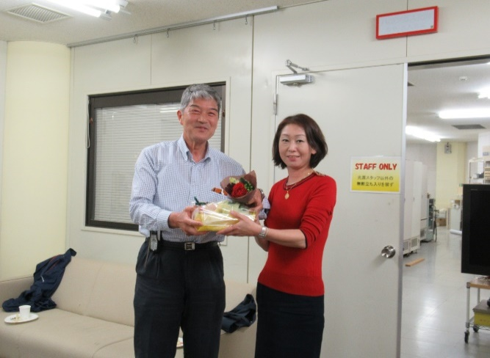
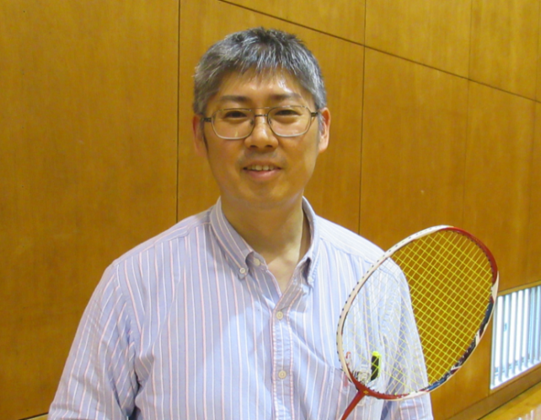
History and Change the target from academia to industry of cERL
2013-2015 The beam commissioning started in 2013 for future 3 GeV ERL light
source and achieve CW 1 mA under energy recovery operation
The future light source was shifted to the high-performance storage ring, so that there is no back ground to continue the ERL R&D. On the other hand, KEK directorates kept the importance of the R&D for industrial application based on ERL technologies*). High bunch charge test operation was approved at the end of the fiscal year 2016. )
See the detail KEK Project Implementation Plan (KEK-PIP)
http://www.kek.jp/ja/NewsRoom/Release/20160802141100/
ERL project Office was closed in KEK and “Utilization Promotion Team based on Superconductive Accelerator (SRF-application team)” was kept in Department of future Accelerator and detector technologies in KEK.
Change the team leader of “SRF application team” from Prof. Kawata to Prof. Hiroshi Sakai.
Restart the beam operation by using cERL for SRF application. (2018.Mar. & Jun. (1mA))
Hiroshi KAWATA (KEK)
Hiroshi SAKAI (KEK)

Slide 5
Result of the commissioning at Injector part (@the end of June/2018)
Parameter | Achieved performance | Target values | Remark
Beam energy T | 5.6 MeV (typ.), 5.9 MeV (max.) | 5 MeV (typical) | OK
DC voltage for DC gun V_{gun} | 500 kV in operation | 500 kV | OK
Acceleration Energy E_{acc} | 7 MV/m (typ.) |  | OK
Normalized Emittance (Very low bunch charge） | ≈ 0.07 μm·rad (@~10 fC/bunch, T=390 keV) | 0.1 μm⋅rad | OK
Normalized Emittance (Low bunch charge） | ≈ 0.17 μm·rad (@0.02 pC/bunch, T=5.6 MeV) | 0.1 μm⋅rad | OK
Normalized Emittance (Medium bunch charge） | ≈ 0.8 μm·rad (@7.7 pC/bunch, T=5.6 MeV) | ≤ 1 μm⋅rad （at the beginning） 0.1 μm⋅rad （aggressive） | OK Still
Normalized Emittance (High bunch charge） | 2~3 （@60 pC/bunch） | 1 μm⋅rad | Not bud
Momentum spread (σ_{p}/p)_{rms} | < 10⁻³ (< 1 pC/bunch) (1.5 - 2.5)×10⁻³ (@7.7 pC/bunch) | ≤ 10⁻⁴ (3 GeV ERL） | Should be OK
Jitter of momentum (Δp/p)_{rms} | 6×10⁻⁵ | ≤ 10⁻⁴ (3 GeV ERL） | OK
Bunch length σ_{t} | ~ 2 ps (@1.5 pC) ~ 7 ps (@7.7 pC) | 2 ps (typical) | Not bad
_{Bunch compression} | 0.25 (ps)@ 2p/bunch | 0.1 (ps) | Not bad

Slide 6
Result of the commissioning at recirculation loop (RL) (@the end of June/2018)
Parameter | Achieved performance | Target Value | Remark
Energy of the electron beam E | 19.9 MeV | 35 MeV | Still
Energy of Injector E_{inj} | 2.9 MeV | 5 MeV | Still
Average Current I₀ | 6.5 μA（steady state）、 1mA (steady state） | 10 μA 10 mA | OK Should be OK
Field gradient of main linac E_{acc} | 8.2 MV/m | 15 MV/m | Still
Normalized Emittance at RL (Very low bunch charge） | ≈ 0.13 μm·rad (@~0.05pC/bunch) | 0.1 μm⋅rad | OK
Normalized Emittance at RL (Low bunch charge） | 0.3 μm·rad (@0.5 pC/bunch) | 0.1 μm⋅rad | Not bud
Normalized Emittance at RL (Medium bunch charge） | ~ 1.0-1.6μm·rad (@7.7 pC/bunch, E=19.9 MeV) | ≤ 1 μm⋅rad （Beginning） 0.1 μm⋅rad （aggressive） | Should be OK Still
Normalized Emittance at RL (High bunch charge） | 2 - 6 μm·rad (@60 pC/bunch) | 1 μm⋅rad (@77 pC/bunch) | Not bad
Momemtun Spread (σ_{p}/p)_{rms} | No data | ≤ 10⁻⁴ (3 GeV ERL）
Jitter of Momemtum (Δp/p)_{rms} | No data | ≤ 10⁻⁴ (3 GeV ERL）
Bunch compression (σ_{t}) | 0.2ps @ 2pC/bunch * | 0.1ps | Not bad
* Beam operation in 2018

Slide 7
Industrial Application of ERL technology
ERL gives us a following outstanding performance on Accelerator.
High current linac-based electron beam
Production of the high intense quantum beam
High quality of the electron beam :
Small Emittance, short pulses, and so on
The quantum beams have excellent performance on energy and space resolution.
EUV-FEL for Lithography, High intense LCS sources,
THz source, RI factory and so on
We restarted beam operation of cERL from 2017.
March 2017: High bunch charge operation (max. 40 pC/bunch) to develop beam handling method toward high average current FEL.
March 2018: High bunch charge operation (max. 60 pC/bunch)
June 2018: CW 1 mA operation to reduce un-wanted beam loss and halo.
Resonant Coherent Diffraction Radiation (RCDR), to generate intence THz.

Slide 8
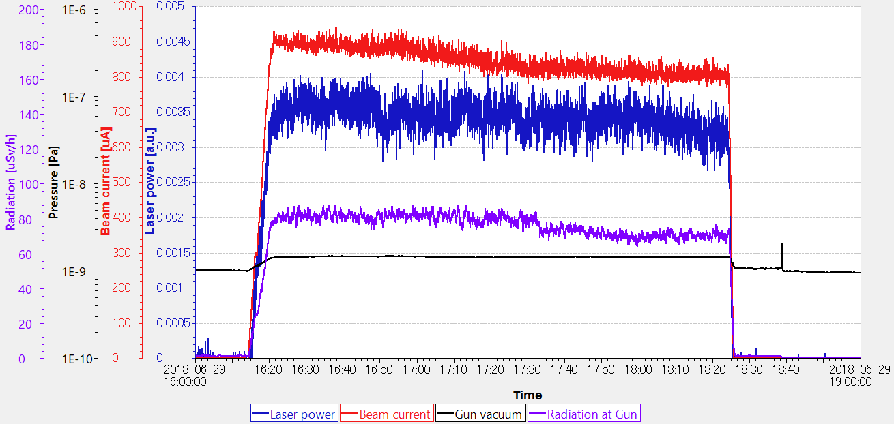
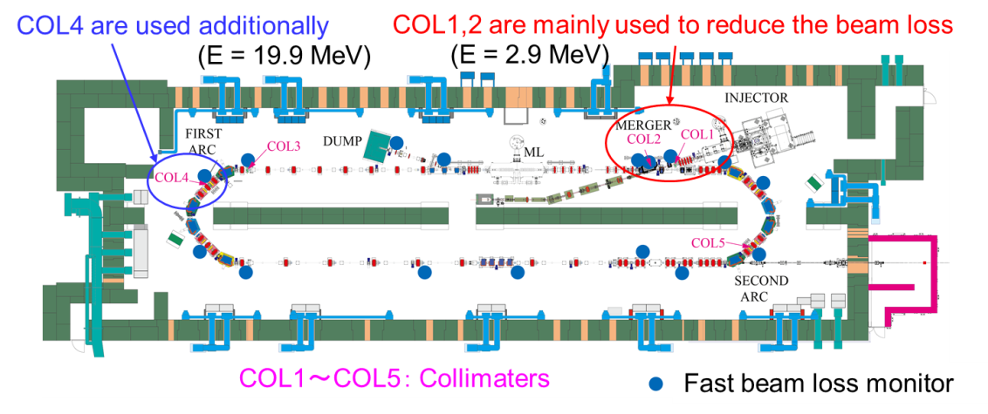
CW 1 mA operation, June 2018
We succeeded in CW 0.9 – 0.8 mA operation. It was very stable in 2 hours. For the CW operation, control of the collimators to reduce un-wanted beam loss was very important.
Beam current: 0.9 – 0.8 mA
Gun voltage:
DC 500 kV
2 hours
Before CW operation: we adjusted the optics and collimators in pulse operation with low average current.
In the CW operation: we can not change any parameter.
(E = 17.7 MeV)

Slide 9
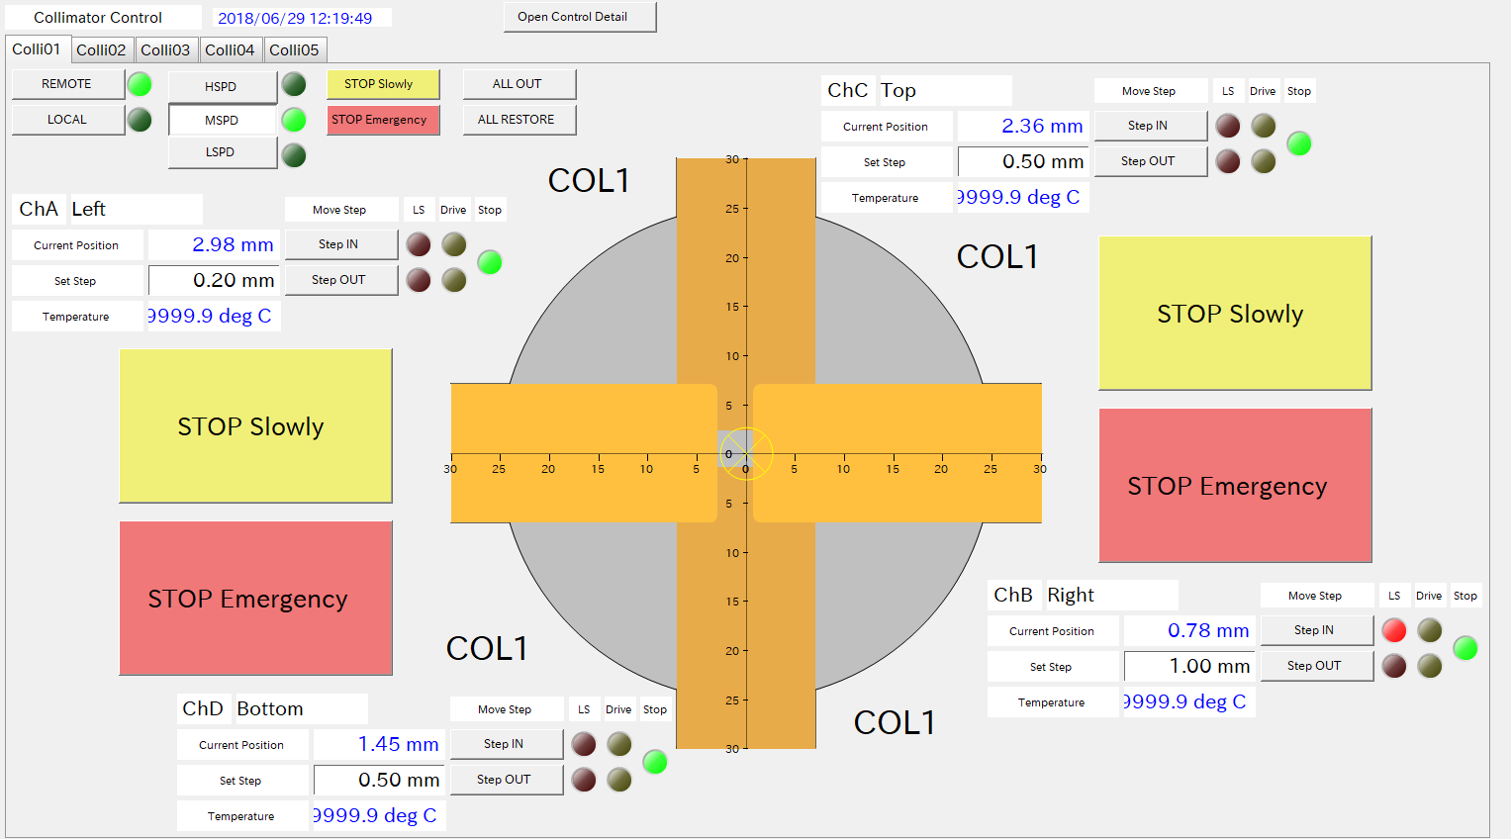
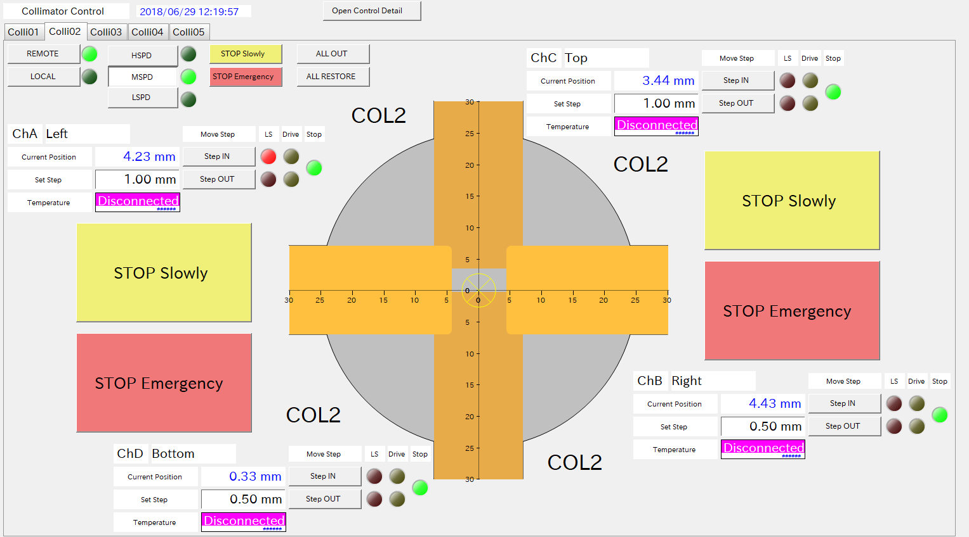
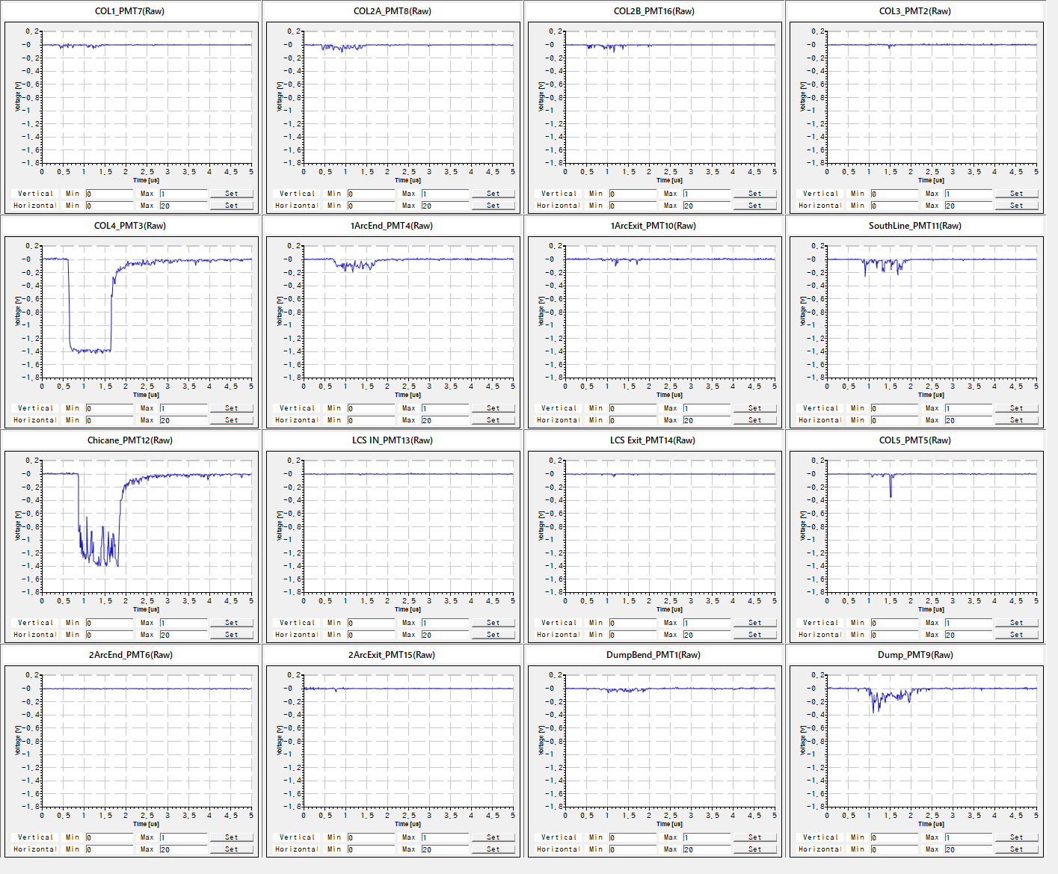
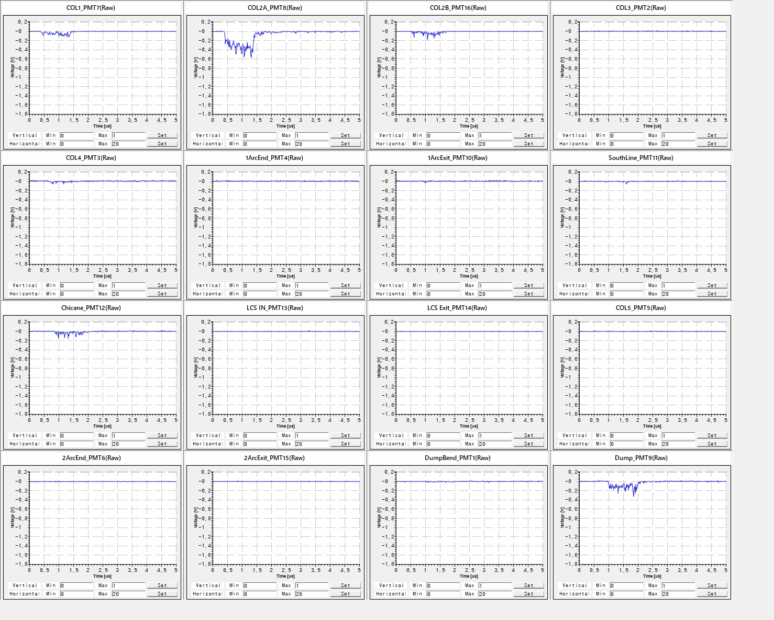
Collimator tuning for CW 1 mA operation
COL1 (Injector, non-dispersive point)
COL2 (Merger, dispersive point)
Los monitor signals
Before collimator tuning.
After collimator tuning.
(E = 17.7 MeV)
1st Arc
Chicane in return loop

Slide 10
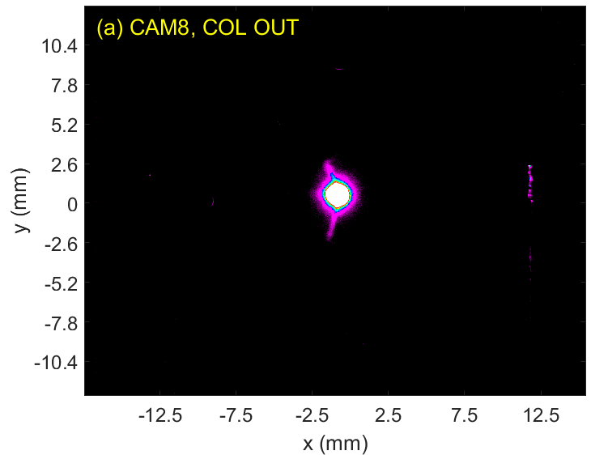
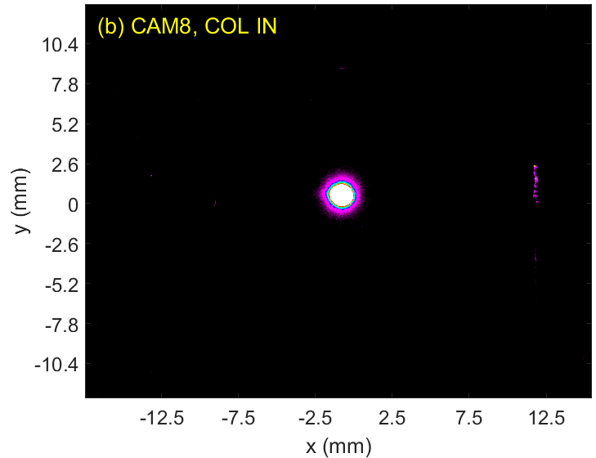
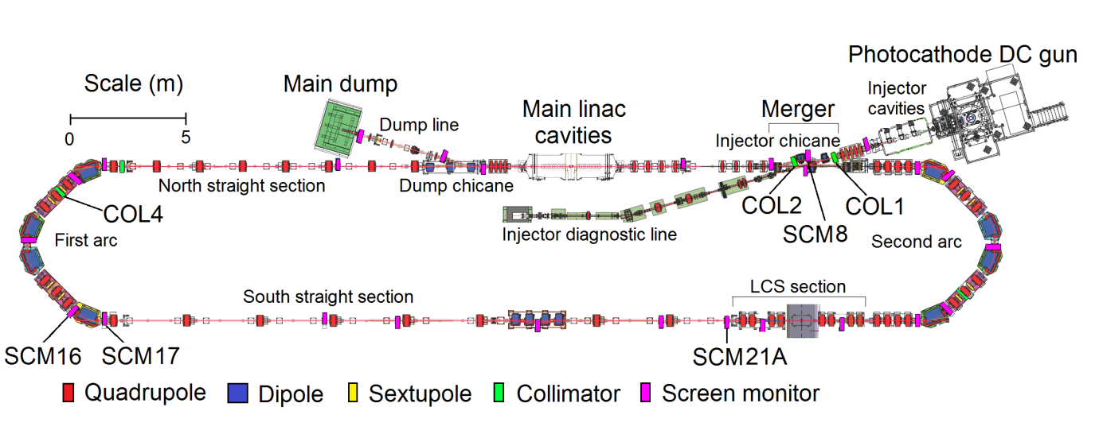
Collimation of Beam Halo
SCM8
COL OUT
COL IN
YAG screen light reflected in the YAG screen holder captured by CCD sensitive area
2/23 burst mode, gain 22 dB, exp. time 10 us
Collimator cuts the beam halo, which causes beam loss in the recirculation loop.
Courtesy of Olga. Tanaka

Slide 11
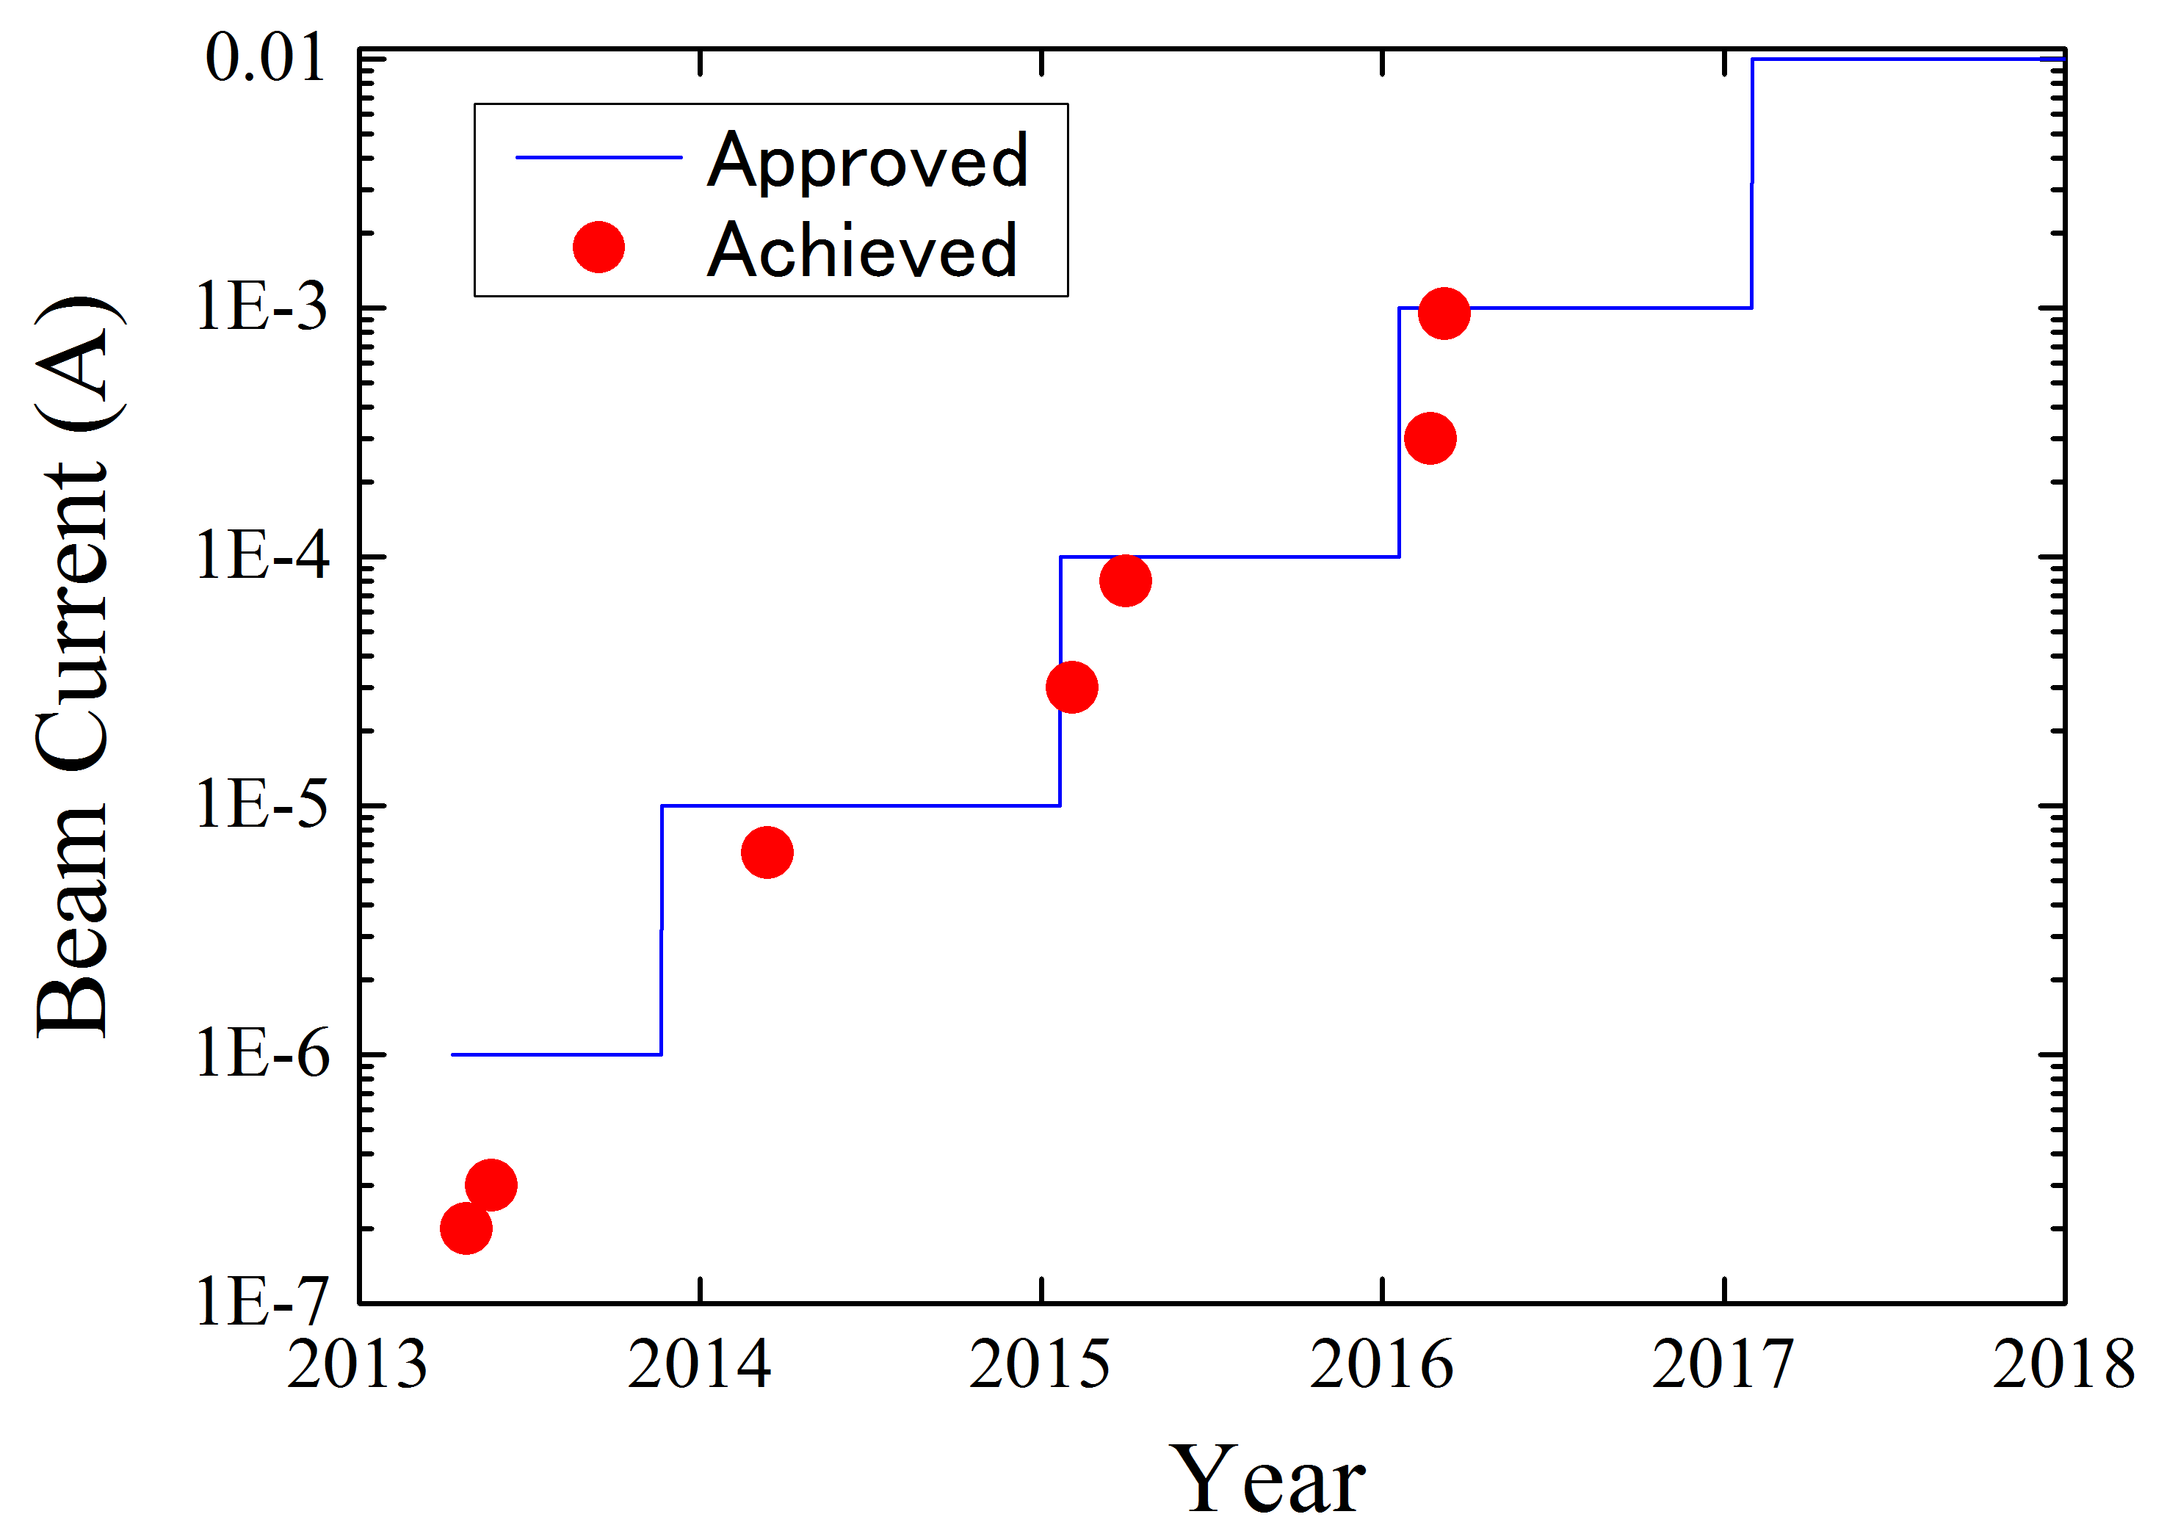
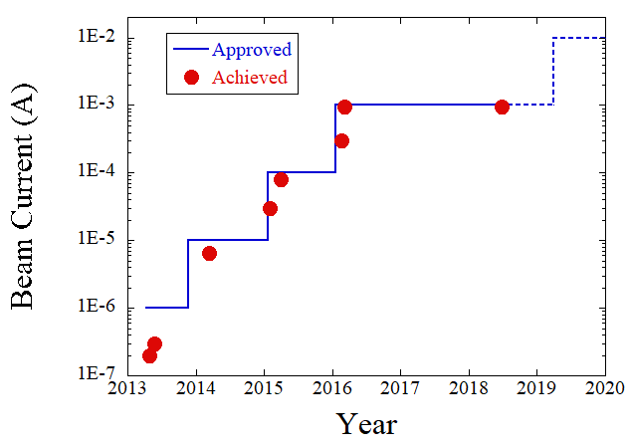
Beam Currents: Achievement and Prospect
Plan to increase 10mA in 2019.
By achieving low loss beam operation and high charge low emittance beam generation of 7.7pC, 10mA operation is within target.

Slide 12
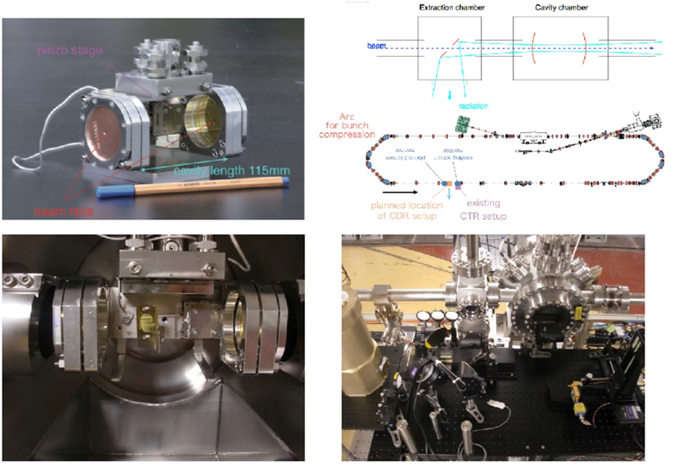
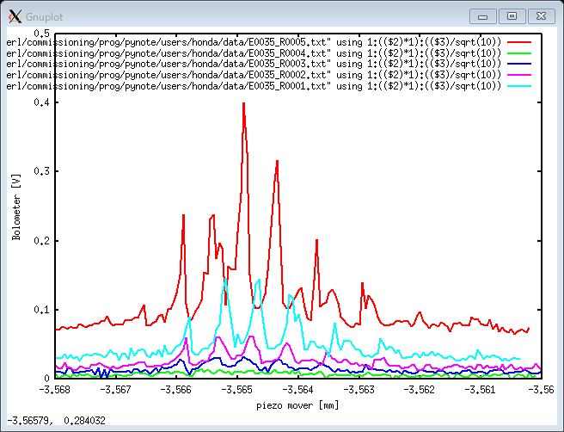
Resonant Coherent Diffraction Radiation (RCDR), THz (2018)
Intensity of THz from Resonant cavity
Piezo scan (Cavity length (mm))
New idea to obtain the intense THz.
ERL beam suitable to generate shorter bunch and high intense THz light.
Detail: PRL, Accepted 12 October 2018 (Y.Honda, et. al)
Red: 1us bunch train condition.
We see resonance peak by scanning the cavity length.

Slide 13
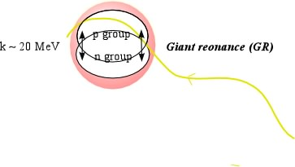
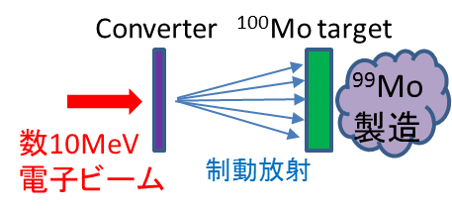
cERL application plan in a few year
Industrial Application of ERL technology
High resolution X-ray imaging device for medical use
Nuclear security system
EUV-FEL for Future Lithography
RI manufacturing facility for nuclear medical examination
99Mo production by using cERL beam line
Already achieved these application
(Laser compton scattering, LCS)
100Mo+γ → 99Mo + n
Giant resonance on 20 MeV
Next targets in a few year
CW high current e- beam by SRF cavity can make a lot of 99 Mo RI for medical use.
Fixed plan with beam operation (2018~2020)
New beam line for 99Mo RI production in cERL. (beam operation will be start in 2019)
Funded Research from “Accelerator” company https://www.accelerator-inc.com/
10 mA beam operation with energy recovery is within our target in 2019 to 2020. And we will produce FEL with this high current beam. (POC of EUV-FEL plan) (2~3 years plan)
Including high charge beam operation (~60pC).
~100fs bunch operation with THz generation (RCDR experiment)
New beam line for 99 Mo RI

Slide 14
Summary of current status of cERL
High current beam operation of 1mA was achieved at Compact ERL (cERL) in KEK. → plan to increase 10mA.
Especially, R&D of SRF technology is in progress for high current beam generation and acceleration for future advanced accelerator.
Conceptual design study for EUV-ERL-FEL was carried out to open the era of more higher light source of EUV-lithography, 10 kW class high power EUV light source is NOT just a dream from the experience of cERL in KEK.
cERL now move to use for the industrial application by using SCRF technology. 99Mo beam line will be built for RI production with CW intense beam.

Slide 15
Potential research on ERLs for EIC
Current performance of cERL
Maximum bunch charge: 60 pC for re-circulation loop (200 pC for gun operation without SC cavity operation)
Beam total energy for re-circulation: 2.9 MeV for injector, 17 MeV for re-circulation loop
Maximum average CW current: 1 mA
Upgrade and operation plan in 2019 and 2020
Maximum bunch charge: 60 pC for re-circulation loop
Beam total energy for re-circulation: 2.9 MeV for injector, 17 MeV for re-circulation loop
Maximum average CW current: 10 mA (1.3 GHz repetition, 7.7 pC/bunch)
Based on these parameters, what can we contribute for ERLs for EIC?

Slide 16
Potential research on ERLs for EIC
Research topics for CBETA
Beam loss:
cERL has collimators and beam loss monitors. And, we are studying beam halo simulation.
High-bunch-charge:
The maximum bunch charge is 60 pC. It is very small compared with 1 nC for EIC…
Magnetized beam-transport:
So far, we don’t care about magnetized beam.
High average CW current ERL operation:
In 2019 and 2020, we consider 10 mA CW operation. However, the initial bunch charge will be 7.7 pC with 1.3 GHz repetition.
Multi-turn ERL operation:
We have space for the construction of second re-circulation loop. However, we don’t have upgrade plan for multi-turn ERL.

Slide 17
Operation plan of cERL and Collaboration
Operation plan of cERL (tentative)
April 2019, 10 μA CW operation for RI production application.
June 2019, test operation toward 10 mA CW operation (beam loss study, high bunch charge study, RCDR study)
2020, 10 mA CW operation test (maximum average current: 1 mA to 10 mA)
cERL team would like to send persons to join CBETA beam operation in Spring 2019.
Beam tuning, beam dynamics simulation, …
cERL team welcomes persons from CBETA group to join cERL beam operation.
We would like to apply a Moderate “Funding Opportunity Assessment” (FOA), “U.S.‐Japan Science and Technology Cooperation” to collaborate with CBETA project (BNL, Cornell, Jefferson Lab. ) about ERL accelerator technologies.

Slide 18
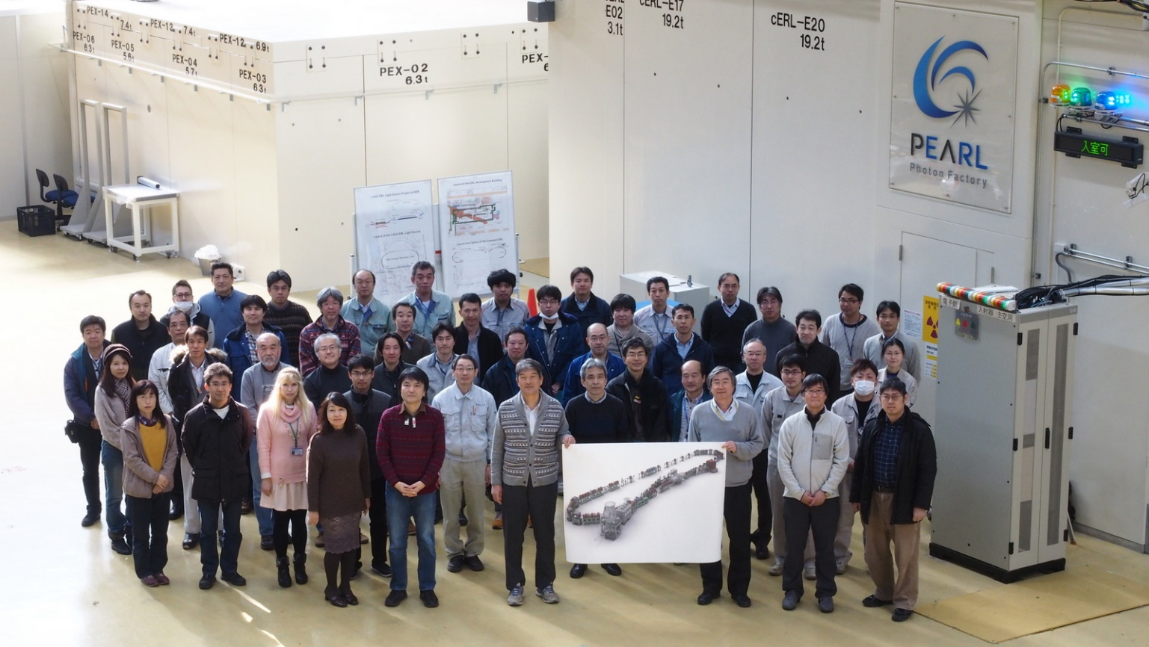
Thank you for your attention!

Slide 19
Backup slides

Slide 20
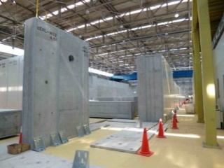
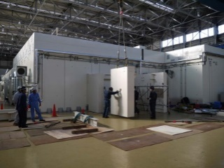
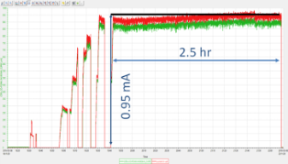
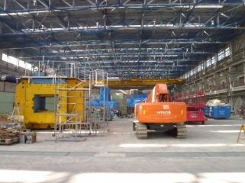
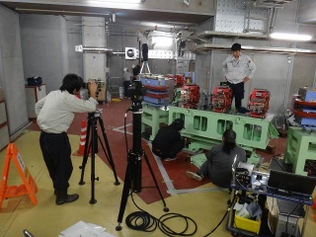
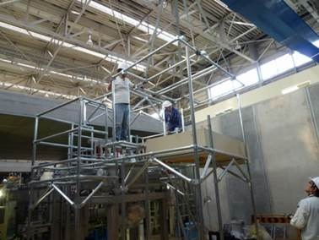
History of Construction and Commissioning of cERL
R&D for Industrial application
2008 | 2009 | 2010 | 2011 | 2012 | 2013 | 2014 | 2015 | 2016 | 2017 | 2018
Construction
High bunch charge
Commissioning/Operation
Increasing the beam current
1mA again
Commissioning of LCS system
Construction of LCS system
Commissioning of cERL (with loop)
Construction of recirculation loop
Commissioning of injector
Construction of
injector
Refurbishment
of building
Clearing radioactive
materials
Construction of
radiation shielding
For industrial application
20
Construction started in 2009 and commissioning start in 2013.
From 2017, we restarted beam operation toward CW 10 mA.

Slide 21
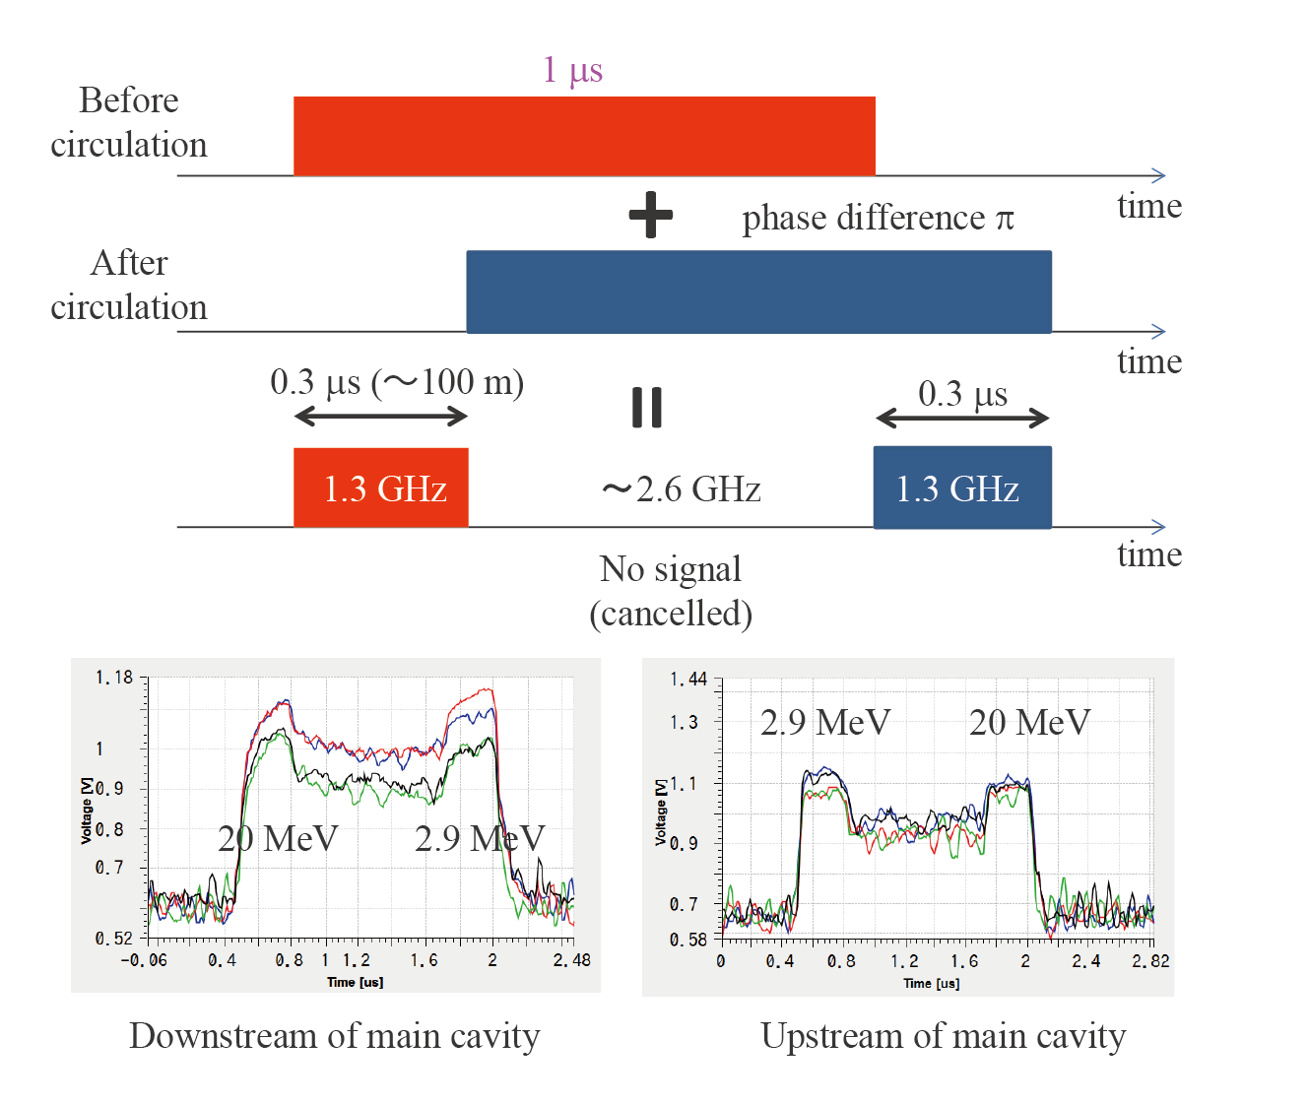
Orbit tuning for two different energy beams
Orbit measurements of injection and
recirculation beams
Beam parameters in orbit tuning
Bunch charge | 10 – 100 fC
Macro pulse width | 1 us
Beam Repetition | 1.3 GHz
Macro pulse repetition | ~ 5 Hz
Average current | few100 pA
・ Orbit measurement and tuning
Screen monitors are used.
・ Two beams section
BPMs are used to measure beam
positions.

Slide 22
cERL Team
High Energy Accelerator Research Organization (KEK)
M. Adachi, S. Adachi, T. Akagi, M. Akemoto, D. Arakawa, S. Araki, S. Asaoka, K. Enami,K. Endo, S. Fukuda, T. Furuya, K. Haga, K. Hara, K. Harada, T. Honda, Y. Honda, H. Honma, T. Honma, K. Hosoyama, K. Hozumi, A. Ishii, X. Jin, E. Kako, Y. Kamiya, H. Katagiri, R. Kato, H. Kawata, Y. Kobayashi, Y. Kojima, Y. Kondou, T. Konomi, A. Kosuge, T. Kubo, T. Kume, T. Matsumoto, H. Matsumura, H. Matsushita, S. Michizono, T. Miura,T. Miyajima, H. Miyauchi, S. Nagahashi, H. Nakai, H. Nakajima, N. Nakamura, K. Nakanishi,K. Nakao, K. Nigorikawa, T. Nogami, S. Noguchi [on leave], S. Nozawa, T. Obina, T. Ozaki, F. Qiu,H. Sagehashi, H. Sakai, S. Sakanaka,S. Sasaki, K. Satoh, M. Satoh, Y. Seimiya, T. Shidara, M. Shimada, K. Shinoe, T. Shioya,T. Shishido,M. Tadano, T. Tahara, T. Takahashi, R. Takai, H. Takaki, O. Tanaka, T. Takenaka,Y. Tanimoto, N. Terunuma, M. Tobiyama, K. Tsuchiya,T. Uchiyama, A. Ueda, K. Umemori, J. Urakawa,K. Watanabe, M. Yamamoto, N. Yamamoto, Y. Yamamoto, Y. Yano, M. Yoshida
National Institutes for Quantum and Radiological Science and Technology (QST)
R. Hajima, S. Matsuba [on leave], M. Mori, R. Nagai, M. Sawamura, T. Shizuma
Tohoku University
N. Nishimori
Hiroshima University
M. Kuriki, Lei Guo
The Graduate University for Advanced Studies (Sokendai)
T. Hotei, E. Cenni [on leave]

Slide 23
Compact ERL
Test accelerator to demonstrate ERL technology
The first arc
Injector diagnostic beamline
Recirculation loop
Beam dump
Dump chicane
Main-linac cryomodule
Merger
Circumference: ~ 90 m
The second arc
Injector cryomodule
©Rey.Hori/KEK
Photocathode DC gun (JAEA)

Slide 24
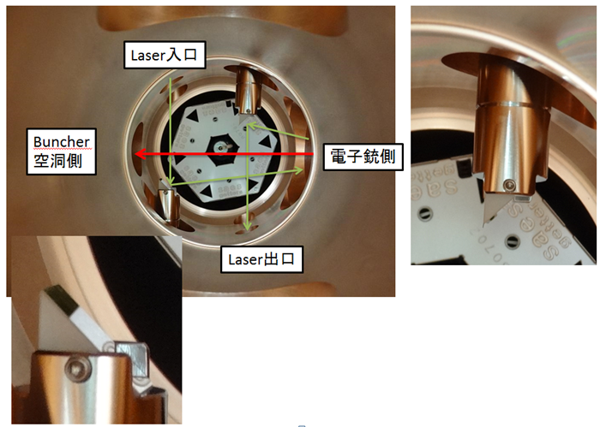
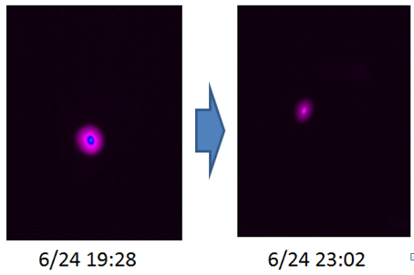
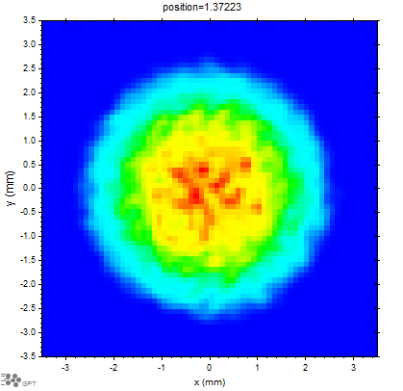
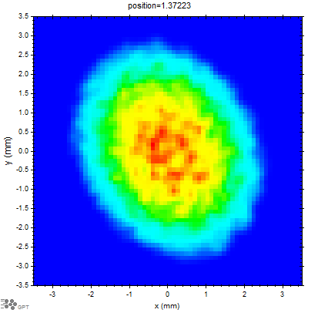
Orbit stability in CW operation
In previous CW operation (2015), orbit distortion and beam loss gradually increased.
Charge-up of laser glass mirror?
Beam profile at the entrance of injector
Before CW operation
After CW operation
Laser entrance
Buncher
cavity
DC Gun
Laser exit
Model simulation
Result shows that the charge-up of glass mirrors may deform the profile.

Slide 25
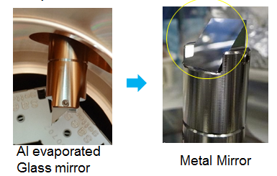
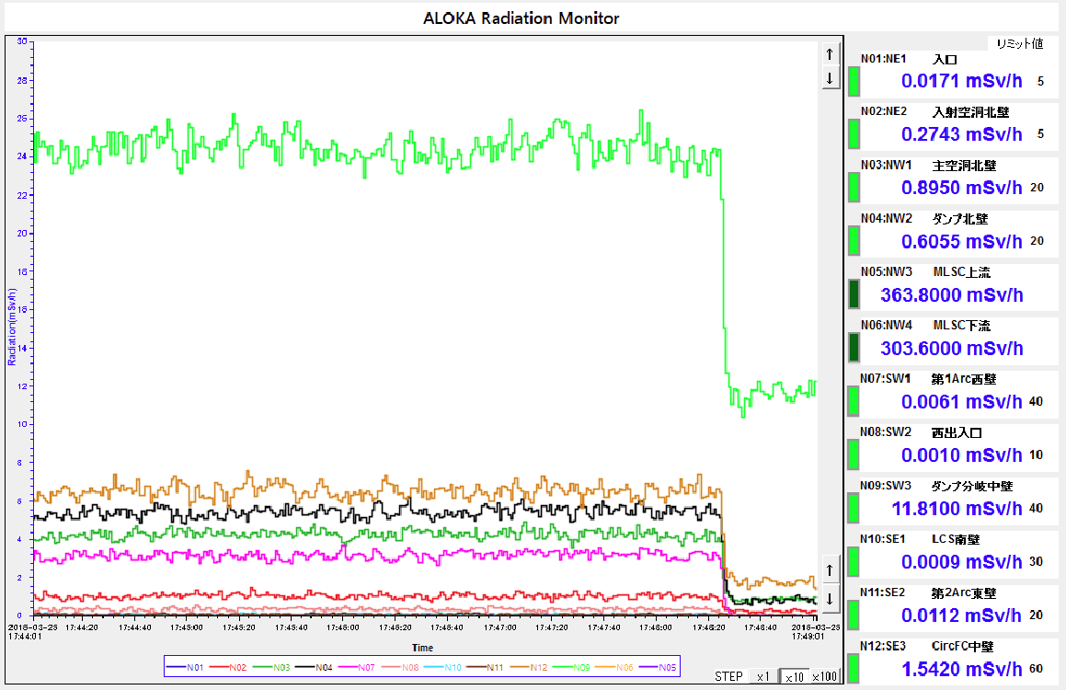
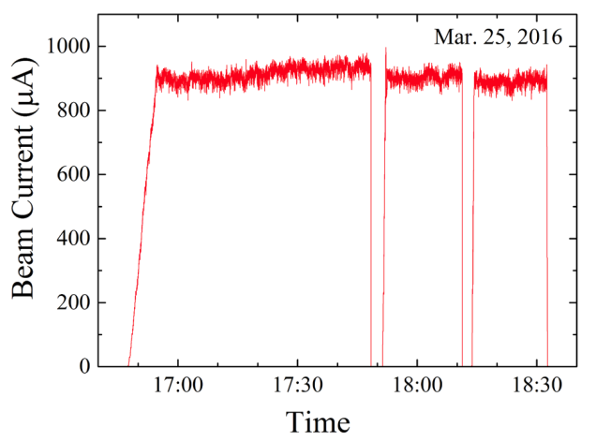
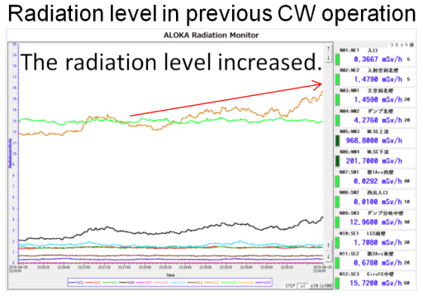
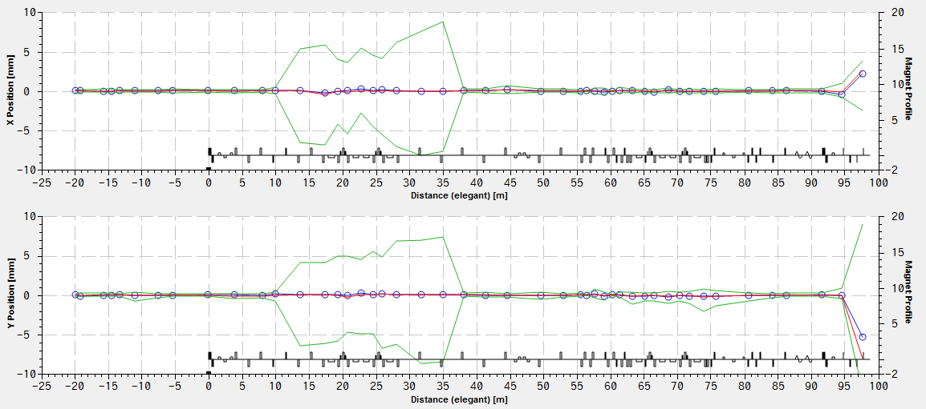
Orbit stability in CW operation
Laser mirror made of glass was charged up, and the electric field bended the orbit of the low energy beam.
⇒ In summer 2015, we exchange the glass mirrors for metal mirrors to avoid charge-up.
CW operation in Mar. 2016
Beam repetition rate：162.5 MHz
Average current: 0.9 mA (charge: 5.5 pC)
Mar. 2015
Orbit fluctuation in CW operation (1 hour) .
X (range: ±10 mm)
Radiation level (17:44-17:49), in Mar. 2016
Result
⇒ In the CW operation, the radiation level was low and very stable. Exchange mirror was effective.
Y (range: ±10 mm)

Slide 26
History of emittance measurement
Previous emittance measurement result （Q-scan method）
Very low charge (< 0.05 pC/bunch)
enx / eny (mm mrad)
 | Before main linac | After main linac | After 1st arc | LCS
2014/6/13 | 0.15 / 0.14 | 0.14 / 0.12 | 0.14 / 0.14 | 0.13 / 0.15
2015/2/17 | -/- | -/- | 0.25 / 0.25 | -/-
2015/2/19 | -/- | -/- | -/- | 0.17 / 0.19
Middle charge (0.5 pC/bunch)
2015/3/25 | -/- | -/- | 0.32 / 0.28 | 0.41 / 0.30
High charge (7.7 pC/bunch)
2014/6/19 | -/- | -/- | 42 / 15 | -/-
2014/6/20 | -/- | 2.9 / 2.4 | 5.8 / 4.6 | -/-
2015/6/15 | -/- | 1.9 / 2.4 | 4.5 / 4.5 | -/-
After the 1st arc section, emittance increased.
Upper column：enx (mm mrad)
Lower column：eny (mm mrad)
Emittance measurement in 2016 （Q-scan method）
We reduced the emittance growth for 7.7 pC operation.
However, to achieve design emittance (0.45 mm mrad),
we required more operation time.
Charge | Before main linac | After main linac | South straight
5.3 pC | 1.0 0.66 | 2.7±0.21 1.0±0.071
7.7 pC | - 0.9 | 1.8±0.40 1.02±0.33 | 1.5±0.082 1.1±0.058

Slide 27
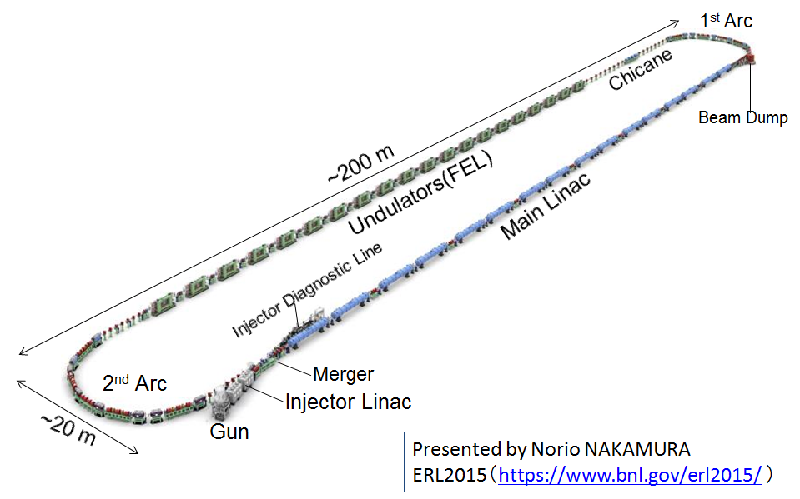
60 pC bunch charge, non-ERL operation
As the next topic of the beam experiment for the cERL, we have planned to increase the bunch charge toward the development of CW-FEL accelerator based on a superconducting linac, since it requires higher bunch charge and higher peak current.
For example, EUV-FEL accelerator based on ERL for future lithography light source requires the bunch charge of 60 pC, and CW-XFEL accelerator like the LCLC-II requires the bunch charge of 300 pC.
In March 2017, we have planned beam operation to demonstrate generation, acceleration and transportation of the bunch charge of 60 pC without energy recovery.
Condition of beam operation
Maximum bunch charge: 60 pC (Target for EUV-FEL)
Injector total energy: 2.9 MeV for energy recovery ⇒ 5.1 MeV (without energy recovery) to reduce space charge effect
EUV-FEL based on ERL
N. Nakamura in this workshop.

Slide 28
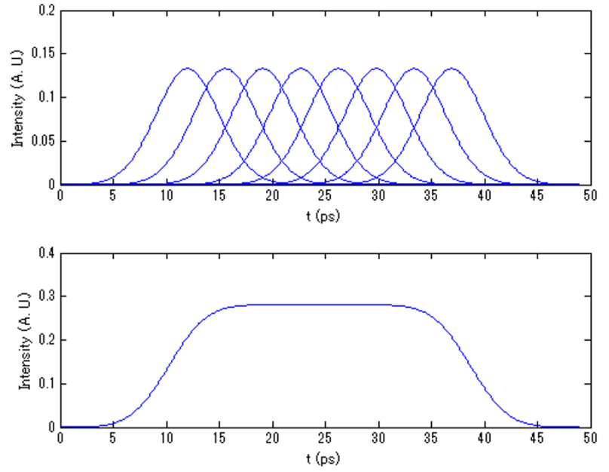
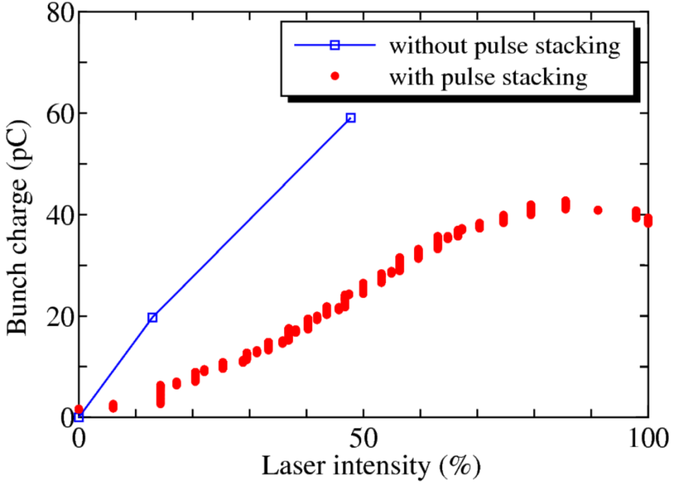
Generation of Higher Bunch Charge
We measured the generated bunch charge from a GaAs photocathode by a Faraday cup, which located at 1 m from the cathode.
Quantum efficiency (QE): 3 %
Laser pulse: single Gaussian 3 ps RMS
We achieved the generation of 60 pC bunch charge.
For emittance compensation, we extend the pulse length of the excitation laser.
Laser pulse: 8 stacked Gaussian 31 ps FWHM
The maximum bunch charge was limited to 40 pC.
The crystals to stack the laser pulse decrease the irradiated laser power on the cathode.
The stacked laser power is about 1/3 of the original power.
⇒ We did the beam operation with 40 pC bunch charge.
Single Gaussian
8 stacked Gaussian

Slide 29
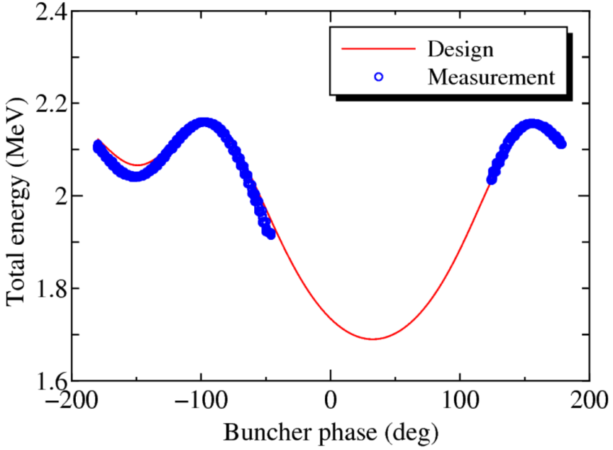
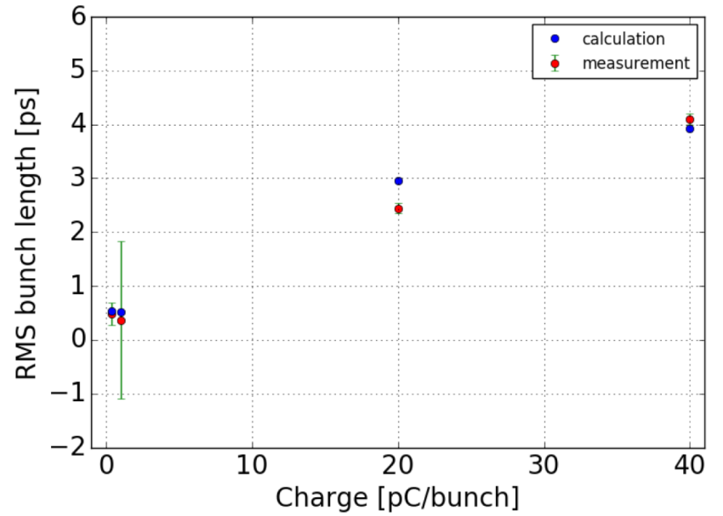
Bunch length measurement in injector diagnostic line
In this operation, we improved phase tuning method for RF cavities.
Pervious phase tuning method (- Mar. 2016)
⇒ The agreement of the longitudinal dynamics between measurement and model was not so good, because this method is not the same as phase tuning method in the optics design simulation.
New phase tuning method (Mar. 2017- )
⇒ The results of the bunch length measurement gave good agreement with the values that had been obtained by model simulation.
Designed and measured responses of accelerated beam energy to buncher phase. In the measurement, the beam was accelerated by the buncher cavity and the first injector cavity. The phase of the first injector cavity was fixed to maximum acceleration phase. The beam energy was measured by the first bending magnet in merger section.

Slide 30
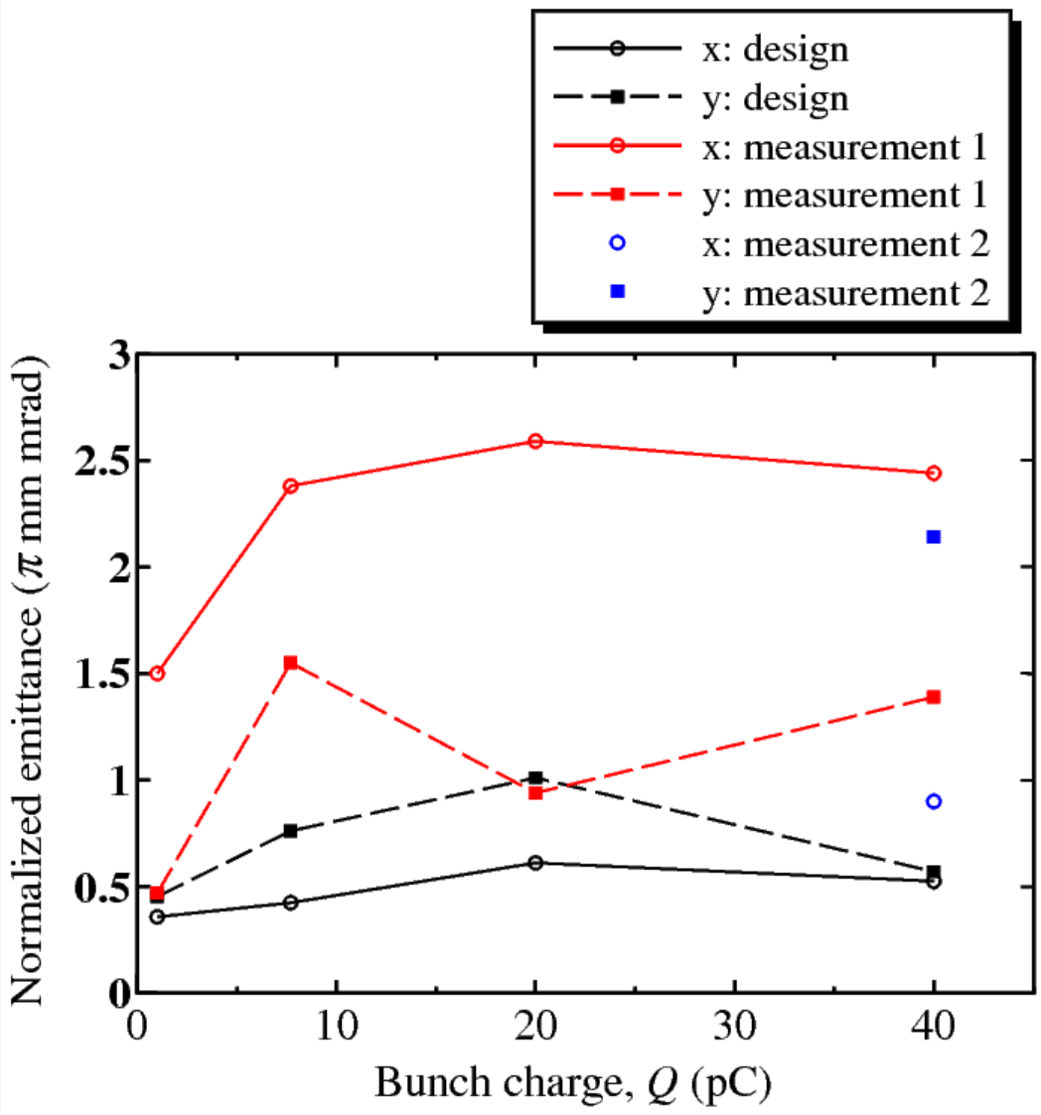
Emittance measurements in diagnostic line
After optics tuning for the bunch charge of 40 pC, we measured normalized rms emittance by slit-scanner in the injector diagnostic line and Quadrupole scan method.
X (meas.1)
Y (meas.2)
Y (meas.1)
Results by slit-scanner in the injector diagnostic line (Preliminary)
Beam total energy: 5.1 MeV
We measured emittances in two different transport conditions.
In measurement 1, the vertical beam size was focused at the slit scanners.
In measurement 2, the horizontal beam size was focused at the slit scanners.
⇒ So far, we did not achieve the design emittance.
Y (design)
X (meas.2)
X (design)

Slide 31
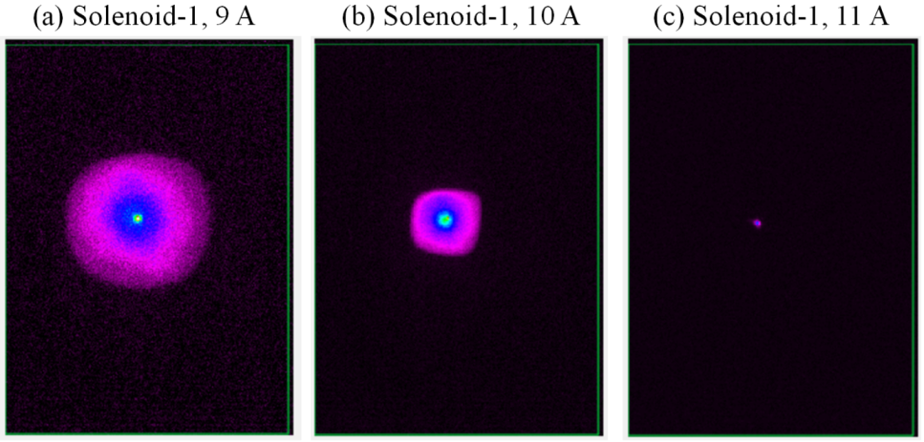
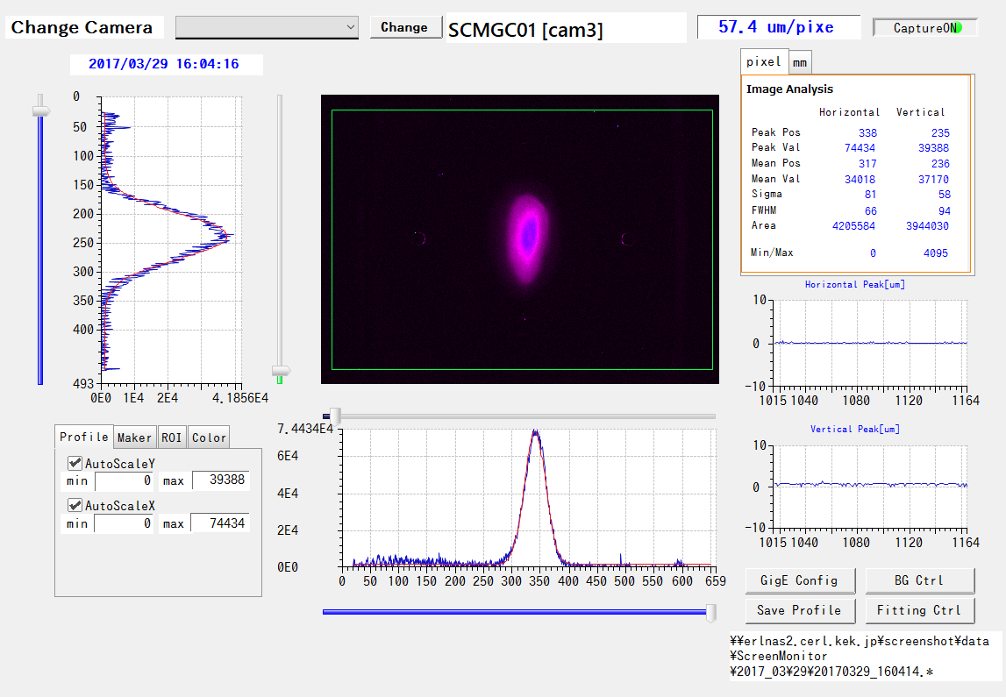
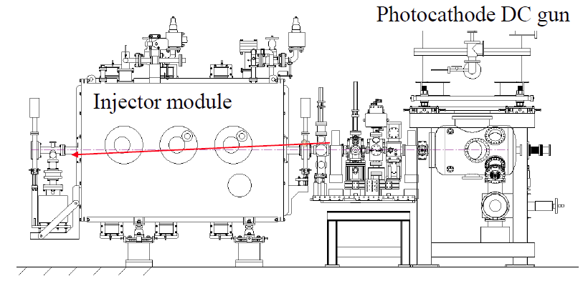
Beam performance in low energy region
To achieve design emittance, we are studying the source of the emittance growth for 40 pC bunch charge.
Distortion of transverse profile from cylindrical symmetry before the injector cavities (450 keV)
Asymmetric transverse profile at the exit of the injector cavities (5.1 MeV)
⇒ In this operation, we carried out single kick response measurements in the low energy region.

Slide 32
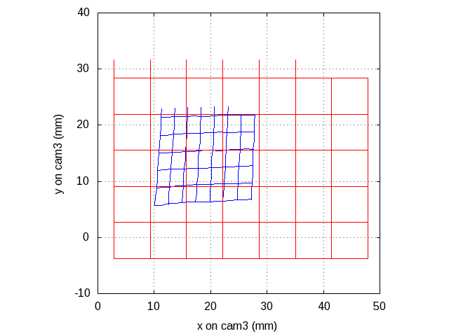
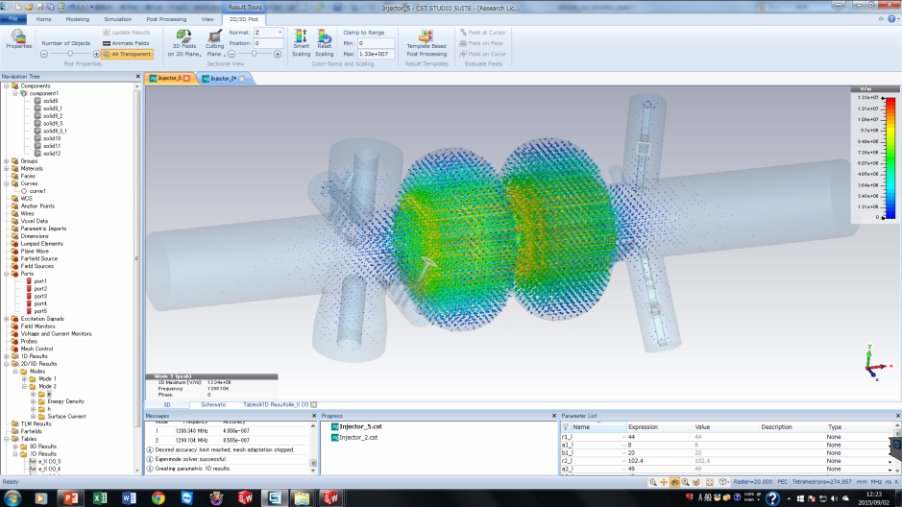
Single kick response for injector 1st 2-cell cavity
In order to find the source of the asymmetry profile, we measure the single kick response for injector 1st 2-cell cavity.
The beam is kicked by horizontal and vertical steering magnets, which are located at the entrance of injector SC linac.
⇒ From the single kick response, we obtained the asymmetric focusing force caused by the injector cavity. The input and HOM coupler may cause the effect.
⇒ Based on the measurement results, we are correcting the model of the injector cavity.
All the injector cavities are turned off.
The first injector cavity is turned on, and it is affected by the focusing force caused by the first cavity.
Input power coupler
HOM coupler
Courtesy of T. Konomi

Slide 33
Beam profiles in 0.5 pC operation
After fine beam tuning, the beam profiles are the almost same as the design beam sizes.
We succeeded to reduce the beam loss in the recirculation loop.
Previous operation (26 Jun. 2015)
3 Mar. 2016

Slide 34
Design optics for 7.7 pC bunch charge
Initial condition
Laser diameter： d = 1.5 mm
Laser pulse： 8 stacked 3 ps gaussian
Beam parameters at the exit main linac
enx = 0.45 mm mrad
eny = 0.44 mm mrad
stdz = 1.47 mm (4.9 ps)

Slide 35
Design optics for 40 pC bunch charge

