Slide 1

Injector Studies
Fay Hannon
Mark Stefani
10/29/2018

Slide 2
Injector Space
I_{peak}
Also magnetized
25A
I_{avg.}
50mA

Slide 3
High charge, high current: questions
Lifetime/QE vs C delivered
Gun vacuum/breakdown
Emittance vs C delivered
Cathode type
Power supply capability
Cathode gradient/ brightness
Where does the injector end
Implemeting magnetizing solenoid
How to best characterize magnetized beams

Slide 4
Experiments
1 – 3.2nC bunch charge
110 – 70mA
eRHIC small transverse emittance
JLEIC magnetized beams
      Big beams

Slide 5
Magnetized beam
Formed when electrons are born in a perpendicular magnetic field.
  Gain angular momentum
Beams are large
  Off axis fields
  Scraping
  Divergent
Where does the injector end?
  Transversely dominated by CAM, but space charge noticeable before booster
  Longitudinally, space charge as usual
Simulation implications

Slide 6
Magnetized beam
Goal to preserve magnetization
  Want linear r, ρΦ
Want to minimize the uncorrelated emittance
  Thermal contributions
  Non linear dynamics
Simulations are good for small, on axis beams
  Benchmarking useful

Slide 7
Diagnostics

Slide 8
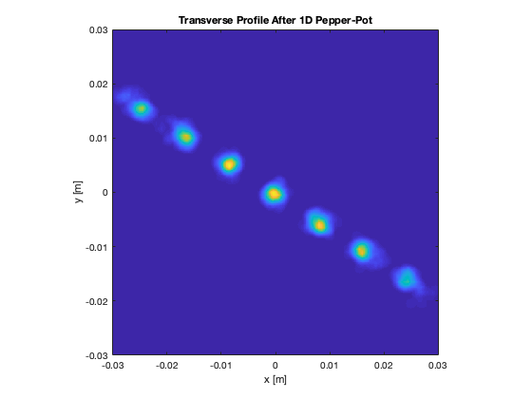
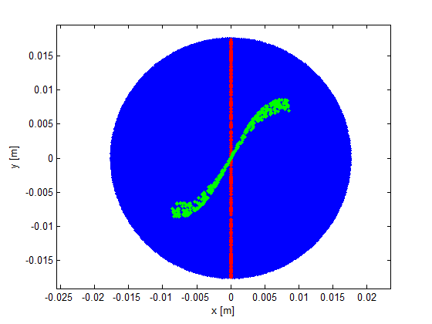
Diagnostics
Is magnetization preserved?
  Slit - screen

Slide 9
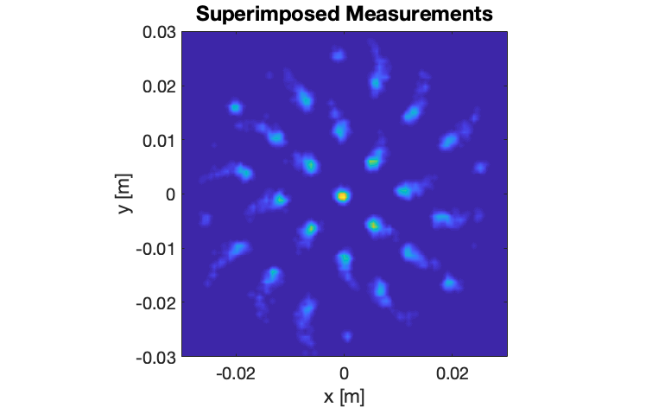
Reality

Slide 10
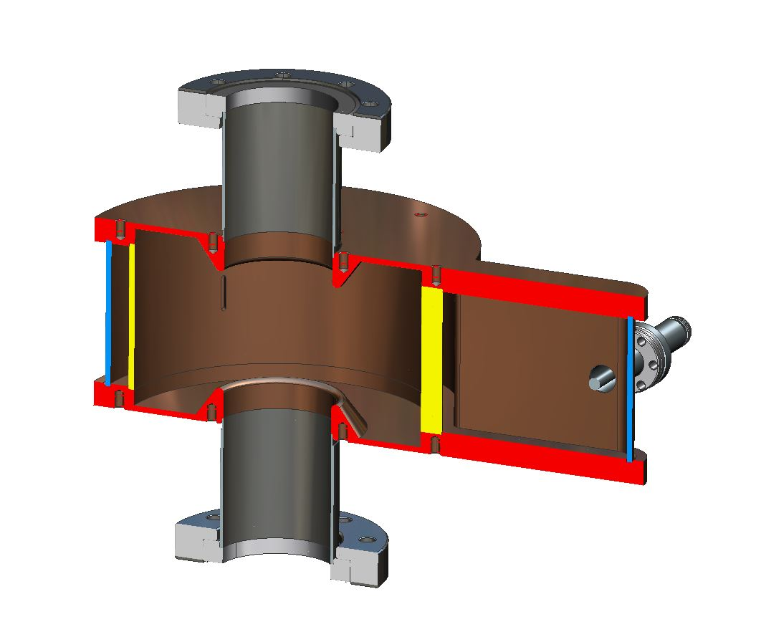
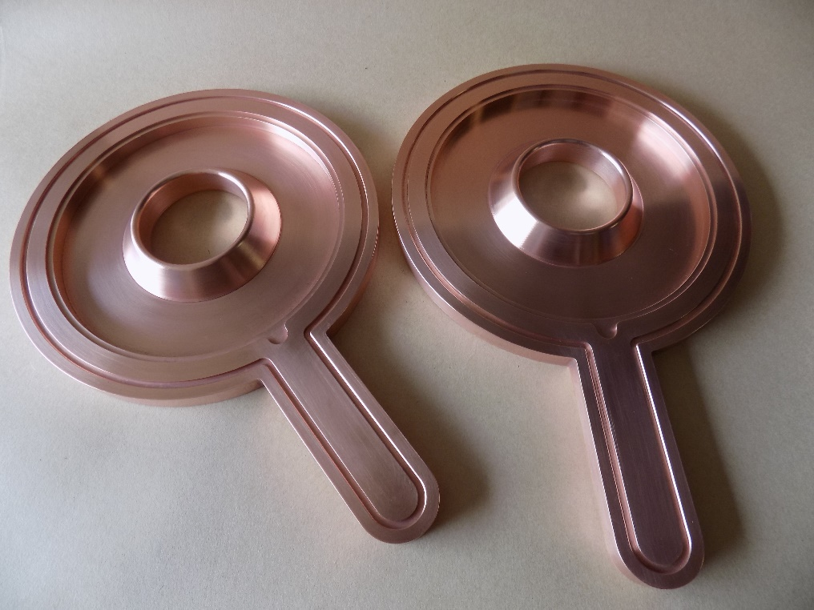
Magnetic Momentum Monitor
A non-invasive real time monitoring system is highly desired to quantify electron beam magnetization.
A passive copper RF cavity in TE011 mode as such a monitor.
Jiquan Guo, et al

Slide 11
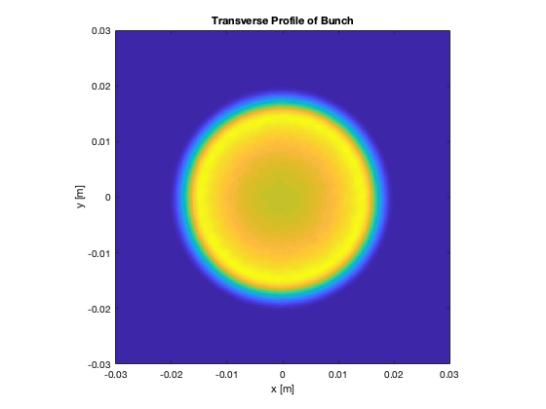
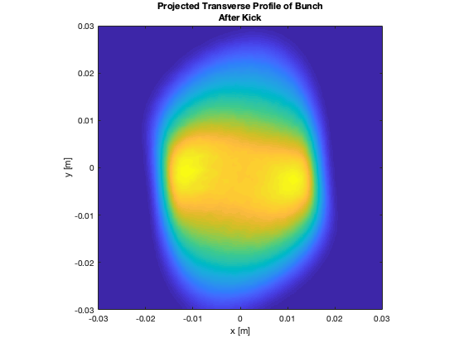
Diagnostics: Bunch length/profile
RF kicker
  Beam large
  Beam rotates
  Beam grows
Use slit, or better still, 1 D pepper-pot

Slide 12
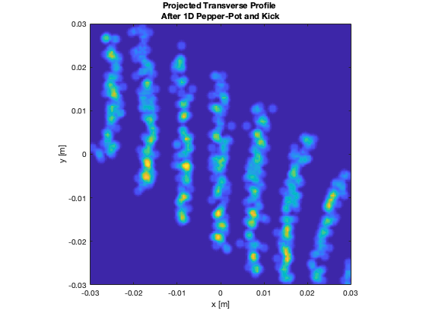
How to dice the image? Sparse mask.
Can actually extract angular momentum from this too
Voronoi Diagram

Slide 13
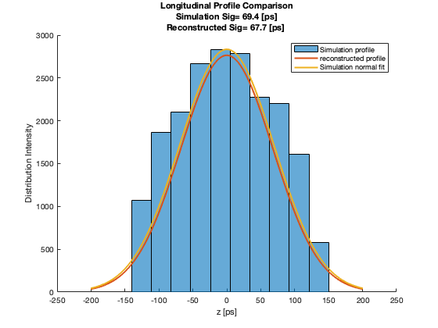

Slide 14
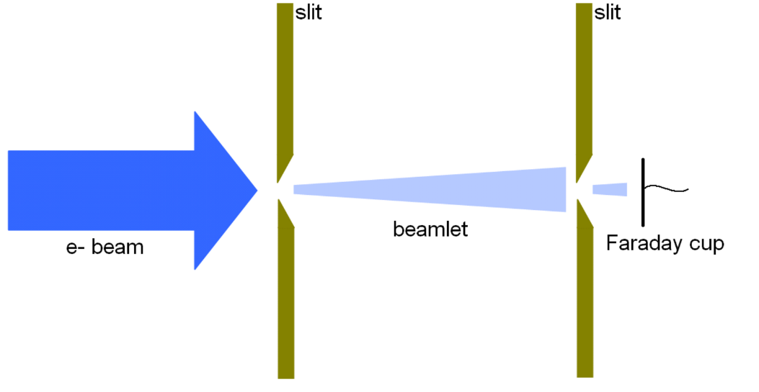
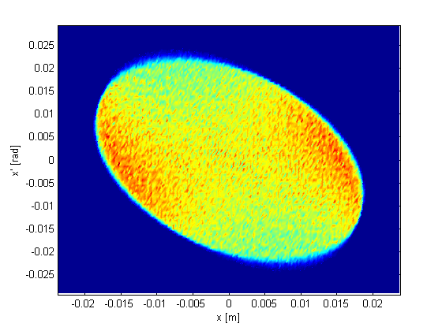
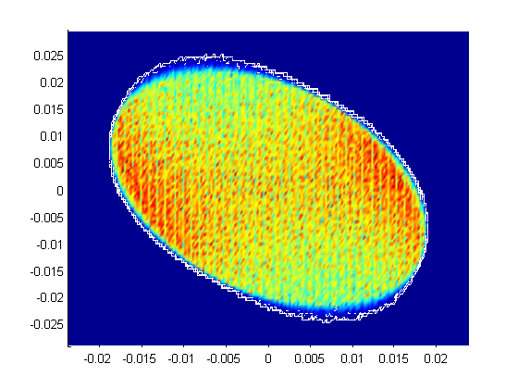
Diagnostics
Emittance
  At the diagnostic, break the beam up into beamlets transversely to simulate the beam scanning over the slit
  Let the beamlet particles drift to the second slit location (removing any that intercept the diagnostic)
  Break the beamlet up into more beamlets
  Count particles in each sub beamlet
  Produce phase space

Slide 15
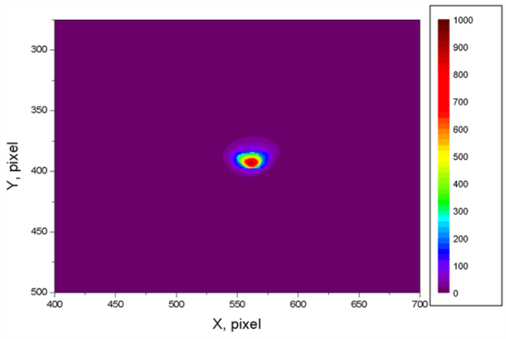
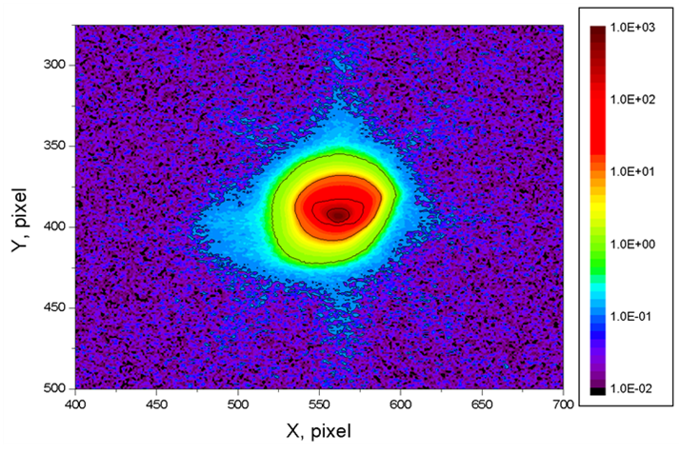
Halo
Probably more noticeable with non-magnetized beams
Large dynamic range diagnostics
More than meets the eye with both measurement and simulation
  Macro-particles
Pavel Evtushenko, Chris Tennant

Slide 16
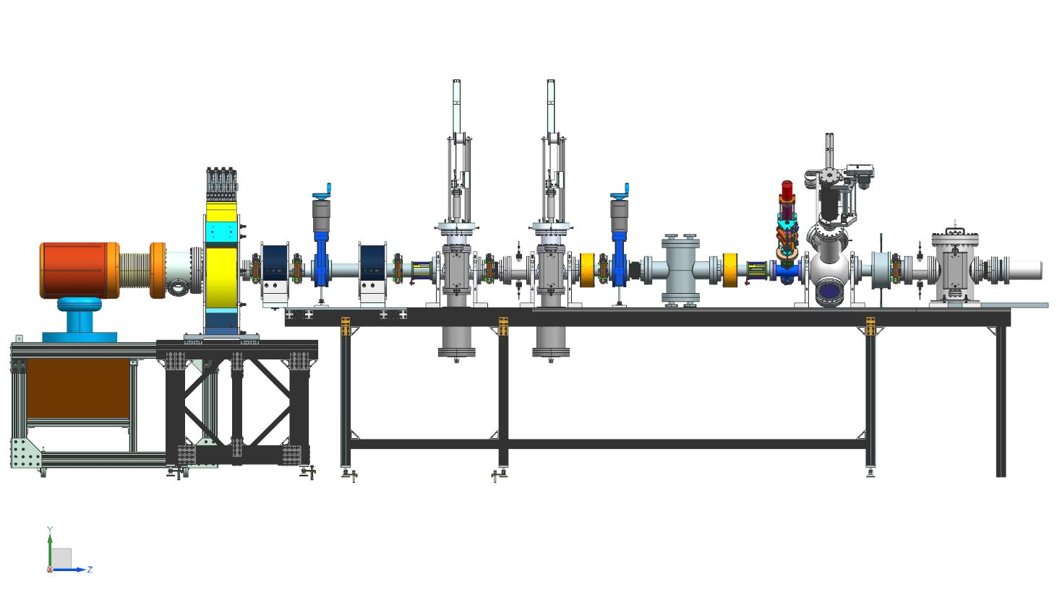
LERF
slit
1D pepper pot
deflecting
TE cavity
Gun Test Stand
Thermionic magnetized
At 500MHz
Have some diagnostics for this gun
Put into LERF
No lightbox – more room to re-arange
Booster options
Through a merger – from non-magnetized to EIC spec

Slide 17

Thank you!

Slide 18
Bending a magnetized beam
Fay Hannon
5/18/2016

Slide 19
Options
Dipole merger
Bent solenoid
RF kicker cavities

Slide 20
Start with a perfect magnetized beam
Sigma = 1mm
Uniform distribution
5MeV (no dE)
Assuming 0.1T on a cathode, no thermal emittance contribution
No space charge
Y [m]
x [m]
Arrows show px, py vector

Slide 21
RF Kicker Scheme

Slide 22
Beamline
~55MeV
952MHz cavities
TM110, Gaussian profile
10cm
5MeV
50cm

Slide 23
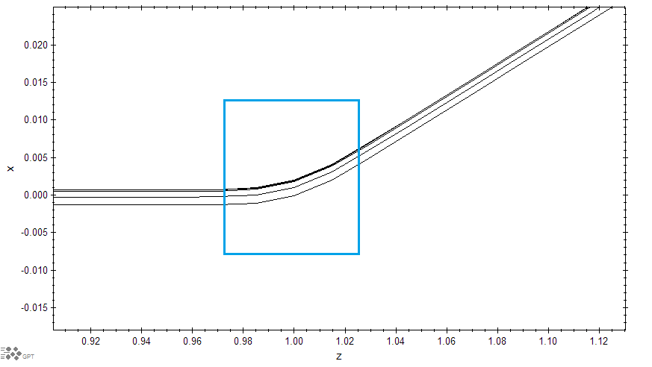
With an non-magnetized beam
Particles run parallel,
  have same length in kicker
<- in reference frame of beam after first kicker

Slide 24
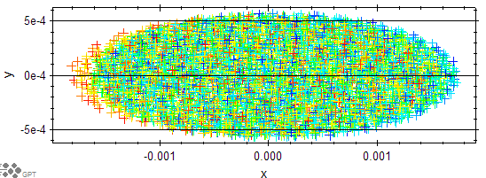
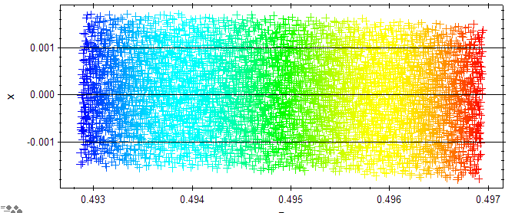
Slight horizontal focusing
Vertical focusing

Slide 25
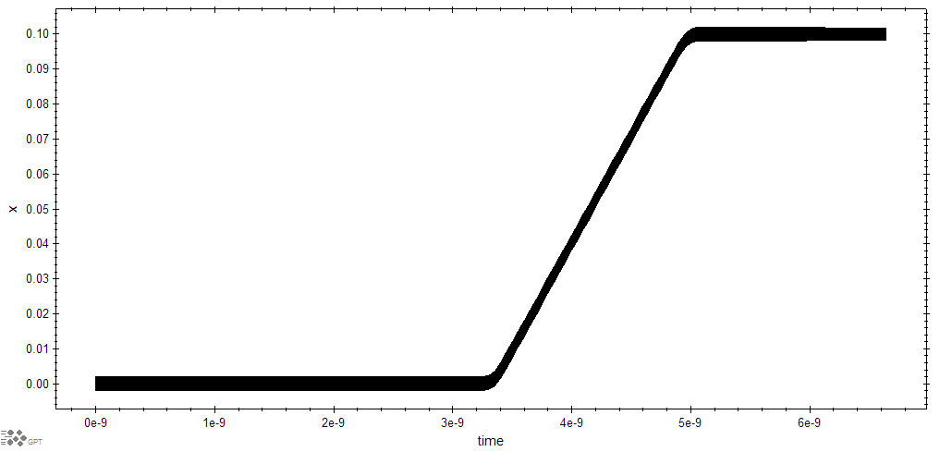
Particle trajectories

Slide 26
Particle trajectories with space charge

Slide 27
In particle reference frame

Slide 28
Transverse beam size in bending plane

Slide 29
After first cavity, beam shears
Red -> Blue = Front -> back of bunch in z

Slide 30
In the solenoid… beam rotates

Slide 31
Second cavity doesn’t remove shear
Beam rotation a problem.

Slide 32
Remove shear by focusing and having the correct number of rotations before second cavity.
Lower voltage
Lower frequency cavities?

Slide 33
Lower frequency cavities 476.3 MHz
No shear
952.6 MHz

Slide 34
After the merger…

Slide 35
What happens to a 50 MeV beam
180 degrees off.
Can easily compensate this small kick.
Magnetization is no longer an issue

Slide 36
Bent solenoid

Slide 37
Single bend
5MeV
50cm
~55MeV

Slide 38
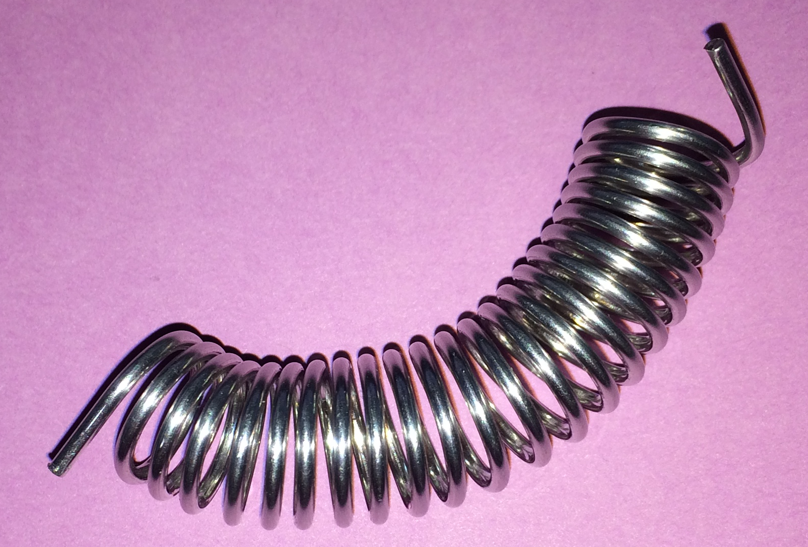
Single bend.
Maxwell means that this configuration would bend in both planes.
Don’t forget that the beam is rotating as it goes through this, so x and y in the lab frame do not match the coordinates of the beam.
A trick is to tilt the coils to compensate for the kick in the unwanted direction
  This tilt will depend on:
  the magnetization,
  the beam energy,
  The desired bend angle
Want to do that analytically?
  No, me either…

Slide 39
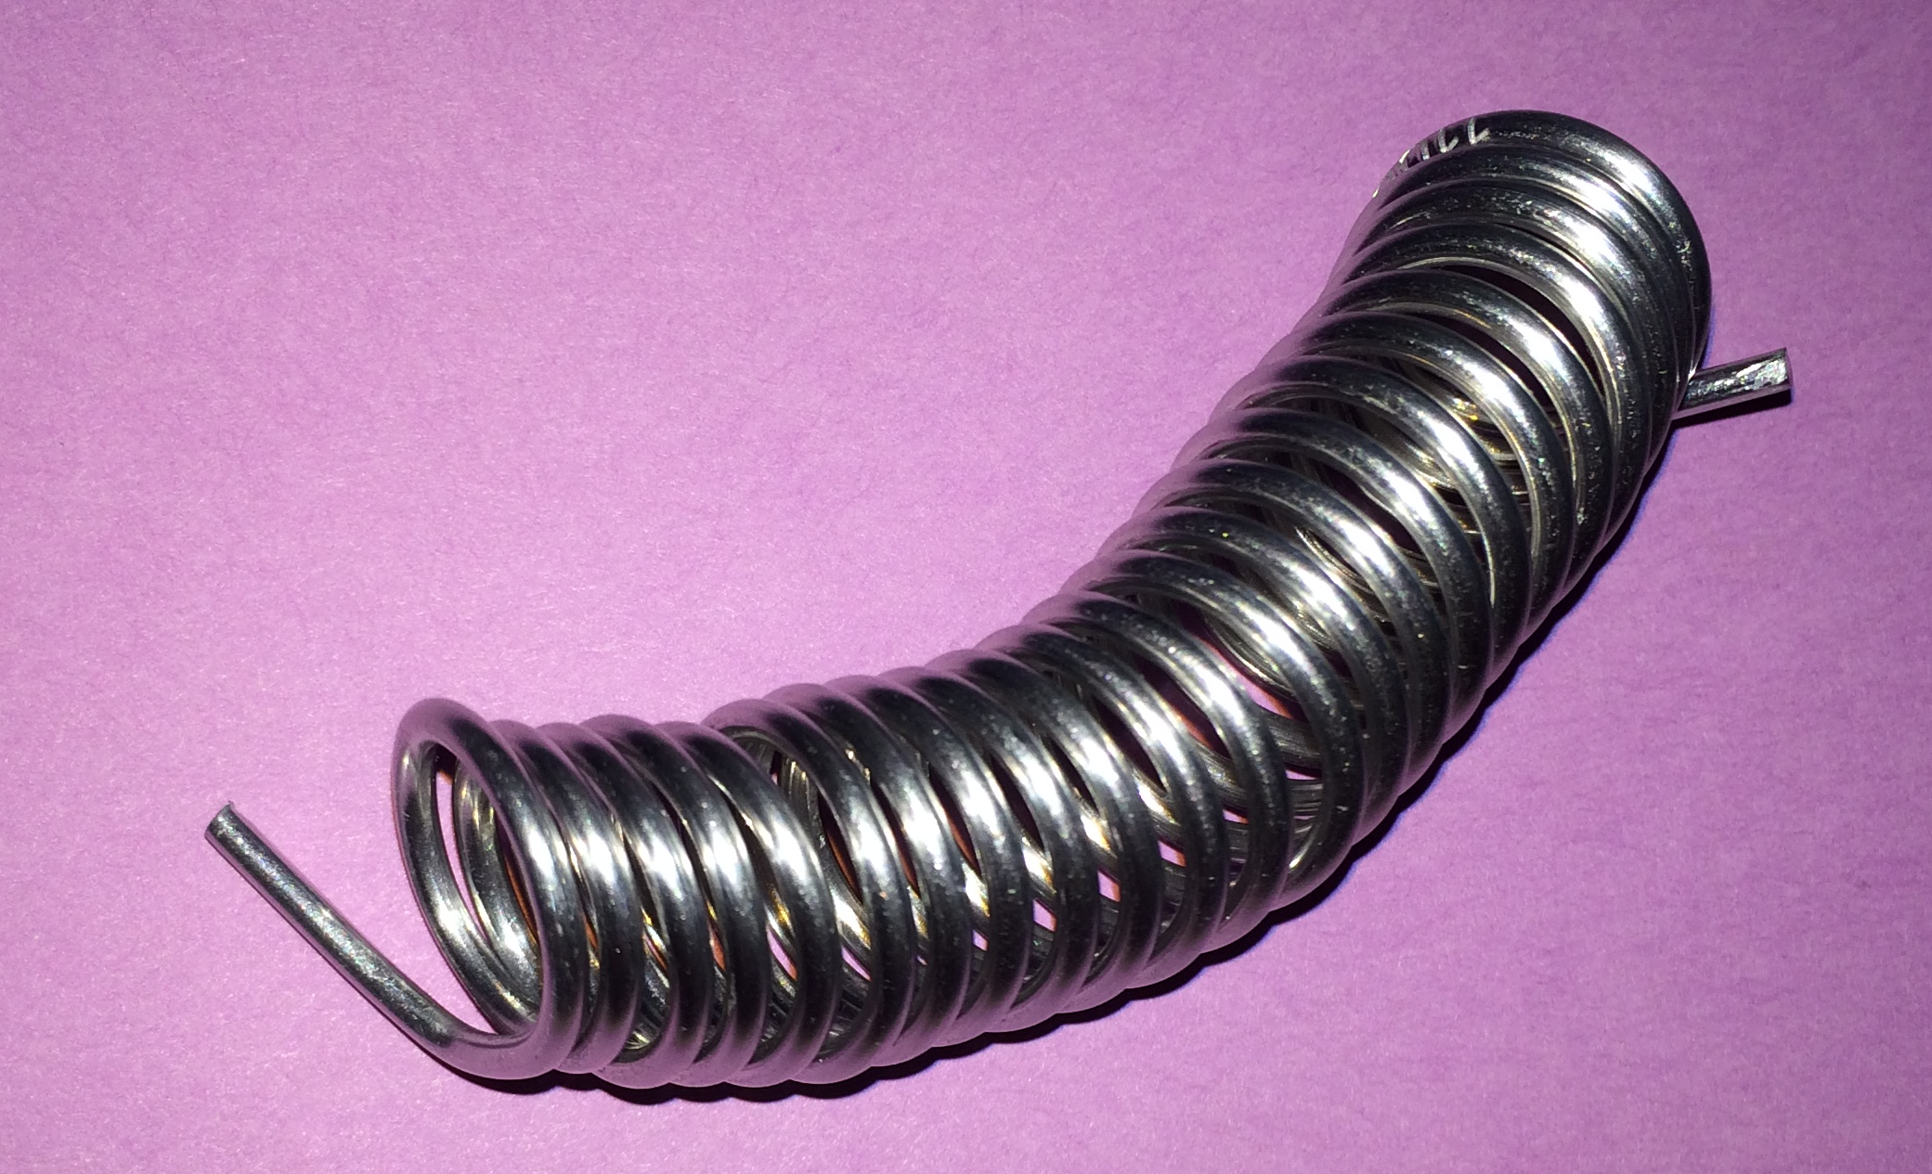
Bent solenoid
How to determine what the tilt should be.
Optimise.

Slide 40
Bent solenoid
What to do with the high energy beam
This design probably isn’t flexible

Slide 41
Traditional Dipole merger

Slide 42
Dipole merger
In a normal scheme, focusing in bend plane, breaks symmetry
  Use indexed dipoles I hear you say….
I hope you know where I’m going with this….

Slide 43
Dipole merger
Maxwell and rotating beams…
Simple configuration, one sector magnet

Slide 44
One dipole
The asymmetry from the dipole rotates
Bunch deforms longitudinally

