Slide 1
Asymmetric ERL for compact source of coherent radiation – design and preliminary experiments
I.V. Konoplev¹, M. Topp-Mugglestone¹, Ya. Shashkov⁴, G. Burt², F. Marhauser³ and A. Seryi³
¹ John Adams Institute, Department of Physics, University of Oxford, Oxford, UK
² Cockcroft Institute, Lancaster University, Lancaster, UK
³Thomas Jefferson National Accelerator Facility, Newport News, VA 23606, USA
⁴National Research Nuclear University MEPhI, Moscow, Russia

Slide 2
Asymmetric ERL
Introduction
  Asymmetric Energy Recovery LINAC
    Basic concept
    Experimental Studies of RF cavity
    Cavity optimisation
  Conclusion

Slide 3
Motivation
Original:
Ultra-High Intensity source of coherent
THz radiation:
-up to 1MW tunable from 0.1 THz to 10 THz
No industrial company can currently produce high power THz in this range, therefore a unique product. Non-contact imaging of coatings, composites, drug formulation, non-destructive sources and material/medical diagnostics research market. Replacing X-ray scanners: the global security screening market is expected to reach $9.10 Billion by 2020.
EUV radiation:
Generating electron beams of typical energy of 10-30 MeV; average current above 1A.
Aim to generate 1kW power radiation at 7-13 nm wavelength for lithography and ~120nm for QA.
Lithography for the £332 billion Semiconductor Industry: $7 billion market in 2014.
New:
Research which may benefit from high current ERL or multi-axis configuration
Recirculating ERL like PERLE and CBETA
FELs and other electron beam driven radiation sources
Electron beam cooling for EIC

Slide 4
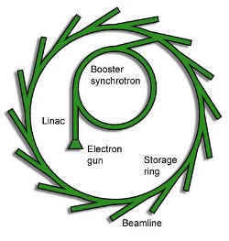
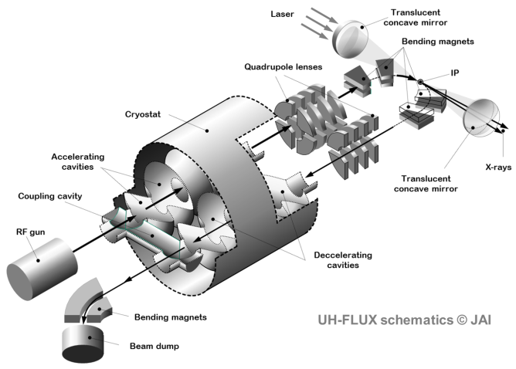
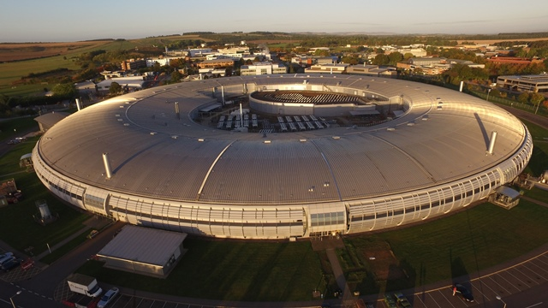
UH- FLUX
Ultra high flux compact source of THz and X-ray
Very large current designs Oxford Design: AERL
5 metre
100 metre +

Slide 5
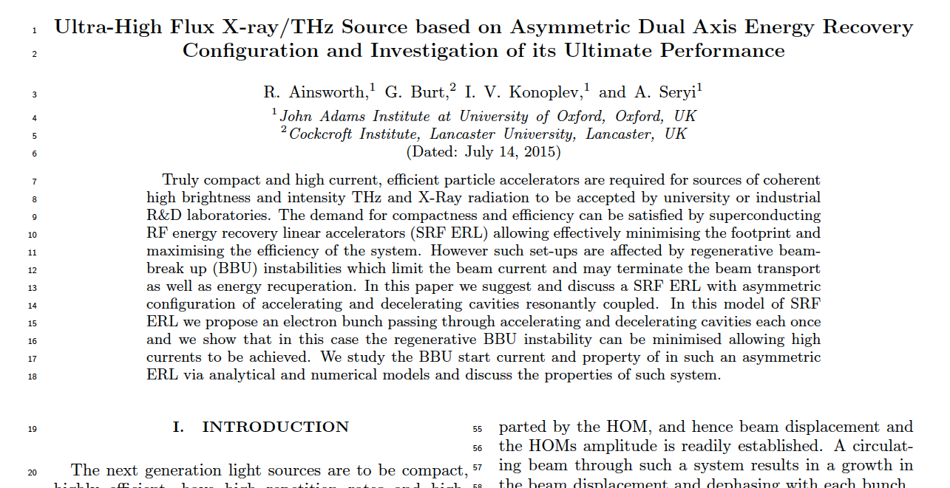
UH-FLUX: AERL

Slide 6

UH-FLUX: AERL
[1] A. Seryi, Patent PCT Application No. PCT/GB2012/052632 (24 Oct 2012)
[2] R. Ainsworth, G. Burt, I. V. Konoplev, and A. Seryi, Patent PCT Application No. PCT/GB2015/053565 (24 Nov 2015).
[3] I. Konoplev, ”Charged particle beam targets” US Patent App. 14/651,693, (2015)

Slide 7
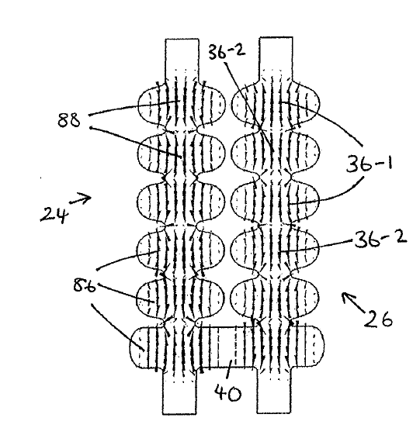
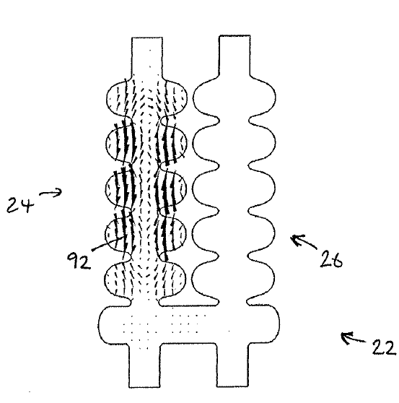
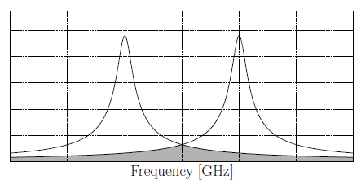
UH-FLUX: AERL
Decoupling all modes except the accelerating mode to maximize the beam current
Acc. mode
One of transverse modes
Partial mode of accel. section
Partial mode of decel. section
Problem: BBU instability development due to HOM in the cavity
Suggested solution:
HOMs localisation to maximise the BBU instability start current and separation of accelerating and decelerating sections; plus single pass

Slide 8
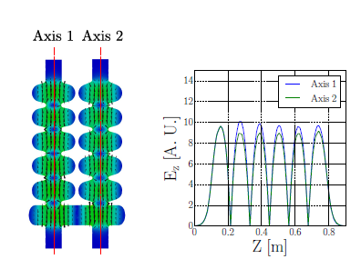
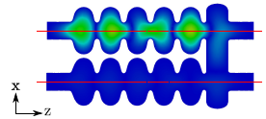
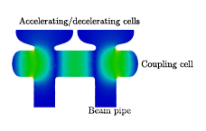
UH-FLUX: AERL
First numerical studies of 11 cells cavity using ACE3P/Omega3P/T3P software packages
Electric field contour plot of resonant coupler eigenmode at 1.48GHz
Electric field contour plot of operating eigenmode at 1.3GHz
Operating field flatness @1.3GHz
Electric field contour plot of dipole eigenmode at 1.73GHz
Small deviations of the cell geometrical parameters which do not affect the operating mode led to desired field distributions.
Unfortunately: pass-band modes are also not affected

Slide 9
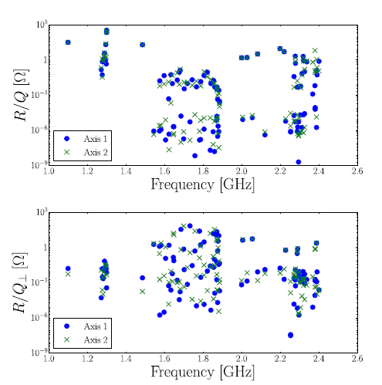
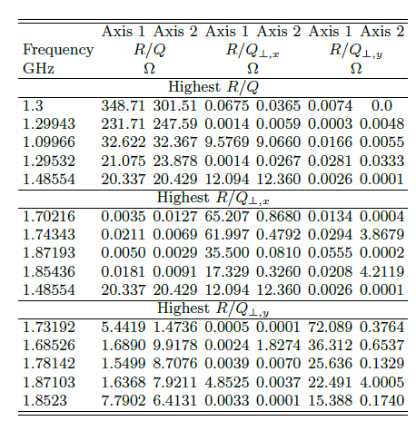


Eigenmodes of the asymmetric cavity
First numerical studies of 11 cells cavity using ACE3P/Omega3P/T3P software packages

Slide 10
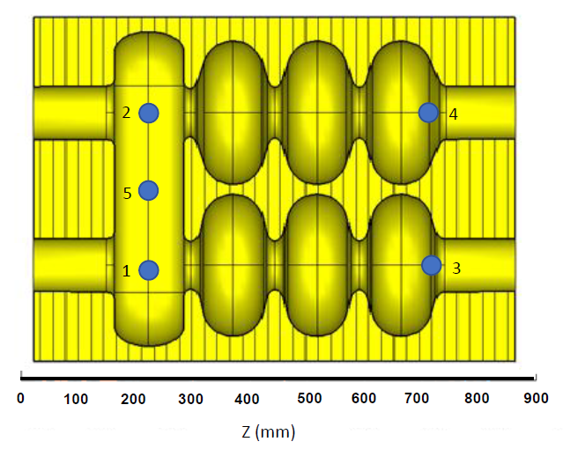
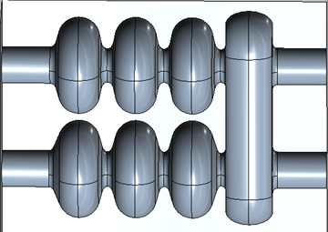
Experimental studies: proof of the concept
  Aluminium 7 cells cavity (manufactured in 2015 studied summer 2016 and summer 2017)
Aim:
- to identify the cavity modes: operating and HOMs
- To compare with numerical data

Slide 11
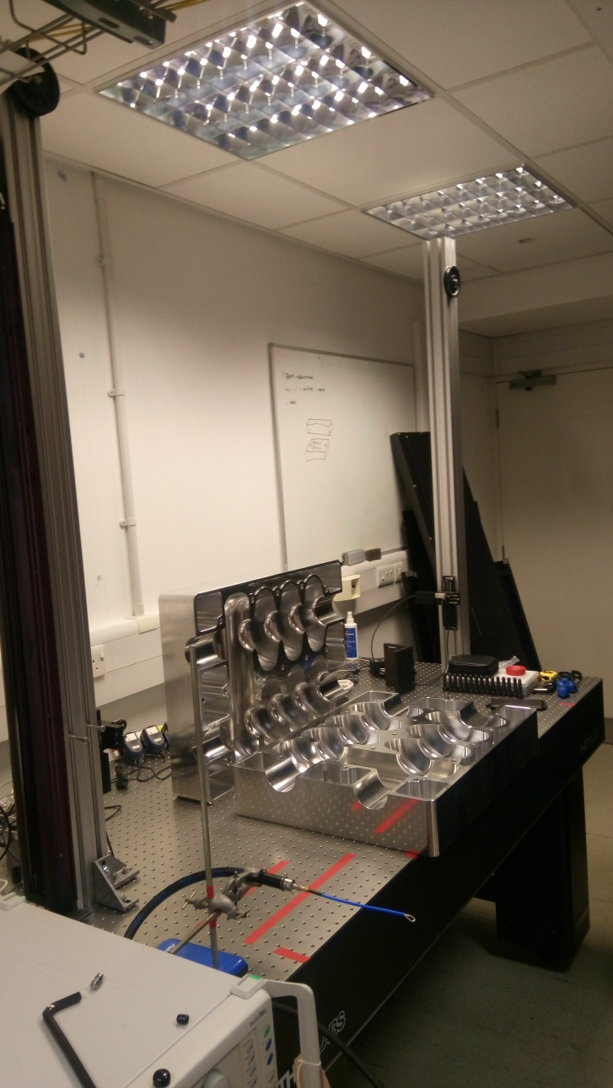
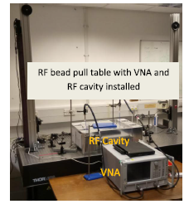
Scaled down prototype of the cavity
7 cells cavity: 3- accelerating; 3 decelerating and coupling cavity
Bead pull pillars
7 cells asymmetric cavity made from 2 blocks of solid aluminium
VNA
Bead pull RF measurements test bench

Slide 12
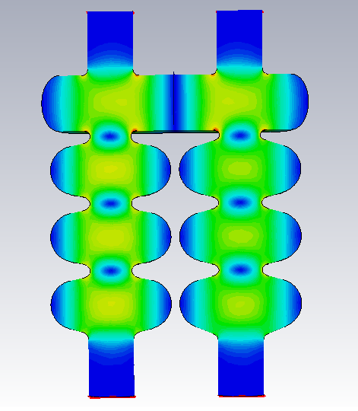
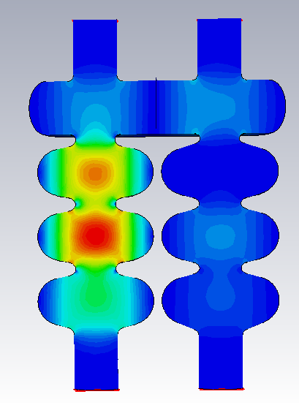
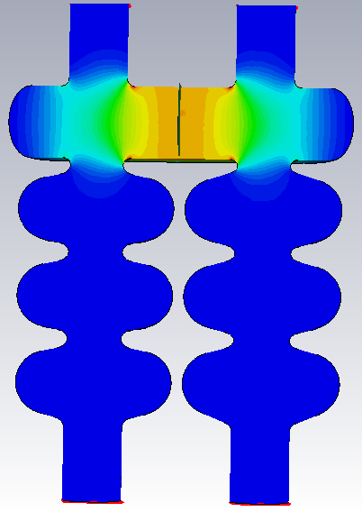
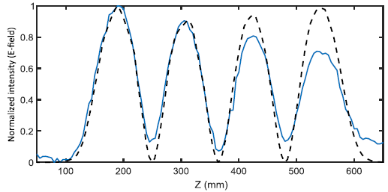



Preliminary experimental and numerical results (CST MW studio)
Parasitic LOM
Mode type-2
Operating mode
$$f=1.300144 GHz$$
$$f=1.279688 GHz$$
$$f=1.099712 GHz$$
Parasitic LOM
Mode type-1
First comparison of the operating mode measured (solid line) with the numerical predictions dashed line. The measurements were carried out at a single axis.

Slide 13
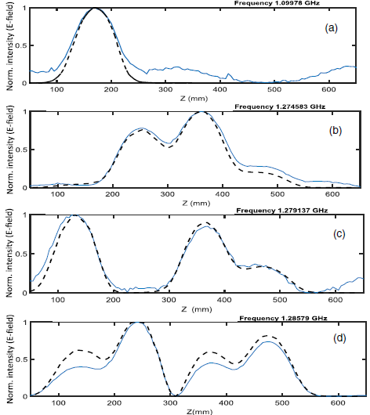
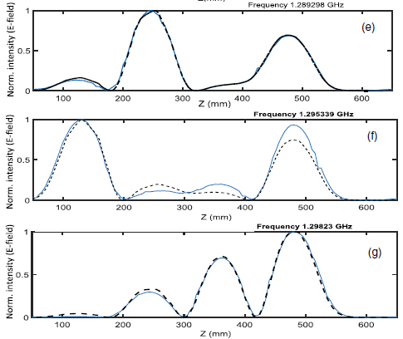
Pass band modes: experiment and theory
First comparison of the pass band modes measured (solid line) with the numerical predictions dashed line. The measurements were carried out at a single axis.

Slide 14
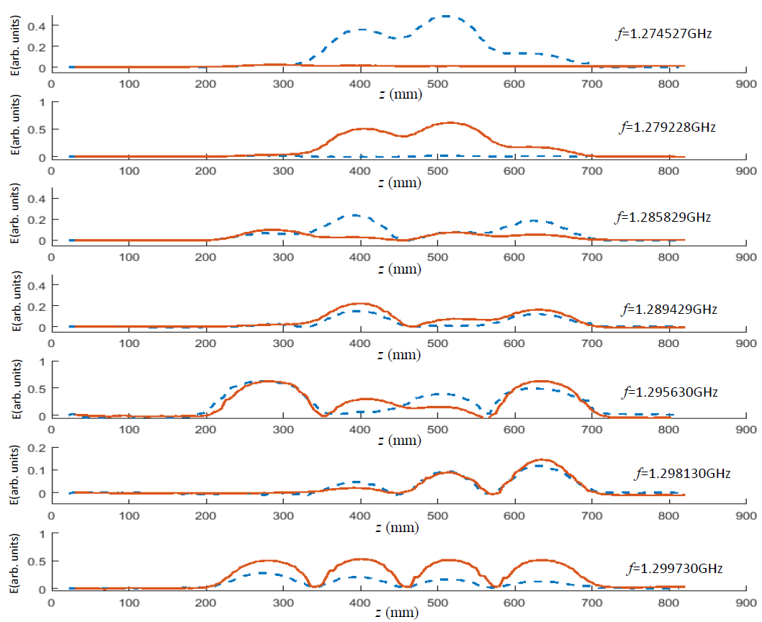
Pass band modes experimental studies at two axes
The RF coupler is located on one axis (active) while the field measurements are conducted on both axes
Red line active axis
Blue line passive axis

Slide 15
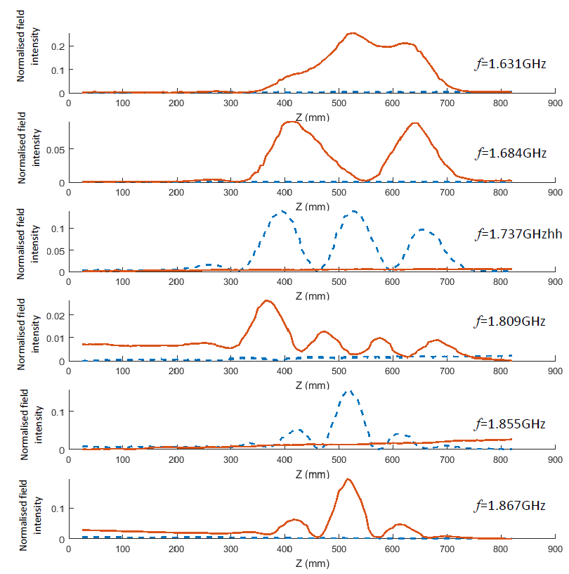
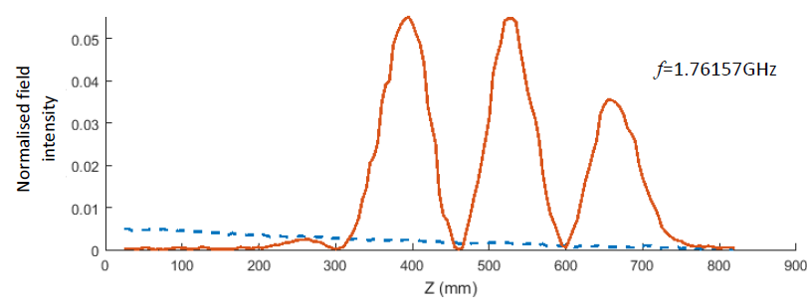
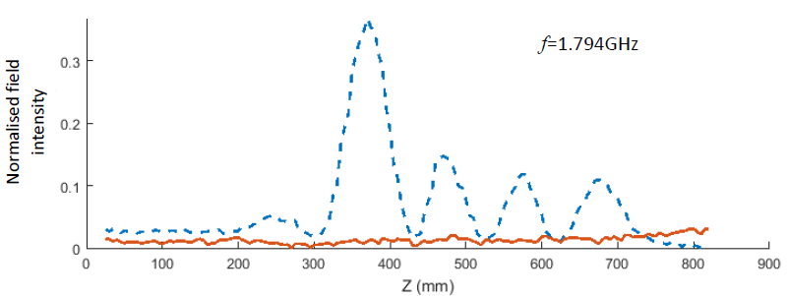
HOMs measurements
HOMs localisation at one or another axis
The RF coupler is located on one axis (active) while the field measurements are conducted on both axes
Red line active axis
Blue line passive axis

Slide 16
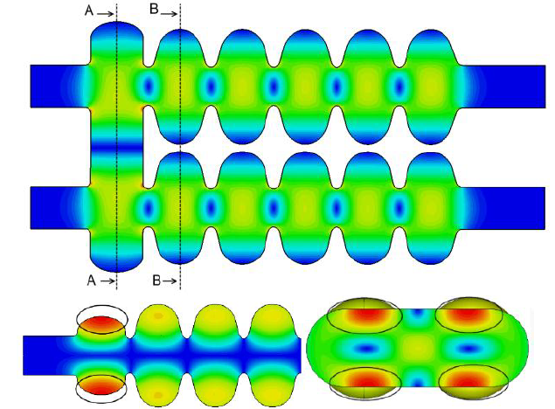
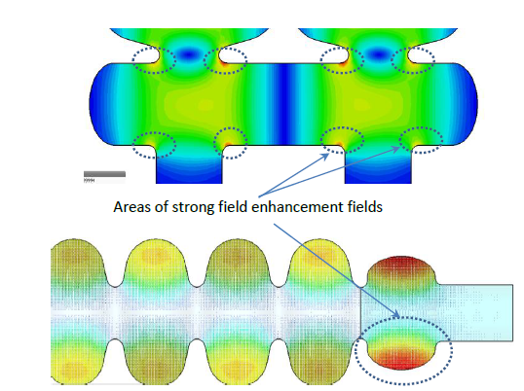
Cavity optimisation
Risk points due to high field intensity on the surface
Other risk factors:
Multipacting
Proximity on modes to operating mode
Cost
Tesla like cavity (TT)
Low Loss like cavity (LL)

Slide 17
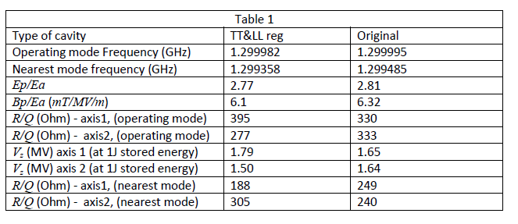
Cavity optimisation
TT&LL cavity with the original bridge
Original cavity TT&TT
& - indicate bridge

Slide 18
Cavity optimisation
LL&TT+LL cavity
TT&LL cavity
TT&LL+TT cavity

Slide 19
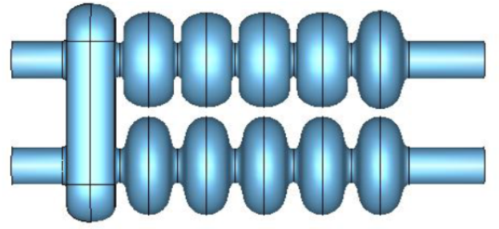
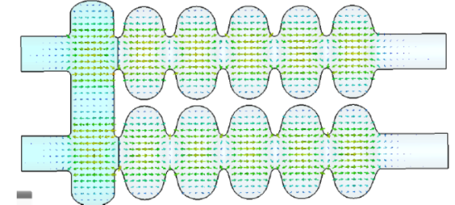
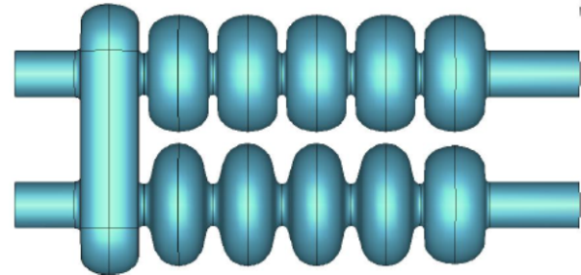
Cavity optimisation
- Improved but did not resolve completely high field risk
- Improved but did not resolved the modes proximity
- Did not resolve the chalenge with multipacting

Slide 20
JLAB dual axis cavity
The cavity was used as a prototype during the optimisation
It was considered as an indication that such structure can be machined

Slide 21
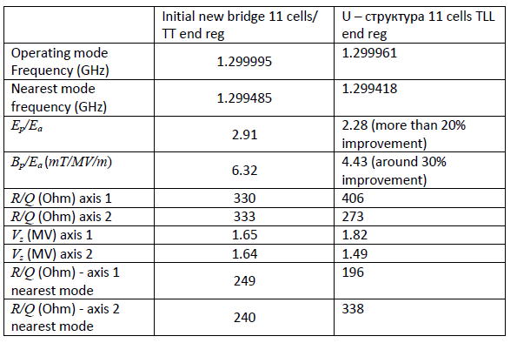
Bridge optimisation
- Resolved high field risk
- Improved the modes proximity
- Resolve the challenge with multipacting

Slide 22
Conclusion
Motivation for a new ERL capable of driving Ampere level average electron beam current has been discussed
Design and studies of the dual axis asymmetric cavity has demonstrated
Results of cavity optimisation have been shown
Proposal to build and test the cavity at JLAB has been submitted to STFC UKRI on 31st of October.
We will know the final decision by the end of Spring 2019.

Slide 23
Future plans
01-October-2019 Start of the project
- Evaluation of the cavity design and technical drawings of the cavity - 3 months
- Machining, assembling and preparation of the cavity – 12 months
- Room temperature RF tests and RF tests with LHe -3 months
Future
Can this development be interesting and useful for EIC (beam cooling perhaps)?
If there are positive outcomes of the studies can it be used for EIC?
HP RF Experiments with such cavity
Building high-current ERL
Thank you

