Slide 1
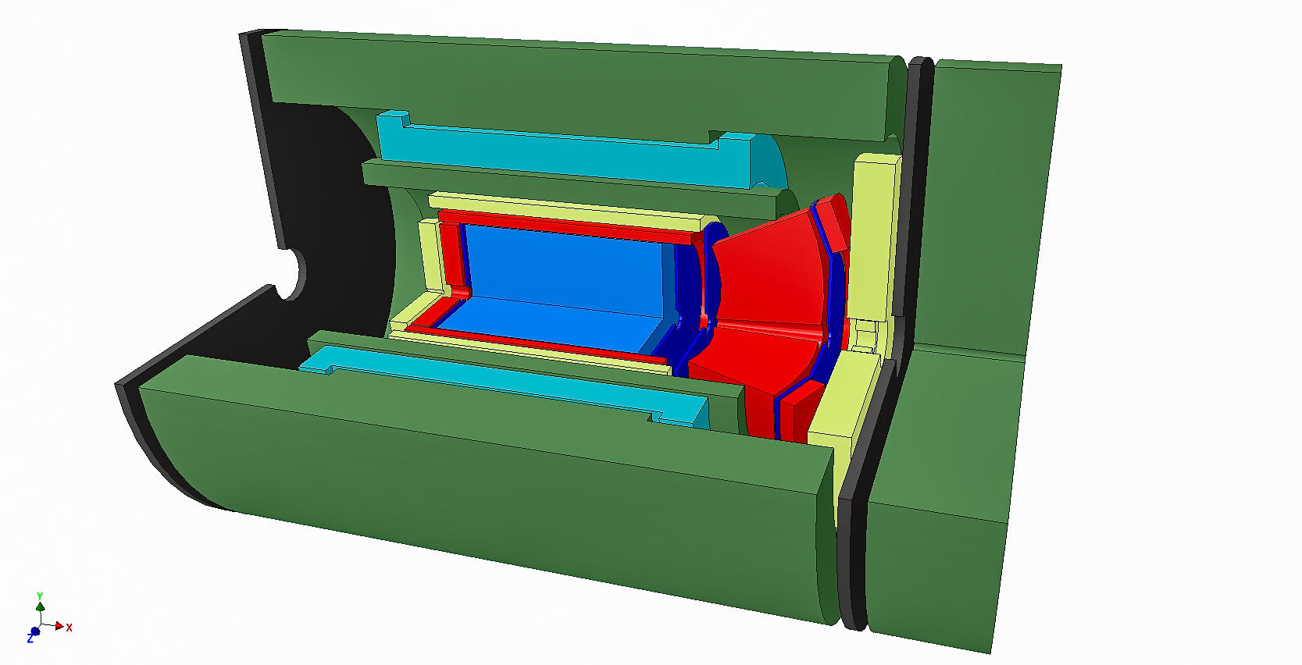
Design Study for a sPHENIX based EIC Detector
Progress on streaming demonstrations for EIC
Jin Huang (BNL)

Slide 2

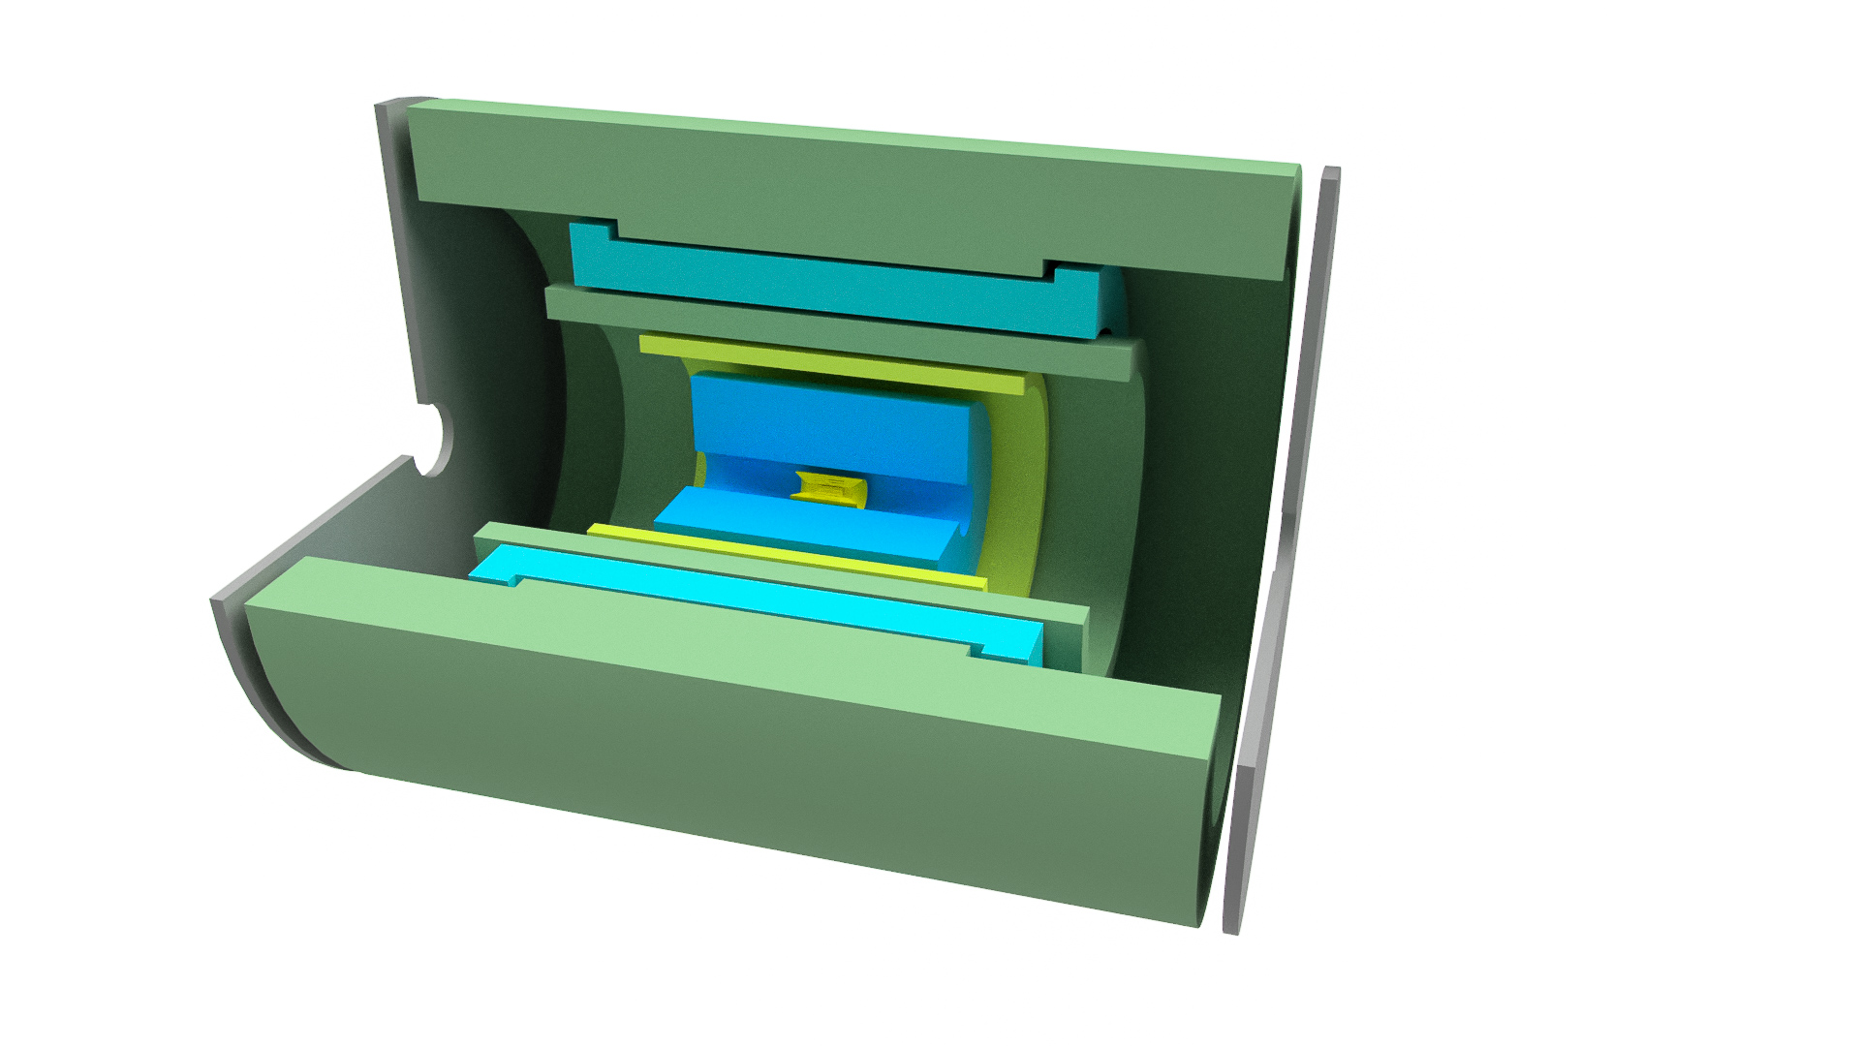
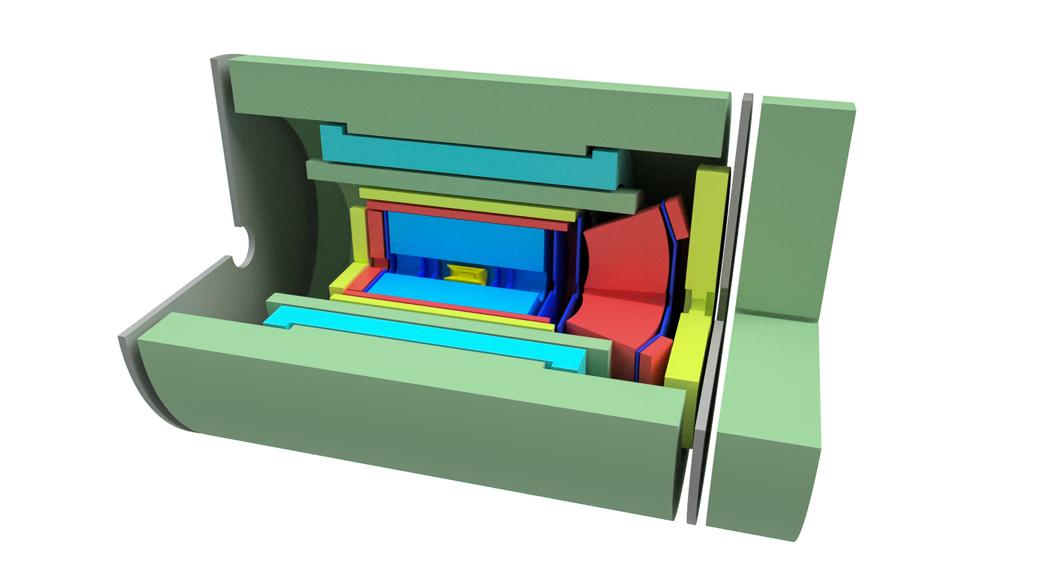
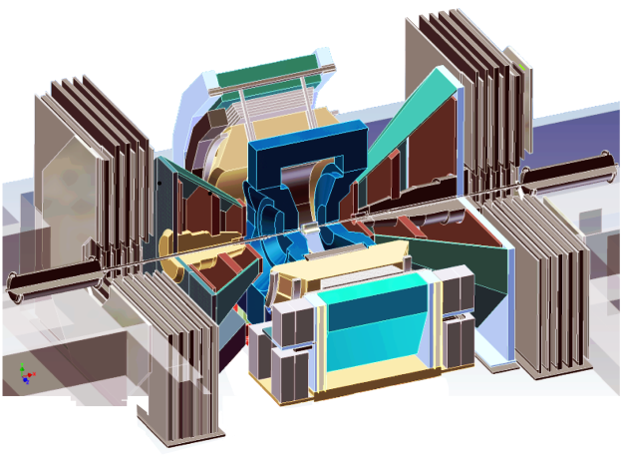
Evolution of the RHIC 1008 Interaction region
PHENIX experiment
An EIC detector
16y+ operation
Broad spectrum of physics 180+ physics papers with 25k citations
1.4-M channel streaming
Comprehensive central upgrade base on previous BaBar magnet
Rich jet and HF physics program
→ Microscopic nature of QGP
Path of PHENIX upgrade leads to a capable EIC detector
Large coverage of tracking, calorimetry and PID
Full streaming DAQ based on sPHENIX
arXiv:1501.06197 [nucl-ex]
arXiv:1402.1209 [nucl-ex]
Update: sPH-cQCD-2018-001
~2000
2017→2023, CD-1/3A Approved
>2025
Time
RHIC: A+A, spin-polarized p+p, spin-polarized p+A
EIC: e+p, e+A

Slide 3
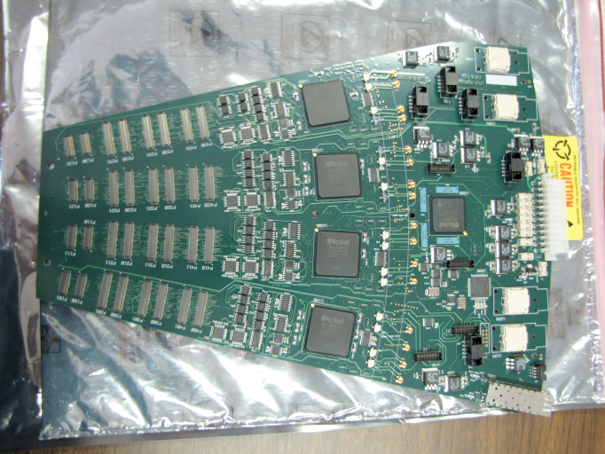
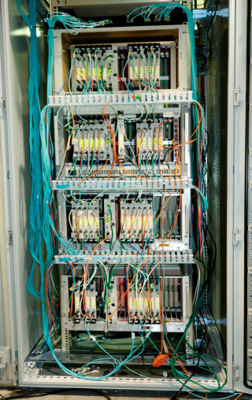
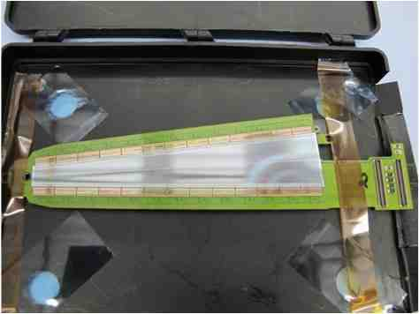
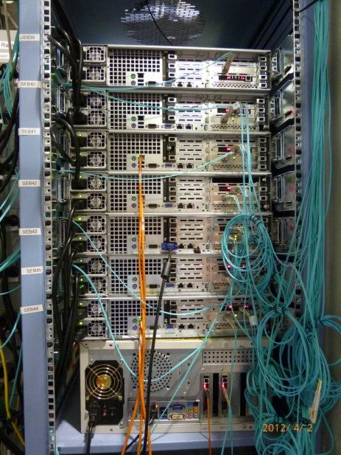
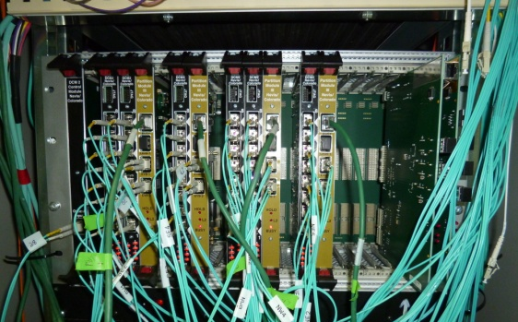
PHENIX/FVTX Streaming FEE
Streaming data processing on FPGA for b-by-b luminosity & Transverse SSA (A_{N})
384 Wedges
1.4M channel 3-bit flash ADC
IR
DAQ Room
HDI
FPHX Chip
17k LVDS
3.2 Tb/s
768 fibers
1.9 Tb/s
Ionizing Hit
Sensor
24 Readout cards (ROC)
Flash ADC & free streaming
48 FEM
PHENIX event builder
/ Data storage
Triggered data
to disks
Online display
8 fibers
Standalone data
(calibration, etc.)
6 DCM II
5x PCIe cards on
5 SEB Servers
Data cable/bandwidth shown on this slide only
Notes:
SEB – sub-event builder

Slide 4
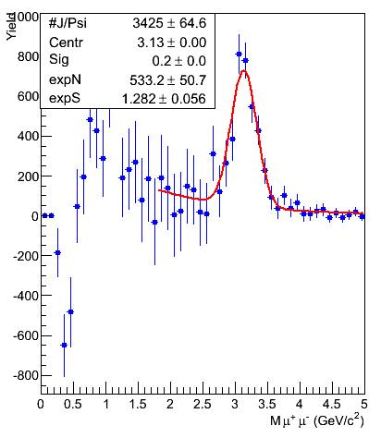
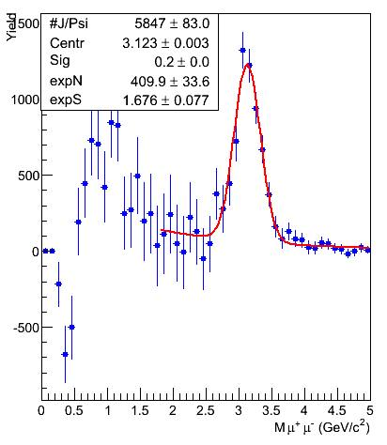
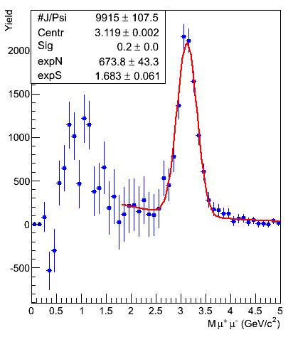
PHENIX Data validation & data processing in near-real-time
PHENIX validate data and perform majority calibration in near-real-time via online system using a subset of raw data prior to disk write
PHENIX has enough CPU to final process all data in real-time, but the limitation is usually special data need and manpower for calibration
J/Psi spectrum in Cu+Au @ sqrtS = 200 GeV via run-time data production & analysis,
Run 12 weekly report : https://www.c-ad.bnl.gov/esfd/Scheduling_Physicist/Time_Meetings/2012/tm120619/tm120619.htm
0 – 5% Most Central
0 – 10% Most Central
0 – 20% Most Central

Slide 5
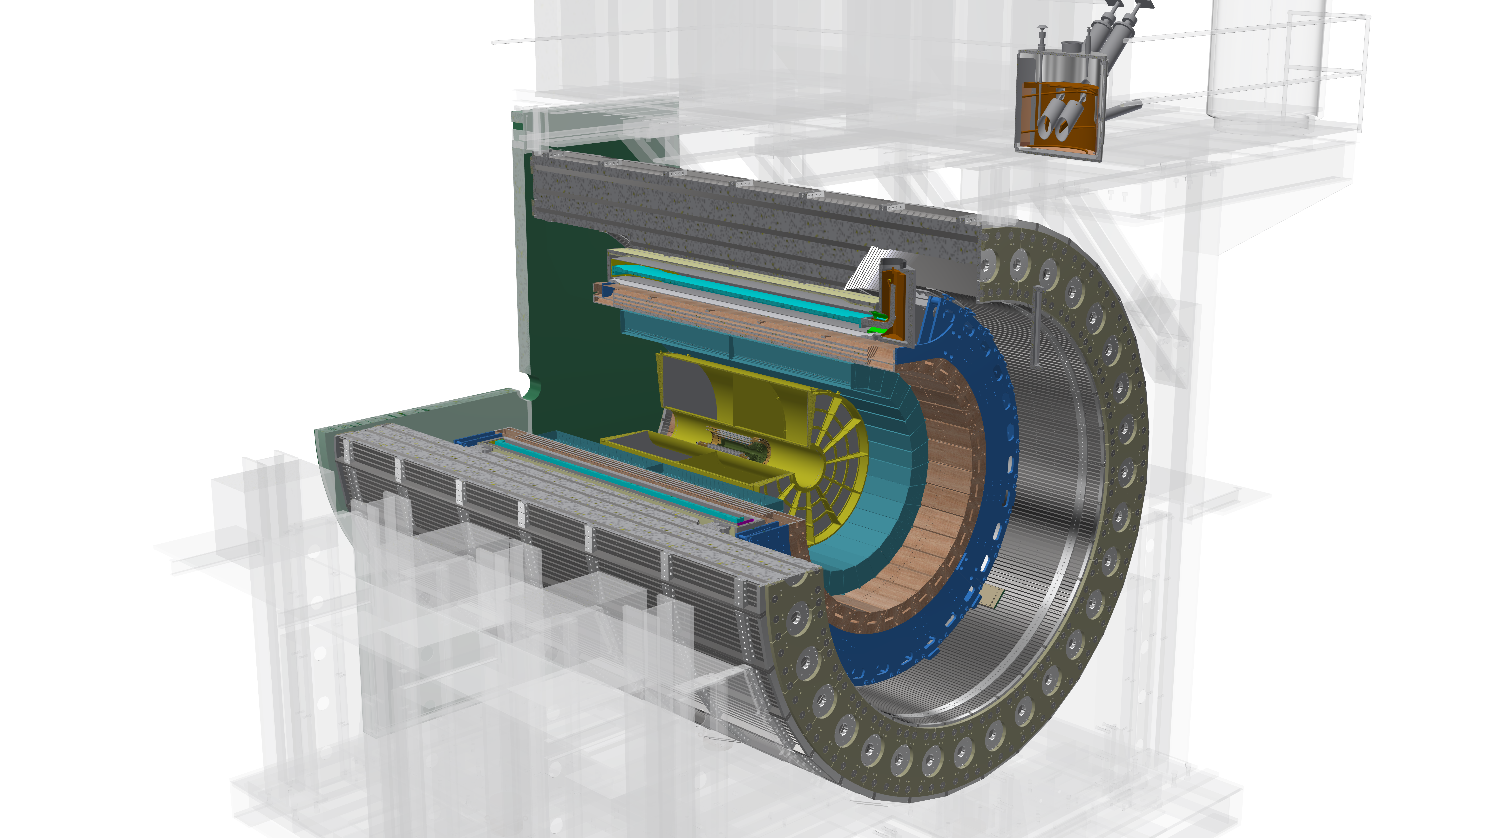
Outer HCal
SC Magnet
Inner HCal
EMCal
TPC
INTT
MVTX
Φ ~ 5m
15 kHz trigger
>10 GB/s data
Detector
2016: Scientific review and DOE mission need Status (CD-0)
2018: Cost/schedule review and DOE approval for production start of long lead-time items (CD-1/3A)
2022: installation in RHIC 1008 Hall; 2023: First data
All tracker front end support streaming readout.
DAQ disk throughput for 9M particle/s + pile ups (> EIC ~4M particle/s)
Notes:
15kHz matched to collision rate.

Slide 6
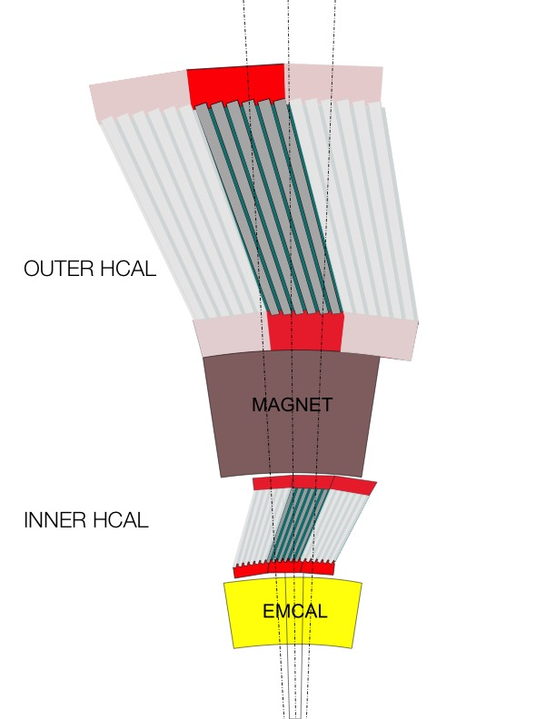
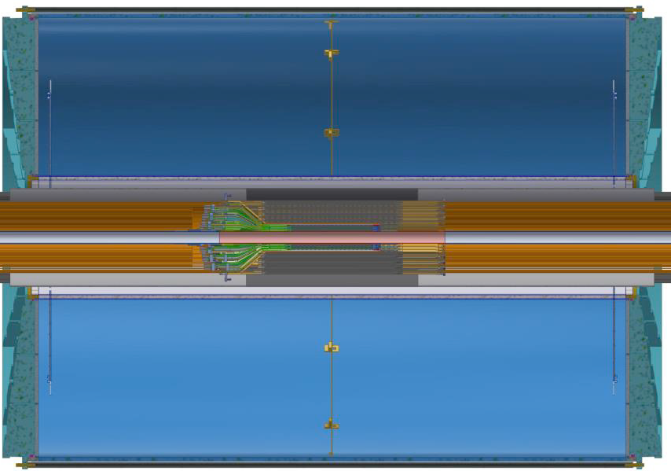
Selection of streaming and triggered front end
For calorimeter triggered FEE,
(signal collision rate 15kHz x signal span 200ns) << 1:
No need for streaming readout which significantly reduce front-end transmission rate
For TPC and MVTX tracker FEE supports full streaming:
(signal collision rate 15kHz x integration time 10-20us) ~ 1:
Streaming readout fits this scenario. Consider late stage data reduction by trigger-based filtering
FEM
10+ Gigabit
Network
Switch
DCM
DCM2
Buffer Box
DCM
DCM
DCM
DCM
ATP
FEM
DCM
SEB
DCM
ATP
Buffer Box
DCM
DCM2
DCM
DCM
ATP
DCM
FEM
DCM
SEB
DCM
ATP
Buffer Box
DCM
DCM
DCM2
ATP
DCM
SEB
DCM
DCM
ATP
Buffer Box
FEE
ATP
DCM
TPC
DCM
DAM
EBDC
ATP
DCM
Buffer Box
FEE
ATP
DCM
DCM
DAM
EBDC
ATP
Buffer Box
DCM
FEE
ATP
MVTX
DCM
DAM
EBDC
DCM
ATP
Buffer Box
DCM
Data Concentration
Computing
Facility
Interaction Region
Rack Room
Rack Room
Rack Room
O(1000) SFP(+) fiber links
Multi-Tbps to DAQ room
Commodity network
~200 Gbps to disk

Slide 7
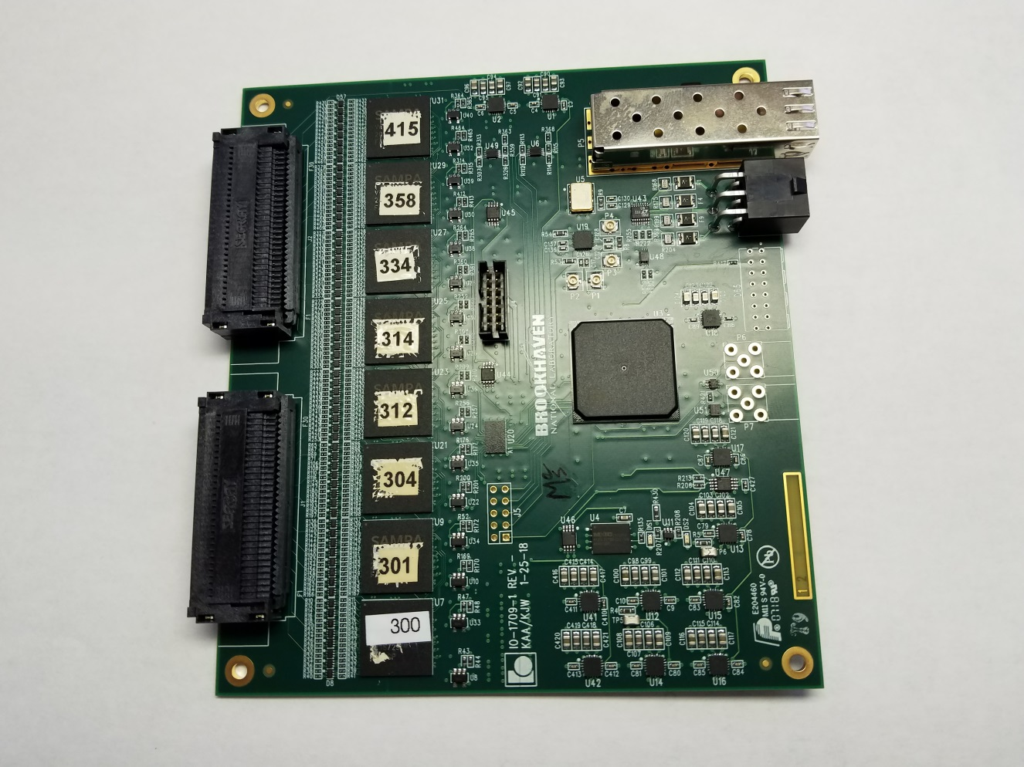
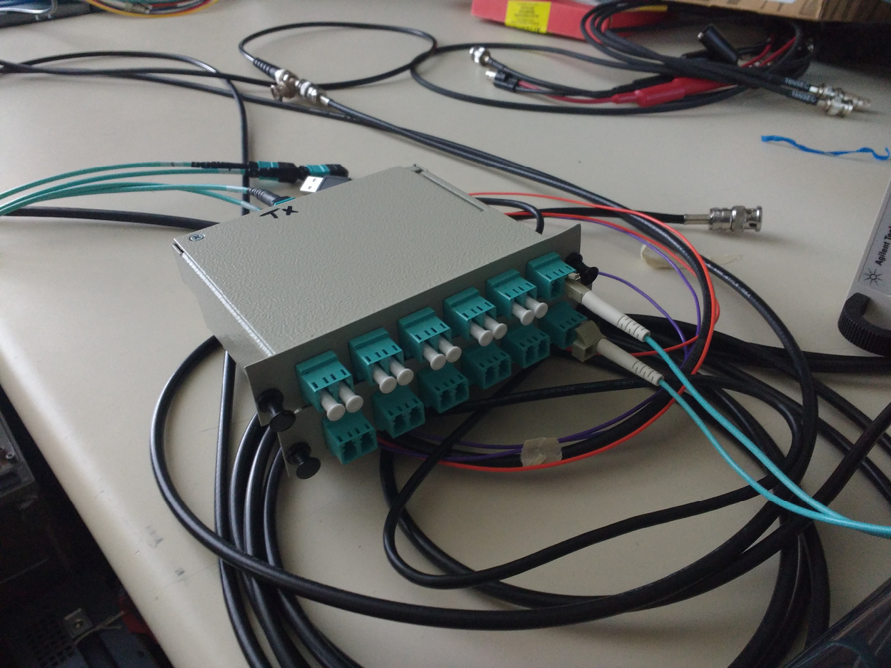
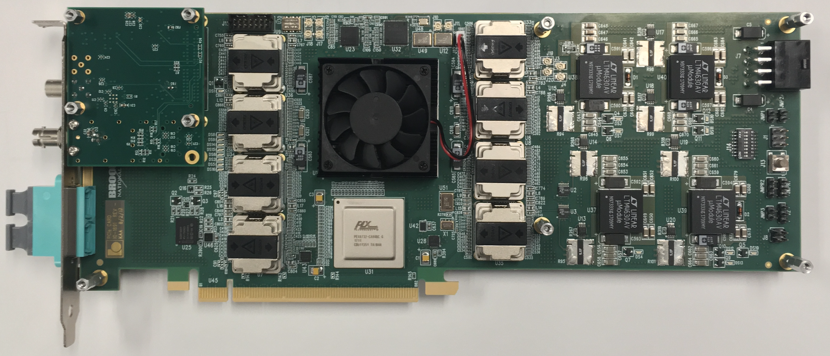
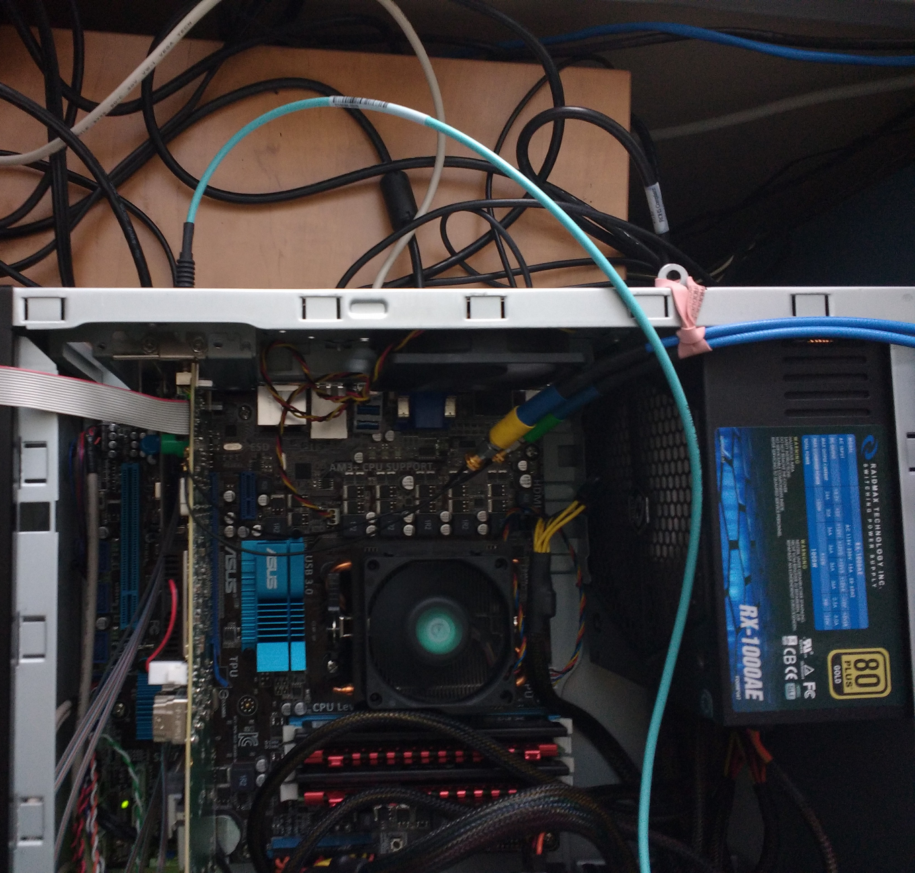
sPHENIX Time projection chamber (TPC)
MVTX
Diameter ~ 1.6 m
INTT
TPC
Next-gen TPC w/ gateless and continuous readout: δp/p < 2% for p_{T}<10 GeV/c
Ne-based gas for fast drift (13us). qGEM amplification and zigzag mini-pads.
160k channels 10b flash ADC @ 20MHz with SAMPA ASIC -> 2 Tbps stream rate.
MTP <-> LC Breakout
(To be built into TPC)
Server
FEE Prototype
BNL-712 v2 (FELIX2)
FELIX in server

Slide 8
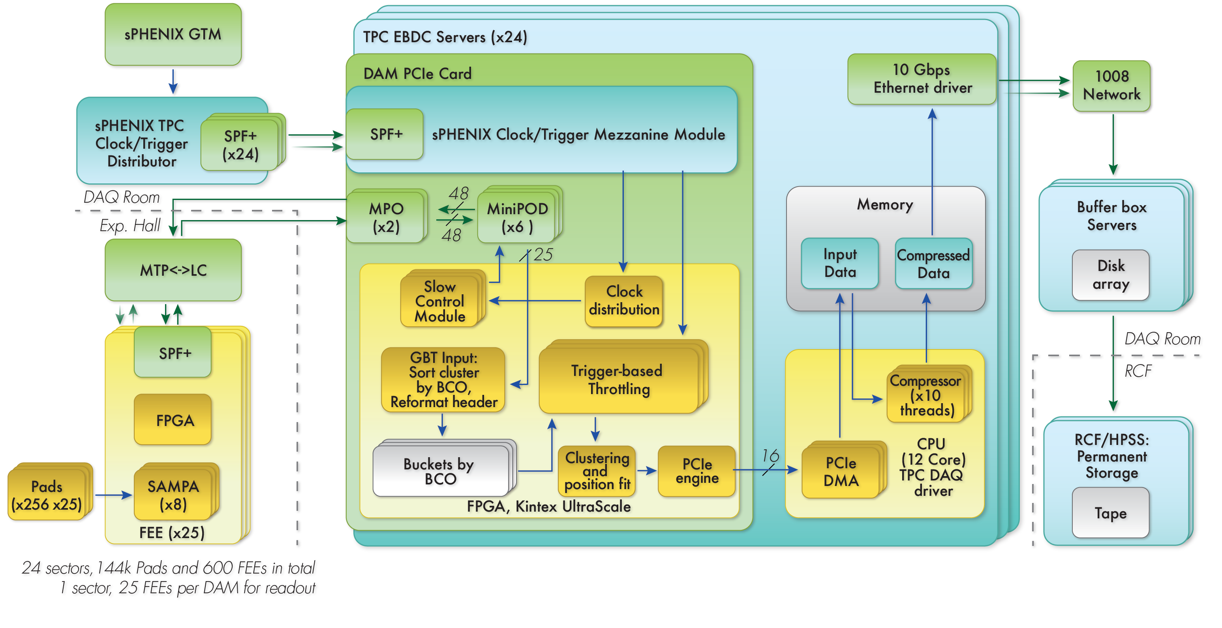
TPC DAQ in streaming mode
600 Fibers @ 600x 6 Gbps
Commodity networking @ 200 Gbps

Slide 9
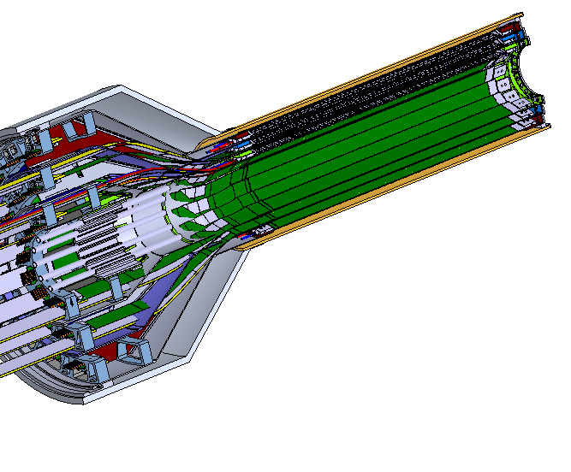
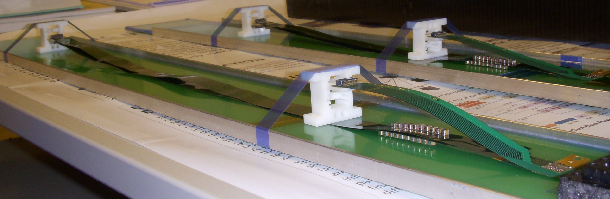
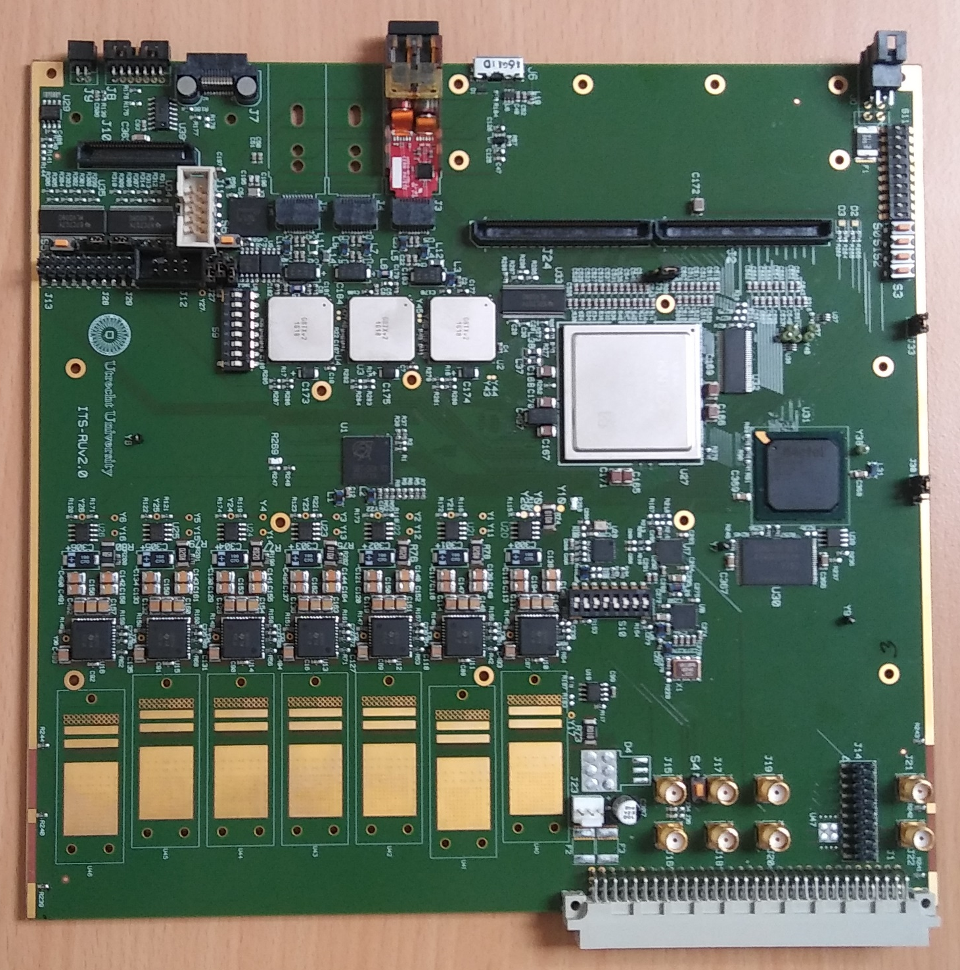
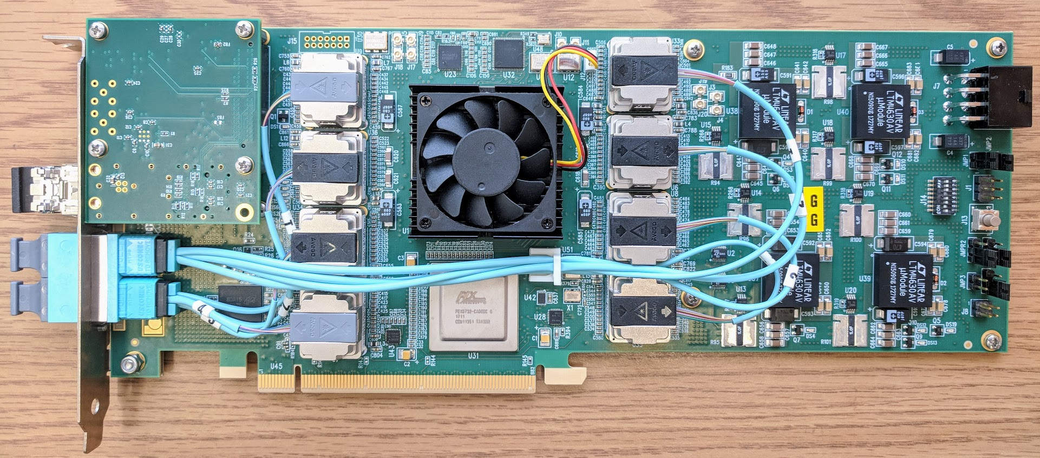
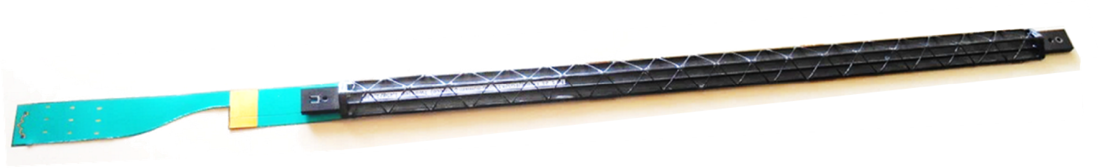
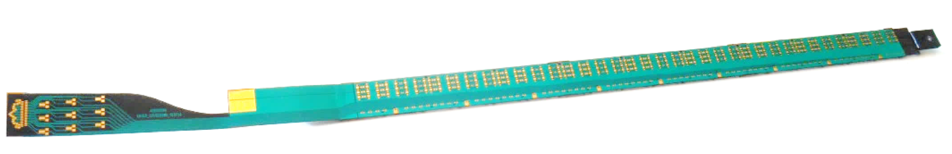
sPHENIX MVTX
200M pixel monolithic active pixel sensors (MAPS) vertex tracker (MVTX)
→ 5μm position resolution, 0.3% X0 / layer → <50 μ m DCA @ 1 GeV/c
In close collaboration with ALICE & ATLAS phase-1 upgrades
Active length
~ 30 cm
MVTX
INTT
Diameter
~ 8 cm
TPC
Thickness ~ 50 μm, 30x30 μm pixels
Sensor test with sPHENIX extension
Readout Unit v2
BNL-712 v2 (FELIX2)
192 GBT fiber links
Exp. Hall DAQ room
Notes:
48 staves + 100% spares
30-um-pitch, 200 M pixel, 0.3% X0/layer, 4-10 us integration time

Slide 10
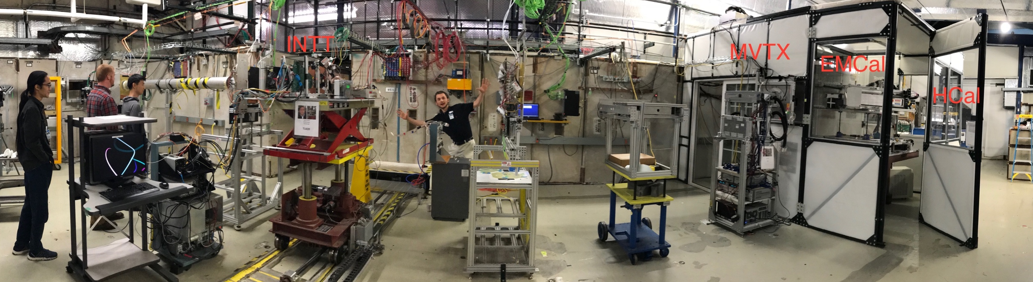
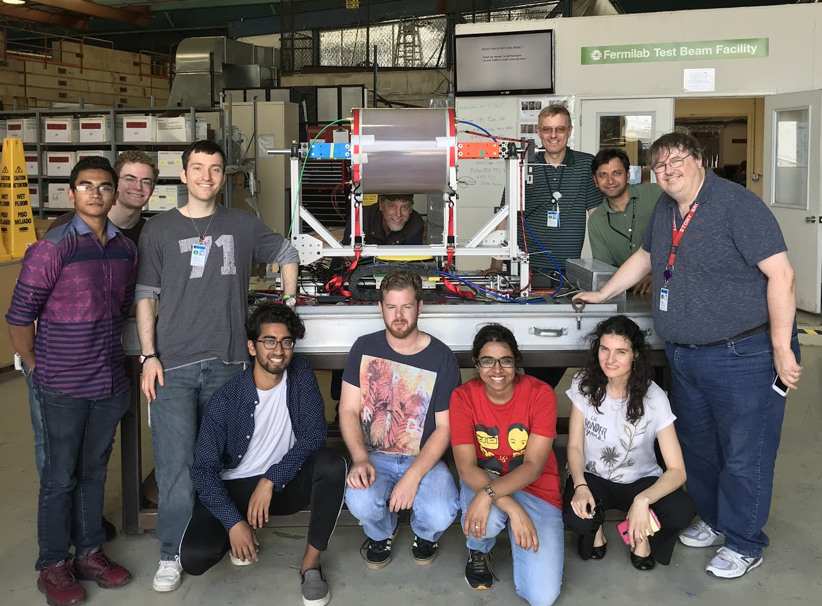
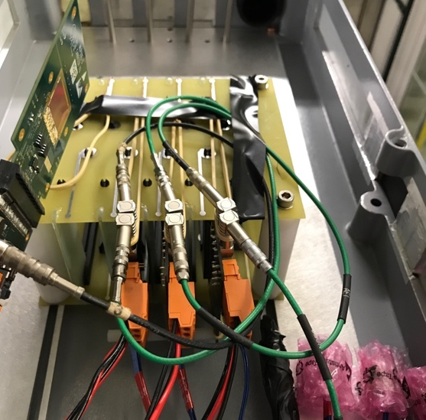
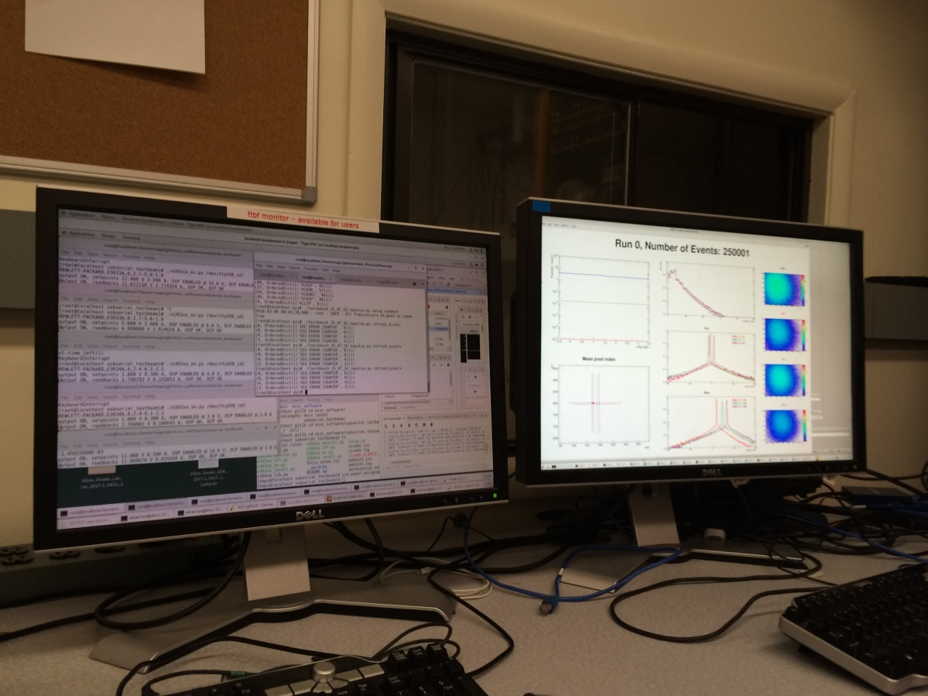
Highlight of sPHENIX prototypes in action
INTT
MVTX EMCal HCal
TPC
Feb-July 2018 FermiLab Test beam facility, test of each sPHENIX detector subsystem
4x MVTX sensor in beam sPHENIX DAQ
MVTX Hit Spatial Resolution: < 5 um

Slide 11
A EIC detector concept based sPHENIX and its streaming DAQ
Detector concept
Rate estimation
DAQ strategy
DAQ interface

Slide 12
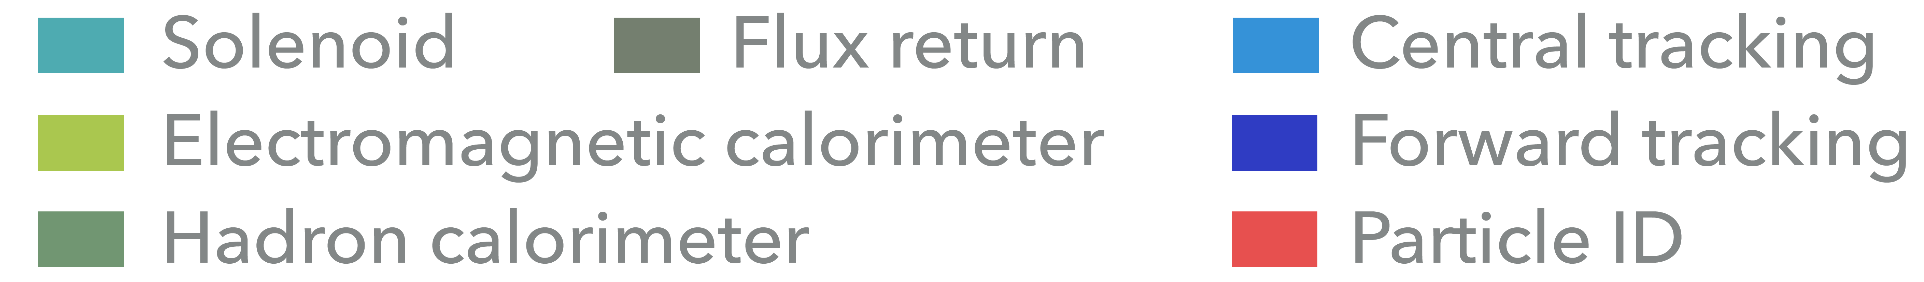
An EIC detector concept based on sPHENIX
Using sPHENIX as a foundation with further instrumentation of tracker, calorimeter and PID
Reuse and upgrade the streaming parts of sPHENIX Readout & DAQ
Letter of intent in 2014: arXiv:1402.1209 [nucl-ex]
On-going design study in public note: sPH-cQCD-2018-001 @ https://indico.bnl.gov/event/5283/

Slide 13
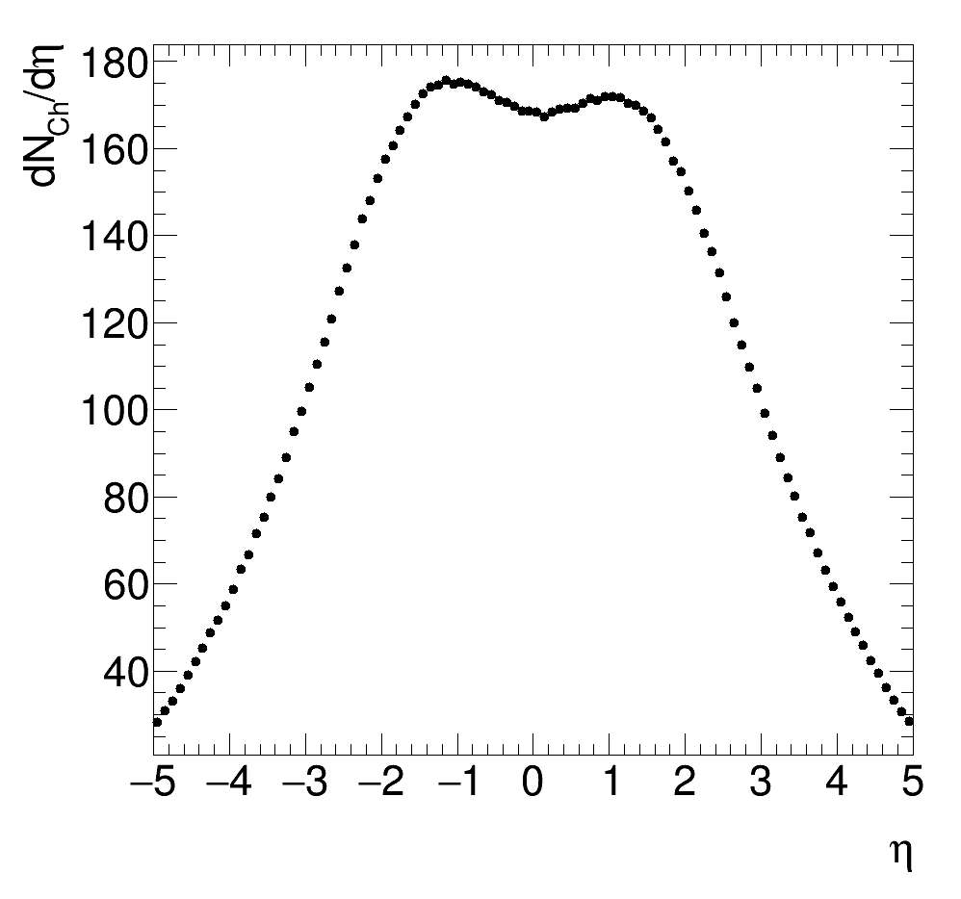
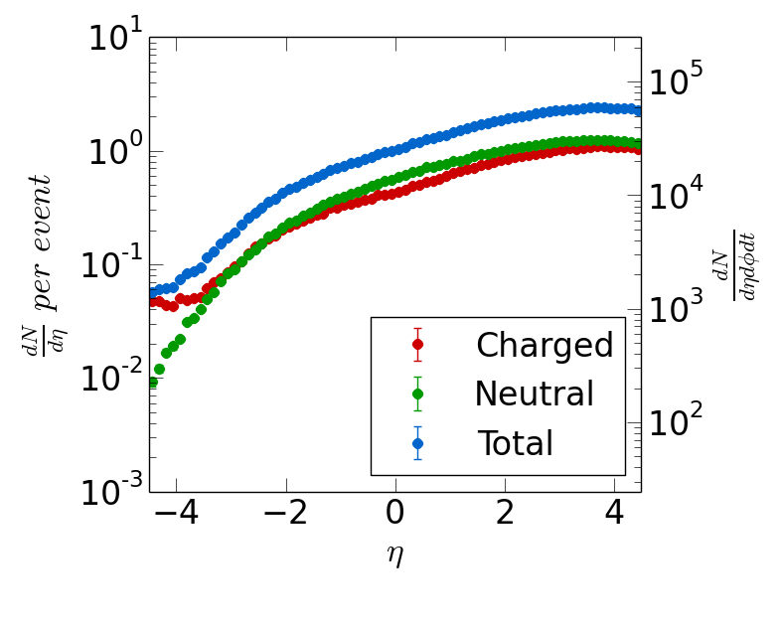
sPHENIX rate VS EIC charge track rate
Charged multiplicity, Au+Au, 100 + 100 GeV/c
HIJING event generator
Multiplicity, e+p 20+250 GeV/c, 50μb
https://wiki.bnl.gov/eic/index.php/Detector_Design_Requirements
sPHENIX AuAu dN_{ch}/dη ~200, |η|<1
Streaming readout @ 200 kHz collision : 80 M N_{ch}/s
DAQ throughput @ trigger rate 15 kHz:
6 M N_{ch}/s + pile up
EIC 20+250 GeV/c dN_{ch}/dη ~1, |η|<4
Streaming readout @ 500kHz collision (10³⁴ cm⁻² s⁻¹) :
4 M N_{ch}/s << sPHENIX
DAQ throughput, full stream:
4 M N_{ch}/s <~ sPHENIX

Slide 14
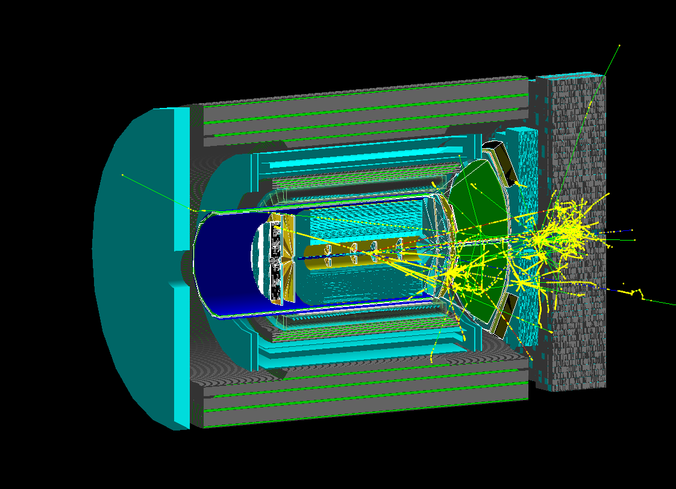
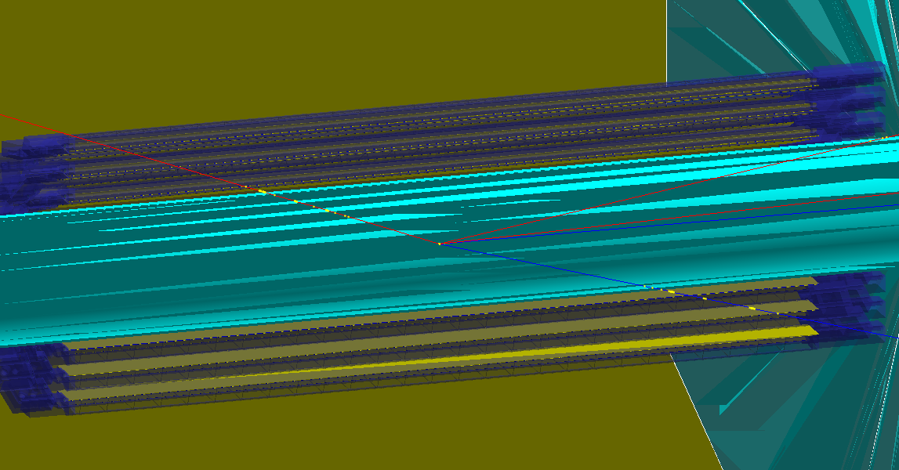
More quantitative? Take a look in EIC simulation
e+p collision 18+275 GeV/c
DIS @ Q² ~ 100 (GeV/c)²

Slide 15
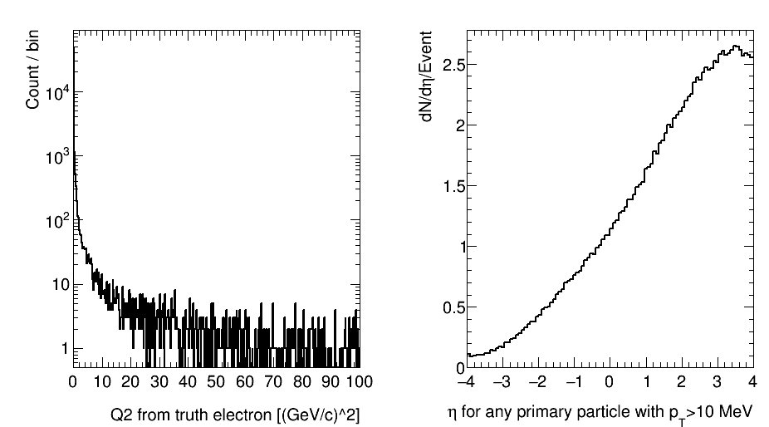
Full detector “Minimal bias” EIC events in sPHENIX framework: quick first look
Multiplicity check for all particles
Minimal bias Pythia6 e+p 20 GeV + 250 GeV
53 µb cross section
BNL EIC taskforce studies
https://wiki.bnl.gov/eic/index.php/Detector_Design_Requirements
  Based on BNL EIC task-force eRHIC-pythia6 event-gen set

Slide 16
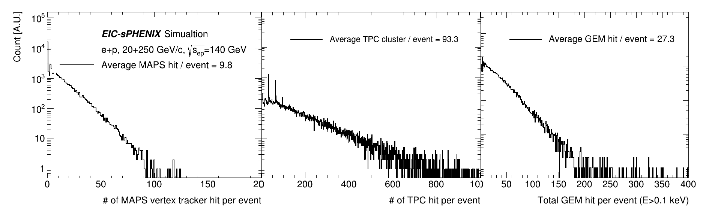
GEANT4-based detector simulation for DAQ simulation: tracker
Raw data: 16 bit / MAPS hit
Raw data: 3x5 10 bit / TPC hit
+ headers (60 bits)
Raw data: 3x5 10 bit / GEM hit
+ headers (60 bits)

Slide 17
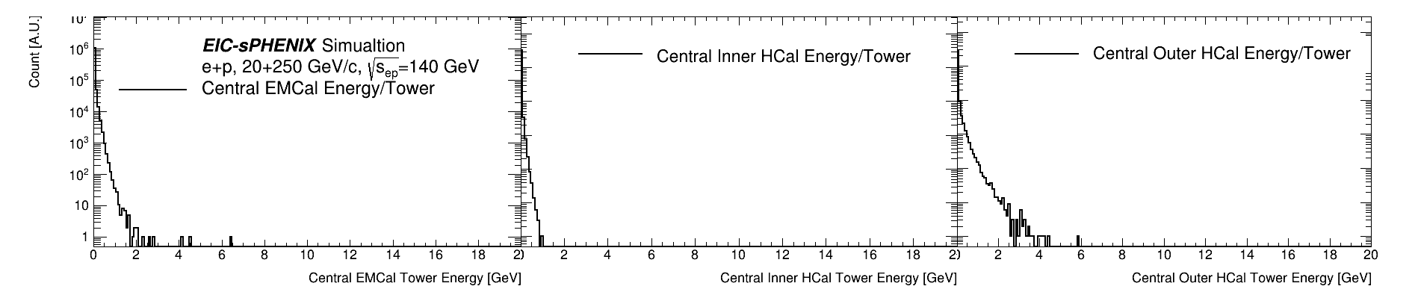
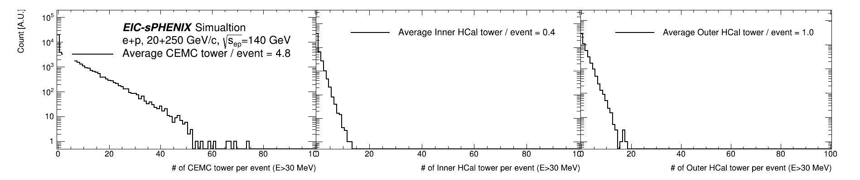
GEANT4-based detector simulation for DAQ simulation: central calorimeters
Raw data: 31x 14 bit / active tower +padding + headers ~ 512 bits / active tower

Slide 18
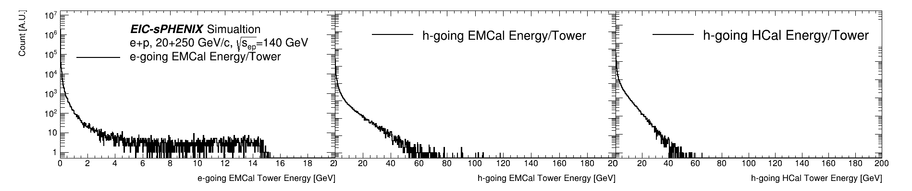
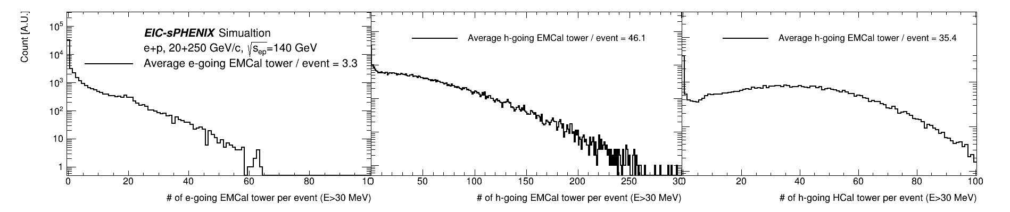
GEANT4-based detector simulation for DAQ simulation: forward calorimeters
Raw data: 31x 14 bit / active tower +padding + headers ~ 512 bits / active tower

Slide 19
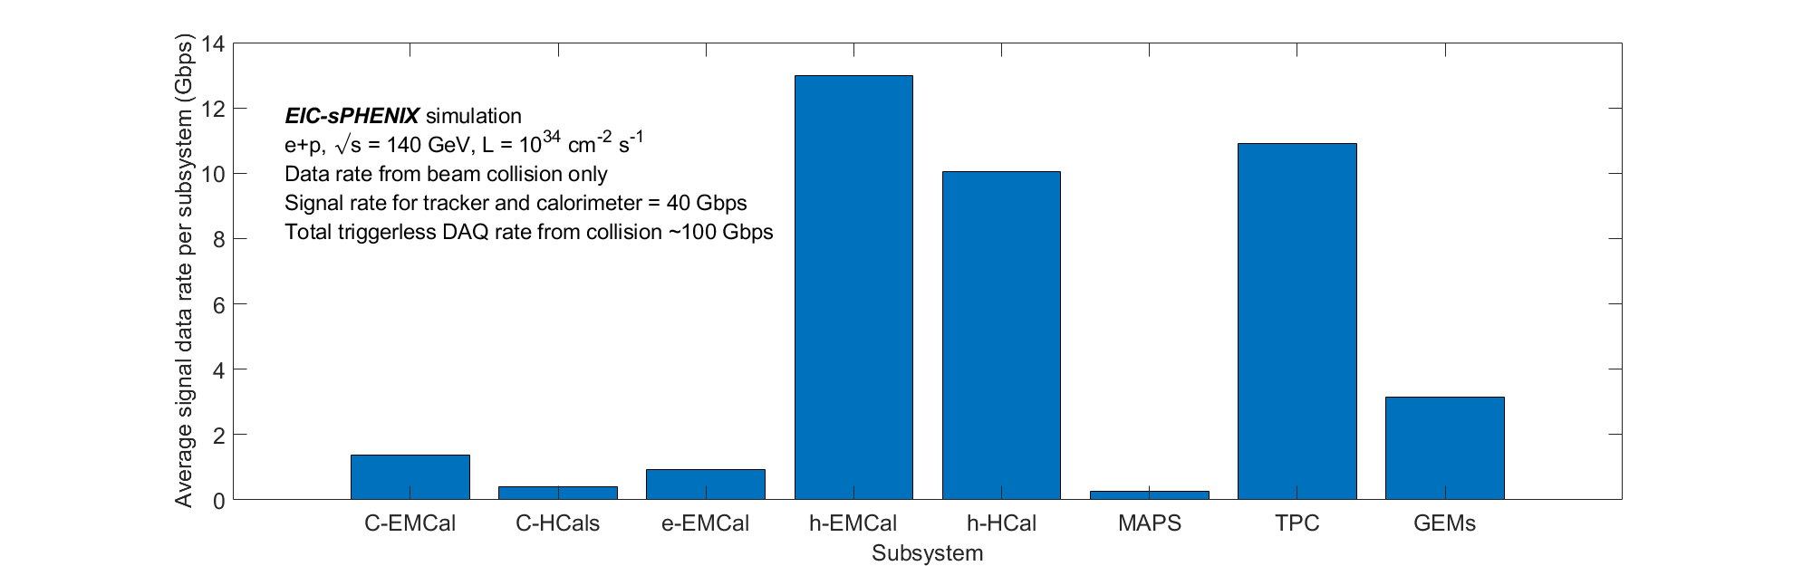
EIC preliminary data rate summary
Tracker + calorimeter ~ 40 Gbps
+ PID detector + 2x for noise ~ 100 Gbps
Signal-collision data rate of 100 Gbps seems quite manageable,
  < sPHENIX TPC disk rate of 200 Gbps
Machine background and noise would be critical in finalizing the total data rate
  From on-going sPHENIX R&D prototyping will show noise level from state-of-art MAPS and SAMPA ASICs
  Prevision for noise filtering in EIC online system

Slide 20
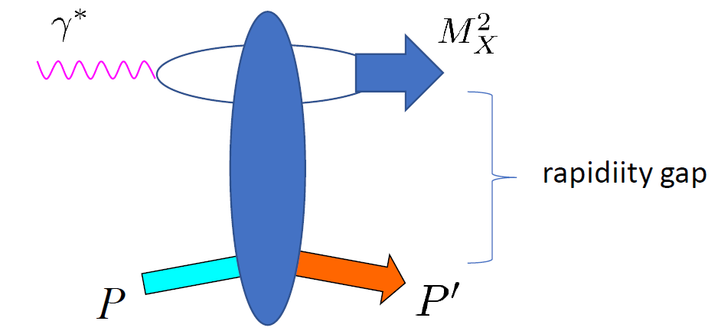
sPHENIX-EIC DAQ Strategy
Full streaming readout → DAQ interface to commodity computing via PCIe-based FPGA cards (e.g. BNL-712/FELIX series) → Disk streaming raw data → Event tagging in offline production
Why streaming readout?
  Versatility of EIC event topology make it challenging to design a trigger on all interested event.
  e.g. new diffractive-type events below, and new type of events not yet envisioned?
  Many EIC measurement, e.g. SF, are systematic driven.
  Streaming minimizing systematics by avoiding hardware trigger decision + keep background and history
  At 500kHz collision rate, many detector would require streaming, e.g. TPC, MAPS
Why BNL-712/FELIX series DAQ interface? [More on next slides]
  0.5 Tbps x bi-direction IO to FEE <-> large FPGA <-> 100 Gbps to commodity computing
  O($100) / 10Gbps bidirectional link
Why keep raw data?
  At 100 Gbps < sPHENIX rate, we can disk all raw data: If you can, always keep raw data.
  Achieve final minimal systematics may require refining calibration with integrated and special (e.g. z.f.) data.
  Calibration in real-time for final production in real-time requires considerable manpower for preparation (100 FTE?) and risky to fit in initial running years.
Diffractive (general)
Diffractive di-”jet” :
Promising new channel to access OAM

Slide 21

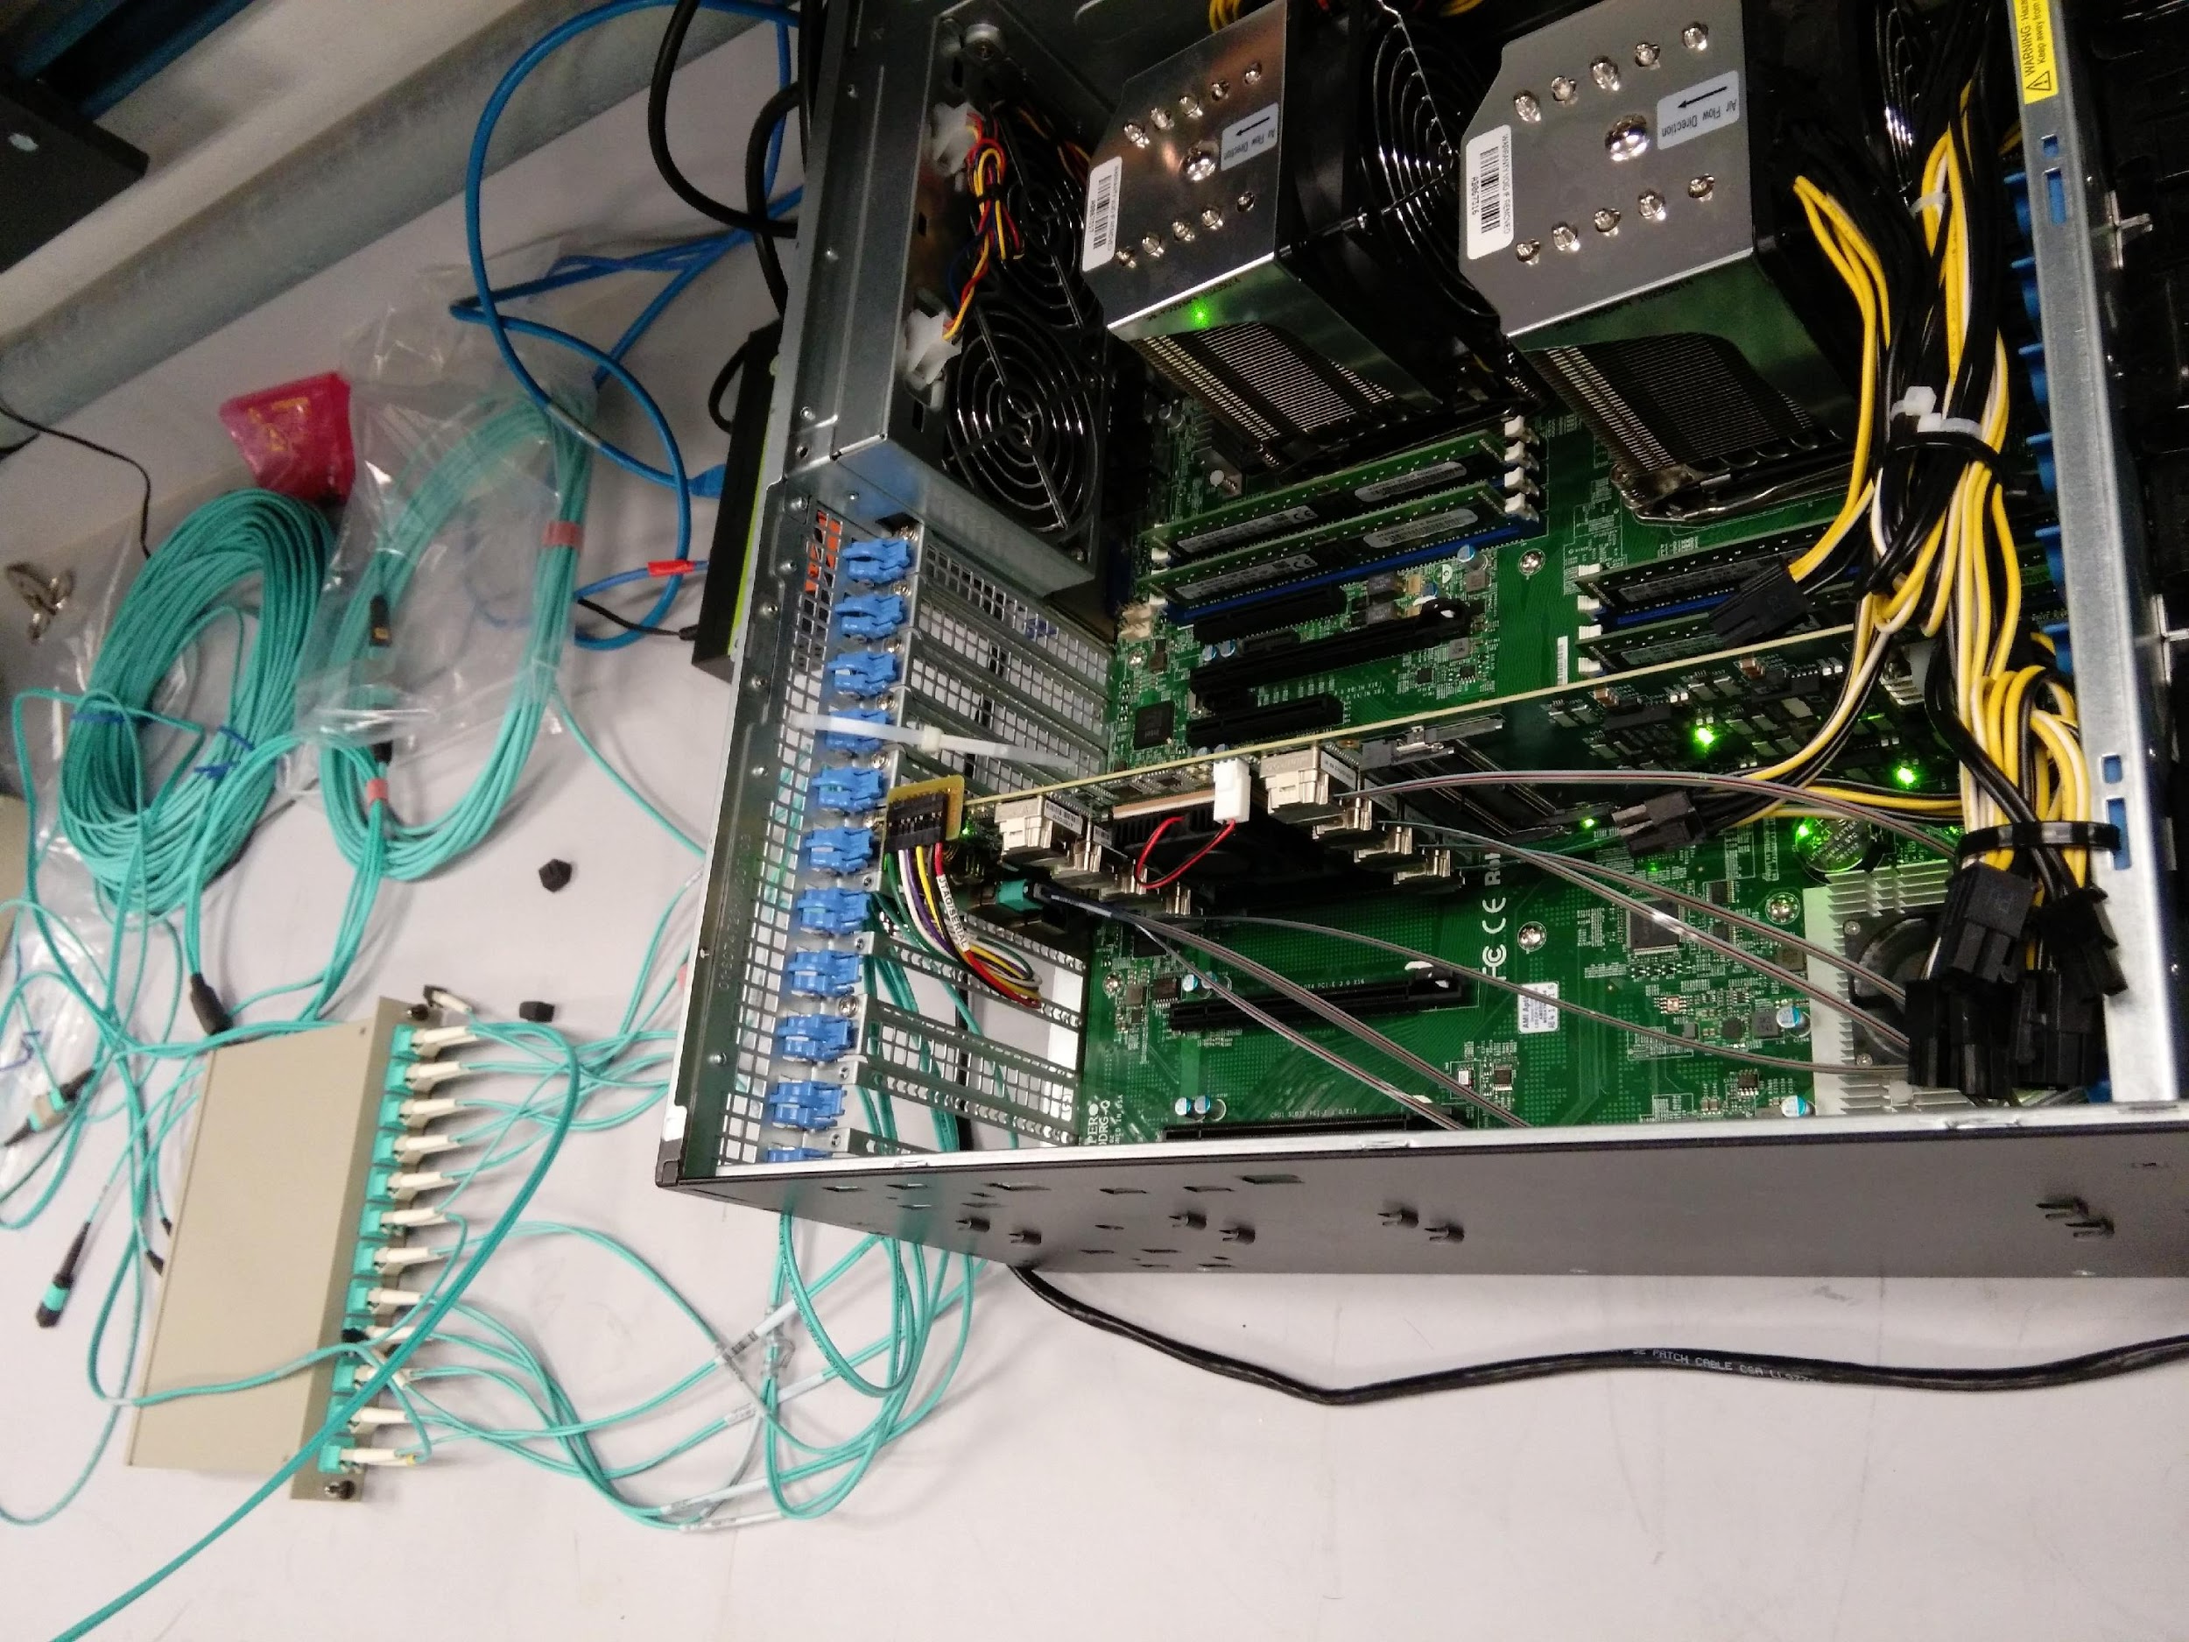
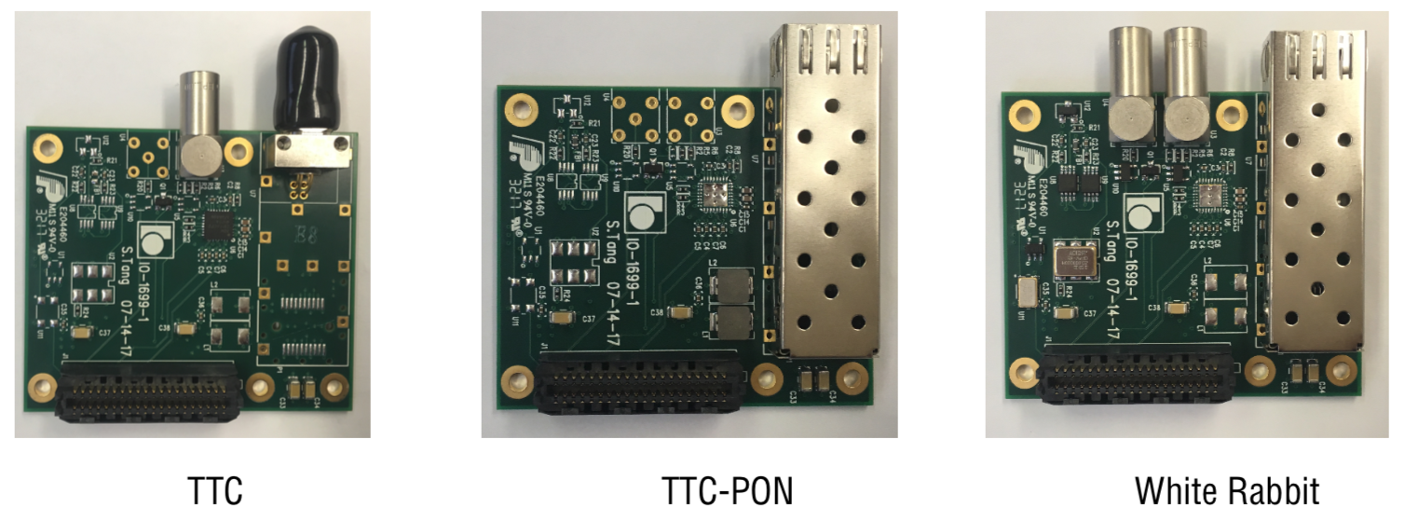
A streaming DAQ architecture
Using PCIe FPGA card bridging stream-readout FEE on detector and commodity online computing
  Similar approach taken at ATLAS, LHCb, ALICE phase-1+ upgrades and sPHENIX
Implementation: BNL-712-series FPGA-PCIe card
  2x 0.5-Tbps optical link to FEE: 48x bi-directional 10-Gbps optical links via MniPODs and 48-core MTP fiber
  100 Gbps to host server: PCIe Gen3 x16
  Large FPGA: Xilinx Kintex-7 Ultra-scale (XCKU115), 1.4 M LC
  Bridge μs-level FEE buffer length with seconds level DAQ time scale
  Interface to multiple timing protocols (SPF+, White Rabbit, TTC)
  Developed at BNL for ATLAS Phase-1 FELIX upgrade, down selection to use for streaming FEE readout in sPHENIX, proto-DUNE, CBM
  Continued development to upgrade to 25-Gbps optical links, Vertex7 FPGA and PCIe-Gen4
Exp. Hall
DAQ room
FEE
Server
COST Network
&
Online Computing
FEE
Server
FEE
Server
FEE
....
Server
48x 10-Gbps
fibers per FELIX
....
10-100 Gbps
Network
EIC Timing
FELIX Card – BNL712 - v2.0
FELIX timing
interface mezzanine
FELIX-server test stands at BNL

Slide 22
Productions for BNL-712v2/FELIXv2
Ongoing FY19 BNL-712v2/FELIXv2 card production from BNL covering sPHENIX advanced R&D
  CBM working on joining this production and adopting this architecture for 2020 campaign too.
  2nd sPHENIX production planned after sPHENIX CD-3B (FY20?)
  BNL produced 40x cards in various versions of FELIX in ATLAS pre-productions, which will continue too.
Synergies from further EIC stream readout R&D welcomed too
Courtesy of C. Stum, D. Emschermann (GSI)
See also talk of Dr. Volker Friese (GSI)

Slide 23
Recent highlights
GEM & TPC streaming FEE – SAMPA
Timing distribution
BNL LDRD on high throughput DAQ

Slide 24
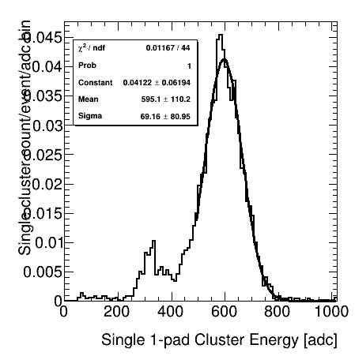
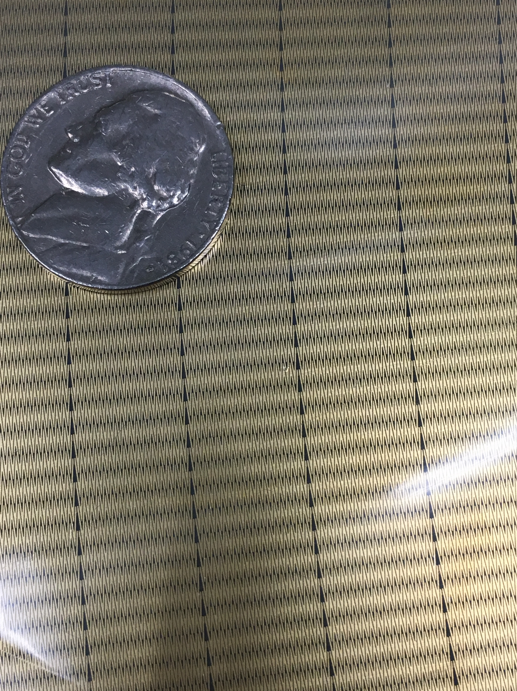
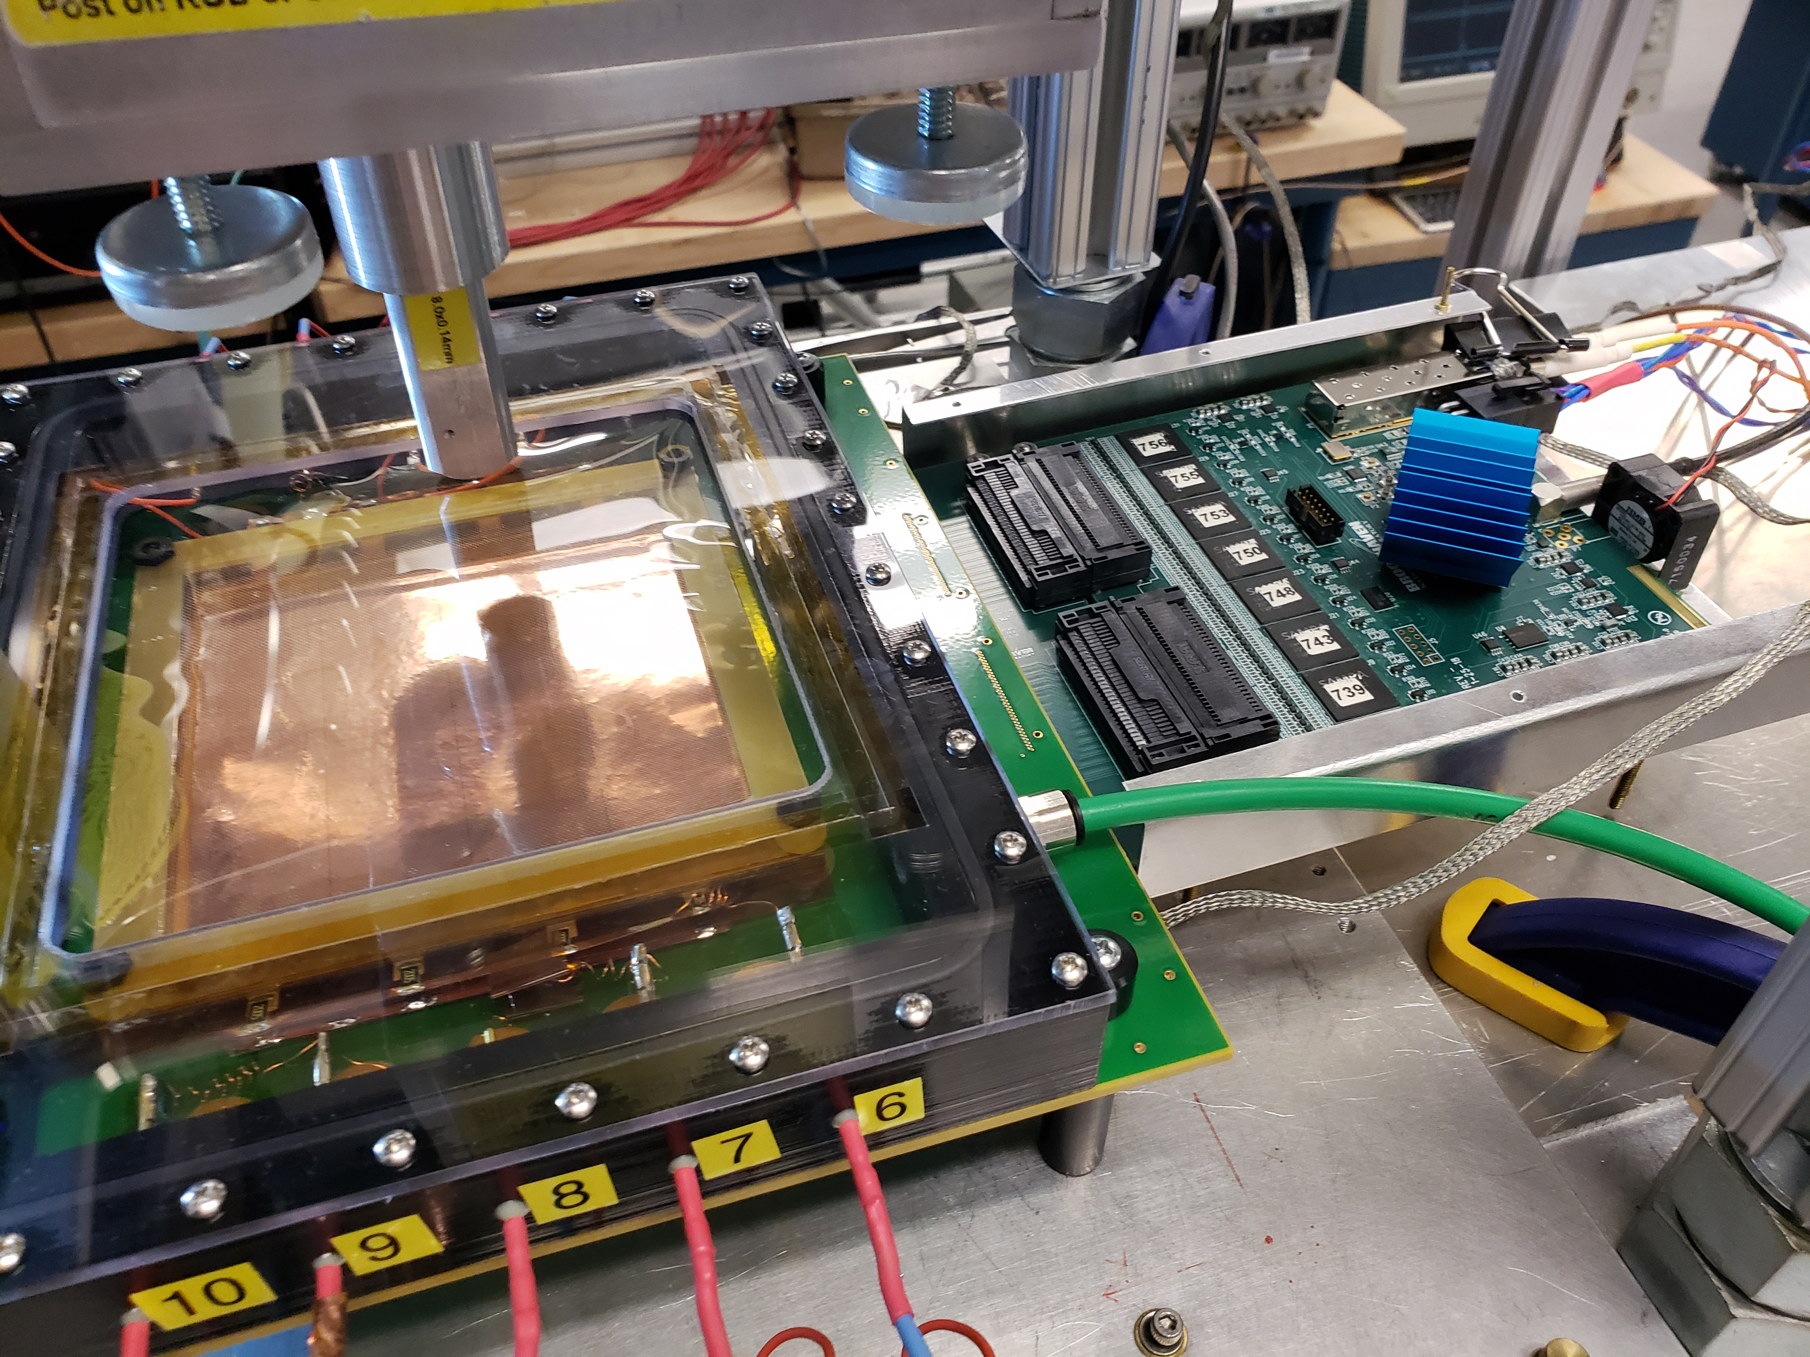

SAMPA test stand with EIC RD GEM tracker
Readout of the eRD6 GEM + zigzag pad with SAMPA FEE + FELIX test stand
sPHENIX also initiate engineering and production for a special version of SAMPA with ½ current min shaping time (→80ns) @ University of São Paulo & TSMC
Fe-55 x-ray on q-GEM (Ar-based)
Raw data, decoder, clustering & Ana.

Slide 25
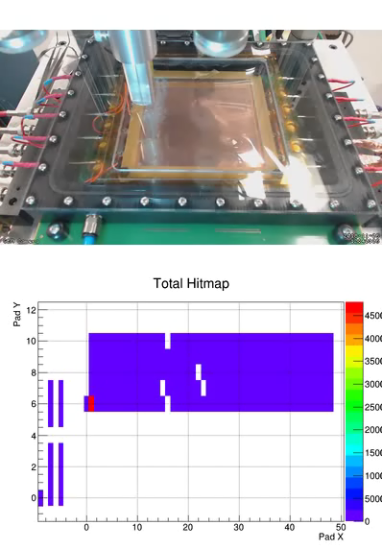
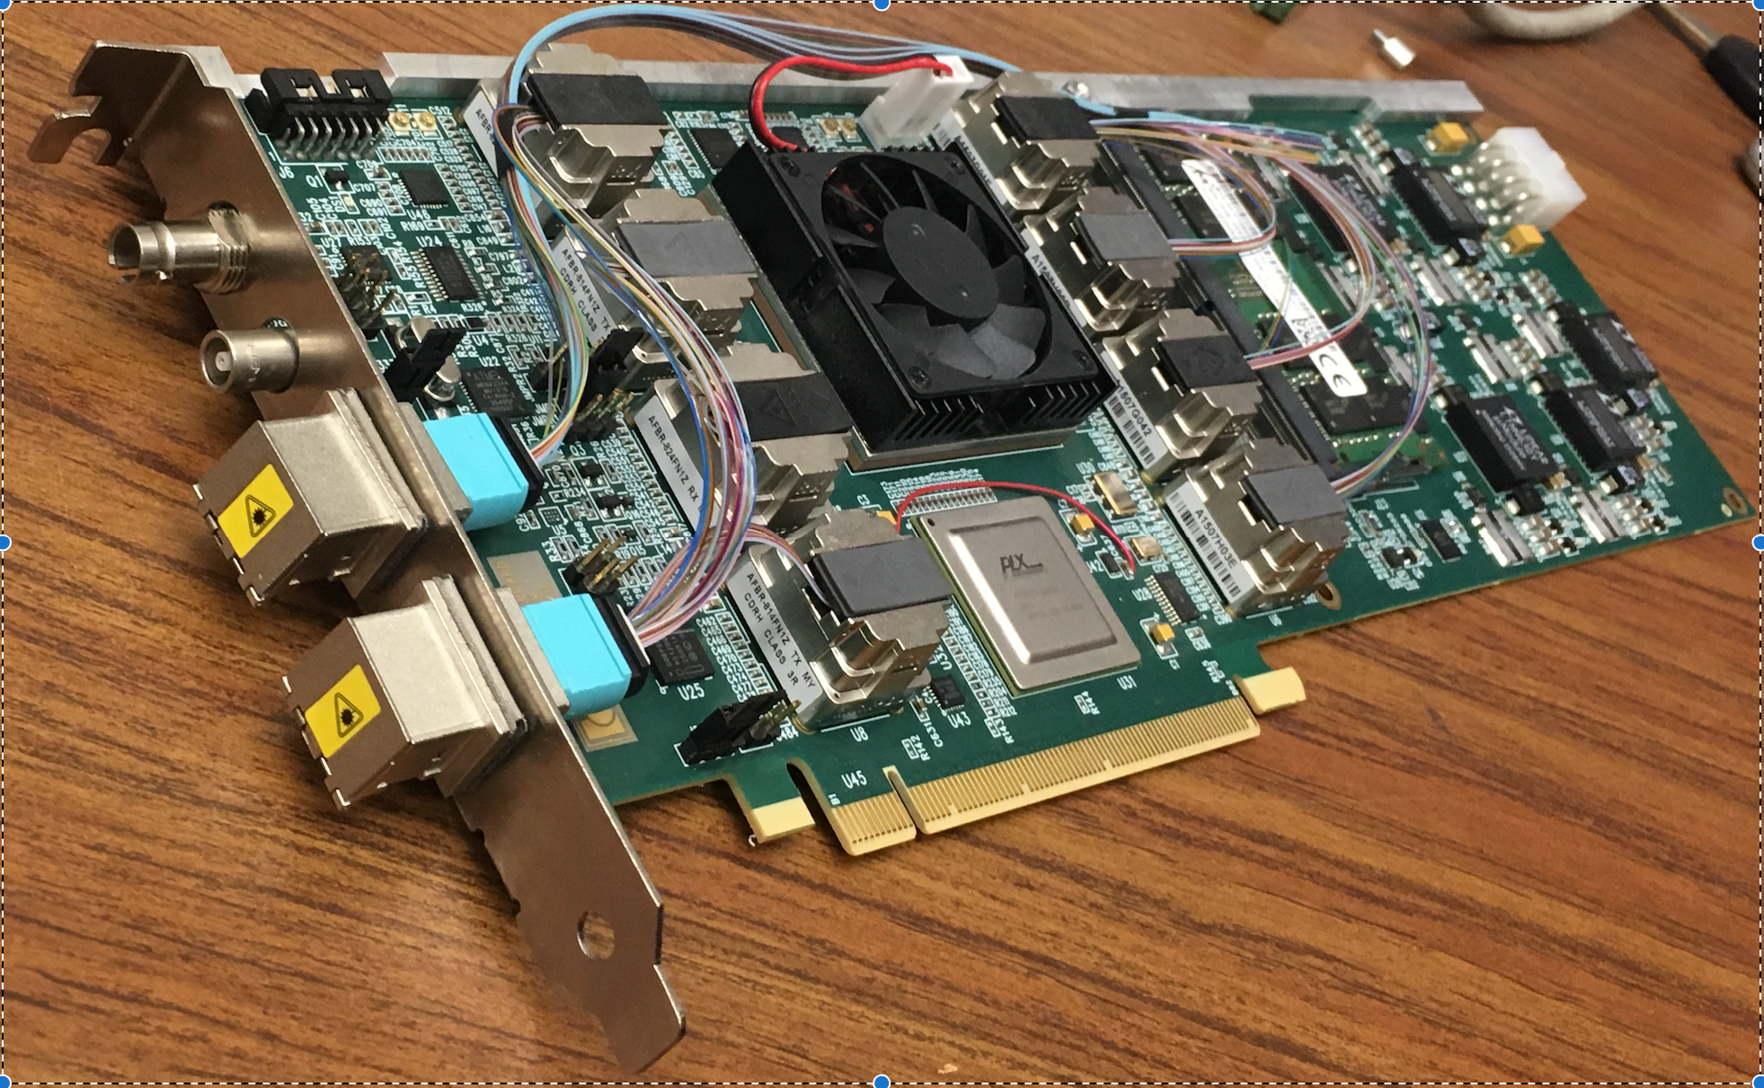

SAMPA test stand with EIC RD GEM tracker
X-ray src, eRD6 GEM + zigzag pad
Picture embedded in raw data stream (animation)
8x SAMPA FEE
Reconstructed GEM hits from SAMPA data
BNL-711 (→ BNL-712v2)
Raw data & Ana.
Commodity server

Slide 26
Timing distributions
All PHENIX/sPHENIX FEE are synced to beam clock/counter. Expecting similar for EIC detector
BNL-712/FELIX can receive clock of multiple protocols (SPF+, White Rabbit, TTC, …) via a timing mezzanine card
SI5345 jitter cleaner control jitter to <0.1 ps
BNL-712/FELIX carries 48x 10 Gbps downlink fiber for control data to FEE. Beam clock and sync word can be encoded on fiber (e.g. 8b10b encoding)
For EIC hadron beam RF, extra cautious need to be taken for hadron machine ramp from low gamma to high gamma, which leads to clock frequency variation [next slide].
Exp. Hall
DAQ room
FEE
Server
COST Network
&
Online Computing
FEE
Server
FEE
Server
FEE
....
Server
48x 10-Gbps
fibers per FELIX
....
10-100 Gbps
Network
EIC Timing
timing mezzanine cards
Courtesy of Kai Chen (BNL)

Slide 27





Embedded clock demo with variable beam clock frequency
RHIC frequency spread (due to ramp) is large, 9.362 MHz ±22 kHz
Function generator mimic repeated RHIC clock ramping (triangle pattern)
Demo FELIX
Kintex-7 Ultrascale
Downlink: 4.8 Gb/s
Multiples of RHIC clock (9.4 MHz)
Recover clock from 8b/10b
Optical Links
Demo FEE
Atrix-7
Uplink: 4.8 Gb/s, fixed clock
Uplink iBERT @ DAM: 1.46e-13
Downlink iBERT @ FEE: 1. 023e-13
Test recovered “RHIC” clock
Kintex 7 (eval board for now) -> Atrix 7 (eval board)

Slide 28









Future explorations, BNL LDRD 19-026:
Common development for Advanced DAQ
EIC detectors
DUNE far detector
nEXO
BELLE-II
21-cm digital interferometer
Common challenge cross multi-discipline of BNL:
Advance DAQ with high throughput @ 100 Gbps
Solution: FELIX-based DAQ, the architecture used
in the LHC upgrades in the 2020s
Deliverable: test stand & firmware for each case
Co-PIs: Kai Chen (BNL/ATLAS),
Jin Huang (BNL/sPHENIX)
Strong contribution from BNL instrumentation
BNL 712 – series PCIe Card
Commodity Computing

Slide 29
Summary
PHENIX and sPHENIX builds long experience for streaming readout front-end
We are exploring one way to build EIC detector streaming readout and trigger-less DAQ based on architecture of sPHENIX DAQ. Looks promising
  Preliminary simulation show disk rate for EIC collision signal (100 Gbps) expected
  lower than sPHENIX disk rate (200 Gbps)
  Controlling background for high-L low-σ collisions would be important for collider, detector and DAQ designs.
BNL-712/FELIX-type DAQ architecture fits EIC purpose. Similar architecture have wide support in 2020+ for high throughput DAQ e.g. ATLAS, ALICE, LHCb, CBM, Bell-2, and cost effectively bridges custom front-end with commodity computing
Productions planned for BNL-712/FELIX DAQ interface, more EIC R&D interests welcomed
PHENIX/FVTX streaming readout sPHENIX SAMPA+FELIX DAQ chain reading out EIC GEM detectors

