Slide 1
Recent 160 C “N infusion” impurity doping results
J. T. Maniscalco
CLASSE, Cornell University

Slide 2
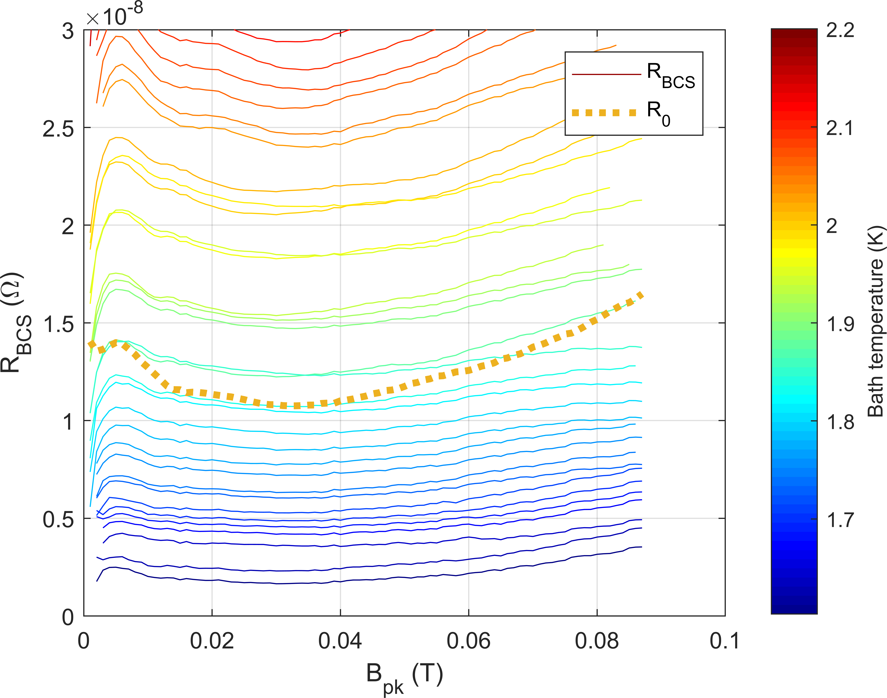
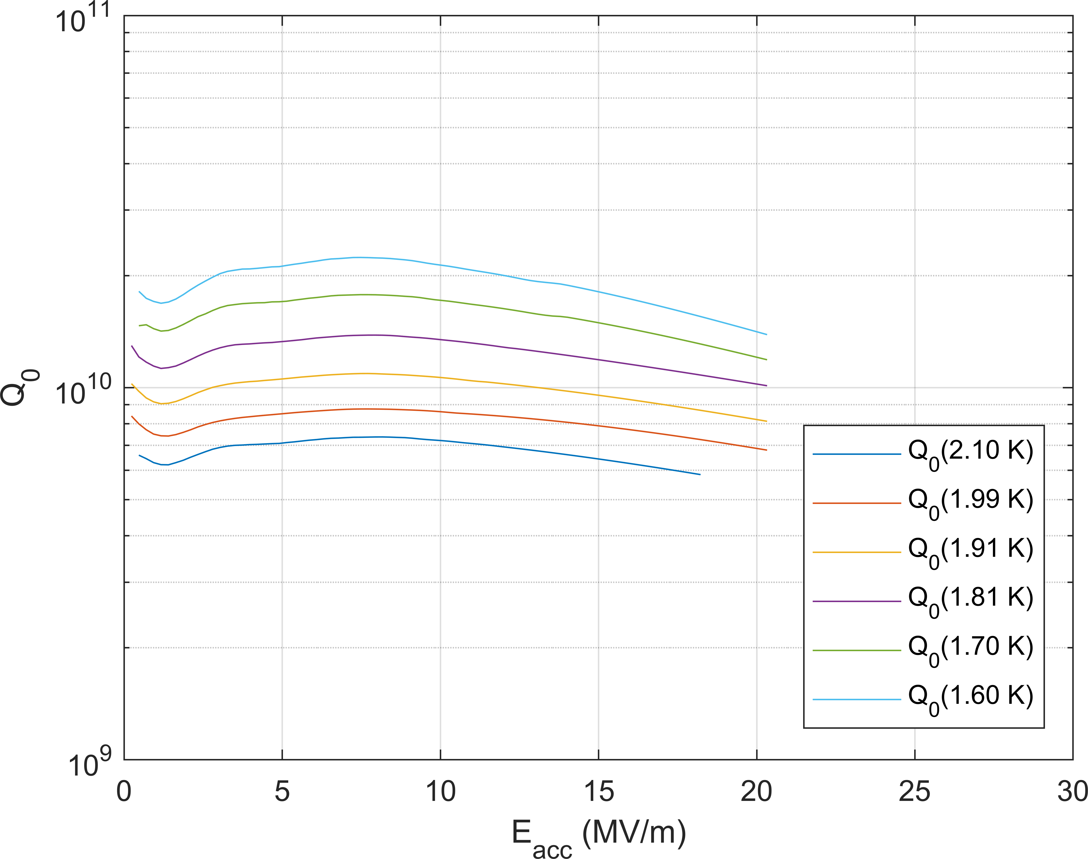
High-frequency results
SC-06: 800 C degas UHV 3 hr, 160 C UHV 3 hr, 160 C 40 mTorr N2 96 hr
No post-chemistry
2 K

Slide 3
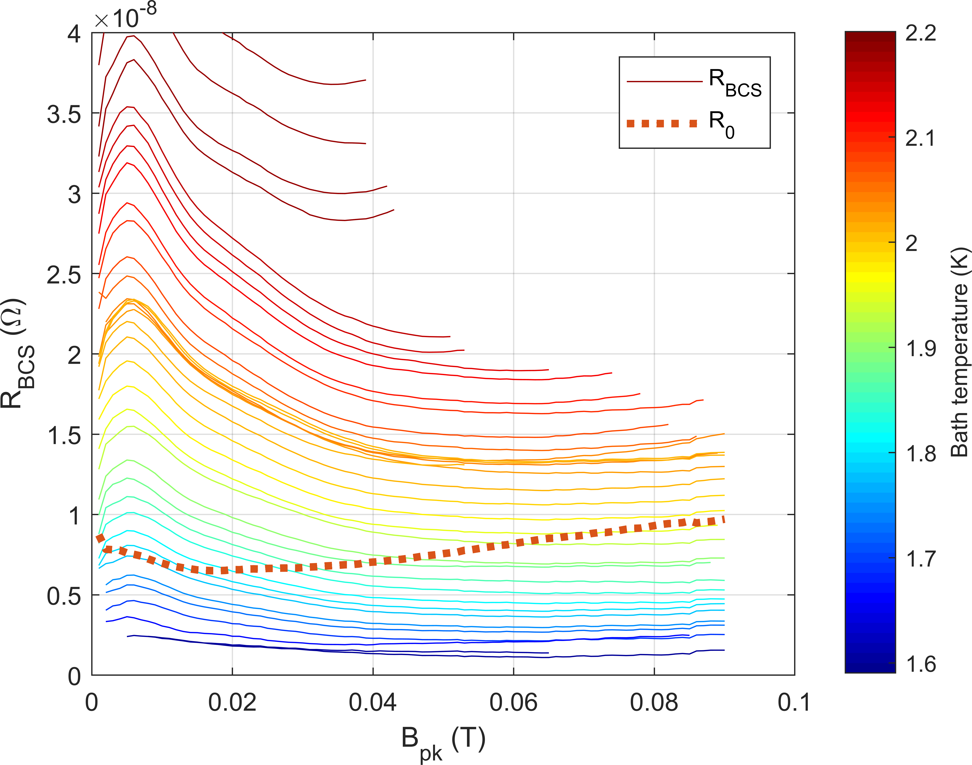
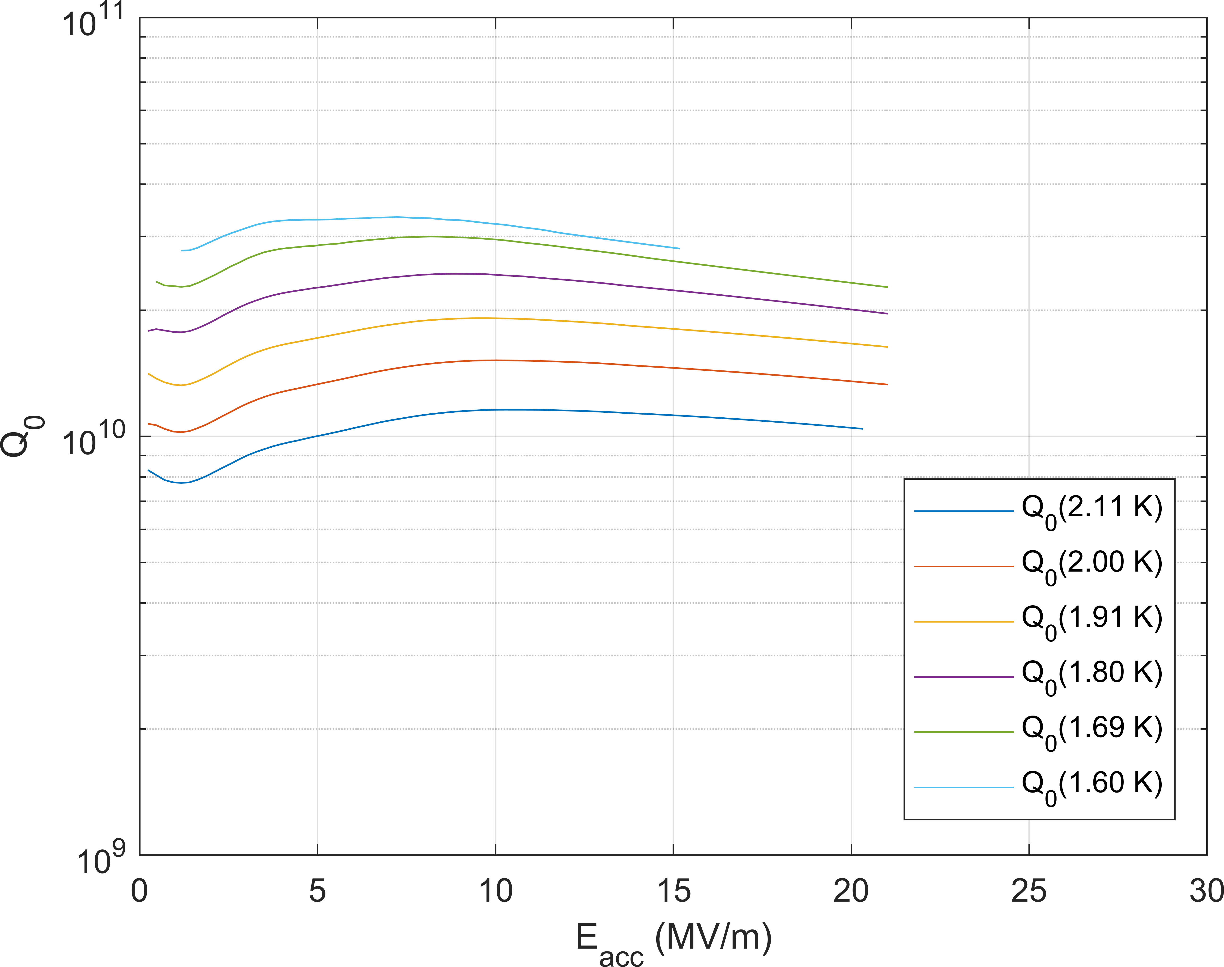
High-frequency results
SC-06: 800 C degas UHV 3 hr, 160 C UHV 3 hr, 160 C 40 mTorr N2 96 hr
HF rinse (~5 nm removal)
2 K

Slide 4
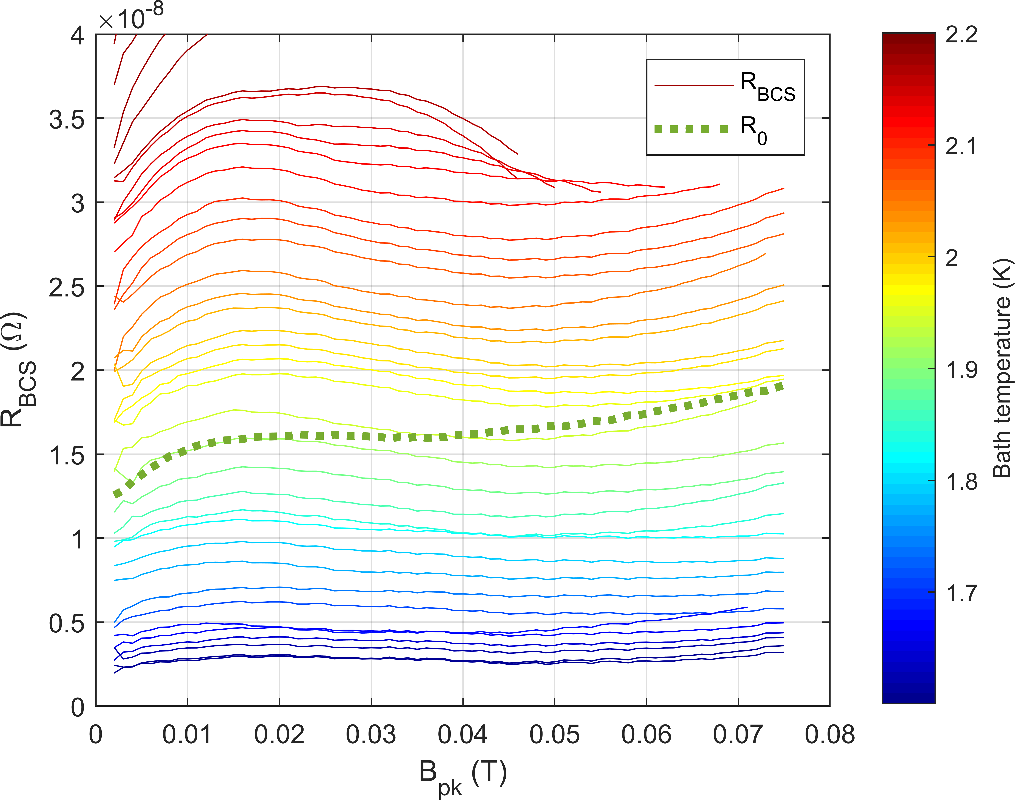
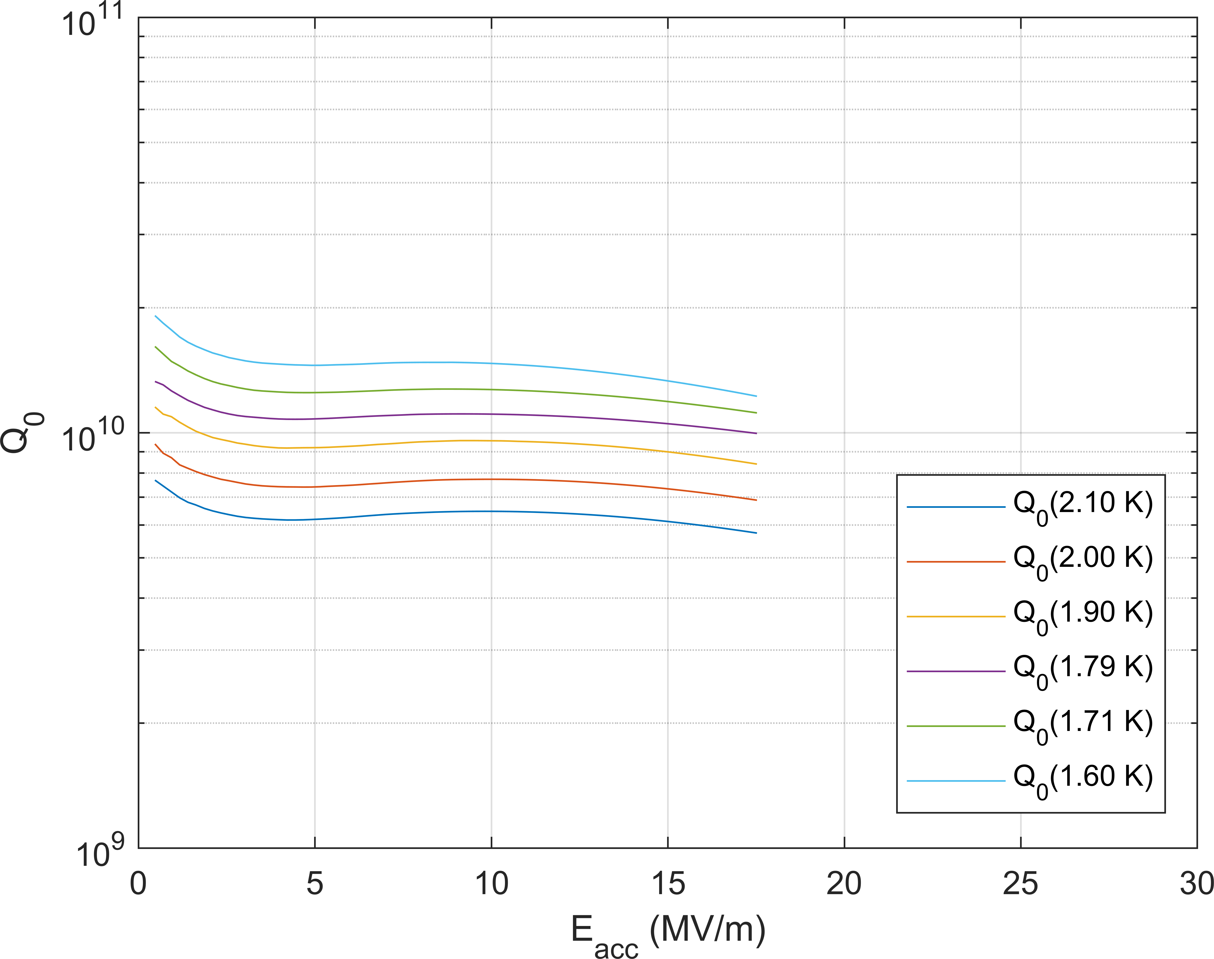
High-frequency results
RDTTD-4: 800 C degas UHV 3 hr, 160 C UHV 3 hr, 160 C 40 mTorr N2 48 hr
No post chemistry
2 K

Slide 5
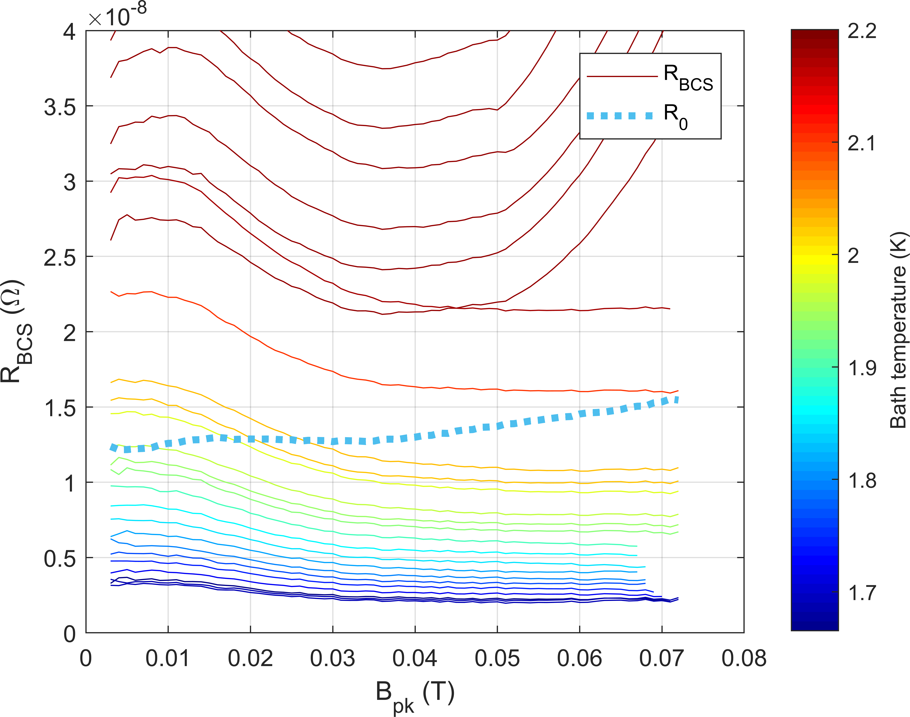
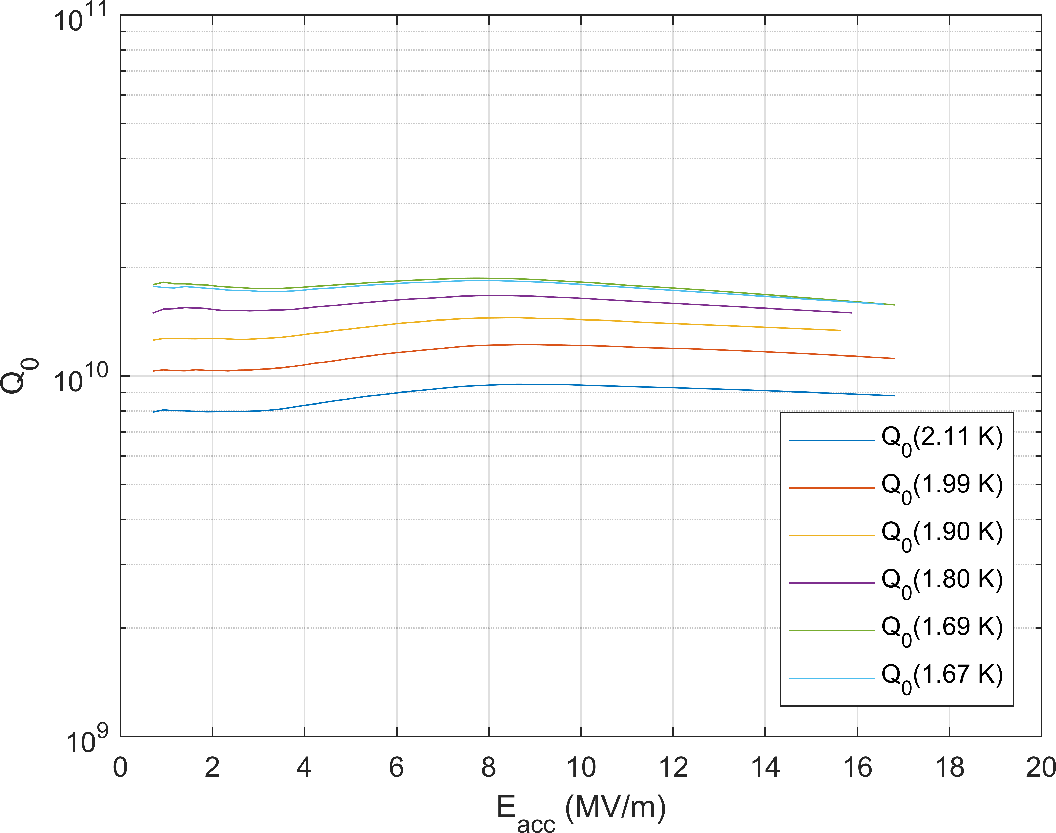
High-frequency results
RDTTD-4: 800 C degas UHV 3 hr, 160 C UHV 3 hr, 160 C 40 mTorr N2 48 hr
2x HF rinse (~10 nm removed)
2 K

Slide 6
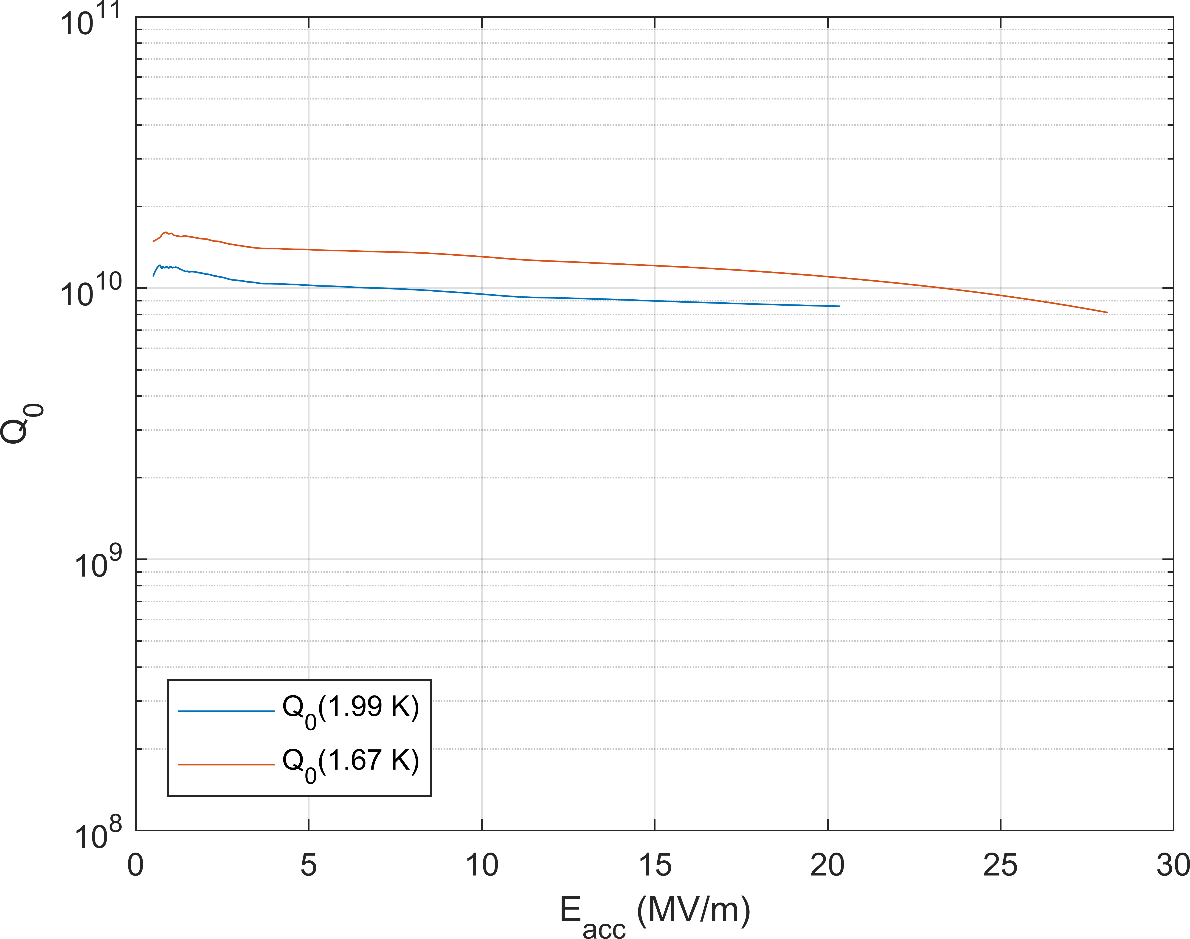
High-frequency results
RDTTD-4: 800 C degas UHV 3 hr, 160 C UHV 3 hr, 160 C 40 mTorr N2 48 hr
2x HF rinse (~10 nm removed) + 100 nm VEP
Similar Q @ low field, improved quench field
High residual resistance – potentially high trapped flux

Slide 7
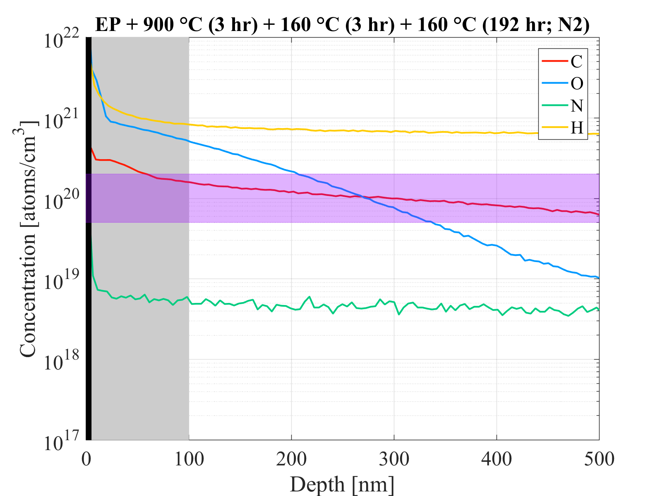
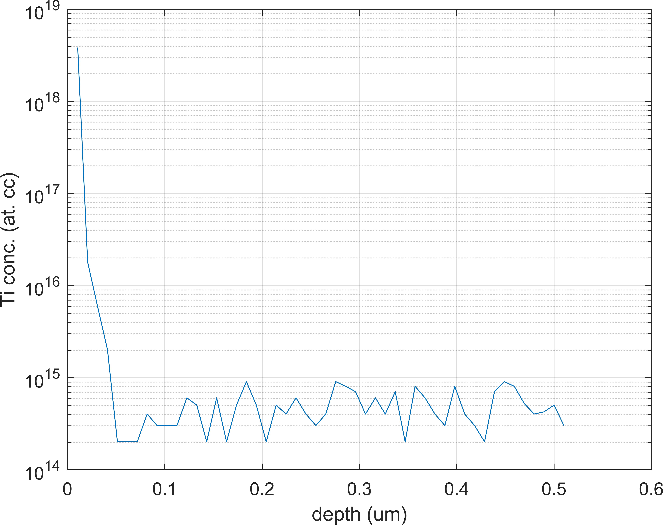
High-frequency results
SIMS results indicate Ti contamination (SC-06 witness sample)
Separated by 2 layers of Nb foil (caps, foil box) – maybe much higher on cavity surface

