Slide 1
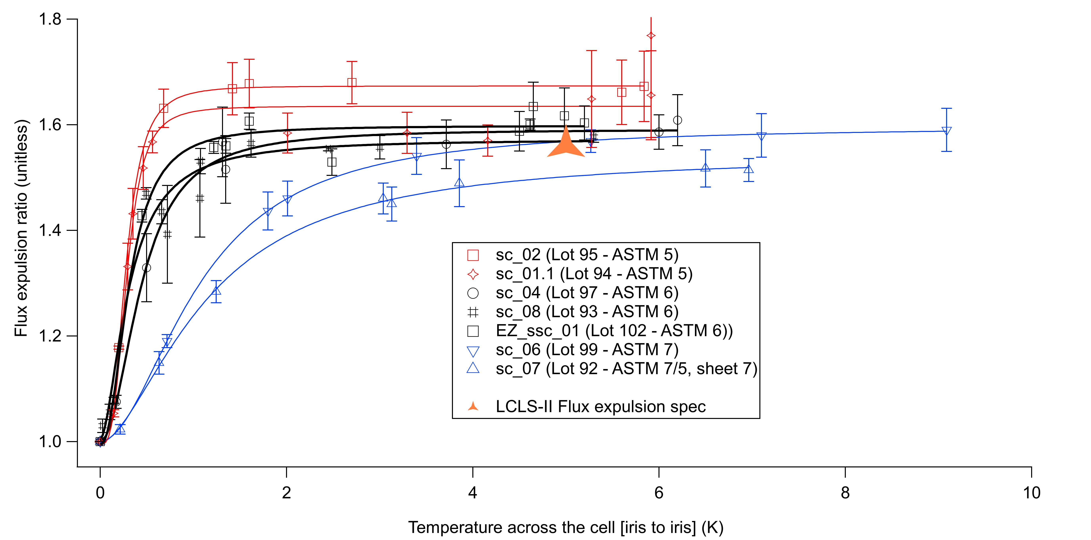
Flux expulsion of new material – Tokyo Denkai niobium cavities all @ 900°C 3 hours
Red – ASTM 5
Black - ASTM 6
Blue - ASTM 7
* Not 900°C
One ASTM 7 ingot lot temperature raised to 950°C all other lots kept at 900°C – lot 92 ASTM 7 ingot
Lot 99 left alone with knowledge it will just meet the specification – all other lots expected to exceed specification
LCLS-II specification comes from the cooldown and magnetic field specification for the cryomodules

Slide 2
HE R&D – new recipe
After the initial 2n6 recipe was developed for the baseline LCLS-II recipe we continued exploring the doping using short doping runs of 1-3 minutes, plus annealing cycle of 40 to 60 minutes. – lower doping
There were some interesting initial results which were not explored because of LCLS-II production needs – 2014 data
2N60 – EP5

Slide 3
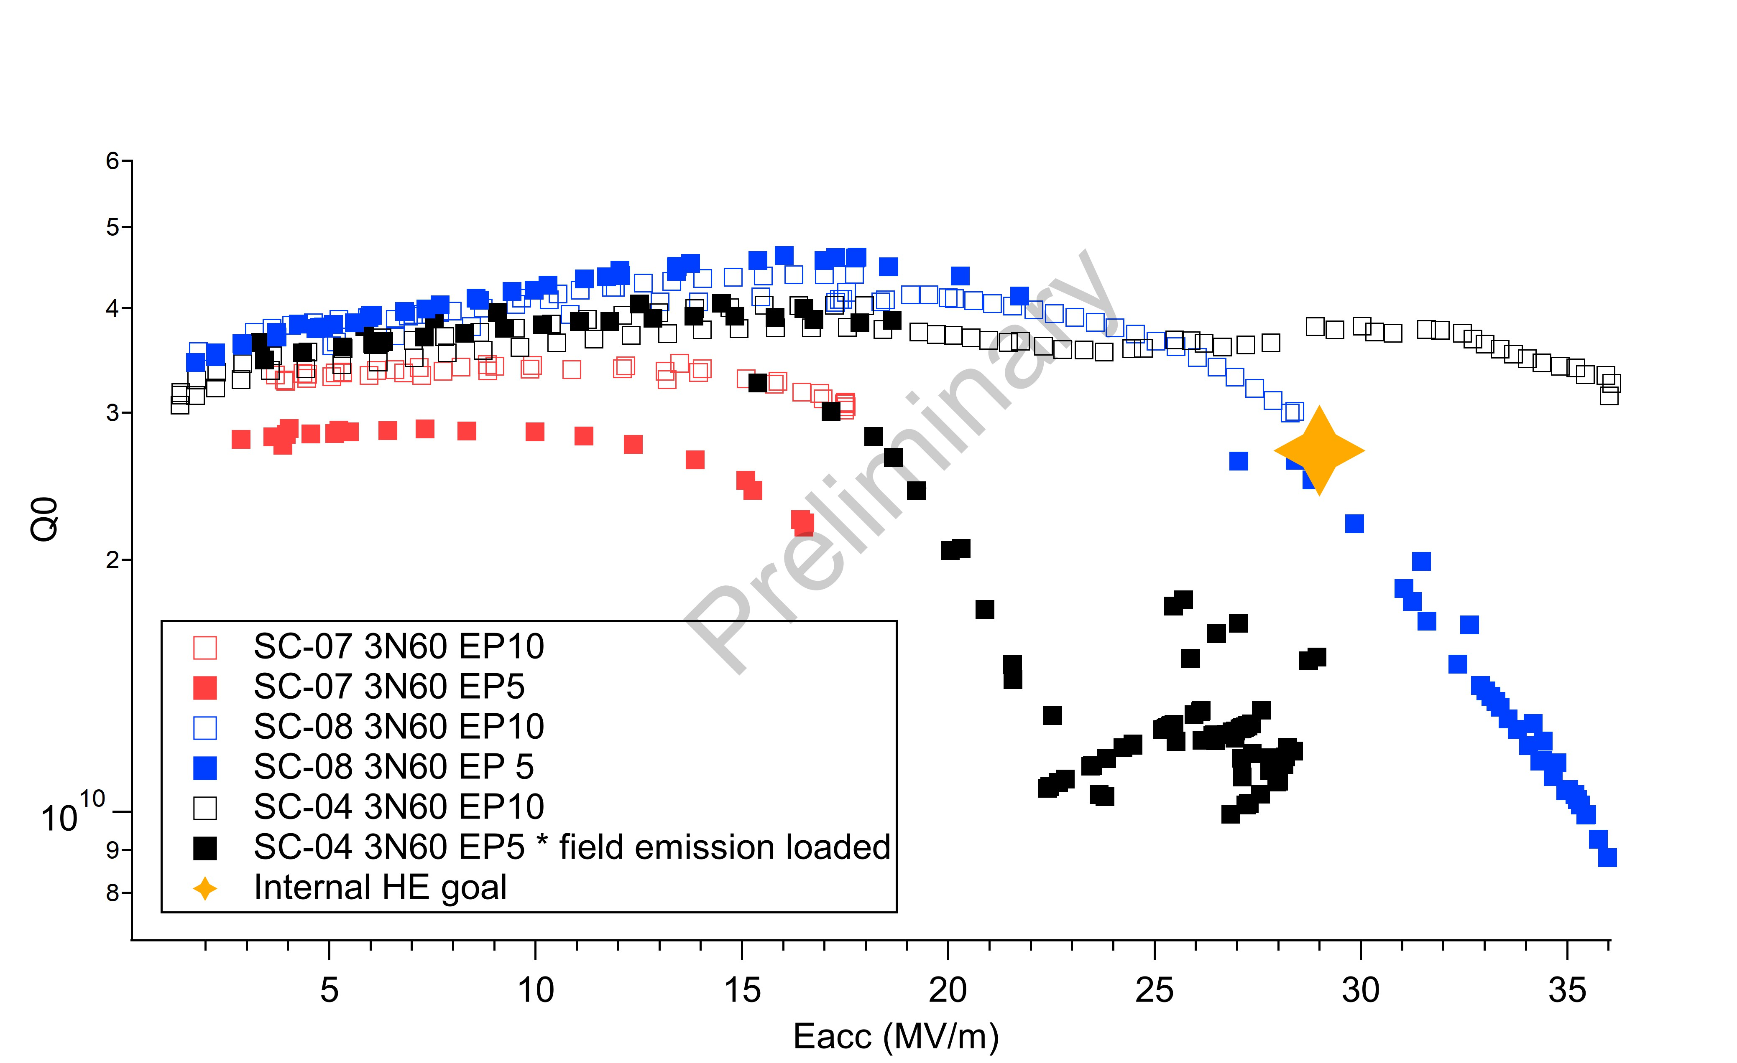
First results of new recipe - preliminary
2K world record
@ 1.3GHz*
Recipe could be used to upgrade C100’s at JLab
2 of the 3 first cavities pass our goal and exceeded the HE specifications. @ 5 & 10 micron removal
Re-doping and verification underway*
SC-07 appears to be defect limited by manufacturing flaw – retests underway
SC-07 trapped ~ 2-4mG of field during this test, others expel well

Slide 4
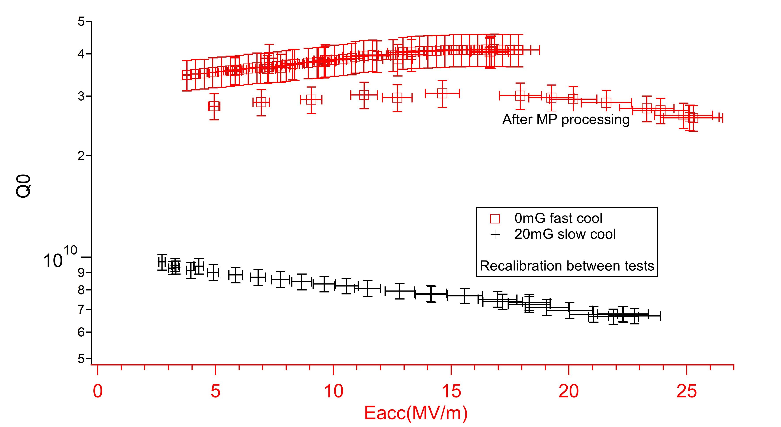
Re-dope SC-04 – quench @ 23-25MV/m (previous 30-35MV/m)

Slide 5
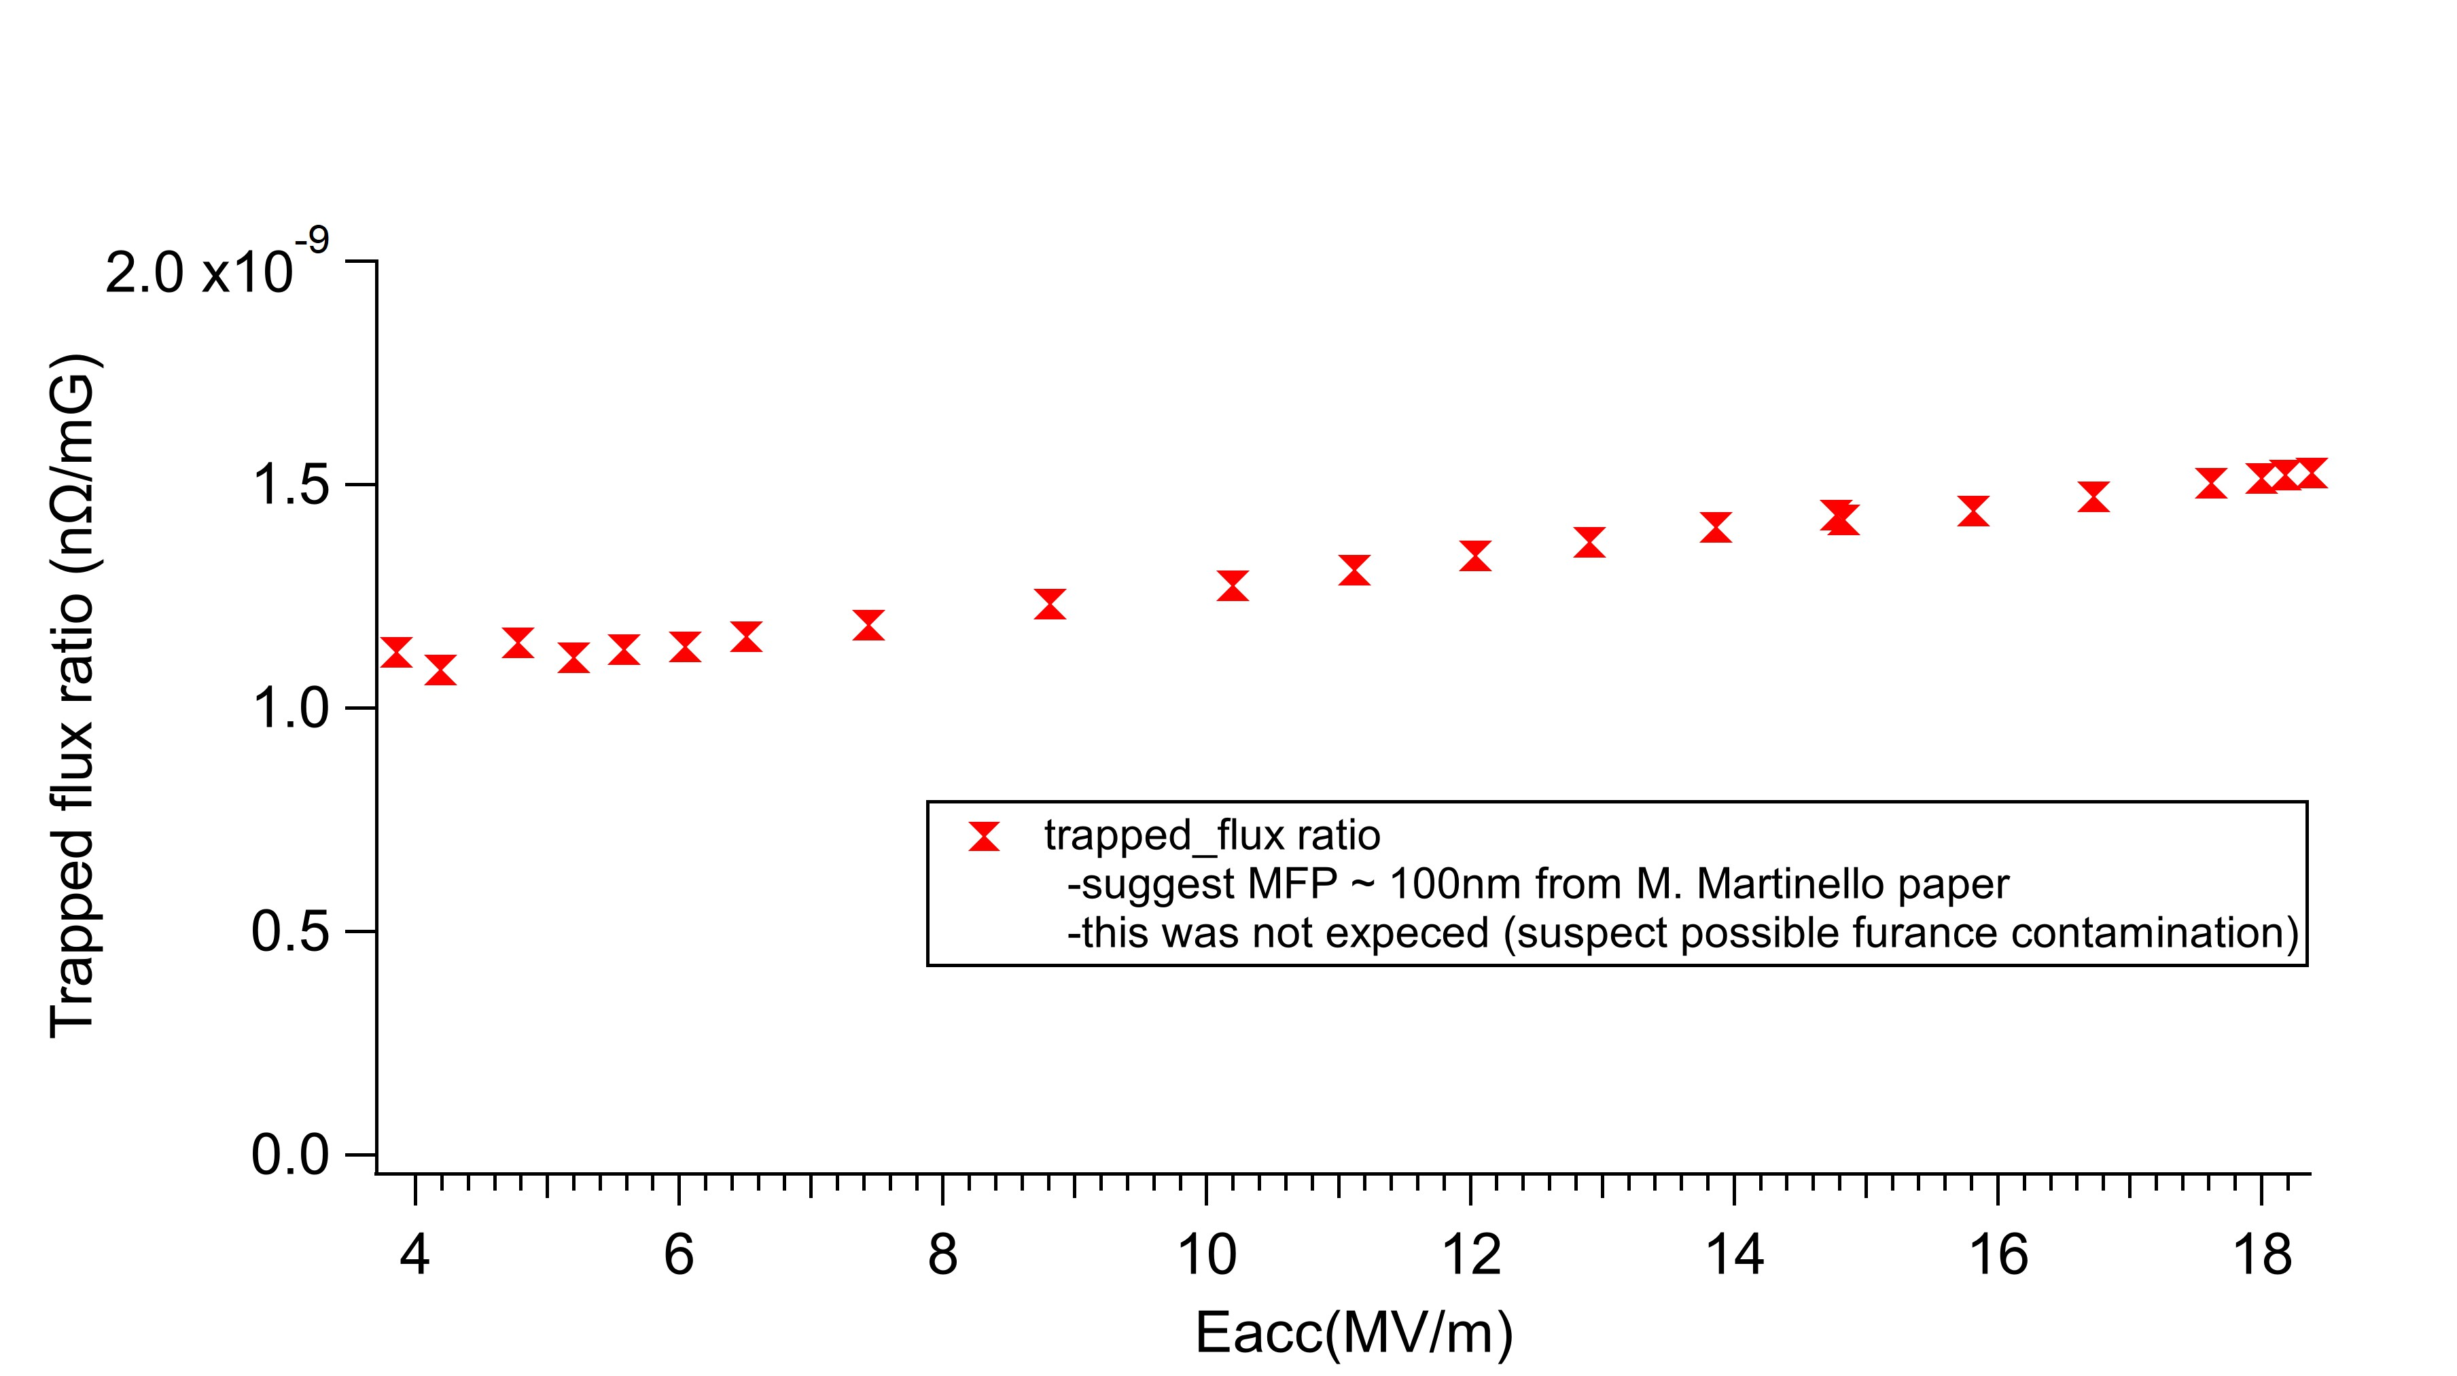
Re-dope trapped flux ratio SC-04

