Slide 1
Duality in 12 GeV Era: Projected Results from E12-10-002
Simona Malace
Jefferson Lab

Slide 2
Outline
F₂ at large x (and not only) in the context of Hall C’s E12-10-002
Expected physics output:
→ constraints for PDF global fits
→ quark-hadron duality studies: inspire the theory community to pursue a fundamental understanding of the phenomenon
→ non-singlet moments to higher Q²
→ modeling of resonance and deep inelastic scattering process

Slide 3
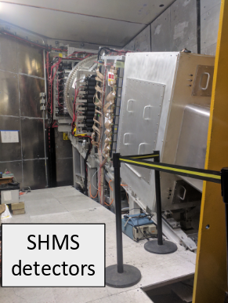
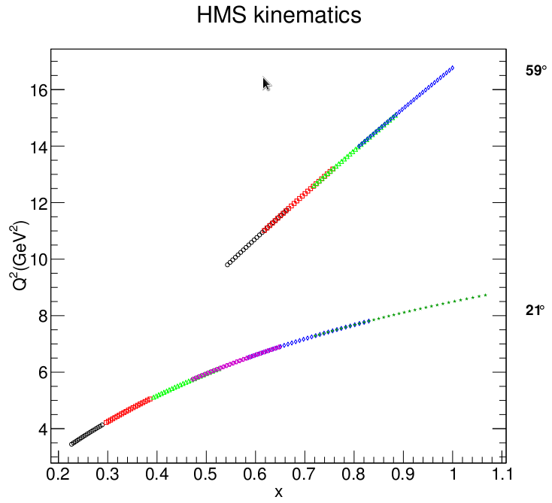
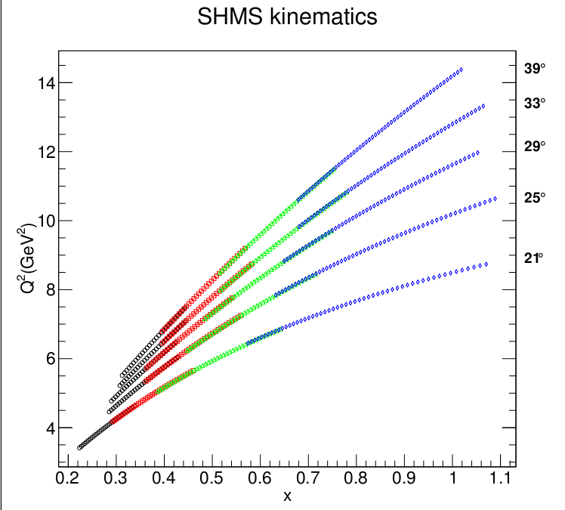
E12-10-002
Ran at JLab in Hall C February – March 2018 to measure inclusive cross sections for H(e,e’p) and D(e,e’p) in the resonance and deep inelastic scattering regions
Beam: 10.6 GeV, unpolarized
Targets: LH2, LD2, Al

Slide 4
Constraints for PDFs
Theory-experiment Collaboration: CJ
Performs global QCD fits of PDFs from data including deep-inelastic lepton-nucleon scattering, proton-proton collisions (lepton pair creation, W-boson and jet production), etc., with particular focus on the large-x region

Slide 5
Constraints for PDFs
Theory-experiment Collaboration: CJ
Performs global QCD fits of PDFs from data including deep-inelastic lepton-nucleon scattering, proton-proton collisions (lepton pair creation, W-boson and jet production), etc., with particular focus on the large-x region
Kinematic cut of almost all other PDF analyses before CJ
W² > 12.25 GeV²
W² > 3 GeV²
CJ cut includes more data at large x

Slide 6
Constraints for PDFs
Theory-experiment Collaboration: CJ
Performs global QCD fits of PDFs from data including deep-inelastic lepton-nucleon scattering, proton-proton collisions (lepton pair creation, W-boson and jet production), etc., with particular focus on the large-x region
Kinematic cut of almost all other PDF analyses before CJ
W² > 12.25 GeV²
W² > 3 GeV²
CJ cut includes more data at large x
Include non-perturbative corrections: data with low W are used
Include nuclear corrections: use of deuterium data requires careful treatment of nuclear corrections

Slide 7
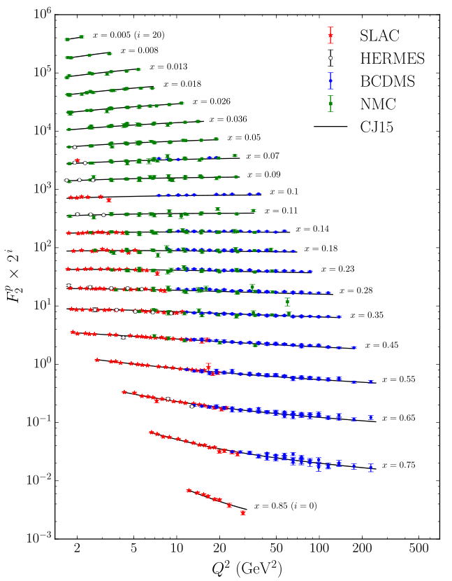
Constraints for PDFs
Theory-experiment Collaboration: CJ
Performs global QCD fits of PDFs from data including deep-inelastic lepton-nucleon scattering, proton-proton collisions (lepton pair creation, W-boson and jet production), etc., with particular focus on the large-x region

Slide 8
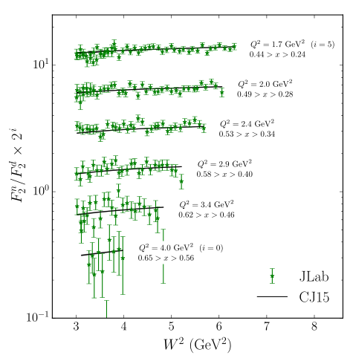
Constraints for PDFs
Theory-experiment Collaboration: CJ
Performs global QCD fits of PDFs from data including deep-inelastic lepton-nucleon scattering, proton-proton collisions (lepton pair creation, W-boson and jet production), etc., with particular focus on the large-x region
BONuS

Slide 9
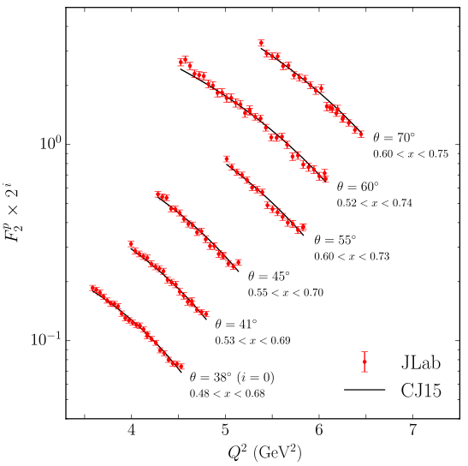
Constraints for PDFs
Theory-experiment Collaboration: CJ
Performs global QCD fits of PDFs from data including deep-inelastic lepton-nucleon scattering, proton-proton collisions (lepton pair creation, W-boson and jet production), etc., with particular focus on the large-x region
6 GeV Hall C data vs CJ15
BONuS

Slide 10
Constraints for PDFs
Theory-experiment Collaboration: CJ
(One of the many) Highlights: Improvement in uncertainty of d/u extraction
SU(6)
DSE-1
DSE-2
scaler diquarks

Slide 11
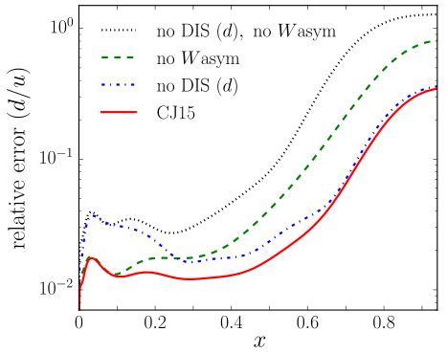
Constraints for PDFs
Theory-experiment Collaboration: CJ
(One of the many) Highlights: Improvement in uncertainty of d/u extraction
SU(6)
DSE-1
DSE-2
scaler diquarks
Deuterium data allow for precise determination of d/u
D0 asymmetries determines the “free nucleon” d-quark AND Deuterium data determine the off-shell correction

Slide 12
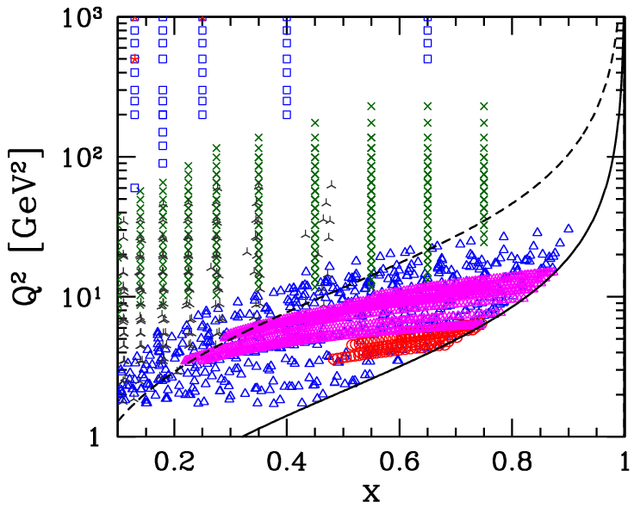
Constraints for PDFs: E12-10-002 Impact
Theory-experiment Collaboration: CJ
We measured both H and D cross sections (free protons and bound neutrons)
We not only push to larger x - up to ~0.87 - but we also cover the low x kinematic region – down to ~0.2
→ this should help with constraining the nuclear corrections and the d-quark at the same time
E12-10-002
From A. Accardi: “… For the d-quark, at large x this data should be competitive with the D0 W asymmetry data, and at low x it might cut another 50% in the uncertainty. So, I would expect some visible impact when we add these to the whole CJ data set.”

Slide 13
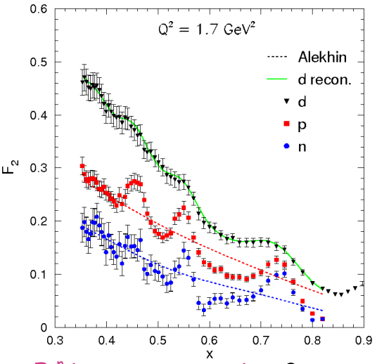
Quark – Hadron Duality
Quark – hadron duality: fundamental property of nucleon structure
→ Observed in: F₂^{p}, F₁^{p}, F_{L}^{p}, F₂^{n}, F₂^{d}, F₂^{C}, F₂^{Fe}, F₂^{Au}, A₁^{p}, g₁^{p}, g₁^{d}, g₁^{n}, g₁^{3He}, SIDIS

Slide 14
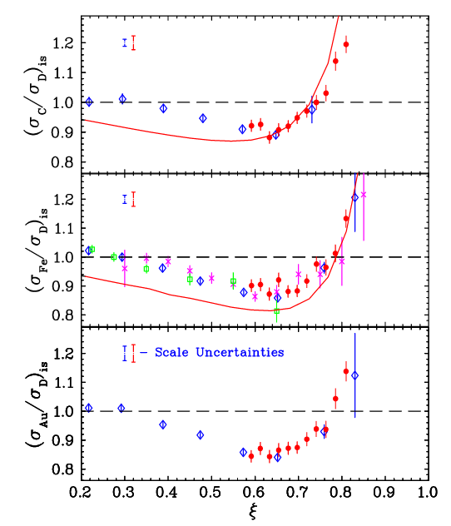
Quark – Hadron Duality
Quark – hadron duality: fundamental property of nucleon structure
→ Observed in: F₂^{p}, F₁^{p}, F_{L}^{p}, F₂^{n}, F₂^{d}, F₂^{C}, F₂^{Fe}, F₂^{Au}, A₁^{p}, g₁^{p}, g₁^{d}, g₁^{n}, g₁^{3He}, SIDIS

Slide 15
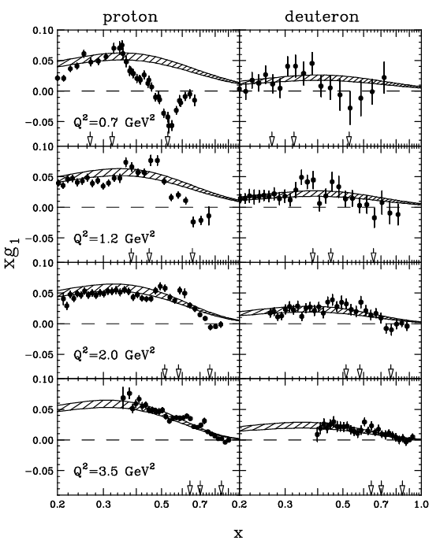
Quark – Hadron Duality
Quark – hadron duality: fundamental property of nucleon structure
→ Observed in: F₂^{p}, F₁^{p}, F_{L}^{p}, F₂^{n}, F₂^{d}, F₂^{C}, F₂^{Fe}, F₂^{Au}, A₁^{p}, g₁^{p}, g₁^{d}, g₁^{n}, g₁^{3He}, SIDIS

Slide 16
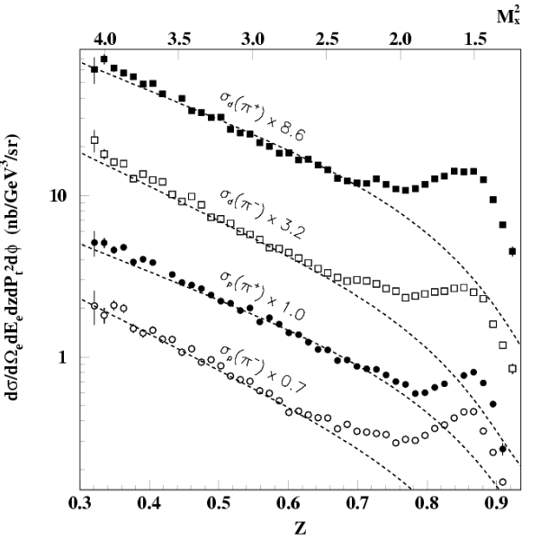
Quark – Hadron Duality
Quark – hadron duality: fundamental property of nucleon structure
→ Observed in: F₂^{p}, F₁^{p}, F_{L}^{p}, F₂^{n}, F₂^{d}, F₂^{C}, F₂^{Fe}, F₂^{Au}, A₁^{p}, g₁^{p}, g₁^{d}, g₁^{n}, g₁^{3He}, SIDIS

Slide 17
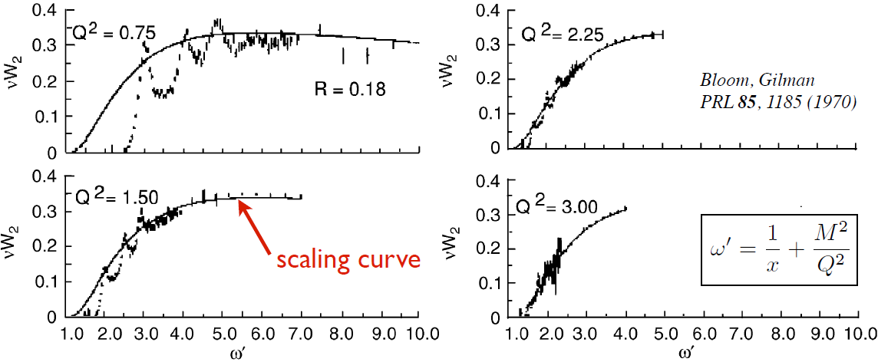
Duality Studies in F₂ - Highlights
Bloom-Gilman Duality in inclusive electron-proton scattering
The resonance region data:
- oscillate around are on average equivalent to the scaling curve
- “slide” along the deep inelastic curve with increasing Q²
Phys. Rev. Lett. 25, 1140 (1970)
Quantitatively: relative difference 10% for Q²=1 GeV² to <2% beyond Q²=2 GeV²

Slide 18
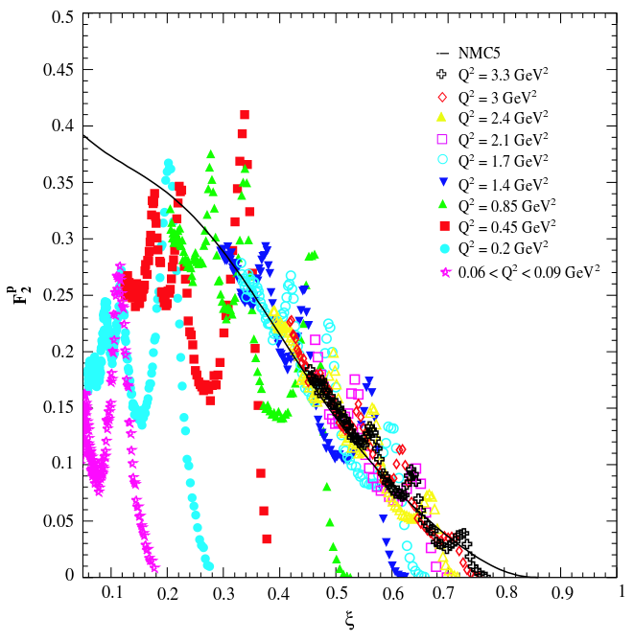
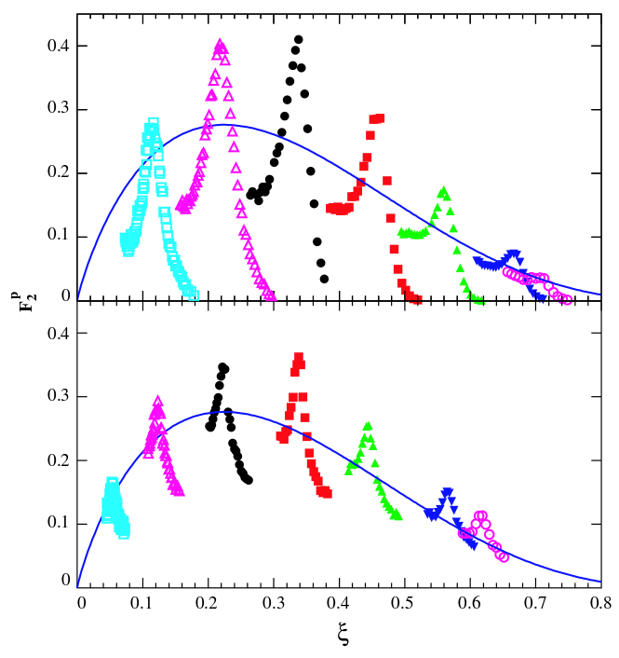
Duality Studies in F₂ - Highlights
ξ variable is used to allow comparison of NMC fit - high (W², Q²) DIS data - to the lower (W², Q²) resonance region data at the same ordinate point
Example: x = 0.6 can correspond to Q² = 1.5 GeV² in the delta region or to a point in DIS with W² = 14 GeV² and Q² = 20 GeV²
I. Niculescu et al., Phys. Rev. Lett. 85, 1186 (2000)
I. Niculescu et al., Phys. Rev. Lett. 85, 1182 (2000)

Slide 19
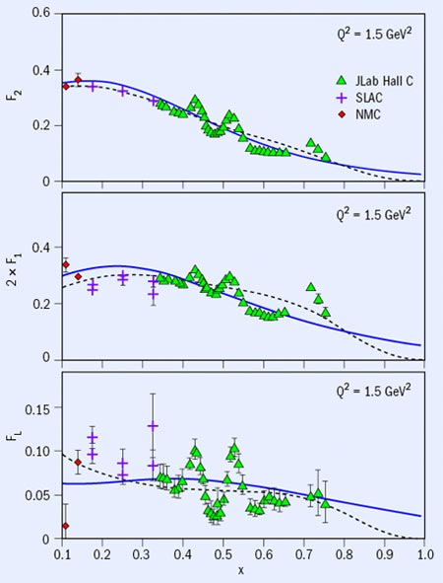
Duality Studies in F₂ - Highlights
Jefferson Lab experiment, E94-110: duality verified in all separated spin-averaged structure functions
pQCD fit + TM
→ Compare resonance region data to pQCD fits with added target mass corrections and use x instead of ξ
Resonances average to pQCD curve down to a surprisingly low Q² not only for F₂ but also for F₁ and F_{L}
This high-precision experiment pushed duality studies to Q² = 3.5 GeV²

Slide 20
Duality Studies in F₂ - Highlights
Jefferson Lab experiment, E00-116: pushing duality studies to higher Q²

Slide 21
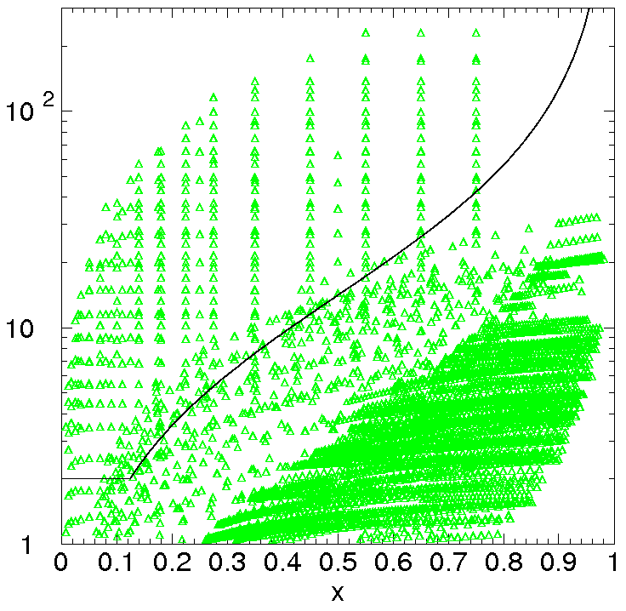
Duality Studies in F₂ - Highlights
Jefferson Lab experiment, E00-116: pushing duality studies to higher Q²
example: MSTW
W² > 15
Q² > 2
data not used

Slide 22
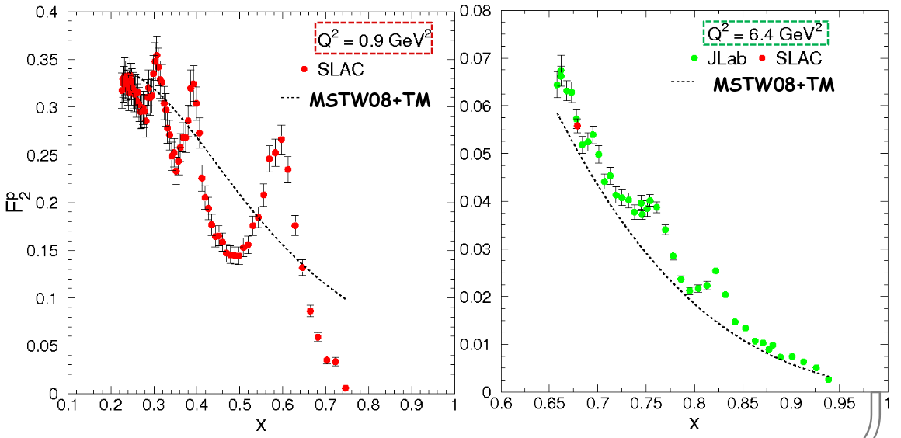
Duality Studies in F₂ - Highlights
It is not surprising that:
→ though resonances DO average to MSTW08+TM at Q² = 0.9 GeV², x ~ (0.25,0.7)
→ resonances DO NOT average to MSTW08+TM at Q² = 6.4 GeV², x ~ (0.7,0.95)
This is not a violation of duality but due to the underestimation of PDFs strength at large x

Slide 23
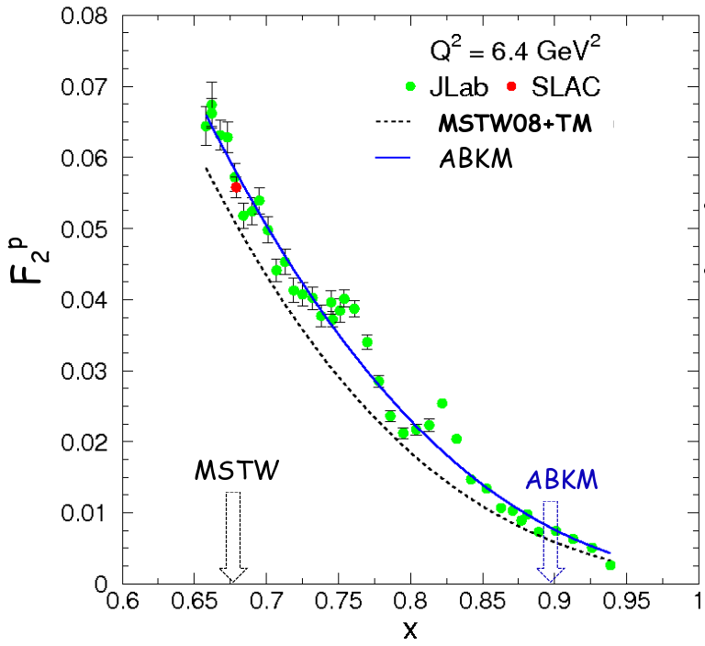
Duality Studies in F₂ - Highlights
“Duality curve” for verification: PDF fit better constrained at large x
→ Second generation PDF fits extended their PDF extraction to larger x by lowering the W² kinematic cuts: ABKM, CJ
→ Curve used for duality verification must be from 2nd generation PDF fits, especially when resonances cover the largest x region
Q²(GeV²)
W² > 12.25 (CTEQ)
W² > 3 (ABKM, CJ)
RES region

Slide 24
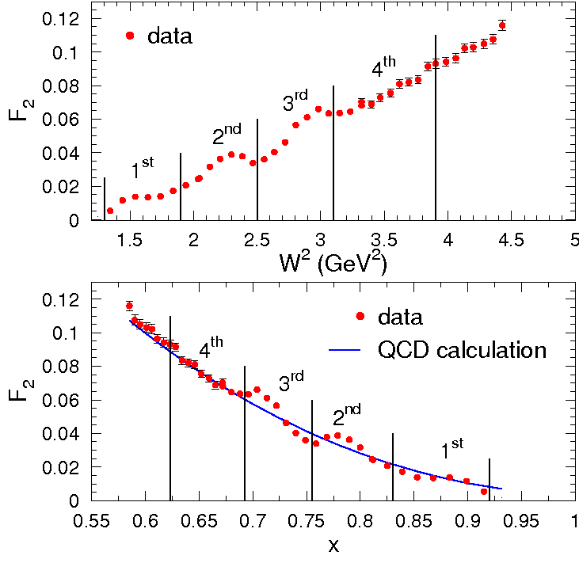
Duality Studies in F₂ - Highlights
Define duality intervals
Region | 1st | 2nd | 3rd | 4th | DIS | global
W_{min} | 1.3 | 1.9 | 2.5 | 3.1 | 3.9 | 1.9
W_{max} | 1.9 | 2.5 | 3.1 | 3.9 | 4.5 | 4.5
→ There is arbitrariness in defining the local W intervals; typically try to catch peaks and valleys within one interval
How well resonance data average to the scaling curve?
Calculate ratio:
$${\int_{x_{min}}^{x_{max}}{F^{data}\left(x,Q^{2}\right)}dx}/{\int_{x_{min}}^{x_{max}}{F^{param.}\left(x,Q^{2}\right)dx}}$$

Slide 25
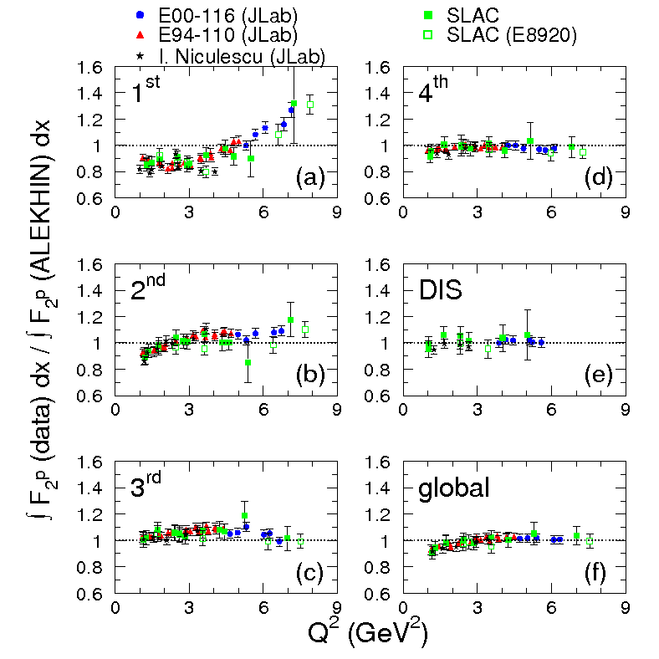
Duality Studies in F₂ - Highlights
Duality verified against scaling from ABKM

Slide 26
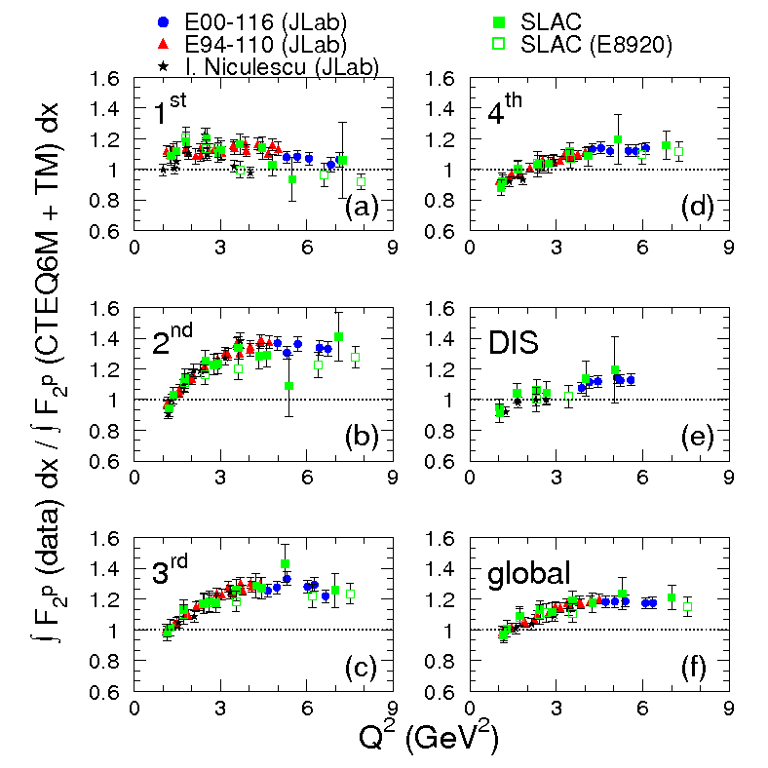
Duality Studies in F₂ - Highlights
Duality verified against scaling from ABKM
The Q² dependence is what matters, right?

Slide 27
Duality Studies in F₂ - Future
Jefferson Lab experiment, E12-10-002: pushing duality studies to even higher Q²

Slide 28
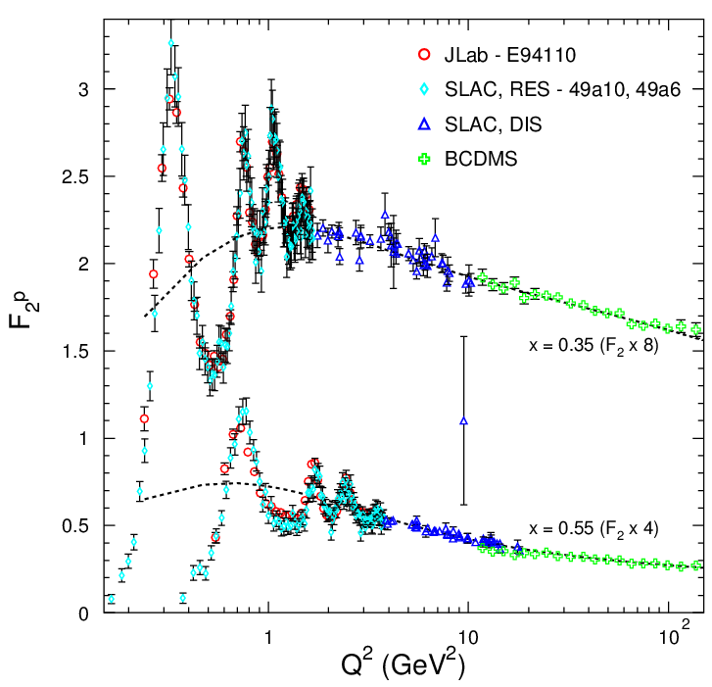
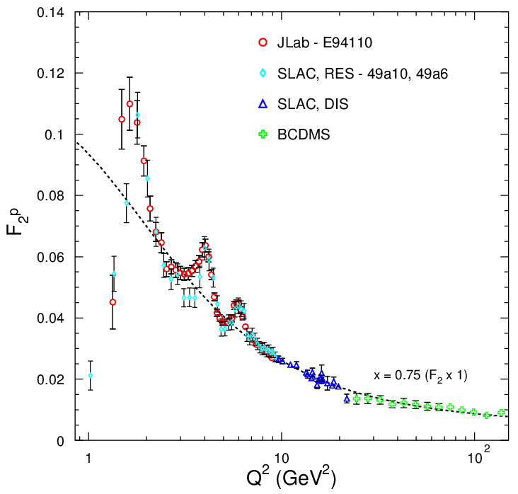
Duality Studies in F₂ - Future
Another Theory-Experiment Collaboration: develop a different framework to understand the quark-hadron duality – see talk by John Collins
----- F2ALLM
----- F2ALLM

Slide 29
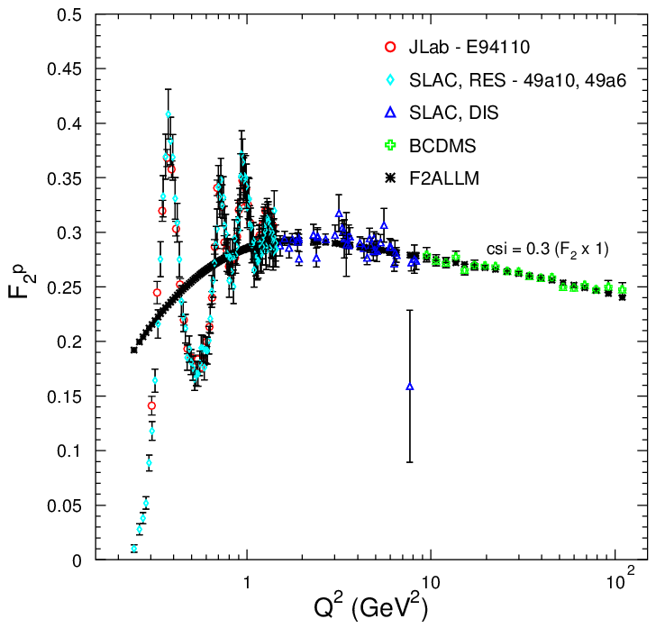
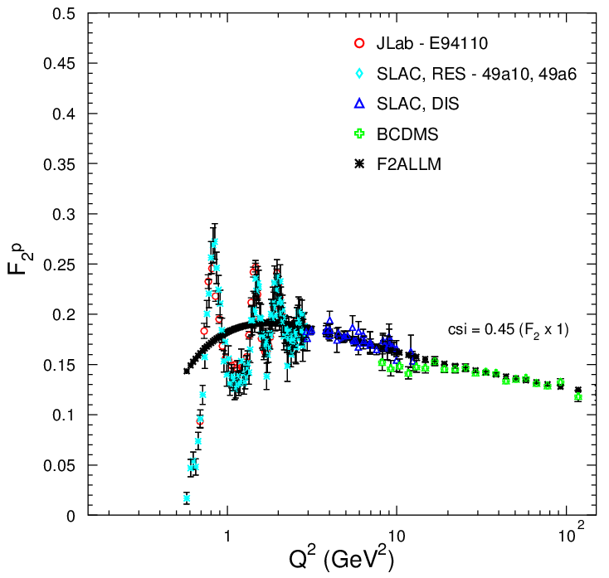
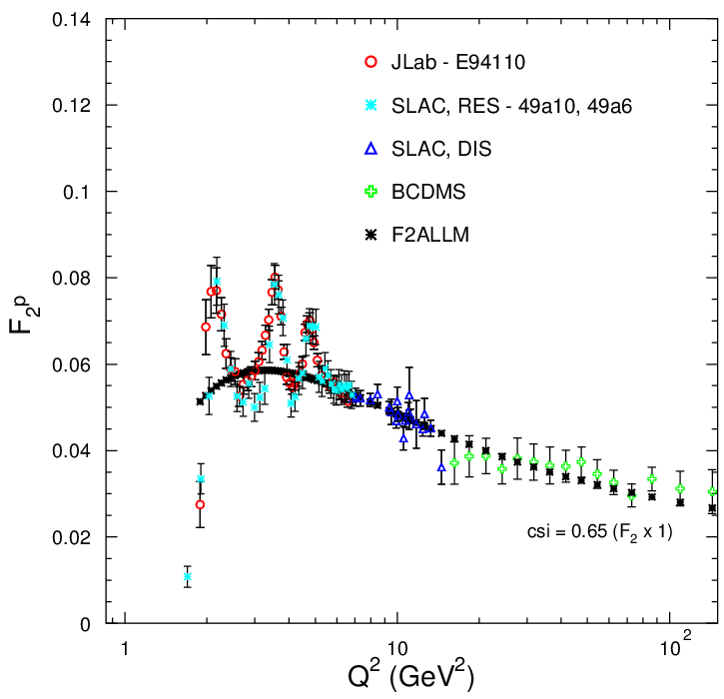
Duality Studies in F₂ - Future
Another Theory-Experiment Collaboration: develop a different framework to understand the quark-hadron duality – see talk by John Collins

Slide 30
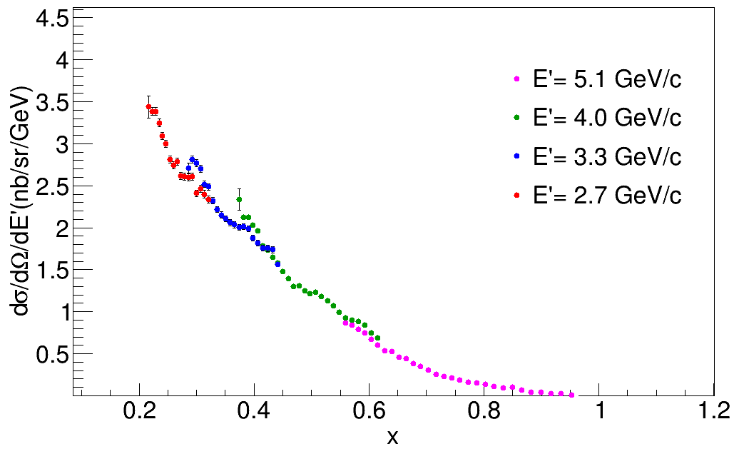
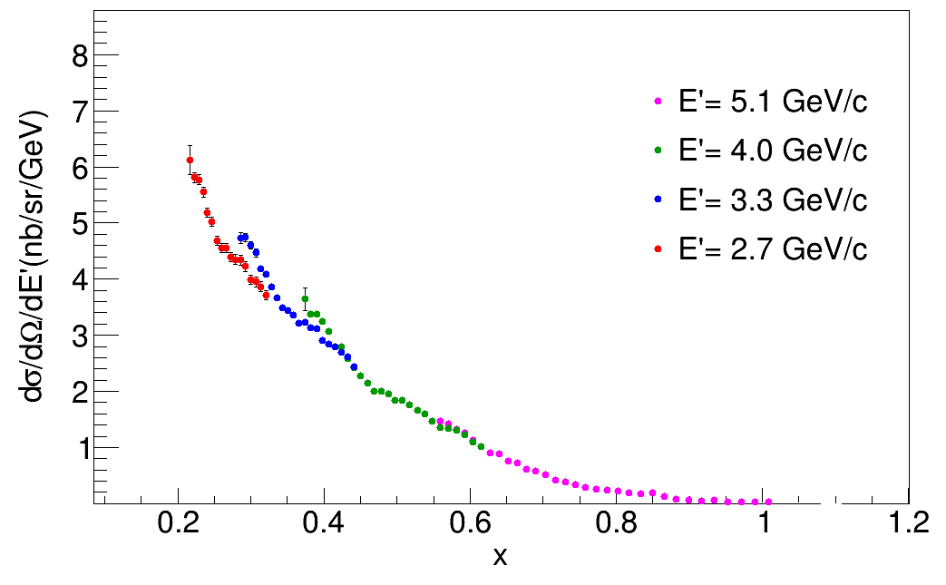
Duality Studies in F₂ - Future
E12-10-002: very preliminary cross sections from our very first pass
Hydrogen
Deuterium
Second pass already done (last week), new preliminary cross sections will be available soon
Preliminary results on duality checks from the new data will be presented at the SESAPS 2018

