Slide 1
Duality in Nuclei: The EMC Effect
Dave Gaskell
Jefferson Lab
Quark Hadron Duality Workshop: Probing the Transition from Free to Confined Quarks
September 23-25, 2018

Slide 2
Outline
The EMC Effect
Structure functions in the resonance region – nucleons → nuclei
Duality in nuclear structure functions → the EMC Effect
JLab measurements at 6 and 11 GeV

Slide 3
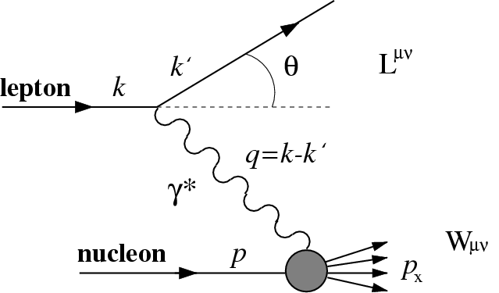
DIS: Structure Functions and Quarks in the Nucleus
Deep Inelastic Scattering provides access to quark distributions in nucleon via structure functions:
Nuclear binding energies (~MeV) small compared to typical DIS energies (~GeV)
→ (Naïve) expectation was that nuclear effects in DIS would be small
Figure from Bickerstaff and Thomas, J. Phys. G 15, 1523 (1989)
Calculation: Bodek and Ritchie PRD 23, 1070 (1981)

Slide 4
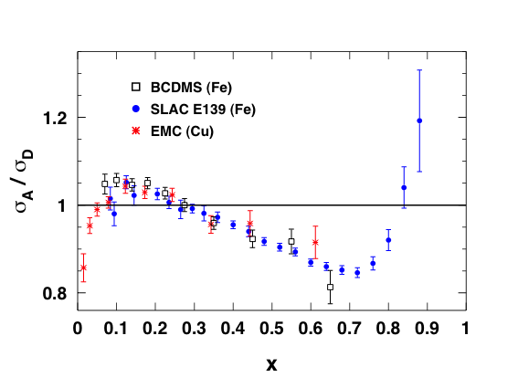
Properties of the EMC Effect
Global properties of the EMC effect
1. Universal x-dependence
2. Little Q² dependence
3. EMC effect increases with A
→ Anti-shadowing region shows little nuclear dependence

Slide 5
Properties of the EMC Effect
Global properties of the EMC effect
1. Universal x-dependence
2. Little Q² dependence
3. EMC effect increases with A
→ Anti-shadowing region shows little nuclear dependence
→ Nuclear structure functions evolve with Q² in same way as nucleon

Slide 6
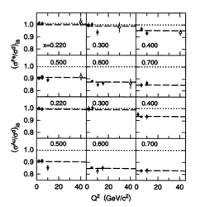
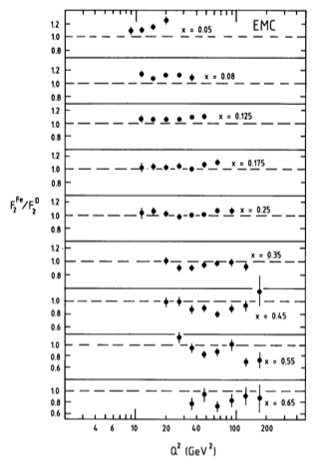
Q² Dependence of the EMC Effect
EMC
Q²=10-200 GeV²
SLAC E139
Q²=1-10 GeV²
x=0.05
x=0.65
Gomez et al, Phys. Rev. D 49, 4348 (1994)
Aubert et al, Nucl. Phys. B293, 740 (1987)

Slide 7
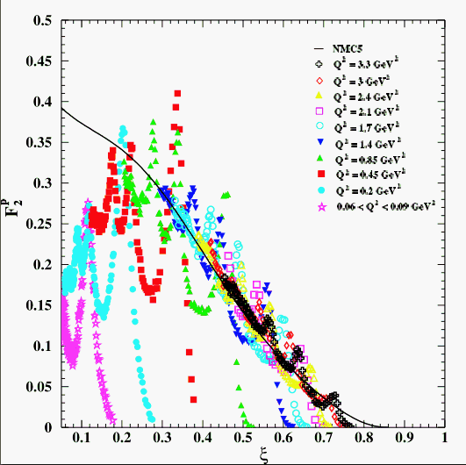
Quark-Hadron Duality in Nucleons
I. Niculescu et al., PRL85:1182 (2000)
→ Resonance region structure functions oscillate around smooth, DIS curve
→ Quantitative agreement between DIS/resonance F₂ when integrating over distinct regions in W²

Slide 8
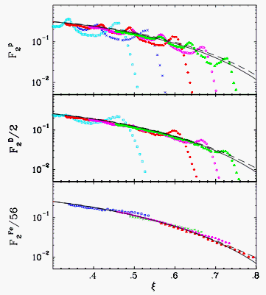
Quark-Hadron Duality in Nuclei
Free nucleon
  average over resonance region = DIS scaling limit
Bound nucleon
  Fermi motion does the averaging for us
  Resonances much less prominent in nuclear structure functions
Nuclear structure functions appear to “scale” to lower Q² than their free nucleon counterparts with no explicit resonance averaging
J. Arrington, et al., PRC73:035205 (2006)

Slide 9
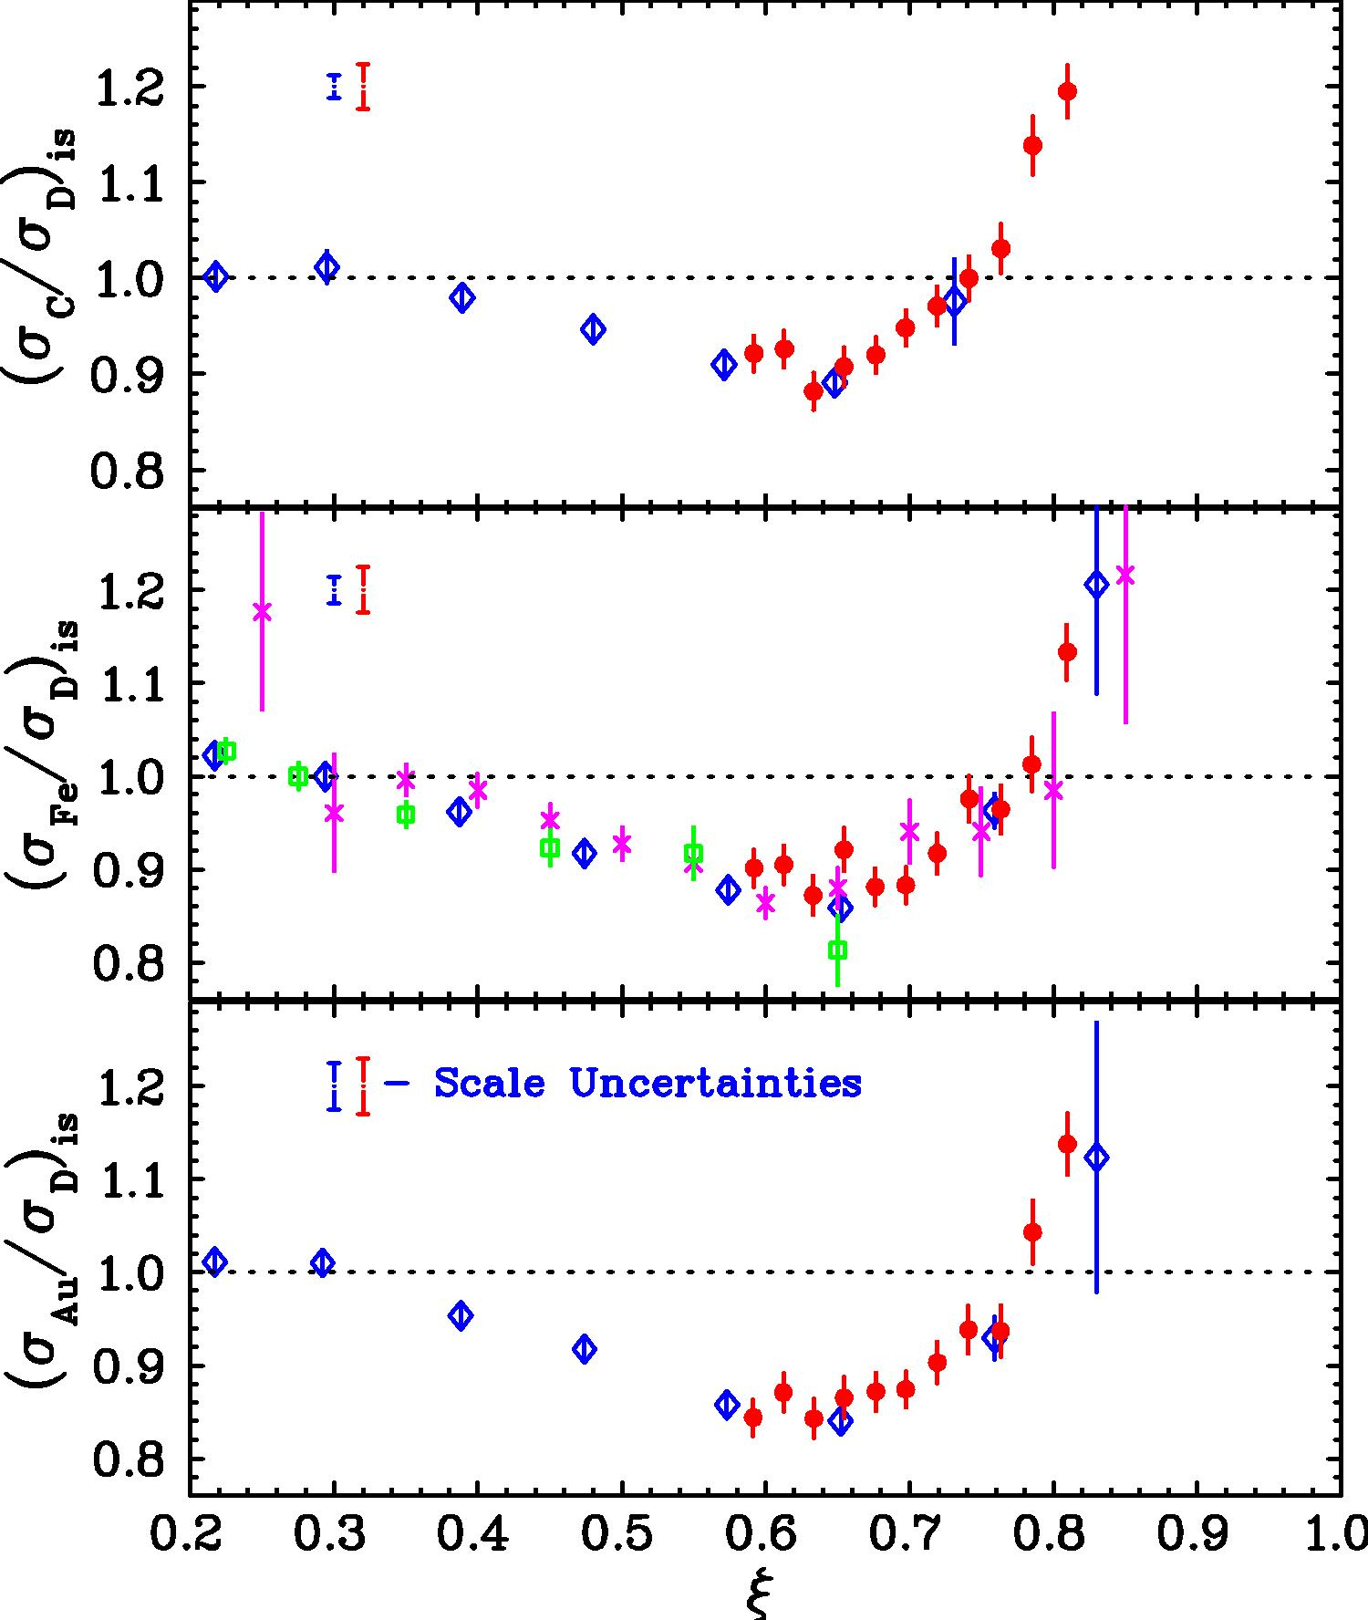
EMC Effect in Resonance Region
JLab E89-008:
Q² ~ 4 GeV²
1.3<W²<2.8 GeV²
data in the resonance
region
→ In region of overlap agrees well with DIS data
Subsequent Hall C data taken at higher Q², tested scaling with precise measurement of Q²-dependence
J. Arrington, et al., PRC73:035205 (2006)‏

Slide 10
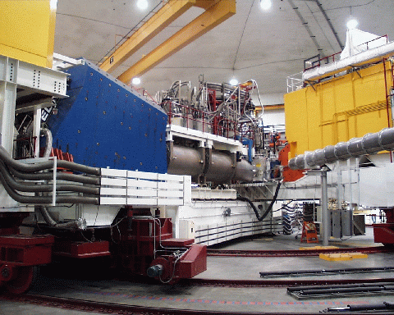
JLab Experiment E03-103
Measurement of the EMC Effect in light nuclei (³He and ⁴He) and at large x
  →³He, ⁴He amenable to calculations using “exact” nuclear wave functions
  → Large x dominated by binding, conventional nuclear effects
A(e,e’) at 5.77 GeV in Hall C at JLAB (with E02-019, x>1)
Targets: H, ²H, ³He, ⁴He,
Be, C, Cu, Au
Six angles to measure Q² dependence
Spokespersons: DG and J. Arrington
Graduate students: J. Seely and A. Daniel
HMS: 6 GeV
SOS: 1.7 GeV

Slide 11
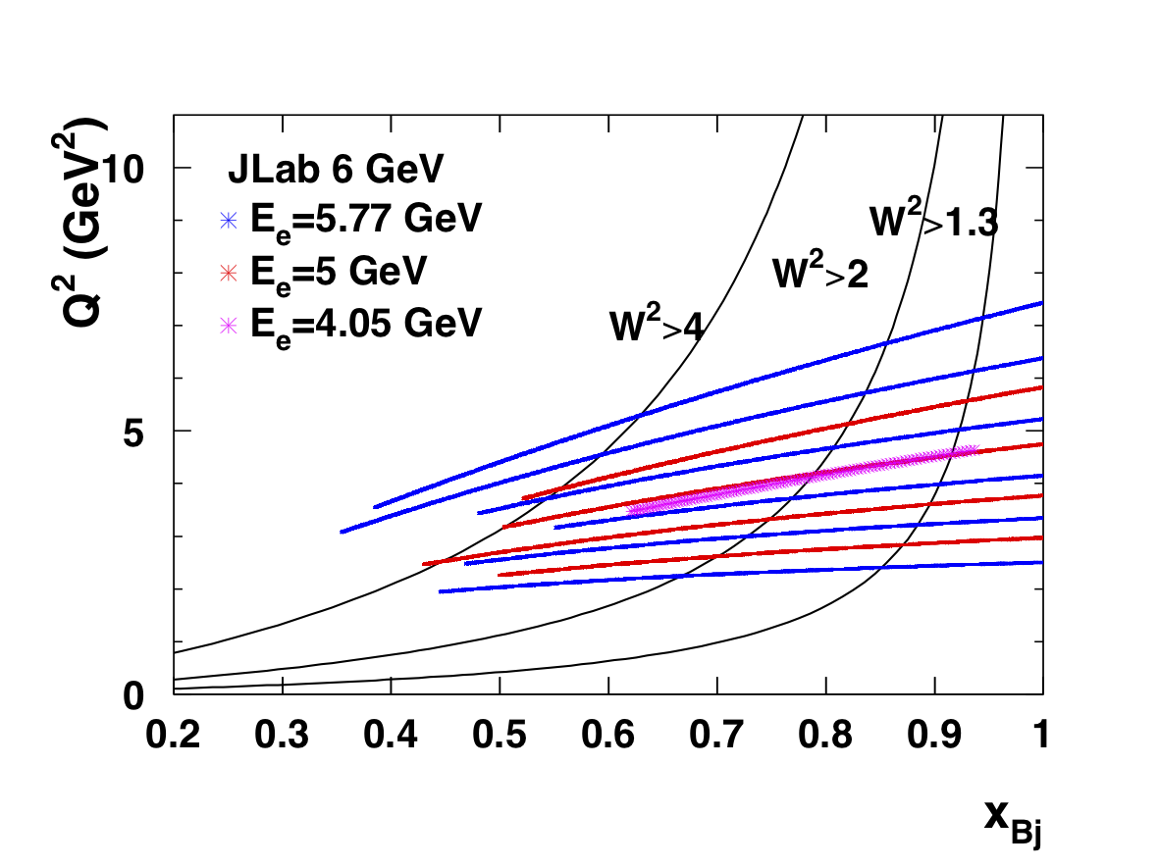
Deep Inelastic Scattering at low W
Canonical DIS
regime:
Q² > 1 GeV² AND
W² > 4 GeV²
At JLab 6 GeV, access to large Q², and W²>4 GeV² up to x=0.6
At x>0.6, we are in the “resonance region”, but Q² is still large
Are we really sensitive to quarks in this regime?
  Test by checking Q² dependence of (carbon) ratios and structure functions

Slide 12
Carbon/²H Ratio and Q² Dependence
E03-103 Results
at x=0.75
Q²=4.0 GeV²
W²=2.2 GeV²
Q²=6.0 GeV²
W²=2.9 GeV²
At larger angles (Q²) the ratio appears to scale to very large x
→ W²>2 GeV² andQ²>3 GeV²

Slide 13
Carbon/²H Ratio and Q² Dependence
E03-103 Results
at x=0.75
Q²=2.3 GeV²
W²=1.65 GeV²
Q²=3.68 GeV²
W²=2.1 GeV²
Clear deviation from scaling at W²<2.2 GeV²

Slide 14
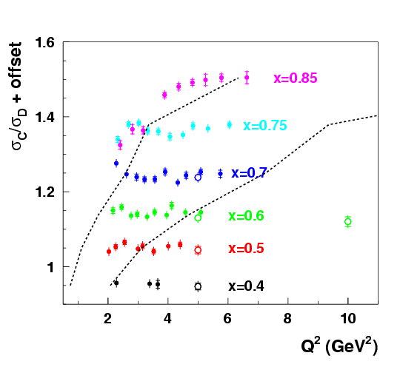
More detailed look at scaling of C/D ratios
C/D ratios at fixed x are Q² independent for
W²>2 GeV² and
Q²>3 GeV²
For E03-103, this extends to x=0.85
W²>2 GeV²
W²>4 GeV²
E03-103
SLAC e139

Slide 15
Structure Functions
D
F₂
C
x
ξ

Slide 16
Scaling of F₂^{D} – Fixed x
Scaling:
SLAC
E03-103
Curves fit to large Q² SLAC data → compared to JLab data at lower Q²
Aji Daniel -thesis
Although target ratios scale down to Q²=3 GeV², for W²>2 GeV², F₂ shows deviations from logarithmic scaling

Slide 17
Scaling of F₂^{D} – Fixed ξ
Scaling:
SLAC
E03-103
Curves fit to large Q² SLAC data → compared to JLab data at lower Q²
Aji Daniel -thesis
Looking at Q² dependence for fixed ξ, structure functions shows improved scaling

Slide 18
JLab E03-103 and the Nuclear Dependence of the EMC Effect
Carbon
New definition of “size” of the EMC effect
Slope of line fit from x=0.35 to 0.7
Assumes shape is universal for all nuclei
→Normalization uncertainties a much smaller relative contribution
W²<4 GeV²
Notes:
Critical improvement – define size of EMC effect as slope between 0.4-0.7: fractional normalization error less important

Slide 19
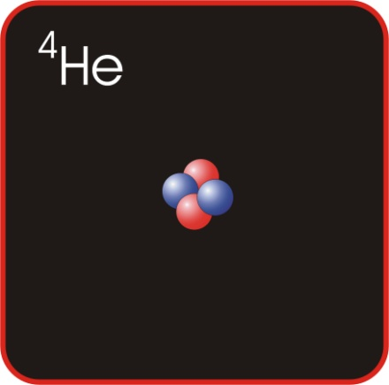
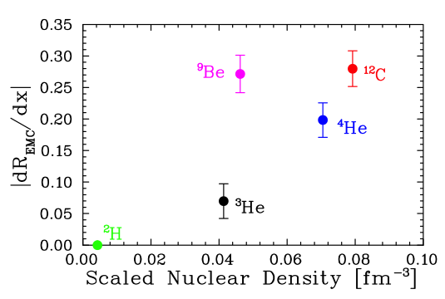
E03103 Results: EMC Effect and Local Nuclear Density
⁹Be has low average density
Large component of structure is 2α+n
Most nucleons in tight, α-like configurations
EMC effect driven by local rather than average nuclear density
Can we see similar behavior in other nuclei?

Slide 20
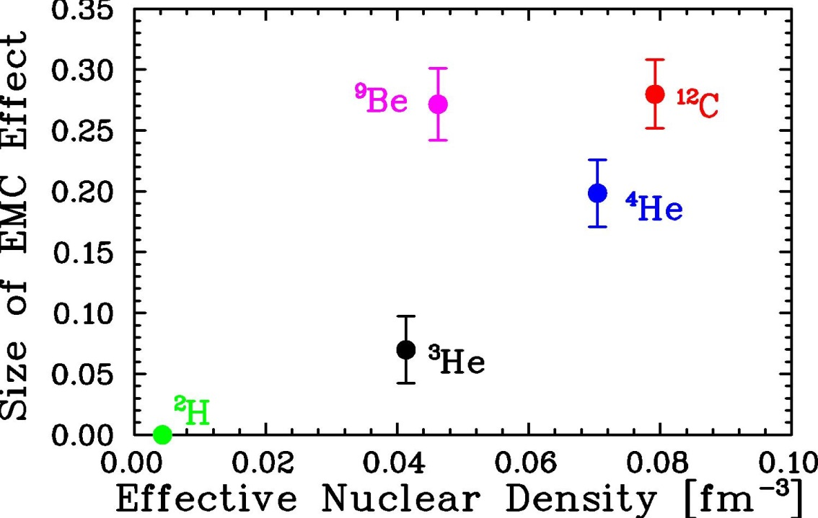

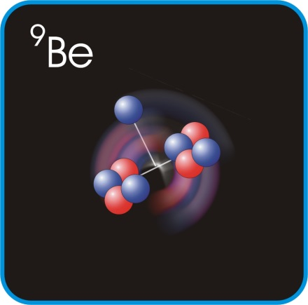
E12-10-008: EMC effect in light→ heavy nuclei
Spokespersons: J. Arrington, A. Daniel, N. Fomin, D. Gaskell
E03-103: EMC at 6 GeV
Focused on light nuclei
  Large EMC effect for ⁹Be
Local density/cluster effects?
J. Seely, et al., PRL 103, 202301 (2009)
E12-10-008: EMC effect at 12 GeV
  Higher Q², expanded range in x (both low and high x)
  Light nuclei includes ¹H, ²H, ³He, ⁴He, ⁶Li, ⁷Li, ⁹Be, ¹⁰B, ¹¹B, ¹²C
  Heavy nuclei include ⁴⁰Ca, ⁴⁸Ca and Cu and additional heavy nuclei of particular interest for EMC-SRC correlation studies

Slide 21
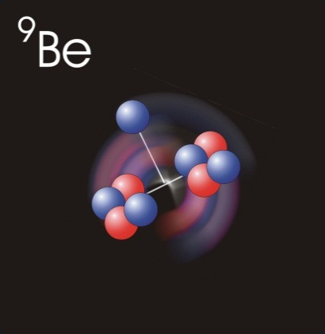
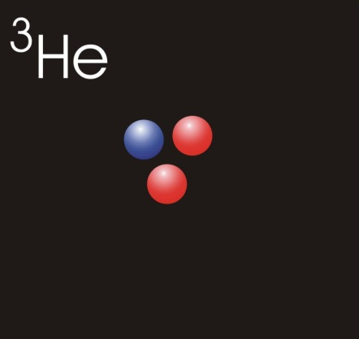


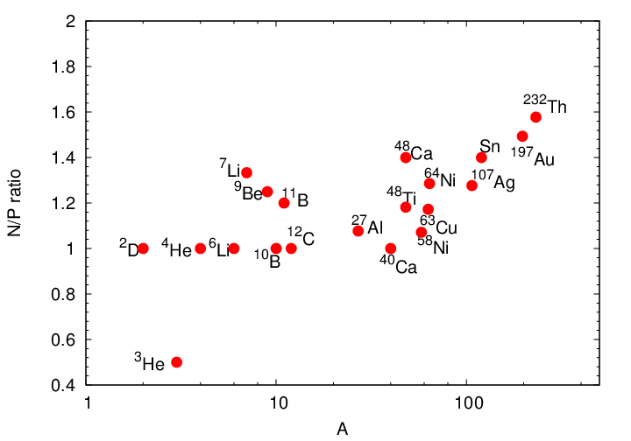
E12-10-008 (EMC effect) and E12-06-105 (x>1)
Light nuclei: Reliable calculations of nuclear structure (e.g. clustering)
¹H
²H
³He
⁴He
^{6,7}Li
⁹Be
^{10,11}B
¹²C
Both experiments use wide range of nuclear targets to study impact of cluster structure, separate mass and isospin dependence on SRCs, nuclear PDFs
Experiments will use a common set of targets to provide more information in the EMC-SRC connection
²⁷Al
^{40*,48}Ca
⁴⁸Ti
⁵⁴Fe
^{58,64}Ni
^{64*}Cu
^{108*}Ag
^{119*}Sn
^{197*}Au
²³²Th
Heavier nuclei: Cover range of N/Z at ~fixed values of A

Slide 22
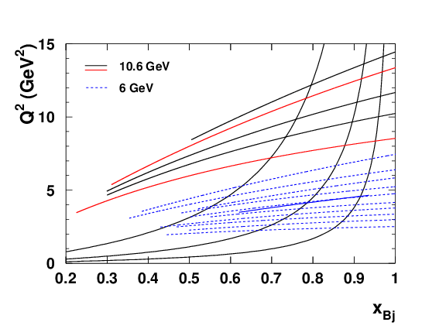
E12-10-008: Commissioning running
Ran with E12-10-002 at part of commissioning experiment run to make some initial EMC effect measurements
~2 days used to:
Measure Q² dependence of EMC effect over range of x to check scaling of EMC ratio → carbon target
Obtain data on a few light nuclei at a single Q²/angle (⁹Be, ¹⁰B, ¹¹B, C)
W²>2
W²>1.3
Full experiment:
All targets at 21 degrees, smaller subset at 35 degrees
25,29,40 degrees used for Q² dependence tests w/Carbon
W²>4
C only
Be,^{10,11}B,C

Slide 23
Summary
Nuclear structure function ratios (EMC effect) appear to show scaling down to W²=2 GeV² for Q²>3 GeV² → consequence of duality + Fermi smearing in nucleus
  Apparent scaling does not work as well for individual structure functions, unless studied as function of ξ
Allows access to EMC effect measurements to rather large x (0.85) at 6 GeV beam energies
  Larger x should be accessible with JLab 12 GeV measurements
  Will ratios for W²<2 GeV² scale at larger Q²
Precise EMC Effect measurements at large x provide test of the wave functions used in EMC effect calculations
Applicability of duality (or not) in nuclear structure functions also relevant for neutrino experiments → Monte Carlo models

Slide 24
EXTRA

Slide 25
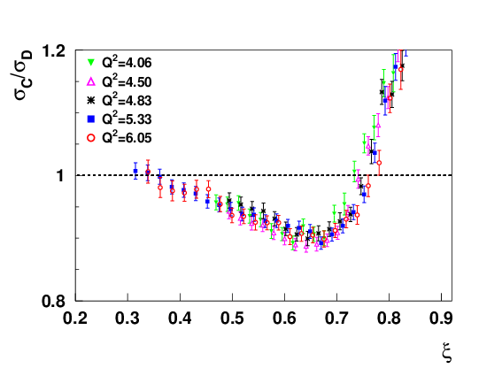
Carbon/²H Ratio and Q² Dependence

Slide 26
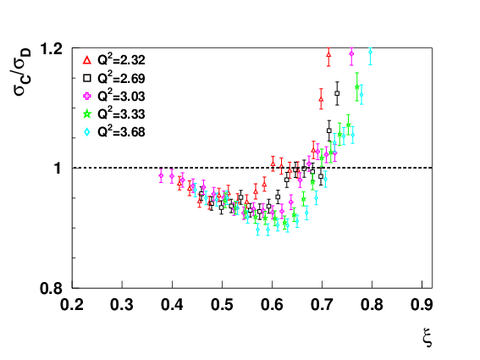
Carbon/²H Ratio and Q² Dependence

Slide 27
Moments of Nuclear Structure Functions
Low Q², large x data used to calculate Cornwall-Norton moments
M₂(Fe) = Z × M₂(p) + (A − Z) × M₂(n)
I. Niculescu, et al, PRC73,035205(2006)

