Slide 1
Quark-Hadron Duality: Probing the Transition from Free to Confined Quarks
James Madison University, September 24, 2018
Duality in electron scattering:
insights from theory
Wally Melnitchouk
Notes:
make opening wise crack...

Slide 2
Outline
What we (think we) understand from theory
Duality (global) in QCD
Local duality
insights from models
What we don’t (yet) know … what do we do next?
Notes:
small value of col. pol’s. suggests small HT’s !

Slide 3
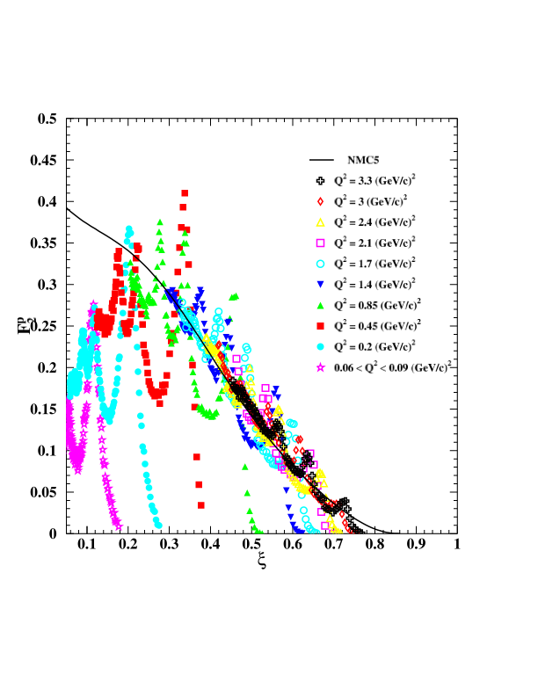
Duality in electron-proton scattering
deep inelastic
function
average over resonances
(strongly Q dependent)
2
2
Q independent
scaling function
Niculescu et al. (2000)

Slide 4
Duality and QCD
Operator product expansion in QCD
2
expand moments of structure functions in powers of 1/Q
matrix elements of operators
with specific “twist”
e.g.
etc.
Notes:
actually operators with twist <= tau

Slide 5
Duality and QCD
Operator product expansion in QCD
2
expand moments of structure functions in powers of 1/Q
If moment independent of Q
2
“higher twist” terms small
Duality suppression of higher twists

Slide 6
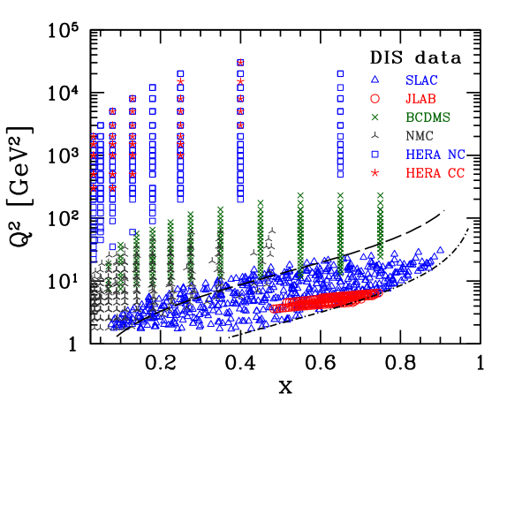
Duality and QCD
2
Note: at finite Q , from kinematics any moment
of any structure function (of any twist) must,
by definition, include the resonance region
resonances
Notes:
small value of col. pol’s. suggests small HT’s !

Slide 7
Duality and QCD
2
Note: at finite Q , from kinematics any moment
of any structure function (of any twist) must,
by definition, include the resonance region
Resonance and DIS regions are intimately connected
resonances an integral part of scaling structure function
e.g. in large-N limit, spectrum of zero-width resonances is “maximally dual” to quark-level (smooth) structure function
c

Slide 8
Resonances & twists
Total “higher twist” is small at scales
On average, nonperturbative interactions between
quarks and gluons not dominant (at these scales)
nontrivial interference between resonances?
Can we understand this dynamically, at quark level?
Can we use resonance region data to learn about
leading twist structure functions (and vice versa)?
expanded data set has potentially significant implications for global quark distribution studies
Notes:
small value of col. pol’s. suggests small HT’s !

Slide 9
Scaling functions from resonances
Earliest attempts predate QCD
e.g. harmonic oscillator spectrum
including states with spin = 1/2, ..., n+1/2
(n even: I = 1/2, n odd: I = 3/2)
Domokos et al. (1971)
2
at large Q magnetic coupling dominates
in Bjorken limit,
scaling function of

Slide 10
Scaling functions from resonances
Earliest attempts predate QCD
e.g. harmonic oscillator spectrum
including states with spin = 1/2, ..., n+1/2
(n even: I = 1/2, n odd: I = 3/2)
Domokos et al. (1971)
in limit
cf. Drell-Yan-West relation
similar behavior found in many models
Einhorn (1976) (‘t Hooft model)
Greenberg (1993) (NR scalar quarks in HO potential)
Pace, Salme, Lev (1995) (relativistic HO with spin)
Isgur et al. (2001) (transition to scaling)
....

Slide 11
Scaling functions from resonances
2
Phenomenological analyses at finite Q
additional constraints from threshold behavior at
and asymptotic behavior at
Davidovsky, Struminsky (2003)
21 isospin-1/2 & 3/2 resonances (with mass < 2 GeV)
in limit,

Slide 12
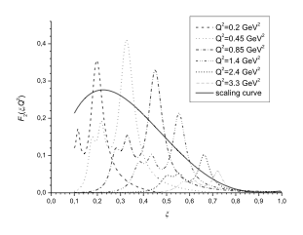
Scaling functions from resonances
2
Phenomenological analyses at finite Q
21 isospin-1/2 & 3/2
resonances (mass < 2 GeV)
Davidovsky, Struminsky (2003)
valence-like structure of dual function suggests
“two-component duality”:
valence (Reggeon exchange) dual to resonances
sea (Pomeron exchange) dual to background

Slide 13
Scaling functions from resonances
Explicit realization of Veneziano & Bloom-Gilman duality
Veneziano model not unitary,
has no imaginary parts
high s, low |t|
generalization of narrow-resonance approximation,
with nonlinear, complex Regge trajectories
“dual amplitude with Mandelstam analyticity” (DAMA) model
Jenkovszky et al.

Slide 14
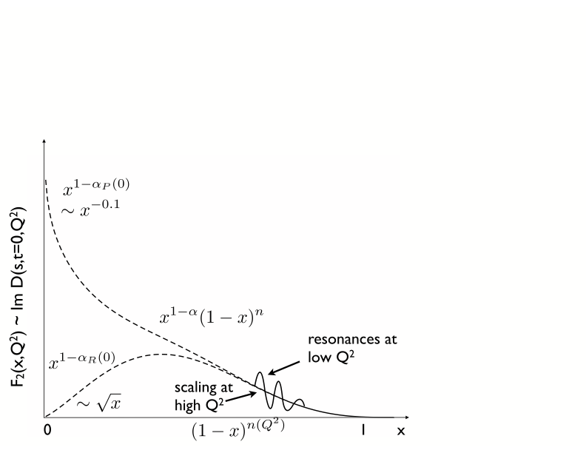
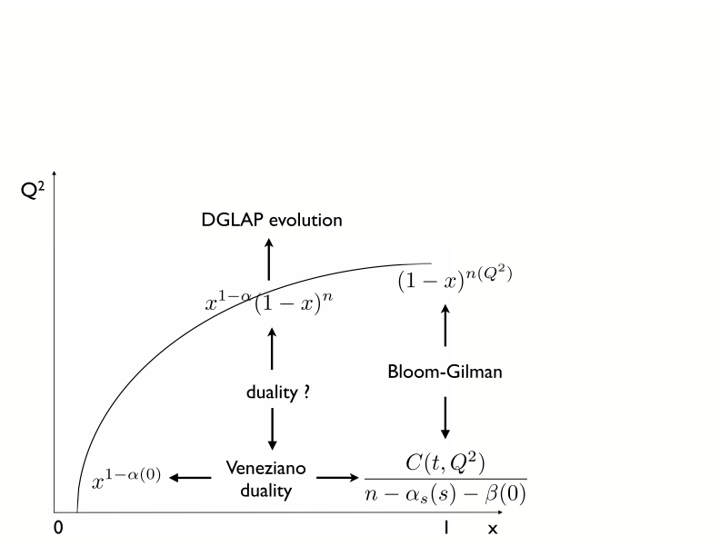
Scaling functions from resonances
Explicit realization of Veneziano & Bloom-Gilman duality
2
for large x and Q , have power-law behavior
2
where parameter can be Q dependent
Jenkovszky, Magas, Londergan, Szczepaniak (2012)

Slide 15
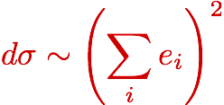
More than one flavor?
Consider simple quark model with spin-flavor symmetric wave function
low energy
coherent scattering from quarks
high energy
incoherent scattering from quarks
For duality to work, these must be equal
how can square of a sum become sum of squares?

Slide 16
Dynamical cancellations
e.g. for toy model of two quarks bound in a harmonic oscillator potential, structure function given by
charge operator excites
even partial waves with strength
odd partial waves with strength
resulting structure function
if states degenerate, cross terms cancel when averaged over nearby even and odd parity states
Close, Isgur (2001)

Slide 17
Dynamical cancellations
duality is realized by summing over at least one complete set of even and odd parity resonances
in NR Quark Model, even & odd parity states generalize
to 56 (L=0) and 70 (L=1) multiplets of spin-flavor SU(6)
(anti) symmetric component of ground state wave function
Close, WM (2003, 2009)

Slide 18
Dynamical cancellations
in SU(6) limit , with relative strengths of
N N* transitions
+
-
summing over all resonances in 56 and 70 multiplets
at the quark level, n/p ratio is
!
if

Slide 19
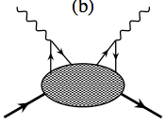
Accidental cancellations of charges?
cat’s ears diagram (4-fermion higher twist ~ )
coherent
incoherent
proton
neutron
duality in proton a coincidence!
should not hold for neutron !!
Brodsky (2000)
Notes:
small value of col. pol’s. suggests small HT’s !

Slide 20
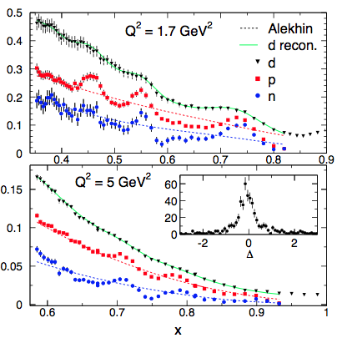
Duality in electron-neutron scattering
No free neutron targets, but iterative method allows neutron resonance structure to be extracted from
deuteron & proton data
locally, violations of duality in
resonance regions < 15−20%
(largest in region)
evidence that duality is not
accidental, but a general
feature of resonance−scaling
transition!
Malace, Kahn, WM, Keppel (2010)
C. Keppel &
I. Niculescu talks

Slide 21
Outlook and open questions
Confirmation of duality (experimentally & theoretically) suggests
origin in dynamical cancelations between resonances
explore more realistic descriptions based on
phenomenological form factors
Era of “quantitative duality” — need to define the extent
to which duality “works”
Is duality between (high energy) continuum and resonances,
or between total (resonance + background)?
“resonance region” vs. “resonances”
incorporate nonresonant background in same framework
+ quantum mechanics
Where does duality not work (and why)?

Slide 22
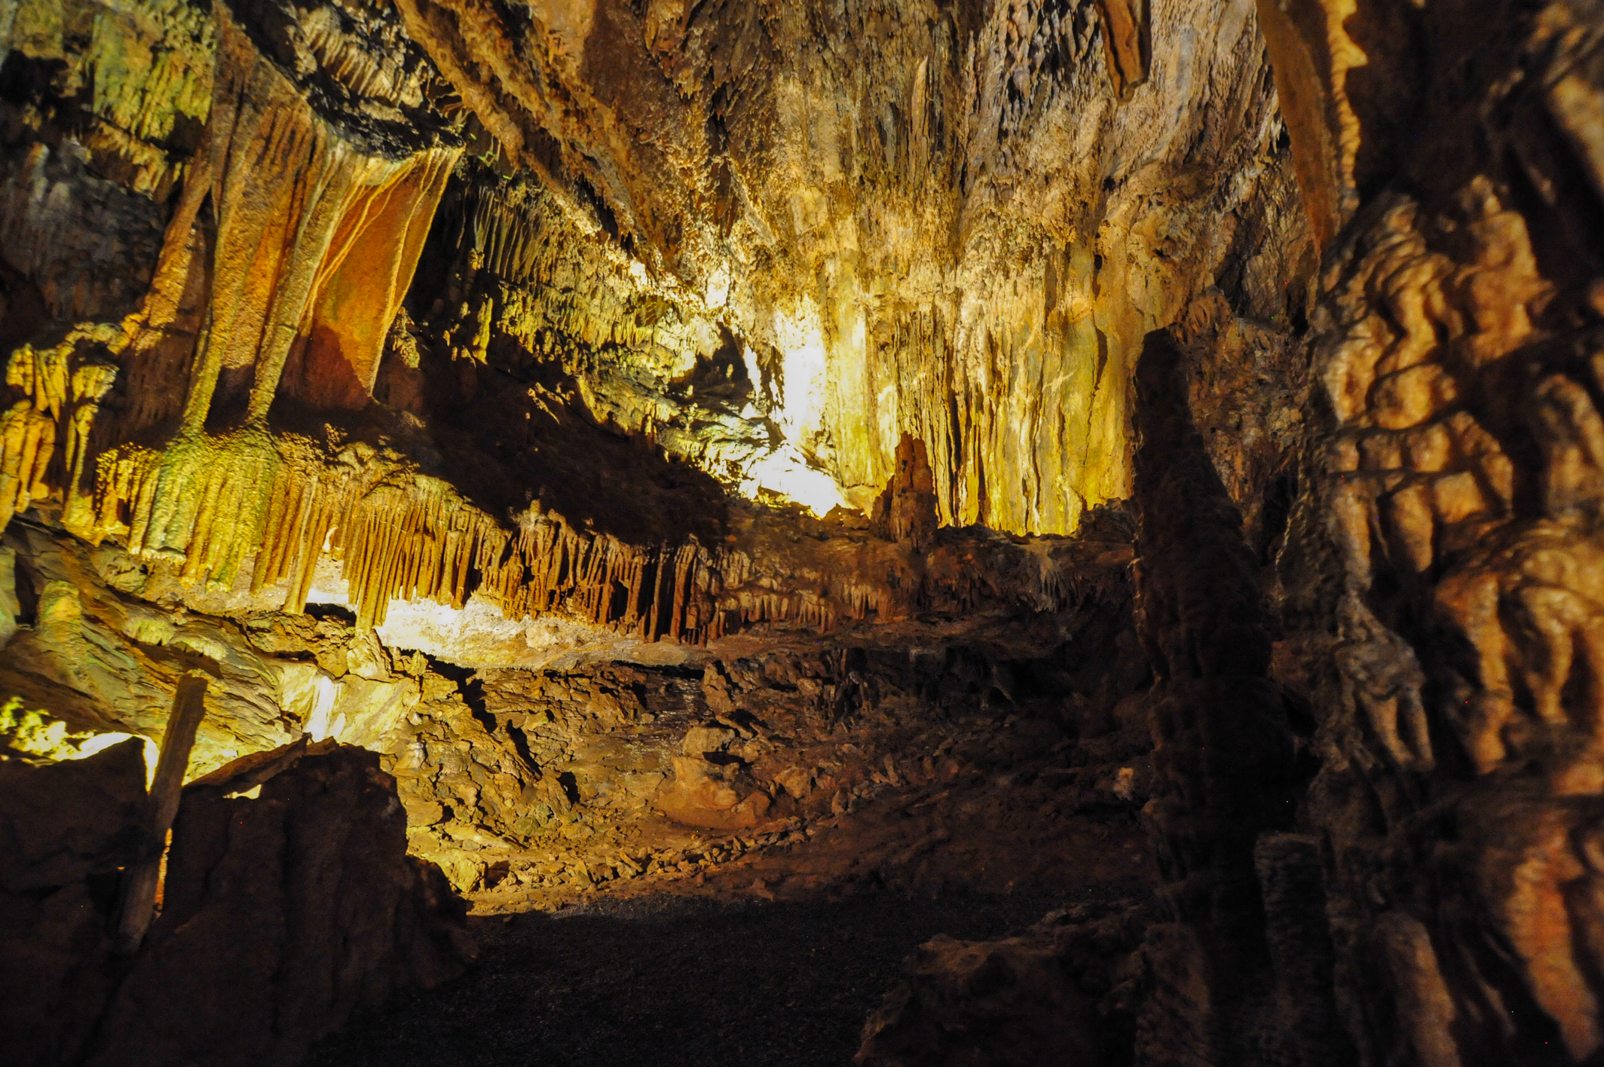
Thank you!

