Slide 1


Dynamical Nucleon-pion System via
Basis Light-front Quantization Approach
Weijie Du, Xingbo Zhao, James P. Vary
Iowa State University
Institute of Modern Physics
Chinese Academy of Sciences
Lanzhou, China
GHP workshop, Apr. 10, 2019

Slide 2
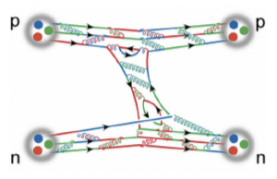
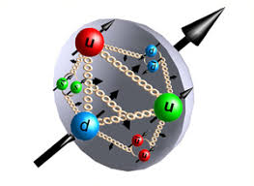

Nuclear physics in the medium energy is challenging
Low energy
High energy
$$π$$
Nucleons & mesons
Challenge-ons
Quarks & gluons
A first question:
What does the proton look like in the medium energy?

Slide 3
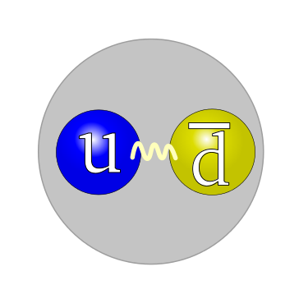
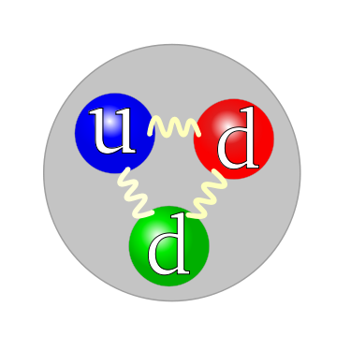
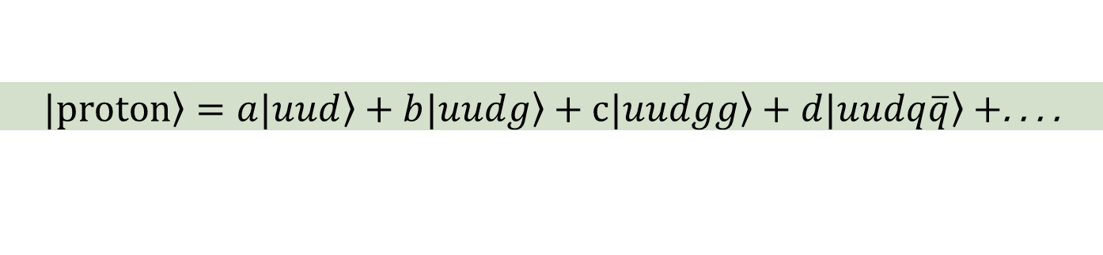
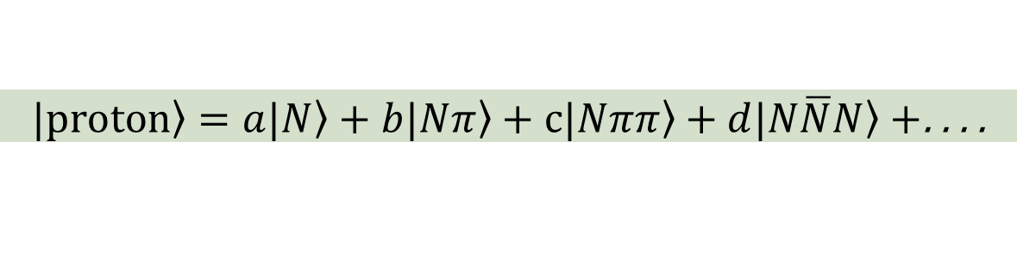
The idea: cloudy-bag model
$\left.|proton\right\rangle =a\left.|N\right\rangle +b\left.|Nπ\right\rangle +c\left.|Nππ\right\rangle +d\left.|N\overline{N}N\right\rangle +$. . . .
π
Step: 1
Solve the proton wave function in terms of the nucleon and pion
N
π
Step: 2
Attach the fundamental degree of freedom: quarks and gluons
$\left.|proton\right\rangle =a\left.|uud\right\rangle +b\left.|uudg\right\rangle +c\left.|uudgg\right\rangle +d\left.|uudq\overline{q}\right\rangle +$. . . .

Slide 4

Current progress: step 1
$\left.|proton\right\rangle =a\left.|N\right\rangle +b\left.|Nπ\right\rangle +c\left.|Nππ\right\rangle +d\left.|N\overline{N}N\right\rangle +$. . . .
π
Step: 1
Solve the proton wave function in terms of the nucleon and pion
N
Developed a non-perturbative, fully relativistic
treatment of a chiral nucleon-pion model on the light-front
Why light-front?
Wave functions are boost invariant.
Vacuum structure is simple (except the zero-mode).
  Fock-sector expansion is convenient.
Observables are taken at fixed light-front time (convenient).

Slide 5
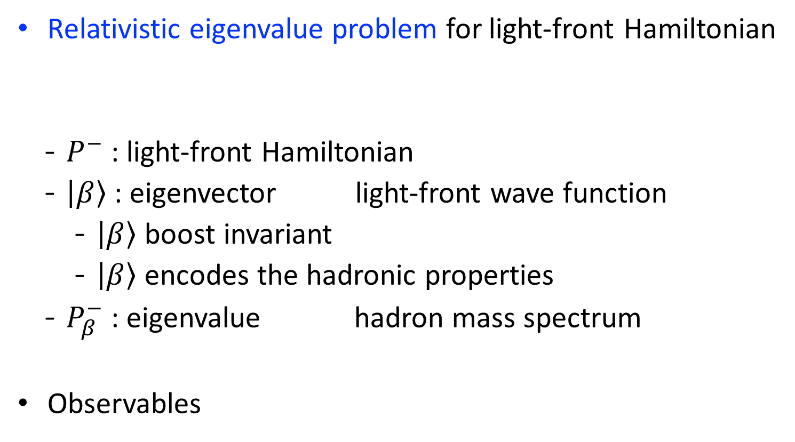

Methodology: Basis Light-front Quantization
[Vary et al., 2008]
  Relativistic eigenvalue problem for light-front Hamiltonian
    $P^{−}$ : light-front Hamiltonian
    $\left|\left.β\right\rangle \right.$ : eigenvector light-front wave function
      $\left|\left.β\right\rangle \right.$ boost invariant
      $\left|\left.β\right\rangle \right.$ encodes the hadronic properties
    $P_{β}^{−}$ : eigenvalue hadron mass spectrum
  Observables
Non-perturbative
Fully relativistic
$$O≡⟨β′|\hat{O}|β⟩$$

Slide 6
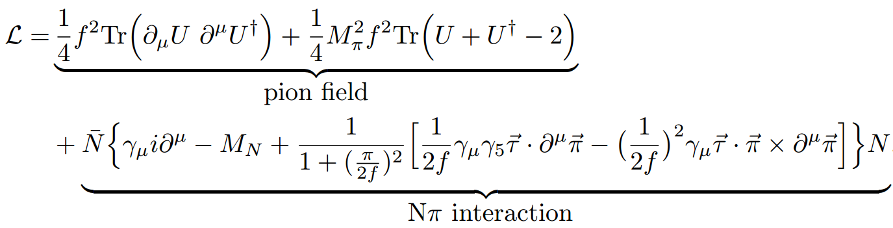
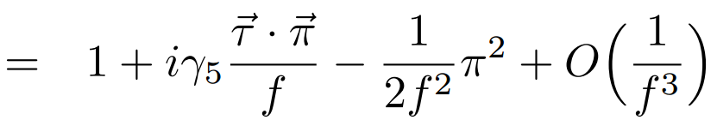
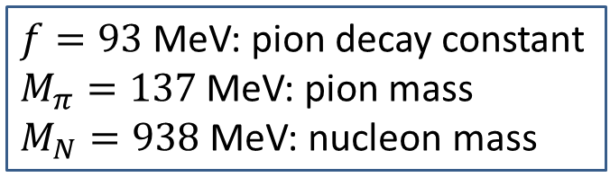

Starting point: chiral model of nucleon and pion
Relativistic $Nπ$ chiral Lagrangian density
$f=93$ MeV: pion decay constant
$M_{π}=137$ MeV: pion mass
$M_{N}=938$ MeV: nucleon mass
[Miller, 1997]

Slide 7
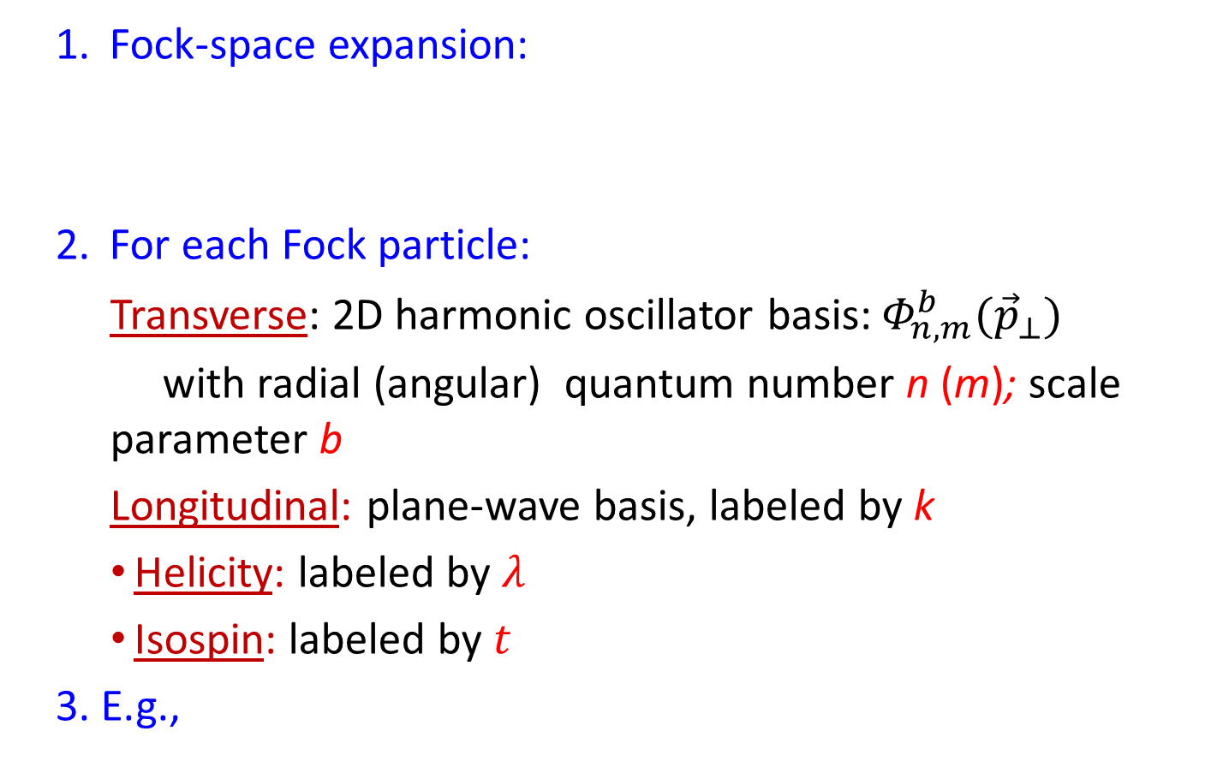
Basis construction
  Fock-space expansion:
  For each Fock particle:
    Transverse: 2D harmonic oscillator basis:${ Φ}_{n,m}^{b}({\vec{p}}_{⊥})$
    with radial (angular) quantum number n (m); scale parameter b
    Longitudinal: plane-wave basis, labeled by k
    Helicity: labeled by $λ$
    Isospin: labeled by $t$
3. E.g.,
$\left.|proton\right\rangle =a\left.|N\right\rangle +b\left.|Nπ\right\rangle +c\left.|Nππ\right\rangle +d\left.|N\overline{N}N\right\rangle +$. . . .
$$\left.|Nπ\right\rangle =|n^{N},m^{N},k^{N},λ^{N},t^{N},n^{π},m^{π},k^{π},λ^{π},t^{π}⟩$$

Slide 8
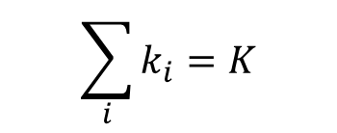
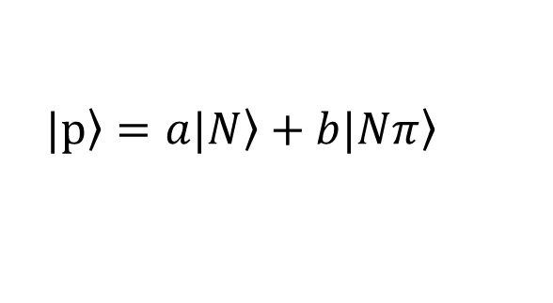



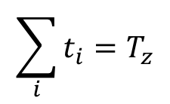
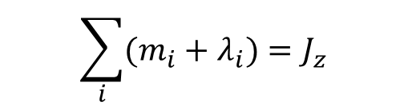
Basis truncation
Symmetries and conserved quantities:
$$\sum_{i}{k_{i}}=K$$
- Longitudinal momentum:
$$\sum_{i}{(m_{i}+λ_{i})}=J_{z}$$
- Total angular momentum projection:
- Total isospin projection:
$$\sum_{i}{t_{i}}=T_{z}$$
Truncations:
- Fock-sector truncation
$$\left.|p\right\rangle =a\left.|N\right\rangle +b\left.|Nπ\right\rangle$$
- “K_{max}” truncation in longitudinal direction
$$K=K_{max}$$
- “N_{max}” truncation in transverse direction
$UV cutoff Λ\sim b\sqrt{N_{max}}$
$$IR cutoff λ\sim b/\sqrt{N_{max}}$$

Slide 9
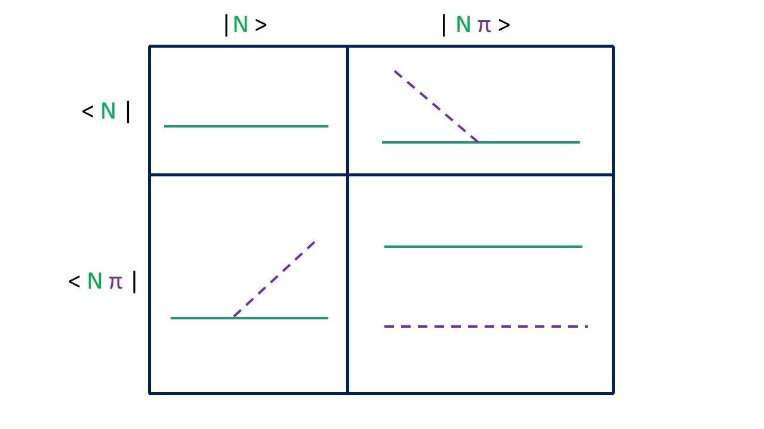
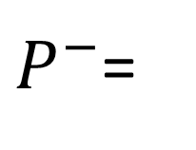
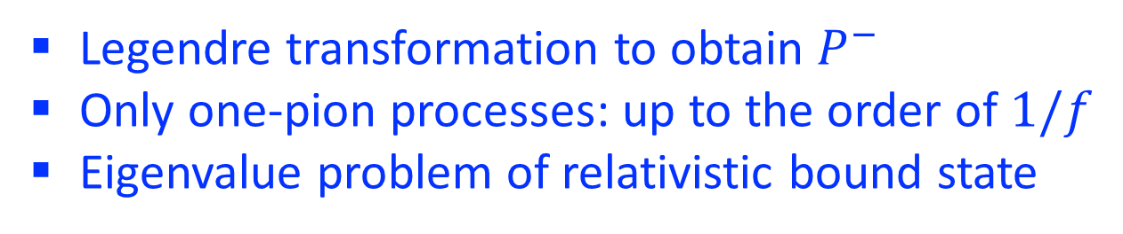
Light-front Hamiltonian in the basis representation
$P^{−}$=
Legendre transformation to obtain $P^{−}$
Only one-pion processes: up to the order of $1/f$
Eigenvalue problem of relativistic bound state

Slide 10
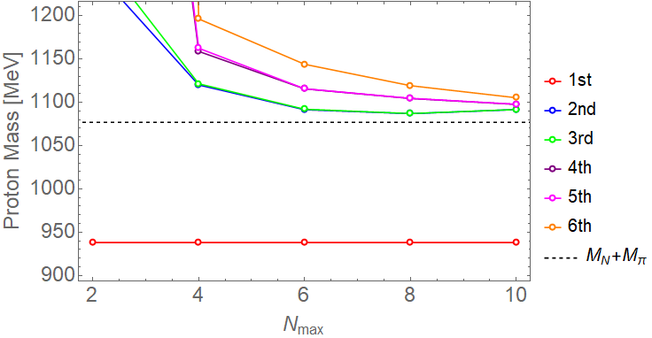
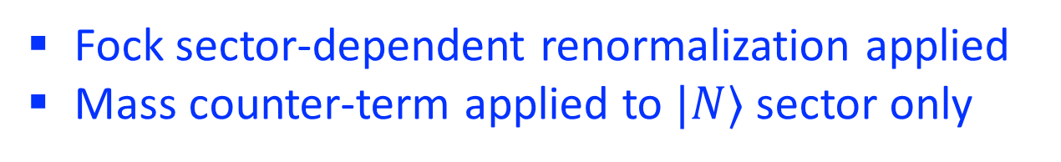
Mass spectrum of the proton system
[Du et al., in preparation]
the physical proton 938 MeV
=K
Fock sector-dependent renormalization applied
Mass counter-term applied to $|N⟩$ sector only
[Karmanov et al, 2008, 2012]

Slide 11

Observable: proton’s Dirac form factor
Schematically:

Slide 12
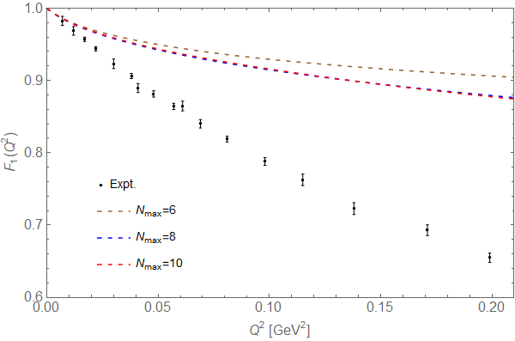
Proton’s Dirac form factor
[Du et al., in preparation]
Constituent nucleon and pion are treated as point particles
Higher Fock-sectors could be important

Slide 13
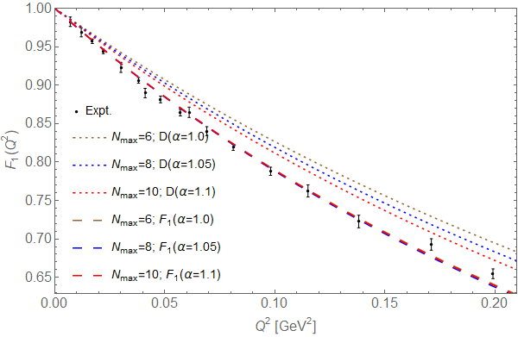
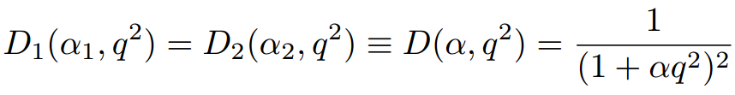
Proton’s Dirac form factor
[Du et al., in preparation]
Dipole form for constituents’ internal structures

Slide 14
Summary and outlook
Chiral model of nucleon-pion is treated by Basis Light-front Quantization method:
  fully relativistic, non-perturbative treatment
  close connection with observables of hadron structure
Initial calculations are performed & results (mass spectrum, Dirac form factor) are promising
Convergence study
Higher order interactions in the chiral Lagrangian
More observables: GPD, TMD, GTMD…
Inclusion of quarks and gluons and comparison with parton picture
Pion cloud for studying light flavor sea-quark asymmetry
Notes:
Other systems: pion, deuteron, light nuclei…

Slide 15
Thank you!

Slide 16
Backups

Slide 17
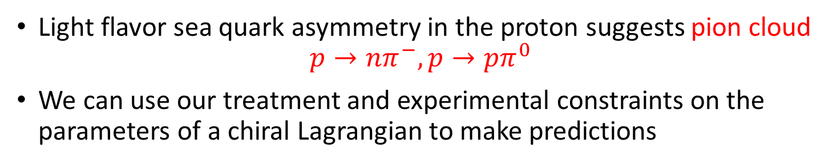
Cloudy-bag model for sea quark asymmetry
[Theberge, Thomas and Miller, 1980]
Adapted from Alberg and Miller, APS April Meeting 2018
Light flavor sea quark asymmetry in the proton suggests pion cloud
$$p→nπ^{−}, p→pπ^{0}$$
We can use our treatment and experimental constraints on the parameters of a chiral Lagrangian to make predictions

Slide 18
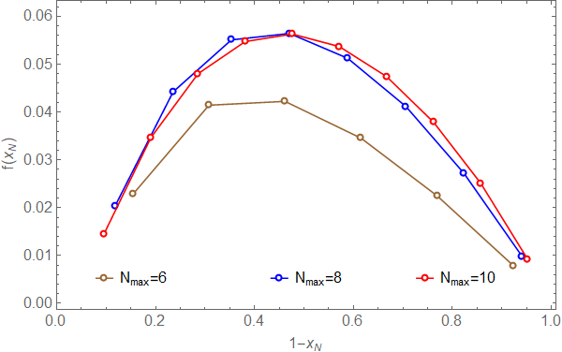
Parton distribution function
Preliminary

Slide 19
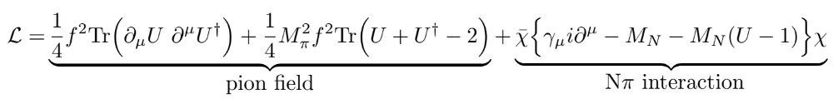



Chiral rotation of nucleon field
Introduce $χ$ such that $N=U^{1/2}χ$
[Miller, 1997]
Constraint equation for nucleon field $χ_$

Slide 20
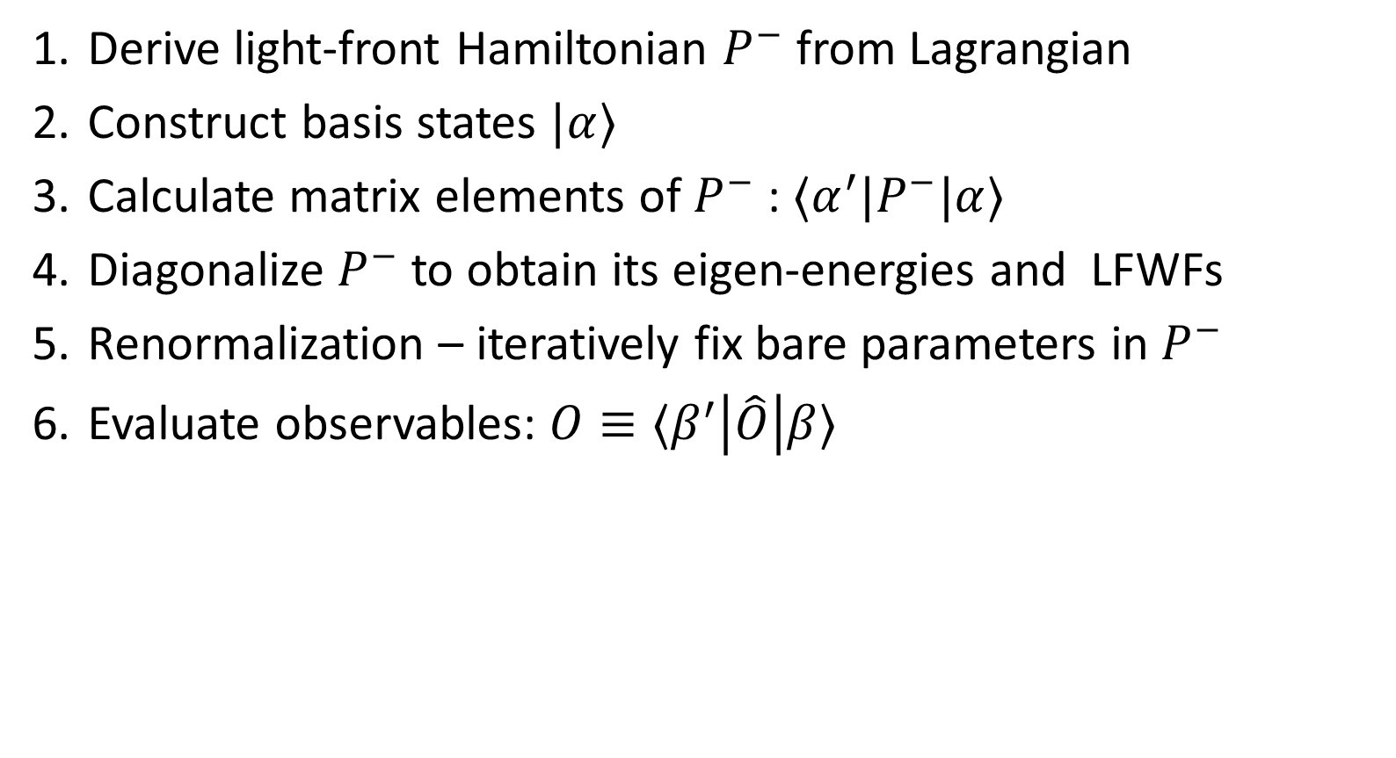
Procedure
Derive light-front Hamiltonian $P^{−}$ from Lagrangian
Construct basis states $|α⟩$
Calculate matrix elements of $P^{−}$ : $⟨α^{′}|P^{−}|α⟩$
Diagonalize $P^{−}$ to obtain its eigen-energies and LFWFs
Renormalization – iteratively fix bare parameters in $P^{−}$
Evaluate observables: $O≡⟨β^{′}\left|\hat{O}\right|β⟩$

Slide 21
Common variables in light-front dynamics
Light-front time
Light-front Hamiltonian
Longitudinal coordinate
Longitudinal momentum
Transverse coordinate
Transverse momentum
Dispersion relation

Slide 22
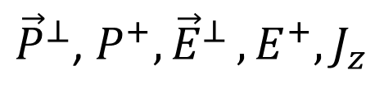
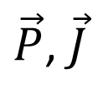
Light-front vs equal-time quantization
[Dirac 1949]
v.s.
equal-time dynamics vs light-front dynamics
$\vec{P}$, $\vec{J}$
${\vec{P}}^{⊥}$, $P^{+}{,\vec{E}}^{⊥},E^{+}, J_{z}$
Notes:
The approach I am introducing today is based on the Light-front field theory. Its basic idea is to solve the Schrodinger equation numerically for the quantum field. The difference from the traditional equal time formalism is that we redefine our light-front time to be the linear combination of the regular time and one of the spatial direction, usually we choose z direction. In the traditional equal time formalism we specify the initial state on a equal time plane and the Schroedinger equation will tell us its evolution time on future times. In the light front theory we specify the initial state on the equal light front surface and the Schrodinger equation will evolve afterwards. The benefits of the lightfront theory includes the fact that the Hamiltonian operator does not have the square root in it. also its amplitude is boost invariant and has simpler vacuum structure.

Slide 23
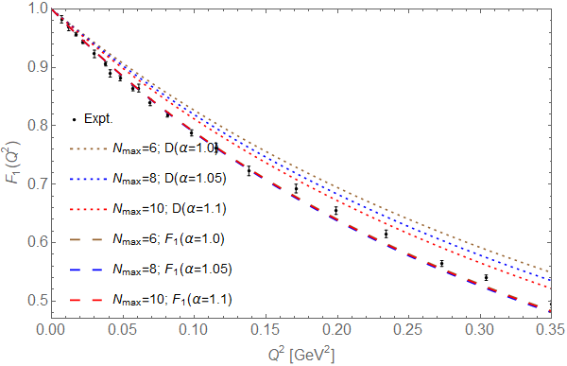
Proton’s Dirac form factor
For larger Q², our prediction is consistently smaller than the experimental results.

Slide 24
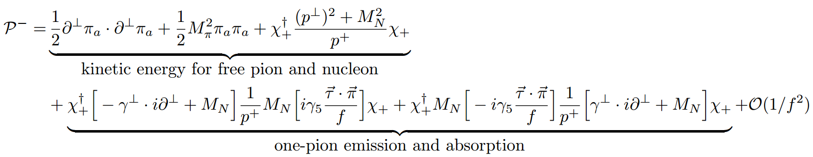
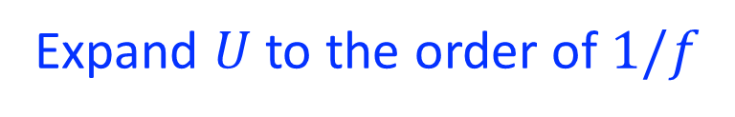
Light-front Hamiltonian density
Legendre transformation
Expand $U$ to the order of $1/f$
π
π
H.C.
N
N
N
N

Slide 25
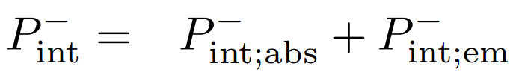
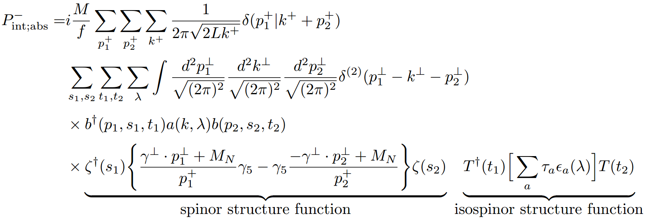
Light-front Hamiltonian in basis representation
π
N
N

Slide 26
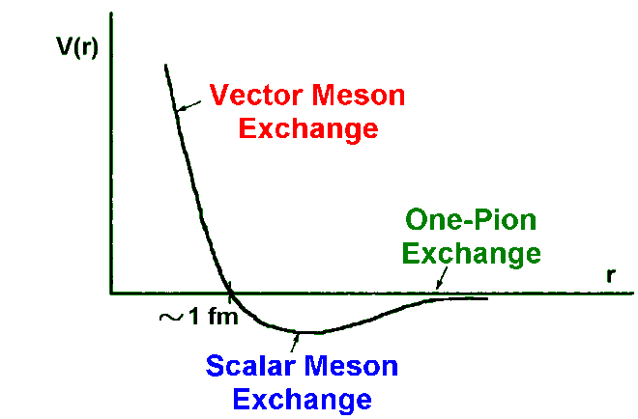
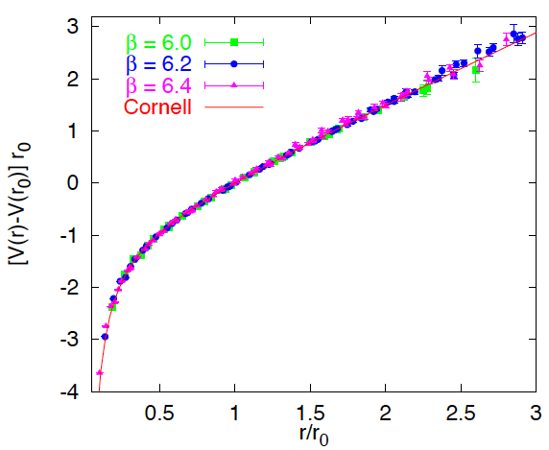
Nuclear physics
Low energy
High energy
Medium energy???
Nucleons & mesons
Quarks & gluons
Mass scale ∼ GeV
Mass scale ∼ MeV

Slide 27
Nuclear physics
Low energy
High energy
$$π$$
Nucleons & mesons
Quarks & gluons
Mass scale ∼ GeV
Non-perturbative
Mass scale ∼ MeV

Slide 28
Nuclear physics in the medium energy is challenging

