Slide 1
eRHIC Machine Design Overview
Christoph Montag, BNL
8th Workshop of the APS Topical Group on Hadronic Physics
April 10-12, 2019

Slide 2
RHIC
Two superconducting storage rings
3.8km circumference
Energy up to 255 GeV protons, or 100 GeV/n gold
110 bunches/beam
60% proton polarization – world’s only polarized proton collider
6 interaction regions, 2 detectors
In operation since 2001

Slide 3
Requirements for the EIC
Requirements for an Electron-Ion Collider are defined in the White Paper:
High luminosity: L = 10³³ to 10³⁴ cm⁻²sec⁻¹
Large range of center-of-mass energies E_{cm}= 20 to 140 GeV
Polarized beams with flexible spin patterns
Favorable condition for detector acceptance such as p_{T} =200 MeV
Large range of hadron species: protons ….Uranium
Collisions of electrons with polarized protons and light ions (h³He, hd,…)
➔
eRHIC meets or exceeds the requirements formulated in the
White Paper on EIC

Slide 4
Design Concept
eRHIC is based on the RHIC complex: Storage ring (Yellow Ring), injectors, ion sources, infrastructure; needs only relatively few modifications and upgrades
Todays RHIC beam parameters are close to what is required for eRHIC (except number of bunches, 3 times higher beam current, and vertical emittance)
A 5 to 18 GeV electron storage ring & its injectors are added to the RHIC complex ➔ Full center-of-mass energy range of E_{cm} = 29 to 141 GeV from the start
Design aims to meet the goals formulated in the EIC WHITE PAPER, in particular the high luminosity of L = 10³⁴cm⁻²s⁻¹.
Design is optimized under the assumption that each beam will have the parameters (in particular beam-beam tune shift) as demonstrated in collisions between equal species (HERA Concept).
The requirement to store electron beams with a variable spin pattern requires an on-energy, spin transparent injector.
The total synchrotron radiation power of the electron beam is assumed to be limited to 10 MW. This is a design choice, not a technical limitation.

Slide 5
Facility layout
Electron complex to be installed in existing RHIC tunnel – cost effective
Large 3.8 km circumference allows for high electron energies of 18 GeV

Slide 6
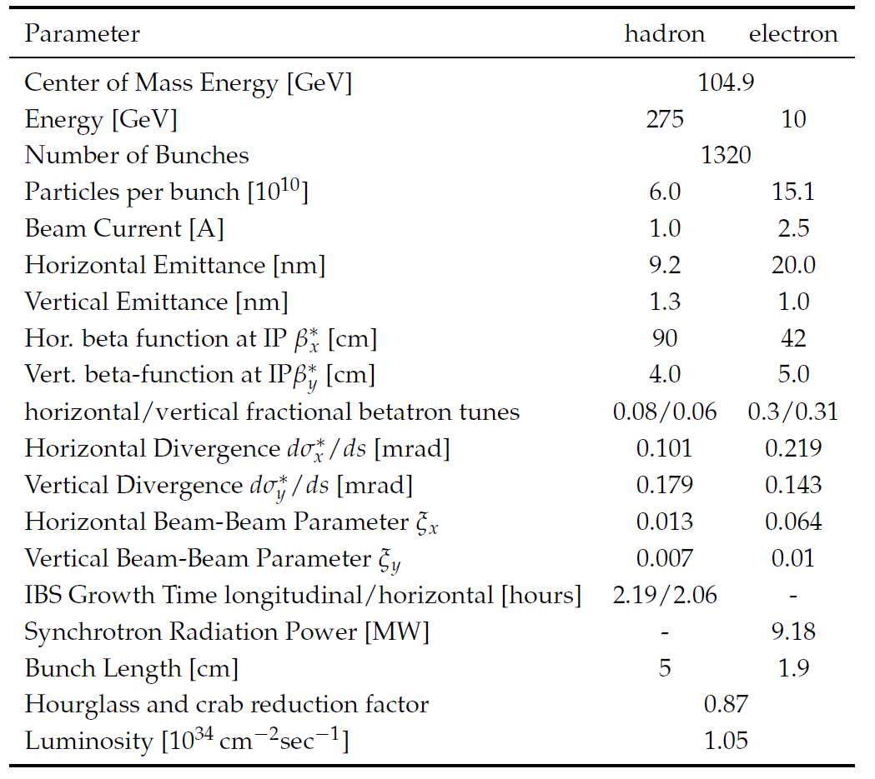
Maximum Luminosity Parameters
High beam currents
Many bunches
Large beam-beam tune-shift
Flat beams
Need strong hadron
cooling
Short hadron bunches
22 mrad crossing angle
with crab cavities
➔ Large Luminosity
0.10
No problem
Challenge
Difficult/R&D required

Slide 7
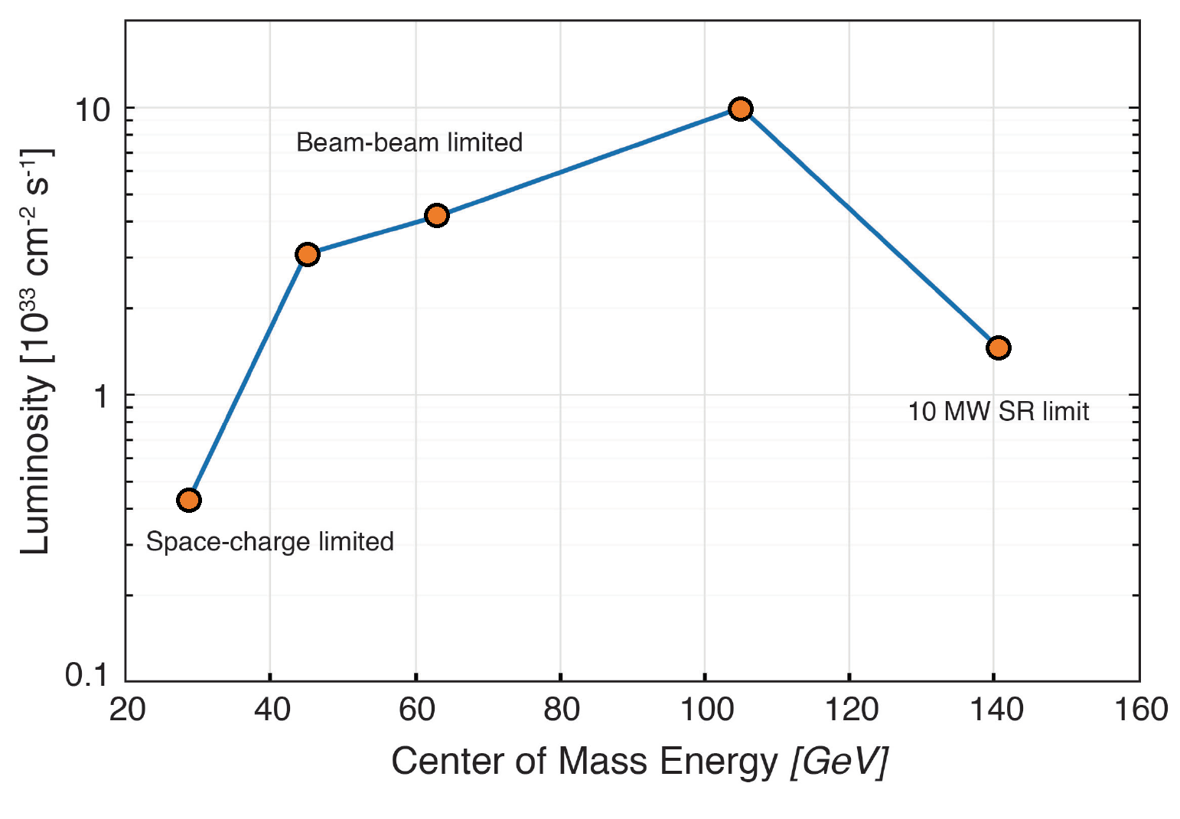
Luminosity versus Center-of-Mass Energy

Slide 8
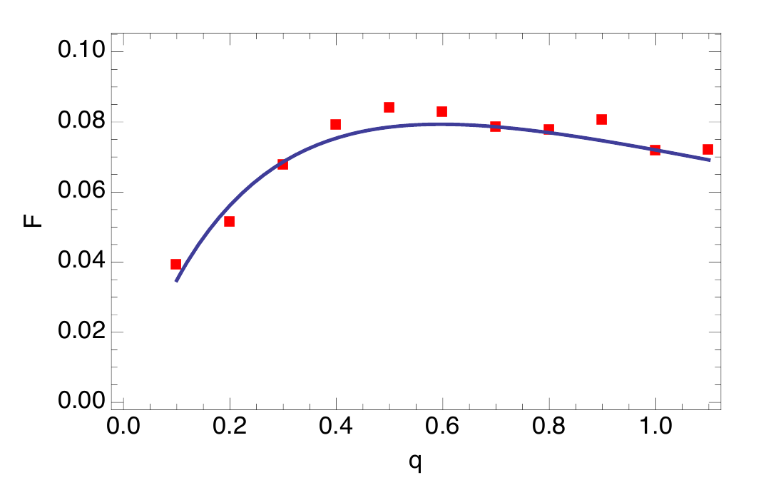
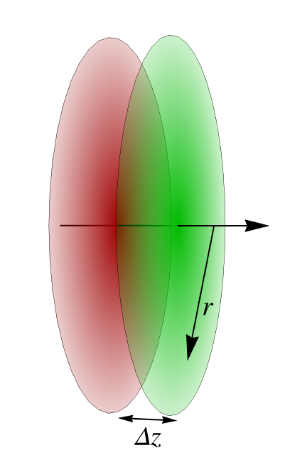
Strong Hadron Cooling
2 hour IBS emittance growth time requires strong hadron cooling – otherwise store length would be limited to ~2h
Several methods of strong hadron cooling have been studied.
Bunched Beam Electron Cooling with an electron storage ring
Coherent electron cooling with FEL amplifier or micro-bunching amplifier – essentially a stochastic cooling concept using an electron beam as pick-up and kicker
➔ The most promising approach at this point is micro-bunched electron beam cooling with 2 plasma amplification stages.
Achievable cooling rates with 100 mA electron current and flat beams are in the order of
1 h which would be sufficient for eRHIC.
Analytical calculation of the
cooling rate agrees well with
simulations within the 1-D model.

Slide 9
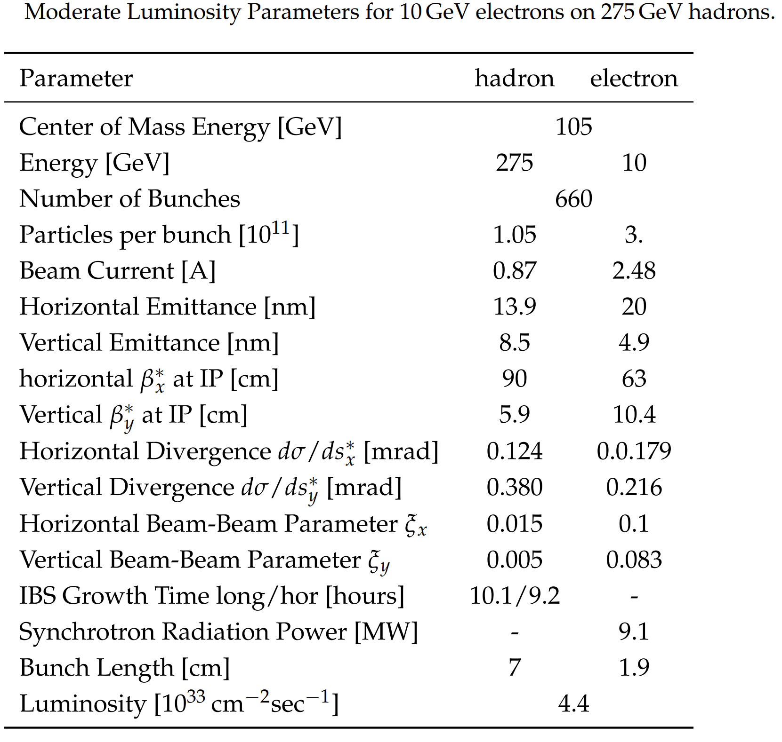
Mitigation of Strong Hadron Cooling Risk
Solution with L = 0.44·10³⁴cm⁻²s⁻¹ and IBS growth rates of 9 h

Slide 10
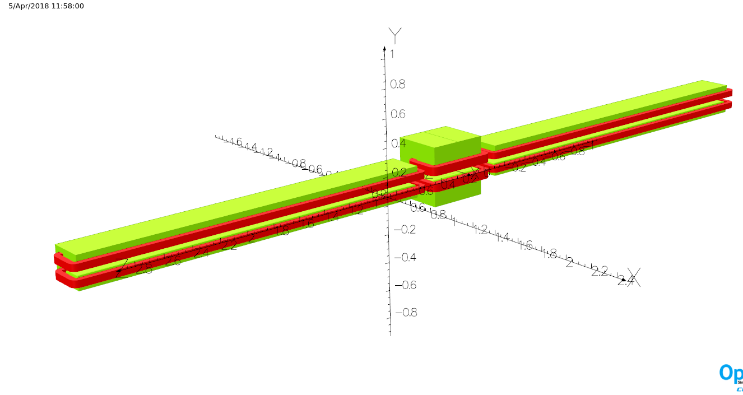
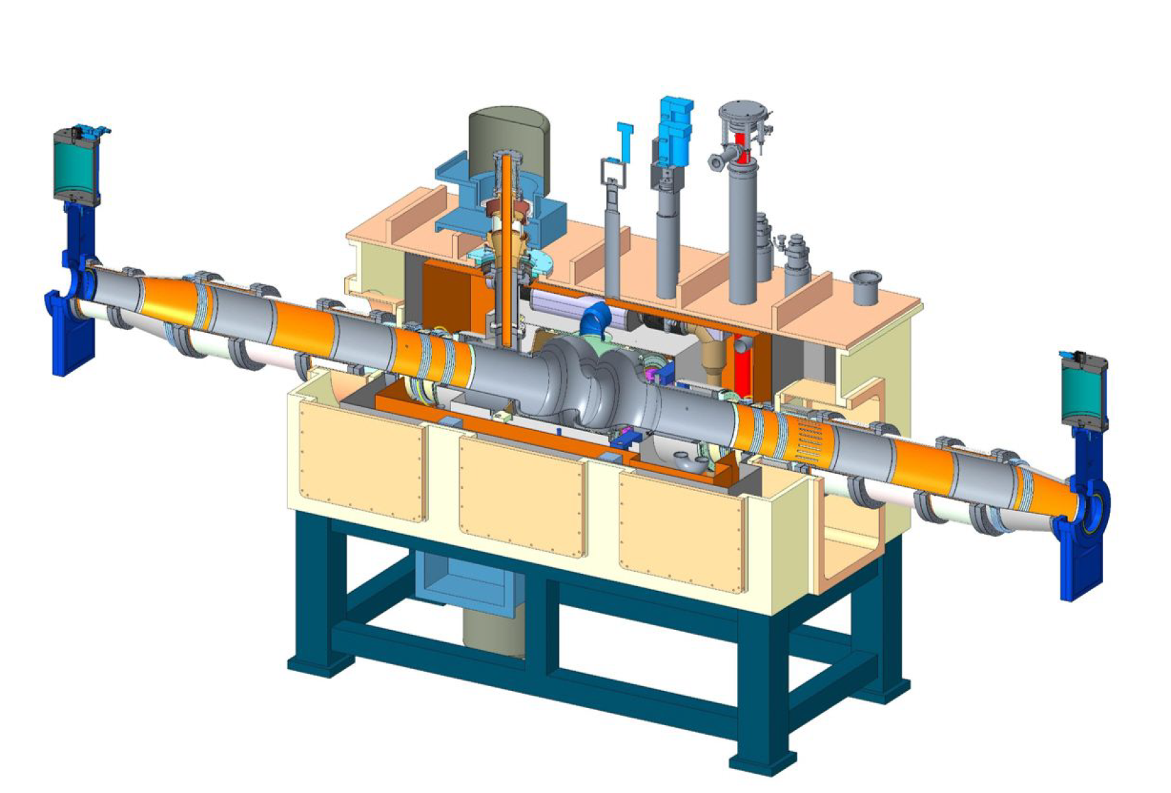
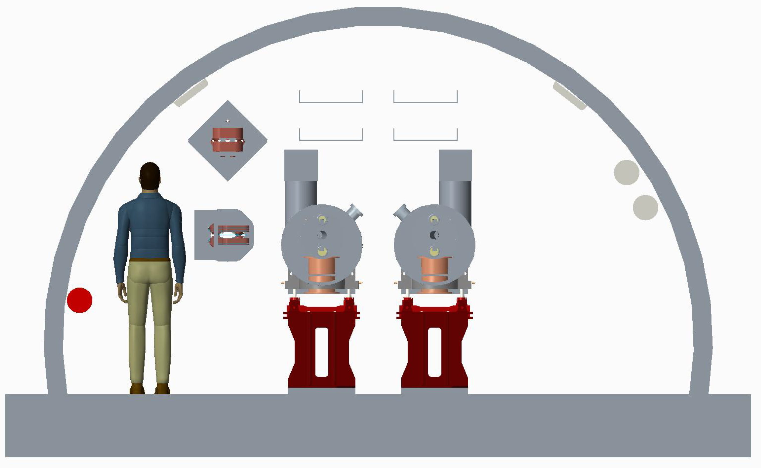
Electron Storage Ring
Composed of six FODO arcs with 60º /cell for 5-10 GeV
90º /cell for 18 GeV
Super-bends for 5 to 10 GeV for emittance control
5 straight sections with simple layout, plus IR straight
Radiate approx. 10 MW for maximum luminosity parameters at 10GeV
➔ 14 superconducting 2-cell 591 MHz RF cavities
Storage
Ring

Slide 11
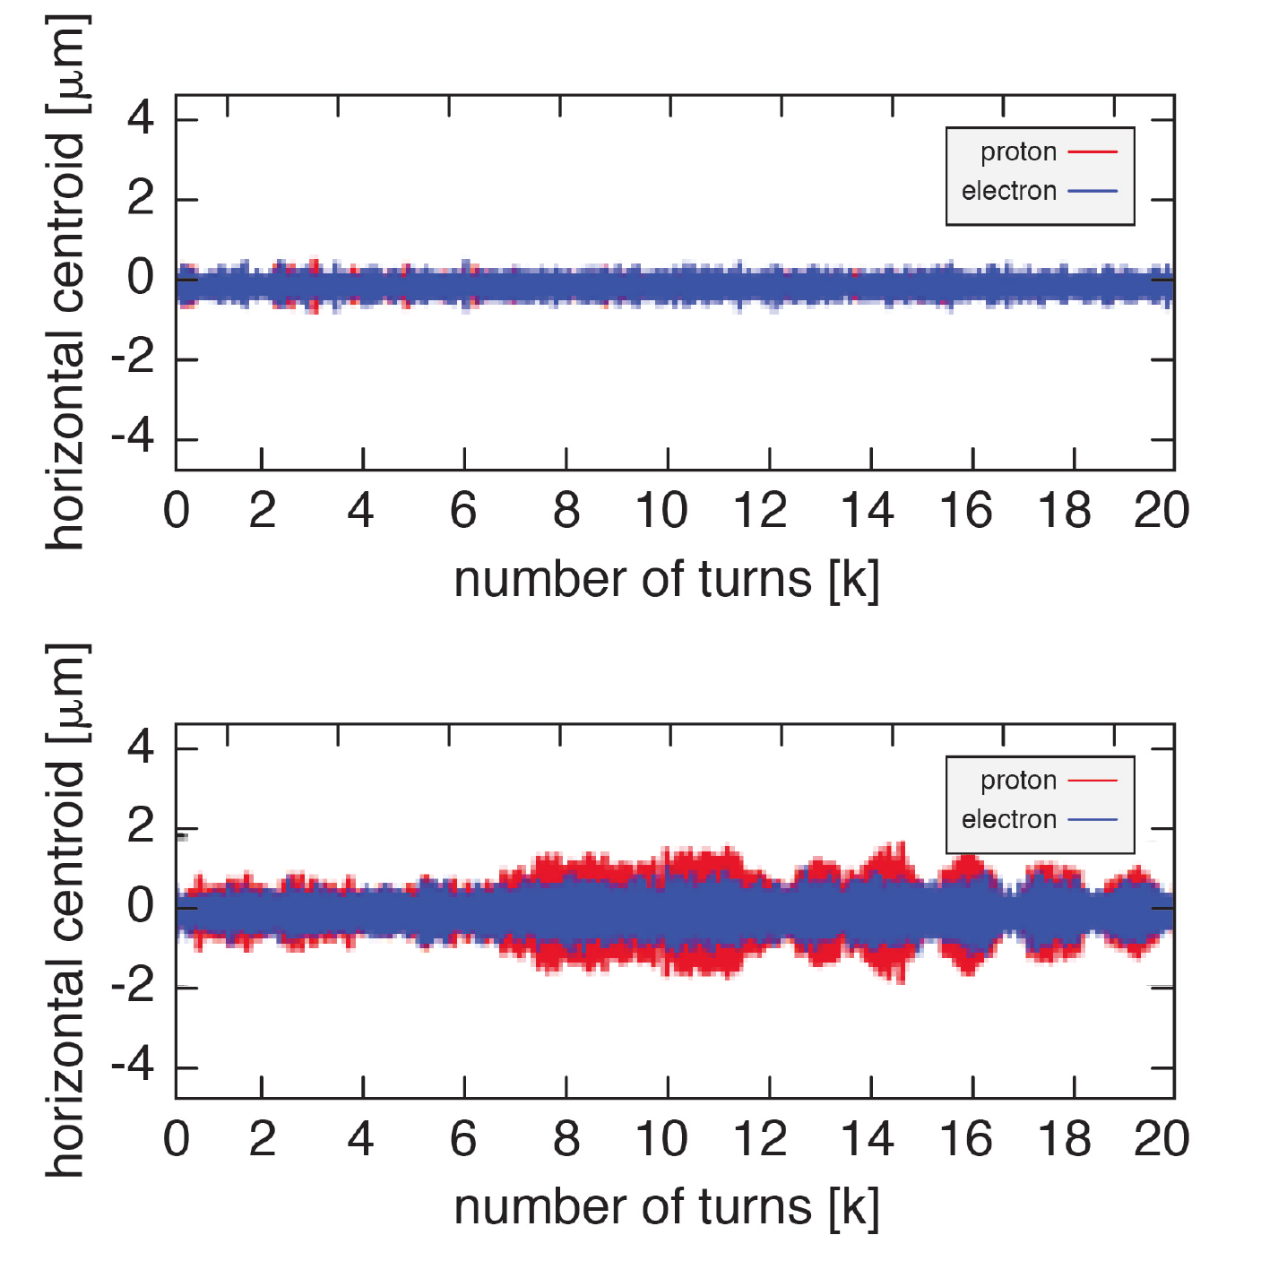
Beam-Beam Physics
Operate electron ring just above integer resonance to benefit from dynamic focusing and to stay away from half-integer spin resonance
Concerns:
Slow hadron emittance growth,
examined using long term weak-strong
simulations
No evidence in head-on collisions; optimum choice of crab cavity frequency on-going
Coherent beam-beam instability,
examined by strong-strong simulations
using several codes
Threshold found
at twice the design intensities
No strong dependence of beam-beam parameter on radiation damping decrement found

Slide 12
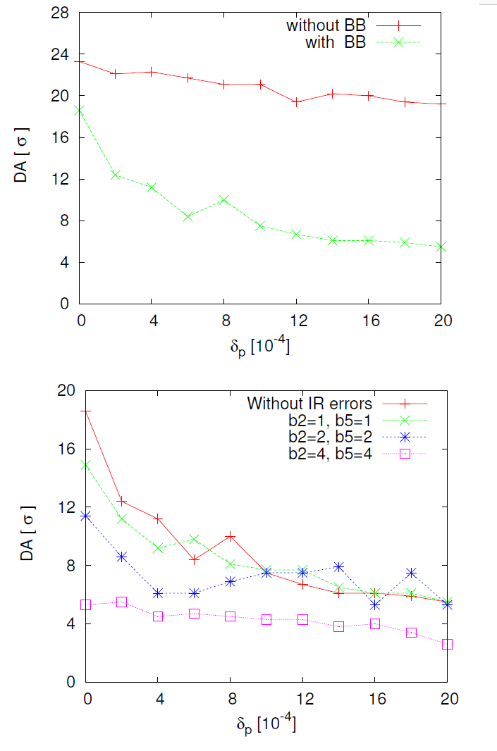
Dynamic Aperture Assessment
Requirements: Hadrons DA> 5 σ (RHIC experience)
Long terms tracking in eRHIC hadron ring
with beam-beam effect
with multipole errors
Beam-beam has a strong impact on DA
Systematic multipole errors in the IR should not
exceed 2 units of 10⁻⁴ @ 25mm
High demand of IR magnet design

Slide 13
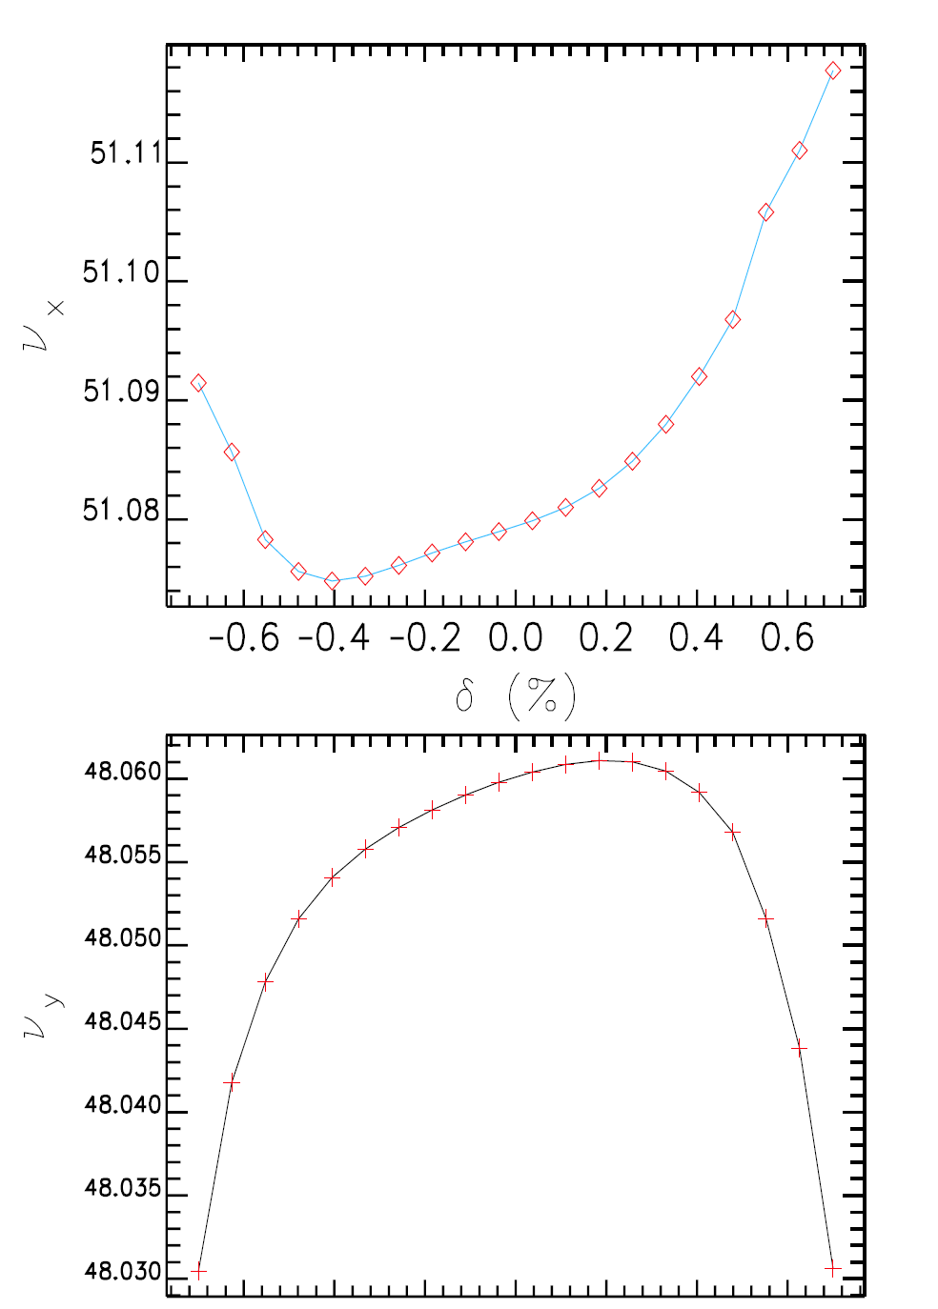
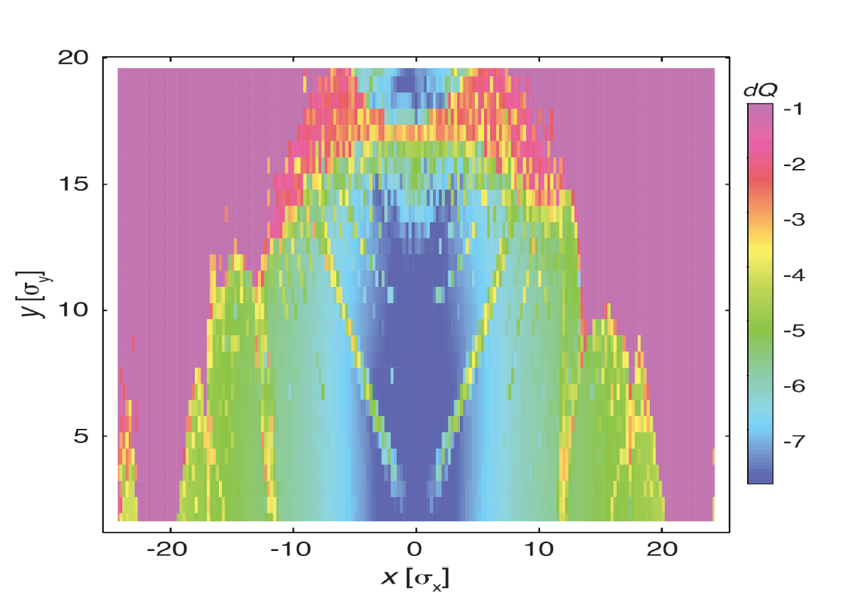
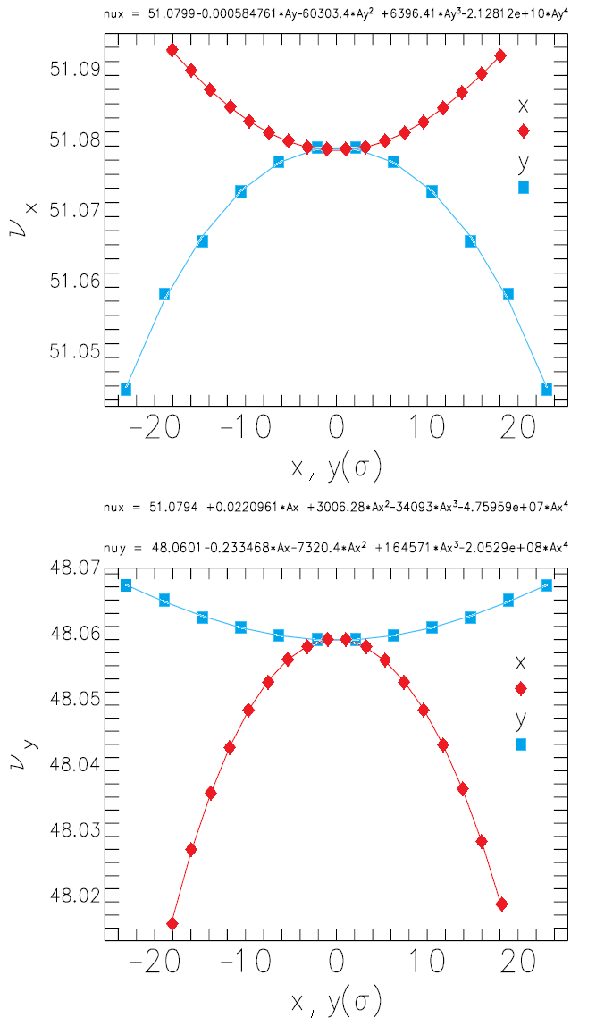
Electron Ring Dynamic Aperture
Requirement: > 10 σ in all three planes (lifetime)
Main issue: 2nd order chromaticity (local IR ξ_{x,y} = -30)
Sextupole scheme: A-B-E-A-B-A-B-C-A-B-C-A-B-E-A-B
Off-momentum DA still limited at 0.7% (12σ) by
2nd order vertical chromaticity
On-momentum DA ~ 20 σ, limited by tune shift with
amplitude $\frac{∂Q_{x,y}}{∂J_{y,x}}$
No results with beam-beam and imperfections yet
No optimization of non-chromatic sextupoles yet

Slide 14
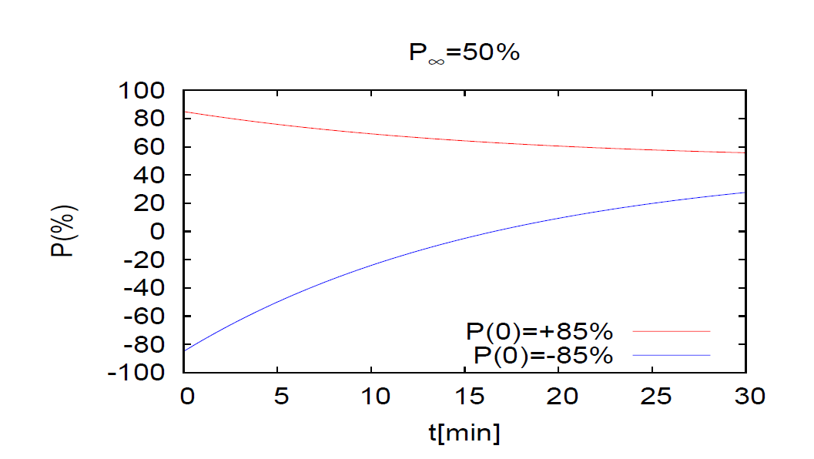
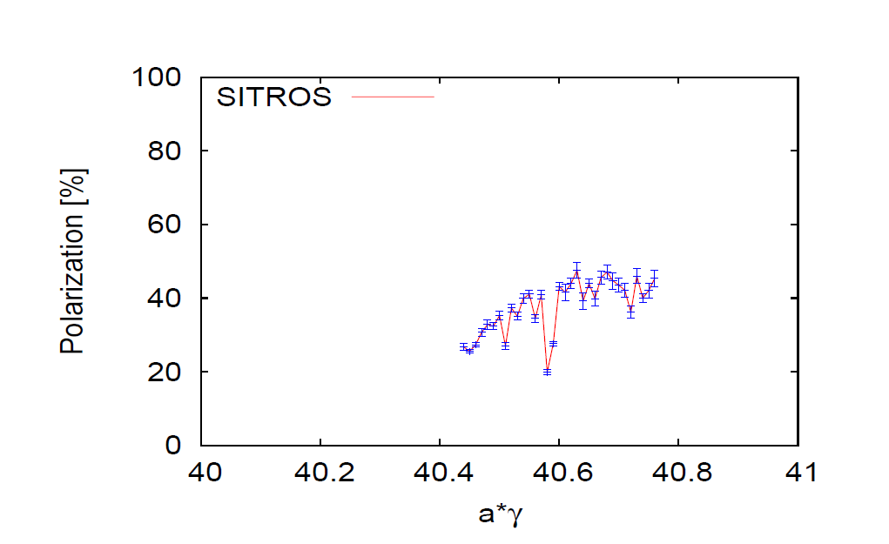
Electron Storage Ring Polarization
Need to store bunches with 85% initial polarization and spins parallel ↑ ↑ and spins antiparallel ↑↓ to guide field in the arc.
Need to replace bunches with parallel spin ↑ ↑ with a rate of up to 1/(5 minutes) because of Sokolov-Ternov depolarization (defines the injection chain – Rapid Cycling Synchrotron)
Equilibrium polarization P∞ = 50% in eRHIC sufficient
to maintain polarization with <P> = 63% (spin ↑↓➔ 80%)
Higher vertical tune better due to easier orbit control
(beam-beam feasibility to be checked))
Spin matching between rotators essential
Conclusion:
Polarization is ok
More improvements expected by longitudinal spin matching, harmonic bumps, BBA, etc
↑ 50% reachable
Polarization with realistic machine errors

Slide 15
Rapid Cycling Synchrotron with Spin Resonance Free Lattice as Full Energy Polarized Injector
Both the strong intrinsic and imperfection resonances occur at spin tunes:
= nP +/- Qy
Gϒ = nP +/- [Qy] (integer part of tune)
To accelerate from 400 MeV to 18 GeV requires the spin tune ramping from
0.907 < Gϒ < 41.
If we use a periodicity of P=96 and a tune Qy with an integer value of 50 then our first two intrinsic resonances will occur outside of the range of our spin tunes
Gϒ1 = 50+ν_{y} (ν_{y} is the fractional part of the tune)
Gϒ2 = 96 – (50+ν_{y} ) =46-ν_{y}
Also our imperfection resonances will follow suit with the first major one occurring at Gϒ2 = 96 – 50 = 46

Slide 16
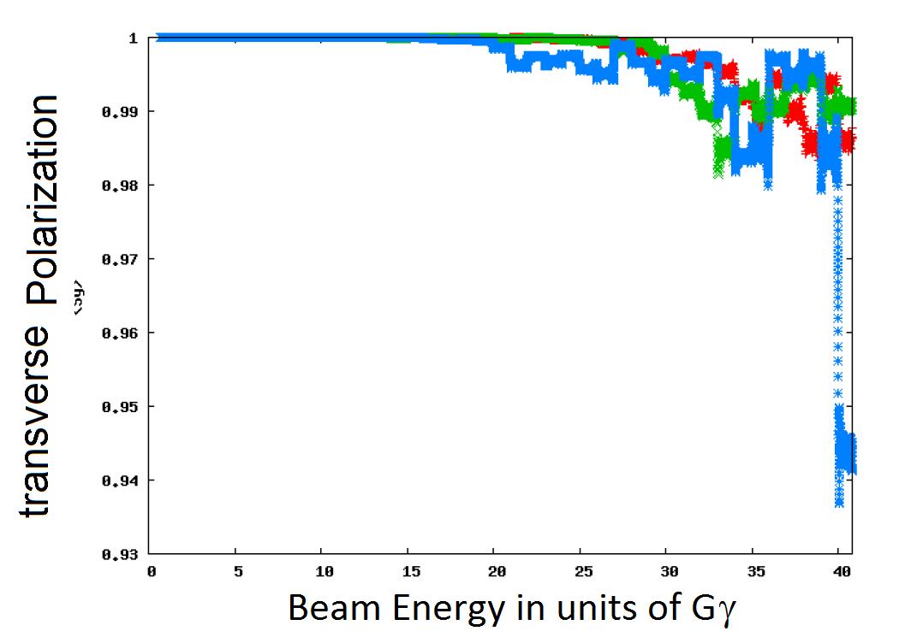
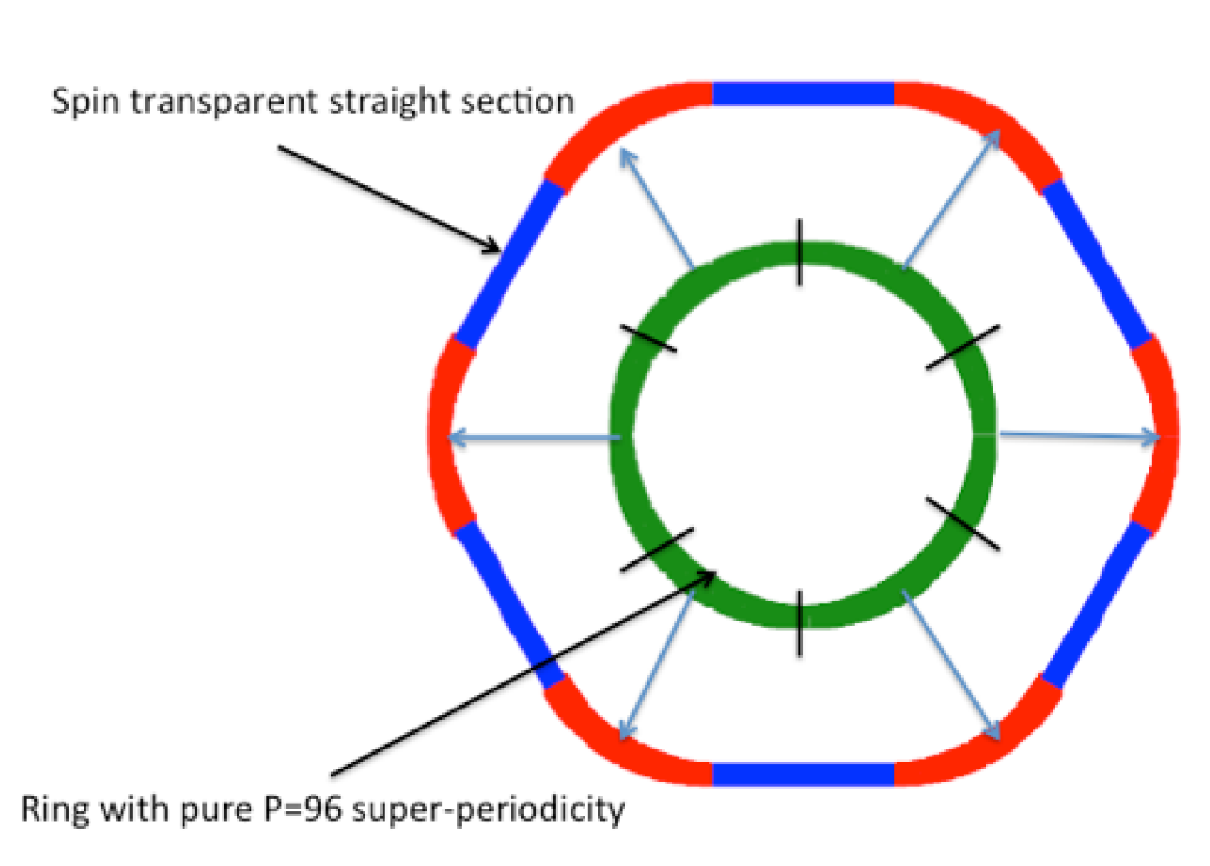
Spin Tracking in the Rapid-Cycling Synchrotron
High quasi-symmetry
➔ Good spin transparency properties
Blue asterisk: 200 ms ramp time

Slide 17
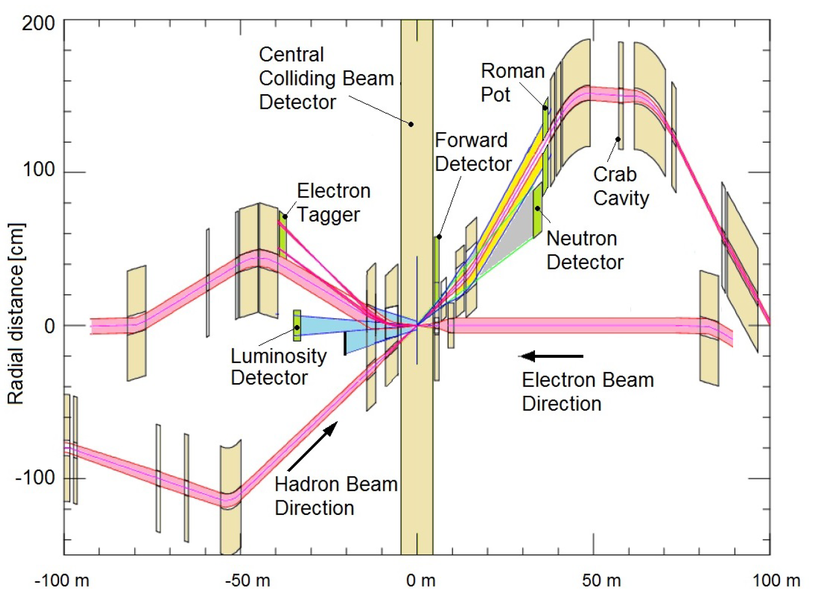
IR Layout
REAR
Forward
IR design requirements:
Small β* for high luminosity
Limited IR chromaticity contributions
Large final focus quadrupole aperture
Large detector acceptance
➔ Large quadrupole aperture, limited beam divergence
Accommodate dipole spectrometer in the low-β optics
No accelerator magnets +/-4.5 m
22 mrad crossing angle, crab crossing, crab cavities 90° from IP
Avoid synchrotron radiation:
- no electron bends on the forward side
- absorb SR far from IP
- need mask against backscattered SR photons
Accommodate spin rotators, spin matching
Space for luminosity monitor, neutron detector, “Roman Pots”
Design meets all requirements
➔ Very constrained systems, requires novel types of magnets in the IR

Slide 18
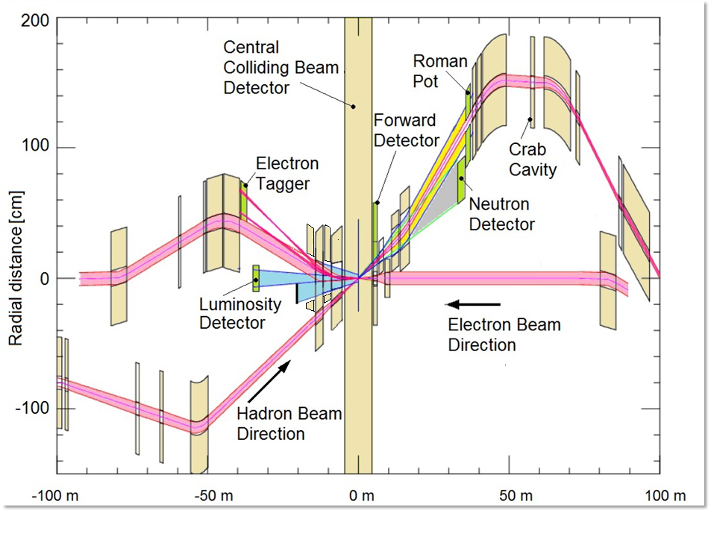
Multi-stage separation:
Electrons from protons
Protons from neutrons
Electrons from Bethe-Heitler photons (luminosity monitor)
Currently working on increasing crossing angle from 22 to 25 mrad to ease magnet design

Slide 19
Summary
eRHIC design reaches a peak luminosity of
L= 1.05·10³⁴cm⁻²s⁻¹
However, this can only be achieved with strong hadron cooling, which is beyond state of the art, and is a topic of ongoing R&D.
The corresponding design risk is mitigated by R&D, exploring variants for hadron cooling and by a fall-back solution with a respectable luminosity of
L= 0.44·10³⁴cm⁻²s⁻¹
eRHIC design has progressed very well and a tremendous amount of design work was accomplished.
There are still critical beam dynamic issues which require more effort. They could have an impact on achievable luminosity but do not constitute a risk of missing the EIC White Paper Requirement
While a large amount of work is still ahead to arrive at a Conceptual Design, we believe that the present state of the eRHIC design matches well the expectations of a Pre-Conceptual Design

Slide 20
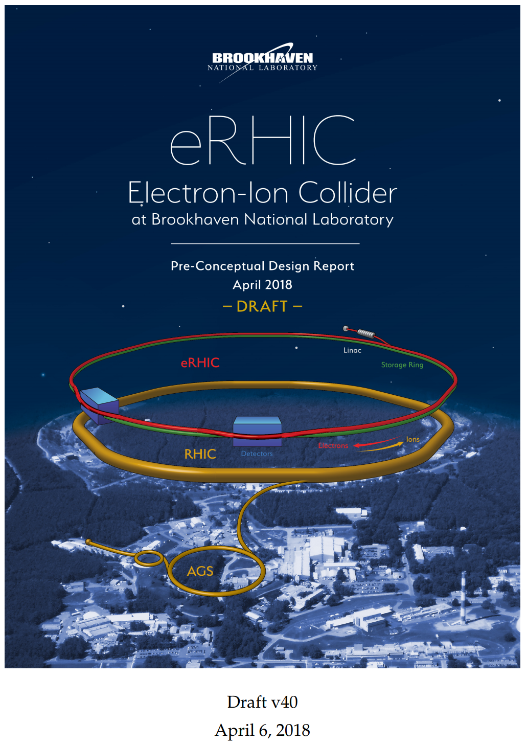
Pre-Conceptual Design Report delivered to DOE on August 20, 2018 – soon to be published
~800 pages, with many subsystems already beyond pre-conceptual stage
Active R&D program on strong hadron cooling

Slide 21
Backup slides

Slide 22
