Slide 1
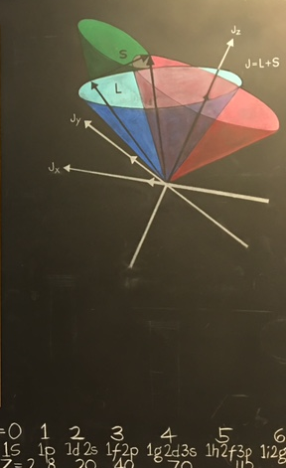


Bounds on the Equation of State of Neutron Stars from High Energy Deeply Virtual Exclusive Experiments
8th APS Group of hadronic physics Workshop
Denver, April 10-13, 2019
Simonetta Liuti
University of Virginia

Slide 2
1. Introduction

Slide 3
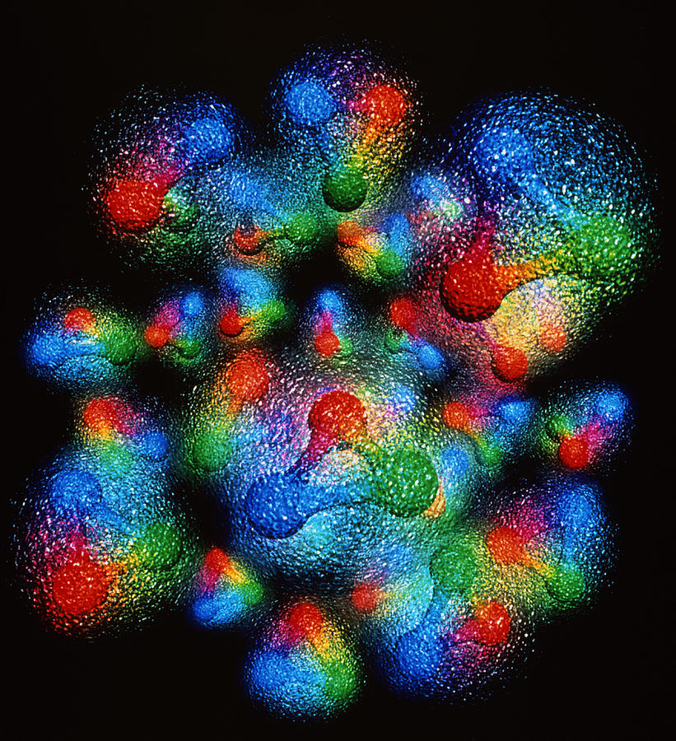
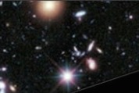
what is the origin of mass and spin?
dark matter
dark energy
visible matter

Slide 4
GPDs and Deeply Virtual Exclusive Experiments
A new paradigm to both penetrate and visualize the deep structure of visible matter … to answer questions that we couldn’t even afford asking before

Slide 5
… a new way of thinking strongly interacting systems
… a link to phenomenology that allows us to measure what
could only be conceivably explored through
“thought” experiments in Lattice QCD

Slide 6
… a new way of thinking strongly interacting systems
… a link to phenomenology that allows us to measure what
could only be conceivably explored through
“thought” experiments in Lattice QCD

Slide 7

what is the spatial structure of hadrons?
Are quarks, antiquarks and gluons uniformly distributed?....
… or can we distinguish where the different species are concentrated?

Slide 8
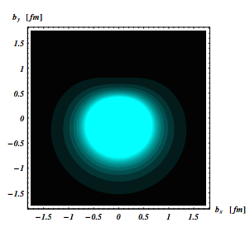
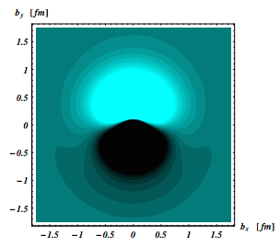
spatial structure and spin
p
n
y
x
z
NA Press, 2013
M. Burkardt
Ph. Haegler, M. Diehl
C.Carlson,
M.Vanderheaghen
spin
momentum
◉

Slide 9
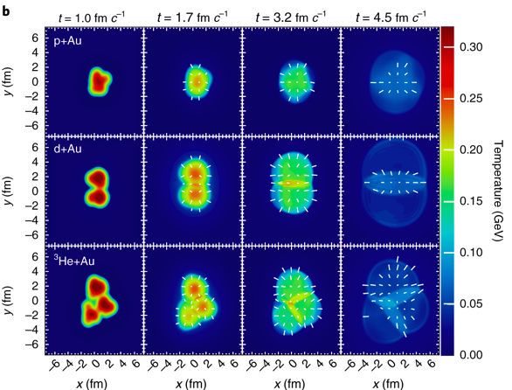
…droplets…?
J. Nagle’s talk

Slide 10
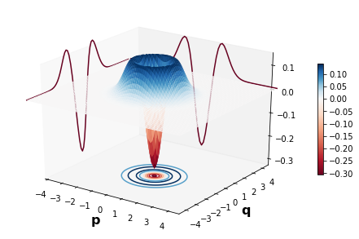
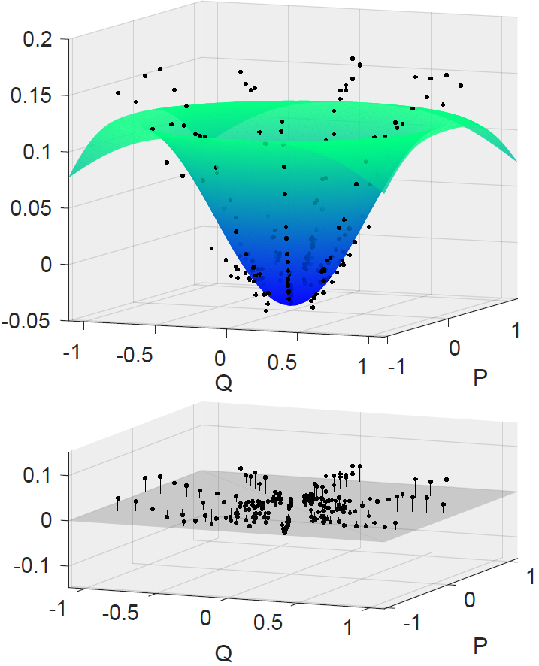
GPDs are projections of phase space distributions (Wigner)
Quantum Optics Example
W(q,p)
x
space
momentum
Theoretical model of Wigner function of the single-photon Fock state.
Experimentally reconstructed Wigner function.
courtesy R. Nehra and O. Pfister (UVA)

Slide 11
…To observe, evaluate and interpret
Wigner distributions at the subatomic level
requires stepping up data analyses from the standard methods ➔ developing new numerical/analytic/quantum computing methods
Center for Nuclear Femtography at Jefferson Lab

Slide 12

After the
Summer Institute on Wigner Imaging and Femtography, SIWIF@UVA: May-August 2019
Organizers
P. Alonzi, M. Burkardt, D. Keller, S. Liuti, O. Pfister, P. Reinke

Slide 13
2. theory: EMT and GPDs

Slide 14
How does the proton/neutron get its mass and spin?
Invariance of L_{QCD} under translations and rotations
Energy Momentum Tensor
from translation inv.
.
Angular Momentum Tensor
from rotation inv.
Notes:
The vast majority of the
nucleon’s mass is due to quantum fluctuations of quarkantiquark
pairs, the gluons, and the energy associated
with quarks moving around at close to the speed of light.
mass of the three valence
quarks in the nucleon comprises only a small fraction
of the nucleon’s total mass. The vast majority of the
nucleon’s mass is due to quantum fluctuations of quarkantiquark
pairs, the gluons, and the energy associated
with quarks moving around at close to the speed of light
The lagrangian looks simple and most importantly it is a “known” expression

Slide 15
QCD Energy Momentum Tensor
Energy density
Conserved quantities
T⁰⁰ | T⁰¹ | T⁰² | T⁰³
T¹⁰ | T¹¹ | T¹² | T¹³
T²⁰ | T²¹ | T²² | T²³
T³⁰ | T³¹ | T³² | T³³
Momentum
Momentum density
Angular Momentum
Shear stress
Pressure
Angular Momentum density
4/10/19
Simonetta Liuti
15
Notes:
Conserved quantities are total P and J, what about the spatial components

Slide 16
EMT Matrix Elements
S=0
q,g
S=1/2
q,g
forward
off-forward
q and g not separately conserved

Slide 17

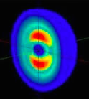
Energy Momentum Tensor in a spin 1 system
PRD86(2012)
7 conserved form factors!
S=1

Slide 18
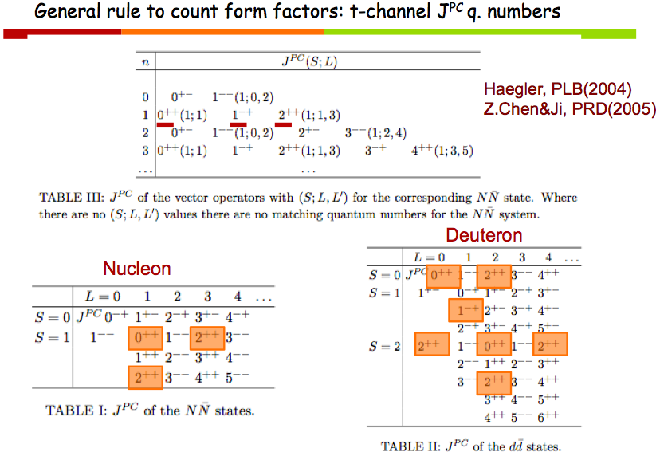
S.L., Talk at INT U. Washington, 2012

Slide 19
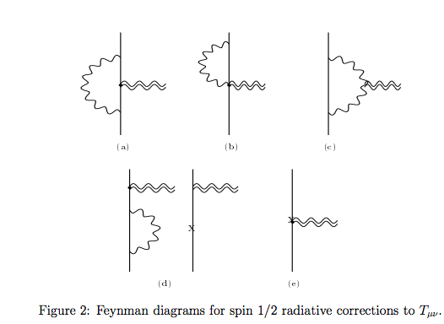
Direct calculation of EMT form factors
Donoghue et al. PLB529 (2002)

Slide 20
GPDs and EMT matrix elements
q’
q
Local Operator Ô
μ
ν
p
p’
p
p’
Q²>>M² ➔ “deep”
W²>>M² ➔ equivalent to an “inelastic” process but not directly accessible

Slide 21
2nd Mellin moments
From OPE
From EMT
Nucleon
D-term
GPDs are the key to interpret the mechanical properties of the proton

Slide 22
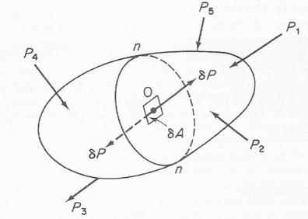
Taneja et al., PRD86(2012)
Deuteron
From OPE
From EMT
Momentum
Angular Momentum
Double flip
D-term dependent on polarization
Quadrupole
ξ-odd
Connected to b₁ SR
Connecting with observables: work in progress with Brandon Kriesten

Slide 23
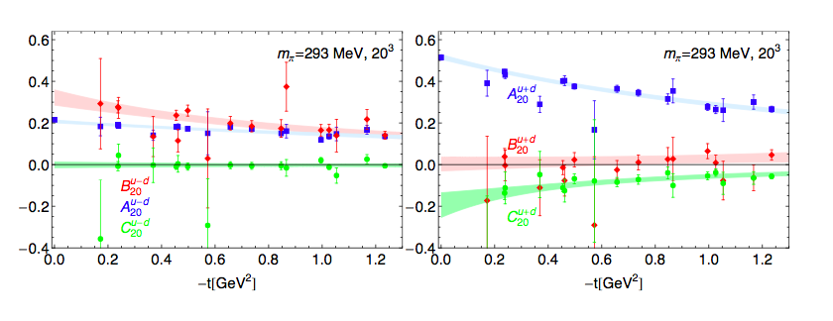
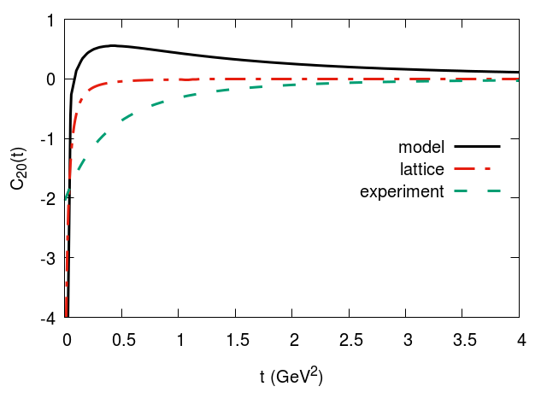
C₂₀
Ph. Haegler, JoP: 295 (2011) 012009
u-d
u+d
Jlab Hall B, Burkert Elouadrhiri, Girod, Nature (2018)
experimental range
Lattice

Slide 24
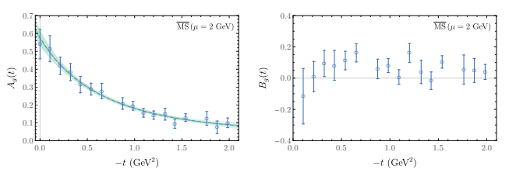
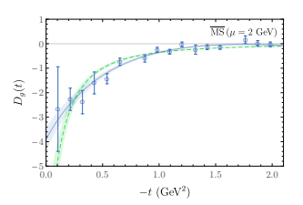
Gluons
m_{π}=450 MeV
Detmold, Shanahan, Phys.Rev. D99 (2019)

Slide 25
Jefferson Lab’s measurement on the pressure inside the nucleon/hadronic matter needs to be corroborated by an independent set of measurements
Neutron stars mergers/multimessenger astronomy provide an independent constraint

Slide 26

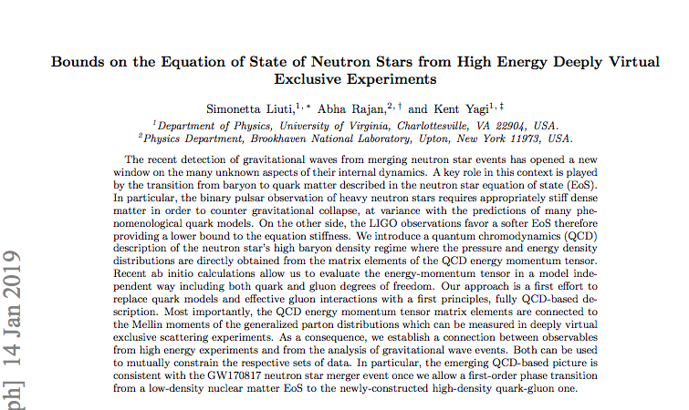
Based on
arXiv:1812.01479

Slide 27
What makes up the interior of neutron stars?
What are the constraints from astronomical measurements on the maximum mass of neutron stars?
How and when does the transition to quark and gluon d.o.f. happen?
How do we describe this in terms of QCD?
What are the subnucleon/hadronic d.o.f….mesons, strangeness, quarks/gluons…?
How do the astronomical observations connect with what we study in Earth laboratories?
(what experiments on Earth can set constraints…? )
… Constraints on the stiffness or softness of EoS?
Are there quark effects at lower densities… does what goes on in the interior crust influence the neutron stars interior… ?

Slide 28
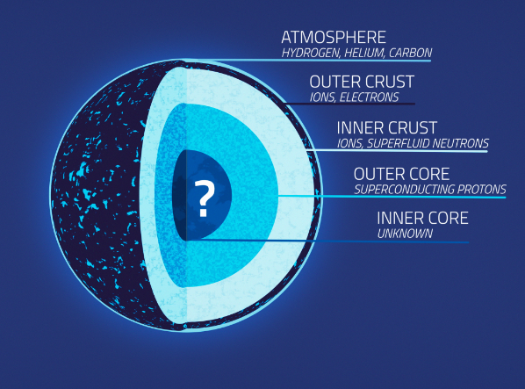
Due to their extreme compactness, the central density of neutron stars exceeds the nuclear saturation density
https://svs.gsfc.nasa.gov/20267

Slide 29
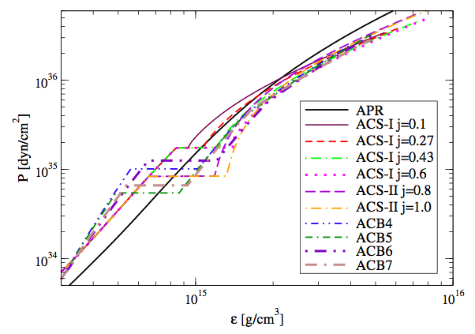
Equation of State: low to high density regimes
Pascalidhis et al., Phys.Rev. D arXiv:1712.00451
If the surface tension between the two phases is low, a mixed phase of quark and nucleonic matter is formed in between.
If the surface tension is high, a sharp transition occurs with a jump in the energy density at a given transition pressure
Notes:
D. E. Alvarez-Castillo and D. B. Blaschke, Phys. Rev.
^{C96, 045809 (2017). Set I}
M. Alford and A. Sedrakian, Phys. Rev. Lett. 119,
^{161104 (2017). Set II}
Zero-temperature nuclear matter in β equilibrium with a low-density phase of nucleonic matter and high- density phase of quark matter.

Slide 30
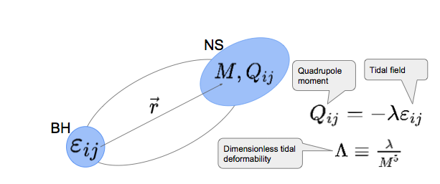
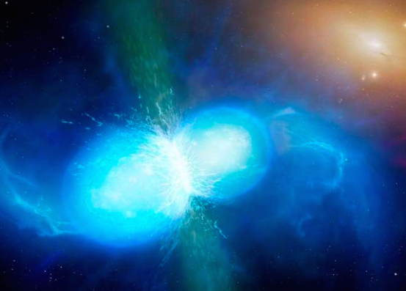
How do GW measurements constrain the EoS
A viable constraint is obtained when one has at least two independent measurements of: mass, M, radius, R, tidal deformability, Λ, moment of inertia, I, quadrupole moment, Q.
LIGO GW170817 constrains Λ
courtesy Zack Carson
University of Warwick/Mark Garlick

Slide 31
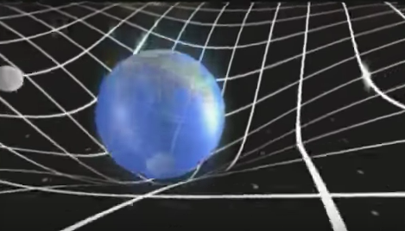
In GR, EMT is the source of the gravitational field
action
Ricci scalar ➔curvature
Flat space
EMT
perturbation
Einstein’s Eqs.
Solve numerically

Slide 32
We propose a new, model independent way of evaluating the EoS in the quark matter phase by inferring it directly from the matrix elements of the QCD Energy Momentum Tensor (EMT) between nucleon states.
Model independent means relating measurement to measurement

Slide 33
3. From momentum to coordinate space

Slide 34
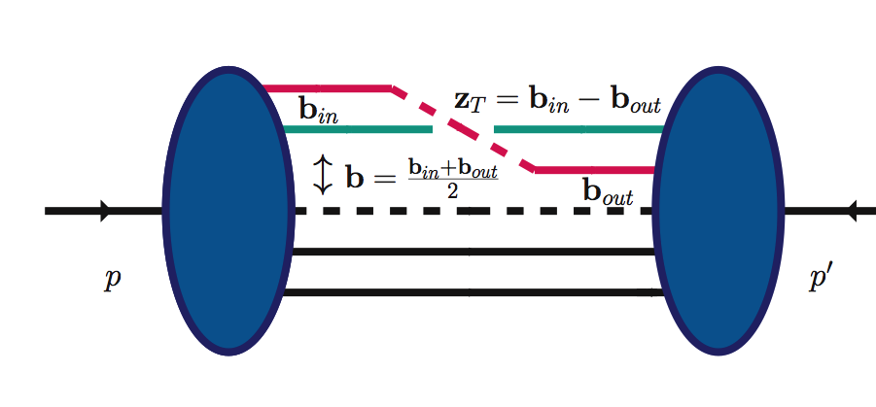
Two distinct distance scales
z⁻
zº
z⁺
Ioffe time
z³
4/10/19
z⁻,z_{T}
z
p-p’=Δ

Slide 35
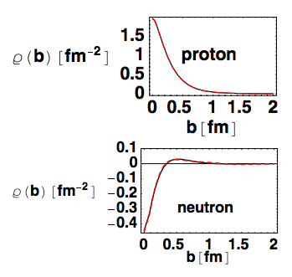
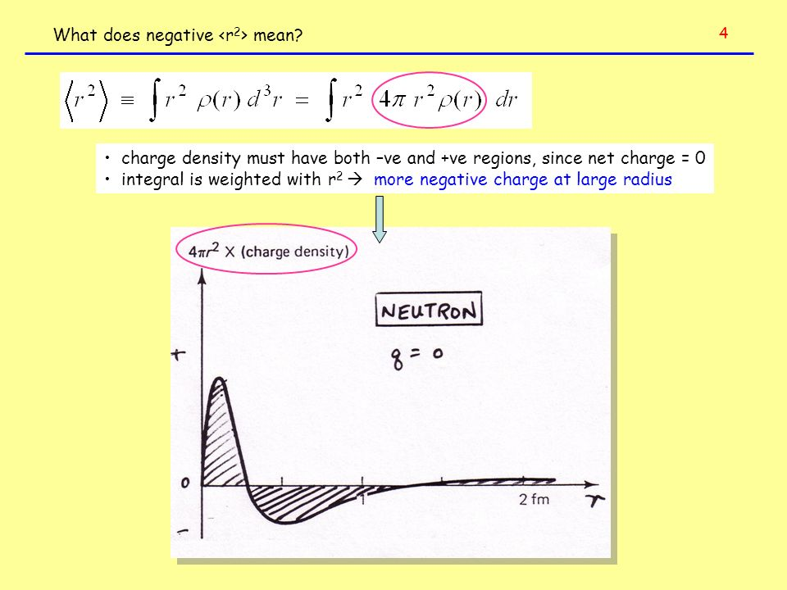
Implication
We can map out faithfully the spatial quark distributions in the transverse plane
(no modeling/approximation)
Soper (1977), Burkardt (2001)
Already a surprise: re-evaluation of nucleon charge distribution
Neutron “textbook” density
G. Miller(2007)

Slide 36
Including all polarization configurations:
number/mass density
1st Mellin M.
2nd Mellin M.
Energy density
Pressure

Slide 37
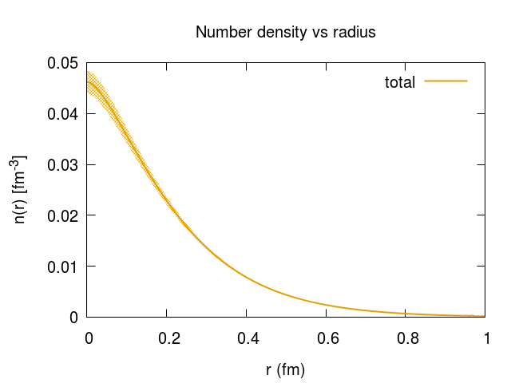
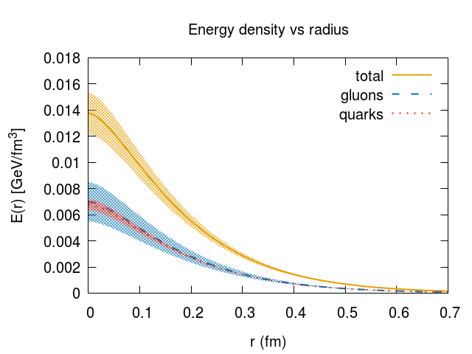
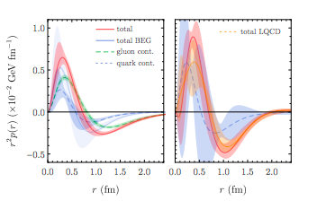
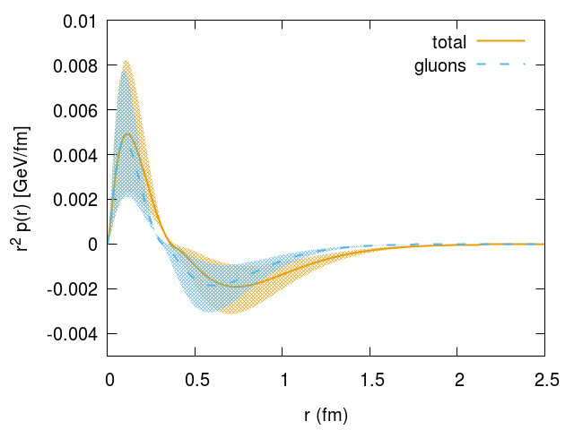
A₁₀
A₂₀
fm
fm
pressure
C₂₀
pressure
Detmold, Shahanan, Phys.Rev.Lett. 122 (2019)
SL, Rajan, Yagi, arXiv:1812.01479

Slide 38
4. Constraining the EoS with dvcs data

Slide 39
GW170817
QCD EMT
MIT bag model: strange quark matter
SL, Rajan, Yagi, arXiv:1812.01479

Slide 40
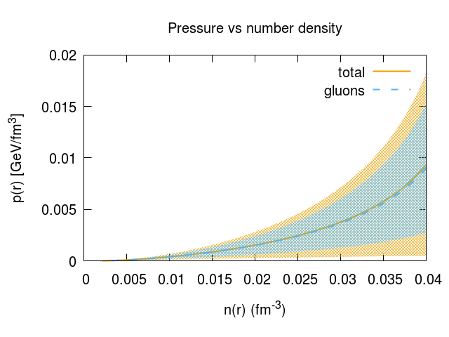
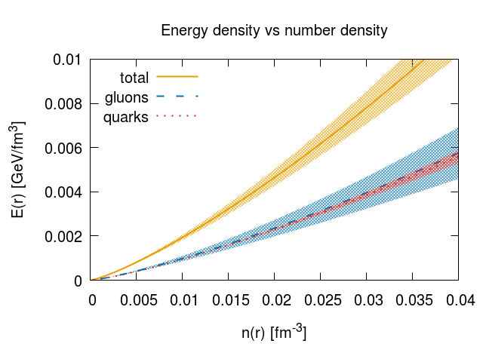

Slide 41
QCD EMT
J0348+0432 pulsar mass
strange quark matter
“stitching” at transition pressure 0.15 GeV/fm³
SL, Rajan, Yagi, arXiv:1812.01479

Slide 42
WHAT’S NEXT…
Key question: how to extract accurate information on the mechanical properties of the nucleon from data

Slide 43
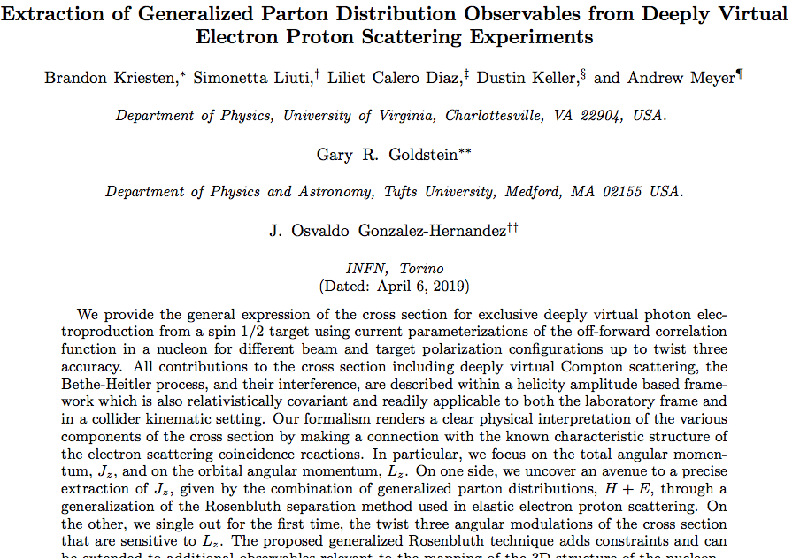
B. Kriesten, 4pm session
arXiv:1903.05742

Slide 44

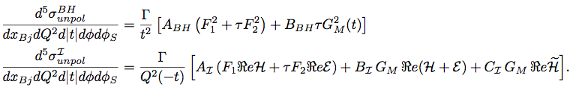
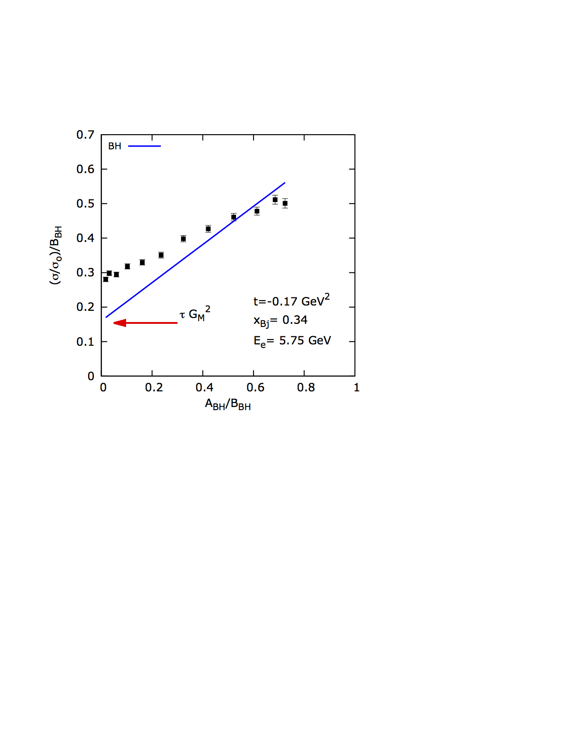
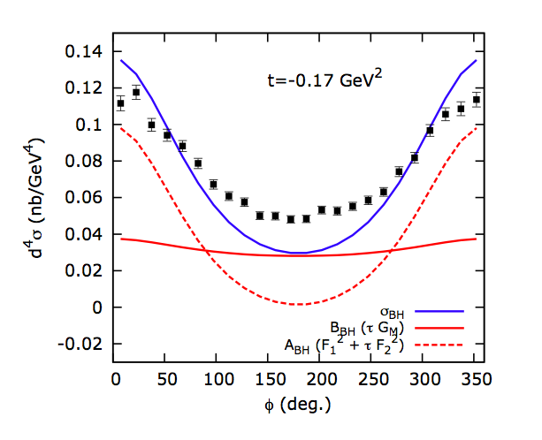
New formalism for deeply virtual exclusive processes
No harmonics, please…..this is just a coincidence experiment
BH
DVCS

Slide 45
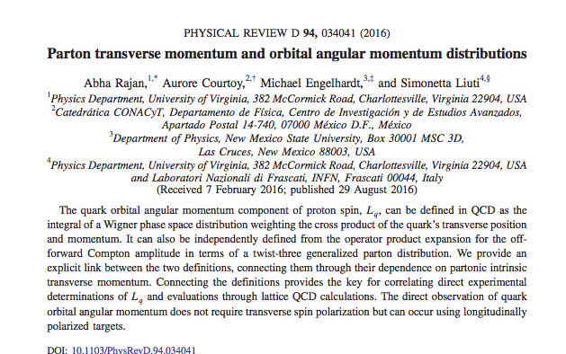
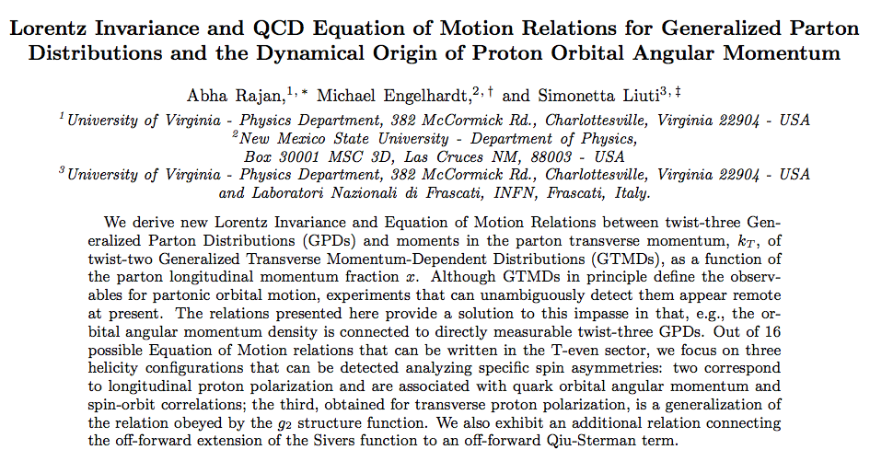
Based on
Abha Rajan’s talk, Friday
Michael Engelhardt’s talk, Sunday
PRD2018
arXiv:1709.05770

Slide 46
Twist 3 GPDs: A New Relation
A. Rajan, A. Courtoy, M. Engelhardt, S.L., PRD (2016) arXiv:1601.06117
A. Rajan, M. Engelhardt, S.L., PRD (2018) arXiv:1709.05770
twist-3 GPD
OAM: twist 2 GTMD
Generalized Lorentz Invariance Relation (LIR)
*Different notation!
Polyakov et al.
Meissner, Metz and Schlegel, JHEP(2009)

Slide 47
Conclusions and Outlook
The EoS of dense matter in QCD can be obtained from first principles, using ab initio calculations for both quark and gluon d.o.f.
Gluons are found to dominate the EoS providing a trend in the high density regime which is consistent with the constraint from LIGO.
We can connect the pressure and energy density in neutron stars with collider observables: the GPDs.
The proposed line of research opens up a new framework for understanding the properties of hybrid stars. In the future we hope to set more stringent constraints on the nature of the hadron to quark matter transition at zero temperature.
These effects are observable!
Notes:
However, in the definition of these distributions, care must be applied to ensure manifest gauge invariance. In general, this can be accomplished by connecting any non- local correlation function with a Wilson-line gauge link. Specifying a Wilson-line gauge link requires selecting a path along which the vector potential is evaluated. The choice of path raises the immediate issue of how the quantities defined using Wigner distributions (TMDs, OAM, . . .) depend on that choice.

Slide 48
backup
TOV Equations
EoS
p(r)-ρ(r) relation

